Slide 1
Custom Flight Controller for FPV Drone
ECE 445 Design Document - Spring 2025
Project #42
Hulya Goodwin, Muhammad Rabbani, Jaelynn Abdullah
Professor: Viktor Gruev
TA: Jason Jung
Monday May 5th, 2025

Slide 2
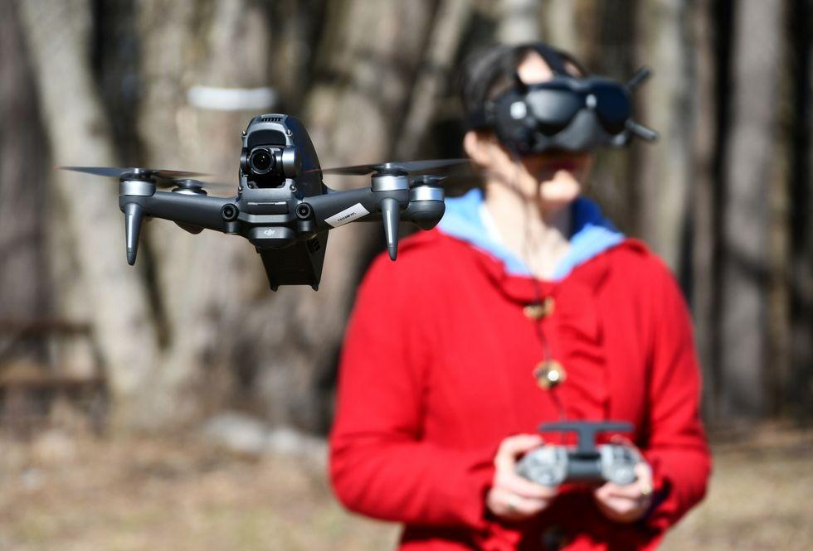
What is an FPV Drone?
Example of FPV Drone
ELECTRICAL & COMPUTER ENGINEERING
GRAINGER ENGINEERING
Notes:
Talk here about how we don't have any drone experience lol

Slide 3
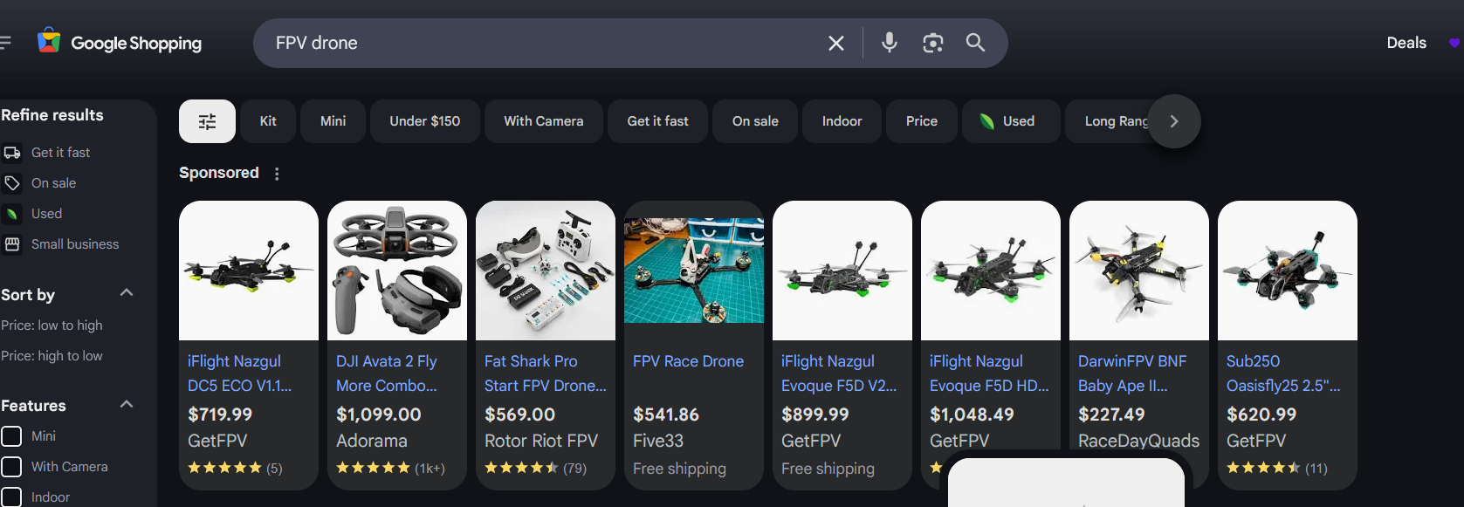
Why Make One?
Screenshot of a google search with pricing of FPV Drones
ELECTRICAL & COMPUTER ENGINEERING
GRAINGER ENGINEERING
Notes:
Talk here about how we don't have any drone experience lol

Slide 4
Objectives
Custom-made Flight Controller for Beginner Friendly, Lightweight FPV Drone
Additional sensors to add robustness to the drone
Cheaper alternative to current day FPV Flight Controllers
Full Betaflight Integration
ELECTRICAL & COMPUTER ENGINEERING
GRAINGER ENGINEERING

Slide 5
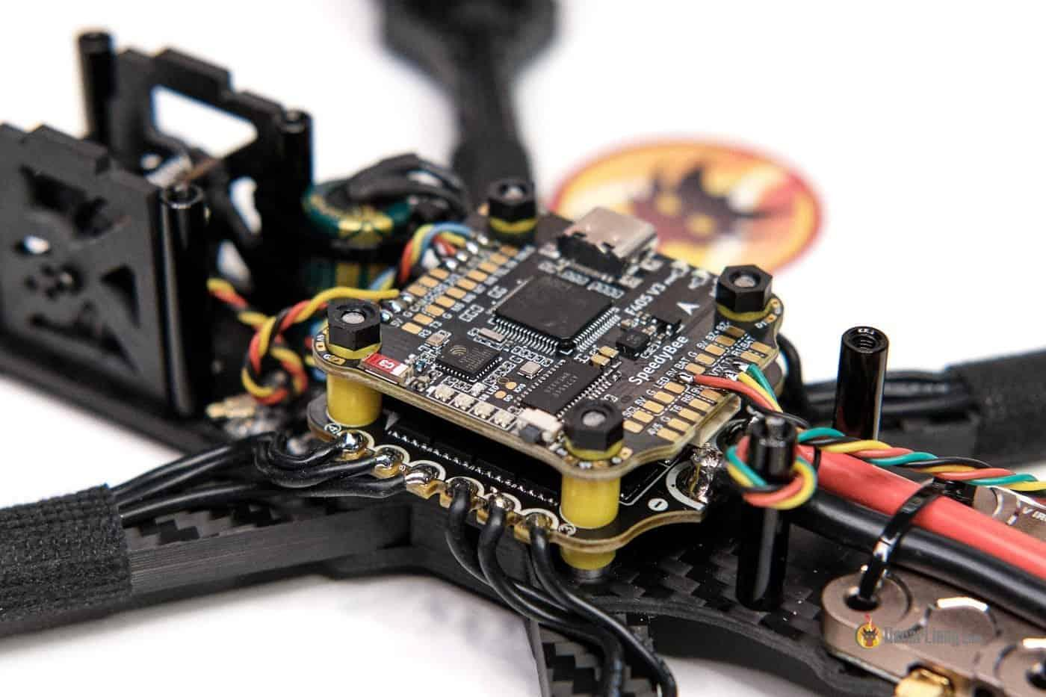
Commercial FC
Example of a Commercial Flight Controller
ELECTRICAL & COMPUTER ENGINEERING
GRAINGER ENGINEERING
Notes:
Talk here about how we don't have any drone experience lol

Slide 6
Design and Functional Requirements
ELECTRICAL & COMPUTER ENGINEERING
GRAINGER ENGINEERING

Slide 7
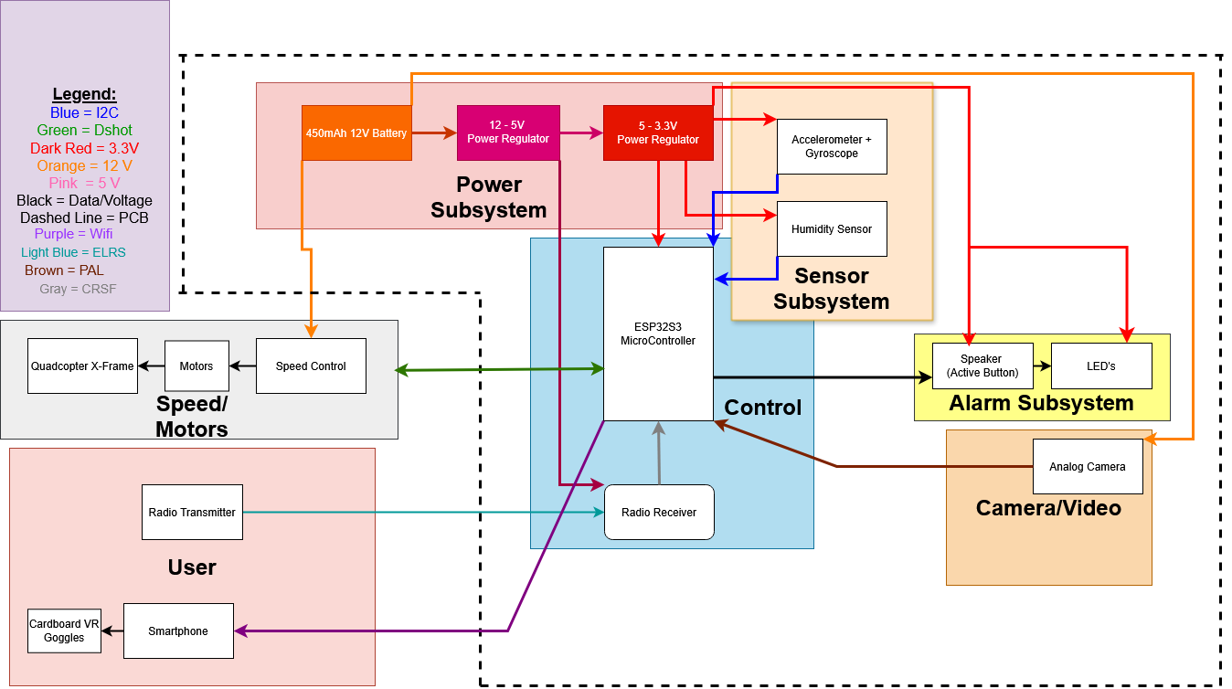
Original Design
ELECTRICAL & COMPUTER ENGINEERING
GRAINGER ENGINEERING

Slide 8
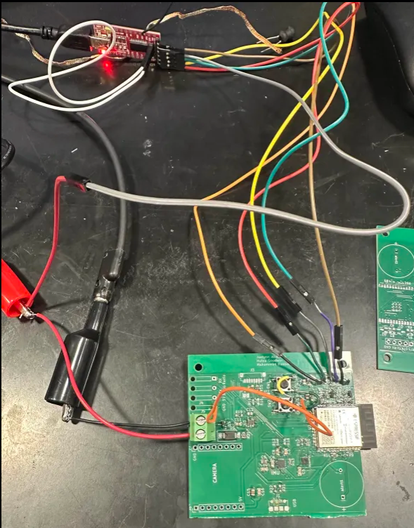
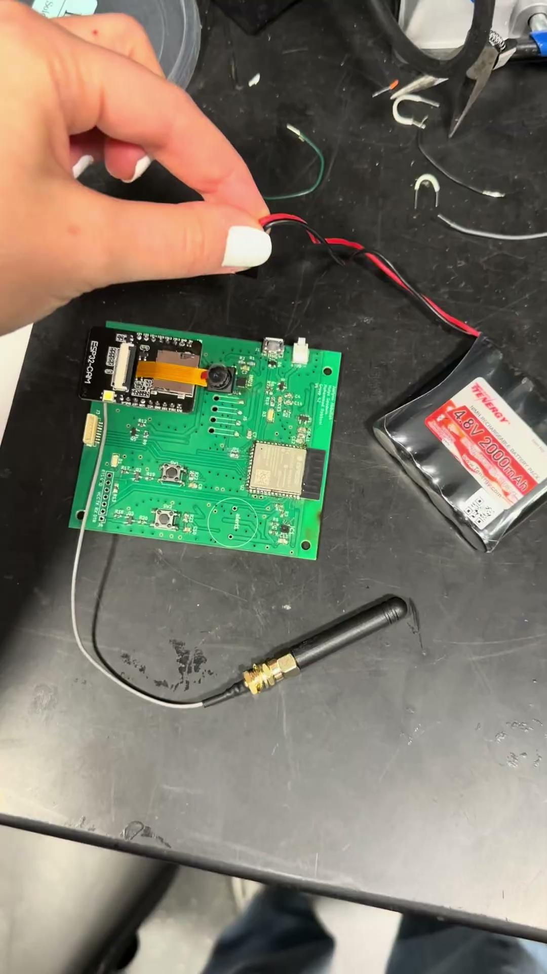
Reasons to Change Design
On the left, our PCB setup to flash with UART to USB TTL
On the right, video of an LED that lights when PCB is powered
ELECTRICAL & COMPUTER ENGINEERING
GRAINGER ENGINEERING

Slide 9
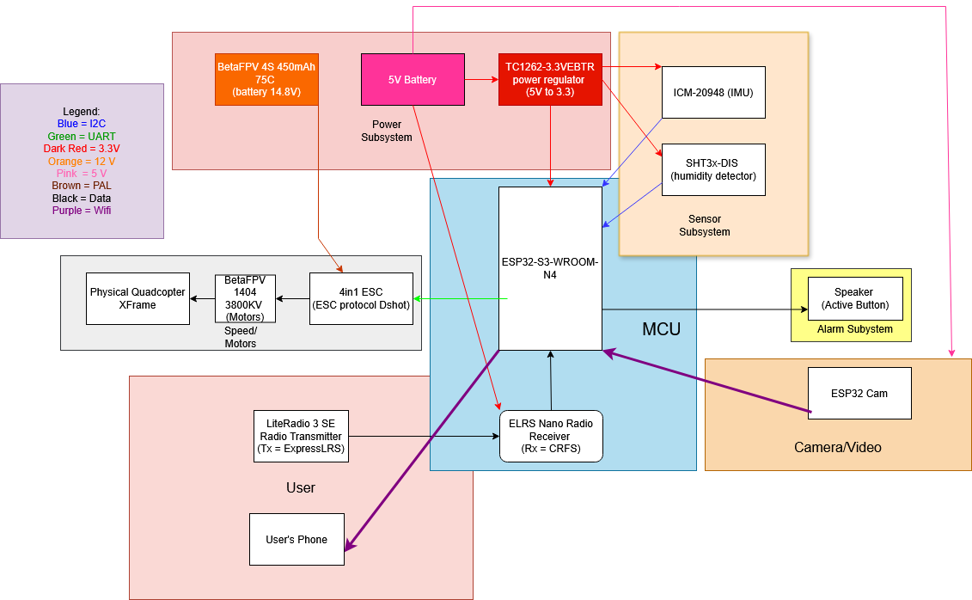
New Design
ELECTRICAL & COMPUTER ENGINEERING
GRAINGER ENGINEERING

Slide 10
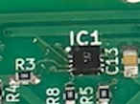
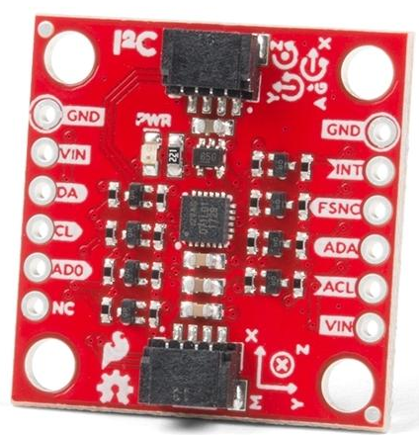
Sensor Subsystem
IMU takes acceleration, gyroscope, and magnetometer measurements
Humidity sensor takes measurements of relative humidity
ELECTRICAL & COMPUTER ENGINEERING
GRAINGER ENGINEERING

Slide 11
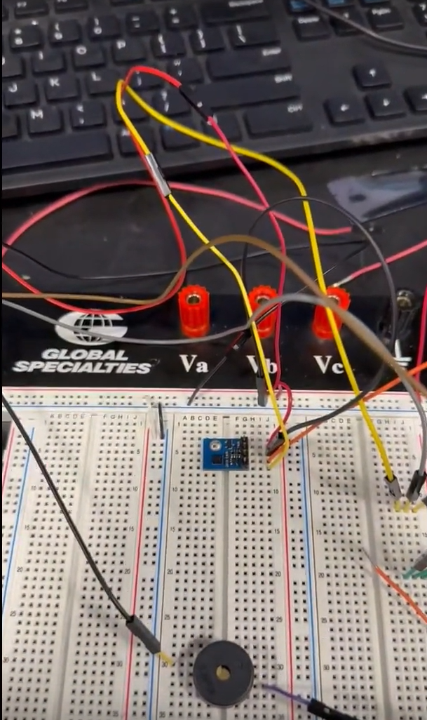
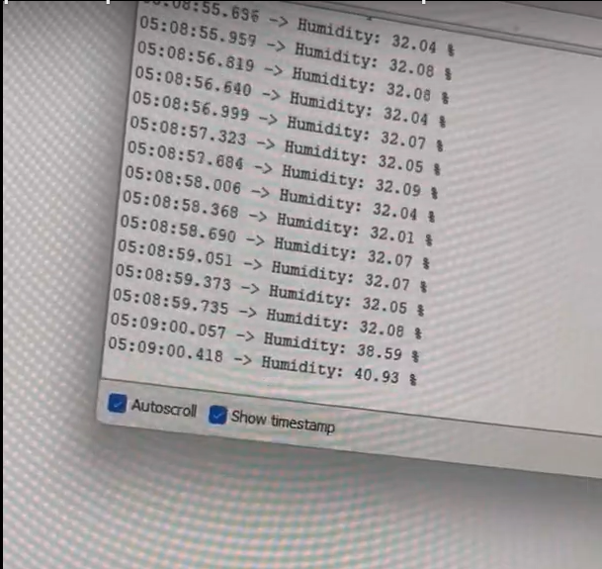
Sensor Subsystem
ELECTRICAL & COMPUTER ENGINEERING
GRAINGER ENGINEERING
Notes:
Add our URL that we got here to just mention it in presentation

Slide 12
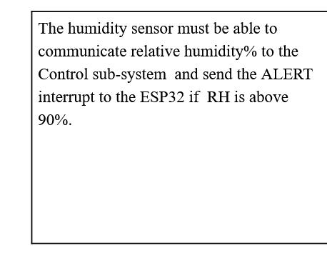
Sensor Subsystem
ELECTRICAL & COMPUTER ENGINEERING
GRAINGER ENGINEERING
Notes:
Add our URL that we got here to just mention it in presentation

Slide 13
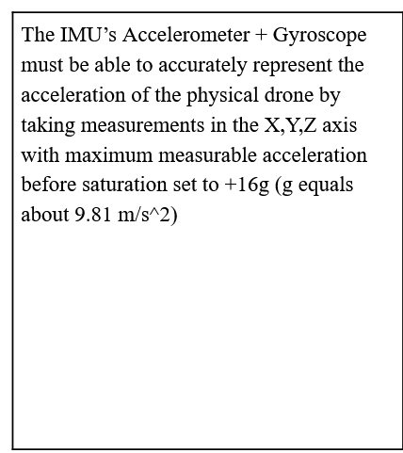
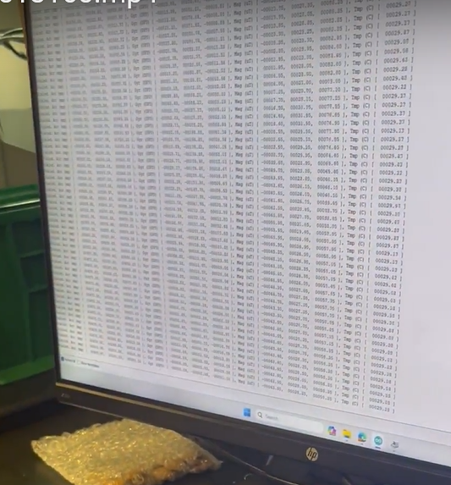
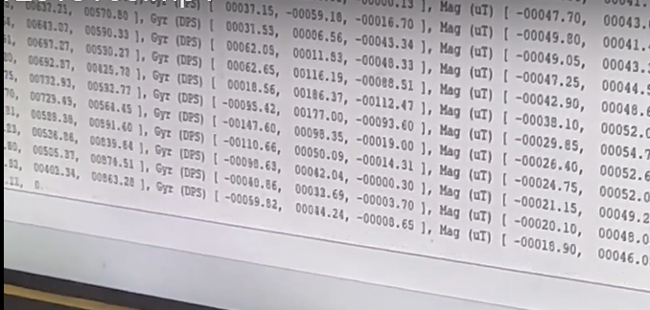
Sensor Subsystem
ELECTRICAL & COMPUTER ENGINEERING
GRAINGER ENGINEERING
Notes:
Add our URL that we got here to just mention it in presentation

Slide 14
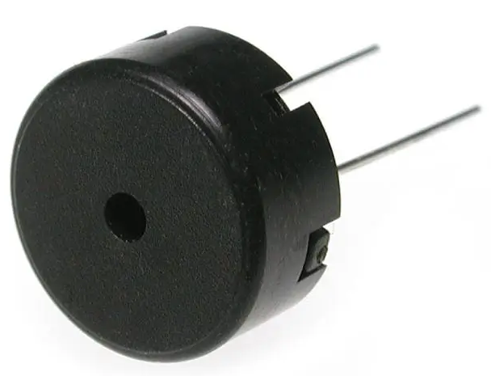
Alarm Subsystem
Piezoelectric Passive Buzzer
5kHz PWM Controlled
Interfaces with microcontroller to be set to high once the maximum safe for flight humidity is met
ELECTRICAL & COMPUTER ENGINEERING
GRAINGER ENGINEERING

Slide 15
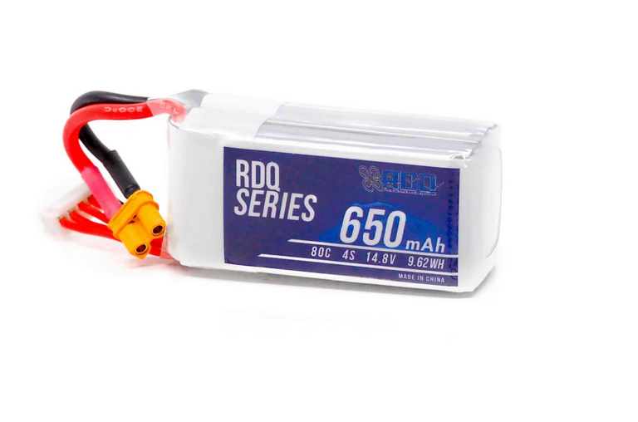
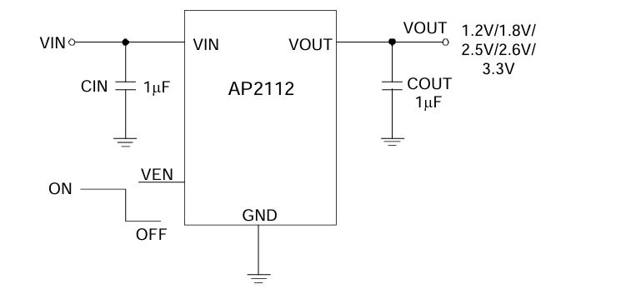
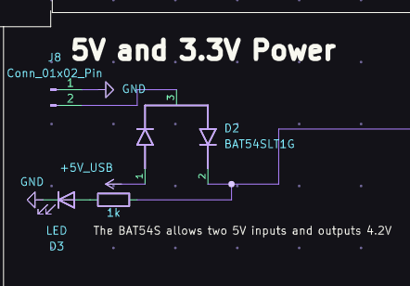
Power Subsystem
14.8 4S Lipo Battery for ESC
5V to 3.3V Voltage Regulator
5V Battery for powering Custom FC
Transient Voltage Suppression Array for 5V Control Line
ELECTRICAL & COMPUTER ENGINEERING
GRAINGER ENGINEERING

Slide 16
Power Subsystem
ELECTRICAL & COMPUTER ENGINEERING
GRAINGER ENGINEERING

Slide 17
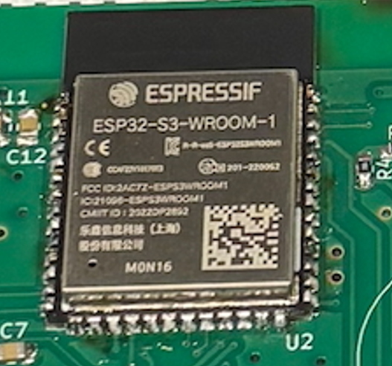
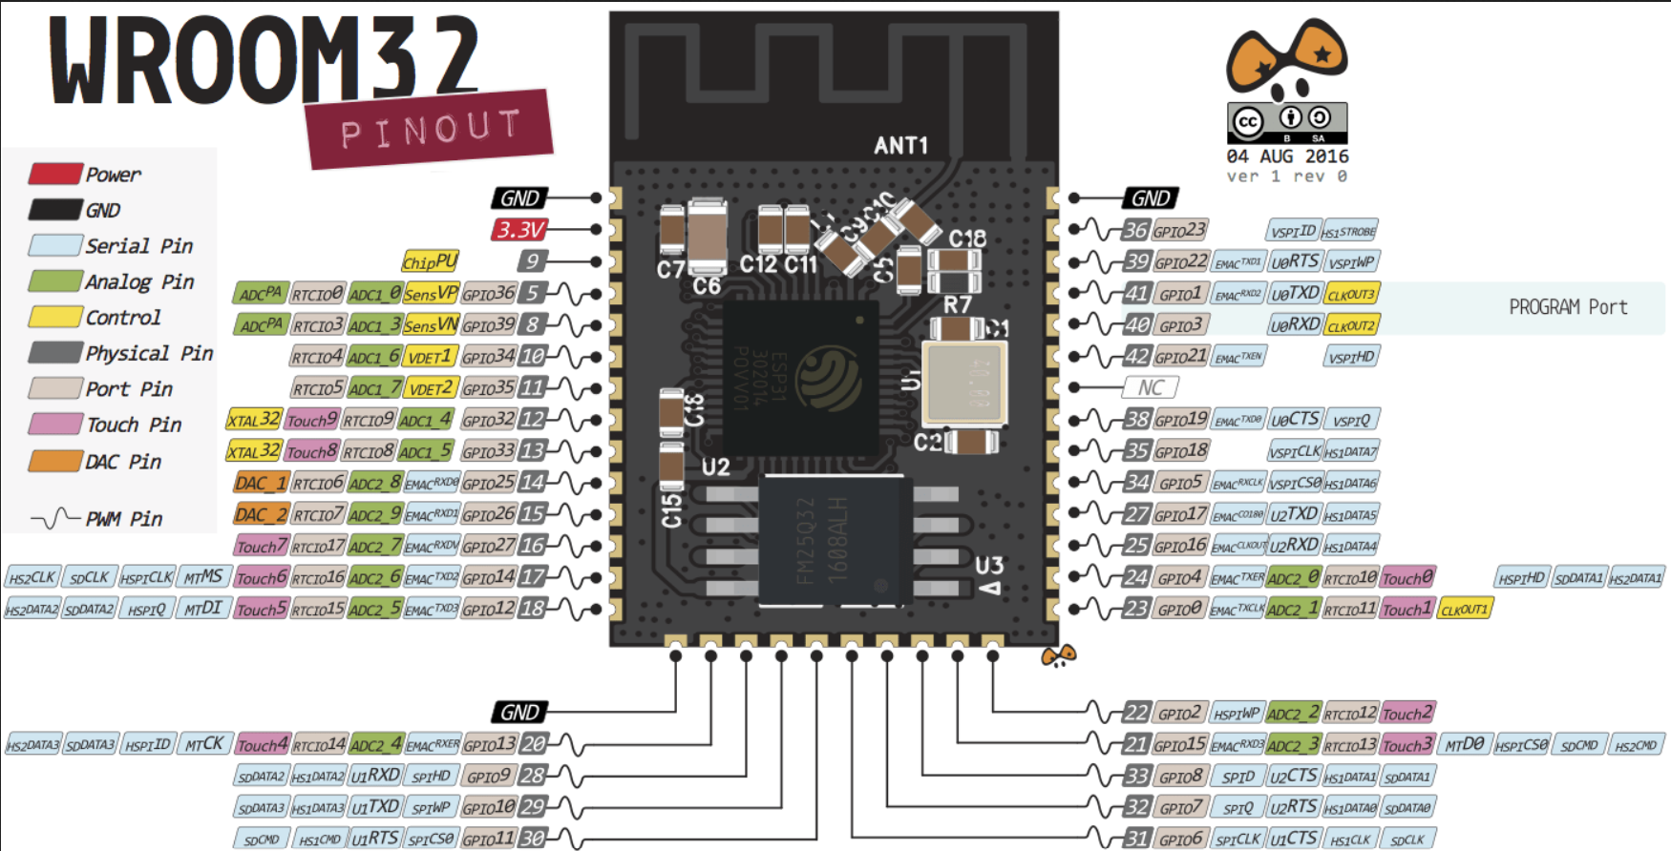
Control Subsystem
ESP32-S3-WROOM
Multiple UARTs
SPI and I2C capabilities
ELECTRICAL & COMPUTER ENGINEERING
GRAINGER ENGINEERING

Slide 18
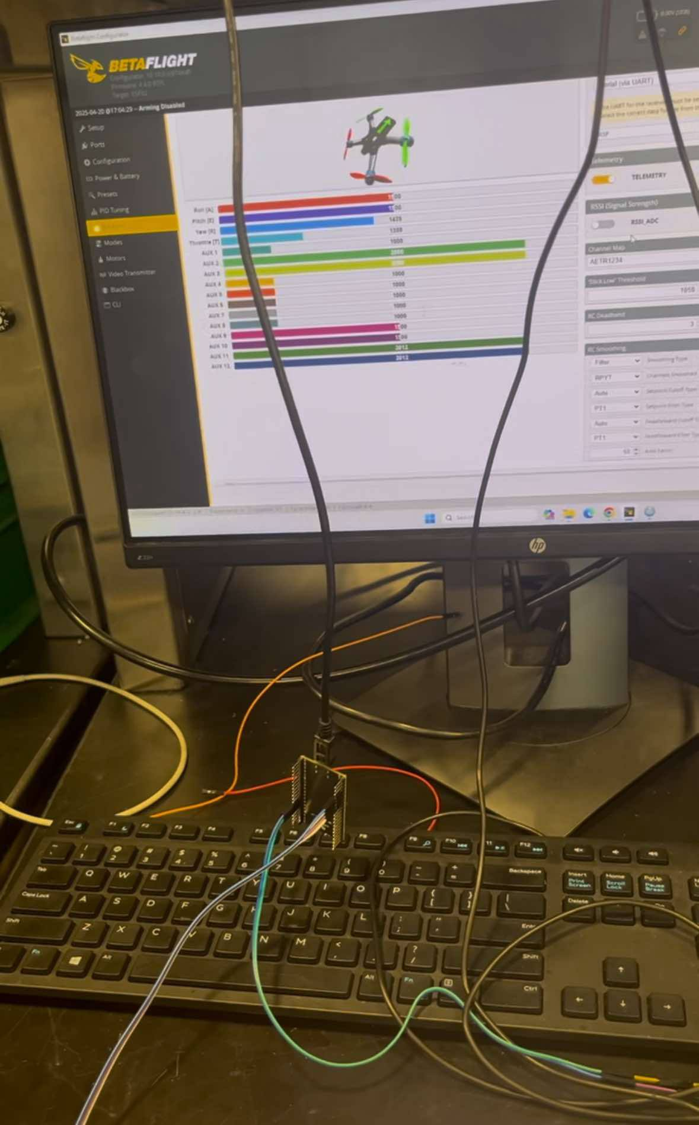
Control Subsystem
ELECTRICAL & COMPUTER ENGINEERING
GRAINGER ENGINEERING

Slide 19
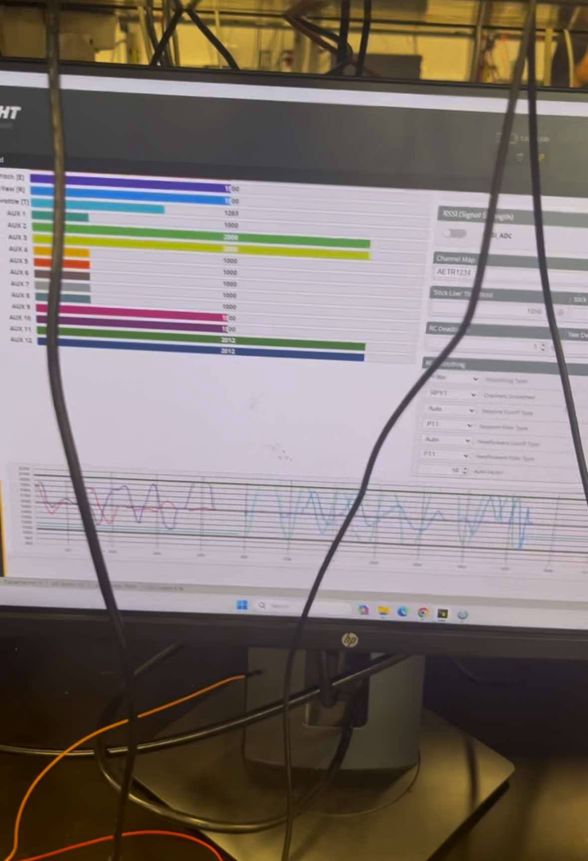
Control Subsystem
ELECTRICAL & COMPUTER ENGINEERING
GRAINGER ENGINEERING

Slide 20
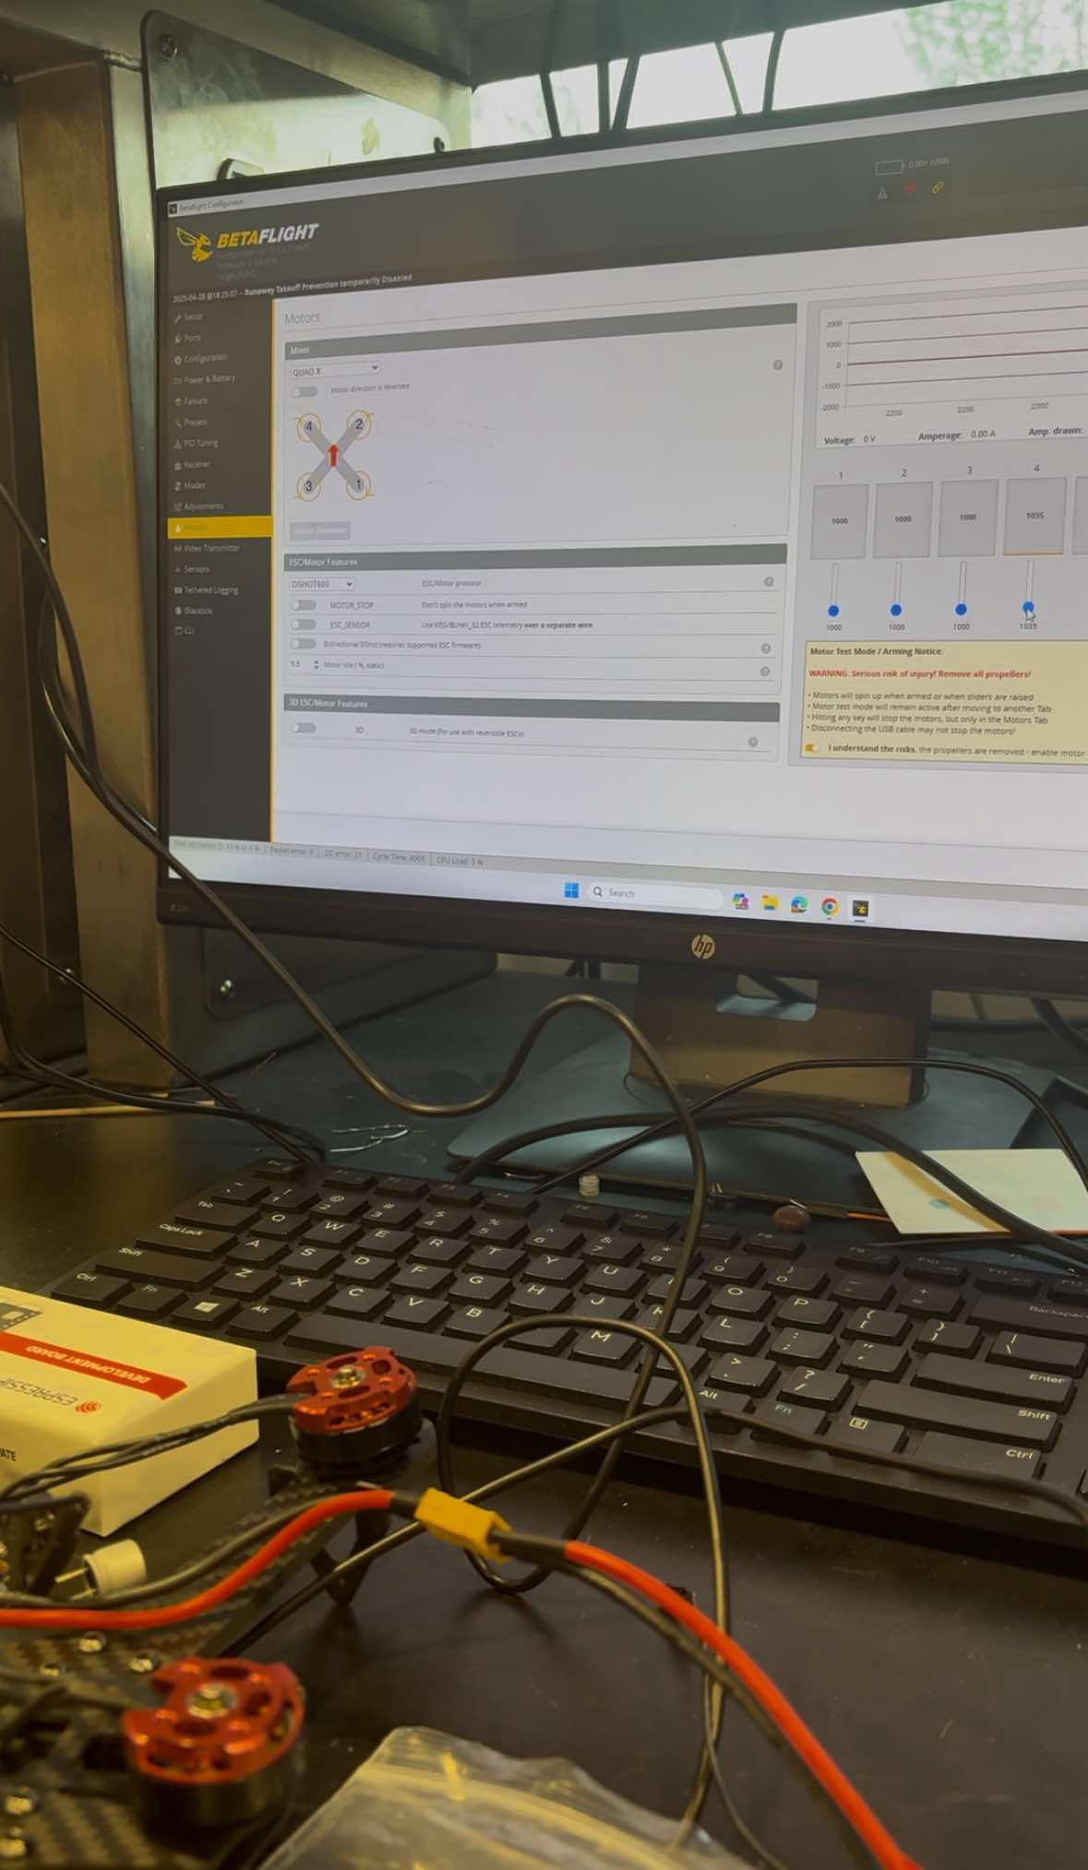
Control Subsystem
ELECTRICAL & COMPUTER ENGINEERING
GRAINGER ENGINEERING

Slide 21
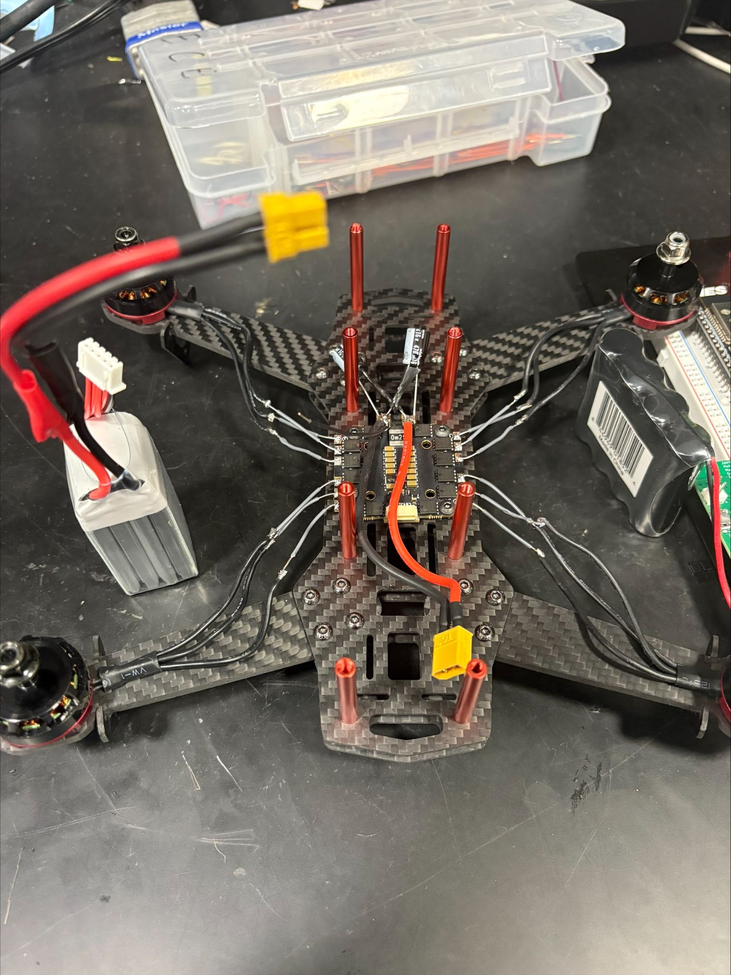
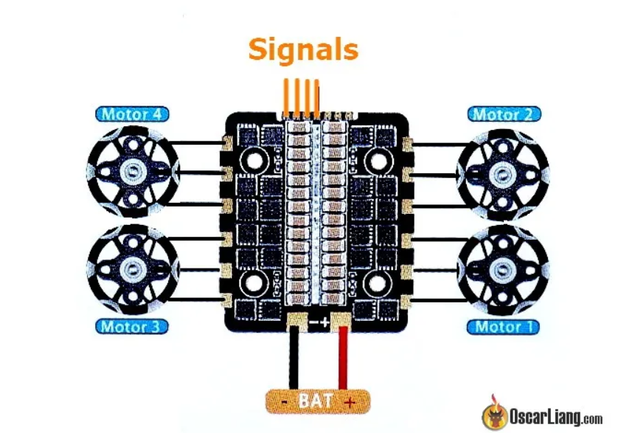
Speed/Motor Subsystem
4 Brushless Motors communicate with ESC (Electronic Speed Controller) to spin
ELECTRICAL & COMPUTER ENGINEERING
GRAINGER ENGINEERING

Slide 22
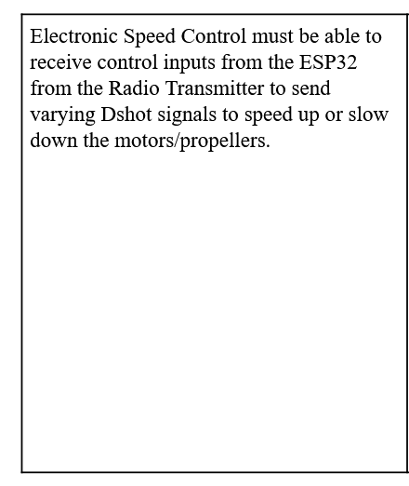
Speed/Motor Subsystem
ELECTRICAL & COMPUTER ENGINEERING
GRAINGER ENGINEERING
Notes:
Here mention how we actually got rid of this

Slide 23
Speed/Motor Subsystem
ELECTRICAL & COMPUTER ENGINEERING
GRAINGER ENGINEERING
Notes:
Here mention how we actually got rid of this

Slide 24
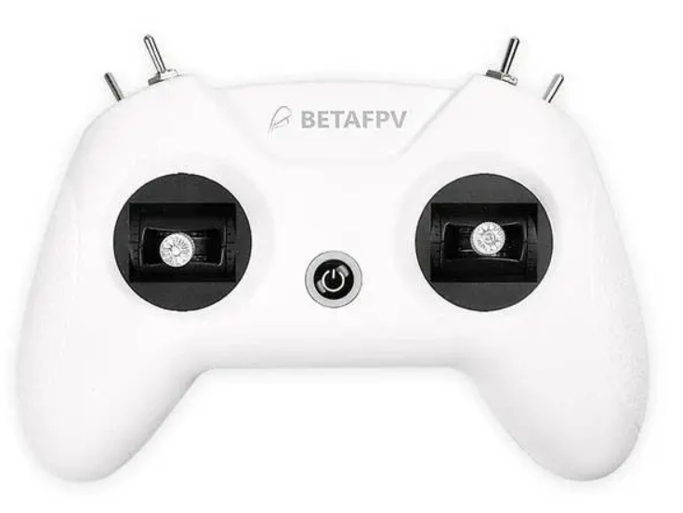
User Subsystem
User streams video from their phone and controls movement with radio transmitter
ELECTRICAL & COMPUTER ENGINEERING
GRAINGER ENGINEERING
Notes:
Ask if we should have R and V for this

Slide 25
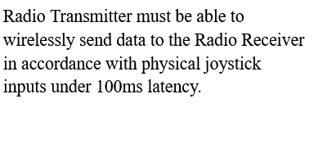
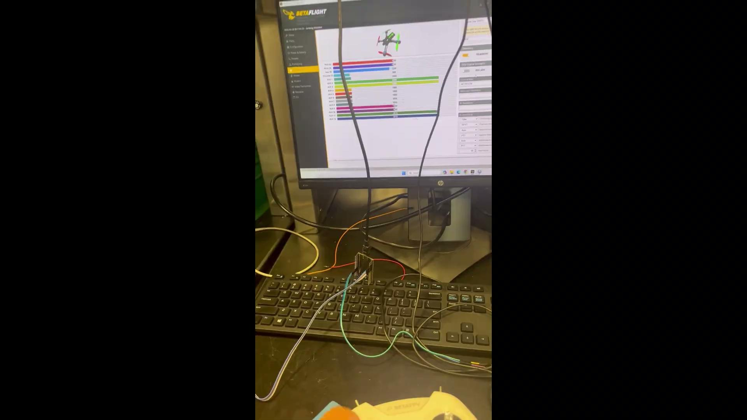
User Subsystem
ELECTRICAL & COMPUTER ENGINEERING
GRAINGER ENGINEERING
Notes:
Here mention how we actually got rid of this

Slide 26
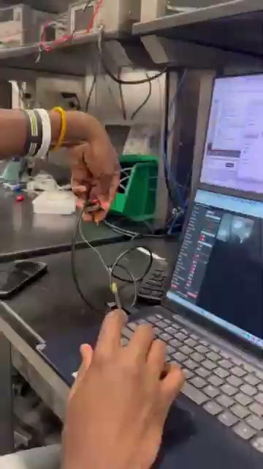
User Subsystem
ELECTRICAL & COMPUTER ENGINEERING
GRAINGER ENGINEERING
Notes:
Here mention how we actually got rid of this

Slide 27
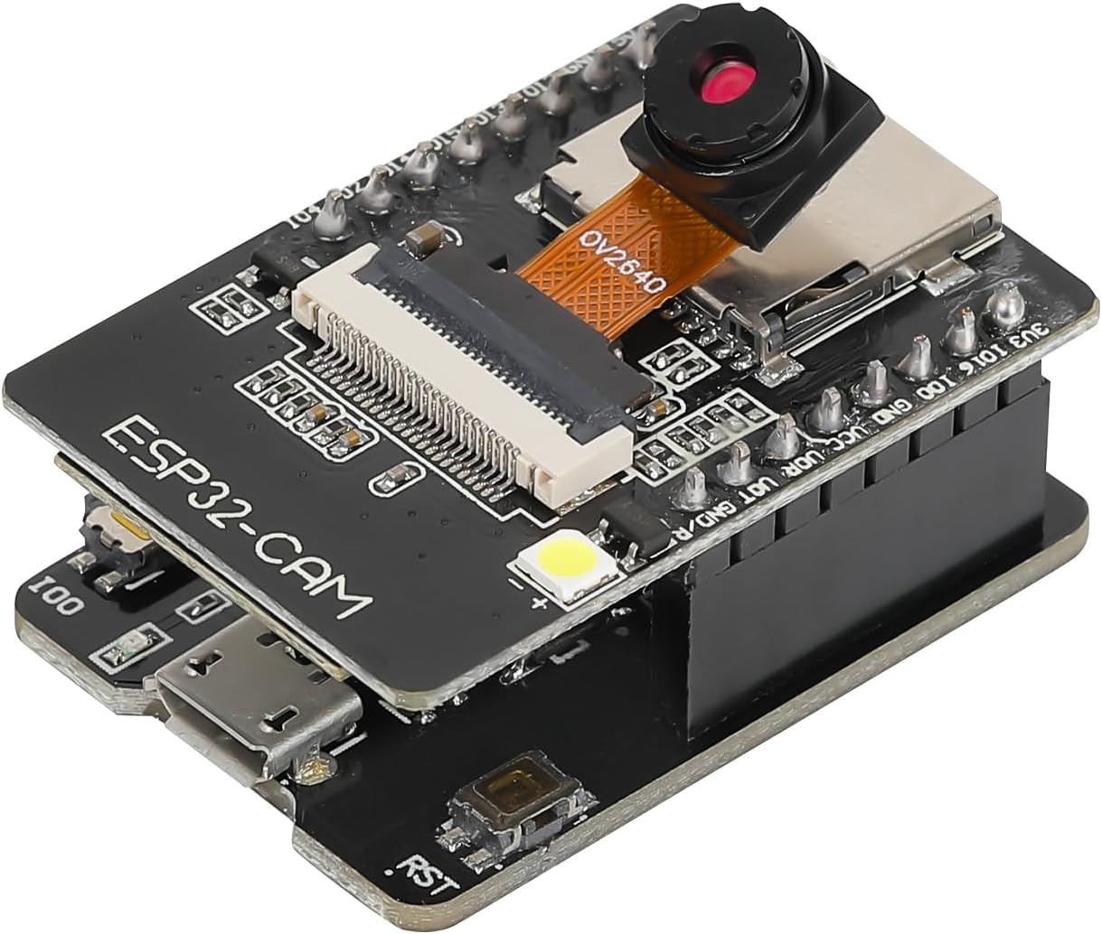
Camera Subsystem
ESP32 Cam Module
Digital Camera
WiFi Protocol
Available Arduino Libraries for testing
ELECTRICAL & COMPUTER ENGINEERING
GRAINGER ENGINEERING

Slide 28
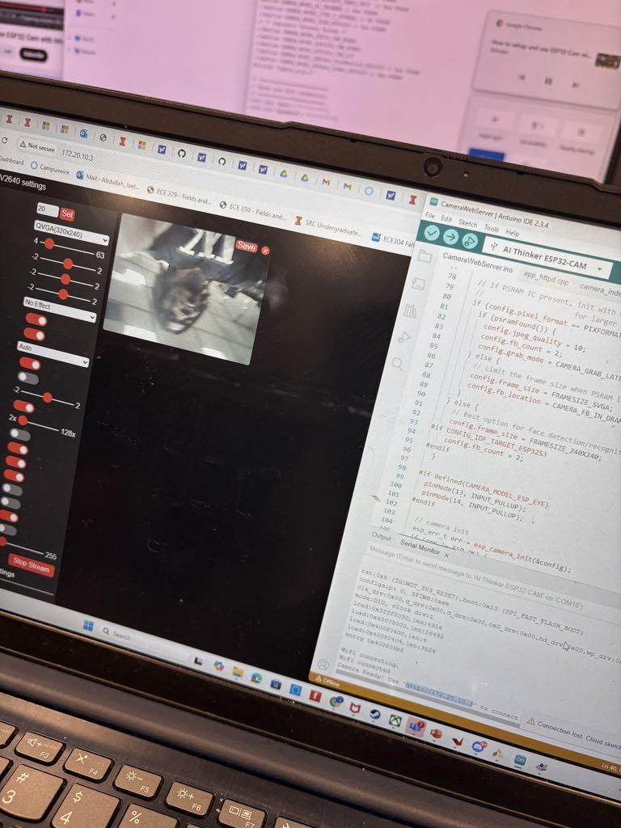
Camera Subsystem
ELECTRICAL & COMPUTER ENGINEERING
GRAINGER ENGINEERING
Notes:
Add our URL that we got here to just mention it in presentation

Slide 29
Successes and Challenges of the Flight Controller
ELECTRICAL & COMPUTER ENGINEERING
GRAINGER ENGINEERING

Slide 30
Successes
Flashing PCB
Betaflight Integration
Breakout Boards IMU and Humidity Sensor
Controllable Motors/ESC
ESP32 and motors receiving commands from Radio Transmitter
ELECTRICAL & COMPUTER ENGINEERING
GRAINGER ENGINEERING

Slide 31
Left: 4 motors connected to ESC powered by 14.8V battery
Right: PCB of FC, IMU (red board), and humidity sensor (blue board) both connected to dev board
ELECTRICAL & COMPUTER ENGINEERING
GRAINGER ENGINEERING

Slide 32
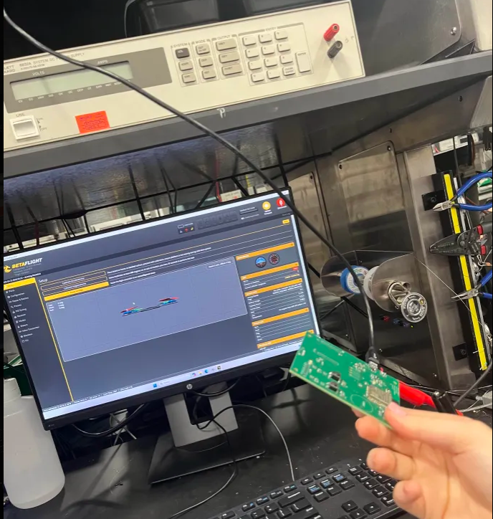
Flashable ESP32 on PCB
ELECTRICAL & COMPUTER ENGINEERING
GRAINGER ENGINEERING

Slide 33
Challenges
Camera Subsystem
IMU/Humidity Sensor integration to BetaFlight
Full PCB Integration
ELECTRICAL & COMPUTER ENGINEERING
GRAINGER ENGINEERING

Slide 34
Camera was functional before demo
Upon soldering to PCB, 5V trace and ground pin were reversed, causing a short
Could have added a ribbon head connector to the PCB directly instead of relying on a module
ELECTRICAL & COMPUTER ENGINEERING
GRAINGER ENGINEERING
Notes:
streaming at 47 FPS using a 160x240 resolution

Slide 35
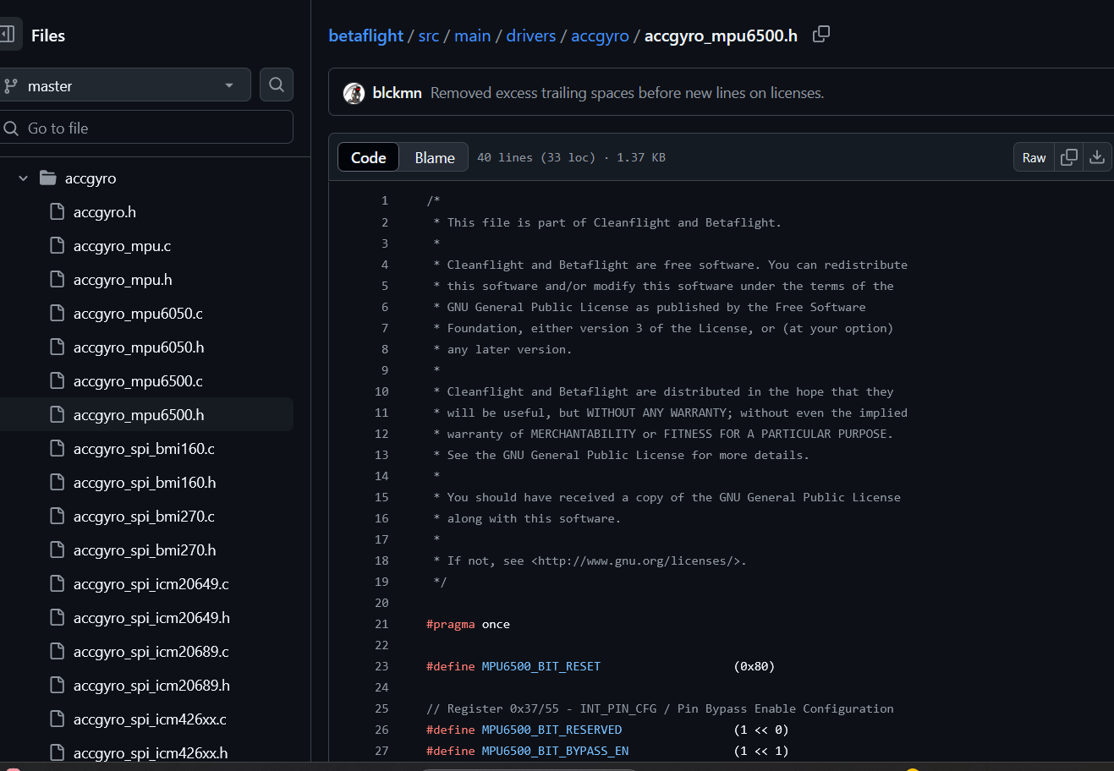
Betaflight was only compatible with certain IMUs and sensors
Look into non-QFN ICs to help the debugging process
The 6 compatible IMUs in the BetaFlight source code
ELECTRICAL & COMPUTER ENGINEERING
GRAINGER ENGINEERING

Slide 36
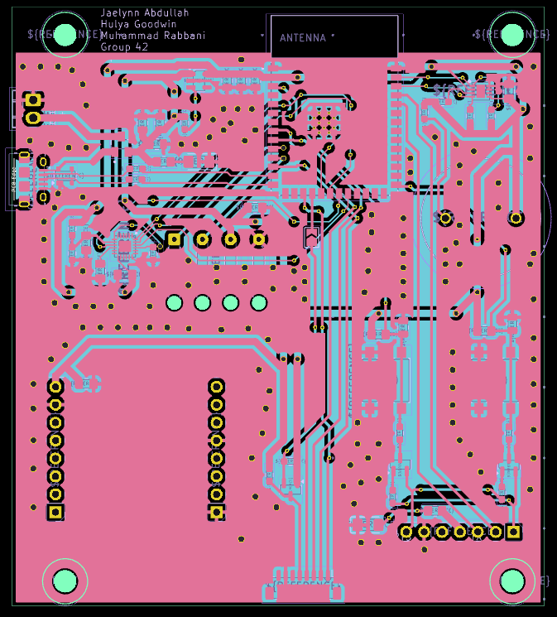
Flash was working, but not with IMU and humidity sensor
IC layouts were very small
Shorts in between pins
Needed more time to debug with breadboard to allow full integration
Final PCB
ELECTRICAL & COMPUTER ENGINEERING
GRAINGER ENGINEERING
Notes:
In the future, look at simplifying certain processes before finalizing PCB design

Slide 37
Conclusion and Future Works
ELECTRICAL & COMPUTER ENGINEERING
GRAINGER ENGINEERING

Slide 38
Concluding Lessons
Level Shifting
Different operating voltages of parts become an issue, especially when working with the ESC
Overvoltage Protection
There were times where parts were saved using TVS or capacitors, if known early, we could have prevented destroyed parts
Importance of ESC Communication Protocols
While we used DSHOT, a big barrier we ran into was when we wanted to use PWM for our motors with Arduino libraries
Part Compatibility
Prior to buying parts, little research was done on the compatibility of all hardware and software. This caused major problems in integration, especially with our sensor subsystem with the rest of our project.
ELECTRICAL & COMPUTER ENGINEERING
GRAINGER ENGINEERING

Slide 39
Future Works
Software Options/Sensor Integration
While Betaflight was very useful to debugging, it was difficult to integrate with IMUs and our humidity sensor. Flix and Madlight are other open source software options that could work
Remove JTAG from FC
We had additional methods to flash the PCB, by removing the JTAG, it opens up more RX and TX pins.
Use camera ribbon directly versus a module
More versatile and we will have an open RX/TX pins for full integration
Debugging with Breadboard
A lot of time was spent on debugging PCB issues. Breadboard makes it easier to isolate variables to better and more quickly debug.
ELECTRICAL & COMPUTER ENGINEERING
GRAINGER ENGINEERING

Slide 40
Thank you! Questions?
ELECTRICAL & COMPUTER ENGINEERING
GRAINGER ENGINEERING

