Slide 1
Team 46: Inventory Tracker
ECE 445: Senior Design Project Lab
Sara Alabbadi, Alex Buchheit, Sooha Ryu
April 29, 2024

Slide 2
Introduction
Problem
Manual tracking of inventory is time consuming, tedious, and can create discrepancies from human error.
Solution
A system that can control user access to and update inventory as it changes can remove these errors and decrease the amount of work needed to keep track of inventory.
ELECTRICAL & COMPUTER ENGINEERING
GRAINGER ENGINEERING

Slide 3
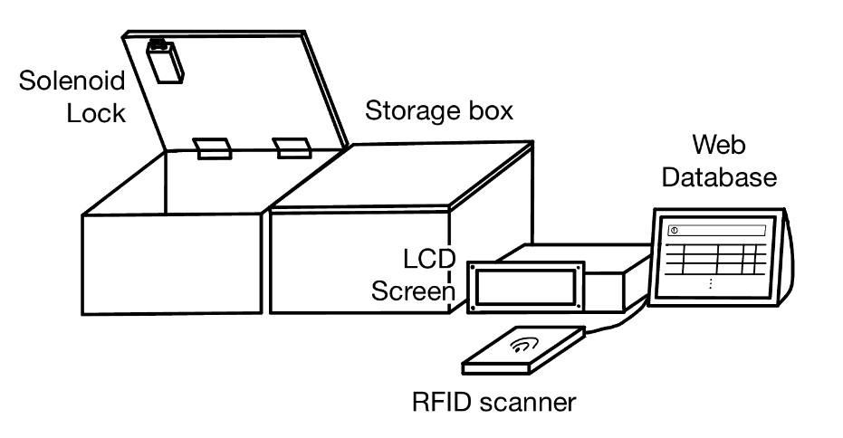
Design
Subsystems
Sensors – Load Cell
Locking Mechanism
User Interface
Control
Power
Physical Design Sketch
ELECTRICAL & COMPUTER ENGINEERING
GRAINGER ENGINEERING

Slide 4
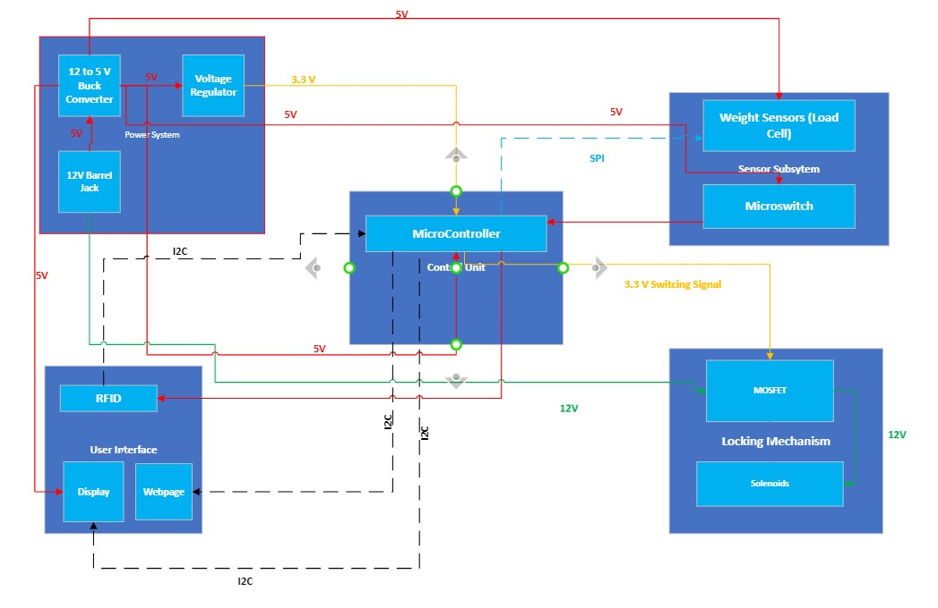
Design
Block Diagram
ELECTRICAL & COMPUTER ENGINEERING
GRAINGER ENGINEERING

Slide 5
High-Level Requirements
Control access to inventory
Track total number of items in inventory
Alert system when boxes are being opened without access being granted
ELECTRICAL & COMPUTER ENGINEERING
GRAINGER ENGINEERING

Slide 6
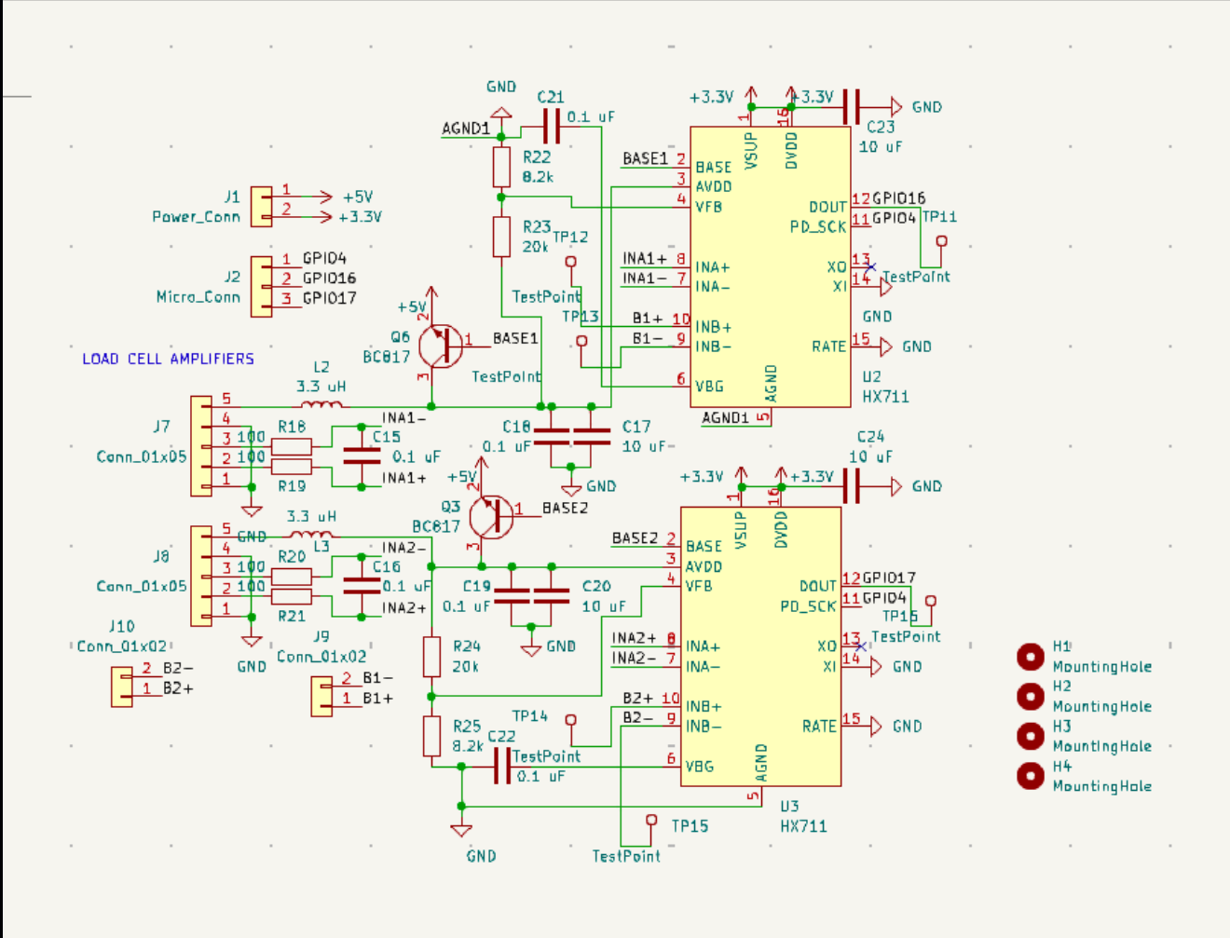
Sensors
Load Cells
Load cells in each box record the weight of the items in each box. By using the known weight of one item, the system can count the total items in each box.
Load Cell Amplifier
ELECTRICAL & COMPUTER ENGINEERING
GRAINGER ENGINEERING

Slide 7
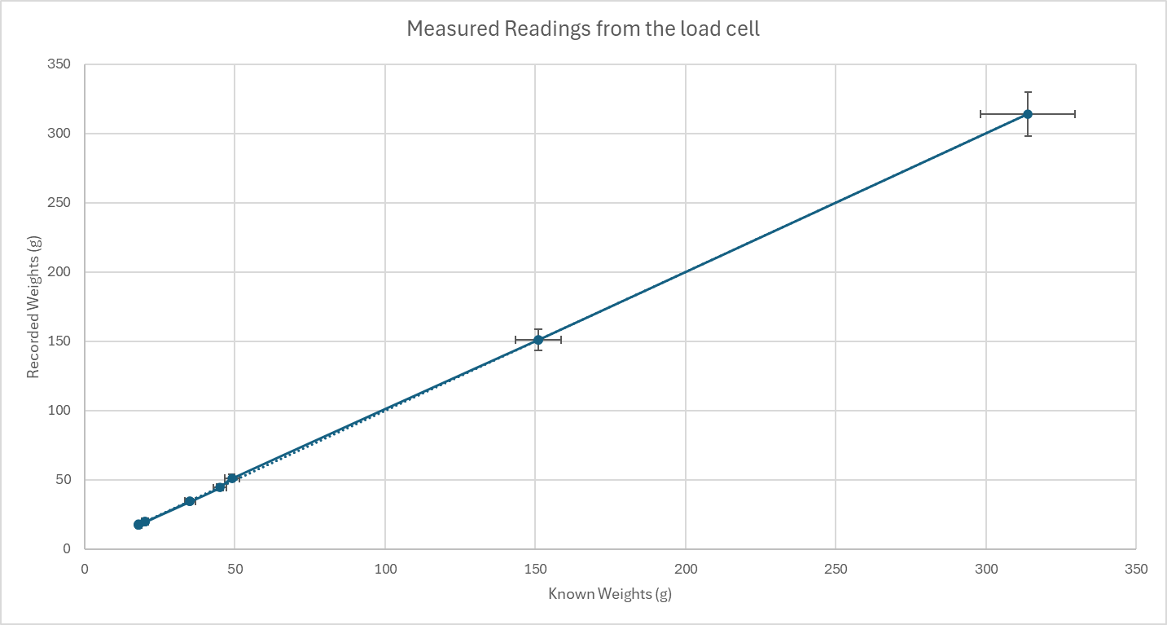
Accuracy of Load Cells
An important aspect of our design is the load cell’s accuracy of the output readings. According to the datasheet, the load cell should have a combined error of +/- 0.05.
Calibration Curve
ELECTRICAL & COMPUTER ENGINEERING
GRAINGER ENGINEERING
Notes:
Talk about repeatablity of data

Slide 8
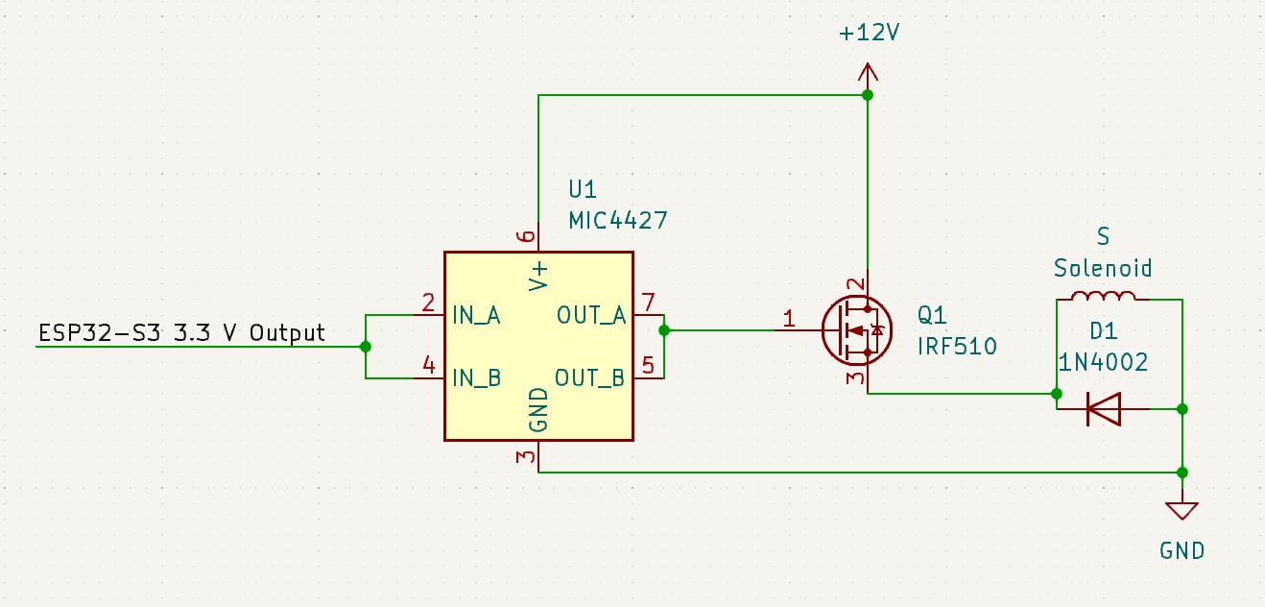
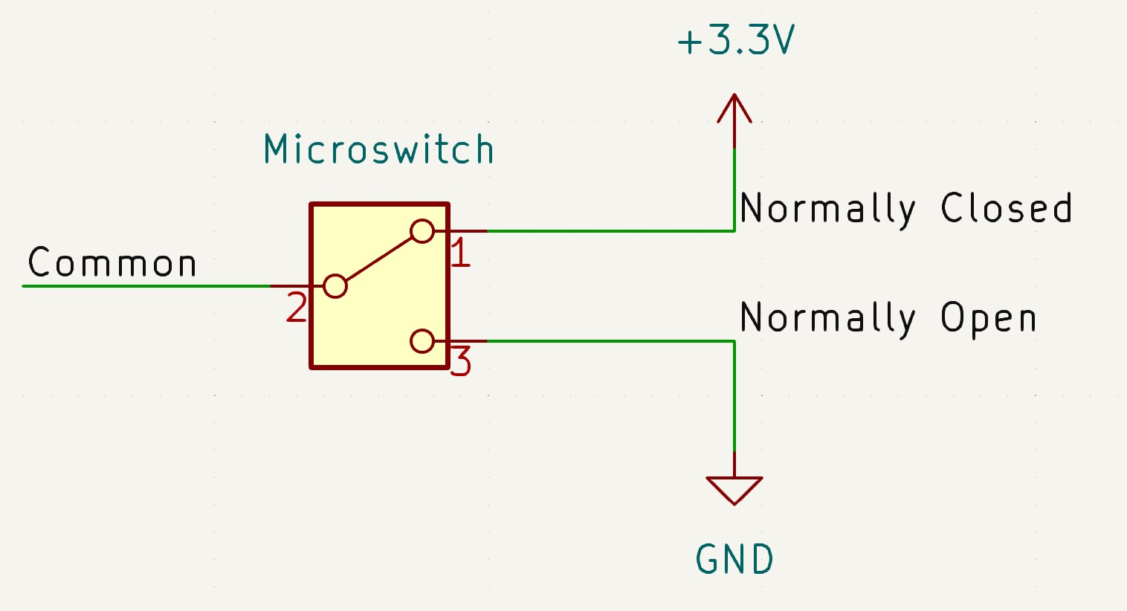
Locking Mechanism
Solenoids
Unlock when correct RFID tag is scanned
Microswitch
Monitors status of box door
Will trigger alert to be displayed on user interface if a box is opened without receiving access
ELECTRICAL & COMPUTER ENGINEERING
GRAINGER ENGINEERING

Slide 9
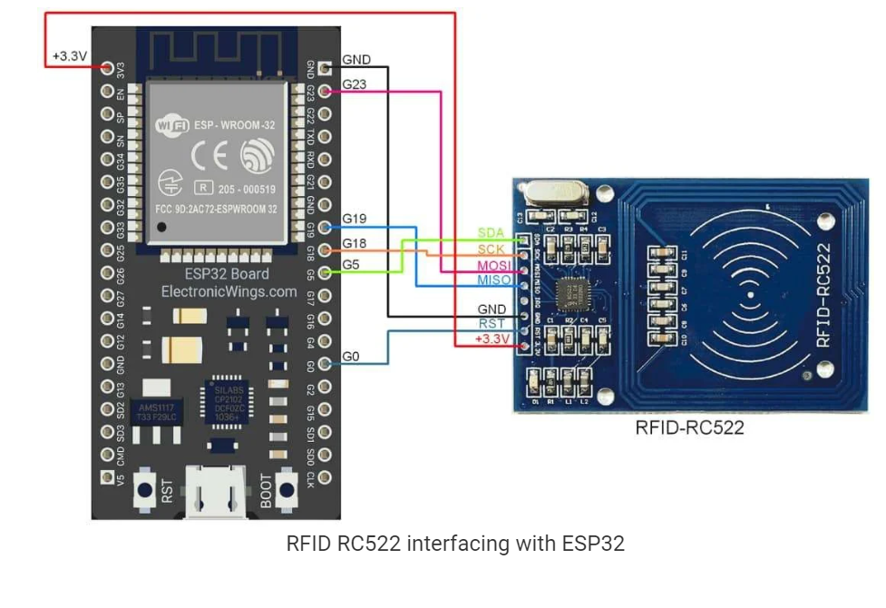
User Interface: Access Control
An RFID module is used to control which boxes unlock so the user can access inventory. When a user scans their RFID tag, the corresponding boxes they have access to unlock. A microswitch monitor if a box is open or closed.
ELECTRICAL & COMPUTER ENGINEERING
GRAINGER ENGINEERING

Slide 10
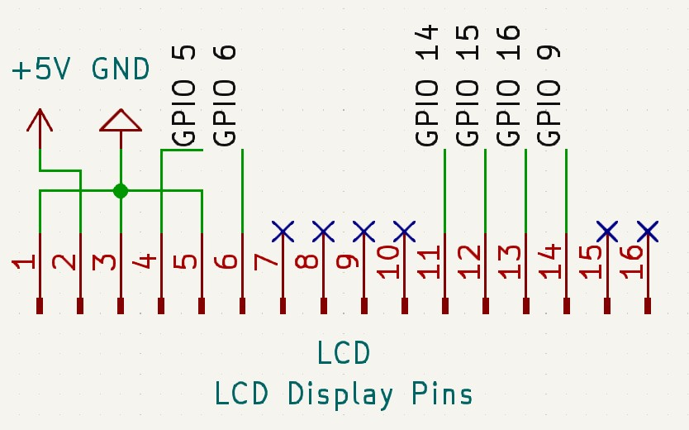
User Interface: LCD
Liquid Crystal Display
Display which boxes are unlocked and if box is opened without access
LCD Pinout [1]
ELECTRICAL & COMPUTER ENGINEERING
GRAINGER ENGINEERING

Slide 11
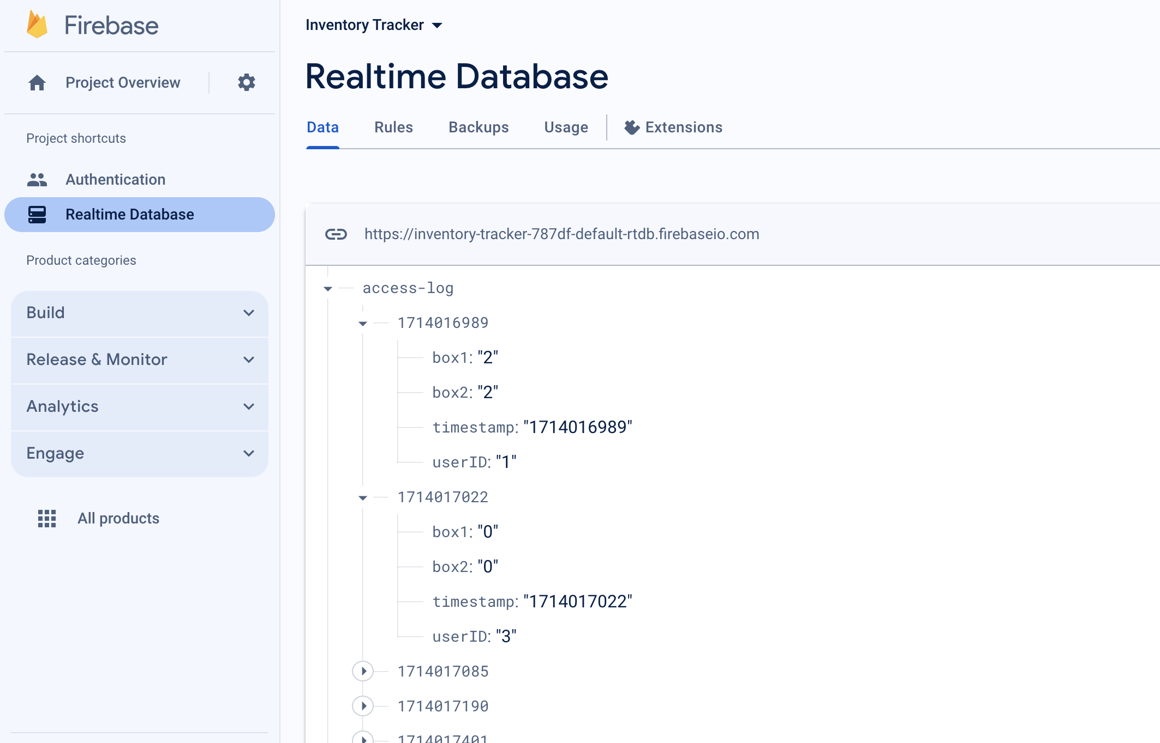
User Interface: Web Database
Firebase Realtime Database is chosen as our main DB
ESP32 sends required user-access log data with timestamps to Realtime database: change in number of items in each box, user ID, and accessed time
Gets total number of items in each box after each use
Constantly monitors box status
ELECTRICAL & COMPUTER ENGINEERING
GRAINGER ENGINEERING

Slide 12
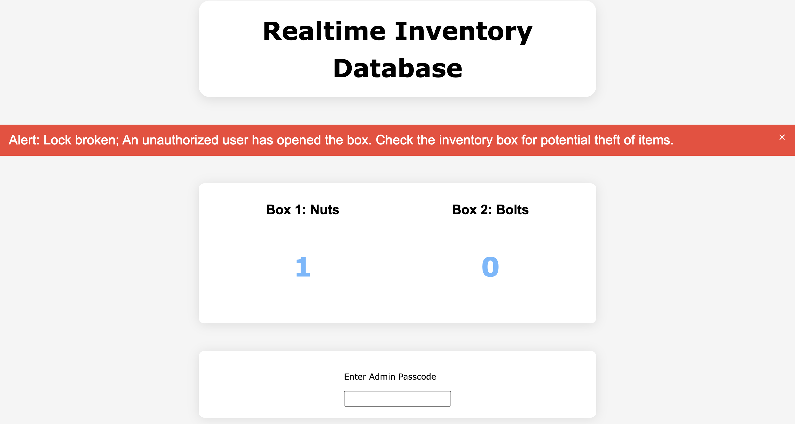
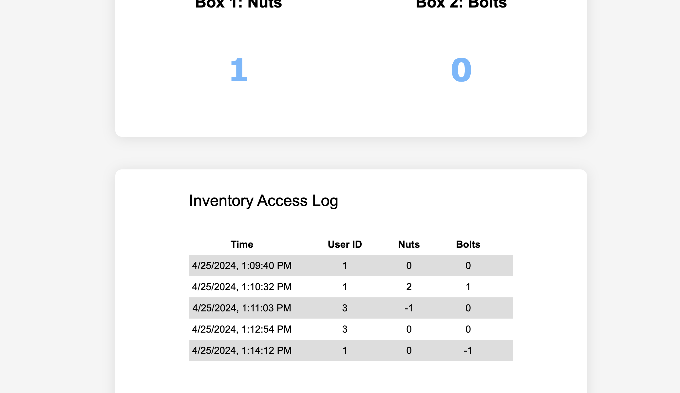
User Interface: Website
Alert message shows up when someone "breaks in" with no access
Warning message to tell users to close the boxes after use while boxes are open
Displays RT number of items in each box
Admin can see the user access logs with a passkey, showing the userID who who accessed the inventory with the change in number of items of each box
ELECTRICAL & COMPUTER ENGINEERING
GRAINGER ENGINEERING

Slide 13
User Interface: Website
ELECTRICAL & COMPUTER ENGINEERING
GRAINGER ENGINEERING

Slide 14
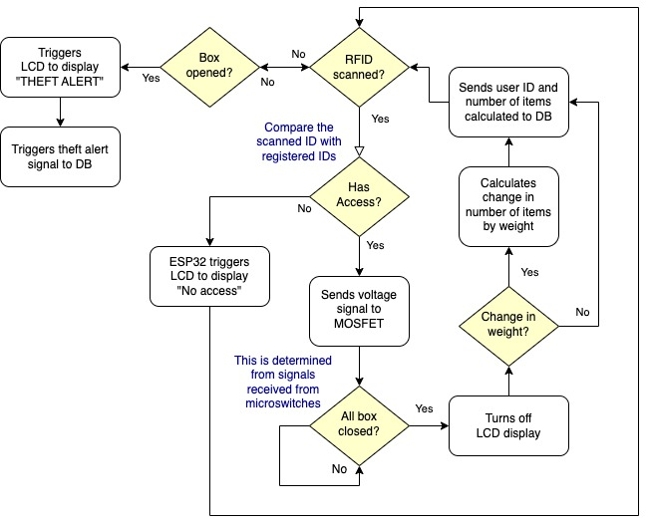
Control
ESP32-S3 Microcontroller
Controls overall flow of the locking-alarm system
Constantly monitors box status (open or close)
Controls user-access from RFID
Calculates the number of items in each inventory box
Retrieves weight in each box from the load cells
WiFi connection to allow communication to web Firebase database
ELECTRICAL & COMPUTER ENGINEERING
GRAINGER ENGINEERING

Slide 15
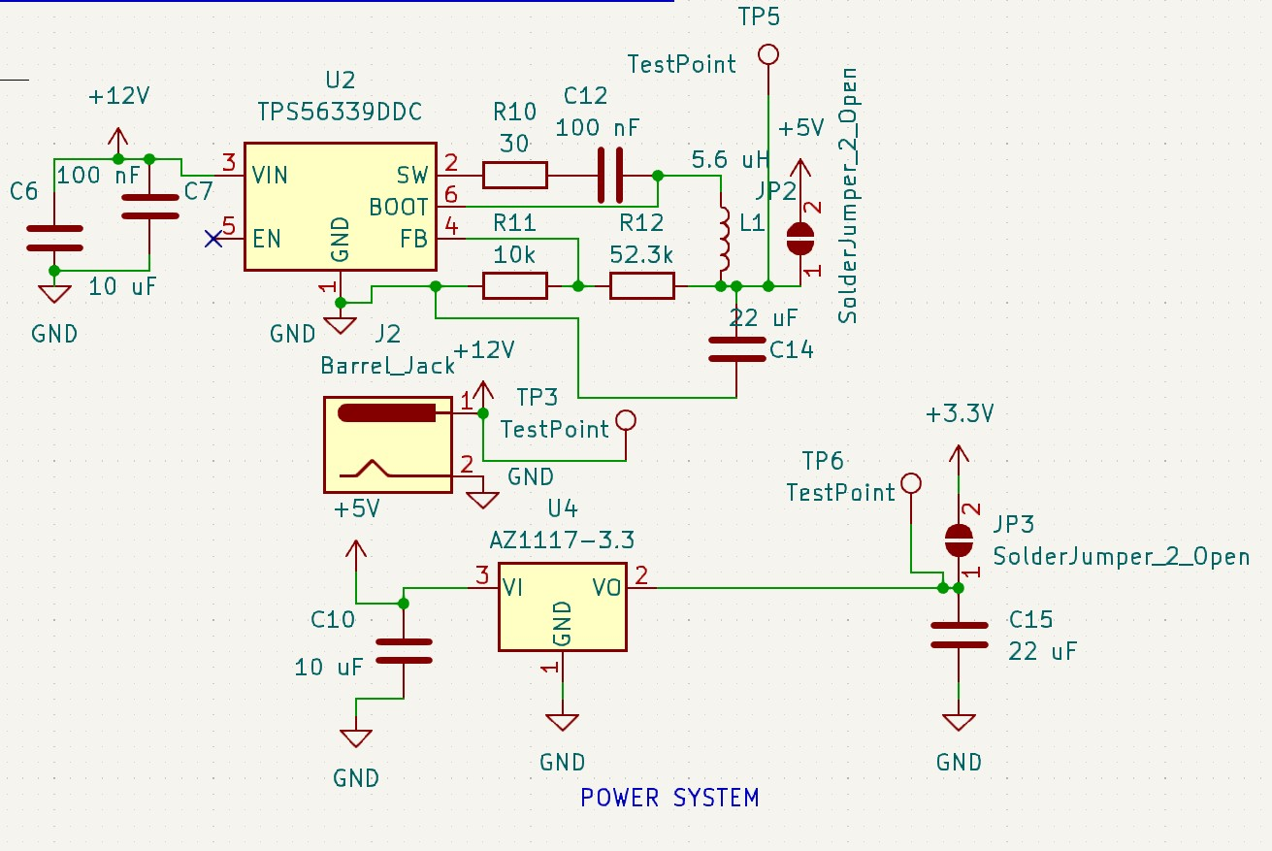
Power
12 V Barrel Connector
Takes 120 V AC wall power and steps it down to 12 V DC to power solenoids
Buck Converter and Voltage Regulator
Buck converter 12 V down to 5 V to power LCD and load cell amplifiers [6]
Voltage regulator steps 5 V down to 3.3 V to power load cell amplifiers, RFID module [2]
ELECTRICAL & COMPUTER ENGINEERING
GRAINGER ENGINEERING

Slide 16
Challenges and Issues
RFID Module
Attempted to use Parallax 28440 module
Test code available compatible with Arduino Uno
Unable to control it with ESP32-S3
Switched to RC522 module
Power System and PCB Issues
Several errors were made in PCB design
2nd wave order was pushed to 3rd wave
User Data
Need to keep user data private
Use administrator passkey
ELECTRICAL & COMPUTER ENGINEERING
GRAINGER ENGINEERING

Slide 17
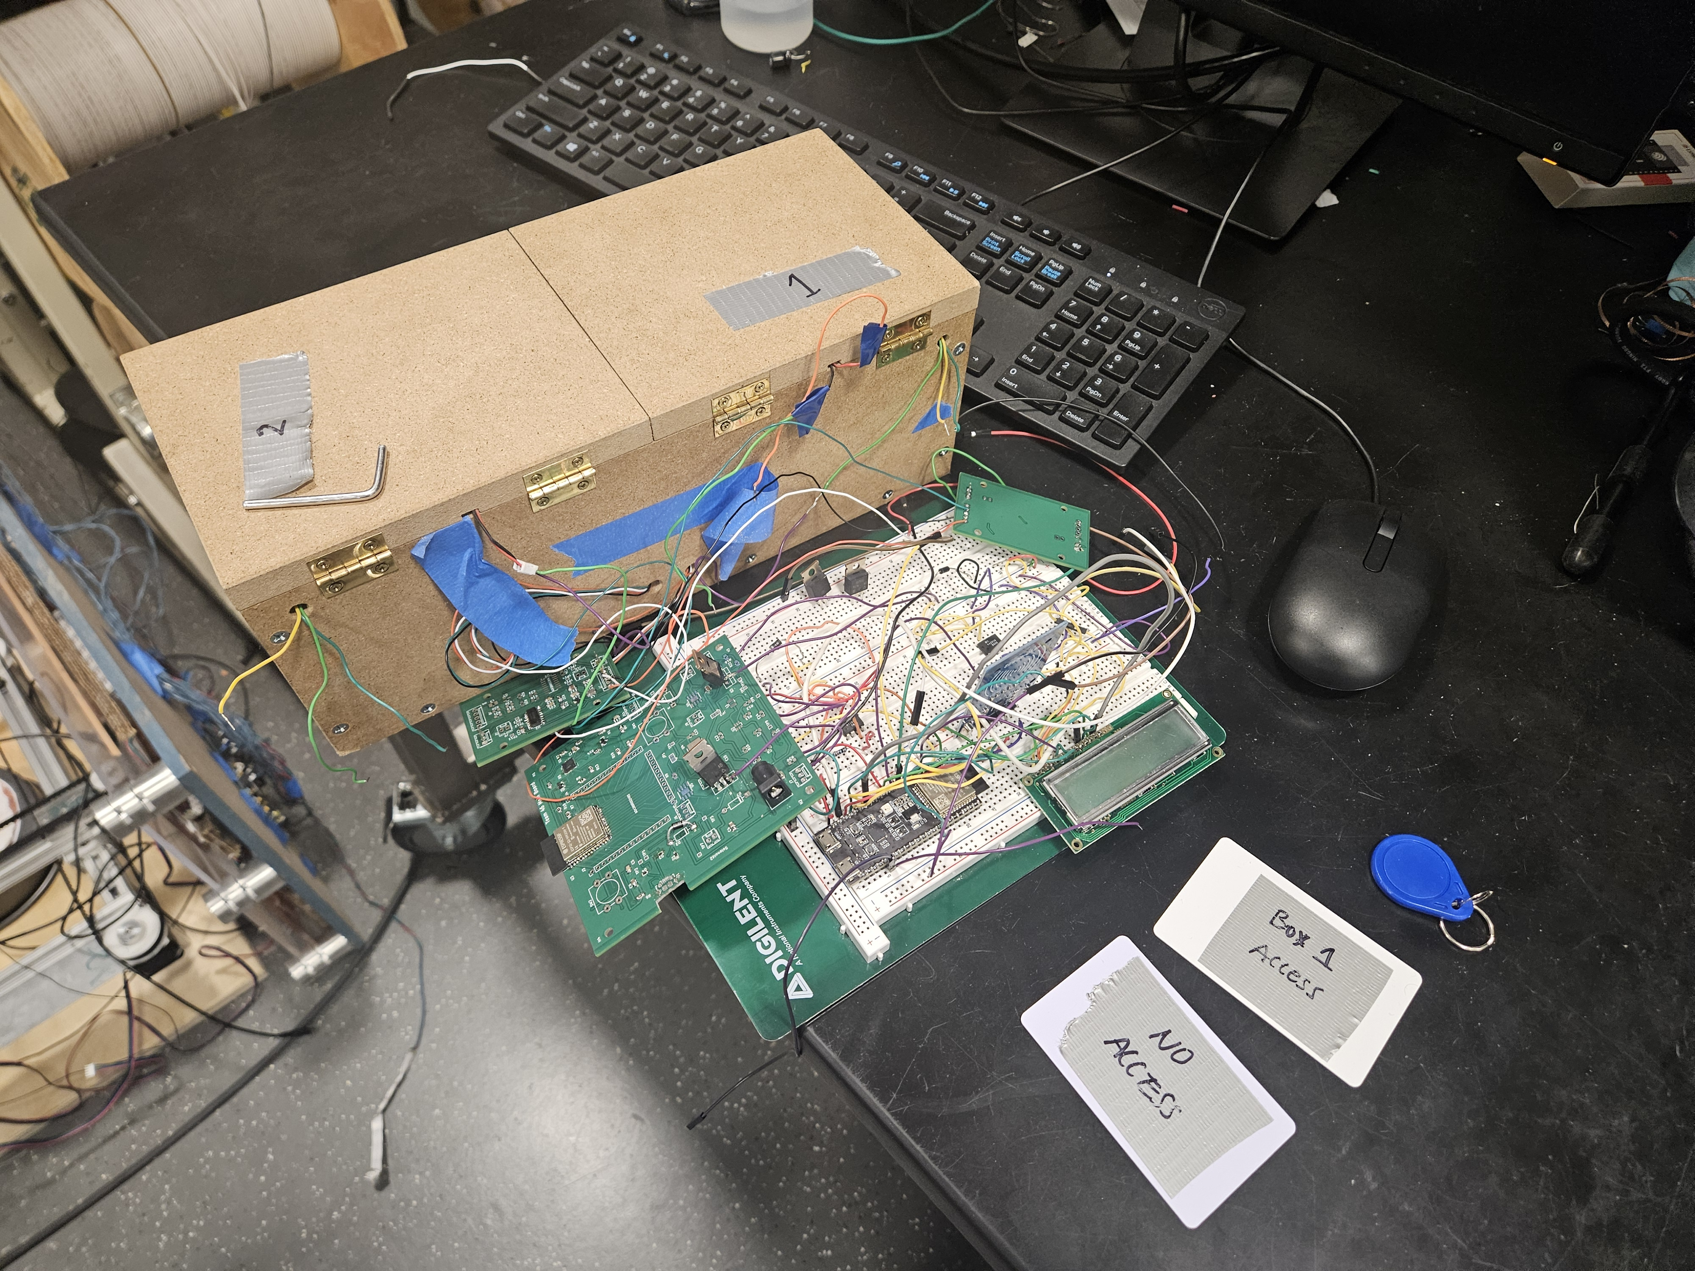
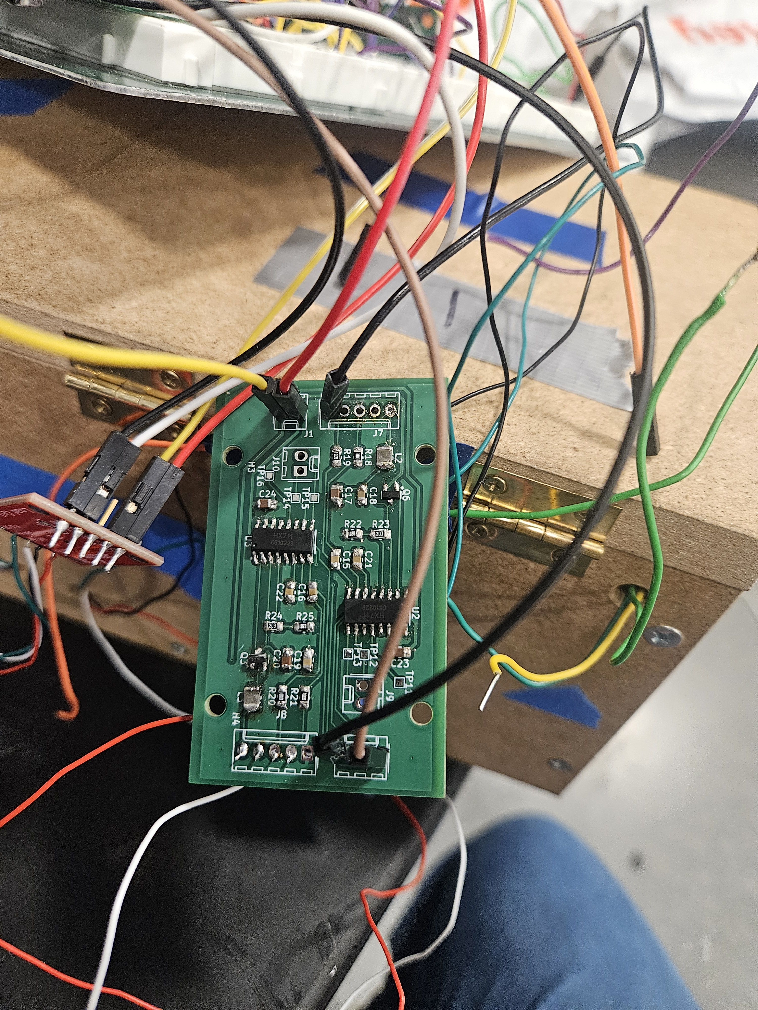
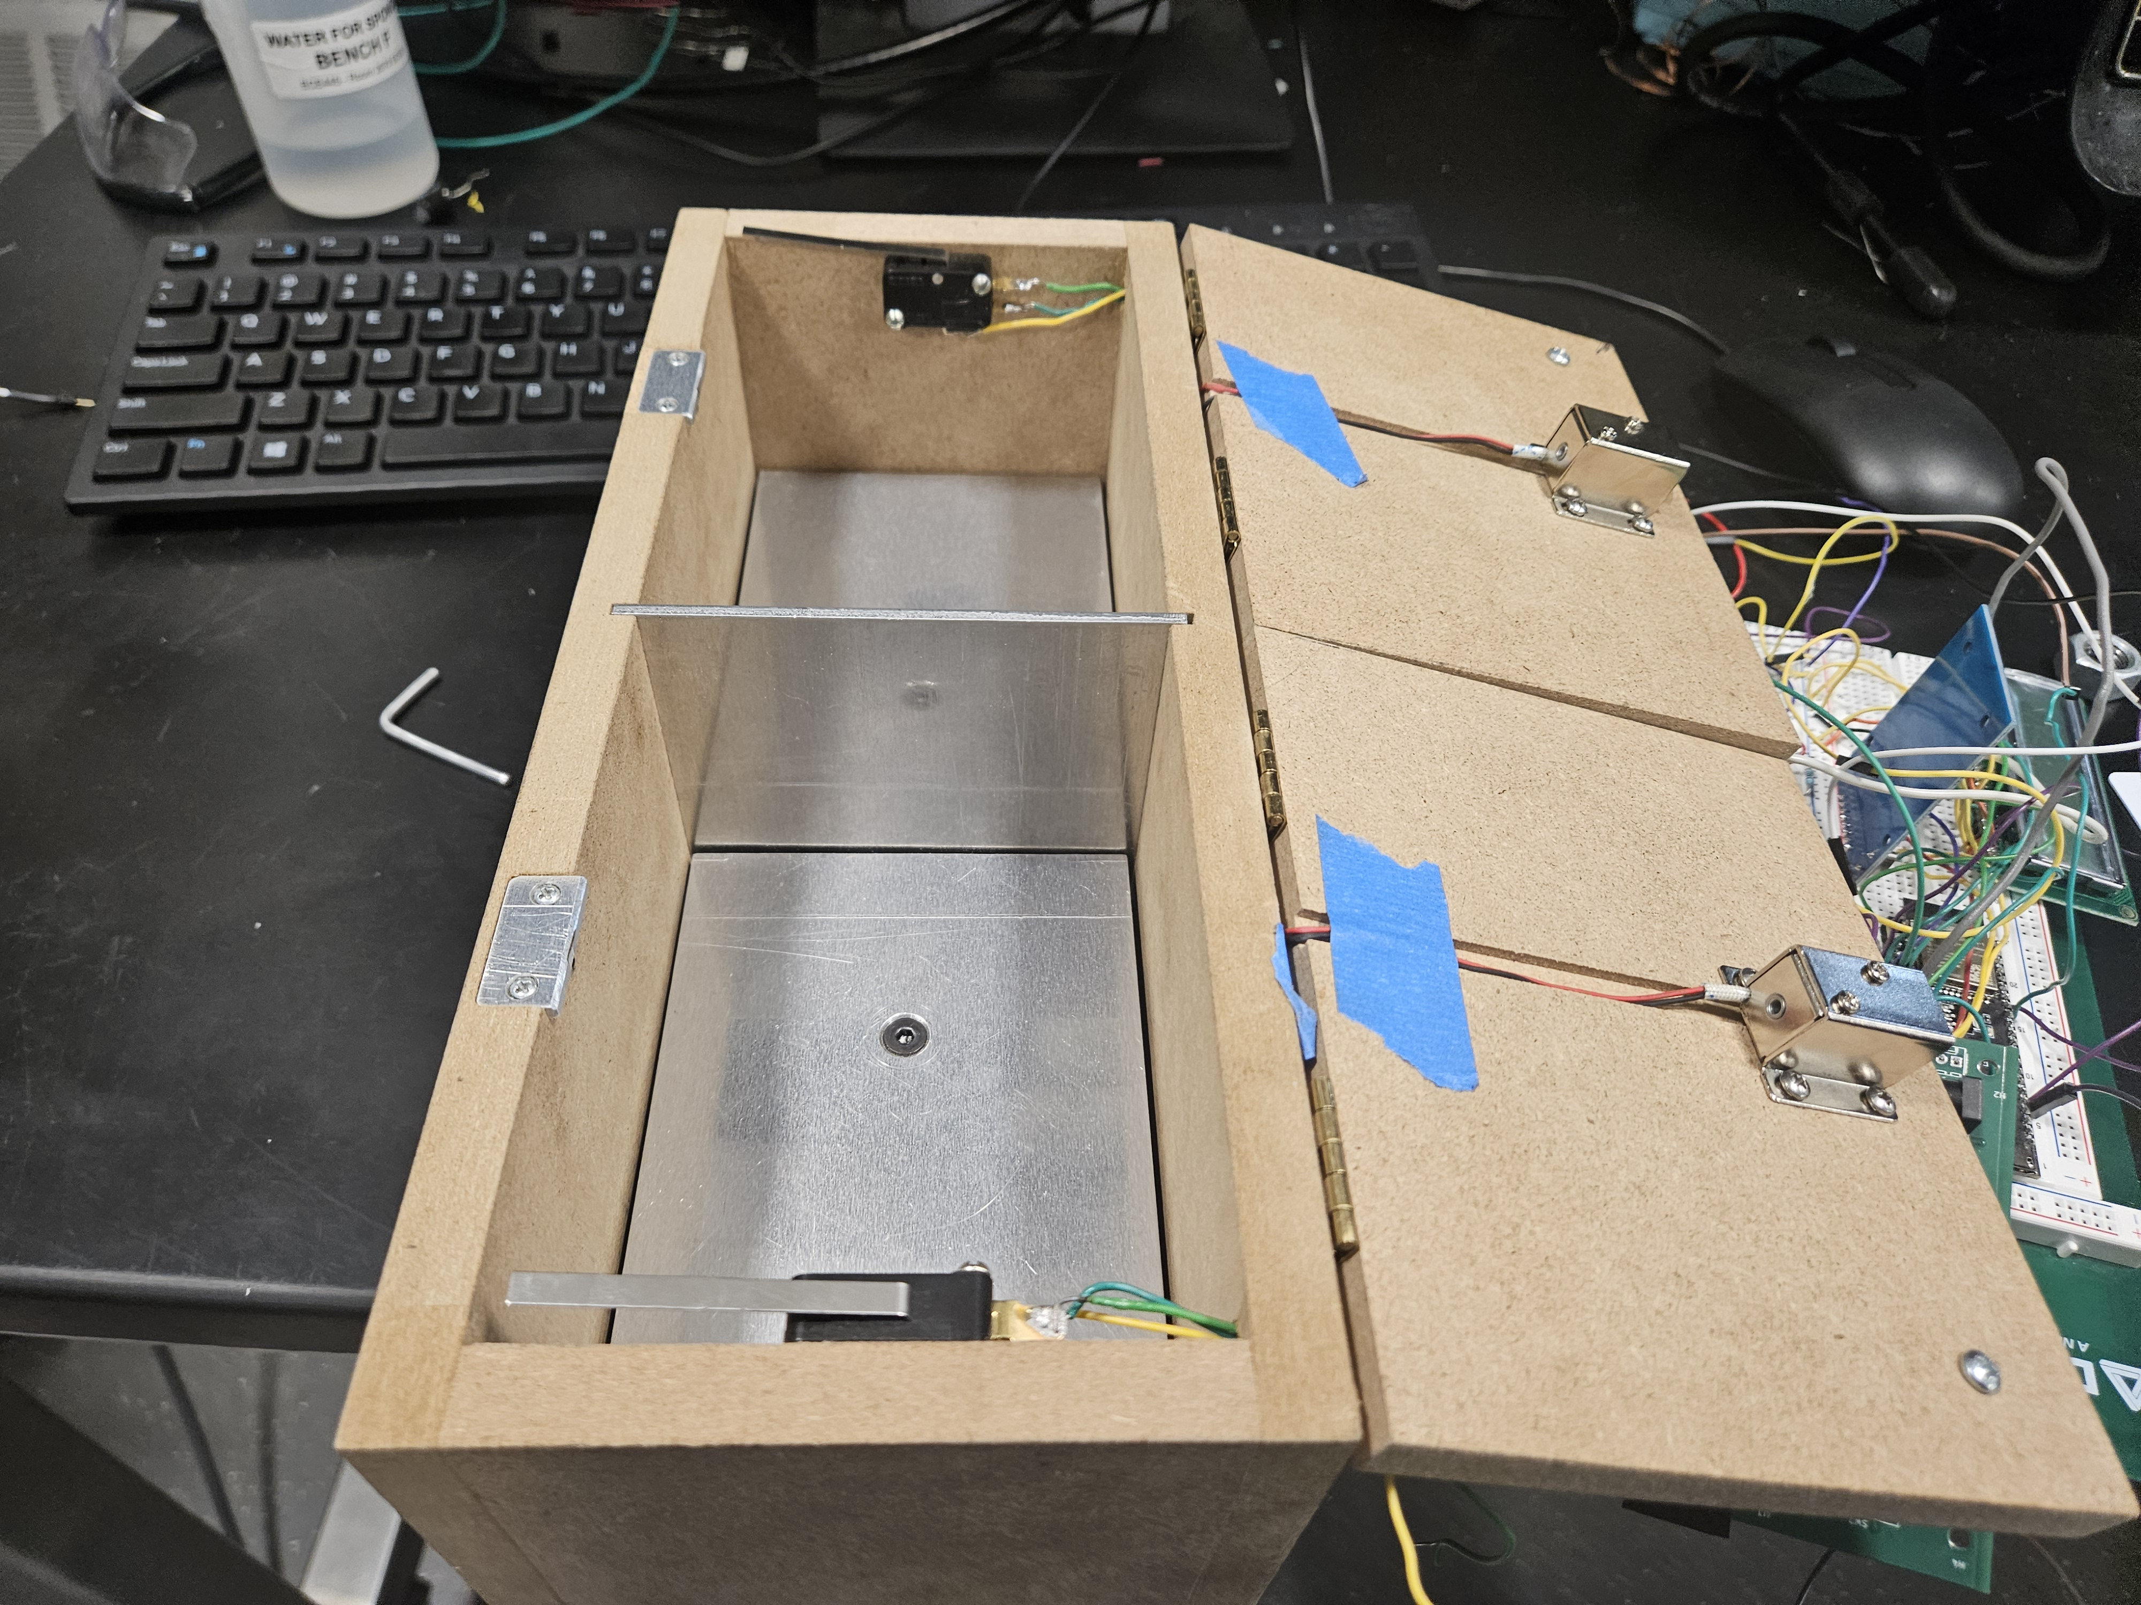
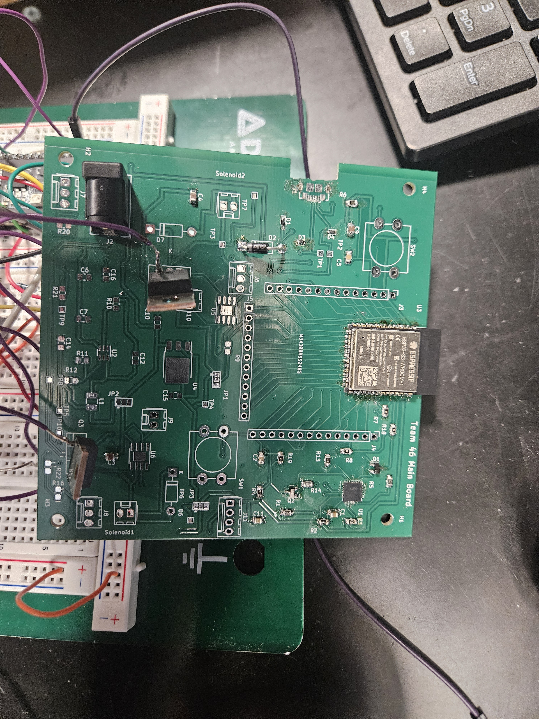
Photos of the Project
Load Cell Amplifier PCB
Project Setup
Open Boxes with Microswitches
Main PCB
ELECTRICAL & COMPUTER ENGINEERING
GRAINGER ENGINEERING

Slide 18
Results
Successes
All sub-systems have been successfully integrated together
Load Cell Amplifier PCB
System shows potential for future applications where automatic inventory tracking is needed
System could be scaled up to integrate as many boxes as needed and with a professional packaging
Failures
Main Board PCB Design
ELECTRICAL & COMPUTER ENGINEERING
GRAINGER ENGINEERING

Slide 19
Future Work
Future Work
Alarm system with audio sound, flash, real-time text message, etc
System could be scaled up to integrate as many boxes and registered RFID cards as needed and with a professional packaging
ELECTRICAL & COMPUTER ENGINEERING
GRAINGER ENGINEERING

Slide 20
References
[1] DeepBlueMbedded. ”ESP32 LCD Display 16×2 Without I2C – Arduino Core”. https://deepbluembedded.com/esp32-lcd-display-16x2-without-i2c-arduino/. (Accessed April 24, 2024).
[2] Diodes Incorporated. “AZ1117 LOW DROPOUT LINEAR REGULATOR WITH INDUSTRIAL TEMPERATURE RANGE .” https://www.diodes.com/assets/Datasheets/AZ1117I.pdf. (accessed Mar. 19, 2024).
[3] Espressif Systems. “ESP32-S3-WROOM-1 ESP32-S3-WROOM-1U Datasheet.” Espressif.com. https://www.espressif.com/sites/default/files/documentation/esp32-s3-wroom-1_wroom-1u_datasheet_en.pdf (Accessed Feb. 8, 2024).
[4] GitHub. ”Espressif KiCad Library”. github.com. https://github.com/espressif/kicad- libraries. (Accessed April 24, 2024).
[5] IEEE. “IEEE Code of Ethics.” IEEE.org. https://www.ieee.org/about/corporate/governance/p7-8.html (Accessed Feb. 8, 2024).
[6] Texas Intruments. "TPS56339 4.5-V to 24-V Input, 3-A Output Synchronous Buck Converter". https://www.ti.com/lit/ds/symlink/tps56339.pdf?HQS=dis-dk-null-digikeymode-dsf-pf-null-wwe&ts=1714130993240&ref_url=https%253A%252F%252Fwww.ti.com%252Fgeneral%252Fdocs%252Fsuppproductinfo.tsp%253FdistId%253D10%2526gotoUrl%253Dhttps%253A%252F%252Fwww.ti.com%252Flit%252Fgpn%252Ftps56339. (Accessed March 19, 2024).
[7] SparkFun. “PARALLEL BEAM LOAD CELL.” https://cdn.sparkfun.com/datasheets/Sensors/ForceFlex/TAL220M4M5Update.pdf. (Accessed Feb 21, 2024).
ELECTRICAL & COMPUTER ENGINEERING
GRAINGER ENGINEERING

