Slide 1
Automatic Smoothie Maker
Group #49
Team members: Anay Koorapaty, Max Gendeh, Avyay Koorapaty

Slide 2
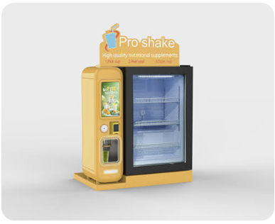
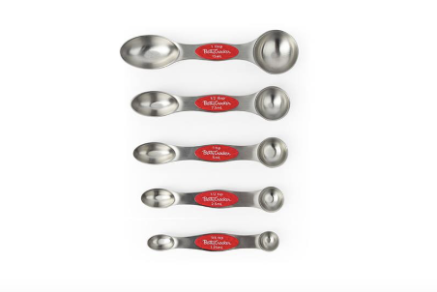
Inspiration/Problem
Smoothies are becoming a popular and healthy option to get nutrients and protein
Preparing a smoothie requires different measurement utilities for variety of ingredients
Automated Smoothie makers are not widely commercially available and cost is high

Slide 3
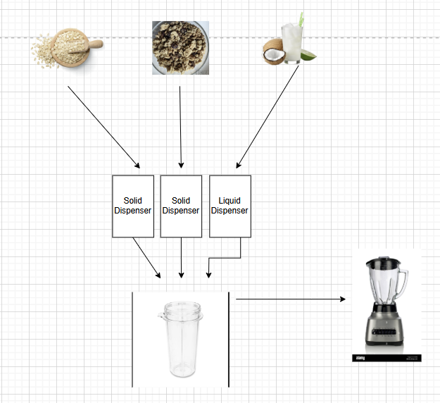
Solution/Visual Aid
Automate measuring process
2 solid ingredients, 1 liquid ingredient
Oats, sugar, water

Slide 4
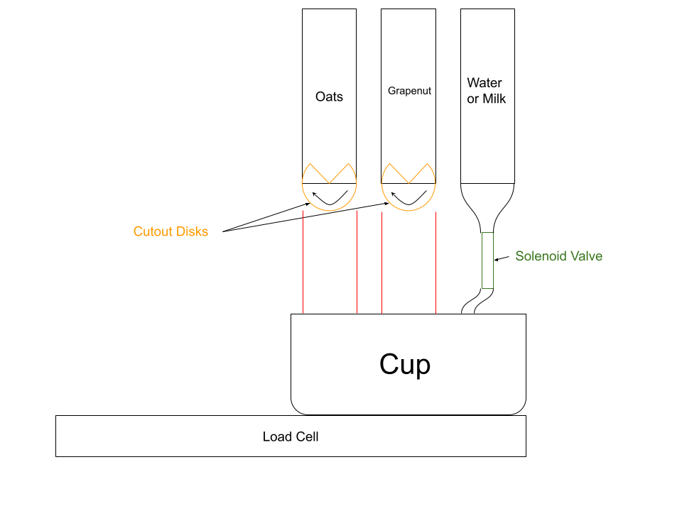
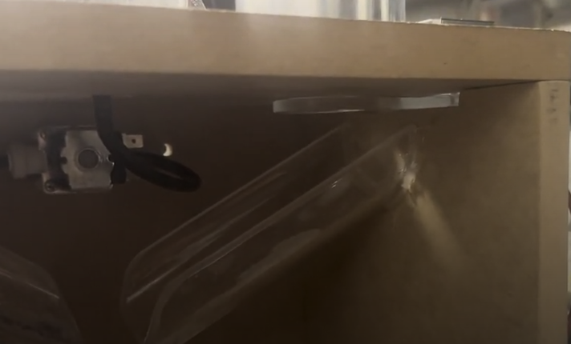
Mechanical Design

Slide 5
High Level Requirements
The system takes a maximum of 1.5 minutes from the start of dispensing to all of the ingredients being inside the blender.
Measurement accuracy will be to ± 20% of intended ingredient amount
The system will dispense the correct ingredients given a preset or user inputted recipe

Slide 6
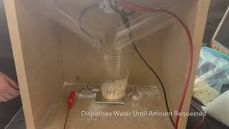
Short Video Demonstrating High Level Reqs

Slide 7
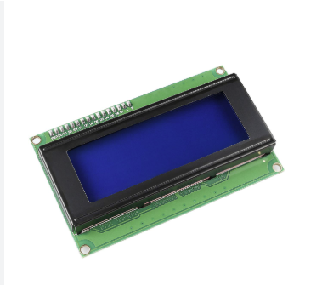
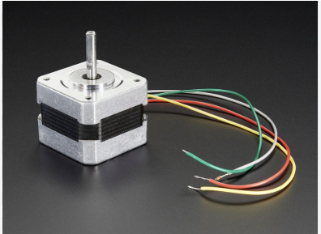
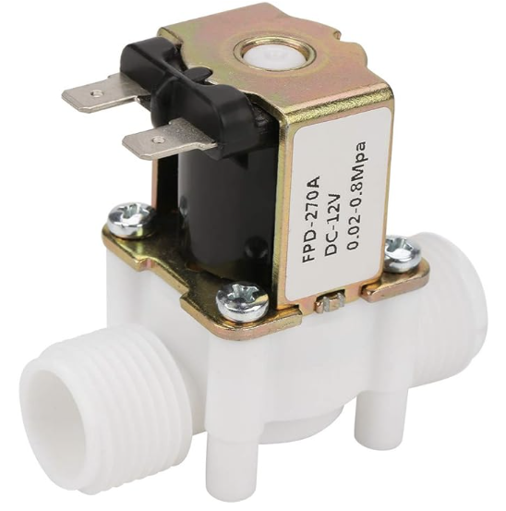
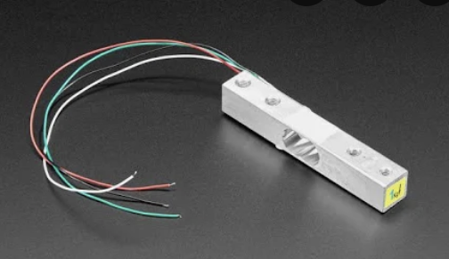
Electronics Intended Function
Interface to show and customize recipes
Actuators to control dispensing with a different method for solid and liquid ingredients
Standardize measurement of ingredient amount

Slide 8
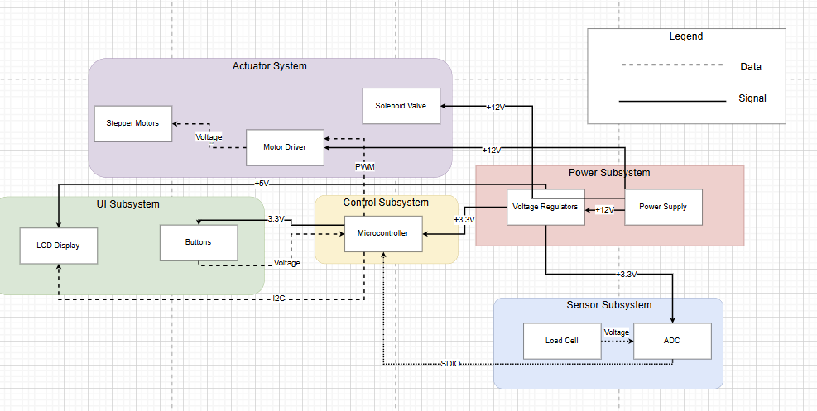
Block Diagram
Note: LCD display voltage should be 3.3 volts so only one regulator

Slide 9
Power Subsystem

Slide 10
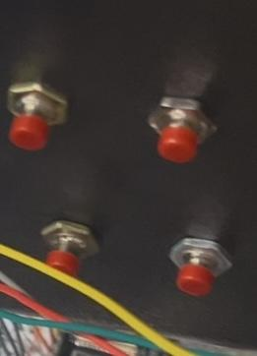
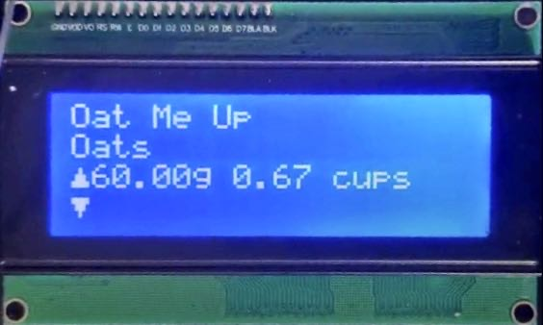
LCD Subsystem
Up Button
Next Recipe Button
Next Ingredient Button
Down Button

Slide 11
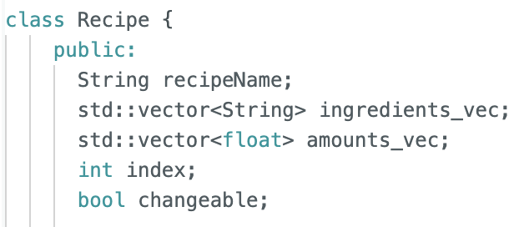
LCD Code

Slide 12
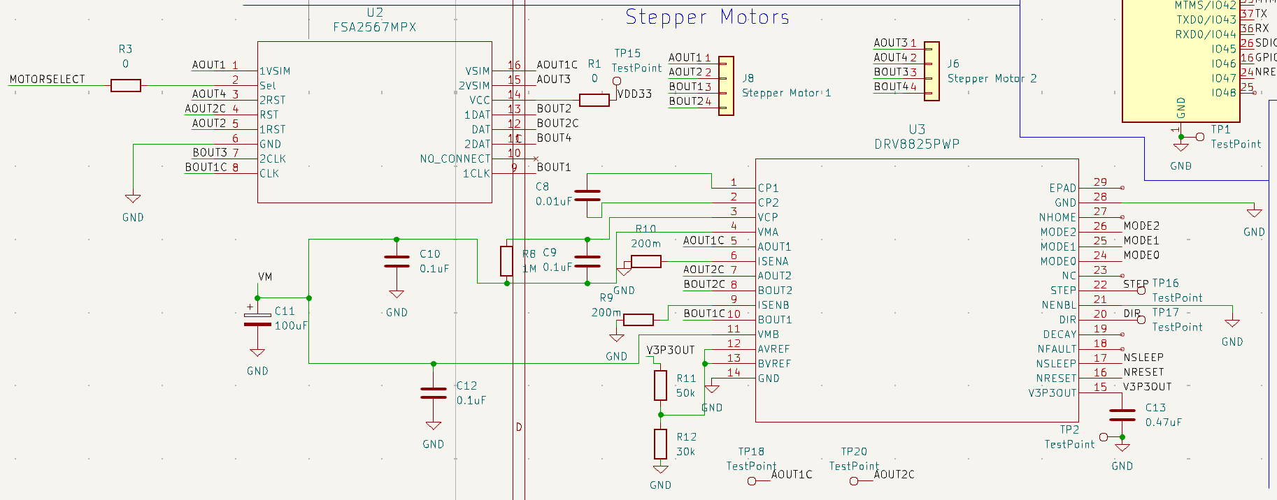
Stepper Motor
Relay
Motor Driver

Slide 13
Important Pins(Stepper Motor)
M0,M1, M2 - control stepping mode of motor
nSleep, nReset - must be high for operation of motor driver
nEnbl - active low to turn on H-bridges
Step - PWM signal whose frequency controls motor speed
Dir - Logical signal to control motor direction

Slide 14
Vref Calculation
Voltage divider circuit:
Too much current drawn!
Current satisfactory!

Slide 15
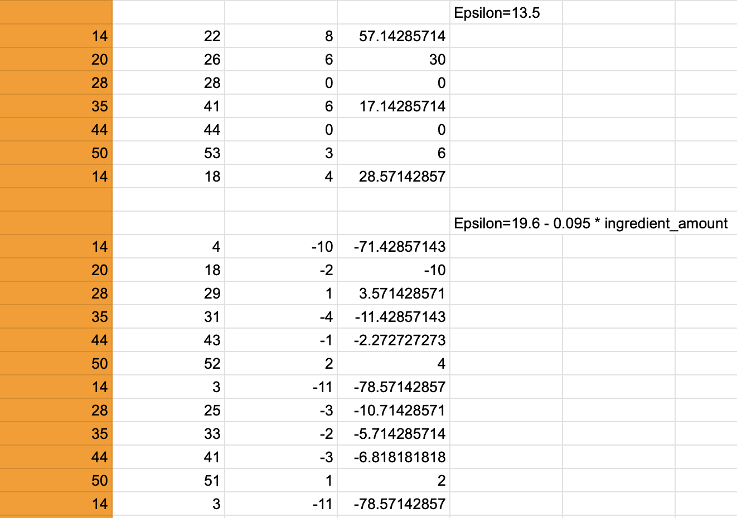
Adjusting Oats Dispensing Amount
Amount Measured Difference Percentage off

Slide 16
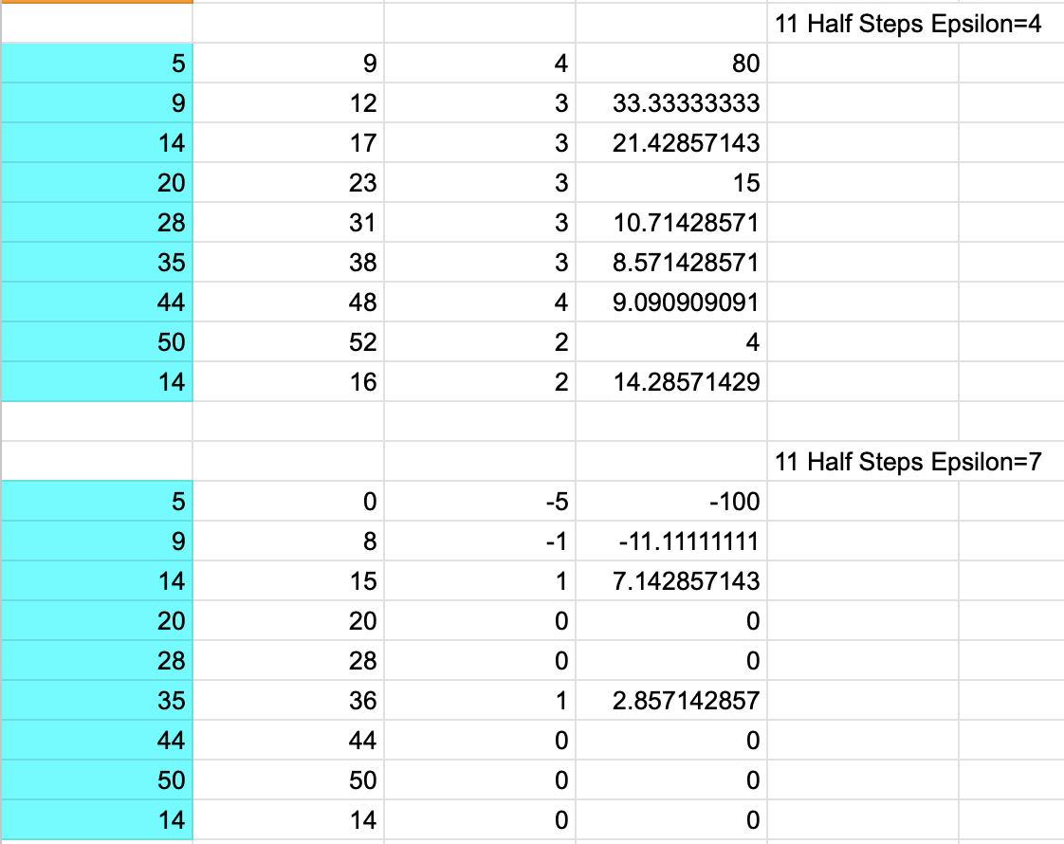
Adjusting Sugar Dispensing Amount
Amount Measured Difference Percentage off

Slide 17
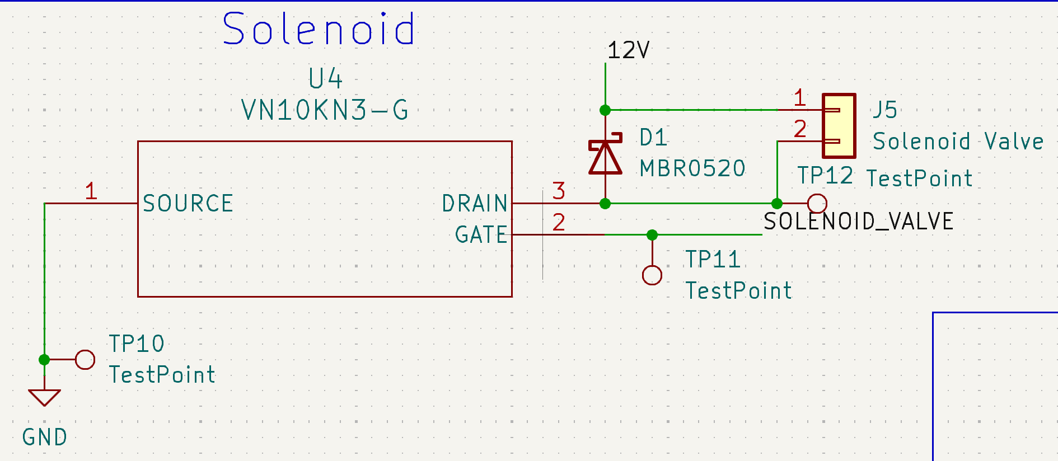
Solenoid MOSFET Problems

Slide 18
Load Cell Calibration
Item | Scale Mass (g) | Load Cell 20 Values Average Number
Tape | 53 | 54791
Screwdriver | 115 | 118631
Pliers | 186 | 191566.09
2A Stepper Motor | 367 | 378410.19
2A Stepper Motor + Tape | 421 | 433379
Cup | 14 | -113.9
Equation
LC = 1030*SM + 211
SM = (LC - 211) / 1030

Slide 19
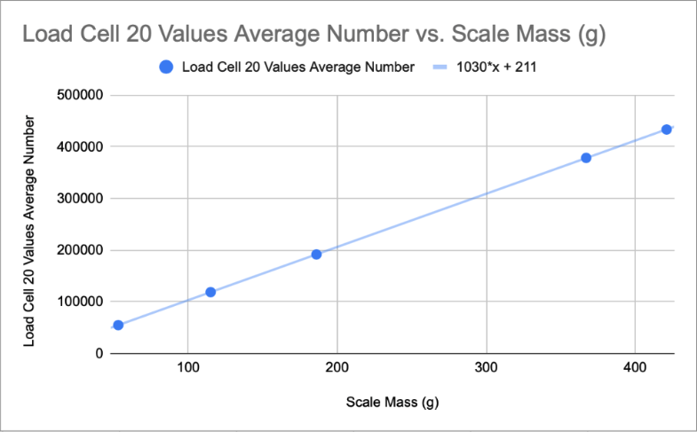
Load Cell Calibration

Slide 20
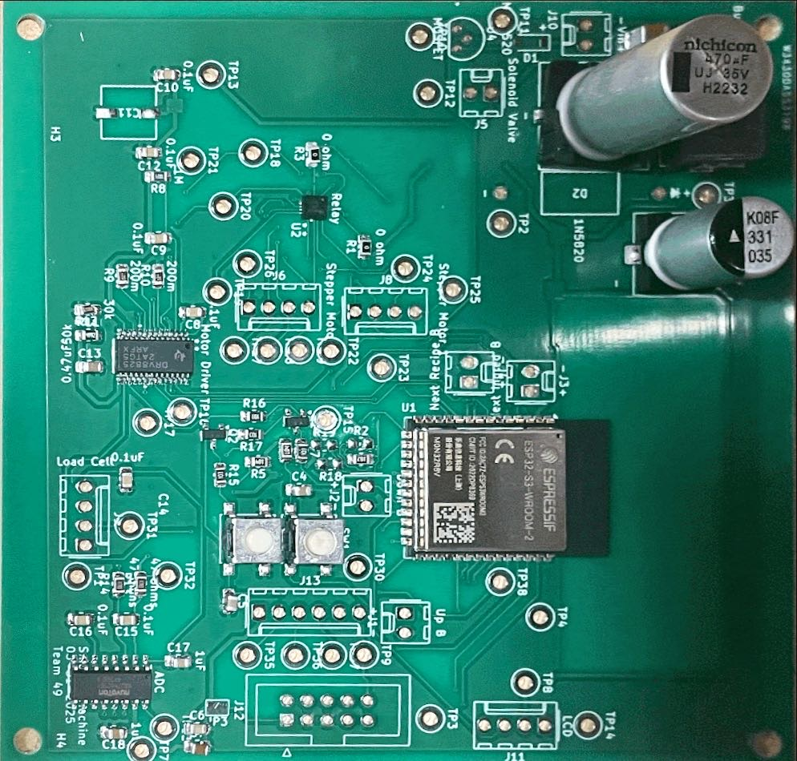
Next Steps

Slide 21
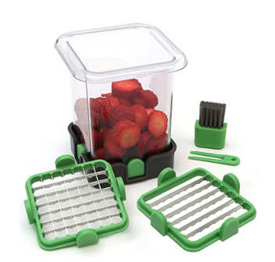
Conclusion
Successful project overall!
All high level requirements fulfilled
Function closely aligns to that outlined in our design document
What we learned
Start testing early!
Ask lots of questions
Potential Design Changes
Redesign to support more ingredients

Slide 22
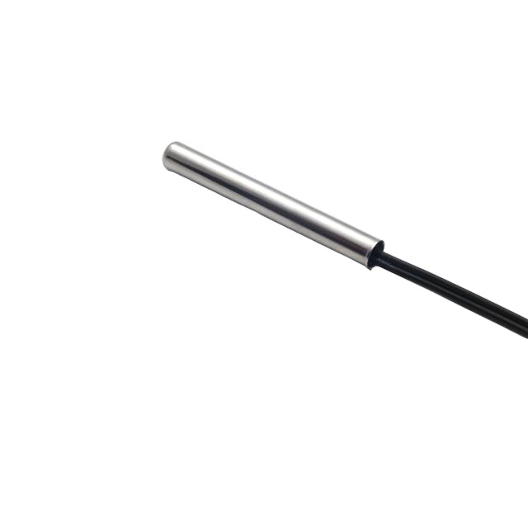
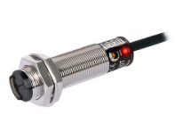
Future Work
Thermocouple
future work
k)
Sensors

Slide 23
Ethics
Extremely Safe
Small number of moving parts
Food safety
Electronics
User-friendliness
Fast and accurate
Compliance
Acknowledged and acted upon the counsel of others

Slide 24
Q&A
Any questions?

Slide 25
Thanks for Listening!

