Slide 1
Anti-Lock Braking for Bicycles
Ethan Chastain, Aidan Rodgers, Leon Ku
April 29, 2024

Slide 2
Introduction
The Problem: Bicycle Brake Locking
ELECTRICAL & COMPUTER ENGINEERING
GRAINGER ENGINEERING

Slide 3
Introduction
Introduction
Simple Modes of Transportation
Bike Safety
Drawing From Cars
ELECTRICAL & COMPUTER ENGINEERING
GRAINGER ENGINEERING
Notes:
Bicycles are intended to be simple, inexpensive modes of transportation
This intention comes at the cost of a lack of safety features
Anti-lock braking systems (ABS) are commonly used in cars to prevent wheels from locking up in inclement weather

Slide 4
Objective
Objective
Anti-Lock Braking Systems (ABS) and Bicycles
Addressing Bike Safety
Braking Modulated
ELECTRICAL & COMPUTER ENGINEERING
GRAINGER ENGINEERING
Notes:
The objective of this project is to implement an anti-lock braking system (ABS) on a bicycle
This project is intended to improve the safety of bicycles by preventing brake lock-ups
This is done by adding a braking system that both detects locking and modulates braking to account for it

Slide 5
Project Design
ELECTRICAL & COMPUTER ENGINEERING
GRAINGER ENGINEERING

Slide 6
Original Design
Original Design
PID Controller
Underrepresented Dynamics
Battery Management System
High Level Requirements
Bicycle Wheel Speed and Brake Lock-Up Prevention
Display the Advantages of ABS over Traditional Braking
Utilizes the Full Extent of the Bicycle Brakes
ELECTRICAL & COMPUTER ENGINEERING
GRAINGER ENGINEERING
Notes:
Originally, the design was going to utilize a PID controller for the motor controller, and the original design had incomplete representations of the dynamics behind bicycle braking. In addition, the original design included a battery management system.
These did not necessarily aim towards the completion of our high level requirements as well as we would have liked.
High Level Requirements:
This project must possess the ability to accurately determine bicycle wheel angular velocity at any point in time and consequently be able to prevent brake lock-ups.
This project must demonstrate the advantages of Anti-Lock Braking (ABS) over traditional braking in emergency situations; this includes coming to a stop faster on adverse road conditions (shorter stopping distances) and the ability to maneuver while braking.
This project must be capable of exerting the necessary control effort to make full use of the bicycle brakes.

Slide 7
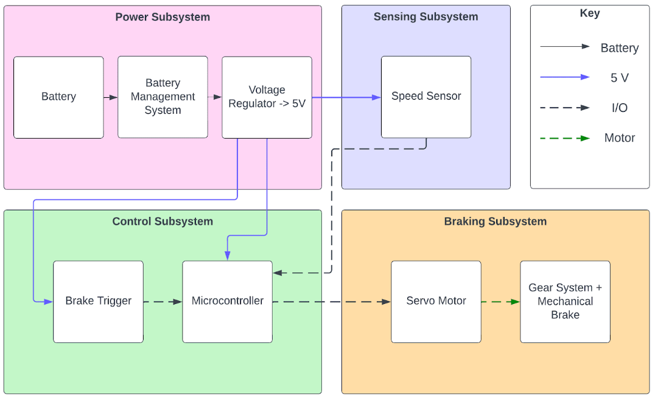
Original Block Diagram
Block diagram of the original design.
ELECTRICAL & COMPUTER ENGINEERING
GRAINGER ENGINEERING

Slide 8
Design Changes
Design Changes
Bang-bang Controller
Completed Bicycle Dynamics
Disclusion of Battery Management
High Level Requirements
Bicycle Wheel Speed and Brake Lock-Up Prevention
Display the Advantages of ABS over Traditional Braking
Prompt ABS Responsiveness
ELECTRICAL & COMPUTER ENGINEERING
GRAINGER ENGINEERING
Notes:
The changes we made to better reach our high level requirements included a swap to using a type of optimal controller, a bang-bang controller. This controller has a faster response time than a PID controller, so we decided to use it since ABS should have fast control systems.
The dynamics of a braking bicycle were completed and accurately model the mechanics behind our project
The battery management system was deemed overly complex compared to the rest of the project and was scrapped in the interest of time. Additionally, the feature did not work towards any of the requirements of the project.
High Level Requirements:
This project must possess the ability to accurately determine bicycle wheel angular velocity at any point in time and consequently be able to prevent brake lock-ups.
This project must demonstrate the advantages of Anti-Lock Braking (ABS) over traditional braking in emergency situations; this includes coming to a stop faster on adverse road conditions (shorter stopping distances) and the ability to maneuver while braking.
This project must display the responsiveness required of ABS; the project must show that within one second of the brake system receiving input, the brakes will begin actuating from the ABS control.

Slide 9
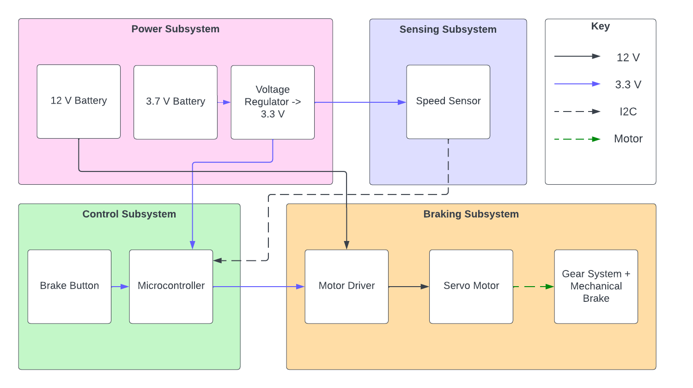
Final Block Diagram
Block diagram of the final design.
ELECTRICAL & COMPUTER ENGINEERING
GRAINGER ENGINEERING

Slide 10
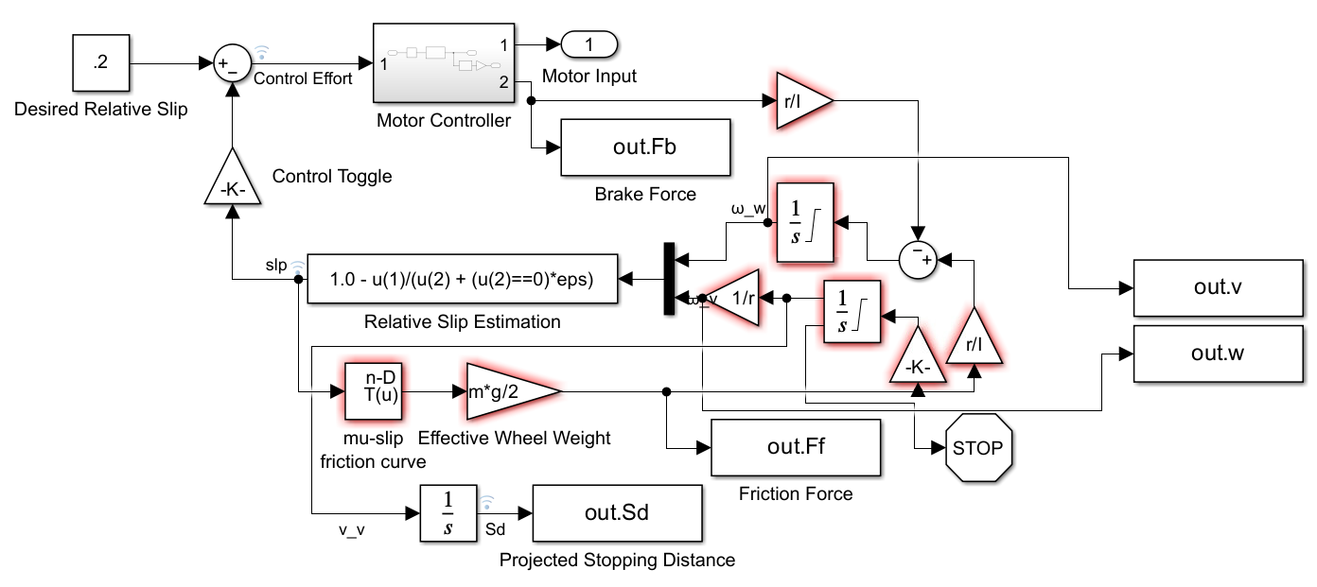
Functional Block Requirements
Control Subsystem
Brake Logic
Slip Tracking
Subsystem Requirements
Rise time <= 75 ms
Settling time <= 125 ms
Overshoot <= 15%
IMAGE / GRAPHIC
ELECTRICAL & COMPUTER ENGINEERING
GRAINGER ENGINEERING
Notes:
Rise time <= 75ms, Settling time <= 125ms, Overshoot <= 15%

Slide 11
Functional Block Requirements
Power Subsystem
Powers Project Components
Batteries and Regulation
Subsystem Requirements
100 mA at 3.3 V with 2% peak-to-peak ripple
Efficiency > 90%
Under Certain Conditions
ELECTRICAL & COMPUTER ENGINEERING
GRAINGER ENGINEERING
Notes:
Delivers power to the other subsystems
Consists of a 3.7 V battery, 12 V battery, and a 3.3 V linear regulator
The power subsystem must be able to supply up to 100 mA at 3.3 V with 2% peak-to-peak voltage ripple.
The power subsystem must operate at an efficiency greater than 90% for loads of up to 100 mA.

Slide 12
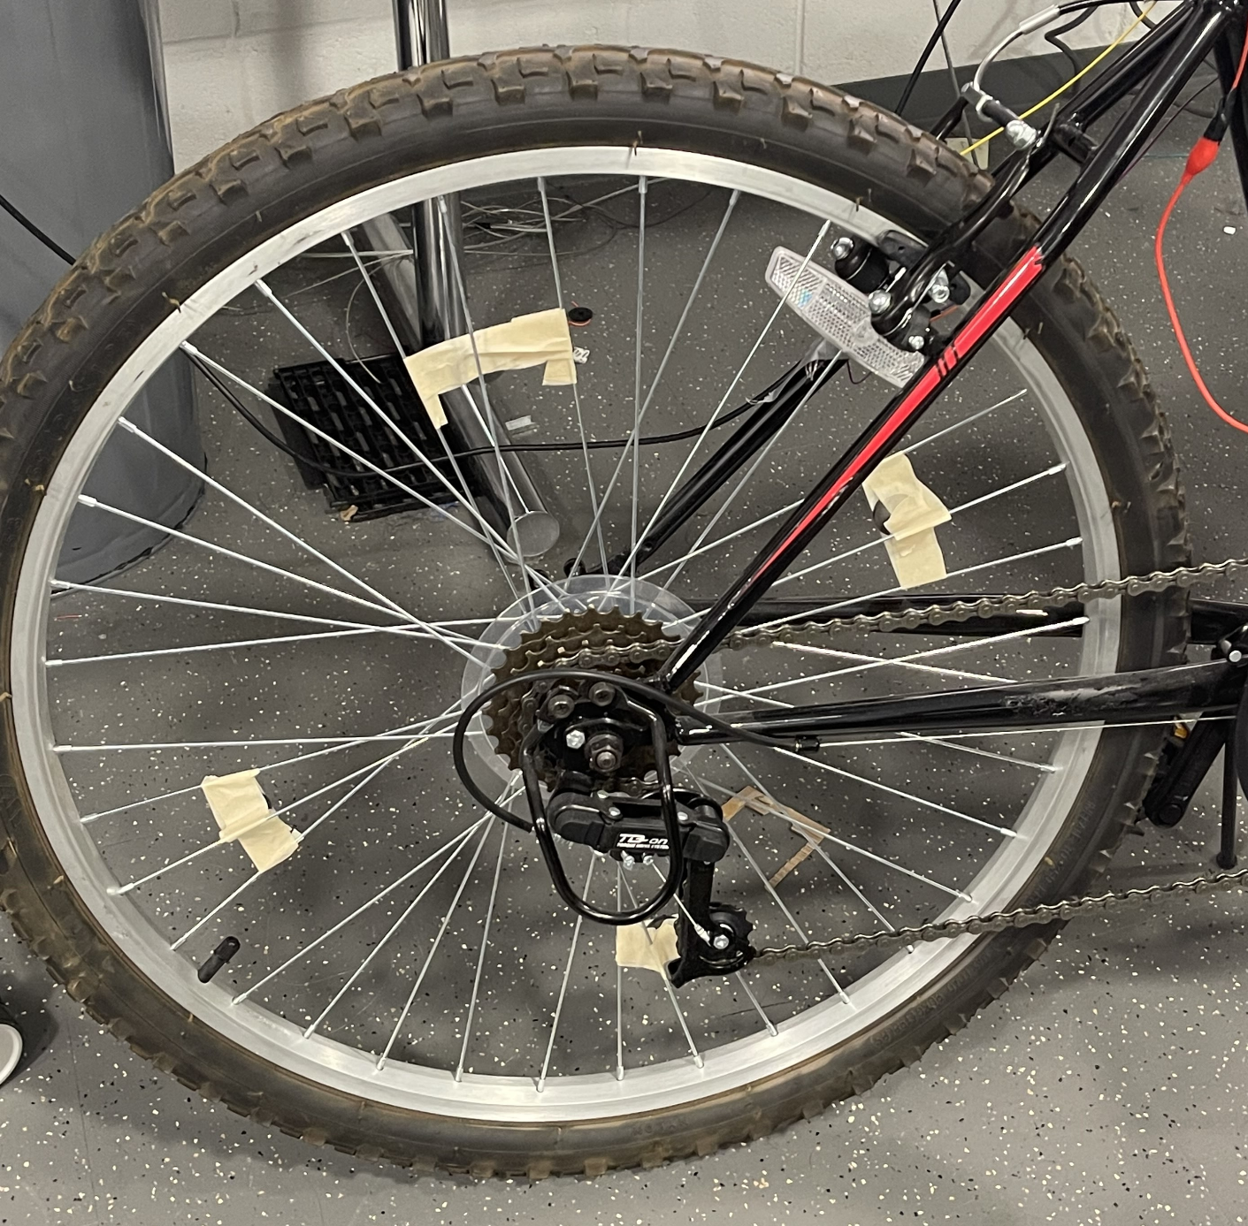
Functional Block Requirements
Sensing Subsystem
Wheel Speed
Hall Effect
Subsystem Requirements
Indicate Wheel Rotations
Digital Signal Output
ELECTRICAL & COMPUTER ENGINEERING
GRAINGER ENGINEERING
Notes:
Used to report wheel speed to the control subsystem
Consists of a hall effect sensor
The hall effect sensors must correctly indicate to the control subsystem each wheel turn in order to determine wheel speed.
The sensors must produce a steep spike which indicates each spin.

Slide 13
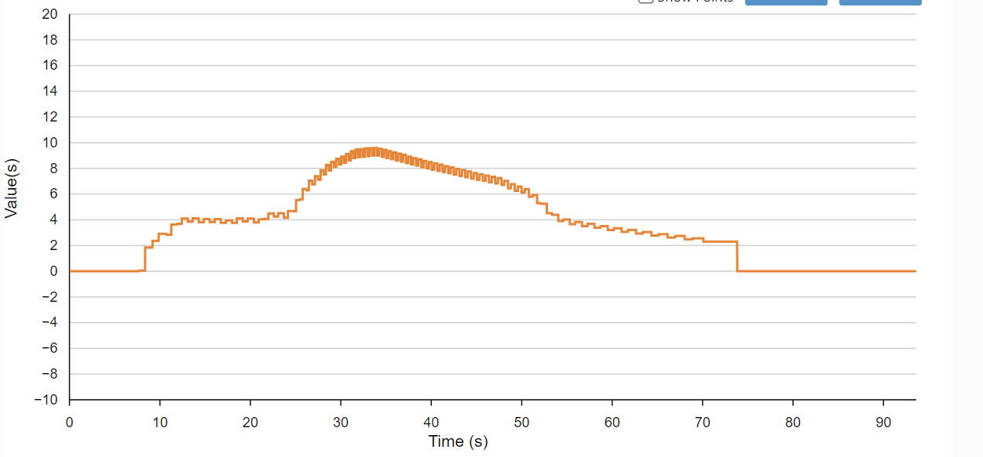
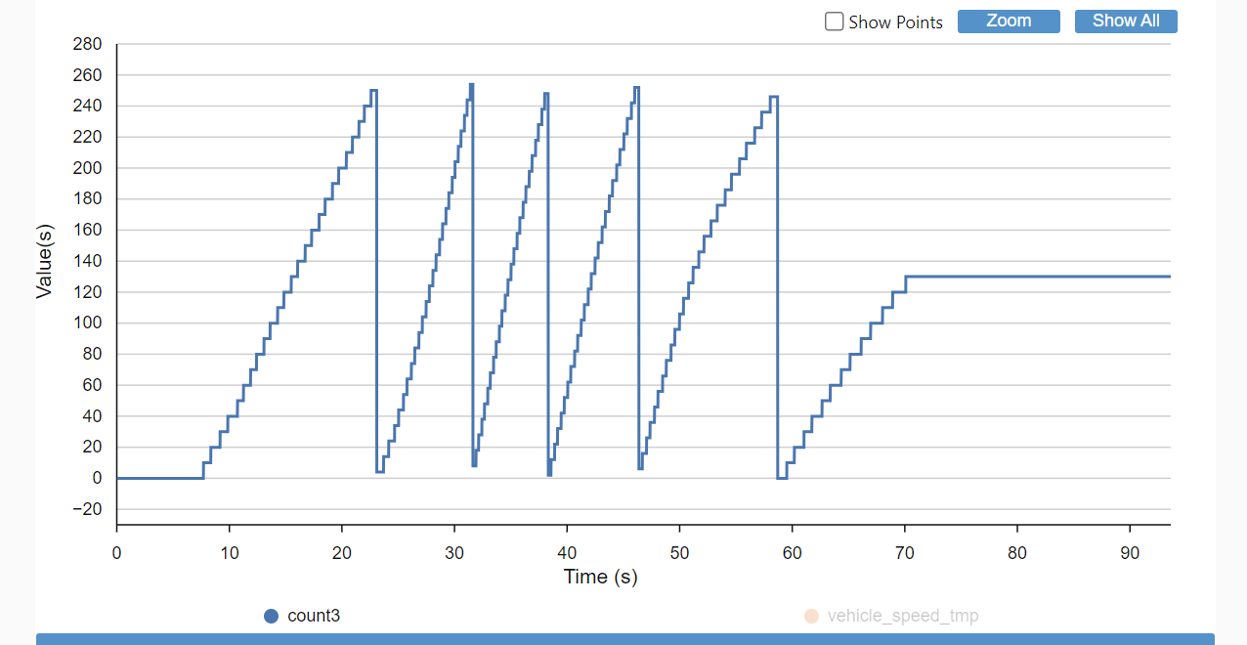
vehicle_speed
count
Vehicle Speed Vs Time (Top) Edge Detection Vs Time (Bottom)
ELECTRICAL & COMPUTER ENGINEERING
GRAINGER ENGINEERING

Slide 14
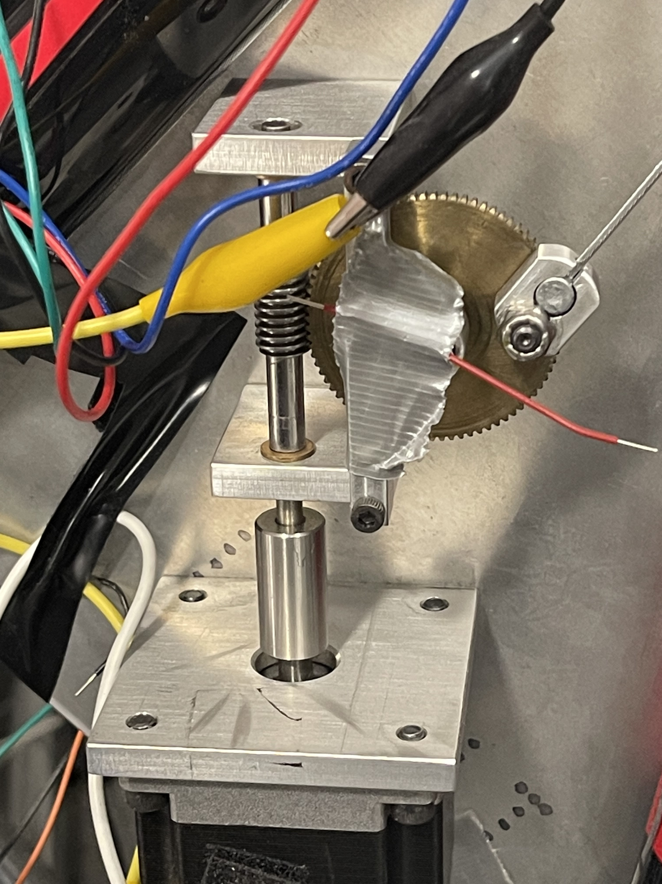
Functional Block Requirements
Braking Subsystem
Brake Actuation
Mechanical System
Subsystem Requirements
100 RPM
Gearing Provides Sufficient Torque
ELECTRICAL & COMPUTER ENGINEERING
GRAINGER ENGINEERING
Notes:
Takes inputs from the control subsystem to actuate the brakes.
Consists of a motor driver, servo motor, and gear system to pull the brake cable.
The driver must drive the motor to a speed of at least 100 RPM in order to perform a quick stop.
The motor and gear system has to provide sufficient force to pull the brake cable.

Slide 15
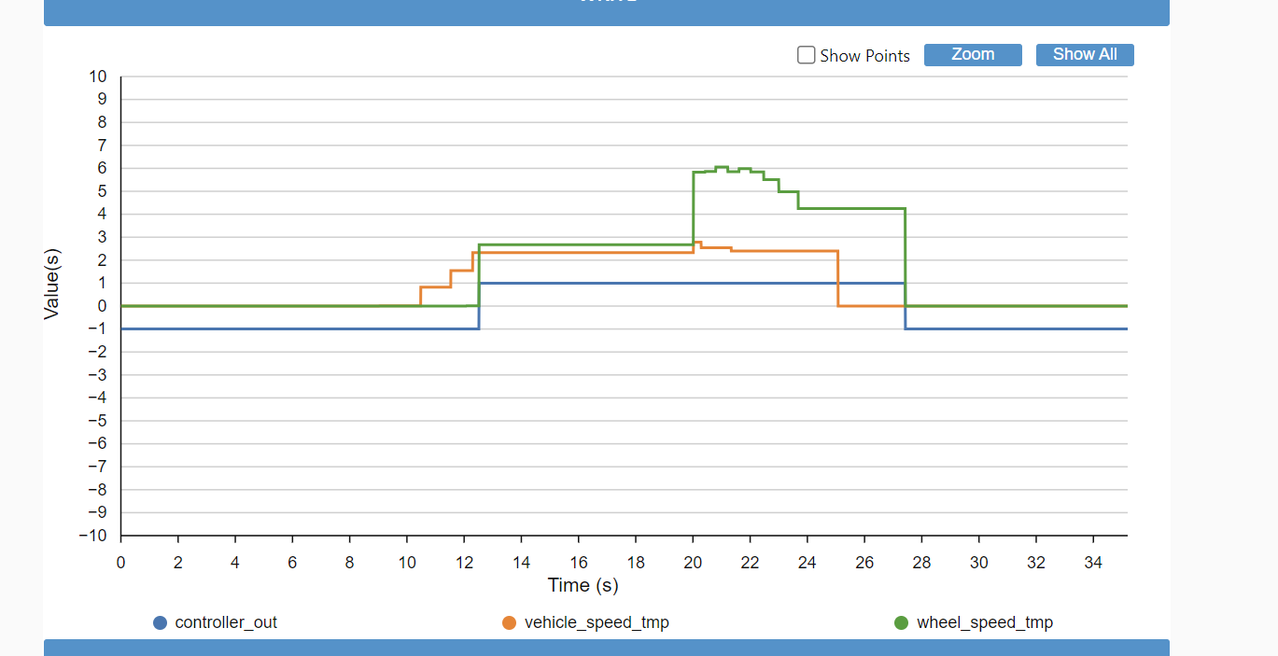
Effect of Wheel Speed on Controller Output
ELECTRICAL & COMPUTER ENGINEERING
GRAINGER ENGINEERING

Slide 16
Project Build and Results
ELECTRICAL & COMPUTER ENGINEERING
GRAINGER ENGINEERING

Slide 17
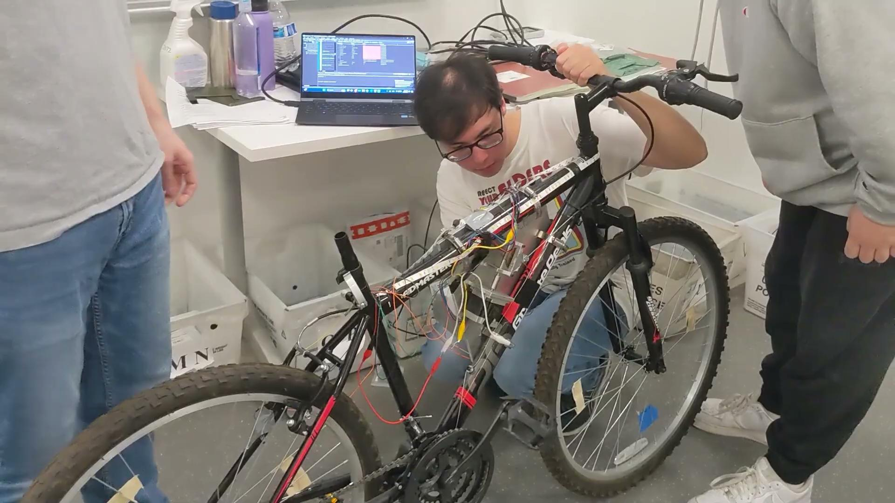
Video Showcasing ABS Disengaging the Brakes when Locked
ELECTRICAL & COMPUTER ENGINEERING
GRAINGER ENGINEERING
Notes:
Use the thumbnail for the video as the image for the next slide (describing project build)

Slide 18
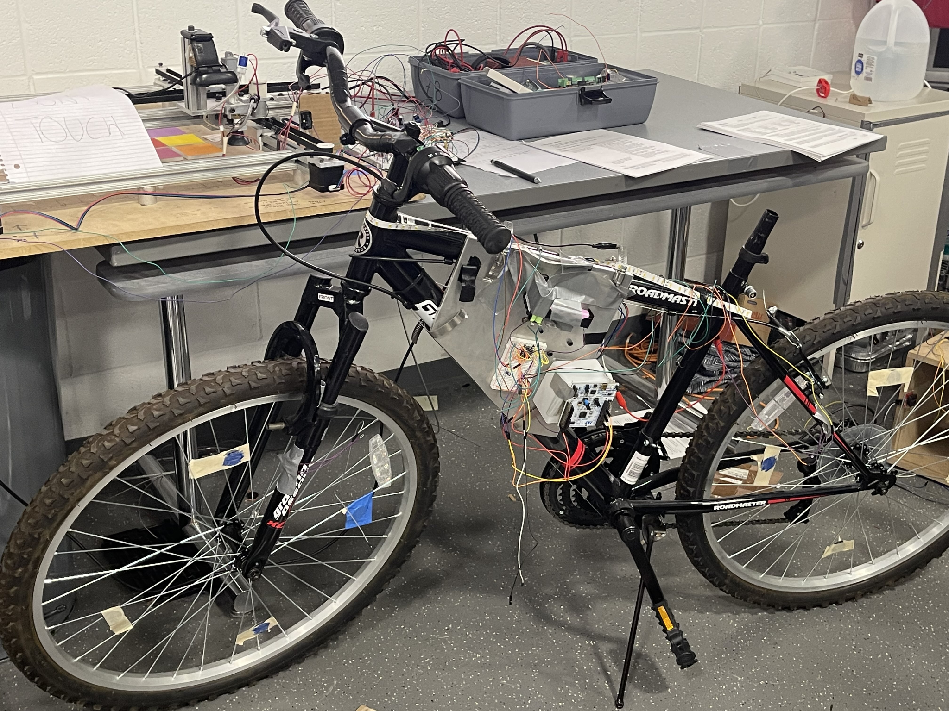
Picture of the Project Build
ELECTRICAL & COMPUTER ENGINEERING
GRAINGER ENGINEERING
Notes:
Use the thumbnail for the video as the image for the next slide (describing project build)

Slide 19
Discussion
Successes
Controller Design
Sensors
Motor Braking
MCU
Motor Driver
Challenges
Communication
Organization
PCB Design
Modeling of Bicycle Dynamics
ELECTRICAL & COMPUTER ENGINEERING
GRAINGER ENGINEERING
Notes:
Remember to explain the engineering reasons behind the failures
First time implementing a controller on a microcontroller and designing a controller outside of a structured, class setting
The sensors we got working after reading many pages of documentation
The MCU was a challenge due to lengthy documentation and manuals, but we figured it out and got it programmed properly
Challenges —
Communication prevented us from working effectively certain weeks and meeting up to coordinate work
Organization prevented us from having our parts grouped together for ease of information.
Because of that, our PCB design failed due to a mismatch between the parts placed in the schematic and the parts we needed for our project
Lastly, the bicycle dynamics were originally represented very poorly, and so the controller design aspect was delayed by the time it took to generate proper figures using a theoretical controller design.

Slide 20
Conclusions
ELECTRICAL & COMPUTER ENGINEERING
GRAINGER ENGINEERING

Slide 21
Conclusions
Insights
Hall Effect Latches vs. Hall Effect I2C
Discretization of Continuous Control
MCU Programing
Hypothetical Redesigns
Project Coordination
Ring Magnets
Braking Gear Ratio
ELECTRICAL & COMPUTER ENGINEERING
GRAINGER ENGINEERING

Slide 22
Ethics
Ethics
Ethical considerations for the future:
Check Brake Condition Before Application
Testing in Different Surface Conditions
Improve Brake Response Time
User Awareness of Project Functionality
ELECTRICAL & COMPUTER ENGINEERING
GRAINGER ENGINEERING
Notes:
Important to check the brake’s condition before applying ABS in order to comply with the IEEE Code of Ethics
The ABS system must be tested in many different surface conditions, namely slippery, icy, and dry conditions.
Important to ensuring that the project should avoid harming people’s safety and belongings
It is essential to consume advice from experienced people on the topic.

Slide 23
Further Work
PCB Integration
Braking Speeds
User Experience
Aesthetics
ELECTRICAL & COMPUTER ENGINEERING
GRAINGER ENGINEERING
Notes:
Image Source: https://www.fool.com/investing/stock-market/market-sectors/industrials/transportation-stocks/bike-stocks/
Successful integration of subsystems onto an enclosed PCB
Improvement of Braking Speeds
User Experience Improvements = Getting a bike seat + making the bike rideable despite tech
Aesthetic Improvements = Make the design appear marketable and refined

Slide 24
Thank You
We would like to give special thanks to:
Nithin, our TA
Professor Schuh
ECE 445 course staff
ELECTRICAL & COMPUTER ENGINEERING
GRAINGER ENGINEERING

