Slide 1
Digital Pitch Shifter for Guitar
ECE 445 Senior Design Laboratory
Group #60:
William Chang
Eric Moreno
Zhengjie Fan
SPRING 2025

Slide 2
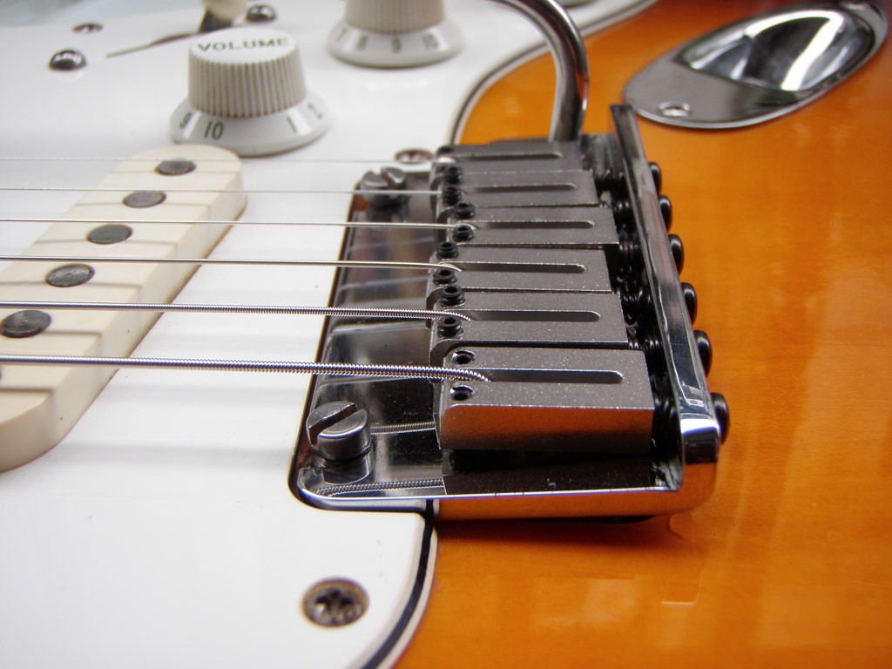
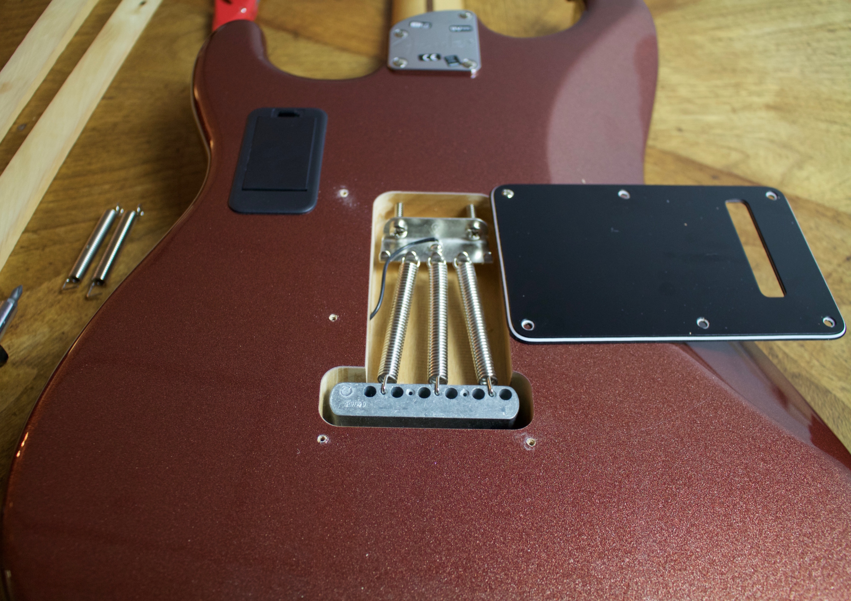
Our Motivation
Desire for pitch modulation on guitar
Alternate Tunings
Tremolo System
The Problem
Alternate tunings require physically re-tuning strings, which is time-consuming and limits flexibility
Mechanical systems like tremolo bridges or whammy bars
Can be invasive to install and alter the guitar’s structural setup.
Compromise tuning stability
ELECTRICAL & COMPUTER ENGINEERING
GRAINGER ENGINEERING

Slide 3
Our Goal
This project develops a digital pitch shifter for guitar, enabling real-time pitch bending without physical modification. The system delivers tremolo-like or detuning effects that can be added to any guitar.
ELECTRICAL & COMPUTER ENGINEERING
GRAINGER ENGINEERING

Slide 4
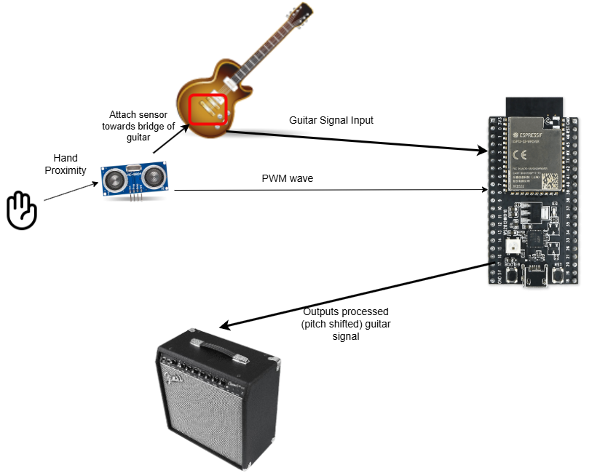
Our Solution
Pedal Box Solution
Digital Processing: Captures audio thru ADC, shifts pitch in real time, and outputs via DAC using the ESP32-S3 microcontroller.
Non-Invasive: Works on any guitar, no hardware mods or tuning changes needed.
Precise & Flexible: Software-controlled pitch shifts allow smooth, accurate, real time modulation.
ELECTRICAL & COMPUTER ENGINEERING
GRAINGER ENGINEERING

Slide 5
Block Diagram
ELECTRICAL & COMPUTER ENGINEERING
GRAINGER ENGINEERING

Slide 6
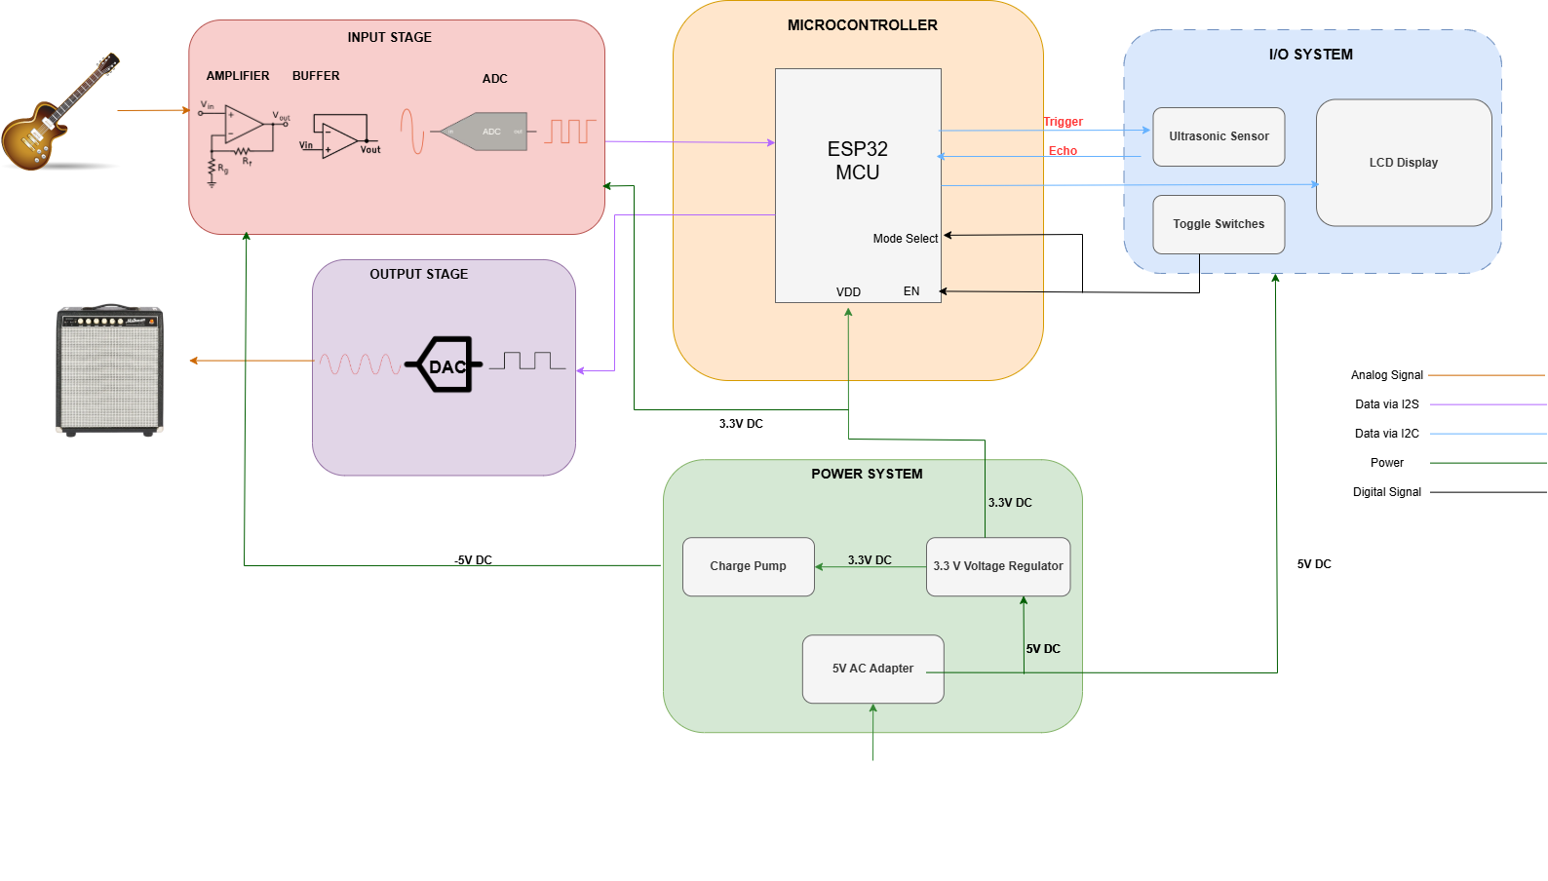
IMAGE (Send to back so Block I is not covered.)
ELECTRICAL & COMPUTER ENGINEERING
GRAINGER ENGINEERING

Slide 7
Design Process: Hardware
ELECTRICAL & COMPUTER ENGINEERING
GRAINGER ENGINEERING

Slide 8
Power Subsystem
3.3V Low Dropout (LDO) Regulator
Convert 5V power from USB/power adapter to 3.3V to power:
ESP32-S3
ADC
DAC
5V power used to power:
Op-Amps
Charge Pump IC (-5V)
The power management system supplies the ESP32 and HC-SR04 sensor using a 5V supply. An LDO regulator steps down 5V to 3.3V for the ESP32.
ELECTRICAL & COMPUTER ENGINEERING
GRAINGER ENGINEERING

Slide 9
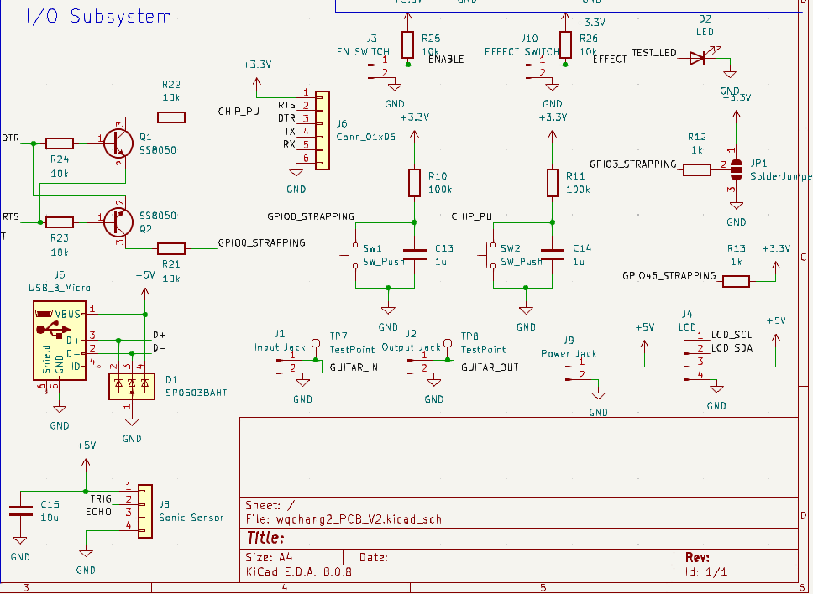
IO Subsystem
Overview
The I/O subsystem integrates components for user interaction and system control.
The ultrasonic sensor provides real-time distance measurements as a primary input.
Additional switches for toggling modes and enabling the effect
Micro USB connection allows USB programming and serve as power delivery to the system.
IMAGE / GRAPHIC
ELECTRICAL & COMPUTER ENGINEERING
GRAINGER ENGINEERING

Slide 10
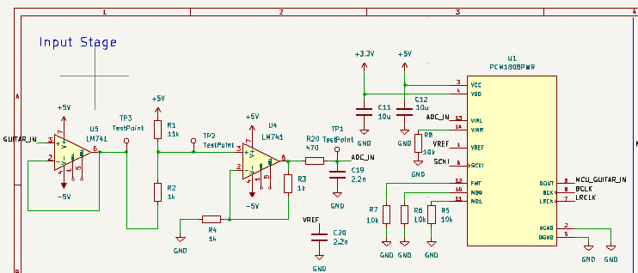
Input Stage
Input
Preamp Section (Guitar Input Conditioning): The guitar's high-impedance signal is first buffered and amplified using an appropriate preamp circuit to match the input range of the ADC. This stage also provides DC biasing to ensure voltages are above 0V.
ADC (PCM1808) Interface: The conditioned analog signal feeds into the PCM1808 ADC, which converts it into a 24-bit digital audio stream at 44.1 kHz sampling rate. Only the left channel input is used, matching the mono nature of the guitar input.
Connection to ESP32-S3 (I2S Bus): The digital audio output from the ADC is sent over the I2S interface to the ESP32-S3 microcontroller, where further digital processing is performed.
IMAGE / GRAPHIC
ELECTRICAL & COMPUTER ENGINEERING
GRAINGER ENGINEERING

Slide 11
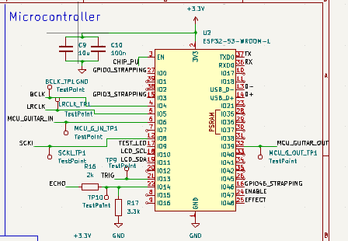
Microcontroller
ESP32-S3-WROOM-1
I2S Audio Data Handling: The ESP32-S3-WROOM-1 receives 24-bit, 44.1 kHz audio data from the PCM1808 ADC over the I2S interface (using GPIO pins). It also outputs processed audio back to the PCM5102 DAC via I2S (using GPIO pins), maintaining synchronized, real-time audio streaming.
Pitch Shifting Processing: Inside the ESP32-S3, digital signal processing algorithms are executed to perform real-time pitch shifting on the incoming guitar signal. This is managed using the dual-core processor and optimized using dedicated hardware accelerators and efficient buffer management.
Control and Connectivity: In addition to audio processing, the ESP32-S3 can handle user controls (e.g., footswitches, knobs), and display outputs, enabling flexible user interfaces.
IMAGE / GRAPHIC
ELECTRICAL & COMPUTER ENGINEERING
GRAINGER ENGINEERING

Slide 12
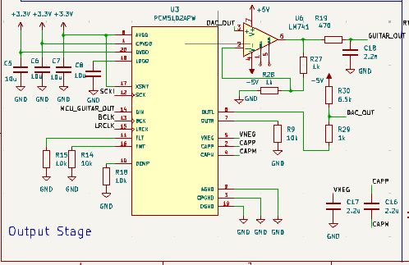
Output Stage
Outputs
DAC (PCM5102) Conversion: The processed 24-bit, 44.1 kHz digital audio stream from the ESP32-S3 is sent to the PCM5102 DAC over the I2S interface (using GPIO 39 for output). The DAC converts this digital signal back into a high-quality analog audio signal.
Line-Level Analog Output: The analog output from the PCM5102 is suitable for line-level audio and is used to drive the next stage in the signal chain — typically a guitar amplifier, effects pedal, or audio interface.
Optional Output Filtering: A simple low-pass filter (typically passive RC) may be added at the DAC output to remove any high-frequency noise or digital artifacts, ensuring a clean analog signal for the guitar amp.
IMAGE / GRAPHIC
ELECTRICAL & COMPUTER ENGINEERING
GRAINGER ENGINEERING

Slide 13
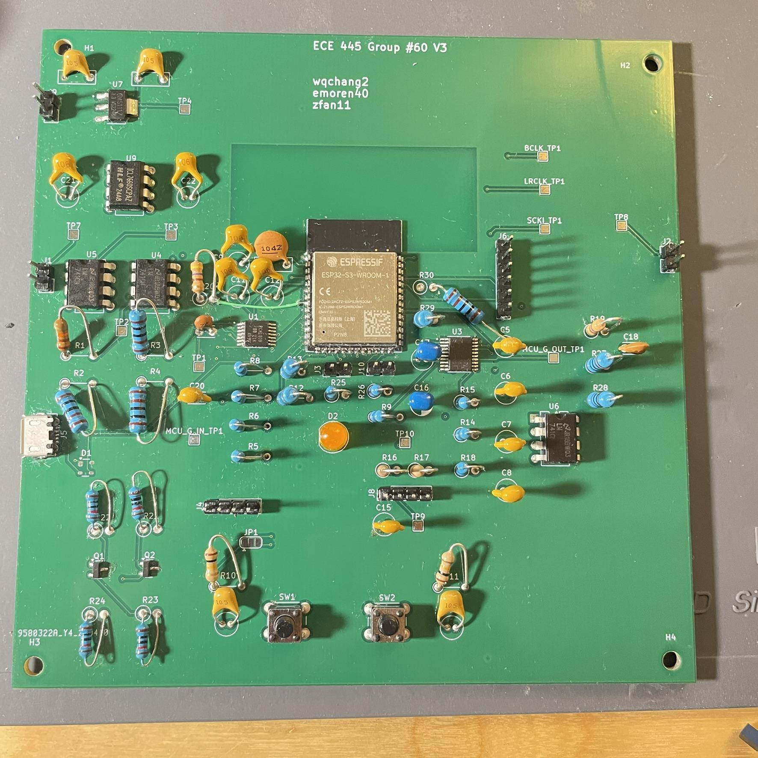
PCB
CHART / GRAPH
ELECTRICAL & COMPUTER ENGINEERING
GRAINGER ENGINEERING

Slide 14
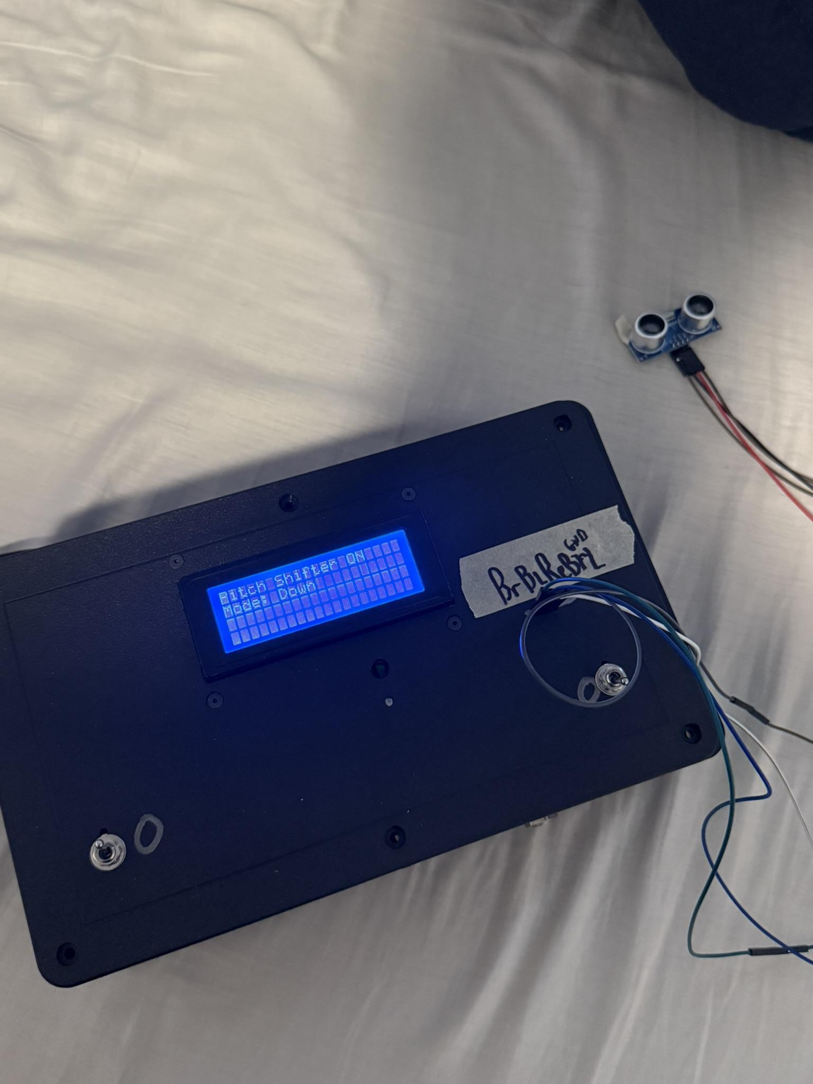
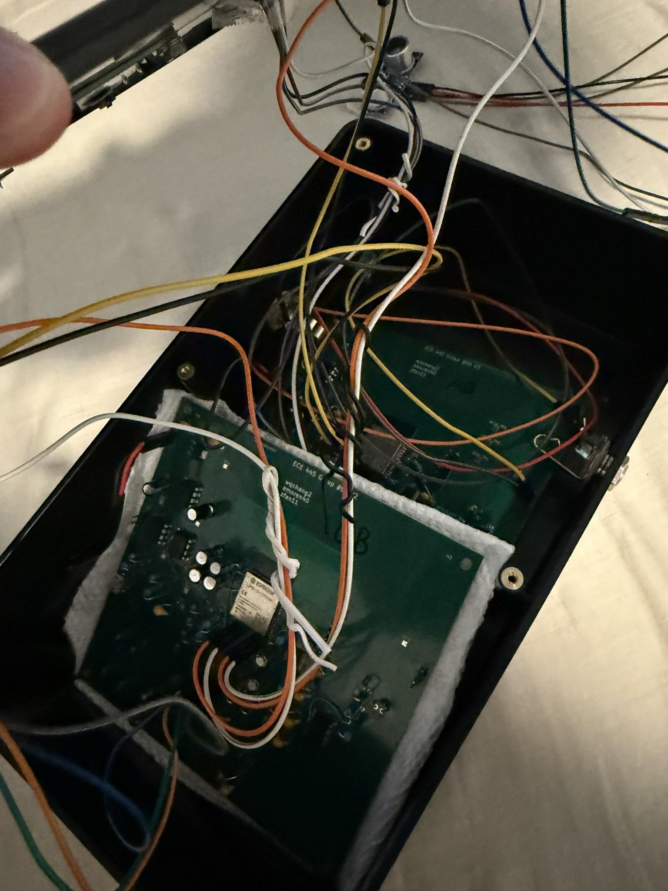
Final Product
ELECTRICAL & COMPUTER ENGINEERING
GRAINGER ENGINEERING

Slide 15
Challenges
ELECTRICAL & COMPUTER ENGINEERING
GRAINGER ENGINEERING

Slide 16
Challenges
ADC/DAC Issues:
I2S ADC/DAC Concurrency Issues: Initially, we planned to use the external PCM1808 ADC and PCM5102 DAC for high-quality 24-bit, 44.1 kHz audio. However, we encountered a critical issue where the ESP32-S3 could not reliably read from the ADC and write to the DAC simultaneously using only a single core. This led to audio dropouts and timing mismatches.
Pivot to Internal ADC: To resolve this, we had to pivot to using the ESP32's internal ADC for input while continuing to output through the I2S DAC. This simplified data handling with one core but came at the cost of reduced input audio quality due to the internal ADC’s lower resolution.
Sampling Rate Reduction: Due to the maximum reliable number of function calls per second (~22,000), we had to lower our audio sampling rate from 44.1 kHz to 22 kHz. This ensured stable, real-time processing but reduced the frequency range (max ~11 kHz) which would still cover the range of frequencies from the guitar signal.
ELECTRICAL & COMPUTER ENGINEERING
GRAINGER ENGINEERING

Slide 17
Design Process: Software
ELECTRICAL & COMPUTER ENGINEERING
GRAINGER ENGINEERING

Slide 18
Dual-Core Operation of the ESP32
Core 0: Uses polling-based read/write—reading one sample and then writing one sample in a loop. This enables real-time I/O using only a single core. The samples read from the DAC are written into a ring buffer for processing by Core 1. Afterward, samples are read from the ring buffer and output via I2S.
Core 1: Calculates the pitch-shift samples using a phase vocoder, based on distance information from an ultrasonic sensor. It reads data from the ring buffer, performs pitch shifting, and writes the processed data back into the ring buffer.
ELECTRICAL & COMPUTER ENGINEERING
GRAINGER ENGINEERING

Slide 19
Dual-Core Operation of the ESP32
Core 0
Ring Buffer
Core 1
Distance
Read a sample
512 Samples
Phase Vocoder
128 Samples
Each Frame is 128 Samples
512 Samples
Write a sample
128 Samples
ELECTRICAL & COMPUTER ENGINEERING
GRAINGER ENGINEERING

Slide 20
Phase Vocoder
1. Windowing: A Hanning window is applied to a frame of samples from the ring buffer.
2. FFT: A forward FFT is performed to convert the frame into the frequency domain.
3. Magnitude & phase extraction: The magnitude and phase are computed for each frequency bin.
4. Phase difference: The phase change between current and previous frame is calculated.
5. Phase accumulation: Corrected phase is scaled by pitch ratio and accumulated.
6. Frequency synthesis: New complex spectrum is generated using magnitude and updated phase.
7. IFFT: An inverse FFT is used to convert the spectrum back to the time domain.
8. Overlap-add: The processed frame is added back to the output ring buffer with a synthesis window.
9. Output buffering: Processed samples are sent to the output buffer for I2S playback.
ELECTRICAL & COMPUTER ENGINEERING
GRAINGER ENGINEERING

Slide 21
System/Logic Requirements
ELECTRICAL & COMPUTER ENGINEERING
GRAINGER ENGINEERING

Slide 22
System Overview
System Overview
Real-time pitch-shifting system based on the ESP32-S3 chip.
Captures and outputs audio continuously using an ADC and DAC.
Utilizes a phase vocoder algorithm to perform pitch-shifting of audio signals.
Pitch-shifting parameters are adjusted dynamically via hand movements detected by an ultrasonic sensor on the guitar.
ELECTRICAL & COMPUTER ENGINEERING
GRAINGER ENGINEERING

Slide 23
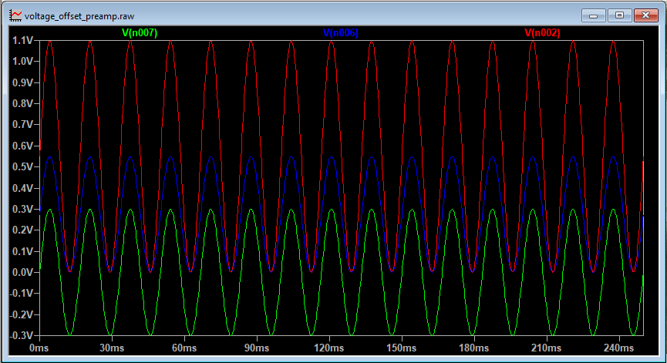
Design Specs
Input Stage Requirements
Preamp Design:
The preamp circuit must condition the guitar signal before it's processed by the ESP32-S3.
Ensure voltage of signal is above 0V for processing.
Simulate using LTSpice to ensure proper performance of design prior to building
Circuit Components:
A 1kΩ resistor connects the guitar signal, while a 3.3V voltage source through another 1kΩ resistor to provide a DC offset.
Two op-amps are required to amplify and buffer the signal for impedance matching and stability.
Green - Original signal
Blue - DC offset signal
Red - Final amplified signal
ELECTRICAL & COMPUTER ENGINEERING
GRAINGER ENGINEERING

Slide 24
Design Specs
Microcontroller Subsystem Requirements
Core Processing Requirements:
The ESP32 must function as the main processor, managing signal I/O and real-time audio processing.
ESP32 must run pitch-shifting algorithms with minimal latency for real-time performance.
Dynamic Modulation:
Hand proximity data must dynamically adjust pitch-shifting parameters during operation.
Internal and external clock sources must provide precise and stable timing to reduce latency.
Configuration:
ESP32 must support multiple selectable modes/settings via external buttons or switches.
Sensor Integration:
ESP32 must interface with the HC-SR04 to detect hand proximity in real time.
ESP32 generates high trigger pulses and receive echo data
ELECTRICAL & COMPUTER ENGINEERING
GRAINGER ENGINEERING

Slide 25
Testing & Verification
ELECTRICAL & COMPUTER ENGINEERING
GRAINGER ENGINEERING

Slide 26
Verification
Waveform Verification
Verify DC Biasing: Measure the output of the preamp (op-amp stage) with a multimeter to ensure the guitar signal is properly biased above 0V, to match ESP32's expected input range and prevent clipping or distortion.
Check Signal Integrity with Oscilloscope: Use an oscilloscope to visualize the preamp output while playing the guitar, confirming that the waveform stays within expected voltage levels.
Test Op-Amp Performance: Verify that the op-amp in the preamp stage is providing clean amplification without added noise, distortion, or oscillation especially under dynamic guitar playing and ensure its output impedance is low enough to drive the ADC input effectively.
ELECTRICAL & COMPUTER ENGINEERING
GRAINGER ENGINEERING

Slide 27
Verification
Microcontroller Subsystem Verification
Ultrasonic Sensor Integration Testing:
Verify ESP32 generates correct trigger pulses for the HC-SR04 sensor using an oscilloscope.
Capture and analyze ECHO pin responses to confirm accurate distance measurements.
Use test program to control blink speed of LED using sensor.
User Input Response Testing:
Test external buttons and switches for correct operation of effects and parameter changes.
Map and verify GPIO inputs for accurate ESP32 response to user commands.
Connected LCD screen for testing and verification of correct state of operation.
ELECTRICAL & COMPUTER ENGINEERING
GRAINGER ENGINEERING

Slide 28
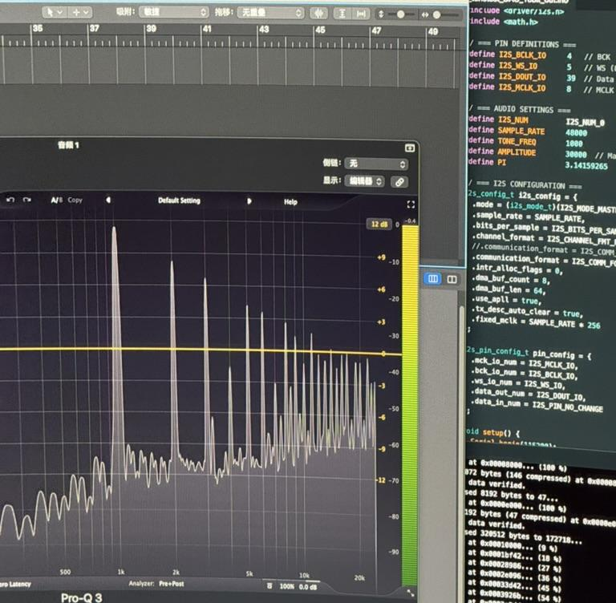
Verification
Processed Signal
We measured the frequency spectrum of the output signal to visualize the dominant frequency components.
By comparing the spectrum before and after processing, we verified that the peak frequency shifted according to the pitch adjustment programmed in the system.
The spectrum measurement confirmed that the pitch shifting algorithm correctly altered the output frequency while maintaining the signal structure, validating the program’s operation.
IMAGE / GRAPHIC
ELECTRICAL & COMPUTER ENGINEERING
GRAINGER ENGINEERING

Slide 29
Conclusion
Solution Reached:
Created cheaper and more convenient alternative
Future Work:
Improve design with audio based microcontroller
Implement a wireless design
ELECTRICAL & COMPUTER ENGINEERING
GRAINGER ENGINEERING

Slide 30
Thank You
ELECTRICAL & COMPUTER ENGINEERING
GRAINGER ENGINEERING

