Slide 1
CCD Image Sensor Board for Film Camera Retrofit
ECE 445, Project #3
Jason Guo, Ayush Garg, & Ethan Greenwald
SPRING 2025

Slide 2
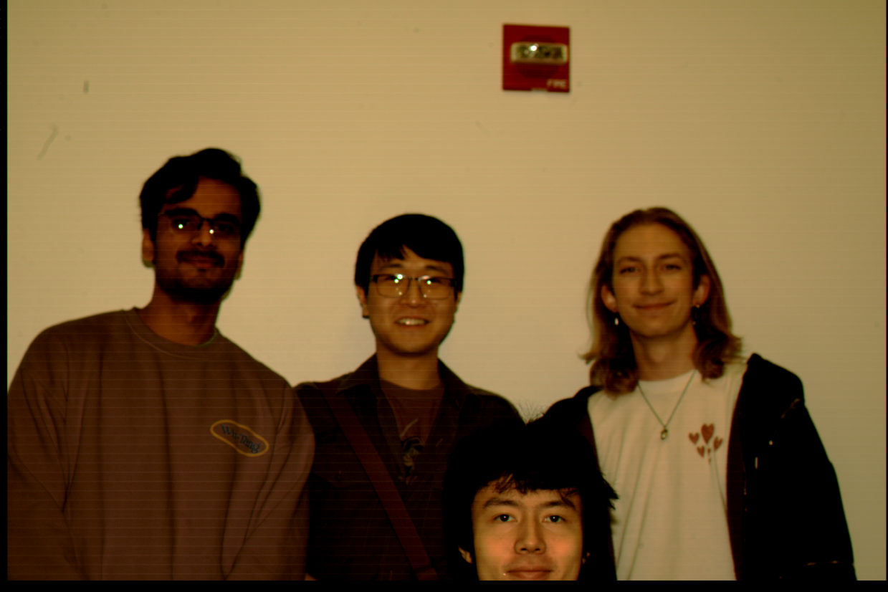
Introduction
Ayush
Jason
Ethan
TA Bill
ELECTRICAL & COMPUTER ENGINEERING
GRAINGER ENGINEERING

Slide 3
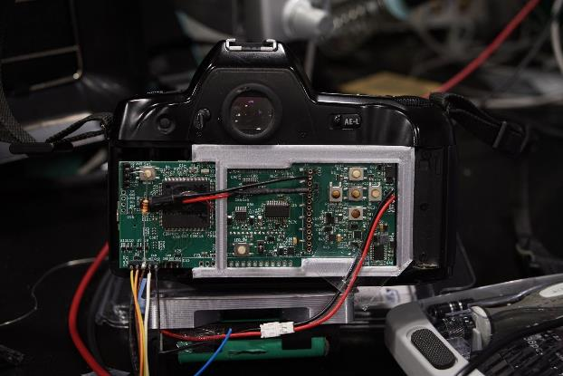
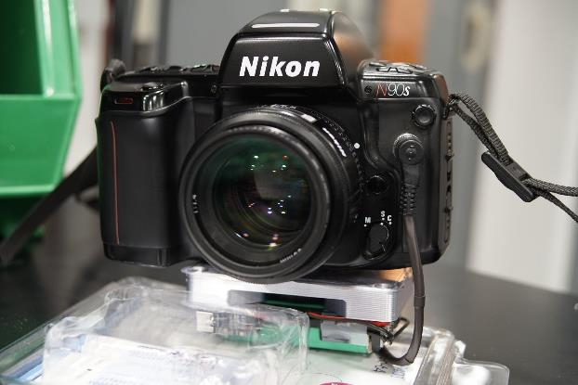
Objective
Growing trend for CCD digicams is mismatched against an unreliable supply of 10-20 year old cameras.
Our project creates reliable CCD fitted PCBs to be installed into old film based analog cameras, thus creating a CCD digicam
Our PCB emulates Kodak DCS460 from 1995, but much smaller and modernized to 2025.
ELECTRICAL & COMPUTER ENGINEERING
GRAINGER ENGINEERING

Slide 4
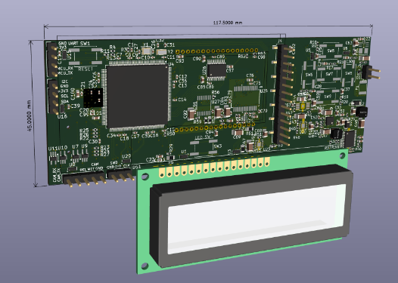
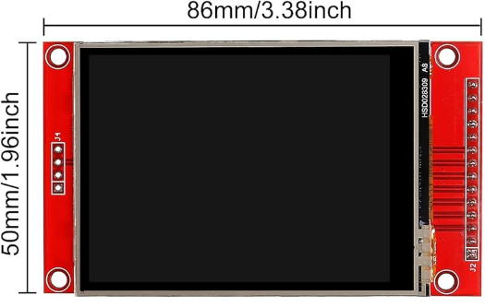
Design Overview
Subsystems
Sony ICX-453 CCD
Core of the design
Complicated device with many considerations
STM32 Microcontroller (MCU)
Driving the CCD
Driving display
Image processing and writing data
Power supply
Power the CCD and the supporting circuitry
6 power rails implemented with emphasis on noise minimization
Battery Management System (BMS)
Implemented overcurrent (8A), overvoltage (8.56V), and overdischarge (4.5V) protection on the battery.
PCB to power the camera with the same battery as the main PCB while minimizing noise from camera draw.
ELECTRICAL & COMPUTER ENGINEERING
GRAINGER ENGINEERING

Slide 5
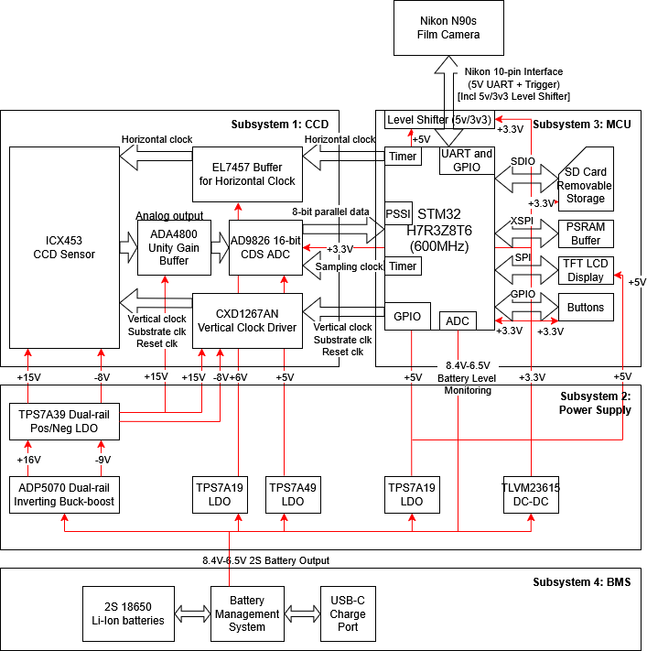
Block Diagram
CHART / GRAPH
ELECTRICAL & COMPUTER ENGINEERING
GRAINGER ENGINEERING

Slide 6
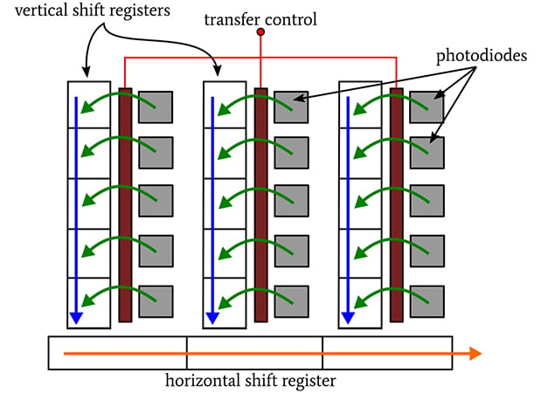
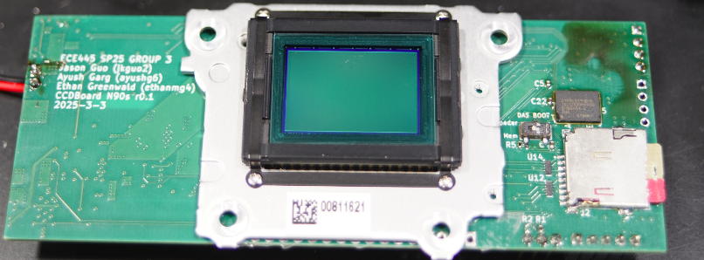
What is a CCD?
CCD Sensor: Sony ICX453 (2004)
6 Megapixel class, APS-C size CCD sensor
Matrix is 3000x2000, Reads as 6000x1000
Bayer color filter array
Interline-Transfer design with global shutter
Fundamentally an analog device without digital interfaces
Vertical clock (+15v/0v/-8v)
Horizontal clock (+6v/0v)
Reset clock (+5v offset)
Substrate (+24v offset)
Output requires a type of differential ADC, the Correlated-Double-Sampling ADC
CHART / GRAPH
ELECTRICAL & COMPUTER ENGINEERING
GRAINGER ENGINEERING

Slide 7
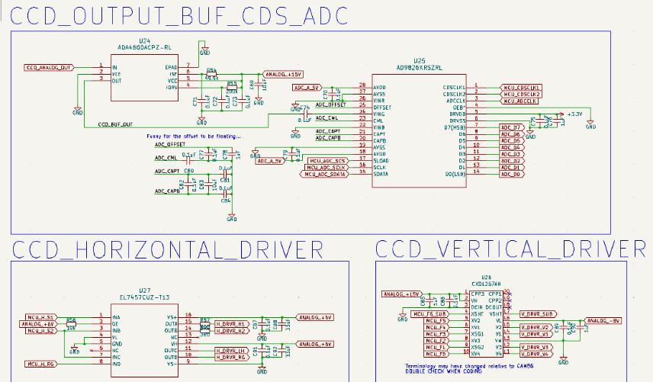
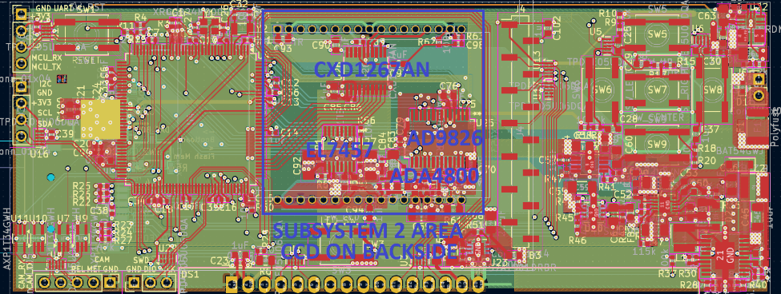
Subsystem 1: CCD
CCD supporting circuitry:
Objectives: Reliability, Quality, Cost
Borrowed from CAM86 opensource design:
Horizontal clock (6v, 12.5MHz) uses EL7457 driver and a current-limiting resistor
Vertical clock (+15v/0v/-8v) uses CXD1267AN tri-state vertical clock driver
CCD output digitized by 16-bit AD9826 Correlated Double-Sampling (CDS) ADC
Borrowed from Sitina1 opensource design:
CCD output buffered by ADA4800 Unity-Gain buffer
ELECTRICAL & COMPUTER ENGINEERING
GRAINGER ENGINEERING

Slide 8
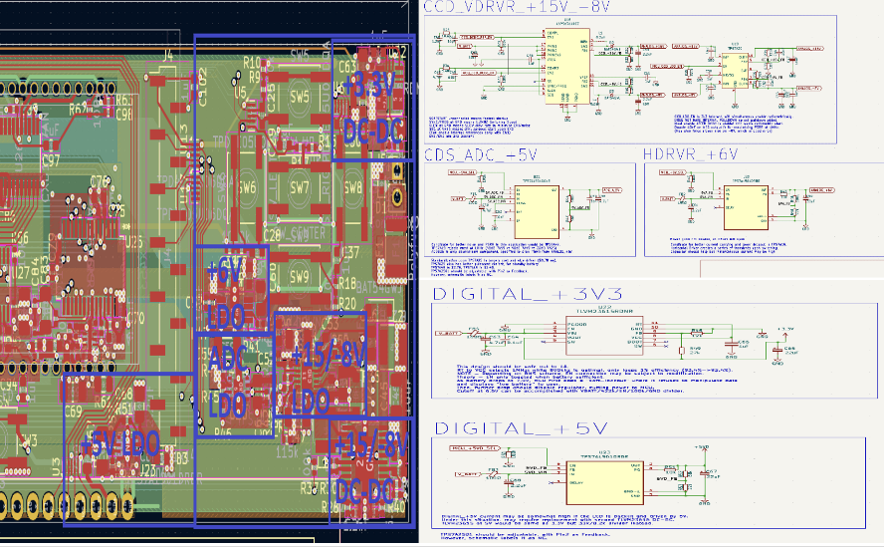
Subsystem 2: Power Supply
Power Rails:
Objectives: Low noise, small size, reasonable efficiency
+15V and -8V used by Subsystem 1: DC-DC boost conversion (ADP5070) followed by low-noise LDO regulators (TPS7A39)
+6V used by Subsystem 1: LDO (TPS7A1901) selected specifically for high possible current draw, low noise output and relatively lower component count
+5V used by Subsystem 3: LDO (TPS7A1901 again) for simplicity
+5V used by the ADC in Subsystem 1: Separate special low-noise LDO (TPS7A49) to ensure isolation of CCD readout analog circuitry in exchange for lower current draw
+3.3V used by Subsystem 3: Integrated-inductor switching DC-DC converter (TLVM23615) chosen for low part count and relaxed noise constraints on this digital rail
Dedicated all of layer 3 in the PCB to power routing, using vias to ensure proper connections of power planes and devices, and used bulk capacitances to minimize noise.
ELECTRICAL & COMPUTER ENGINEERING
GRAINGER ENGINEERING

Slide 9
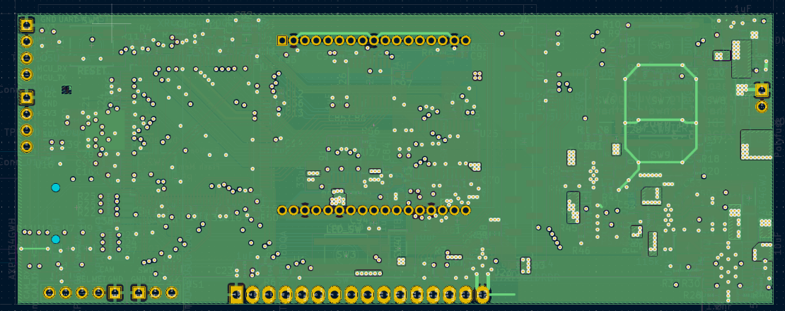
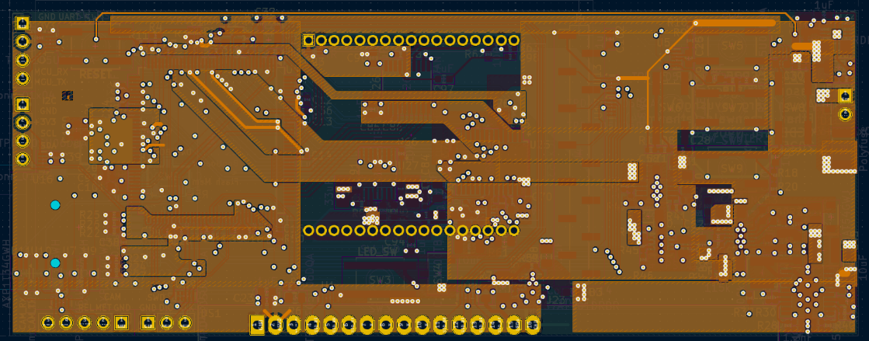
Subsystem 2: Power Routing
ELECTRICAL & COMPUTER ENGINEERING
GRAINGER ENGINEERING

Slide 10
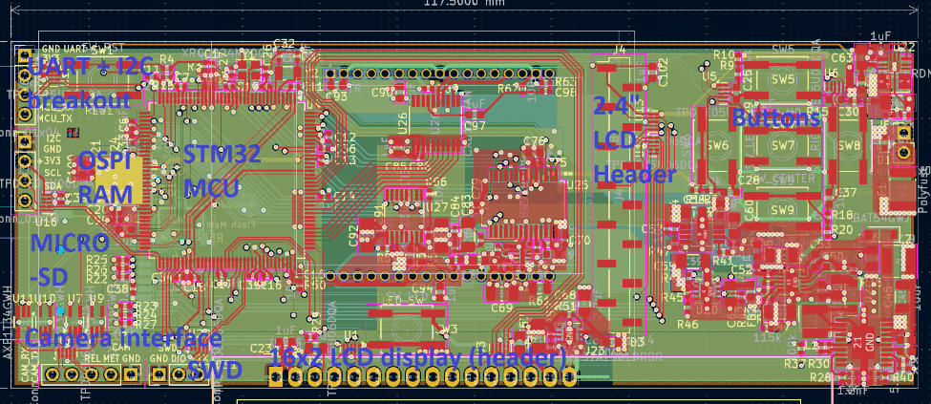
Subsystem 3: MCU
Microcontroller & Programming
Objectives: Speed and Peripherals
STM 32H7R3Z8T6 MCU
Sufficient pinout (144)
High clock speed & I/O (600 MHz)
Bare-metal operation
128 Mbit PSRAM buffer
Generate clocks for the CCD
Receive image data
Process and write to microSD card
Controlling subsystem 2 for power saving
Monitor battery voltage from subsystem 4
Utilizes ADC
Communicate with camera
Nikon 10-pin interface
Drive 2.4” LCD display and/or 16x2 LCD display
ELECTRICAL & COMPUTER ENGINEERING
GRAINGER ENGINEERING

Slide 11
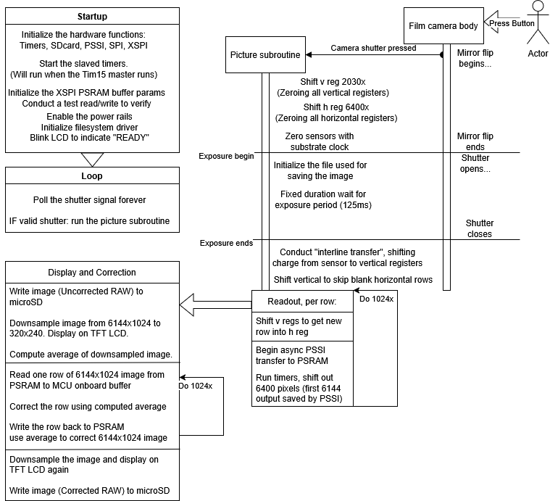
Subsystem 3: MCU
Software control
Heavy use of STM32 hardware features:
Automatic row readout achieved by chaining STM32’s high-precision timers, driving 12.5MHz CCD horizontal clocks and ADC clocks with proper phase offset
Automatic row data collection with PSSI interface implementing DMA
Memory-mapping the PSRAM enables usage as DMA target buffer (direct ADC->PSRAM link)
High-speed bare-metal operation:
Vertical clock can be bitbanged with little performance loss
Processing algorithms run very quickly
Limitations of single-core device:
Image collection, processing, and saving must be sequential and cannot be pipelined
ELECTRICAL & COMPUTER ENGINEERING
GRAINGER ENGINEERING

Slide 12
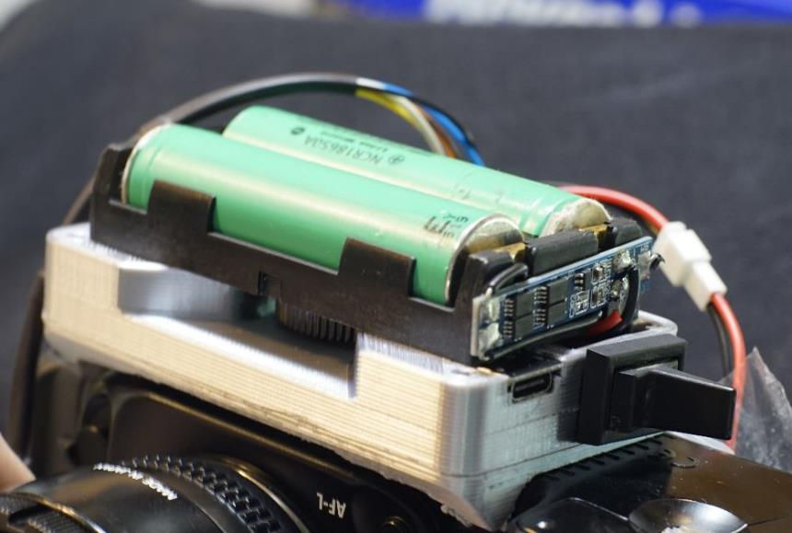
Subsystem 4: BMS
Battery Management System
Objectives: Reliable protection, Cost
Uses an off-the-shelf module with FM7021DB BMS and 8205LA switching FET on one PCB
Originally planned to use BQ25886, but this module was already available on hand, and had similar functionality to the BQ25886 (overcurrent (8A), overvoltage (8.56V), and overdischarge (4.5V) protection)
Connected to a USB-PD 9V source w/ diode to prevent reverse current and drop charging voltage to ~8.4V
Kill switch for emergency use
ELECTRICAL & COMPUTER ENGINEERING
GRAINGER ENGINEERING

Slide 13
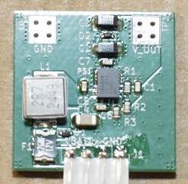
Subsystem 4: BMS
Camera power supply from BMS
Objectives: Efficient, compact, low quiescent current
TPSM84338 integrated-inductor buck converter converts battery input to 5.5V
Input filter ensures minimal noise is inserted back into the source given the camera's significant transient current draw
Achieved with an inductor connected in series with the input power supply to minimize current ripple
Output transient correction minimizes transient ringing or droop to ensure that the camera does not assume the battery is dead.
A feedforward capacitor was added to the feedback loop to minimize overshoot without forcing an exceptionally long rise time.
ELECTRICAL & COMPUTER ENGINEERING
GRAINGER ENGINEERING

Slide 14
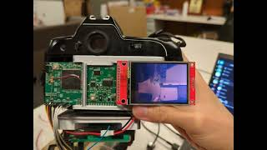
Project Build & Functional Test Results
Build Summary
In short, it works!
PCB integrated in camera housing
Battery, display do not fit
Still capable to stabilize and shoot with
On-board color balancing updates shown image
Image is stored post-processing to removable microSD card
Can shoot approx. 1 image per second
Note: processing increases this time
ELECTRICAL & COMPUTER ENGINEERING
GRAINGER ENGINEERING

Slide 15
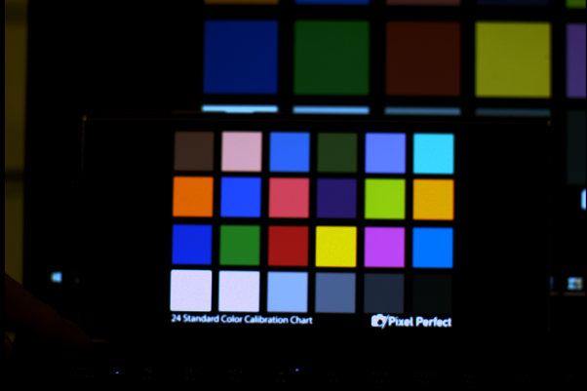
Successes & Challenges
Successes
Minimal visual artifacts in images
Maintained reasonable footprint w.r.t. the camera housing
6 MP images color-corrected and saved
Ultra-low noise
Challenges
Sourcing parts & general PCB complexity
Poor documentation and difficulty of STM32 programming
Dealing with small buffer size
Quality vs speed tradeoff with correction algorithms
ELECTRICAL & COMPUTER ENGINEERING
GRAINGER ENGINEERING

Slide 16
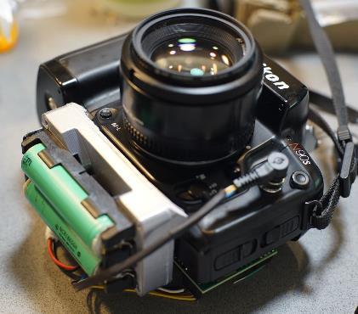
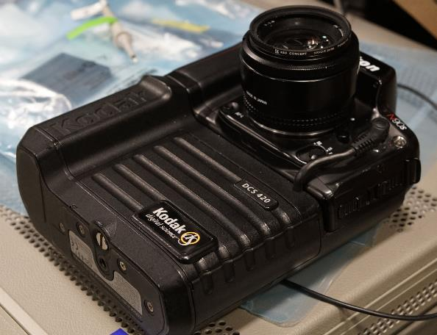
Project Conclusions
Accomplished most primary goals
All systems thoroughly integrated
Direct integration with camera
On-board image correction for 6 megapixel raw images
BMS allows for USB type-C charging
What to have done better
More software features
Enable use of D-pad buttons
Incorporate menu to access, review, and delete photos on the SD card
Incorporate menu to select quality vs speed
More sophisticated user interface
ELECTRICAL & COMPUTER ENGINEERING
GRAINGER ENGINEERING

Slide 17
Further Work Recommendations
Port over more software features and niceties of modern digital cameras to our design with additional firmware development
Additional image processing steps, such as debayering, upscaling, and image compression can be implemented in future firmware versions
Integrate peripherals such as light sensors, GPS modules, and segmented or dot-matrix LCD displays
Pinouts remain available for future integration.
Adapt the existing hardware to fit a different film camera. The Nikon N90s single-lens reflex camera was used in our implementation as it was available on-hand and its electrical interface was well understood.
ELECTRICAL & COMPUTER ENGINEERING
GRAINGER ENGINEERING

Slide 18
Thank you all for attending!
Please feel free to ask any questions
ELECTRICAL & COMPUTER ENGINEERING
GRAINGER ENGINEERING

Slide 19
Power rails output
Requirement | Verification | Verification Status
+15V for subsystem 1 <5% variation | Multimeter readout | Y: 14.787V
-8V for subsystem 1 <5% variation | Multimeter readout | Y: -8.087V
+6V for subsystem 1 <5% variation | Multimeter readout | Y: 5.99V
+5V for subsystem 1 <5% variation | Multimeter readout | Y: 4.989V
+5V for subsystem 3 <5% variation | Multimeter readout | Y: 5.065V
+3.3V for subsystem 3 <5% variation | Multimeter readout | Y: 3.247V
ELECTRICAL & COMPUTER ENGINEERING
GRAINGER ENGINEERING

Slide 20
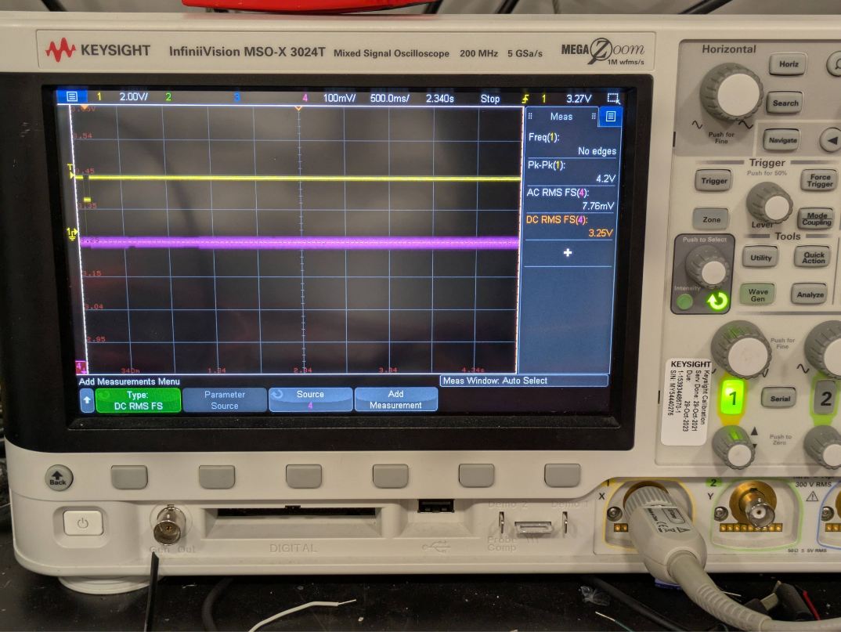
3.3V Rail Noise Measurements Without LDO: Load Regulation (Clicking Pic)
ELECTRICAL & COMPUTER ENGINEERING
GRAINGER ENGINEERING

Slide 21
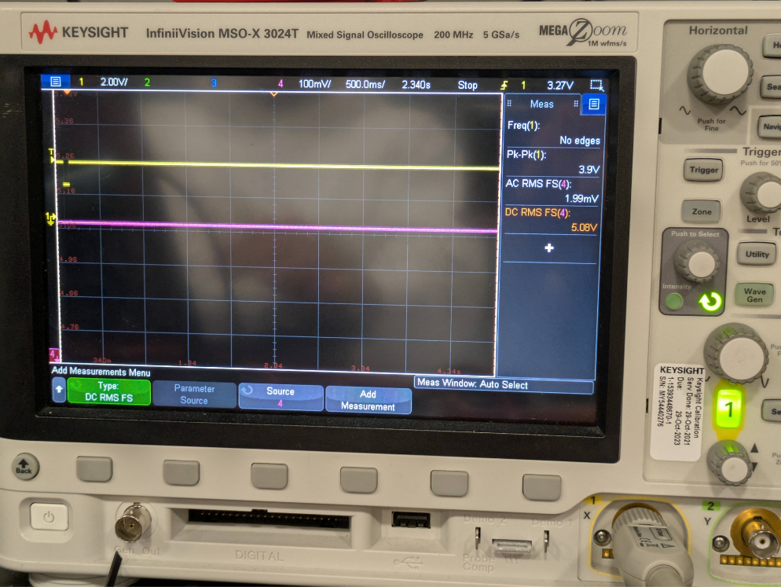
5V Digital for Subsystem 3: Load Regulation (Clicking Pic)
ELECTRICAL & COMPUTER ENGINEERING
GRAINGER ENGINEERING

Slide 22
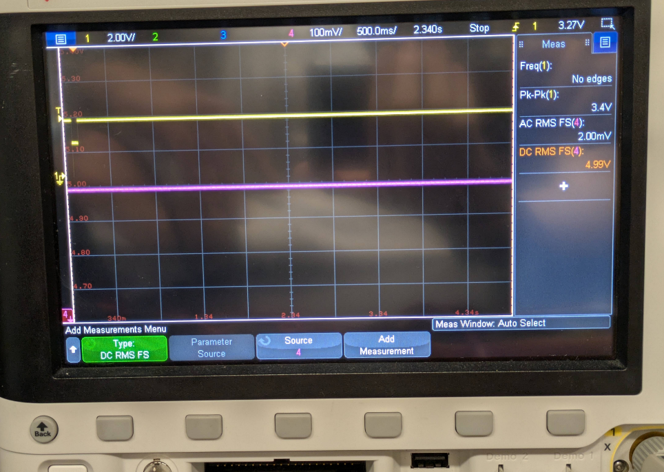
5V Analog for Subsystem 1: Load Regulation (Clicking Pic)
ELECTRICAL & COMPUTER ENGINEERING
GRAINGER ENGINEERING

Slide 23
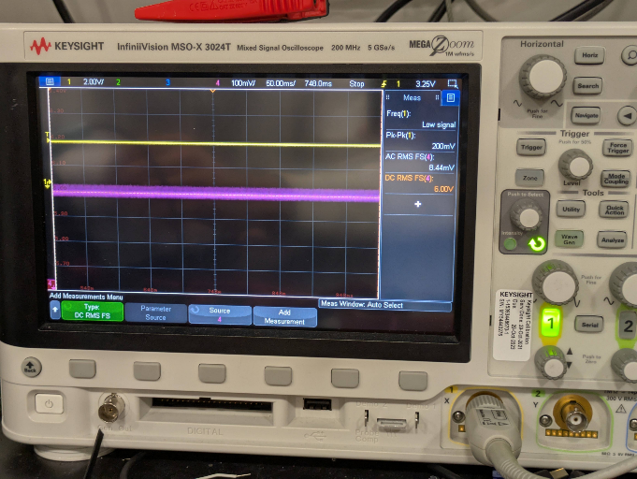
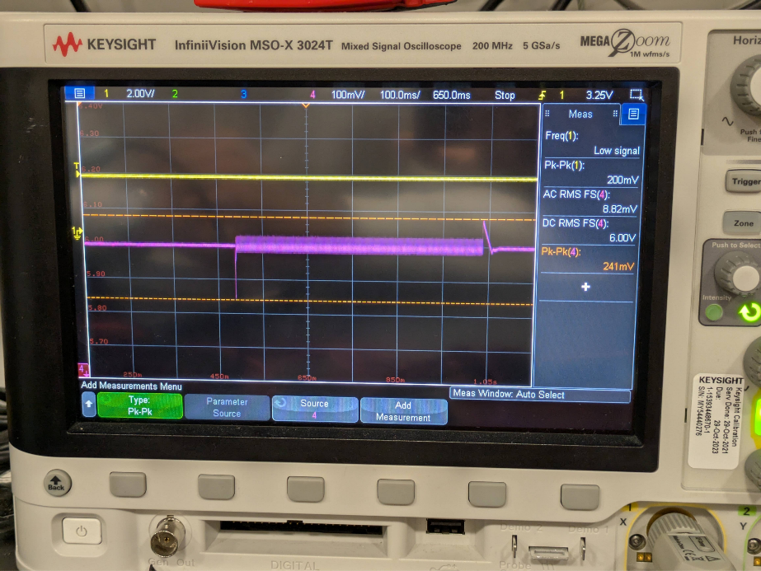
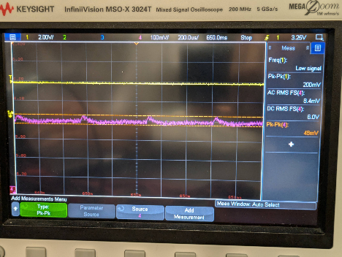
6V Rail LDO Without Converter: Load Regulation (Clicking Pic) (horizontal clock driver)
Zoomed In
Fine Detail (4 cycles of VERTICAL clock, or 4 horizontal lines)
Zoomed Out
ELECTRICAL & COMPUTER ENGINEERING
GRAINGER ENGINEERING

Slide 24
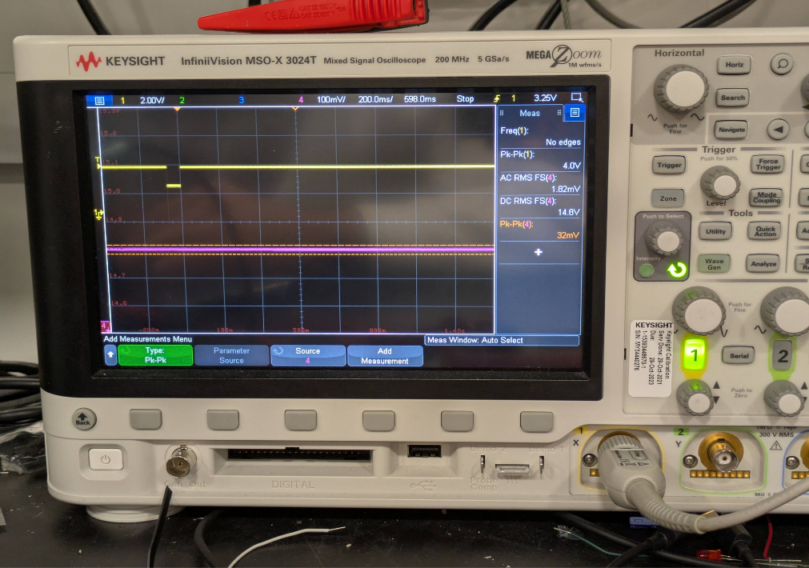
15V Rail Buck-Boost With LDO: Load Regulation (Pic taken)
ELECTRICAL & COMPUTER ENGINEERING
GRAINGER ENGINEERING

Slide 25
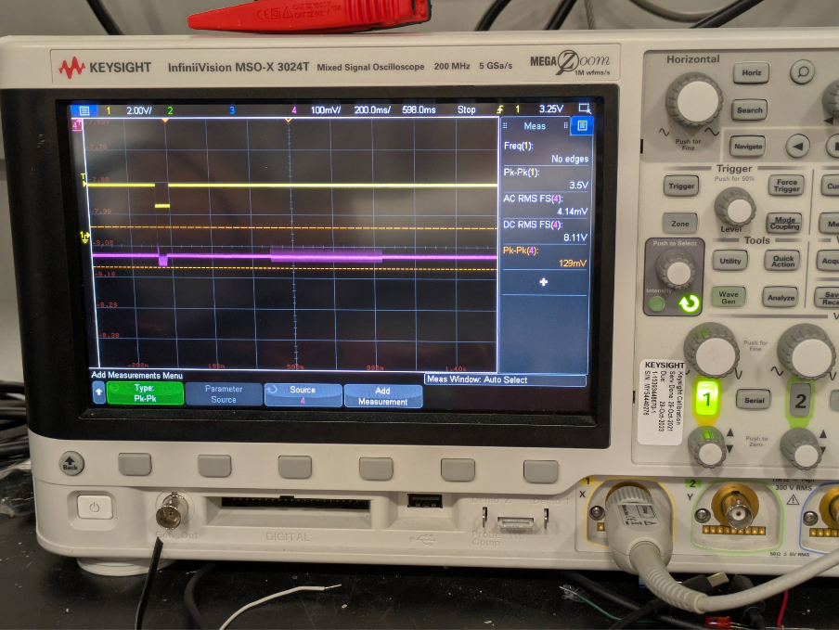
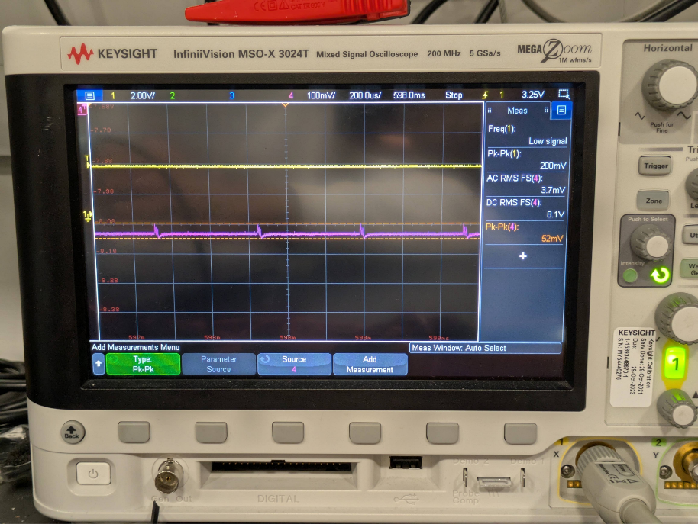
-8V rail buck-boost with an LDO: Load Regulation (Clicking Pic)(Vertical Clock driver)
Zoomed out
Zoomed in (4 lines)
ELECTRICAL & COMPUTER ENGINEERING
GRAINGER ENGINEERING

Slide 26
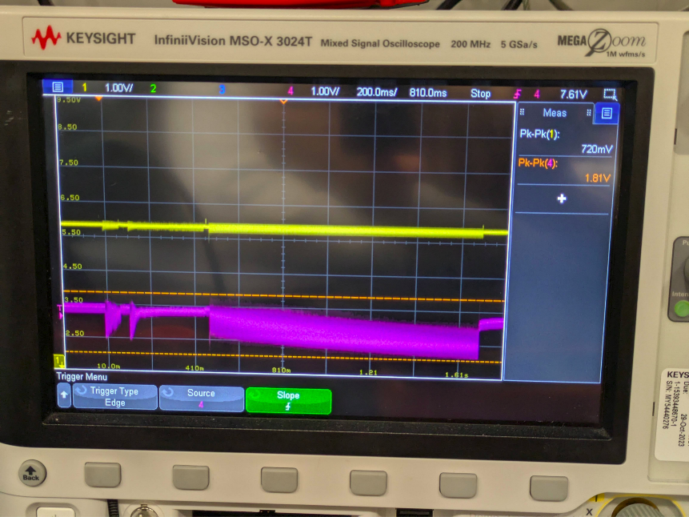
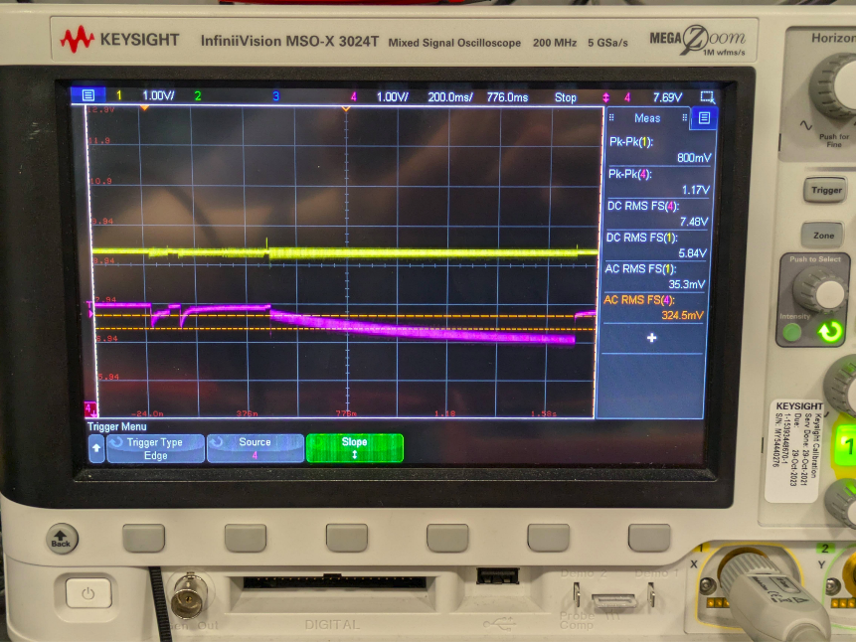
5.5V camera power rail load regulation and input interference (under 3A+ load)
Without inductor
With inductor
ELECTRICAL & COMPUTER ENGINEERING
GRAINGER ENGINEERING

Slide 27
Closeup view of noise (400x300 crop of 1500x1000 image), contrast boosted
ELECTRICAL & COMPUTER ENGINEERING
GRAINGER ENGINEERING

