Slide 1
Voice Dosimeter
ECE 445 Senior Design Laboratory
Team 79
David Gong
Jaden Li
Michael Rizk
May 6, 2025

Slide 2
Presentation Outline
Introduction and Motivation
Electrical Hardware Design
Firmware and Software Design
Mechanical Design
Requirements and Verification
Video Demo
Discussion and Future Work
ELECTRICAL & COMPUTER ENGINEERING
GRAINGER ENGINEERING

Slide 3
Background Information
Professional Voice Users
Constitutes about 30% of working population
Absenteeism and treatment costs approximately $2.5 billion a year
Voice Dosimeter
A device to measure vocal features throughout the day
No options that are currently commercially available
[1] The Journal of the Acoustical Society of America, vol. 101, no. 6, pp. 3722–3727.
[2] Logopedics Phoniatrics Vocology, vol. 26, no. 1, pp. 37–46.
ELECTRICAL & COMPUTER ENGINEERING
GRAINGER ENGINEERING

Slide 4
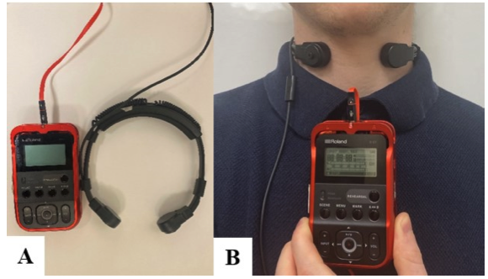
Objective
Working with Prof. Bottalico and Charlie Nudelman in the Department of SHS…
We want to create a device that is…
Small and compact
Battery powered
Capable of recording data for long periods
Able to transfer data wirelessly
Analyze data in real time
[1] Journal of Speech, Language and Hearing Research, vol. 66, no. 7, pp. 2149-2163.
ELECTRICAL & COMPUTER ENGINEERING
GRAINGER ENGINEERING

Slide 5
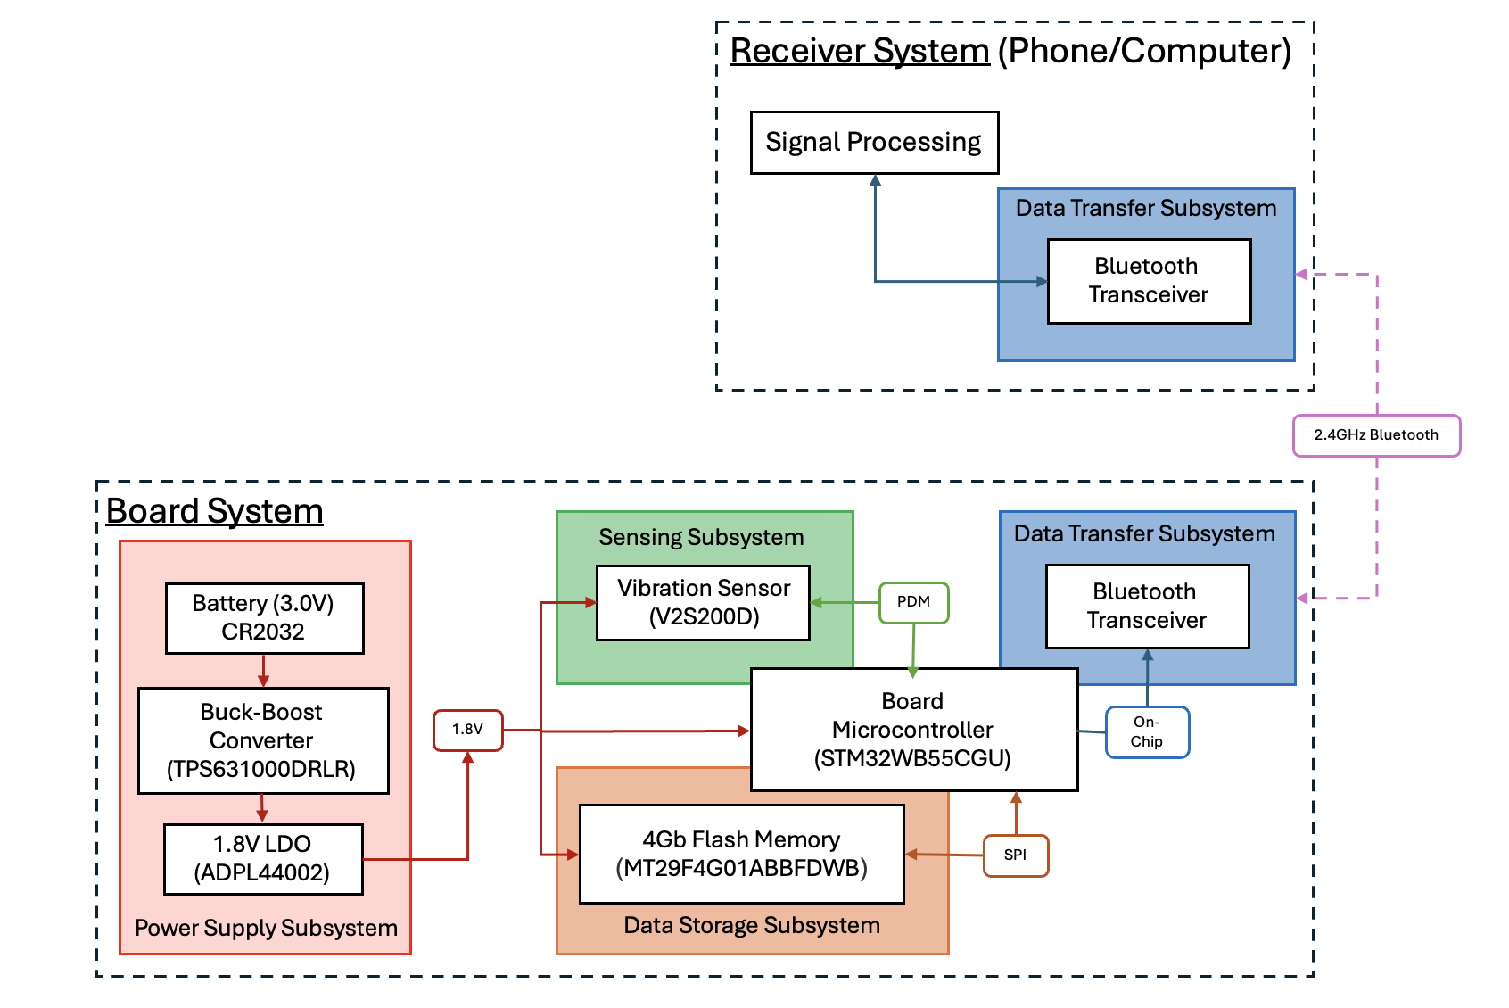
Hardware Block Diagram
High-Level Requirements:
The device should be capable of measuring sound pressure level to within 2dB, fundamental frequency within 5Hz, and cepstral peak prominence within 2dB
The website for view voice features in real time should have latency of less than 1 second
The device should have at least 8 hours of battery life to last through a full workday
ELECTRICAL & COMPUTER ENGINEERING
GRAINGER ENGINEERING

Slide 6
Electrical
Hardware Design
ELECTRICAL & COMPUTER ENGINEERING
GRAINGER ENGINEERING
Notes:
Next, I will talk about our electrical hardware design. I will talk about each subsystem and about our component selection.

Slide 7
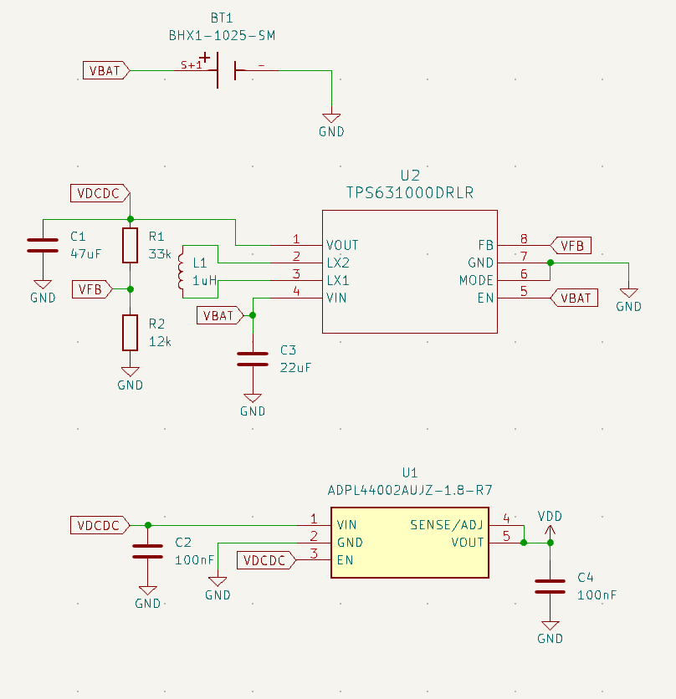
Hardware Design: Power Subsystem
Power
CR-2032: Button Battery
3V nominal, 225 mAh
Battery voltage sent to MCU with voltage divider
TPS631000DRLR: Buck Boost Converter
Around 85% efficiency
1.9 V output
TPS72218: 1.8 V LDO
50 mV dropout voltage
IMAGE / GRAPHIC
ELECTRICAL & COMPUTER ENGINEERING
GRAINGER ENGINEERING

Slide 8
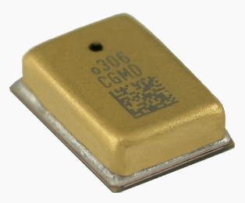
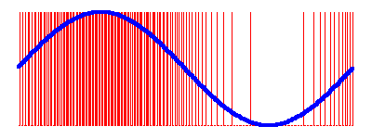
Hardware Design: Sensor
Sensor
V2S200D
Voice vibration sensor with PDM output
10 kHz bandwidth
550 microamp supply current
Vibration sensor vs microphone
Only records vibrations from vocal cords
Does not record external noise or voices
IMAGE / GRAPHIC
PDM
ELECTRICAL & COMPUTER ENGINEERING
GRAINGER ENGINEERING

Slide 9
Hardware Design: RF Front end
RF Front end
Low Pass Pi Filter
Impedance matching from MCU output to 50 ohms
Low Pass Filter
2.45GHz LPF
Antenna
Monopole antenna
66% efficiency
+2.0 dBi peak gain
ELECTRICAL & COMPUTER ENGINEERING
GRAINGER ENGINEERING

Slide 10
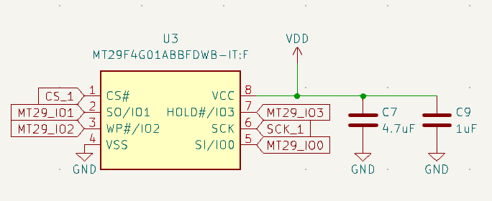
Hardware Design: Memory
Memory
MT29F4G01ABBFDWB 4 gigabit nand flash memory
Quad SPI interface
8-pin U-PDFN package (hand solderable)
Had to write a driver as none were available online.
IMAGE / GRAPHIC
ELECTRICAL & COMPUTER ENGINEERING
GRAINGER ENGINEERING

Slide 11
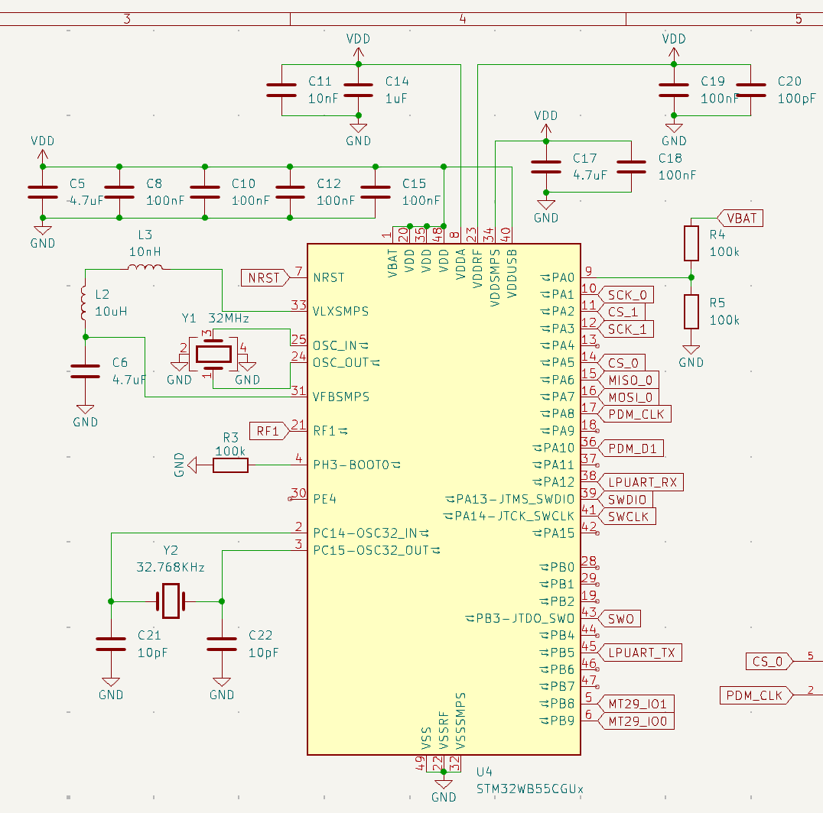
Hardware Design: Microcontroller
Microcontroller
STM32WB55CGU
Dual CPUs:
Arm cortex M4 for general use
Arm cortex M0 for BLE stack
32 MHz system clock from external oscillator
QFN 48 package
32 kB of RAM
Programmed and debugged using STLINK-V3MINIE
IMAGE / GRAPHIC
ELECTRICAL & COMPUTER ENGINEERING
GRAINGER ENGINEERING

Slide 12
Firmware and
Software Design
ELECTRICAL & COMPUTER ENGINEERING
GRAINGER ENGINEERING

Slide 13
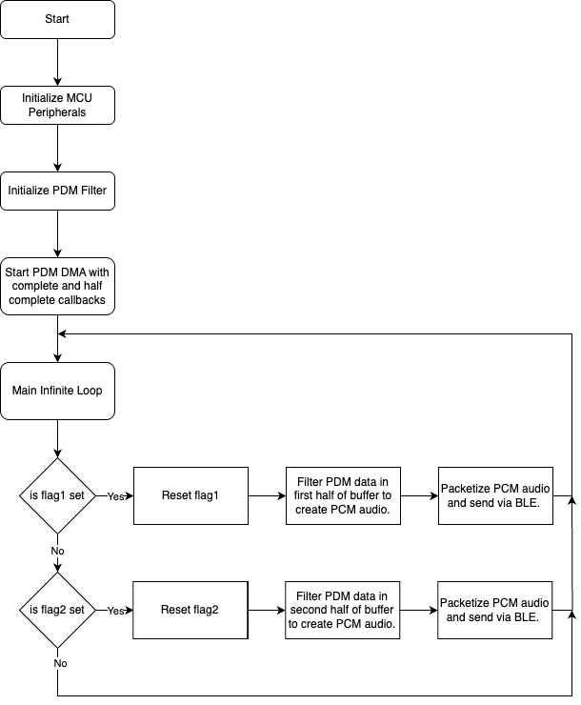
Firmware Flowchart
Firmware Flowchart
Flag1 and Flag2 are set at PDM Half complete and PDM complete callbacks respectively.
PDM DMA is circular. It will keep transferring data forever in the background.
ELECTRICAL & COMPUTER ENGINEERING
GRAINGER ENGINEERING

Slide 14
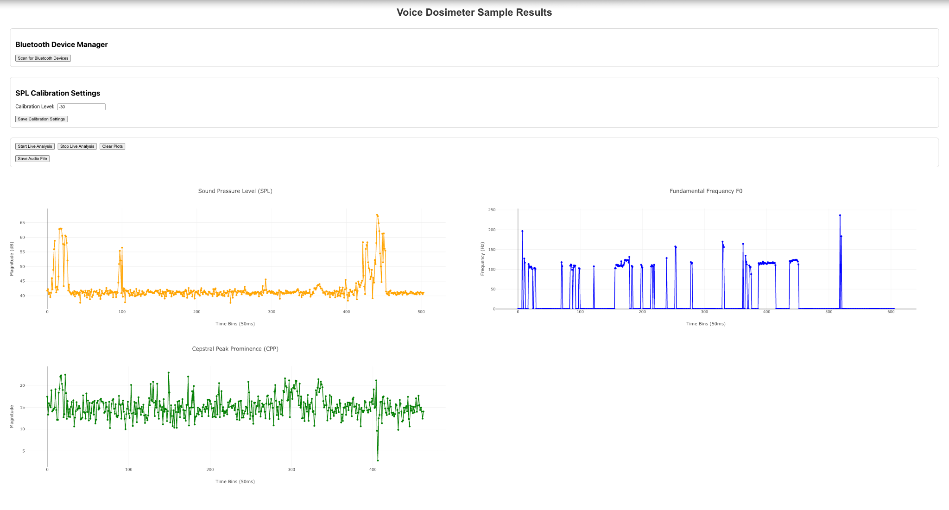
Web Application
ELECTRICAL & COMPUTER ENGINEERING
GRAINGER ENGINEERING

Slide 15
Web Application Flowchart
Web App Action
A button on the website is pressed
Update Web App
Trigger Javascript
Python script finishes running and updates frontend features
A JavaScript action is called by the button press
Call Python Endpoint
The JavaScript calls an endpoint that runs a Python script
An action on the website front end calls a Python endpoint to run a script
ELECTRICAL & COMPUTER ENGINEERING
GRAINGER ENGINEERING

Slide 16
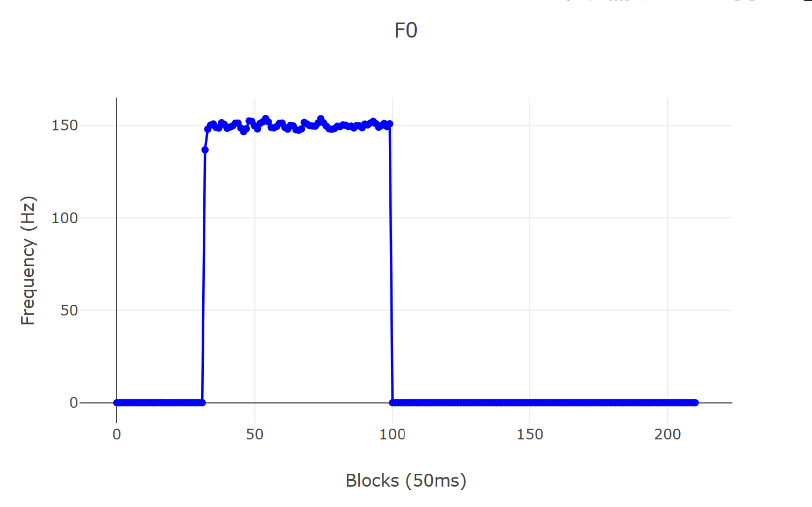
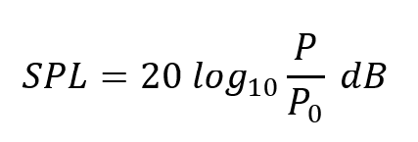
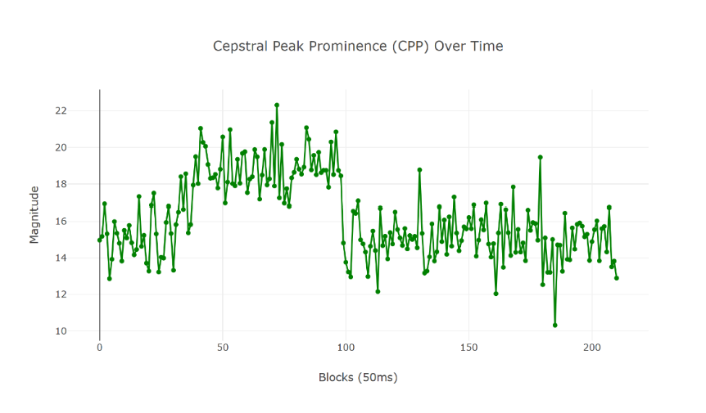
Feature Algorithms
In 50ms time bins…
Sound Pressure Level: User’s sound intensity
Fundamental Frequency: User’s pitch
Autocorrelation
Cepstral Peak Prominence: “Purity” of the fundamental frequency
ELECTRICAL & COMPUTER ENGINEERING
GRAINGER ENGINEERING

Slide 17
Mechanical Design
ELECTRICAL & COMPUTER ENGINEERING
GRAINGER ENGINEERING

Slide 18
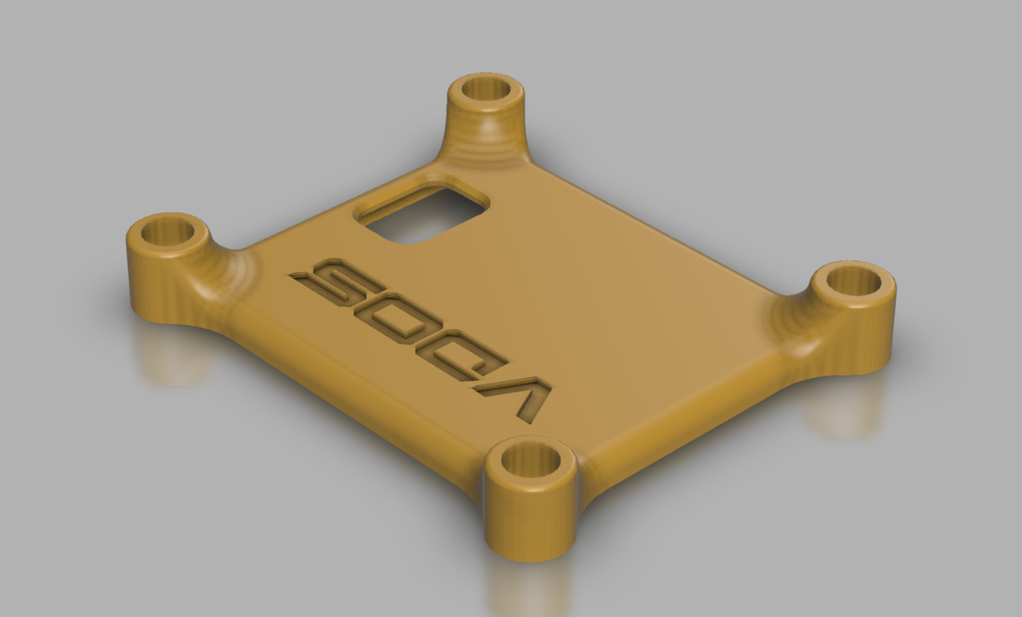
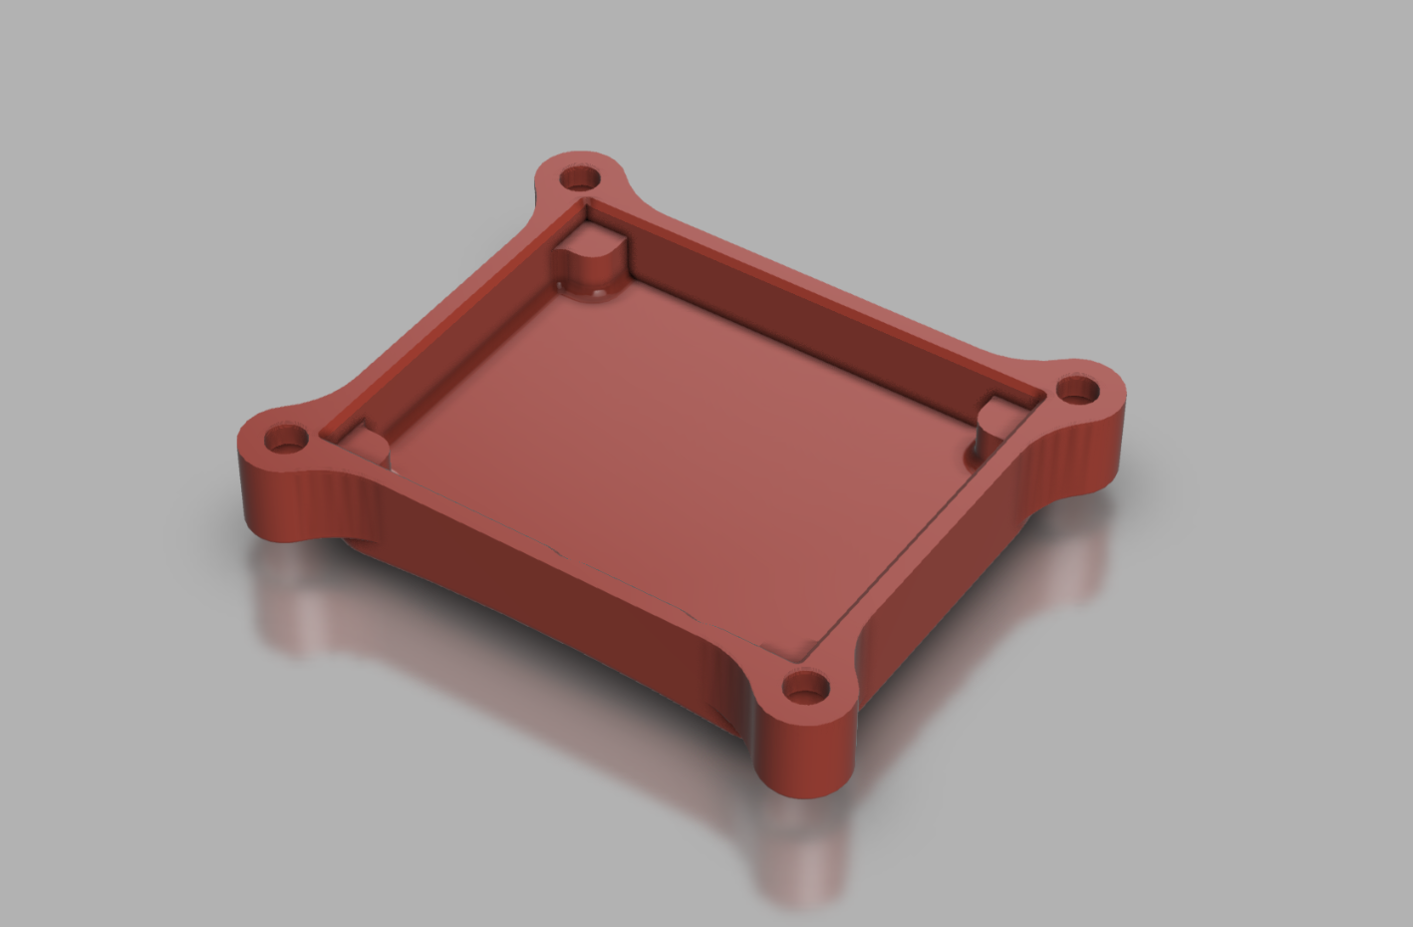
Enclosure
3D-printed for reproducibility
Used TPU filament with the following characteristics
1.75mm diameter
95A hardness
Bottom was rounded to fit the profile of the vocal cords
IMAGE / GRAPHIC
IMAGE / GRAPHIC
ELECTRICAL & COMPUTER ENGINEERING
GRAINGER ENGINEERING

Slide 19
Requirements and Verification
ELECTRICAL & COMPUTER ENGINEERING
GRAINGER ENGINEERING

Slide 20
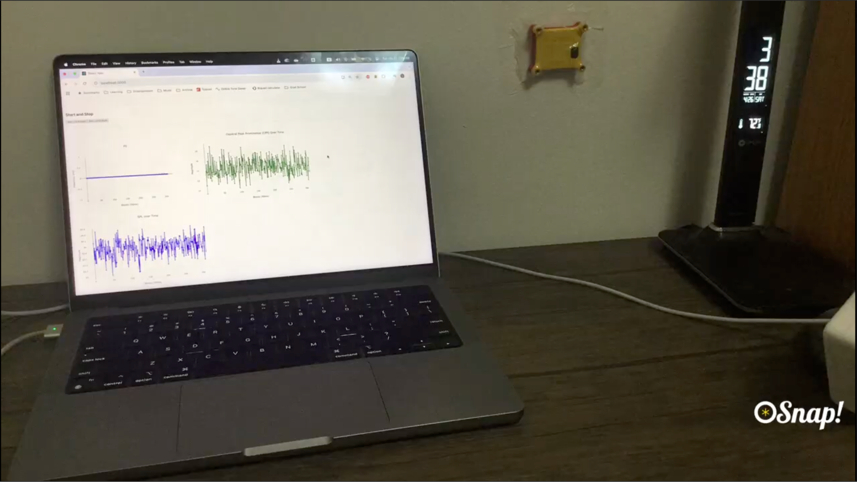
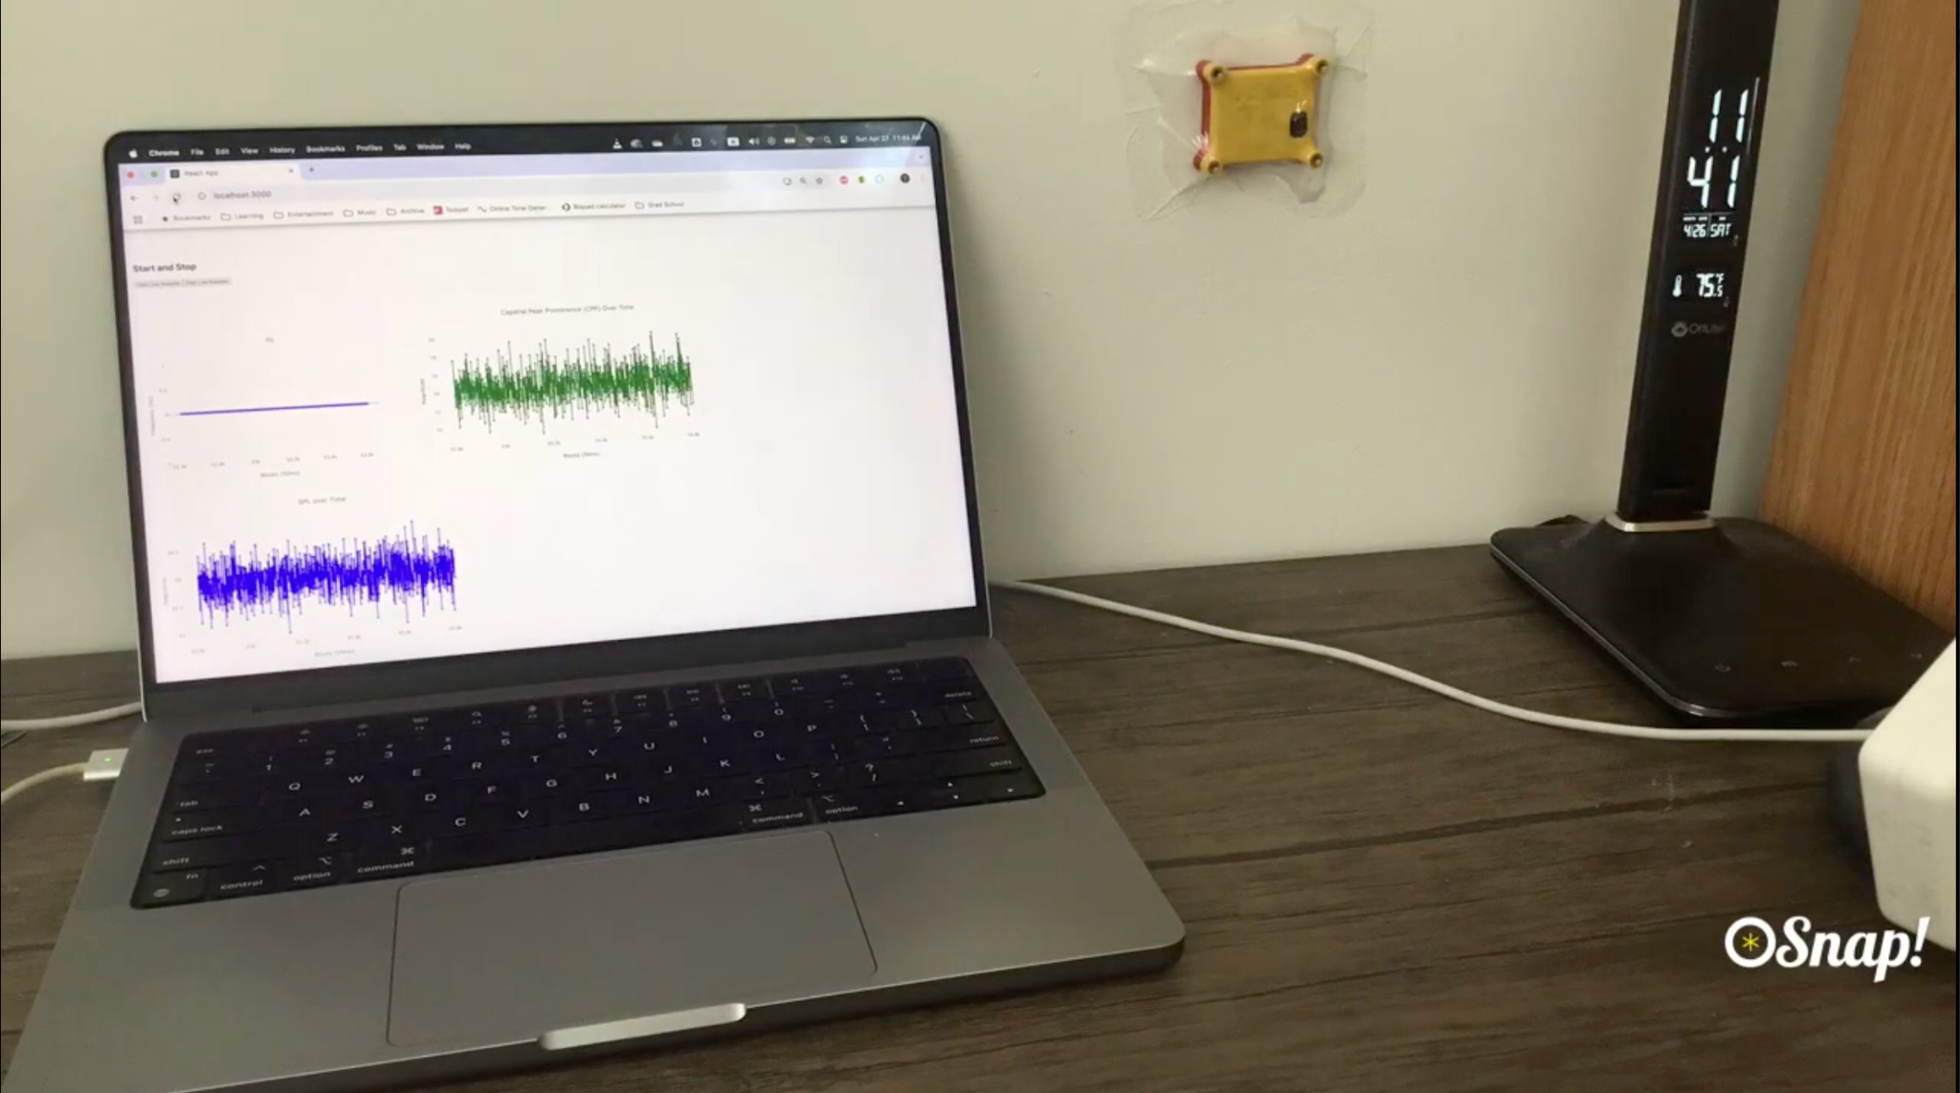
Power Subsystem
After 8 hours of continuous transmission, the battery voltage was at 2.91V
The device operates with a battery voltage of 3.5V down to 1.5V
ELECTRICAL & COMPUTER ENGINEERING
GRAINGER ENGINEERING

Slide 21
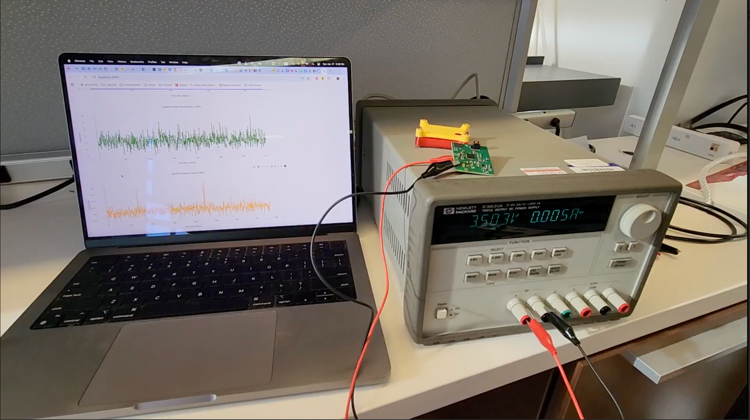
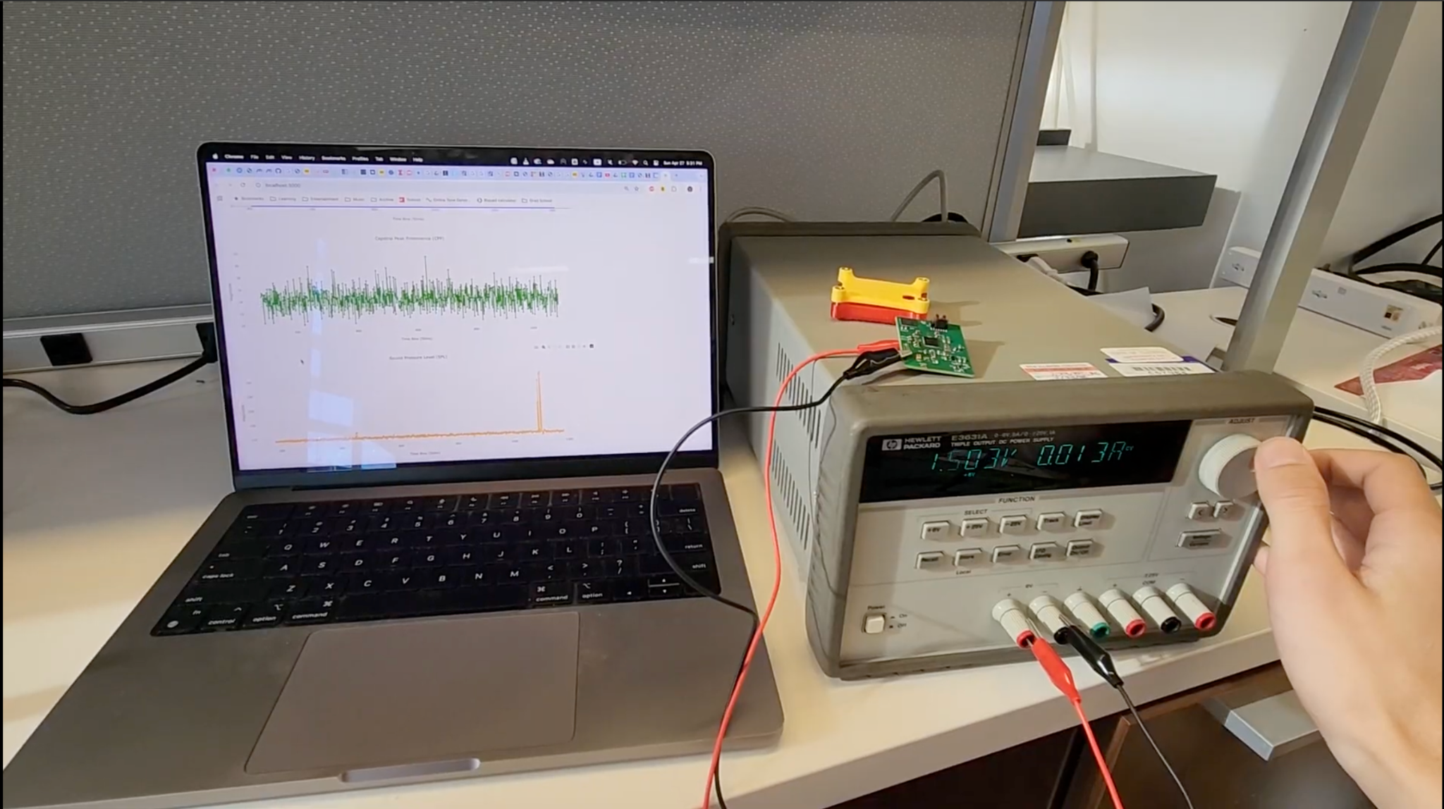
Power Subsystem Voltage Test
3.5 V, 5 mA
1.5 V, 13 mA
ELECTRICAL & COMPUTER ENGINEERING
GRAINGER ENGINEERING

Slide 22
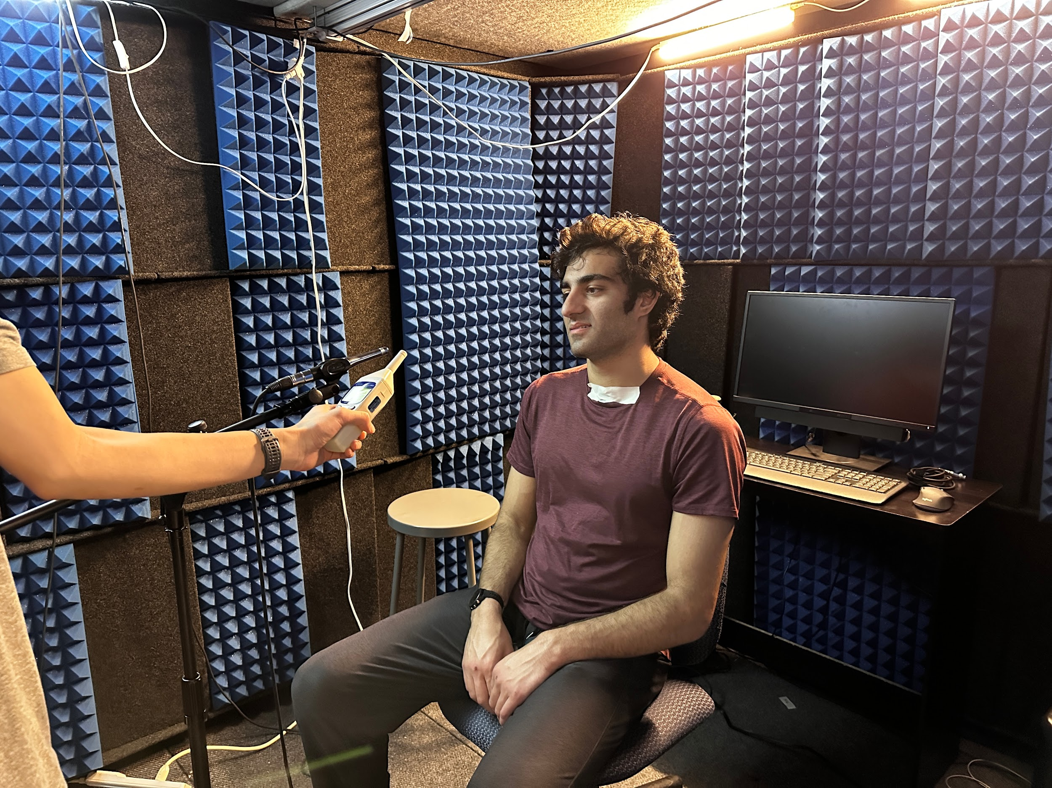
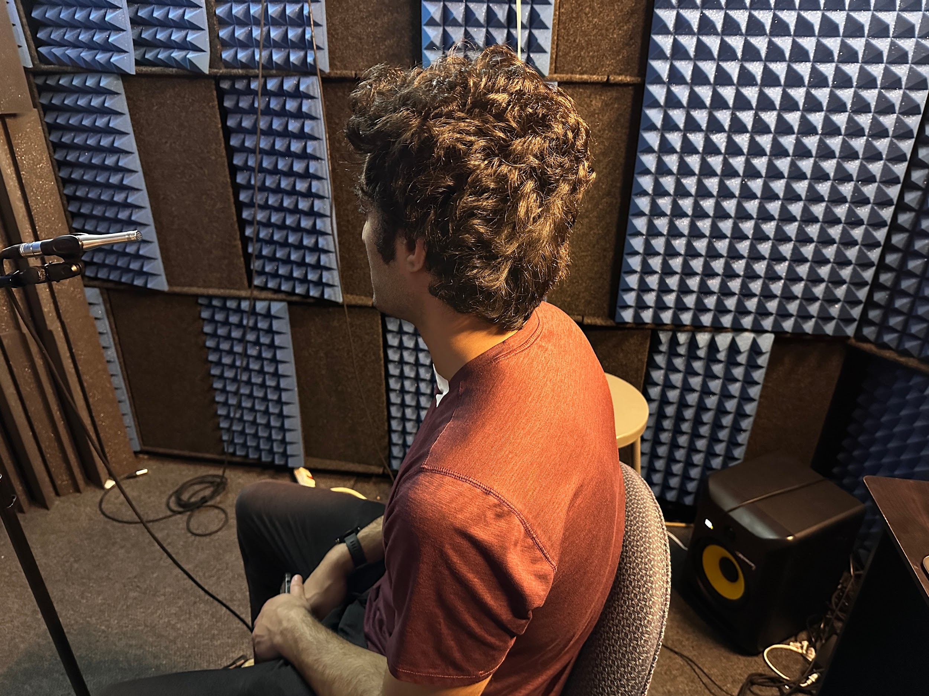
Sensing Subsystem Quiet Room Test
Device Testing with Charlie Nudelman in the Speech and Hearing Sciences Building
ELECTRICAL & COMPUTER ENGINEERING
GRAINGER ENGINEERING

Slide 23
Sensing Subsystem Quiet Room Test Results
We performed five tests where a measurement microphone and our device simultaneously recorded the user’s voice. Then, we analyzed and compared the features
We didn’t fully reach our goal accuracy, but we had promising results
Goal: sound pressure level within 2dB, fundamental frequency within 5Hz, and cepstral peak prominence within 2dB
Clean Passage | SPL Average (dB) | F0 Average (Hz) | CPP Average (dB)
Microphone | 77.5 | 103.8 | 12.9
Voice Dosimeter | 86.1 | 106.6 | 11.9
Passage with white noise | SPL Average (dB) | F0 Average (Hz) | CPP Average (dB)
Microphone | 80.7 | 108.1 | 12.9
Voice Dosimeter | 85.7 | 100.5 | 11.9
ELECTRICAL & COMPUTER ENGINEERING
GRAINGER ENGINEERING
Notes:
Reasons why we were off: Our device mostly picks up vowel and voiced consonant sounds. The microphone will pick up all vocal sounds including unvoiced consonants. This will mess with the SPL and CPP measurements. For the F0 measurements, there are octave errors on both the microphone and dosimeter recordings.

Slide 24
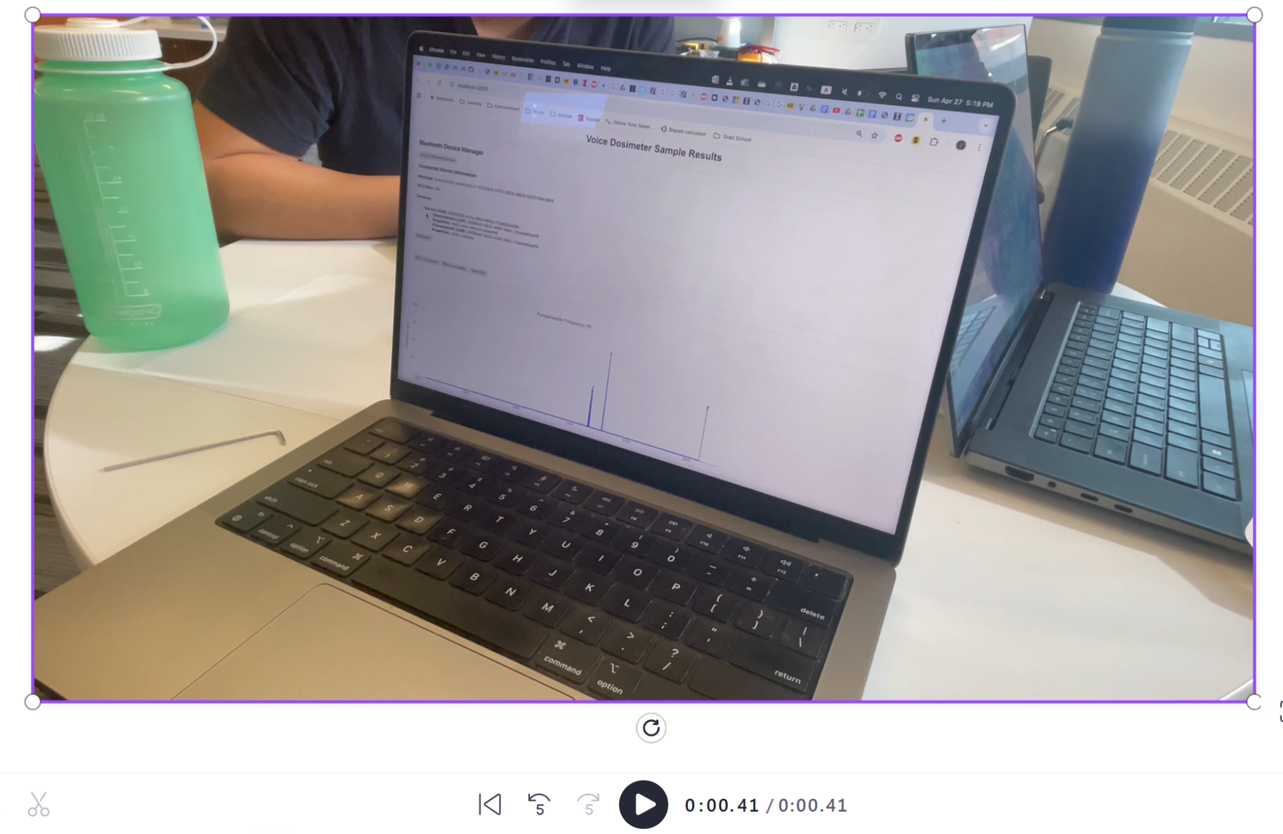
Bluetooth Subsystem
A full end to end (user speaking to website display) latency of 0.41 seconds
A maximum transmission range of 15 meters via BLE
ELECTRICAL & COMPUTER ENGINEERING
GRAINGER ENGINEERING

Slide 25
Mechanical Subsystem
Multiple test subjects said that the device was comfortable.
The enclosure taped onto the user’s vocal cords does not impeded data transmission between the device and the web application
The transparent medical dressing stays on for more than 8 hours
ELECTRICAL & COMPUTER ENGINEERING
GRAINGER ENGINEERING

Slide 26
Video Demonstration
ELECTRICAL & COMPUTER ENGINEERING
GRAINGER ENGINEERING

Slide 27
Video Demonstration
CHART / GRAPH
ELECTRICAL & COMPUTER ENGINEERING
GRAINGER ENGINEERING

Slide 28
Discussion
ELECTRICAL & COMPUTER ENGINEERING
GRAINGER ENGINEERING

Slide 29
Major Development Challenges
Noisy Vibration Signal
Previously, we had a lot of noise on our vibration signal.
After some debugging, I found that we were using an older version of the PDM filter library. After updating the library, the noise was fixed.
BLE packet size limit
BLE allows packets of size 512, but we could only send packets of size 128 due to an inter-core communication issue, which limited our sensor to 8-bit outputs.
Soldering
Originally, we chose the BMA580 vibration sensor. But it was too small to hand solder, so we switched to our current sensor.
Hand soldering the QFN 48 package was tough. We used the oven, but we had to re-solder with hot air due to bridged pins.
ELECTRICAL & COMPUTER ENGINEERING
GRAINGER ENGINEERING

Slide 30
Successes and Points of Improvement
Successes
Small and compact design
Low-latency data streaming
Low-noise operation
Only records the user’s voice
Points of Improvement
Make device even smaller
Remove flash memory, and instead, stream and upload data continuously
Improve comfortability of enclosure
Cloud data storage
ELECTRICAL & COMPUTER ENGINEERING
GRAINGER ENGINEERING

Slide 31
Q&A
ELECTRICAL & COMPUTER ENGINEERING
GRAINGER ENGINEERING

