Slide 1
CS440/ECE448 Lecture 22: Linear Classifiers
Mark Hasegawa-Johnson, 3/2020
Including Slides by
Svetlana Lazebnik, 10/2016
License: CC-BY 4.0

Slide 2
Linear Classifiers
Classifiers
Perceptron
Linear classifiers in general
Logistic regression

Slide 3
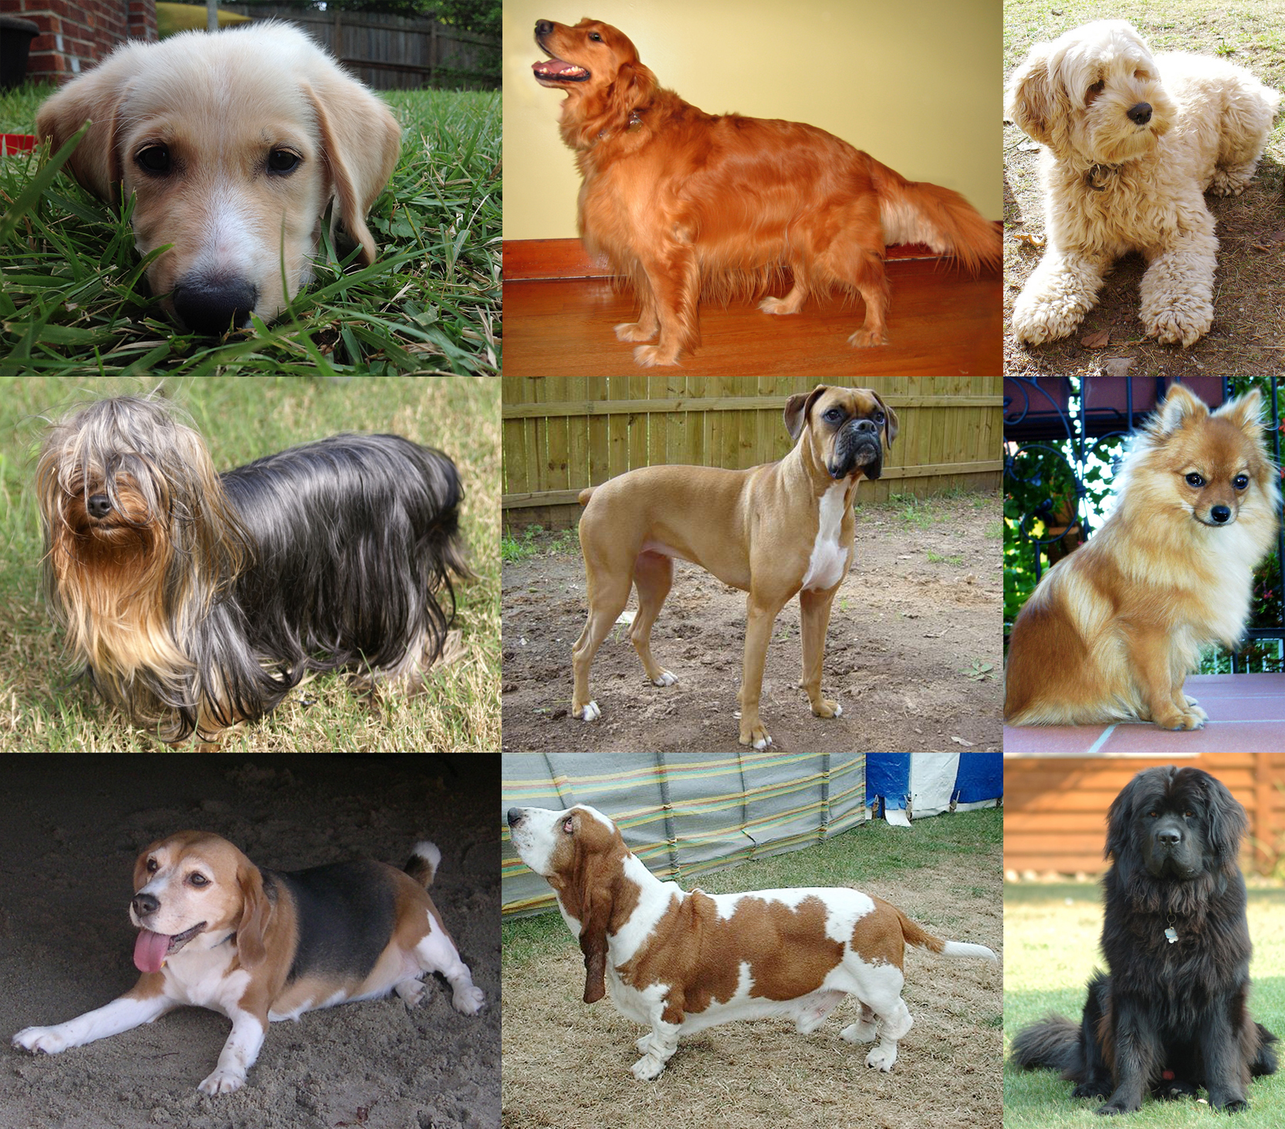
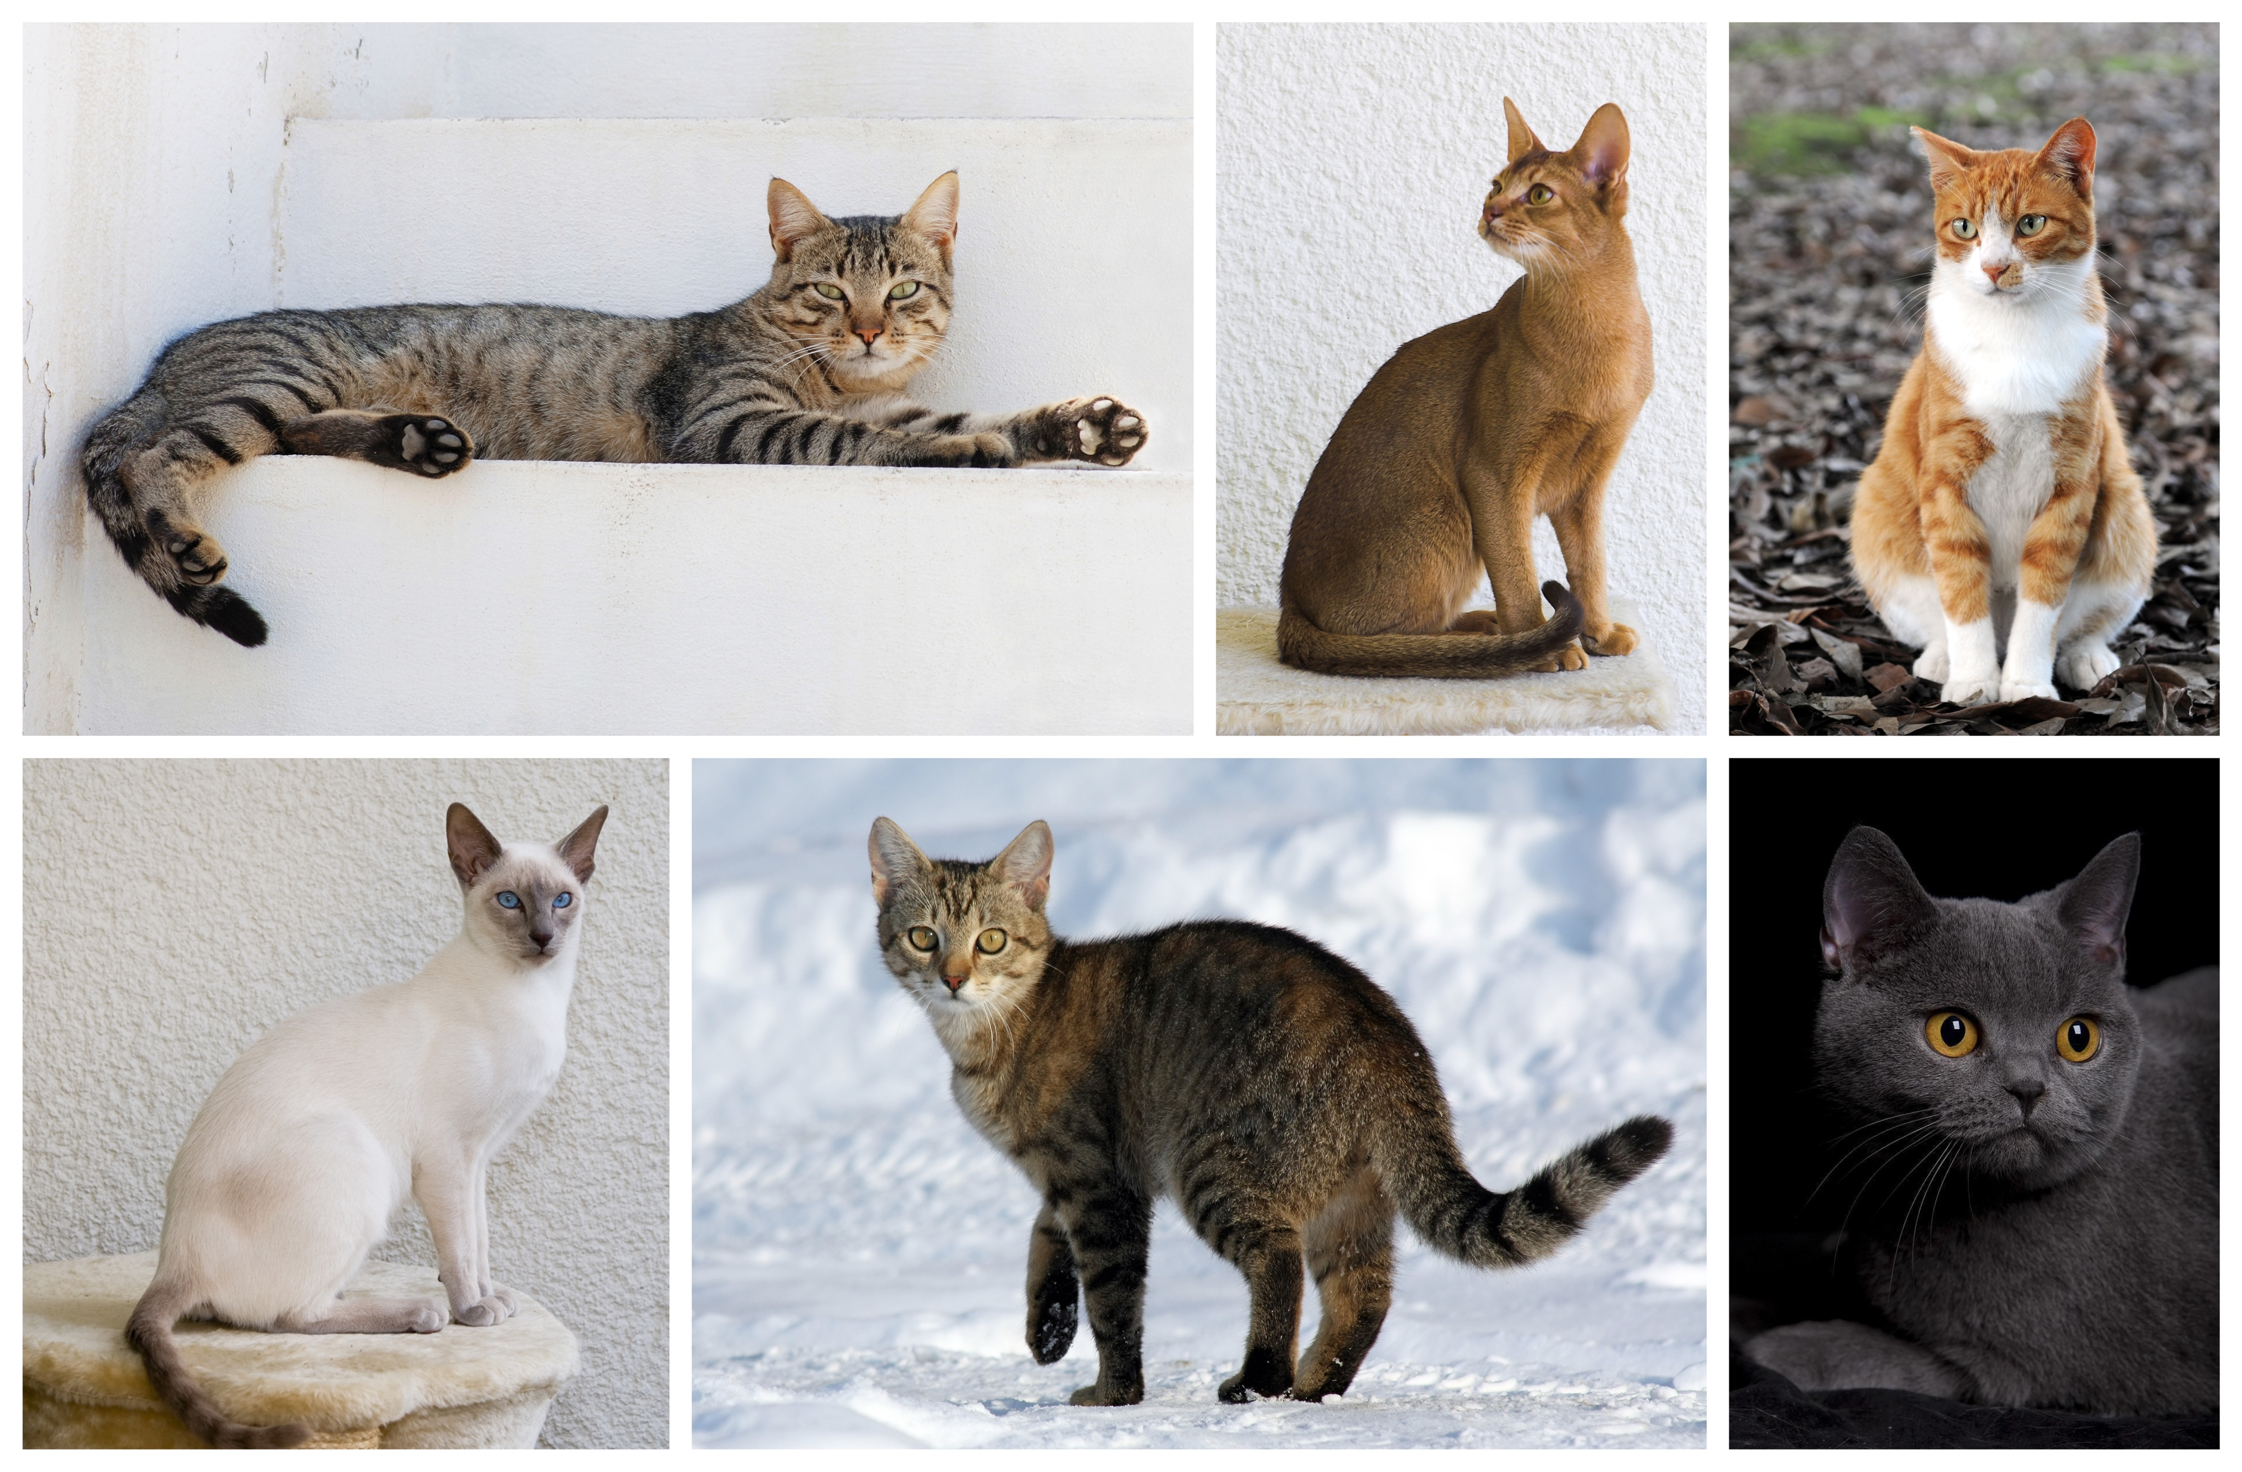
Classifiers example: dogs versus cats
Can you write a program that can tell which ones are dogs, and which ones are cats?
By YellowLabradorLooking_new.jpg: *derivative work: Djmirko (talk)YellowLabradorLooking.jpg: User:HabjGolden_Retriever_Sammy.jpg: Pharaoh HoundCockerpoo.jpg: ALMMLonghaired_yorkie.jpg: Ed Garcia from United StatesBoxer_female_brown.jpg: Flickr user boxercabMilù_050.JPG: AleRBeagle1.jpg: TobycatBasset_Hound_600.jpg: ToBNewfoundland_dog_Smoky.jpg: Flickr user DanDee Shotsderivative work: December21st2012Freak (talk) - YellowLabradorLooking_new.jpgGolden_Retriever_Sammy.jpgCockerpoo.jpgLonghaired_yorkie.jpgBoxer_female_brown.jpgMilù_050.JPGBeagle1.jpgBasset_Hound_600.jpgNewfoundland_dog_Smoky.jpg, CC BY-SA 3.0, https://commons.wikimedia.org/w/index.php?curid=10793219
By Alvesgaspar - Top left:File:Cat August 2010-4.jpg by AlvesgasparTop middle:File:Gustav chocolate.jpg by Martin BahmannTop right:File:Orange tabby cat sitting on fallen leaves-Hisashi-01A.jpg by HisashiBottom left:File:Siam lilacpoint.jpg by Martin BahmannBottom middle:File:Felis catus-cat on snow.jpg by Von.grzankaBottom right:File:Sheba1.JPG by Dovenetel, CC BY-SA 3.0, https://commons.wikimedia.org/w/index.php?curid=17960205

Slide 4
Classifiers example: dogs versus cats
Can you write a program that can tell which ones are dogs, and which ones are cats?
Idea #1: Cats are smaller than dogs.
Our robot will pick up the animal and weigh it.
If it weighs more than 20 pounds, call it a dog. Otherwise, call it a cat.

Slide 5
Classifiers example: dogs versus cats
Can you write a program that can tell which ones are dogs, and which ones are cats?
Oops.
CC BY-SA 4.0, https://commons.wikimedia.org/w/index.php?curid=55084303

Slide 6
Classifiers example: dogs versus cats
Can you write a program that can tell which ones are dogs, and which ones are cats?
Idea #2: Dogs are tame, cats are wild.
We’ll try the following experiment: 40 different people call the animal’s name. Count how many times the animal comes when called.
If the animal comes when called, more than 20 times out of 40, it’s a dog.
If not, it’s a cat.

Slide 7
Classifiers example: dogs versus cats
Can you write a program that can tell which ones are dogs, and which ones are cats?
Oops.
By Smok Bazyli - Own work, CC BY-SA 3.0, https://commons.wikimedia.org/w/index.php?curid=16864492

Slide 8
Classifiers example: dogs versus cats
Can you write a program that can tell which ones are dogs, and which ones are cats?
Idea #3:
$x_{1}=$ # times the animal comes when called (out of 40).
$x_{2}=$ weight of the animal, in pounds.
If $0.5x_{1}+0. 5x_{2}>20$, call it a dog.
Otherwise, call it a cat.
This is called a “linear classifier” because $0.5x_{1}+0. 5x_{2}=20$ is the equation for a line.

Slide 9
Linear Classifiers
Classifiers
Perceptron
Linear classifiers in general
Logistic regression

Slide 10
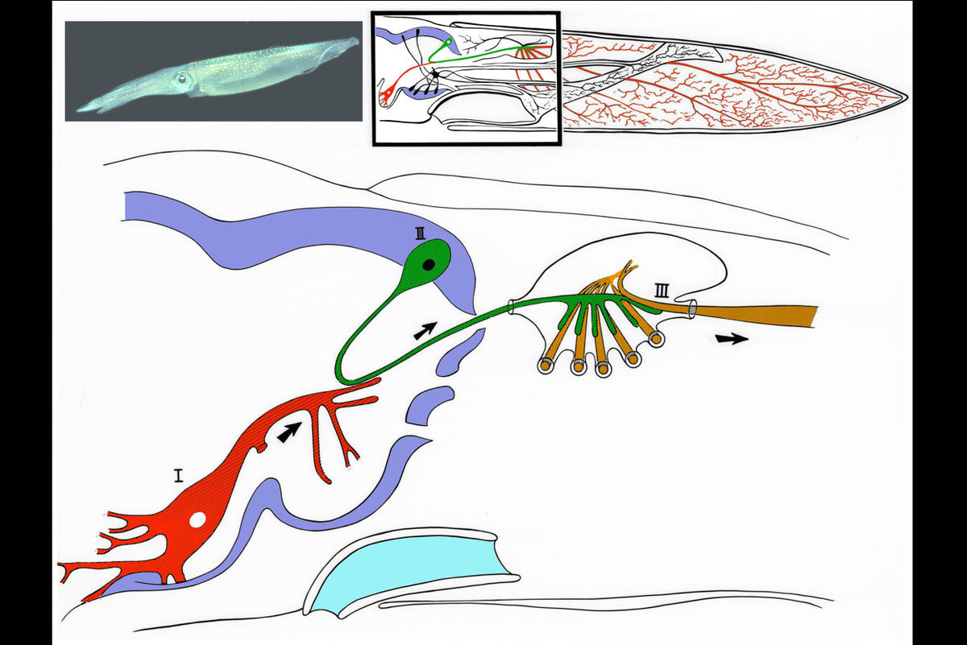
The Giant Squid Axon
1909: Williams discovers that the giant squid has a giant neuron (axon 1mm thick)
1939: Young finds a giant synapse (fig. shown: Llinás, 1999, via Wikipedia). Hodgkin & Huxley put in voltage clamps.
1952: Hodgkin & Huxley publish an electrical current model for the generation of binary action potentials from real-valued inputs.

Slide 11
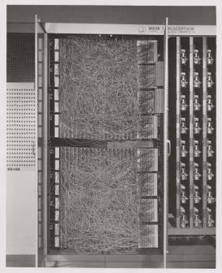
Perceptron
1959: Rosenblatt is granted a patent for the “perceptron,” an electrical circuit model of a neuron.

Slide 12
Perceptron
Perceptron model: action potential = signum(affine function of the features)
y* = sgn(w₁x₁ + w₂x₂ + … + w_{D}x_{D} + b) = sgn(${\vec{w}}^{T}\vec{x}$)
Where $\vec{w}={[w_{1},…,w_{D},b]}^{T}$
and $\vec{x}={[x_{1},…,x_{D},1]}^{T}$
Input
Weights
x₁
w₁
x₂
w₂
Output: sgn(w⋅x + b)
x₃
w₃
.
.
.
w_{D}
Can incorporate bias as component of the weight vector by always including a feature with value set to 1
x_{D}

Slide 13
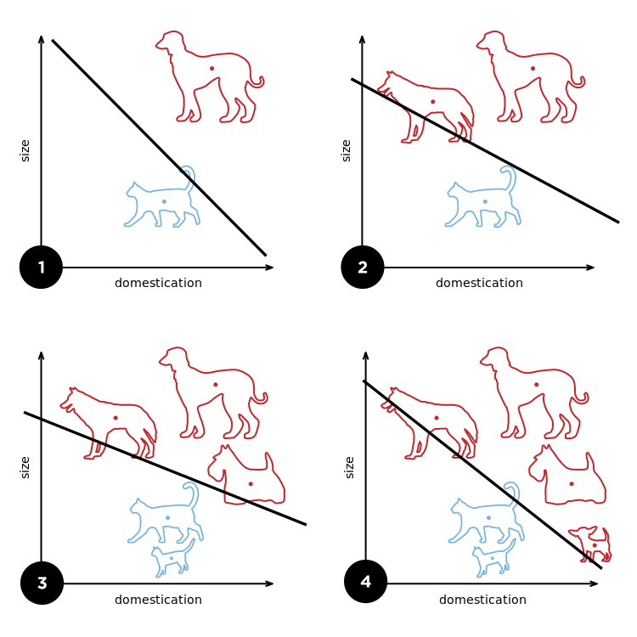
Perceptron
Rosenblatt’s big innovation: the perceptron learns from examples.
Initialize weights randomly
Cycle through training examples in multiple passes (epochs)
For each training example:
If classified correctly, do nothing
If classified incorrectly, update weights
By Elizabeth Goodspeed - Own work, CC BY-SA 4.0, https://commons.wikimedia.org/w/index.php?curid=40188333

Slide 14
Perceptron
For each training instance $\vec{x}$ with ground truth label $y∈\{−1,1\}$:
Classify with current weights: $y^{∗}=sgn({\vec{w}}^{T}\vec{x})$
Update weights:
if $y=y^{∗}$ then do nothing
If $y≠y^{∗}$ then $\vec{w}=\vec{w}+\text{η}\text{y}\vec{x}$
η (eta) is a “learning rate.” More about that later.

Slide 15
Perceptron training example: dogs vs. cats
Let’s start with the rule “if it comes when called (by at least 20 different people out of 40), it’s a dog.”
So if $x_{1}=$ # times it comes when called, then the rule is:
If $x_{1}−20>0$, call it a dog.
In other words, $y^{∗}=sgn({\vec{w}}^{T}\vec{x})$, where ${\vec{w}}^{T}=\left[1,0,−20\right]$, and ${\vec{x}}^{T}=[x_{1},x_{2},1]$.
$$x_{2}$$
$$sgn\left({\vec{w}}^{T}\vec{x}\right)=1$$
$${\vec{w}}^{T}=\left[1,0,−20\right]$$
$$sgn\left({\vec{w}}^{T}\vec{x}\right)=−1$$
$$x_{1}$$

Slide 16
Perceptron training example: dogs vs. cats
The Presa Canario gets misclassified as a cat ($y=1,$ but $y^{∗}=−1$) because it only obeys its trainer ($x_{1}=1$), and nobody else. But we notice that the Presa Canario, though it rarely comes when called, is very large ($x_{2}=100$ pounds), so we have ${\vec{x}}^{T}=\left[x_{1},x_{2},1\right]=[1,100,1]$.
$$x_{2}$$
$$sgn\left({\vec{w}}^{T}\vec{x}\right)=1$$
$${\vec{w}}^{T}=\left[1,0,−20\right]$$
$$sgn\left({\vec{w}}^{T}\vec{x}\right)=−1$$
$$x_{1}$$

Slide 17
Perceptron training example: dogs vs. cats
The Presa Canario gets misclassified as a cat ($y=1,$ but $y^{∗}=−1$) because it only obeys its trainer ($x_{1}=1$), and nobody else. But we notice that the Presa Canario, though it rarely comes when called, is very large ($x_{2}=100$ pounds), so we have ${\vec{x}}^{T}=\left[x_{1},x_{2},1\right]=[1,100,1]$.
So we update: $\vec{w}$= $\vec{w}+y\vec{x}=\left[1,0,−20\right]+\left[1,100,1\right]=[2,100,−19]$
$$x_{2}$$
$$sgn\left({\vec{w}}^{T}\vec{x}\right)=1$$
$${\vec{w}}^{T}=\left[2,100,−19\right]$$
$$sgn\left({\vec{w}}^{T}\vec{x}\right)=−1$$
$$x_{1}$$

Slide 18
Perceptron training example: dogs vs. cats
The Maltese, though it’s small ($x_{2}=10$ pounds), is very tame ($x_{1}=40$): $\vec{x}=\left[x_{1},x_{2},1\right]=\left[40,10,1\right]$.
But it’s correctly classified! $y^{∗}=sgn\left({\vec{w}}^{T}\vec{x}\right)=sgn\left(2×40+100×10−19\right)=+1$, which is equal to $y=1$.
So the $\vec{w}$vector is unchanged.
$$x_{2}$$
$$sgn\left({\vec{w}}^{T}\vec{x}\right)=1$$
$${\vec{w}}^{T}=\left[2,100,−19\right]$$
$$sgn\left({\vec{w}}^{T}\vec{x}\right)=−1$$
$$x_{1}$$

Slide 19
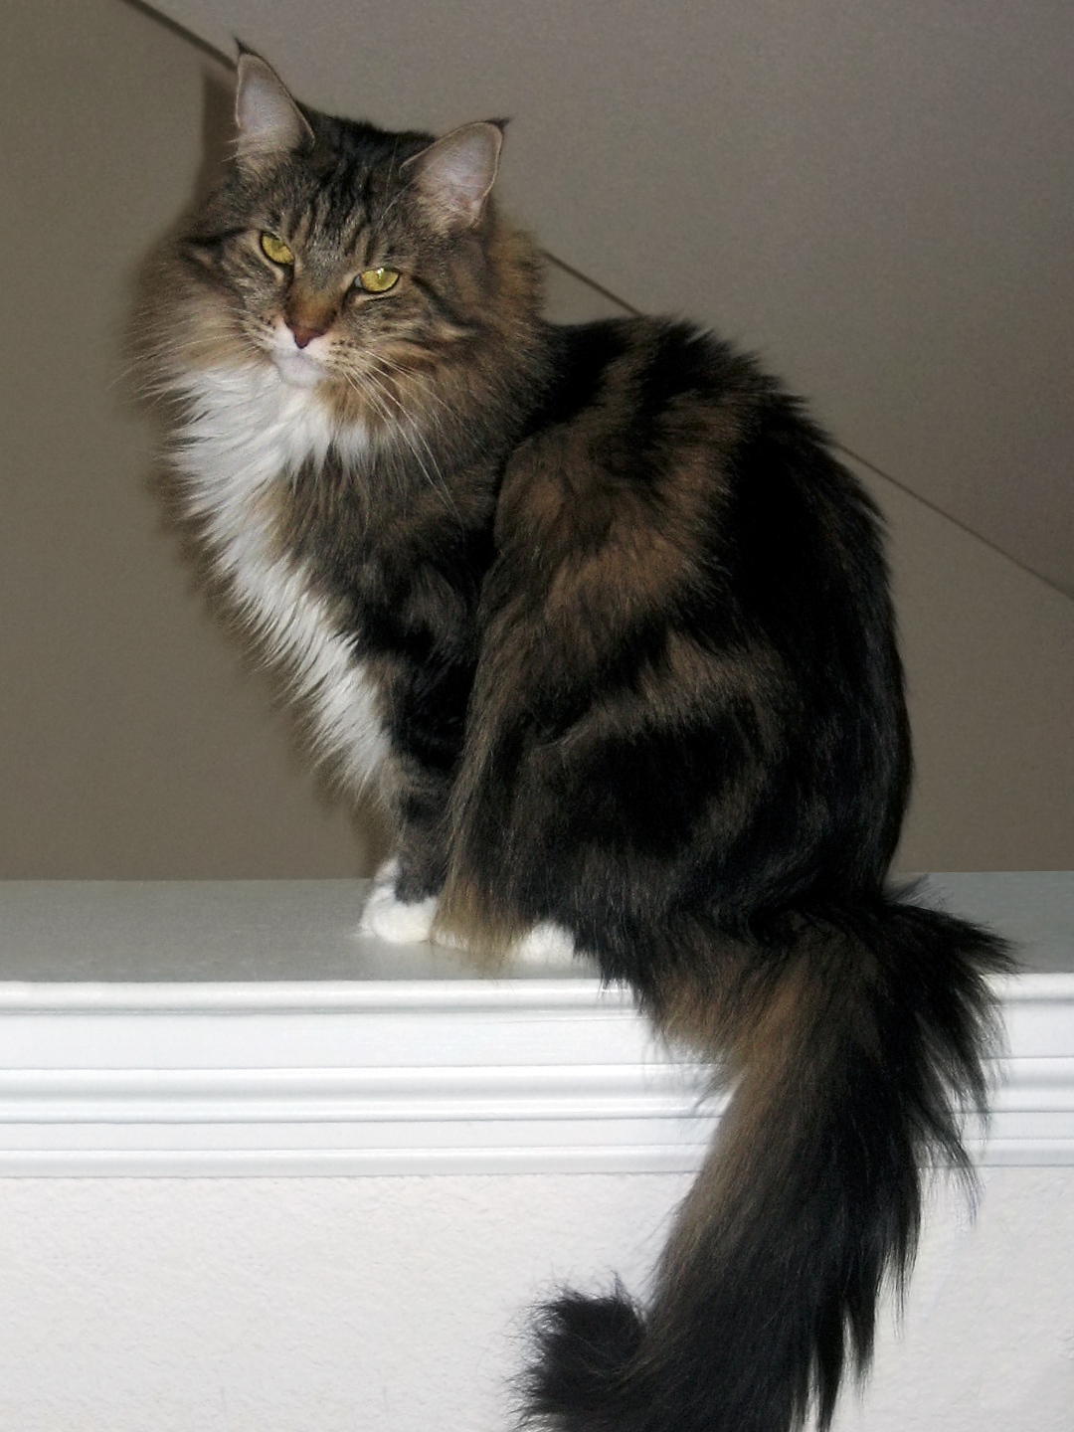
Perceptron training example: dogs vs. cats
The Maine Coon cat is big ($x_{2}=20$ pounds: $\vec{x}=\left[0,20,1\right]$), so it gets misclassified as a dog (true label is $y=−1$=“cat,” but the classifier thinks $y^{∗}=1$=“dog”).
$$x_{2}$$
$$sgn\left({\vec{w}}^{T}\vec{x}\right)=1$$
$${\vec{w}}^{T}=\left[2,100,−19\right]$$
$$sgn\left({\vec{w}}^{T}\vec{x}\right)=−1$$
$$x_{1}$$

Slide 20
Perceptron training example: dogs vs. cats
The Maine Coon cat is big ($x_{2}=20$ pounds: $\vec{x}=\left[0,20,1\right]$), so it gets misclassified as a dog (true label is $y=−1$=“cat,” but the classifier thinks $y^{∗}=1$=“dog”).
So we update: $\vec{w}$= $\vec{w}+y\vec{x}=\left[2,100,−19\right]+(−1)×\left[0,20,1\right]=[2,80,−20]$
$$x_{2}$$
$$sgn\left({\vec{w}}^{T}\vec{x}\right)=1$$
$${\vec{w}}^{T}=\left[2,80,−20\right]$$
$$sgn\left({\vec{w}}^{T}\vec{x}\right)=−1$$
$$x_{1}$$

Slide 21
Perceptron: Proof of Convergence
Definition: linearly separable:
A dataset is linearly separable if and only if there exists a vector, $\vec{w}$, such that the ground truth label of each token is given by $y=sgn\left({\vec{w}}^{T}\vec{x}\right)$.
Theorem (proved in the next few slides):
If the data are linearly separable, then the perceptron learning algorithm converges to a correct solution, even with a learning rate of $\text{η}\text{=1}$.

Slide 22
Perceptron: Proof of Convergence
Suppose the data are linearly separable. For example, suppose red dots are the class y=1, and blue dots are the class y=-1:
$$x_{2}$$
$$x_{1}$$

Slide 23
Perceptron: Proof of Convergence
Instead of plotting $\vec{x}$, plot $y\vec{x}$. The red dots are unchanged; the blue dots are multiplied by -1.
Since the original data were linearly separable, the new data are all in the same half of the feature space.
$${yx}_{2}$$
$$yx_{1}$$

Slide 24
Perceptron: Proof of Convergence
Suppose we start out with some initial guess, $\vec{w}$, that makes mistakes. In other words, $sgn\left({\vec{w}}^{T}(y\vec{x})\right)=−1$ for some of the tokens.
$$\vec{w}$$
$${yx}_{2}$$
$$yx_{1}$$
Oops! An error.

Slide 25
Perceptron: Proof of Convergence
In that case, $\vec{w}$ will be updated by adding $y\vec{x}$ to it.
Old $\vec{w}$
$$y\vec{x}$$
New $\vec{w}$
$${yx}_{2}$$
$$yx_{1}$$

Slide 26
Perceptron: Proof of Convergence
If there is any $\vec{w}$ such that $sgn\left({\vec{w}}^{T}(y\vec{x})\right)=1$ for all tokens, then this procedure will eventually find it.
If the data are linearly separable, the perceptron algorithm converges to a correct solution, even with $\text{η}\text{=1}$.
New $\vec{w}$
$${yx}_{2}$$
$$yx_{1}$$

Slide 27
What about non-separable data?
If the data are NOT linearly separable, then the perceptron with $\text{η}\text{=1}$doesn’t converge.
In fact, that’s what $\text{η}$ is for.
Remember that $\vec{w}=\vec{w}+\text{η}\text{y}\vec{x}$.
We can force the perceptron to stop wiggling around by forcing $\text{η}$ (and therefore $\text{η}\text{y}\vec{x}$) to get gradually smaller and smaller.
This works: for the $n^{th}$ training token, set $\text{η}\text{=}\frac{1}{n}$.
Notice: $\sum_{n=1}^{∞}{\frac{1}{n}}$ is infinite. Nevertheless, $\text{η}\text{=}\frac{1}{n}$ works, because the $\text{y}\vec{x}$ tokens are not all in the same direction.

Slide 28
Linear Classifiers
Classifiers
Perceptron
Linear classifiers in general
Logistic regression

Slide 29
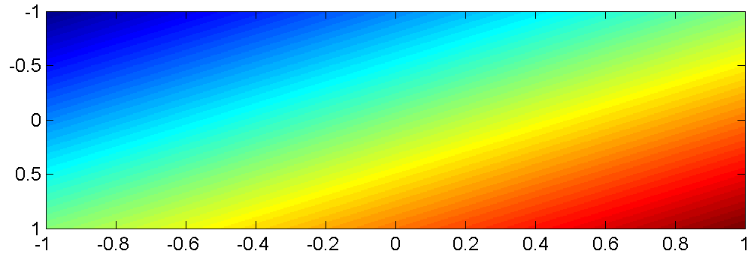
Linear Classifiers in General
The function $b+\sum_{j=1}^{D}{w_{j}x_{j}}$ is an affine function of the features $x_{j}$. That means that its contours are all straight lines. Here is an example of such a function, plotted as variations of color in a two-dimensional space $x_{1}$ by $x_{2}$:
$$x_{2}$$
$$x_{1}$$

Slide 30
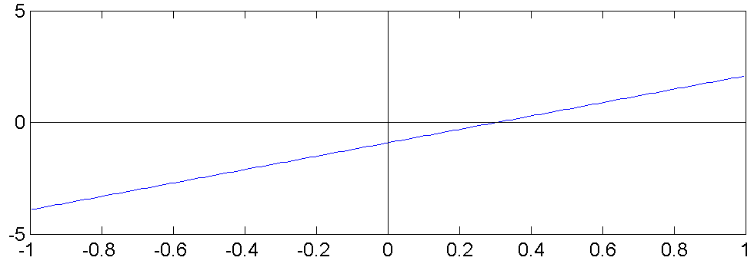
Linear Classifiers in General
Consider the classifier
$$Y^{∗}=1 if: b+\sum_{j=1}^{D}{w_{j}x_{j}}>0$$
$$Y^{∗}=0 if: b+\sum_{j=1}^{D}{w_{j}x_{j}}<0$$
This is called a “linear classifier” because the boundary between the two classes is a line. Here is an example of such a classifier, with its boundary plotted as a line in the two-dimensional space $x_{1}$ by $x_{2}$:
$$Y^{∗}=0$$
$$x_{2}$$
$$Y^{∗}=1$$
$$x_{1}$$

Slide 31
Linear Classifiers in General
$$Y^{∗}=1$$
$$Y^{∗}=2$$
$$Y^{∗}=3$$
Consider the classifier
$$Y^{∗}=arg\max_{c}\left(b_{c}+\sum_{j}{w_{cj}x_{j}}\right)$$
This is called a “multi-class linear classifier.”
The regions $Y^{∗}=0$, $Y^{∗}=1$, $Y^{∗}=2$ etc. are called “Voronoi regions.”
They are regions with piece-wise linear boundaries. Here is an example from Wikipedia of Voronoi regions plotted in the two-dimensional space $x_{1}$ by $x_{2}$:
$$Y^{∗}=4$$
$$Y^{∗}=0$$
$$Y^{∗}=5$$
$$Y^{∗}=6$$
$$Y^{∗}=7$$
…
…
…
…
$$x_{2}$$
…
…
$$x_{1}$$

Slide 32
Linear Classifiers in General
When the features are binary ($x_{j}∈\{0,1\}$), many (but not all!) binary functions can be re-written as linear functions. For example, the function
$$Y^{∗}=(x_{1}∨x_{2})$$
can be re-written as
$$Y^{∗}=1 if: x_{1}+x_{2}−0.5>0$$
Similarly, the function
$$Y^{∗}=(x_{1}∧x_{2})$$
can be re-written as
$$Y^{∗}=1 if: x_{1}+x_{2}−1.5>0$$
$$x_{2}$$
$$x_{2}$$
$$x_{1}$$
$$x_{1}$$

Slide 33
Linear Classifiers in General
Not all logical functions can be written as linear classifiers!
Minsky and Papert wrote a book called Perceptrons in 1969. Although the book said many other things, the only thing most people remembered about the book was that:
“A linear classifier cannot learn an XOR function.”
Because of that statement, most people gave up working on neural networks from about 1969 to about 2006.
Minsky and Papert also proved that a two-layer neural net can learn an XOR function. But most people didn’t notice.
$$x_{2}$$
$$x_{1}$$

Slide 34
Linear Classifiers
Classification:
$$Y^{∗}=arg\max_{c}\left(b_{c}+\sum_{j=1}^{D}{w_{cj}x_{j}}\right)$$
Where $x_{j}$ are the features (binary, integer, or real), $w_{cj}$ are the feature weights, and $b_{c}$ is the offset for the $c^{th}$ class.

Slide 35
Linear Classifiers
Classifiers
Perceptron
Linear classifiers in general
Logistic regression

Slide 36
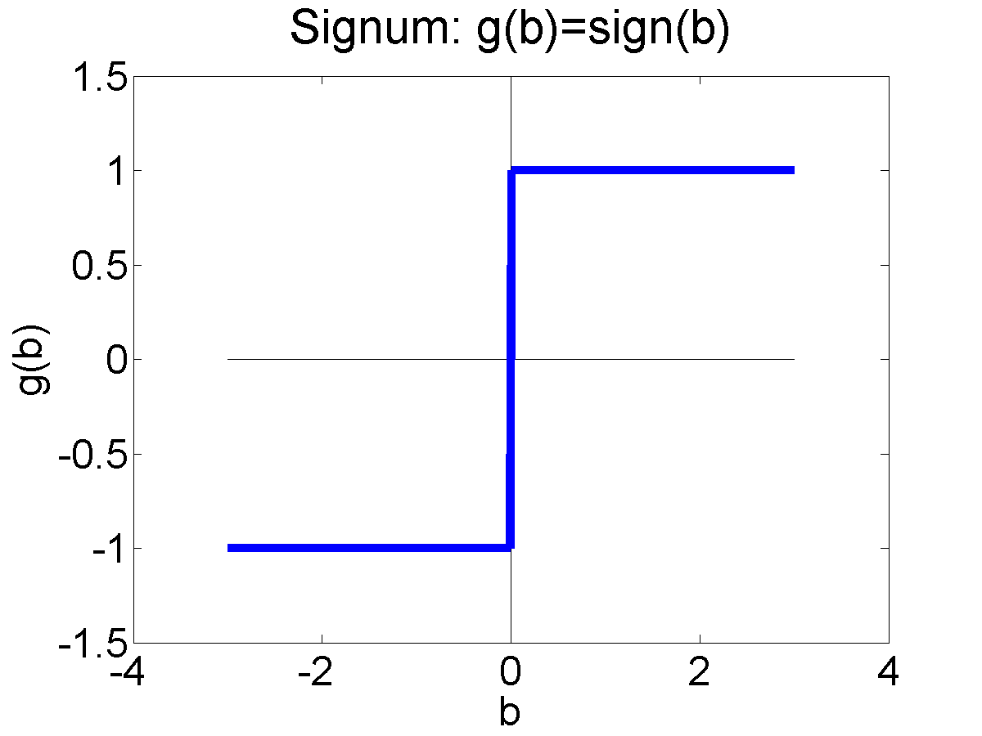
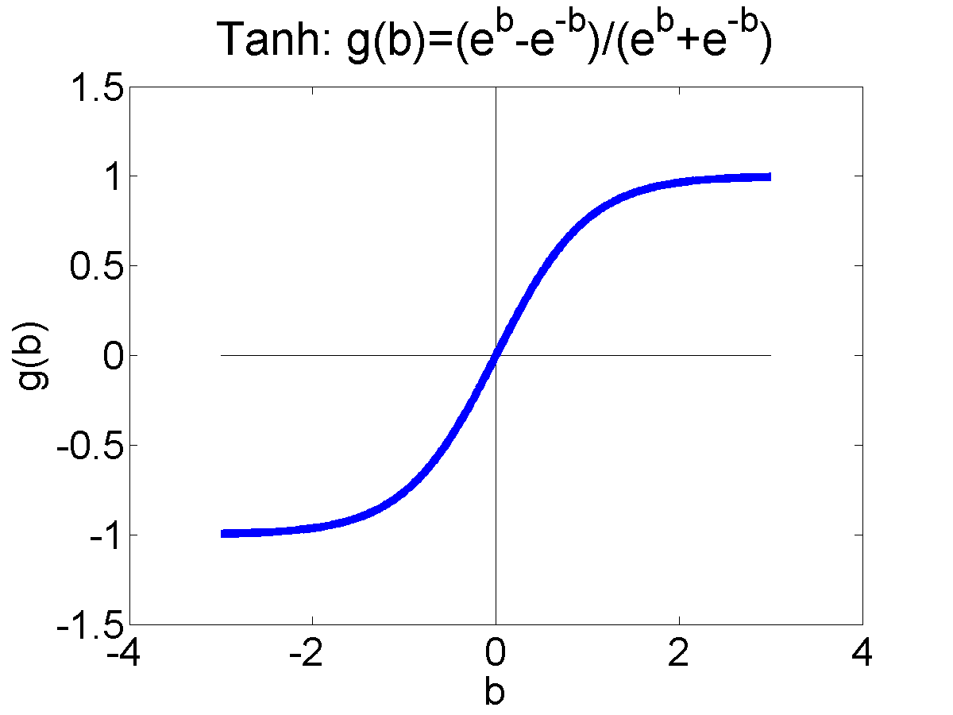
Differentiable Perceptron
Also known as a “one-layer feedforward neural network,” also known as “logistic regression.” Has been re-invented many times by many different people.
Basic idea: replace the non-differentiable decision function
$$y^{∗}= sgn({\vec{w}}^{T}\vec{x})$$
with a differentiable decision function:
$$y^{∗}=tanh\left({\vec{w}}^{T}\vec{x}\right)$$
$$=\frac{1−e^{−2w\vec{x}}}{1+e^{−2{\vec{w}}^{T}\vec{x}}}$$

Slide 37
Why?

Slide 38
More about perceptron learning
Let’s re-write the training data in a different way.
Suppose we have n training vectors, ${\vec{x}}_{1}$through ${\vec{x}}_{n}$, where
$${\vec{x}}_{i}={\left[x_{i1},…,x_{ij},…,x_{iD},1\right]}^{T}$$
Each one has an associated ground-truth reference label $y_{i}∈\left\{−1,1\right\}$. The perceptron computes a classifier output $y_{i}^{∗}=\operatorname{sgn}\left({\vec{w}}^{T}{\vec{x}}_{i}\right)$ which is also $∈\left\{−1,1\right\}$.
The LOSS FUNCTION (a.k.a. the error rate on the training corpus) is
$$L(\vec{w})=\frac{1}{4}\sum_{i=1}^{n}{{\left(y_{i}−y_{i}^{∗}\right)}^{2}}$$

Slide 39
More about perceptron learning
$$L(\vec{w})=\frac{1}{4}\sum_{i=1}^{n}{{\left(y_{i}−y_{i}^{∗}\right)}^{2}}$$
The perceptron learning algorithm tries to minimize the loss function using the following strategy:
If $y_{i}=y_{i}^{∗}$ then do nothing.
If $y_{i}≠y_{i}^{∗}$ then set $\vec{w}=\vec{w}+η{y_{i}\vec{x}}_{i}$.

Slide 40
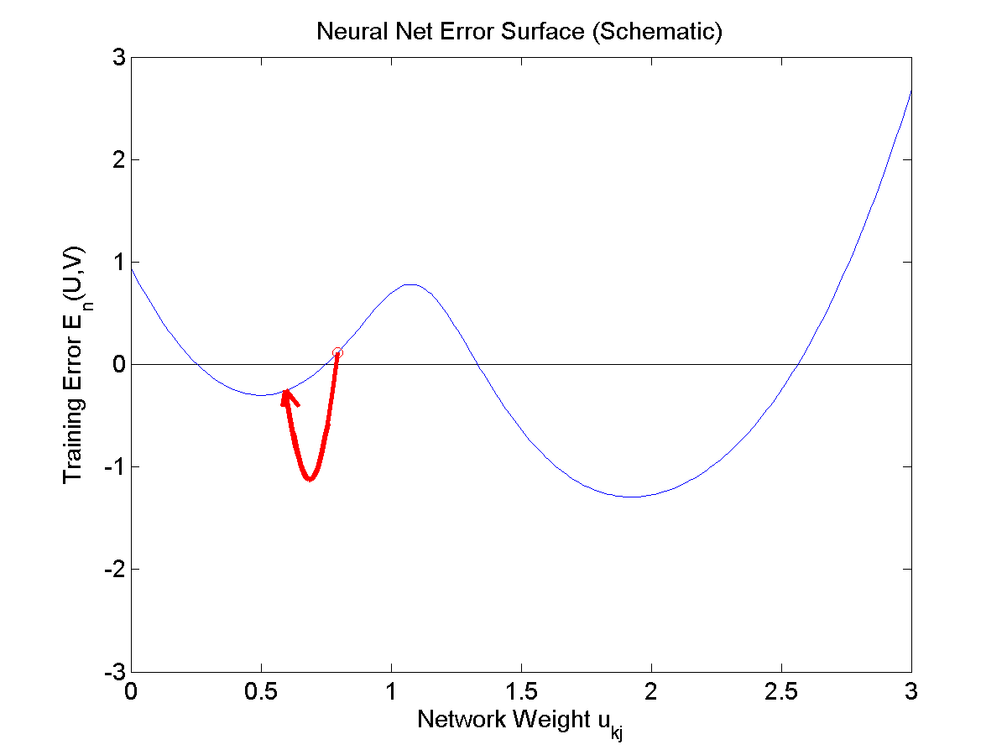
Why is the perceptron so weird?
basic gradient descent
If $y_{i}=y_{i}^{∗}$ then do nothing.
If $y_{i}≠y_{i}^{∗}$ then set $\vec{w}=\vec{w}+η{y_{i}\vec{x}}_{i}$.
… that seems really weird. Why not just use gradient descent, i.e., why not just set $\vec{w}=\vec{w}−η∇_{\vec{w}}L$?
Answer: because $y_{i}^{∗}=\operatorname{sgn}\left({\vec{w}}^{T}{\vec{x}}_{i}\right)$ is not differentiable.
Loss function $L(\vec{w})$
Coefficient $\vec{w}$

Slide 41
Fixing the perceptron
Let’s make $L(\vec{w})$ differentiable.
First, we make $y^{∗}(\vec{w})$ differentiable.
Instead of $y_{i}^{∗}=\operatorname{sgn}\left({\vec{w}}^{T}{\vec{x}}_{i}\right)$
We’ll use $y_{i}^{∗}=\tanh\left({\vec{w}}^{T}{\vec{x}}_{i}\right)$.
That’s pronounced “tanch,” it means
“hyperbolic tangent,” and it looks like this:
$$y_{i}^{∗}=\tanh\left({\vec{w}}^{T}{\vec{x}}_{i}\right)=\frac{e^{{\vec{w}}^{T}\vec{x}}−e^{−{\vec{w}}^{T}\vec{x}}}{e^{{\vec{w}}^{T}\vec{x}}+e^{−{\vec{w}}^{T}\vec{x}}}=\frac{1−e^{−2{\vec{w}}^{T}\vec{x}}}{1+e^{−2{\vec{w}}^{T}\vec{x}}}$$

Slide 42
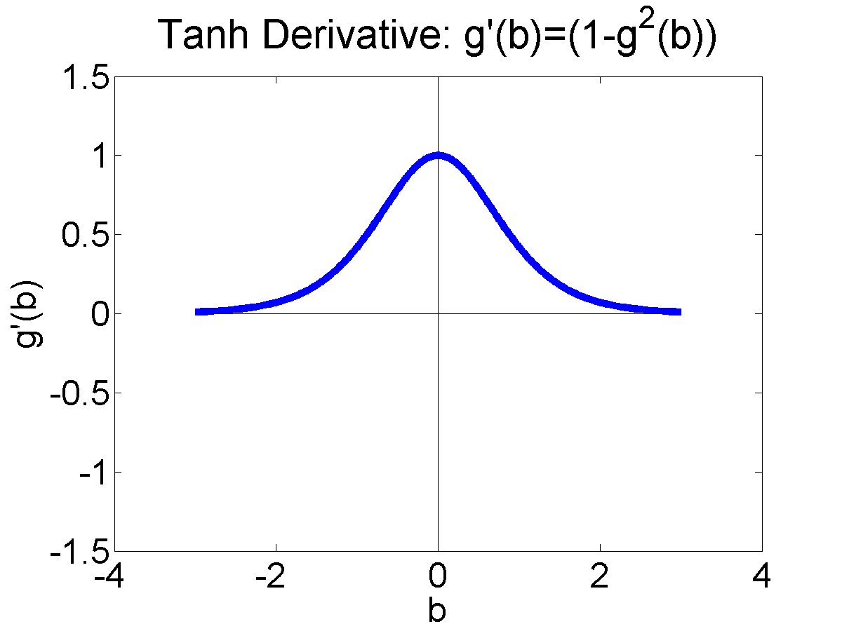
Fixing the perceptron
Let’s make $L(\vec{w})$ differentiable.
First, we make $y^{∗}(\vec{w})$ differentiable.
Instead of $y_{i}^{∗}=\operatorname{sgn}\left({\vec{w}}^{T}{\vec{x}}_{i}\right)$
We’ll use $y_{i}^{∗}=\tanh\left({\vec{w}}^{T}{\vec{x}}_{i}\right)$.
That’s pronounced “tanch,” it means
“hyperbolic tangent,” and it looks like this:
$$y_{i}^{∗}=\tanh\left({\vec{w}}^{T}{\vec{x}}_{i}\right)=\frac{e^{{\vec{w}}^{T}\vec{x}}−e^{−{\vec{w}}^{T}\vec{x}}}{e^{{\vec{w}}^{T}\vec{x}}+e^{−{\vec{w}}^{T}\vec{x}}}=\frac{1−e^{−2{\vec{w}}^{T}\vec{x}}}{1+e^{−2{\vec{w}}^{T}\vec{x}}}$$
Its derivative is
$$\frac{dy_{i}^{∗}}{d{\vec{w}}^{T}{\vec{x}}_{i}}=\frac{d\tanh\left({\vec{w}}^{T}{\vec{x}}_{i}\right)}{d{\vec{w}}^{T}{\vec{x}}_{i}}=1−\tanh^{2}\left({\vec{w}}^{T}{\vec{x}}_{i}\right)=1−y_{i}^{∗2}$$

Slide 43
Fixing the perceptron
basic gradient descent
Now, we just differentiate $L(\vec{w})$.
Remember that $L(\vec{w})=\frac{1}{4}\sum_{i=1}^{n}{{\left(y_{i}−y_{i}^{∗}\right)}^{2}}$.
Its derivative is:
$$∇_{\vec{w}}L=−\frac{1}{2}\sum_{i=1}^{n}{\left(y_{i}−y_{i}^{∗}\right)}∇_{\vec{w}}y_{i}^{∗}$$
$$=−\frac{1}{2}\sum_{i=1}^{n}{\left(y_{i}−y_{i}^{∗}\right)}\left(1−y_{i}^{∗2}\right)∇_{\vec{w}}({\vec{w}}^{T}{\vec{x}}_{i})=−\sum_{i=1}^{n}{\left(\frac{y_{i}−y_{i}^{∗}}{2}\right)}\left(1−y_{i}^{∗2}\right){\vec{x}}_{i}$$
Loss function $L(\vec{w})$
Coefficient $\vec{w}$

Slide 44
Comparing logistic regression vs. the perceptron
Logistic regression:
$$\vec{w}=\vec{w}−η∇_{\vec{w}}L=\vec{w}+η\sum_{i=1}^{n}{\left(\frac{y_{i}−y_{i}^{∗}}{2}\right)}\left(1−y_{i}^{∗2}\right){\vec{x}}_{i}$$
If $y_{i}=y_{i}^{∗}$ then do nothing.
If $y_{i}≠y_{i}^{∗}$ then set $\vec{w}=\vec{w}+η{\left(\frac{y_{i}−y_{i}^{∗}}{2}\right)\left(1−y_{i}^{∗2}\right)\vec{x}}_{i}$
Perceptron:
If $y_{i}=y_{i}^{∗}$ then do nothing.
If $y_{i}≠y_{i}^{∗}$ then set $\vec{w}=\vec{w}+η{y_{i}\vec{x}}_{i}$

Slide 45
Conclusions
Perceptron and Logistic Regression are similar in most ways:
They both implement linear classification rules.
They can both be initialized either using random weights, or using all zero weights, or setting the weight vector equal to the average of the y=+1 class, or any other reasonable initialization.
They can both be trained, one training token at a time. They only change when the classifier output is different from the ground truth label, i.e., $y_{i}≠y_{i}^{∗}$.
They both use a “learning rate,” $η$, which should start at $η≈1$, and should gradually decay toward zero as you see more and more data.
They differ only in the way the weight vector, w, is updated.
Perceptron just adds $η{y_{i}\vec{x}}_{i}$.
Logistic regression adds $−η∇_{\vec{w}}L=η{\left(\frac{y_{i}−y_{i}^{∗}}{2}\right)\left(1−y_{i}^{∗2}\right)\vec{x}}_{i}$.

