Slide 1
Lecture 27: Neural Networks and Deep Learning
Mark Hasegawa-Johnson
April 6, 2020
License: CC-BY 4.0. You may remix or redistribute if you cite the source.

Slide 2
Outline
Why use more than one layer?
Biological inspiration
Representational power: the XOR function
Two-layer neural networks
The Fundamental Theorem of Calculus
Feature learning for linear classifiers
Deep networks
Biological inspiration: features computed from features
Flexibility: convolutional, recurrent, and gated architectures

Slide 3
Biological Inspiration: McCulloch-Pitts Artificial Neuron, 1943
Input
In 1943, McCulloch & Pitts proposed that biological neurons have a nonlinear activation function (a step function) whose input is a weighted linear combination of the currents generated by other neurons.
They showed lots of examples of mathematical and logical functions that could be computed using networks of simple neurons like this.
Weights
x₁
w₁
x₂
w₂
Output: u(w⋅x)
x₃
w₃
.
.
.
w_{D}
x_{D}

Slide 4
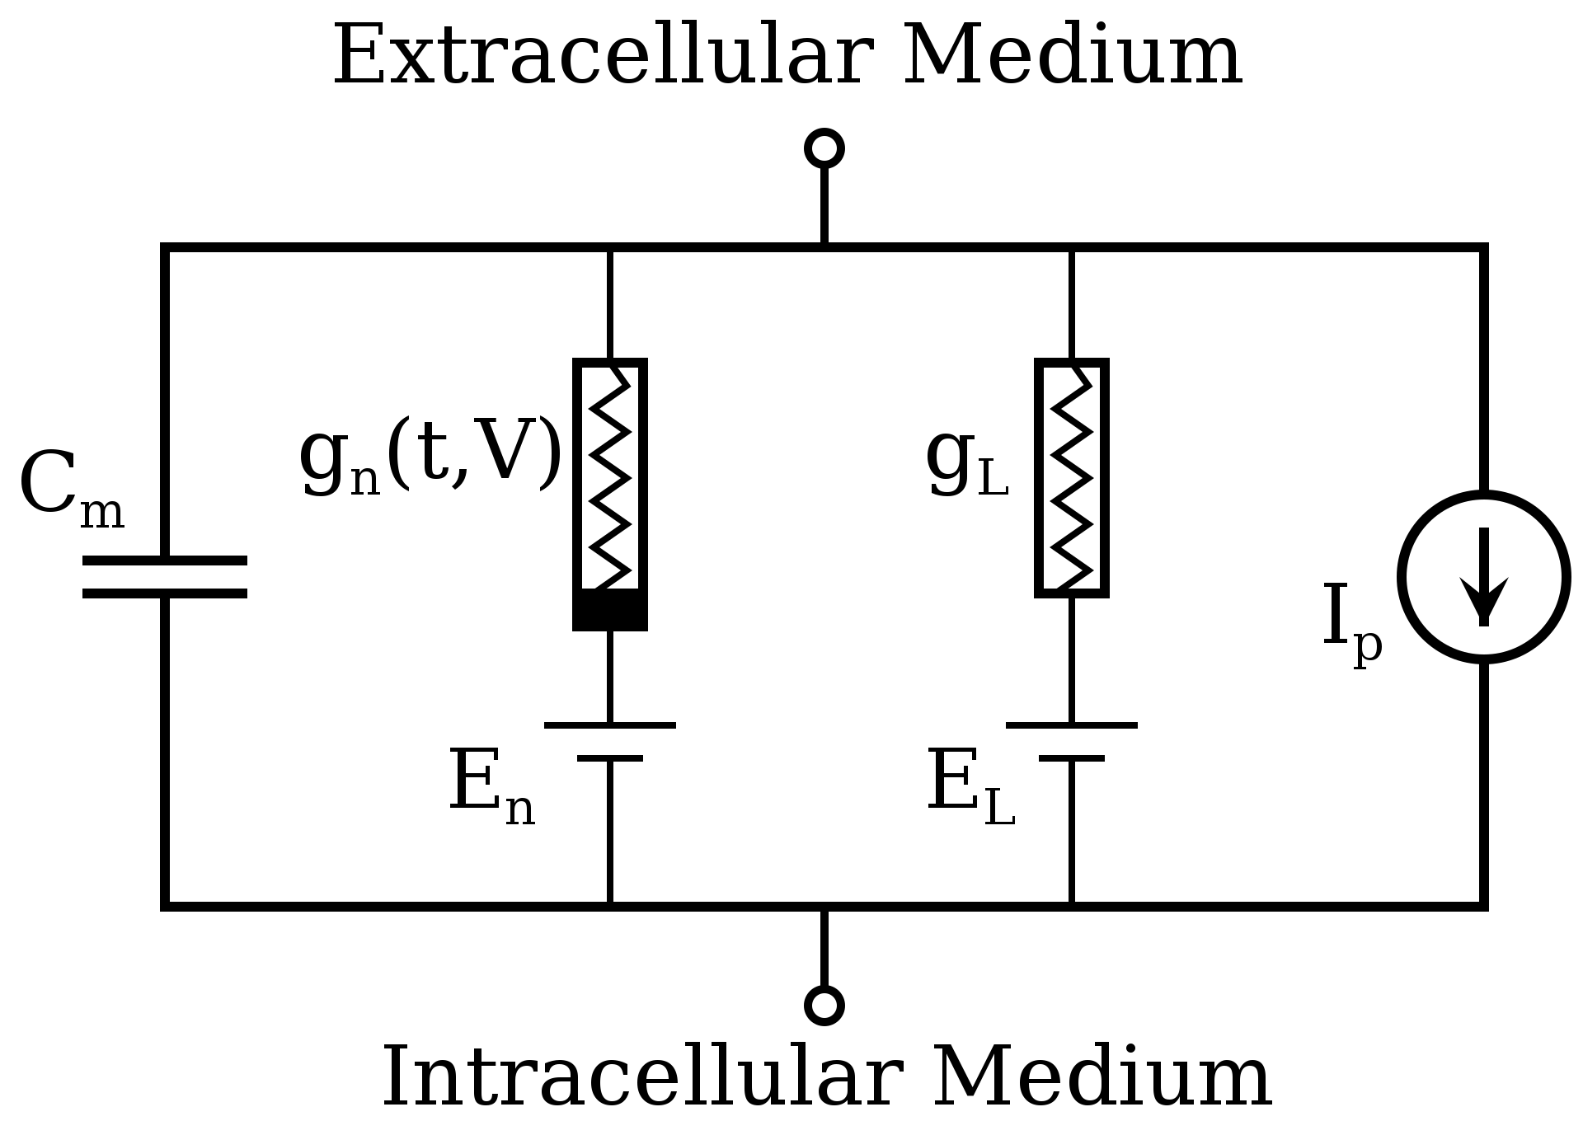
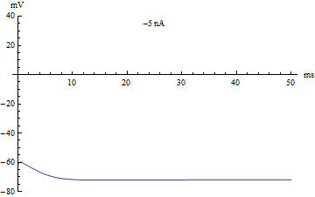
Biological Inspiration: Hodgkin & Huxley
Hodgkin & Huxley won the Nobel prize for their model of cell membranes, which provided lots more detail about how the McCulloch-Pitts model works in nature. Their nonlinear model has two step functions:
$I <$ threshold1: V$=−75mV$
threshold1 $< I <$ threshold2: V has a spike, then returns to rest.
threshold 2 $< I$: V spikes periodically
Hodgkin & Huxley Circuit Model of a Neuron Membrane
By Krishnavedala - Own work, CC0, https://commons.wikimedia.org/w/index.php?curid=21725464
Membrane voltage versus time. As current passes 0mA, spike appears. As current passes 10mA, spike train appears.
By Alexander J. White - Own work, CC BY-SA 3.0, https://commons.wikimedia.org/w/index.php?curid=30310965

Slide 5
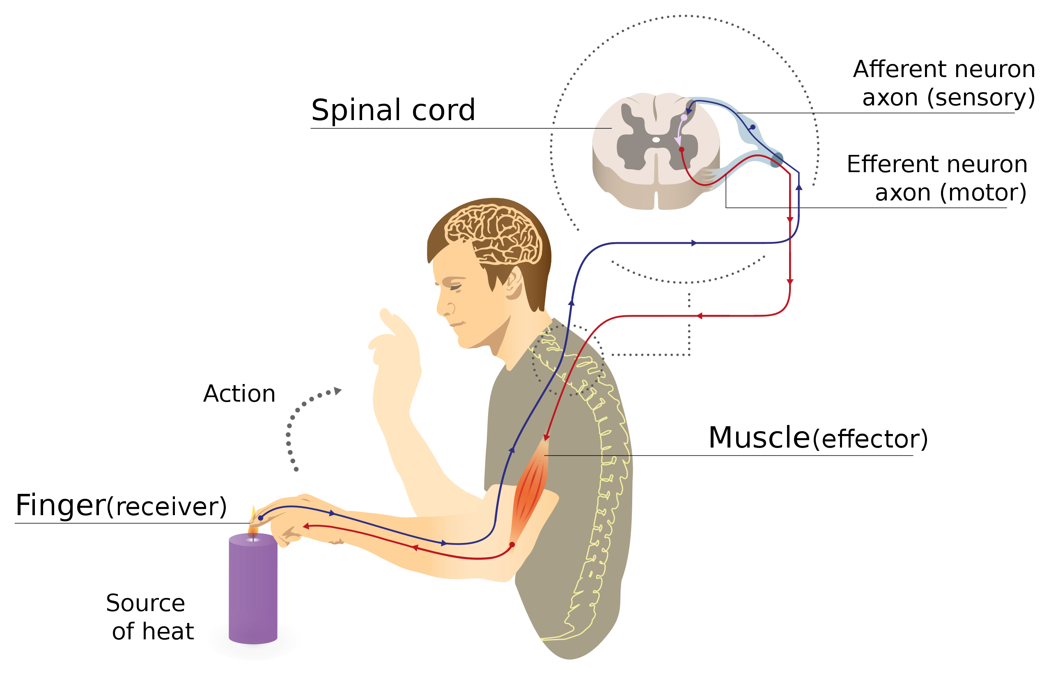
Biological Inspiration: Neuronal Circuits
Even the simplest actions involve more than one neuron, acting in sequence in a neuronal circuit.
One of the simplest neuronal circuits is a reflex arc, which may contain just two neurons:
The sensor neuron detects a stimulus, and communicates an electrical signal to …
The motor neuron, which activates the muscle.
Illustration of a reflex arc: sensor neuron sends a voltage spike to the spinal column, where the resulting current causes a spike in a motor neuron, whose spike activates the muscle.
By MartaAguayo - Own work, CC BY-SA 3.0, https://commons.wikimedia.org/w/index.php?curid=39181552

Slide 6
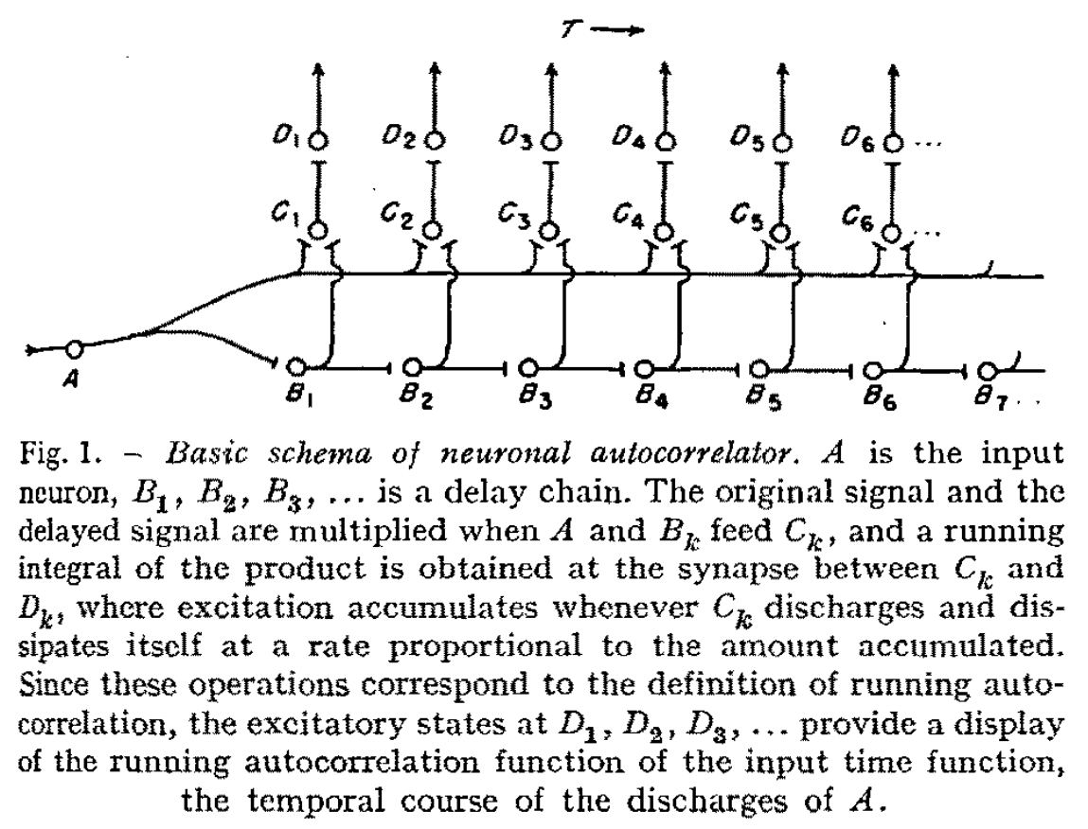
Biological Inspiration: Neuronal Circuits
A circuit composed of many neurons can compute the autocorrelation function of an input sound, and from the autocorrelation, can estimate the pitch frequency.
The circuit depends on output neurons, C, that each compute a step function in response to the sum of two different input neurons, A and B.
J.C.R. Licklider, “A Duplex Theory of Pitch Perception,” Experientia VII(4):128-134, 1951

Slide 7
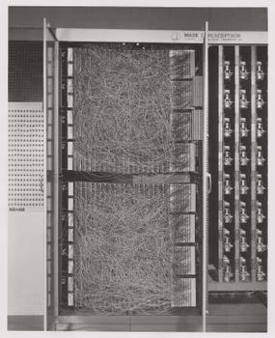
Perceptron
Rosenblatt was granted a patent for the “perceptron,” an electrical circuit model of a neuron.
The perceptron is basically a network of McCulloch-Pitts neurons.
Rosenblatt’s key innovation was the perceptron learning algorithm.

Slide 8
A McCulloch-Pitts Neuron can compute some logical functions…
When the features are binary ($x_{j}∈\{0,1\}$), many (but not all!) binary functions can be re-written as linear functions. For example, the function
$$Y^{∗}=(x_{1}∨x_{2})$$
can be re-written as
$$Y^{∗}=1 if: x_{1}+x_{2}−0.5>0$$
Similarly, the function
$$Y^{∗}=(x_{1}∧x_{2})$$
can be re-written as
$$Y^{∗}=1 if: x_{1}+x_{2}−1.5>0$$
$$x_{2}$$
$$x_{2}$$
$$x_{1}$$
$$x_{1}$$

Slide 9
… but not all.
Not all logical functions can be written as linear classifiers!
Minsky and Papert wrote a book called Perceptrons in 1969. Although the book said many other things, the only thing most people remembered about the book was that:
“A linear classifier cannot learn an XOR function.”
Because of that statement, most people gave up working on neural networks from about 1969 to about 2006.
Minsky and Papert also proved that a two-layer neural net can compute an XOR function. But most people didn’t notice.
$$x_{2}$$
$$x_{1}$$

Slide 10
Outline
Why use more than one layer?
Biological inspiration
Representational power: the XOR function
Two-layer neural networks
The Fundamental Theorem of Calculus
Feature learning for linear classifiers
Deep networks
Biological inspiration: features computed from features
Flexibility: convolutional, recurrent, and gated architectures

Slide 11
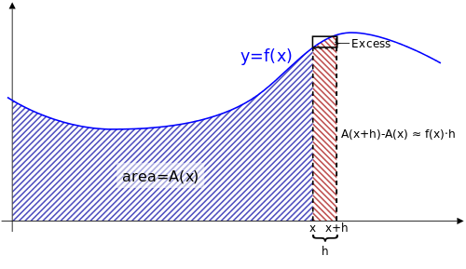
The Fundamental Theorem of Calculus
The Fundamental Theorem of Calculus (proved by Isaac Newton) says that
$$f\left(x\right)=\lim_{Δ→0}{\frac{A\left(x+Δ\right)−A(x)}{Δ}}$$
Illustration of the Fundamental Theorem of Calculus: any smooth function is the derivative of its own integral. The integral can be approximated as the sum of rectangles, with error going to zero as the width goes to zero.
By Kabel - Own work, CC BY-SA 4.0, https://commons.wikimedia.org/w/index.php?curid=11034713

Slide 12
The Fundamental Theorem of Calculus
Imagine the following neural network. Each neuron computes
$$h_{k}\left(x\right)=u(x−kΔ)$$
Where u(x) is the unit step function. Define
$$w_{k}=A\left(kΔ\right)−A((k−1)Δ)$$
Then, for any smooth function A(x),
$$A\left(x\right)=\lim_{Δ→0}{\sum_{k=−∞}^{∞}{w_{k}h_{k}\left(x\right)}}$$
A(x)
+
By Kabel - Own work, CC BY-SA 4.0, https://commons.wikimedia.org/w/index.php?curid=11034713
$$w_{1}$$
$$w_{2}$$
$$w_{3}$$
$$w_{4}$$
$$w_{5}$$
$$…$$
$$w_{N}$$
x
1

Slide 13
The Fundamental Theorem of Calculus
Imagine the following neural network. Each neuron computes
$$h_{k}\left(x\right)=u(x−kΔ)$$
Where u(x) is the unit step function. Define
$$w_{k}=f\left(kΔ\right)−f((k−1)Δ)$$
Then, for any smooth function f(x),
$$f\left(x\right)=\lim_{Δ→0}{\sum_{k=−∞}^{∞}{w_{k}h_{k}\left(x\right)}}$$
f(x)
+
By Kabel - Own work, CC BY-SA 4.0, https://commons.wikimedia.org/w/index.php?curid=11034713
$$w_{1}$$
$$w_{2}$$
$$w_{3}$$
$$w_{4}$$
$$w_{5}$$
$$…$$
$$w_{N}$$
x
1

Slide 14
The Neural Network Representer Theorem (Barron, 1993, “Universal Approximation Bounds for Superpositions of a Sigmoidal Function”)
For any vector function $f(\vec{x})$ that is sufficiently smooth, and whose limit as $\vec{x}→∞$ decays sufficiently, there is a two-layer neural network with N sigmoidal hidden nodes $h_{k}\left(\vec{x}\right)$ and second-layer weights $w_{k}$such that
$$f\left(\vec{x}\right)=\lim_{N→∞}{\sum_{k=1}^{N}{w_{k}h_{k}\left(\vec{x}\right)}}$$
$$f\left(\vec{x}\right)$$
+
By Kabel - Own work, CC BY-SA 4.0, https://commons.wikimedia.org/w/index.php?curid=11034713
$$w_{1}$$
$$w_{2}$$
$$w_{3}$$
$$w_{4}$$
$$w_{5}$$
$$…$$
$$w_{N}$$
$$\vec{x}$$
1

Slide 15
Outline
Why use more than one layer?
Biological inspiration
Representational power: the XOR function
Two-layer neural networks
The Fundamental Theorem of Calculus
Feature learning for linear classifiers
Deep networks
Biological inspiration: features computed from features
Flexibility: convolutional, recurrent, and gated architectures

Slide 16
Classifiers example: dogs versus cats
Can you write a program that can tell which ones are dogs, and which ones are cats?
Idea #3:
$x_{1}=$ tameness (# times the animal comes when called, out of 40).
$x_{2}=$ weight of the animal, in pounds.
If $0.5x_{1}+0. 5x_{2}>20$, call it a dog.
Otherwise, call it a cat.
This is called a “linear classifier” because $0.5x_{1}+0. 5x_{2}=20$ is the equation for a line.

Slide 17
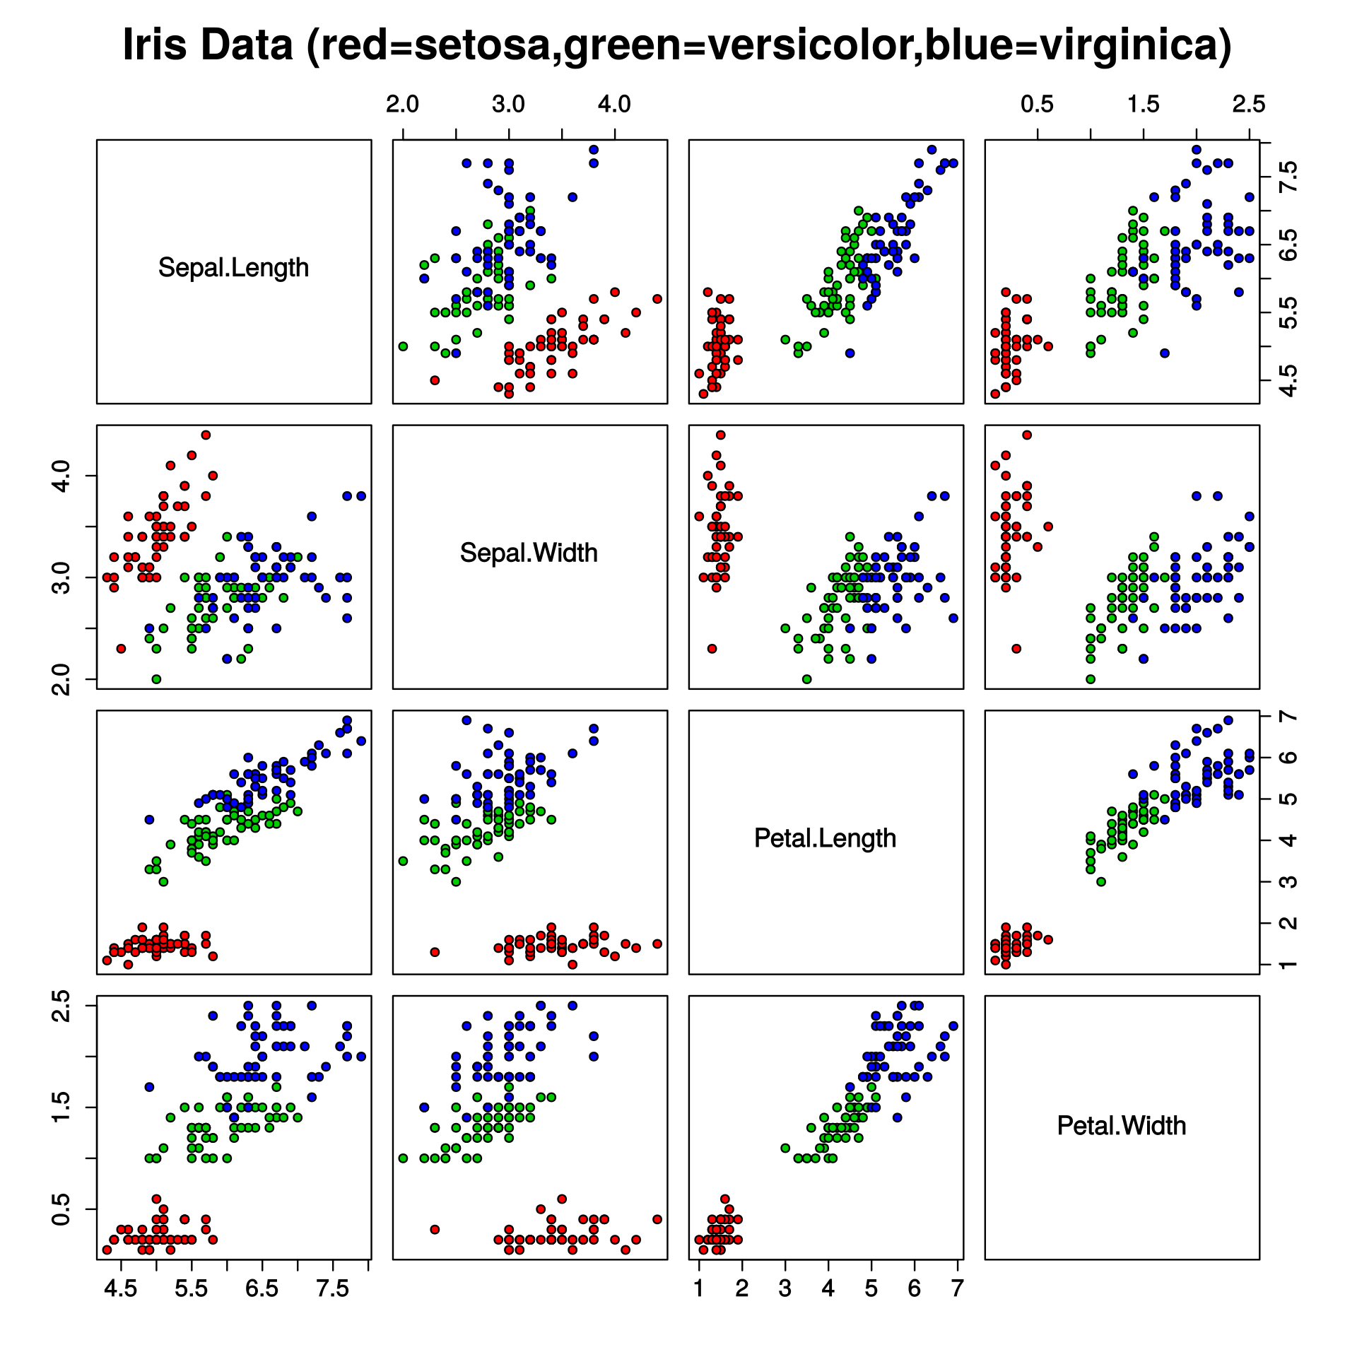
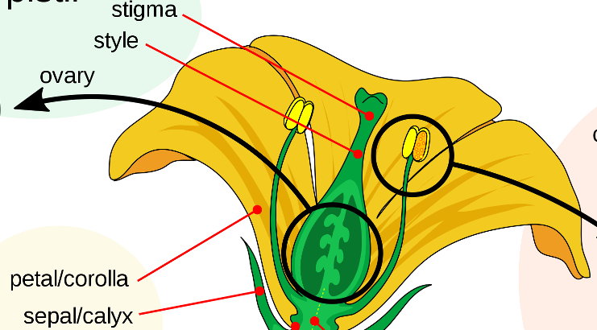
The feature selection problem
By Nicoguaro - Own work, CC BY 4.0, https://commons.wikimedia.org/w/index.php?curid=46257808
The biggest problem people had with linear classifiers, until back-propagation came along, was: Which features should I observe?
(TAMENESS? Really? What is that, and how do you measure it?)
Example: linear discriminant analysis was invented by Ronald Fisher (1936) using 4 measurements of irises:
Sepal width & length
Petal width & length
How did he come up with those measurements? Why are they good measurements?
Extracted from Mature_flower_diagram.svg
By Mariana Ruiz LadyofHats - Own work, Public Domain, https://commons.wikimedia.org/w/index.php?curid=2273307

Slide 18
Feature Learning: A way to think about neural nets
$$f\left(\vec{x}\right)$$
The solution to the “feature selection” problem turns out to be, in many cases, totally easy: if you don’t know the features, then learn them!
Define a two-layer neural network. The first-layer weights are $w_{kd}^{(1)}$. The first layer computes
$$h_{k}\left(\vec{x}\right)=σ\left(\sum_{d=1}^{D+1}{w_{kd}^{(1)}x_{d}}\right)$$
The second-layer weights are $w_{k}^{(2)}$. It computes
$$f\left(\vec{x}\right)=\sum_{k=1}^{N}{w_{k}^{(2)}h_{k}\left(\vec{x}\right)}$$
+
$$w_{1}^{(2)}$$
$$w_{2}^{(2)}$$
$$w_{3}^{(2)}$$
$$…$$
$$w_{N}^{(2)}$$
$$w_{1,D+1}^{(1)}$$
$$w_{N,1}^{(1)}$$
$$w_{12}^{(1)}$$
$$w_{N,D}^{(1)}$$
$$w_{11}^{(1)}$$
$$w_{N,D+1}^{(1)}$$
$$x_{1}$$
$$x_{2}$$
$$…$$
$$x_{D}$$
$$1$$

Slide 19
Feature Learning: A way to think about neural nets
$$x_{2}$$
$h_{2}\left(\vec{x}\right)=1$ up in this region
For example, consider the XOR problem. Suppose we create two hidden nodes:
$$h_{1}\left(\vec{x}\right)=u\left(0.5−x_{1}−x_{2}\right)$$
$$h_{2}\left(\vec{x}\right)=u\left(x_{1}+x_{2}−1.5\right)$$
Then the XOR function $Y^{∗}=(x_{1}⊕x_{2})$ is given by
$$Y^{∗}=h_{1}\left(\vec{x}\right)+h_{2}\left(\vec{x}\right)−1$$
$h_{1}\left(\vec{x}\right)=1$ down in this region
$$x_{1}$$
Here in the middle, both $h_{1}\left(\vec{x}\right)$and $h_{2}\left(\vec{x}\right)$ are zero.
$$h_{2}\left(\vec{x}\right)$$
$$h_{1}\left(\vec{x}\right)$$

Slide 20
Feature Learning: A way to think about neural nets
$$x_{2}$$
In general, this is one of the most useful ways to think about neural nets:
The first layer learns a set of features.
The second layer learns a linear classifier, using those features as its input.
$$x_{1}$$
$$h_{2}\left(\vec{x}\right)$$
$$h_{1}\left(\vec{x}\right)$$

Slide 21
Outline
Why use more than one layer?
Biological inspiration
Representational power: the XOR function
Two-layer neural networks
The Fundamental Theorem of Calculus
Feature learning for linear classifiers
Deep networks
Biological inspiration: features computed from features
Flexibility: convolutional, recurrent, and gated architectures

Slide 22
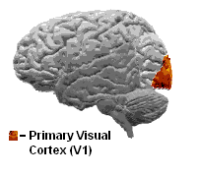
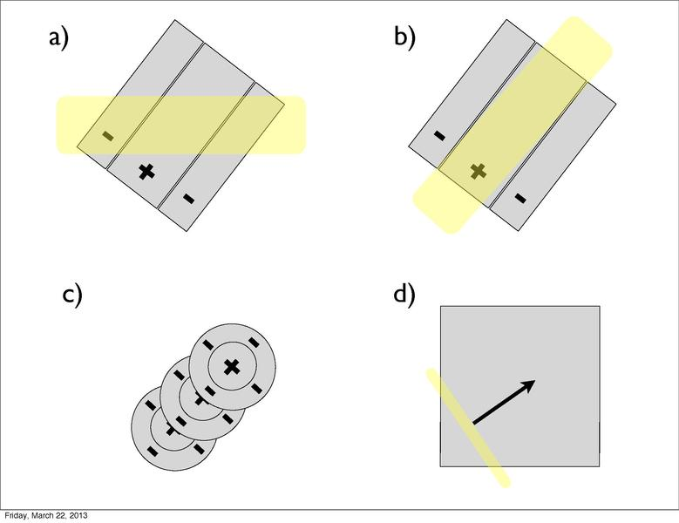
Biological Inspiration: Simple, Complex, and Hypercomplex Cells in the Visual Cortex
By Chavez01 at English Wikipedia - Transferred from en.wikipedia to Commons by ××ª× ×× using CommonsHelper., Public Domain, https://commons.wikimedia.org/w/index.php?curid=4431766
D. Hubel and T. Wiesel (1959, 1962, Nobel Prize 1981) found that the human visual cortex consists of a hierarchy of simple, complex, and hypercomplex cells.
Simple cells (in visual area 1, called V1) fire when you see a simple pattern of colors in a particular orientation (figure (b), at right)
Gabor filter-type receptive field typical for a simple cell. Blue regions indicate inhibition, red facilitation.
By ​English Wikipedia user Joe pharos, CC BY-SA 3.0, https://commons.wikimedia.org/w/index.php?curid=7437457
Permission is granted to copy, distribute and/or modify this document under the terms of the GNU Free Documentation License, Version 1.2 or any later version published by the Free Software Foundation; with no Invariant Sections, no Front-Cover Texts, and no Back-Cover Texts.

Slide 23
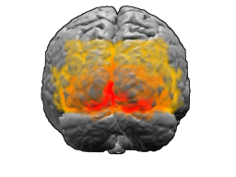
Biological Inspiration: Simple, Complex, and Hypercomplex Cells in the Visual Cortex
D. Hubel and T. Wiesel (1959, 1962, Nobel Prize 1981) found that the human visual cortex consists of a hierarchy of simple, complex, and hypercomplex cells.
Complex cells are sensitive to moving stimuli of a particular orientation traveling in a particular direction (figure (d) at right).
Complex cells can be modeled as linear combinations of simple cells!
View of the brain from behind. Brodman area 17=Red; 18=orange; 19=yellow. By Washington irving at English Wikipedia, CC BY-SA 3.0, https://commons.wikimedia.org/w/index.php?curid=1643737
Permission is granted to copy, distribute and/or modify this document under the terms of the GNU Free Documentation License, Version 1.2 or any later version published by the Free Software Foundation; with no Invariant Sections, no Front-Cover Texts, and no Back-Cover Texts.

Slide 24
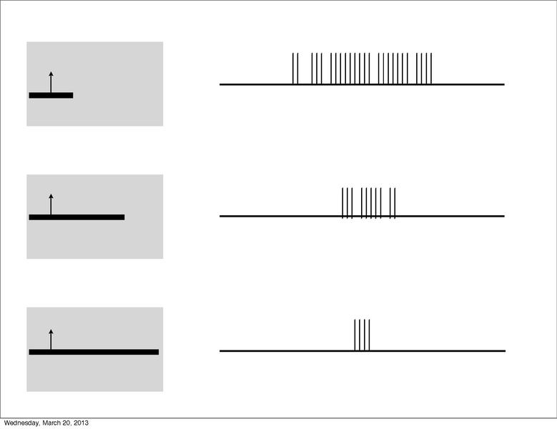
Biological Inspiration: Simple, Complex, and Hypercomplex Cells in the Visual Cortex
D. Hubel and T. Wiesel (1959, 1962, Nobel Prize 1981) found that the human visual cortex consists of a hierarchy of simple, complex, and hypercomplex cells.
Hypercomplex cells are sensitive to moving stimuli of a particular orientation traveling in a particular direction, and they also stop firing if the stimulus gets too long.
Hypercomplex cells can be modeled as linear combinations of complex cells!
View of the brain from behind. Brodman area 17=Red; 18=orange; 19=yellow. By Washington irving at English Wikipedia, CC BY-SA 3.0, https://commons.wikimedia.org/w/index.php?curid=1643737
Permission is granted to copy, distribute and/or modify this document under the terms of the GNU Free Documentation License, Version 1.2 or any later version published by the Free Software Foundation; with no Invariant Sections, no Front-Cover Texts, and no Back-Cover Texts.

Slide 25
Biological Inspiration: Simple, Complex, and Hypercomplex Cells in the Visual Cortex
Hypercomplex Cells
Hubel & Wiesel’s simple, complex, and hypercomplex cells have been modeled as a hierarchy, in which each type of cell computes a linear combination of the type below it, followed by a nonlinear activation function.
Complex Cells
Simple Cells

Slide 26
Outline
Why use more than one layer?
Biological inspiration
Representational power: the XOR function
Two-layer neural networks
The Fundamental Theorem of Calculus
Feature learning for linear classifiers
Deep networks
Biological inspiration: features computed from features
Flexibility: convolutional, recurrent, and gated architectures

Slide 27
Flexibility: many types of deep networks
The other reason to use deep neural networks is that, with a deep enough network, many types of learning algorithms are possible, far beyond simple classifiers.
Convolutional neural networks: output depends on the shape of the input, regardless of where it occurs in the image.
Recurrent neural network: output depends on past values of the output.
Gated neural network: one set of cells is capable of turning another set of cells on or off.

Slide 28
Convolutional Neural Network
In a convolutional neural network, the multiplicative first layer is replaced by a convolutional first layer:
$$h_{k}\left(\vec{x}\right)=σ\left(\sum_{d=−D}^{D}{w_{d}x_{k−d}}\right)$$
By Aphex34 - Own work, CC BY-SA 4.0, https://commons.wikimedia.org/w/index.php?curid=45679374

Slide 29
Recurrent Neural Network
In a recurrent neural network, the hidden nodes at time t depend on the hidden nodes at time t-1:
$$h_{kt}=σ\left(\sum_{d=1}^{D}{u_{kd}x_{dt}}+\sum_{j=1}^{N}{v_{kj}h_{j,t−1}}\right)$$
By fdeloche - Own work, CC BY-SA 4.0, https://commons.wikimedia.org/w/index.php?curid=60109157

Slide 30
Gated Neural Network
In a gated neural network (like the “long-short-term memory” network shown here), the output of some hidden nodes are called ”gates:”
$$g=σ\left(u_{1}x+b_{1}\right)∈[0,1]$$
The gates are then multiplied by the outputs of other hidden nodes, effectively turning them on or off:
$$c=u_{2}x+b_{2}$$
$$f(x)=g×c$$
$$f(x)$$
$$×$$
+
$$x$$
$$1$$

Slide 31
What are these architectures for?
Convolutional neural networks: output depends on the shape of the input, regardless of where it occurs in the image.
Recurrent neural network: output depends on past values of the output.
Gated neural network: one set of cells is capable of turning another set of cells on or off.

Slide 32
Conclusions
Why use more than one layer?
Biological inspiration: the simplest neuronal network in the human body, the reflex arc, still uses at least two neurons
Representational power: the XOR function can’t be computed with a one-layer network (a perceptron), but it can be computed with two layers
Two-layer neural networks
The Fundamental Theorem of Calculus means that a two-layer network can approximate any function f(x) arbitrarily well, as the number of hidden nodes goes to infinity
A useful way to think about neural nets: the last layer is a linear classifier; all of the other layers compute features for the last layer to use
Deep networks
Biological inspiration: human vision (and hearing) compute complex and hypercomplex features from simpler features
Flexibility: convolutional=independent of where it occurs in space, recurrent=has internal memory, gated=one hidden node can turn another node on or off

