Slide 1
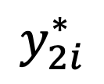
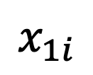

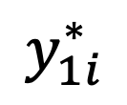

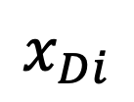

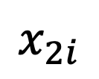
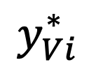
Lecture 28: Back-Propagation
$$y_{1i}^{∗}$$
$$y_{2i}^{∗}$$
$$y_{Vi}^{∗}$$
$$1$$
Mark Hasegawa-Johnson
April 6, 2020
License: CC-BY 4.0. You may remix or redistribute if you cite the source.
$$1$$
$$x_{1i}$$
$$x_{2i}$$
$$…$$
$$x_{Di}$$
$$1$$

Slide 2
How to make a neural network
Training Data
Forward propagation
Loss Function
Back propagation

Slide 3
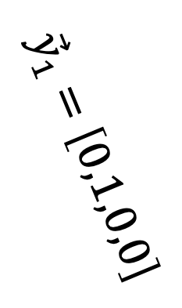
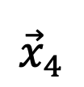
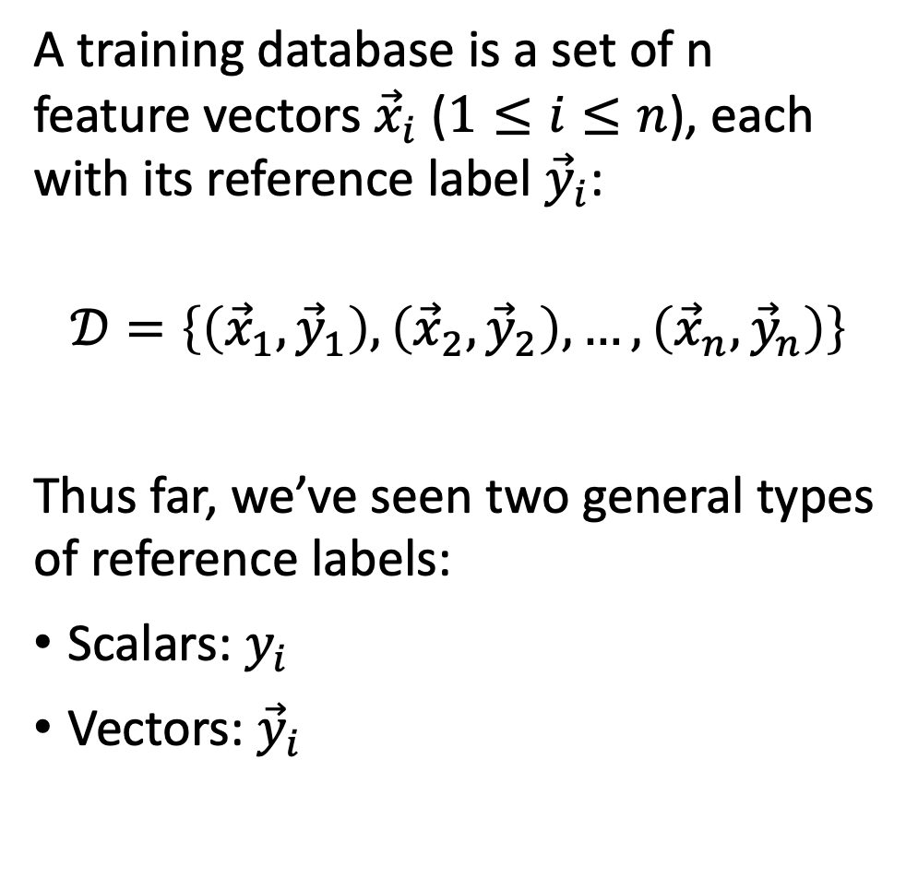
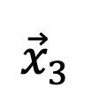
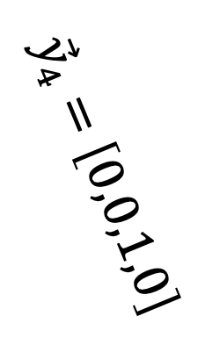
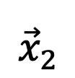
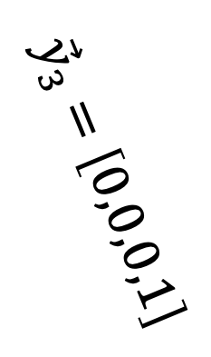
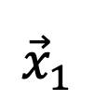
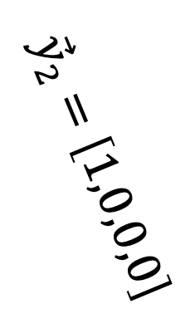
Training Data
A training database is a set of n feature vectors ${\vec{x}}_{i}$ ($1≤i≤n$), each with its reference label ${\vec{y}}_{i}$:
$$𝒟=\left\{\left({\vec{x}}_{1},{\vec{y}}_{1}\right),\left({\vec{x}}_{2},{\vec{y}}_{2}\right),…,\left({\vec{x}}_{n},{\vec{y}}_{n}\right)\right\}$$
Thus far, we’ve seen two general types of reference labels:
Scalars: $y_{i}$
Vectors: ${\vec{y}}_{i}$
$${\vec{x}}_{1}$$
$${\vec{x}}_{2}$$
$${\vec{x}}_{3}$$
$${\vec{x}}_{4}$$
$${\vec{y}}_{2}=\left[1,0,0,0\right]$$
$${\vec{y}}_{1}=\left[0,1,0,0\right]$$
$${\vec{y}}_{4}=\left[0,0,1,0\right]$$
$${\vec{y}}_{3}=\left[0,0,0,1\right]$$
Class Index | Class Name
1 | abacus
2 | camera
3 | chickens
4 | slug

Slide 4








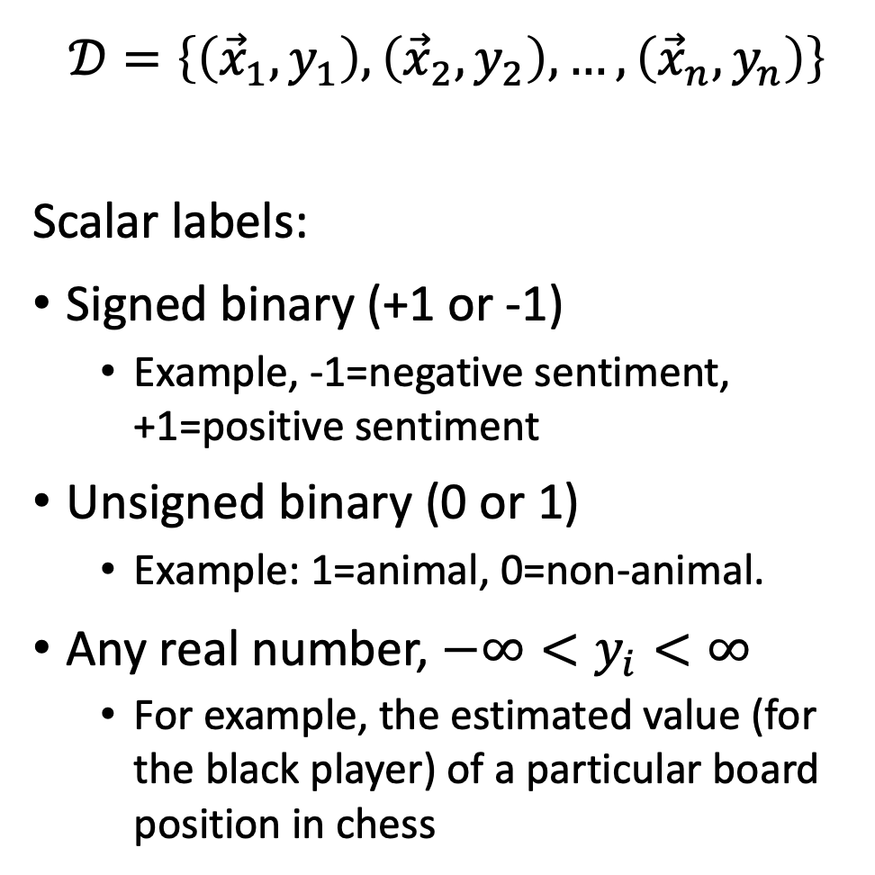




Scalar Labels
$$𝒟=\left\{\left({\vec{x}}_{1},y_{1}\right),\left({\vec{x}}_{2},y_{2}\right),…,\left({\vec{x}}_{n},y_{n}\right)\right\}$$
Scalar labels:
Signed binary (+1 or -1)
  Example, -1=negative sentiment, +1=positive sentiment
Unsigned binary (0 or 1)
  Example: 1=animal, 0=non-animal.
Any real number, $−∞<y_{i}<∞$
  For example, the estimated value (for the black player) of a particular board position in chess
$$y_{1}=−1$$
I’m warning you, it’s pretty pathetic.
$$y_{2}=+1$$
This is a beautiful movie, you’ll love it.
$$y_{1}=1$$
$$y_{2}=0$$
$$y_{3}=1$$
$$y_{4}=0$$
Learning Multiple Layers of Features from Tiny Images, Alex Krizhevsky, 2009
$$y=97$$

Slide 5
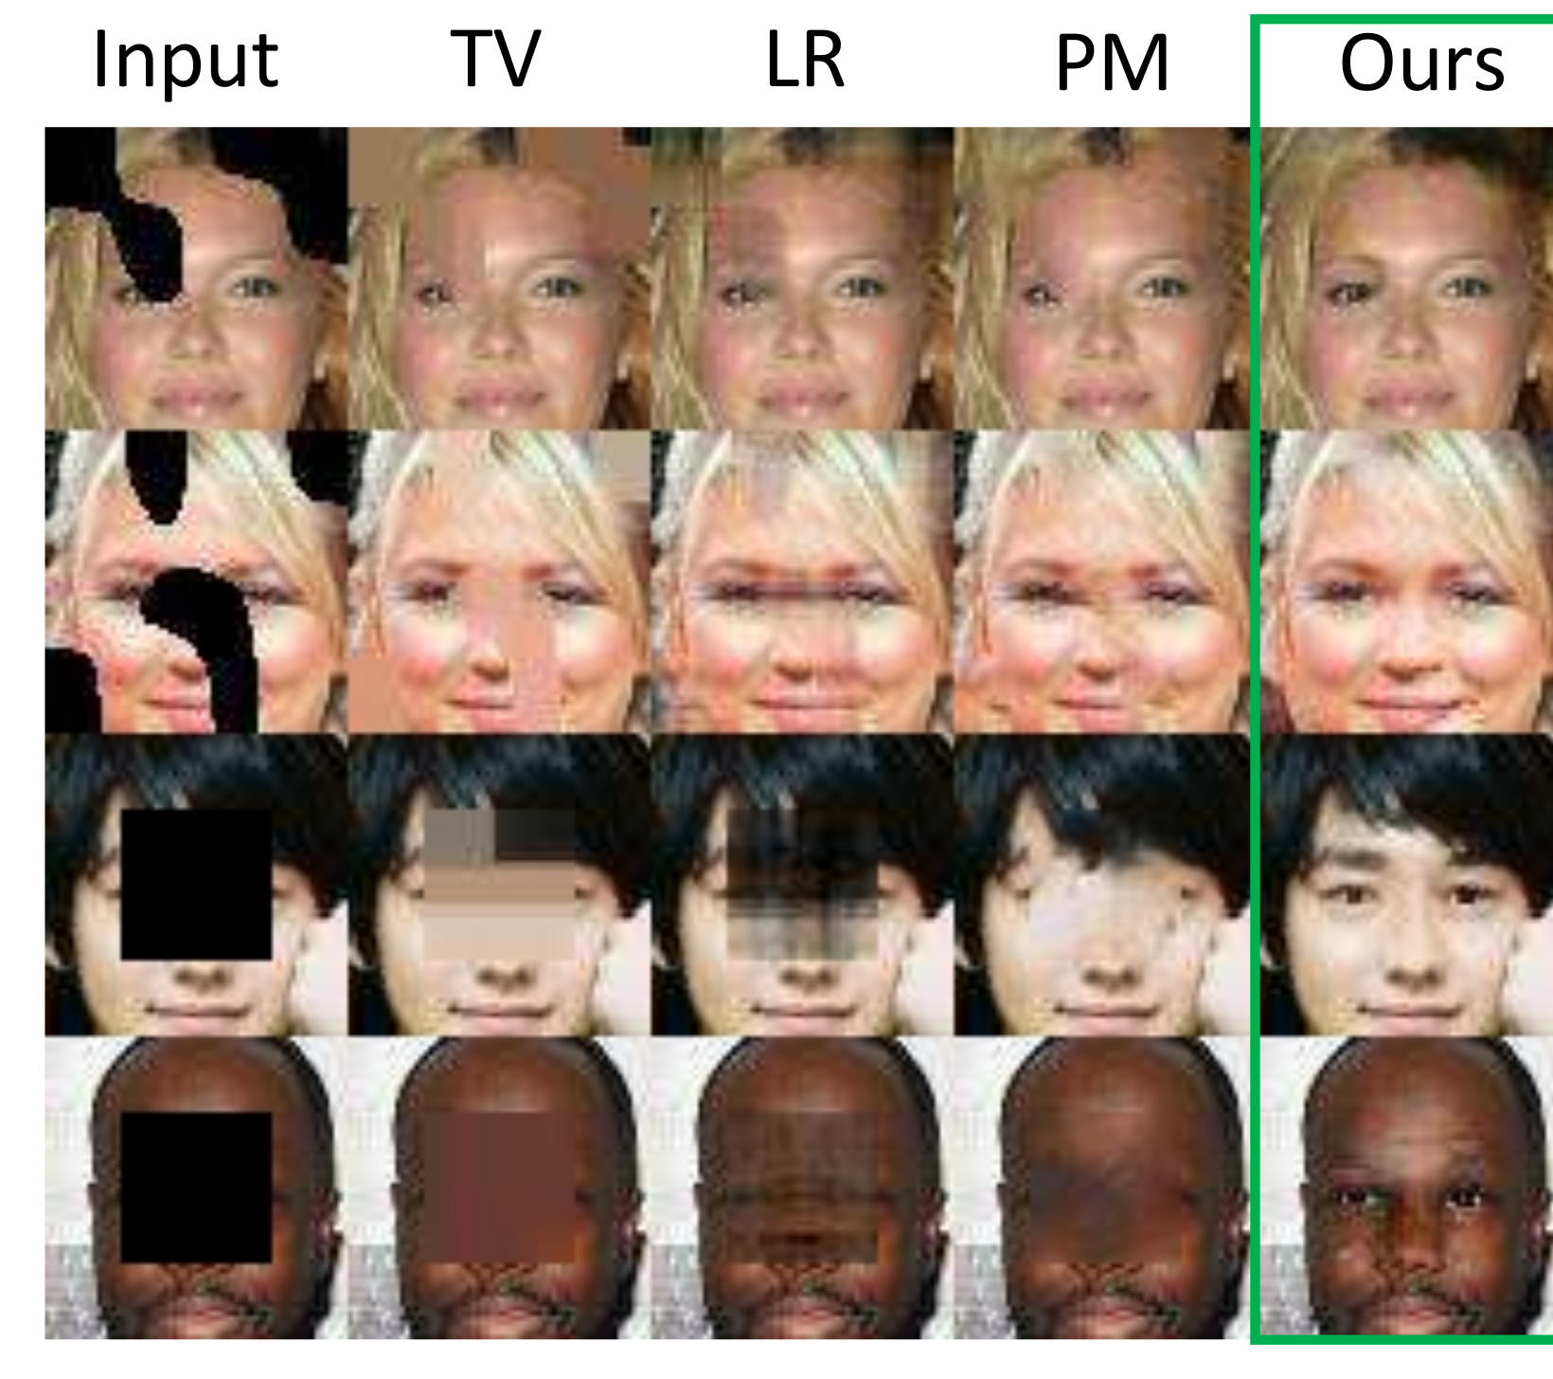
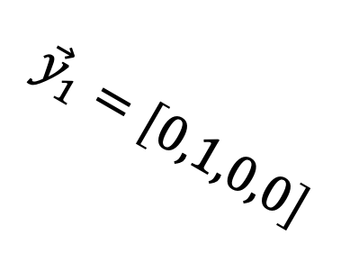
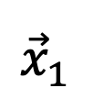
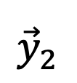

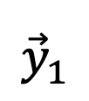
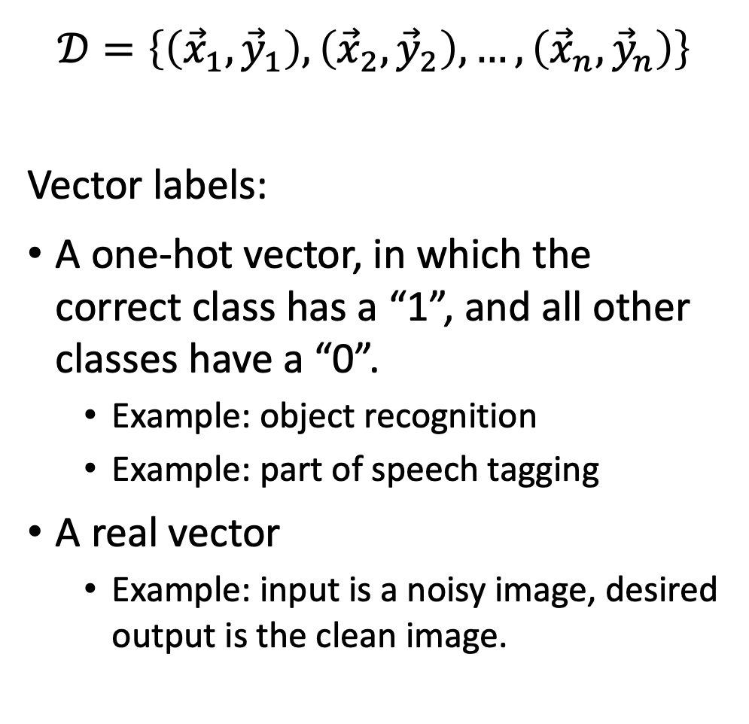
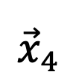
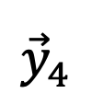

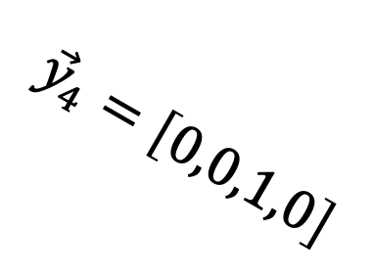

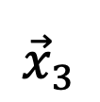
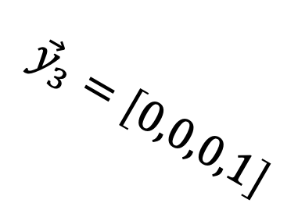
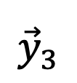

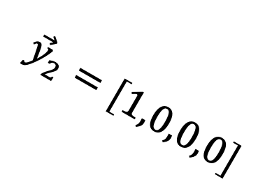
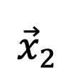
Vector Labels
$$𝒟=\left\{\left({\vec{x}}_{1},{\vec{y}}_{1}\right),\left({\vec{x}}_{2},{\vec{y}}_{2}\right),…,\left({\vec{x}}_{n},{\vec{y}}_{n}\right)\right\}$$
Vector labels:
A one-hot vector, in which the correct class has a “1”, and all other classes have a “0”.
  Example: object recognition
  Example: part of speech tagging
A real vector
  Example: input is a noisy image, desired output is the clean image.
$${\vec{x}}_{1}$$
$${\vec{x}}_{2}$$
$${\vec{x}}_{3}$$
$${\vec{x}}_{4}$$
$${\vec{y}}_{4}=\left[0,0,1,0\right]$$
$${\vec{y}}_{1}=\left[0,1,0,0\right]$$
$${\vec{y}}_{3}=\left[0,0,0,1\right]$$
$${\vec{y}}_{2}=\left[1,0,0,0\right]$$
$${\vec{x}}_{1}$$
$${\vec{y}}_{1}$$
$${\vec{x}}_{2}$$
$${\vec{y}}_{2}$$
$${\vec{x}}_{3}$$
$${\vec{y}}_{3}$$
$${\vec{x}}_{4}$$
$${\vec{y}}_{4}$$
“Semantic Image Inpainting with Deep Generative Models,” Raymond Yeh, Chen Chen, Teck Yian Lim, Alexander G. Schwing, Mark Hasegawa-Johnson and Minh Do

Slide 6
How to make a neural network
Training Data
Forward propagation
Loss Function
Back propagation

Slide 7
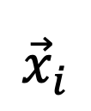
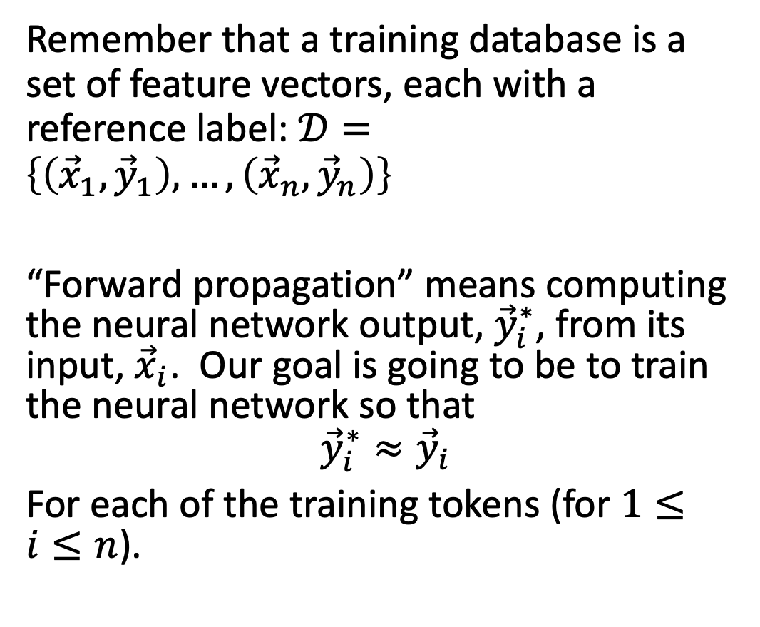
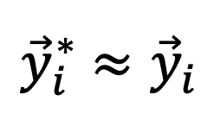
Forward propagation
${\vec{y}}_{i}^{∗}$ $≈{\vec{y}}_{i}$
Remember that a training database is a set of feature vectors, each with a reference label: $𝒟=\left\{\left({\vec{x}}_{1},{\vec{y}}_{1}\right), …,\left({\vec{x}}_{n},{\vec{y}}_{n}\right)\right\}$
“Forward propagation” means computing the neural network output, ${\vec{y}}_{i}^{∗}$, from its input, ${\vec{x}}_{i}$. Our goal is going to be to train the neural network so that
$${\vec{y}}_{i}^{∗}≈{\vec{y}}_{i}$$
For each of the training tokens (for $1≤i≤n$).
Neural Network
$${\vec{x}}_{i}$$

Slide 8

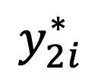
Forward propagation
$$y_{1i}^{∗}$$
$$y_{2i}^{∗}$$
$$y_{Vi}^{∗}$$
Neural Network
“Forward propagation” means:
Computing the neural network output, ${\vec{y}}_{i}^{∗}=\left[y_{1i}^{∗},…,y_{Vi}^{∗}\right]$,
from its input, ${\vec{x}}_{i}=\left[x_{1i},…,x_{Di}\right]$.
$$x_{1i}$$
$$x_{2i}$$
$$…$$
$$x_{Di}$$
$$1$$

Slide 9
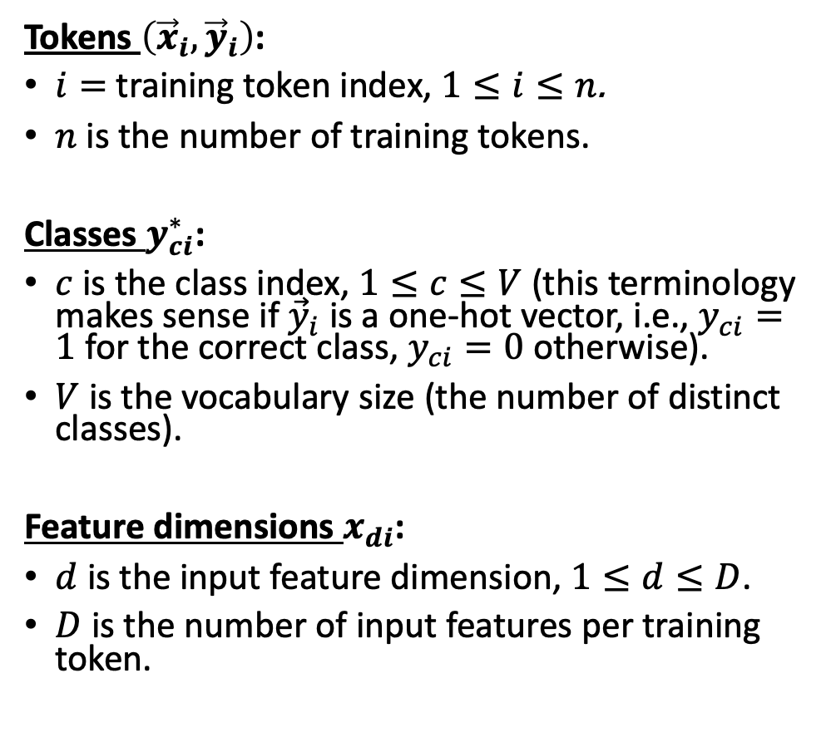
Forward propagation
$$y_{1i}^{∗}$$
$$y_{2i}^{∗}$$
$$y_{Vi}^{∗}$$
Tokens $\left({\vec{x}}_{i},{\vec{y}}_{i}\right)$:
$i=$ training token index, $1≤i≤n$.
$n$is the number of training tokens.
Classes $y_{ci}^{∗}$:
$c$ is the class index, $1≤c≤V$ (this terminology makes sense if ${\vec{y}}_{i}$ is a one-hot vector, i.e., $y_{ci}=1$ for the correct class, $y_{ci}=0$ otherwise).
$V$ is the vocabulary size (the number of distinct classes).
Feature dimensions $x_{di}$:
$d$ is the input feature dimension, $1≤d≤D$.
$D$ is the number of input features per training token.
Neural Network
$$x_{1i}$$
$$x_{2i}$$
$$…$$
$$x_{Di}$$
$$1$$

Slide 10
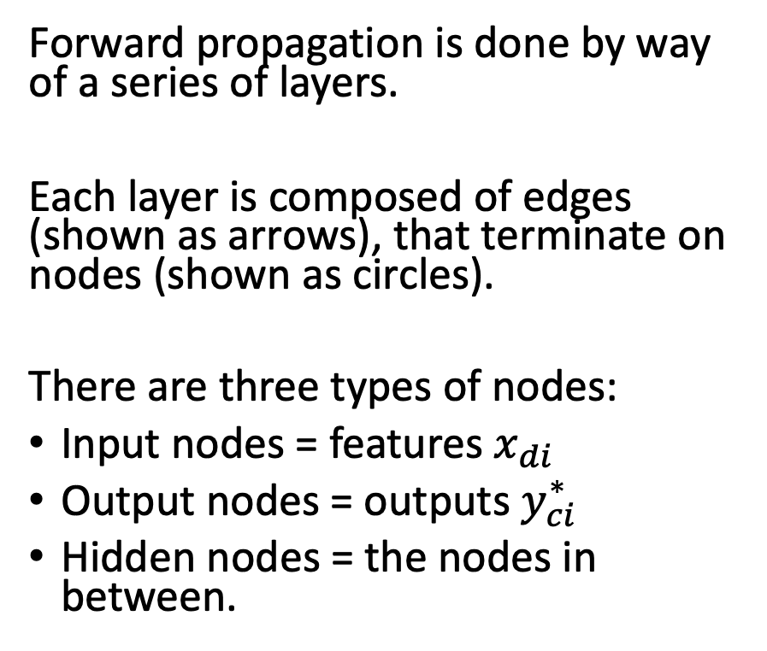
Forward propagation
$$y_{1i}^{∗}$$
$$y_{2i}^{∗}$$
$$y_{Vi}^{∗}$$
Forward propagation is done by way of a series of layers.
Each layer is composed of edges (shown as arrows), that terminate on nodes (shown as circles).
There are three types of nodes:
Input nodes = features $x_{di}$
Output nodes = outputs $y_{ci}^{∗}$
Hidden nodes = the nodes in between.
$$1$$
$$1$$
$$x_{1i}$$
$$x_{2i}$$
$$…$$
$$x_{Di}$$
$$1$$

Slide 11
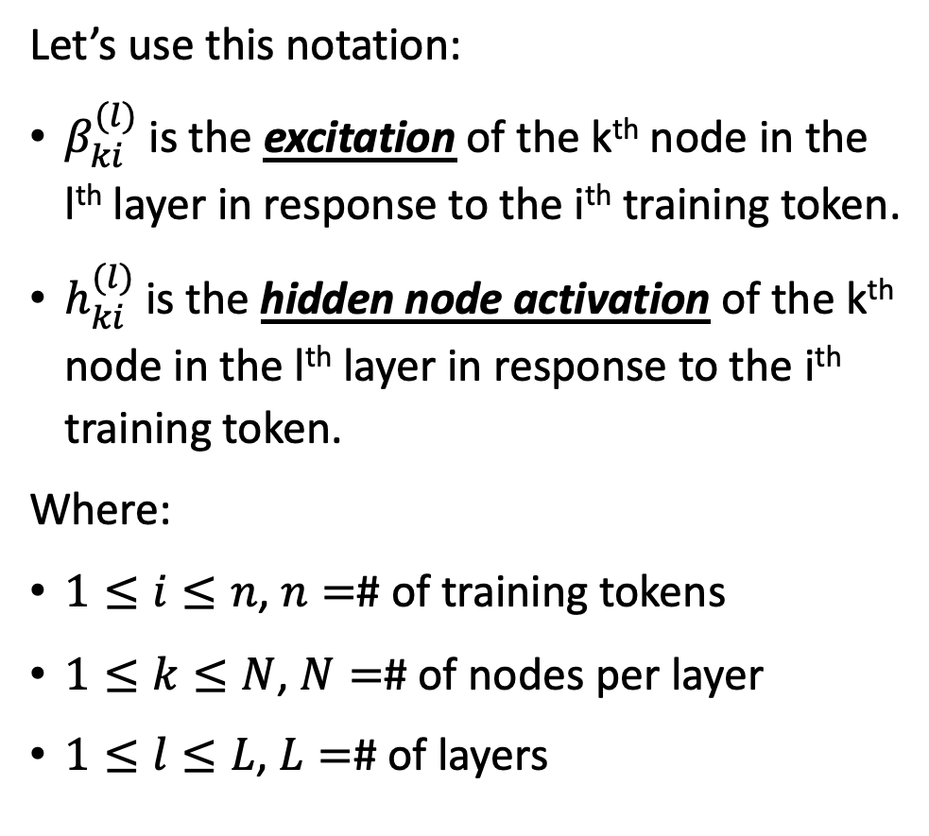
Forward propagation
$$y_{1i}^{∗}$$
$$y_{2i}^{∗}$$
$$y_{Vi}^{∗}$$
Let’s use this notation:
$β_{ki}^{(l)}$ is the excitation of the k^{th} node in the l^{th} layer in response to the i^{th} training token.
$h_{ki}^{(l)}$is the hidden node activation of the k^{th} node in the l^{th} layer in response to the i^{th} training token.
Where:
$1≤i≤n$, $n=$# of training tokens
$1≤k≤N$, $N=$# of nodes per layer
$1≤l≤L$, $L=$# of layers
$$1$$
$$1$$
$$x_{1i}$$
$$x_{2i}$$
$$…$$
$$x_{Di}$$
$$1$$

Slide 12
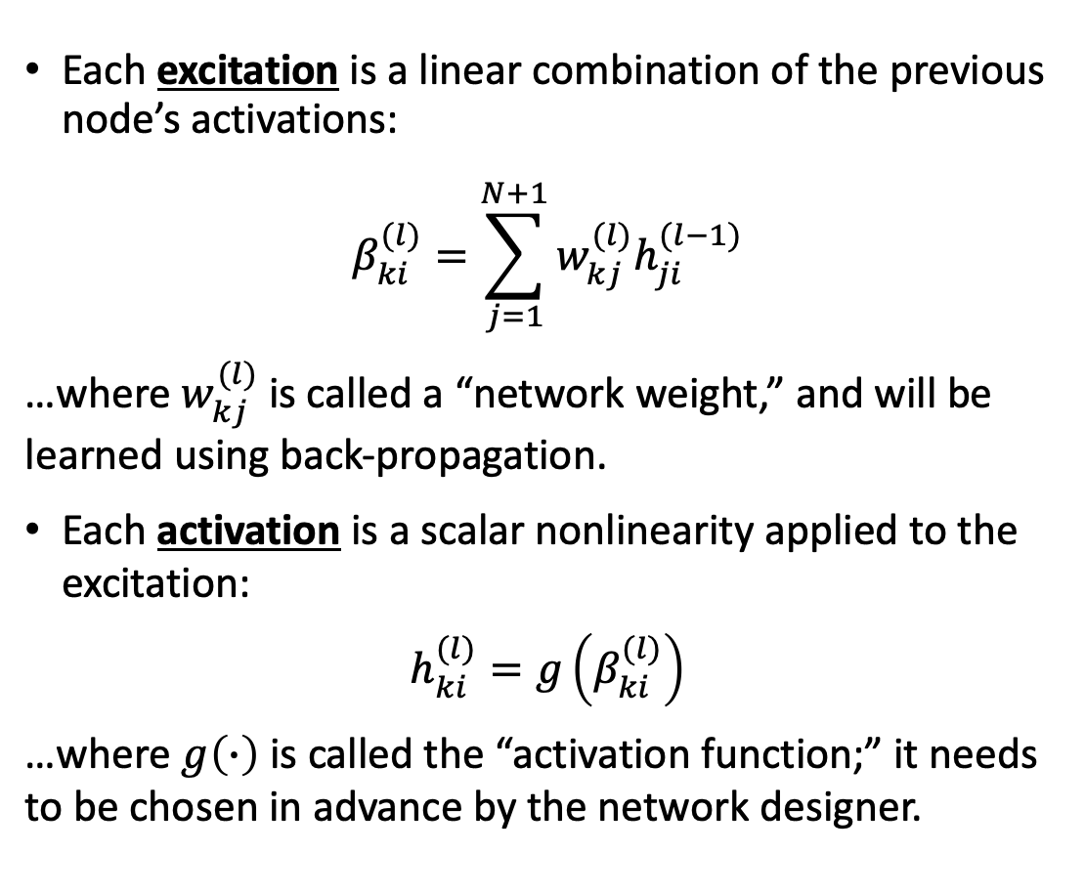
How forward propagation works
$$y_{1i}^{∗}$$
$$y_{2i}^{∗}$$
$$y_{Vi}^{∗}$$
Each excitation is a linear combination of the previous node’s activations:
$$β_{ki}^{(l)}=\sum_{j=1}^{N+1}{w_{kj}^{(l)}h_{ji}^{(l−1)}}$$
…where $w_{kj}^{(l)}$is called a “network weight,” and will be learned using back-propagation.
Each activation is a scalar nonlinearity applied to the excitation:
$$h_{ki}^{(l)}=g\left(β_{ki}^{(l)}\right)$$
…where $g\left(∙\right)$ is called the “activation function;” it needs to be chosen in advance by the network designer.
$$1$$
$$1$$
$$x_{1i}$$
$$x_{2i}$$
$$…$$
$$x_{Di}$$
$$1$$

Slide 13
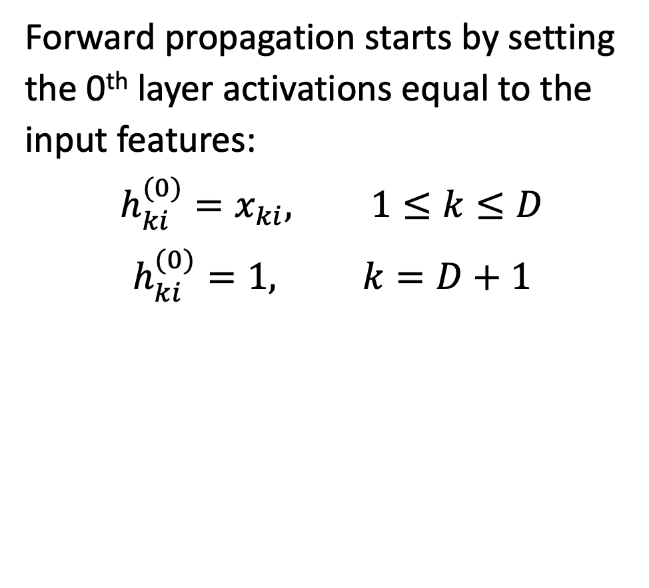
How forward propagation starts…
Forward propagation starts by setting the 0th layer activations equal to the input features:
$$h_{ki}^{(0)}=x_{ki}, 1≤k≤D$$
$$h_{ki}^{(0)}=1, k=D+1$$
$$x_{1i}$$
$$x_{2i}$$
$$…$$
$$x_{Di}$$
$$1$$

Slide 14

How forward propagation continues…
Then we calculate the first layer excitations as:
$$β_{ki}^{(1)}=\sum_{j=1}^{D+1}{w_{kj}^{(1)}h_{ji}^{(0)}}, 1≤k≤N$$
$$x_{1i}$$
$$x_{2i}$$
$$…$$
$$x_{Di}$$
$$1$$

Slide 15

How forward propagation continues…
Then we calculate the first-layer activations as:
$$h_{ki}^{(1)}=g\left(β_{ki}^{(1)}\right), 1≤k≤N$$
$$x_{1i}$$
$$x_{2i}$$
$$…$$
$$x_{Di}$$
$$1$$

Slide 16
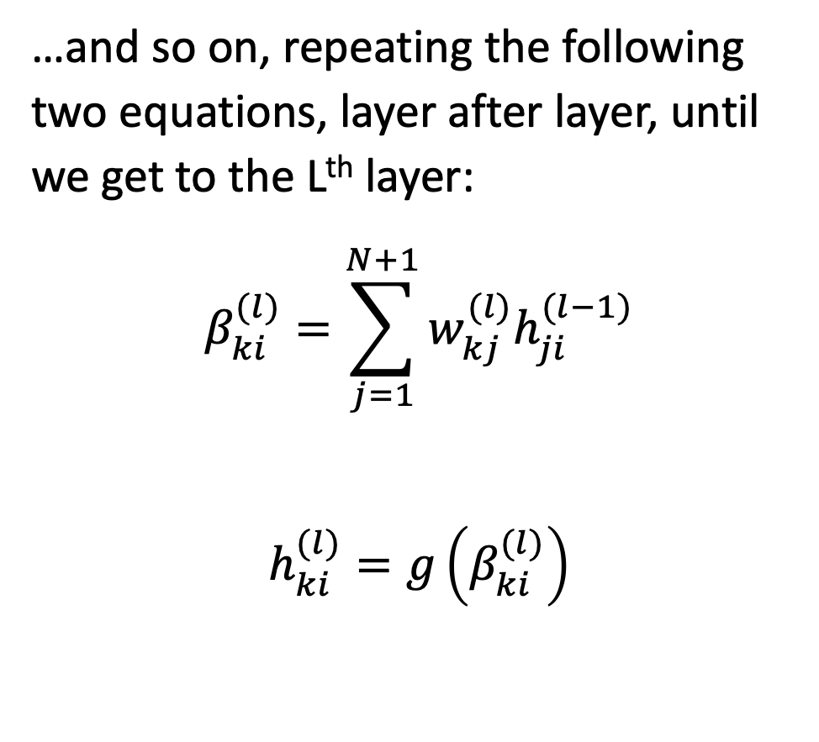
How forward propagation continues…
…and so on, repeating the following two equations, layer after layer, until we get to the Lth layer:
$$β_{ki}^{(l)}=\sum_{j=1}^{N+1}{w_{kj}^{(l)}h_{ji}^{(l−1)}}$$
$$h_{ki}^{(l)}=g\left(β_{ki}^{(l)}\right)$$
$$1$$
$$1$$
$$x_{1i}$$
$$x_{2i}$$
$$…$$
$$x_{Di}$$
$$1$$

Slide 17
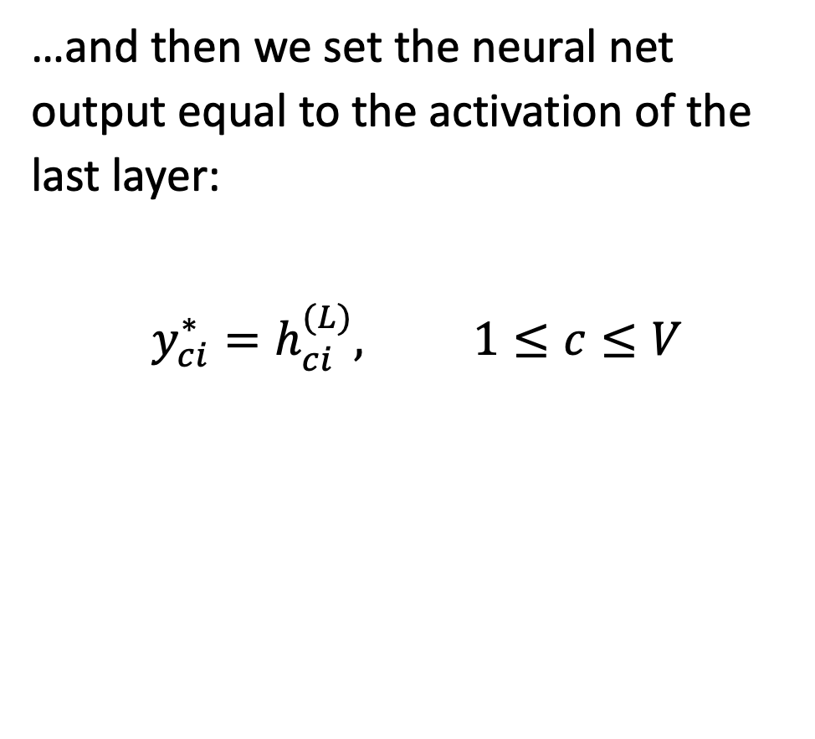
How forward propagation ends.
$$y_{1i}^{∗}$$
$$y_{2i}^{∗}$$
$$y_{Vi}^{∗}$$
…and then we set the neural net output equal to the activation of the last layer:
$$y_{ci}^{∗}=h_{ci}^{(L)}, 1≤c≤V$$
$$1$$
$$1$$
$$x_{1i}$$
$$x_{2i}$$
$$…$$
$$x_{Di}$$
$$1$$

Slide 18
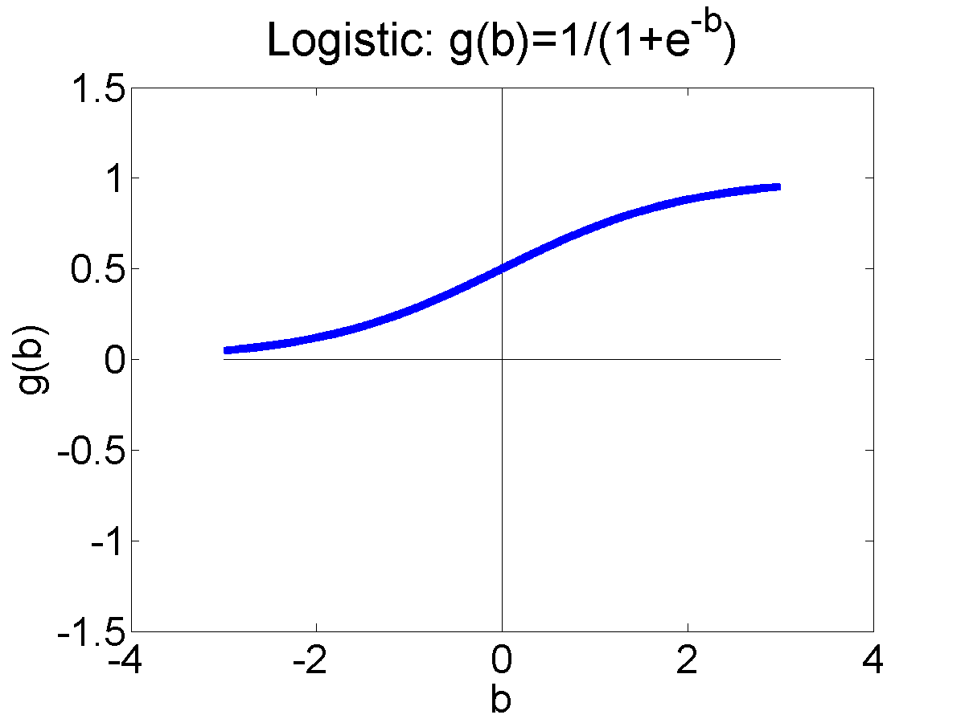
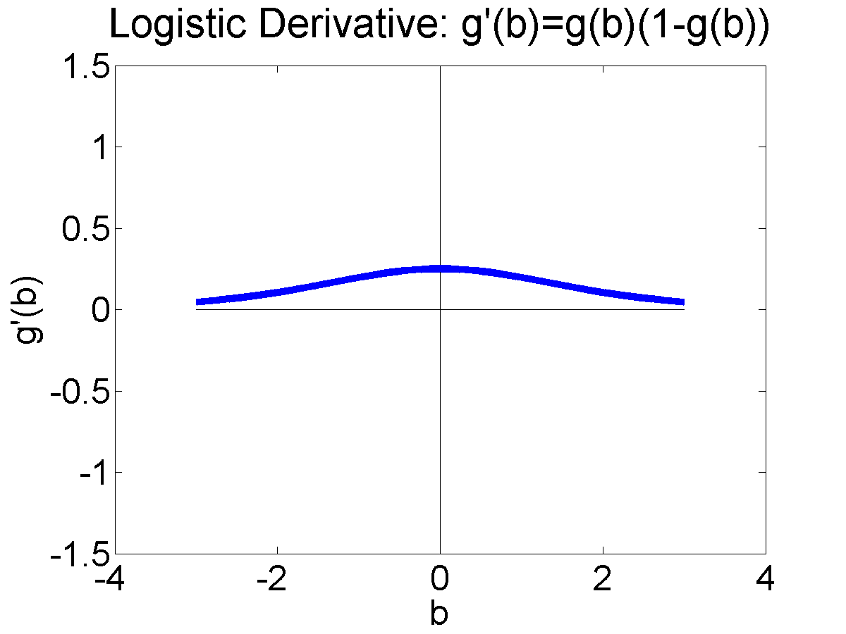
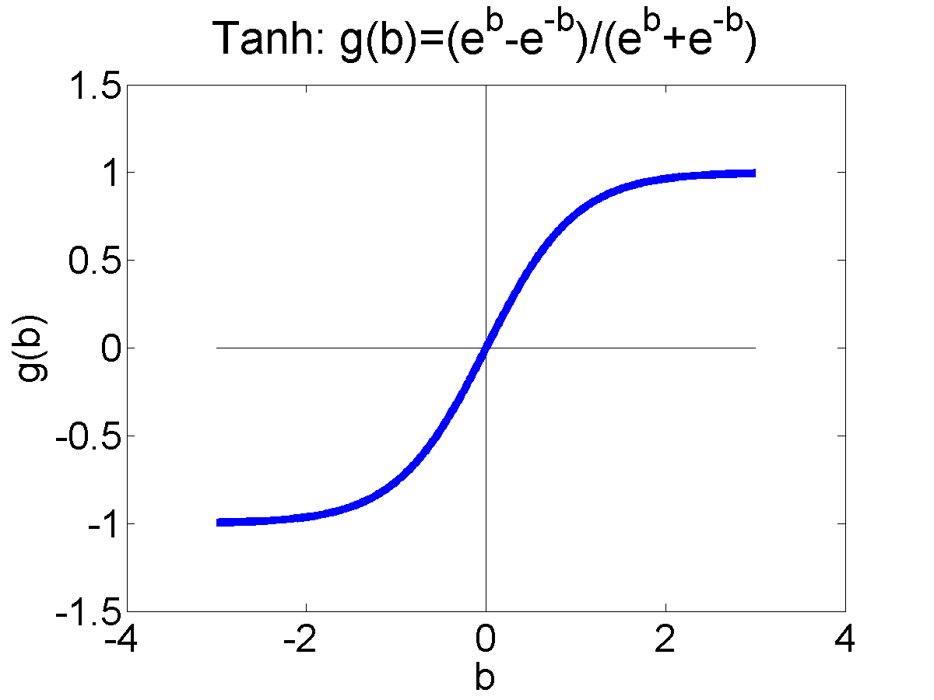
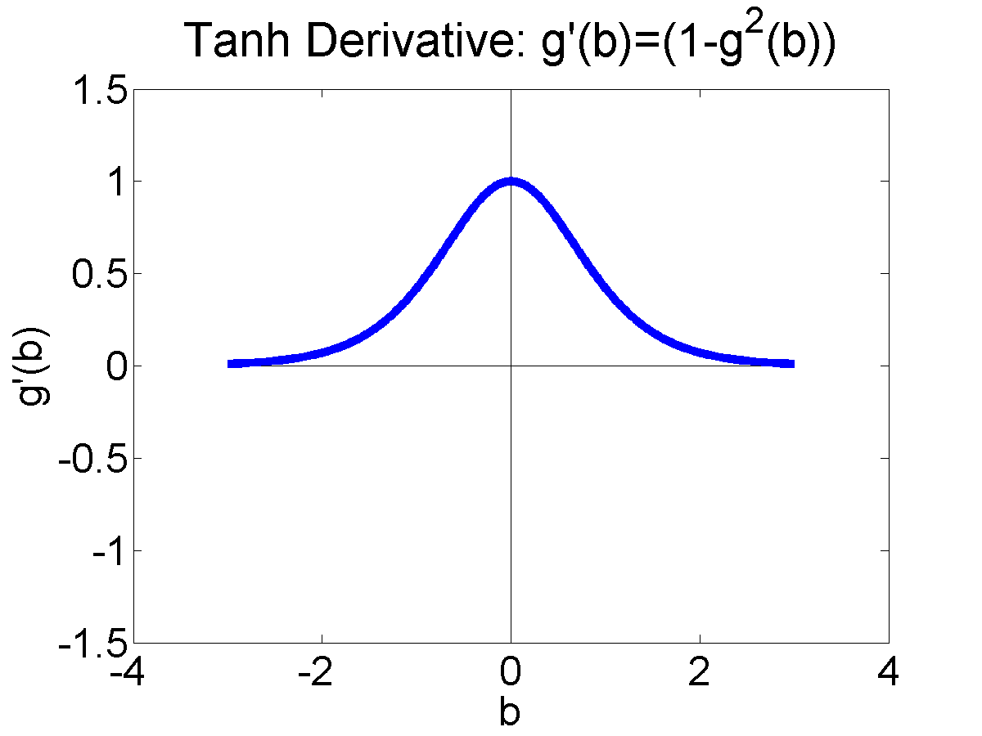
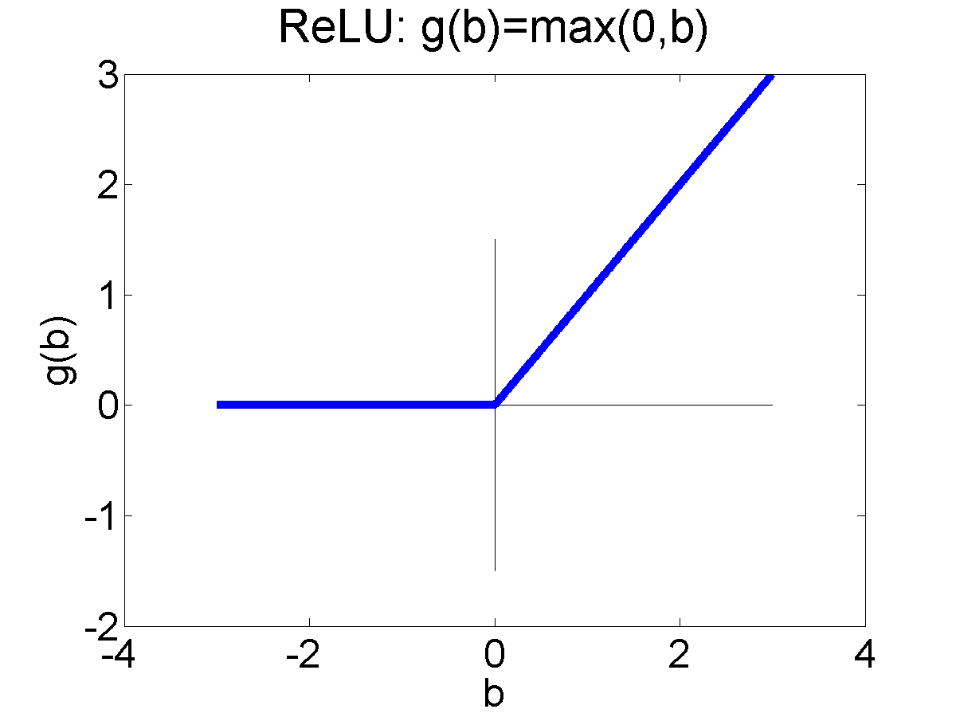
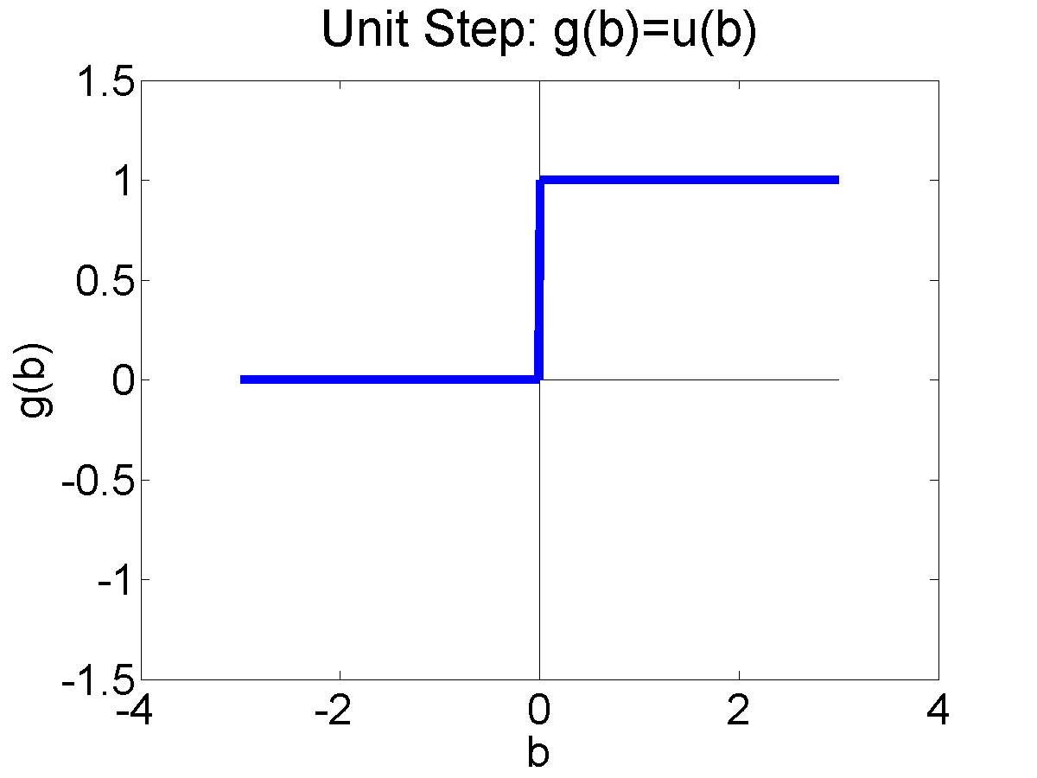

Activation functions
What is that “activation function?” Here are some that you should know about:
Logistic Sigmoid:
$$σ\left(β\right)=\frac{1}{1+e^{−β}}, σ^{′}\left(β\right)=σ\left(β\right)\left(1−σ\left(β\right)\right)$$
Tanh:
$$tanh\left(β\right)=\frac{e^{β}−e^{−β}}{e^{β}+e^{−β}}, \tanh^{′}\left(β\right)=1−\tanh^{2}\left(β\right)$$
And here’s one you haven’t seen before, called the rectified linear unit:
$$ReLU\left(β\right)=\max\left(0,β\right), {ReLU}^{′}\left(β\right)=u\left(β\right)$$

Slide 19

Activation functions
The last activation function you need to know is the softmax. Softmax is almost never used anywhere except the output layer. It’s basically a sigmoid, but normalized so that $\sum_{c=1}^{V}{y_{ci}^{∗}}=1$, so that you can interpret $y_{ci}^{∗}$as a probability:
$$\operatorname{softmax}\left(β_{j}\right)=\frac{e^{β_{j}}}{\sum_{k=1}^{V}{e^{β_{k}}}}$$
Because of the normalization, softmax is the only commonly used nonlinearity that depends on excitations other than its own:
$$\frac{∂\operatorname{softmax}\left(β_{j}\right)}{{∂β}_{k}}=\left\{\begin{matrix}y_{j}^{∗}(1−y_{j}^{∗}) & j=k \\ −y_{j}^{∗}y_{k}^{∗} & j≠k\end{matrix}\right.$$

Slide 20
How to make a neural network
Training Data
Forward propagation
Loss Function
Back propagation

Slide 21

Loss Function
Now that the neural net has computed ${\vec{y}}_{i}^{∗}$ for each of the training tokens ${\vec{x}}_{i}$…
How badly did it do?

Slide 22

Loss Function
The “loss function” is a function that measures how badly the neural network did by comparing its hypothesis output, ${\vec{y}}_{i}^{∗}$, to a reference label ${\vec{y}}_{i}$:
$$ℓ\left({\vec{y}}_{i},{\vec{y}}_{i}^{∗}\right)=a “badness” score for the NN output {\vec{y}}_{i}^{∗}$$
The average of $ℓ\left({\vec{y}}_{i},{\vec{y}}_{i}^{∗}\right)$, over the entire training corpus, tells you how badly the neural net is doing on the whole training corpus.
$$ℒ=\frac{1}{n}\sum_{i=1}^{n}{ℓ\left({\vec{y}}_{i},{\vec{y}}_{i}^{∗}\right)}=“badness” score for the whole training corpus$$

Slide 23
Loss Function
How do we choose the loss function?
We want it to measure how badly we’re doing.
For an image de-noising task, or something like that: we want it to measure the difference between the target images, and the neural net outputs.
For a classification task: we want it to measure something like the percentage error rate on the training corpus.

Slide 24









Image de-noising, and other regression tasks
A neural network that computes a real-valued output, ${\vec{y}}_{i}^{∗}$ $≈{\vec{y}}_{i}$, from a real-valued input, ${\vec{x}}_{i}$, is called a “nonlinear regression.”
For example, ${\vec{x}}_{i}$ might be an image with some distortion (a bunch of pixels missing, or something ).
${\vec{y}}_{i}$ is the corresponding clean image.
Our goal is to compute a cleaned-up image, ${\vec{y}}_{i}^{∗}$ $≈{\vec{y}}_{i}$
$${\vec{x}}_{1}$$
$${\vec{y}}_{1}$$
$${\vec{x}}_{2}$$
$${\vec{y}}_{2}$$
$${\vec{x}}_{3}$$
$${\vec{y}}_{3}$$
$${\vec{x}}_{4}$$
$${\vec{y}}_{4}$$
“Semantic Image Inpainting with Deep Generative Models,” Raymond Yeh, Chen Chen, Teck Yian Lim, Alexander G. Schwing, Mark Hasegawa-Johnson and Minh Do

Slide 25




Mean-Squared Error
${\vec{y}}_{i}=\left[y_{1i},…,y_{Vi}\right]$ is a vector of real numbers that the neural net is supposed to produce.
${\vec{y}}_{i}^{∗}=\left[y_{1i}^{∗},…,y_{Vi}^{∗}\right]$ is what the neural net actually produces.
Mean Squared Error (MSE) measures how badly you did:
$$ℓ_{MSE}\left({\vec{y}}_{i},{\vec{y}}_{i}^{∗}\right)=\frac{1}{K}\sum_{c=1}^{V}{{\left(y_{ci}−y_{ci}^{∗}\right)}^{2}}$$
$$ℒ_{MSE}=\frac{1}{n}\sum_{i=1}^{n}{ℓ_{MSE}\left({\vec{y}}_{i},{\vec{y}}_{i}^{∗}\right)}$$
$$ℓ_{MSE}\left({\vec{y}}_{i},{\vec{y}}_{i}^{∗}\right)$$
$$y_{ci}^{∗}$$
$$y_{ci}$$

Slide 26






Object recognition, and other multi-class classification tasks
$${\vec{x}}_{1}$$
$${\vec{x}}_{2}$$
$${\vec{x}}_{3}$$
$${\vec{x}}_{4}$$
A neural network is called a multi-class classifier if it computes a probability distribution over a set of class labels:
$$0≤y_{ci}^{∗}≤1, \sum_{c=1}^{V}{y_{ci}^{∗}}=1$$
Usually, we train such a network using a one-hot label vector:
$$y_{ci}=\left\{\begin{matrix}1 & c is correct class for token i \\ 0 & otherwise\end{matrix}\right.$$
$${\vec{y}}_{2}=\left[1,0,0,0\right]$$
$${\vec{y}}_{1}=\left[0,1,0,0\right]$$
$${\vec{y}}_{4}=\left[0,0,1,0\right]$$
$${\vec{y}}_{3}=\left[0,0,0,1\right]$$
Class Index | Class Name
1 | abacus
2 | camera
3 | chickens
4 | slug

Slide 27



Zero-One Loss
The simplest loss function is called the zero-one loss. It’s equal to zero if there is no error, and it’s equal to one if there is an error:
$$ℓ_{ZO}\left({\vec{y}}_{i},{\vec{y}}_{i}^{∗}\right)=\left\{\begin{matrix}0 & {\vec{y}}_{i}={\vec{y}}_{i}^{∗} \\ 1 & otherwise\end{matrix}\right.$$
The average of the zero-one loss, over the training database, is equal to the training corpus error rate:
$$ℒ_{ZO}=\frac{1}{n}\sum_{i=1}^{n}{ℓ_{ZO}\left({\vec{y}}_{i},{\vec{y}}_{i}^{∗}\right)}$$
The problem with the zero-one loss is that it’s not differentiable.
$$ℓ_{ZO}\left({\vec{y}}_{i},{\vec{y}}_{i}^{∗}\right)$$
$$1$$
$$y_{ci}^{∗}$$
$$y_{ci}$$

Slide 28




Cross Entropy
$$y_{ci}=\left\{\begin{matrix}1 & c is correct class for token i \\ 0 & otherwise\end{matrix}\right.$$
$y_{ic}^{∗}=$ Estimated $P\left(class of token i is c \right| {\vec{x}}_{i})$
Then: minimizing cross-entropy = maximizing likelihood:
$$ℓ_{CE}\left({\vec{y}}_{i},{\vec{y}}_{i}^{∗}\right)=−\log{Estimated P\left(correct class\right| {\vec{x}}_{i})}$$
$$=−\log{y_{c\left(i\right),i}^{∗}}=−\sum_{c=1}^{V}{y_{ci}\log{y_{ci}^{∗}}}$$
$$ℒ_{CE}=\frac{1}{n}\sum_{i=1}^{n}{ℓ_{CE}\left({\vec{y}}_{i},{\vec{y}}_{i}^{∗}\right)}$$
$$ℓ_{CE}\left({\vec{y}}_{i},{\vec{y}}_{i}^{∗}\right)$$
$$y_{c\left(i\right),i}^{∗}$$
$$y_{c\left(i\right),i}=1$$

Slide 29






Binary object recognition
$$y_{1}=−1$$
I’m warning you, it’s pretty pathetic.
Sometimes, a neural network computes a scalar output that is between 0 and 1:
$$0≤y_{i}^{∗}≤1$$
Usually, we train such a network using a binary target label:
$$y_{i}=\left\{\begin{matrix}1 & token i is of class +1 \\ 0 & otherwise\end{matrix}\right.$$
$$y_{2}=+1$$
This is a beautiful movie, you’ll love it.
…or…
$$y_{1}=1$$
$$y_{2}=0$$
$$y_{3}=1$$
$$y_{4}=0$$
Learning Multiple Layers of Features from Tiny Images, Alex Krizhevsky, 2009

Slide 30








Binary Cross Entropy
$$ℓ_{CE}\left({\vec{y}}_{i},{\vec{y}}_{i}^{∗}\right)$$
$$y_{i}=\left\{\begin{matrix}1 & token i is of class +1 \\ 0 & otherwise\end{matrix}\right.$$
$y_{i}^{∗}=$ Estimated $P\left(class of token i is+1 \right| {\vec{x}}_{i})$
Then: minimizing binary cross-entropy = maximizing likelihood:
$$ℓ_{BCE}\left({\vec{y}}_{i},{\vec{y}}_{i}^{∗}\right)=−\log{Estimated P\left(correct class\right| {\vec{x}}_{i})}$$
$$=−y_{i}\log{y_{i}^{∗}}−\left(1−y_{i}\right)\log\left(1−y_{i}^{∗}\right)$$
$$=\left\{\begin{matrix}−\log{y_{i}^{∗}} & c\left(i\right)=+1 \\ −\log\left(1−y_{i}^{∗}\right) & otherwise\end{matrix}\right.$$
$$ℒ_{BCE}=\frac{1}{n}\sum_{i=1}^{n}{ℓ_{BCE}\left({\vec{y}}_{i},{\vec{y}}_{i}^{∗}\right)}$$
$$y_{i}^{∗}$$
$$y_{i}=1$$
$$ℓ_{CE}\left({\vec{y}}_{i},{\vec{y}}_{i}^{∗}\right)$$
$$y_{i}^{∗}$$
$$y_{i}=0$$
$$1$$

Slide 31
Loss Function
How do we choose the loss function?
We want it to measure how badly we’re doing.
For an image de-noising task, or something like that: MSE measures the average squared difference between the target images and the neural net outputs.
For a classification task:
  Zero-one loss counts the errors
  Cross entropy is the negative log probability of the correct answer

Slide 32
How to make a neural network
Training Data
Forward propagation
Loss Function
Back propagation

Slide 33

Back propagation
OK, now we know how badly we did.
How can we adjust the network weights, $w_{kj}^{(l)}$, in order to do better?
General strategy: we will use some subset of the training data, $𝒟=\left\{\left({\vec{x}}_{1},{\vec{y}}_{1}\right), …,\left({\vec{x}}_{n},{\vec{y}}_{n}\right)\right\}$, to compute an update step, ${dw}_{kj}^{(l)}$, simultaneously for all of the network weights. Then we will update them all simultaneously, as
$$w_{kj}^{(l)}←w_{kj}^{(l)}−{dw}_{kj}^{(l)}, \begin{matrix}1≤l≤L \\ 1≤k≤N \\ 1≤j≤N+1\end{matrix}$$

Slide 34



Newton’s method
Basically, we use gradient descent, which is similar to Newton’s method, but simpler: we only use the first derivative, not the second derivative.
For each $w_{kj}^{(l)}$, we compute $\frac{dℒ}{dw_{kj}^{(l)}}$, and then we update all of the weights simultaneously as
$$w_{kj}^{(l)}←w_{kj}^{(l)}−η\frac{dℒ}{dw_{kj}^{(l)}}, \begin{matrix}1≤l≤L \\ 1≤k≤N \\ 1≤j≤N+1\end{matrix}$$
where $η$ is a learning rate.
Animated illustration of Newton’s method for finding the zeros of the $f(x)=dℒ/dx$.
By Ralf Pfeifer - de:Image:NewtonIteration Ani.gif, CC BY-SA 3.0, https://commons.wikimedia.org/w/index.php?curid=2268473

Slide 35

Finding the gradient
How do we find $\frac{dℒ}{dw_{kj}^{(l)}}$?
The technique for doing that is called “back propagation.”

Slide 36

Back propagation
$$y_{1i}^{∗}$$
$$y_{2i}^{∗}$$
$$y_{Vi}^{∗}$$
Remember that
$$ℒ=\frac{1}{n}\sum_{i=1}^{n}{ℓ\left({\vec{y}}_{i},{\vec{y}}_{i}^{∗}\right)}$$
so
$$\frac{dℒ}{dw_{kj}^{(l)}}=\frac{1}{n}\sum_{i=1}^{n}{\frac{dℓ\left({\vec{y}}_{i},{\vec{y}}_{i}^{∗}\right)}{dw_{kj}^{(l)}}}$$
So we need to find $\frac{dℓ\left({\vec{y}}_{i},{\vec{y}}_{i}^{∗}\right)}{dw_{kj}^{(l)}}$ for each of the training tokens individually, and then just average them.
$$1$$
$$1$$
$$x_{1i}$$
$$x_{2i}$$
$$…$$
$$x_{Di}$$
$$1$$

Slide 37

Back propagation
$$y_{1i}^{∗}$$
$$y_{2i}^{∗}$$
$$y_{Vi}^{∗}$$
Remember that
$ℓ\left({\vec{y}}_{i},{\vec{y}}_{i}^{∗}\right)$ depends on each $y_{ci}^{∗}$, for $1≤c≤V$
Each $y_{ci}^{∗}$ depends on its corresponding $β_{ci}^{(L)}$
Each $β_{ci}^{(L)}$ depends on each $h_{ki}^{(L−1)}$, for $1≤k≤N$
… and so on backward through the network…
$$1$$
$$1$$
$$x_{1i}$$
$$x_{2i}$$
$$…$$
$$x_{Di}$$
$$1$$

Slide 38

Back propagation
$$y_{1i}^{∗}$$
$$y_{2i}^{∗}$$
$$y_{Vi}^{∗}$$
$$\frac{dℓ\left({\vec{y}}_{i},{\vec{y}}_{i}^{∗}\right)}{dw_{kj}^{(l)}}=\sum_{c=1}^{V}{\frac{∂ℓ\left({\vec{y}}_{i},{\vec{y}}_{i}^{∗}\right)}{∂y_{ci}^{∗}}\frac{dy_{ci}^{∗}}{dw_{kj}^{(l)}}}$$
$$\frac{dy_{ci}^{∗}}{dw_{kj}^{(l)}}=\frac{dh_{ci}^{\left(L\right)}}{dw_{kj}^{(l)}}=\frac{∂h_{ci}^{\left(L\right)}}{∂β_{ci}^{\left(L\right)}}\frac{dβ_{ci}^{\left(L\right)}}{dw_{kj}^{(l)}}$$
$$\frac{dβ_{ci}^{\left(L\right)}}{dw_{kj}^{(l)}}=\sum_{k=1}^{N}{\frac{∂β_{ci}^{\left(L\right)}}{∂h_{ki}^{(L−1)}}\frac{dh_{ki}^{(L−1)}}{dw_{kj}^{(l)}}}$$
… and so on backward through the network…
$$1$$
$$1$$
$$x_{1i}$$
$$x_{2i}$$
$$…$$
$$x_{Di}$$
$$1$$

Slide 39

Back propagation
$$y_{1i}^{∗}$$
$$y_{2i}^{∗}$$
$$y_{Vi}^{∗}$$
In other words, “back propagation” just means that you apply the chain rule of differentiation, backward through the network, for each training token, in order to compute
$$\frac{dℓ\left({\vec{y}}_{i},{\vec{y}}_{i}^{∗}\right)}{dw_{kj}^{(l)}}$$
…and then you just average that quantity over the training tokens.
$$1$$
$$1$$
$$x_{1i}$$
$$x_{2i}$$
$$…$$
$$x_{Di}$$
$$1$$

Slide 40

Back propagation
Back-propagation depends on two main types of derivatives:
The derivative of an excitation with respect to the preceding layer’s activation, $\frac{∂β_{ki}^{\left(l\right)}}{∂h_{ji}^{(l−1)}}$.
The derivative of an activation with respect to its own excitation, $\frac{∂h_{ki}^{\left(l\right)}}{∂β_{ki}^{\left(l\right)}}$
These two quantities are both easy to compute, and interesting. But I’m not going to tell you what they are, because you don’t need to know. The reason you don’t need to know is that pytorch has lookup tables for each of them, and will compute these quantities for you during MP6.

Slide 41

How to make a neural network
Training Data: $𝒟=\left\{\left({\vec{x}}_{1},{\vec{y}}_{1}\right), …,\left({\vec{x}}_{n},{\vec{y}}_{n}\right)\right\}$
Forward propagation: compute ${\vec{y}}_{i}^{∗}$ $≈{\vec{y}}_{i}$ for each training token by alternating these two equations:
$$β_{ki}^{(l)}=\sum_{j=1}^{N+1}{w_{kj}^{(l)}h_{ji}^{(l−1)}}$$
$$h_{ki}^{(l)}=g\left(β_{ki}^{(l)}\right)$$
Loss Function: $ℒ=\frac{1}{n}\sum_{i=1}^{n}{ℓ\left({\vec{y}}_{i},{\vec{y}}_{i}^{∗}\right)}$
Back propagation: apply the chain rule backward through the network to compute $\frac{dℓ\left({\vec{y}}_{i},{\vec{y}}_{i}^{∗}\right)}{dw_{kj}^{(l)}}$, then average over training data to compute $\frac{dℒ}{dw_{kj}^{(l)}}$, then update the weights as
$$w_{kj}^{(l)}←w_{kj}^{(l)}−η\frac{dℒ}{dw_{kj}^{(l)}}$$

