Slide 1
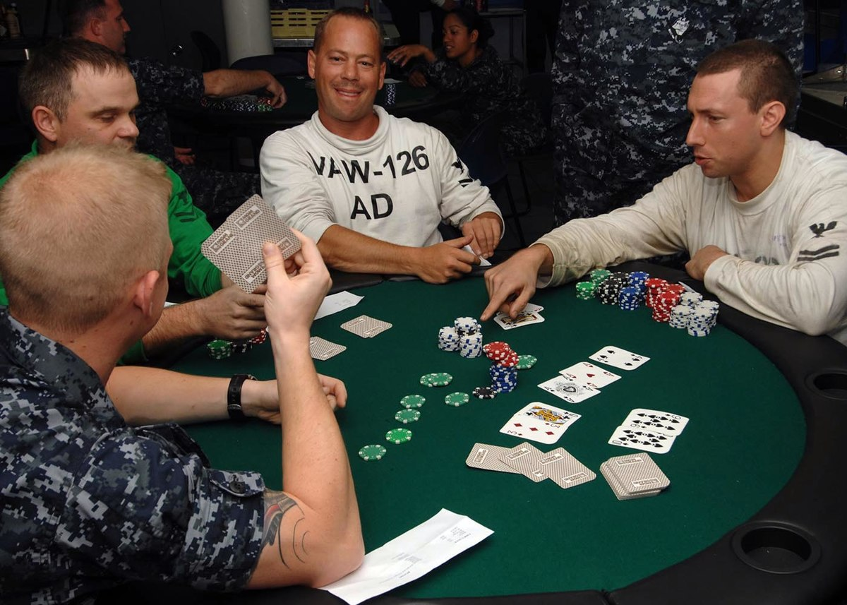
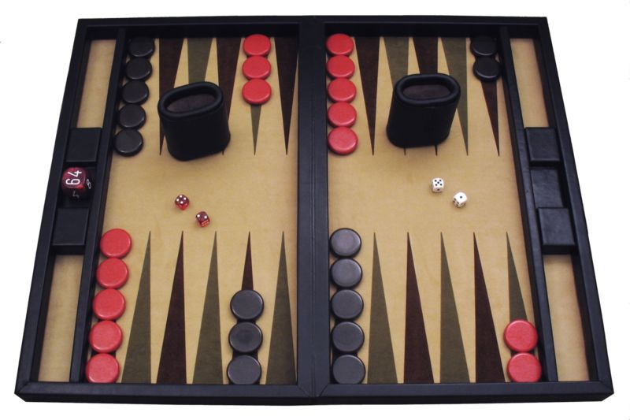
CS440/ECE448 Lecture 34: Games of Chance and Imperfect Information
Mark Hasegawa-Johnson, 4/2020
Including slides by Svetlana Lazebnik
CC-BY 4.0: you may remix or redistribute if you cite the source.
A contemporary backgammon set. Public domain photo by Manuel Hegner,
2013, https://commons.wikimedia.org/w/index.php?curid=25006945
A game of Texas Hold’em in progress. Copyright US Navy, released for public distribution 2009, https://commons.wikimedia.org/w/index.php?curid=8361356

Slide 2
Types of game environments
 | Deterministic | Stochastic
Perfect information (fully observable)
Imperfect information (partially observable)
Chess, checkers, go
Backgammon, monopoly
Battleship
Scrabble, poker, bridge

Slide 3
Content of today’s lecture
Stochastic games: the Expectiminimax algorithm
Imperfect information: belief states

Slide 4
Stochastic games
How can we incorporate dice throwing into the game tree?

Slide 5
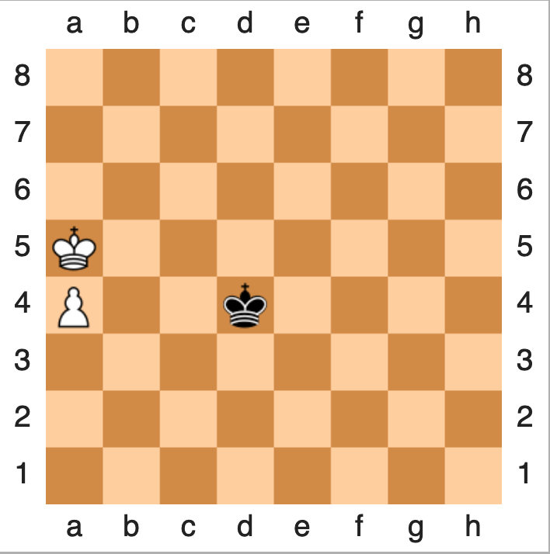
Minimax
State evolves deterministically (when a player acts, that action uniquely determines the following state).
Current state is visible to both players.
Each player tries to maximize his or her own reward:
Maximize (over all possible moves I can make) the
Minimum (over all possible moves Min can make) of the resulting utility:
$$U\left(s\right)=\max_{s′∈C(s)}{U(s^{′})}$$
$$U\left(s′\right)=\min_{s′′∈C(s′)}{U(s^{′′})}$$

Slide 6
Bellman’s Equation
State evolves stochastically (when a player acts, that action influences the state transition probability).
Current state is visible to the player.
The player tries to maximize his or her own reward:
Maximize (over all possible moves I can make) the
Expected value (over all possible successor states) of the resulting utility:
$$U\left(s\right)=R\left(s\right)+γ\max_{a}{\sum_{s′}{P\left(s^{′} | s,a\right)U(s^{′})}}$$

Slide 7
Expectiminimax
State evolves stochastically (when a player acts, that action influences the state transition probability).
Current state is visible to both players.
Each player tries to maximize his or her own reward:
Maximize (over all possible moves I can make) the
Minimum (over all possible moves Min can make) of the
Expected value (over all possible successor states) of the resulting utility:
$$U\left(s\right)=\max_{a}{\sum_{s′}{P\left(s^{′} | s,a\right)U(s^{′})}}$$
$$U\left(s′\right)=\min_{a′}{\sum_{s′′}{P\left(s^{′′} | s′,a′\right)U(s^{′′})}}$$

Slide 8
Expectiminimax: notation
= MAX node. $U\left(s\right)=\max_{a∈A(s)}{Q(s,a)}$
= MIN node. $U\left(s\right)=\min_{a∈A(s)}{Q(s,a)}$
= Chance node. $Q\left(s,a\right)=\sum_{s′}{P\left(s^{′} | s,a\right)U(s^{′})}$

Slide 9
Expectiminimax example
MIN: Min decides whether to count heads (action H) or tails (action T) as a forward movement.
H
Emojis by Twitter, CC BY 4.0, https://commons.wikimedia.org/w/index.php?curid=59974366

Slide 10
Expectiminimax example
MIN: Min decides whether to count heads (action H) or tails (action T) as a forward movement.
H
Emojis by Twitter, CC BY 4.0, https://commons.wikimedia.org/w/index.php?curid=59974366

Slide 11
Expectiminimax example
MIN: Min decides whether to count heads (action H) or tails (action T) as a forward movement.
Chance: she flips a coin and moves her game piece in the direction indicated.
By ICMA Photos - Coin Toss, CC BY-SA 2.0, https://commons.wikimedia.org/w/index.php?curid=71147286
Emojis by Twitter, CC BY 4.0, https://commons.wikimedia.org/w/index.php?curid=59974366

Slide 12
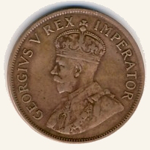
Expectiminimax example
MIN: Min decides whether to count heads (action H) or tails (action T) as a forward movement.
Chance: she flips a coin and moves her game piece in the direction indicated.
By NJR ZA - Own work, CC BY-SA 3.0, https://commons.wikimedia.org/w/index.php?curid=4228918
Emojis by Twitter, CC BY 4.0, https://commons.wikimedia.org/w/index.php?curid=59974366

Slide 13
Expectiminimax example
MIN: Min decides whether to count heads (action H) or tails (action T) as a forward movement.
Chance: she flips a coin and moves her game piece in the direction indicated.
MAX: Max decides whether to count heads (action H) or tails (action T) as a forward movement.
By NJR ZA - Own work, CC BY-SA 3.0, https://commons.wikimedia.org/w/index.php?curid=4228918
H
Emojis by Twitter, CC BY 4.0, https://commons.wikimedia.org/w/index.php?curid=59974366

Slide 14
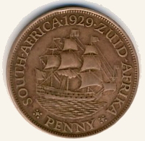
Expectiminimax example
MIN: Min decides whether to count heads (action H) or tails (action T) as a forward movement.
Chance: she flips a coin and moves her game piece in the direction indicated.
MAX: Max decides whether to count heads (action H) or tails (action T) as a forward movement.
Chance: he flips a coin and moves his game piece in the direction indicated.
By NJR ZA - Own work, CC BY-SA 3.0, https://commons.wikimedia.org/w/index.php?curid=4228918
By NJR ZA - Own work, CC BY-SA 3.0, https://commons.wikimedia.org/w/index.php?curid=4228918
Emojis by Twitter, CC BY 4.0, https://commons.wikimedia.org/w/index.php?curid=59974366

Slide 15
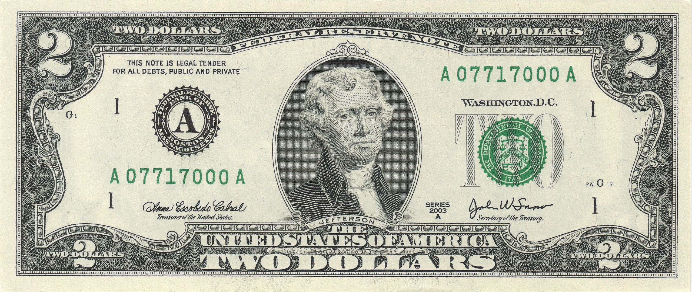
Expectiminimax example
MIN: Min decides whether to count heads (action H) or tails (action T) as a forward movement.
Chance: she flips a coin and moves her game piece in the direction indicated.
MAX: Max decides whether to count heads (action H) or tails (action T) as a forward movement.
Chance: he flips a coin and moves his game piece in the direction indicated.
Reward: $2 to the winner, $0 for a draw.
By NJR ZA - Own work, CC BY-SA 3.0, https://commons.wikimedia.org/w/index.php?curid=4228918
By NJR ZA - Own work, CC BY-SA 3.0, https://commons.wikimedia.org/w/index.php?curid=4228918
Emojis by Twitter, CC BY 4.0, https://commons.wikimedia.org/w/index.php?curid=59974366.
$2 By Bureau of Engraving and Printing: U.S. Department of the Treasury - own scanned, Public Domain, https://commons.wikimedia.org/w/index.php?curid=56299470

Slide 16
Expectiminimax example
MIN: Min decides whether to count heads (action H) or tails (action T) as a forward movement.
Chance: she flips a coin and moves her game piece in the direction indicated.
MAX: Max decides whether to count heads (action H) or tails (action T) as a forward movement.
Chance: he flips a coin and moves his game piece in the direction indicated.
Reward: $2 to the winner, $0 for a draw.
T
H
T
H
T
H
T
H
T
H
T
H
T
H
T
H
H
0
-2
-2
0
2
0
0
2
2
0
0
2
0
-2
-2
0

Slide 17
Expectiminimax example
Chance node:
$Q\left(s,a\right)=\sum_{s′}{P\left(s^{′} | s,a\right)U(s^{′})}$
T
H
T
H
T
H
T
H
T
H
T
H
T
H
-1
-1
1
1
1
1
-1
-1
T
H
H
0
-2
-2
0
2
0
0
2
2
0
0
2
0
-2
-2
0

Slide 18
Expectiminimax example
Max node:
$$U\left(s\right)=\max_{a∈A(s)}{Q(s,a)}$$
T
H
T
H
T
H
-1
1
-1
1
T
H
T
H
T
H
T
H
-1
-1
1
1
1
1
-1
-1
T
H
H
0
-2
-2
0
2
0
0
2
2
0
0
2
0
-2
-2
0

Slide 19
Expectiminimax example
Chance node:
$Q\left(s,a\right)=\sum_{s′}{P\left(s^{′} | s,a\right)U(s^{′})}$
T
H
0
0
T
H
T
H
-1
1
-1
1
T
H
T
H
T
H
T
H
-1
-1
1
1
1
1
-1
-1
T
H
H
0
-2
-2
0
2
0
0
2
2
0
0
2
0
-2
-2
0

Slide 20
Expectiminimax example
0
Min node:
$$U\left(s\right)=\min_{a∈A(s)}{Q(s,a)}$$
T
H
0
0
T
H
T
H
-1
1
1
-1
T
H
T
H
T
H
T
H
-1
-1
1
1
1
1
-1
-1
T
H
H
0
-2
-2
0
2
0
0
2
2
0
0
2
0
-2
-2
0

Slide 21
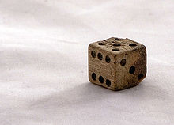
Expectiminimax example #2
MIN: Min decides whether she’s going to move $D−3$ or $3−D$ steps forward, where $D$ is the roll of the dice.
Chance: she rolls the dice and moves her game piece in the direction indicated.
MAX: Max decides whether he’s going to move $D−3$ or $3−D$ steps forward, where $D$ is the roll of the dice.
Chance: he rolls the dice and moves his game piece in the direction indicated.
Reward: loser pays the winner a number of dollars equal to the number of spaces difference.
By Kolby Kirk, CC BY 3.0, https://commons.wikimedia.org/w/index.php?curid=3037476
Emojis by Twitter, CC BY 4.0, https://commons.wikimedia.org/w/index.php?curid=59974366.

Slide 22
Expectiminimax example #2
MIN: Min decides whether she’s going to move $D−3$ or $3−D$ steps forward, where $D$ is the roll of the dice.
Chance: she rolls the dice and moves her game piece in the direction indicated.
MAX: Max decides whether he’s going to move $D−3$ or $3−D$ steps forward, where $D$ is the roll of the dice.
Chance: he rolls the dice and moves his game piece in the direction indicated.
Reward: loser pays the winner a number of dollars equal to the number of spaces difference.
$$D−3$$
$$3−D$$
…
1
2
3
4
5
6
1
…
…
…
…
…
…
…
…
…

Slide 23
Expectiminimax summary
All of the same methods are useful:
Alpha-Beta pruning
Evaluation function
Quiescence search, Singular move
Computational complexity is pretty bad
Branching factor of the random choice can be high
Twice as many “levels” in the tree

Slide 24
Content of today’s lecture
Stochastic games: the Expectiminimax algorithm
Imperfect information: belief states

Slide 25
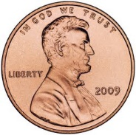
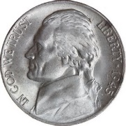
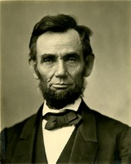
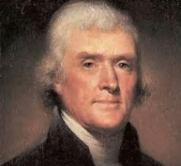
Imperfect information example
Min chooses a coin.
I say the name of a U.S. President.
If I guessed right, she gives me the coin.
If I guessed wrong, I have to give her a coin to match the one she has.
1
-1
-5
5

Slide 26
Imperfect information example
The problem: I don’t know which state I’m in. I only know it’s one of these two.
1
-1
-5
5

Slide 27
Imperfect information example
The equivalent of the minimax question, in this environment, is:
Is there any strategy I can use that will guarantee that I win a positive reward? (Minimax strategy)
If I assume a probability distribution over the set of possible states, what is the strategy that maximizes my expected reward? (Expectiminimax strategy)
1
-1
-5
5

Slide 28
Belief states
If the environment is only partially observable, then an agent’s “belief state,” $b$, is the set of all states, $s$, that are currently possible, given the agent’s past and current actions, $a$, and observations, $o$.

Slide 29
Example: Maze War
Orange robot and blue robot can see one another if there is no wall in the way. They can’t see around corners.
A complete description of the current game state specifies the locations of both robots, e.g., $s=[O:\left(2,1\right),B:\left(4,2\right)]$.
The loser is the robot who moves to a position from which it can be seen by the other robot.

Slide 30
Example: Maze War
Orange robot knows:
Orange robot is in (2,1)
Blue robot might be in (1,2), (1,3), (2,3), …
we can say that
Orange robot’s current belief state is
$$b=\left[O:\left(2,1\right),B∈\left\{\left(1,2\right),\left(1,3\right),\left(2,3\right),\left(3,2\right), \left(3,3\right),\left(4,2\right),(4,3)\right\}\right]$$

Slide 31
Belief state update equations
When the robot in belief state $b$ performs action $a$ and then sees observation $o$, it can then update its belief state using a two-part algorithm:
$PREDICT(b,a)$ is the set of all states $s’$ that could be reached by performing action $a$ in any state $s$ in the current belief state:
$$PREDICT\left(b,a\right)=\left\{s^{′}:s∈b,s′=RESULT(s,a)\right\}$$
$UPDATE(b,o)$ is the set of states in $b$ from which it is possible to perceive $o$:
$$UPDATE\left(b,o\right)=\left\{s:s∈b,o=PERCEPT(s)\right\}$$

Slide 32
Example: Maze War
Orange robot moves as shown.
Blue robot is not observed.
$$PREDICT(b,a)=\left[O:\left(1,1\right),B∈\left\{\left(1,2\right),\left(1,3\right),\left(2,3\right),\left(3,2\right), \left(3,3\right),\left(4,2\right),(4,3)\right\}\right]$$

Slide 33
Example: Maze War
Orange robot moves as shown.
Blue robot is not observed.
$$PREDICT\left(b,a\right)=\left[O:\left(1,1\right),B∈\left\{\left(1,2\right),\left(1,3\right),\left(2,3\right),\left(3,2\right), \left(3,3\right),\left(4,2\right),\left(4,3\right)\right\}\right]$$
$$UPDATE(PREDICT\left(b,a\right),o)=\left[O:\left(1,1\right),B∈\left\{\left(2,3\right),\left(3,2\right), \left(3,3\right),\left(4,2\right),(4,3)\right\}\right]$$

Slide 34
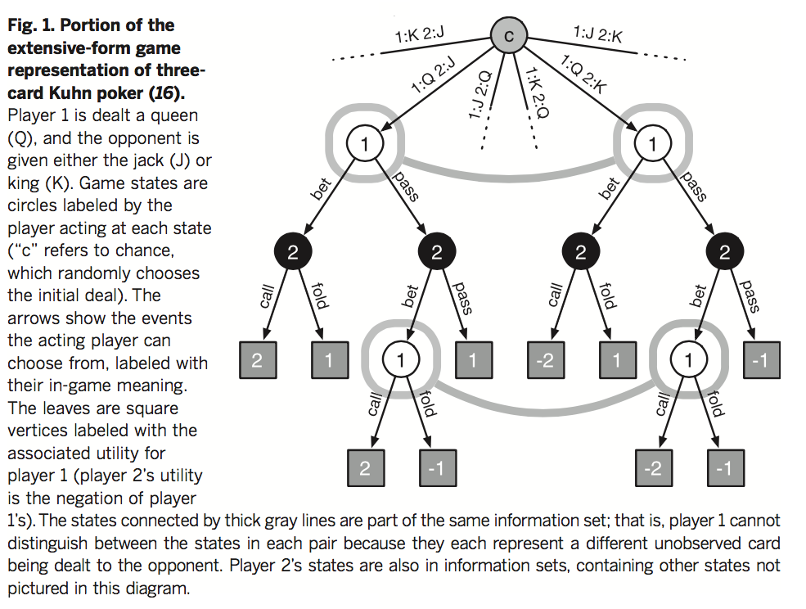
Stochastic games of imperfect information
States are grouped into information sets for each player
Source

Slide 35
Game AI: Origins
Minimax algorithm: Ernst Zermelo, 1912
Chess playing with evaluation function, quiescence search, selective search: Claude Shannon, 1949 (paper)
Alpha-beta search: John McCarthy, 1956
Checkers program that learns its own evaluation function by playing against itself: Arthur Samuel, 1956 (Rodney Brooks blog post)

Slide 36
Game AI: State of the art
Observable & Deterministic:
Checkers: solved in 2007
Chess: Deep learning machine teaches itself chess in 72 hours, plays at International Master Level (arXiv, September 2015)
Go: AlphaGo beats Lee Sedol, 2015
Observable & Stochastic:
Backgammon: TD-Gammon system (1992) used reinforcement learning to learn a good evaluation function
Partially Observable and Stochastic:
Poker
Heads-up limit hold’em poker is solved (2015)
Simplest variant played competitively by humans
Smaller number of states than checkers, but partial observability makes it difficult
Essentially weakly solved = cannot be beaten with statistical significance in a lifetime of playing
CMU’s Libratus system beats four of the best human players at no-limit Texas Hold’em poker (2017)

Slide 37
Content of today’s lecture
Stochastic games: the Expectiminimax algorithm
$$U\left(s\right)=\max_{a}{\sum_{s′}{P\left(s^{′} | s,a\right)U(s^{′})}}$$
$$U\left(s′\right)=\min_{a′}{\sum_{s′′}{P\left(s^{′′} | s′,a′\right)U(s^{′′})}}$$
Imperfect information: belief states
$$PREDICT\left(b,a\right)=\left\{s^{′}:s∈b,s′=RESULT(s,a)\right\}$$
$$UPDATE\left(b,o\right)=\left\{s:s∈b,o=PERCEPT(s)\right\}$$

