Slide 1
Lecture 38 – tf/idf and information retrieval
Mark Hasegawa-Johnson
5/1/2020
CC-BY 4.0: you may remix or redistribute if you cite the source

Slide 2
Outline
similarity vs. semantic field: word2vec at different scales
term frequency (tf): the term-document matrix
cosine similarity
document classification: tf on a log scale
document classification: inverse document frequency (idf)
relatedness again: the word co-occurrence matrix

Slide 3
Similarity: The Internet is the database
Similarity = words can be used interchangeably in most contexts
How do we measure that in practice?
Answer: extract examples of word $w_{1}$, +/- k words ($2≤k≤5$, for example):
…hot, although iced coffee is a popular…
…indicate that moderate coffee consumption is benign…
…and of $w_{2}$:
…consumed as iced tea. Sweet tea is…
…national average of tea consumption in Ireland…
The words “iced” and “consumption” appear in both contexts, so we can conclude that $s(coffea,tea) > 0$. No other words are shared, so we can conclude $s(coffee,tea)<1$.

Slide 4
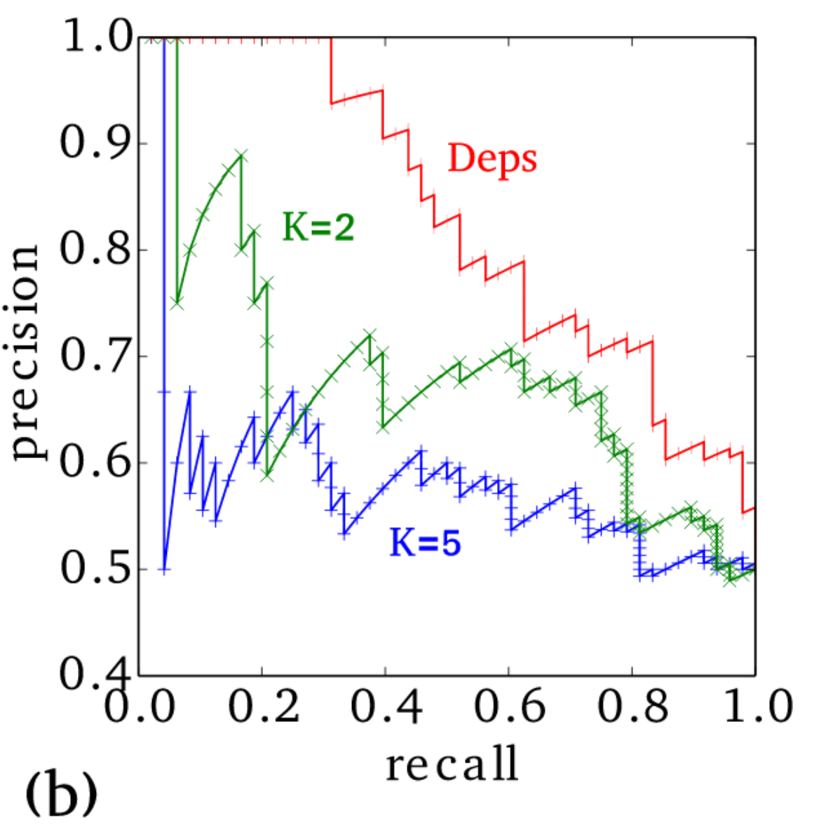
Similarity vs. Relatedness
Levy & Goldberg (2014) trained word2vec in three different ways:
k=2
k=5
Context determined by first parsing the sentence to get syntactic dependency structure (Deps)
They tested all three method for the similarity vs. relatedness of the nearest-neighbor of each word.
Precision vs. Recall on the WordSim-353 database, in which word pairs may be either related or similar (Fig. 2(a), Levy & Goldberg 2014)
Precision vs. Recall on the Chiarello et al. database, in which word pairs are only similar (Fig. 2(b), Levy & Goldberg 2014)

Slide 5
Similarity vs. Relatedness
Apparently, the smaller context window (k=2) produces vectors whose nearest neighbors are more similar (they can be used identically in a sentence).
The larger context (k=5) produces vectors whose nearest neighbors are related, not just similar.
More specifically, the latter words pairs are said to inhabit the same semantic field.
A semantic field is a group of words that refers to the same subject.
Precision vs. Recall on the WordSim-353 database, in which word pairs may be either related or similar (Fig. 2(a), Levy & Goldberg 2014)
Precision vs. Recall on the Chiarello et al. database, in which word pairs are only similar (Fig. 2(b), Levy & Goldberg 2014)

Slide 6
Similarity vs. Relatedness
…studied at hogwarts, a castle… | w=hogwarts |  | … harry potter studied at hogwarts…
 | vector nearest neighbors, context k=2 | vector nearest neighbors, context k=5
…studied at evernight, a castle… | evernight | dumbledore | …harry potter learned from dumbledore…
…studied at sunnydale… | sunnydale | hallows | …harry potter and the deathly hallows..
…a castle garderobe… | garderobe | half-blood | …harry potter and the half-blood…
…lives at blandings, a castle… | blandings | malfoy | …harry potter said to malfoy…
…lives at collinwood, a castle… | collinwood | snape | …harry potter said to snape…
Examples of k=2 and k=5 nearest-neighbors, from (Levy & Goldberg, 2014)

Slide 7
What if you wanted semantic field, not similarity?
What if you wanted your vector embedding to capture semantic field, as in the second column (not similar usage, like the first column)?
If you want that, it seems that larger contexts are better.
Why not just set context window = the whole document?
w=hogwarts
vector nearest neighbors, context k=2 | vector nearest neighbors, context k=5
evernight | dumbledore
sunnydale | hallows
garderobe | half-blood
blandings | malfoy
collinwood | snape

Slide 8
Outline
similarity vs. semantic field: word2vec at different scales
term frequency (tf): the term-document matrix
cosine similarity
document classification: tf on a log scale
document classification: inverse document frequency (idf)
relatedness again: the word co-occurrence matrix

Slide 9
the term-document matrix
 | document
term | Hogwarts | Dumbledore | Collinwood
a | 1 | 1 | 1
of | 1 | 2
in | 1 | 1 | 2
is | 2 | 4 | 1
fictional | 1 | 1 | 1
school | 1
rowling’s | 1 | 1
harry | 1 | 1
potter | 1 | 1
series | 1 | 1
house |  |  | 1
featured |  |  | 1
gothic |  |  | 1
Hogwarts School of Witchcraft and Wizardry, commonly shortened to Hogwarts, is a fictional British school of magic for students aged eleven to eighteen, and is the primary setting for the first six books in J. K. Rowling's Harry Potter series…
Albus Percival Wulfric Brian Dumbledore is a fictional character in J. K. Rowling's Harry Potter series. For most of the series, he is the headmaster of the wizarding school Hogwarts. As part of his backstory, it is revealed that he is the founder and leader of …
Collinwood Mansion is a fictional house featured in the Gothic horror soap opera Dark Shadows (1966–1971). Built in 1795 by Joshua Collins, Collinwood has been home to the Collins family—and other sometimes unwelcome supernatural visitors…

Slide 10
the term-document matrix
From the term-document matrix, we can define each term vector to be just the vector of term frequencies:
$$\vec{v}(i)=[tf(i,1),…,tf(i,D)]$$
…where we now define the term frequency (of term $i$ in document $j$) to be the number of times the term occurs in the document:
$$tf(i,j)=Count\left(word i in document j\right)$$
For example,
$$\vec{v}\left(a\right)=\left[1,1,1\right]$$
$$\vec{v}(of)=[1,2,1]$$
$$\vec{v}(potter)=[1,1,0]$$
 | document
term | Hogwarts | Dumbledore | Collinwood
a | 1 | 1 | 1
of | 1 | 2
in | 1 | 1 | 2
is | 2 | 4 | 1
fictional | 1 | 1 | 1
school | 1
rowling’s | 1 | 1
harry | 1 | 1
potter | 1 | 1
series | 1 | 1
house |  |  | 1
featured |  |  | 1
gothic |  |  | 1

Slide 11
Outline
similarity vs. semantic field: word2vec at different scales
term frequency (tf): the term-document matrix
cosine similarity
document classification: tf on a log scale
document classification: inverse document frequency (idf)
relatedness again: the word co-occurrence matrix

Slide 12
cosine similarity
The relatedness of two words can now be measured using their cosine similarity. For example,
$$s(rowling^{′}s,harry)=\cos{∡\left(rowling^{′}s,harry\right)}$$
$$=\frac{\vec{v}({rowling}^{′}s)∙\vec{v}(harry)}{\left|\vec{v}({rowling}^{′}s)\right|\left|\vec{v}(harry)\right|}$$
$$=\frac{1×1+1×1+0×0}{\sqrt{2}×\sqrt{2}}=1$$
$$s(harry,gothic)=\cos{∡\left(harry,gothic\right)}$$
$$=\frac{\vec{v}(harry)∙\vec{v}(gothic)}{\left|\vec{v}(harry)\right|\left|\vec{v}(gothic)\right|}$$
$$=\frac{1×0+1×0+0×1}{\sqrt{2}×1}=0$$
 | document
term | Hogwarts | Dumbledore | Collinwood
a | 1 | 1 | 1
of | 1 | 2
in | 1 | 1 | 2
is | 2 | 4 | 1
fictional | 1 | 1 | 1
school | 1
rowling’s | 1 | 1
harry | 1 | 1
potter | 1 | 1
series | 1 | 1
house |  |  | 1
featured |  |  | 1
gothic |  |  | 1

Slide 13
document vectors
Now let’s try something different. Let’s define a vector for each document, rather than for each term:
$$\vec{d}(j)=[tf(1,j),…,tf(V,j)]$$
Thus,
$$\vec{d}\left(H\right)=\left[1,1,1,2,1,1,1,1,1,0,0,0\right]$$
$$\vec{d}(D)=[1,2,1,4,1,0,1,1,1,1,0,0,0]$$
$$\vec{d}(C)=[1,0,2,1,1,0,0,0,0,0,1,1,1]$$
 | document
term | Hogwarts | Dumbledore | Collinwood
a | 1 | 1 | 1
of | 1 | 2
in | 1 | 1 | 2
is | 2 | 4 | 1
fictional | 1 | 1 | 1
school | 1
rowling’s | 1 | 1
harry | 1 | 1
potter | 1 | 1
series | 1 | 1
house |  |  | 1
featured |  |  | 1
gothic |  |  | 1

Slide 14
information retrieval
Document vectors are useful because they allow us to retrieve a document, based on the degree to which it matches a query. For example, the query:
“What school did Harry Potter attend?”
…can be written as a query vector:
$$\vec{q}=[0,0,0,0,0,1,0,1,1,0,0,0,0]$$
We can sometimes find the most relevant document using cosine distance:
$$\frac{\vec{q}∙\vec{d}\left(H\right)}{\left|\vec{q}\right|\left|\vec{d}\left(H\right)\right|}=\frac{3}{\sqrt{3}\sqrt{13}}=0.48$$
$$\frac{\vec{q}∙\vec{d}\left(D\right)}{\left|\vec{q}\right|\left|\vec{d}\left(D\right)\right|}=\frac{2}{\sqrt{3}\sqrt{27}}=0.22$$
$$\frac{\vec{q}∙\vec{d}\left(C\right)}{\left|\vec{q}\right|\left|\vec{d}\left(C\right)\right|}=\frac{0}{\sqrt{3}\sqrt{10}}=0.00$$
 | document
term | Hogwarts | Dumbledore | Collinwood
a | 1 | 1 | 1
of | 1 | 2
in | 1 | 1 | 2
is | 2 | 4 | 1
fictional | 1 | 1 | 1
school | 1
rowling’s | 1 | 1
harry | 1 | 1
potter | 1 | 1
series | 1 | 1
house |  |  | 1
featured |  |  | 1
gothic |  |  | 1

Slide 15
Outline
similarity vs. semantic field: word2vec at different scales
term frequency (tf): the term-document matrix
cosine similarity
document classification: tf on a log scale
document classification: inverse document frequency (idf)
relatedness again: the word co-occurrence matrix

Slide 16
document classification
Suppose that we find a new document on the web:
Dark Shadows is an American Gothic soap opera that originally aired weekdays on the ABC television network, from June 27, 1966, to April 2, 1971. The show depicted the lives, loves, trials, and tribulations of …
Now we want to determine whether this document is about the Dark Shadows soap opera, or about the Harry Potter series.
How?
 | document
term | Hogwarts | Dumbledore | Collinwood
a | 1 | 1 | 1
of | 1 | 2
in | 1 | 1 | 2
is | 2 | 4 | 1
fictional | 1 | 1 | 1
school | 1
rowling’s | 1 | 1
harry | 1 | 1
potter | 1 | 1
series | 1 | 1
house |  |  | 1
featured |  |  | 1
gothic |  |  | 1

Slide 17
document classification
To start with, let’s create a single merged document class vector, for each class, by just adding together all of the document vectors in the class:
$$\vec{x}\left(Harry Potter\right)=\vec{d}\left(H\right)+\vec{d}\left(D\right)$$
$$\vec{x}\left(Dark Shadows\right)=\vec{d}\left(C\right)$$
 | document class
term | Harry Potter | Dark Shadows
a | 2 | 1
of | 3
in | 2 | 2
is | 6 | 1
fictional | 2 | 1
school | 1
rowling’s | 2
harry | 2
potter | 2
series | 2
house |  | 1
featured |  | 1
gothic |  | 1

Slide 18
document classification
Now we turn the new document into a vector with the same dimensions:
Dark Shadows is an American Gothic soap opera that originally aired weekdays on the ABC television network, from June 27, 1966, to April 2, 1971. The show depicted the lives, loves, trials, and tribulations of …
$$\vec{q}=[0,1,0,1,0,0,0,0,0,0,0,0,1]$$
 | document class
term | Harry Potter | Dark Shadows
a | 2 | 1
of | 3
in | 2 | 2
is | 6 | 1
fictional | 2 | 1
school | 1
rowling’s | 2
harry | 2
potter | 2
series | 2
house |  | 1
featured |  | 1
gothic |  | 1

Slide 19
document classification
Now let’s just compute the cosine similarity with each document class:
Dark Shadows is an American Gothic soap opera that originally aired weekdays on the ABC television network, from June 27, 1966, to April 2, 1971. The show depicted the lives, loves, trials, and tribulations of …
$$\vec{q}=[0,1,0,1,0,0,0,0,0,0,0,0,1]$$
$$\frac{\vec{q}∙\vec{x}\left(HP\right)}{\left|\vec{q}\right|\left|\vec{d}\left(HP\right)\right|}=\frac{1×3+1×6+1×0}{\sqrt{3}\sqrt{74}}=0.60$$
$$\frac{\vec{q}∙\vec{x}\left(DS\right)}{\left|\vec{q}\right|\left|\vec{d}\left(DS\right)\right|}=\frac{1×0+1×1+1×1}{\sqrt{3}\sqrt{10}}=0.37$$
…oops…
 | document class
term | Harry Potter | Dark Shadows
a | 2 | 1
of | 3
in | 2 | 2
is | 6 | 1
fictional | 2 | 1
school | 1
rowling’s | 2
harry | 2
potter | 2
series | 2
house |  | 1
featured |  | 1
gothic |  | 1

Slide 20
document classification: tf on a log scale
We need some way to point out that the difference between $tf(HP,gothic)=0$ and $tf(DS,gothic)=1$ is much more important than the difference between $tf(HP,is)=6$ and $tf(DS,is)=1$.
One way to think about it: it’s not the difference between term frequencies that matters, it’s their ratio that matters.
$$6−1≫1−0$$
$$\frac{6}{1}≪\frac{1}{0}$$
 | document class
term | Harry Potter | Dark Shadows
a | 2 | 1
of | 3
in | 2 | 2
is | 6 | 1
fictional | 2 | 1
school | 1
rowling’s | 2
harry | 2
potter | 2
series | 2
house |  | 1
featured |  | 1
gothic |  | 1

Slide 21
document classification: tf on a log scale
We can emphasize ratios, rather than differences, by measuring the log of tf, rather than the raw frequencies:
$$\log{6}−\log{1}≪\log{1}−\log{0}$$
So let’s redefine term frequency to be
$$tf(i,j)=\log_{10}{Count\left(word i in document j\right) }$$
The use of a base-10 logarithm is a sort of anachronism; it’s because this definition was first published in 1972. Really, though, the base of the logarithm doesn’t matter much.
 | document class
term | Harry Potter | Dark Shadows
a | 0.3 | 0
of | 0.5 | $$−∞$$
in | 0.3 | 0.3
is | 0.8 | 0
fictional | 0.3 | 0
school | 0 | $$−∞$$
rowling’s | 0.3 | $$−∞$$
harry | 0.3 | $$−∞$$
potter | 0.3 | $$−∞$$
series | 0.3 | $$−∞$$
house | $$−∞$$ | 0
featured | $$−∞$$ | 0
gothic | $$−∞$$ | 0

Slide 22
document classification: tf on a log scale
All those $−∞$ terms are annoying and numerically awful. There are two standard ways to deal with them:
If you’re in the big data regime, where the difference between 0 and 1 is unimportant, and the difference between 1 and 10 is about the same as the difference between 10 and 100:
$$tf\left(i,j\right)=1+\max\left(0,\log_{10}{Count}\right)$$
If you’re in the small-data regime (as in our example), where the difference between 0 and 1 is about as important as the difference between 1 and 3:
$$tf\left(i,j\right)=\log_{10}\left(1+Count\right)$$
 | document class
term | Harry Potter | Dark Shadows
a | 0.5 | 0.3
of | 0.6 | 0
in | 0.5 | 0.5
is | 0.8 | 0.3
fictional | 0.5 | 0.3
school | 0.3 | 0
rowling’s | 0.5 | 0
harry | 0.5 | 0
potter | 0.5 | 0
series | 0.5 | 0
house | 0 | 0.3
featured | 0 | 0.3
gothic | 0 | 0.3

Slide 23
document classification: tf on a log scale
Using this new notation, our query vector is:
$$\vec{q}=[0,0.3,0,0.3,0,0,0,0,0,0,0,0,0.3]$$
$$\frac{\vec{q}∙\vec{x}\left(HP\right)}{\left|\vec{q}\right|\left|\vec{d}\left(HP\right)\right|}=\frac{0.18+0.24+0}{\sqrt{0.27}\sqrt{2.84}}=0.48$$
$$\frac{\vec{q}∙\vec{x}\left(DS\right)}{\left|\vec{q}\right|\left|\vec{d}\left(DS\right)\right|}=\frac{0+0.09+0.09}{\sqrt{0.27}\sqrt{0.79}}=0.39$$
So, now the “Dark Shadows” class is closer to correctly claiming this query. But we’re not quite there yet…
 | document class
term | Harry Potter | Dark Shadows
a | 0.5 | 0.3
of | 0.6 | 0
in | 0.5 | 0.5
is | 0.8 | 0.3
fictional | 0.5 | 0.3
school | 0.3 | 0
rowling’s | 0.5 | 0
harry | 0.5 | 0
potter | 0.5 | 0
series | 0.5 | 0
house | 0 | 0.3
featured | 0 | 0.3
gothic | 0 | 0.3

Slide 24
Digression: relationship between tf and naïve Bayes
Did you notice that most words occur in a query either once, or zero times? So every element of the query vector is either $\log_{10}\left(1+0\right)=0$ or $\log_{10}\left(1+1\right)=0.3$. So, for q but not for x, let’s return it to binary, $\vec{q}=[0,1,0,…]$. Then:
$$\vec{q}∙\vec{x}\left(j\right)=\sum_{i=1}^{V}{Count(i,q)}\log_{10}\left(1+Count(i,j)\right)$$
$$=\log_{10}{\prod_{i=1}^{V}{{\left(1+Count(i,j)\right)}^{Count(i,q)}}}$$
Just for the heck of it, let’s divide by ${\left(V+N(j)\right)}^{N(q)}$, where $V$ is vocabulary size, $N(j)$ is the number of words in class $j$, and $N(q)$ is the number of words in the query. That gives us:
$$\vec{q}∙\vec{x}\left(j\right)=\log_{10}{\prod_{i=1}^{V}{{\left(\frac{1+Count\left(i,j\right)}{V+N\left(j\right)}\right)}^{Count\left(i,q\right)}}}=\log_{10}{\prod_{\begin{aligned}i:Word i \\ is in the Query\end{aligned}}{p\left(word i | class j\right)}}$$

Slide 25
Outline
similarity vs. semantic field: word2vec at different scales
term frequency (tf): the term-document matrix
cosine similarity
document classification: tf on a log scale
document classification: inverse document frequency (idf)
relatedness again: the word co-occurrence matrix

Slide 26
document classification: idf
We saw that putting tf on a log scale is not quite enough for us to correctly classify the test document as being part of class “Dark Shadows,” so let’s look for more problems to fix.
Here’s a problem: why do the words “a,” “of,” “in,” “is” count more than “potter” and “gothic”?
Those function words are used by all classes, so we shouldn’t really pay so much attention to them.
 | document class
term | Harry Potter | Dark Shadows
a | 0.5 | 0.3
of | 0.6 | 0
in | 0.5 | 0.5
is | 0.8 | 0.3
fictional | 0.5 | 0.3
school | 0.3 | 0
rowling’s | 0.5 | 0
harry | 0.5 | 0
potter | 0.5 | 0
series | 0.5 | 0
house | 0 | 0.3
featured | 0 | 0.3
gothic | 0 | 0.3

Slide 27
document classification: idf
Inverse document frequency (idf) is a discount weight, meant to reduce the importance of any word that’s used equally across all classes. A typical definition is:
$$idf\left(i\right)=\log_{10}\left(\frac{D}{df(i)}\right)$$
...where $D$ is the number of document classes (2, in our example), and $df(i)$ is the number of documents in which the i^{th} word appears.
 | document class
term (idf) | Harry Potter | Dark Shadows
a(0) | 0.5 | 0.3
of(0.3) | 0.6 | 0
in(0) | 0.5 | 0.5
is(0) | 0.8 | 0.3
fictional(0) | 0.5 | 0.3
school(0.3) | 0.3 | 0
rowling’s(0.3) | 0.5 | 0
harry(0.3) | 0.5 | 0
potter(0.3) | 0.5 | 0
series(0.3) | 0.5 | 0
house(0.3) | 0 | 0.3
featured(0.3) | 0 | 0.3
gothic(0.3) | 0 | 0.3

Slide 28
document classification: tf-idf
With that definition, we get
$$tf(i,j)idf\left(i\right)=\log_{10}\left(1+Count(i,j)\right)\log_{10}\left(\frac{D}{df(i)}\right)$$
…and the document class vectors are now
$$\vec{x}(j)=[tf\left(1,j\right)idf(1),…,tf\left(V,j\right)idf(V)]$$
 | document class
term (idf) | Harry Potter | Dark Shadows
a(0) | 0 | 0
of(0.3) | 0.18 | 0
in(0) | 0 | 0
is(0) | 0 | 0
fictional(0) | 0 | 0
school(0.3) | 0.09 | 0
rowling’s(0.3) | 0.15 | 0
harry(0.3) | 0.15 | 0
potter(0.3) | 0.15 | 0
series(0.3) | 0.15 | 0
house(0.3) | 0 | 0.09
featured(0.3) | 0 | 0.09
gothic(0.3) | 0 | 0.09

Slide 29
document classification: tf-idf
Remember, the original word counts in our query were:
$$\vec{q}=[0,1,0,1,0,0,0,0,0,0,0,0,1]$$
If we convert those into tf-idf, we get
$$\vec{q}=[0,0.09,0,0,0,0,0,0,0,0,0,0,0.09]$$
Then
$$\frac{\vec{q}∙\vec{x}\left(HP\right)}{\left|\vec{q}\right|\left|\vec{d}\left(HP\right)\right|}=\frac{0.0162+0+0}{\sqrt{0.0162}\sqrt{0.1305}}=0.35$$
$$\frac{\vec{q}∙\vec{x}\left(DS\right)}{\left|\vec{q}\right|\left|\vec{d}\left(DS\right)\right|}=\frac{0+0+0.0081}{\sqrt{0.0162}\sqrt{0.0243}}=0.41$$
It worked! We got the right answer!
 | document class
term (idf) | Harry Potter | Dark Shadows
a(0) | 0 | 0
of(0.3) | 0.18 | 0
in(0) | 0 | 0
is(0) | 0 | 0
fictional(0) | 0 | 0
school(0.3) | 0.09 | 0
rowling’s(0.3) | 0.15 | 0
harry(0.3) | 0.15 | 0
potter(0.3) | 0.15 | 0
series(0.3) | 0.15 | 0
house(0.3) | 0 | 0.09
featured(0.3) | 0 | 0.09
gothic(0.3) | 0 | 0.09

Slide 30
tf-idf for information retrieval: key concepts
It’s not the difference between counts that matters, it’s the ratio. So instead of raw counts, use log counts:
$$tf\left(i,j\right)=\log_{10}\left(1+Count\right)$$
Words that occur in many documents are unimportant. Discount them by the factor
$$idf\left(i\right)=\log_{10}\left(\frac{D}{df(i)}\right)$$
 | document class
term (idf) | Harry Potter | Dark Shadows
a(0) | 0 | 0
of(0.3) | 0.18 | 0
in(0) | 0 | 0
is(0) | 0 | 0
fictional(0) | 0 | 0
school(0.3) | 0.09 | 0
rowling’s(0.3) | 0.15 | 0
harry(0.3) | 0.15 | 0
potter(0.3) | 0.15 | 0
series(0.3) | 0.15 | 0
house(0.3) | 0 | 0.09
featured(0.3) | 0 | 0.09
gothic(0.3) | 0 | 0.09

Slide 31
Outline
similarity vs. semantic field: word2vec at different scales
term frequency (tf): the term-document matrix
cosine similarity
document classification: tf on a log scale
document classification: inverse document frequency (idf)
relatedness again: the word co-occurrence matrix

Slide 32
The Word Co-Occurrence Matrix
Now that we understand information retrieval, let’s go back to our original question:
How can we determine whether or not two words are related?

Slide 33
The Word Co-Occurrence Matrix
Instead of creating a term-document matrix, let’s create a matrix that shows how often each pair of words occurs in the same document.
This will be
$$W\left(i,k\right)=\sum_{j=1}^{D}{Count\left(i,j\right)Count(k,j)}$$
For example, for the words $i=$a and $k=$of,
$$W\left(a,of\right)=1×1+1×2+0=3$$
 | document
term | Hogwarts | Dumbledore | Collinwood
a | 1 | 1 | 1
of | 1 | 2
in | 1 | 1 | 2
is | 2 | 4 | 1
fictional | 1 | 1 | 1
school | 1
rowling’s | 1 | 1
harry | 1 | 1
potter | 1 | 1
series | 1 | 1
house |  |  | 1
featured |  |  | 1
gothic |  |  | 1

Slide 34
The Word Co-Occurrence Matrix
Here’s a subset of the word co-occurrence matrix.
Notice that this seems, again, to give too much credit to the function words. Let’s reduce their importance using tf-idf.
 | term 2
term 1 | a | of | in | school | harry | potter | house | gothic
a | 3 | 3 | 4 | 1 | 2 | 2 | 1 | 1
of | 3 | 5 | 3 | 1 | 3 | 3
in | 4 | 3 | 6 | 1 | 2 | 2 | 2 | 2
school | 1 | 1 | 1 | 1 | 1 | 1
harry | 2 | 3 | 2 | 1 | 2 | 2
potter | 2 | 3 | 2 | 1 | 2 | 2
house | 1 |  | 2 |  |  |  | 1 | 1
gothic | 1 |  | 2 |  |  |  | 1 | 1

Slide 35
The Word Co-Occurrence Matrix
In this example, we have D=3 documents, so the possible values of idf are
$$\log_{10}\left(3/3\right)=0$$
$$\log_{10}\left(3/2\right)≈0.2$$
$$\log_{10}\left(3/1\right)≈0.3$$
 | term 2
term 1 | a | of | in | school | harry | potter | house | gothic
a
of |  | 0.032 |  | 0.018 | 0.024 | 0.024
in
school |  | 0.018 |  | 0.027 | 0.018 | 0.018
harry |  | 0.024 |  | 0.018 | 0.020 | 0.020
potter |  | 0.024 |  | 0.018 | 0.020 | 0.020
house |  |  |  |  |  |  | 0.027 | 0.027
gothic |  |  |  |  |  |  | 0.027 | 0.027
$$W\left(i,k\right)=\log_{10}\left(1+\sum_{j=1}^{D}{Count\left(i,j\right)Count(k,j)}\right)\log_{10}\left(\frac{D}{df(i)}\right)\log_{10}\left(\frac{D}{df(k)}\right)$$

Slide 36
Conclusions
semantic field = a group of words that refers to the same subject
term frequency (tf): Count(term i appears in document j)
cosine similarity
$$s(rowling^{′}s,harry)=\cos{∡\left(rowling^{′}s,harry\right)}=\frac{\vec{v}({rowling}^{′}s)∙\vec{v}(harry)}{\left|\vec{v}({rowling}^{′}s)\right|\left|\vec{v}(harry)\right|}$$
document classification: tf on a log scale
$$tf\left(i,j\right)=\log_{10}\left(1+Count\right)$$
document classification: inverse document frequency (idf)
$$idf\left(i\right)=\log_{10}\left(\frac{D}{df(i)}\right)$$
word co-occurrence matrix
$$W\left(i,k\right)=\sum_{j=1}^{D}{Count\left(i,j\right)Count(k,j)}$$

