Slide 1
Lecture 40 – final exam review
Mark Hasegawa-Johnson
5/6/2020

Slide 2
Some sample problems
DNNs: Practice Final, question 23
Reinforcement learning: Practice Final, question 24
Games: Practice Final, question 25
Game theory: Practice Final, question 26

Slide 3
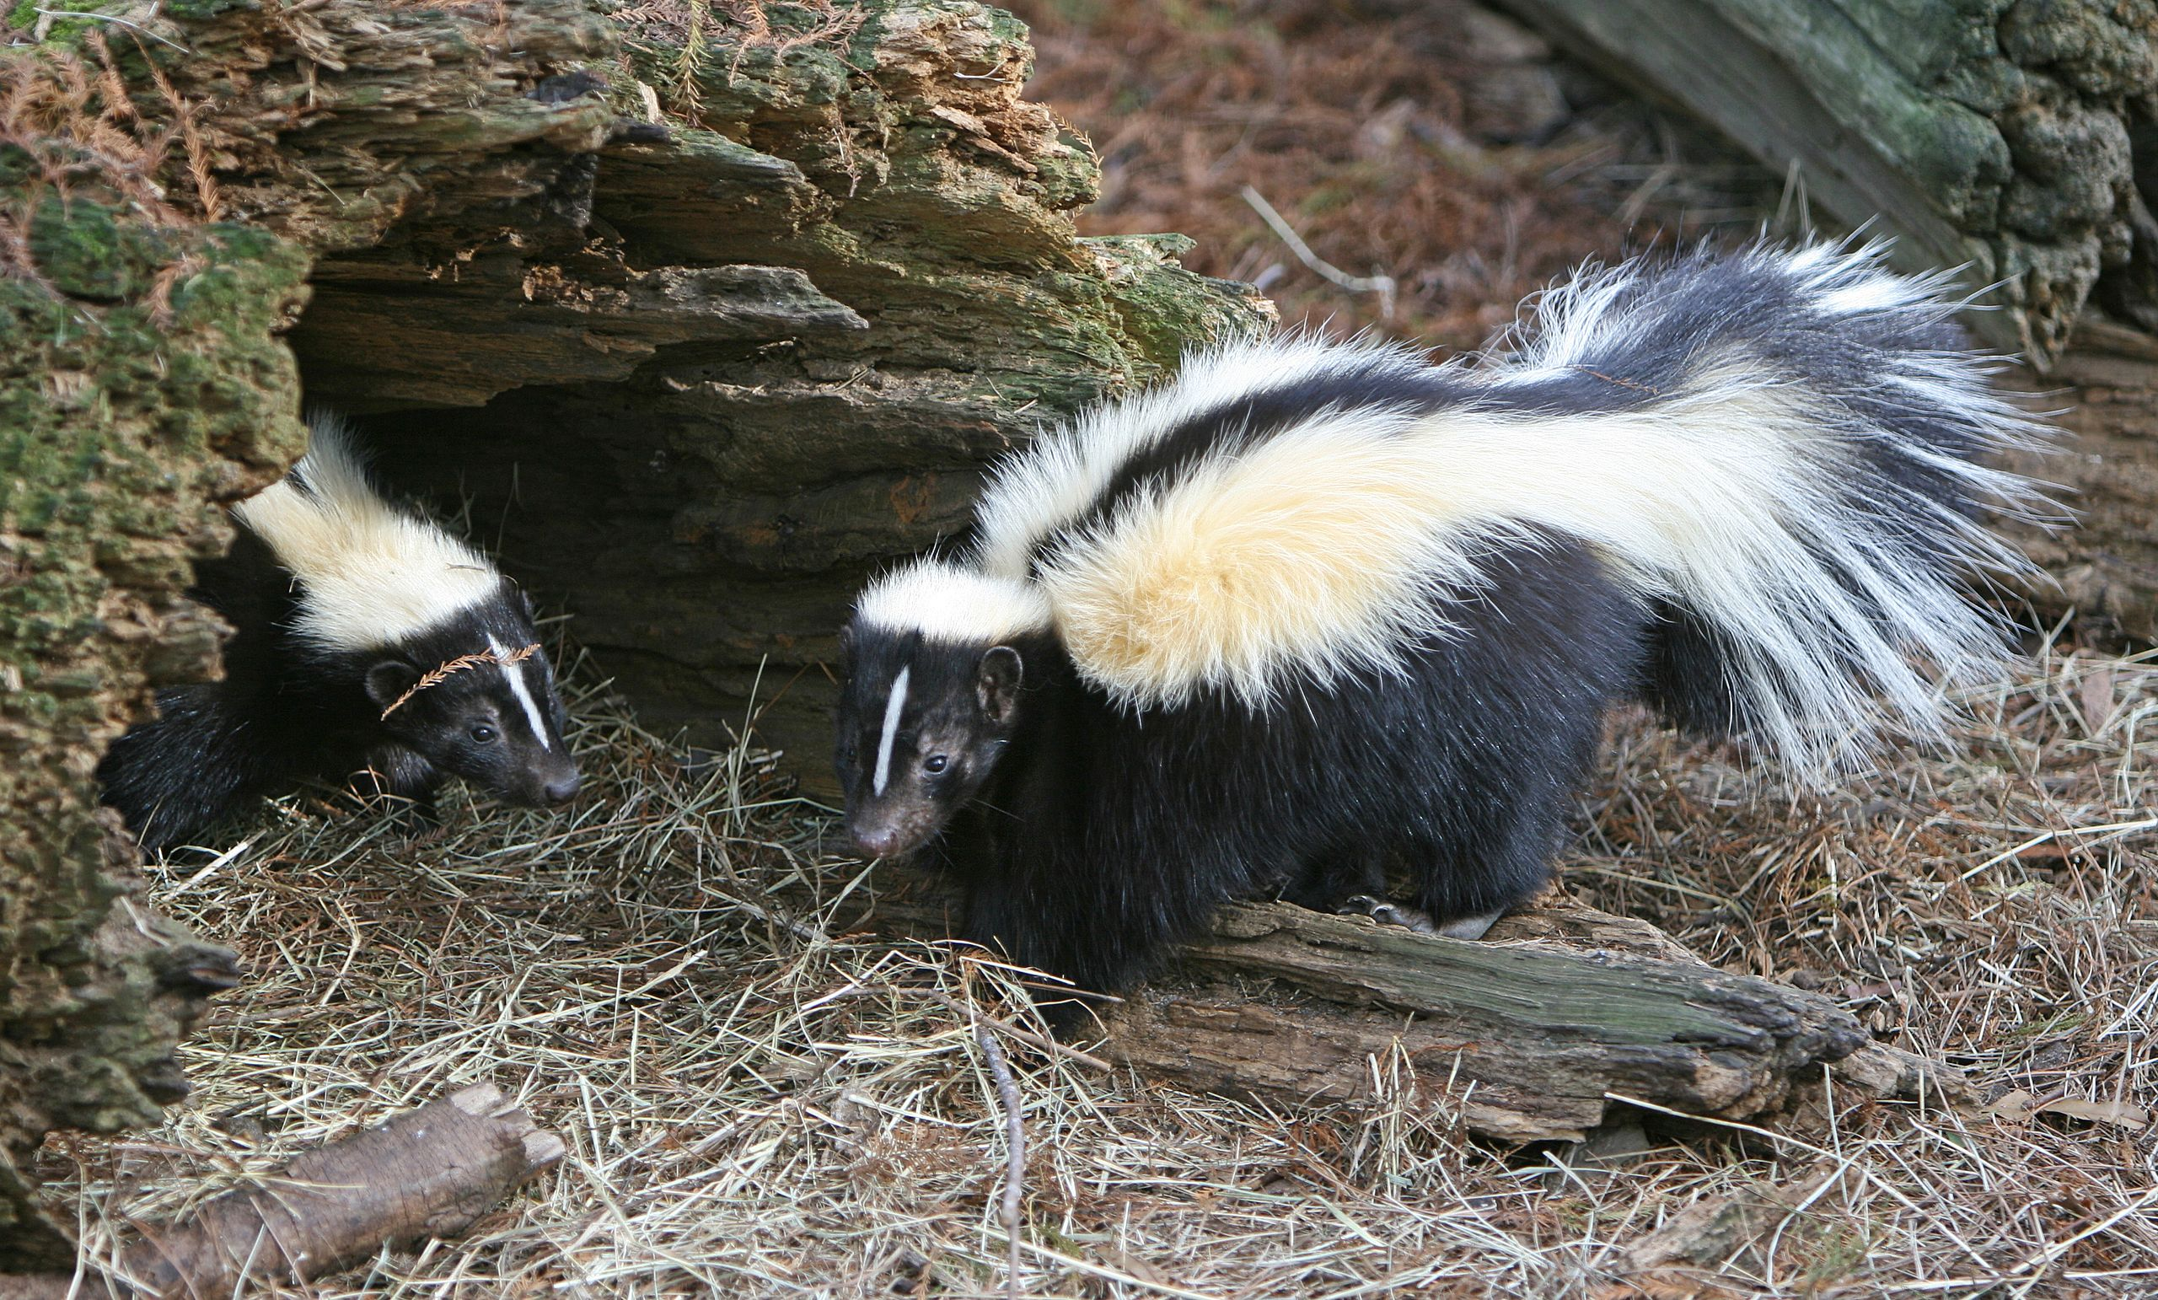
Practice Exam, question 23
You have a two-layer neural network trained as an animal classier. The input feature vector is $\vec{x} = [x_{1},x_{2},x_{3}, 1]$, where $x_{1}$, $x_{2}$, and $x_{3}$ are some features, and 1 is multiplied by the bias. There are two hidden nodes, and three output nodes, ${\vec{y}}^{∗} = [y_{1}^{∗},y_{2}^{∗},y_{3}^{∗},]$, corresponding to the three output classes $y_{1}^{∗}=Pr⁡(dog|$ $\vec{x}$), $y_{2}^{∗}=Pr⁡(cat|$ $\vec{x}$), $y_{3}^{∗}=Pr⁡(skunk|$ $\vec{x}$). Hidden node activations are sigmoid; output node activations are softmax.
Input
Weights
$$x_{1}$$
$$w_{11}$$
$$y_{1}^{∗}$$
$$h_{1}$$
$$w_{12}$$
$$x_{2}$$
$$w_{21}$$
$$w_{22}$$
$$y_{2}^{∗}$$
$$x_{3}$$
$$h_{2}$$
$$w_{32}$$
$$w_{31}$$
1
1
$$y_{3}^{∗}$$
By http://www.birdphotos.com - Own work, CC BY 3.0, https://commons.wikimedia.org/w/index.php?curid=4409510

Slide 4
Practice Exam, question 23
(a) A Maltese puppy has feature vector $\vec{x} = [2,20,−1, 1]$. All weights and biases are initialized to zero. What is ${\vec{y}}^{∗}$?
Input
Weights
$$x_{1}$$
$$w_{11}$$
$$y_{1}^{∗}$$
$$h_{1}$$
$$w_{12}$$
$$x_{2}$$
$$w_{21}$$
$$w_{22}$$
$$y_{2}^{∗}$$
$$x_{3}$$
$$h_{2}$$
$$w_{32}$$
$$w_{31}$$
1
1
$$y_{3}^{∗}$$
By http://www.birdphotos.com - Own work, CC BY 3.0, https://commons.wikimedia.org/w/index.php?curid=4409510

Slide 5
Practice Exam, question 23
A Maltese puppy has feature vector $\vec{x} = [2,20,−1, 1]$. All weights and biases are initialized to zero. What is ${\vec{y}}^{∗}$?
Hidden node excitations are both: $0×\vec{x}=0$
Therefore, hidden node activations are both:
$$\frac{1}{1+e^{−0}}=\frac{1}{1+1}=\frac{1}{2}$$
Input
Weights
$$x_{1}$$
$$w_{11}$$
$$y_{1}^{∗}$$
$$h_{1}$$
$$w_{12}$$
$$x_{2}$$
$$w_{21}$$
$$w_{22}$$
$$y_{2}^{∗}$$
$$x_{3}$$
$$h_{2}$$
$$w_{32}$$
$$w_{31}$$
1
1
$$y_{3}^{∗}$$
By http://www.birdphotos.com - Own work, CC BY 3.0, https://commons.wikimedia.org/w/index.php?curid=4409510

Slide 6
Practice Exam, question 23
A Maltese puppy has feature vector $\vec{x} = [2,20,−1, 1]$. All weights and biases are initialized to zero. What is ${\vec{y}}^{∗}$?
Output node excitations are all: $0×\vec{h}=0$
Therefore, output node activations are all:
$$\frac{e^{0}}{\sum_{i=1}^{3}{e^{0}}}=\frac{1}{3}$$
Input
Weights
$$x_{1}$$
$$w_{11}$$
$$y_{1}^{∗}$$
$$h_{1}$$
$$w_{12}$$
$$x_{2}$$
$$w_{21}$$
$$w_{22}$$
$$y_{2}^{∗}$$
$$x_{3}$$
$$h_{2}$$
$$w_{32}$$
$$w_{31}$$
1
1
$$y_{3}^{∗}$$
By http://www.birdphotos.com - Own work, CC BY 3.0, https://commons.wikimedia.org/w/index.php?curid=4409510

Slide 7
Practice Exam, question 23
(b) Let $w_{ij}$ be the weight connecting the ith output node to the jth hidden node. What is $\frac{dy_{2}^{∗}}{dw_{21}}$ ? Write your answer in terms of $y_{i}^{∗}$, $w_{ij}$, and/or $h_{j}$ for appropriate values of i and/or j.
Input
Weights
$$x_{1}$$
$$w_{11}$$
$$y_{1}^{∗}$$
$$h_{1}$$
$$w_{12}$$
$$x_{2}$$
$$w_{21}$$
$$w_{22}$$
$$y_{2}^{∗}$$
$$x_{3}$$
$$h_{2}$$
$$w_{32}$$
$$w_{31}$$
1
1
$$y_{3}^{∗}$$
By http://www.birdphotos.com - Own work, CC BY 3.0, https://commons.wikimedia.org/w/index.php?curid=4409510

Slide 8
Practice Exam, question 23
(b) What is $\frac{dy_{2}^{∗}}{dw_{21}}$ ?
Answer: OK, first we need the definition of softmax. Let’s write it in lots of parts, so it will be easier to differentiate.
$$y_{2}^{∗}=\frac{num}{den}$$
Where ”num” is the numerator of the softmax function:
$$num=exp\left(f_{2}\right)$$
“den” is the denominator of the softmax function:
$$den=\sum_{i=1}^{3}{exp\left(f_{i}\right)}$$
And both of those are written in terms of the softmax excitations, let’s call them $f_{i}$:
$$f_{i}=\sum_{j}{w_{ij}h_{i}}$$
Input
Weights
$$x_{1}$$
$$w_{11}$$
$$y_{1}^{∗}$$
$$h_{1}$$
$$w_{12}$$
$$x_{2}$$
$$w_{21}$$
$$w_{22}$$
$$y_{2}^{∗}$$
$$x_{3}$$
$$h_{2}$$
$$w_{32}$$
$$w_{31}$$
1
1
$$y_{3}^{∗}$$
By http://www.birdphotos.com - Own work, CC BY 3.0, https://commons.wikimedia.org/w/index.php?curid=4409510

Slide 9
Practice Exam, question 23
(b) What is $\frac{dy_{2}^{∗}}{dw_{21}}$ ?
Now we differentiate each part:
$$\frac{dy_{2}^{∗}}{dw_{21}}=\left(\frac{1}{den}\right)\frac{dnum}{dw_{21}}−\left(\frac{num}{{den}^{2}}\right)\frac{dden}{dw_{21}}$$
$$\frac{dnum}{dw_{21}}=exp\left(f_{2}\right)\frac{df_{2}}{dw_{21}}$$
$$\frac{dden}{dw_{21}}=\sum_{i=1}^{3}{exp\left(f_{i}\right)}\frac{df_{i}}{dw_{21}}=exp\left(f_{2}\right)\frac{df_{2}}{dw_{21}}$$
$$\frac{df_{2}}{dw_{21}}=h_{1}$$
Input
Weights
$$x_{1}$$
$$w_{11}$$
$$y_{1}^{∗}$$
$$h_{1}$$
$$w_{12}$$
$$x_{2}$$
$$w_{21}$$
$$w_{22}$$
$$y_{2}^{∗}$$
$$x_{3}$$
$$h_{2}$$
$$w_{32}$$
$$w_{31}$$
1
1
$$y_{3}^{∗}$$
By http://www.birdphotos.com - Own work, CC BY 3.0, https://commons.wikimedia.org/w/index.php?curid=4409510

Slide 10
Practice Exam, question 23
(b) What is $\frac{dy_{2}^{∗}}{dw_{21}}$ ?
Putting it all back together again:
$$\frac{dy_{2}^{∗}}{dw_{21}}=\left(\frac{1}{\sum_{i=1}^{3}{exp\left(f_{i}\right)}}\right)exp\left(f_{2}\right)h_{1}−\left(\frac{exp\left(f_{2}\right)}{{\left(\sum_{i=1}^{3}{exp\left(f_{i}\right)}\right)}^{2}}\right)exp\left(f_{2}\right)h_{1}$$
$$\frac{dy_{2}^{∗}}{dw_{21}}=y_{2}^{∗}h_{1}−{\left(y_{2}^{∗}\right)}^{2}h_{1}$$
Input
Weights
$$x_{1}$$
$$w_{11}$$
$$y_{1}^{∗}$$
$$h_{1}$$
$$w_{12}$$
$$x_{2}$$
$$w_{21}$$
$$w_{22}$$
$$y_{2}^{∗}$$
$$x_{3}$$
$$h_{2}$$
$$w_{32}$$
$$w_{31}$$
1
1
$$y_{3}^{∗}$$
By http://www.birdphotos.com - Own work, CC BY 3.0, https://commons.wikimedia.org/w/index.php?curid=4409510

Slide 11
Some sample problems
DNNs: Practice Final, question 23
Reinforcement learning: Practice Final, question 24
Games: Practice Final, question 25
Game theory: Practice Final, question 26

Slide 12
Practice Exam, question 24
A cat lives in a two-room apartment. It has two possible actions: purr, or walk. It starts in room s0 = 1, where it receives the reward r0 = 2 (petting). It then implements the following sequence of actions: a0 =walk, a1 =purr. In response, it observes the following sequence of states and rewards: s1 = 2, r1 = 5 (food), s2 = 2.

Slide 13
Practice Exam, question 24
The cat starts out with a Q-table whose entries are all Q(s,a) = 0.
…then performs one iteration of TD-learning using each of the two SARS sequences described above.
…it uses a relatively high learning rate (alpha = 0.05) and a relatively low discount factor (gamma = 3/4).
Which entries in the Q-table have changed, after this learning, and what are their new values?

Slide 14
Practice Exam, question 24
Time step 0:
$$SARS=(1,walk,2,2)$$
$$Qlocal = R(1)+γ\max_{a}{Q(2,a)}$$
$$= 2 +\left(\frac{3}{4}\right)\max\left(0,0\right)=2$$
$$Q(1,w) = Q(1,w) +α(Qlocal−Q\left(1,w\right))$$
$$= 0 + 0.05∗(2−0) = 0.1$$
Time step 1:
$$SARS=(2,purr,5,2)$$
$$Qlocal = R(2)+γ\max_{a}{Q(2,a)}$$
$$=5 +\left(\frac{3}{4}\right)\max\left(0,0\right)=5$$
$$Q(2,purr) = Q(2,p) +α(Qlocal−Q\left(2,p\right))$$
$$= 0 + 0.05∗(5−0) = 0.25$$

Slide 15
Practice Exam, question 24
(b) The cat decides, instead, to use model-based learning. Based on these two observations, it estimates P(s’|s,a) with Laplace smoothing, where the smoothing constant is k=1. Find P(s’|2,purr).
Time step 0:
$$SARS=(1,walk,2,2)$$
Time step 1:
$$SARS=(2,purr,5,2)$$

Slide 16
Practice Exam, question 24
(b) Find P(s’|2,purr).
$$P\left(s^{′}=1 | s=2,a=purr\right)$$
$$=\frac{1+Count(s=2,a=purr,s^{′}=1)}{2+\sum{Count(s=2,a=purr,s^{′})}}=\frac{1}{2+1}$$
$$P\left(s^{′}=2 | s=2,a=purr\right)$$
$$=\frac{1+Count(s=2,a=purr,s^{′}=2)}{2+\sum{Count(s=2,a=purr,s^{′})}}=\frac{1+1}{2+1}$$

Slide 17
Practice Exam, question 24
(c) The cat estimates R(1)=2, R(2)=5, and the following P(s’|s,a) table. It chooses the policy pi(1)=purr, pi(2)=walk. What is the policy-dependent utility of each room? Write two equations in the two unknowns U(1) and U(2); don’t solve.
 | a=purr |  | a=walk
 | s=1 | s=2 | s=1 | s=2
s’=1 | 2/3 | 1/3 | 1/3 | 2/3
s’=2 | 1/3 | 2/3 | 2/3 | 1/3

Slide 18
Practice Exam, question 24
(c) Answer: policy-dependent utility is just like Bellman’s equation, but without the max operation. The equations are
$$U\left(1\right)=R\left(1\right)+γ\sum_{s′}{P\left(s^{′} | s=1,π\left(1\right)\right)U(s^{′})}$$
$$U\left(2\right)=R\left(2\right)+γ\sum_{s′}{P\left(s^{′} | s=2,π\left(2\right)\right)U(s^{′})}$$
 | a=purr |  | a=walk
 | s=1 | s=2 | s=1 | s=2
s’=1 | 2/3 | 1/3 | 1/3 | 2/3
s’=2 | 1/3 | 2/3 | 2/3 | 1/3

Slide 19
Practice Exam, question 24
(c) Answer: So to solve, we just plug in the values for all variables except U(1) and U(2):
$$U\left(1\right)=2+(\frac{3}{4})\left(\frac{2}{3}U\left(1\right)+\frac{1}{3}U(2)\right)$$
$$U\left(2\right)=5+(\frac{3}{4})\left(\frac{2}{3}U\left(1\right)+\frac{1}{3}U(2)\right)$$
 | a=purr |  | a=walk
 | s=1 | s=2 | s=1 | s=2
s’=1 | 2/3 | 1/3 | 1/3 | 2/3
s’=2 | 1/3 | 2/3 | 2/3 | 1/3

Slide 20
Practice Exam, question 24
(d) Since it has some extra time, and excellent python programming skills, the cat decides to implement deep reinforcement learning, using an actor-critic algorithm. Inputs are one-hot encodings of state and action. What are the input and output dimensions of the actor network, and of the critic network?

Slide 21
Practice Exam, question 24
(d)
Actor network is $π_{a} \left(s\right)=$ probability that action a is the best action, where a=1 or a=2. So output has two dimensions.
Input is the state, s. If there are two states, encoded using a one-hot vector, then state 1 is encoded as $s=[1,0]$, state 2 is encoded as $s=[0,1]$. So, two dimensions.

Slide 22
Practice Exam, question 24
(d)
Critic network is $Q\left(s,a\right)=$ quality of action a in state s. Quality is a scalar (for any given action and state), so output has one dimension (scalar).
Input is the state, s, and the action, a. Problem statement says that each is a one-hot vector, so $s=[1,0]$ or $s=[0,1]$, concatenated with $a=[1,0]$ or $a=[0,1]$, for a total of 4 dimensions.

Slide 23
Some sample problems
DNNs: Practice Final, question 23
Reinforcement learning: Practice Final, question 24
Games: Practice Final, question 25
Game theory: Practice Final, question 26

Slide 24
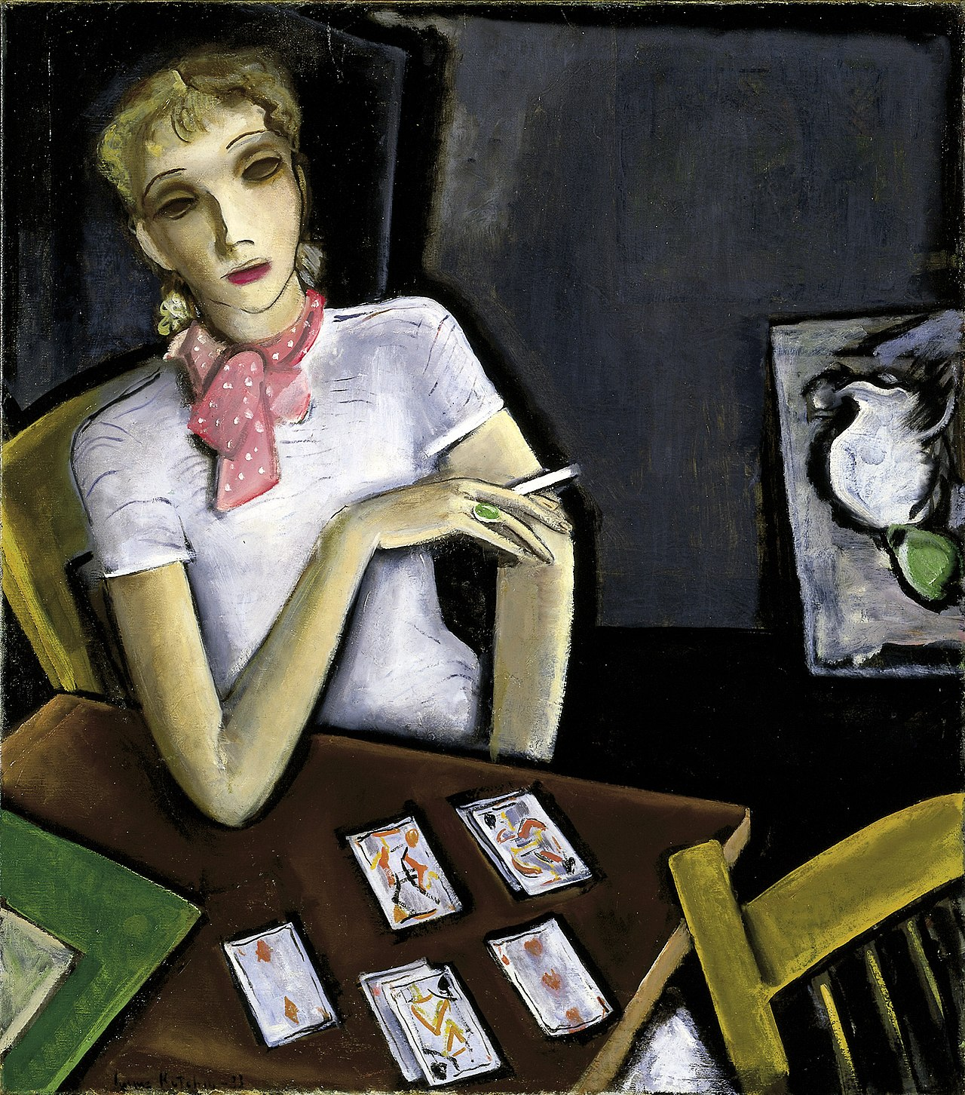
Practice Exam, question 25
Girl with Cards by Lucius Kutchin, 1933, Smithsonian American Art Museum
Consider a game with eight cards, sorted onto the table in four stacks of two cards each. MAX and MIN each know the contents of each stack, but they don't know which card is on top. The game proceeds as follows.
MAX chooses either the left or the right pair of stacks.
MIN chooses either the left or the right stack, within the pair that MAX chose.
The top card is revealed. MAX receives the face value of the card (c), and MIN receives 9-c.

Slide 25
Practice Exam, question 25
Girl with Cards by Lucius Kutchin, 1933, Smithsonian American Art Museum
(a) What is the value of the MAX node?
6
2
6
2
4
6
6

Slide 26
Practice Exam, question 25
Girl with Cards by Lucius Kutchin, 1933, Smithsonian American Art Museum
Rule change: after MAX chooses a pair of stacks, he is permitted to look at the top card in any one stack. He must show the card to MIN, then replace it, so that it remains the top card in that stack. Define the belief state, b, to be the set of all possible outcomes of the game, i.e., the starting belief state is the set b = {1,2,3,4,5,6,7,8}.
PREDICT operation modifies the belief state based on the action of a player.
OBSERVE operation modifies the belief state based on MAX’s observation.
Suppose MAX chooses the action R. He then turns up the top card in the rightmost deck, revealing it to be a 7. What is the resulting belief state?

Slide 27
Practice Exam, question 25
Girl with Cards by Lucius Kutchin, 1933, Smithsonian American Art Museum
Starting belief state is the set b = {1,2,3,4,5,6,7,8}.
PREDICT operation modifies the belief state based on the action of a player. (MAX chooses the action R).
OBSERVE operation modifies the belief state based on MAX’s observation. (MAX observes that 7 is on top).
Starting belief state is the set b = {1,2,3,4,5,6,7,8}.

Slide 28
Practice Exam, question 25
Girl with Cards by Lucius Kutchin, 1933, Smithsonian American Art Museum
Starting belief state is the set b = {1,2,3,4,5,6,7,8}.
PREDICT operation modifies the belief state based on the action of a player. (MAX chooses the action R).
OBSERVE operation modifies the belief state based on MAX’s observation. (MAX observes that 7 is on top).
MAX chooses the action R.

Slide 29
Practice Exam, question 25
Girl with Cards by Lucius Kutchin, 1933, Smithsonian American Art Museum
Starting belief state is the set b = {1,2,3,4,5,6,7,8}.
PREDICT operation modifies the belief state based on the action of a player. (MAX chooses the action R).
OBSERVE operation modifies the belief state based on MAX’s observation. (MAX observes that 7 is on top).
Final belief state is therefore b={4,8,7}.
MAX observes that 7 is on top of 5.

Slide 30
Some sample problems
DNNs: Practice Final, question 23
Reinforcement learning: Practice Final, question 24
Games: Practice Final, question 25
Game theory: Practice Final, question 26

Slide 31
Practice exam, question 26
(a). Two cookies, three roommates.
We decide to use a VCG auction, with proceeds going into a cookie fund.
…and the bids are:
$5
$3
$6
Calculate the net value (value received
minus price paid) of each roommate, and of the cookie fund.

Slide 32
Practice exam, question 26
VCG auction:
Cookies go to the N highest bidders, i.e., the judge and the DJ.
They each pay b(N+1), i.e., $3.
Because they each pay b(N+1), it’s a dominant strategy to bid what the cookie is really worth to each of them, so we can assume that’s what they’ve done.
$5=$3+$2
$3
$6=$3+$3

Slide 33
Practice exam, question 26
Value to the construction worker: $0, because they didn’t get a cookie, or spend any money.
Value to the judge: $5 (value of the cookie) - $3 (price paid) = $2
Value to the DJ: $6 (value of the cookie) - $3 (price paid) = $3
Value to the cookie fund: 2 * $3 = $6
$3
$2
$0
$3
$3

Slide 34
Practice exam, question 26
(b). Three cookies, two roommates.
One cookie is deluxe, worth $10.
The other two are regular, worth $1 each.
Possible outcomes:
A chooses deluxe ($10), B chooses regular, then B gets the third ($2), or vice versa.
A and B each choose a regular, then they split the deluxe ($6 each).
A and B each choose deluxe, then they fight, and the dog eats all of the cookies ($0).

Slide 35
Practice exam, question 26
Find the mixed-strategy Nash equilibrium.
 | Regular | Deluxe
Regular
Deluxe
6
10
6
2
2
0
10
0

Slide 36
Practice exam, question 26
Find the mixed-strategy Nash equilibrium.
If chooses deluxe with probability p, then it is rational for
to choose randomly only if
$$2p+6\left(1−p\right)=0p+10\left(1−p\right)$$
…in other words, random choice is rational for only if $p=2/3$.
 | Regular | Deluxe
Regular
Deluxe
6
10
6
2
2
0
10
0

Slide 37
Practice exam, question 26
: Random choice is rational only if chooses deluxe with probability $p=2/3$.
: Random choice is rational only if chooses deluxe with probability $q=2/3$.
So $p=2/3$, $q=2/3$ is a Nash equilibrium.
 | Regular | Deluxe
Regular
Deluxe
6
10
6
2
2
0
10
0

Slide 38
Final thoughts…
Some books worth reading

Slide 39
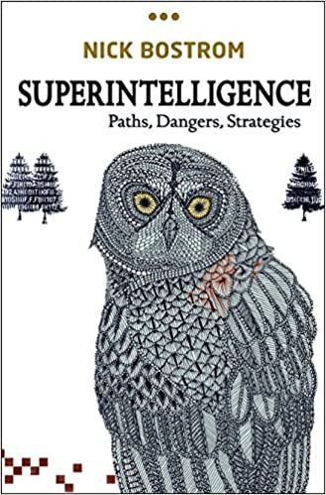
Superintelligence (2014)
What would happen if we produced an AI with the goal of making as many paper clips as possible… and it succeeded?

Slide 40
Weapons of math destruction (2016)
A “weapon of math destruction” is a statistical model used in a way that is
Scaled beyond the level for which it was designed
Measures a proxy-measure, rather than the thing it’s actually trying to optimize
Blind to the actual outcomes it produces

Slide 41
Zucked (2019)
Uses Facebook as an illustrative model of the way in which the drive to provide customers what they want is often, but not always, in the best interest of society.

Slide 42
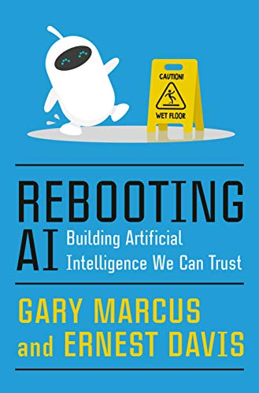
Rebooting AI (2019)
Argues that the greatest threat of AI is not that it will replace human beings, but that it will fail outrageously, in ways human beings are unable to predict, because no human would ever fail in that way.

Slide 43
Thank you! Have a happy summer!
Input
Weights
$$x_{1}$$
$$w_{11}$$
$$y_{1}^{∗}$$
$$h_{1}$$
$$w_{12}$$
$$x_{2}$$
$$w_{21}$$
$$w_{22}$$
$$y_{2}^{∗}$$
$$x_{3}$$
$$h_{2}$$
$$w_{32}$$
$$w_{31}$$
1
1
$$y_{3}^{∗}$$
By http://www.birdphotos.com - Own work, CC BY 3.0, https://commons.wikimedia.org/w/index.php?curid=4409510

