Slide 1
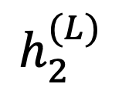
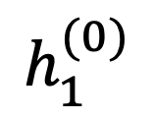

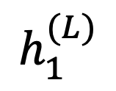


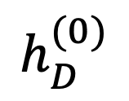

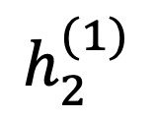
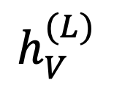
Deep Learning
$$h_{1}^{(L)}$$
$$h_{2}^{(L)}$$
$$h_{V}^{(L)}$$
Mark Hasegawa-Johnson, May 2022
Some slides by Svetlana Lazebnik
CC-BY 4.0: Copy or modify at will, but please cite the source
$$1$$
$$1$$
$$h_{1}^{(0)}$$
$$h_{2}^{(1)}$$
$$…$$
$$h_{D}^{(0)}$$
$$1$$

Slide 2
Outline
Review: multi-class perceptron
Breaking the constraints of linearity: multi-layer neural nets
Flow diagram for the XOR problem
Flow diagram for a multi-layer neural net
One-hot vectors
Softmax
Cross-entropy = negative log probability of the training data
Stochastic gradient descent
Training a neural net using numpy
The same example using pytorch
torch.nn: standard layers and units

Slide 3










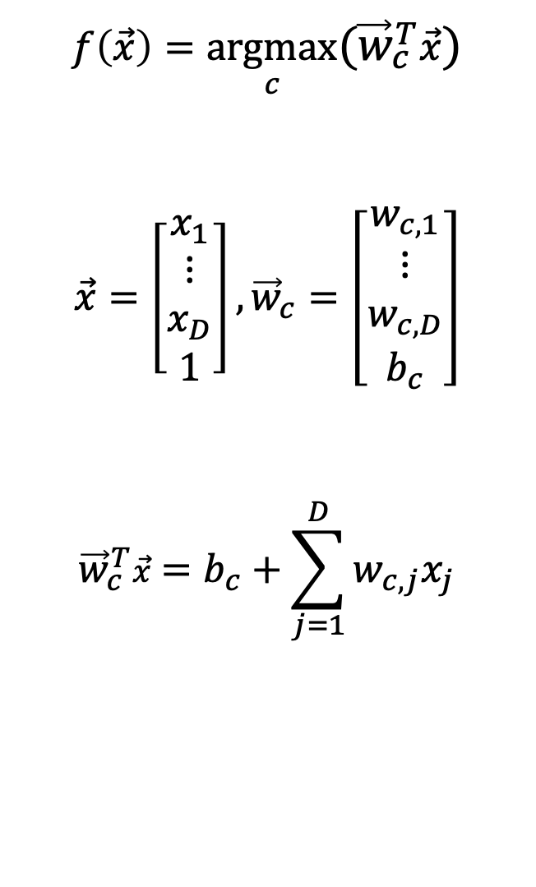













Review: Multi-Class Perceptron
$$x_{2}$$
$$f(x)=1$$
$$f(x)=2$$
$$f(x)=3$$
$$f\left(\vec{x}\right)=\underset{c}{argmax}{({\vec{w}}_{c}^{T}\vec{x})}$$
$$\vec{x}=\left[\begin{matrix}x_{1} \\ \begin{matrix}⋮ \\ x_{D}\end{matrix} \\ 1\end{matrix}\right],{\vec{w}}_{c}=\left[\begin{matrix}w_{c,1} \\ \begin{matrix}⋮ \\ w_{c,D}\end{matrix} \\ b_{c}\end{matrix}\right]$$
$${\vec{w}}_{c}^{T}\vec{x}=b_{c}+\sum_{j=1}^{D}{w_{c,j}x_{j}}$$
$$f(x)=4$$
$$f(x)=0$$
$$f(x)=6$$
$$f(x)=8$$
$$f(x)=5$$
$$f(x)=9$$
$$f(x)=10$$
$$f(x)=11$$
$$f(x)=12$$
$$f(x)=7$$
$$f(x)=13$$
$$f(x)=14$$
$$f(x)=15$$
$$f(x)=16$$
$$f(x)=17$$
$$f(x)=18$$
$$f(x)=19$$
$$x_{1}$$

Slide 4
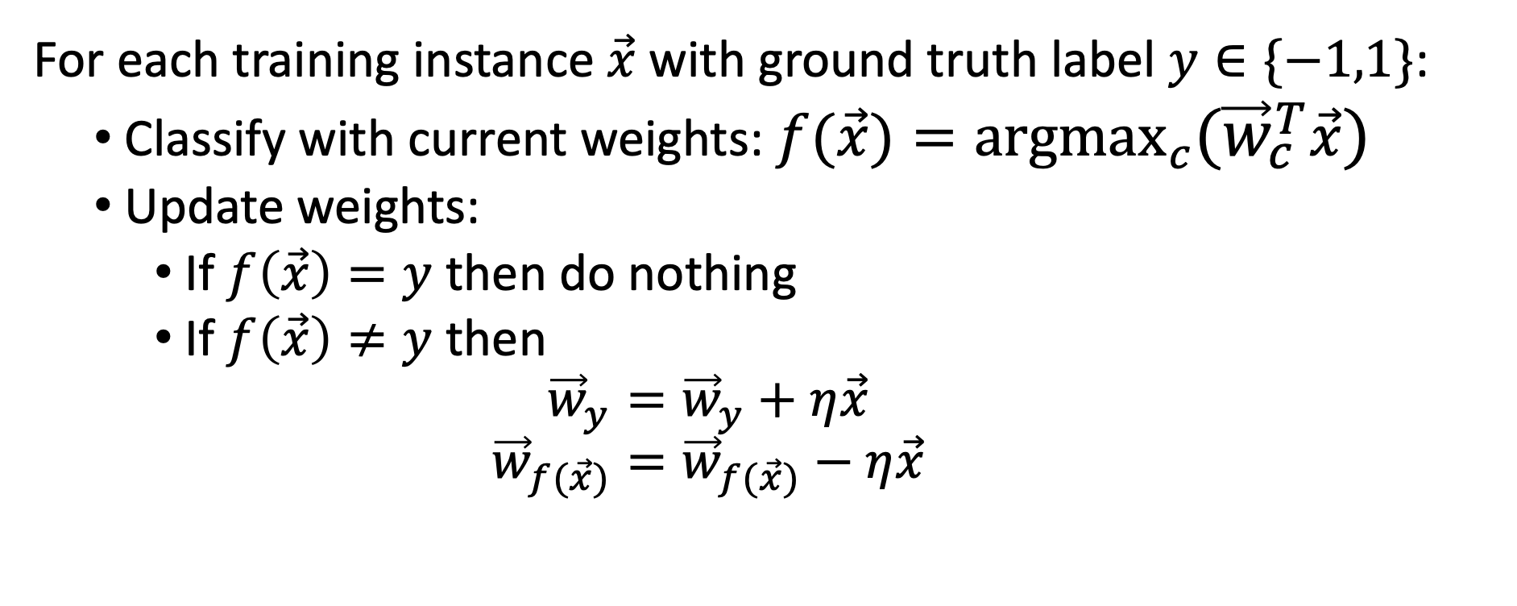
Training Algorithm for the Multi-Class Perceptron
For each training instance $\vec{x}$ with ground truth label $y∈\{−1,1\}$:
  Classify with current weights: $f(\vec{x})=\underset{c}{argmax}{({\vec{w}}_{c}^{T}\vec{x})}$
  Update weights:
    If $f\left(\vec{x}\right)=y$ then do nothing
    If $f\left(\vec{x}\right)≠y$ then
    $${\vec{w}}_{y}={\vec{w}}_{y}+η\vec{x}$$
    $${\vec{w}}_{f(\vec{x})}={\vec{w}}_{f(\vec{x})}−η\vec{x}$$

Slide 5
Outline
Review: multi-class perceptron
Breaking the constraints of linearity: multi-layer neural nets
Flow diagram for the XOR problem
Flow diagram for a multi-layer neural net
One-hot vectors
Softmax
Cross-entropy = negative log probability of the training data
Stochastic gradient descent
Training a neural net using numpy
The same example using pytorch
torch.nn: standard layers and units

Slide 6
Biological Inspiration: McCulloch-Pitts Artificial Neuron, 1943
Input
In 1943, McCulloch & Pitts proposed that biological neurons have a nonlinear activation function (a step function) whose input is a weighted linear combination of the currents generated by other neurons.
They showed lots of examples of mathematical and logical functions that could be computed using networks of simple neurons like this.
Weights
x₁
w₁
x₂
w₂
Output: u(w⋅x)
x₃
w₃
.
.
.
w_{D}
x_{D}

Slide 7
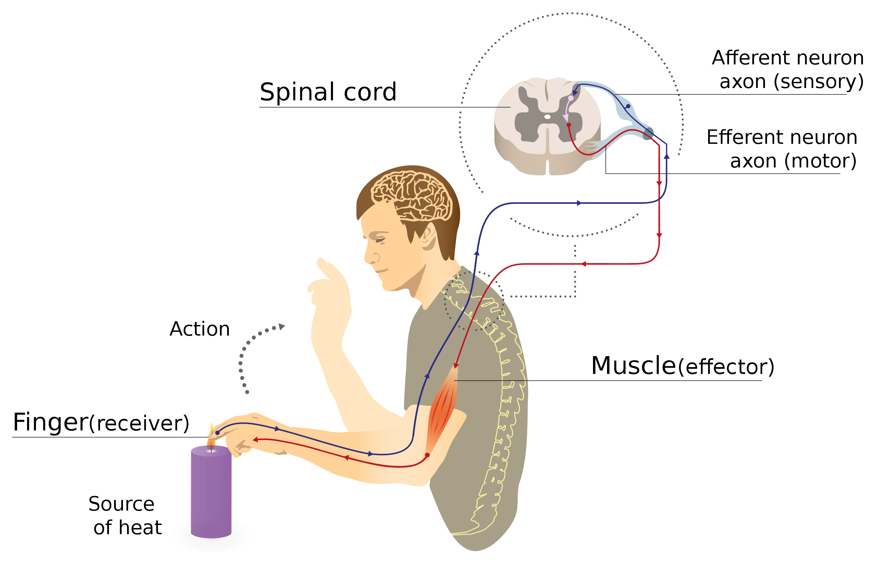
Biological Inspiration: Neuronal Circuits
Even the simplest actions involve more than one neuron, acting in sequence in a neuronal circuit.
One of the simplest neuronal circuits is a reflex arc, which may contain just two neurons:
  The sensor neuron detects a stimulus, and communicates an electrical signal to …
  The motor neuron, which activates the muscle.
Illustration of a reflex arc: sensor neuron sends a voltage spike to the spinal column, where the resulting current causes a spike in a motor neuron, whose spike activates the muscle.
By MartaAguayo - Own work, CC BY-SA 3.0, https://commons.wikimedia.org/w/index.php?curid=39181552

Slide 8
A McCulloch-Pitts Neuron can compute some logical functions…
When the features are binary ($x_{j}∈\{0,1\}$), many (but not all!) binary functions can be re-written as linear functions. For example, the function
$$f\left(\vec{x}\right)=(x_{1}∨x_{2})$$
can be re-written as
$$f\left(\vec{x}\right)=u\left(x_{1}+x_{2}−0.5\right)$$
Similarly, the function
$$f\left(\vec{x}\right)=(x_{1}∧x_{2})$$
can be re-written as
$$f\left(\vec{x}\right)=u\left(x_{1}+x_{2}−1.5\right)$$
$$x_{2}$$
$$x_{2}$$
$$x_{1}$$
$$x_{1}$$

Slide 9
… but not all.
“A linear classifier cannot learn an XOR function.”
- Minsky & Papert, 1969
…but a two-layer neural net can compute an XOR function!
$$x_{2}$$
$$x_{1}$$

Slide 10
Outline
Review: multi-class perceptron
Breaking the constraints of linearity: multi-layer neural nets
Flow diagram for the XOR problem
Flow diagram for a multi-layer neural net
One-hot vectors
Softmax
Cross-entropy = negative log probability of the training data
Stochastic gradient descent
Training a neural net using numpy
The same example using pytorch
torch.nn: standard layers and units

Slide 11
Example: one way (of many possible ways) to represent the XOR function using a two-layer neural network
$$x_{2}$$
$h_{2}\left(\vec{x}\right)=1$ up in this region
For example, consider the XOR problem. Suppose we create two hidden nodes:
$$h_{1}\left(\vec{x}\right)=u\left(0.5−x_{1}−x_{2}\right)$$
$$h_{2}\left(\vec{x}\right)=u\left(x_{1}+x_{2}−1.5\right)$$
Then the XOR function $f\left(\vec{x}\right)=(x_{1}⊕x_{2})$ is given by $f\left(\vec{x}\right)=¬(h_{1}∨h_{2})$. For example, we could write this as:
$$f\left(\vec{x}\right)=u\left(0.5−h_{1}\left(x\right)−h_{2}\left(x\right)\right)$$
$h_{1}\left(\vec{x}\right)=1$ down in this region
$$x_{1}$$
Here in the middle, both $h_{1}\left(\vec{x}\right)$and $h_{2}\left(\vec{x}\right)$ are zero.
$$x_{2}$$
$$x_{1}$$

Slide 12
Flow diagrams
$$x_{2}$$
$h_{2}\left(\vec{x}\right)=1$ up in this region
Suppose we create two hidden nodes:
$$h_{1}\left(\vec{x}\right)=u\left(0.5−x_{1}−x_{2}\right)$$
$$h_{2}\left(\vec{x}\right)=u\left(x_{1}+x_{2}−1.5\right)$$
Here is a flow diagram for this computation:
$h_{1}\left(\vec{x}\right)=1$ down in this region
$$x_{1}$$
Here in the middle, both $h_{1}\left(\vec{x}\right)$and $h_{2}\left(\vec{x}\right)$ are zero.
$$h_{1}(\vec{x})$$
$$h_{2}(\vec{x})$$
$$−1.5$$
$$−1$$
$$1$$
$$−1$$
$$1$$
$$0.5$$
$$x_{1}$$
$$x_{2}$$
$$1$$

Slide 13
Flow diagrams
$$x_{2}$$
$$h_{2}=1$$
A flow diagram is a way to represent the computations performed by a neural network.
Circles, a.k.a. “nodes,” a.k.a. “neurons,” represent scalar operations.
  The circles above $x_{1}$ and $x_{2}$ represent the scalar operation of “read this datum in from the dataset.”
  The circles labeled $h_{1}$ and $h_{1}$ represent the scalar operation of “unit step function.”
Lines represent multiplication by a scalar.
Where arrowheads come together, the corresponding variables are added.
$$h_{1}=1$$
$$x_{1}$$
Here in the middle, both $h_{1}\left(\vec{x}\right)$and $h_{2}\left(\vec{x}\right)$ are zero.
$$h_{1}$$
$$h_{2}$$
$$−1.5$$
$$−1$$
$$1$$
$$1$$
$$−1$$
$$0.5$$
$$x_{1}$$
$$x_{2}$$
$$1$$

Slide 14
Flow diagrams
$$x_{2}$$
$$h_{2}=1$$
It’s often useful to distinguish two types of hidden variables at each neuron:
The neural excitation, $ξ_{j}$, is the result of adding together all of the inputs to the neuron.
The neural activation, $h_{j}$, is the result of passing $ξ_{j}$ through a scalar nonlinearity.
$$h_{1}=1$$
$$x_{1}$$
Here in the middle, both $h_{1}\left(\vec{x}\right)$and $h_{2}\left(\vec{x}\right)$ are zero.
$$h_{1}$$
$$h_{2}$$
$$−1.5$$
$$−1$$
$$1$$
$$1$$
$$−1$$
$$0.5$$
$$x_{1}$$
$$x_{2}$$
$$1$$

Slide 15
Flow diagrams
$$x_{2}$$
$$h_{2}=1$$
So in this flow diagram, for example, we can see that:
$$ξ_{1}=0.5−1∙x_{1}−1∙x_{2}$$
$$ξ_{2}=−1.5+1∙x_{1}+1∙x_{2}$$
… and then …
$$h_{1}=u\left(ξ_{1}\right)$$
$$h_{2}=u\left(ξ_{2}\right)$$
… where $u\left(∙\right)$ is the unit step function.
$$h_{1}=1$$
$$x_{1}$$
Here in the middle, both $h_{1}\left(\vec{x}\right)$and $h_{2}\left(\vec{x}\right)$ are zero.
$$h_{1}$$
$$h_{2}$$
$$−1.5$$
$$−1$$
$$1$$
$$1$$
$$−1$$
$$0.5$$
$$x_{1}$$
$$x_{2}$$
$$1$$

Slide 16
Flow diagrams
$$x_{2}$$
$$h_{2}=1$$
Now suppose that we want to compute
$f\left(\vec{x}\right)=(x_{1}⊕x_{2})$. We could write this as:
$$f\left(\vec{x}\right)=u\left(0.5−h_{1}−h_{2}\right)$$
$$x_{1}$$
$$h_{1}=1$$
Here in the middle, both $h_{1}\left(\vec{x}\right)$and $h_{2}\left(\vec{x}\right)$ are zero.
$$x_{2}$$
$$x_{1}$$

Slide 17
Flow diagrams
We can write the XOR function as:
$$ξ_{3}=0.5−1∙h_{1}−1∙h_{2}$$
$$f\left(\vec{x}\right)=u\left(ξ_{3}\right)$$
$$f$$
$$−1$$
$$−1$$
$$0.5$$
$$1$$
$$h_{1}$$
$$h_{2}$$
$$−1.5$$
$$1$$
$$−1$$
$$1$$
$$−1$$
$$0.5$$
$$x_{1}$$
$$x_{2}$$
$$1$$

Slide 18
Flow diagrams
Putting it all together:
$$ξ_{1}=0.5−1∙x_{1}−1∙x_{2}$$
$$ξ_{2}=−1.5+1∙x_{1}+1∙x_{2}$$
$$h_{1}=u\left(ξ_{1}\right)$$
$$h_{2}=u\left(ξ_{2}\right)$$
$$ξ_{3}=0.5−1∙h_{1}−1∙h_{2}$$
$$f\left(\vec{x}\right)=u\left(ξ_{3}\right)$$
$$f$$
$$−1$$
$$−1$$
$$0.5$$
$$1$$
$$h_{1}$$
$$h_{2}$$
$$−1.5$$
$$1$$
$$−1$$
$$1$$
$$−1$$
$$0.5$$
$$x_{1}$$
$$x_{2}$$
$$1$$

Slide 19
Outline
Review: multi-class perceptron
Breaking the constraints of linearity: multi-layer neural nets
Flow diagram for the XOR problem
Flow diagram for a multi-layer neural net
One-hot vectors
Softmax
Cross-entropy = negative log probability of the training data
Stochastic gradient descent
Training a neural net using numpy
The same example using pytorch
torch.nn: standard layers and units

Slide 20
Multi-layer neural net
$ξ_{j}^{(l)}=$ excitation of the j^{th} neuron (a.k.a. “node”) in the l^{th} layer
  Computed by adding together inputs from many other neurons, each weighted by a corresponding connection strength or connection weight, $w_{j,k}^{(l)}$
$h_{j}^{(l)}=$activation of the j^{th} node in the l^{th} layer
  This is computed by just passing the excitation through a scalar nonlinear activation function, thus $h_{j}^{(l)}=g(ξ_{j}^{\left(l\right)})$. The activation functions in different layers differ, so to be pedantic, sometimes we’ll write $h_{j}^{(l)}=g^{(l)}\left(ξ_{j}^{(l)}\right)$.

Slide 21
Multi-layer neural net
Given: some training token $\vec{x}={[x_{1},…,x_{D},1]}^{T}$ and its target label $y$
Initialize: $h_{k}^{(0)}=x_{k}$
Forward propagate: for $l∈\left\{1,…,L\right\}$:
  Compute the excitations as weighted sums of the previous-layer activations:
  $$ξ_{j}^{(l)}=b_{j}^{(l)}+\sum_{k}{w_{j,k}^{(l)}h_{k}^{(l−1)}}$$
  Compute the activations by applying scalar nonlinearities:
  $$h_{j}^{(l)}=g^{(l)}\left(ξ_{j}^{(l)}\right)$$
Output: $P(Y=k|x) =h_{k}^{(L)}$

Slide 22
Forward propagation
From activation to excitation is a matrix multiply:
$$ξ_{j}^{(l)}=b_{j}^{(l)}+\sum_{k}{w_{j,k}^{(l)}h_{k}^{(l−1)}}$$
From excitation to activation is a scalar nonlinearity:
$$h_{j}^{(l)}=g^{(l)}\left(ξ_{j}^{(l)}\right)$$
$$…$$
$$h_{1}^{(l)}$$
$$h_{2}^{(l)}$$
$$h_{N}^{(l)}$$
$$g^{(l)}$$
$$g^{(l)}$$
$$g^{(l)}$$
$$ξ_{1}^{(l)}$$
$$ξ_{2}^{(l)}$$
$$…$$
$$ξ_{N}^{(l)}$$
$$h_{1}^{(l−1)}$$
$$h_{2}^{(l−1)}$$
$$…$$
$$h_{M}^{(l−1)}$$
$$1$$

Slide 23
Forward propagation: Matrix multiply
From activation to excitation is a matrix multiply:
$${\vec{ξ}}^{(l)}=W^{(l)}{\vec{h}}^{(l−1)}$$
…where…
$${\vec{ξ}}^{(l)}=\left[\begin{matrix}ξ_{1}^{(l)} \\ ⋮ \\ ξ_{N}^{(l)}\end{matrix}\right], {\vec{h}}^{(l−1)}=\left[\begin{matrix}h_{1}^{(l−1)} \\ ⋮ \\ \begin{matrix}h_{M}^{(l−1)} \\ 1\end{matrix}\end{matrix}\right],$$
$$W^{(l)}=\left[\begin{matrix}w_{1,1}^{(l)} & ⋯ & w_{1,M}^{(l)} \\ ⋮ & ⋱ & ⋮ \\ w_{N,1}^{(l)} & ⋯ & w_{N,M}^{(l)}\end{matrix} \begin{matrix}b_{1}^{(l)} \\ ⋮ \\ b_{N}^{(l)}\end{matrix}\right]$$
$$h_{1}^{(l)}$$
$$h_{2}^{(l)}$$
$$…$$
$$h_{N}^{(l)}$$
$$g^{(l)}$$
$$g^{(l)}$$
$$g^{(l)}$$
$$ξ_{1}^{(l)}$$
$$ξ_{2}^{(l)}$$
$$…$$
$$ξ_{N}^{(l)}$$
$$h_{1}^{(l−1)}$$
$$h_{2}^{(l−1)}$$
$$…$$
$$h_{M}^{(l−1)}$$
$$1$$

Slide 24
Forward propagation
From excitation to activation is a scalar nonlinearity:
$$h_{j}^{(l)}=g^{(l)}\left(ξ_{j}^{(l)}\right)$$
What type of nonlinearity?
Answer: it depends on what task you want your neural net to learn.
$$…$$
$$h_{1}^{(l)}$$
$$h_{2}^{(l)}$$
$$h_{N}^{(l)}$$
$$g^{(l)}$$
$$g^{(l)}$$
$$g^{(l)}$$
$$ξ_{1}^{(l)}$$
$$ξ_{2}^{(l)}$$
$$…$$
$$ξ_{N}^{(l)}$$
$$h_{1}^{(l−1)}$$
$$h_{2}^{(l−1)}$$
$$…$$
$$h_{M}^{(l−1)}$$
$$1$$

Slide 25
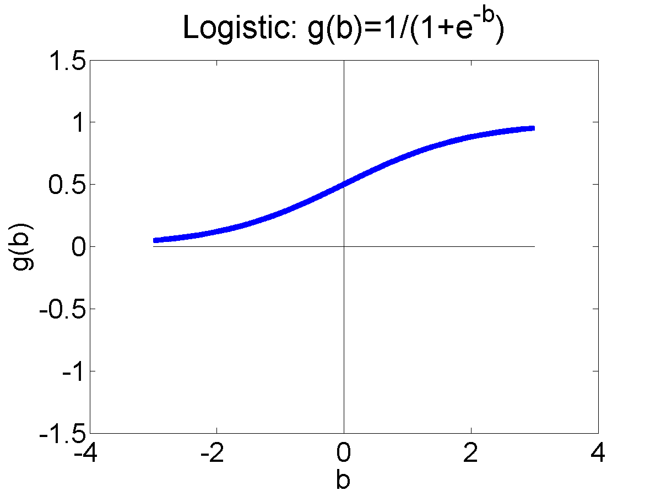
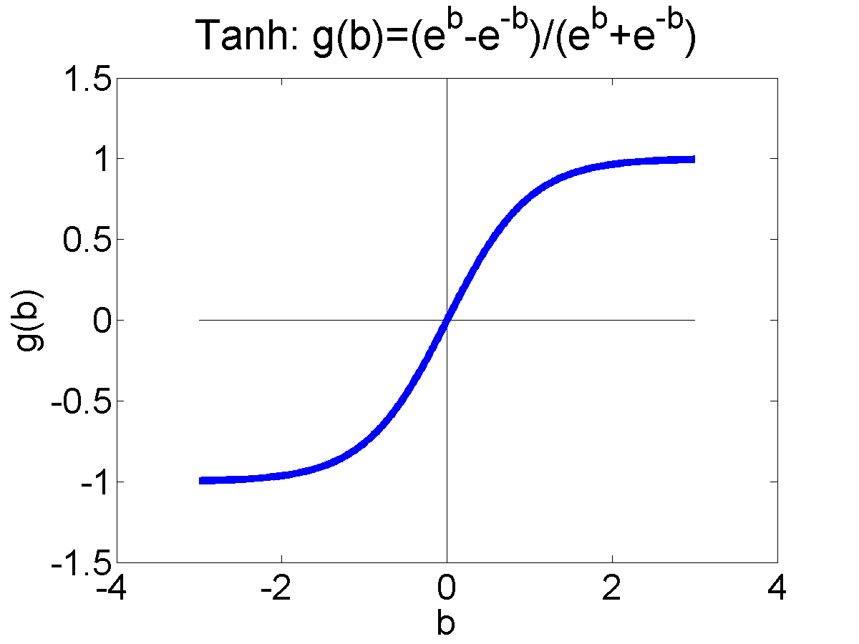
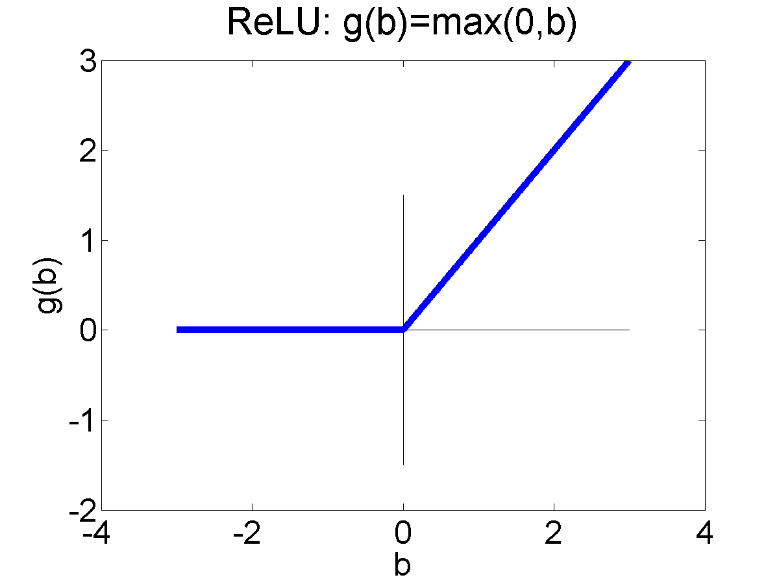
Activation functions
The “activation function,” $g^{(l)}\left(∙\right)$, can be any scalar nonlinearity. Common ones that you should know include the unit step and signum functions, and:
Logistic Sigmoid:
$$σ\left(β\right)=\frac{1}{1+e^{−β}}$$
Hyperbolic Tangent (tanh):
$$tanh\left(β\right)=\frac{e^{β}−e^{−β}}{e^{β}+e^{−β}}$$
Rectified Linear Unit (ReLU):
$$ReLU\left(β\right)=\max\left(0,β\right)$$

Slide 26
Outline
Review: multi-class perceptron
Breaking the constraints of linearity: multi-layer neural nets
Flow diagram for the XOR problem
Flow diagram for a multi-layer neural net
One-hot vectors
Softmax
Cross-entropy = negative log probability of the training data
Stochastic gradient descent
Training a neural net using numpy
The same example using pytorch
torch.nn: standard layers and units

Slide 27



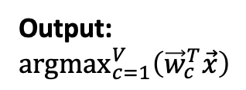












Comparison of Multi-Class Perceptron to Multiple Linear Regression
Multi-Class Perceptron
Multiple Linear Regression
Input
Weights
Input
Weights
1
1
$$b_{1}$$
$$b_{1}$$
$$b_{2}$$
$$b_{2}$$
$$f_{1}\left(\vec{x}\right)={\vec{w}}_{1}^{T}\vec{x}$$
x₁
x₁
Output: ${argmax}_{c=1}^{V}\left({\vec{w}}_{c}^{T}\vec{x}\right)$
$$f_{2}\left(\vec{x}\right)={\vec{w}}_{2}^{T}\vec{x}$$
argmax
x₂
.
.
.
.
.
.
x₂
.
.
.
.
.
.
$$b_{V}$$
.
.
.
$$b_{V}$$
$$w_{1,D}$$
$$w_{1,D}$$
$$w_{2,D}$$
$$w_{2,D}$$
$$f_{V}\left(\vec{x}\right)={\vec{w}}_{V}^{T}\vec{x}$$
x_{D}
$$w_{V,D}$$
x_{D}
$$w_{V,D}$$

Slide 28
Here’s a weird question:
Can we come up with some new notation that can be used to write both the multi-class perceptron AND the linear regression algorithm?

Slide 29
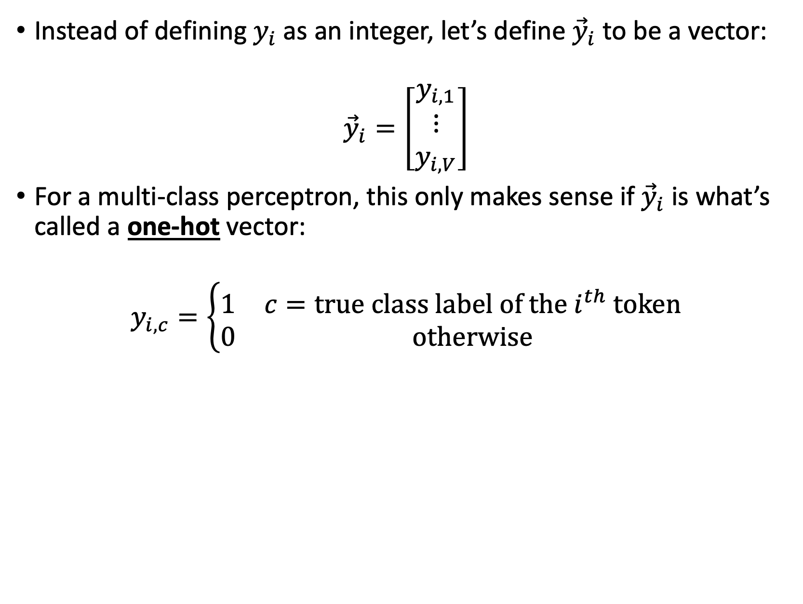
New notation: Don’t change the multi-class perceptron algorithm, but make it easier to write
Instead of defining $y_{i}$as an integer, let’s define ${\vec{y}}_{i}$ to be a vector:
$${\vec{y}}_{i}=\left[\begin{matrix}y_{i,1} \\ ⋮ \\ y_{i,V}\end{matrix}\right]$$
For a multi-class perceptron, this only makes sense if ${\vec{y}}_{i}$ is what’s called a one-hot vector:
$$y_{i,c}=\left\{\begin{matrix}1 & c=true class label of the i^{th} token \\ 0 & otherwise\end{matrix}\right.$$

Slide 30
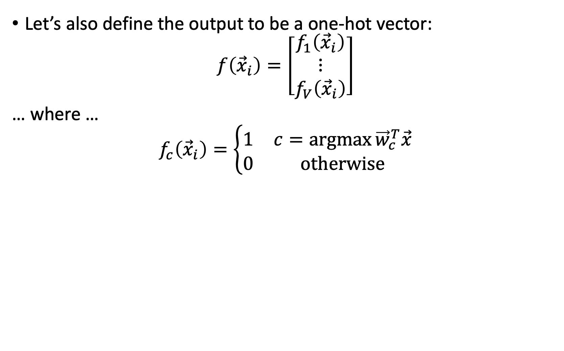
New notation: Don’t change the multi-class perceptron algorithm, but make it easier to write
Let’s also define the output to be a one-hot vector:
$$f\left({\vec{x}}_{i}\right)=\left[\begin{matrix}f_{1}\left({\vec{x}}_{i}\right) \\ ⋮ \\ f_{V}\left({\vec{x}}_{i}\right)\end{matrix}\right]$$
… where …
$$f_{c}\left({\vec{x}}_{i}\right)=\left\{\begin{matrix}1 & c=\operatorname{argmax}{{\vec{w}}_{c}^{T}\vec{x}} \\ 0 & otherwise\end{matrix}\right.$$

Slide 31
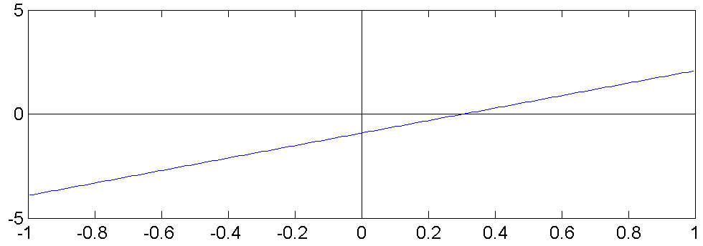
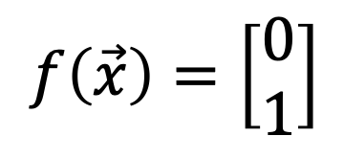
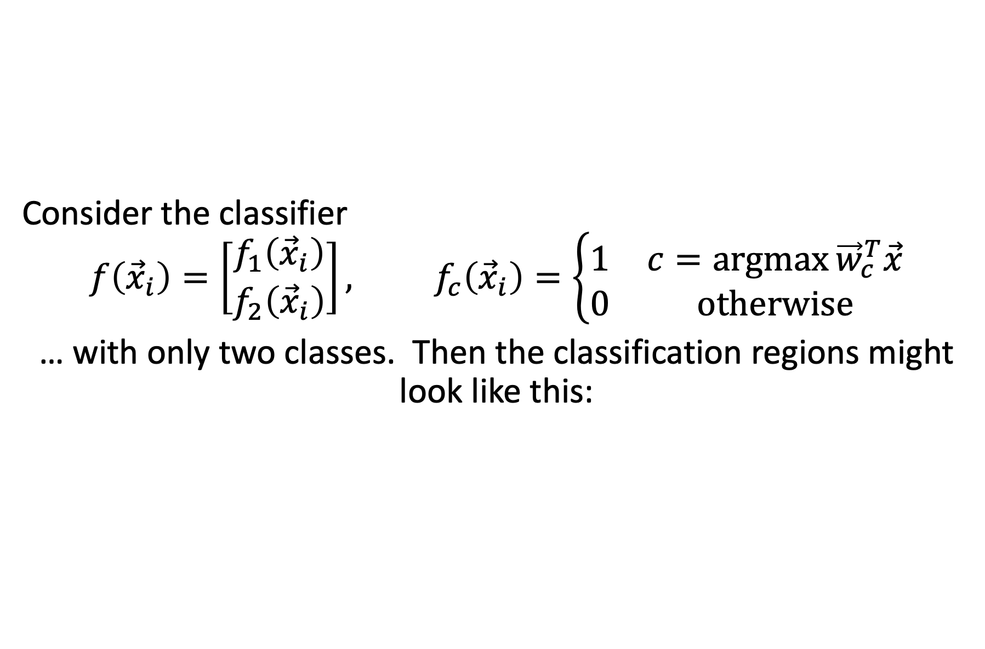
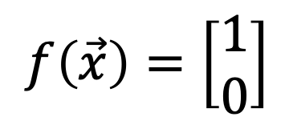
Example: Binary classifier
Consider the classifier
$$f\left({\vec{x}}_{i}\right)=\left[\begin{matrix}f_{1}\left({\vec{x}}_{i}\right) \\ f_{2}\left({\vec{x}}_{i}\right)\end{matrix}\right], f_{c}\left({\vec{x}}_{i}\right)=\left\{\begin{matrix}1 & c=\operatorname{argmax}{{\vec{w}}_{c}^{T}\vec{x}} \\ 0 & otherwise\end{matrix}\right.$$
… with only two classes. Then the classification regions might look like this:
$$f\left(\vec{x}\right)=\left[\begin{matrix}1 \\ 0\end{matrix}\right]$$
$$x_{2}$$
$$f\left(\vec{x}\right)=\left[\begin{matrix}0 \\ 1\end{matrix}\right]$$
$$x_{1}$$

Slide 32

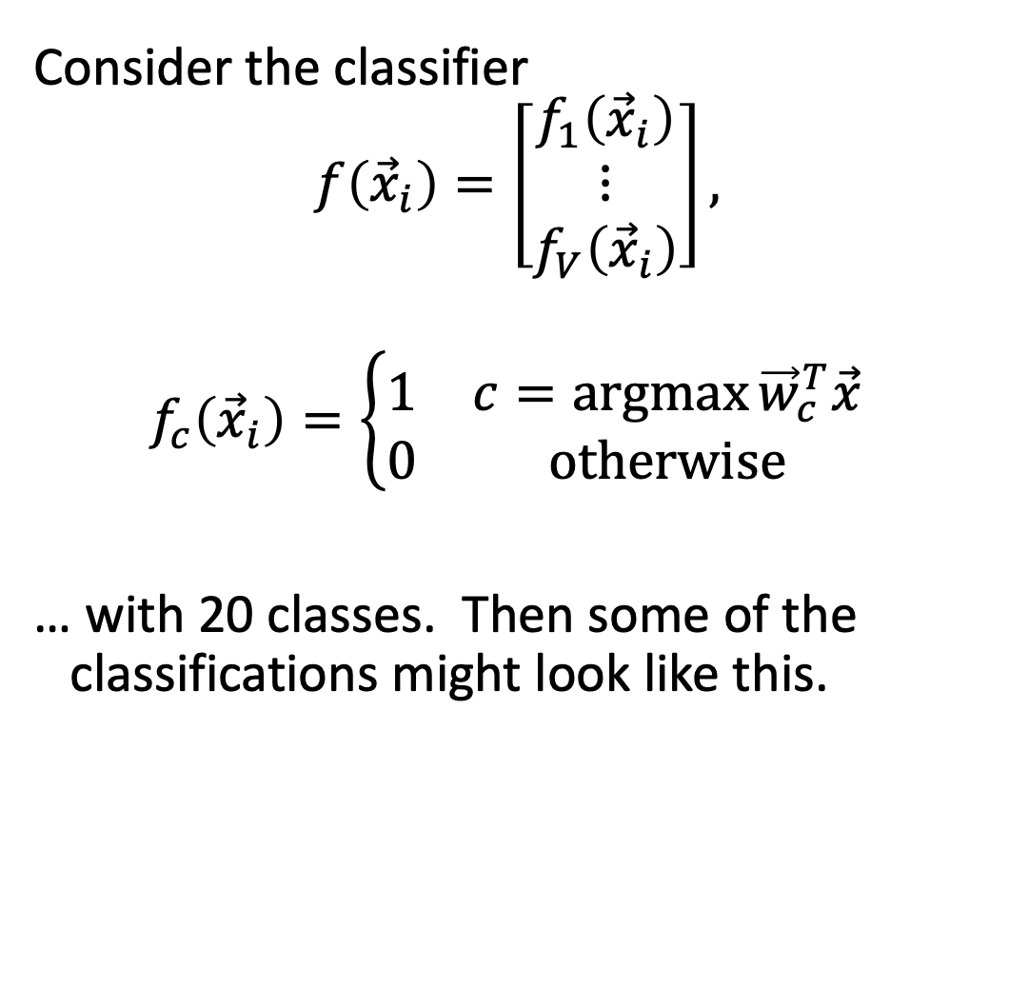





Multi-Class Linear Classifiers
$$x_{2}$$
Consider the classifier
$$f\left({\vec{x}}_{i}\right)=\left[\begin{matrix}f_{1}\left({\vec{x}}_{i}\right) \\ ⋮ \\ f_{V}\left({\vec{x}}_{i}\right)\end{matrix}\right],$$
$$f_{c}\left({\vec{x}}_{i}\right)=\left\{\begin{matrix}1 & c=\operatorname{argmax}{{\vec{w}}_{c}^{T}\vec{x}} \\ 0 & otherwise\end{matrix}\right.$$
… with 20 classes. Then some of the classifications might look like this.
$$f(\vec{x})=\left[\begin{matrix}1 \\ \begin{matrix}0 \\ ⋮ \\ 0\end{matrix} \\ 0\end{matrix}\right]$$
$$f(\vec{x})=\left[\begin{matrix}0 \\ \begin{matrix}1 \\ ⋮ \\ 0\end{matrix} \\ 0\end{matrix}\right]$$
$$f(\vec{x})=\left[\begin{matrix}0 \\ \begin{matrix}0 \\ ⋮ \\ 1\end{matrix} \\ 0\end{matrix}\right]$$
$$f(\vec{x})=\left[\begin{matrix}0 \\ \begin{matrix}0 \\ ⋮ \\ 0\end{matrix} \\ 1\end{matrix}\right]$$
By Balu Ertl - Own work, CC BY-SA 4.0, https://commons.wikimedia.org/w/index.php?curid=38534275
$$x_{1}$$

Slide 33
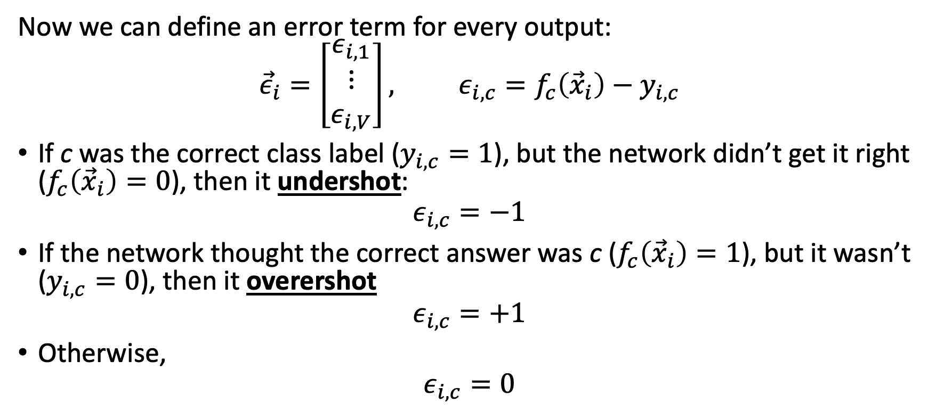
Now the perceptron has a vector error, just like linear regression
Now we can define an error term for every output:
$${\vec{ε}}_{i}=\left[\begin{matrix}ε_{i,1} \\ ⋮ \\ ε_{i,V}\end{matrix}\right], ε_{i,c}=f_{c}\left({\vec{x}}_{i}\right)−y_{i,c}$$
If c was the correct class label ($y_{i,c}=1$), but the network didn’t get it right ($f_{c}\left({\vec{x}}_{i}\right)=0$), then it undershot:
$$ε_{i,c}=−1$$
If the network thought the correct answer was c ($f_{c}\left({\vec{x}}_{i}\right)=1$), but it wasn’t ($y_{i,c}=0$), then it overershot
$$ε_{i,c}=+1$$
Otherwise,
$$ε_{i,c}=0$$

Slide 34
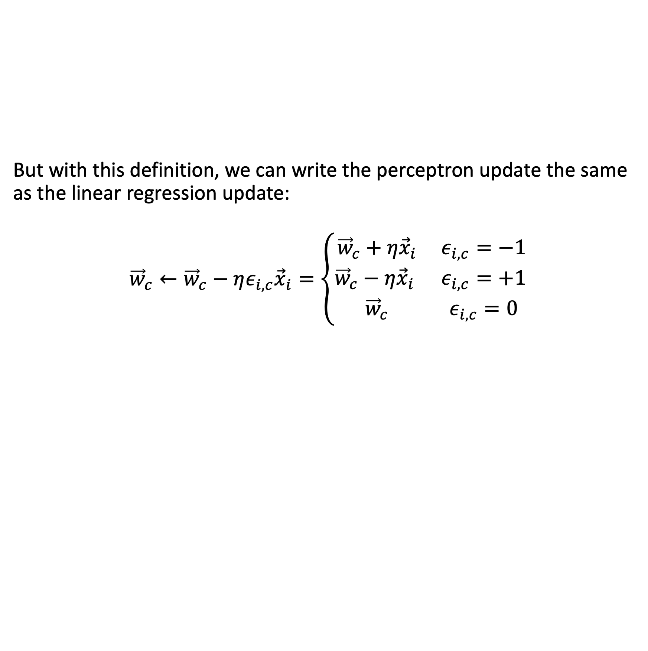
Multi-class perceptron, written in terms of one-hot vectors
But with this definition, we can write the perceptron update the same as the linear regression update:
$${\vec{w}}_{c}←{\vec{w}}_{c}−ηε_{i,c}{\vec{x}}_{i}=\left\{\begin{matrix}{\vec{w}}_{c}+η{\vec{x}}_{i} & ε_{i,c}=−1 \\ {\vec{w}}_{c}−η{\vec{x}}_{i} & ε_{i,c}=+1 \\ {\vec{w}}_{c} & ε_{i,c}=0\end{matrix}\right.$$

Slide 35

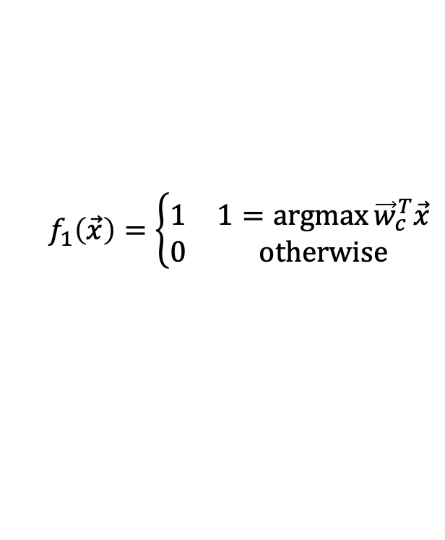



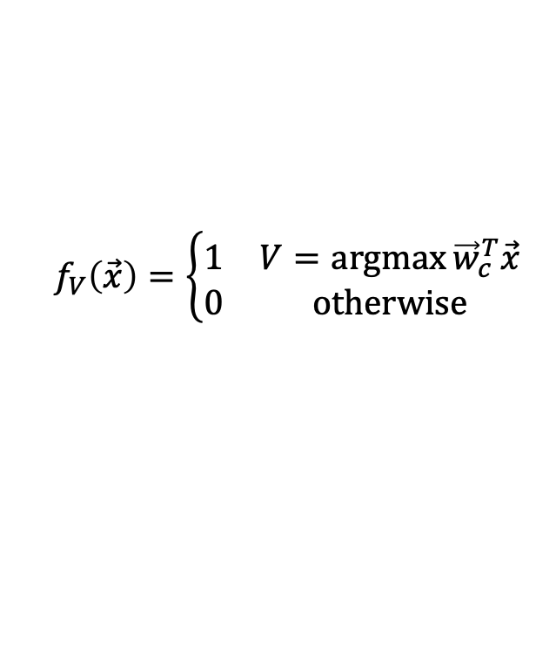



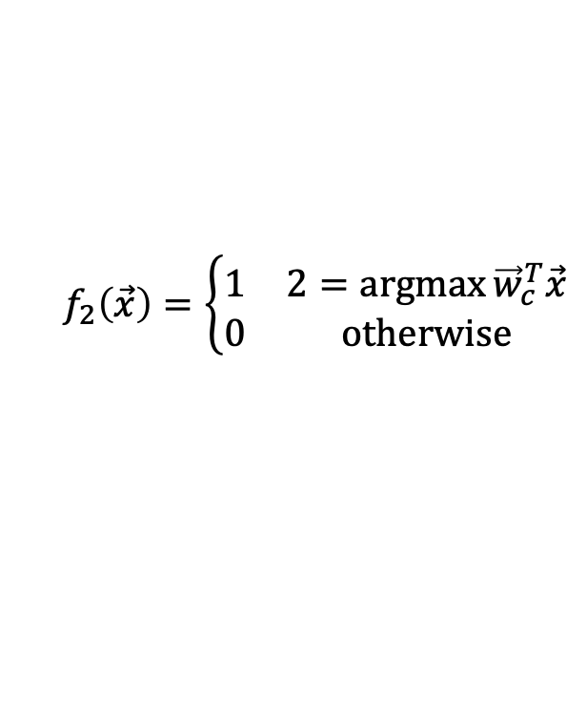


Comparison of Multi-Class Perceptron to Multiple Regression
Multi-Class Perceptron:
One-hot output
Multiple Regression:
Real-valued Output
Input
Weights
Input
Weights
1
1
$$b_{1}$$
$$f_{1}\left(\vec{x}\right)=\left\{\begin{matrix}1 & 1=\operatorname{argmax}{{\vec{w}}_{c}^{T}\vec{x}} \\ 0 & otherwise\end{matrix}\right.$$
$$b_{1}$$
$$b_{2}$$
$$b_{2}$$
$$f_{1}\left(\vec{x}\right)={\vec{w}}_{1}^{T}\vec{x}$$
x₁
x₁
$$f_{2}\left(\vec{x}\right)=\left\{\begin{matrix}1 & 2=\operatorname{argmax}{{\vec{w}}_{c}^{T}\vec{x}} \\ 0 & otherwise\end{matrix}\right.$$
$$f_{2}\left(\vec{x}\right)={\vec{w}}_{2}^{T}\vec{x}$$
x₂
.
.
.
x₂
.
.
.
.
.
.
.
.
.
.
.
.
$$b_{V}$$
.
.
.
$$b_{V}$$
$$w_{1,D}$$
$$w_{1,D}$$
$$w_{2,D}$$
$$f_{V}\left(\vec{x}\right)=\left\{\begin{matrix}1 & V=\operatorname{argmax}{{\vec{w}}_{c}^{T}\vec{x}} \\ 0 & otherwise\end{matrix}\right.$$
$$w_{2,D}$$
$$f_{V}\left(\vec{x}\right)={\vec{w}}_{V}^{T}\vec{x}$$
x_{D}
$$w_{V,D}$$
x_{D}
$$w_{V,D}$$

Slide 36
Outline
Review: multi-class perceptron
Breaking the constraints of linearity: multi-layer neural nets
Flow diagram for the XOR problem
Flow diagram for a multi-layer neural net
One-hot vectors
Softmax
Cross-entropy = negative log probability of the training data
Stochastic gradient descent
Training a neural net using numpy
The same example using pytorch
torch.nn: standard layers and units

Slide 37

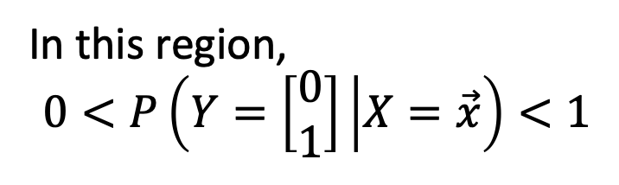

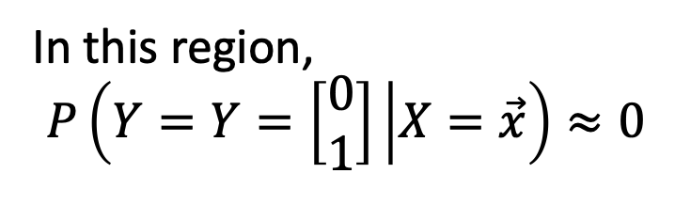
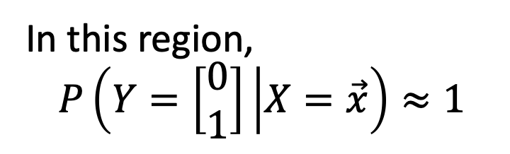

Softmax: Probabilistic boundaries
Instead of trying to find the exact boundaries, let’s model the probability that token $\vec{x}$ belongs to class$\vec{y}$.
$$x_{2}$$
In this region,
$$P\left(Y=\left[\begin{matrix}0 \\ 1\end{matrix}\right] | X=\vec{x}\right)≈1$$
$$x_{1}$$
In this region,
$$P\left(Y=Y=\left[\begin{matrix}0 \\ 1\end{matrix}\right] | X=\vec{x}\right)≈0$$
In this region,
$$0<P\left(Y=\left[\begin{matrix}0 \\ 1\end{matrix}\right] | X=\vec{x}\right)<1$$

Slide 38
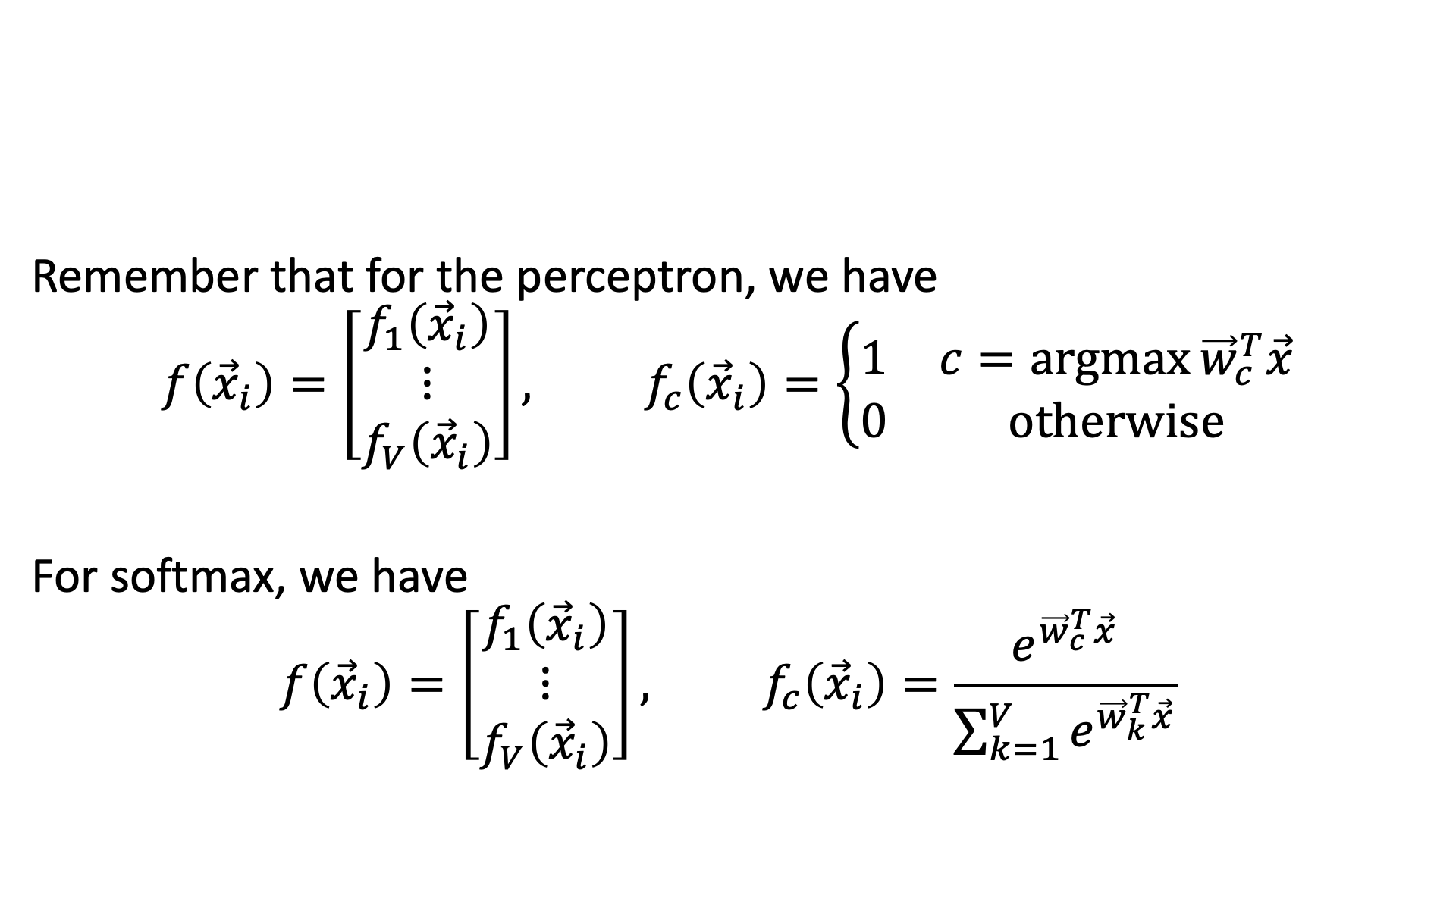
Argmax versus Softmax
Remember that for the perceptron, we have
$$f\left({\vec{x}}_{i}\right)=\left[\begin{matrix}f_{1}\left({\vec{x}}_{i}\right) \\ ⋮ \\ f_{V}\left({\vec{x}}_{i}\right)\end{matrix}\right], f_{c}\left({\vec{x}}_{i}\right)=\left\{\begin{matrix}1 & c=\operatorname{argmax}{{\vec{w}}_{c}^{T}\vec{x}} \\ 0 & otherwise\end{matrix}\right.$$
For softmax, we have
$$f\left({\vec{x}}_{i}\right)=\left[\begin{matrix}f_{1}\left({\vec{x}}_{i}\right) \\ ⋮ \\ f_{V}\left({\vec{x}}_{i}\right)\end{matrix}\right], f_{c}\left({\vec{x}}_{i}\right)=\frac{e^{{\vec{w}}_{c}^{T}\vec{x}}}{\sum_{k=1}^{V}{e^{{\vec{w}}_{k}^{T}\vec{x}}}}$$

Slide 39
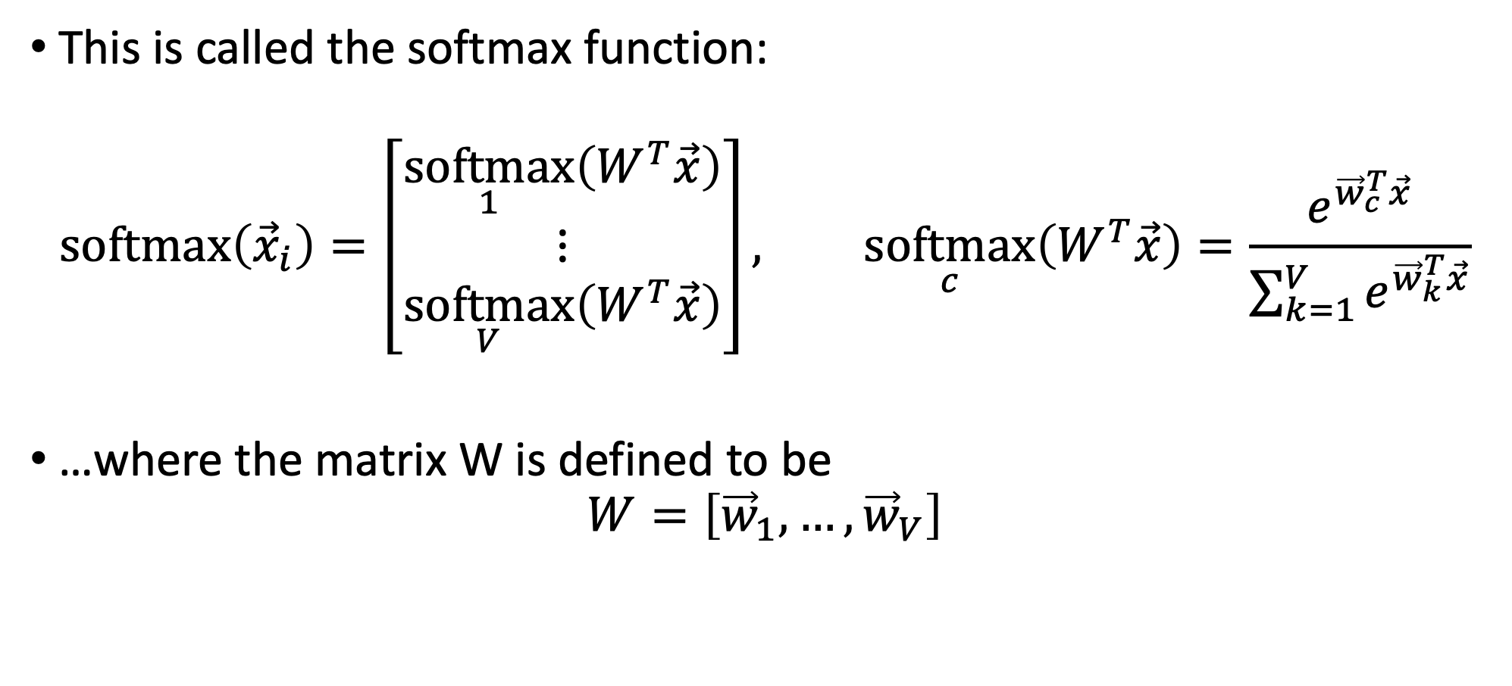
The softmax function
This is called the softmax function:
$$\operatorname{softmax}\left({\vec{x}}_{i}\right)=\left[\begin{matrix}\underset{1}{softmax}\left(W^{T}\vec{x}\right) \\ ⋮ \\ \underset{V}{softmax}\left(W^{T}\vec{x}\right)\end{matrix}\right], \underset{c}{softmax}\left(W^{T}\vec{x}\right)=\frac{e^{{\vec{w}}_{c}^{T}\vec{x}}}{\sum_{k=1}^{V}{e^{{\vec{w}}_{k}^{T}\vec{x}}}}$$
…where the matrix W is defined to be
$$W=\left[{\vec{w}}_{1},…,{\vec{w}}_{V}\right]$$

Slide 40
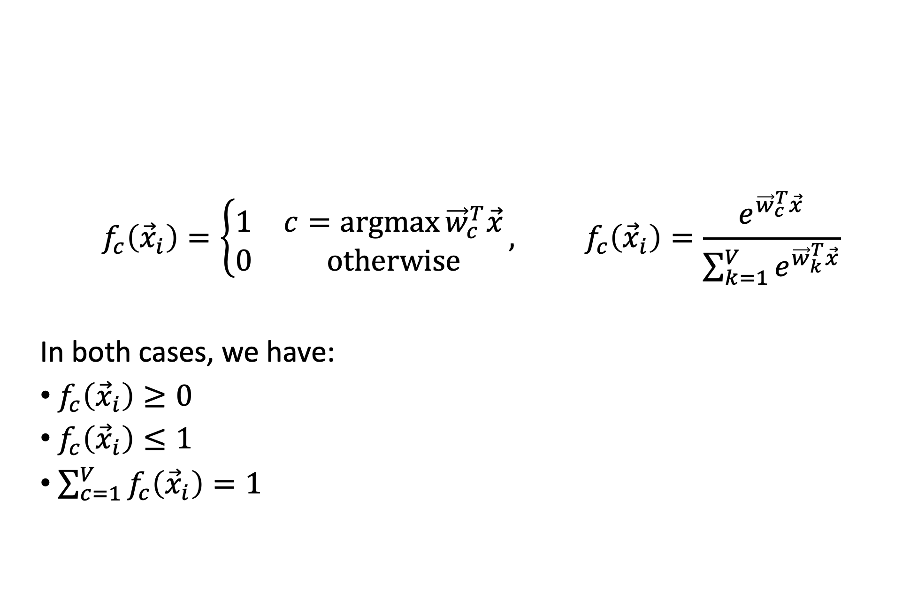
Argmax and Softmax
$$f_{c}\left({\vec{x}}_{i}\right)=\left\{\begin{matrix}1 & c=\operatorname{argmax}{{\vec{w}}_{c}^{T}\vec{x}} \\ 0 & otherwise\end{matrix}\right., f_{c}\left({\vec{x}}_{i}\right)=\frac{e^{{\vec{w}}_{c}^{T}\vec{x}}}{\sum_{k=1}^{V}{e^{{\vec{w}}_{k}^{T}\vec{x}}}}$$
In both cases, we have:
$f_{c}\left({\vec{x}}_{i}\right)≥0$
$f_{c}\left({\vec{x}}_{i}\right)≤1$
$\sum_{c=1}^{V}{f_{c}\left({\vec{x}}_{i}\right)}=1$

Slide 41
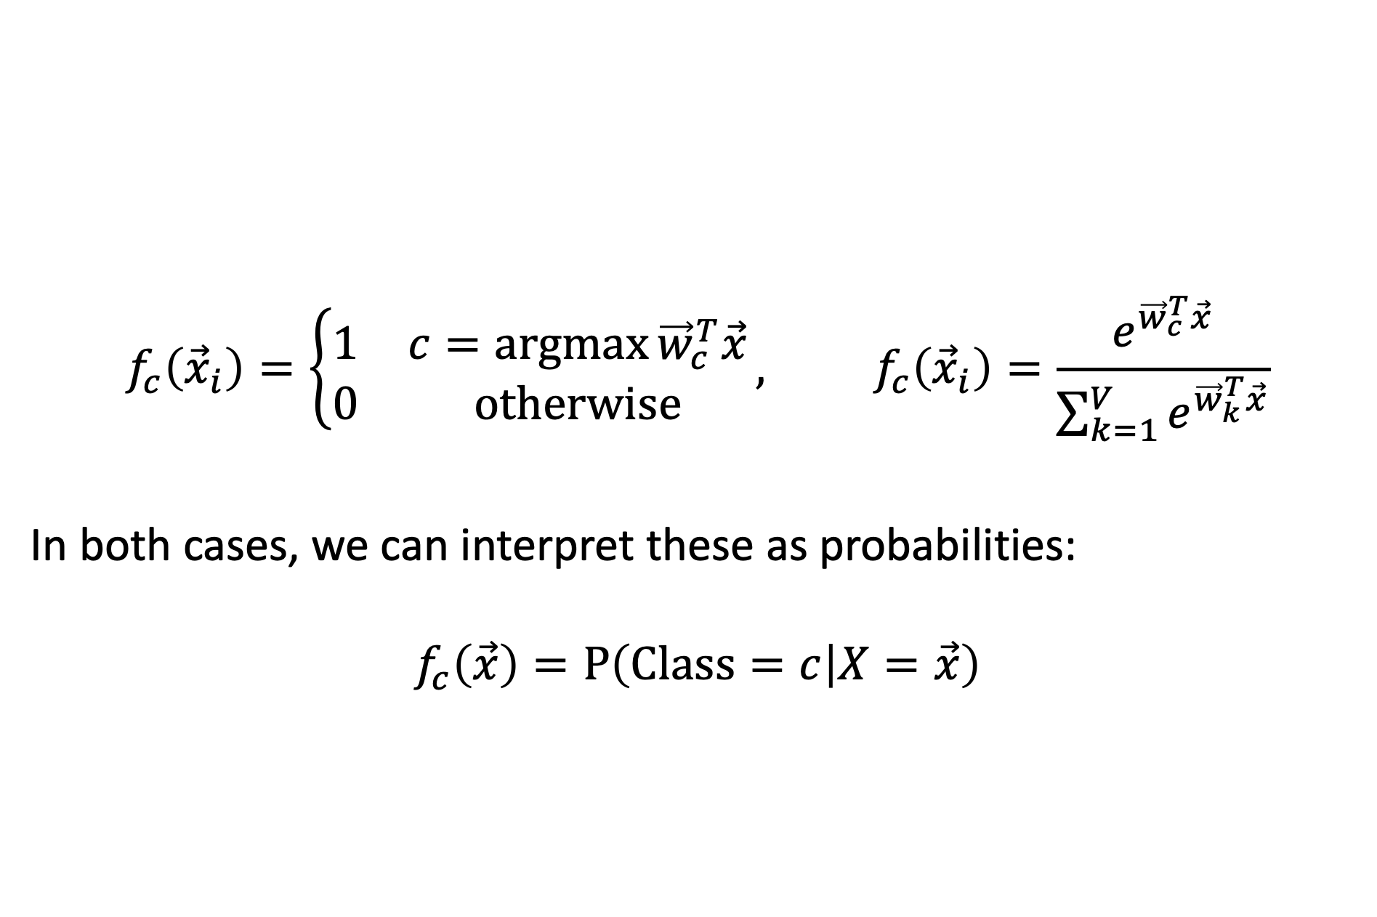
Argmax and Softmax
$$f_{c}\left({\vec{x}}_{i}\right)=\left\{\begin{matrix}1 & c=\operatorname{argmax}{{\vec{w}}_{c}^{T}\vec{x}} \\ 0 & otherwise\end{matrix}\right., f_{c}\left({\vec{x}}_{i}\right)=\frac{e^{{\vec{w}}_{c}^{T}\vec{x}}}{\sum_{k=1}^{V}{e^{{\vec{w}}_{k}^{T}\vec{x}}}}$$
In both cases, we can interpret these as probabilities:
$$f_{c}\left(\vec{x}\right)=P\left(Class=c | X=\vec{x}\right)$$

Slide 42
Outline
Review: multi-class perceptron
Breaking the constraints of linearity: multi-layer neural nets
Flow diagram for the XOR problem
Flow diagram for a multi-layer neural net
One-hot vectors
Softmax
Cross-entropy = negative log probability of the training data
Stochastic gradient descent
Training a neural net using numpy
The same example using pytorch
torch.nn: standard layers and units

Slide 43
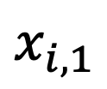
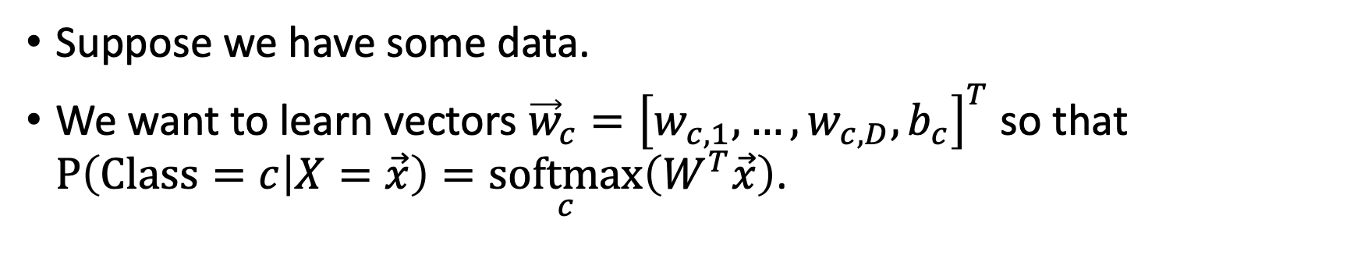
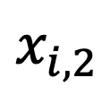
Classifier Learning using a Softmax Layer
Suppose we have some data.
We want to learn vectors ${\vec{w}}_{c}={\left[w_{c,1},…,w_{c,D},b_{c}\right]}^{T}$ so that $P\left(Class=c | X=\vec{x}\right)=\underset{c}{softmax}\left(W^{T}\vec{x}\right)$.
$$x_{i,2}$$
$$x_{i,1}$$

Slide 44

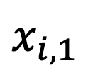

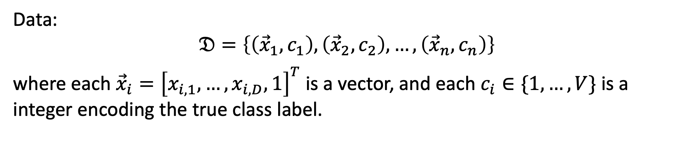


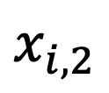
Learning a Softmax: Training data
Data:
$$𝔇=\left\{\left({\vec{x}}_{1},c_{1}\right),\left({\vec{x}}_{2},c_{2}\right),…,\left({\vec{x}}_{n},c_{n}\right)\right\}$$
where each ${\vec{x}}_{i}={\left[x_{i,1},…,x_{i,D},1\right]}^{T}$ is a vector, and each $c_{i}∈\{1,…,V\}$ is a integer encoding the true class label.
$$({\vec{x}}_{1},{\vec{y}}_{1}=\left[\begin{matrix}0 \\ 1\end{matrix}\right])$$
$$x_{i,2}$$
$$({\vec{x}}_{2},{\vec{y}}_{2}=\left[\begin{matrix}1 \\ 0\end{matrix}\right])$$
$$({\vec{x}}_{3},{\vec{y}}_{3}=\left[\begin{matrix}1 \\ 0\end{matrix}\right])$$
$$x_{i,1}$$
$$({\vec{x}}_{4},{\vec{y}}_{4}=\left[\begin{matrix}0 \\ 1\end{matrix}\right])$$

Slide 45





Learning a Softmax: Model parameters
We want to learn the model parameters
$$W=\left[{\vec{w}}_{1},…,{\vec{w}}_{V}\right]$$
so that
$$P\left(C=c_{i} | X={\vec{x}}_{i}\right)=\underset{c_{i}}{softmax}\left(W^{T}{\vec{x}}_{i}\right)$$
$$({\vec{x}}_{1},c_{1}=2)$$
$$x_{i,2}$$
$$({\vec{x}}_{2},c_{2}=1)$$
$$({\vec{x}}_{3},c_{3}=1)$$
$$x_{i,1}$$
$$({\vec{x}}_{4},c_{4}=2)$$

Slide 46
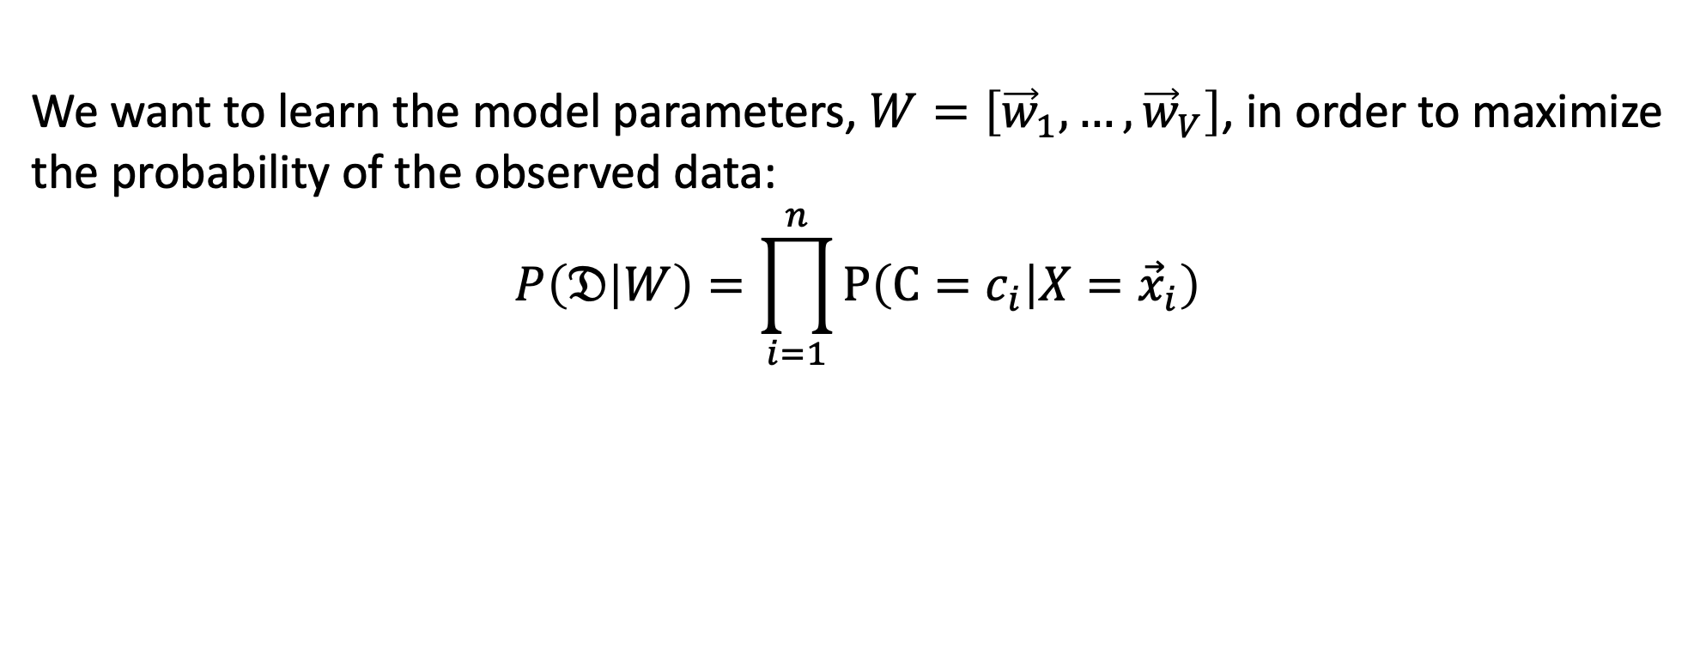
Learning a Softmax: Training criterion
We want to learn the model parameters, $W=\left[{\vec{w}}_{1},…,{\vec{w}}_{V}\right]$, in order to maximize the probability of the observed data:
$$P\left(𝔇 | W\right)=\prod_{i=1}^{n}{P\left(C=c_{i} | X={\vec{x}}_{i}\right)}$$
$$({\vec{x}}_{1},c_{1}=2)$$
$$x_{i,2}$$
$$({\vec{x}}_{2},c_{2}=1)$$
$$({\vec{x}}_{3},c_{3}=1)$$
$$x_{i,1}$$
$$({\vec{x}}_{4},c_{4}=2)$$

Slide 47
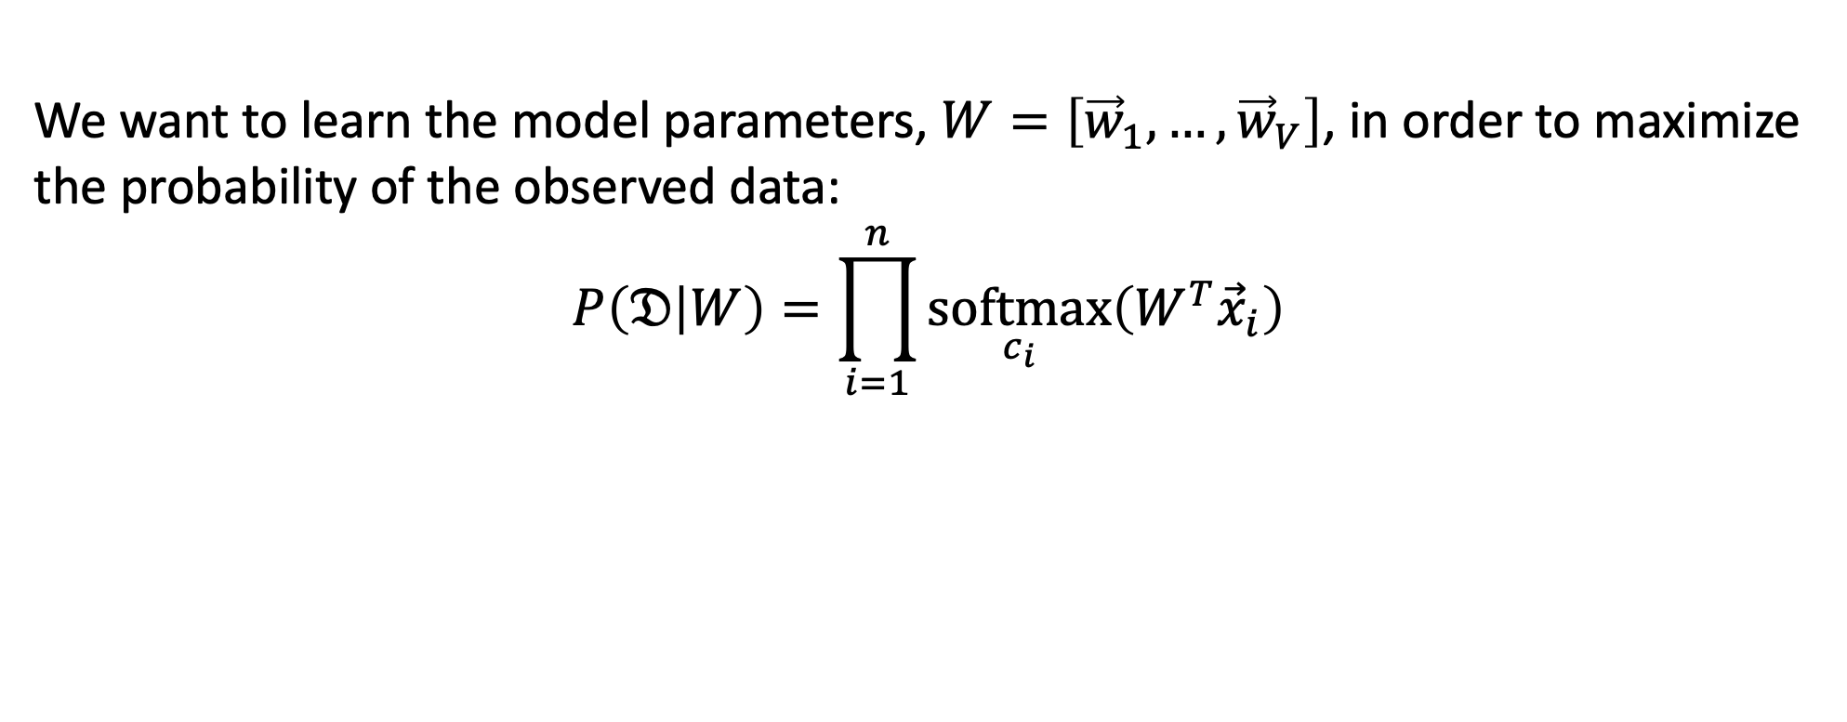
Learning a Softmax: Training Criterion
We want to learn the model parameters, $W=\left[{\vec{w}}_{1},…,{\vec{w}}_{V}\right]$, in order to maximize the probability of the observed data:
$$P\left(𝔇 | W\right)=\prod_{i=1}^{n}{\underset{c_{i}}{softmax}\left(W^{T}{\vec{x}}_{i}\right)}$$
$$({\vec{x}}_{1},c_{1}=2)$$
$$x_{i,2}$$
$$({\vec{x}}_{2},c_{2}=1)$$
$$({\vec{x}}_{3},c_{3}=1)$$
$$x_{i,1}$$
$$({\vec{x}}_{4},c_{4}=2)$$

Slide 48
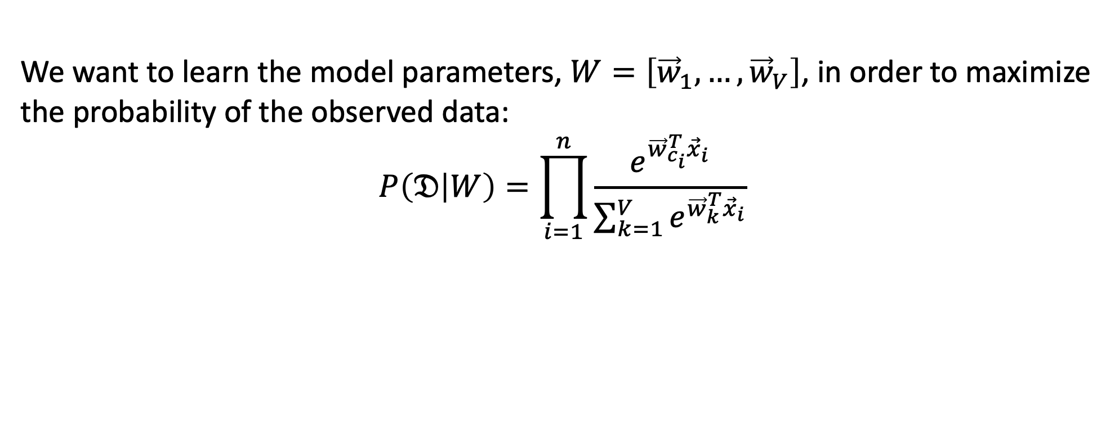
Learning a Softmax: Training Criterion
We want to learn the model parameters, $W=\left[{\vec{w}}_{1},…,{\vec{w}}_{V}\right]$, in order to maximize the probability of the observed data:
$$P\left(𝔇 | W\right)=\prod_{i=1}^{n}{\frac{e^{{\vec{w}}_{c_{i}}^{T}{\vec{x}}_{i}}}{\sum_{k=1}^{V}{e^{{\vec{w}}_{k}^{T}{\vec{x}}_{i}}}}}$$
$$({\vec{x}}_{1},c_{1}=2)$$
$$x_{i,2}$$
$$({\vec{x}}_{2},c_{2}=1)$$
$$({\vec{x}}_{3},c_{3}=1)$$
$$x_{i,1}$$
$$({\vec{x}}_{4},c_{4}=2)$$

Slide 49
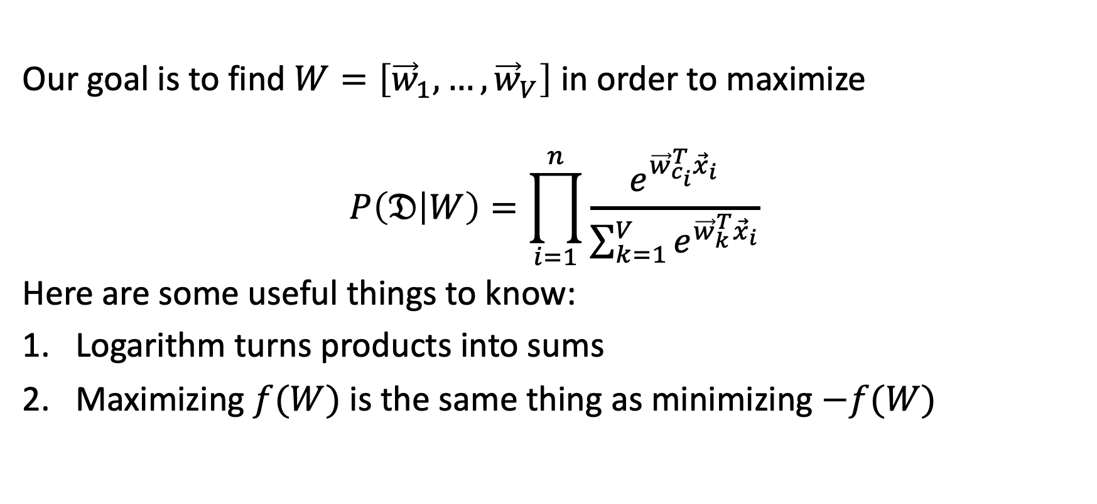
How do you maximize a function?
Our goal is to find $W=\left[{\vec{w}}_{1},…,{\vec{w}}_{V}\right]$ in order to maximize
$$P\left(𝔇 | W\right)=\prod_{i=1}^{n}{\frac{e^{{\vec{w}}_{c_{i}}^{T}{\vec{x}}_{i}}}{\sum_{k=1}^{V}{e^{{\vec{w}}_{k}^{T}{\vec{x}}_{i}}}}}$$
Here are some useful things to know:
Logarithm turns products into sums
Maximizing $f(W)$ is the same thing as minimizing $−f(W)$

Slide 50
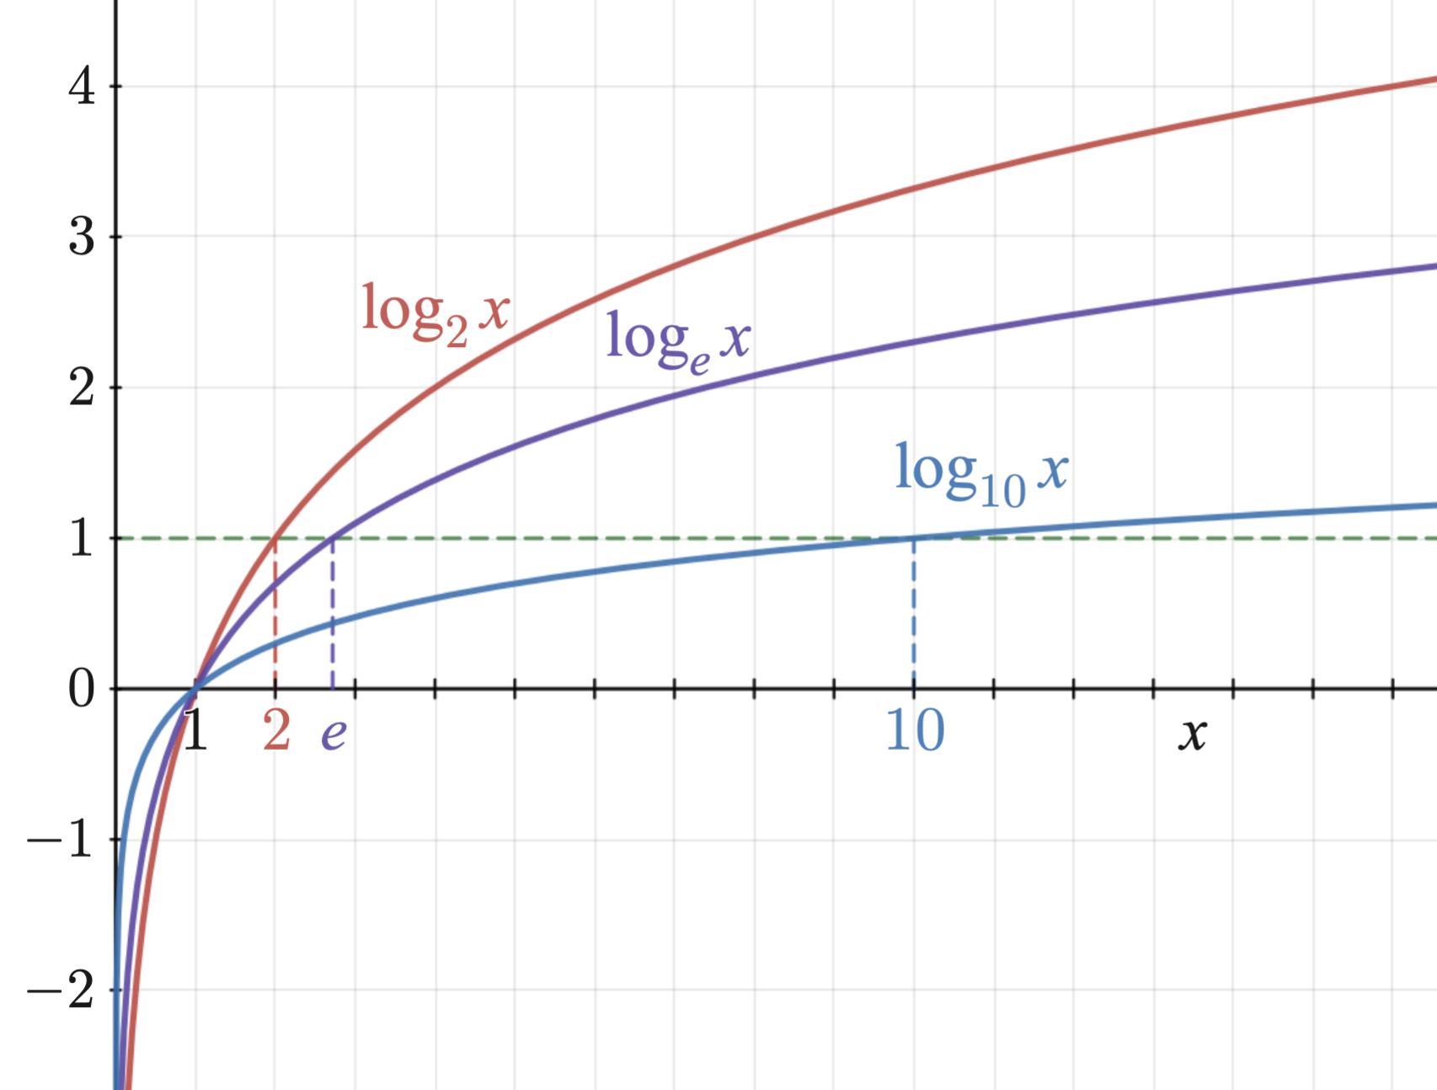
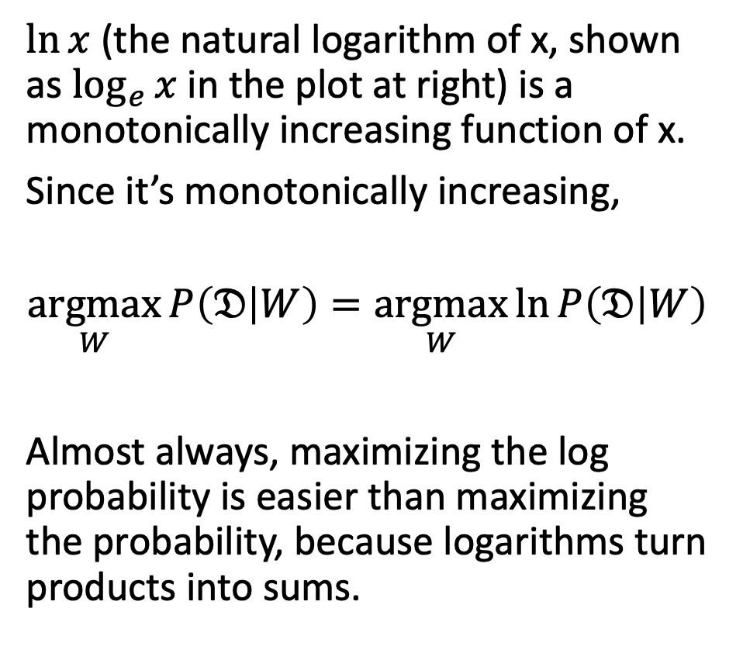
1. Logarithms turn products into sums
$\ln{x}$ (the natural logarithm of x, shown as $\log_{e}{x}$ in the plot at right) is a monotonically increasing function of x.
Since it’s monotonically increasing,
$$\underset{W}{argmax}{P\left(𝔇 | W\right)}=\underset{W}{argmax}{\ln{P\left(𝔇 | W\right)}}$$
Almost always, maximizing the log probability is easier than maximizing the probability, because logarithms turn products into sums.
Logarithm_plots.png, CC-SA 3.0, Richard F. Lyon, 2011

Slide 51
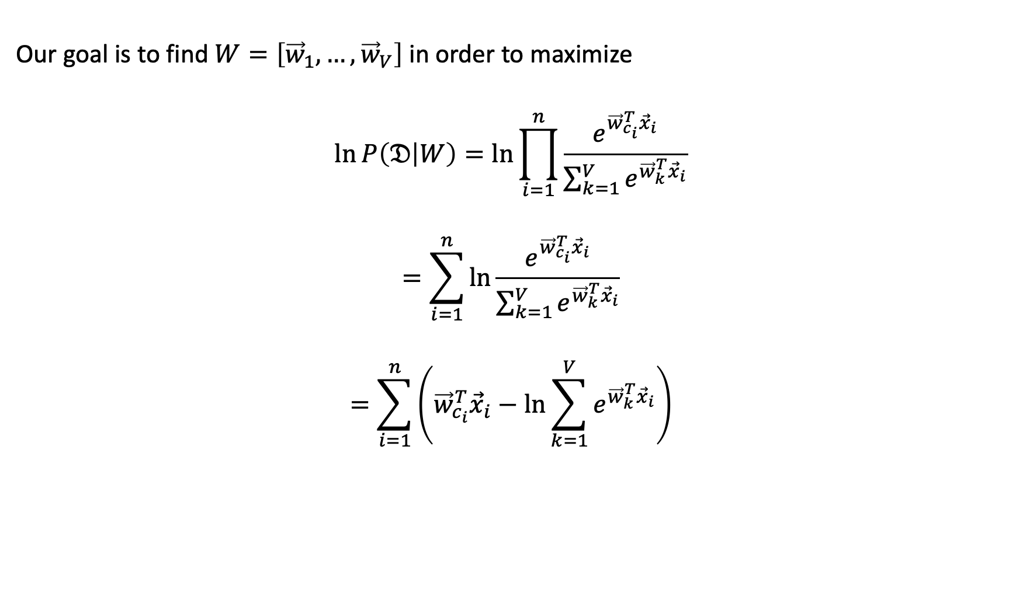
1. Logarithms turn products into sums
Our goal is to find $W=\left[{\vec{w}}_{1},…,{\vec{w}}_{V}\right]$ in order to maximize
$$\ln{P\left(𝔇 | W\right)}=\ln{\prod_{i=1}^{n}{\frac{e^{{\vec{w}}_{c_{i}}^{T}{\vec{x}}_{i}}}{\sum_{k=1}^{V}{e^{{\vec{w}}_{k}^{T}{\vec{x}}_{i}}}}}}$$
$$=\sum_{i=1}^{n}{\ln{\frac{e^{{\vec{w}}_{c_{i}}^{T}{\vec{x}}_{i}}}{\sum_{k=1}^{V}{e^{{\vec{w}}_{k}^{T}{\vec{x}}_{i}}}}}}$$
$$=\sum_{i=1}^{n}{\left({\vec{w}}_{c_{i}}^{T}{\vec{x}}_{i}−\ln{\sum_{k=1}^{V}{e^{{\vec{w}}_{k}^{T}{\vec{x}}_{i}}}}\right)}$$

Slide 52
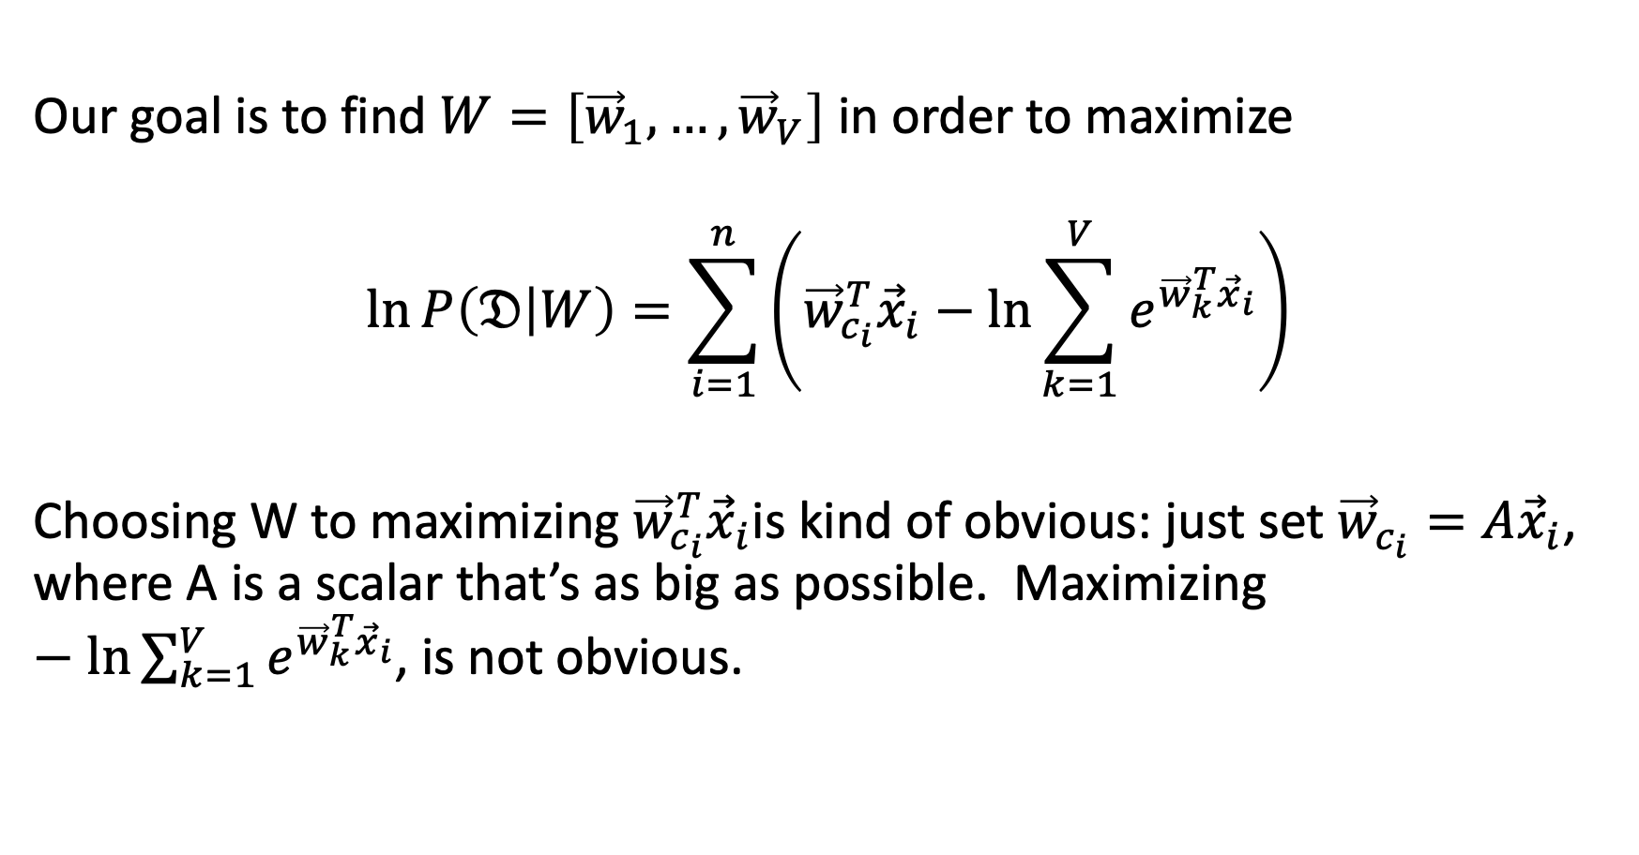
2. Maximizing $f(W)$ is the same thing as minimizing $−f(W)$.
Our goal is to find $W=\left[{\vec{w}}_{1},…,{\vec{w}}_{V}\right]$ in order to maximize
$$\ln{P\left(𝔇 | W\right)}=\sum_{i=1}^{n}{\left({\vec{w}}_{c_{i}}^{T}{\vec{x}}_{i}−\ln{\sum_{k=1}^{V}{e^{{\vec{w}}_{k}^{T}{\vec{x}}_{i}}}}\right)}$$
Choosing W to maximizing ${\vec{w}}_{c_{i}}^{T}{\vec{x}}_{i}$is kind of obvious: just set ${\vec{w}}_{c_{i}}=A{\vec{x}}_{i}$, where A is a scalar that’s as big as possible. Maximizing $−\ln{\sum_{k=1}^{V}{e^{{\vec{w}}_{k}^{T}{\vec{x}}_{i}}}}$, is not obvious.

Slide 53
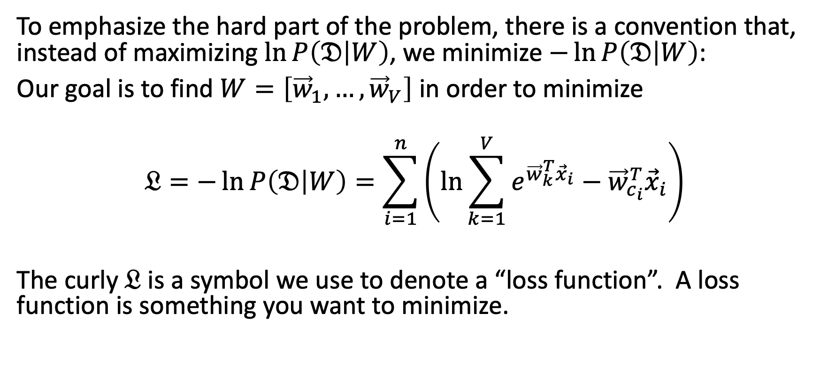
2. Maximizing $f(W)$ is the same thing as minimizing $−f(W)$.
To emphasize the hard part of the problem, there is a convention that, instead of maximizing $\ln{P\left(𝔇 | W\right)}$, we minimize $−\ln{P\left(𝔇 | W\right)}$:
Our goal is to find $W=\left[{\vec{w}}_{1},…,{\vec{w}}_{V}\right]$ in order to minimize
$$𝔏=−\ln{P\left(𝔇 | W\right)}=\sum_{i=1}^{n}{\left(\ln{\sum_{k=1}^{V}{e^{{\vec{w}}_{k}^{T}{\vec{x}}_{i}}}}−{\vec{w}}_{c_{i}}^{T}{\vec{x}}_{i}\right)}$$
The curly $𝔏$ is a symbol we use to denote a “loss function”. A loss function is something you want to minimize.

Slide 54
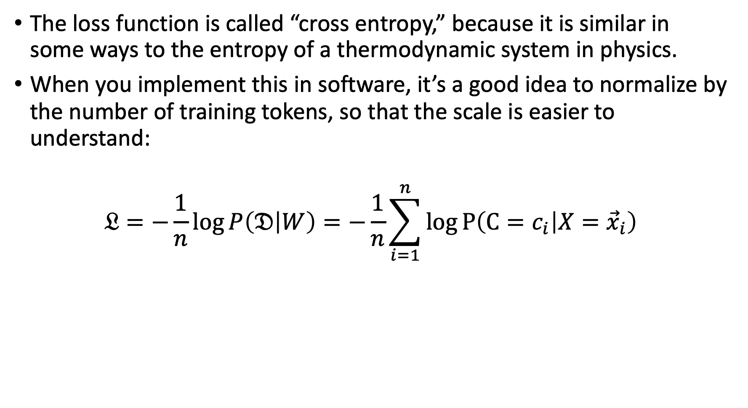
Some details: Cross entropy
The loss function is called “cross entropy,” because it is similar in some ways to the entropy of a thermodynamic system in physics.
When you implement this in software, it’s a good idea to normalize by the number of training tokens, so that the scale is easier to understand:
$$𝔏=−\frac{1}{n}\log{P\left(𝔇 | W\right)}=−\frac{1}{n}\sum_{i=1}^{n}{\log{P\left(C=c_{i} | X={\vec{x}}_{i}\right)}}$$

Slide 55
Outline
Review: multi-class perceptron
Breaking the constraints of linearity: multi-layer neural nets
Flow diagram for the XOR problem
Flow diagram for a multi-layer neural net
One-hot vectors
Softmax
Cross-entropy = negative log probability of the training data
Stochastic gradient descent
Training a neural net using numpy
The same example using pytorch
torch.nn: standard layers and units

Slide 56
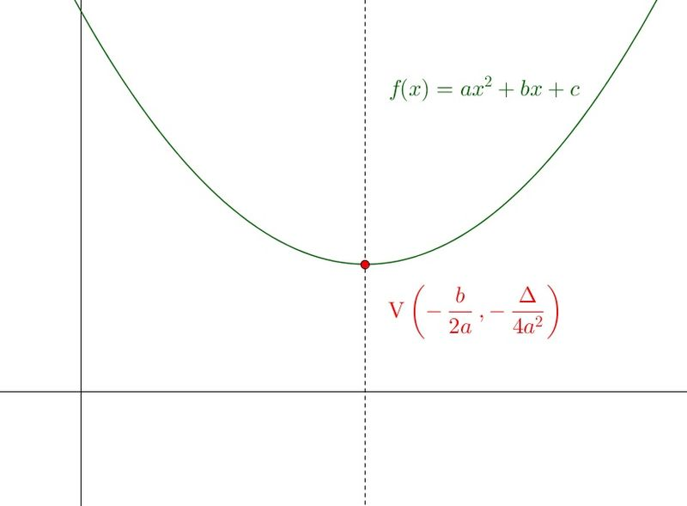

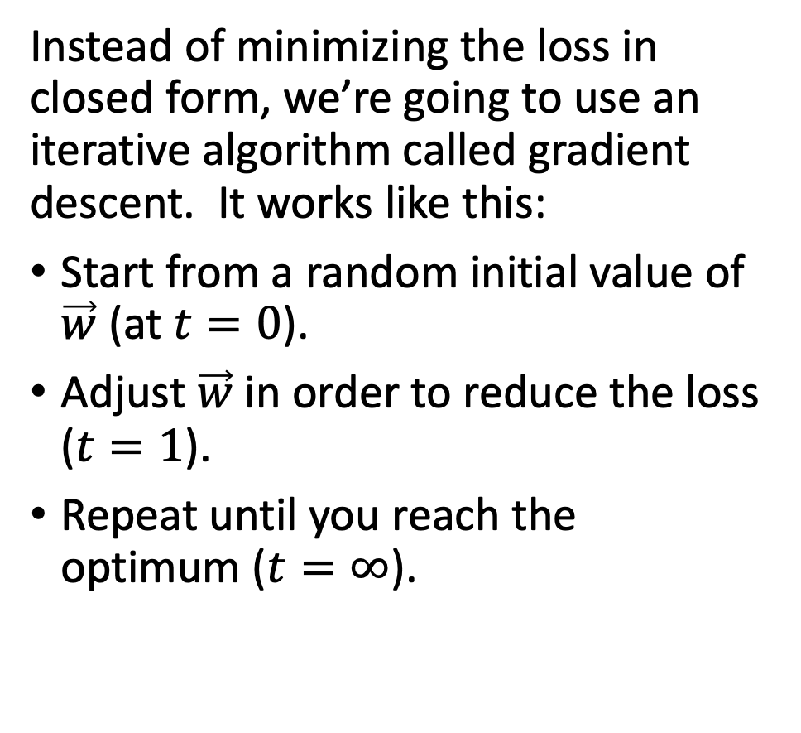




The iterative solution to training a neural net
Instead of minimizing the loss in closed form, we’re going to use an iterative algorithm called gradient descent. It works like this:
Start from a random initial value of $\vec{w}$ (at $t=0$).
Adjust $\vec{w}$ in order to reduce the loss ($t=1$).
Repeat until you reach the optimum ($t=∞$).
$$𝔏=−\frac{1}{n}\log{P\left(𝔇 | W\right)}$$
$$t=0$$
$$t=1$$
$$t=∞$$
…
$$w$$

Slide 57


The gradient descent algorithm
Start from a random initial value of $\vec{w}$.
Calculate the derivative of the loss with respect to $\vec{w}$:
$$∇_{\vec{w}}𝔏=\left[\begin{matrix}\frac{∂𝔏}{∂w_{1}} \\ \begin{matrix}⋮ \\ \frac{∂𝔏}{∂w_{D}}\end{matrix} \\ \frac{∂𝔏}{∂b}\end{matrix}\right]$$
Take a step “downhill” (in the direction of the negative gradient
$$\vec{w}←\vec{w}−\frac{η}{2}∇_{\vec{w}}𝔏$$
…where $η$ is a constant called the “learning rate,” that determines how big of a step you take. Usually, you need to adjust $η$ in order to get optimum performance on a dev set, but often $η≈0.001$.
$$MSE=aw^{2}+bw+c$$
$$𝔏=−\frac{1}{n}\log{P\left(𝔇 | W\right)}$$
$$w$$

Slide 58

Stochastic gradient descent
If n is large, computing or differentiating the loss for the entire training dataset, all at once, can be expensive.
The stochastic gradient descent algorithm picks one training token $\left({\vec{x}}_{i},y_{i}\right)$at random (”stochastically”), and adjusts $\vec{w}$ in order to reduce the error a little bit for that one token:
$$\vec{w}←\vec{w}−\frac{η}{2}∇_{\vec{w}}𝔏_{i}$$
…where
$$𝔏_{i}=−\ln{P\left(C=c_{i} | X={\vec{x}}_{i},W\right)}$$
… in other words, the part of the loss function that only depends on the $i^{th}$ token.

Slide 59


Stochastic gradient descent
$$𝔏_{i}=\ln{\sum_{k=1}^{V}{e^{{\vec{w}}_{k}^{T}{\vec{x}}_{i}}}}−{\vec{w}}_{c_{i}}^{T}{\vec{x}}_{i}$$
If we differentiate that, we discover that:
$$∇_{{\vec{w}}_{c}}𝔏_{i}=\left(f_{c}\left(\vec{x}\right)−y_{i,c}\right){\vec{x}}_{i}$$
So the stochastic gradient descent algorithm is:
$${\vec{w}}_{c}←{\vec{w}}_{c}−η\left(f_{c}\left(\vec{x}\right)−y_{i,c}\right){\vec{x}}_{i}$$
$$𝔏_{i}=−\ln{P\left(C=c_{i} | X={\vec{x}}_{i},W\right)}$$
$$w$$

Slide 60
Outline
Review: multi-class perceptron
Breaking the constraints of linearity: multi-layer neural nets
Flow diagram for the XOR problem
Flow diagram for a multi-layer neural net
One-hot vectors
Softmax
Cross-entropy = negative log probability of the training data
Stochastic gradient descent
Training a neural net using numpy
The same example using pytorch
torch.nn: standard layers and units

Slide 61

Training a neural net using numpy or pytorch
Running example: linear regression
For example, suppose $y=sin⁡(x)$
Suppose that the network can only model functions of the form
$$f\left(x\right)=a+bx+cx^{2}+dx^{3}={\vec{x}}^{T}\vec{w}$$
…where we’re defining…
$$\vec{w}=\left[\begin{matrix}a \\ \begin{matrix}b \\ c\end{matrix} \\ d\end{matrix}\right],\vec{x}=\left[\begin{matrix}1 \\ \begin{matrix}x \\ x^{2}\end{matrix} \\ x^{3}\end{matrix}\right]$$
We want to learn a, b, c, d so that $f(x) ≈y$

Slide 62

Running example: neural net regression

Slide 63

Mean-squared error
First, let’s define the loss function.
$$f\left(x_{i}\right)=a+bx_{i}+c{x_{i}}^{2}+d{x_{i}}^{3},$$
$$ε_{i}=f\left(x_{i}\right)−y_{i},$$
$$ℒ=\frac{1}{n}\sum_{i=1}^{n}{{ε_{i}}^{2}}$$

Slide 64

Loss gradient
Next, find the derivative of the loss.
$$f\left(x_{i}\right)=a+bx_{i}+c{x_{i}}^{2}+d{x_{i}}^{3}, ε_{i}=f\left(x_{i}\right)−y_{i}, ℒ=\frac{1}{n}\sum_{i=1}^{n}{{ε_{i}}^{2}}$$
$$∇_{\vec{w}}ℒ=\left[\begin{matrix}\frac{dℒ}{da} \\ \begin{matrix}\frac{dℒ}{db} \\ \frac{dℒ}{dc}\end{matrix} \\ \frac{dℒ}{dd}\end{matrix}\right]=\frac{2}{n}\sum_{i=1}^{n}{ε_{i}∇_{\vec{w}}ε_{i}}=\frac{2}{n}\sum_{i=1}^{n}{ε_{i}\left[\begin{matrix}\frac{df\left(x_{i}\right)}{da} \\ \begin{matrix}\frac{df\left(x_{i}\right)}{db} \\ \frac{df\left(x_{i}\right)}{dc}\end{matrix} \\ \frac{df\left(x_{i}\right)}{dd}\end{matrix}\right]}=\frac{2}{n}\sum_{i=1}^{n}{ε_{i}\left[\begin{matrix}1 \\ \begin{matrix}x_{i} \\ {x_{i}}^{2}\end{matrix} \\ {x_{i}}^{3}\end{matrix}\right]}$$

Slide 65

Gradient update
Now, update the weights by subtracting the gradient.
$$a=a−\frac{η}{2}\frac{dℒ}{da}=a−\frac{η}{n}\sum_{i=1}^{n}{\left(f\left(x_{i}\right)−y_{i}\right)},$$
$$b=b−η\frac{dℒ}{db}=b−\frac{η}{n}\sum_{i=1}^{n}{\left(f\left(x_{i}\right)−y_{i}\right)x_{i}},$$
$$c=c−η\frac{dℒ}{dc}=c−\frac{η}{n}\sum_{i=1}^{n}{\left(f\left(x_{i}\right)−y_{i}\right){x_{i}}^{2}},$$
$$d=d−η\frac{dℒ}{dd}=d−\frac{η}{n}\sum_{i=1}^{n}{\left(f\left(x_{i}\right)−y_{i}\right){x_{i}}^{3}}$$

Slide 66

How a neural network is trained
Here’s Justin Johnson’s code for doing those things:
(https://pytorch.org/tutorials/beginner/pytorch_with_examples.html)
© 2021 Pytorch, https://pytorch.org/tutorials/beginner/pytorch_with_examples.html

Slide 67
Outline
Review: multi-class perceptron
Breaking the constraints of linearity: multi-layer neural nets
Flow diagram for the XOR problem
Flow diagram for a multi-layer neural net
One-hot vectors
Softmax
Cross-entropy = negative log probability of the training data
Stochastic gradient descent
Training a neural net using numpy
The same example using pytorch
torch.nn: standard layers and units

Slide 68

Autograd: Main idea
A neural network is a complicated function $f(x)$, made up of many simple components
If we try to take all the derivatives, $dℒ/dw_{j,k}^{(l)}$, all at once, in a big mass of spaghetti code, then the code will be really ugly.
HOWEVER: Each of the components is simple to compute. Furthermore, the derivative of its output w.r.t. its input is simple.

Slide 69

Autograd: Tensor objects
The basic idea of autograd is to create a new kind of object that takes responsibility for its own gradient.
For example, the object might be a network weight, $w_{j,k}^{(l)}$

Slide 70

Autograd: Tensor objects
In pytorch, variables that take responsibility for their own gradients are called “tensors” (https://pytorch.org/docs/stable/tensors.html)
Here’s how Justin Johnson defines tensors for the polynomial regression problem:
© 2017 Pytorch, https://pytorch.org/tutorials/beginner/pytorch_with_examples.html

Slide 71

Autograd: Overloaded operators
The basic idea of autograd is to create a new kind of object that takes responsibility for its own gradient.
For example, the object might be a network weight, $w_{j,k}^{(l)}$
These new objects have overloaded operators, so that any time we use them to compute some output, the input is cached. For example, it might be used to compute
$$ξ_{j}^{(l)}=b_{j}^{(l)}+\sum_{k}{w_{j,k}^{(l)}h_{k}^{(l−1)}}$$

Slide 72

Autograd: Overloaded operators
Here’s how it gets used:
Python overloaded operators: if “b” is an object that has a method named __mul__, then the expression “f=b*x” actually calls “f=b.__mul__(x)”.

Slide 73
Autograd: Overloaded operators
The operator overload code looks something like this:
class Tensor(torch.autograd.Function):
def __init__(self, weight):
self.weight = weight
self.saved_tensors = ()
def __mul__(self, other):
self.saved_tensors = (self.saved_tensors[:], other)
returnvalue = self.weight * other
return Tensor(returnvalue)
Cache x in self.saved_tensors, so we can use it later…
Then calculate the output of the multiply operation,
… and cast the return value as a Tensor.

Slide 74
Autograd: Overloaded operators
Here’s how it gets used:
Stores x in b.saved_tensors
Stores x**2 in c.saved_tensors
Python overloaded operators: the expression “b*x” actually calls b.__mul__(x).

Slide 75

Autograd: the Loss tensor
The basic idea of autograd is to create a new kind of object, a tensor, that takes responsibility for its own gradient. Any time we use tensors to compute some output, the input is cached. For example, these operations:
$$f\left(x_{i}\right)=a+bx_{i}+c{x_{i}}^{2}+d{x_{i}}^{3}$$
$$ℒ=\frac{1}{n}\sum_{i=1}^{n}{{\left(f\left(x_{i}\right)−y_{i}\right)}^{2}}$$
f = a + b*x + c*x**2 + d*x**3
loss = (f-y).pow(2)
...will calculate the loss, but will also store some extra information in loss.saved_tensors, f.saved_tensors, a.saved_tensors, b.saved_tensors, c.saved_tensors, d.saved_tensors, and x.saved_tensors.

Slide 76
Autograd: the Loss tensor
loss
Notice the flow diagram that was implied by those lines of code.
Each tensor’s overloaded __mul__ operator keeps track of the variables used to compute it:
loss.saved_tensors has pointers to f and y
f.saved_tensors has pointers to x, a, b, c, and d
f
y
x
a
b
c
d

Slide 77

Autograd
loss depends on y_pred, which depends on a, b, c, d.

Slide 78

Autograd: the backward function
loss
Every tensor object has a method called backward().
If backward() is called with no arguments, it calculates the derivative with respect to the inputs:
loss.backward() calculates
tmp= $\frac{dℒ}{df}$, then calls the method f.backward(tmp).
f
y
x
a
b
c
d

Slide 79

Autograd: the backward function
loss
If backward() is called with the argument tmp= $\frac{dℒ}{df}$, it does three things:
Store f.grad= $\frac{dℒ}{df}$
Calculate derivative w.r.t. each input, for example, tmp=
$$\frac{dℒ}{dc}=\frac{dℒ}{df}×\frac{df}{dc}$$
Pass the input derivatives back to the inputs, e.g., call c.backward(tmp)
f
y
x
a
b
c
d

Slide 80
Autograd
loss depends on y_pred, which depends on a, b, c, d.
Calculates the derivative of the loss w.r.t. each of its input tensors.
Uses the resulting derivatives to update the weights.

Slide 81
Details: How to turn off autograd
As you know, every time you add, subtract, multiply or divide a tensor by anything, the tensor stores data in self.saved_tensors, so it can use that information later to compute the gradient
How do you turn this behavior off?

Slide 82
Dynamically turning off Autograd
These weight updates are not part of the neural network forward pass.

Slide 83
How to zero out the gradients
When you call backward() over a tensor, it doesn’t zero out any previous gradients
Instead, it adds the current gradient to the previous gradients
A very very very common mistake: running 2000 iterations, with the gradient accumulating from each iteration to the next, instead of zeroing it out in between iterations

Slide 84

Manually zeroing out the gradients
Here’s the part I didn’t show you before.

Slide 85
Outline
Review: multi-class perceptron
Breaking the constraints of linearity: multi-layer neural nets
Flow diagram for the XOR problem
Flow diagram for a multi-layer neural net
One-hot vectors
Softmax
Cross-entropy = negative log probability of the training data
Stochastic gradient descent
Training a neural net using numpy
The same example using pytorch
torch.nn: standard layers and units

Slide 86
Pytorch nn module
The autograd feature of pytorch allows you to define only the forward propagation of your neural net. As long as all of the component operations are in pytorch’s library, the back-propagation will be computed for you.
Tensors just do multiplication and addition. What about other types of operations?
General operations are contained in the nn module, using the formalism of a “layer.”

Slide 87

Some types of layers
torch.nn.Linear: a layer that computes $\vec{o}=W\vec{i}+\vec{b}$
torch.nn.Softmax: a layer that computes $o_{j}=\frac{exp⁡(i_{j})}{\sum_{k}{exp⁡(i_{k})}}$
torch.nn.Sigmoid: a layer that computes $o_{j}=\frac{1}{1−exp⁡(−i_{j})}$
torch.nn.ReLU: a layer that computes $o_{j}=max⁡(0,i_{j})$
torch.nn.Sequential: a model that takes a sequence of layers as its arguments, and applies them, one after the other, in order

Slide 88

m=torch.nn.Linear(n_1,n_2)
This creates a callable object, m, such that o=m(i) treats each row of i as a vector, and generates a corresponding row of o using the operation:
$$\vec{o}=W\vec{i}+\vec{b}$$
i can be a tensor of any size, as long as its last dimension (the dimension of each row) is n_1
o is then a tensor of the same shape as i, except that its last dimension (the row length) is now n_2
m.weight (W) is a tensor of size (n_2,n_1)
m.bias (b) is a row vector of length n_2

Slide 89










Example: Linear, Sigmoid, Softmax
Here’s an example flowgraph. We could create the layers as:
linear1 = torch.nn.Linear(2,3)
sigmoid1 = torch.nn.Sigmoid()
linear2 = torch.nn.Linear(3,2)
loss_function = torch.nn.MSEloss()
Having created them, we could then run forward pass as:
xi = linear1(x)
h = sigmoid1(xi)
f = linear2(h)
loss = loss_function(f,y)
Then we could calculate all of the gradients by running
loss.backward()
$$f_{1}$$
$$f_{2}$$
$$h_{1}$$
$$h_{2}$$
$$h_{3}$$
$$ξ_{1}$$
$$ξ_{2}$$
$$ξ_{3}$$
$$x_{1}$$
$$x_{2}$$

Slide 90
torch.nn.Sequential
torch.nn.Sequential is a special module that creates a sequence of layers, where each layer’s output is the next layer’s input. For example:
model = torch.nn.Sequential(
torch.nn.Linear(2,3),
torch.nn.Sigmoid(),
torch.nn.Linear(3,2))
loss_function = torch.nn.MSEloss()
Then you can run forward pass by just typing:
f = model(x)
loss = loss_function(f,y)
You can still calculate all of the gradients by running
loss.backward()
$$f_{1}$$
$$f_{2}$$
$$h_{1}$$
$$h_{2}$$
$$h_{3}$$
$$ξ_{1}$$
$$ξ_{2}$$
$$ξ_{3}$$
$$x_{1}$$
$$x_{2}$$

Slide 91
torch.nn.Sequential: where are the parameters?
The layers each have their own parameters, for example, a model created using the commands on the previous slide would have
model[0].weight
model[0].bias
model[2].weight
model[2].bias
Accessing them that way requires you to know which layers have weights and biases, and which don’t. An easier way is to use the function model.parameters(), which iterates through all trainable parameters, regardless of where they are actually stored:
for param in model.parameters():
param -= learning_rate * param.grad

Slide 92

Conclusions
Neural network forward propagation:
$$ξ_{j}^{(l)}=b_{j}^{(l)}+\sum_{k}{w_{j,k}^{(l)}h_{k}^{(l−1)}}, h_{j}^{(l)}=g^{(l)}\left(ξ_{j}^{(l)}\right)$$
One-hot vectors
$$y_{i,c}=\left\{\begin{matrix}1 & c=true class label of the i^{th} token \\ 0 & otherwise\end{matrix}\right.$$
Softmax
$$f_{c}\left({\vec{x}}_{i}\right)=\frac{e^{{\vec{w}}_{c}^{T}\vec{x}}}{\sum_{k=1}^{V}{e^{{\vec{w}}_{k}^{T}\vec{x}}}}=P\left(Class=c | X=\vec{x},W\right)$$
Stochastic gradient descent w/cross-entropy
$$𝔏_{i}=−\ln{P\left(C=c_{i} | X={\vec{x}}_{i},W\right)}, \vec{w}←\vec{w}−\frac{η}{2}∇_{\vec{w}}𝔏_{i}$$
Toolkits: https://pytorch.org/tutorials/beginner/pytorch_with_examples.html

