Slide 1
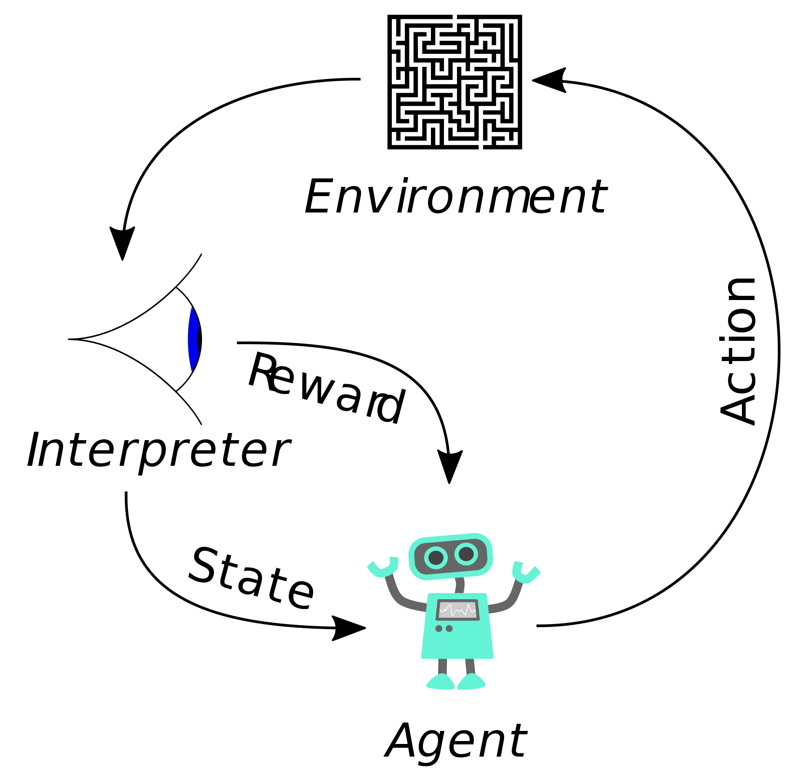
Deep Reinforcement Learning CS440/ECE448
Mark Hasegawa-Johnson, 4/2022
CC-BY 4.0: you may remix or redistribute if you cite the source
Image: Megajuice, CC0, https://commons.wikimedia.org/
w/index.php?curid=57895741

Slide 2
Outline
Review: MDP and Q-Learning
Deep Q-Learning
Imitation Learning
Actor-Critic Learning

Slide 3




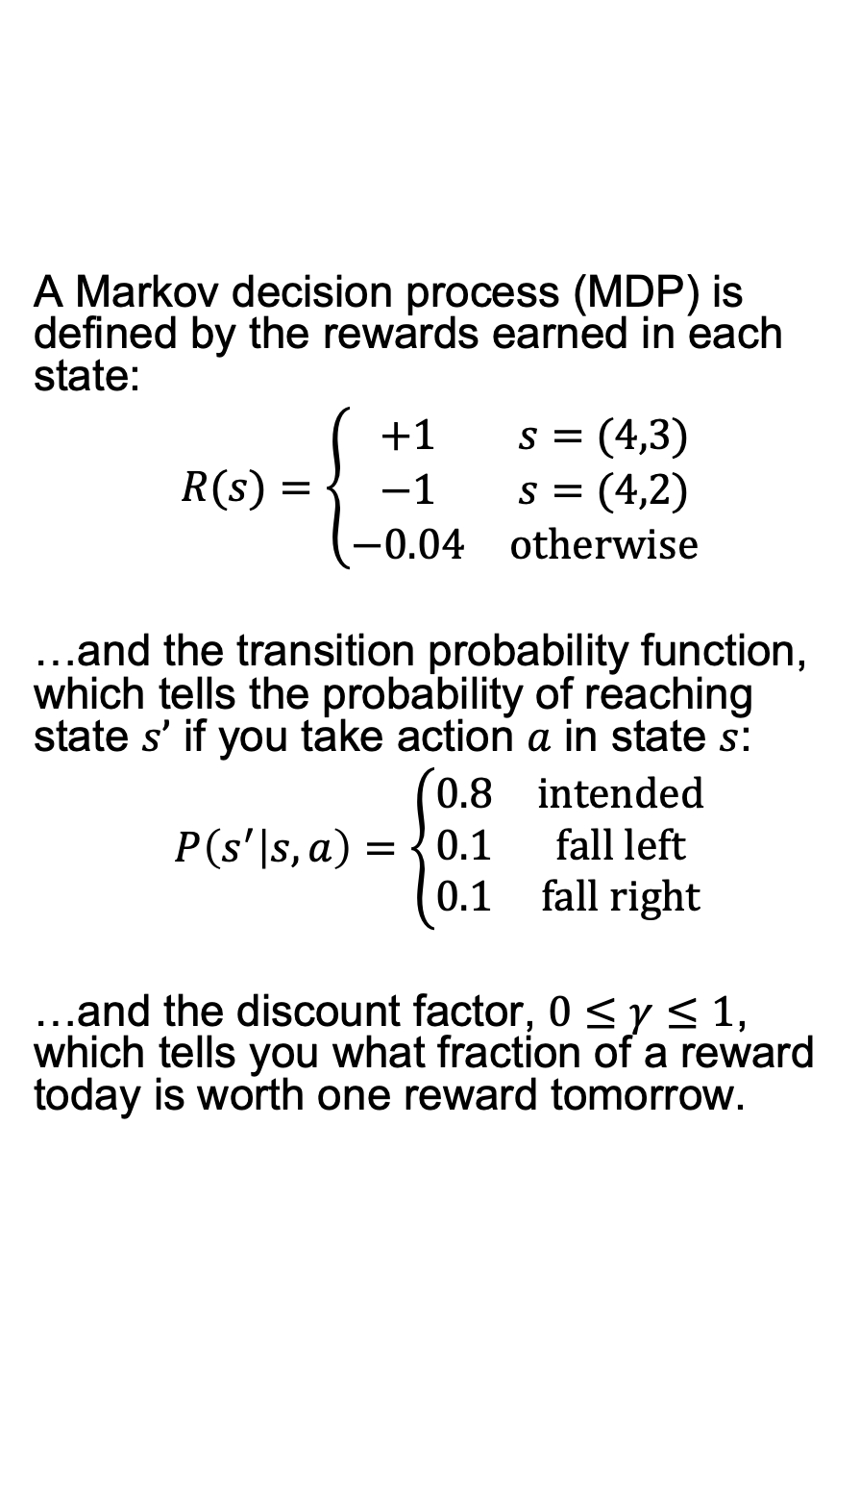
Review: Markov Decision Process
A Markov decision process (MDP) is defined by the rewards earned in each state:
$$R(s)=\left\{\begin{matrix}+1 & s=(4,3) \\ −1 & s=(4,2) \\ −0.04 & otherwise\end{matrix}\right.$$
…and the transition probability function, which tells the probability of reaching state $s’$ if you take action $a$ in state $s$:
$$P\left(s^{′} | s,a\right)=\left\{\begin{matrix}0.8 & intended \\ 0.1 & fall left \\ 0.1 & fall right\end{matrix}\right.$$
…and the discount factor, $0≤γ≤1$, which tells you what fraction of a reward today is worth one reward tomorrow.

Slide 4
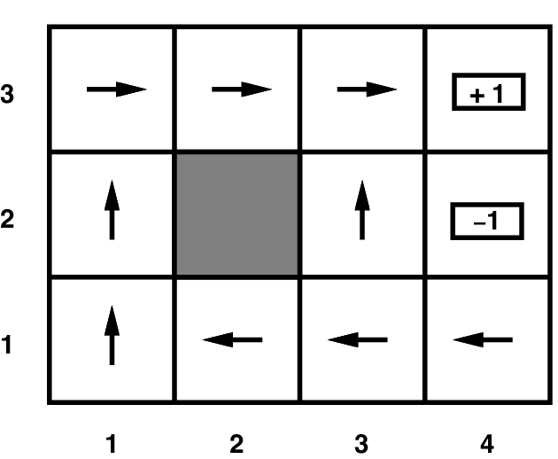
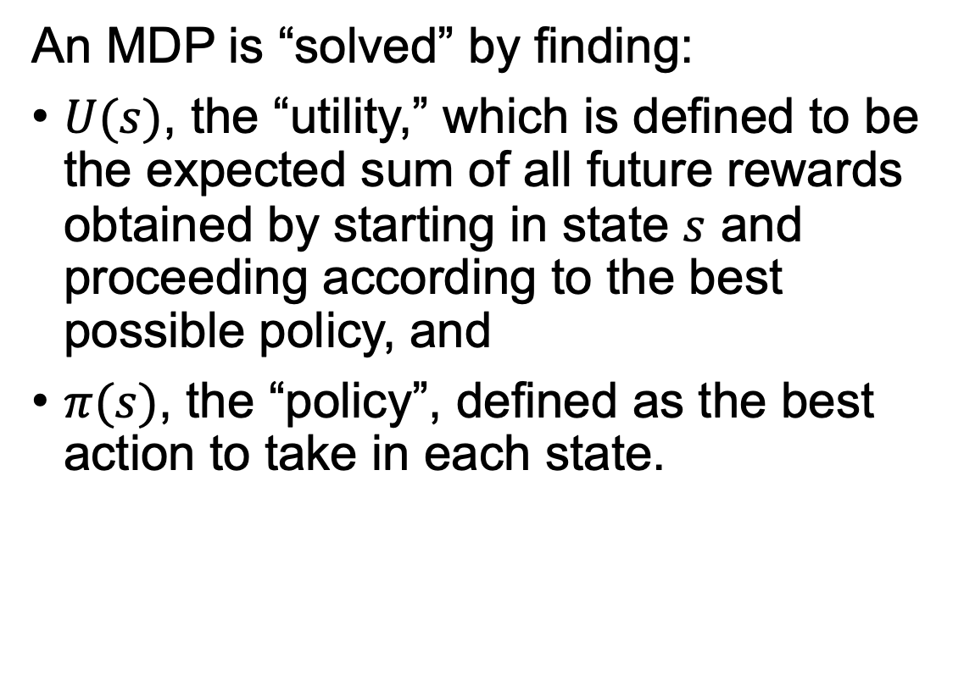
Review: Markov Decision Process
0.81 | 0.87 | 0.92
0.76 |  | 0.66
0.71 | 0.66 | 0.61 | 0.39
An MDP is “solved” by finding:
$U(s)$, the “utility,” which is defined to be the expected sum of all future rewards obtained by starting in state $s$ and proceeding according to the best possible policy, and
$π(s)$, the “policy”, defined as the best action to take in each state.

Slide 5
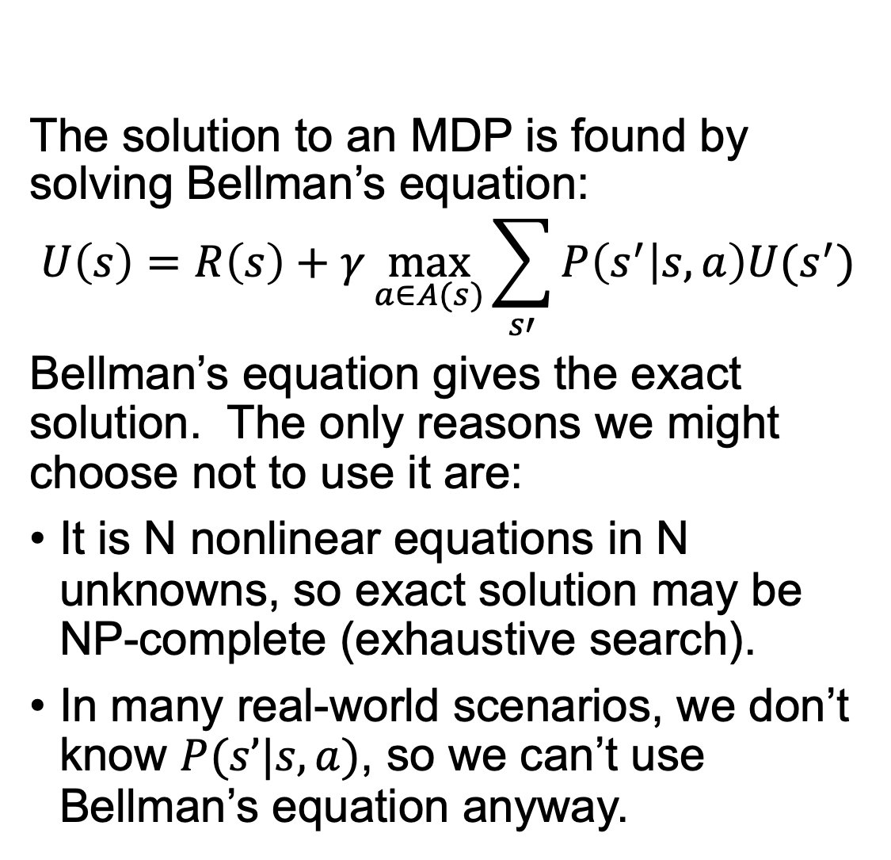
Review: Markov Decision Process
The solution to an MDP is found by solving Bellman’s equation:
$$U\left(s\right)=R\left(s\right)+γ\max_{a∈A(s)}{\sum_{s′}{P\left(s^{′} | s,a\right)U(s^{′})}}$$
Bellman’s equation gives the exact solution. The only reasons we might choose not to use it are:
It is N nonlinear equations in N unknowns, so exact solution may be NP-complete (exhaustive search).
In many real-world scenarios, we don’t know $P(s’|s,a)$, so we can’t use Bellman’s equation anyway.
0.81 | 0.87 | 0.92
0.76 |  | 0.66
0.71 | 0.66 | 0.61 | 0.39

Slide 6
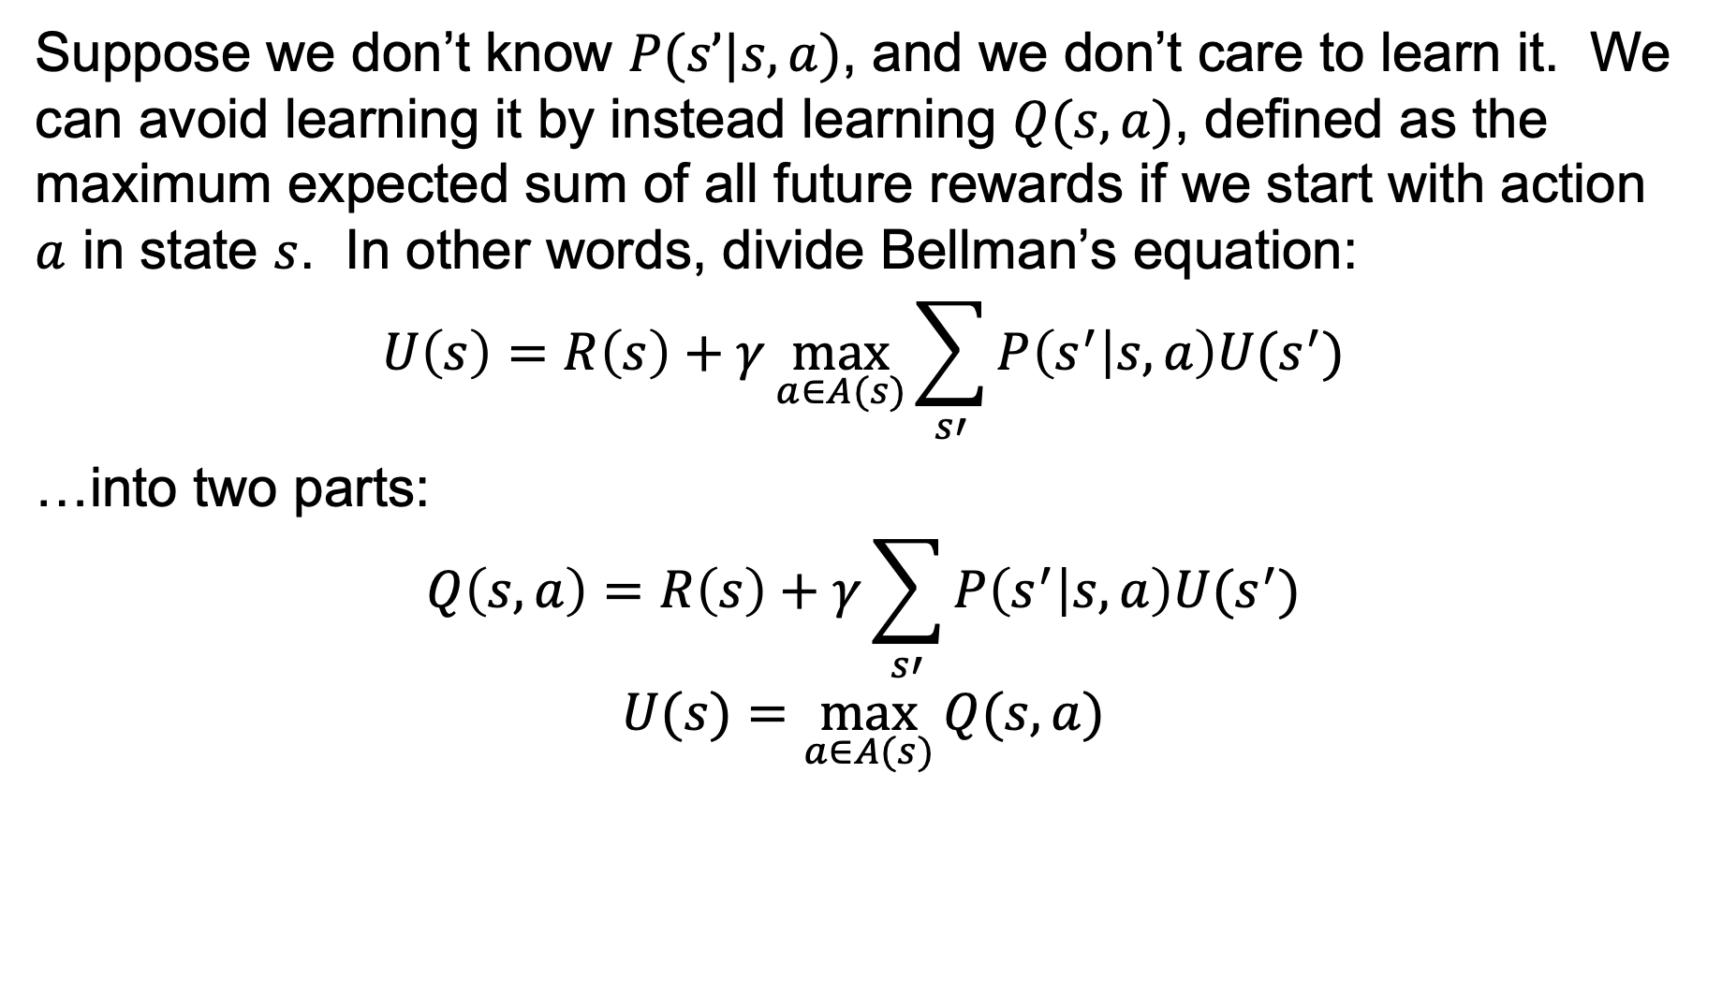
Review: Q-Learning
Suppose we don’t know $P(s’|s,a)$, and we don’t care to learn it. We can avoid learning it by instead learning $Q(s,a)$, defined as the maximum expected sum of all future rewards if we start with action $a$ in state $s$. In other words, divide Bellman’s equation:
$$U\left(s\right)=R\left(s\right)+γ\max_{a∈A(s)}{\sum_{s′}{P\left(s^{′} | s,a\right)U(s^{′})}}$$
…into two parts:
$$Q\left(s,a\right)=R\left(s\right)+γ\sum_{s′}{P\left(s^{′} | s,a\right)U(s^{′})}$$
$$U(s)=\max_{a∈A(s)}{Q(s,a)}$$

Slide 7
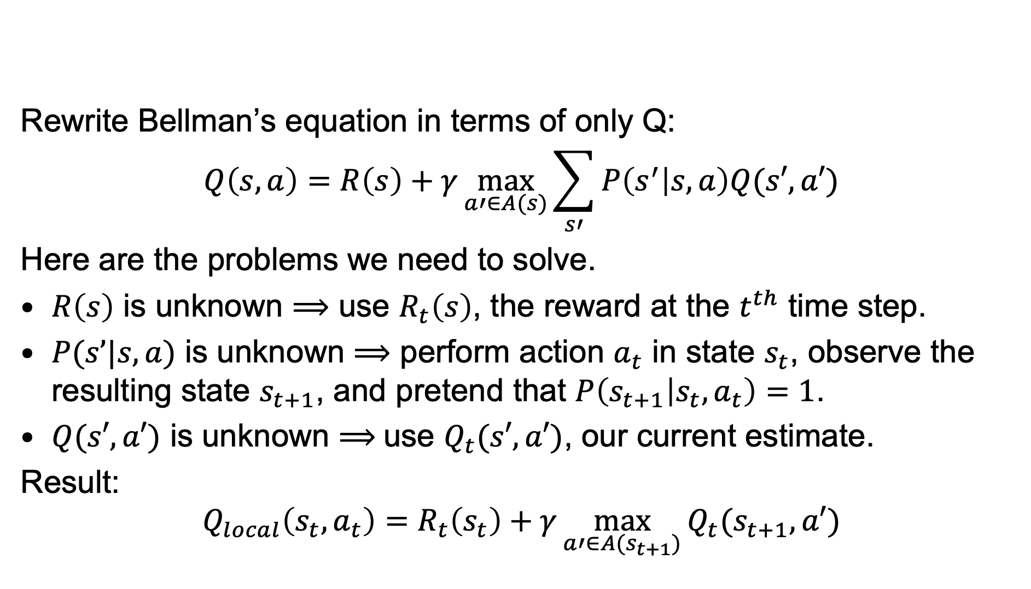
Review: Q-Learning
Rewrite Bellman’s equation in terms of only Q:
$$Q\left(s,a\right)=R\left(s\right)+γ\max_{a′∈A(s)}{\sum_{s′}{P\left(s^{′} | s,a\right)Q(s′,a′)}}$$
Here are the problems we need to solve.
$R\left(s\right)$ is unknown $⟹$ use $R_{t}\left(s\right)$, the reward at the $t^{th}$ time step.
$P(s’|s,a)$ is unknown $⟹$ perform action $a_{t}$ in state $s_{t}$, observe the resulting state $s_{t+1}$, and pretend that $P\left(s_{t+1} | s_{t},a_{t}\right)=1$.
$Q(s′,a′)$ is unknown $⟹$use $Q_{t}(s′,a′)$, our current estimate.
Result:
$$Q_{local}\left(s_{t},a_{t}\right)=R_{t}\left(s_{t}\right)+γ\max_{a′∈A(s_{t+1})}{Q_{t}(s_{t+1},a′)}$$

Slide 8
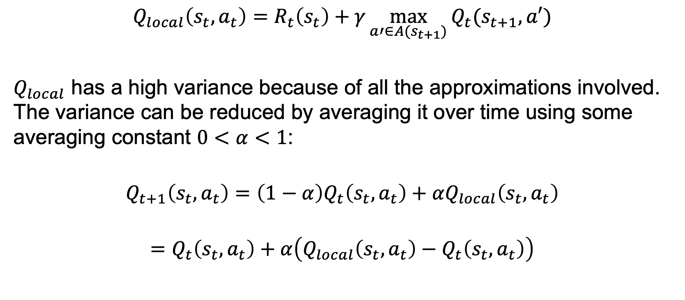
Review: Q-Learning
$$Q_{local}\left(s_{t},a_{t}\right)=R_{t}\left(s_{t}\right)+γ\max_{a′∈A(s_{t+1})}{Q_{t}(s_{t+1},a′)}$$
$Q_{local}$ has a high variance because of all the approximations involved. The variance can be reduced by averaging it over time using some averaging constant $0<α<1$:
$$Q_{t+1}\left(s_{t},a_{t}\right)=\left(1−α\right)Q_{t}\left(s_{t},a_{t}\right)+αQ_{local}\left(s_{t},a_{t}\right)$$
$$=Q_{t}\left(s_{t},a_{t}\right)+α\left(Q_{local}\left(s_{t},a_{t}\right)−Q_{t}\left(s_{t},a_{t}\right)\right)$$

Slide 9
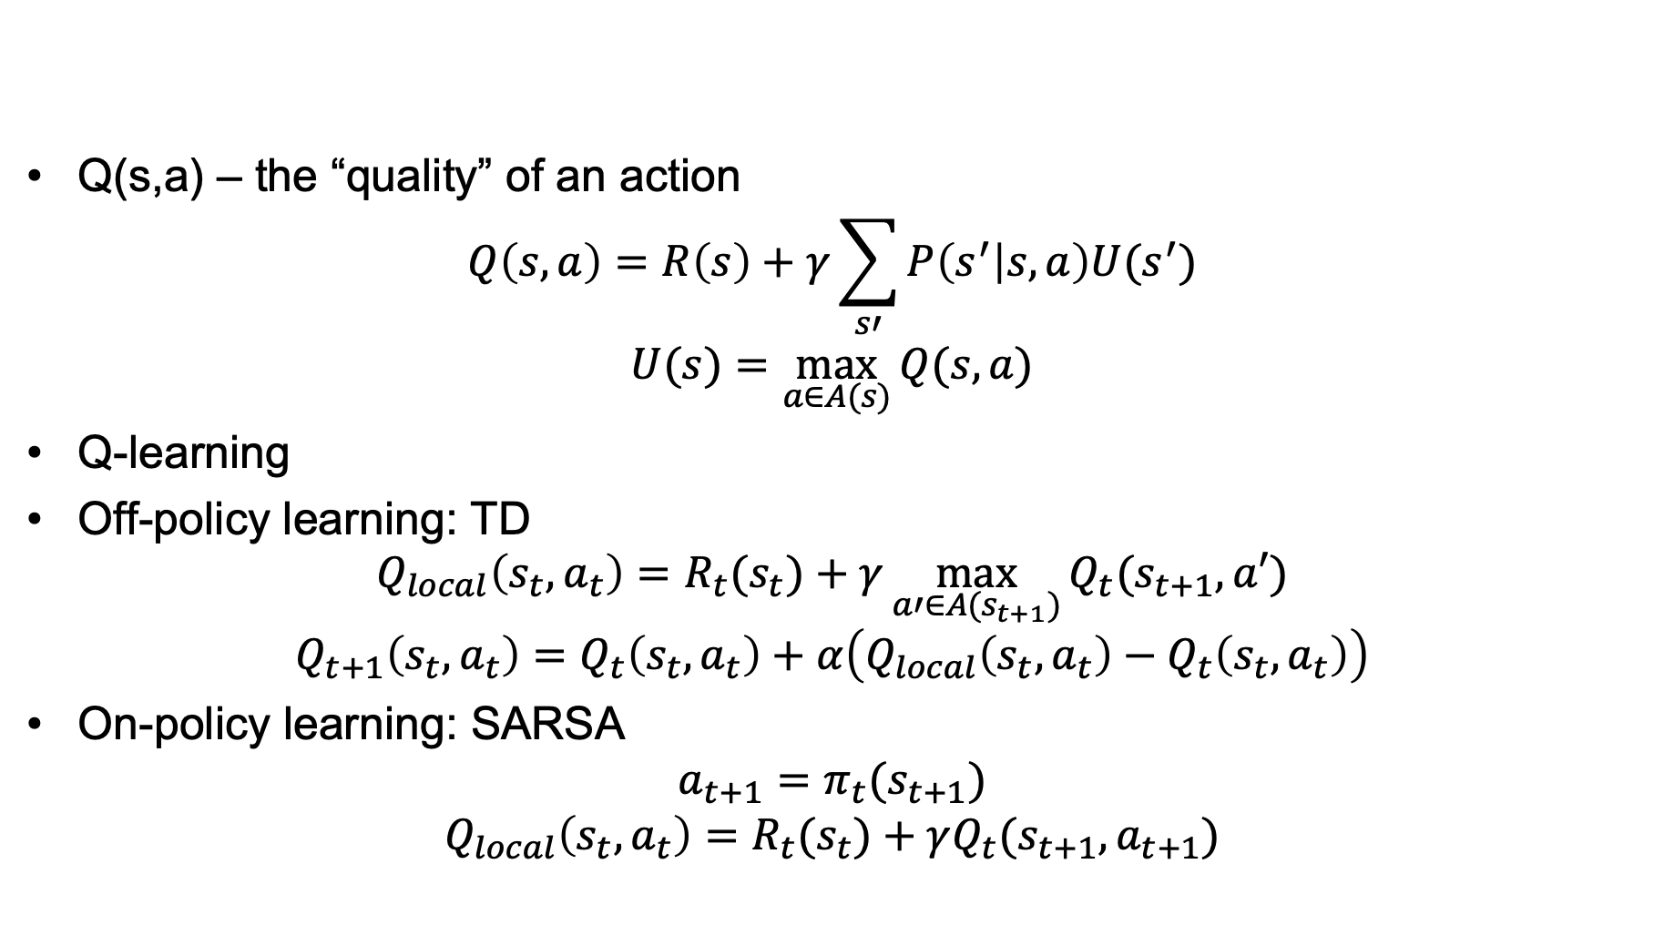
Summary: Q-Learning
Q(s,a) – the “quality” of an action
$$Q\left(s,a\right)=R\left(s\right)+γ\sum_{s′}{P\left(s^{′} | s,a\right)U(s^{′})}$$
$$U(s)=\max_{a∈A(s)}{Q(s,a)}$$
Q-learning
Off-policy learning: TD
$$Q_{local}\left(s_{t},a_{t}\right)=R_{t}(s_{t})+γ\max_{a′∈A(s_{t+1})}{Q_{t}(s_{t+1},a′)}$$
$$Q_{t+1}\left(s_{t},a_{t}\right)=Q_{t}\left(s_{t},a_{t}\right)+α\left(Q_{local}\left(s_{t},a_{t}\right)−Q_{t}\left(s_{t},a_{t}\right)\right)$$
On-policy learning: SARSA
$${a_{t+1}=π}_{t}(s_{t+1})$$
$$Q_{local}\left(s_{t},a_{t}\right)=R_{t}(s_{t})+γQ_{t}(s_{t+1},a_{t+1})$$

Slide 10
Outline
Review: MDP and Q-Learning
Deep Q-Learning
Imitation Learning
Actor-Critic Learning

Slide 11
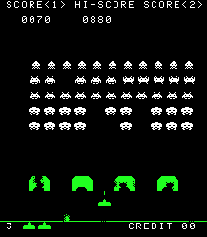
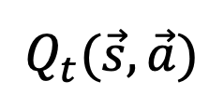




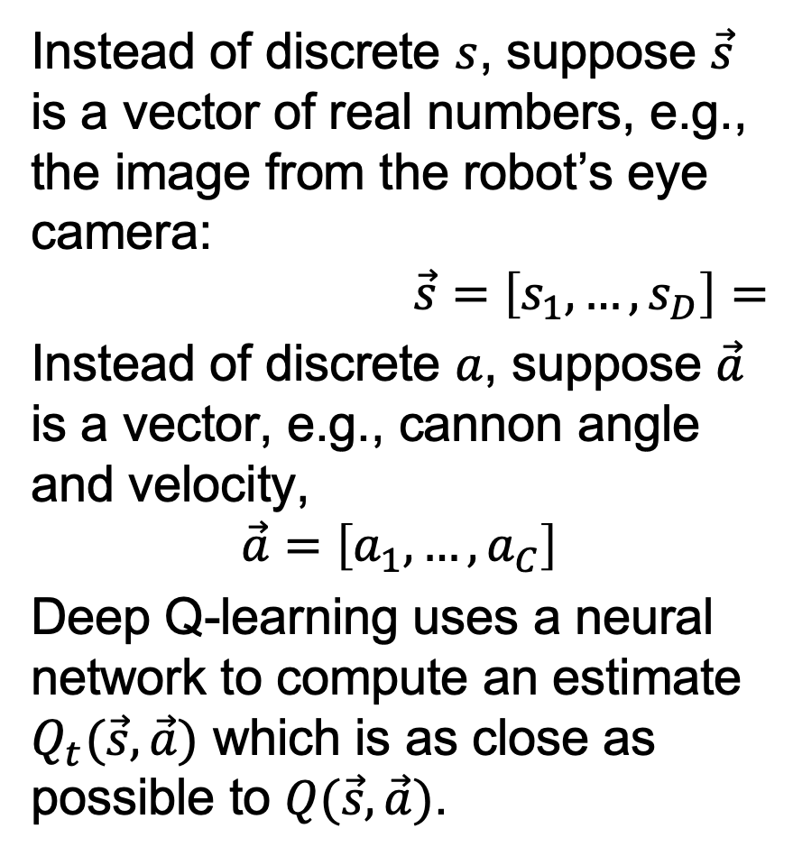







Deep Q learning
Instead of discrete $s$, suppose $\vec{s}$ is a vector of real numbers, e.g., the image from the robot’s eye camera:
$$\vec{s}=\left[s_{1},…,s_{D}\right]=$$
Instead of discrete $a$, suppose $\vec{a}$ is a vector, e.g., cannon angle and velocity,
$$\vec{a}=\left[a_{1},…,a_{C}\right]$$
Deep Q-learning uses a neural network to compute an estimate $Q_{t}(\vec{s},\vec{a})$ which is as close as possible to $Q(\vec{s},\vec{a})$.
$$Q_{t}(\vec{s},\vec{a})$$
$$1$$
$$1$$
Copyright Taito.
$$1$$
$$1$$
$$s_{1}$$
$$…$$
$$s_{D}$$
$$a_{1}$$
$$…$$
$$a_{C}$$
$$1$$
$$…$$

Slide 12
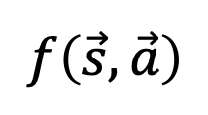
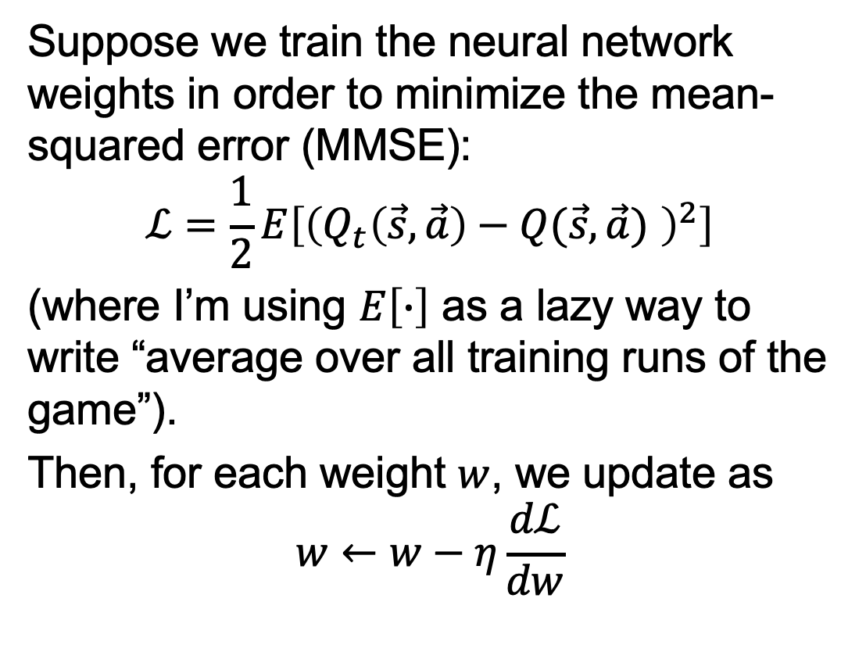
MMSE Deep Q learning
Suppose we train the neural network weights in order to minimize the mean-squared error (MMSE):
$$ℒ=\frac{1}{2}E\left[{\left(Q_{t}\left(\vec{s},\vec{a}\right)−Q(\vec{s},\vec{a}) \right)}^{2}\right]$$
(where I’m using $E\left[∙\right]$ as a lazy way to write “average over all training runs of the game”).
Then, for each weight $w$, we update as
$$w←w−η\frac{dℒ}{dw}$$
$$f\left(\vec{s},\vec{a}\right)$$
$$1$$
$$1$$
$$1$$
$$1$$
$$s_{1}$$
$$…$$
$$s_{D}$$
$$a_{1}$$
$$…$$
$$a_{C}$$
$$1$$
$$…$$

Slide 13
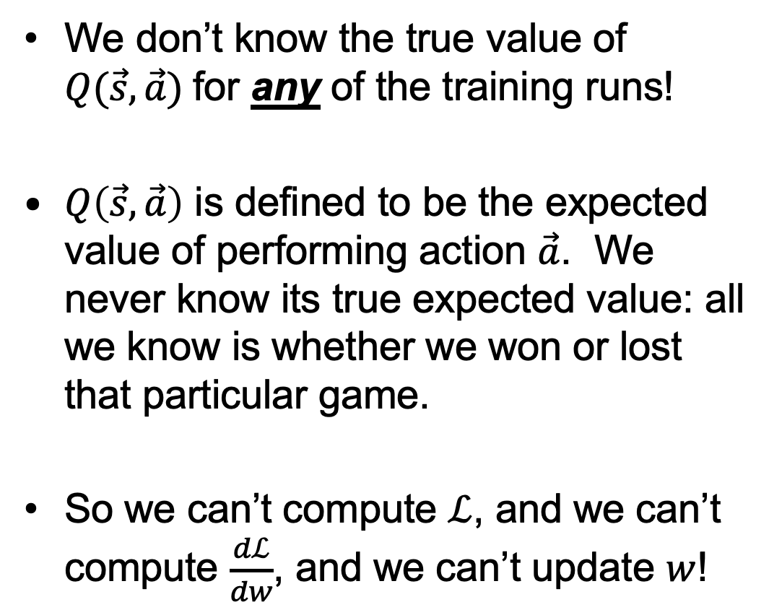
What makes deep Q learning harder than normal neural network training
We don’t know the true value of $Q(\vec{s},\vec{a})$for any of the training runs!
$Q\left(\vec{s},\vec{a}\right)$ is defined to be the expected value of performing action $\vec{a}$. We never know its true expected value: all we know is whether we won or lost that particular game.
So we can’t compute $ℒ$, and we can’t compute $\frac{dℒ}{dw}$, and we can’t update $w$!
$$f\left(\vec{s},\vec{a}\right)$$
$$1$$
$$1$$
$$1$$
$$1$$
$$s_{1}$$
$$…$$
$$s_{D}$$
$$a_{1}$$
$$…$$
$$a_{C}$$
$$1$$
$$…$$

Slide 14
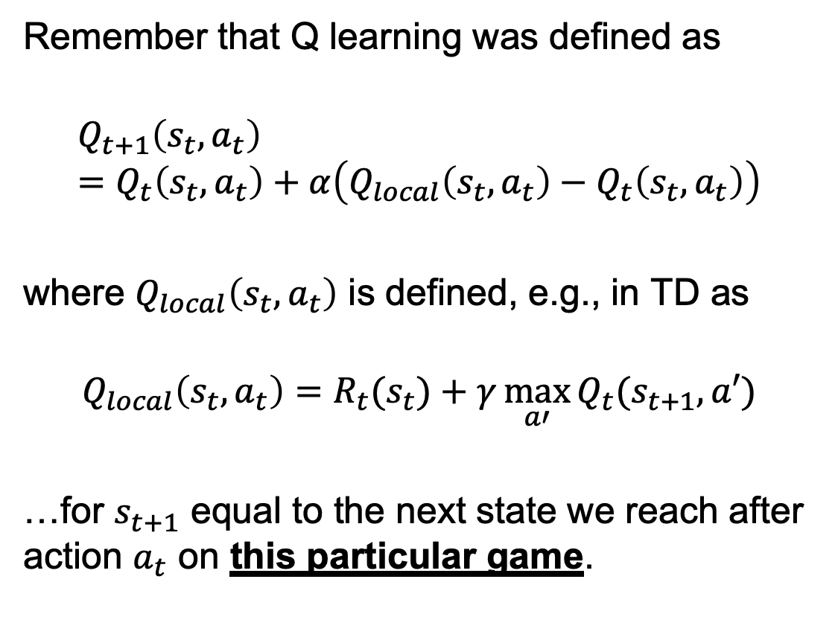
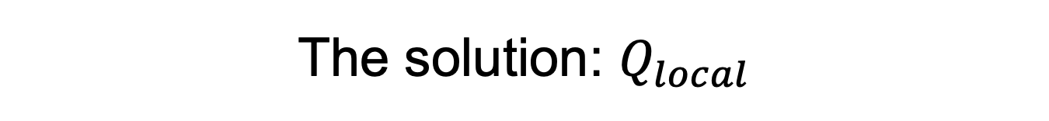
The solution: $Q_{local}$
Remember that Q learning was defined as
$$Q_{t+1}\left(s_{t},a_{t}\right)=Q_{t}\left(s_{t},a_{t}\right)+α\left(Q_{local}\left(s_{t},a_{t}\right)−Q_{t}\left(s_{t},a_{t}\right)\right)$$
where $Q_{local}\left(s_{t},a_{t}\right)$ is defined, e.g., in TD as
$$Q_{local}\left(s_{t},a_{t}\right)=R_{t}(s_{t})+γ\max_{a′}{Q_{t}(s_{t+1},a′)}$$
…for $s_{t+1}$ equal to the next state we reach after action $a_{t}$ on this particular game.
$$…$$

Slide 15
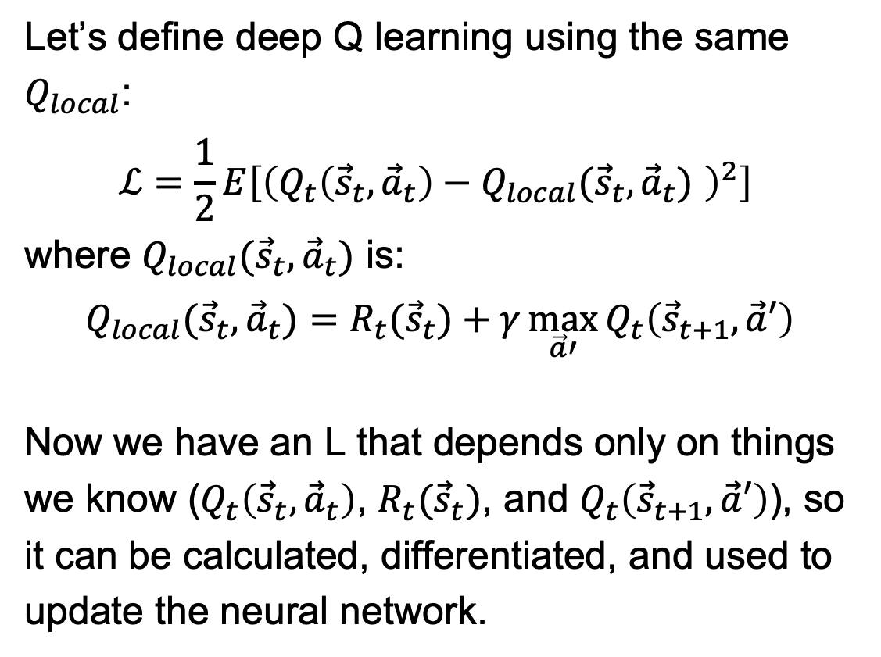
The solution: $Q_{local}$
Let’s define deep Q learning using the same $Q_{local}$:
$$ℒ=\frac{1}{2}E\left[{\left(Q_{t}\left({\vec{s}}_{t},{\vec{a}}_{t}\right)−Q_{local}({\vec{s}}_{t},{\vec{a}}_{t}) \right)}^{2}\right]$$
where $Q_{local}({\vec{s}}_{t},{\vec{a}}_{t})$ is:
$$Q_{local}({\vec{s}}_{t},{\vec{a}}_{t})=R_{t}({\vec{s}}_{t})+γ\max_{\vec{a}′}{Q_{t}\left({\vec{s}}_{t+1},\vec{a}′\right)}$$
Now we have an L that depends only on things we know ($Q_{t}\left({\vec{s}}_{t},{\vec{a}}_{t}\right)$, $R_{t}({\vec{s}}_{t})$, and $Q_{t}\left({\vec{s}}_{t+1},\vec{a}′\right)$), so it can be calculated, differentiated, and used to update the neural network.
$$…$$

Slide 16
Dealing with training instability
Challenges
Target values are not fixed
Successive experiences are correlated and dependent on the policy
Policy may change rapidly with slight changes to parameters, leading to drastic change in data distribution
Solutions
Freeze target Q network
Use experience replay

Slide 17
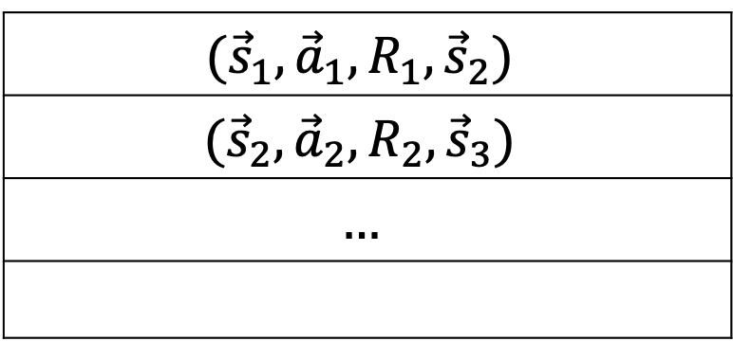
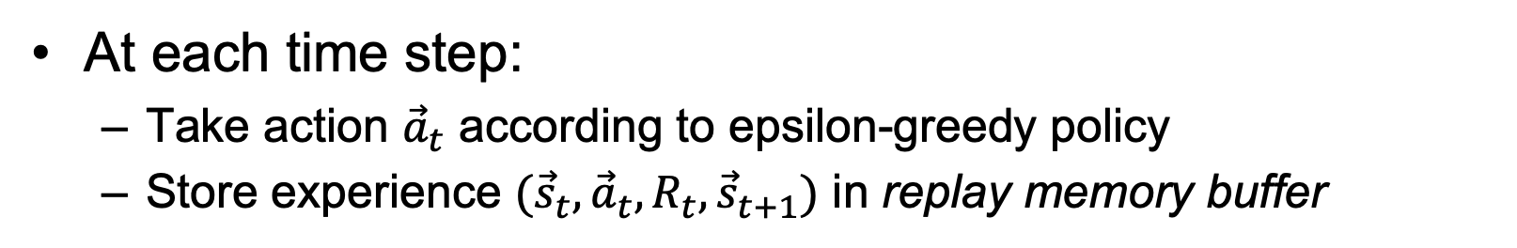
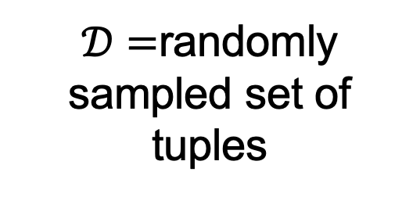
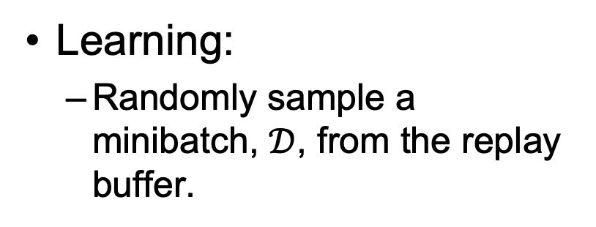
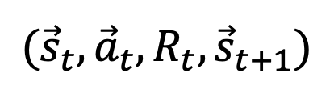
Experience replay
At each time step:
Take action ${\vec{a}}_{t}$ according to epsilon-greedy policy
Store experience $({\vec{s}}_{t},{\vec{a}}_{t},R_{t},{\vec{s}}_{t+1})$ in replay memory buffer
$$({\vec{s}}_{1},{\vec{a}}_{1},R_{1},{\vec{s}}_{2})$$
$$({\vec{s}}_{2},{\vec{a}}_{2},R_{2},{\vec{s}}_{3})$$
$$…$$
$$({\vec{s}}_{t},{\vec{a}}_{t},R_{t},{\vec{s}}_{t+1})$$
Learning:
Randomly sample a minibatch, $𝒟$, from the replay buffer.
$𝒟=$randomly sampled set of tuples

Slide 18
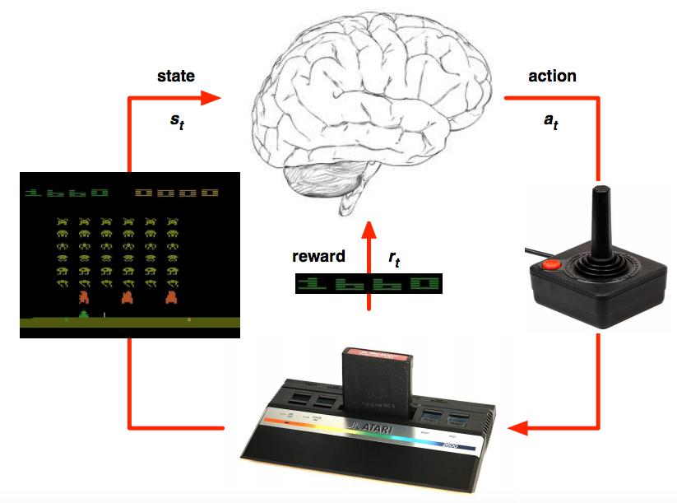
Deep Q learning in Atari
Mnih et al. Human-level control through deep reinforcement learning, Nature 2015

Slide 19
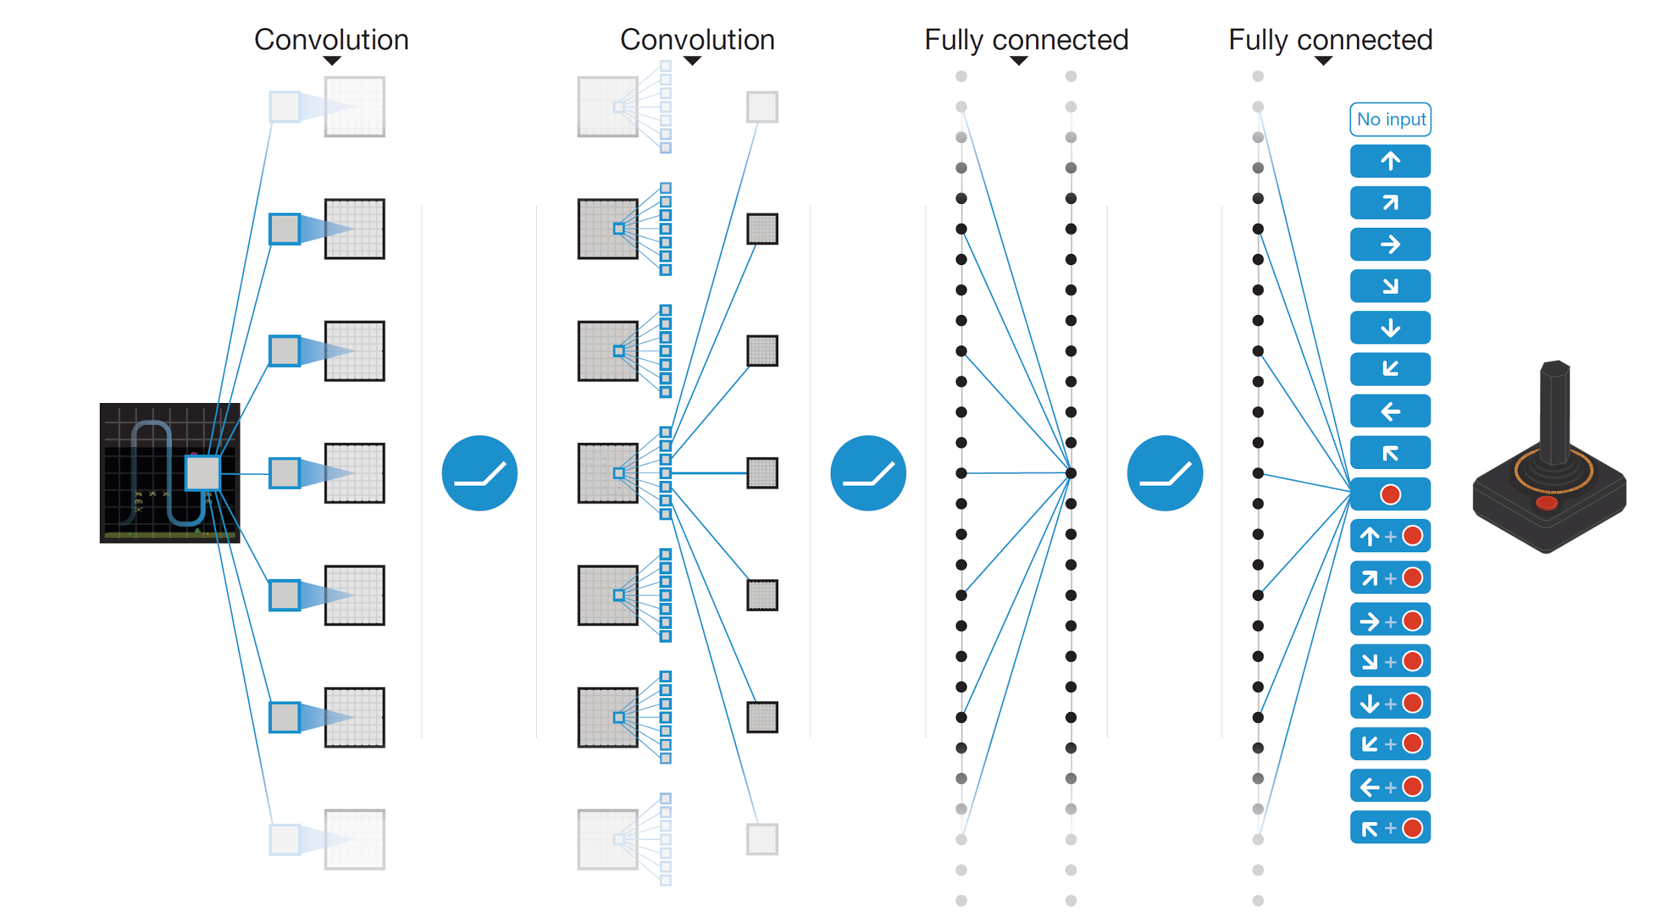

Deep Q learning in Atari
End-to-end learning of $Q_{t}\left(\vec{s},a\right)$ from pixels $\vec{s}$
Output is $Q_{t}\left(\vec{s},a\right)$ for $a∈$18 joystick/button configurations
Reward is change in score for that step
Q(s,a₁)
Q(s,a₂)
Q(s,a₃)
.
.
.
.
.
.
.
.
.
.
.
Q(s,a₁₈)
Mnih et al. Human-level control through deep reinforcement learning, Nature 2015

Slide 20
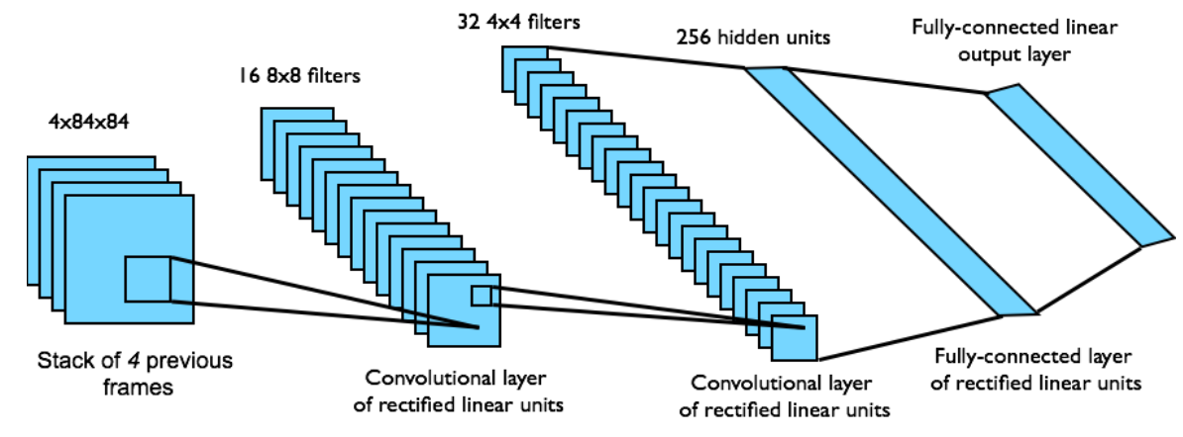

Deep Q learning in Atari
Input state $\vec{s}$ is stack of raw pixels from last 4 frames
Network architecture and hyperparameters fixed for all games
Mnih et al. Human-level control through deep reinforcement learning, Nature 2015

Slide 21
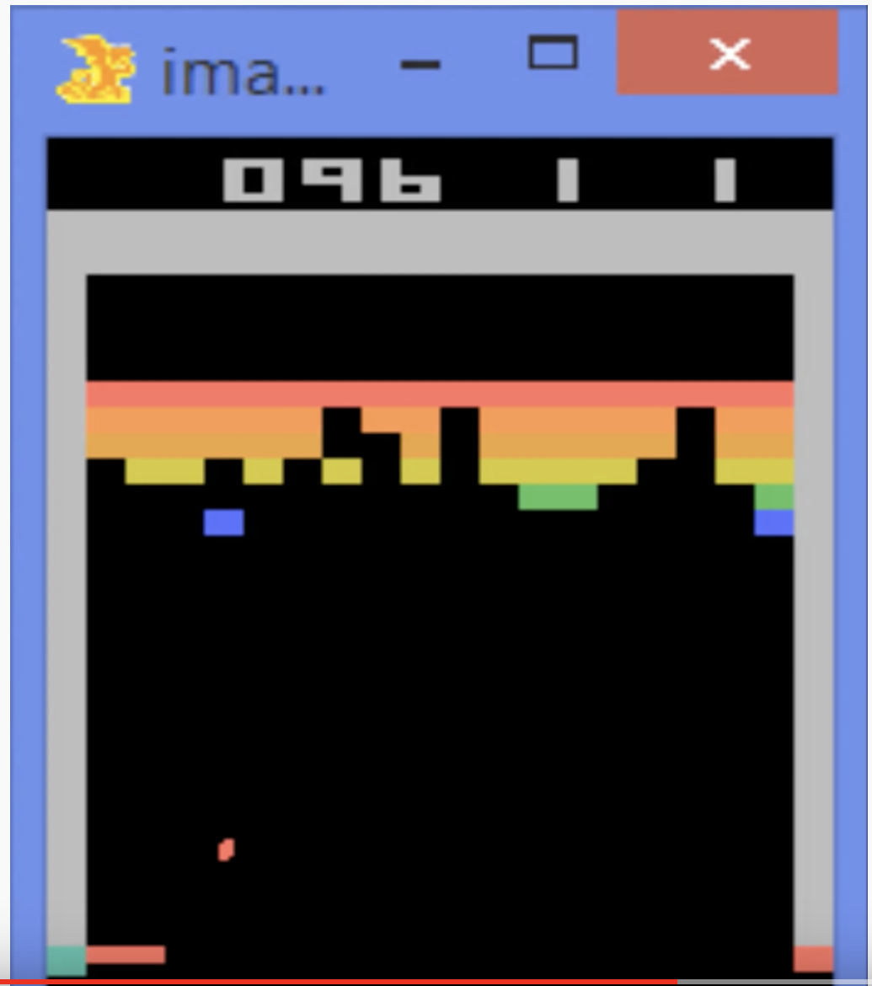
Deep Q learning in Atari
Deep Q-Learning Playing Atari Breakout

Slide 22
Outline
Review: MDP and Q-Learning
Deep Q-Learning
Imitation Learning
Actor-Critic Learning

Slide 23
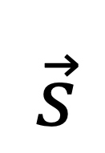
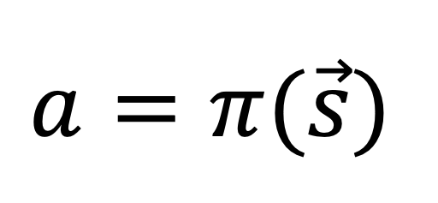
Policy Learning
Why can’t we just learn a model (neural net, or even a table lookup) that does this:
Model
$$\vec{s}$$
$$a=π(\vec{s})$$

Slide 24
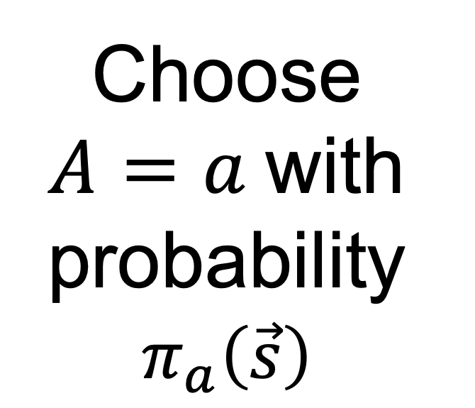
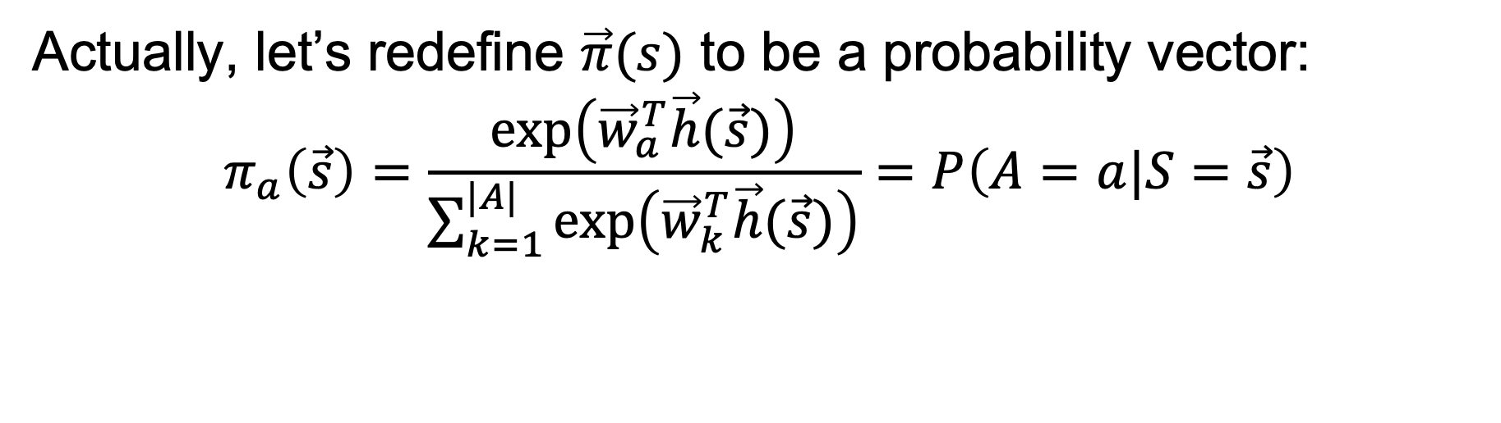
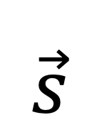
Policy Learning
Actually, let’s redefine $\vec{π}(s)$ to be a probability vector:
$$π_{a}\left(\vec{s}\right)=\frac{exp⁡\left({\vec{w}}_{a}^{T}\vec{h}(\vec{s})\right)}{\sum_{k=1}^{|A|}{exp⁡\left({\vec{w}}_{k}^{T}\vec{h}(\vec{s})\right)}}=P\left(A=a|S=\vec{s}\right)$$
Choose $A=a$ with probability
$$π_{a}\left(\vec{s}\right)$$
Model
$$\vec{s}$$

Slide 25
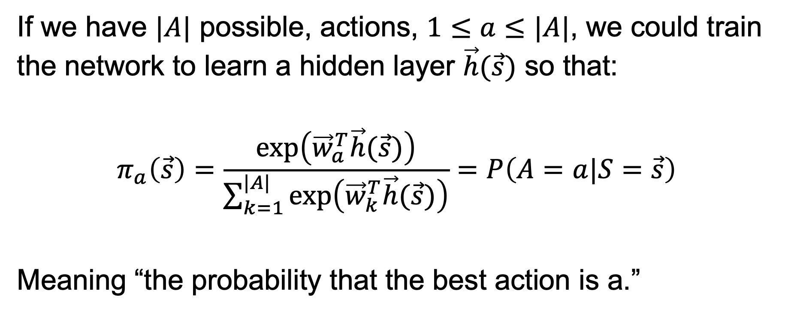
Probabilistic Policy
If we have $|A|$ possible, actions, $1≤a≤|A|$, we could train the network to learn a hidden layer $\vec{h}(\vec{s})$ so that:
$$π_{a}\left(\vec{s}\right)=\frac{exp⁡\left({\vec{w}}_{a}^{T}\vec{h}(\vec{s})\right)}{\sum_{k=1}^{|A|}{exp⁡\left({\vec{w}}_{k}^{T}\vec{h}(\vec{s})\right)}}=P\left(A=a|S=\vec{s}\right)$$
Meaning “the probability that the best action is a.”

Slide 26
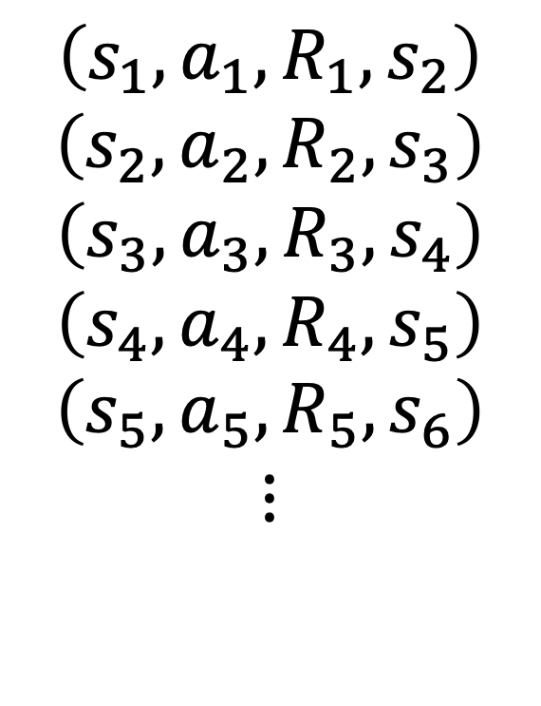
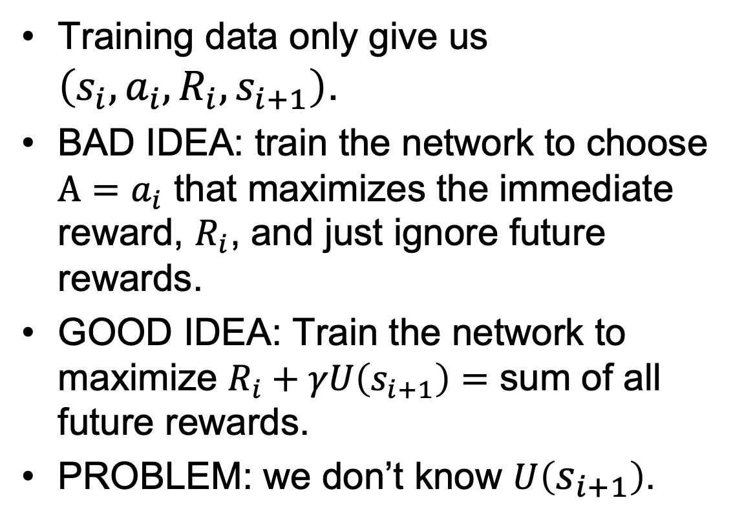
How do we train it?
Training data only give us $\left(s_{i},a_{i},R_{i},s_{i+1}\right)$.
BAD IDEA: train the network to choose $A=a_{i}$ that maximizes the immediate reward, $R_{i}$, and just ignore future rewards.
GOOD IDEA: Train the network to maximize $R_{i}+γU\left(s_{i+1}\right)=$ sum of all future rewards.
PROBLEM: we don’t know $U\left(s_{i+1}\right)$.
$$\left(s_{1},a_{1}, R_{1},s_{2}\right)$$
$$\left(s_{2},a_{2}, R_{2},s_{3}\right)$$
$$\left(s_{3},a_{3}, R_{3},s_{4}\right)$$
$$\left(s_{4},a_{4}, R_{4},s_{5}\right)$$
$$\left(s_{5},a_{5}, R_{5},s_{6}\right)$$
$$⋮$$

Slide 27
How to make Policy Learning trainable
Watch a human perform the task,
assume that each of the human’s actions is the best action that could possibly have been taken at that time,
train the neural net to imitate the human’s actions with high probability.
This is called “apprenticeship learning,” which is a type of “imitation learning.”

Slide 28


Imitation learning
In some applications, you cannot bootstrap yourself from random policies
High-dimensional state and action spaces where most random trajectories fail miserably
Expensive to evaluate policies in the physical world, especially in cases of failure
Solution: learn to imitate sample trajectories or demonstrations
This is also helpful when there is no natural reward formulation

Slide 29
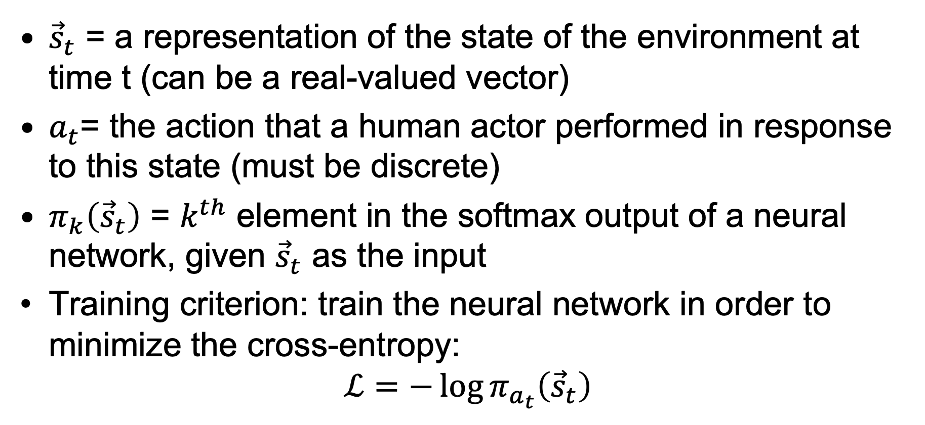
Imitation learning
${\vec{s}}_{t}$ = a representation of the state of the environment at time t (can be a real-valued vector)
$a_{t}$= the action that a human actor performed in response to this state (must be discrete)
$π_{k}\left({\vec{s}}_{t}\right)$ = $k^{th}$ element in the softmax output of a neural network, given ${\vec{s}}_{t}$ as the input
Training criterion: train the neural network in order to minimize the cross-entropy:
$$ℒ=−\log{π_{a_{t}}\left({\vec{s}}_{t}\right)}$$

Slide 30
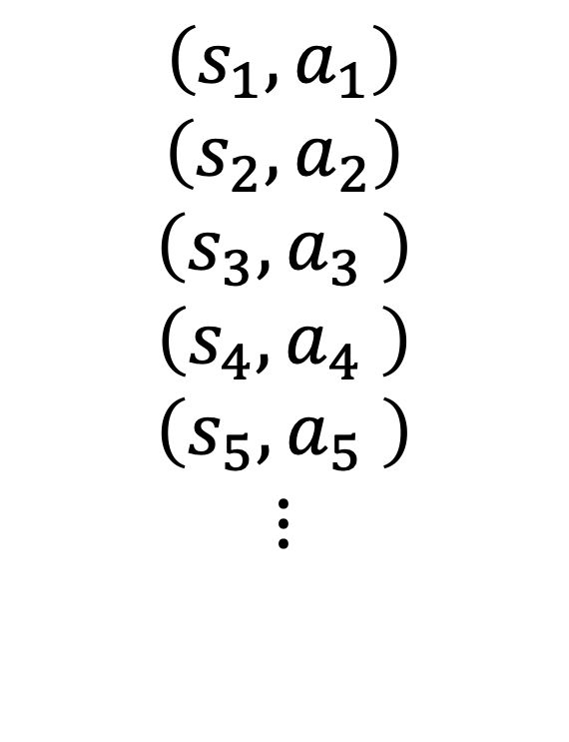

How do we train it?
Now our training data don’t even require $R_{i}$ or $s_{i+1}$!
All we need is a set of state vectors, $s_{i}$, and the action that the human performed in the same situation, $a_{i}$.
$$\left(s_{1},a_{1}\right)$$
$$\left(s_{2},a_{2}\right)$$
$$\left(s_{3},a_{3} \right)$$
$$\left(s_{4},a_{4} \right)$$
$$\left(s_{5},a_{5} \right)$$
$$⋮$$

Slide 31
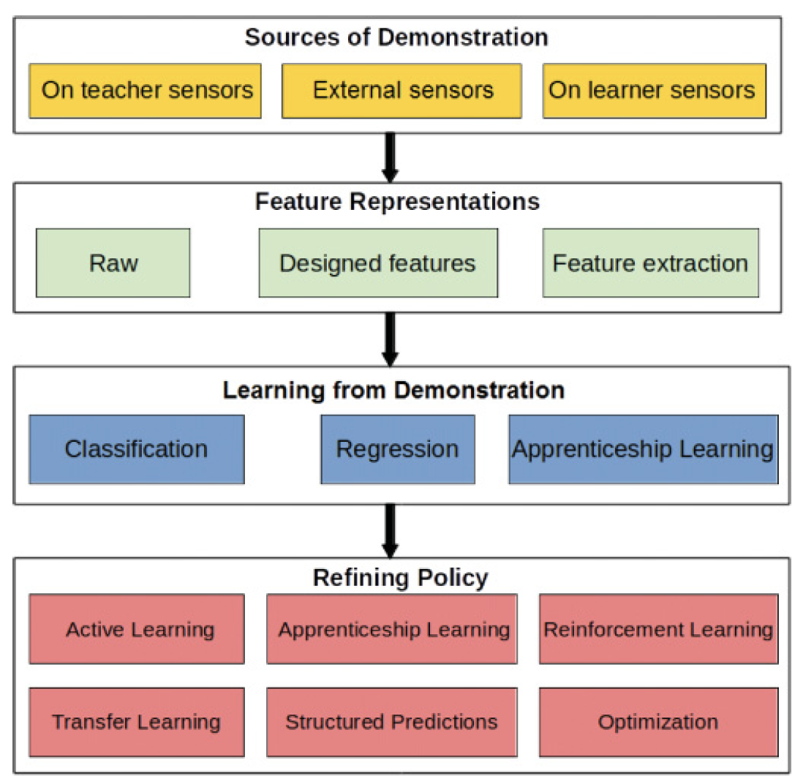
Overview of imitation learning methods
Apprenticeship learning (copy the human’s action) needs a lot of human supervision. Sometimes we can benefit by combining apprenticeship learning with other methods (active learning, transfer learning, structured prediction, reinforcement learning, optimization).
Hussein et al. Imitation Learning: A Survey of Learning Methods, 2018.

Slide 32
Overview of imitation learning methods
Other ways to make imitation learning efficient:
Use many sensors
Use designed features, or features extracted w/a pre-trained neural net
Balance between classification (discrete actions) vs regression (continuous actions)
Hussein et al. Imitation Learning: A Survey of Learning Methods, 2018.

Slide 33
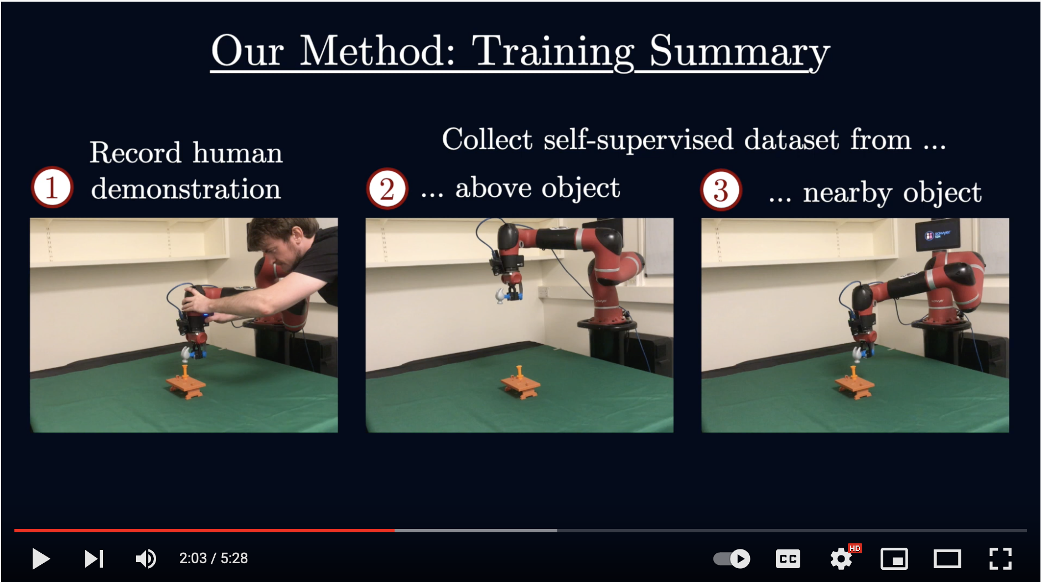
Example: Coarse-to-Fine Imitation Learning
Edward Johns, Coarse-to-Fine Imitation Learning: Robot Manipulation from a Single Demonstration, 2021.

Slide 34
Outline
Review: MDP and Q-Learning
Deep Q-Learning
Imitation Learning
Actor-Critic Learning

Slide 35
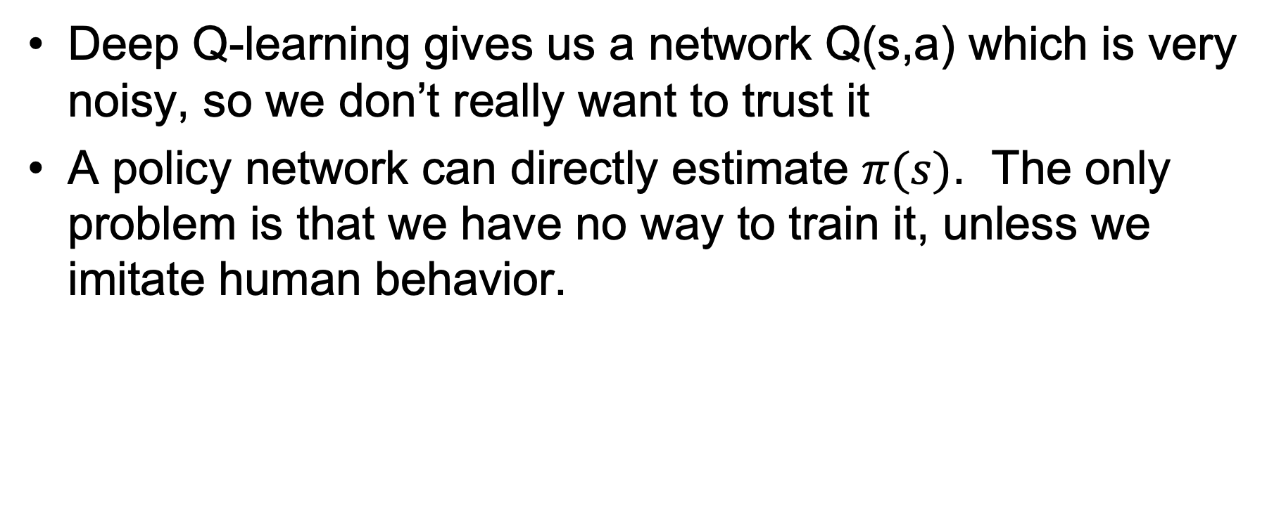
The Deep RL Methods We’ve Learned So Far
Deep Q-learning gives us a network Q(s,a) which is very noisy, so we don’t really want to trust it
A policy network can directly estimate $π(s)$. The only problem is that we have no way to train it, unless we imitate human behavior.

Slide 36
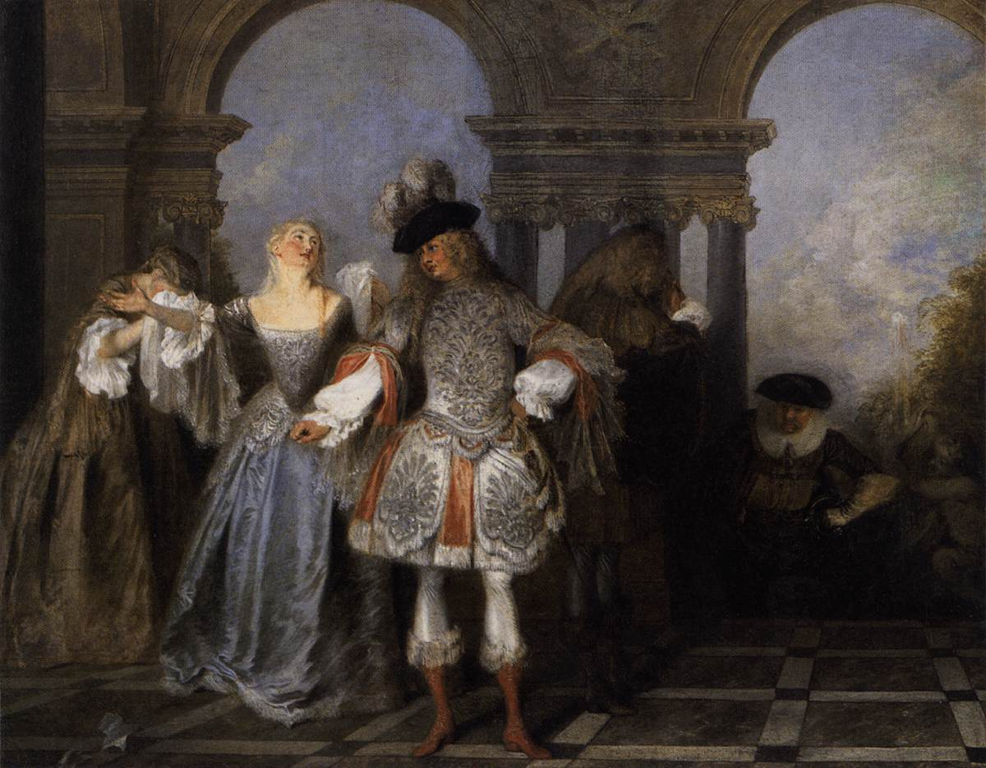
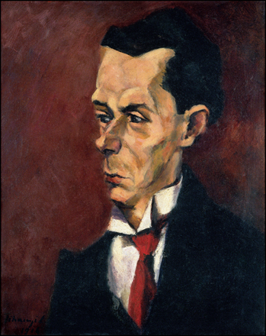
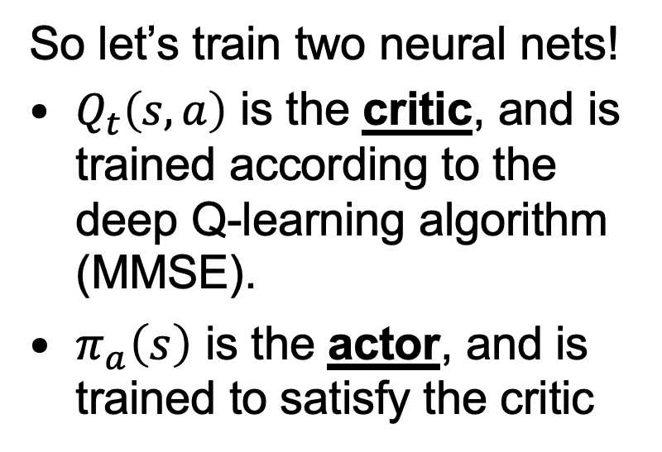
Actor-critic algorithm
So let’s train two neural nets!
$Q_{t}\left(s,a\right)$ is the critic, and is trained according to the deep Q-learning algorithm (MMSE).
$π_{a}\left(s\right)$ is the actor, and is trained to satisfy the critic
Actors from the Comédie Française, by Antoine Watteau, 1720. Public Domain, https://commons.wikimedia.org/w/index.php?curid=15418670
The Critic, by Lajos Tihanyi. Oil on canvas, 1916.
Public Domain, https://commons.wikimedia.org/w/index.php?curid=17837438

Slide 37
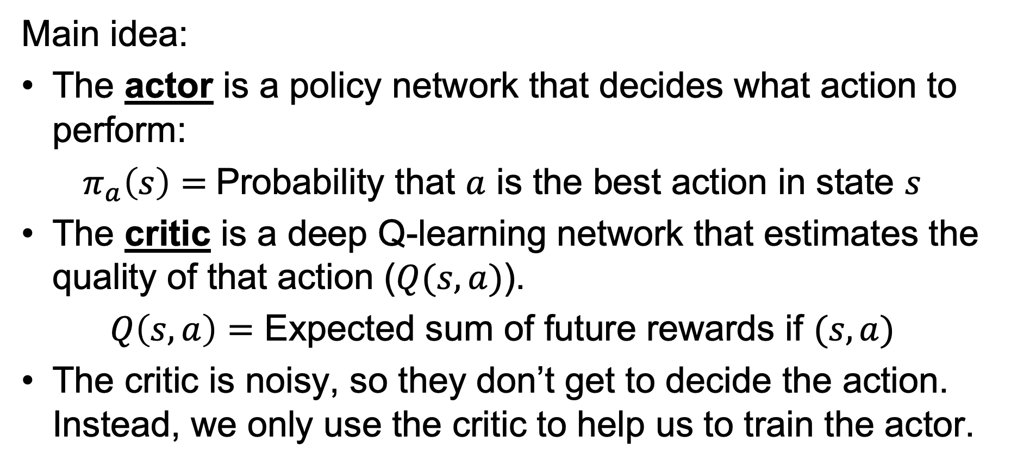
The Actor-Critic Algorithm
Main idea:
The actor is a policy network that decides what action to perform:
$π_{a}\left(s\right)=$Probability that $a$ is the best action in state $s$
The critic is a deep Q-learning network that estimates the quality of that action ($Q(s,a)$).
$Q\left(s,a\right)=$ Expected sum of future rewards if $(s,a)$
The critic is noisy, so they don’t get to decide the action. Instead, we only use the critic to help us to train the actor.

Slide 38
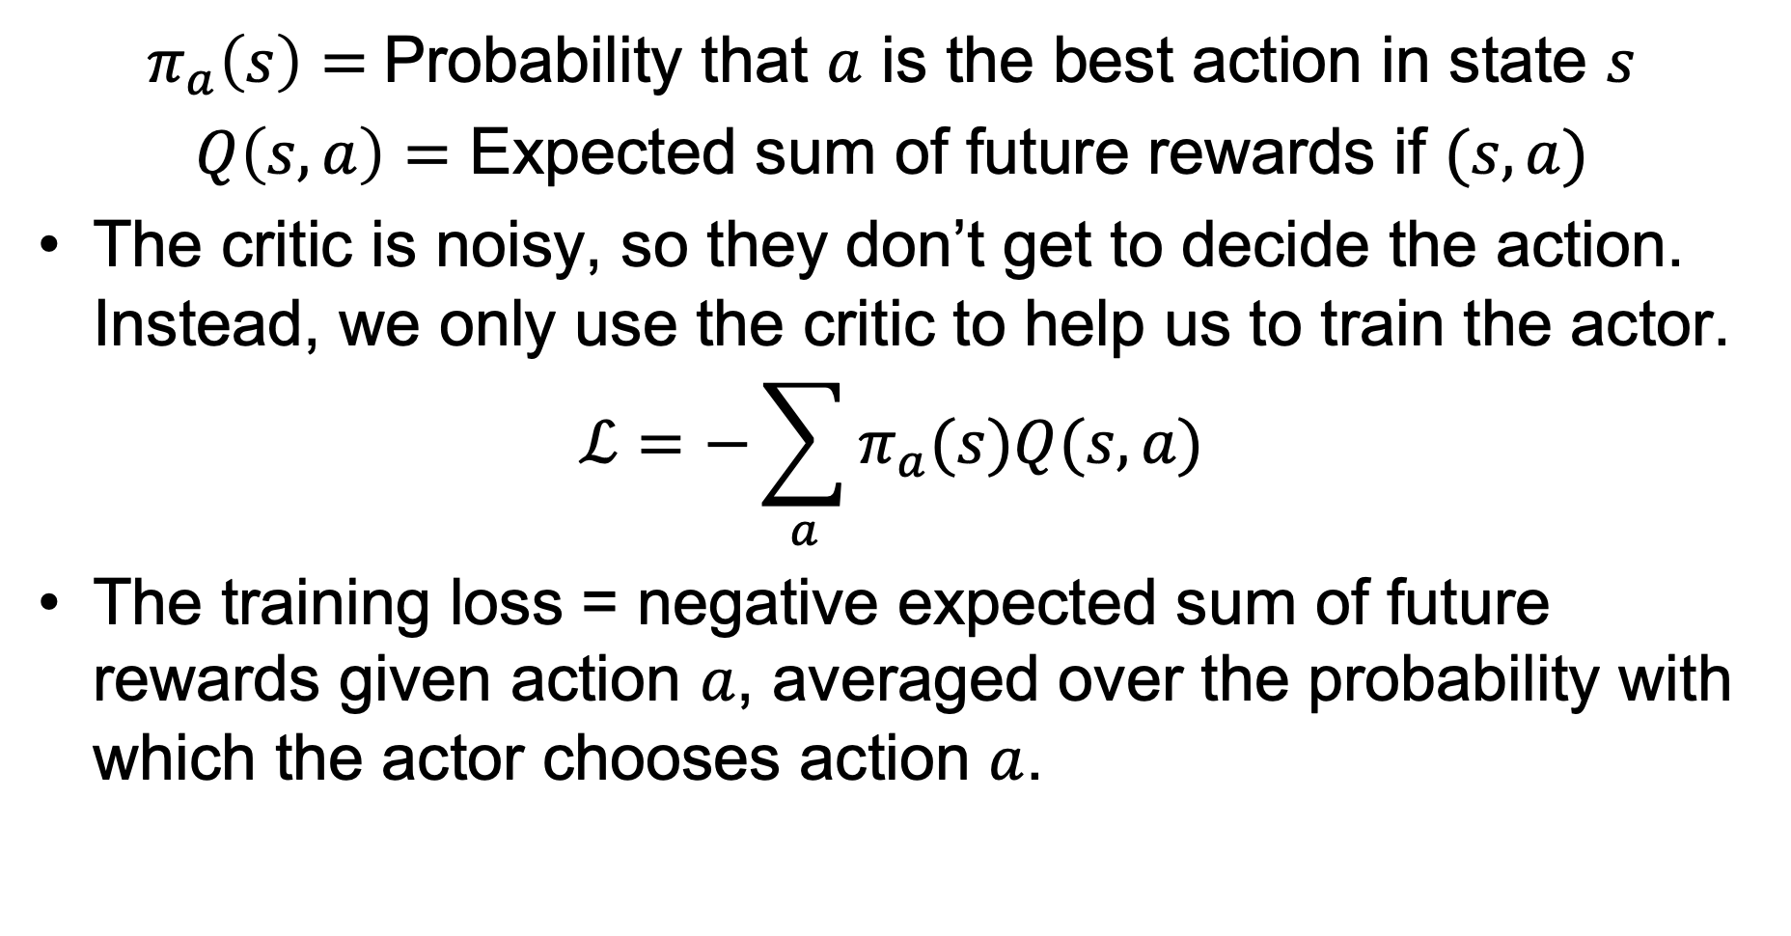
The Actor-Critic Algorithm
$π_{a}\left(s\right)=$Probability that $a$ is the best action in state $s$
$Q\left(s,a\right)=$ Expected sum of future rewards if $(s,a)$
The critic is noisy, so they don’t get to decide the action. Instead, we only use the critic to help us to train the actor.
$$ℒ=−\sum_{a}{π_{a}(s)Q(s,a)}$$
The training loss = negative expected sum of future rewards given action $a$, averaged over the probability with which the actor chooses action $a$.

Slide 39
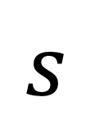



The Actor-Critic Algorithm: Forward-Prop
Actor
$$s$$
$$π_{a}\left(s\right)=P(a|s)$$
Critic
$$Q_{t}(s,a)$$
$$s$$

Slide 40




The Actor-Critic Algorithm: Back-Prop
Actor
$$s$$
$$π_{a}\left(s\right)$$
$$ℒ_{actor}=−\sum_{a}{π_{a}(s)Q_{t}(s,a)}$$
Critic
$$Q_{t}(s,a)$$
$$s$$
$$ℒ_{critic}=\frac{1}{2}{\left(Q_{t}\left(\vec{s},\vec{a}\right)−Q_{local} (\vec{s},\vec{a}) \right)}^{2}$$

Slide 41

Asynchronous advantage actor-critic (A3C)
TORCS car racing simulation video
Mnih et al. Asynchronous Methods for Deep Reinforcement Learning. ICML 2016

Slide 42

Summary: Deep Reinforcement Learning
Deep Q-learning:
$$ℒ=\frac{1}{2}E\left[{\left(Q_{t}\left({\vec{s}}_{t},{\vec{a}}_{t}\right)−Q_{local}({\vec{s}}_{t},{\vec{a}}_{t}) \right)}^{2}\right]$$
Imitation Learning:
$$ℒ=−\log{π_{a_{t}}\left({\vec{s}}_{t}\right)}$$
Actor-Critic:
$$ℒ_{actor}=−\sum_{a}{π_{a}(s)Q_{t}(s,a)}$$

