Slide 1

CS440/ECE 448 Lecture 1:
Introduction to AI
Mark Hasegawa-Johnson, 1/2022

Slide 2
Outline
Syllabus: CoViD, Text, Grades, Quizzes, MPs, Exams, and Project
A brief history of Artificial Intelligence
Artificially Intelligent Agents
  Words to know: Performance, Environment, Actions, Sensors (PEAS)
  Words to know: Rational, Human-like, Autonomous
Environments in which an AI can operate
  Words to know: Observable, Deterministic vs. Stochastic, Episodic vs. Sequential, Static vs. Dynamic, Discrete vs. Continuous, Single-Agent vs. Multi-Agent, Known vs. Unknown
Outline of the rest of this course

Slide 3
Course Intro: Syllabus
Web page: https://courses.engr.illinois.edu/ece448/sp2022/
CampusWire
CoViD policy
Textbook
Grading
Quizzes, MPs, and Exams
Graduate Section: Project

Slide 4
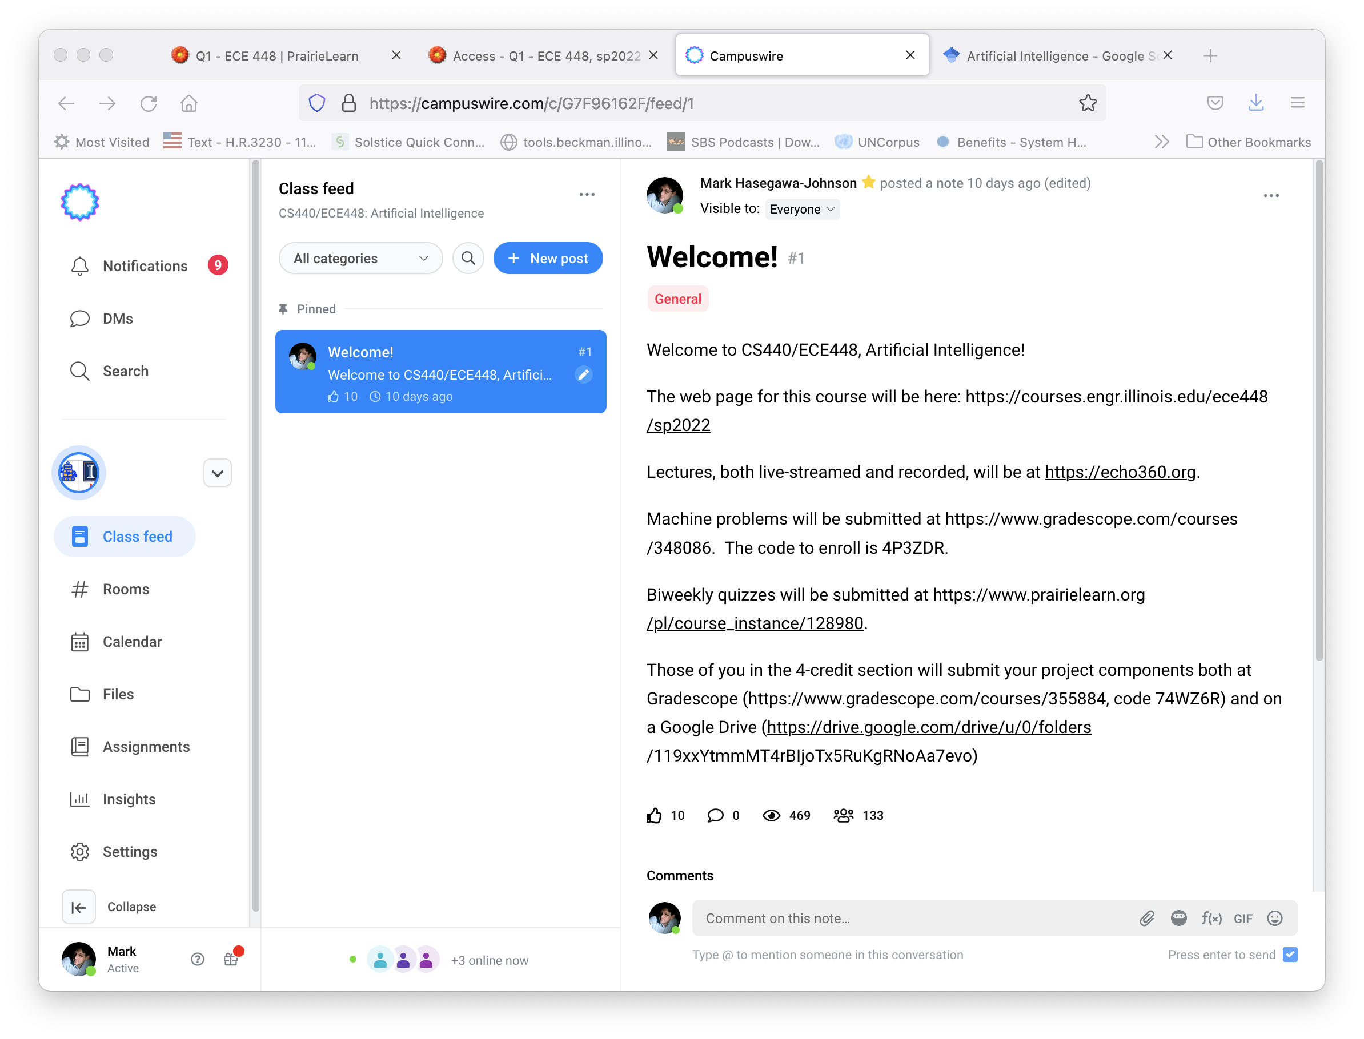
CampusWire
Add yourself to CampusWire if you’re not already added: https://campuswire.com/p/G7F96162F,
Code 9270.

Slide 5
CoViD Policy
You can watch lectures in any of these three ways, any time:
  In person, beginning 1/31
  In real-time, streaming live at echo360.org, beginning 1/31
  In recordings, available on echo360.org within a few hours after class
CoViD is NOT usually a valid reason for a quiz or MP deadline extension. All assignments are available for you a week early. If you miss the deadline, our standard late penalty is extremely lenient (5% per day).
CoViD IS a valid reason for an exam or project extension. If you can take it on the regular exam day (by zoom), please do; if not, we’ll arrange a make-up.

Slide 6
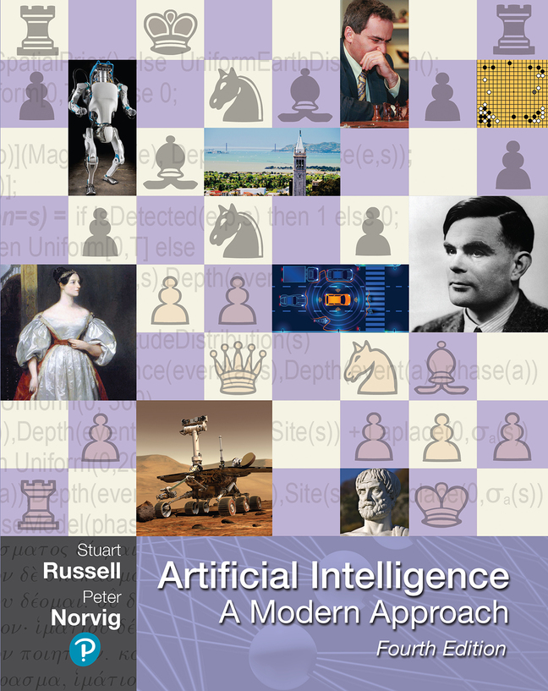
Textbook
Artificial Intelligence, A Modern Approach: Fourth Edition by Russell & Norvig
Readings will be specified for each lecture.
Material will only show up on exams if it has first appeared in the lecture slides, and usually, on a quiz or MP. Textbook is a backup, if you want deeper understanding.

Slide 7
Grading: 3-credit
Grading: 4-credit
Exams: 40%
Machine Problems (MPs): 45%
Quizzes: 15%
Exams: 30%
MPs: 33%
Quizzes: 12%
Project: 25%

Slide 8
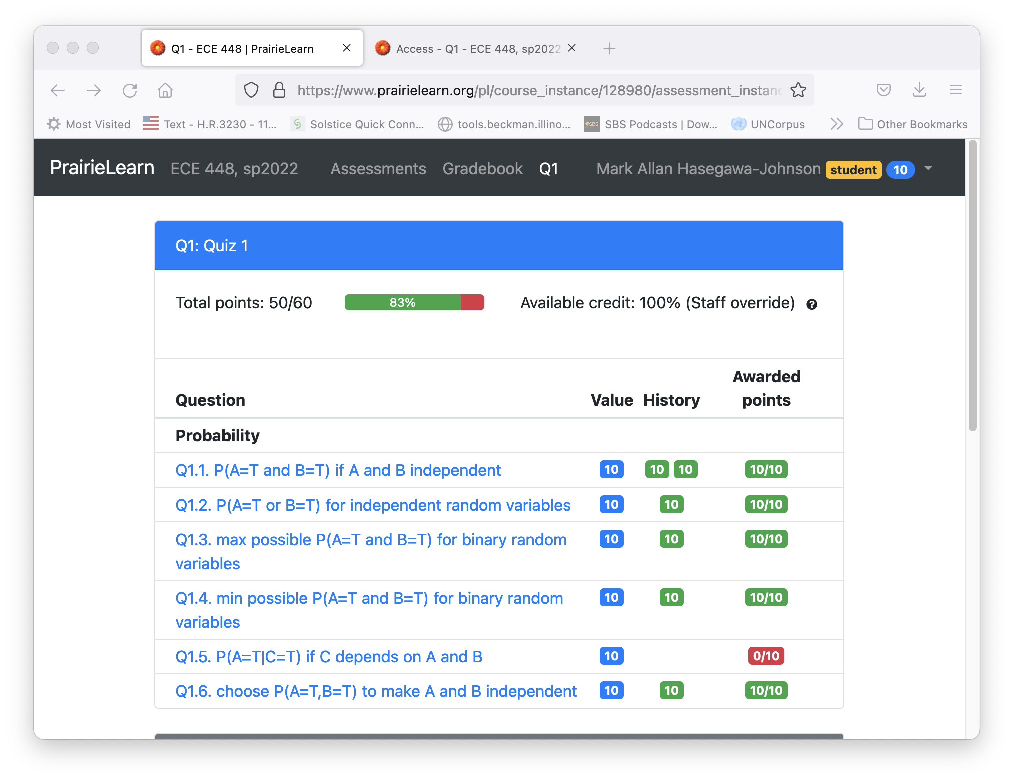
Quizzes
Released ten days before due.
Try each problem as often as you like (“Try a New Variant” button).
Late penalty 5% per day.
You may submit any time during the semester for 50% credit.
Late penalty is not waived for travel, trauma, interviews, religious holidays, or for any illness or injury that leaves you with the use of your hands.

Slide 9

Machine Problems (MPs)
Released ten days before due.
Submit results to Gradescope, as often as you like.
Late penalty up to 5% per day.
You may submit any time during the semester for 50% credit.
Late penalty is not waived for travel, trauma, interviews, religious holidays, or for any illness or injury that leaves you with the use of your hands.

Slide 10
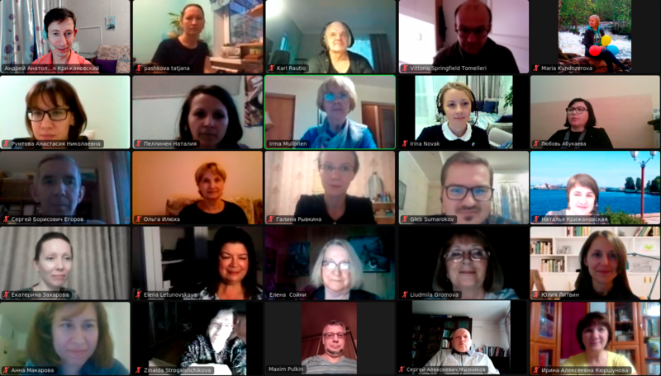
Exams
Exams will be conducted synchronously, in person and via zoom.
If you’re in the in-person section and want to take the exam on zoom, tell us in advance.
Those on zoom will need to turn your webcams on.
Zoom participants of the conference "Bubrikh readings: a documented vernacular", 2020.
Public domain image, AKA MBG, 2020.

Slide 11
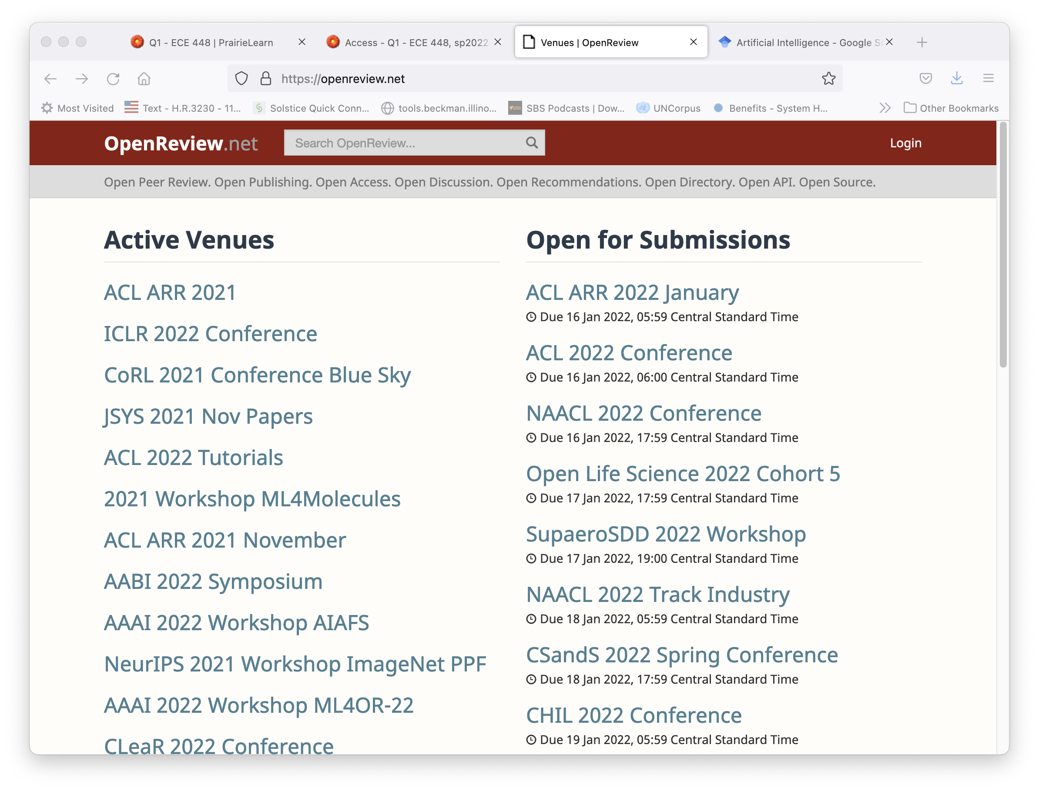
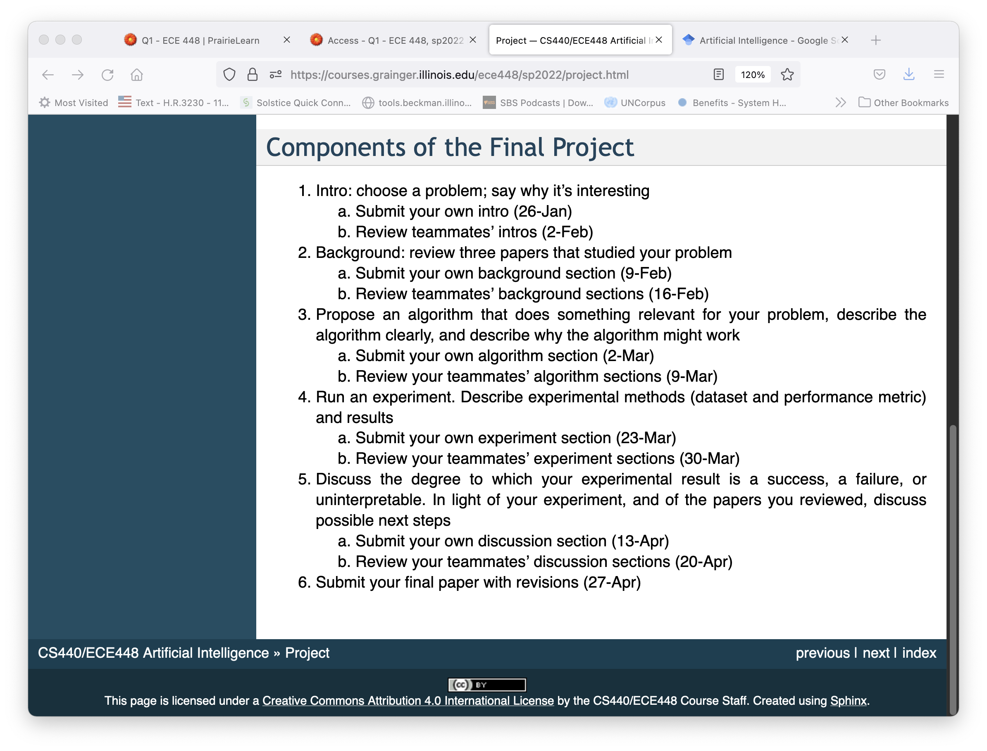
Project
4-credit students do a final project.
There are six stages in the final project.
Each stage is graded (by me) and peer-reviewed (which does not affect the reviewee’s grade).

Slide 12
Outline
Syllabus: CoViD, Text, Grades, Quizzes, MPs, Exams, and Project
A brief history of Artificial Intelligence
Artificially Intelligent Agents
  Words to know: Performance, Environment, Actions, Sensors (PEAS)
  Words to know: Rational, Human-like, Autonomous
Environments in which an AI can operate
  Words to know: Observable, Deterministic vs. Stochastic, Episodic vs. Sequential, Static vs. Dynamic, Discrete vs. Continuous, Single-Agent vs. Multi-Agent, Known vs. Unknown
Outline of the rest of this course

Slide 13

A brief history of Artificial Intelligence
1954-1981: Symbolic reasoning
  ”Artificial Intelligence” coined by John McCarthy in 1954
1982-2011: Probabilistic reasoning
  Louis Liporace published continuous-observation hidden Markov models in 1982
2012-present: Deep learning
  AlexNet won ImageNet in 2012
John McCarthy at a conference in 2006. CC-BY-SA 2.0, Author: null0

Slide 14
Outline
Syllabus: CoViD, Text, Grades, Quizzes, MPs, Exams, and Project
A brief history of Artificial Intelligence
Artificially Intelligent Agents
  Words to know: Performance, Environment, Actions, Sensors (PEAS)
  Words to know: Rational, Human-like, Autonomous
Environments in which an AI can operate
  Words to know: Observable, Deterministic vs. Stochastic, Episodic vs. Sequential, Static vs. Dynamic, Discrete vs. Continuous, Single-Agent vs. Multi-Agent, Known vs. Unknown
Outline of the rest of this course

Slide 15
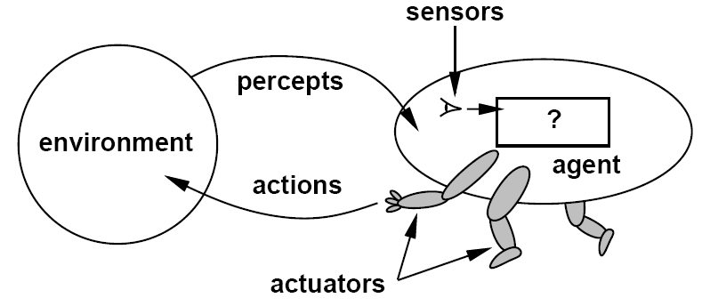
Artificially Intelligent Agents
An agent is anything that can be viewed as perceiving its environment through sensors and acting upon that environment through actuators
sensations

Slide 16
PEAS
Performance measure: Determined by the system designer, attempts to measure some intuitive description of behavior goodness.
Environment: Where will the agent operate?
Actions: Determined by the system designer, usually trades off cost versus utility
Sensors: Determined by the system designer, usually trades off cost versus utility

Slide 17
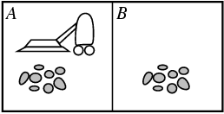
Example: Vacuum Cleaner Agent
Performance Measure:
  Does it get the rooms clean?
  How quickly?
  Using how much electricity?
Environment:
  A two-room apartment
Actions:
  Suck; Move; DoNothing
Sensors:
  Is this room dirty or not?
  (Maybe): which room am I in?

Slide 18
Criteria for judging an agent
Intelligent: Is it intelligent?
Rational: Does it always act in a manner that maximizes its expected performance metric?
Human-like: Is it able to communicate with human beings, and explain or demonstrate its reasoning to them?
Autonomous: Is it capable of revising its sensor→action mapping in response to changes in the environment?

Slide 19
What is Intelligence?
The word “intelligence” is surprisingly recent. Ancients used it to mean “the universal mind.” Early moderns (e.g., Bacon, Hobbes; 1500s) ridiculed it, and stopped using it.

Slide 20
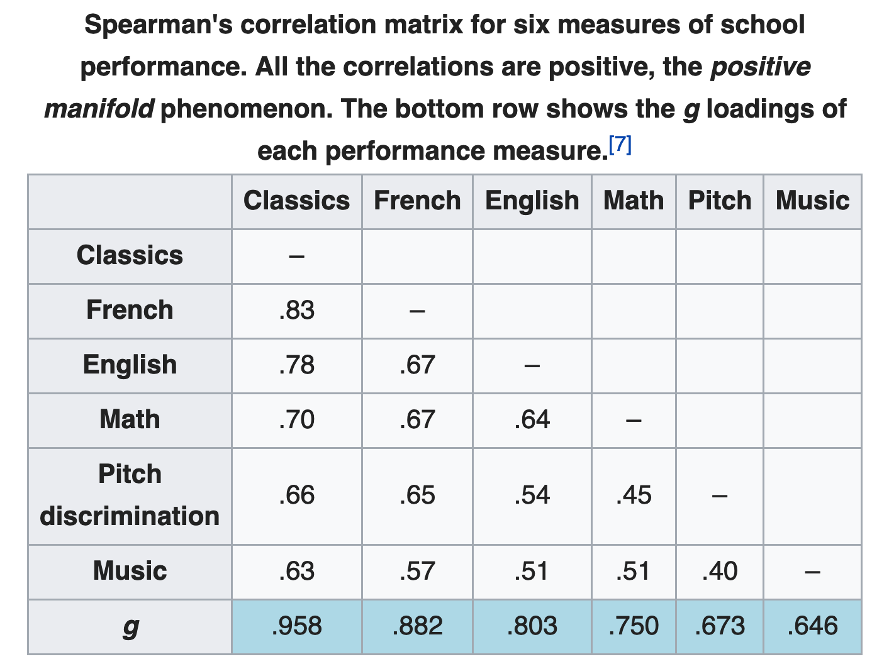
What is Intelligence?
Charles Spearman popularized the modern definition in his paper “General intelligence objectively determined and measured,” American Journal of Psychology 15(2):201-292.
He showed that test scores are correlated across many subjects and proposed “general intelligence” as the faculty that unifies them.
https://en.wikipedia.org/wiki/G_factor_(psychometrics)

Slide 21
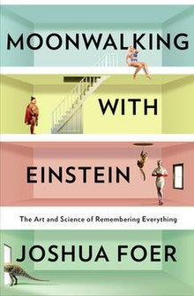
Intelligence can be learned
It is possible to learn new strategies for learning.
By doing so, it is possible to increase your score on tests of general intelligence.

Slide 22
What is “Artificial Intelligence”
We usually mean more than just the ability to learn (ability to learn is covered in “Machine Learning”). We usually mean:
Ability to learn (a.k.a. intelligence)
Ability to choose a plan that optimizes my rewards (a.k.a. rationality)
Ability to communicate my plan to human beings, and behave in a human-like manner around human beings (a.k.a. human-like)
Ability to modify my own behavior based on things I have learned (a.k.a. autonomous)
Ability to appropriately trade off my own performance measures against the goals of other agents (a.k.a. morality)

Slide 23
Rationality
Performance Measure:
  Does it get the rooms clean?
  How quickly?
  Using how much electricity?
Then here is a rational agent program:
  If the current room is dirty, then Suck.
  If I have not been to the other room, Move then Suck.
  DoNothing.

Slide 24
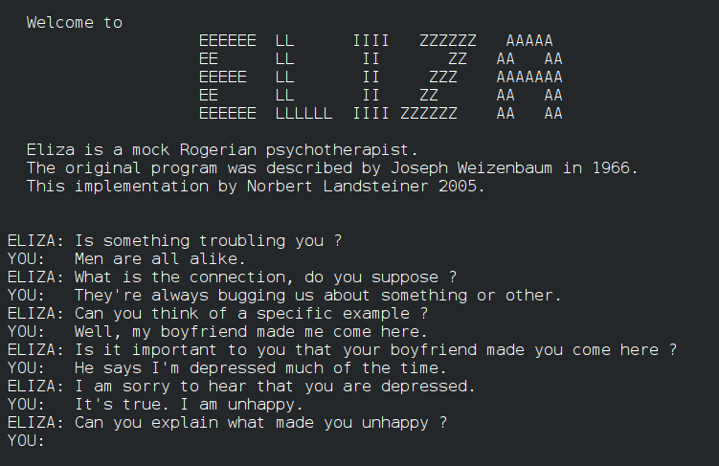
Human-likeness
The Turing test proposes that an AI is intelligent if a human interviewer can’t tell whether or not it is human.
…but…
Chatbots have been fooling human interviewers since 1966.
The chatbot Eugene Goostman fooled 30% of judges in 2014, by pretending to be a 13-year-old Ukrainian boy.

Slide 25
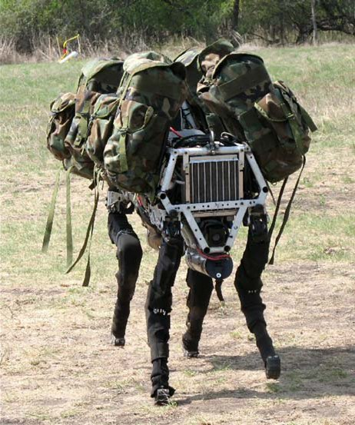
Autonomy
An agent is “autonomous” if it is capable of revising its own behavior in response to changes in the environment.
The quadrupedal military robot Cheetah, an evolution of BigDog (pictured), was clocked as the world's fastest legged robot in 2012. Open-source image, DARPA strategic plan 2007.

Slide 26

Morality
Many recent authors have argued that an intelligent, rational, human-like, autonomous agent is undesirable if it cannot appropriately weight the needs & goals of other agents, including human beings.
Ethics & morality of AI will be interspersed throughout this course, to give you some idea of current thinking.
Reproduction of the Prague Golem. Public domain image, Thander, 2007

Slide 27
Outline
Syllabus: CoViD, Text, Grades, Quizzes, MPs, Exams, and Project
A brief history of Artificial Intelligence
Artificially Intelligent Agents
  Words to know: Rational, Human-like, Autonomous
Environments in which an AI can operate
  Words to know: Observable, Deterministic vs. Stochastic, Episodic vs. Sequential, Static vs. Dynamic, Discrete vs. Continuous, Single-Agent vs. Multi-Agent, Known vs. Unknown
Outline of the rest of this course

Slide 28
Properties of Environments
Fully observable vs. partially observable
Deterministic vs. stochastic
Episodic vs. sequential
Static vs. dynamic
Discrete vs. continuous
Single agent vs. multi-agent
Known vs. unknown

Slide 29
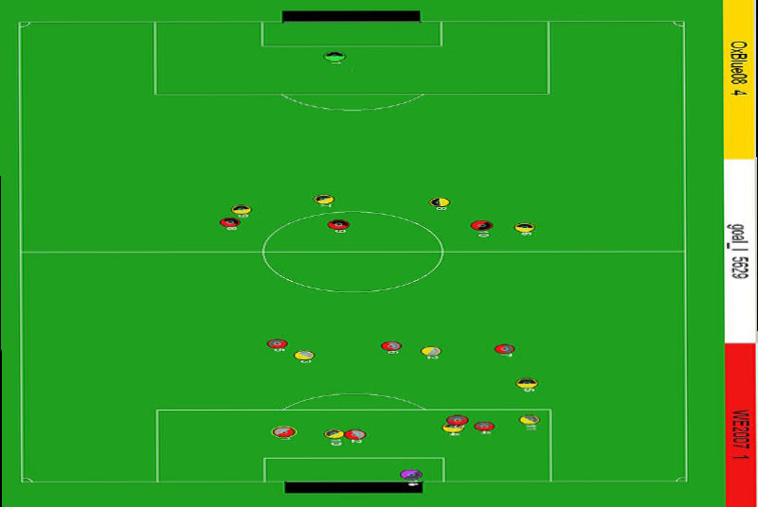
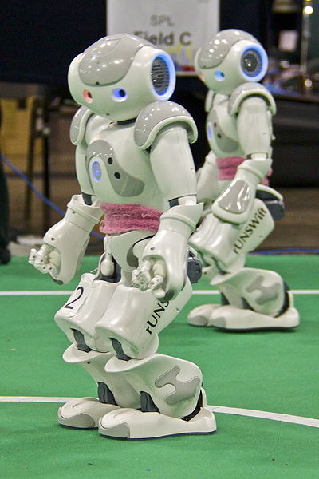
Fully observable vs. partially observable
Do the agent's sensors give it access to the complete state of the environment?
  For any given world state, are the values of all the variables known to the agent?
vs.
Source: L. Zettlemoyer

Slide 30

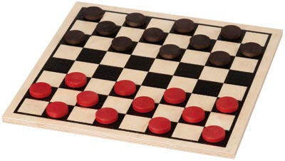
Deterministic vs. stochastic
Is the next state of the environment completely determined by the current state and the agent’s action?
  Is the transition model deterministic (unique successor state given current state and action) or stochastic (distribution over successor states given current state and action)?
  strategic: the environment is deterministic except for the actions of other agents
vs.

Slide 31
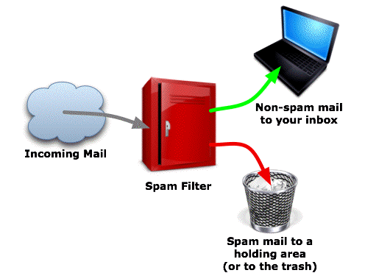
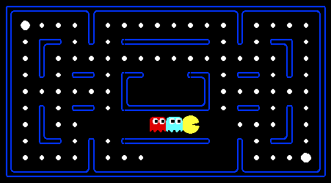
Episodic vs. sequential
Is the agent’s experience divided into unconnected episodes, or is it a coherent sequence of observations and actions?
  Does each problem instance involve just one action or a series of actions that change the world state according to the transition model?
vs.
Notes:
Episodic: The agent's experience is divided into atomic “episodes,” and the choice of action in each episode depends only on the episode itself

Slide 32


Static vs. dynamic
Is the world changing while the agent is thinking?
vs.

Slide 33
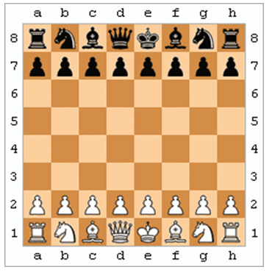
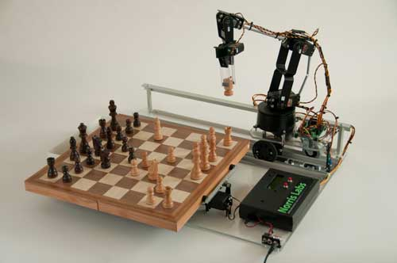
Discrete vs. continuous
Does the environment provide a countable (discrete) or uncountably infinite (continuous) number of distinct percepts, actions, and environment states?
  Are the values of the state variables discrete or continuous?
  Time can also evolve in a discrete or continuous fashion
  “Distinct” = different values of utility
vs.

Slide 34
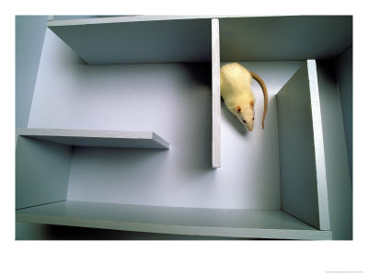
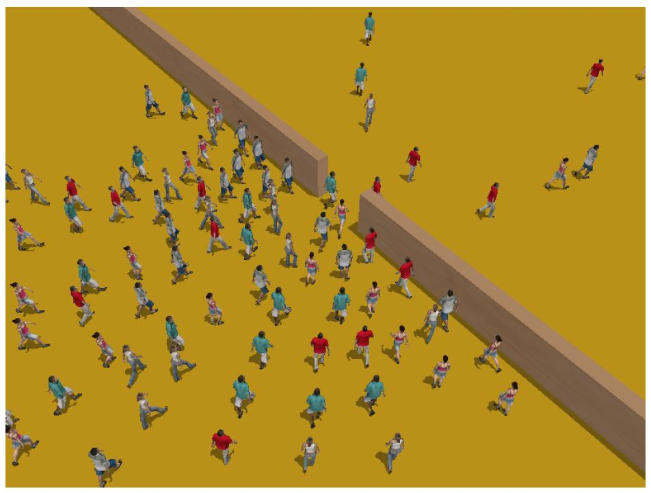
Single-agent vs. multiagent
Is an agent operating by itself in the environment?
vs.

Slide 35
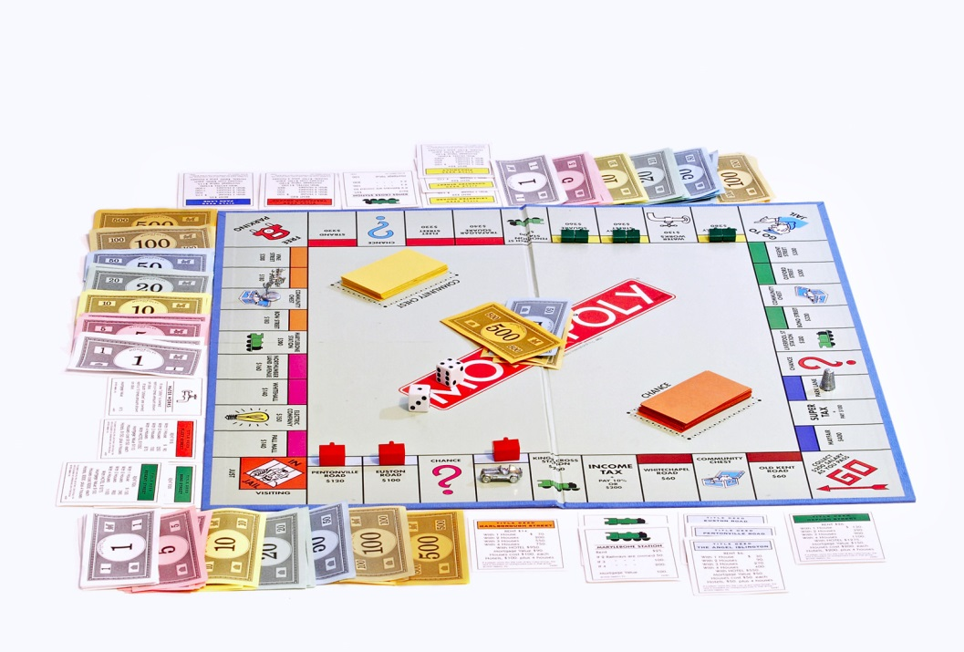

Known vs. unknown
Are the rules of the environment (transition model and rewards associated with states) known to the agent?
  Strictly speaking, not a property of the environment, but of the agent’s state of knowledge
vs.

Slide 36
Outline
Syllabus: CoViD, Text, Grades, Quizzes, MPs, Exams, and Project
A brief history of Artificial Intelligence
Artificially Intelligent Agents
  Words to know: Rational, Human-like, Autonomous
Environments in which an AI can operate
  Words to know: Observable, Deterministic vs. Stochastic, Episodic vs. Sequential, Static vs. Dynamic, Discrete vs. Continuous, Single-Agent vs. Multi-Agent, Known vs. Unknown
Outline of the rest of this course

Slide 37
Outline of the Course
Episodic environments: Deterministic vs. Stochastic
  MP1: Naïve Bayes spam filter
Episodic environments: Discrete vs. Continuous
  MP2: Neural Network image classifier
Sequential environments
  MP3: A*-Search maze solver
Sequential environments: Fully vs. Partially Observable
  MP4: Hidden Markov Model text parser
Sequential environments: Single-agent vs. Multi-agent
  MP5: Alpha-beta chess player
Sequential environments: Known vs. Unknown
  MP6: Reinforcement learning video game player

