Slide 1
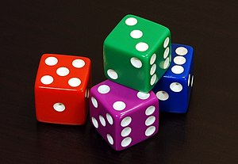
CS 440/ECE 448 Lecture 2:
Probability
Mark Hasegawa-Johnson, 1/2022
All content CC-BY-4.0 unless otherwise noted
CC-BY-3.0 Image by Diacritica, 2010
https://commons.wikimedia.org/wiki/File:6sided_dice.jpg

Slide 2
Outline
Motivation: Why use probability?
Random variables
The axioms of probability
Conditional probability
Mutually exclusive vs. Independent vs. Conditionally Independent

Slide 3
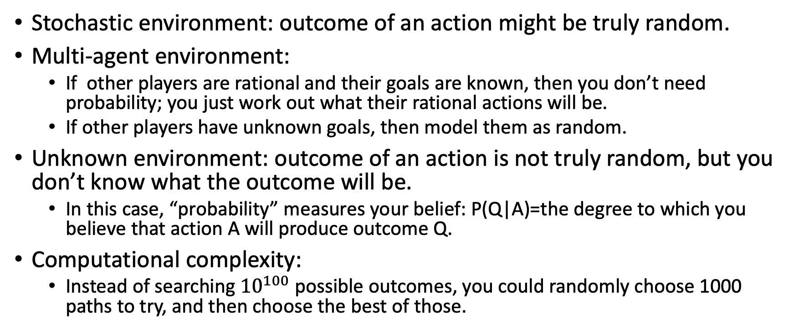
Why use probability?
Stochastic environment: outcome of an action might be truly random.
Multi-agent environment:
  If other players are rational and their goals are known, then you don’t need probability; you just work out what their rational actions will be.
  If other players have unknown goals, then model them as random.
Unknown environment: outcome of an action is not truly random, but you don’t know what the outcome will be.
  In this case, “probability” measures your belief: P(Q|A)=the degree to which you believe that action A will produce outcome Q.
Computational complexity:
  Instead of searching ${10}^{100}$ possible outcomes, you could randomly choose 1000 paths to try, and then choose the best of those.

Slide 4
Why NOT use probability?
Multi-agent environment:
  Maybe it’s better to find out what the other players really want?
Unknown environment:
  Maybe it’s better to learn the rules of the game?
Computational complexity:
  Maybe it’s better to do a complete search, instead of just a partial search?
Notice: these are quantitative questions. “Better” requires some metric: how much better, and with what probability?

Slide 5
What is probability?
Latin probabilis = probable, commendable, believable, from probare = to test something
If tested, it will (probably) turn out to be true

Slide 6
Outline
Motivation: Why use probability?
Random variables
The axioms of probability
Conditional probability
Mutually exclusive vs. Independent vs. Conditionally Independent

Slide 7
Random variables
A random variable is a function that maps from the outcomes of an experiment to a set of values
Example: throw four dice, all different colors. X = number of pips showing on the green die.
Then run the experiment…
In this particular outcome, X=3.
In some other outcome, X would have taken a different value.
We totally ignore aspects of the outcome that are irrelevant to X, e.g., the pips on the red, purple, and blue dice.

Slide 8
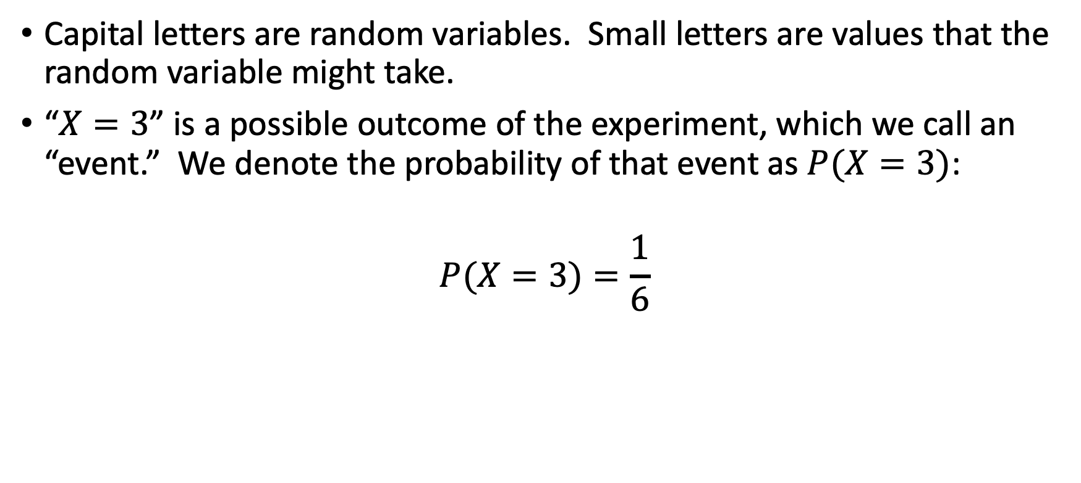

Notation: $P(X=x)$ is a number
Capital letters are random variables. Small letters are values that the random variable might take.
“$X=3$” is a possible outcome of the experiment, which we call an “event.” We denote the probability of that event as $P(X=3)$:
$$P(X=3)=\frac{1}{6}$$

Slide 9
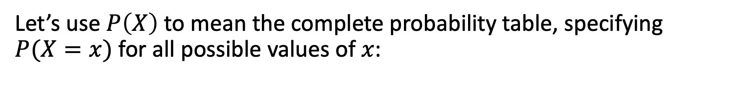



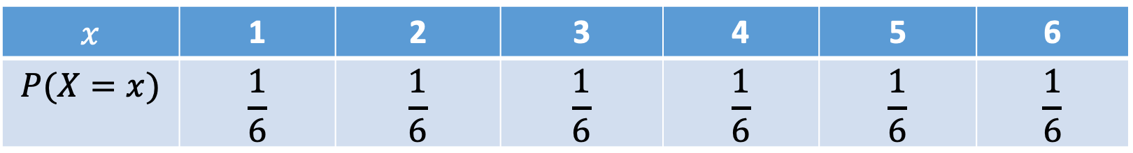
Notation: $P\left(X\right)$ is a table
Let’s use $P\left(X\right)$ to mean the complete probability table, specifying $P(X=x)$ for all possible values of $x$:
$$x$$ | 1 | 2 | 3 | 4 | 5 | 6
$$P(X=x)$$ | $$\frac{1}{6}$$ | $$\frac{1}{6}$$ | $$\frac{1}{6}$$ | $$\frac{1}{6}$$ | $$\frac{1}{6}$$ | $$\frac{1}{6}$$
$$P\left(X\right)=$$
We call this table of numbers, $P\left(X\right)$, a probability distribution.

Slide 10
Outline
Motivation: Why use probability?
Random variables
The axioms of probability
Conditional probability
Mutually exclusive vs. Independent vs. Conditionally Independent

Slide 11
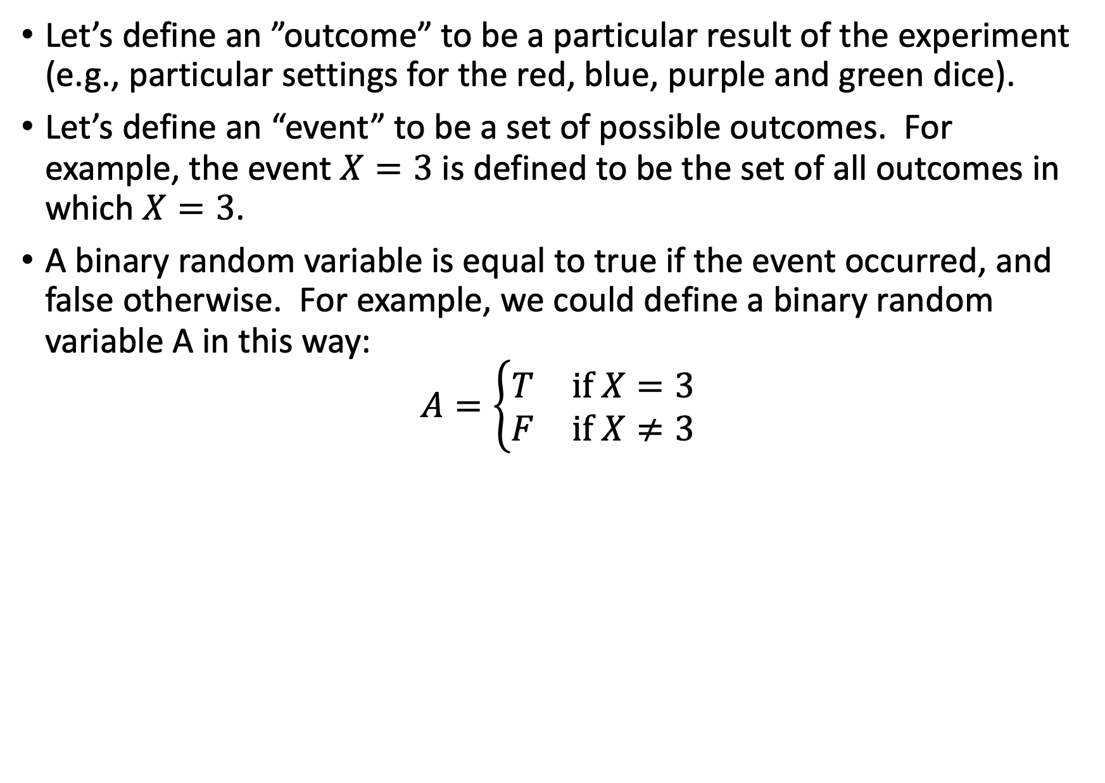
Outcomes, events, and binary random variables
Let’s define an ”outcome” to be a particular result of the experiment (e.g., particular settings for the red, blue, purple and green dice).
Let’s define an “event” to be a set of possible outcomes. For example, the event $X=3$ is defined to be the set of all outcomes in which $X=3$.
A binary random variable is equal to true if the event occurred, and false otherwise. For example, we could define a binary random variable A in this way:
$$A=\left\{\begin{matrix}T & if X=3 \\ F & if X≠3\end{matrix}\right.$$

Slide 12
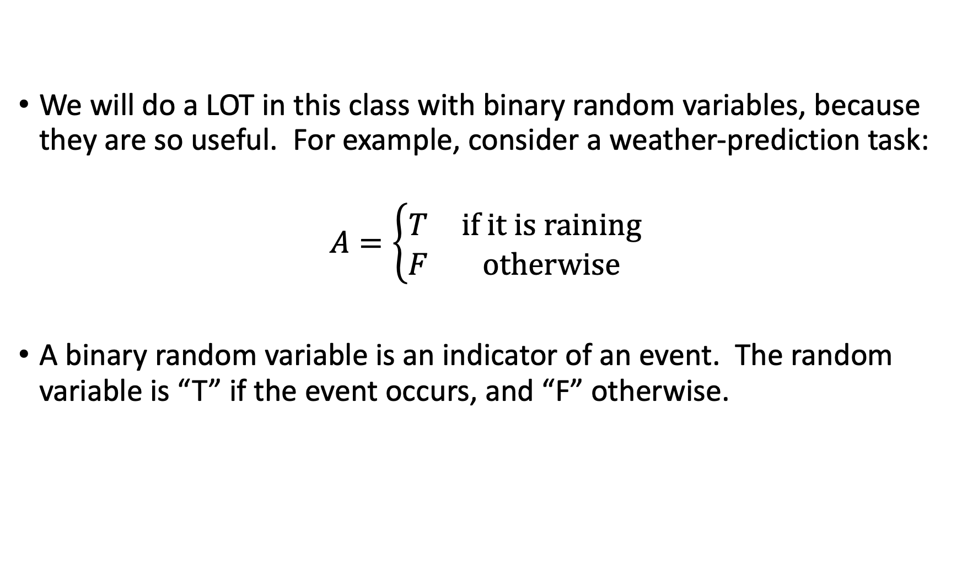
Outcomes, events, and binary random variables
We will do a LOT in this class with binary random variables, because they are so useful. For example, consider a weather-prediction task:
$$A=\left\{\begin{matrix}T & if it is raining \\ F & otherwise\end{matrix}\right.$$
A binary random variable is an indicator of an event. The random variable is “T” if the event occurs, and “F” otherwise.

Slide 13
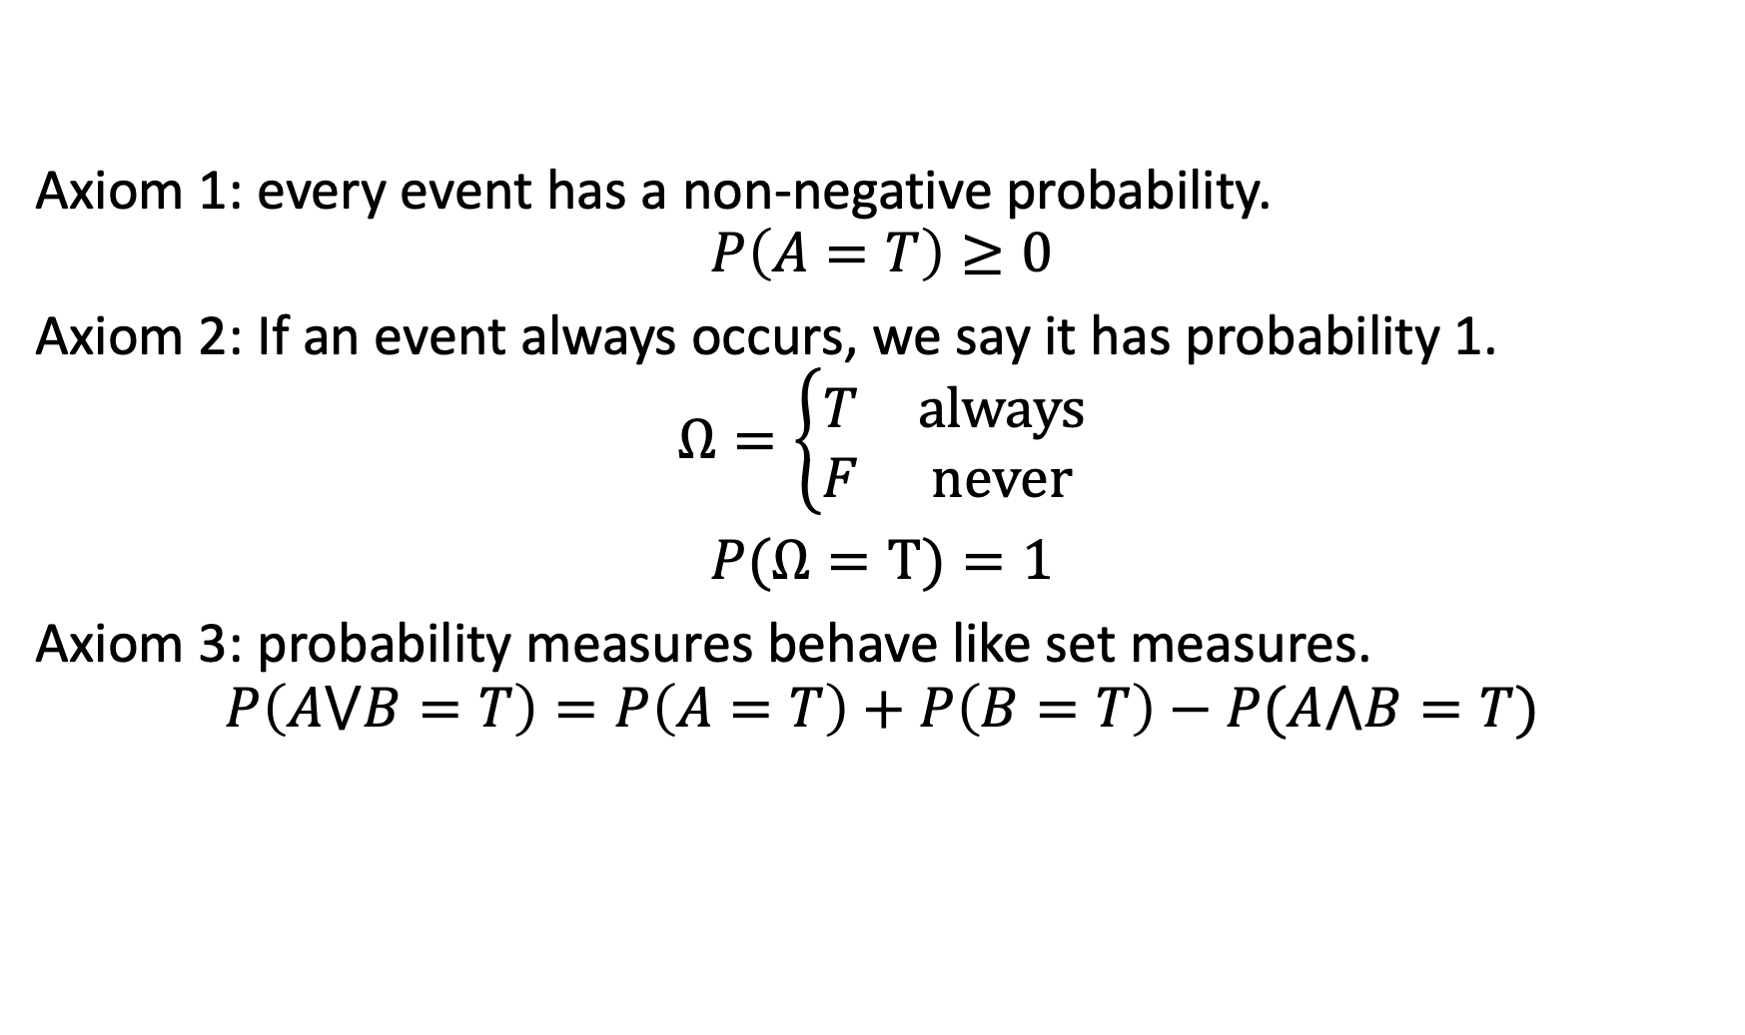
The axioms of probability
Axiom 1: every event has a non-negative probability.
$$P\left(A=T\right)≥0$$
Axiom 2: If an event always occurs, we say it has probability 1.
$$Ω=\left\{\begin{matrix}T & always \\ F & never\end{matrix}\right.$$
$P(Ω=T)=1$
Axiom 3: probability measures behave like set measures.
$$P\left(A⋁B=T\right)=P\left(A=T\right)+P\left(B=T\right)−P(A⋀B=T)$$

Slide 14
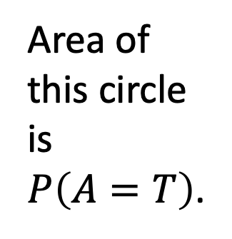
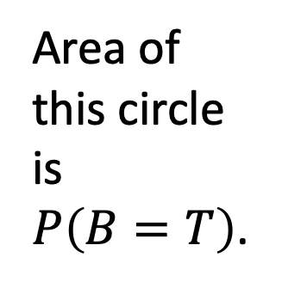
Axiom 3: probability measures behave like set measures.
Area of the whole rectangle is $P\left(Ω=T\right)=1$.
A
B
Area of this circle is $P\left(A=T\right)$.
Area of this circle is $P\left(B=T\right)$.
Area of their intersection is $P\left(A⋀B=T\right)$.
Area of their union is $P\left(A⋁B=T\right)=P\left(A=T\right)+P\left(B=T\right)−P(A⋀B=T)$

Slide 15
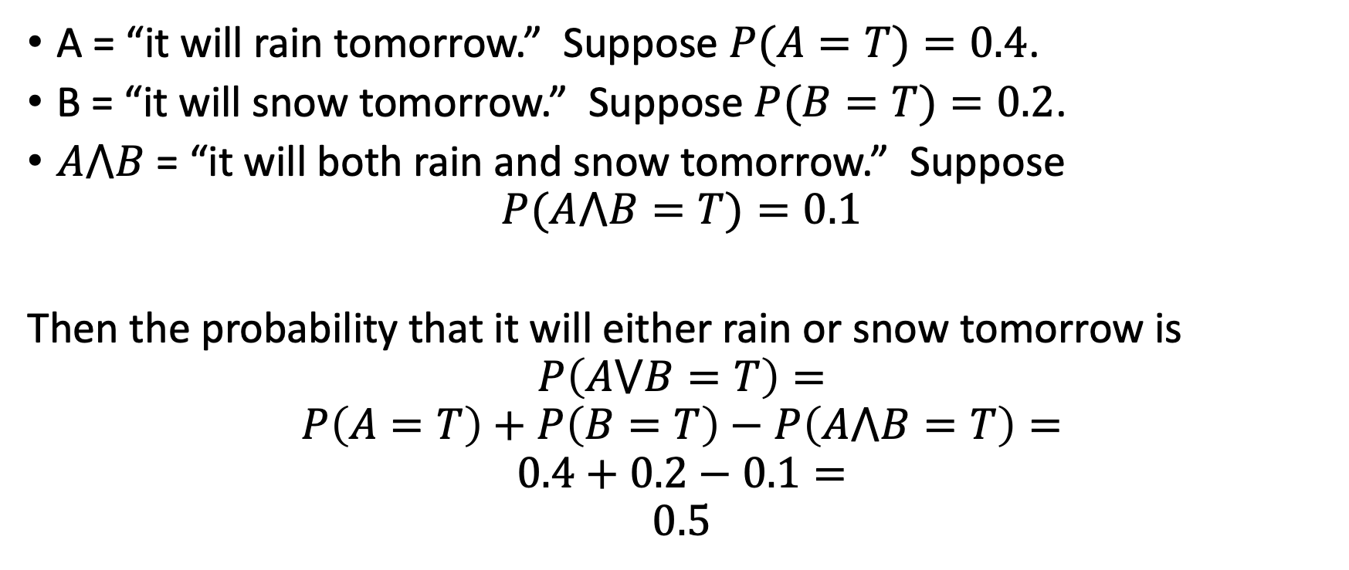
Example
A = “it will rain tomorrow.” Suppose $P(A=T)=0.4$.
B = “it will snow tomorrow.” Suppose $P(B=T)=0.2$.
$A⋀B$ = “it will both rain and snow tomorrow.” Suppose
$$P(A⋀B=T)=0.1$$
Then the probability that it will either rain or snow tomorrow is
$$P\left(A⋁B=T\right)=$$
$$P\left(A=T\right)+P\left(B=T\right)−P\left(A⋀B=T\right)=$$
$$0.4+0.2−0.1=$$
$$0.5$$

Slide 16
Outline
Motivation: Why use probability?
The axioms of probability
Random variables
Conditional probability
Mutually exclusive vs. Independent vs. Conditionally Independent

Slide 17
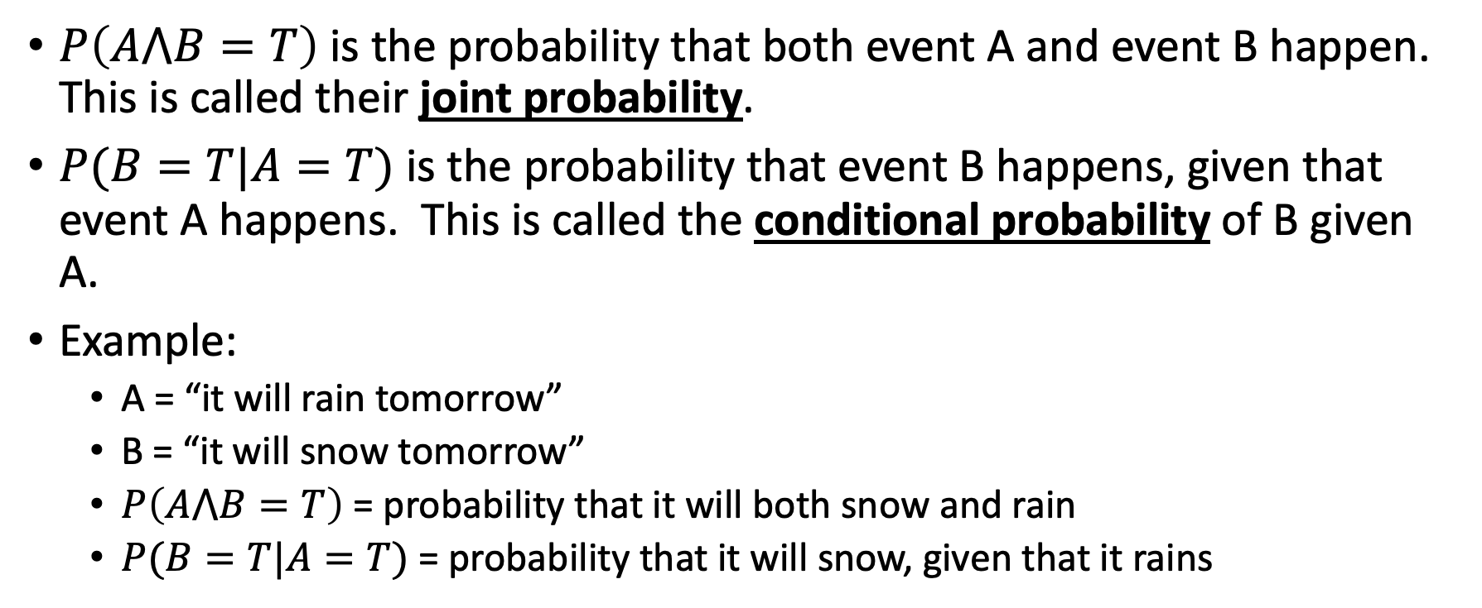
Joint and Conditional probabilities: definitions
$P\left(A⋀B=T\right)$ is the probability that both event A and event B happen. This is called their joint probability.
$P(B=T|A=T)$ is the probability that event B happens, given that event A happens. This is called the conditional probability of B given A.
Example:
  A = “it will rain tomorrow”
  B = “it will snow tomorrow”
  $P\left(A⋀B=T\right)$ = probability that it will both snow and rain
  $P(B=T|A=T)$ = probability that it will snow, given that it rains

Slide 18
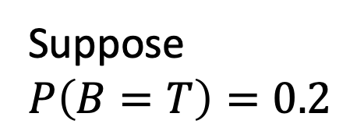
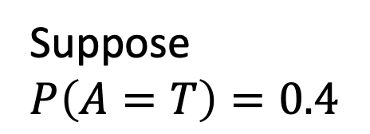

Joint probabilities are usually given in the problem statement
Area of the whole rectangle is $P\left(True\right)=1$.
A
B
Suppose $P\left(A=T\right)=0.4$
Suppose $P\left(B=T\right)=0.2$
Suppose $P\left(A⋀B=T\right)=0.1$

Slide 19

Conditioning events change our knowledge!
For example, given that A is true…
Most of the events in this rectangle are no longer possible!
A
A
B
$$A⋀B$$
Only the events inside this circle are now possible.

Slide 20
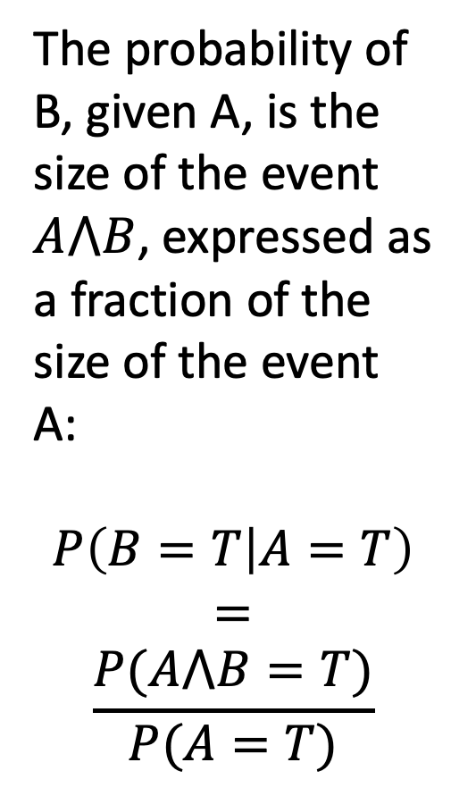


Conditioning events change our knowledge!
For example, given that A is true…
The probability of B, given A, is the size of the event $A⋀B$, expressed as a fraction of the size of the event A:
$$P\left(B=T | A=T\right)$$
$$=$$
$$\frac{P(A⋀B=T)}{P(A=T)}$$
If A always occurs, then by the axioms of probability, the probability of
A=T
is 1.
We can
say that
$P(A=T|A=T)=1$.
A
$$A⋀B$$

Slide 21
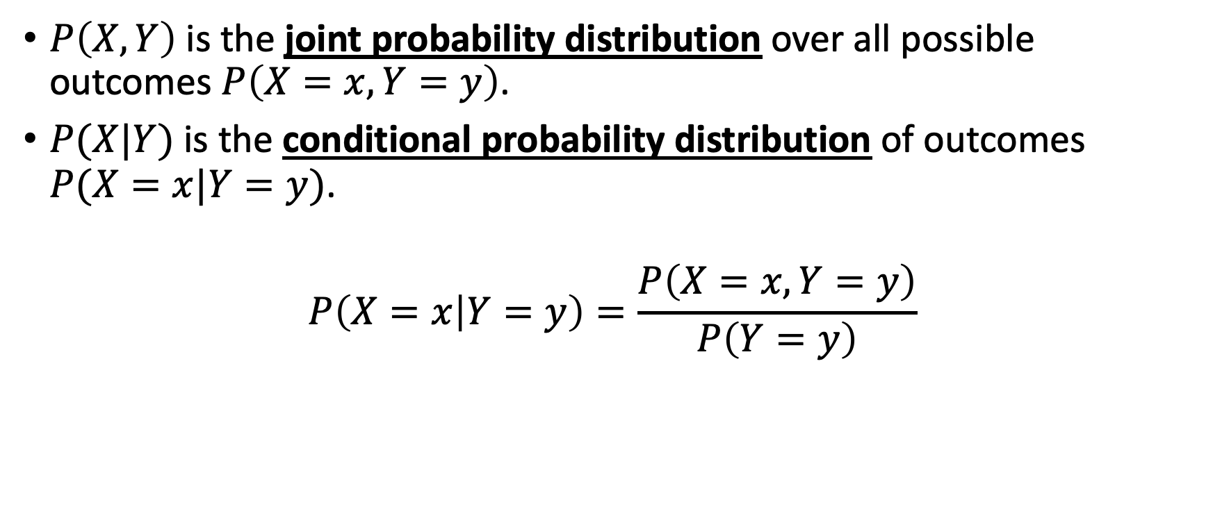
Joint and Conditional distributions of random variables
$P\left(X,Y\right)$ is the joint probability distribution over all possible outcomes $P\left(X=x,Y=y\right)$.
$P(X|Y)$ is the conditional probability distribution of outcomes $P(X=x|Y=y)$.
$$P\left(X=x | Y=y\right)=\frac{P\left(X=x,Y=y\right)}{P\left(Y=y\right)}$$

Slide 22
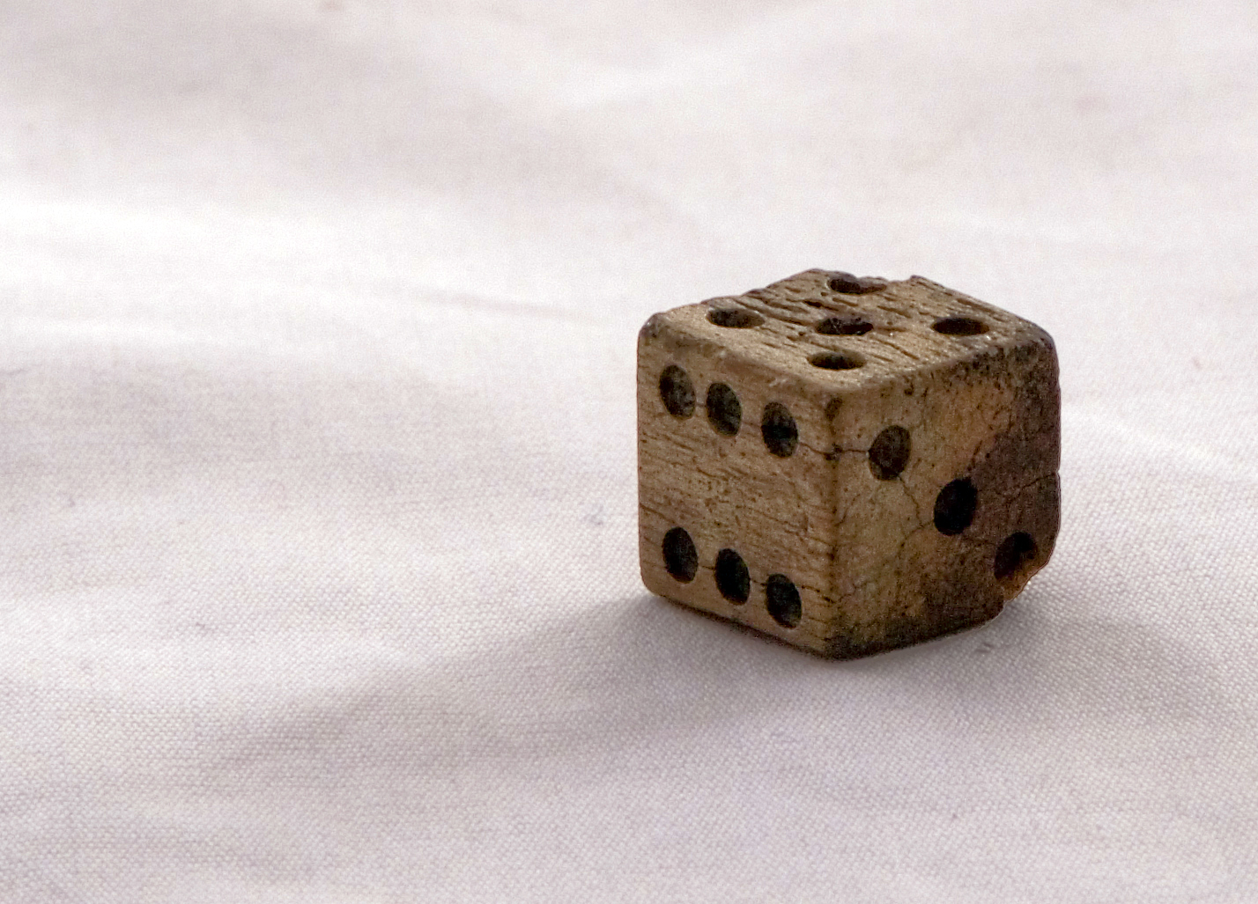
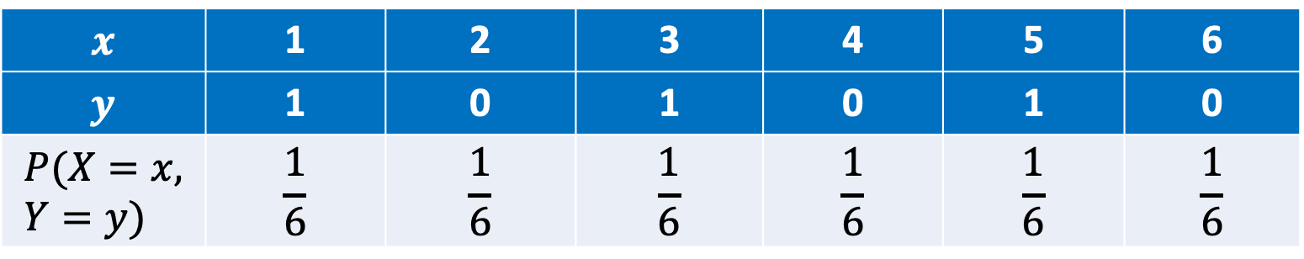
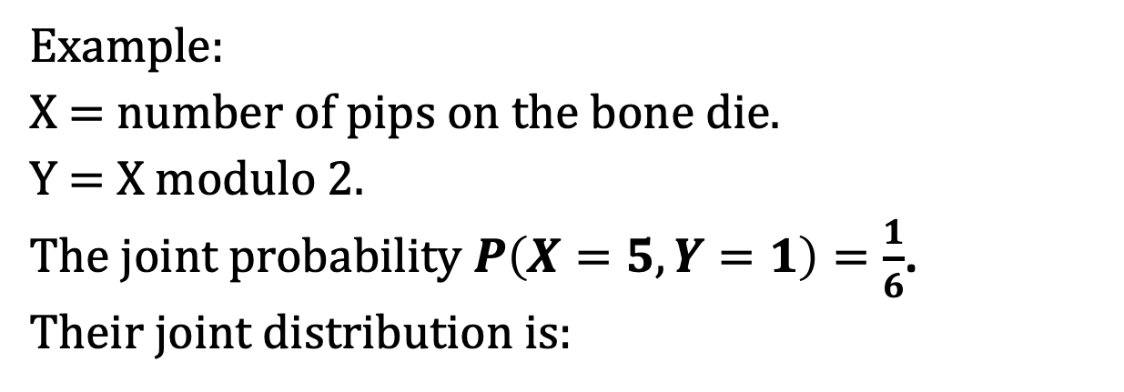

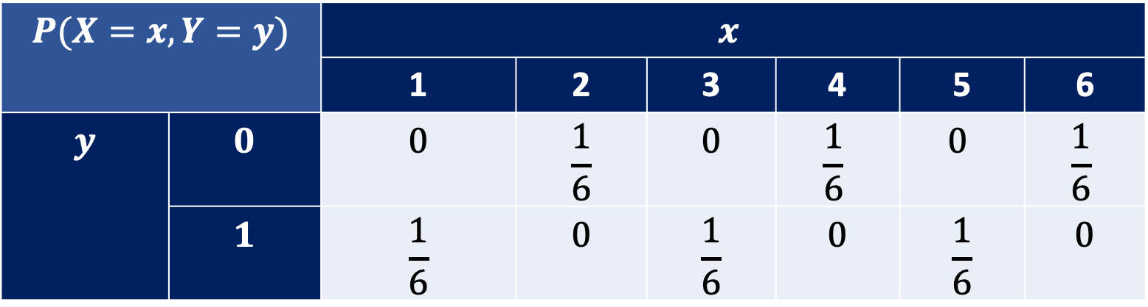
Joint and Conditional distributions of random variables
Example:
X = number of pips on the bone die.
Y = X modulo 2.
The joint probability $P\left(X=5,Y=1\right)=\frac{1}{6}$.
Their joint distribution is:
Bone die found at Cantonment Clinch. CC-BY-3.0, Colby Kirk, 2007.
$$P(X=x,Y=y)$$ | $$P(Y=y | X=x)$$ | $$x$$
 |  | 1 | 2 | 3 | 4 | 5 | 6
$$y$$ | $$0$$ | $$0$$ | $$\frac{1}{6}$$ | $$0$$ | $$\frac{1}{6}$$ | $$0$$ | $$\frac{1}{6}$$
 | $$1$$ | $$\frac{1}{6}$$ | $$0$$ | $$\frac{1}{6}$$ | $$0$$ | $$\frac{1}{6}$$ | $$0$$
$$x$$ | 1 | 2 | 3 | 4 | 5 | 6
$$y$$ | 1 | 0 | 1 | 0 | 1 | 0
$$P(X=x, Y=y)$$ | $$\frac{1}{6}$$ | $$\frac{1}{6}$$ | $$\frac{1}{6}$$ | $$\frac{1}{6}$$ | $$\frac{1}{6}$$ | $$\frac{1}{6}$$
$$P\left(X,Y\right)=$$

Slide 23
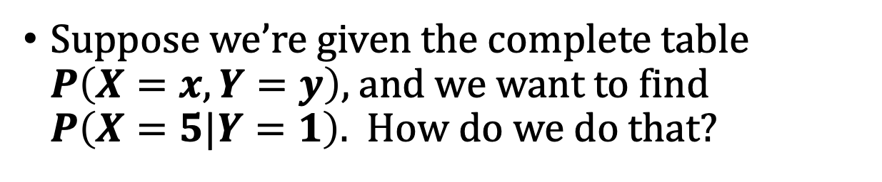
Joint and Conditional distributions of random variables
Suppose we’re given the complete table $P\left(X=x,Y=y\right)$, and we want to find $P\left(X=5|Y=1\right)$. How do we do that?
Bone die found at Cantonment Clinch. CC-BY-3.0, Colby Kirk, 2007.
$$P(X=x,Y=y)$$ | $$P(Y=y | X=x)$$ | $$x$$
 |  | 1 | 2 | 3 | 4 | 5 | 6
$$y$$ | $$0$$ | $$0$$ | $$\frac{1}{6}$$ | $$0$$ | $$\frac{1}{6}$$ | $$0$$ | $$\frac{1}{6}$$
 | $$1$$ | $$\frac{1}{6}$$ | $$0$$ | $$\frac{1}{6}$$ | $$0$$ | $$\frac{1}{6}$$ | $$0$$
$$x$$ | 1 | 2 | 3 | 4 | 5 | 6
$$y$$ | 1 | 0 | 1 | 0 | 1 | 0
$$P(X=x, Y=y)$$ | $$\frac{1}{6}$$ | $$\frac{1}{6}$$ | $$\frac{1}{6}$$ | $$\frac{1}{6}$$ | $$\frac{1}{6}$$ | $$\frac{1}{6}$$
$$P\left(X,Y\right)=$$

Slide 24
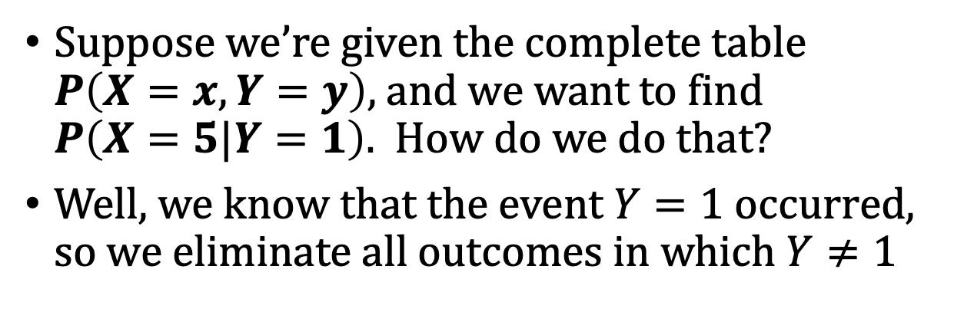
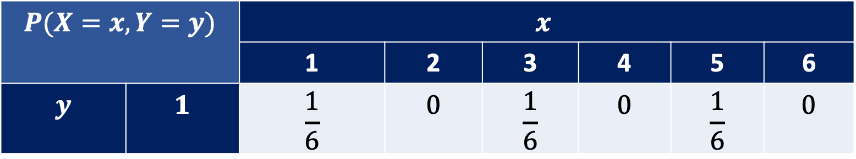
Joint and Conditional distributions of random variables
Suppose we’re given the complete table $P\left(X=x,Y=y\right)$, and we want to find $P\left(X=5|Y=1\right)$. How do we do that?
Well, we know that the event $Y=1$ occurred, so we eliminate all outcomes in which $Y≠1$
Bone die found at Cantonment Clinch. CC-BY-3.0, Colby Kirk, 2007.
$$P(X=x,Y=y)$$ | $$P(Y=y | X=x)$$ | $$x$$
 |  | 1 | 2 | 3 | 4 | 5 | 6
$$y$$ | $$1$$ | $$\frac{1}{6}$$ | $$0$$ | $$\frac{1}{6}$$ | $$0$$ | $$\frac{1}{6}$$ | $$0$$

Slide 25
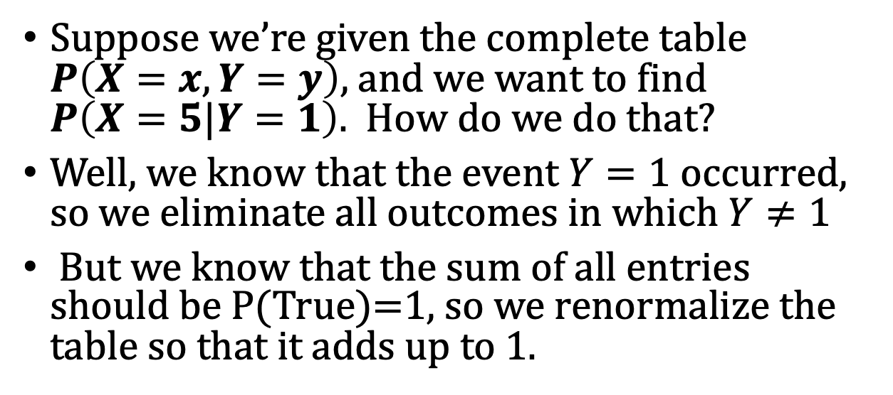
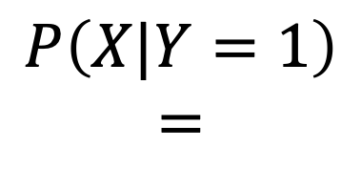

Joint and Conditional distributions of random variables
Suppose we’re given the complete table $P\left(X=x,Y=y\right)$, and we want to find $P\left(X=5|Y=1\right)$. How do we do that?
Well, we know that the event $Y=1$ occurred, so we eliminate all outcomes in which $Y≠1$
But we know that the sum of all entries should be P(True)=1, so we renormalize the table so that it adds up to 1.
Bone die found at Cantonment Clinch. CC-BY-3.0, Colby Kirk, 2007.
$$P\left(X|Y=1\right)$$
$$=$$
$$P(X=x,Y=y)$$ | $$P(Y=y | X=x)$$ | $$x$$
 |  | 1 | 2 | 3 | 4 | 5 | 6
$$y$$ | $$1$$ | $$\frac{1}{3}$$ | $$0$$ | $$\frac{1}{3}$$ | $$0$$ | $$\frac{1}{3}$$ | $$0$$

Slide 26

Joint and Conditional distributions of random variables
Thus, the conditional probability is $P\left(X=5|Y=1\right)=\frac{1}{3}$.
Bone die found at Cantonment Clinch. CC-BY-3.0, Colby Kirk, 2007.
$$P\left(X|Y=1\right)$$
$$=$$
$$P(X=x,Y=y)$$ | $$P(Y=y | X=x)$$ | $$x$$
 |  | 1 | 2 | 3 | 4 | 5 | 6
$$y$$ | $$1$$ | $$\frac{1}{3}$$ | $$0$$ | $$\frac{1}{3}$$ | $$0$$ | $$\frac{1}{3}$$ | $$0$$

Slide 27
Outline
Motivation: Why use probability?
Random variables
The axioms of probability
Conditional probability
Mutually exclusive vs. Independent vs. Conditionally Independent

Slide 28
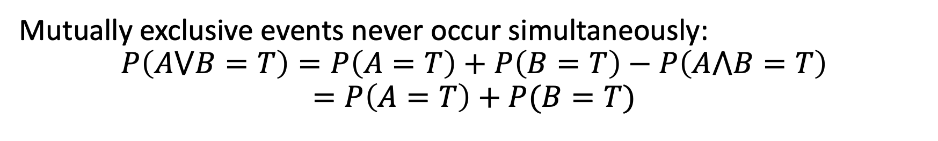
Mutually exclusive events
Mutually exclusive events never occur simultaneously:
$$P\left(A⋁B=T\right)=P\left(A=T\right)+P\left(B=T\right)−P\left(A⋀B=T\right)$$
$$=P\left(A=T\right)+P(B=T)$$
A
B

Slide 29
Examples of mutually exclusive events
If A is the event “tomorrow it rains,” and B is the event “tomorrow it does not rain,” then A and B are mutually exclusive.
If A is the event “the number on the die is 5 or 6,” and B is the event “the number on the die is 1 or 2”, then A and B are mutually exclusive.

Slide 30
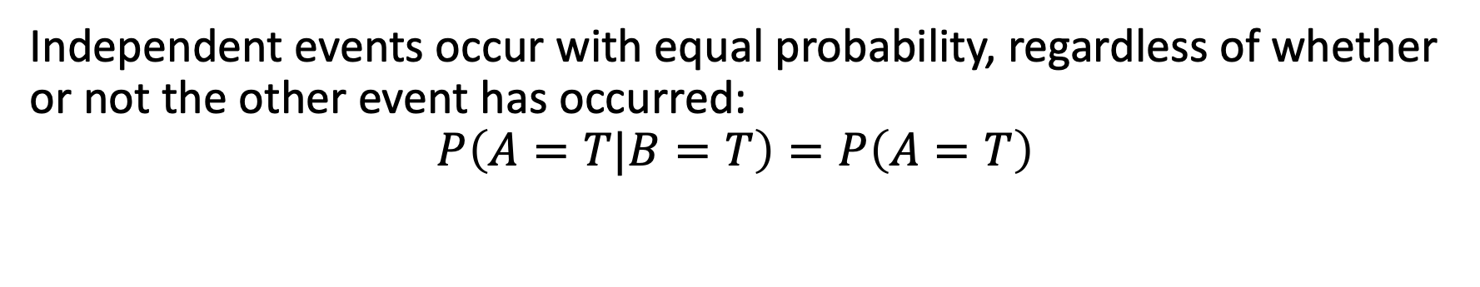
Independent events
Independent events occur with equal probability, regardless of whether or not the other event has occurred:
$$P\left(A=T|B=T\right)=P\left(A=T\right)$$
A
B

Slide 31
Examples of independent events
If A is the event “it rains,” and B is the event “the stock market goes down,” those are probably independent events.
If A is the event “the number on the green die is 5”, and B is the event “the number on the red die is 2”, those are probably independent events.

Slide 32
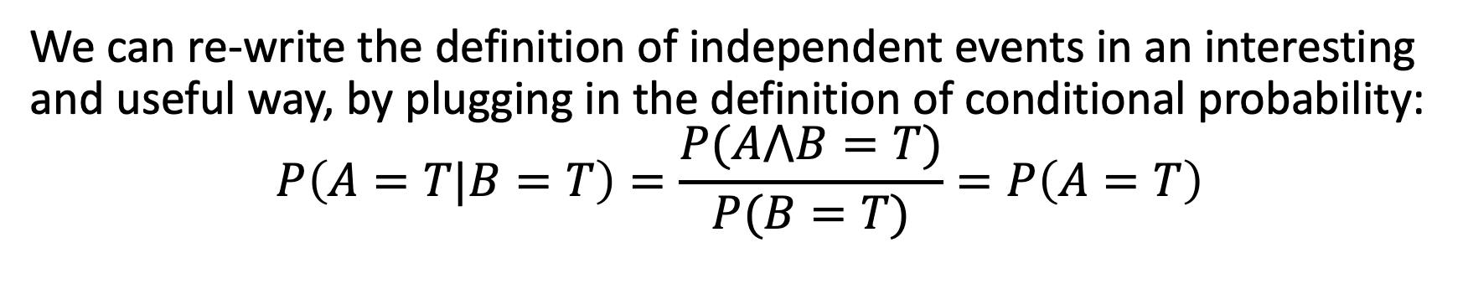
Independent events
We can re-write the definition of independent events in an interesting and useful way, by plugging in the definition of conditional probability:
$$P\left(A=T|B=T\right)=\frac{P(A⋀B=T)}{P(B=T)}=P\left(A=T\right)$$
A
B

Slide 33
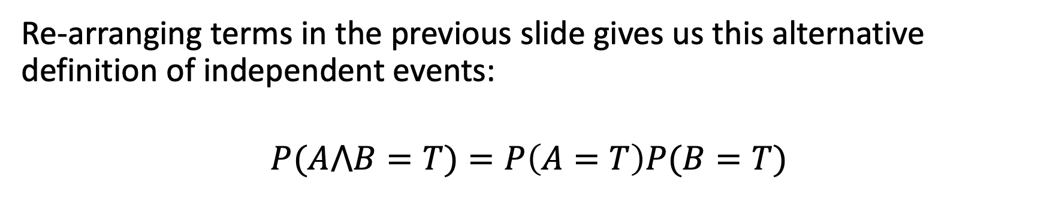
Independent events: A useful alternate definition
Re-arranging terms in the previous slide gives us this alternative definition of independent events:
$$P(A⋀B=T)=P\left(A=T\right)P(B=T)$$
A
B

Slide 34
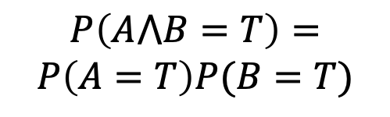

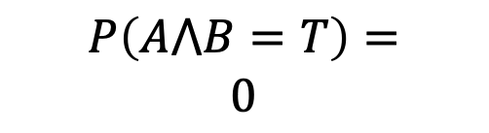
Independent vs. Mutually Exclusive
Independent events:
$$P(A⋀B=T)=P\left(A=T\right)P(B=T)$$
Mutually exclusive events:
$$P\left(A⋁B=T\right)=P\left(A=T\right)+P(B=T)$$
Don’t confuse them! Mutually exclusive events are not independent. Quite the contrary. Think about the set pictures.
A
A
B
$$P\left(A⋀B=T\right)=$$
$$0$$
$$P\left(A⋀B=T\right)=$$
$$P\left(A=T\right)P(B=T)$$
B

Slide 35

Conditionally independent events
Events A and B are conditionally independent, given C, if
$$P\left(A=T|B=T,C=T\right)=P\left(A=T|C=T\right)$$
C
A
B

Slide 36

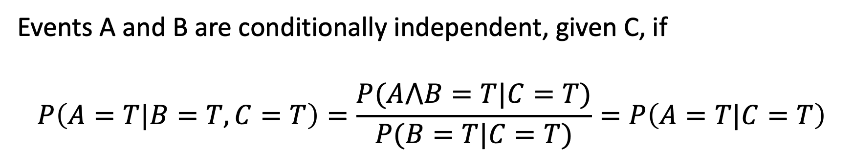

Conditionally independent events
Events A and B are conditionally independent, given C, if
$$P\left(A=T|B=T,C=T\right)=\frac{P(A⋀B=T|C=T)}{P(B=T|C=T)}=P\left(A=T|C=T\right)$$
C
A
$$A|C$$
$$B|C$$
B

Slide 37

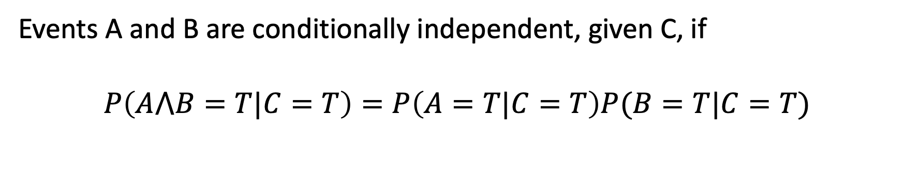

Conditionally independent events
Events A and B are conditionally independent, given C, if
$$P\left(A⋀B=T|C=T\right)=P\left(A=T|C=T\right)P(B=T|C=T)$$
C
$$A|C$$
$$B|C$$

Slide 38
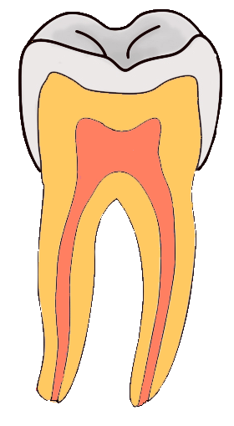
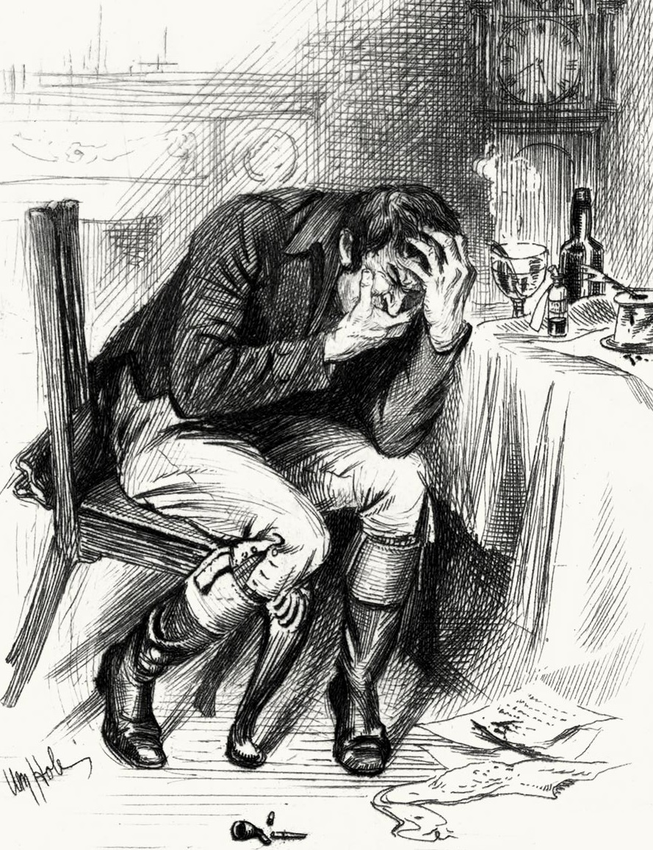

Independence ≠ Conditional Independence
Cavity= the patient has a cavity
Toothache= patient has a toothache
Catch= dentist’s probe catches on something in the mouth
By Aduran, CC-SA 3.0
By William Brassey Hole(Died:1917)
By Dozenist, CC-SA 3.0

Slide 39
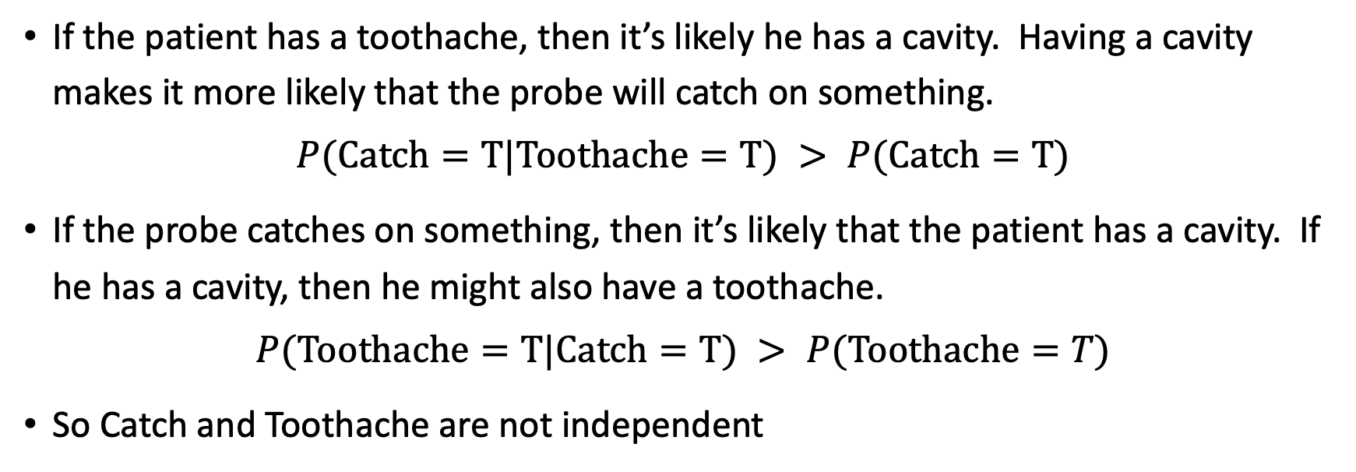
These Events are not Independent
If the patient has a toothache, then it’s likely he has a cavity. Having a cavity makes it more likely that the probe will catch on something.
$$P(Catch=T|Toothache=T) > P(Catch=T)$$
If the probe catches on something, then it’s likely that the patient has a cavity. If he has a cavity, then he might also have a toothache.
$$P(Toothache=T|Catch=T) > P(Toothache=T)$$
So Catch and Toothache are not independent

Slide 40
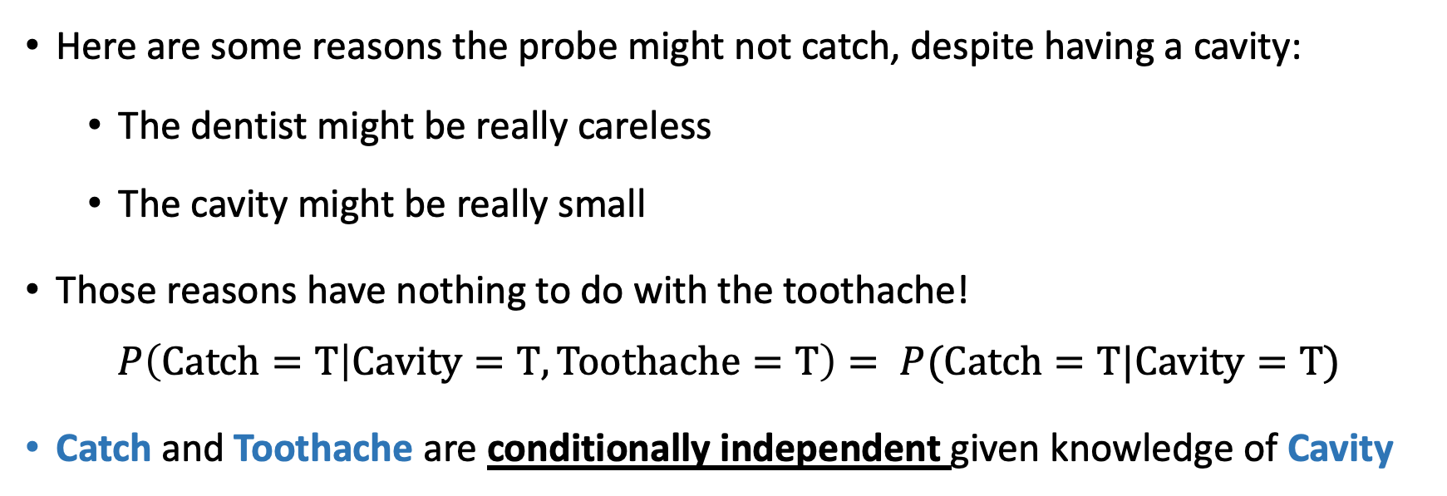
…but they are Conditionally Independent
Dependent
Dependent
Conditionally Dependent given knowledge of Cavity
Here are some reasons the probe might not catch, despite having a cavity:
  The dentist might be really careless
  The cavity might be really small
Those reasons have nothing to do with the toothache!
$$P\left(Catch=T | Cavity=T,Toothache=T\right)= P(Catch=T|Cavity=T)$$
Catch and Toothache are conditionally independent given knowledge of Cavity

Slide 41
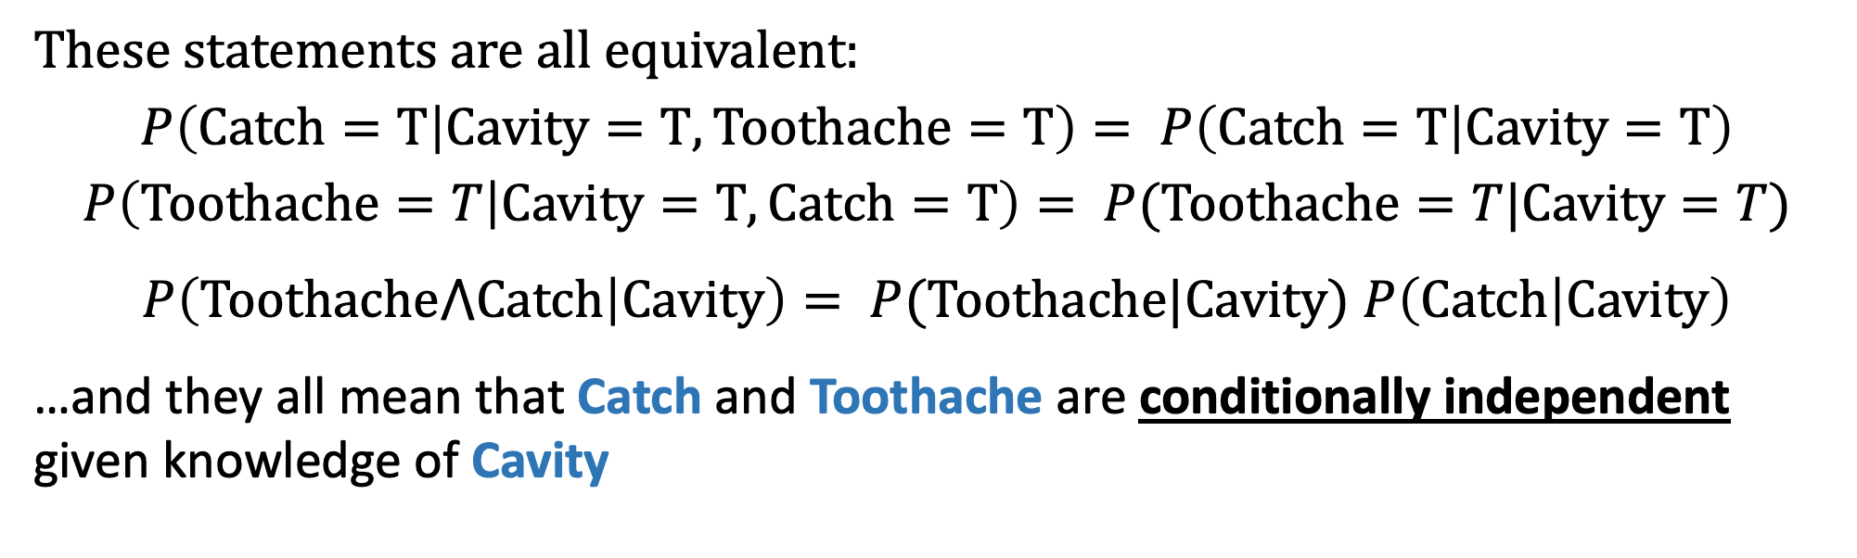
…but they are Conditionally Independent
Dependent
Dependent
Conditionally Dependent given knowledge of Cavity
These statements are all equivalent:
$$P\left(Catch=T | Cavity=T,Toothache=T\right)= P\left(Catch=T | Cavity=T\right)$$
$$P\left(Toothache=T | Cavity=T,Catch=T\right)= P(Toothache=T|Cavity=T)$$
$P\left(Toothache⋀Catch | Cavity\right)= P(Toothache|Cavity)$ $P\left(Catch | Cavity\right)$
…and they all mean that Catch and Toothache are conditionally independent given knowledge of Cavity

Slide 42
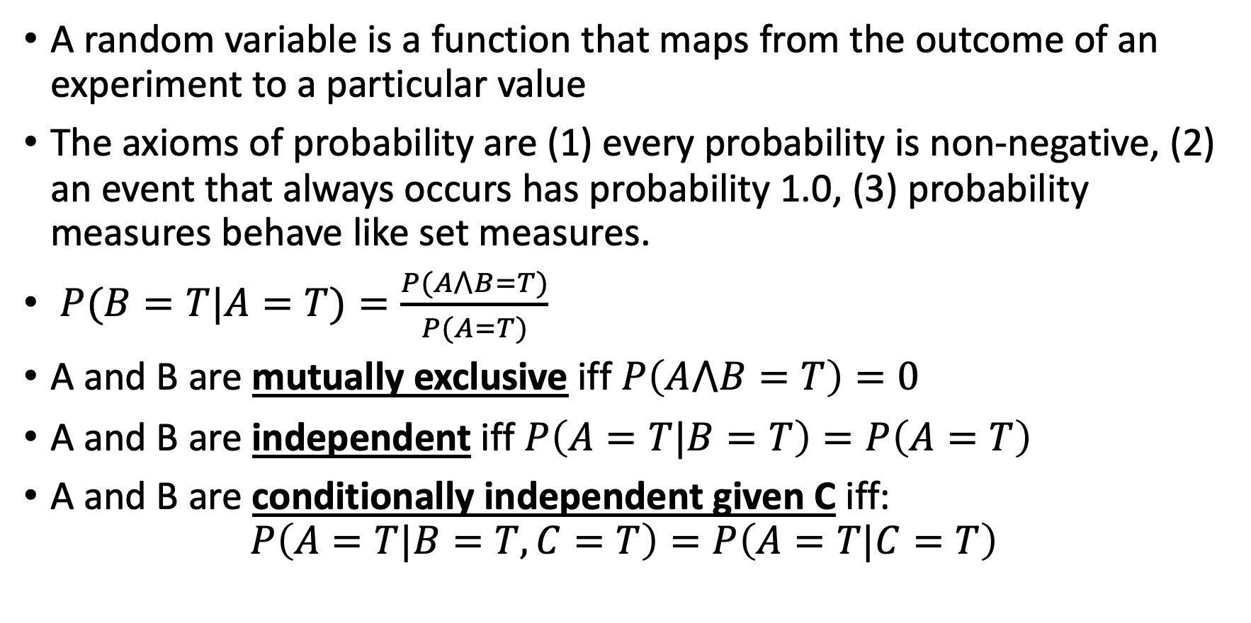
Summary
A random variable is a function that maps from the outcome of an experiment to a particular value
The axioms of probability are (1) every probability is non-negative, (2) an event that always occurs has probability 1.0, (3) probability measures behave like set measures.
$P(B=T|A=T)=\frac{P(A⋀B=T)}{P(A=T)}$
A and B are mutually exclusive iff $P\left(A⋀B=T\right)=0$
A and B are independent iff $P\left(A=T|B=T\right)=P\left(A=T\right)$
A and B are conditionally independent given C iff:
$$P\left(A=T|B=T,C=T\right)=P\left(A=T|C=T\right)$$

