Slide 1

CS440/ECE448 Lecture 6:
Perceptron
Mark Hasegawa-Johnson, 1/2022
License: CC-BY 4.0; redistribute at will, as long as you cite the source.

Slide 2
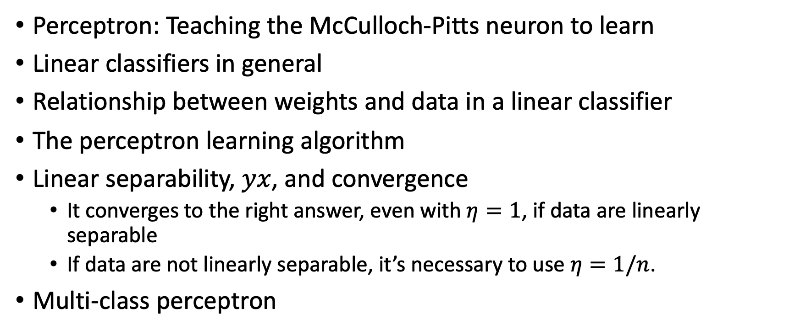
Outline
Perceptron: Teaching the McCulloch-Pitts neuron to learn
Linear classifiers in general
Relationship between weights and data in a linear classifier
The perceptron learning algorithm
Linear separability, $yx$, and convergence
  It converges to the right answer, even with $η=1$, if data are linearly separable
  If data are not linearly separable, it’s necessary to use $η=1/n$.
Multi-class perceptron

Slide 3
McCulloch-Pitts Artificial Neuron, 1943
Input
In 1943, McCulloch & Pitts proposed that biological neurons have a nonlinear activation function (a step function) whose input is a weighted linear combination of the currents generated by other neurons.
They showed lots of examples of mathematical and logical functions that could be computed using networks of simple neurons like this.
Weights
x₁
w₁
x₂
w₂
Output: u(w⋅x)
x₃
w₃
.
.
.
w_{D}
x_{D}

Slide 4
Biological inspiration: Hebbian learning
“Neurons that fire together, wire together.
…
The general idea is an old one, that any two cells or systems of cells that are repeatedly active at the same time will tend to become `associated’ so that activity in one facilitates activity in the other.”
D.O. Hebb, 1949

Slide 5
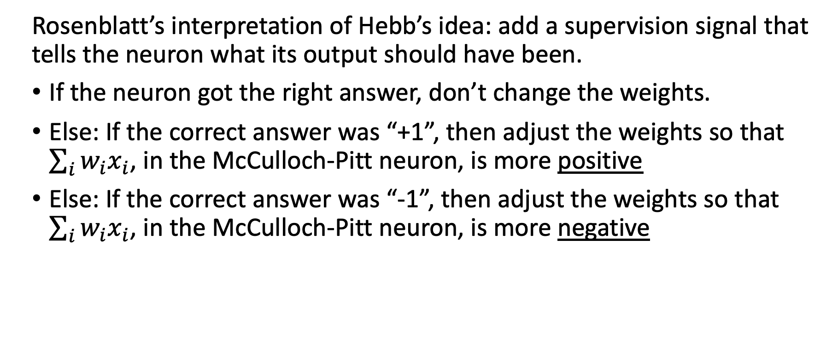
Rosenblatt’s interpretation of Hebb’s idea: add a supervision signal that tells the neuron what its output should have been.
If the neuron got the right answer, don’t change the weights.
Else: If the correct answer was “+1”, then adjust the weights so that $\sum_{i}{w_{i}x_{i}}$, in the McCulloch-Pitt neuron, is more positive
Else: If the correct answer was “-1”, then adjust the weights so that $\sum_{i}{w_{i}x_{i}}$, in the McCulloch-Pitt neuron, is more negative

Slide 6
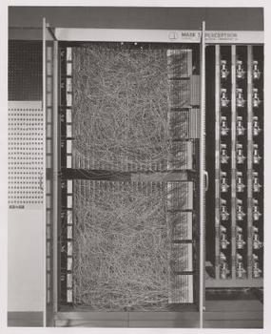
Perceptron
1959: Rosenblatt is granted a patent for the “perceptron,” an electrical circuit model of a neuron, with the ability to learn from data.

Slide 7
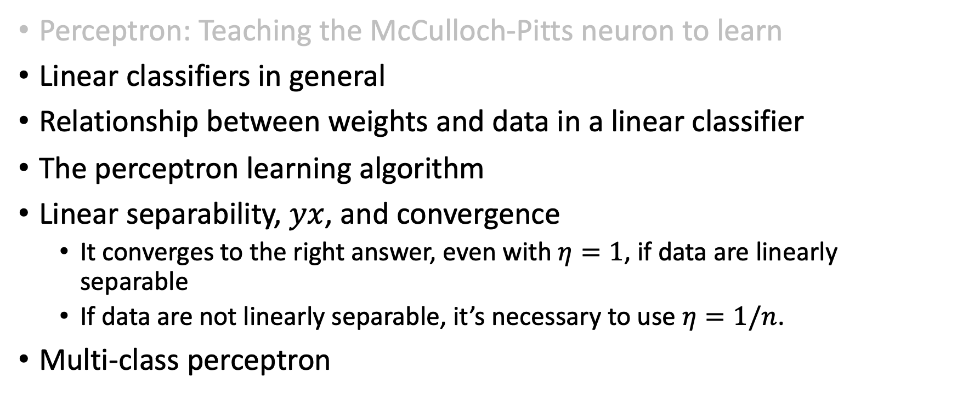
Outline
Perceptron: Teaching the McCulloch-Pitts neuron to learn
Linear classifiers in general
Relationship between weights and data in a linear classifier
The perceptron learning algorithm
Linear separability, $yx$, and convergence
  It converges to the right answer, even with $η=1$, if data are linearly separable
  If data are not linearly separable, it’s necessary to use $η=1/n$.
Multi-class perceptron

Slide 8


Classifier example: dogs versus cats
Can you write a program that can tell which ones are dogs, and which ones are cats?
By YellowLabradorLooking_new.jpg: *derivative work: Djmirko (talk)YellowLabradorLooking.jpg: User:HabjGolden_Retriever_Sammy.jpg: Pharaoh HoundCockerpoo.jpg: ALMMLonghaired_yorkie.jpg: Ed Garcia from United StatesBoxer_female_brown.jpg: Flickr user boxercabMilù_050.JPG: AleRBeagle1.jpg: TobycatBasset_Hound_600.jpg: ToBNewfoundland_dog_Smoky.jpg: Flickr user DanDee Shotsderivative work: December21st2012Freak (talk) - YellowLabradorLooking_new.jpgGolden_Retriever_Sammy.jpgCockerpoo.jpgLonghaired_yorkie.jpgBoxer_female_brown.jpgMilù_050.JPGBeagle1.jpgBasset_Hound_600.jpgNewfoundland_dog_Smoky.jpg, CC BY-SA 3.0, https://commons.wikimedia.org/w/index.php?curid=10793219
By Alvesgaspar - Top left:File:Cat August 2010-4.jpg by AlvesgasparTop middle:File:Gustav chocolate.jpg by Martin BahmannTop right:File:Orange tabby cat sitting on fallen leaves-Hisashi-01A.jpg by HisashiBottom left:File:Siam lilacpoint.jpg by Martin BahmannBottom middle:File:Felis catus-cat on snow.jpg by Von.grzankaBottom right:File:Sheba1.JPG by Dovenetel, CC BY-SA 3.0, https://commons.wikimedia.org/w/index.php?curid=17960205

Slide 9


Classifier example: dogs versus cats
Can you write a program that can tell which ones are dogs, and which ones are cats?
Idea #1: Cats are smaller than dogs.
Our robot will pick up the animal and weigh it.
If it weighs more than 20 pounds, call it a dog. Otherwise, call it a cat.

Slide 10

Classifier example: dogs versus cats
Can you write a program that can tell which ones are dogs, and which ones are cats?
Oops.
CC BY-SA 4.0, https://commons.wikimedia.org/w/index.php?curid=55084303

Slide 11



Classifier example: dogs versus cats
Can you write a program that can tell which ones are dogs, and which ones are cats?
Idea #2: Dogs are tame, cats are wild.
We’ll try the following experiment: 40 different people call the animal’s name. Count how many times the animal comes when called.
If the animal comes when called, more than 20 times out of 40, it’s a dog.
If not, it’s a cat.

Slide 12

Classifier example: dogs versus cats
Can you write a program that can tell which ones are dogs, and which ones are cats?
Oops.
By Smok Bazyli - Own work, CC BY-SA 3.0, https://commons.wikimedia.org/w/index.php?curid=16864492

Slide 13
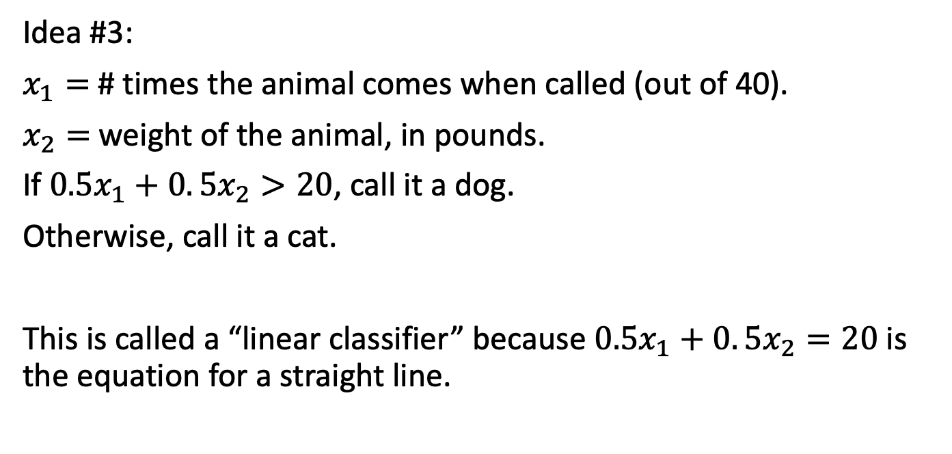
Classifier example: dogs versus cats
Can you write a program that can tell which ones are dogs, and which ones are cats?
Idea #3:
$x_{1}=$ # times the animal comes when called (out of 40).
$x_{2}=$ weight of the animal, in pounds.
If $0.5x_{1}+0. 5x_{2}>20$, call it a dog.
Otherwise, call it a cat.
This is called a “linear classifier” because $0.5x_{1}+0. 5x_{2}=20$ is the equation for a straight line.

Slide 14
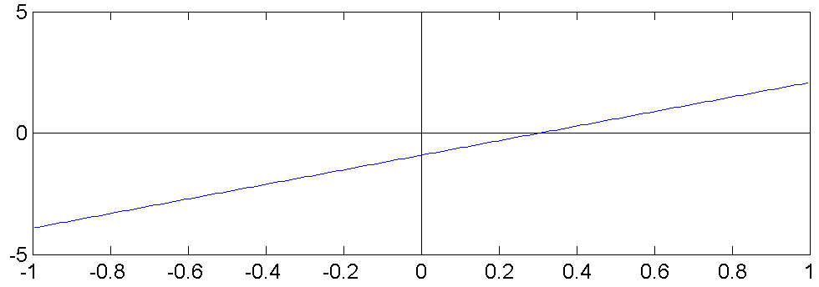
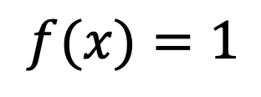
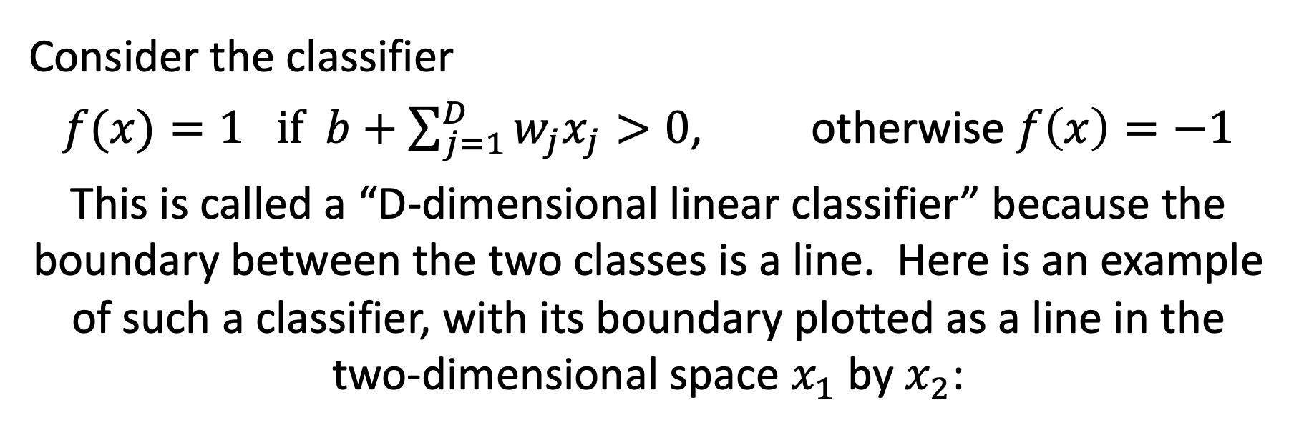
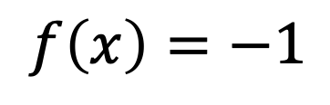
Linear Classifiers in General
Consider the classifier
$f(x)=1 if b+\sum_{j=1}^{D}{w_{j}x_{j}}>0$, otherwise $f\left(x\right)=−1$
This is called a “D-dimensional linear classifier” because the boundary between the two classes is a line. Here is an example of such a classifier, with its boundary plotted as a line in the two-dimensional space $x_{1}$ by $x_{2}$:
$$f\left(x\right)=−1$$
$$x_{2}$$
$$f(x)=1$$
$$x_{1}$$

Slide 15
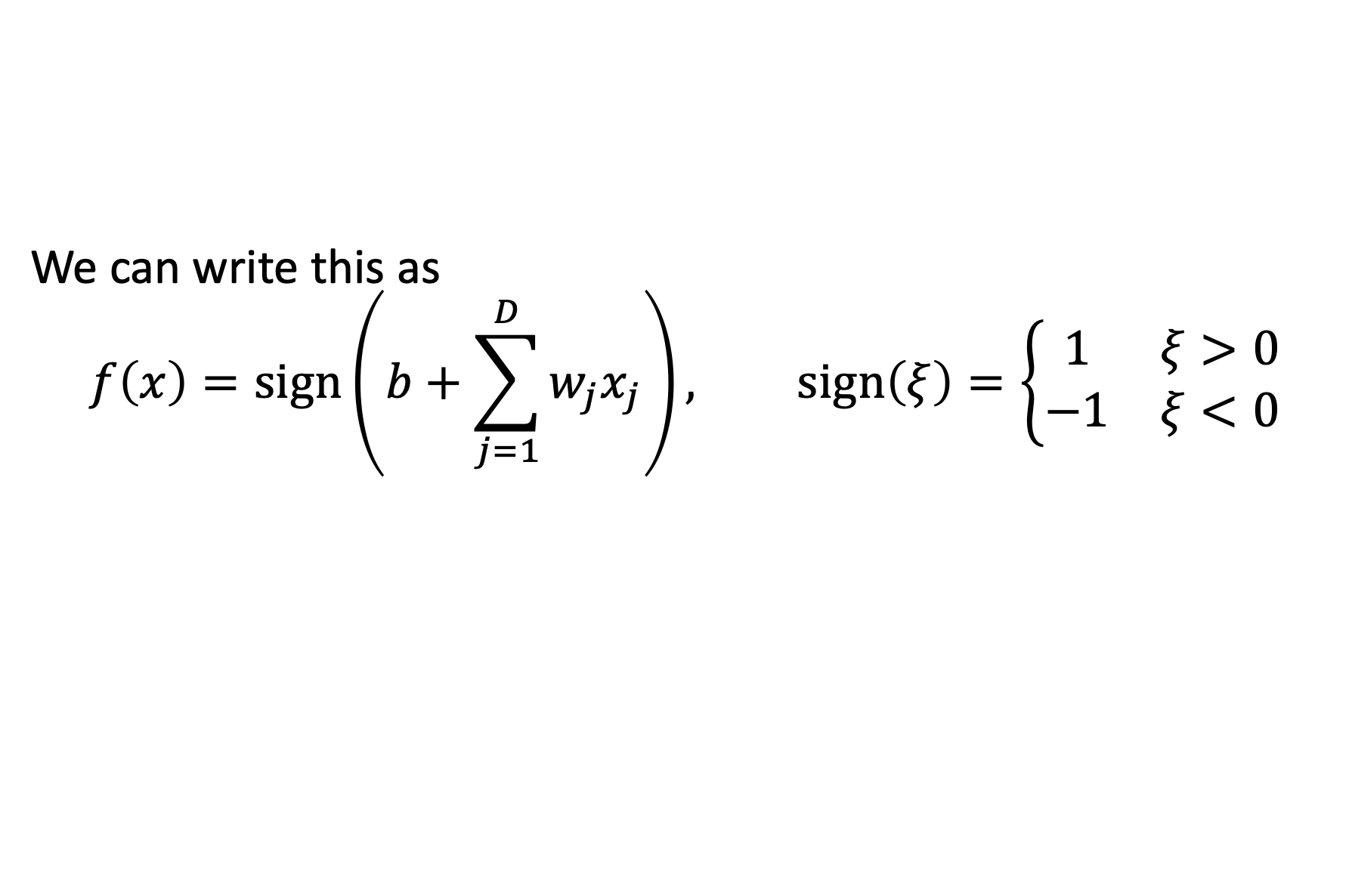
Simplify notation: use the signum function
We can write this as
$$f\left(x\right)=sign\left(b+\sum_{j=1}^{D}{w_{j}x_{j}}\right), sign\left(ξ\right)=\left\{\begin{matrix}1 & ξ>0 \\ −1 & ξ<0\end{matrix}\right.$$
$$f\left(x\right)=−1$$
$$x_{2}$$
$$f(x)=1$$
$$x_{1}$$

Slide 16
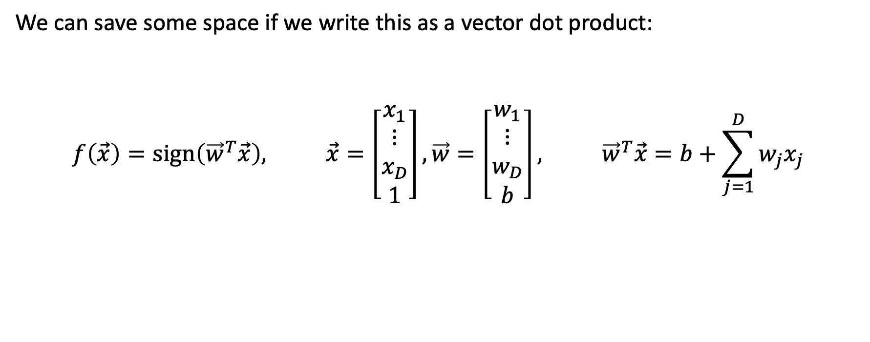


Simplify notation: use a vector dot product
We can save some space if we write this as a vector dot product:
$$f\left(\vec{x}\right)=sign\left({\vec{w}}^{T}\vec{x}\right), \vec{x}=\left[\begin{matrix}x_{1} \\ \begin{matrix}⋮ \\ x_{D}\end{matrix} \\ 1\end{matrix}\right],\vec{w}=\left[\begin{matrix}w_{1} \\ \begin{matrix}⋮ \\ w_{D}\end{matrix} \\ b\end{matrix}\right], {\vec{w}}^{T}\vec{x}=b+\sum_{j=1}^{D}{w_{j}x_{j}}$$
$$f\left(x\right)=−1$$
$$x_{2}$$
$$f(x)=1$$
$$x_{1}$$

Slide 17
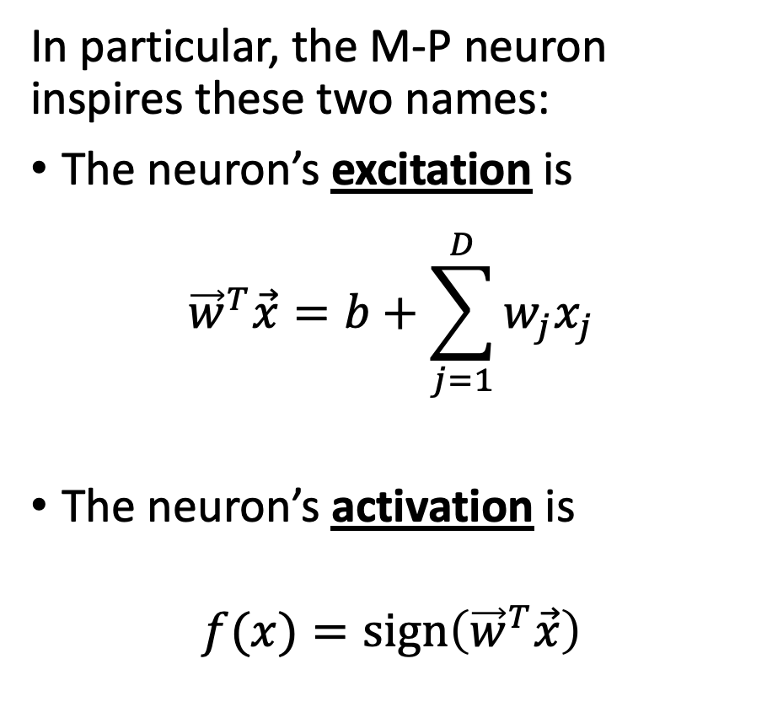
McCulloch-Pitt Neuron is a Linear Classifier
Input
Can incorporate bias as component of the weight vector by always including a feature with value set to 1
In particular, the M-P neuron inspires these two names:
The neuron’s excitation is
$${\vec{w}}^{T}\vec{x}=b+\sum_{j=1}^{D}{w_{j}x_{j}}$$
The neuron’s activation is
$$f(x)=sign\left({\vec{w}}^{T}\vec{x}\right)$$
1
b
x₁
w₁
Output: sign(w^{T}x)
x₂
w₂
.
.
.
w_{D}
x_{D}
Weights

Slide 18
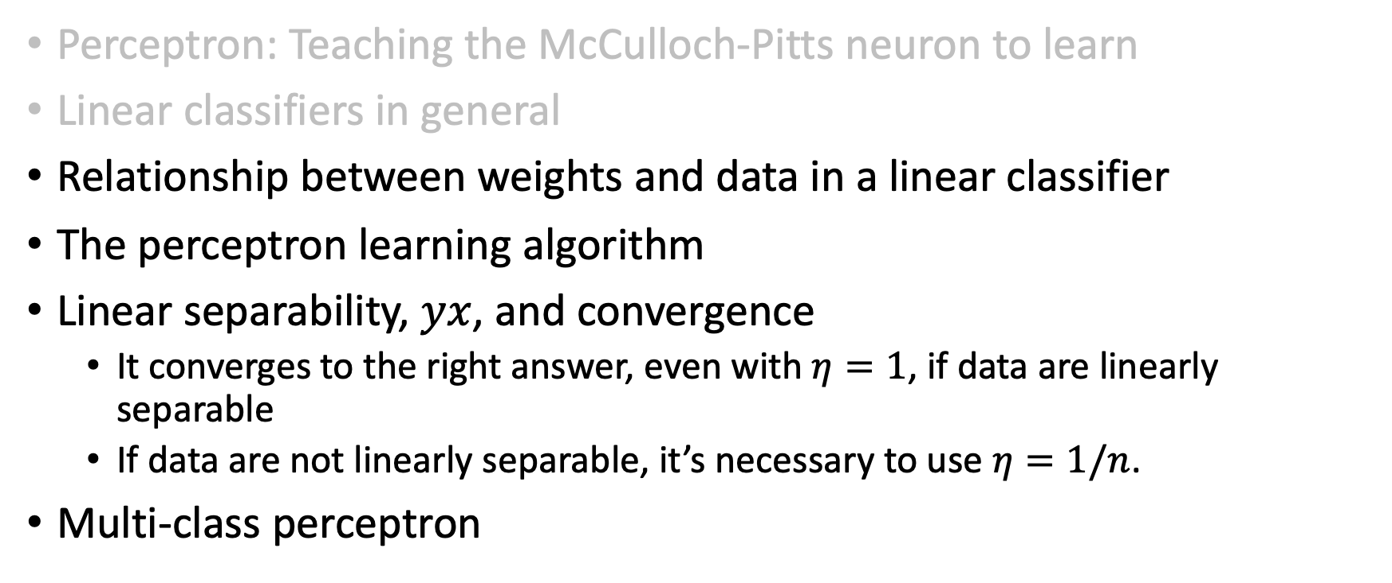
Outline
Perceptron: Teaching the McCulloch-Pitts neuron to learn
Linear classifiers in general
Relationship between weights and data in a linear classifier
The perceptron learning algorithm
Linear separability, $yx$, and convergence
  It converges to the right answer, even with $η=1$, if data are linearly separable
  If data are not linearly separable, it’s necessary to use $η=1/n$.
Multi-class perceptron

Slide 19
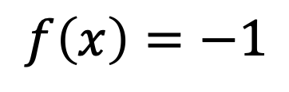
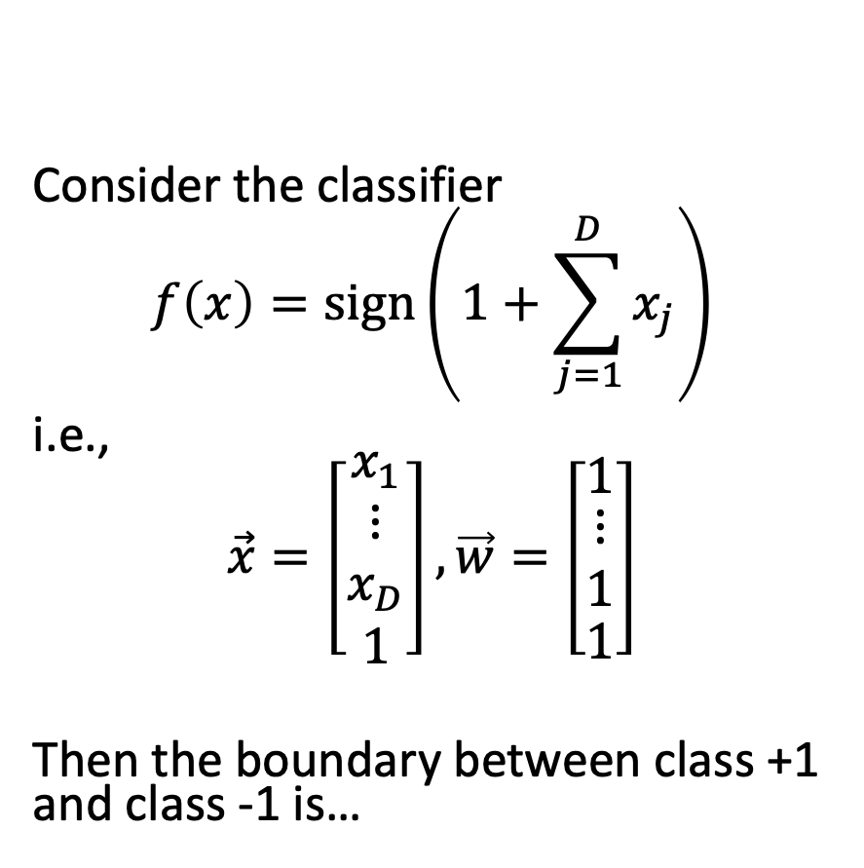
Relationship between weights and data
Consider the classifier
$$f\left(x\right)=sign\left(1+\sum_{j=1}^{D}{x_{j}}\right)$$
i.e.,
$$\vec{x}=\left[\begin{matrix}x_{1} \\ \begin{matrix}⋮ \\ x_{D}\end{matrix} \\ 1\end{matrix}\right],\vec{w}=\left[\begin{matrix}1 \\ \begin{matrix}⋮ \\ 1\end{matrix} \\ 1\end{matrix}\right]$$
Then the boundary between class +1 and class -1 is…
$$f(x)=1$$
$$f\left(x\right)=−1$$

Slide 20
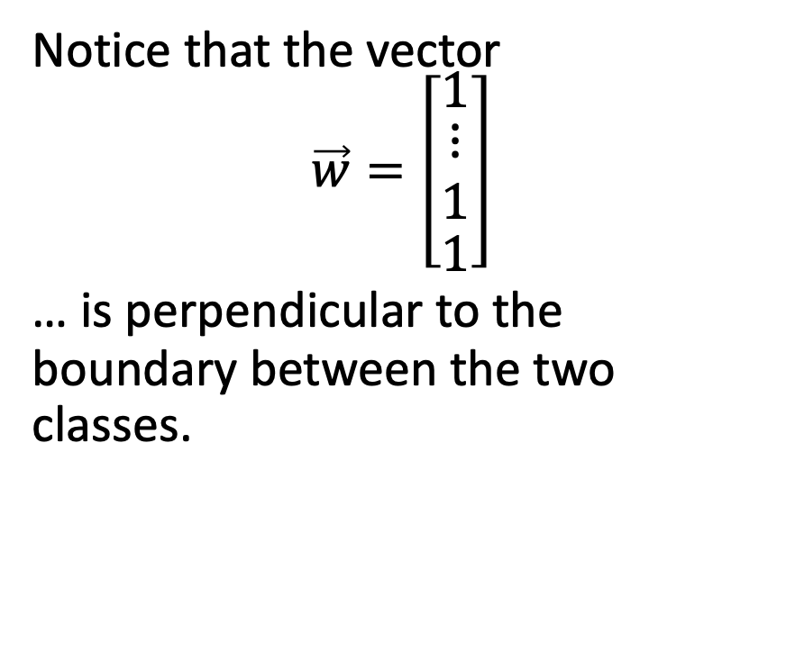
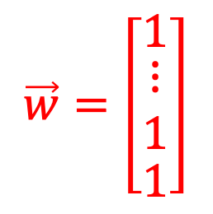
Relationship between weights and data
Notice that the vector
$$\vec{w}=\left[\begin{matrix}1 \\ \begin{matrix}⋮ \\ 1\end{matrix} \\ 1\end{matrix}\right]$$
… is perpendicular to the boundary between the two classes.
$$f(x)=1$$
$$\vec{w}=\left[\begin{matrix}1 \\ \begin{matrix}⋮ \\ 1\end{matrix} \\ 1\end{matrix}\right]$$
$$f\left(x\right)=−1$$

Slide 21
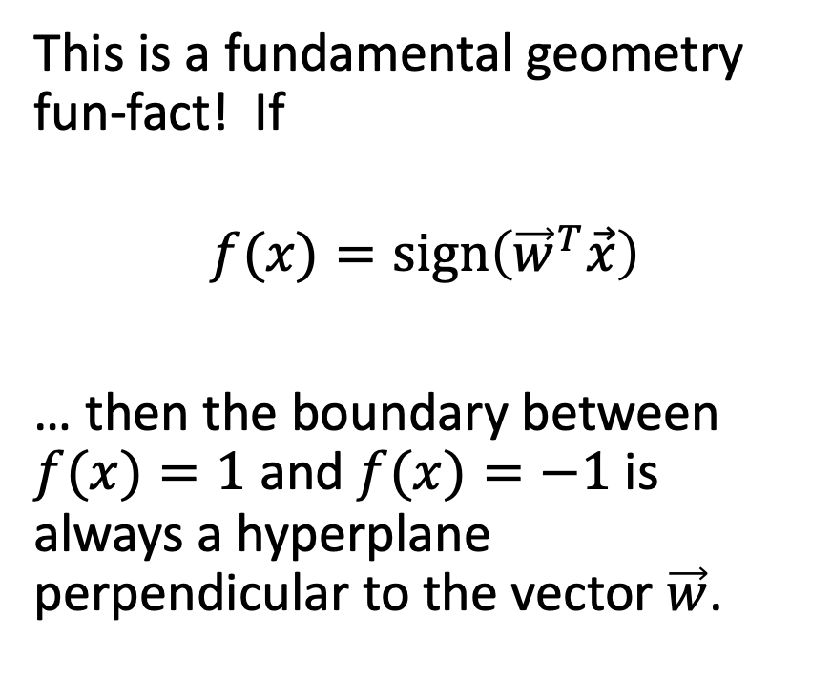
Relationship between weights and data
This is a fundamental geometry fun-fact! If
$$f(x)=sign\left({\vec{w}}^{T}\vec{x}\right)$$
… then the boundary between $f(x)=1$ and $f(x)=−1$ is always a hyperplane perpendicular to the vector $\vec{w}$.
$$f(x)=1$$
$$\vec{w}=\left[\begin{matrix}1 \\ \begin{matrix}⋮ \\ 1\end{matrix} \\ 1\end{matrix}\right]$$
$$f\left(x\right)=−1$$

Slide 22

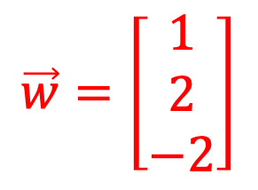
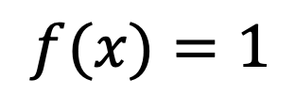
Another example
$$f(x)=1$$
$$f\left(x\right)=sign\left(−2+x_{1}+2x_{2}\right)$$
i.e.,
$$\vec{x}=\left[\begin{matrix}x_{1} \\ x_{2} \\ 1\end{matrix}\right],\vec{w}=\left[\begin{matrix}1 \\ 2 \\ −2\end{matrix}\right]$$
$$\vec{w}=\left[\begin{matrix}1 \\ 2 \\ −2\end{matrix}\right]$$
$$f\left(x\right)=−1$$

Slide 23
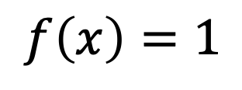

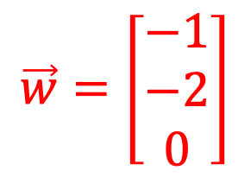
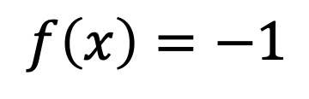
Another example
$$f\left(x\right)=sign\left(−x_{1}−2x_{2}\right)$$
i.e.,
$$\vec{x}=\left[\begin{matrix}x_{1} \\ x_{2} \\ 1\end{matrix}\right],\vec{w}=\left[\begin{matrix}−1 \\ −2 \\ 0\end{matrix}\right]$$
$$f\left(x\right)=−1$$
$$f\left(x\right)=1$$
$$\vec{w}=\left[\begin{matrix}−1 \\ −2 \\ 0\end{matrix}\right]$$

Slide 24
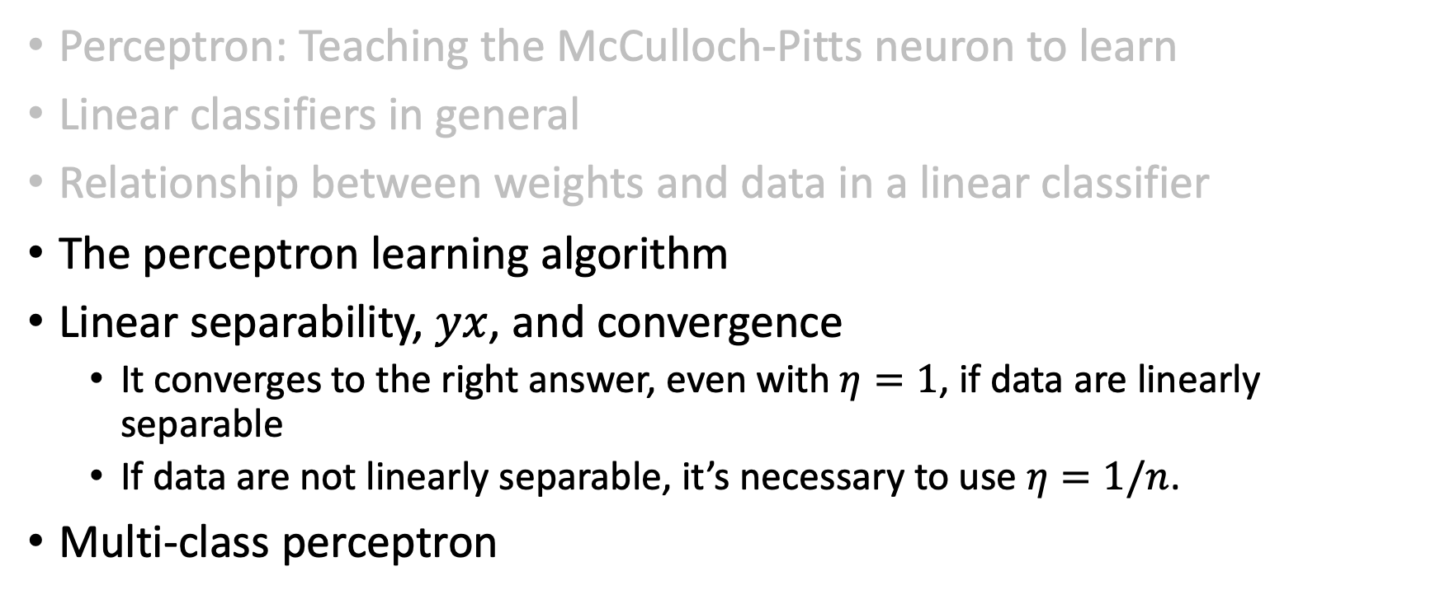
Outline
Perceptron: Teaching the McCulloch-Pitts neuron to learn
Linear classifiers in general
Relationship between weights and data in a linear classifier
The perceptron learning algorithm
Linear separability, $yx$, and convergence
  It converges to the right answer, even with $η=1$, if data are linearly separable
  If data are not linearly separable, it’s necessary to use $η=1/n$.
Multi-class perceptron

Slide 25
Perceptron Learning Algorithm
Rosenblatt’s interpretation of Hebb’s idea: add a supervision signal that tells the neuron what its output should have been.
If the neuron got the right answer, don’t change the weights.
Else: If the correct answer was “+1”, then adjust the weights so that $\sum_{i}{w_{i}x_{i}}$, in the McCulloch-Pitt neuron, is more positive
Else: If the correct answer was “-1”, then adjust the weights so that $\sum_{i}{w_{i}x_{i}}$, in the McCulloch-Pitt neuron, is more negative

Slide 26
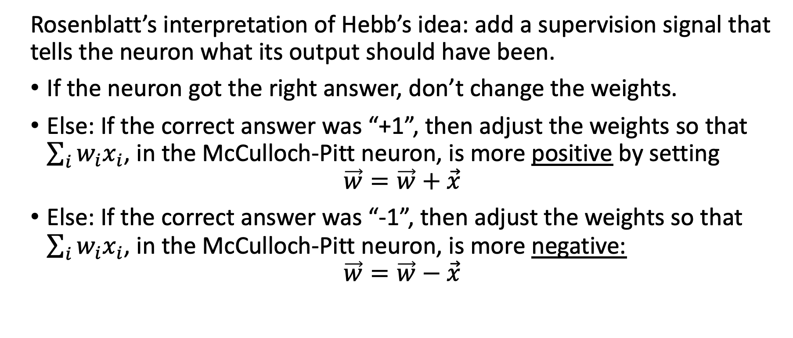
Perceptron Learning Algorithm
Rosenblatt’s interpretation of Hebb’s idea: add a supervision signal that tells the neuron what its output should have been.
If the neuron got the right answer, don’t change the weights.
Else: If the correct answer was “+1”, then adjust the weights so that $\sum_{i}{w_{i}x_{i}}$, in the McCulloch-Pitt neuron, is more positive by setting
$$\vec{w}=\vec{w}+\vec{x}$$
Else: If the correct answer was “-1”, then adjust the weights so that $\sum_{i}{w_{i}x_{i}}$, in the McCulloch-Pitt neuron, is more negative:
$$\vec{w}=\vec{w}−\vec{x}$$

Slide 27
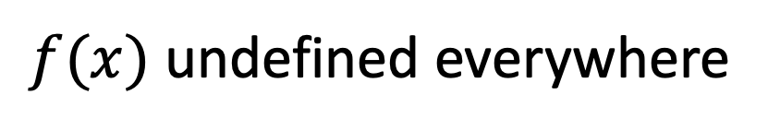
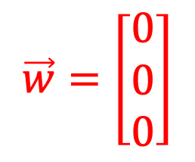
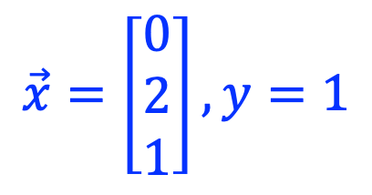
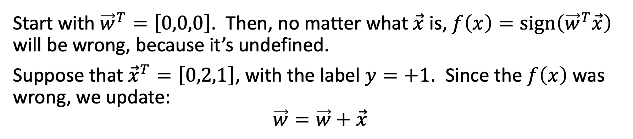
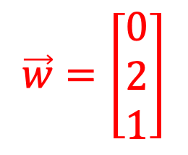
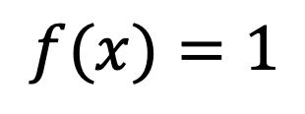
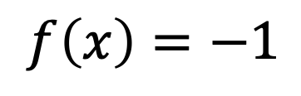
Example
Start with ${\vec{w}}^{T}=\left[0,0,0\right]$. Then, no matter what $\vec{x}$ is, $f\left(x\right)=sign\left({\vec{w}}^{T}\vec{x}\right)$ will be wrong, because it’s undefined.
Suppose that ${\vec{x}}^{T}=\left[0,2,1\right]$, with the label $y=+1$. Since the $f\left(x\right)$ was wrong, we update:
$$\vec{w}=\vec{w}+\vec{x}$$
$$\vec{x}=\left[\begin{matrix}0 \\ 2 \\ 1\end{matrix}\right], y=1$$
$$\vec{w}=\left[\begin{matrix}0 \\ 2 \\ 1\end{matrix}\right]$$
+1
LEARN!
+1
$$f(x)=1$$
$$\vec{w}=\left[\begin{matrix}0 \\ 0 \\ 0\end{matrix}\right]$$
$$f\left(x\right)=−1$$
$f(x)$ undefined everywhere

Slide 28
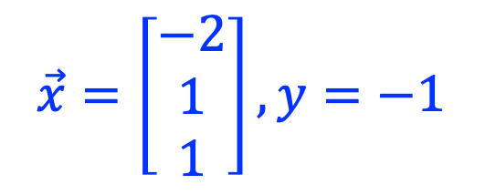
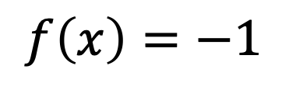

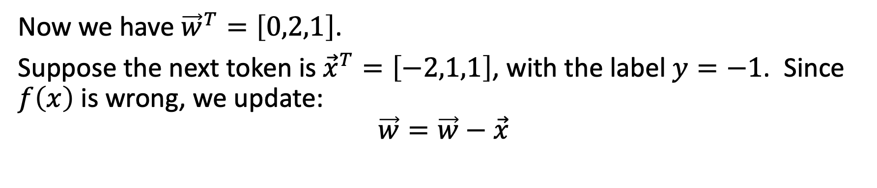
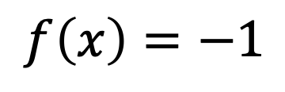
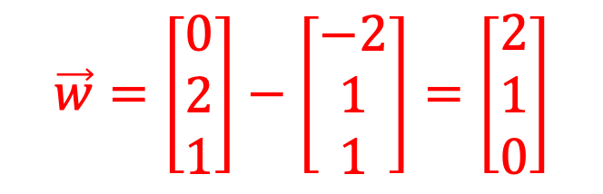

Example
Now we have ${\vec{w}}^{T}=\left[0,2,1\right]$.
Suppose the next token is ${\vec{x}}^{T}=\left[−2,1,1\right]$, with the label $y=−1$. Since $f\left(x\right)$ is wrong, we update:
$$\vec{w}=\vec{w}−\vec{x}$$
$$\vec{x}=\left[\begin{matrix}−2 \\ 1 \\ 1\end{matrix}\right], y=−1$$
$$\vec{w}=\left[\begin{matrix}0 \\ 2 \\ 1\end{matrix}\right]−\left[\begin{matrix}−2 \\ 1 \\ 1\end{matrix}\right]=\left[\begin{matrix}2 \\ 1 \\ 0\end{matrix}\right]$$
+1
+1
$$f(x)=1$$
LEARN!
-1
$$f(x)=1$$
-1
$$f\left(x\right)=−1$$
$$f\left(x\right)=−1$$

Slide 29

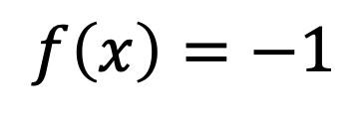
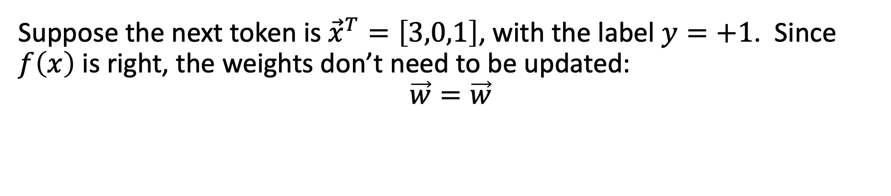
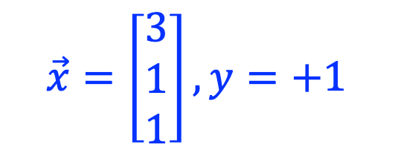

Example
Suppose the next token is ${\vec{x}}^{T}=\left[3,0,1\right]$, with the label $y=+1$. Since $f\left(x\right)$ is right, the weights don’t need to be updated:
$$\vec{w}=\vec{w}$$
$$\vec{x}=\left[\begin{matrix}3 \\ 1 \\ 1\end{matrix}\right], y=+1$$
$\vec{w}$ unchanged
$$f(x)=1$$
No correction necessary!
+1
+1
$$f(x)=1$$
-1
-1
+1
+1
$$f\left(x\right)=−1$$
$$f\left(x\right)=−1$$

Slide 30
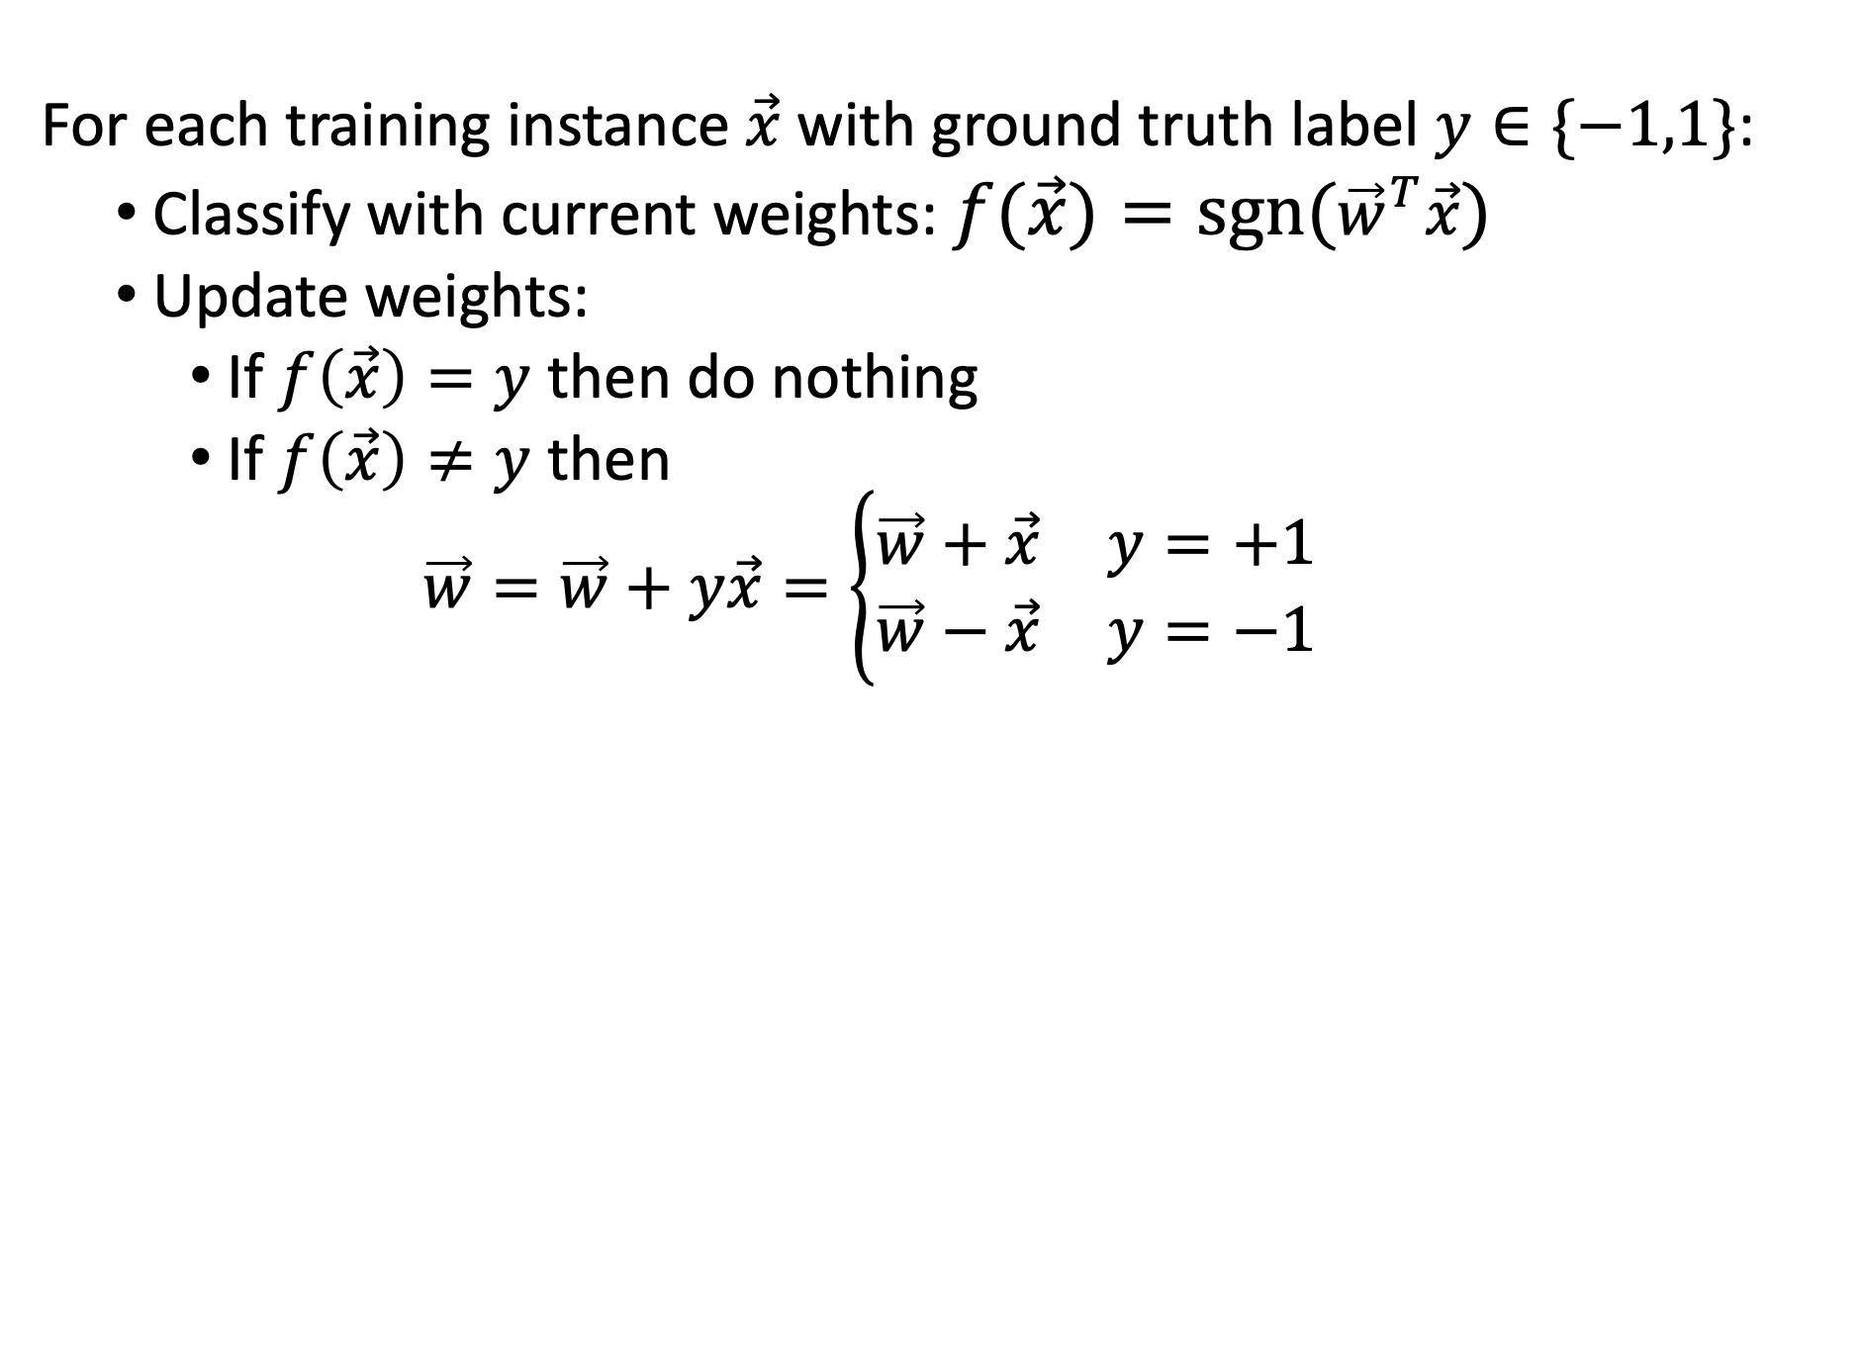
Perceptron Learning Algorithm
For each training instance $\vec{x}$ with ground truth label $y∈\{−1,1\}$:
  Classify with current weights: $f(\vec{x})=sgn({\vec{w}}^{T}\vec{x})$
  Update weights:
    If $f\left(\vec{x}\right)=y$ then do nothing
    If $f\left(\vec{x}\right)≠y$ then
    $$\vec{w}=\vec{w}+y\vec{x}=\left\{\begin{matrix}\vec{w}+\vec{x} & y=+1 \\ \vec{w}−\vec{x} & y=−1\end{matrix}\right.$$

Slide 31
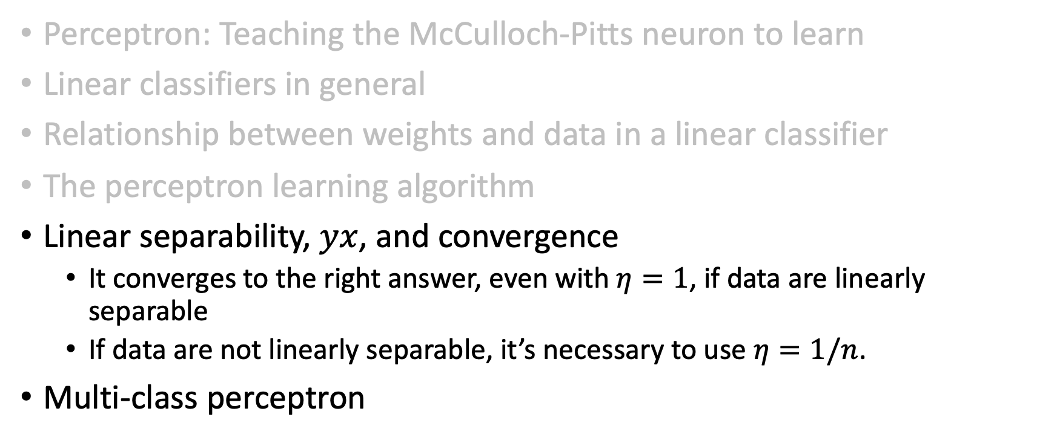
Outline
Perceptron: Teaching the McCulloch-Pitts neuron to learn
Linear classifiers in general
Relationship between weights and data in a linear classifier
The perceptron learning algorithm
Linear separability, $yx$, and convergence
  It converges to the right answer, even with $η=1$, if data are linearly separable
  If data are not linearly separable, it’s necessary to use $η=1/n$.
Multi-class perceptron

Slide 32


Does the perceptron find an answer?
Does it find the correct answer?
Suppose we run the perceptron algorithm for a very long time. Will it converge to an answer? Will it converge to the correct answer?
That depends on whether or not the data are linearly separable.
”Linearly separable” means it’s possible to find a line (a hyperplane, in D-dimensional space) that separates the two classes, like this:
$$x_{2}$$
$$x_{1}$$

Slide 33
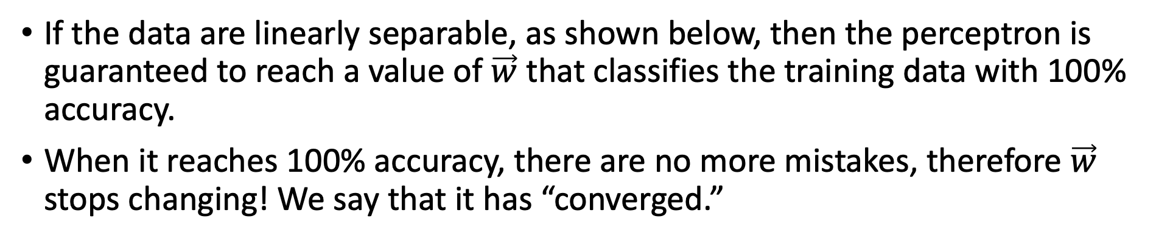
Convergence of the Perceptron
If the data are linearly separable, as shown below, then the perceptron is guaranteed to reach a value of $\vec{w}$ that classifies the training data with 100% accuracy.
When it reaches 100% accuracy, there are no more mistakes, therefore $\vec{w}$ stops changing! We say that it has “converged.”
$$x_{2}$$
$$x_{1}$$

Slide 34
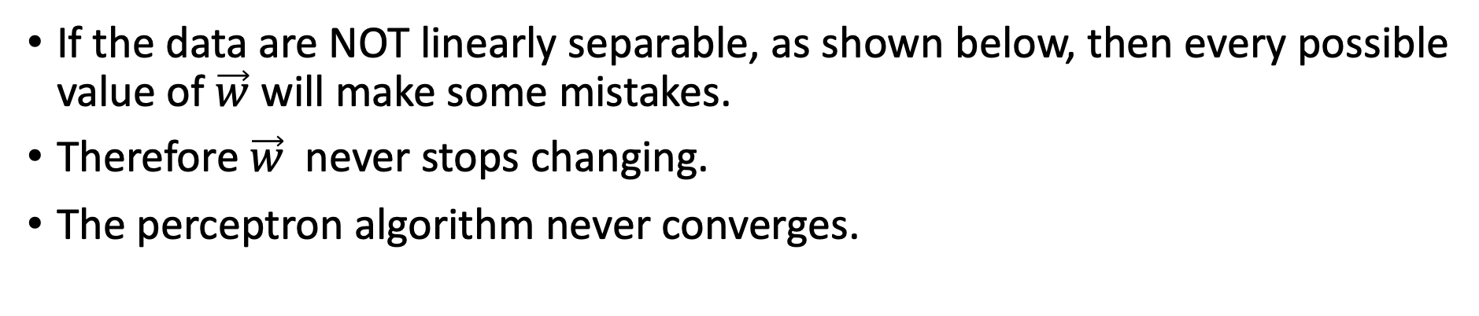

Convergence of the Perceptron
If the data are NOT linearly separable, as shown below, then every possible value of $\vec{w}$ will make some mistakes.
Therefore $\vec{w}$ never stops changing.
The perceptron algorithm never converges.
$$x_{2}$$
$$x_{1}$$
$$?$$

Slide 35
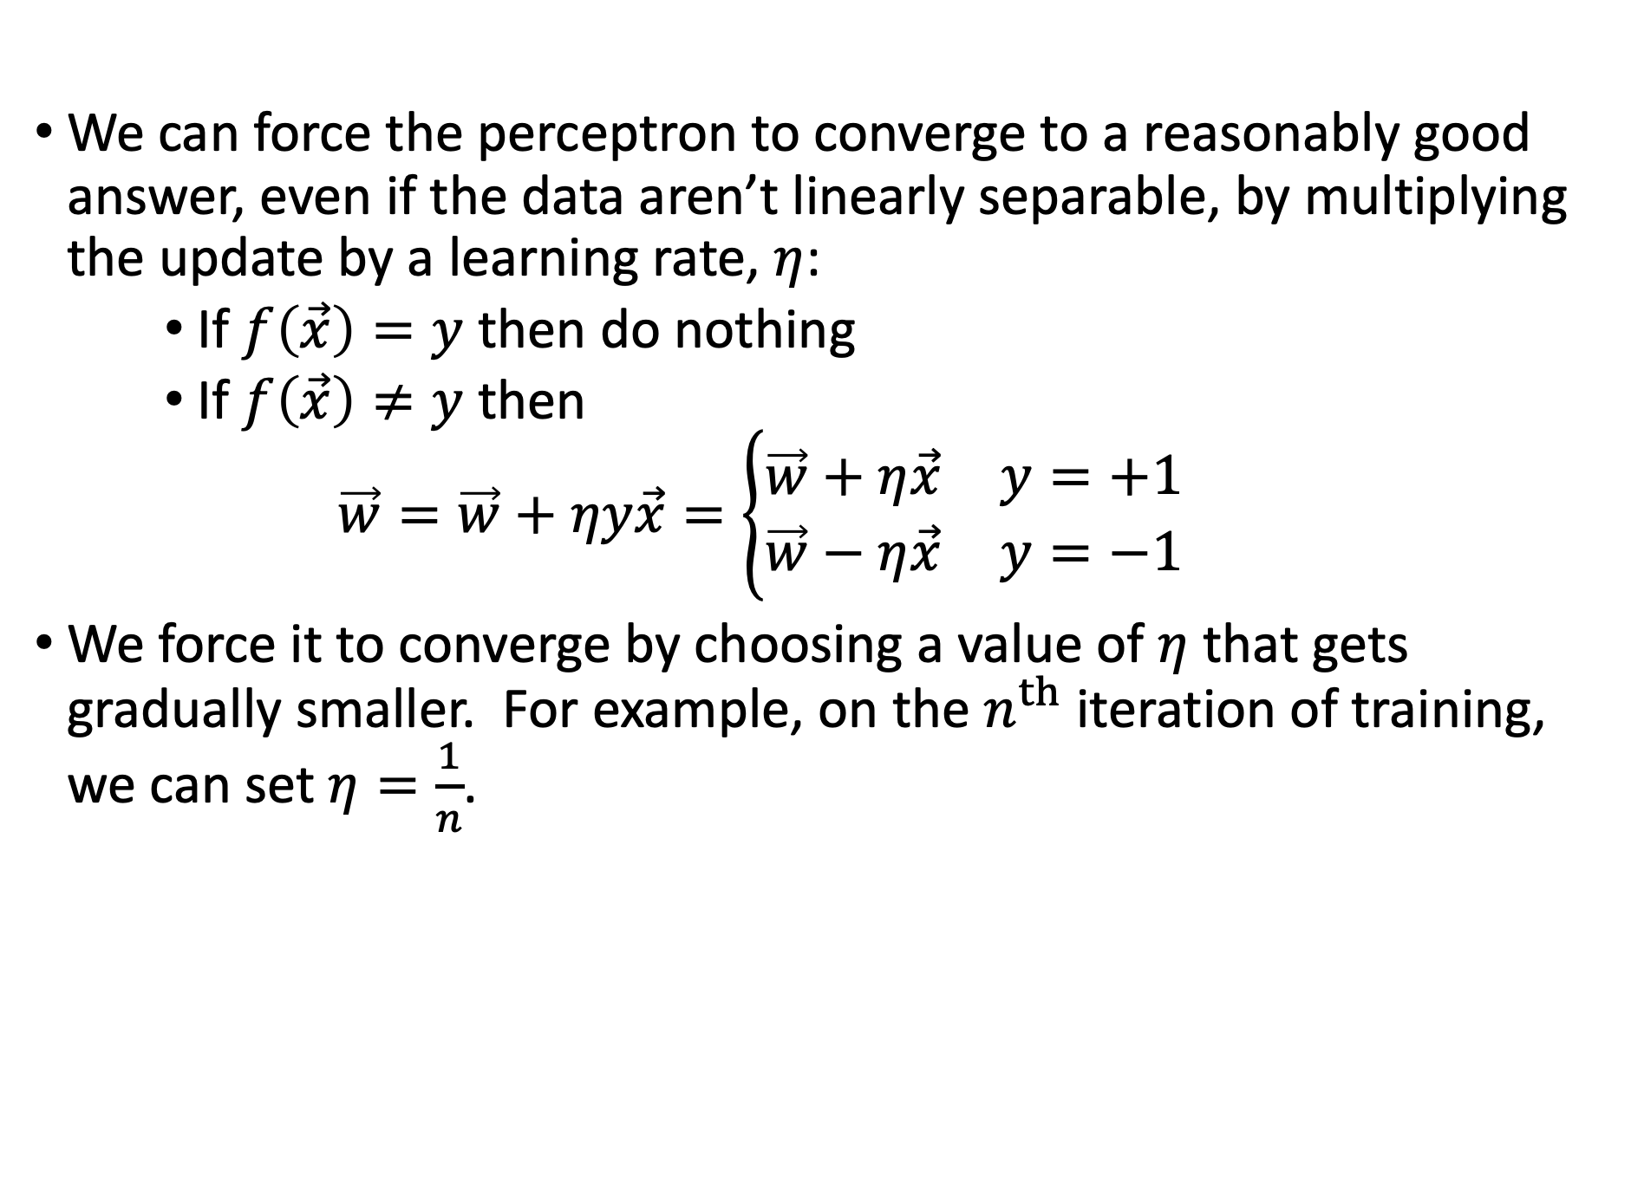
Perceptron with learning rate
We can force the perceptron to converge to a reasonably good answer, even if the data aren’t linearly separable, by multiplying the update by a learning rate, $η$:
    If $f\left(\vec{x}\right)=y$ then do nothing
    If $f\left(\vec{x}\right)≠y$ then
    $$\vec{w}=\vec{w}+ηy\vec{x}=\left\{\begin{matrix}\vec{w}+η\vec{x} & y=+1 \\ \vec{w}−η\vec{x} & y=−1\end{matrix}\right.$$
We force it to converge by choosing a value of $η$ that gets gradually smaller. For example, on the $n^{th}$ iteration of training, we can set $η=\frac{1}{n}$.

Slide 36

Outline
Perceptron: Teaching the McCulloch-Pitts neuron to learn
Linear classifiers in general
Relationship between weights and data in a linear classifier
The perceptron learning algorithm
Linear separability, $yx$, and convergence
  It converges to the right answer, even with $η=1$, if data are linearly separable
  If data are not linearly separable, it’s necessary to use $η=1/n$.
Multi-class perceptron

Slide 37








Multi-Class Perceptron
True class is $y∈\{1,2,…,V\}$.
Classifier output is
$$f(x)={argmax}_{c=0}^{V−1}\left(w_{c,1}x_{1}+…+w_{c,D}x_{D}+b_{c}\right)$$
$$={argmax}_{c=1}^{V}\left({\vec{w}}_{c}^{T}\vec{x}\right)$$
$$\vec{x}=\left[\begin{matrix}x_{1} \\ \begin{matrix}⋮ \\ x_{D}\end{matrix} \\ 1\end{matrix}\right],{\vec{w}}_{c}=\left[\begin{matrix}w_{c,1} \\ \begin{matrix}⋮ \\ w_{c,D}\end{matrix} \\ b_{c}\end{matrix}\right]$$
Input
Weights
1
$$b_{0}$$
$$b_{1}$$
x₁
Output: ${argmax}_{c=1}^{V}\left({\vec{w}}_{c}^{T}\vec{x}\right)$
argmax
x₂
.
.
.
.
.
.
.
.
.
$$b_{V−1}$$
$$w_{0D}$$
$$w_{1D}$$
x_{D}
$$w_{V−1,D}$$

Slide 38
























Multi-Class Perceptron
The argmax classifier,
$$f(\vec{x})={argmax}_{c=1}^{V}\left({\vec{w}}_{c}^{T}\vec{x}\right)$$
results in classification boundaries that are piece-wise linear.
Just think about why that is: the boundary between the regions for y=1 and y=2 is the line where
$${\vec{w}}_{1}^{T}\vec{x}={\vec{w}}_{2}^{T}\vec{x}$$
… or in other words, ${\left({\vec{w}}_{1}−{\vec{w}}_{2}\right)}^{T}\vec{x}=0$, which is the equation for a straight line!
$$x_{2}$$
$$f(x)=1$$
$$f(x)=2$$
$$f(x)=3$$
$$f(x)=4$$
$$f(x)=0$$
$$f(x)=6$$
$$f(x)=8$$
$$f(x)=5$$
$$f(x)=9$$
$$f(x)=10$$
$$f(x)=11$$
$$f(x)=12$$
$$f(x)=7$$
$$f(x)=13$$
$$f(x)=14$$
$$f(x)=15$$
$$f(x)=16$$
$$f(x)=17$$
$$f(x)=18$$
$$f(x)=19$$
$$x_{1}$$

Slide 39

Training a Multi-Class Perceptron
First, classify a training token, $f(\vec{x})={argmax}_{c=1}^{V}\left({\vec{w}}_{c}^{T}\vec{x}\right)$. Then:
  If $f\left(\vec{x}\right)=y$ then do nothing
  If $f\left(\vec{x}\right)≠y$ then
    Add x to the vector that should have been the winner:
    $${\vec{w}}_{y}={\vec{w}}_{y}+η\vec{x}$$
    Subtract x from the vector that shouldn’t have won, but did:
    $${\vec{w}}_{f(x)}={\vec{w}}_{f(x)}−η\vec{x}$$
    Don’t change any of the other classes

Slide 40

Conclusions
Perceptron as a model of a biological neuron: $f(x)=sign(w^{T}x)$
The perceptron learning algorithm: if $y=f(x)$ then do nothing, else $w=w+ηyx$.
Linear separability, $yx$, and convergence
  It converges to the right answer, even with $η=1$, if data are linearly separable
  If data are not linearly separable, it’s necessary to use $η=1/n$.
Multi-class perceptron: if $y=f(x)$ then do nothing, else $w_{y}=w_{y}+ηx$, and $w_{f(x)}=w_{f(x)}−ηx$.

