Slide 1
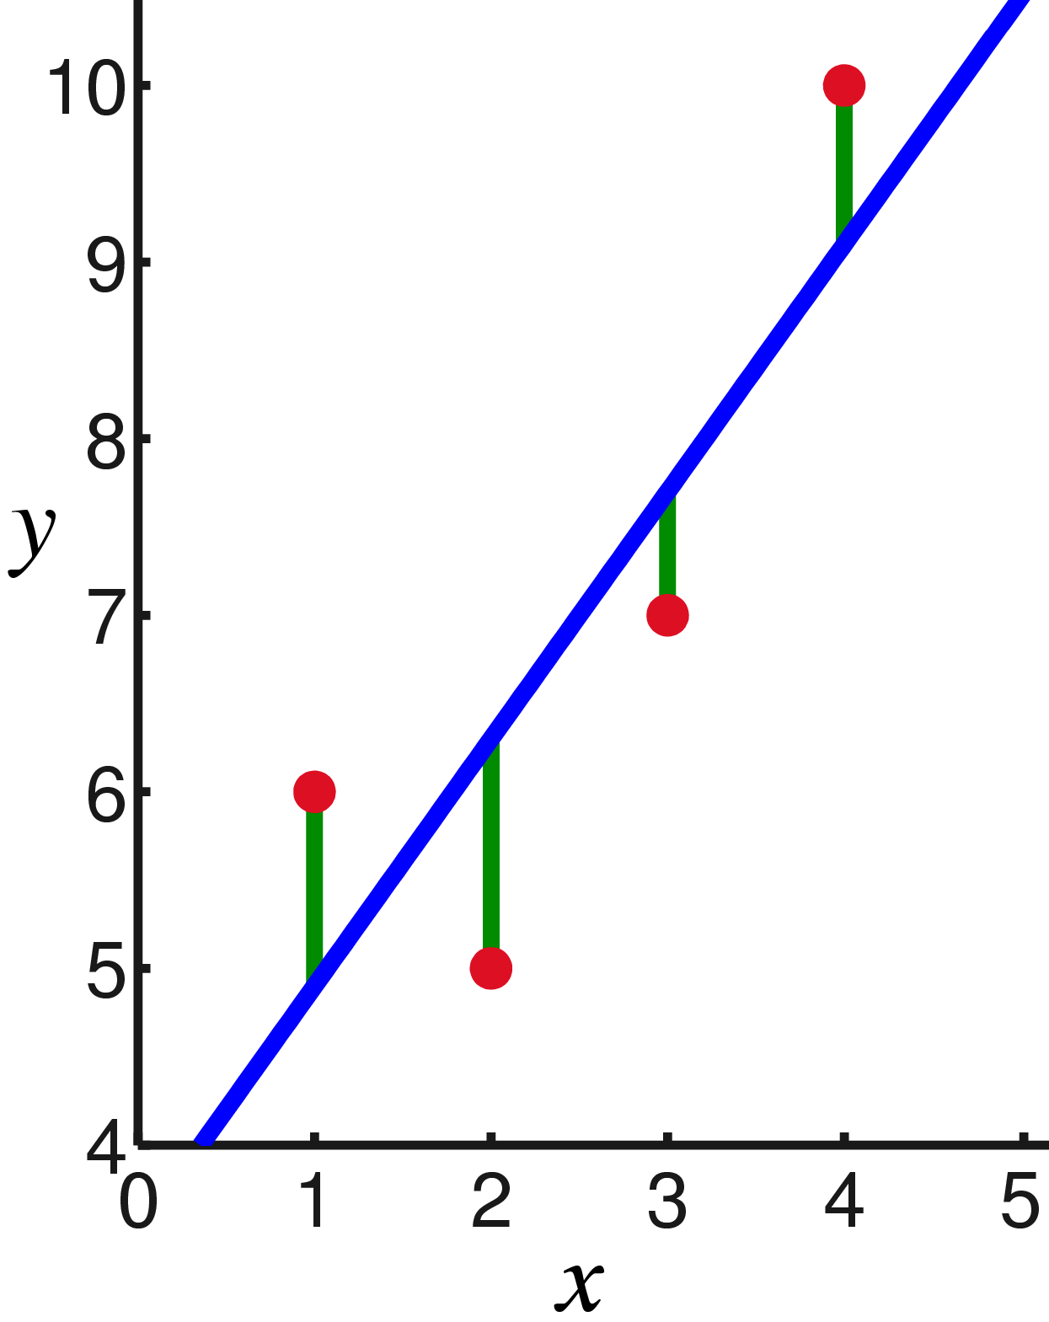
CS440/ECE448 Lecture 7: Linear Regression
Mark Hasegawa-Johnson, 1/2022
License: CC-BY 4.0; redistribute at will, as long as you cite the source.
Public domain image, Oleg Alexandrov, 2008

Slide 2
Outline
Review: perceptron
Linear regression: a neuron without the nonlinearity
Mean-squared error
Learning the solution: stochastic gradient descent
Multiple linear regression

Slide 3
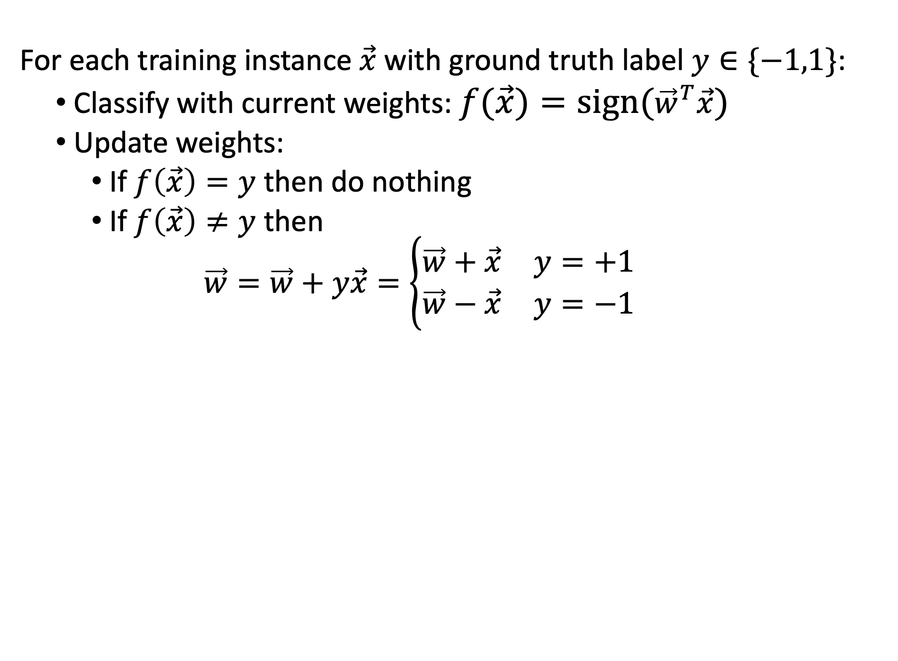
Review: Perceptron Learning Algorithm
For each training instance $\vec{x}$ with ground truth label $y∈\{−1,1\}$:
Classify with current weights: $f(\vec{x})=sign({\vec{w}}^{T}\vec{x})$
Update weights:
If $f\left(\vec{x}\right)=y$ then do nothing
If $f\left(\vec{x}\right)≠y$ then
$$\vec{w}=\vec{w}+y\vec{x}=\left\{\begin{matrix}\vec{w}+\vec{x} & y=+1 \\ \vec{w}−\vec{x} & y=−1\end{matrix}\right.$$

Slide 4
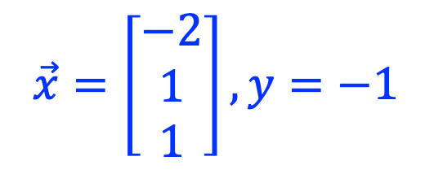
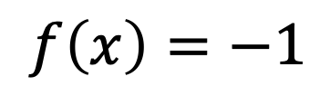

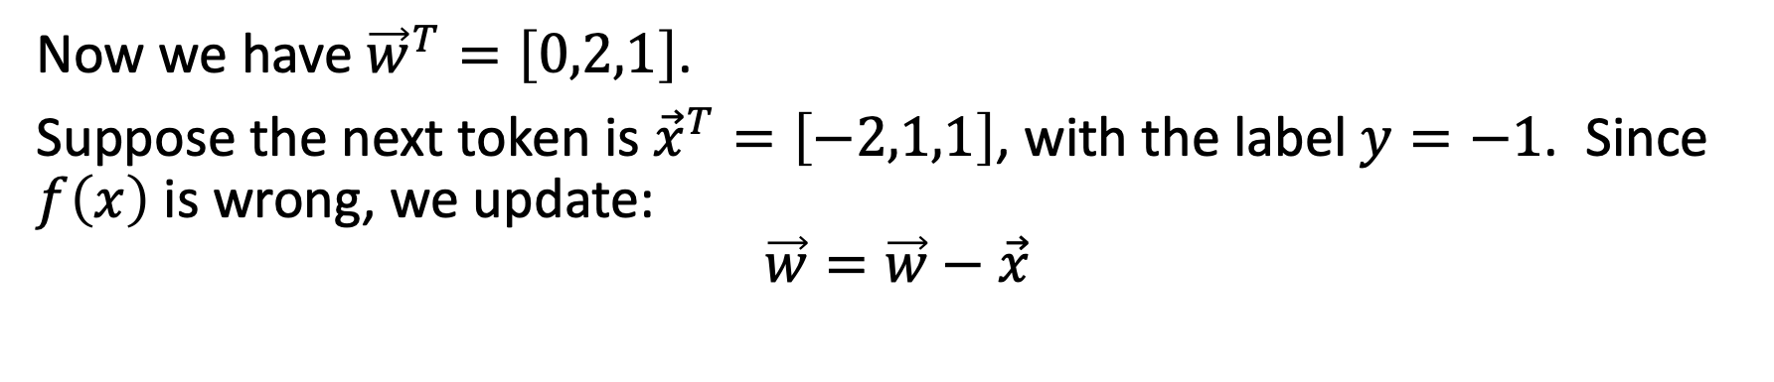
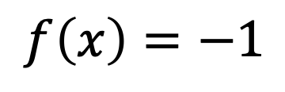
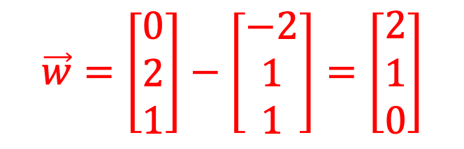

Example
Now we have ${\vec{w}}^{T}=\left[0,2,1\right]$.
Suppose the next token is ${\vec{x}}^{T}=\left[−2,1,1\right]$, with the label $y=−1$. Since $f\left(x\right)$ is wrong, we update:
$$\vec{w}=\vec{w}−\vec{x}$$
$$\vec{x}=\left[\begin{matrix}−2 \\ 1 \\ 1\end{matrix}\right], y=−1$$
$$\vec{w}=\left[\begin{matrix}0 \\ 2 \\ 1\end{matrix}\right]−\left[\begin{matrix}−2 \\ 1 \\ 1\end{matrix}\right]=\left[\begin{matrix}2 \\ 1 \\ 0\end{matrix}\right]$$
+1
+1
$$f(x)=1$$
LEARN!
-1
$$f(x)=1$$
-1
$$f\left(x\right)=−1$$
$$f\left(x\right)=−1$$

Slide 5
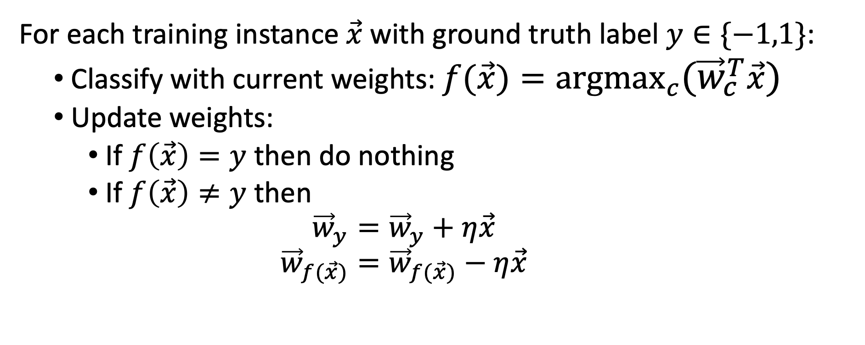
Review: Multi-Class Perceptron
For each training instance $\vec{x}$ with ground truth label $y∈\{−1,1\}$:
Classify with current weights: $f(\vec{x})=\underset{c}{argmax}{({\vec{w}}_{c}^{T}\vec{x})}$
Update weights:
If $f\left(\vec{x}\right)=y$ then do nothing
If $f\left(\vec{x}\right)≠y$ then
$${\vec{w}}_{y}={\vec{w}}_{y}+η\vec{x}$$
$${\vec{w}}_{f(\vec{x})}={\vec{w}}_{f(\vec{x})}−η\vec{x}$$

Slide 6










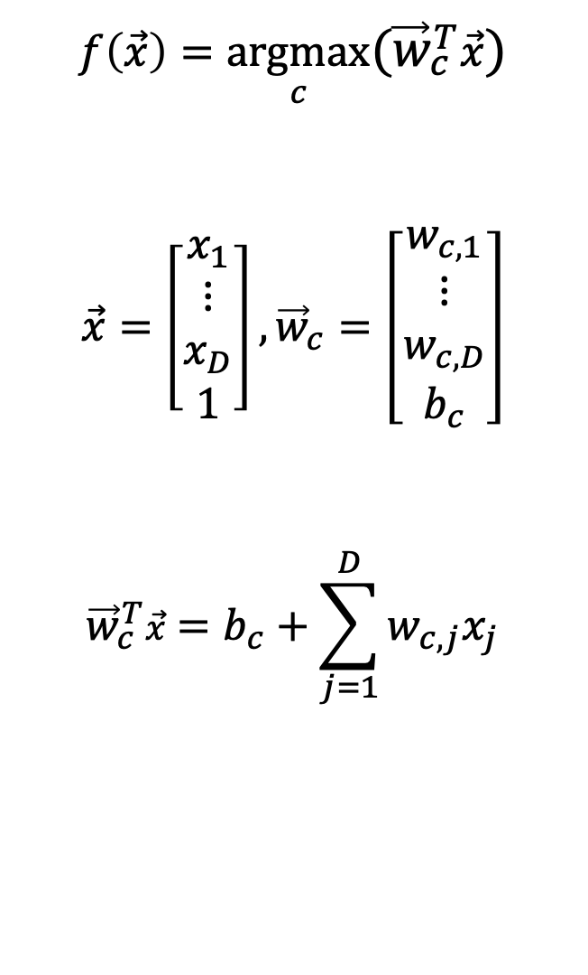













Notation: Vector dot product, with bias added
$$x_{2}$$
$$f(x)=1$$
$$f(x)=2$$
$$f(x)=3$$
$$f\left(\vec{x}\right)=\underset{c}{argmax}{({\vec{w}}_{c}^{T}\vec{x})}$$
$$\vec{x}=\left[\begin{matrix}x_{1} \\ \begin{matrix}⋮ \\ x_{D}\end{matrix} \\ 1\end{matrix}\right],{\vec{w}}_{c}=\left[\begin{matrix}w_{c,1} \\ \begin{matrix}⋮ \\ w_{c,D}\end{matrix} \\ b_{c}\end{matrix}\right]$$
$${\vec{w}}_{c}^{T}\vec{x}=b_{c}+\sum_{j=1}^{D}{w_{c,j}x_{j}}$$
$$f(x)=4$$
$$f(x)=0$$
$$f(x)=6$$
$$f(x)=8$$
$$f(x)=5$$
$$f(x)=9$$
$$f(x)=10$$
$$f(x)=11$$
$$f(x)=12$$
$$f(x)=7$$
$$f(x)=13$$
$$f(x)=14$$
$$f(x)=15$$
$$f(x)=16$$
$$f(x)=17$$
$$f(x)=18$$
$$f(x)=19$$
$$x_{1}$$

Slide 7
Outline
Review: perceptron
Linear regression: a neuron without the nonlinearity
Mean-squared error
Learning the solution: stochastic gradient descent
Multiple linear regression

Slide 8
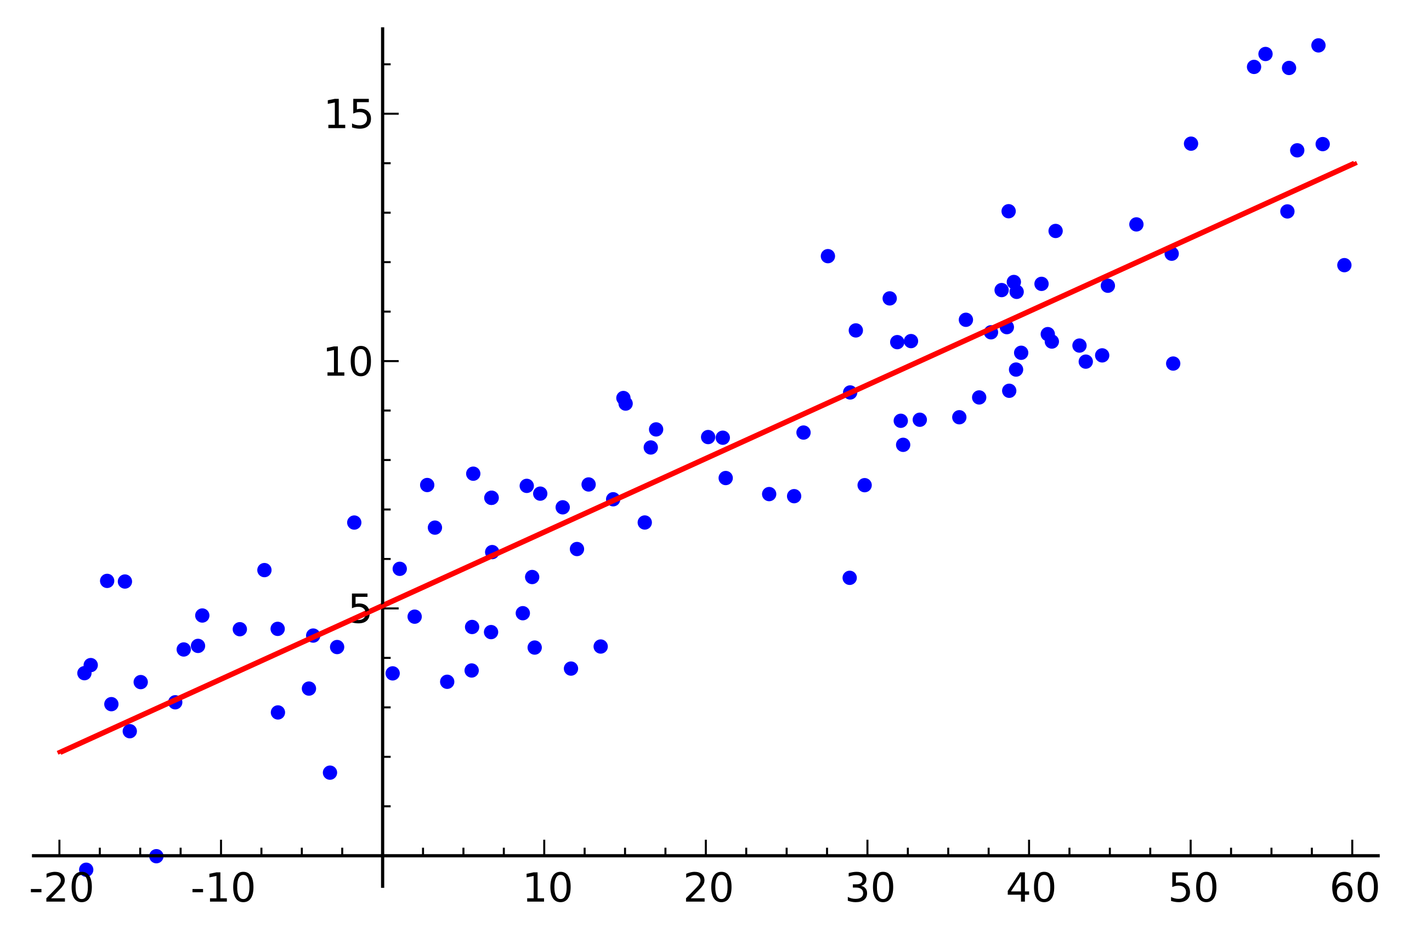


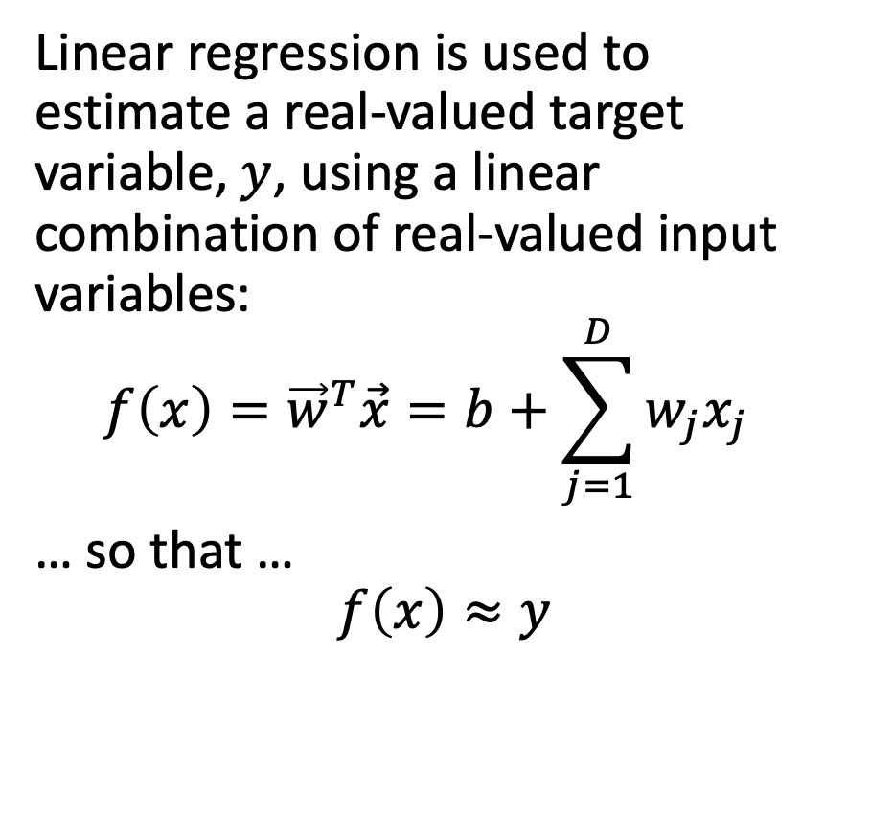

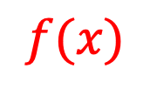

Linear regression
$$y$$
Linear regression is used to estimate a real-valued target variable, $y$, using a linear combination of real-valued input variables:
$$f\left(x\right)={\vec{w}}^{T}\vec{x}=b+\sum_{j=1}^{D}{w_{j}x_{j}}$$
… so that …
$$f\left(x\right)≈y$$
$$f(x)$$
$$b$$
$$w_{1}$$
$$x_{1}$$
Linear regression. Public domain image, Seewaqu, 2010

Slide 9
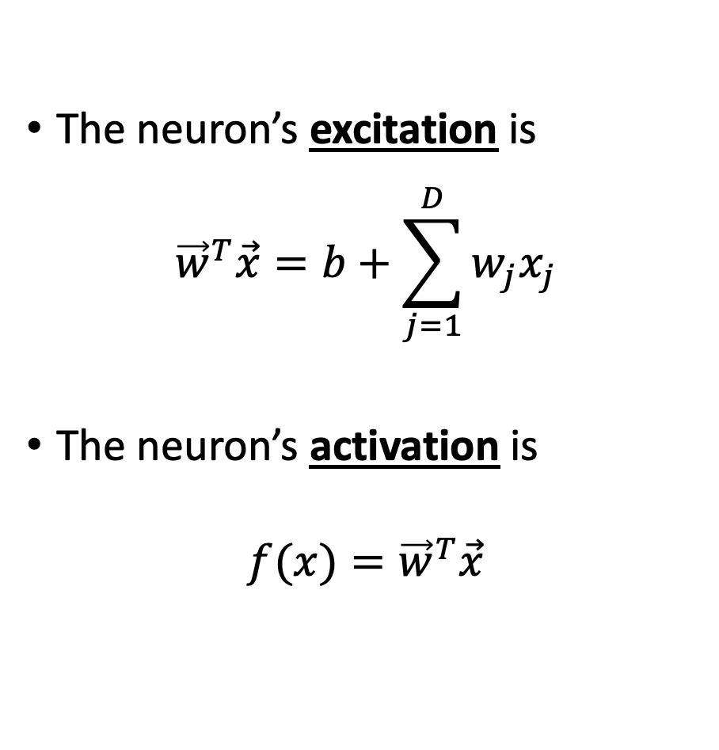
Linear regression is like a neuron without a nonlinearity
Input
The neuron’s excitation is
$${\vec{w}}^{T}\vec{x}=b+\sum_{j=1}^{D}{w_{j}x_{j}}$$
The neuron’s activation is
$$f(x)={\vec{w}}^{T}\vec{x}$$
1
b
x₁
w₁
Output: w^{T}x
x₂
w₂
.
.
.
w_{D}
x_{D}
Weights

Slide 10
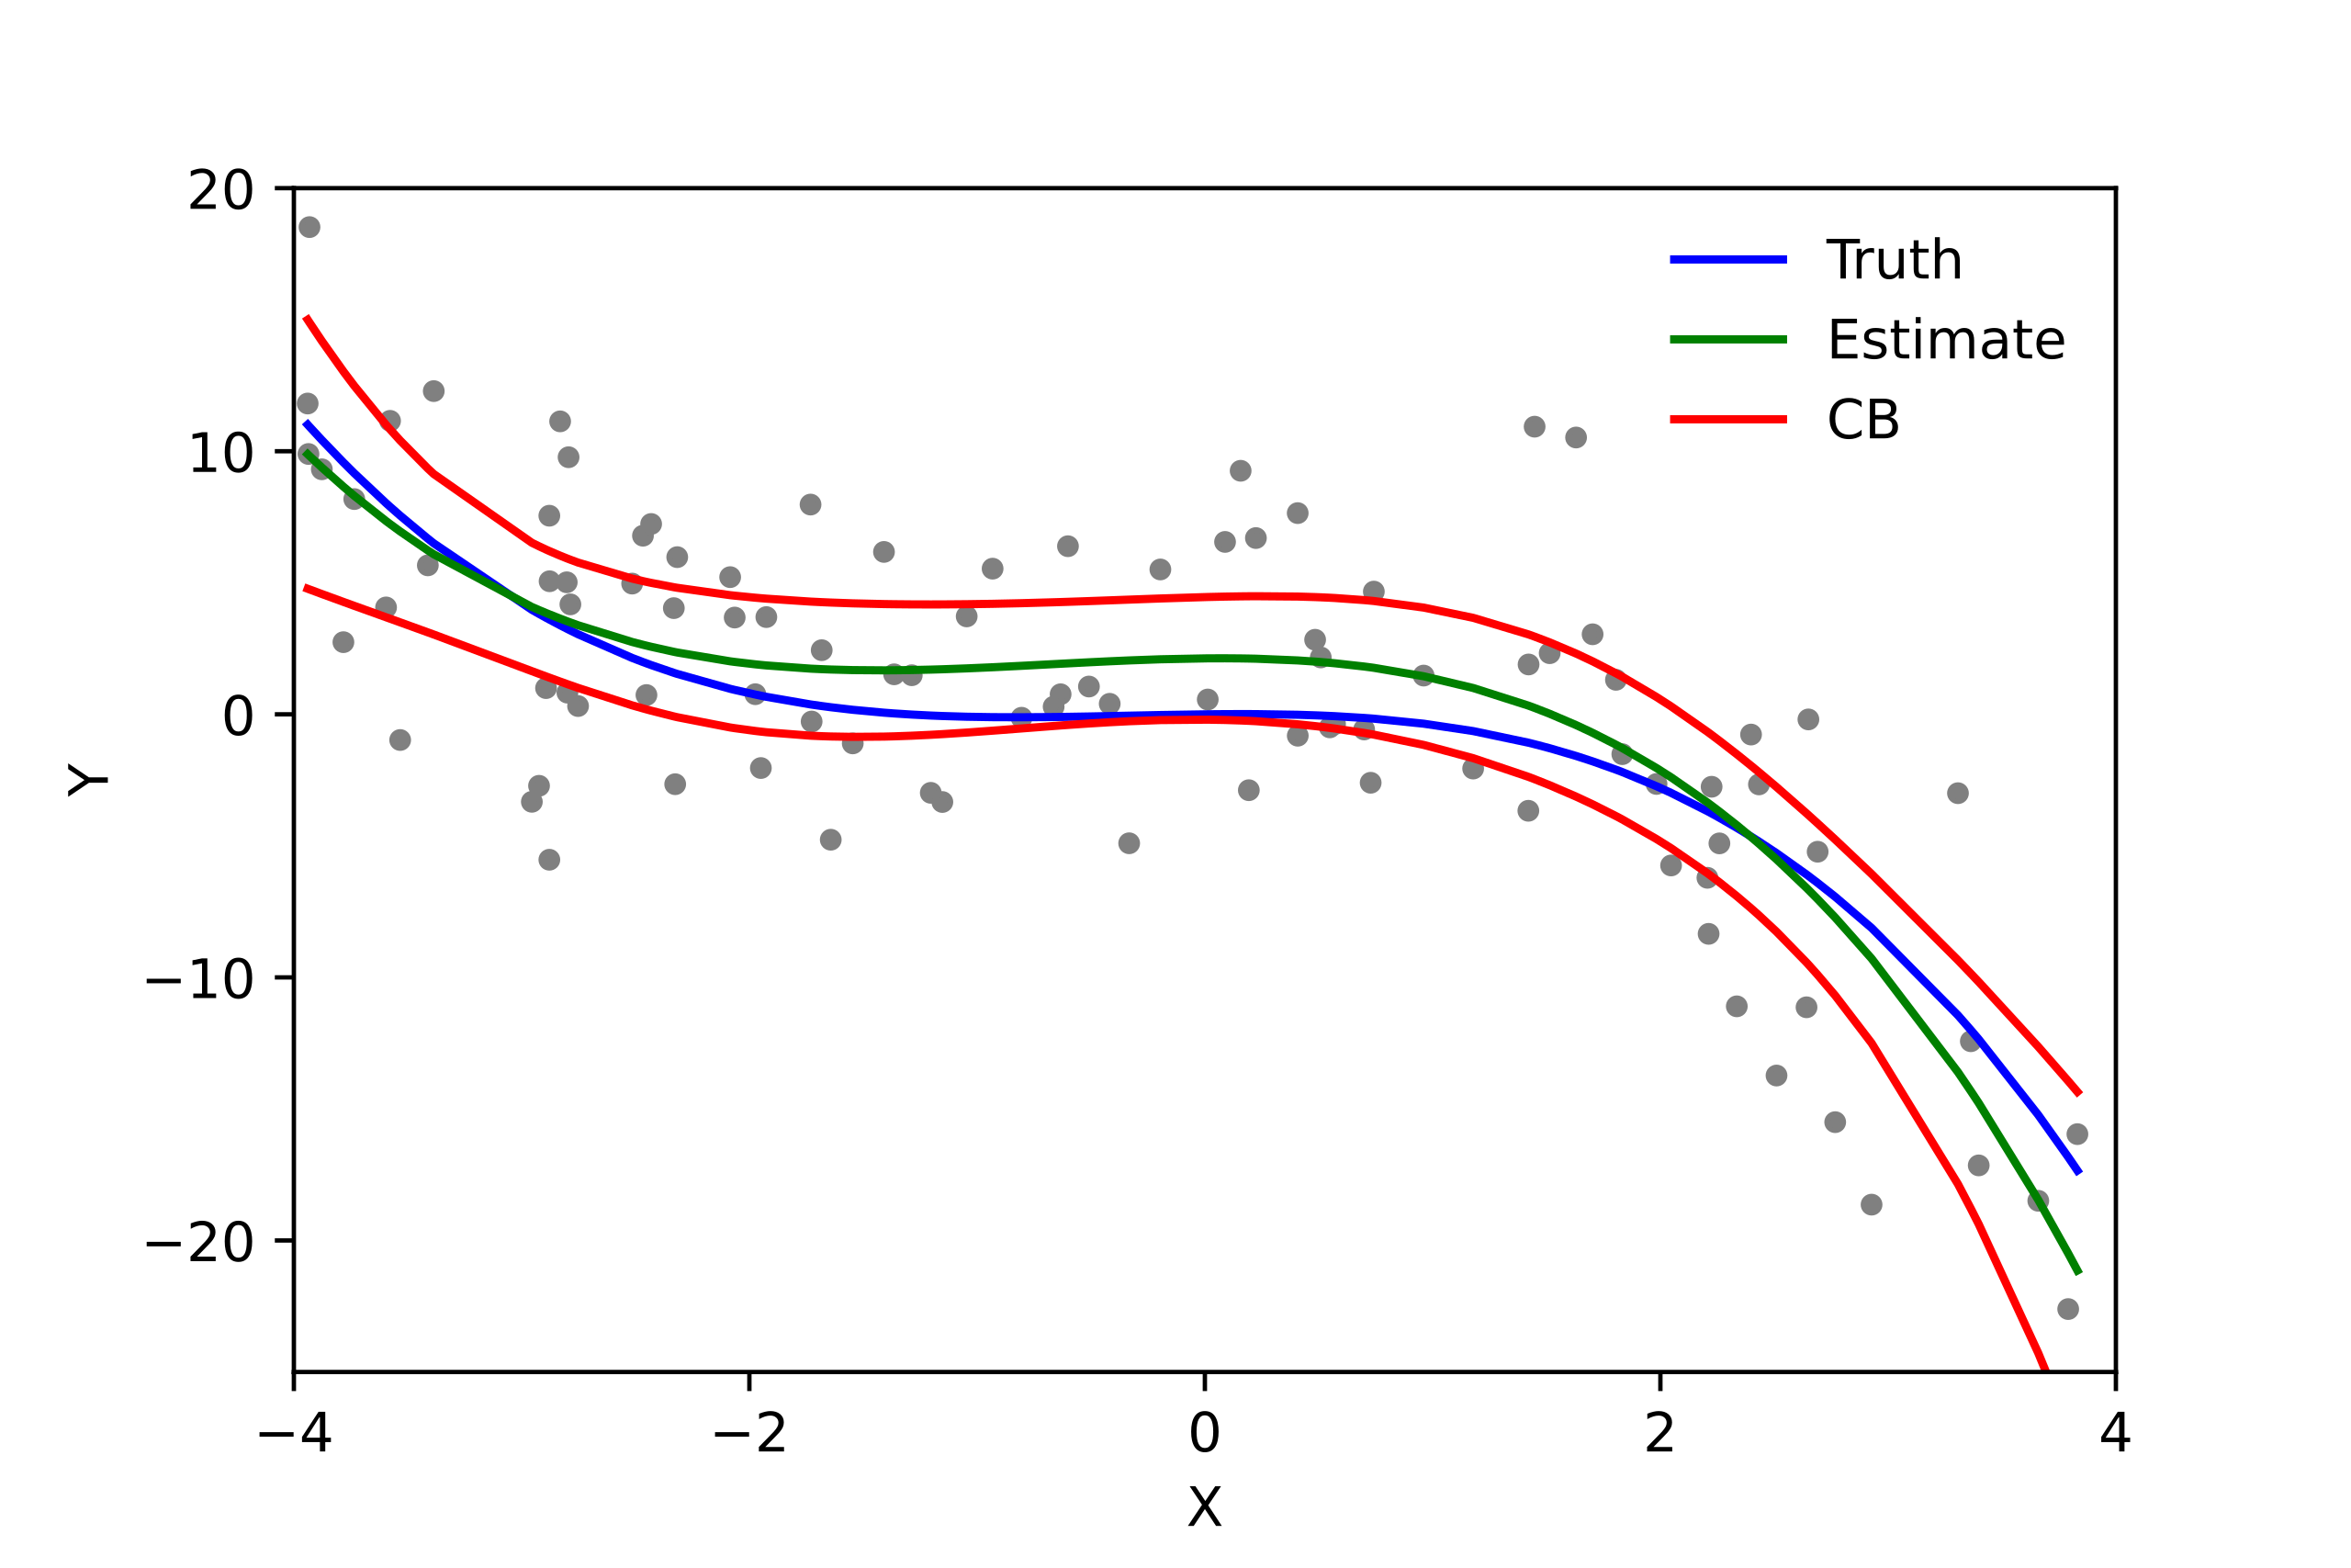
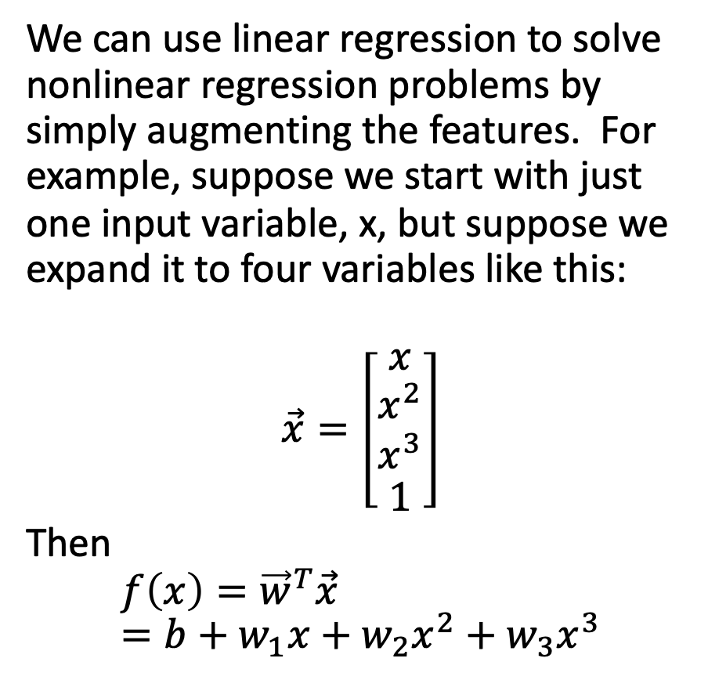
Polynomial regression = multivariate linear regression
We can use linear regression to solve nonlinear regression problems by simply augmenting the features. For example, suppose we start with just one input variable, x, but suppose we expand it to four variables like this:
$$\vec{x}=\left[\begin{matrix}x \\ \begin{matrix}x^{2} \\ x^{3}\end{matrix} \\ 1\end{matrix}\right]$$
Then
$$f\left(x\right)={\vec{w}}^{T}\vec{x}=b+w_{1}x+w_{2}x^{2}+w_{3}x^{3}$$
Polyreg_scheffe.svg. CC-BY 3.0, Skbkekas, 2009

Slide 11
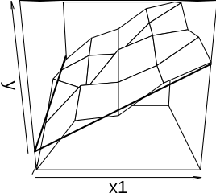
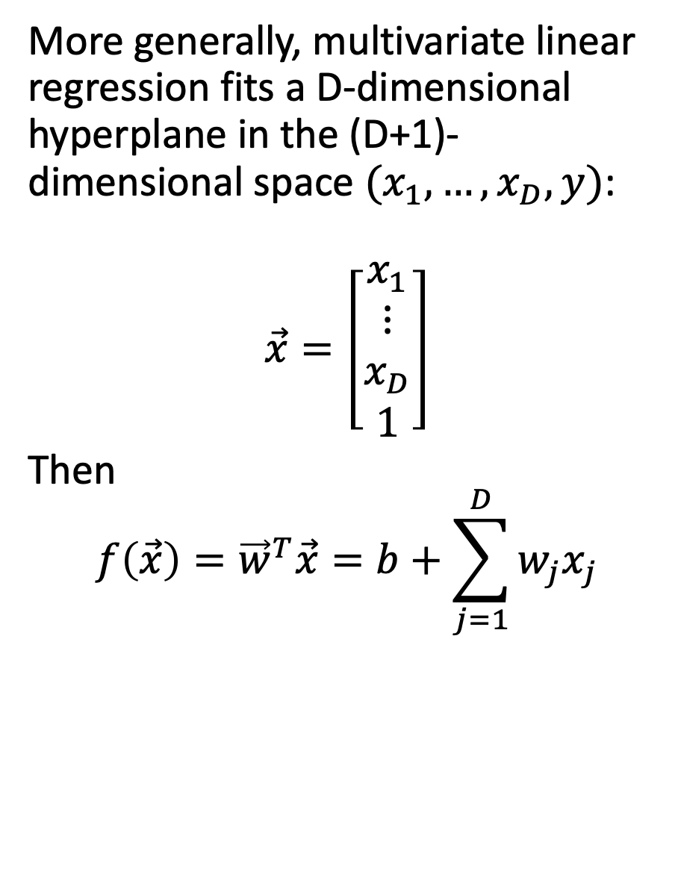
Multivariate linear regression in general
More generally, multivariate linear regression fits a D-dimensional hyperplane in the (D+1)-dimensional space $(x_{1},…,x_{D},y)$:
$$\vec{x}=\left[\begin{matrix}x_{1} \\ \begin{matrix}⋮ \\ x_{D}\end{matrix} \\ 1\end{matrix}\right]$$
Then
$$f\left(\vec{x}\right)={\vec{w}}^{T}\vec{x}=b+\sum_{j=1}^{D}{w_{j}x_{j}}$$
Regression_plane_avc_R.svg. CC-SA 3.0, Cdang, 2013

Slide 12
Outline
Review: perceptron
Linear regression: a neuron without the nonlinearity
Mean-squared error
Learning the solution: stochastic gradient descent
Multiple linear regression

Slide 13
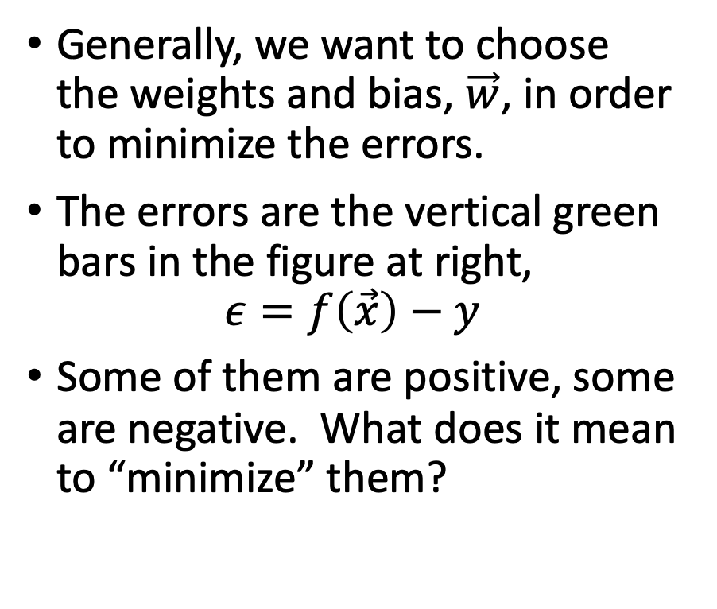

What does it mean that $f\left(x\right)≈y$?
Generally, we want to choose the weights and bias, $\vec{w}$, in order to minimize the errors.
The errors are the vertical green bars in the figure at right,
$$ε=f\left(\vec{x}\right)−y$$
Some of them are positive, some are negative. What does it mean to “minimize” them?
Public domain image, Oleg Alexandrov, 2008

Slide 14
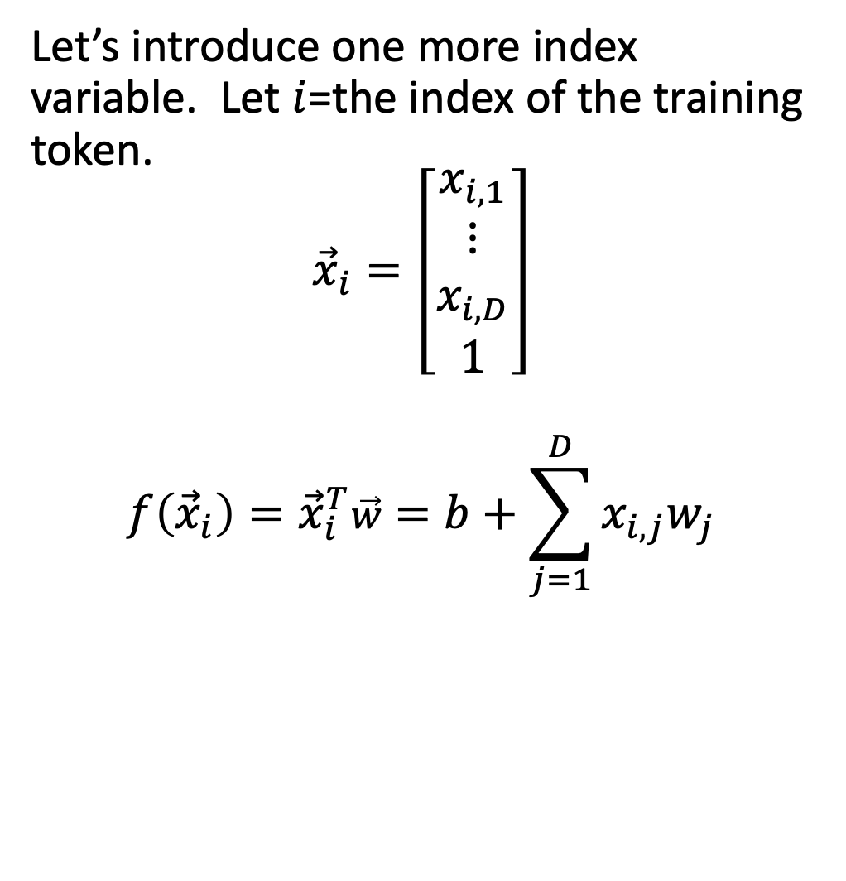
First: count the training tokens
Let’s introduce one more index variable. Let $i$=the index of the training token.
$${\vec{x}}_{i}=\left[\begin{matrix}x_{i,1} \\ \begin{matrix}⋮ \\ x_{i,D}\end{matrix} \\ 1\end{matrix}\right]$$
$$f\left({\vec{x}}_{i}\right)={\vec{x}}_{i}^{T}\vec{w}=b+\sum_{j=1}^{D}{x_{i,j}w_{j}}$$
Public domain image, Oleg Alexandrov, 2008

Slide 15
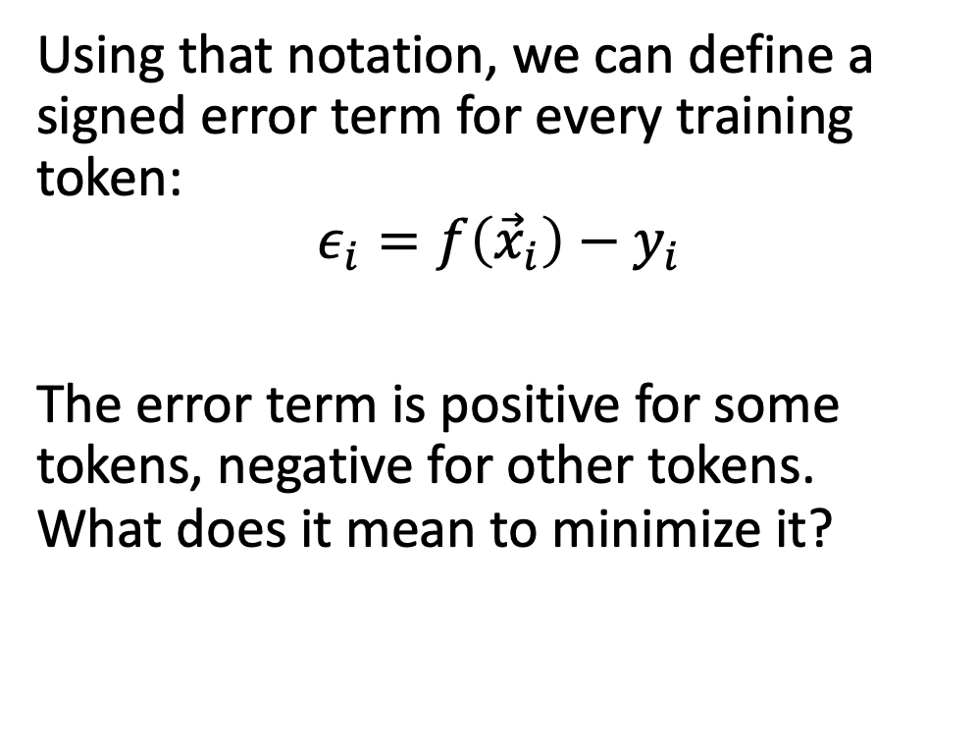
Training token errors
Using that notation, we can define a signed error term for every training token:
$$ε_{i}=f\left({\vec{x}}_{i}\right)−y_{i}$$
The error term is positive for some tokens, negative for other tokens. What does it mean to minimize it?
Public domain image, Oleg Alexandrov, 2008

Slide 16
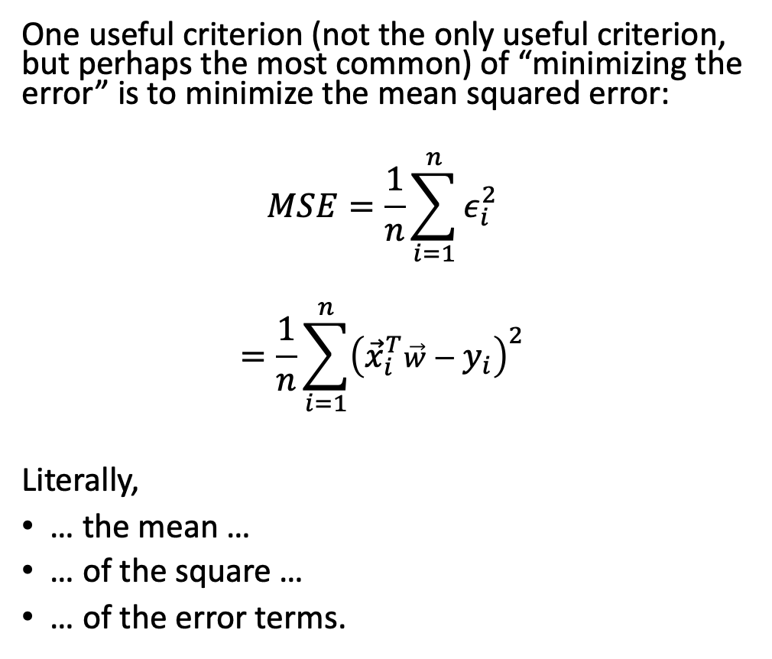
Mean-squared error
One useful criterion (not the only useful criterion, but perhaps the most common) of “minimizing the error” is to minimize the mean squared error:
$$MSE=\frac{1}{n}\sum_{i=1}^{n}{ε_{i}^{2}}$$
$$=\frac{1}{n}\sum_{i=1}^{n}{{\left({\vec{x}}_{i}^{T}\vec{w}−y_{i}\right)}^{2}}$$
Literally,
… the mean …
… of the square …
… of the error terms.
Public domain image, Oleg Alexandrov, 2008

Slide 17
Outline
Review: perceptron
Linear regression: a neuron without the nonlinearity
Mean-squared error
Learning the solution: stochastic gradient descent
Multiple linear regression

Slide 18
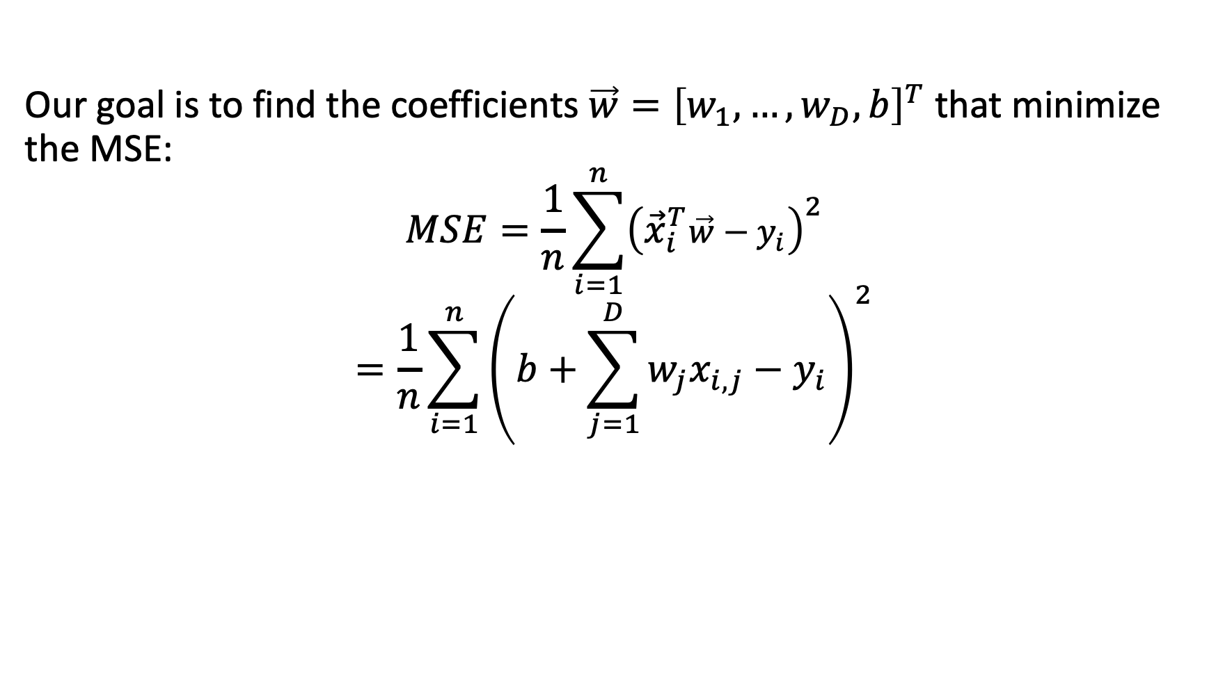
Minimizing the MSE
Our goal is to find the coefficients $\vec{w}={\left[w_{1},…,w_{D},b\right]}^{T}$ that minimize the MSE:
$$MSE=\frac{1}{n}\sum_{i=1}^{n}{{\left({\vec{x}}_{i}^{T}\vec{w}−y_{i}\right)}^{2}}$$
$$=\frac{1}{n}\sum_{i=1}^{n}{{\left(b+\sum_{j=1}^{D}{w_{j}x_{i,j}}−y_{i}\right)}^{2}}$$

Slide 19
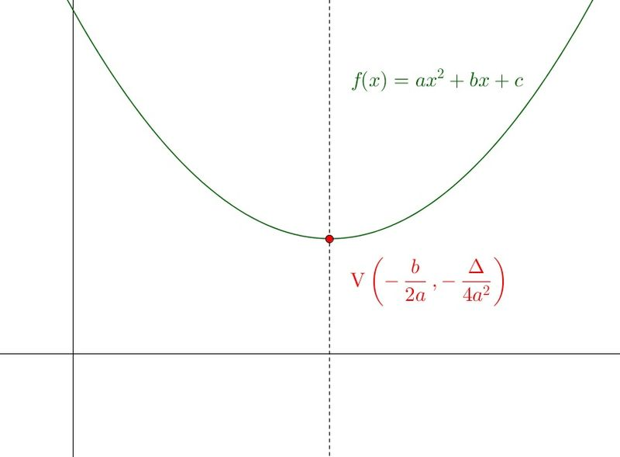
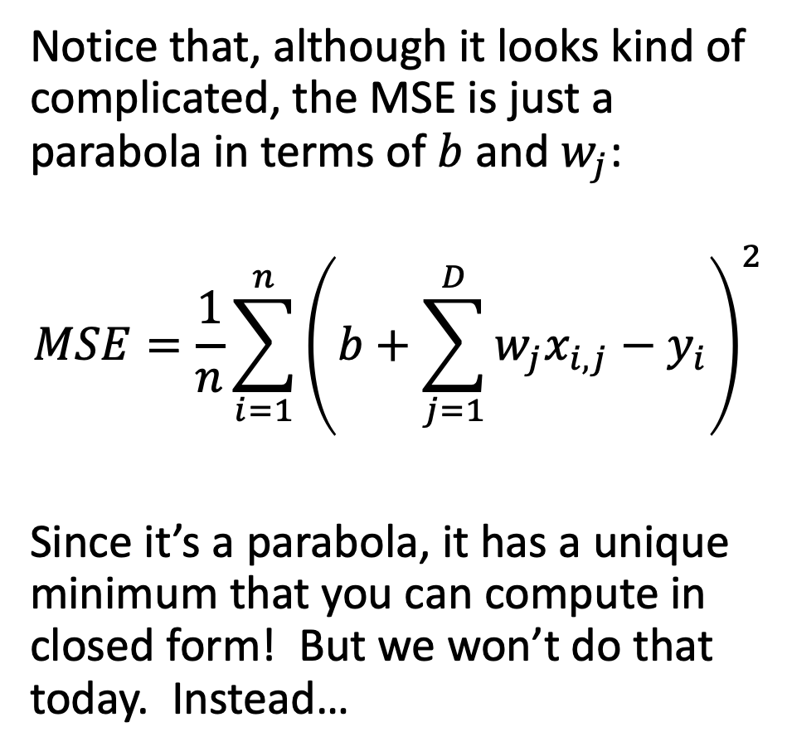


MSE = Parabola
Notice that, although it looks kind of complicated, the MSE is just a parabola in terms of $b$ and $w_{j}$:
$$MSE=\frac{1}{n}\sum_{i=1}^{n}{{\left(b+\sum_{j=1}^{D}{w_{j}x_{i,j}}−y_{i}\right)}^{2}}$$
Since it’s a parabola, it has a unique minimum that you can compute in closed form! But we won’t do that today. Instead…
$$MSE=aw^{2}+bw+c$$
$$w$$

Slide 20

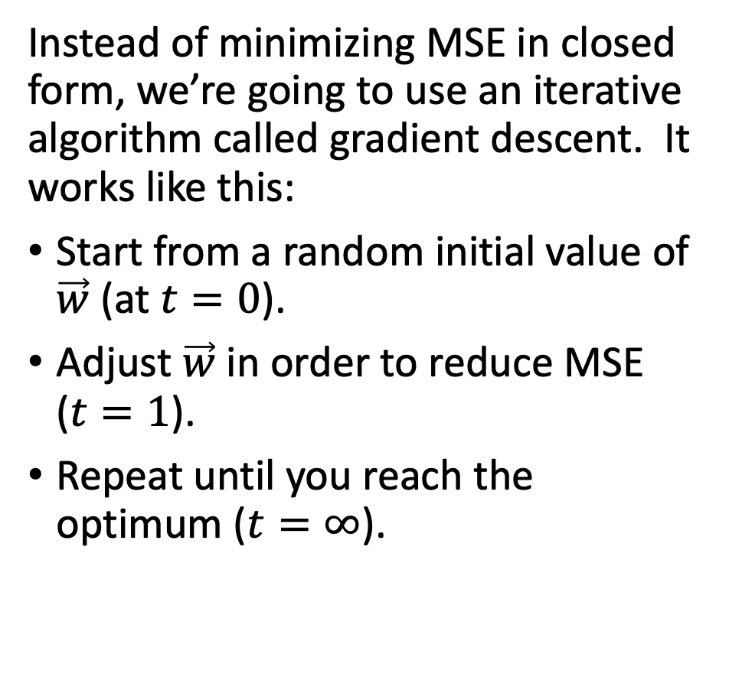



The iterative solution to linear regression
Instead of minimizing MSE in closed form, we’re going to use an iterative algorithm called gradient descent. It works like this:
Start from a random initial value of $\vec{w}$ (at $t=0$).
Adjust $\vec{w}$ in order to reduce MSE ($t=1$).
Repeat until you reach the optimum ($t=∞$).
$$MSE=aw^{2}+bw+c$$
$$t=0$$
$$t=1$$
$$t=∞$$
…
$$w$$

Slide 21
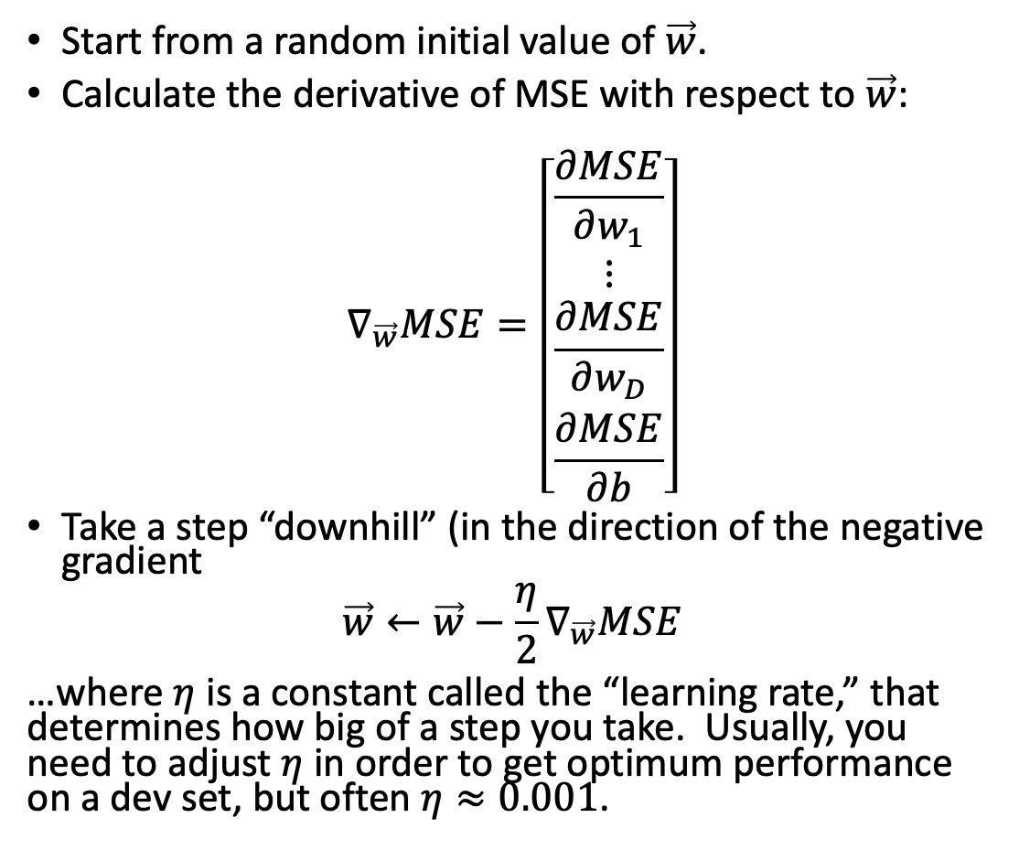

The gradient descent algorithm
Start from a random initial value of $\vec{w}$.
Calculate the derivative of MSE with respect to $\vec{w}$:
$$∇_{\vec{w}}MSE=\left[\begin{matrix}\frac{∂MSE}{∂w_{1}} \\ \begin{matrix}⋮ \\ \frac{∂MSE}{∂w_{D}}\end{matrix} \\ \frac{∂MSE}{∂b}\end{matrix}\right]$$
Take a step “downhill” (in the direction of the negative gradient
$$\vec{w}←\vec{w}−\frac{η}{2}∇_{\vec{w}}MSE$$
…where $η$ is a constant called the “learning rate,” that determines how big of a step you take. Usually, you need to adjust $η$ in order to get optimum performance on a dev set, but often $η≈0.001$.
$$MSE=aw^{2}+bw+c$$
$$w$$

Slide 22
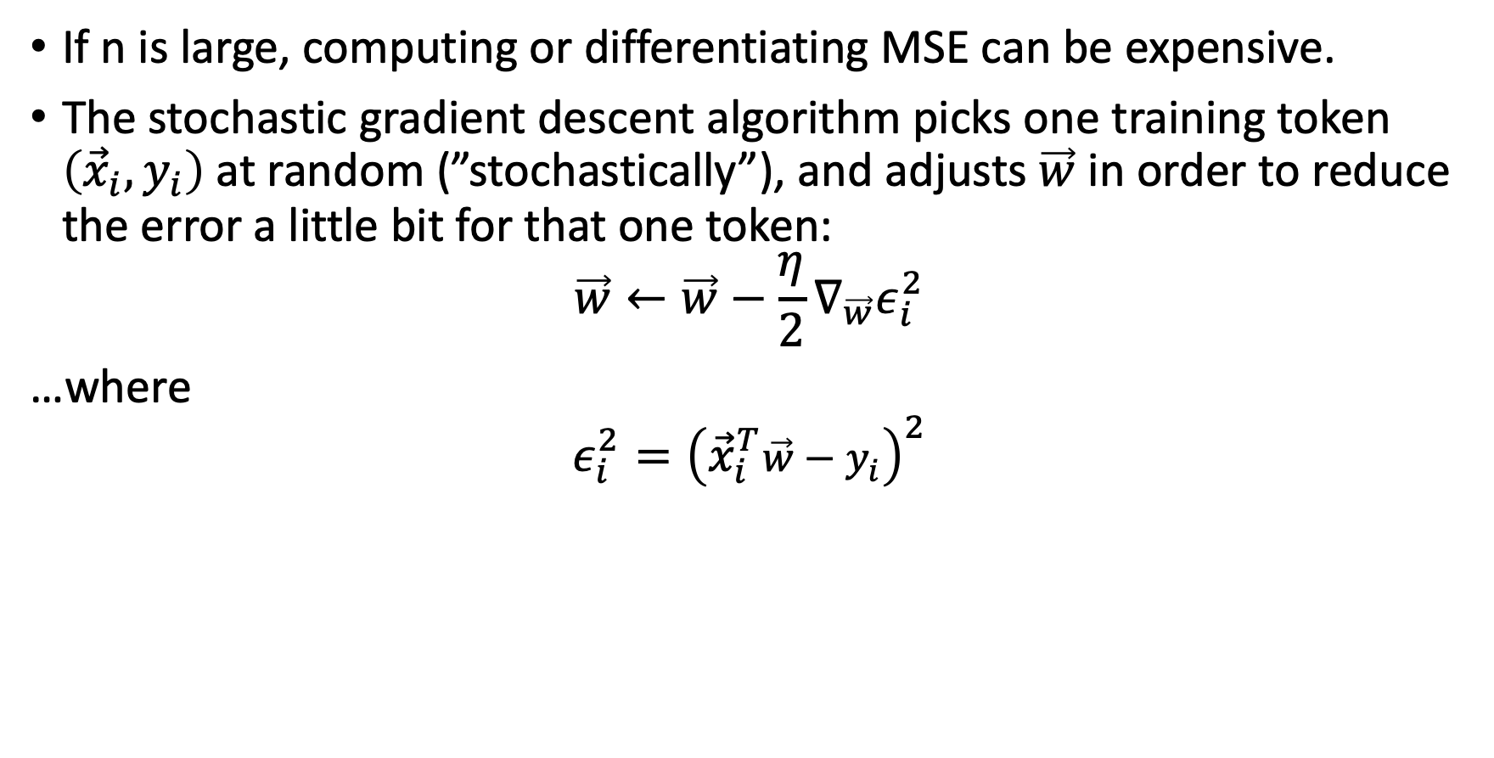
Stochastic gradient descent
If n is large, computing or differentiating MSE can be expensive.
The stochastic gradient descent algorithm picks one training token $\left({\vec{x}}_{i},y_{i}\right)$at random (”stochastically”), and adjusts $\vec{w}$ in order to reduce the error a little bit for that one token:
$$\vec{w}←\vec{w}−\frac{η}{2}∇_{\vec{w}}ε_{i}^{2}$$
…where
$${ε_{i}^{2}=\left({\vec{x}}_{i}^{T}\vec{w}−y_{i}\right)}^{2}$$

Slide 23
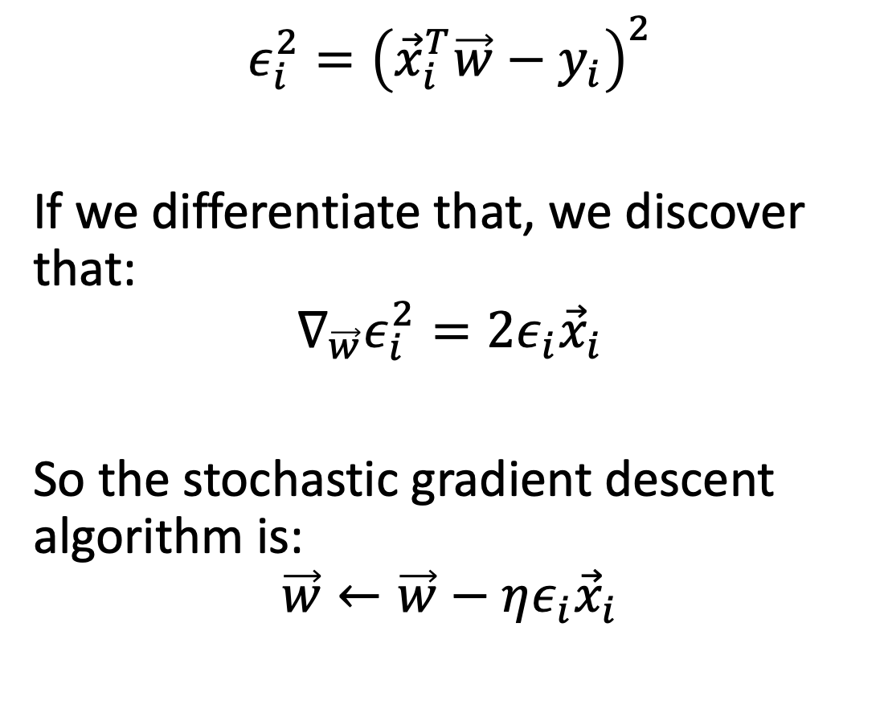

Stochastic gradient descent
$${ε_{i}^{2}=\left({\vec{x}}_{i}^{T}\vec{w}−y_{i}\right)}^{2}$$
If we differentiate that, we discover that:
$$∇_{\vec{w}}ε_{i}^{2}=2ε_{i}{\vec{x}}_{i}$$
So the stochastic gradient descent algorithm is:
$$\vec{w}←\vec{w}−ηε_{i}{\vec{x}}_{i}$$
$$ε_{i}^{2}=aw^{2}+bw+c$$
$$w$$

Slide 24
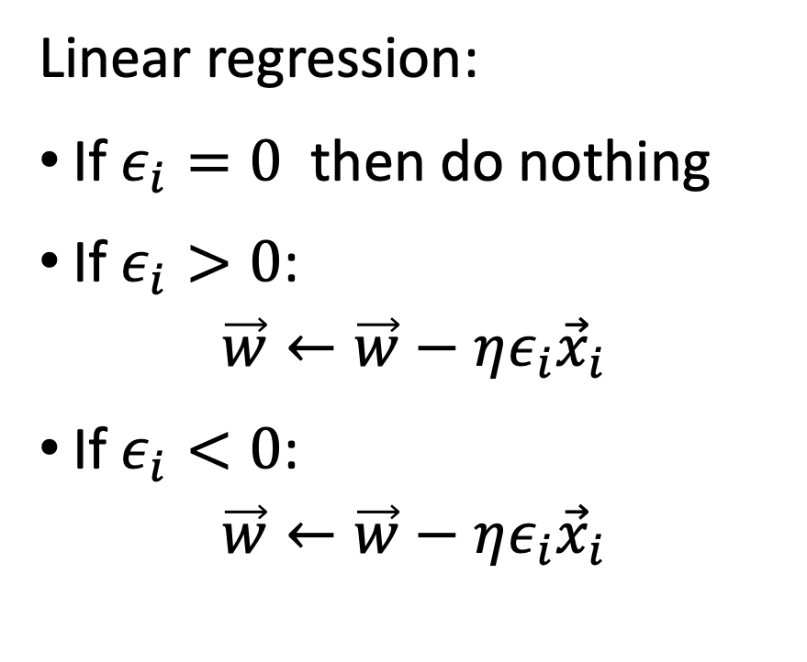
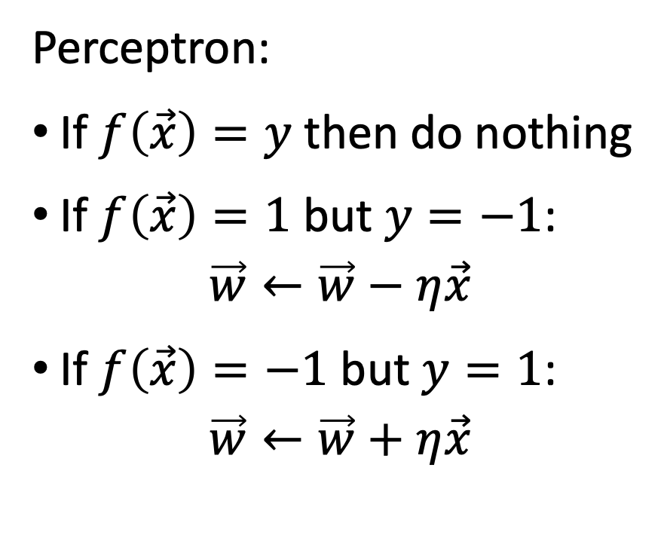
Comparison of perceptron and linear regression
Perceptron:
If $f\left(\vec{x}\right)=y$ then do nothing
If $f\left(\vec{x}\right)=1$ but $y=−1$:
$$\vec{w}←\vec{w}−η\vec{x}$$
If $f\left(\vec{x}\right)=−1$ but $y=1$:
$$\vec{w}←\vec{w}+η\vec{x}$$
Linear regression:
If $ε_{i}=0$ then do nothing
If $ε_{i}>0$:
$$\vec{w}←\vec{w}−ηε_{i}{\vec{x}}_{i}$$
If $ε_{i}<0$:
$$\vec{w}←\vec{w}−ηε_{i}{\vec{x}}_{i}$$

Slide 25
Outline
Review: perceptron
Linear regression: a neuron without the nonlinearity
Mean-squared error
Learning the solution: stochastic gradient descent
Multiple linear regression

Slide 26

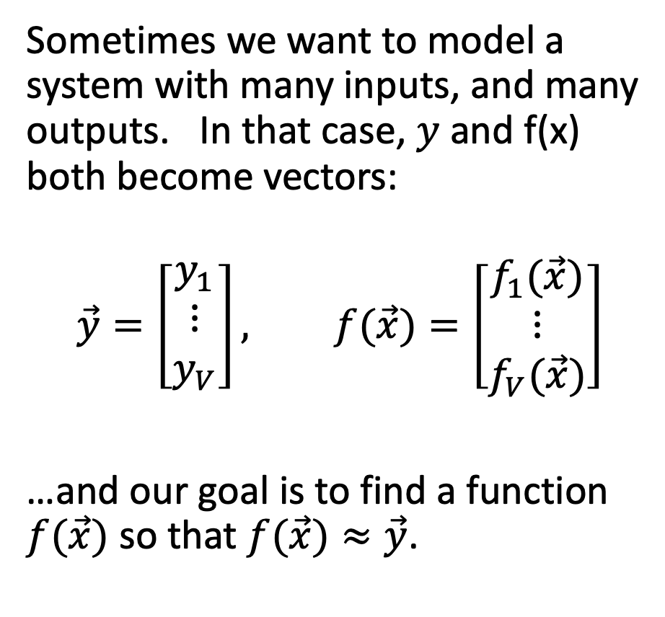

What if $\vec{y}$ is a vector?
Sometimes we want to model a system with many inputs, and many outputs. In that case, $y$ and f(x) both become vectors:
$$\vec{y}=\left[\begin{matrix}y_{1} \\ ⋮ \\ y_{V}\end{matrix}\right], f(\vec{x})=\left[\begin{matrix}f_{1}(\vec{x}) \\ ⋮ \\ f_{V}(\vec{x})\end{matrix}\right]$$
…and our goal is to find a function $f(\vec{x})$ so that $f(\vec{x})≈\vec{y}$.
CC-SA 4.0, Joseph Lamiot, 2019

Slide 27
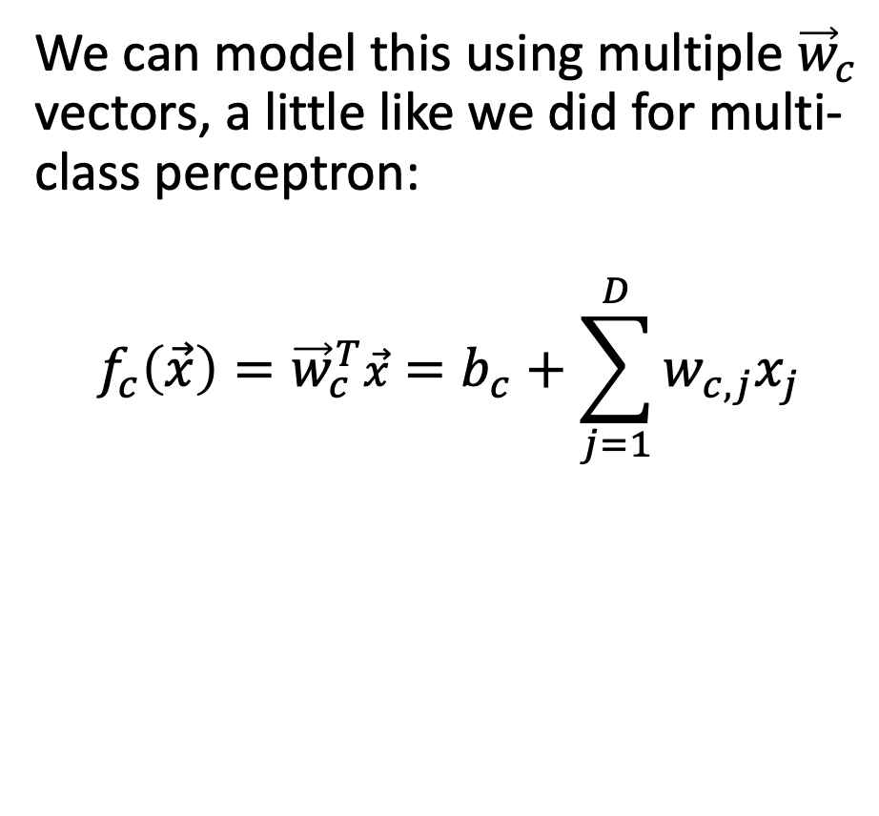
What if $\vec{y}$ is a vector?
We can model this using multiple ${\vec{w}}_{c}$ vectors, a little like we did for multi-class perceptron:
$$f_{c}\left(\vec{x}\right)={\vec{w}}_{c}^{T}\vec{x}=b_{c}+\sum_{j=1}^{D}{w_{c,j}x_{j}}$$
CC-SA 4.0, Joseph Lamiot, 2019

Slide 28


… it means ${\vec{ε}}_{i}$ is a vector!
The gradient of the error with respect to each of the weights is:
$$ε_{c,i}=f_{c}\left({\vec{x}}_{i}\right)−y_{c,i}$$
CC-SA 4.0, Joseph Lamiot, 2019

Slide 29
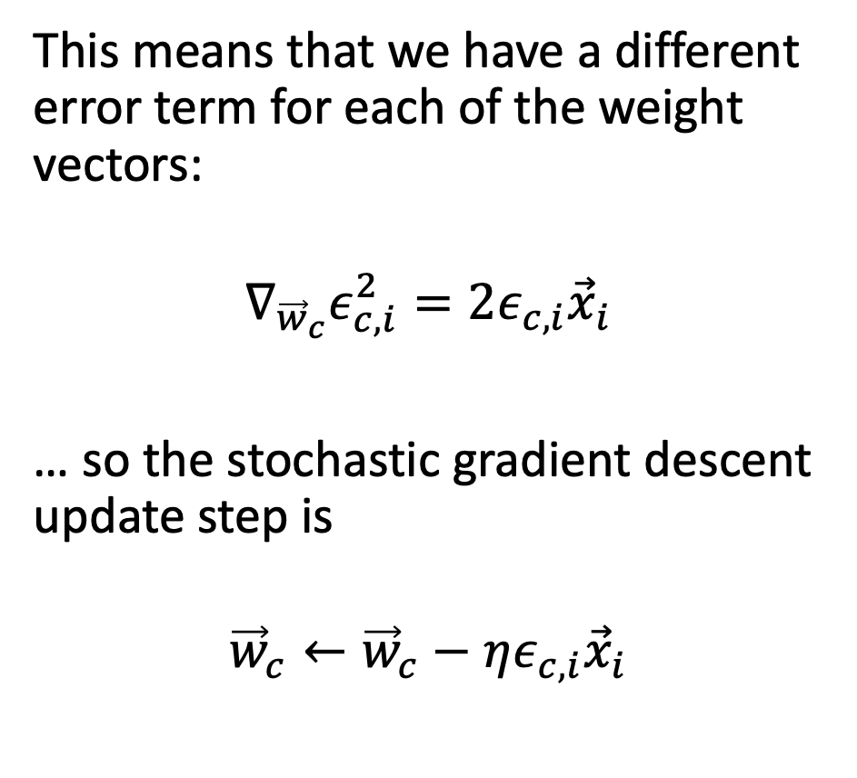

… and each ${\vec{w}}_{c}$ has its own gradient.
This means that we have a different error term for each of the weight vectors:
$$∇_{{\vec{w}}_{c}}ε_{c,i}^{2}=2ε_{c,i}{\vec{x}}_{i}$$
… so the stochastic gradient descent update step is
$${\vec{w}}_{c}←{\vec{w}}_{c}−ηε_{c,i}{\vec{x}}_{i}$$
CC-SA 4.0, Joseph Lamiot, 2019

Slide 30



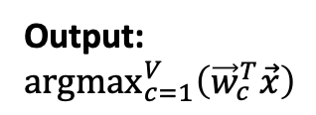












Comparison of Multi-Class Perceptron to Multiple Regression
Multi-Class Perceptron
Multiple Regression
Input
Weights
Input
Weights
1
1
$$b_{0}$$
$$b_{0}$$
$$b_{1}$$
$$b_{1}$$
$$f_{1}\left(\vec{x}\right)={\vec{w}}_{1}^{T}\vec{x}$$
x₁
x₁
Output: ${argmax}_{c=1}^{V}\left({\vec{w}}_{c}^{T}\vec{x}\right)$
$$f_{2}\left(\vec{x}\right)={\vec{w}}_{2}^{T}\vec{x}$$
argmax
x₂
.
.
.
.
.
.
x₂
.
.
.
.
.
.
$$b_{V−1}$$
.
.
.
$$b_{V−1}$$
$$w_{0D}$$
$$w_{0D}$$
$$w_{1D}$$
$$w_{1D}$$
$$f_{V}\left(\vec{x}\right)={\vec{w}}_{V}^{T}\vec{x}$$
x_{D}
$$w_{V−1,D}$$
x_{D}
$$w_{V−1,D}$$

Slide 31
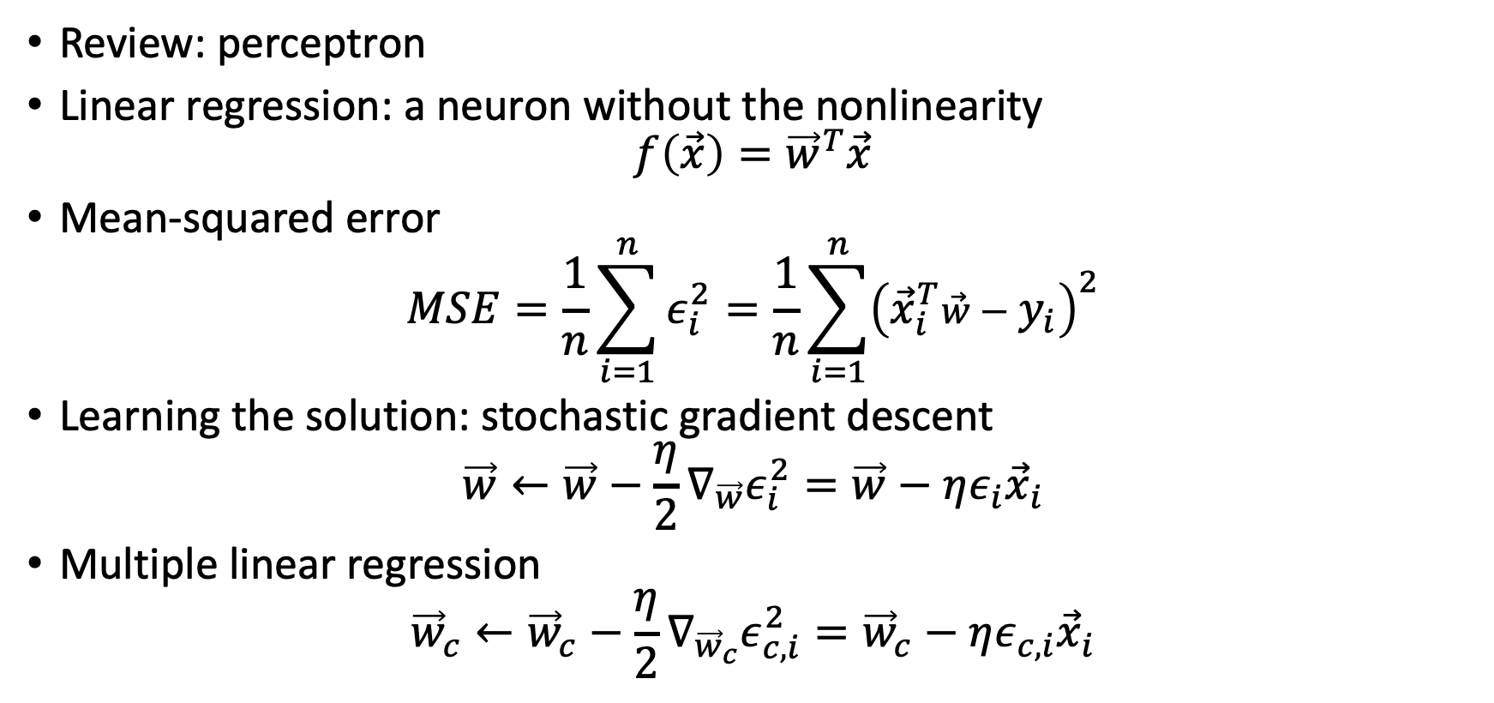
Summary
Review: perceptron
Linear regression: a neuron without the nonlinearity
$$f\left(\vec{x}\right)={\vec{w}}^{T}\vec{x}$$
Mean-squared error
$$MSE=\frac{1}{n}\sum_{i=1}^{n}{ε_{i}^{2}}=\frac{1}{n}\sum_{i=1}^{n}{{\left({\vec{x}}_{i}^{T}\vec{w}−y_{i}\right)}^{2}}$$
Learning the solution: stochastic gradient descent
$$\vec{w}←\vec{w}−\frac{η}{2}∇_{\vec{w}}ε_{i}^{2}=\vec{w}−ηε_{i}{\vec{x}}_{i}$$
Multiple linear regression
$${\vec{w}}_{c}←{\vec{w}}_{c}−\frac{η}{2}∇_{{\vec{w}}_{c}}ε_{c,i}^{2}={\vec{w}}_{c}−ηε_{c,i}{\vec{x}}_{i}$$

