Slide 1
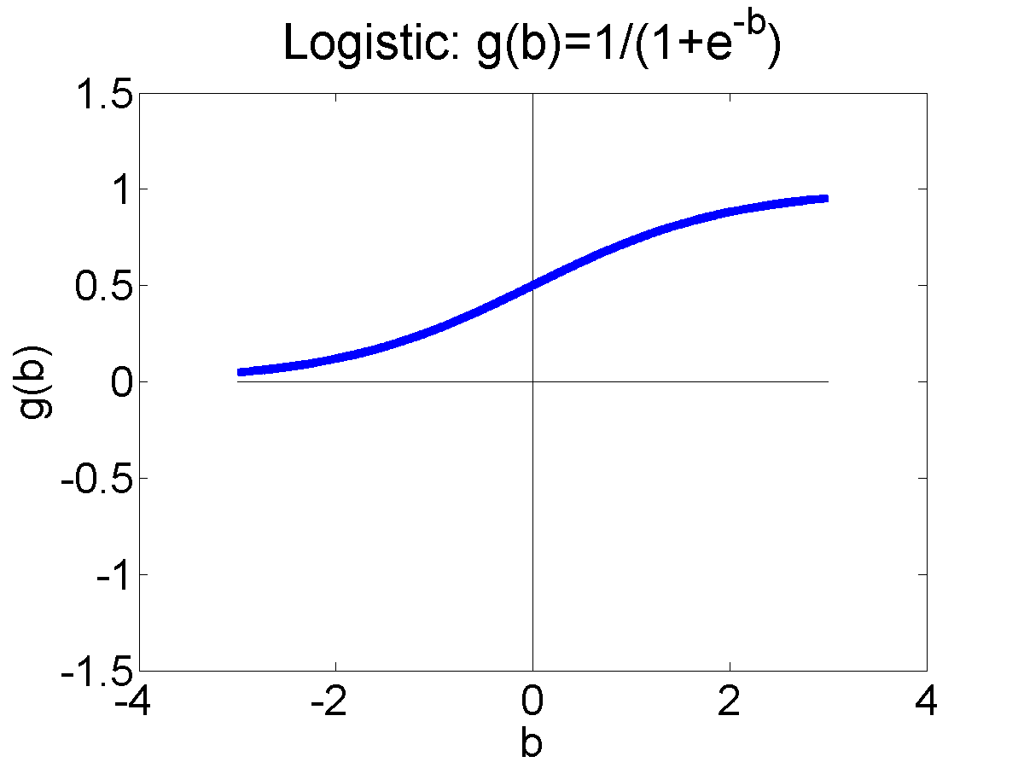
CS440/ECE448 Lecture 8: Logistic Regression
Mark Hasegawa-Johnson, 2/2022
License: CC-BY 4.0

Slide 2
Outline
One-hot vectors: rewriting the perceptron to look like linear regression
Softmax: Soft category boundaries
Cross-entropy = negative log probability of the training data
Stochastic gradient descent for logistic regression

Slide 3



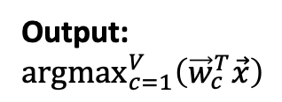












Comparison of Multi-Class Perceptron to Multiple Regression
Multi-Class Perceptron
Multiple Regression
Input
Weights
Input
Weights
1
1
$$b_{1}$$
$$b_{1}$$
$$b_{2}$$
$$b_{2}$$
$$f_{1}\left(\vec{x}\right)={\vec{w}}_{1}^{T}\vec{x}$$
x₁
x₁
Output: ${argmax}_{c=1}^{V}\left({\vec{w}}_{c}^{T}\vec{x}\right)$
$$f_{2}\left(\vec{x}\right)={\vec{w}}_{2}^{T}\vec{x}$$
argmax
x₂
.
.
.
.
.
.
x₂
.
.
.
.
.
.
$$b_{V}$$
.
.
.
$$b_{V}$$
$$w_{1,D}$$
$$w_{1,D}$$
$$w_{2,D}$$
$$w_{2,D}$$
$$f_{V}\left(\vec{x}\right)={\vec{w}}_{V}^{T}\vec{x}$$
x_{D}
$$w_{V,D}$$
x_{D}
$$w_{V,D}$$

Slide 4
Here’s a weird question:
Can we come up with some new notation that can be used to write both the multi-class perceptron AND the linear regression algorithm?

Slide 5
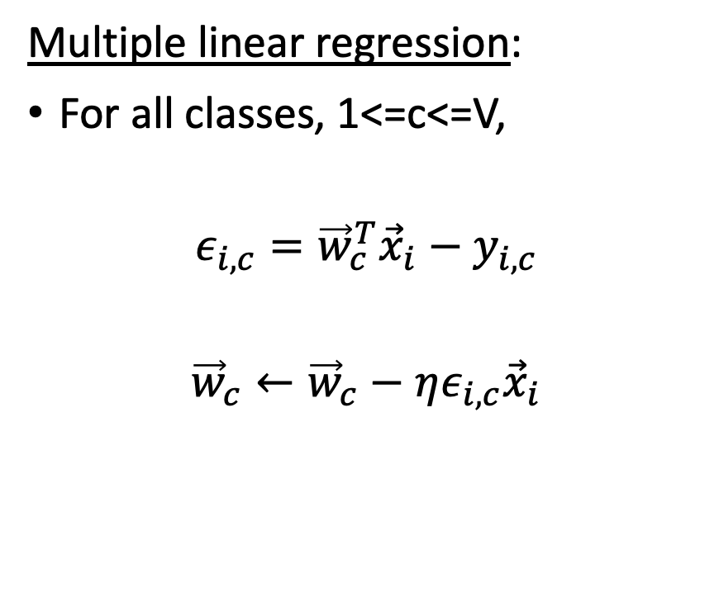
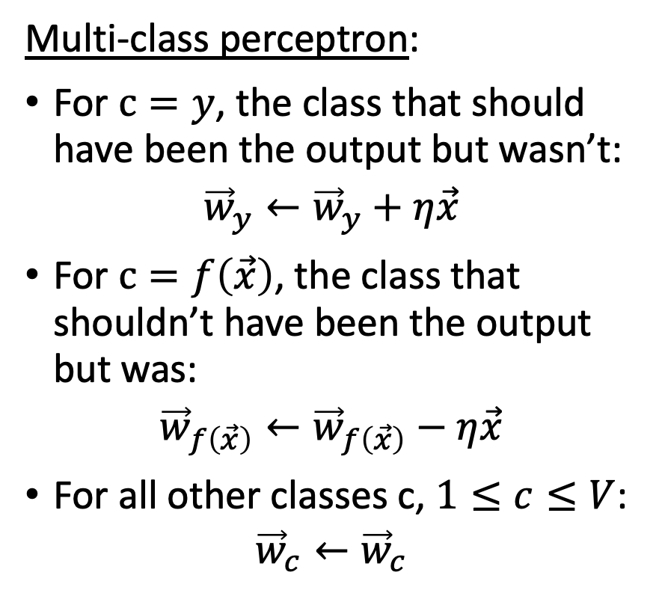
Comparison of multi-class perceptron and multiple linear regression
Multi-class perceptron:
For $c=y$, the class that should have been the output but wasn’t:
$${\vec{w}}_{y}←{\vec{w}}_{y}+η\vec{x}$$
For $c=f\left(\vec{x}\right)$, the class that shouldn’t have been the output but was:
$${\vec{w}}_{f\left(\vec{x}\right)}←{\vec{w}}_{f\left(\vec{x}\right)}−η\vec{x}$$
For all other classes c, $1≤c≤V$:
$${\vec{w}}_{c}←{\vec{w}}_{c}$$
Multiple linear regression:
For all classes, 1<=c<=V,
$$ε_{i,c}={\vec{w}}_{c}^{T}{\vec{x}}_{i}−y_{i,c}$$
$${\vec{w}}_{c}←{\vec{w}}_{c}−ηε_{i,c}{\vec{x}}_{i}$$

Slide 6
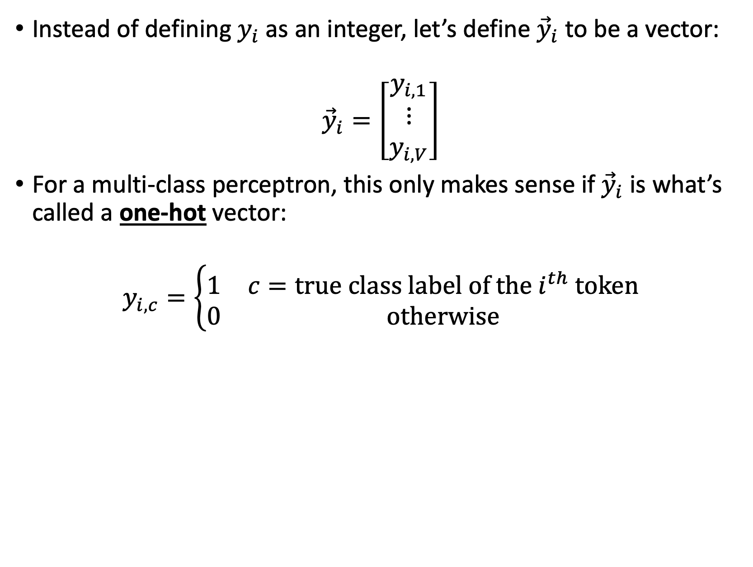
New notation: Don’t change the multi-class perceptron algorithm, but make it easier to write
Instead of defining $y_{i}$as an integer, let’s define ${\vec{y}}_{i}$ to be a vector:
$${\vec{y}}_{i}=\left[\begin{matrix}y_{i,1} \\ ⋮ \\ y_{i,V}\end{matrix}\right]$$
For a multi-class perceptron, this only makes sense if ${\vec{y}}_{i}$ is what’s called a one-hot vector:
$$y_{i,c}=\left\{\begin{matrix}1 & c=true class label of the i^{th} token \\ 0 & otherwise\end{matrix}\right.$$

Slide 7
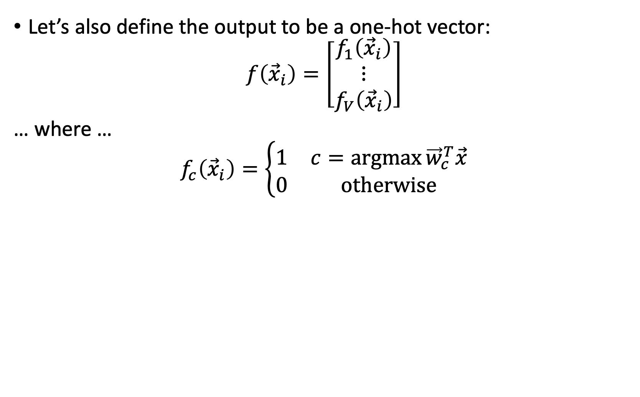
New notation: Don’t change the multi-class perceptron algorithm, but make it easier to write
Let’s also define the output to be a one-hot vector:
$$f\left({\vec{x}}_{i}\right)=\left[\begin{matrix}f_{1}\left({\vec{x}}_{i}\right) \\ ⋮ \\ f_{V}\left({\vec{x}}_{i}\right)\end{matrix}\right]$$
… where …
$$f_{c}\left({\vec{x}}_{i}\right)=\left\{\begin{matrix}1 & c=\operatorname{argmax}{{\vec{w}}_{c}^{T}\vec{x}} \\ 0 & otherwise\end{matrix}\right.$$

Slide 8
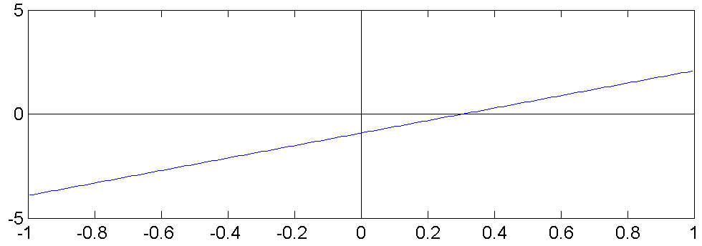
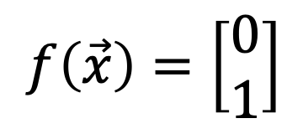
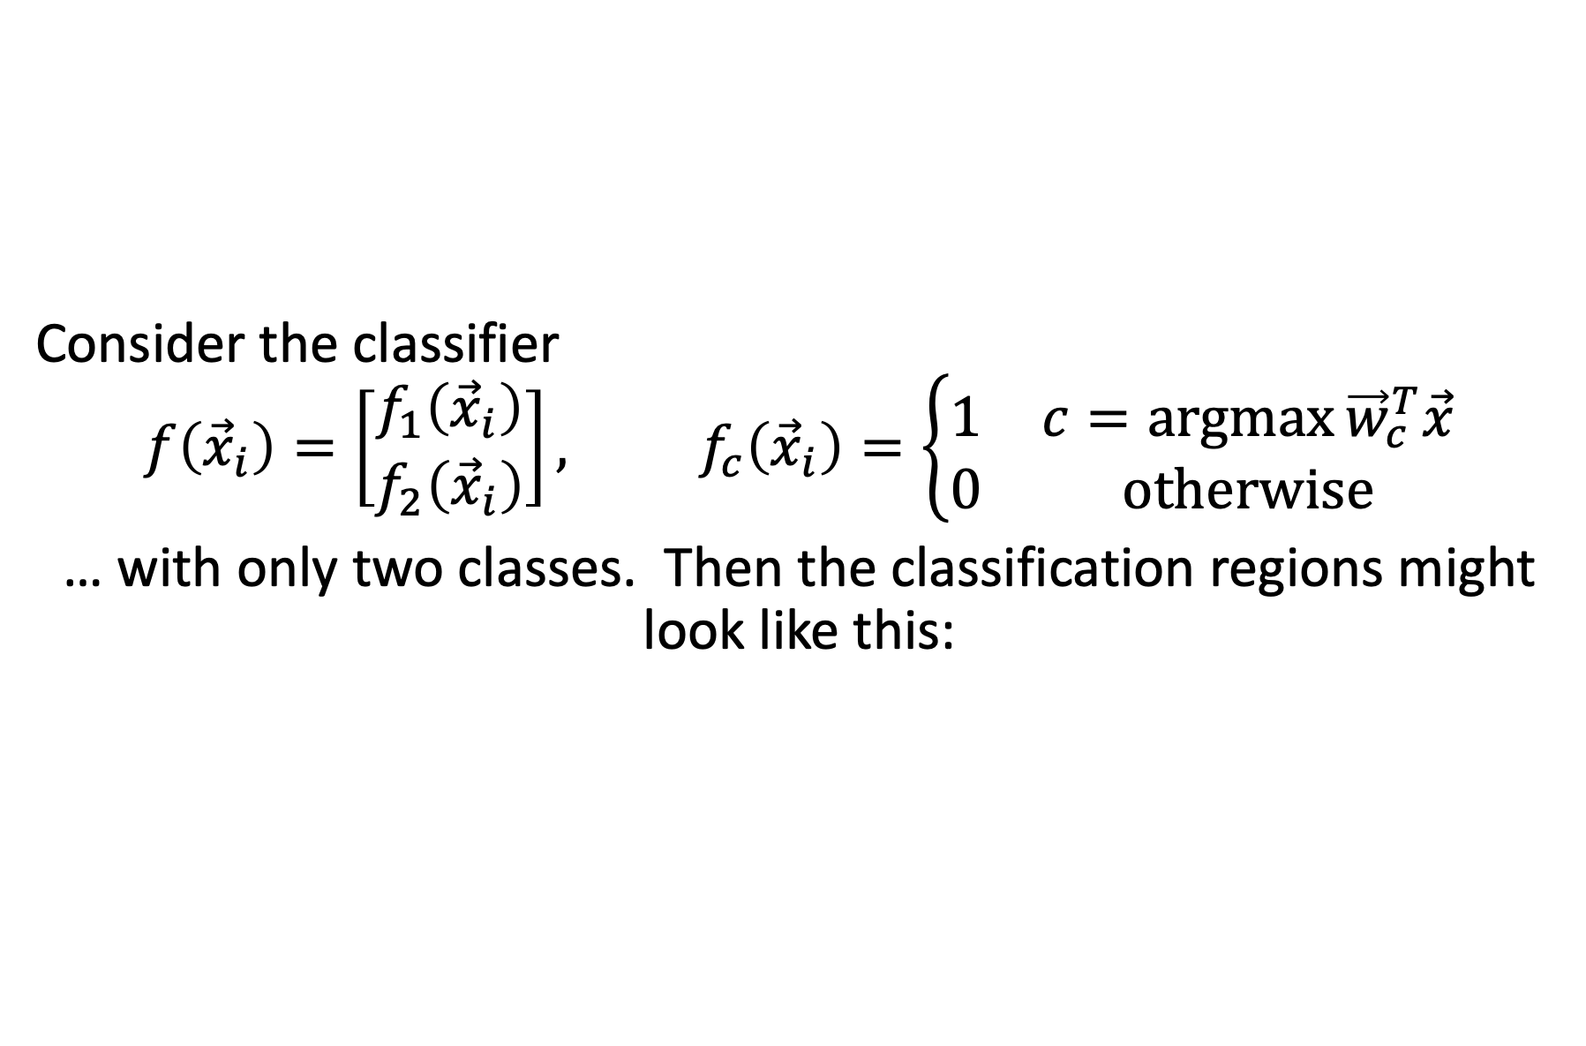
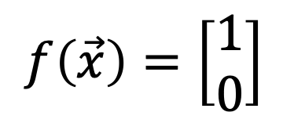
Example: Binary classifier
Consider the classifier
$$f\left({\vec{x}}_{i}\right)=\left[\begin{matrix}f_{1}\left({\vec{x}}_{i}\right) \\ f_{2}\left({\vec{x}}_{i}\right)\end{matrix}\right], f_{c}\left({\vec{x}}_{i}\right)=\left\{\begin{matrix}1 & c=\operatorname{argmax}{{\vec{w}}_{c}^{T}\vec{x}} \\ 0 & otherwise\end{matrix}\right.$$
… with only two classes. Then the classification regions might look like this:
$$f\left(\vec{x}\right)=\left[\begin{matrix}1 \\ 0\end{matrix}\right]$$
$$x_{2}$$
$$f\left(\vec{x}\right)=\left[\begin{matrix}0 \\ 1\end{matrix}\right]$$
$$x_{1}$$

Slide 9


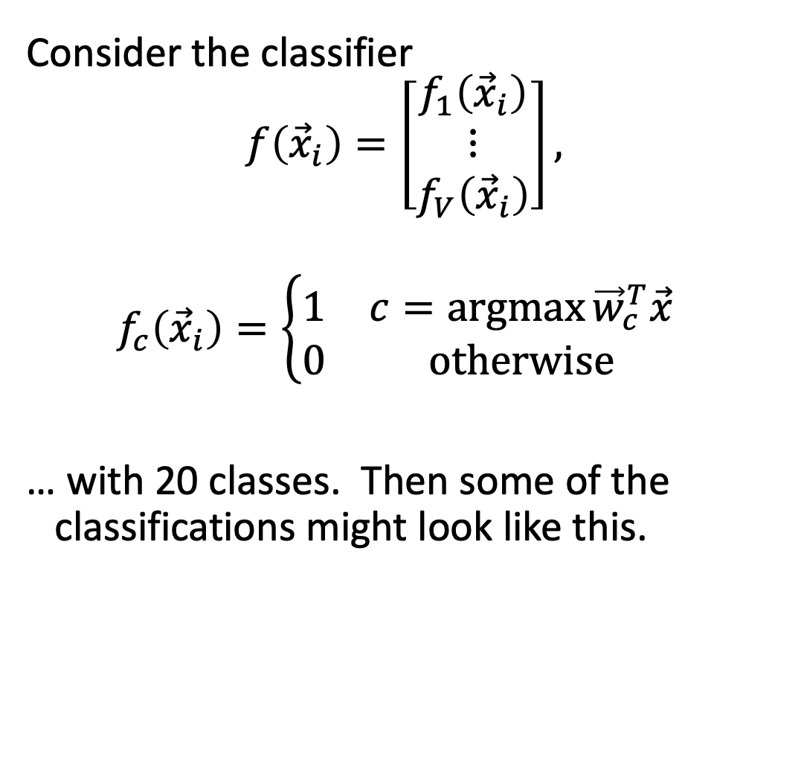





Multi-Class Linear Classifiers
$$x_{2}$$
Consider the classifier
$$f\left({\vec{x}}_{i}\right)=\left[\begin{matrix}f_{1}\left({\vec{x}}_{i}\right) \\ ⋮ \\ f_{V}\left({\vec{x}}_{i}\right)\end{matrix}\right],$$
$$f_{c}\left({\vec{x}}_{i}\right)=\left\{\begin{matrix}1 & c=\operatorname{argmax}{{\vec{w}}_{c}^{T}\vec{x}} \\ 0 & otherwise\end{matrix}\right.$$
… with 20 classes. Then some of the classifications might look like this.
$$f(\vec{x})=\left[\begin{matrix}1 \\ \begin{matrix}0 \\ ⋮ \\ 0\end{matrix} \\ 0\end{matrix}\right]$$
$$f(\vec{x})=\left[\begin{matrix}0 \\ \begin{matrix}1 \\ ⋮ \\ 0\end{matrix} \\ 0\end{matrix}\right]$$
$$f(\vec{x})=\left[\begin{matrix}0 \\ \begin{matrix}0 \\ ⋮ \\ 1\end{matrix} \\ 0\end{matrix}\right]$$
$$f(\vec{x})=\left[\begin{matrix}0 \\ \begin{matrix}0 \\ ⋮ \\ 0\end{matrix} \\ 1\end{matrix}\right]$$
By Balu Ertl - Own work, CC BY-SA 4.0, https://commons.wikimedia.org/w/index.php?curid=38534275
$$x_{1}$$

Slide 10
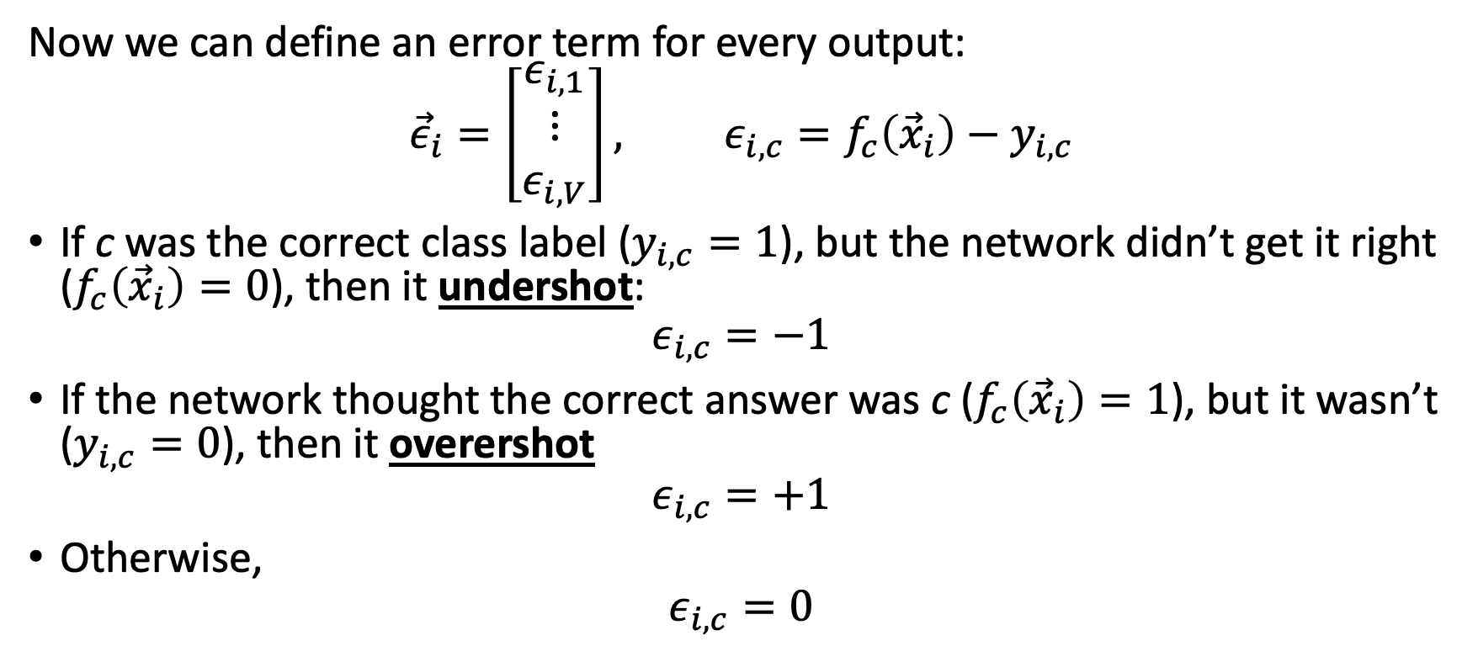
Now the perceptron has a vector error, just like linear regression
Now we can define an error term for every output:
$${\vec{ε}}_{i}=\left[\begin{matrix}ε_{i,1} \\ ⋮ \\ ε_{i,V}\end{matrix}\right], ε_{i,c}=f_{c}\left({\vec{x}}_{i}\right)−y_{i,c}$$
If c was the correct class label ($y_{i,c}=1$), but the network didn’t get it right ($f_{c}\left({\vec{x}}_{i}\right)=0$), then it undershot:
$$ε_{i,c}=−1$$
If the network thought the correct answer was c ($f_{c}\left({\vec{x}}_{i}\right)=1$), but it wasn’t ($y_{i,c}=0$), then it overershot
$$ε_{i,c}=+1$$
Otherwise,
$$ε_{i,c}=0$$

Slide 11
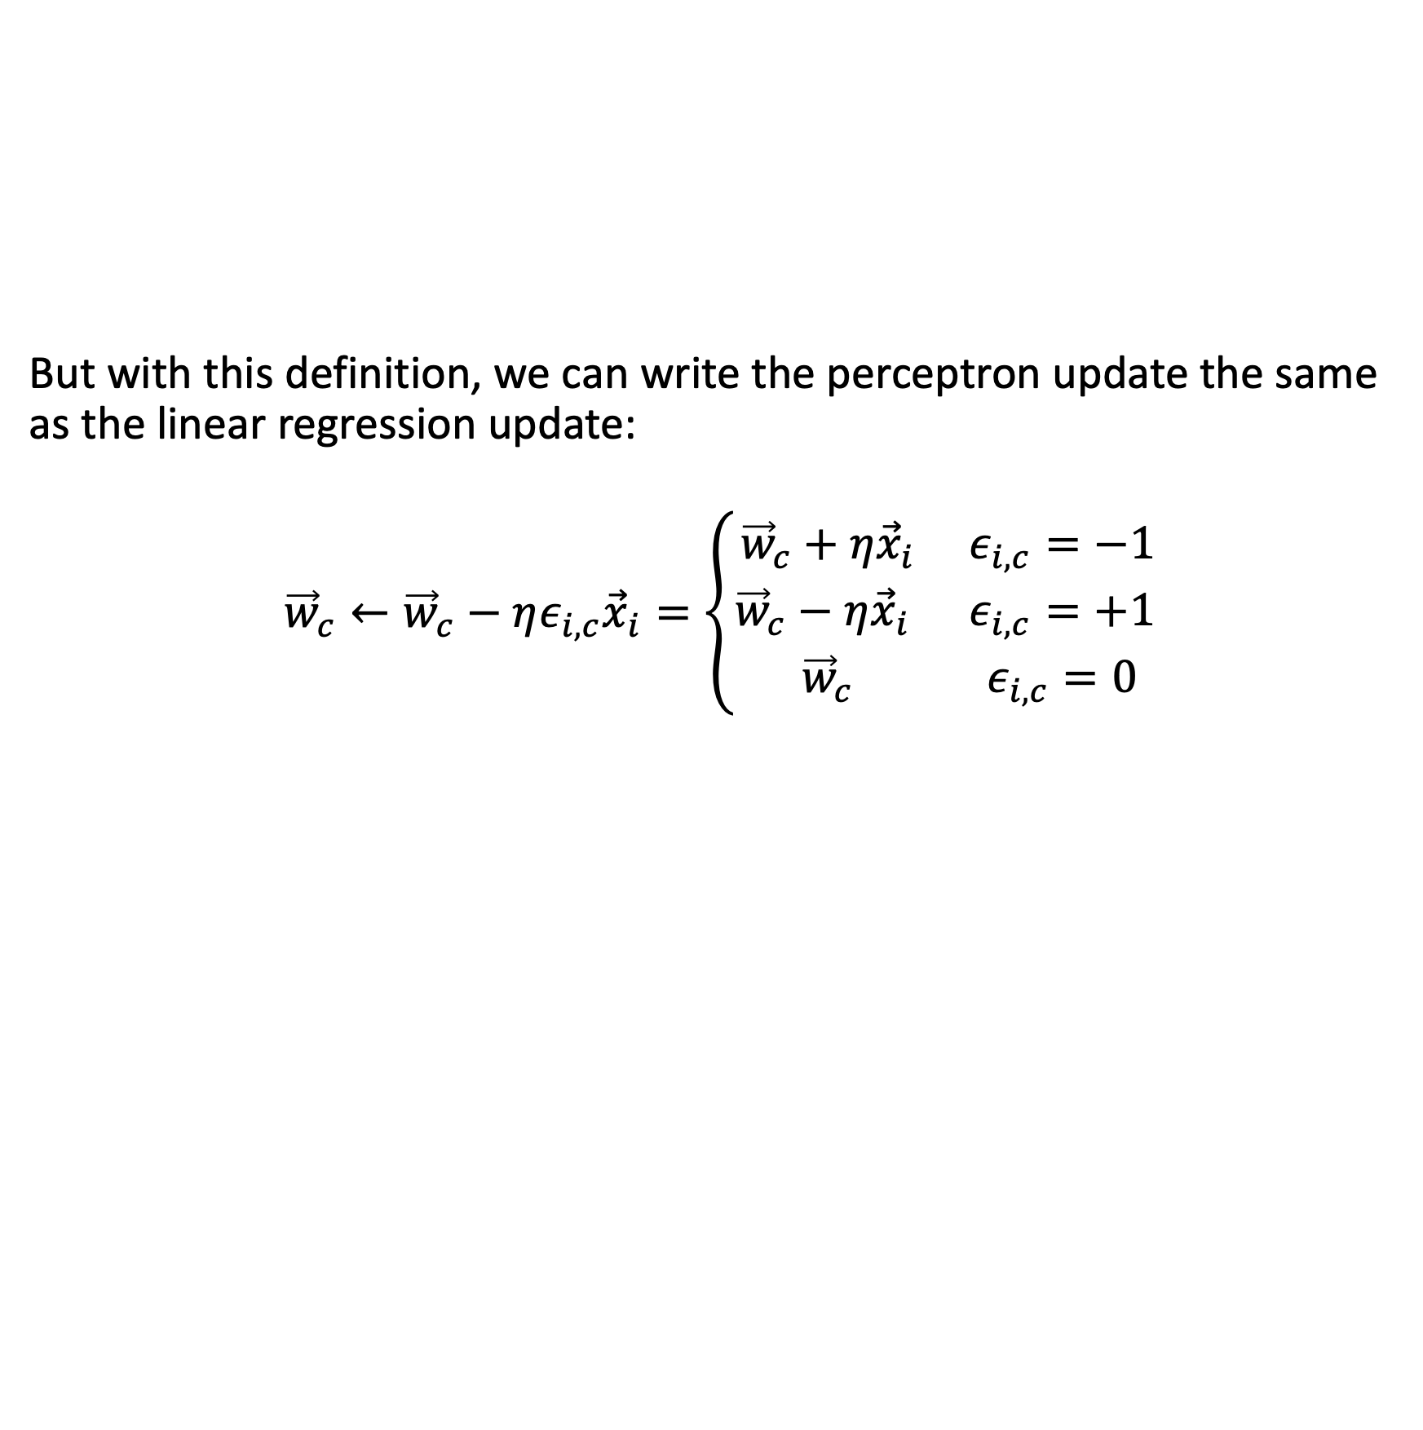
Multi-class perceptron, written in terms of one-hot vectors
But with this definition, we can write the perceptron update the same as the linear regression update:
$${\vec{w}}_{c}←{\vec{w}}_{c}−ηε_{i,c}{\vec{x}}_{i}=\left\{\begin{matrix}{\vec{w}}_{c}+η{\vec{x}}_{i} & ε_{i,c}=−1 \\ {\vec{w}}_{c}−η{\vec{x}}_{i} & ε_{i,c}=+1 \\ {\vec{w}}_{c} & ε_{i,c}=0\end{matrix}\right.$$

Slide 12

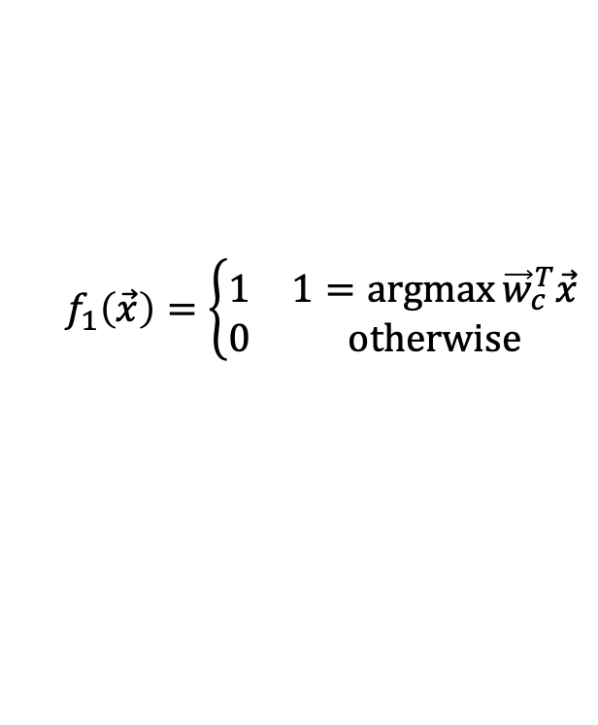



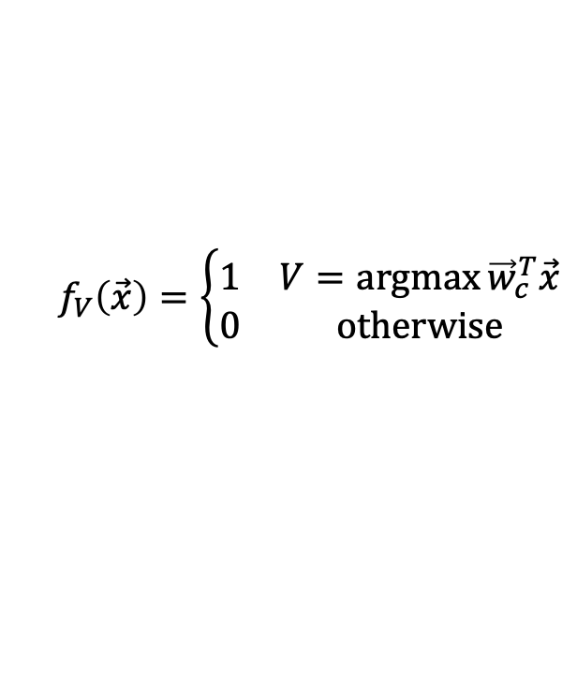



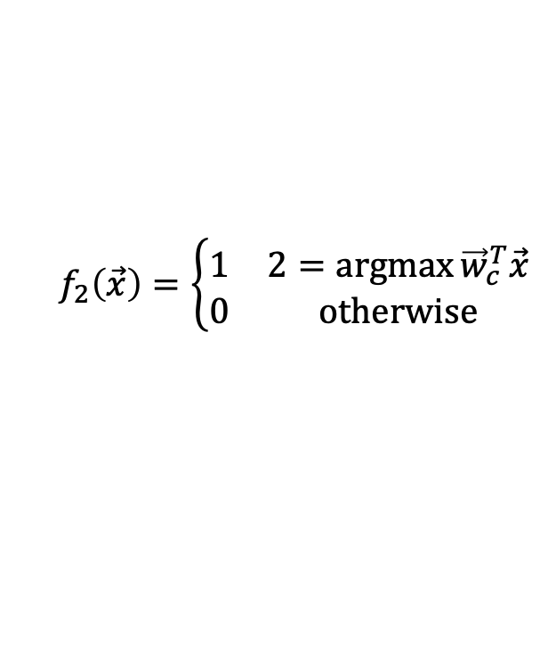


Comparison of Multi-Class Perceptron to Multiple Regression
Multi-Class Perceptron:
One-hot output
Multiple Regression:
Real-valued Output
Input
Weights
Input
Weights
1
1
$$b_{1}$$
$$f_{1}\left(\vec{x}\right)=\left\{\begin{matrix}1 & 1=\operatorname{argmax}{{\vec{w}}_{c}^{T}\vec{x}} \\ 0 & otherwise\end{matrix}\right.$$
$$b_{1}$$
$$b_{2}$$
$$b_{2}$$
$$f_{1}\left(\vec{x}\right)={\vec{w}}_{1}^{T}\vec{x}$$
x₁
x₁
$$f_{2}\left(\vec{x}\right)=\left\{\begin{matrix}1 & 2=\operatorname{argmax}{{\vec{w}}_{c}^{T}\vec{x}} \\ 0 & otherwise\end{matrix}\right.$$
$$f_{2}\left(\vec{x}\right)={\vec{w}}_{2}^{T}\vec{x}$$
x₂
.
.
.
x₂
.
.
.
.
.
.
.
.
.
.
.
.
$$b_{V}$$
.
.
.
$$b_{V}$$
$$w_{1,D}$$
$$w_{1,D}$$
$$w_{2,D}$$
$$f_{V}\left(\vec{x}\right)=\left\{\begin{matrix}1 & V=\operatorname{argmax}{{\vec{w}}_{c}^{T}\vec{x}} \\ 0 & otherwise\end{matrix}\right.$$
$$w_{2,D}$$
$$f_{V}\left(\vec{x}\right)={\vec{w}}_{V}^{T}\vec{x}$$
x_{D}
$$w_{V,D}$$
x_{D}
$$w_{V,D}$$

Slide 13
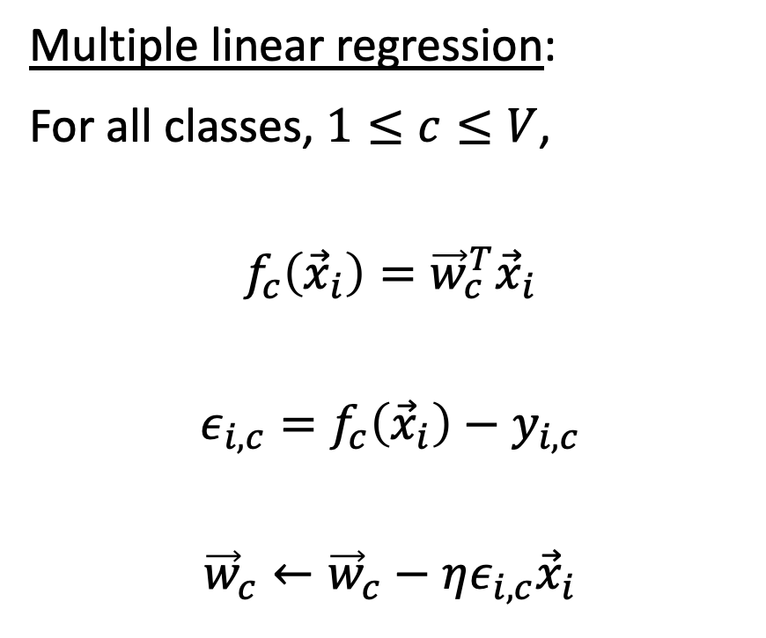
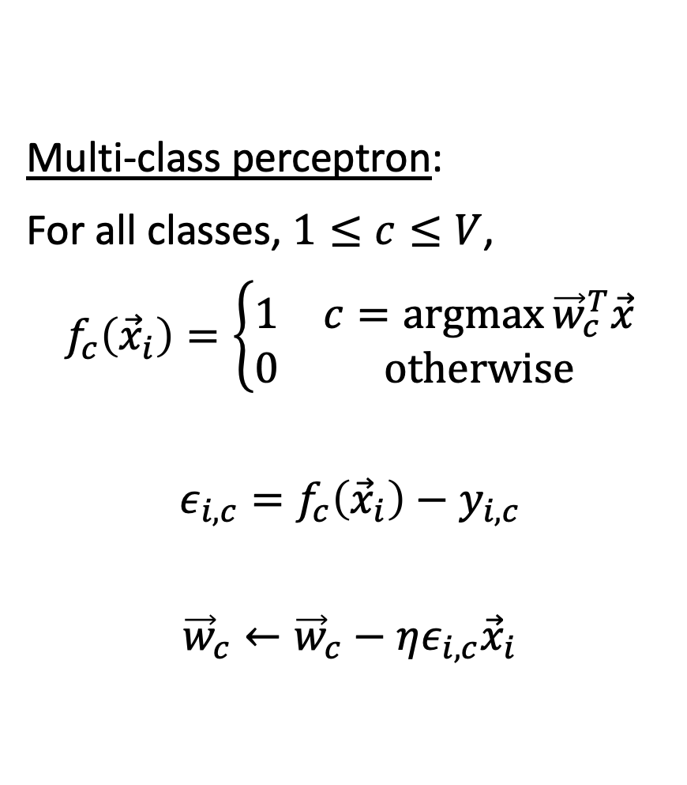
Comparison of multi-class perceptron and multiple linear regression
Multi-class perceptron:
For all classes, $1≤c≤V$,
$$f_{c}\left({\vec{x}}_{i}\right)=\left\{\begin{matrix}1 & c=\operatorname{argmax}{{\vec{w}}_{c}^{T}\vec{x}} \\ 0 & otherwise\end{matrix}\right.$$
$$ε_{i,c}=f_{c}\left({\vec{x}}_{i}\right)−y_{i,c}$$
$${\vec{w}}_{c}←{\vec{w}}_{c}−ηε_{i,c}{\vec{x}}_{i}$$
Multiple linear regression:
For all classes, $1≤c≤V$,
$$f_{c}\left({\vec{x}}_{i}\right)={\vec{w}}_{c}^{T}{\vec{x}}_{i}$$
$$ε_{i,c}=f_{c}\left({\vec{x}}_{i}\right)−y_{i,c}$$
$${\vec{w}}_{c}←{\vec{w}}_{c}−ηε_{i,c}{\vec{x}}_{i}$$

Slide 14
Outline
One-hot vectors: rewriting the perceptron to look like linear regression
Softmax: Soft category boundaries
Cross-entropy = negative log probability of the training data
Stochastic gradient descent for logistic regression

Slide 15

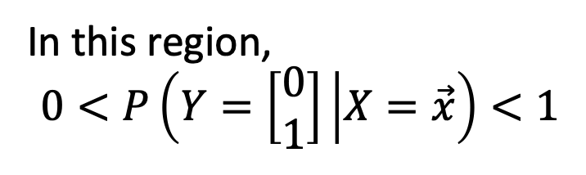

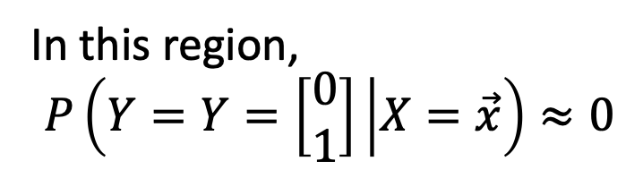
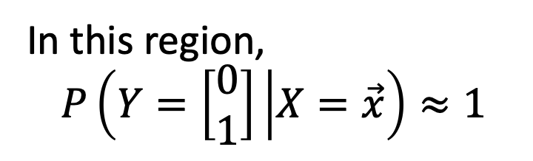

Probabilistic boundaries
Instead of trying to find the exact boundaries, logistic regression models the probability that token $\vec{x}$ belongs to class$\vec{y}$.
$$x_{2}$$
In this region,
$$P\left(Y=\left[\begin{matrix}0 \\ 1\end{matrix}\right] | X=\vec{x}\right)≈1$$
$$x_{1}$$
In this region,
$$P\left(Y=Y=\left[\begin{matrix}0 \\ 1\end{matrix}\right] | X=\vec{x}\right)≈0$$
In this region,
$$0<P\left(Y=\left[\begin{matrix}0 \\ 1\end{matrix}\right] | X=\vec{x}\right)<1$$

Slide 16
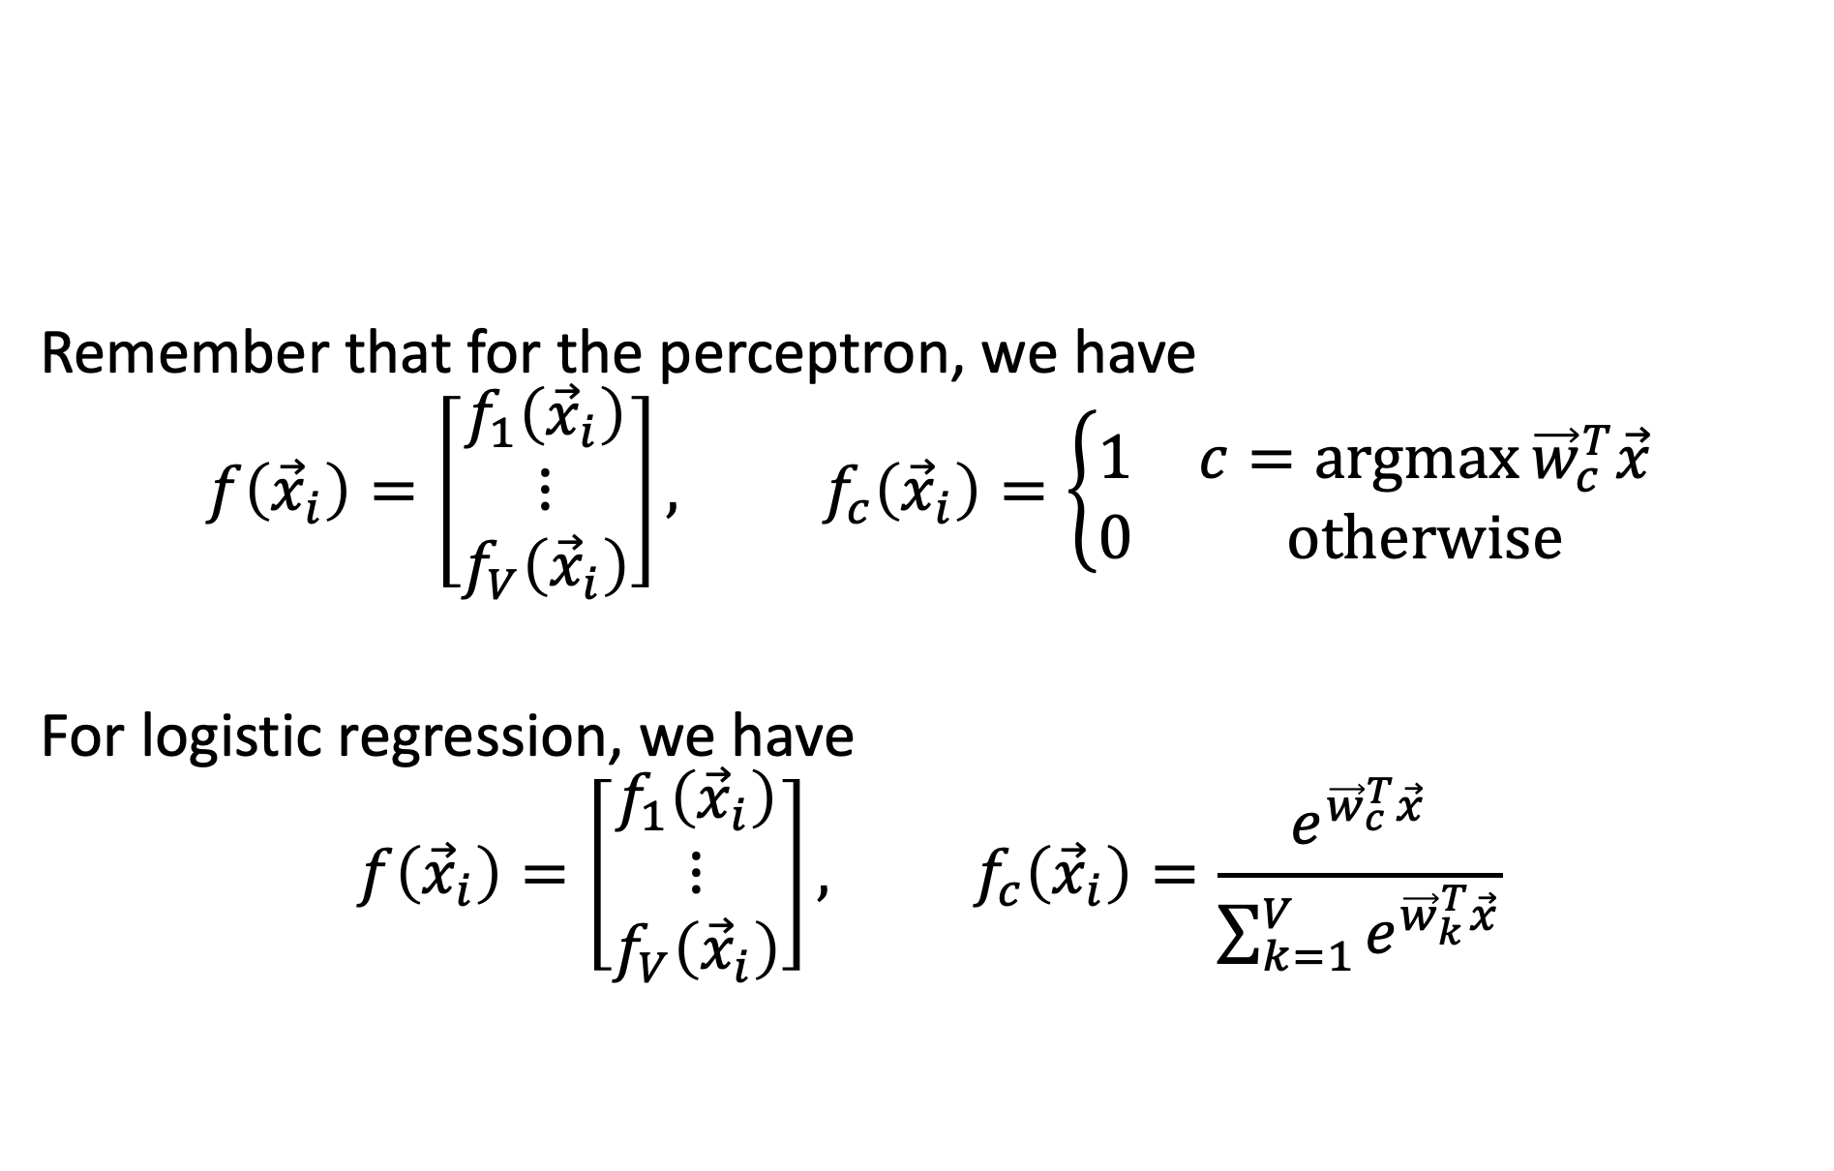
Perceptron versus logistic regression
Remember that for the perceptron, we have
$$f\left({\vec{x}}_{i}\right)=\left[\begin{matrix}f_{1}\left({\vec{x}}_{i}\right) \\ ⋮ \\ f_{V}\left({\vec{x}}_{i}\right)\end{matrix}\right], f_{c}\left({\vec{x}}_{i}\right)=\left\{\begin{matrix}1 & c=\operatorname{argmax}{{\vec{w}}_{c}^{T}\vec{x}} \\ 0 & otherwise\end{matrix}\right.$$
For logistic regression, we have
$$f\left({\vec{x}}_{i}\right)=\left[\begin{matrix}f_{1}\left({\vec{x}}_{i}\right) \\ ⋮ \\ f_{V}\left({\vec{x}}_{i}\right)\end{matrix}\right], f_{c}\left({\vec{x}}_{i}\right)=\frac{e^{{\vec{w}}_{c}^{T}\vec{x}}}{\sum_{k=1}^{V}{e^{{\vec{w}}_{k}^{T}\vec{x}}}}$$

Slide 17
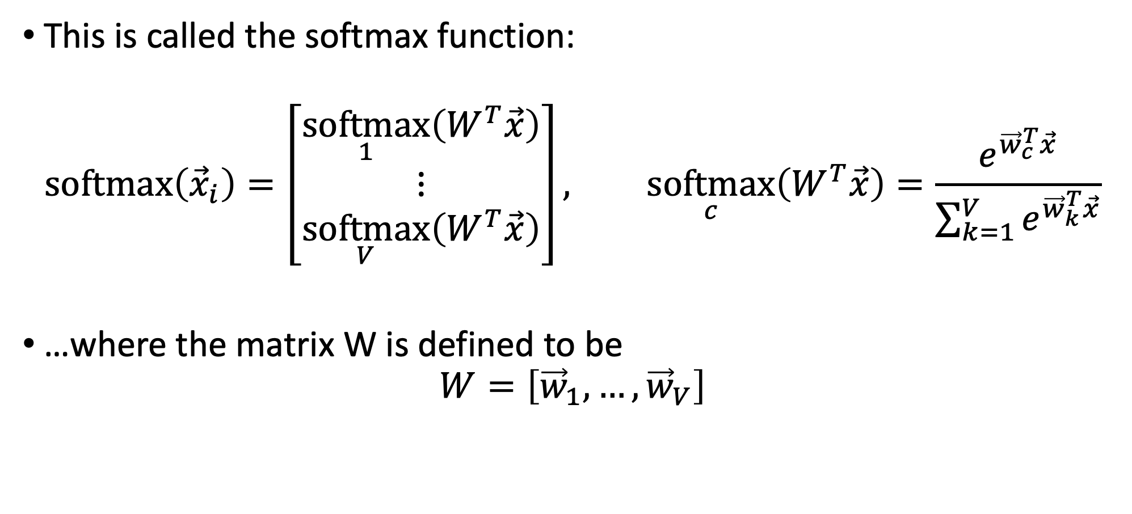
The softmax function
This is called the softmax function:
$$\operatorname{softmax}\left({\vec{x}}_{i}\right)=\left[\begin{matrix}\underset{1}{softmax}\left(W^{T}\vec{x}\right) \\ ⋮ \\ \underset{V}{softmax}\left(W^{T}\vec{x}\right)\end{matrix}\right], \underset{c}{softmax}\left(W^{T}\vec{x}\right)=\frac{e^{{\vec{w}}_{c}^{T}\vec{x}}}{\sum_{k=1}^{V}{e^{{\vec{w}}_{k}^{T}\vec{x}}}}$$
…where the matrix W is defined to be
$$W=\left[{\vec{w}}_{1},…,{\vec{w}}_{V}\right]$$

Slide 18
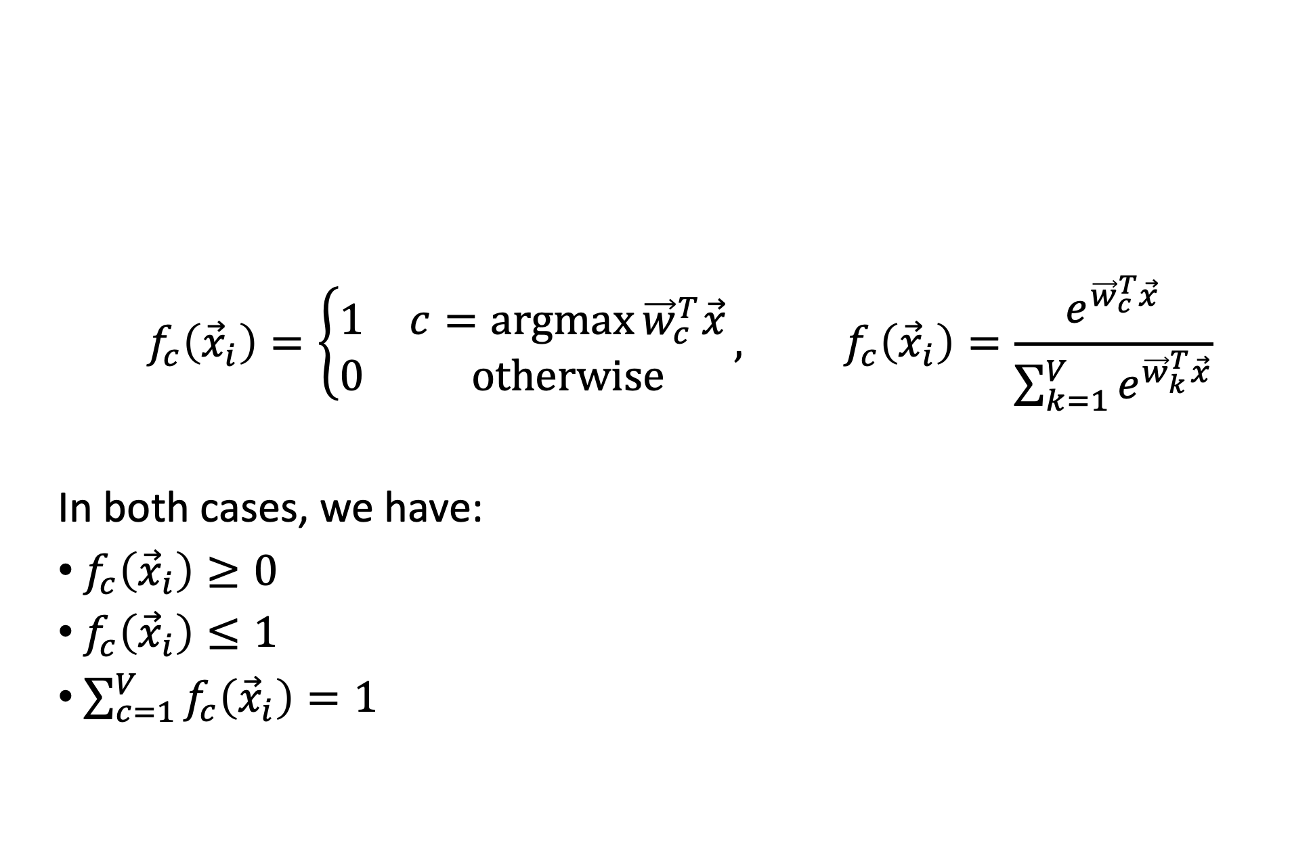
Argmax and Softmax
$$f_{c}\left({\vec{x}}_{i}\right)=\left\{\begin{matrix}1 & c=\operatorname{argmax}{{\vec{w}}_{c}^{T}\vec{x}} \\ 0 & otherwise\end{matrix}\right., f_{c}\left({\vec{x}}_{i}\right)=\frac{e^{{\vec{w}}_{c}^{T}\vec{x}}}{\sum_{k=1}^{V}{e^{{\vec{w}}_{k}^{T}\vec{x}}}}$$
In both cases, we have:
$f_{c}\left({\vec{x}}_{i}\right)≥0$
$f_{c}\left({\vec{x}}_{i}\right)≤1$
$\sum_{c=1}^{V}{f_{c}\left({\vec{x}}_{i}\right)}=1$

Slide 19
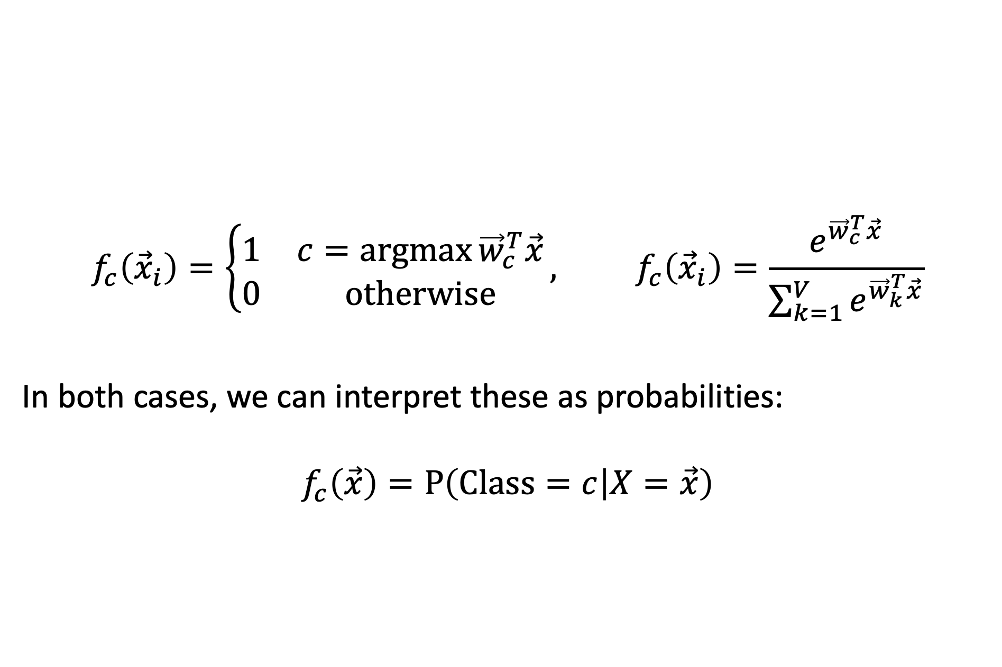
Argmax and Softmax
$$f_{c}\left({\vec{x}}_{i}\right)=\left\{\begin{matrix}1 & c=\operatorname{argmax}{{\vec{w}}_{c}^{T}\vec{x}} \\ 0 & otherwise\end{matrix}\right., f_{c}\left({\vec{x}}_{i}\right)=\frac{e^{{\vec{w}}_{c}^{T}\vec{x}}}{\sum_{k=1}^{V}{e^{{\vec{w}}_{k}^{T}\vec{x}}}}$$
In both cases, we can interpret these as probabilities:
$$f_{c}\left(\vec{x}\right)=P\left(Class=c | X=\vec{x}\right)$$

Slide 20
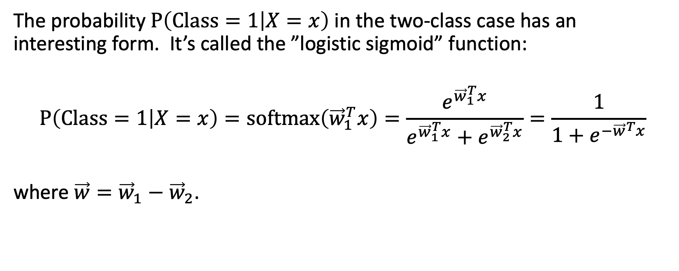
Some details: Logistic function
The probability $P\left(Class=1 | X=x\right)$ in the two-class case has an interesting form. It’s called the ”logistic sigmoid” function:
$$P\left(Class=1 | X=x\right)=\operatorname{softmax}\left({\vec{w}}_{1}^{T}x\right)=\frac{e^{{\vec{w}}_{1}^{T}x}}{e^{{\vec{w}}_{1}^{T}x}+e^{{\vec{w}}_{2}^{T}x}}=\frac{1}{1+e^{−{\vec{w}}^{T}x}}$$
where $\vec{w}={\vec{w}}_{1}−{\vec{w}}_{2}$.

Slide 21
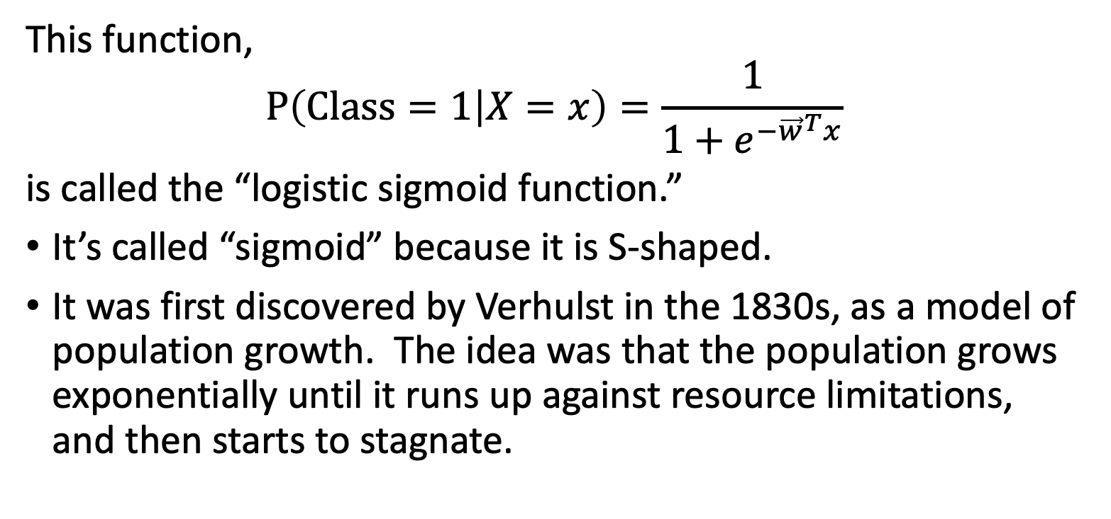
Some details: Logistic function
This function,
$$P\left(Class=1 | X=x\right)=\frac{1}{1+e^{−{\vec{w}}^{T}x}}$$
is called the “logistic sigmoid function.”
It’s called “sigmoid” because it is S-shaped.
It was first discovered by Verhulst in the 1830s, as a model of population growth. The idea was that the population grows exponentially until it runs up against resource limitations, and then starts to stagnate.

Slide 22
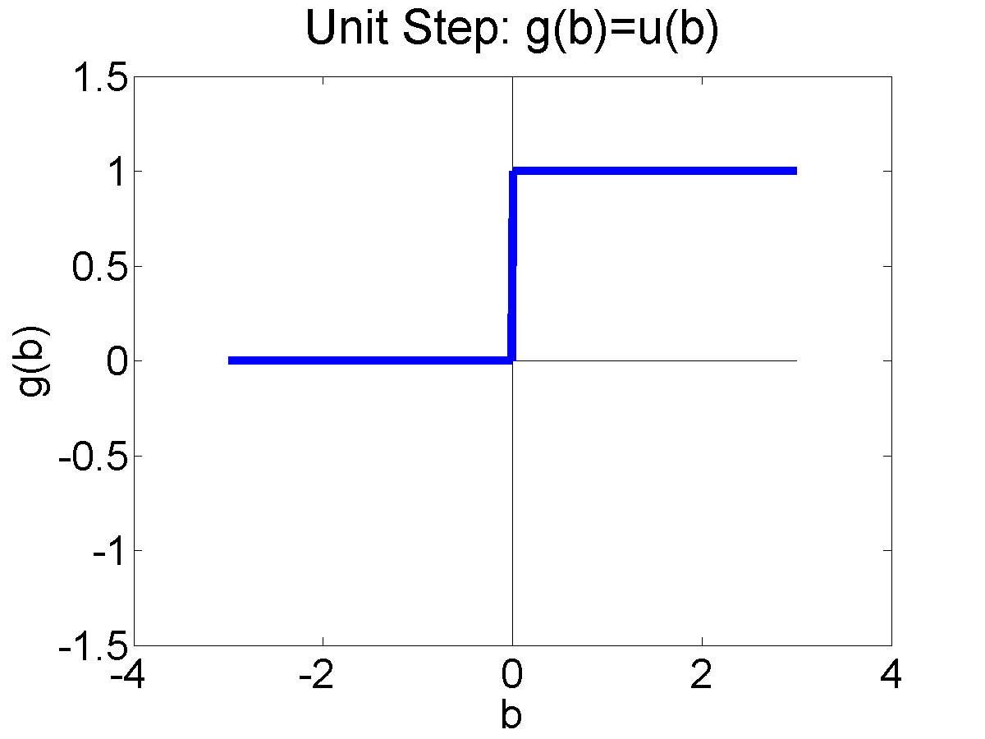
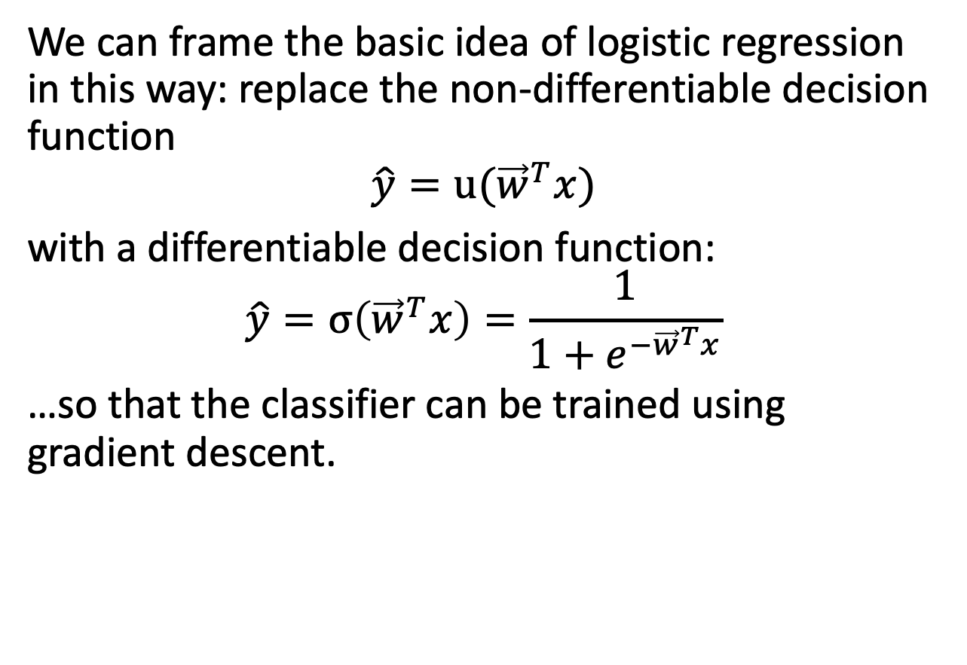
Logistic Regression
We can frame the basic idea of logistic regression in this way: replace the non-differentiable decision function
$$\hat{y}=u({\vec{w}}^{T}x)$$
with a differentiable decision function:
$$\hat{y}=σ\left({\vec{w}}^{T}x\right)=\frac{1}{1+e^{−{\vec{w}}^{T}x}}$$
…so that the classifier can be trained using gradient descent.

Slide 23
Outline
One-hot vectors: rewriting the perceptron to look like linear regression
Softmax: Soft category boundaries
Cross-entropy = negative log probability of the training data
Stochastic gradient descent for logistic regression

Slide 24
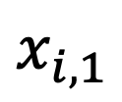
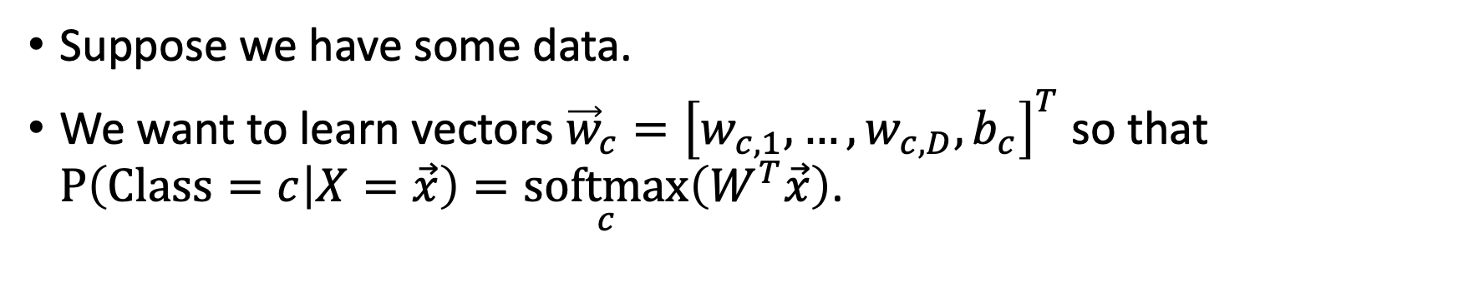
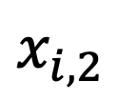
Learning logistic regression
Suppose we have some data.
We want to learn vectors ${\vec{w}}_{c}={\left[w_{c,1},…,w_{c,D},b_{c}\right]}^{T}$ so that $P\left(Class=c | X=\vec{x}\right)=\underset{c}{softmax}\left(W^{T}\vec{x}\right)$.
$$x_{i,2}$$
$$x_{i,1}$$

Slide 25

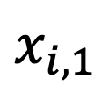

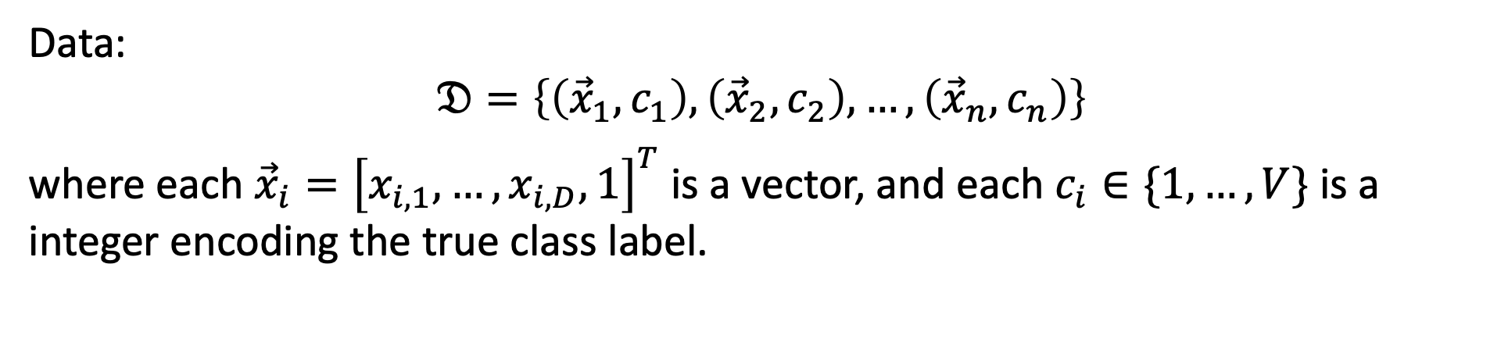


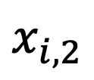
Learning logistic regression: Training data
Data:
$$𝔇=\left\{\left({\vec{x}}_{1},c_{1}\right),\left({\vec{x}}_{2},c_{2}\right),…,\left({\vec{x}}_{n},c_{n}\right)\right\}$$
where each ${\vec{x}}_{i}={\left[x_{i,1},…,x_{i,D},1\right]}^{T}$ is a vector, and each $c_{i}∈\{1,…,V\}$ is a integer encoding the true class label.
$$({\vec{x}}_{1},{\vec{y}}_{1}=\left[\begin{matrix}0 \\ 1\end{matrix}\right])$$
$$x_{i,2}$$
$$({\vec{x}}_{2},{\vec{y}}_{2}=\left[\begin{matrix}1 \\ 0\end{matrix}\right])$$
$$({\vec{x}}_{3},{\vec{y}}_{3}=\left[\begin{matrix}1 \\ 0\end{matrix}\right])$$
$$x_{i,1}$$
$$({\vec{x}}_{4},{\vec{y}}_{4}=\left[\begin{matrix}0 \\ 1\end{matrix}\right])$$

Slide 26





Learning logistic regression: Model parameters
We want to learn the model parameters
$$W=\left[{\vec{w}}_{1},…,{\vec{w}}_{V}\right]$$
so that
$$P\left(C=c_{i} | X={\vec{x}}_{i}\right)=\underset{c_{i}}{softmax}\left(W^{T}{\vec{x}}_{i}\right)$$
$$({\vec{x}}_{1},c_{1}=2)$$
$$x_{i,2}$$
$$({\vec{x}}_{2},c_{2}=1)$$
$$({\vec{x}}_{3},c_{3}=1)$$
$$x_{i,1}$$
$$({\vec{x}}_{4},c_{4}=2)$$

Slide 27
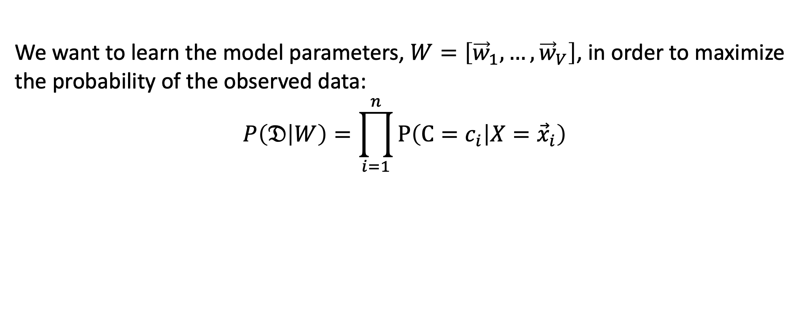
Learning logistic regression: Training criterion
We want to learn the model parameters, $W=\left[{\vec{w}}_{1},…,{\vec{w}}_{V}\right]$, in order to maximize the probability of the observed data:
$$P\left(𝔇 | W\right)=\prod_{i=1}^{n}{P\left(C=c_{i} | X={\vec{x}}_{i}\right)}$$
$$({\vec{x}}_{1},c_{1}=2)$$
$$x_{i,2}$$
$$({\vec{x}}_{2},c_{2}=1)$$
$$({\vec{x}}_{3},c_{3}=1)$$
$$x_{i,1}$$
$$({\vec{x}}_{4},c_{4}=2)$$

Slide 28
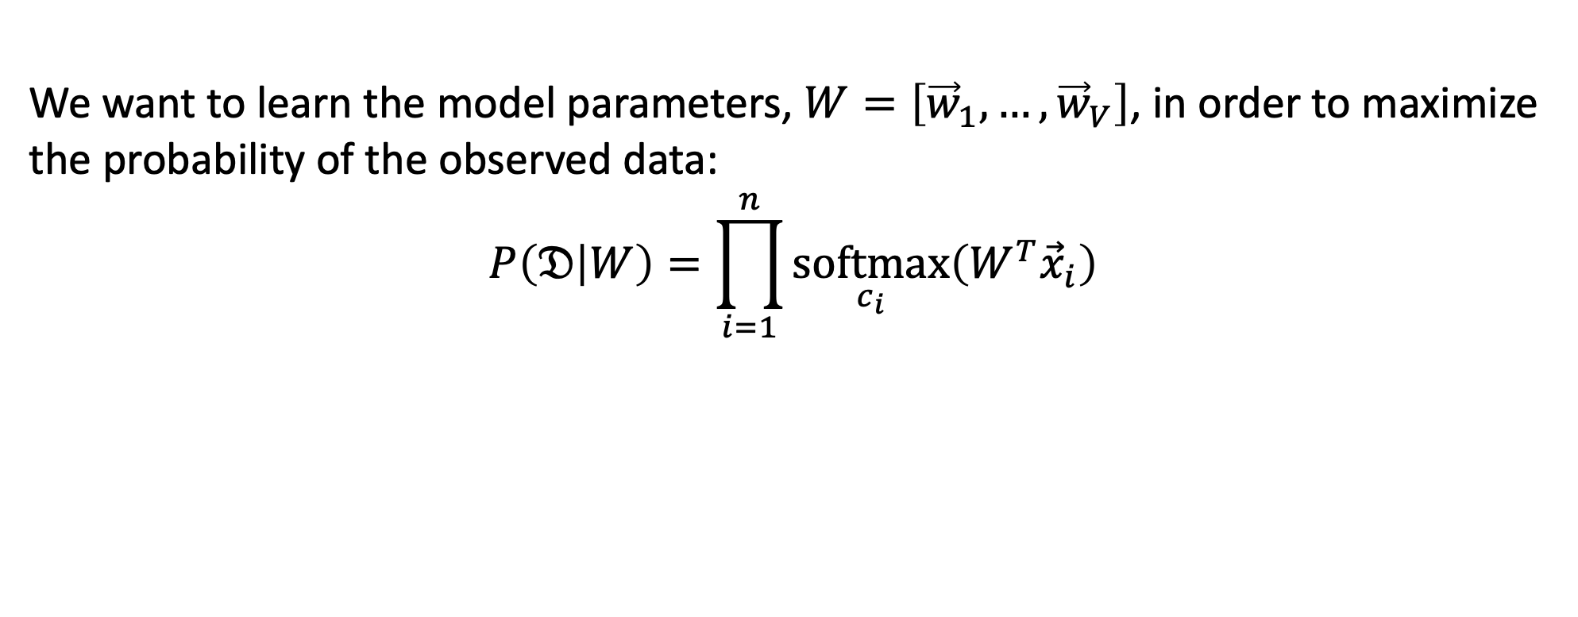
Learning logistic regression
We want to learn the model parameters, $W=\left[{\vec{w}}_{1},…,{\vec{w}}_{V}\right]$, in order to maximize the probability of the observed data:
$$P\left(𝔇 | W\right)=\prod_{i=1}^{n}{\underset{c_{i}}{softmax}\left(W^{T}{\vec{x}}_{i}\right)}$$
$$({\vec{x}}_{1},c_{1}=2)$$
$$x_{i,2}$$
$$({\vec{x}}_{2},c_{2}=1)$$
$$({\vec{x}}_{3},c_{3}=1)$$
$$x_{i,1}$$
$$({\vec{x}}_{4},c_{4}=2)$$

Slide 29
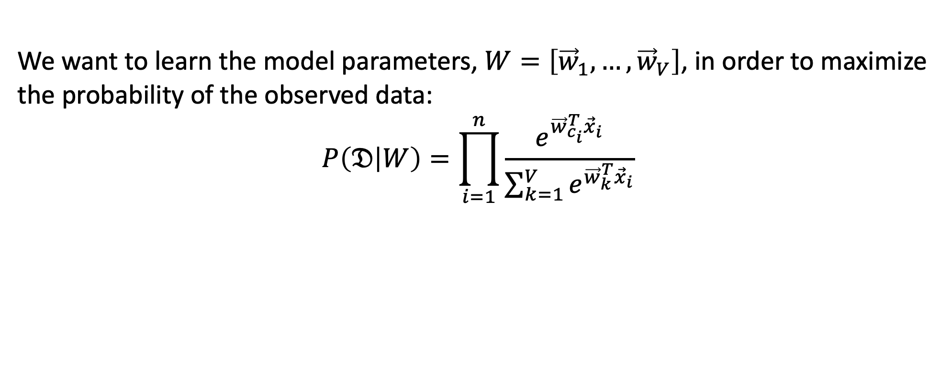
Learning logistic regression
We want to learn the model parameters, $W=\left[{\vec{w}}_{1},…,{\vec{w}}_{V}\right]$, in order to maximize the probability of the observed data:
$$P\left(𝔇 | W\right)=\prod_{i=1}^{n}{\frac{e^{{\vec{w}}_{c_{i}}^{T}{\vec{x}}_{i}}}{\sum_{k=1}^{V}{e^{{\vec{w}}_{k}^{T}{\vec{x}}_{i}}}}}$$
$$({\vec{x}}_{1},c_{1}=2)$$
$$x_{i,2}$$
$$({\vec{x}}_{2},c_{2}=1)$$
$$({\vec{x}}_{3},c_{3}=1)$$
$$x_{i,1}$$
$$({\vec{x}}_{4},c_{4}=2)$$

Slide 30
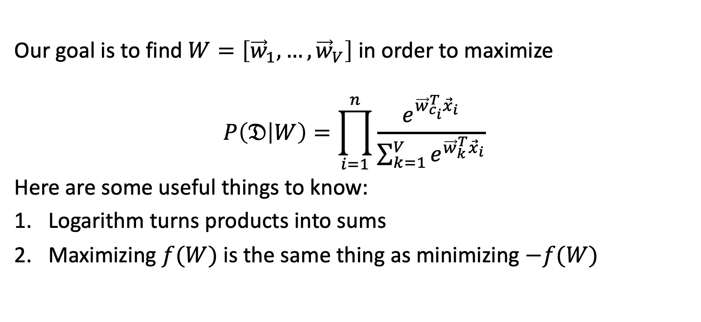
How do you maximize a function?
Our goal is to find $W=\left[{\vec{w}}_{1},…,{\vec{w}}_{V}\right]$ in order to maximize
$$P\left(𝔇 | W\right)=\prod_{i=1}^{n}{\frac{e^{{\vec{w}}_{c_{i}}^{T}{\vec{x}}_{i}}}{\sum_{k=1}^{V}{e^{{\vec{w}}_{k}^{T}{\vec{x}}_{i}}}}}$$
Here are some useful things to know:
Logarithm turns products into sums
Maximizing $f(W)$ is the same thing as minimizing $−f(W)$

Slide 31
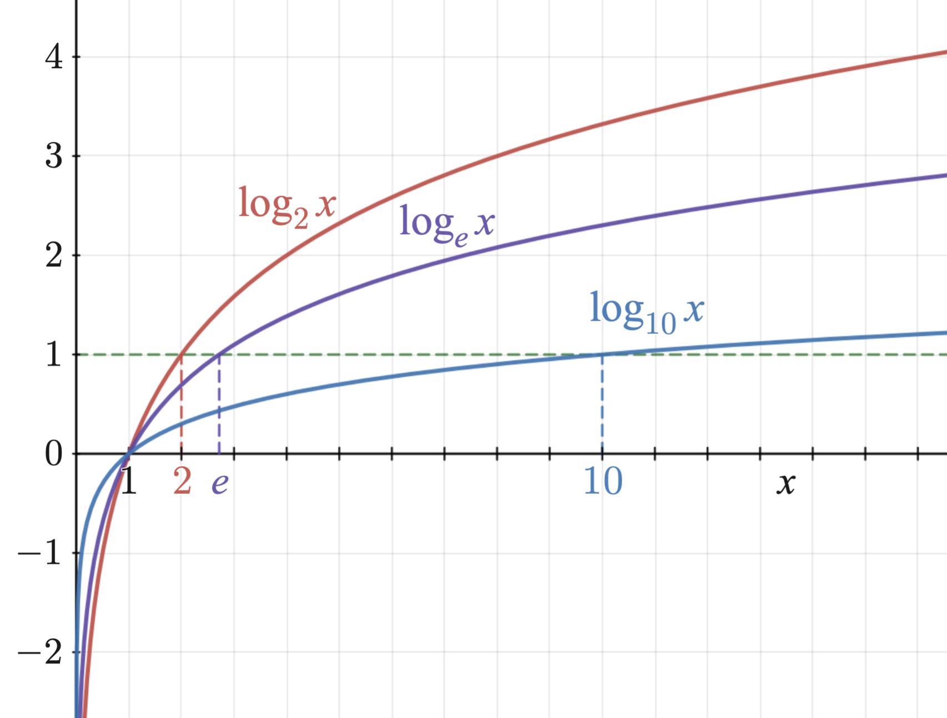
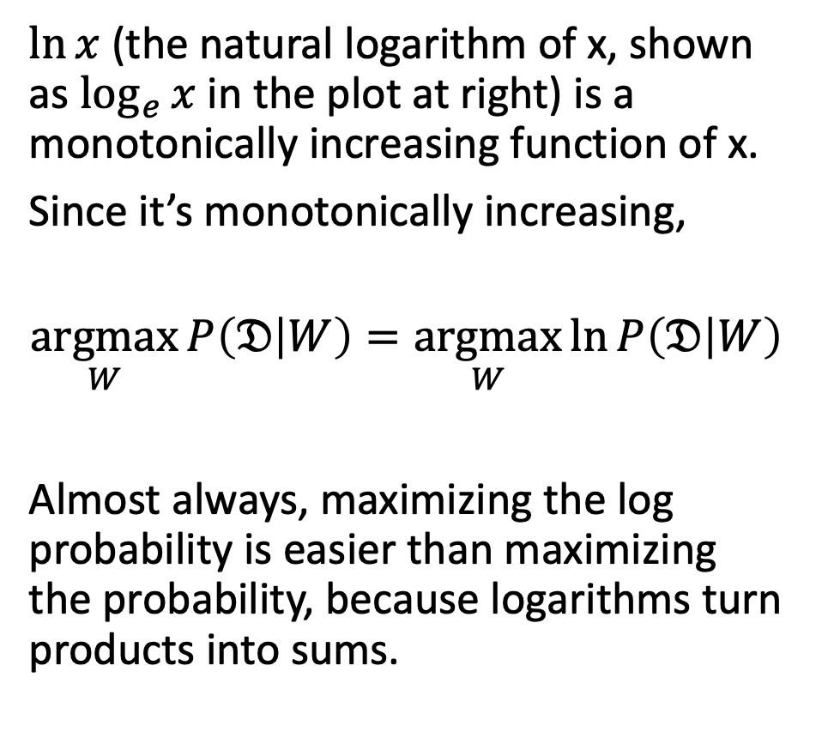
1. Logarithms turn products into sums
$\ln{x}$ (the natural logarithm of x, shown as $\log_{e}{x}$ in the plot at right) is a monotonically increasing function of x.
Since it’s monotonically increasing,
$$\underset{W}{argmax}{P\left(𝔇 | W\right)}=\underset{W}{argmax}{\ln{P\left(𝔇 | W\right)}}$$
Almost always, maximizing the log probability is easier than maximizing the probability, because logarithms turn products into sums.
Logarithm_plots.png, CC-SA 3.0, Richard F. Lyon, 2011

Slide 32
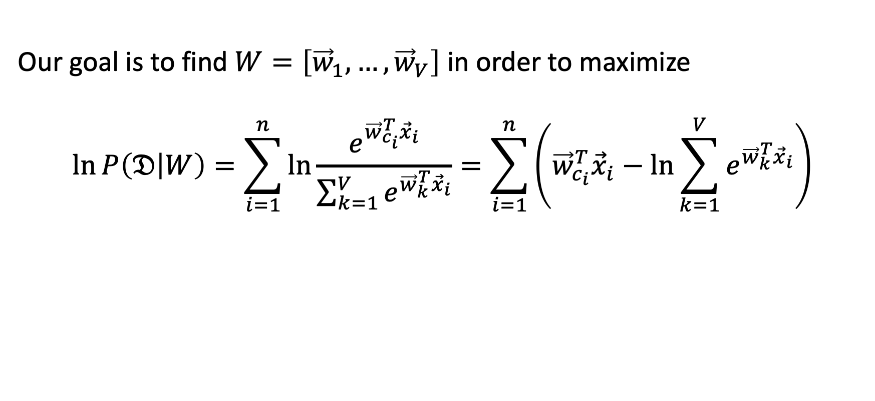
1. Logarithms turn products into sums
Our goal is to find $W=\left[{\vec{w}}_{1},…,{\vec{w}}_{V}\right]$ in order to maximize
$$\ln{P\left(𝔇 | W\right)}=\sum_{i=1}^{n}{\ln{\frac{e^{{\vec{w}}_{c_{i}}^{T}{\vec{x}}_{i}}}{\sum_{k=1}^{V}{e^{{\vec{w}}_{k}^{T}{\vec{x}}_{i}}}}}}=\sum_{i=1}^{n}{\left({\vec{w}}_{c_{i}}^{T}{\vec{x}}_{i}−\ln{\sum_{k=1}^{V}{e^{{\vec{w}}_{k}^{T}{\vec{x}}_{i}}}}\right)}$$

Slide 33
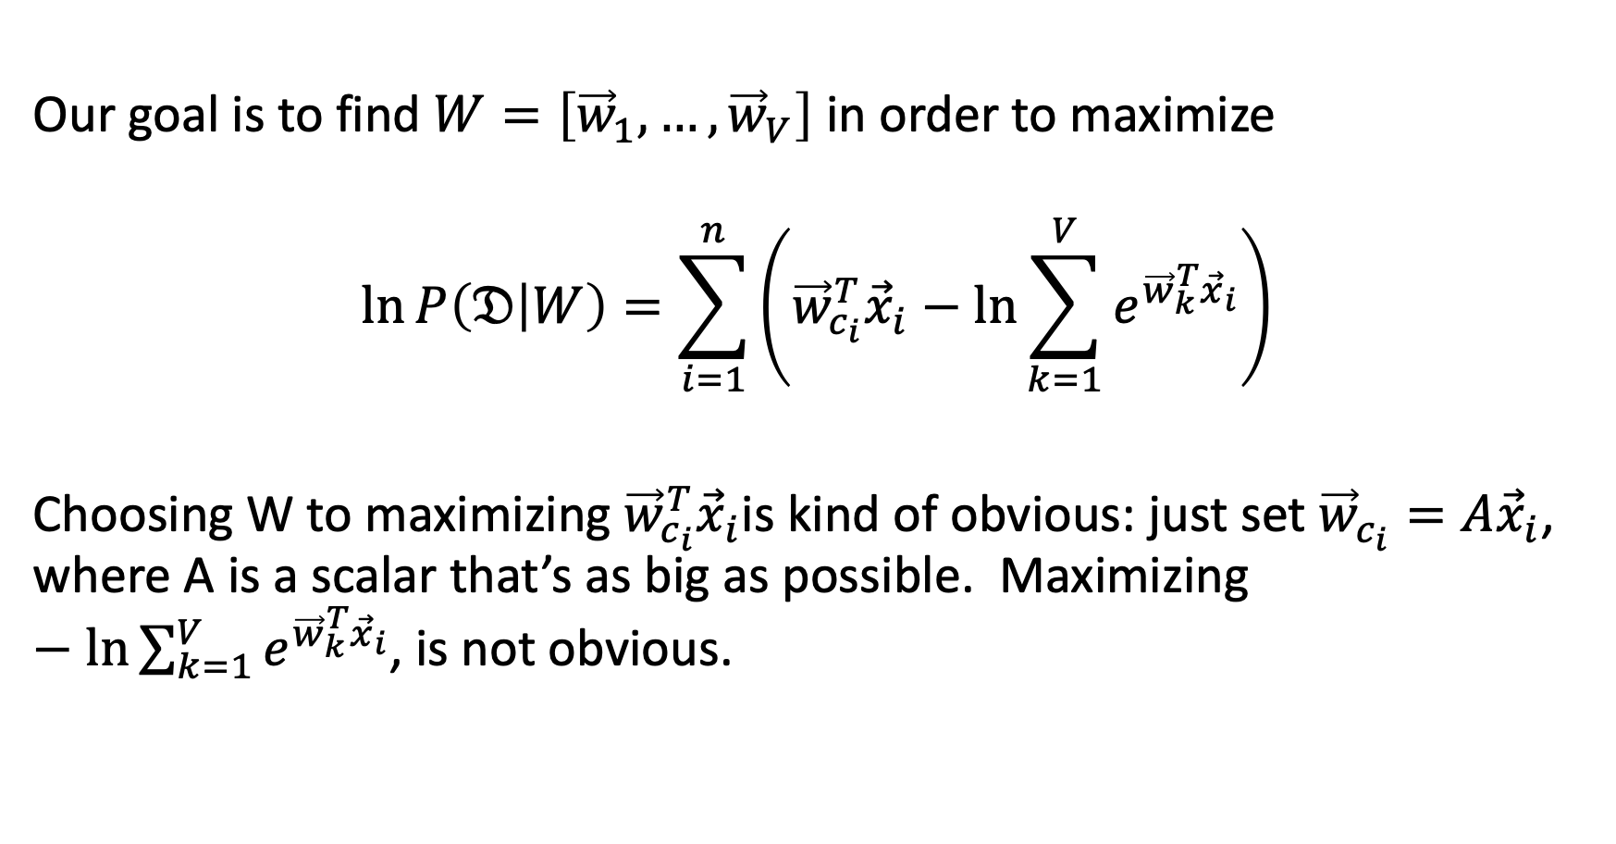
2. Maximizing $f(W)$ is the same thing as minimizing $−f(W)$.
Our goal is to find $W=\left[{\vec{w}}_{1},…,{\vec{w}}_{V}\right]$ in order to maximize
$$\ln{P\left(𝔇 | W\right)}=\sum_{i=1}^{n}{\left({\vec{w}}_{c_{i}}^{T}{\vec{x}}_{i}−\ln{\sum_{k=1}^{V}{e^{{\vec{w}}_{k}^{T}{\vec{x}}_{i}}}}\right)}$$
Choosing W to maximizing ${\vec{w}}_{c_{i}}^{T}{\vec{x}}_{i}$is kind of obvious: just set ${\vec{w}}_{c_{i}}=A{\vec{x}}_{i}$, where A is a scalar that’s as big as possible. Maximizing $−\ln{\sum_{k=1}^{V}{e^{{\vec{w}}_{k}^{T}{\vec{x}}_{i}}}}$, is not obvious.

Slide 34
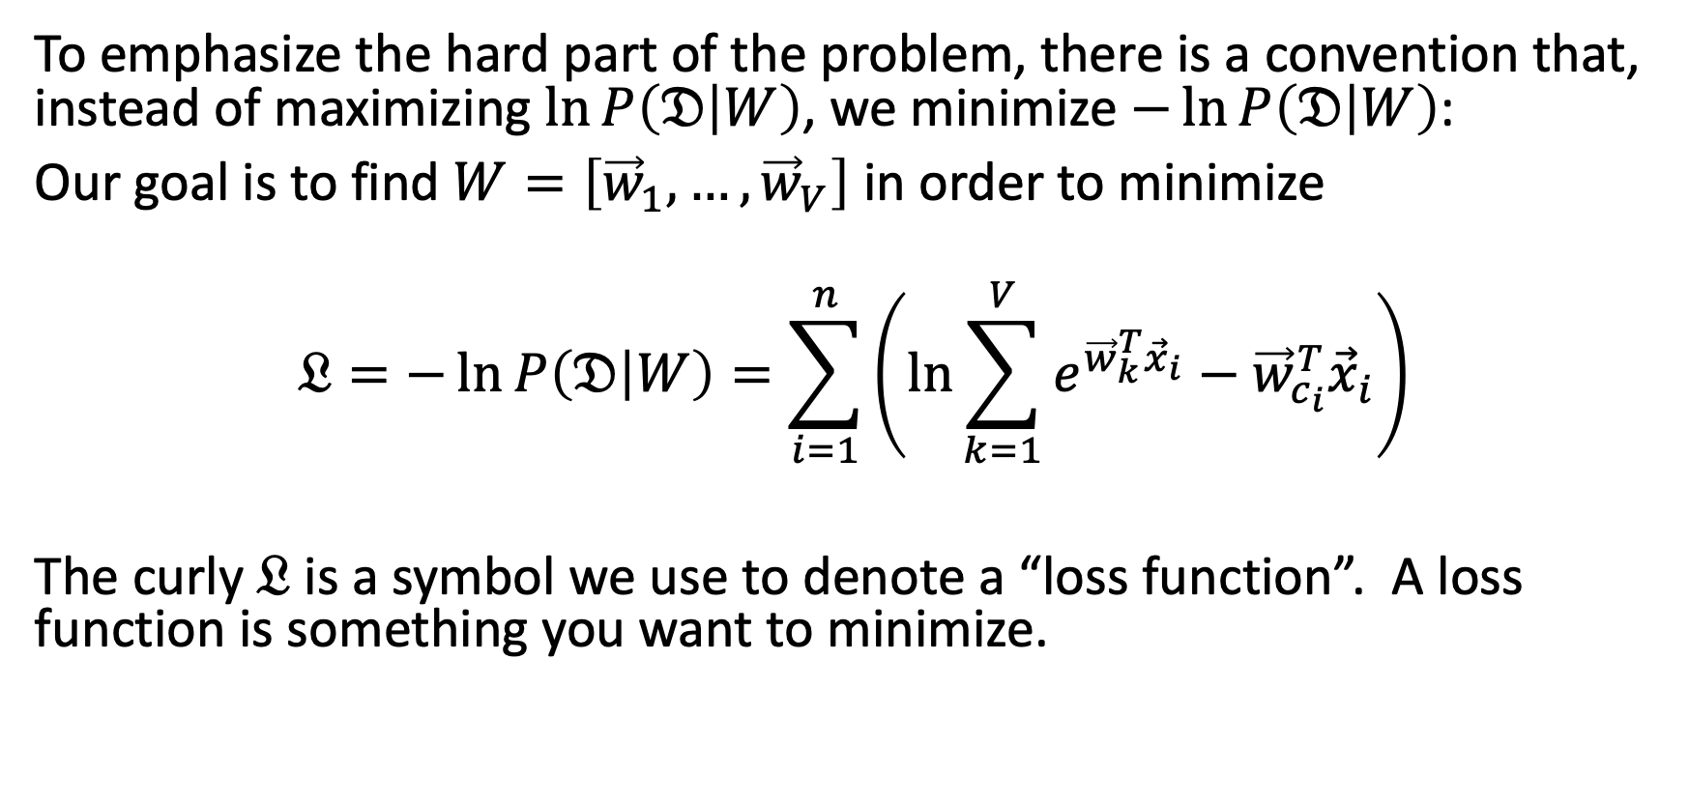
2. Maximizing $f(W)$ is the same thing as minimizing $−f(W)$.
To emphasize the hard part of the problem, there is a convention that, instead of maximizing $\ln{P\left(𝔇 | W\right)}$, we minimize $−\ln{P\left(𝔇 | W\right)}$:
Our goal is to find $W=\left[{\vec{w}}_{1},…,{\vec{w}}_{V}\right]$ in order to minimize
$$𝔏=−\ln{P\left(𝔇 | W\right)}=\sum_{i=1}^{n}{\left(\ln{\sum_{k=1}^{V}{e^{{\vec{w}}_{k}^{T}{\vec{x}}_{i}}}}−{\vec{w}}_{c_{i}}^{T}{\vec{x}}_{i}\right)}$$
The curly $𝔏$ is a symbol we use to denote a “loss function”. A loss function is something you want to minimize.

Slide 35
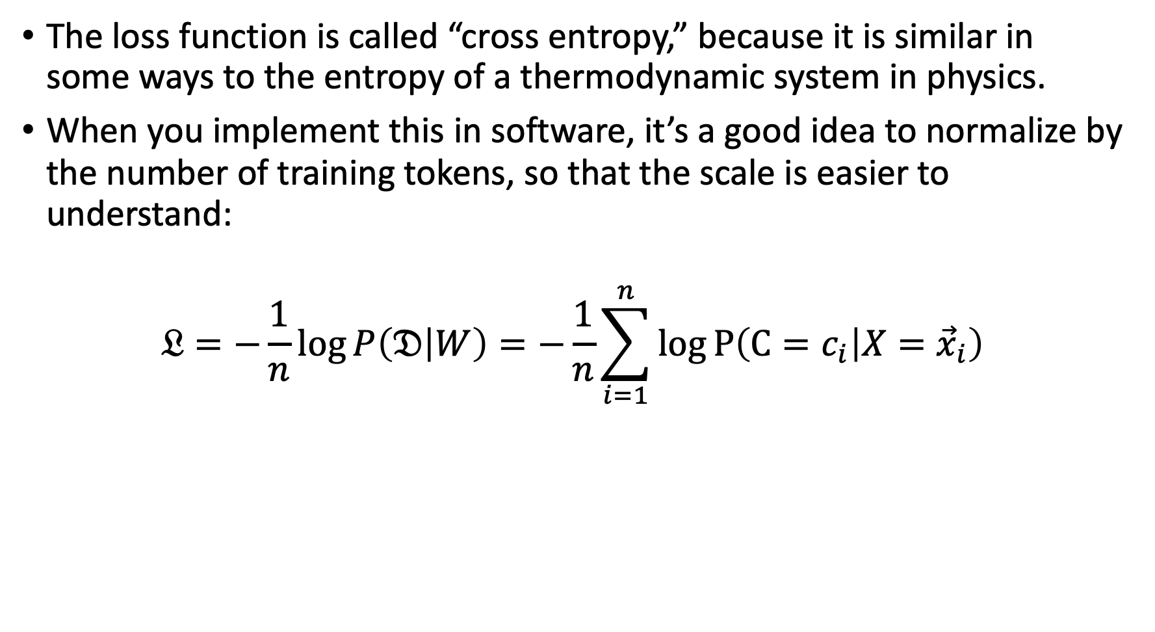
Some details: Cross entropy
The loss function is called “cross entropy,” because it is similar in some ways to the entropy of a thermodynamic system in physics.
When you implement this in software, it’s a good idea to normalize by the number of training tokens, so that the scale is easier to understand:
$$𝔏=−\frac{1}{n}\log{P\left(𝔇 | W\right)}=−\frac{1}{n}\sum_{i=1}^{n}{\log{P\left(C=c_{i} | X={\vec{x}}_{i}\right)}}$$

Slide 36
Outline
One-hot vectors: rewriting the perceptron to look like linear regression
Softmax: Soft category boundaries
Cross-entropy = negative log probability of the training data
Stochastic gradient descent for logistic regression

Slide 37
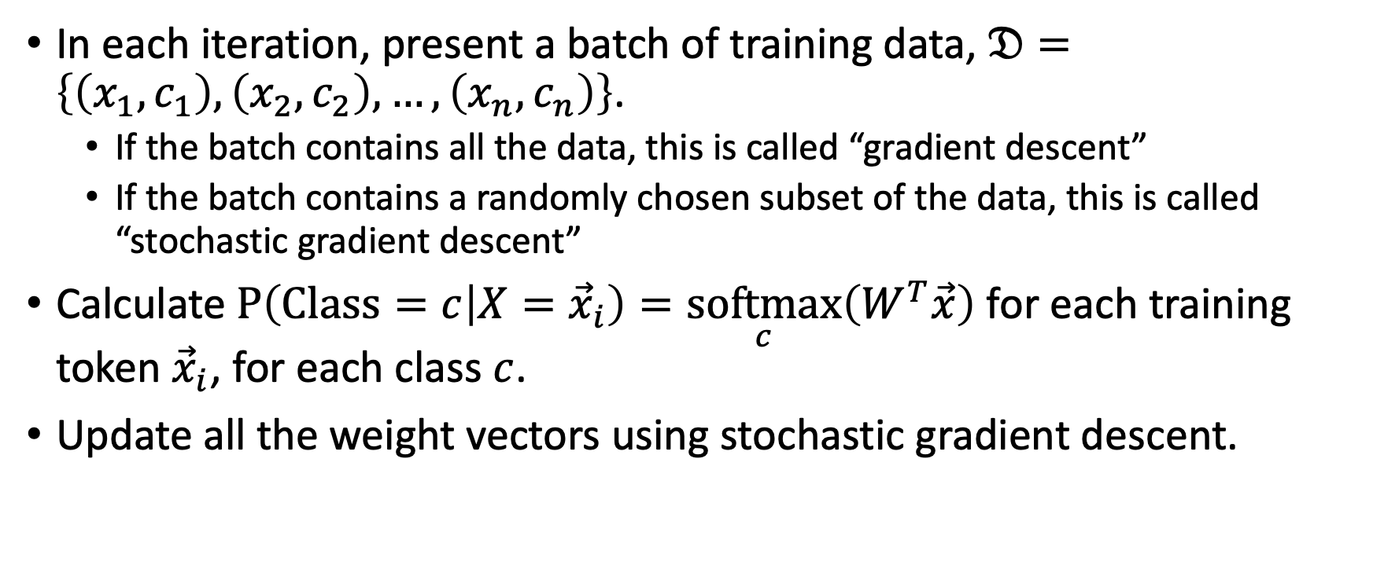
Logistic regression training
In each iteration, present a batch of training data, $𝔇=\left\{\left(x_{1},c_{1}\right),\left(x_{2},c_{2}\right),…,\left(x_{n},c_{n}\right)\right\}$.
If the batch contains all the data, this is called “gradient descent”
If the batch contains a randomly chosen subset of the data, this is called “stochastic gradient descent”
Calculate $P\left(Class=c | X={\vec{x}}_{i}\right)=\underset{c}{softmax}\left(W^{T}\vec{x}\right)$ for each training token ${\vec{x}}_{i}$, for each class $c$.
Update all the weight vectors using stochastic gradient descent.

Slide 38
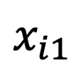

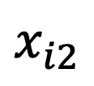
Logistic regression training example
Start with the given dataset $𝔇$. Here the true class is indicated by both color and shape.
$$x_{i2}$$
$$x_{i1}$$

Slide 39
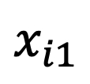
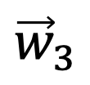




Logistic regression training example
Randomly initialize the weight vectors, and then calculate the probabilities $P\left(Y=c | X=x_{i}\right)$ for every class $c$, for every training token (shown as transparency and color change, left side)
$$x_{i2}$$
$${\vec{w}}_{1}$$
$$x_{i1}$$
$${\vec{w}}_{2}$$
$${\vec{w}}_{3}$$

Slide 40




Logistic regression training example
Modify the weight vectors to reduce the loss function, as
$${\vec{w}}_{c}←{\vec{w}}_{c}−η∇_{{\vec{w}}_{c}}𝔏$$
$$x_{i2}$$
$${\vec{w}}_{1}$$
$${\vec{w}}_{3}$$
$$x_{i1}$$
$${\vec{w}}_{2}$$

Slide 41




Logistic regression training example
Repeat until the loss stops decreasing: ${\vec{w}}_{c}←{\vec{w}}_{c}−η∇_{{\vec{w}}_{c}}𝔏$
$$x_{i2}$$
$${\vec{w}}_{3}$$
$${\vec{w}}_{1}$$
$$x_{i1}$$
$${\vec{w}}_{2}$$

Slide 42

Stochastic gradient descent
Our goal is to find $W=\left[{\vec{w}}_{1},…,{\vec{w}}_{V}\right]$ in order to minimize
$$𝔏=−\ln{P\left(𝔇 | W\right)}=\sum_{i=1}^{n}{\left(\ln{\sum_{k=1}^{V}{e^{{\vec{w}}_{k}^{T}{\vec{x}}_{i}}}}−{\vec{w}}_{c_{i}}^{T}{\vec{x}}_{i}\right)}$$
Just like in linear regression, let’s do that one token at a time. Choose a training token $\left({\vec{x}}_{i},c_{i}\right)$, and try to minimize
$$𝔏_{i}=−\ln{P\left(C=c_{i} | X={\vec{x}}_{i}\right)}=\ln{\sum_{k=1}^{V}{e^{{\vec{w}}_{k}^{T}{\vec{x}}_{i}}}}−{\vec{w}}_{c_{i}}^{T}{\vec{x}}_{i}$$

Slide 43

Stochastic gradient descent
Our goal is to find $W=\left[{\vec{w}}_{1},…,{\vec{w}}_{V}\right]$ in order to minimize
$$𝔏_{i}=\ln{\sum_{k=1}^{V}{e^{{\vec{w}}_{k}^{T}{\vec{x}}_{i}}}}−{\vec{w}}_{c_{i}}^{T}{\vec{x}}_{i}$$
We do that by adjusting ${\vec{w}}_{c}←{\vec{w}}_{c}−η∇_{{\vec{w}}_{c}}𝔏_{i}$, where
$η$is called the learning rate. Typically $η≈0.001$, but it’s very hard to know in advance what learning rate will work for a particular problem; you need to experiment to see what works.
$∇_{{\vec{w}}_{c}}𝔏_{i}$ is the gradient of the loss with respect to ${\vec{w}}_{c}$.

Slide 44

The gradient of the cross-entropy of a softmax
Now, let’s calculate that gradient.
$$∇_{{\vec{w}}_{c}}𝔏_{i}=∇_{{\vec{w}}_{c}}\left(\ln{\sum_{k=1}^{V}{e^{{\vec{w}}_{k}^{T}{\vec{x}}_{i}}}}\right)−∇_{{\vec{w}}_{c}}\left({\vec{w}}_{c_{i}}^{T}{\vec{x}}_{i}\right)$$
$$=∇_{{\vec{w}}_{c}}\left(\ln{\sum_{k=1}^{V}{e^{{\vec{w}}_{k}^{T}{\vec{x}}_{i}}}}\right)−y_{i,c}{\vec{x}}_{i}$$
…where $y_{i,c}$ is our old friend the one-hot vector:
$$y_{i,c}=\left\{\begin{matrix}1 & c_{i}=c \\ 0 & otherwise\end{matrix}\right.$$

Slide 45

The gradient of the cross-entropy of a softmax
$$∇_{{\vec{w}}_{c}}𝔏_{i}=∇_{{\vec{w}}_{c}}\left(\ln{\sum_{k=1}^{V}{e^{{\vec{w}}_{k}^{T}{\vec{x}}_{i}}}}\right)−y_{i,c}{\vec{x}}_{i}$$
$$=\frac{e^{{\vec{w}}_{c}^{T}{\vec{x}}_{i}}}{\sum_{k=1}^{V}{e^{{\vec{w}}_{k}^{T}{\vec{x}}_{i}}}}{\vec{x}}_{i}−y_{i,c}{\vec{x}}_{i}$$
$$=\left(f_{c}\left({\vec{x}}_{i}\right)−y_{i,c}\right){\vec{x}}_{i}$$
$$=ε_{i,c}{\vec{x}}_{i}$$

Slide 46

Comparison of perceptron, linear regression, and logistic regression
Perceptron:
$$ε_{i,c}=f_{c}\left({\vec{x}}_{i}\right)−y_{i,c}, {\vec{w}}_{c}←{\vec{w}}_{c}−ηε_{i,c}{\vec{x}}_{i}$$
Linear Regression:
$$ε_{i,c}=f_{c}\left({\vec{x}}_{i}\right)−y_{i,c}, {\vec{w}}_{c}←{\vec{w}}_{c}−ηε_{i,c}{\vec{x}}_{i}$$
Logistic Regression:
$$ε_{i,c}=f_{c}\left({\vec{x}}_{i}\right)−y_{i,c}, {\vec{w}}_{c}←{\vec{w}}_{c}−ηε_{i,c}{\vec{x}}_{i}$$
The only difference is how you define the network output (argmax, linear, or softmax).

Slide 47
Outline
One-hot vectors: rewriting the perceptron to look like linear regression
Probabilistic-boundary classifiers
How do you maximize a function?
Learning a logistic regression
Two-class logistic regression

Slide 48

Some details: Binary cross entropy
For two-class problems, it’s wasteful to compute both $P\left(C=0 | X=x_{i}\right)$ and $P\left(C=1 | X=x_{i}\right)$, so sometimes we don’t.
Instead, we use binary cross entropy, which is:
$$𝔏=−\frac{1}{n}\left(\sum_{i:y_{i}=1}{\log{P\left(C=1 | X=x_{i}\right)}}+\sum_{i:y_{i}=0}{log\left(1−P\left(C=1 | X=x_{i}\right)\right)}\right)$$

Slide 49

Some details: Logistic function
The probability $P\left(C=1 | X=x\right)$ in the two-class case is particularly simple. It’s
$$P\left(C=1 | X=x\right)=\operatorname{softmax}\left(w_{1}^{T}x\right)=\frac{e^{w_{1}^{T}x}}{e^{w_{1}^{T}x}+e^{w_{2}^{T}x}}=\frac{1}{1+e^{−w^{T}x}}$$
where $w=w_{1}−w_{2}$.

Slide 50

Some details: Logistic function
This function,
$$P\left(Y=1 | X=x\right)=\frac{1}{1+e^{−w^{T}x}}$$
is called the “logistic sigmoid function.”
It’s called “sigmoid” because it is S-shaped.
It was first discovered by Verhulst in the 1830s, as a model of population growth. The idea was that the population grows exponentially until it runs up against resource limitations, and then starts to stagnate.

Slide 51

Logistic Regression
We can frame the basic idea of logistic regression in this way: replace the non-differentiable decision function
$$\hat{y}=u(w^{T}x)$$
with a differentiable decision function:
$$\hat{y}=σ\left(w^{T}x\right)=\frac{1}{1+e^{−w^{T}x}}$$
…so that the classifier can be trained using gradient descent.

Slide 52
Conclusion
Perceptron:
$$ε_{i,c}=f_{c}\left({\vec{x}}_{i}\right)−y_{i,c}, {\vec{w}}_{c}←{\vec{w}}_{c}−ηε_{i,c}{\vec{x}}_{i}$$
Linear Regression:
$$ε_{i,c}=f_{c}\left({\vec{x}}_{i}\right)−y_{i,c}, {\vec{w}}_{c}←{\vec{w}}_{c}−ηε_{i,c}{\vec{x}}_{i}$$
Logistic Regression:
$$ε_{i,c}=f_{c}\left({\vec{x}}_{i}\right)−y_{i,c}, {\vec{w}}_{c}←{\vec{w}}_{c}−ηε_{i,c}{\vec{x}}_{i}$$
The only difference is how you define the network output (argmax, linear, or softmax).

Slide 53
Comparison of Multi-Class Perceptron to Multiple Regression
Multi-Class Perceptron:
One-hot output
Multiple Regression:
Real-valued Output
Input
Weights
Input
Weights
1
1
$$b_{1}$$
$$f_{1}\left(\vec{x}\right)=\left\{\begin{matrix}1 & 1=\operatorname{argmax}{{\vec{w}}_{c}^{T}\vec{x}} \\ 0 & otherwise\end{matrix}\right.$$
$$b_{1}$$
$$b_{2}$$
$$b_{2}$$
$$f_{1}\left(\vec{x}\right)={\vec{w}}_{1}^{T}\vec{x}$$
x₁
x₁
$$f_{2}\left(\vec{x}\right)=\left\{\begin{matrix}1 & 2=\operatorname{argmax}{{\vec{w}}_{c}^{T}\vec{x}} \\ 0 & otherwise\end{matrix}\right.$$
$$f_{2}\left(\vec{x}\right)={\vec{w}}_{2}^{T}\vec{x}$$
x₂
.
.
.
x₂
.
.
.
.
.
.
.
.
.
.
.
.
$$b_{V}$$
.
.
.
$$b_{V}$$
$$w_{1,D}$$
$$w_{1,D}$$
$$w_{2,D}$$
$$f_{V}\left(\vec{x}\right)=\left\{\begin{matrix}1 & V=\operatorname{argmax}{{\vec{w}}_{c}^{T}\vec{x}} \\ 0 & otherwise\end{matrix}\right.$$
$$w_{2,D}$$
$$f_{V}\left(\vec{x}\right)={\vec{w}}_{V}^{T}\vec{x}$$
x_{D}
$$w_{V,D}$$
x_{D}
$$w_{V,D}$$

Slide 54




Logistic Regression
Logistic Regression:
Output is a vector of probabilities
Input
Weights
1
$$b_{1}$$
$$b_{2}$$
$$f_{1}\left(\vec{x}\right)=\underset{1}{softmax}\left(W^{T}{\vec{x}}_{i}\right)$$
x₁
$$f_{2}\left(\vec{x}\right)=\underset{2}{softmax}\left(W^{T}{\vec{x}}_{i}\right)$$
x₂
.
.
.
.
.
.
.
.
.
$$b_{V}$$
$$w_{1,D}$$
$$w_{2,D}$$
$$f_{V}\left(\vec{x}\right)=\underset{V}{softmax}\left(W^{T}{\vec{x}}_{i}\right)$$
x_{D}
$$w_{V,D}$$

