Slide 1
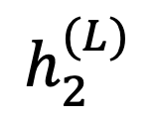
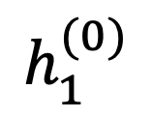

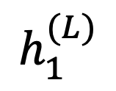

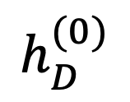

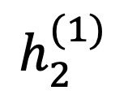
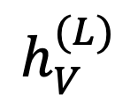
Lecture 9: Two-Layer Neural Nets
$$h_{1}^{(L)}$$
$$h_{2}^{(L)}$$
$$h_{V}^{(L)}$$
$$1$$
Mark Hasegawa-Johnson
2/2022
License: CC-BY 4.0. You may remix or redistribute if you cite the source.
$$1$$
$$h_{1}^{(0)}$$
$$h_{2}^{(1)}$$
$$…$$
$$h_{D}^{(0)}$$
$$1$$

Slide 2
Outline
Breaking the constraints of linearity: multi-layer neural nets
Flow diagram for the XOR problem
Flow diagram for a multi-layer neural net
Forward-propagation example

Slide 3
Biological Inspiration: McCulloch-Pitts Artificial Neuron, 1943
Input
In 1943, McCulloch & Pitts proposed that biological neurons have a nonlinear activation function (a step function) whose input is a weighted linear combination of the currents generated by other neurons.
They showed lots of examples of mathematical and logical functions that could be computed using networks of simple neurons like this.
Weights
x₁
w₁
x₂
w₂
Output: u(w⋅x)
x₃
w₃
.
.
.
w_{D}
x_{D}

Slide 4
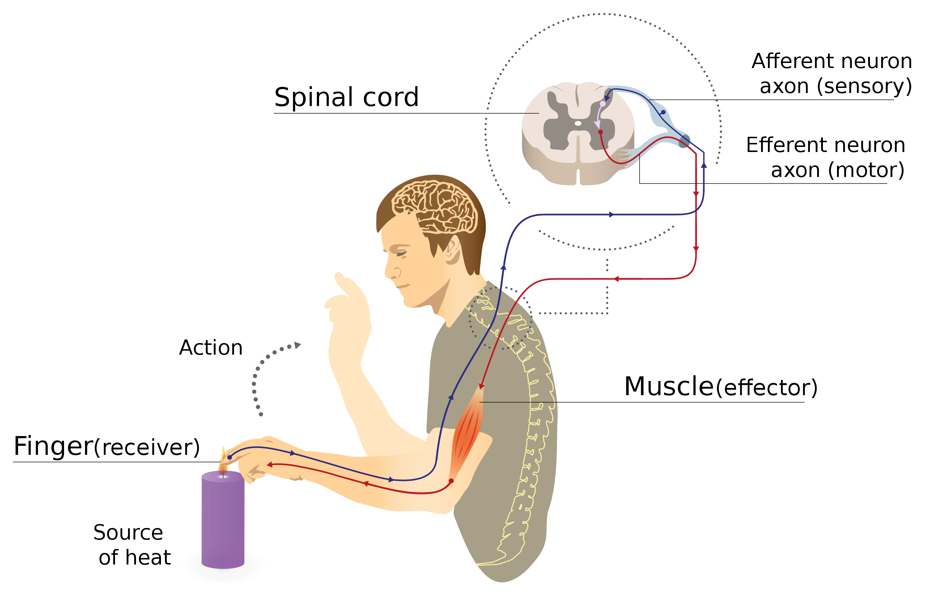
Biological Inspiration: Neuronal Circuits
Even the simplest actions involve more than one neuron, acting in sequence in a neuronal circuit.
One of the simplest neuronal circuits is a reflex arc, which may contain just two neurons:
The sensor neuron detects a stimulus, and communicates an electrical signal to …
The motor neuron, which activates the muscle.
Illustration of a reflex arc: sensor neuron sends a voltage spike to the spinal column, where the resulting current causes a spike in a motor neuron, whose spike activates the muscle.
By MartaAguayo - Own work, CC BY-SA 3.0, https://commons.wikimedia.org/w/index.php?curid=39181552

Slide 5


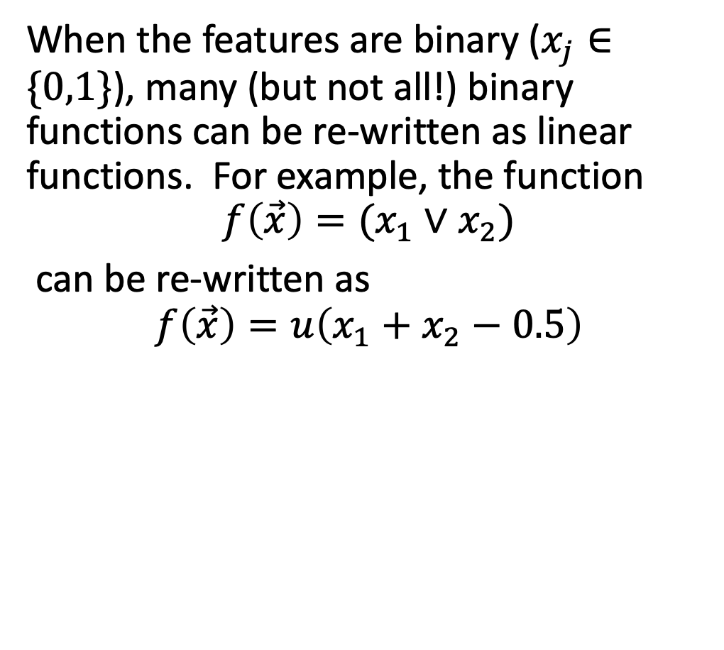



A McCulloch-Pitts Neuron can compute some logical functions…
When the features are binary ($x_{j}∈\{0,1\}$), many (but not all!) binary functions can be re-written as linear functions. For example, the function
$$f\left(\vec{x}\right)=(x_{1}∨x_{2})$$
can be re-written as
$$f\left(\vec{x}\right)=u\left(x_{1}+x_{2}−0.5\right)$$
Similarly, the function
$$f\left(\vec{x}\right)=(x_{1}∧x_{2})$$
can be re-written as
$$f\left(\vec{x}\right)=u\left(x_{1}+x_{2}−1.5\right)$$
$$x_{2}$$
$$x_{2}$$
$$x_{1}$$
$$x_{1}$$

Slide 6


… but not all.
“A linear classifier cannot learn an XOR function.”
- Minsky & Papert, 1969
…but a two-layer neural net can compute an XOR function!
$$x_{2}$$
$$x_{1}$$

Slide 7
Outline
Breaking the constraints of linearity: multi-layer neural nets
Flow diagram for the XOR problem
Flow diagram for a multi-layer neural net
Forward-propagation example

Slide 8
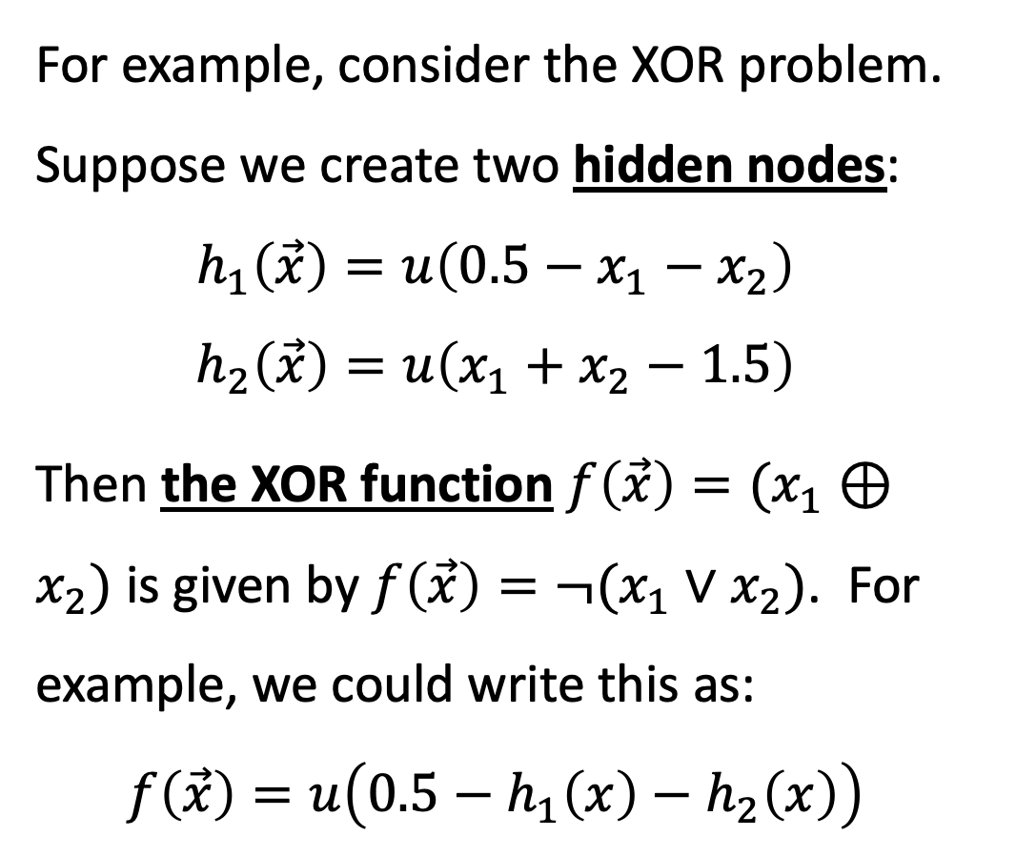
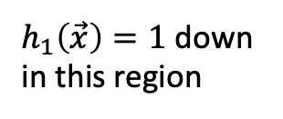

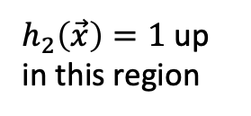


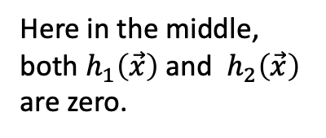
Example: one way (of many possible ways) to represent the XOR function using a two-layer neural network
$$x_{2}$$
$h_{2}\left(\vec{x}\right)=1$ up in this region
For example, consider the XOR problem. Suppose we create two hidden nodes:
$$h_{1}\left(\vec{x}\right)=u\left(0.5−x_{1}−x_{2}\right)$$
$$h_{2}\left(\vec{x}\right)=u\left(x_{1}+x_{2}−1.5\right)$$
Then the XOR function $f\left(\vec{x}\right)=(x_{1}⊕x_{2})$ is given by $f\left(\vec{x}\right)=¬(x_{1}∨x_{2})$. For example, we could write this as:
$$f\left(\vec{x}\right)=u\left(0.5−h_{1}\left(x\right)−h_{2}\left(x\right)\right)$$
$h_{1}\left(\vec{x}\right)=1$ down in this region
$$x_{1}$$
Here in the middle, both $h_{1}\left(\vec{x}\right)$and $h_{2}\left(\vec{x}\right)$ are zero.
$$x_{2}$$
$$x_{1}$$

Slide 9
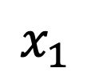


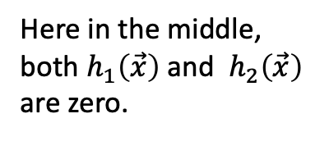

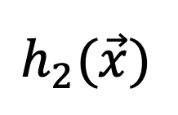
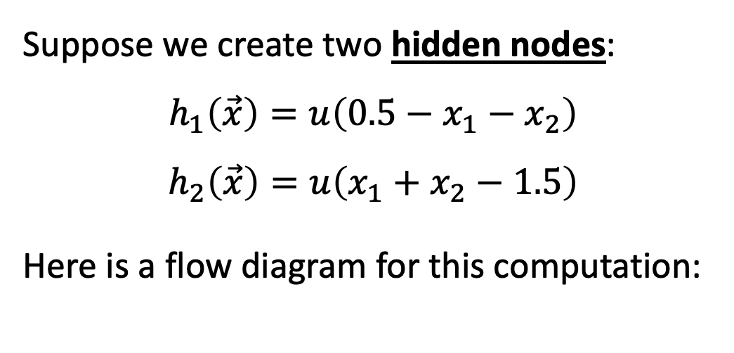
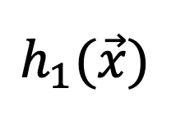




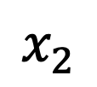

Flow diagrams
$$x_{2}$$
$h_{2}\left(\vec{x}\right)=1$ up in this region
Suppose we create two hidden nodes:
$$h_{1}\left(\vec{x}\right)=u\left(0.5−x_{1}−x_{2}\right)$$
$$h_{2}\left(\vec{x}\right)=u\left(x_{1}+x_{2}−1.5\right)$$
Here is a flow diagram for this computation:
$h_{1}\left(\vec{x}\right)=1$ down in this region
$$x_{1}$$
Here in the middle, both $h_{1}\left(\vec{x}\right)$and $h_{2}\left(\vec{x}\right)$ are zero.
$$h_{1}(\vec{x})$$
$$h_{2}(\vec{x})$$
$$−1.5$$
$$−1$$
$$1$$
$$−1$$
$$1$$
$$0.5$$
$$x_{1}$$
$$x_{2}$$
$$1$$

Slide 10
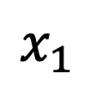

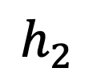
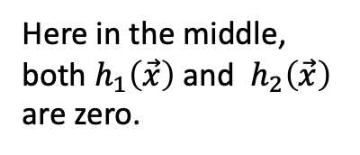

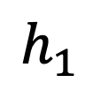
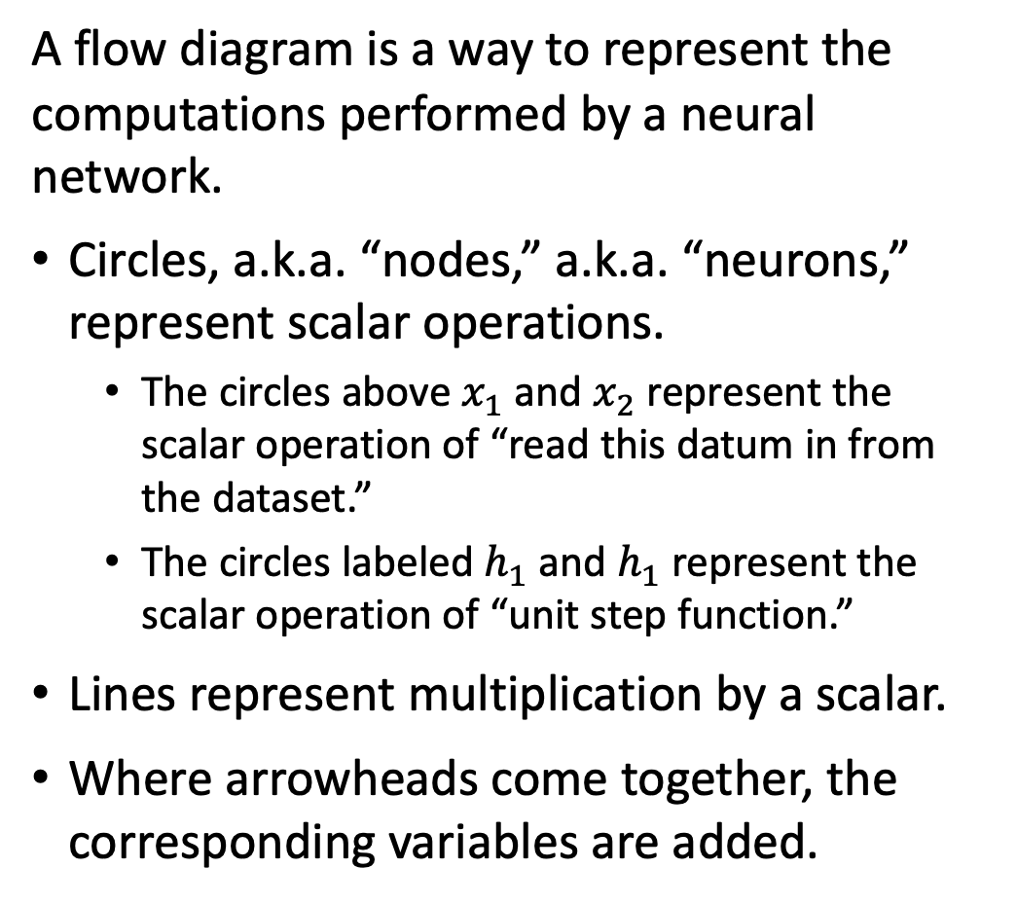







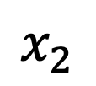

Flow diagrams
$$x_{2}$$
$$h_{2}=1$$
A flow diagram is a way to represent the computations performed by a neural network.
Circles, a.k.a. “nodes,” a.k.a. “neurons,” represent scalar operations.
The circles above $x_{1}$ and $x_{2}$ represent the scalar operation of “read this datum in from the dataset.”
The circles labeled $h_{1}$ and $h_{1}$ represent the scalar operation of “unit step function.”
Lines represent multiplication by a scalar.
Where arrowheads come together, the corresponding variables are added.
$$h_{1}=1$$
$$x_{1}$$
Here in the middle, both $h_{1}\left(\vec{x}\right)$and $h_{2}\left(\vec{x}\right)$ are zero.
$$h_{1}$$
$$h_{2}$$
$$−1.5$$
$$−1$$
$$1$$
$$1$$
$$−1$$
$$0.5$$
$$x_{1}$$
$$x_{2}$$
$$1$$

Slide 11
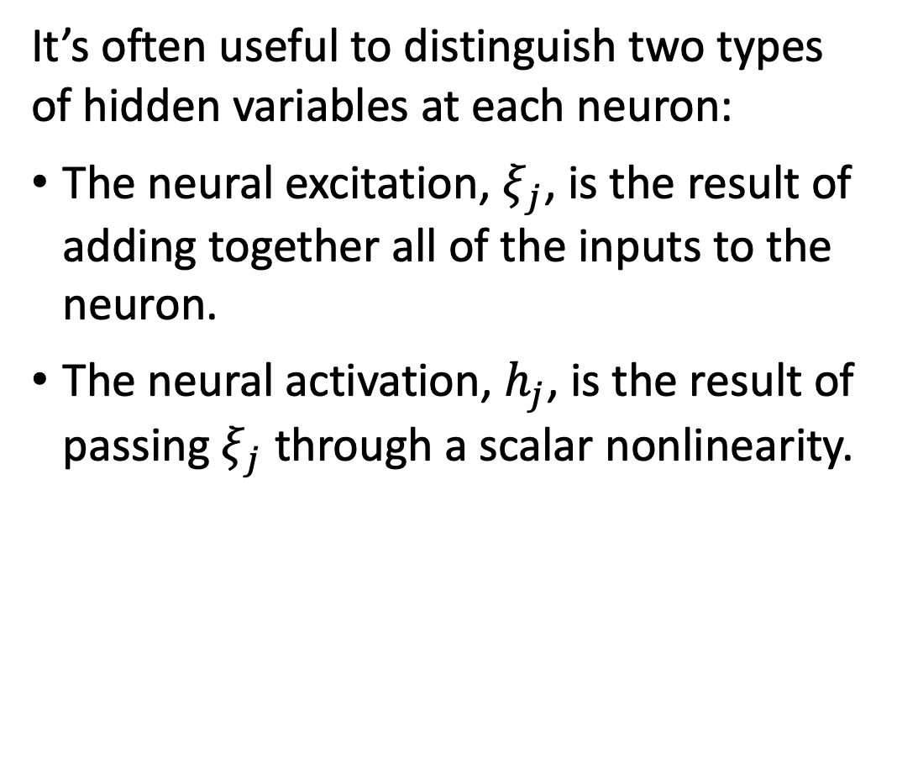
Flow diagrams
$$x_{2}$$
$$h_{2}=1$$
It’s often useful to distinguish two types of hidden variables at each neuron:
The neural excitation, $ξ_{j}$, is the result of adding together all of the inputs to the neuron.
The neural activation, $h_{j}$, is the result of passing $ξ_{j}$ through a scalar nonlinearity.
$$h_{1}=1$$
$$x_{1}$$
Here in the middle, both $h_{1}\left(\vec{x}\right)$and $h_{2}\left(\vec{x}\right)$ are zero.
$$h_{1}$$
$$h_{2}$$
$$−1.5$$
$$−1$$
$$1$$
$$1$$
$$−1$$
$$0.5$$
$$x_{1}$$
$$x_{2}$$
$$1$$

Slide 12
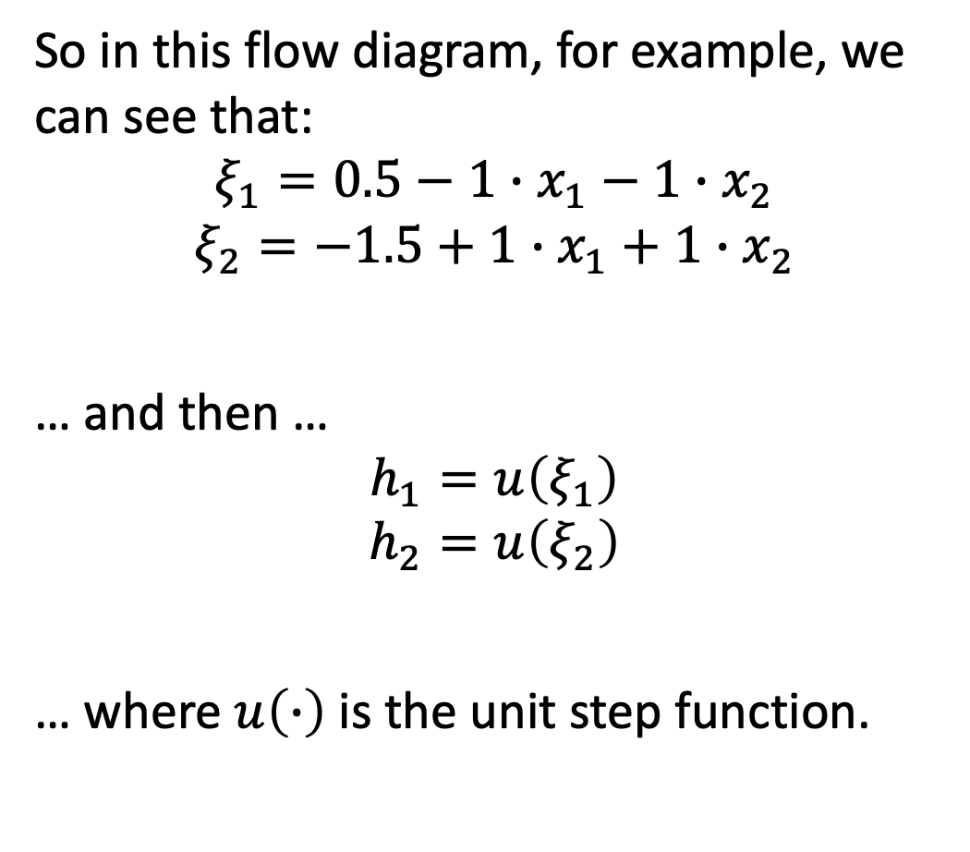
Flow diagrams
$$x_{2}$$
$$h_{2}=1$$
So in this flow diagram, for example, we can see that:
$$ξ_{1}=0.5−1∙x_{1}−1∙x_{2}$$
$$ξ_{2}=−1.5+1∙x_{1}+1∙x_{2}$$
… and then …
$$h_{1}=u\left(ξ_{1}\right)$$
$$h_{2}=u\left(ξ_{2}\right)$$
… where $u\left(∙\right)$ is the unit step function.
$$h_{1}=1$$
$$x_{1}$$
Here in the middle, both $h_{1}\left(\vec{x}\right)$and $h_{2}\left(\vec{x}\right)$ are zero.
$$h_{1}$$
$$h_{2}$$
$$−1.5$$
$$−1$$
$$1$$
$$1$$
$$−1$$
$$0.5$$
$$x_{1}$$
$$x_{2}$$
$$1$$

Slide 13



Flow diagrams
$$x_{2}$$
$$h_{2}=1$$
Now suppose that we want to compute
$f\left(\vec{x}\right)=(x_{1}⊕x_{2})$. We could write this as:
$$f\left(\vec{x}\right)=u\left(0.5−h_{1}−h_{2}\right)$$
$$x_{1}$$
$$h_{1}=1$$
Here in the middle, both $h_{1}\left(\vec{x}\right)$and $h_{2}\left(\vec{x}\right)$ are zero.
$$x_{2}$$
$$x_{1}$$

Slide 14





Flow diagrams
We can write the XOR function as:
$$ξ_{3}=0.5−1∙h_{1}−1∙h_{2}$$
$$f\left(\vec{x}\right)=u\left(ξ_{3}\right)$$
$$f$$
$$−1$$
$$−1$$
$$0.5$$
$$1$$
$$h_{1}$$
$$h_{2}$$
$$−1.5$$
$$1$$
$$−1$$
$$1$$
$$−1$$
$$0.5$$
$$x_{1}$$
$$x_{2}$$
$$1$$

Slide 15
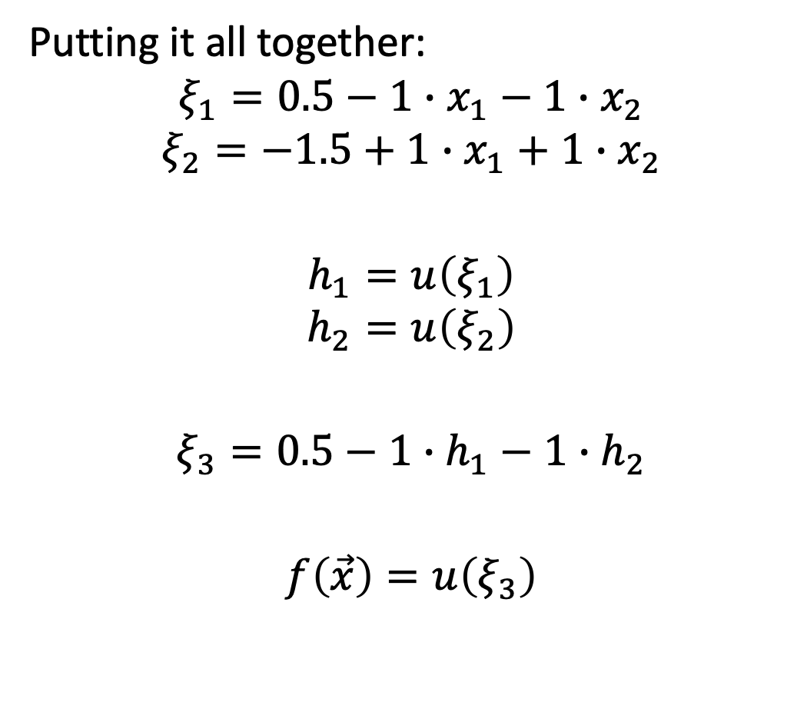
Flow diagrams
Putting it all together:
$$ξ_{1}=0.5−1∙x_{1}−1∙x_{2}$$
$$ξ_{2}=−1.5+1∙x_{1}+1∙x_{2}$$
$$h_{1}=u\left(ξ_{1}\right)$$
$$h_{2}=u\left(ξ_{2}\right)$$
$$ξ_{3}=0.5−1∙h_{1}−1∙h_{2}$$
$$f\left(\vec{x}\right)=u\left(ξ_{3}\right)$$
$$f$$
$$−1$$
$$−1$$
$$0.5$$
$$1$$
$$h_{1}$$
$$h_{2}$$
$$−1.5$$
$$1$$
$$−1$$
$$1$$
$$−1$$
$$0.5$$
$$x_{1}$$
$$x_{2}$$
$$1$$

Slide 16
Outline
Breaking the constraints of linearity: multi-layer neural nets
Flow diagram for the XOR problem
Flow diagram for a multi-layer neural net
Forward-propagation example

Slide 17
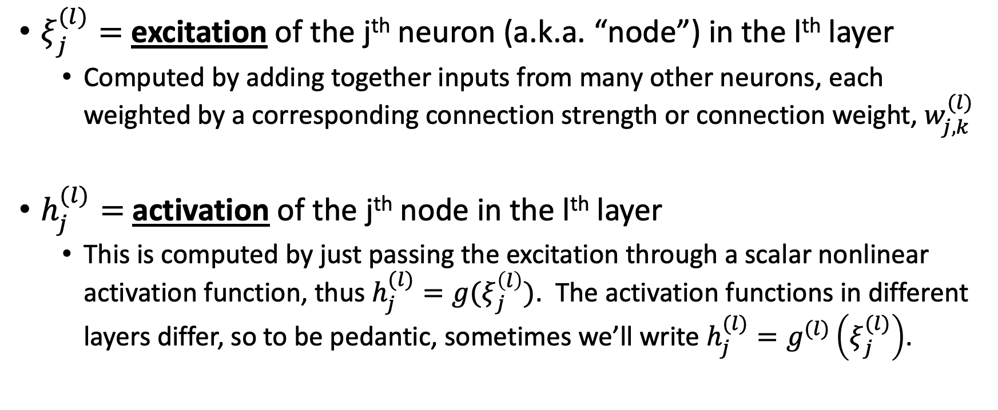
Multi-layer neural net
$ξ_{j}^{(l)}=$ excitation of the j^{th} neuron (a.k.a. “node”) in the l^{th} layer
Computed by adding together inputs from many other neurons, each weighted by a corresponding connection strength or connection weight, $w_{j,k}^{(l)}$
$h_{j}^{(l)}=$activation of the j^{th} node in the l^{th} layer
This is computed by just passing the excitation through a scalar nonlinear activation function, thus $h_{j}^{(l)}=g(ξ_{j}^{\left(l\right)})$. The activation functions in different layers differ, so to be pedantic, sometimes we’ll write $h_{j}^{(l)}=g^{(l)}\left(ξ_{j}^{(l)}\right)$.

Slide 18
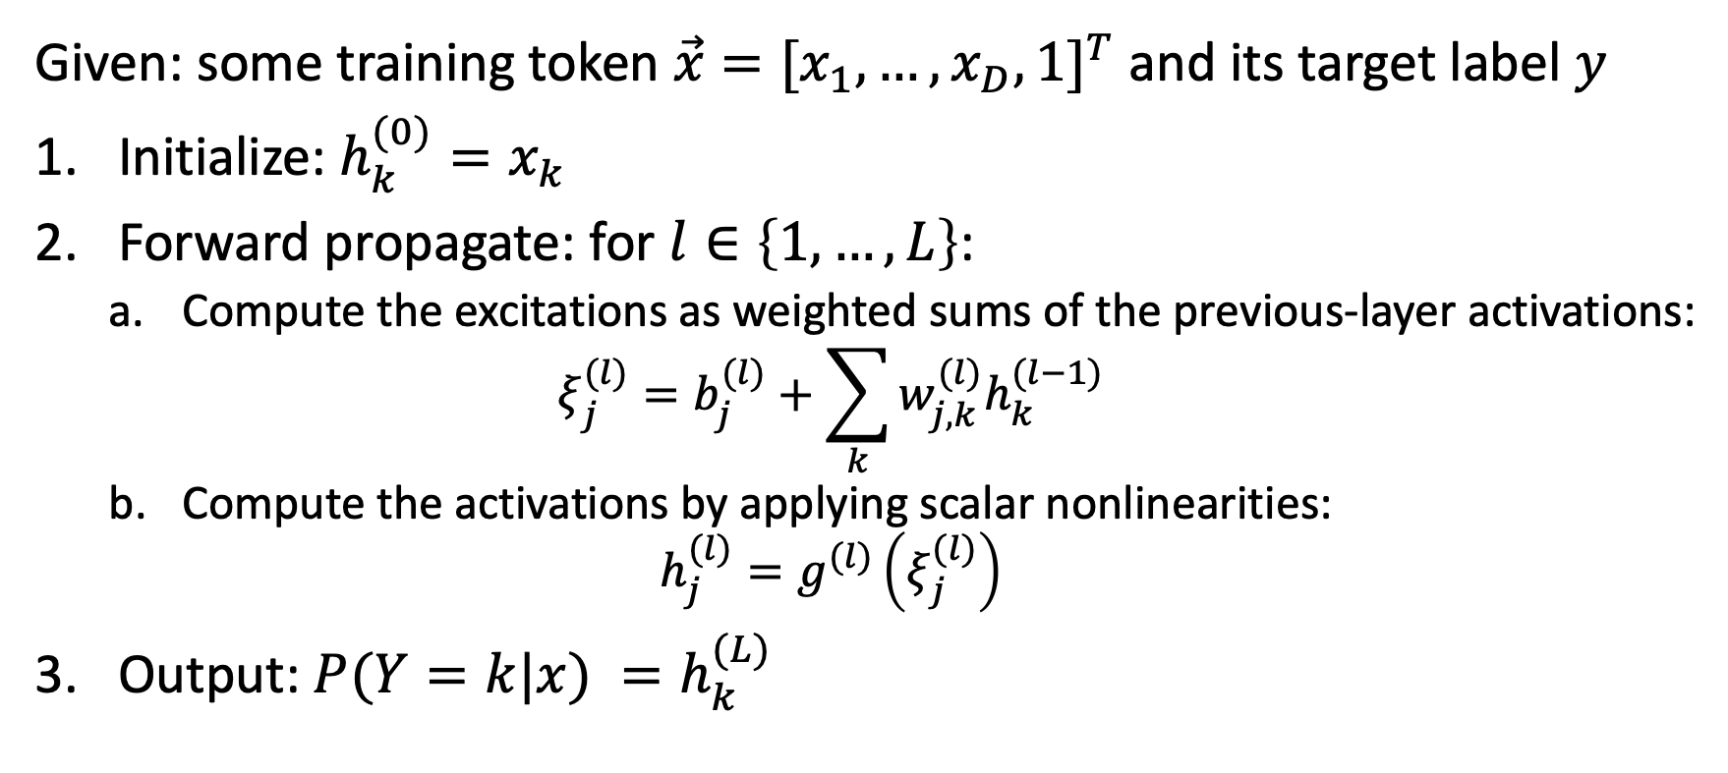
Multi-layer neural net
Given: some training token $\vec{x}={[x_{1},…,x_{D},1]}^{T}$ and its target label $y$
Initialize: $h_{k}^{(0)}=x_{k}$
Forward propagate: for $l∈\left\{1,…,L\right\}$:
Compute the excitations as weighted sums of the previous-layer activations:
$$ξ_{j}^{(l)}=b_{j}^{(l)}+\sum_{k}{w_{j,k}^{(l)}h_{k}^{(l−1)}}$$
Compute the activations by applying scalar nonlinearities:
$$h_{j}^{(l)}=g^{(l)}\left(ξ_{j}^{(l)}\right)$$
Output: $P(Y=k|x) =h_{k}^{(L)}$

Slide 19
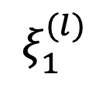
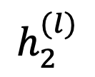
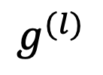


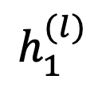
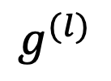
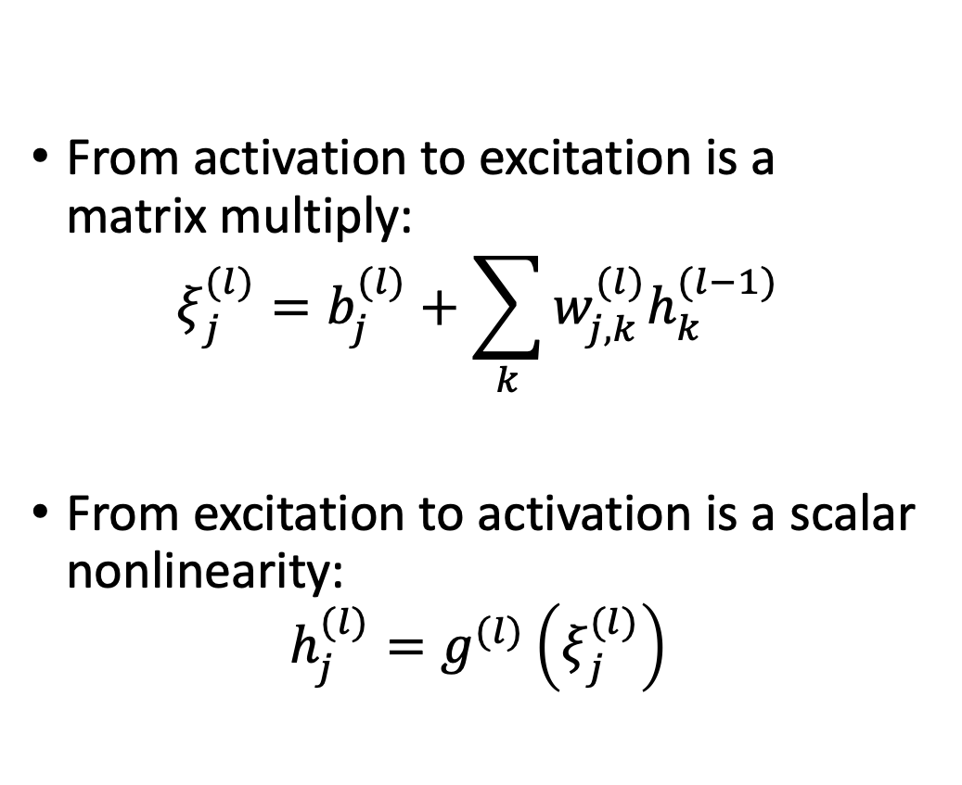
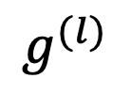
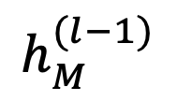

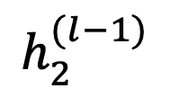

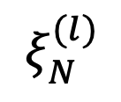
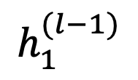
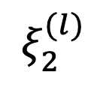
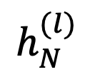
Forward propagation
From activation to excitation is a matrix multiply:
$$ξ_{j}^{(l)}=b_{j}^{(l)}+\sum_{k}{w_{j,k}^{(l)}h_{k}^{(l−1)}}$$
From excitation to activation is a scalar nonlinearity:
$$h_{j}^{(l)}=g^{(l)}\left(ξ_{j}^{(l)}\right)$$
$$…$$
$$h_{1}^{(l)}$$
$$h_{2}^{(l)}$$
$$h_{N}^{(l)}$$
$$g^{(l)}$$
$$g^{(l)}$$
$$g^{(l)}$$
$$ξ_{1}^{(l)}$$
$$ξ_{2}^{(l)}$$
$$…$$
$$ξ_{N}^{(l)}$$
$$h_{1}^{(l−1)}$$
$$h_{2}^{(l−1)}$$
$$…$$
$$h_{M}^{(l−1)}$$
$$1$$

Slide 20
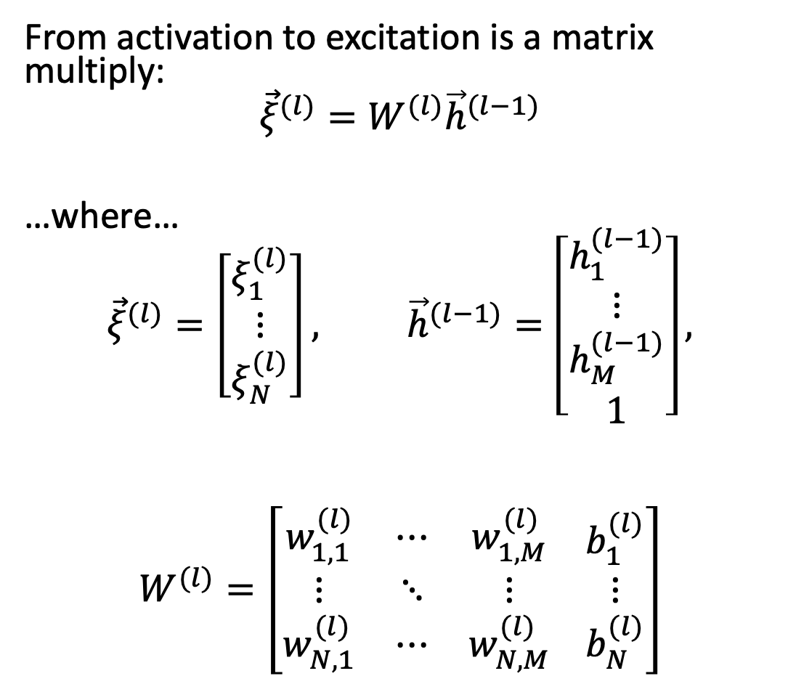
Forward propagation: Matrix multiply
From activation to excitation is a matrix multiply:
$${\vec{ξ}}^{(l)}=W^{(l)}{\vec{h}}^{(l−1)}$$
…where…
$${\vec{ξ}}^{(l)}=\left[\begin{matrix}ξ_{1}^{(l)} \\ ⋮ \\ ξ_{N}^{(l)}\end{matrix}\right], {\vec{h}}^{(l−1)}=\left[\begin{matrix}h_{1}^{(l−1)} \\ ⋮ \\ \begin{matrix}h_{M}^{(l−1)} \\ 1\end{matrix}\end{matrix}\right],$$
$$W^{(l)}=\left[\begin{matrix}w_{1,1}^{(l)} & ⋯ & w_{1,M}^{(l)} \\ ⋮ & ⋱ & ⋮ \\ w_{N,1}^{(l)} & ⋯ & w_{N,M}^{(l)}\end{matrix} \begin{matrix}b_{1}^{(l)} \\ ⋮ \\ b_{N}^{(l)}\end{matrix}\right]$$
$$h_{1}^{(l)}$$
$$h_{2}^{(l)}$$
$$…$$
$$h_{N}^{(l)}$$
$$g^{(l)}$$
$$g^{(l)}$$
$$g^{(l)}$$
$$ξ_{1}^{(l)}$$
$$ξ_{2}^{(l)}$$
$$…$$
$$ξ_{N}^{(l)}$$
$$h_{1}^{(l−1)}$$
$$h_{2}^{(l−1)}$$
$$…$$
$$h_{M}^{(l−1)}$$
$$1$$

Slide 21
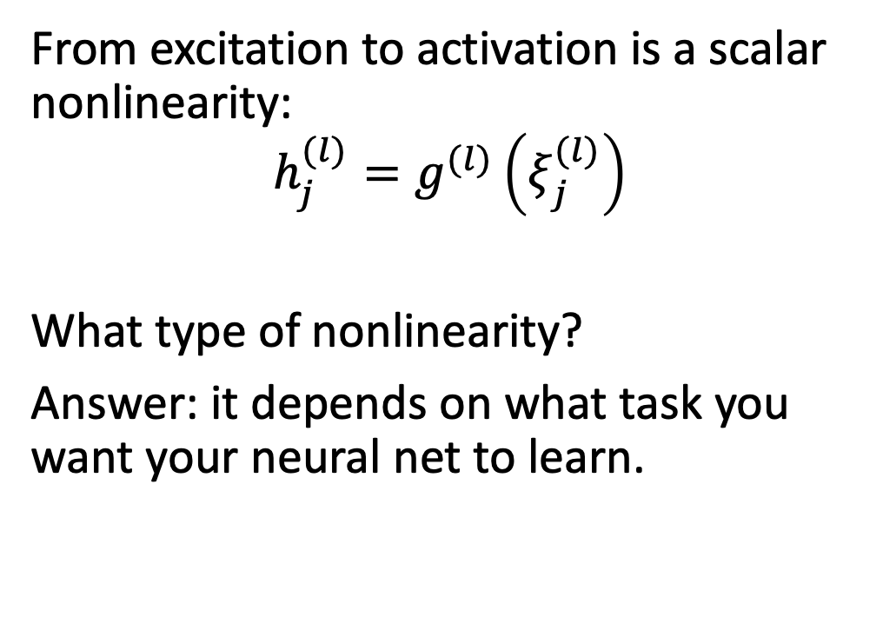
Forward propagation
From excitation to activation is a scalar nonlinearity:
$$h_{j}^{(l)}=g^{(l)}\left(ξ_{j}^{(l)}\right)$$
What type of nonlinearity?
Answer: it depends on what task you want your neural net to learn.
$$…$$
$$h_{1}^{(l)}$$
$$h_{2}^{(l)}$$
$$h_{N}^{(l)}$$
$$g^{(l)}$$
$$g^{(l)}$$
$$g^{(l)}$$
$$ξ_{1}^{(l)}$$
$$ξ_{2}^{(l)}$$
$$…$$
$$ξ_{N}^{(l)}$$
$$h_{1}^{(l−1)}$$
$$h_{2}^{(l−1)}$$
$$…$$
$$h_{M}^{(l−1)}$$
$$1$$

Slide 22
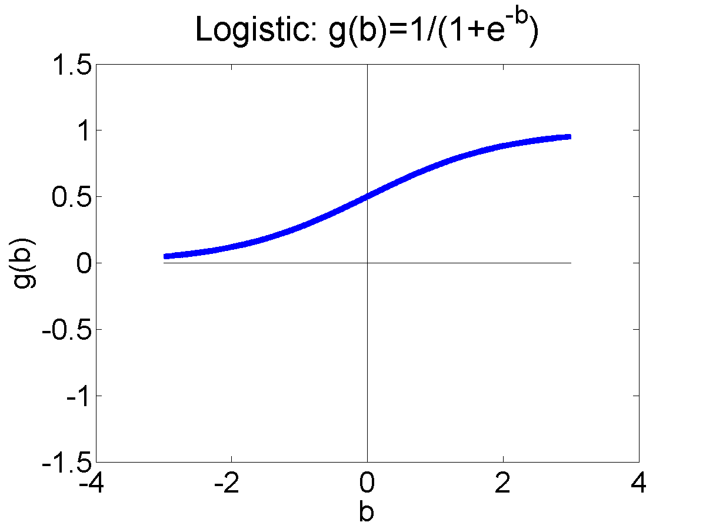
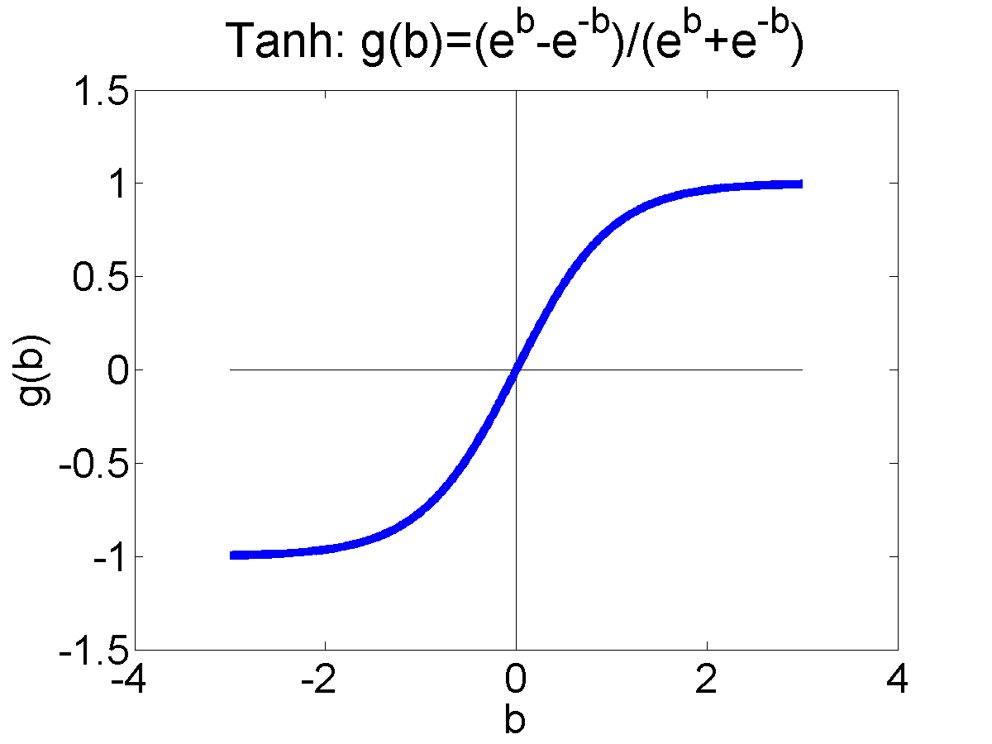
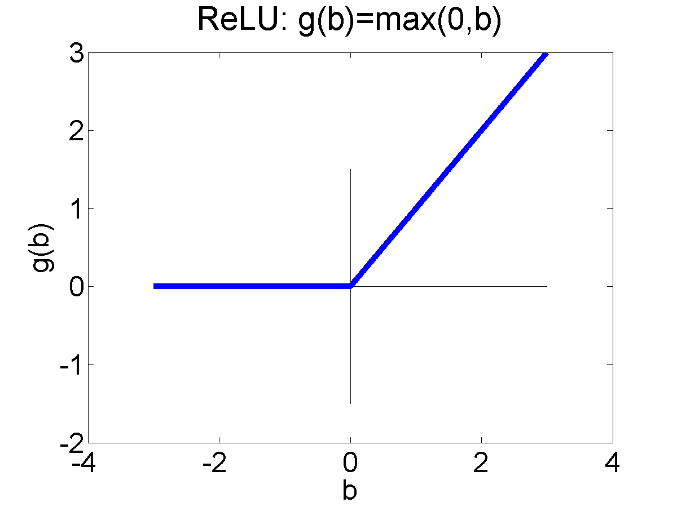

Activation functions
The “activation function,” $g^{(l)}\left(∙\right)$, can be any scalar nonlinearity. Common ones that you should know include the unit step and signum functions, and:
Logistic Sigmoid:
$$σ\left(β\right)=\frac{1}{1+e^{−β}}$$
Hyperbolic Tangent (tanh):
$$tanh\left(β\right)=\frac{e^{β}−e^{−β}}{e^{β}+e^{−β}}$$
Rectified Linear Unit (ReLU):
$$ReLU\left(β\right)=\max\left(0,β\right)$$

Slide 23
Outline
Breaking the constraints of linearity: multi-layer neural nets
Flow diagram for the XOR problem
Flow diagram for a multi-layer neural net
Forward-propagation example

Slide 24



Example: Square smiley
$$x_{2}$$
Input: $\vec{x}={[x_{1}, x_{2},1]}^{T}$
Output: $f\left(\vec{x}\right)={[R,G,B]}^{T}$
Remember that yellow = red + green, so we just need to compute $R,G,B$ as functions of $x_{1}$ and $x_{2}$.
This could be done using a two-layer network, but I it’s easier using a three-layer network, so let’s do it that way.
$$x_{1}$$

Slide 25














Layer 1
$$h_{3}$$
$$h_{5}$$
$$h_{2}$$
$$h_{4}$$
$$h_{1}$$
$$h_{6}$$
In layer 1, let’s find all the different ways in which we need to bisect the image plane:
$$h_{1}^{(1)}=sign\left(x_{1}−0.5\right)$$
$$⋮$$
$$h_{13}^{(1)}=sign\left(x_{2}−1.5\right)$$
$$h_{13}$$
$$h_{12}$$
$$h_{11}$$
$$h_{10}$$
$$h_{9}$$
$$h_{8}$$
$$h_{7}$$

Slide 26










Layer 1
In layer 1, let’s find all the different ways in which we need to bisect the image plane:
$$h_{1}^{(1)}=sign\left(x_{1}−0.5\right)$$
$$⋮$$
$$h_{13}^{(1)}=sign\left(x_{2}−1.5\right)$$
$$h_{1}^{(1)}$$
$$…$$
$$h_{13}^{(1)}$$
$$1$$
$$−0.5$$
$$−1.5$$
$$1$$
$$x_{1}$$
$$x_{2}$$
$$1$$

Slide 27









Layer 2
$$h_{2}^{(1)}$$
$$h_{5}^{(1)}$$
$$h_{6}^{(1)}$$
$$h_{1}^{(1)}$$
In layer 2, let’s compute rectangles of solid color. We can compute those using logical operations:
$$h_{1}^{(2)}=h_{1}^{(1)}∧¬h_{2}^{\left(1\right)}∧h_{7}^{\left(1\right)}∧¬h_{13}^{\left(1\right)}$$
$$⋮$$
$$h_{12}^{(2)}= h_{5}^{(1)}∧¬h_{6}^{\left(1\right)}∧h_{7}^{\left(1\right)}∧¬h_{13}^{\left(1\right)}$$
$$h_{13}^{(1)}$$
$$h_{7}^{(1)}$$
$$h_{12}^{(2)}$$
$$h_{1}^{(2)}$$

Slide 28

Layer 2
$$h_{2}^{(1)}$$
$$h_{5}^{(1)}$$
$$h_{6}^{(1)}$$
$$h_{1}^{(1)}$$
… and then convert the logical operations into linear functions:
$$h_{1}^{(2)}=u\left(h_{1}^{(1)}−h_{2}^{\left(1\right)}+h_{7}^{\left(1\right)}−h_{13}^{\left(1\right)}−3.5\right)$$
$$⋮$$
$$h_{12}^{(2)}=u\left(h_{5}^{(1)}−h_{6}^{\left(1\right)}+h_{7}^{\left(1\right)}−h_{13}^{\left(1\right)}−3.5\right)$$
$$h_{13}^{(1)}$$
$$h_{7}^{(1)}$$
$$h_{12}^{(2)}$$
$$h_{1}^{(2)}$$

Slide 29








Layer 2
In layer 2, let’s compute rectangles of solid color:
$$h_{1}^{(2)}=u\left(h_{1}^{(1)}−h_{2}^{\left(1\right)}+h_{7}^{\left(1\right)}−h_{13}^{\left(1\right)}−3.5\right)$$
$$⋮$$
$$h_{12}^{(2)}=u\left(h_{5}^{(1)}−h_{6}^{\left(1\right)}+h_{7}^{\left(1\right)}−h_{13}^{\left(1\right)}−3.5\right)$$
$$h_{1}^{(2)}$$
$$…$$
$$h_{12}^{(2)}$$
$$−3.5$$
$$−1$$
$$−3.5$$
$$1$$
$$−1$$
$$h_{1}^{(1)}$$
$$…$$
$$h_{13}^{(1)}$$
$$1$$
$$1$$
$$−0.5$$
$$−1.5$$
$$1$$
$$x_{1}$$
$$x_{2}$$
$$1$$

Slide 30







Layer 3
$$h_{8}^{(2)}$$
$$h_{9}^{(2)}$$
$$h_{10}^{(2)}$$
$$h_{12}^{(2)}$$
In layer 3, let’s compute the red, green, and blue regions using the inclusive-OR of these rectangles:
$$R=h_{1}^{(2)}∨h_{2}^{\left(2\right)}∨h_{3}^{\left(2\right)}∨h_{4}^{\left(2\right)}$$
$$∨h_{5}^{\left(2\right)}∨h_{6}^{\left(2\right)}∨h_{7}^{\left(2\right)}∨h_{9}^{\left(2\right)}∨h_{11}^{\left(2\right)}∨h_{12}^{\left(2\right)}$$
$$G=h_{1}^{(2)}∨h_{2}^{\left(2\right)}∨h_{5}^{\left(2\right)}∨h_{7}^{\left(2\right)}∨h_{9}^{\left(2\right)}∨h_{11}^{\left(2\right)}∨h_{12}^{\left(2\right)}$$
$$B= h_{8}^{(2)}∨h_{10}^{\left(2\right)}$$
$$h_{1}^{(2)}$$
$$h_{2}^{(2)}$$

Slide 31

Layer 3
$$h_{8}^{(2)}$$
$$h_{9}^{(2)}$$
$$h_{10}^{(2)}$$
$$h_{12}^{(2)}$$
In layer 3, let’s compute the red, green, and blue regions using the inclusive-OR of these rectangles:
$$R=u\left(\begin{aligned}h_{1}^{(2)}+h_{2}^{\left(2\right)}+h_{3}^{\left(2\right)}+h_{4}^{\left(2\right)}+h_{5}^{\left(2\right)} \\ +h_{6}^{\left(2\right)}+h_{7}^{\left(2\right)}+h_{9}^{\left(2\right)}+h_{11}^{\left(2\right)}+h_{12}^{\left(2\right)}−0.5\end{aligned}\right)$$
$$G=u\left(\begin{aligned}h_{1}^{(2)}+h_{2}^{\left(2\right)}+h_{5}^{\left(2\right)}+h_{7}^{\left(2\right)}+h_{9}^{\left(2\right)}+ \\ h_{11}^{\left(2\right)}+h_{12}^{\left(2\right)}−0.5\end{aligned}\right)$$
$$B= \text{u}\left(h_{8}^{(2)}+h_{10}^{\left(2\right)}−0.5\right)$$
$$h_{1}^{(2)}$$
$$h_{2}^{(2)}$$

Slide 32






















Layer 3
$$R$$
$$G$$
$$B$$
$$−0.5$$
$$−0.5$$
In layer 3, let’s compute the red, green, and blue regions using the inclusive-OR of these rectangles:
$$R=u\left(\begin{aligned}h_{1}^{(2)}+h_{2}^{\left(2\right)}+h_{3}^{\left(2\right)}+h_{4}^{\left(2\right)}+h_{5}^{\left(2\right)} \\ +h_{6}^{\left(2\right)}+h_{7}^{\left(2\right)}+h_{9}^{\left(2\right)}+h_{11}^{\left(2\right)}+h_{12}^{\left(2\right)}−0.5\end{aligned}\right)$$
$$G=u\left(\begin{aligned}h_{1}^{(2)}+h_{2}^{\left(2\right)}+h_{5}^{\left(2\right)}+h_{7}^{\left(2\right)}+h_{9}^{\left(2\right)}+ \\ h_{11}^{\left(2\right)}+h_{12}^{\left(2\right)}−0.5\end{aligned}\right)$$
$$B= \text{u}\left(h_{8}^{(2)}+h_{10}^{\left(2\right)}−0.5\right)$$
$$1$$
$$−0.5$$
$$1$$
$$1$$
$$1$$
$$h_{1}^{(2)}$$
$$…$$
$$h_{12}^{(2)}$$
$$1$$
$$−3.5$$
$$−1$$
$$−3.5$$
$$1$$
$$−1$$
$$h_{1}^{(1)}$$
$$…$$
$$h_{13}^{(1)}$$
$$1$$
$$1$$
$$−0.5$$
$$−1.5$$
$$1$$
$$x_{1}$$
$$x_{2}$$
$$1$$

Slide 33

Summary
Breaking the constraints of linearity: multi-layer neural nets
Flow diagram for the XOR problem: if $x_{1}$ and $x_{2}$ are binary, then
$$\left(x_{1}∨x_{2}\right)=u\left(x_{1}+x_{2}−0.5\right)$$
$$\left(x_{1}∧x_{2}\right)=u\left(x_{1}+x_{2}−1.5\right)$$
Flow diagram for a multi-layer neural net
$$ξ_{j}^{(l)}=b_{j}^{(l)}+\sum_{k}{w_{j,k}^{(l)}h_{k}^{(l−1)}}$$
$$h_{j}^{(l)}=g^{(l)}\left(ξ_{j}^{(l)}\right)$$
Forward-propagation example

