Slide 1
CS440/ECE448 Lecture 10: Pytorch
Mark Hasegawa-Johnson
2/2022
Some of the material in these slides is © Pytorch

Slide 2
Outline
Review: linear regression
Training a linear regression model using numpy
The same example with pytorch
torch.nn module: using predefined neural net components

Slide 3
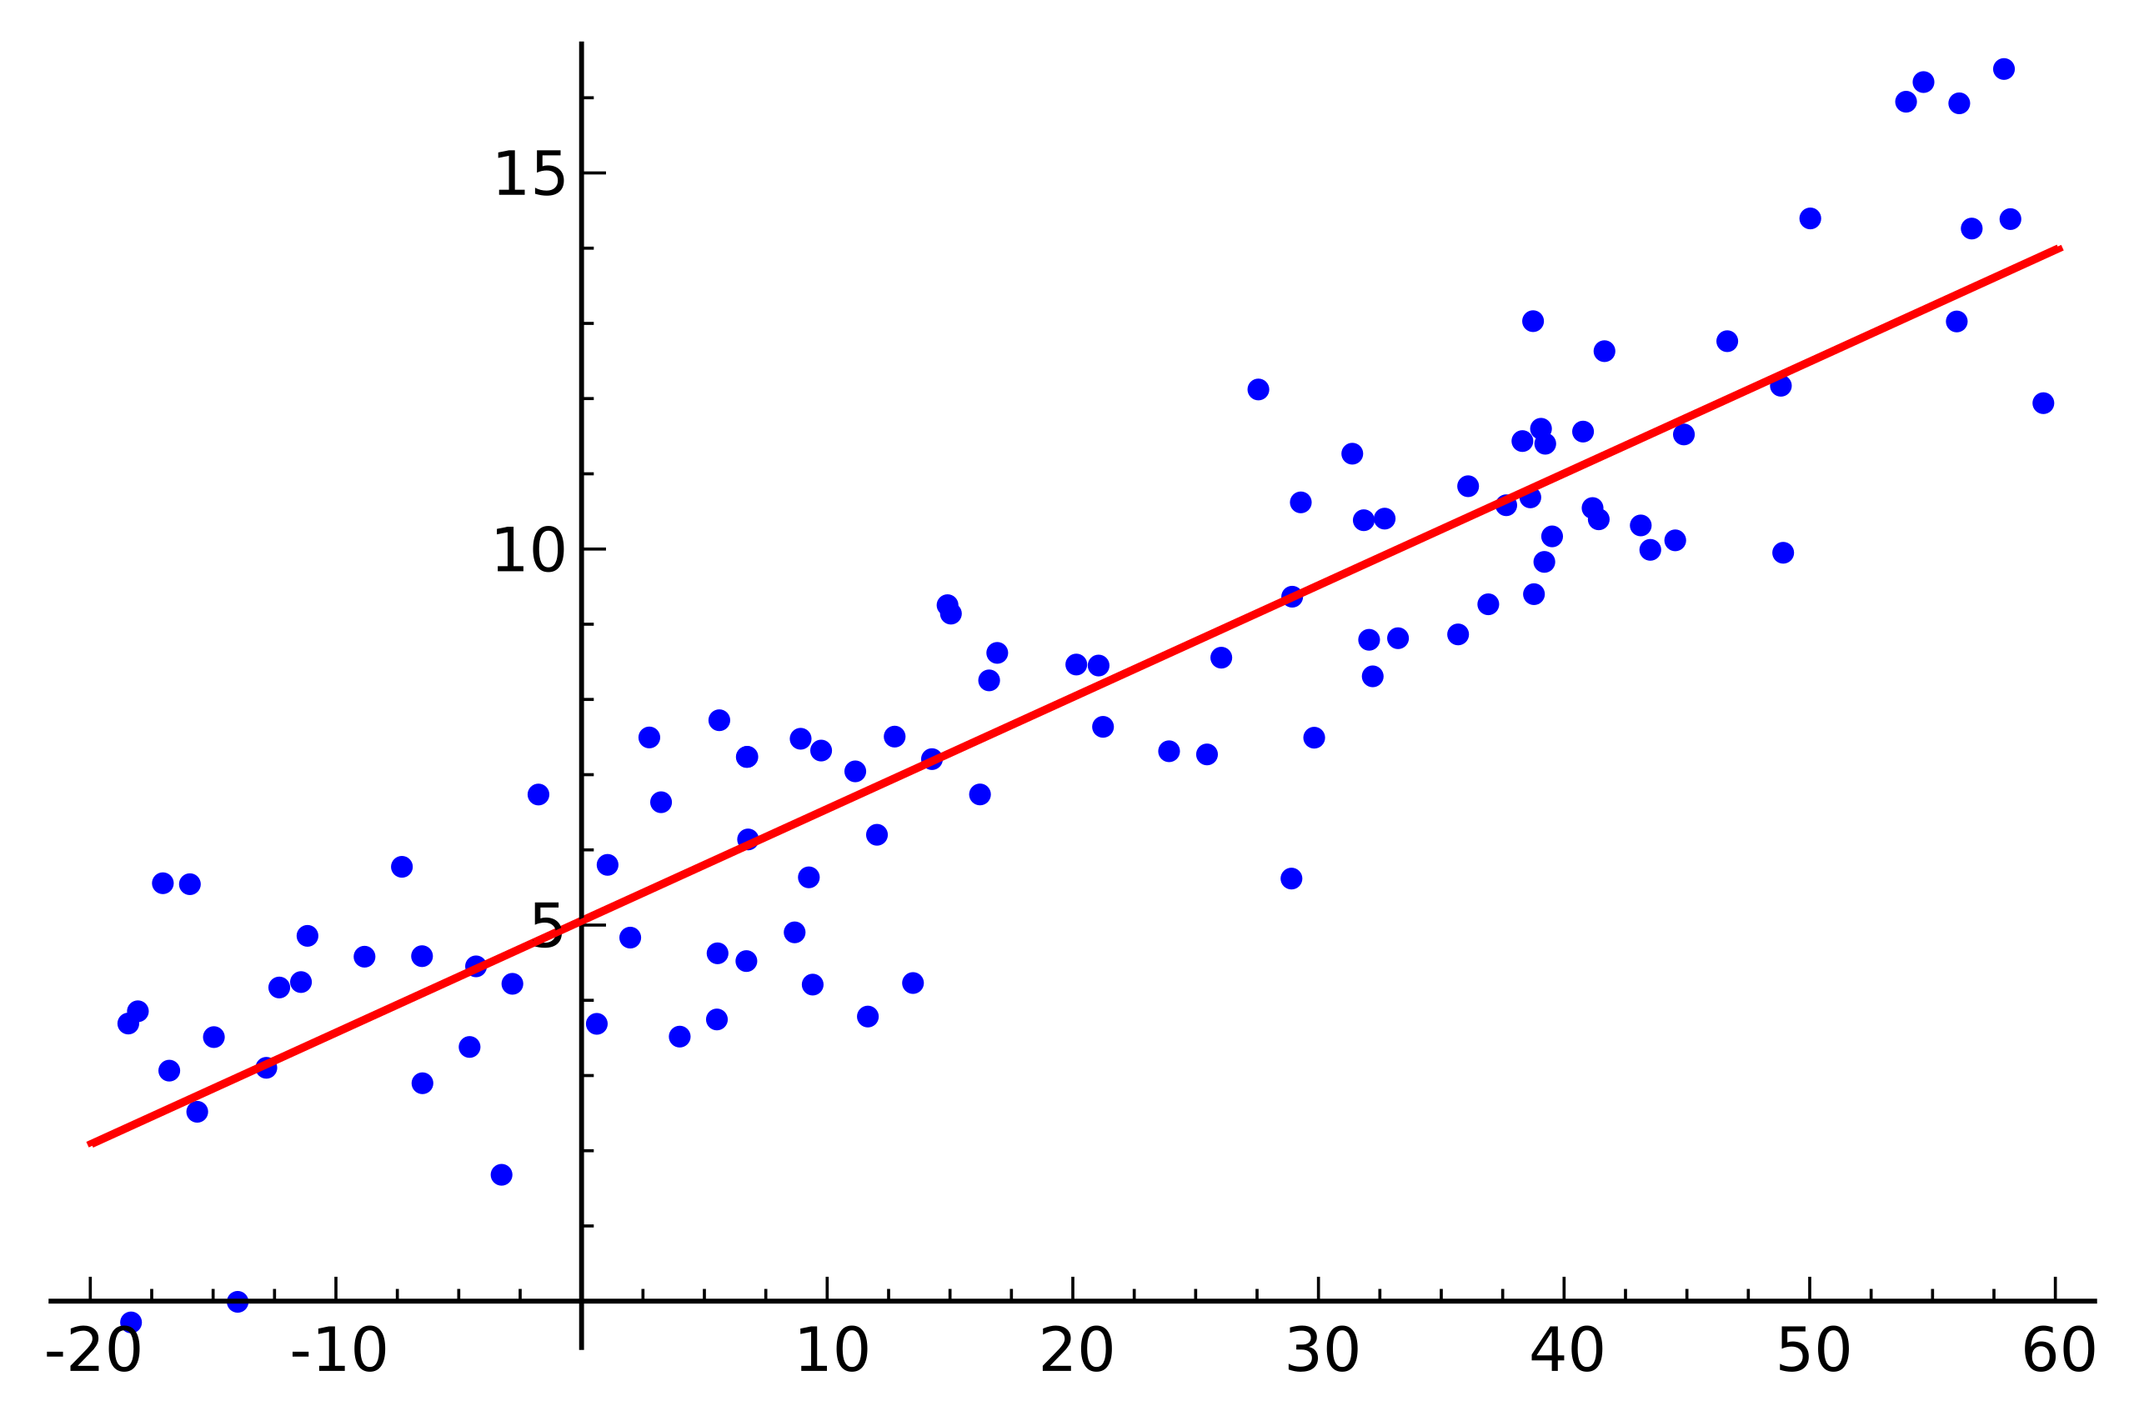


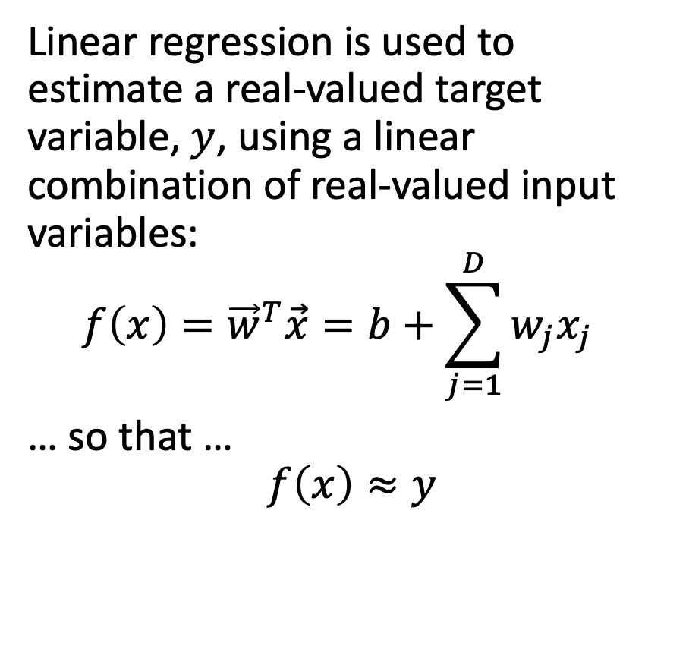

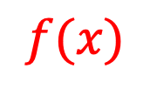

Linear regression
$$y$$
Linear regression is used to estimate a real-valued target variable, $y$, using a linear combination of real-valued input variables:
$$f\left(x\right)={\vec{w}}^{T}\vec{x}=b+\sum_{j=1}^{D}{w_{j}x_{j}}$$
… so that …
$$f\left(x\right)≈y$$
$$f(x)$$
$$b$$
$$w_{1}$$
$$x_{1}$$
Linear regression. Public domain image, Seewaqu, 2010

Slide 4
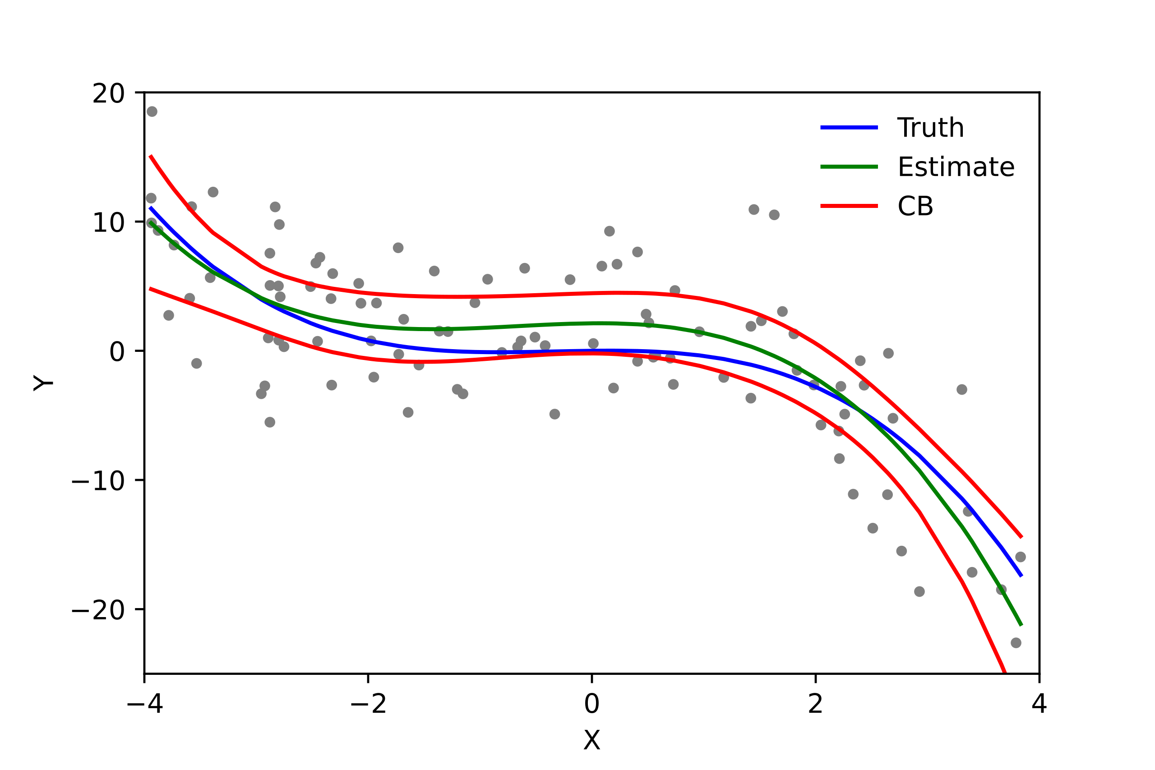
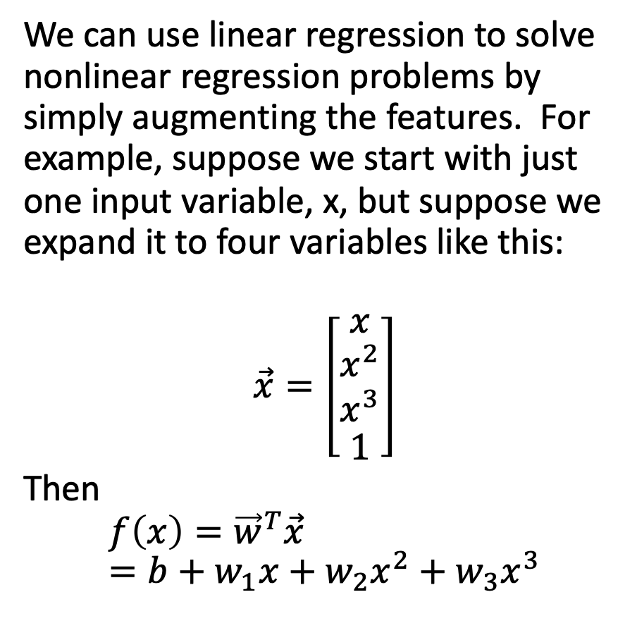
Polynomial regression = multivariate linear regression
We can use linear regression to solve nonlinear regression problems by simply augmenting the features. For example, suppose we start with just one input variable, x, but suppose we expand it to four variables like this:
$$\vec{x}=\left[\begin{matrix}x \\ \begin{matrix}x^{2} \\ x^{3}\end{matrix} \\ 1\end{matrix}\right]$$
Then
$$f\left(x\right)={\vec{w}}^{T}\vec{x}=b+w_{1}x+w_{2}x^{2}+w_{3}x^{3}$$
Polyreg_scheffe.svg. CC-BY 3.0, Skbkekas, 2009

Slide 5
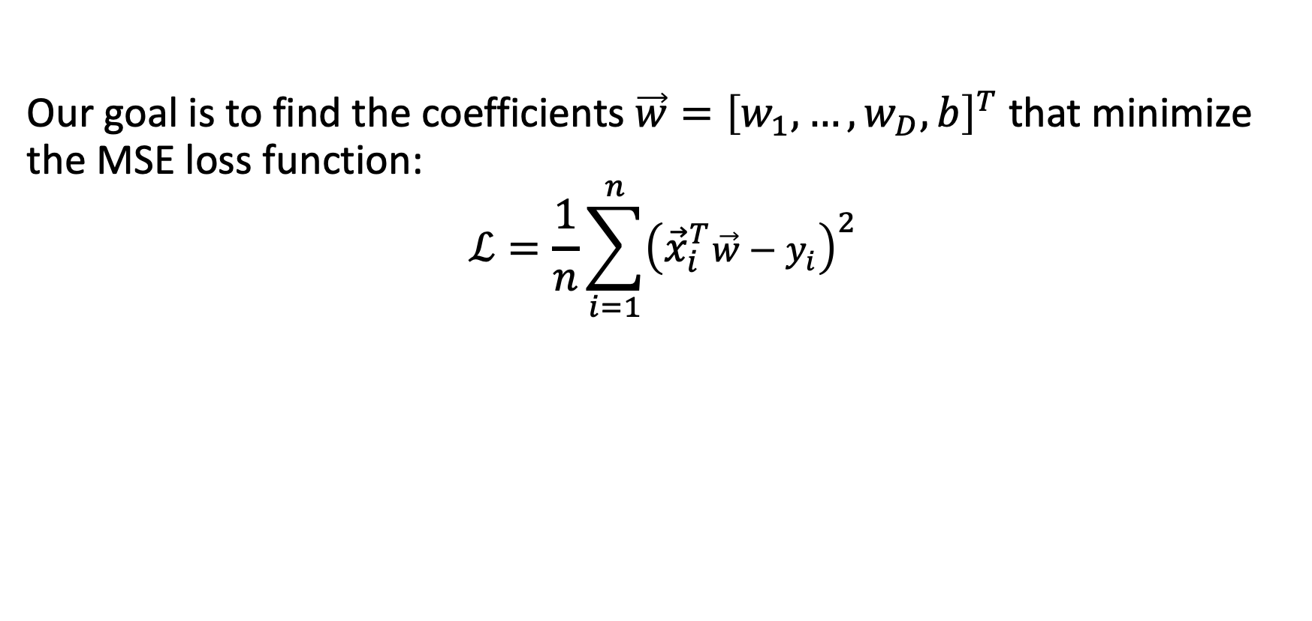
Minimizing the MSE
Our goal is to find the coefficients $\vec{w}={\left[w_{1},…,w_{D},b\right]}^{T}$ that minimize the MSE loss function:
$$ℒ=\frac{1}{n}\sum_{i=1}^{n}{{\left({\vec{x}}_{i}^{T}\vec{w}−y_{i}\right)}^{2}}$$

Slide 6
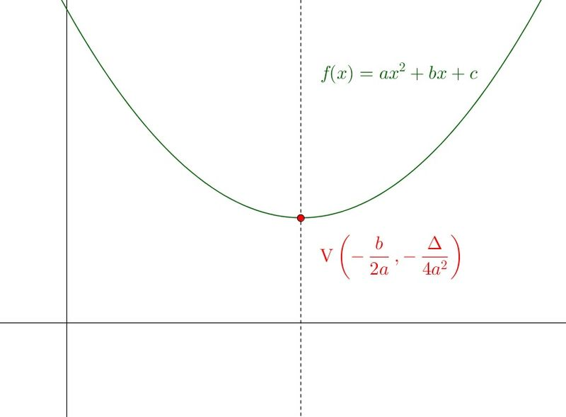
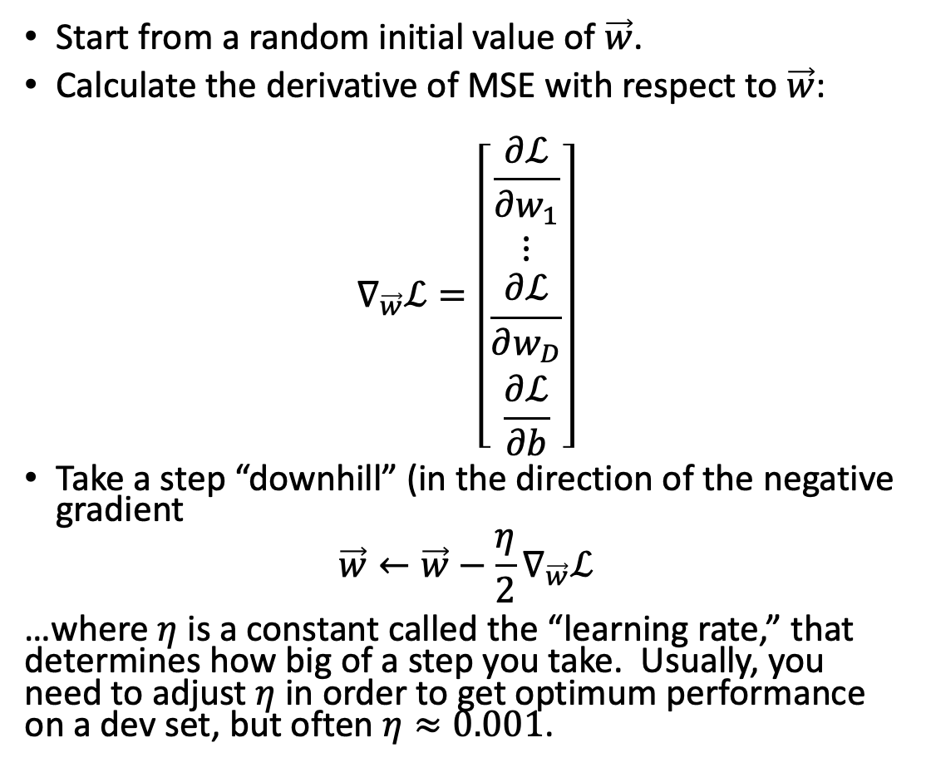


The gradient descent algorithm
Start from a random initial value of $\vec{w}$.
Calculate the derivative of MSE with respect to $\vec{w}$:
$$∇_{\vec{w}}ℒ=\left[\begin{matrix}\frac{∂ℒ}{∂w_{1}} \\ \begin{matrix}⋮ \\ \frac{∂ℒ}{∂w_{D}}\end{matrix} \\ \frac{∂ℒ}{∂b}\end{matrix}\right]$$
Take a step “downhill” (in the direction of the negative gradient
$$\vec{w}←\vec{w}−\frac{η}{2}∇_{\vec{w}}ℒ$$
…where $η$ is a constant called the “learning rate,” that determines how big of a step you take. Usually, you need to adjust $η$ in order to get optimum performance on a dev set, but often $η≈0.001$.
$$ℒ=aw^{2}+bw+c$$
$$w$$

Slide 7
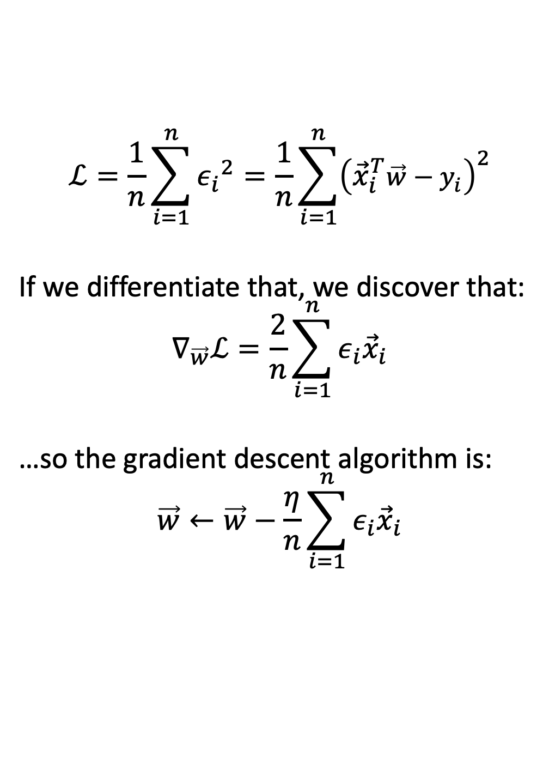
Gradient descent
$$ℒ=\frac{1}{n}\sum_{i=1}^{n}{{ε_{i}}^{2}}=\frac{1}{n}\sum_{i=1}^{n}{{\left({\vec{x}}_{i}^{T}\vec{w}−y_{i}\right)}^{2}}$$
If we differentiate that, we discover that:
$$∇_{\vec{w}}ℒ=\frac{2}{n}\sum_{i=1}^{n}{ε_{i}{\vec{x}}_{i}}$$
…so the gradient descent algorithm is:
$$\vec{w}←\vec{w}−\frac{η}{n}\sum_{i=1}^{n}{ε_{i}{\vec{x}}_{i}}$$
$$ℒ=aw^{2}+bw+c$$
$$w$$

Slide 8
Outline
Review: linear regression
Training a linear regression model using numpy
The same example with pytorch
torch.nn module: using predefined neural net components

Slide 9
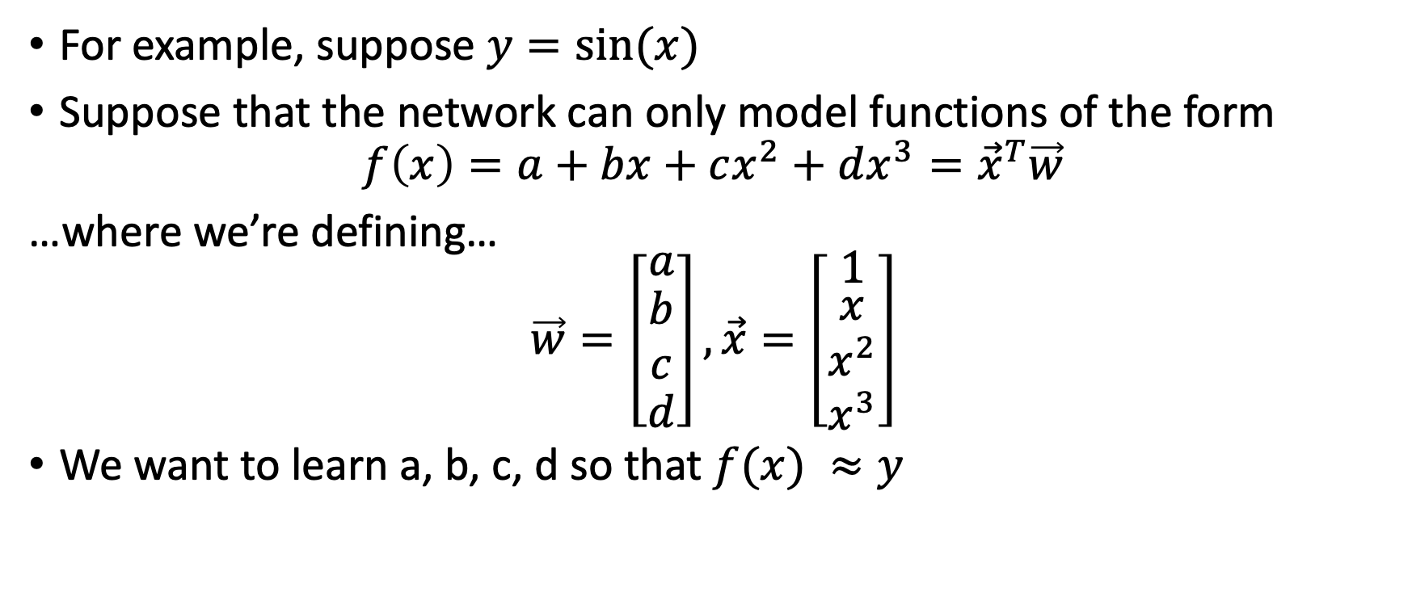
Running example: neural net regression
For example, suppose $y=sin⁡(x)$
Suppose that the network can only model functions of the form
$$f\left(x\right)=a+bx+cx^{2}+dx^{3}={\vec{x}}^{T}\vec{w}$$
…where we’re defining…
$$\vec{w}=\left[\begin{matrix}a \\ \begin{matrix}b \\ c\end{matrix} \\ d\end{matrix}\right],\vec{x}=\left[\begin{matrix}1 \\ \begin{matrix}x \\ x^{2}\end{matrix} \\ x^{3}\end{matrix}\right]$$
We want to learn a, b, c, d so that $f(x) ≈y$

Slide 10
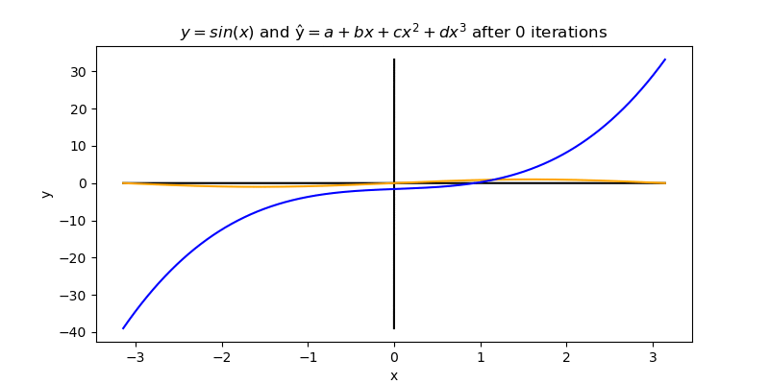
Running example: neural net regression

Slide 11
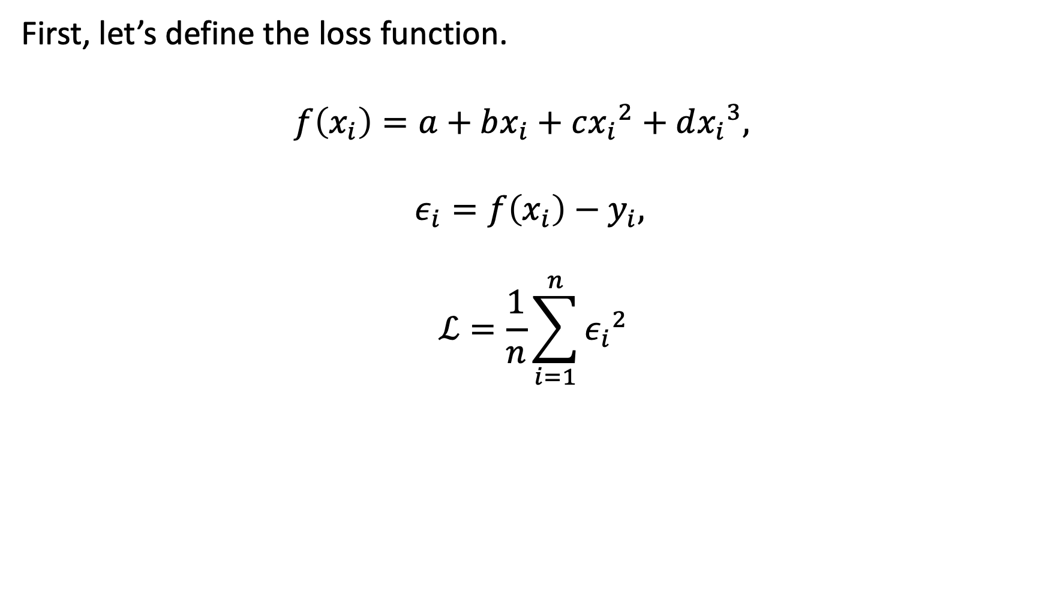
Mean-squared error
First, let’s define the loss function.
$$f\left(x_{i}\right)=a+bx_{i}+c{x_{i}}^{2}+d{x_{i}}^{3},$$
$$ε_{i}=f\left(x_{i}\right)−y_{i},$$
$$ℒ=\frac{1}{n}\sum_{i=1}^{n}{{ε_{i}}^{2}}$$

Slide 12
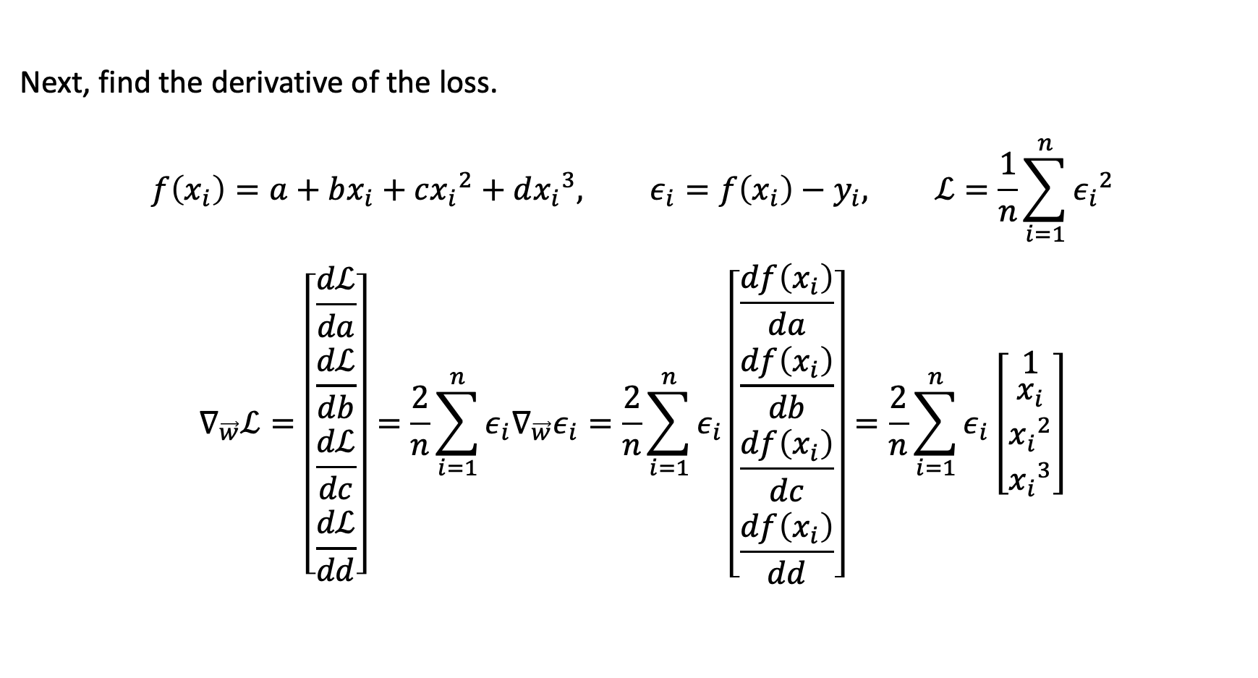
Loss gradient
Next, find the derivative of the loss.
$$f\left(x_{i}\right)=a+bx_{i}+c{x_{i}}^{2}+d{x_{i}}^{3}, ε_{i}=f\left(x_{i}\right)−y_{i}, ℒ=\frac{1}{n}\sum_{i=1}^{n}{{ε_{i}}^{2}}$$
$$∇_{\vec{w}}ℒ=\left[\begin{matrix}\frac{dℒ}{da} \\ \begin{matrix}\frac{dℒ}{db} \\ \frac{dℒ}{dc}\end{matrix} \\ \frac{dℒ}{dd}\end{matrix}\right]=\frac{2}{n}\sum_{i=1}^{n}{ε_{i}∇_{\vec{w}}ε_{i}}=\frac{2}{n}\sum_{i=1}^{n}{ε_{i}\left[\begin{matrix}\frac{df\left(x_{i}\right)}{da} \\ \begin{matrix}\frac{df\left(x_{i}\right)}{db} \\ \frac{df\left(x_{i}\right)}{dc}\end{matrix} \\ \frac{df\left(x_{i}\right)}{dd}\end{matrix}\right]}=\frac{2}{n}\sum_{i=1}^{n}{ε_{i}\left[\begin{matrix}1 \\ \begin{matrix}x_{i} \\ {x_{i}}^{2}\end{matrix} \\ {x_{i}}^{3}\end{matrix}\right]}$$

Slide 13
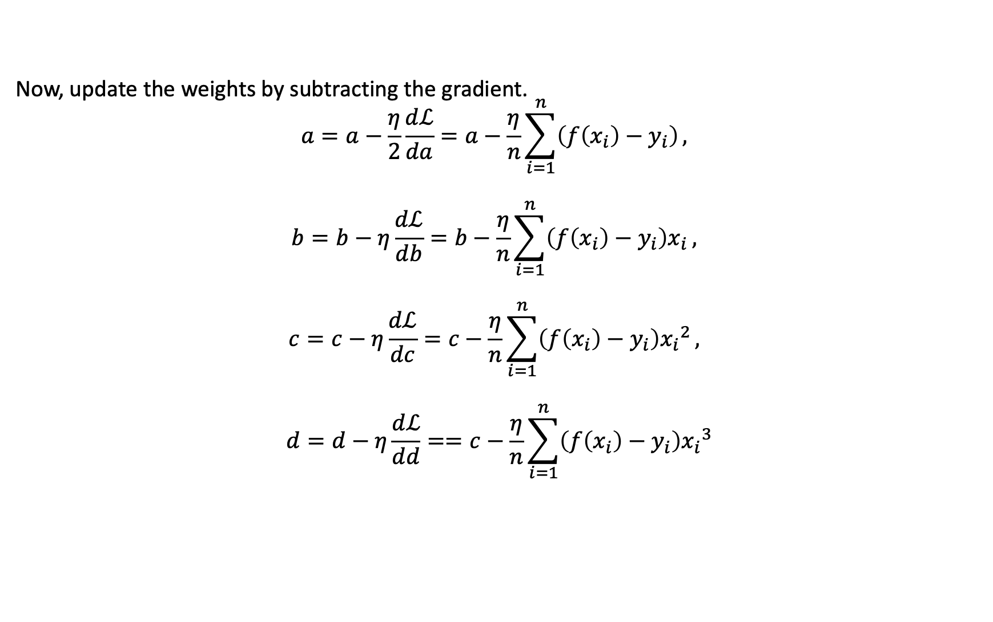
Gradient update
Now, update the weights by subtracting the gradient.
$$a=a−\frac{η}{2}\frac{dℒ}{da}=a−\frac{η}{n}\sum_{i=1}^{n}{\left(f\left(x_{i}\right)−y_{i}\right)},$$
$$b=b−η\frac{dℒ}{db}=b−\frac{η}{n}\sum_{i=1}^{n}{\left(f\left(x_{i}\right)−y_{i}\right)x_{i}},$$
$$c=c−η\frac{dℒ}{dc}=c−\frac{η}{n}\sum_{i=1}^{n}{\left(f\left(x_{i}\right)−y_{i}\right){x_{i}}^{2}},$$
$$d=d−η\frac{dℒ}{dd}==c−\frac{η}{n}\sum_{i=1}^{n}{\left(f\left(x_{i}\right)−y_{i}\right){x_{i}}^{3}}$$

Slide 14
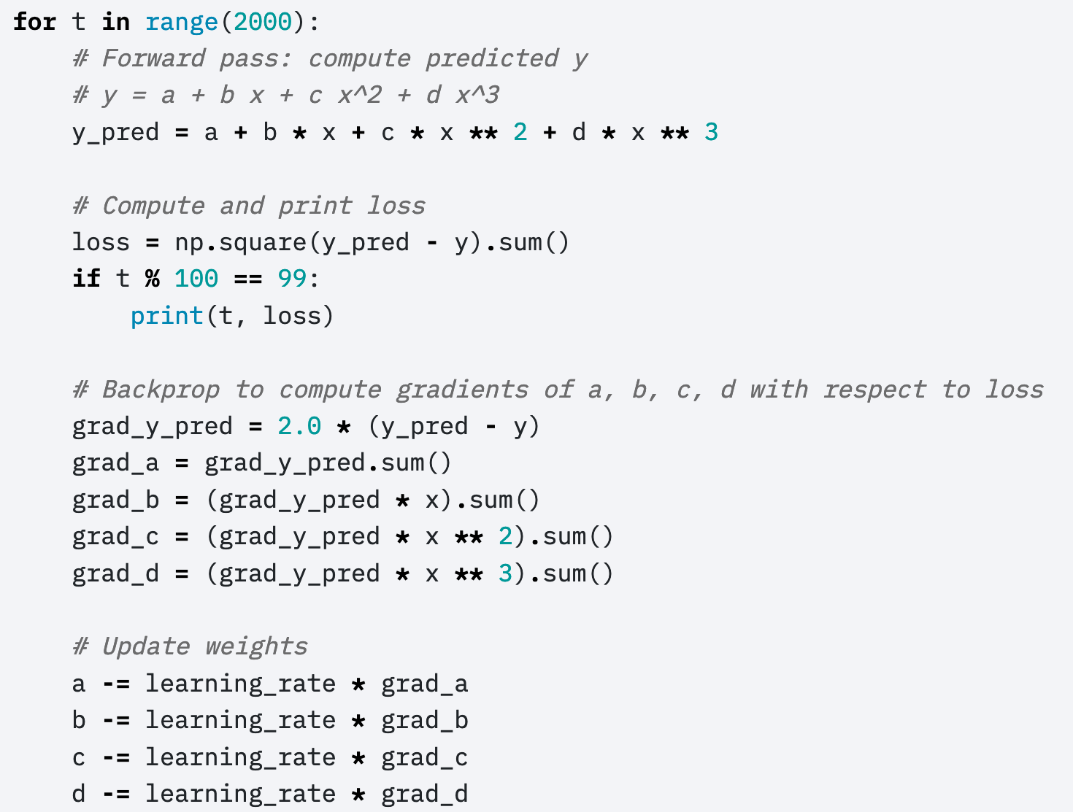
How a neural network is trained
Here’s Justin Johnson’s code for doing those things:
(https://pytorch.org/tutorials/beginner/pytorch_with_examples.html)
© 2021 Pytorch, https://pytorch.org/tutorials/beginner/pytorch_with_examples.html

Slide 15
Outline
Review: linear regression
Training a linear regression model using numpy
The same example with pytorch
torch.nn module: using predefined neural net components

Slide 16
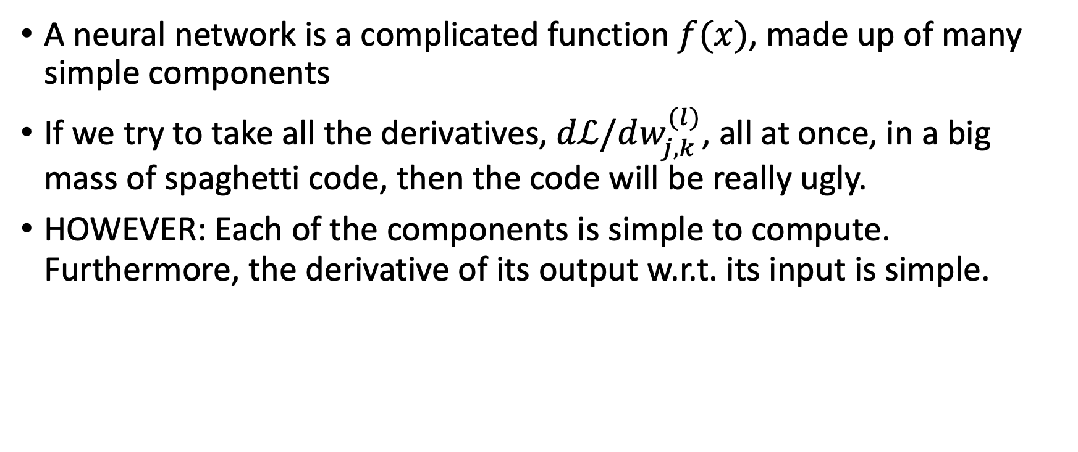
Autograd: Main idea
A neural network is a complicated function $f(x)$, made up of many simple components
If we try to take all the derivatives, $dℒ/dw_{j,k}^{(l)}$, all at once, in a big mass of spaghetti code, then the code will be really ugly.
HOWEVER: Each of the components is simple to compute. Furthermore, the derivative of its output w.r.t. its input is simple.

Slide 17

Autograd: Tensor objects
The basic idea of autograd is to create a new kind of object that takes responsibility for its own gradient.
For example, the object might be a network weight, $w_{j,k}^{(l)}$

Slide 18
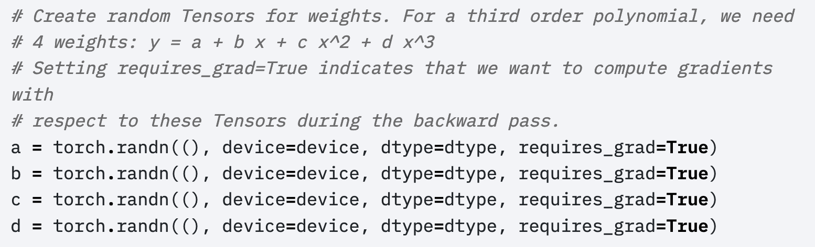
Autograd: Tensor objects
In pytorch, variables that take responsibility for their own gradients are called “tensors” (https://pytorch.org/docs/stable/tensors.html)
Here’s how Justin Johnson defines tensors for the polynomial regression problem:
© 2017 Pytorch, https://pytorch.org/tutorials/beginner/pytorch_with_examples.html

Slide 19
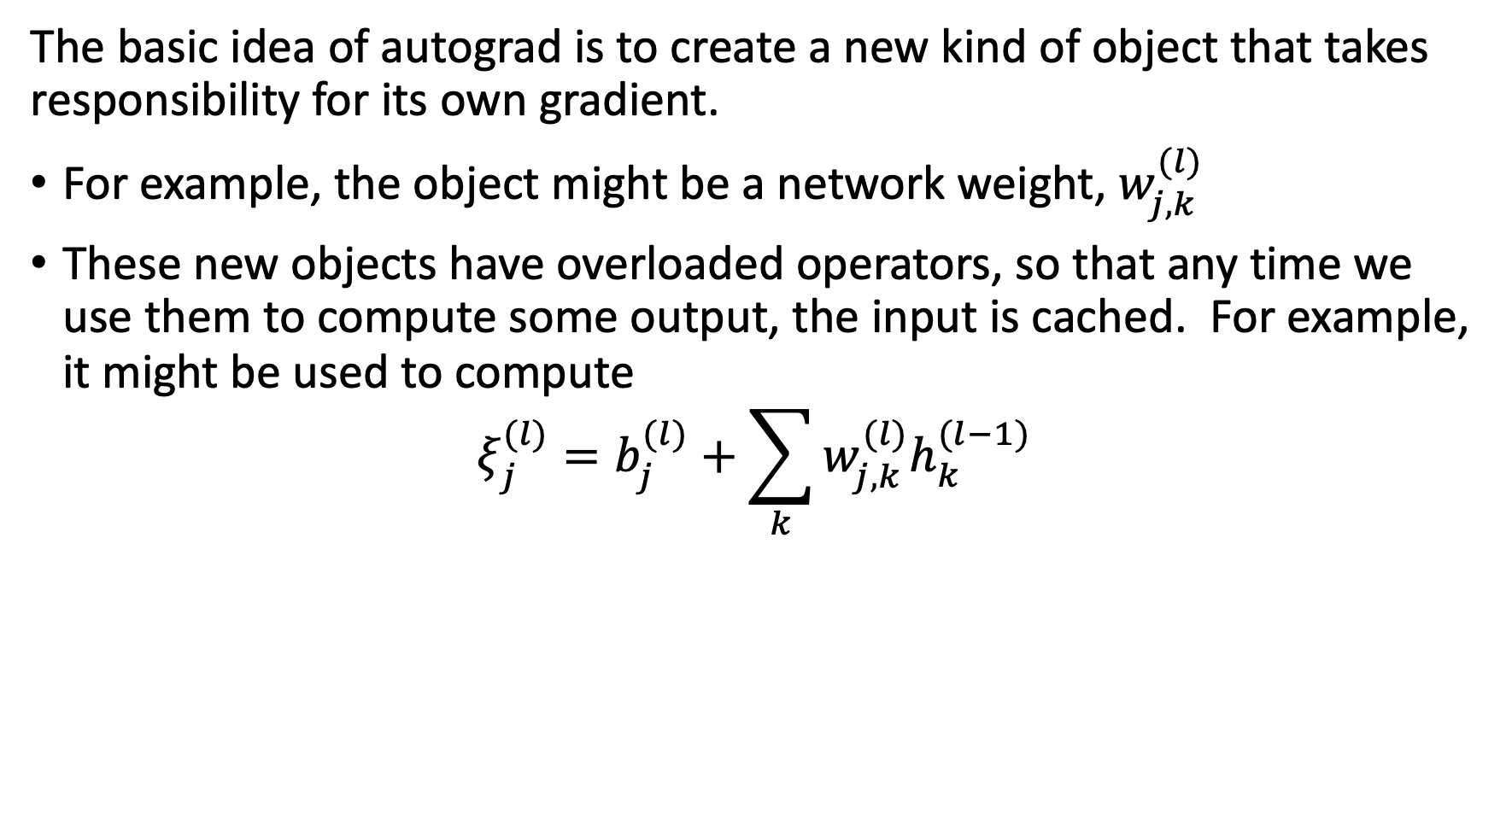
Autograd: Overloaded operators
The basic idea of autograd is to create a new kind of object that takes responsibility for its own gradient.
For example, the object might be a network weight, $w_{j,k}^{(l)}$
These new objects have overloaded operators, so that any time we use them to compute some output, the input is cached. For example, it might be used to compute
$$ξ_{j}^{(l)}=b_{j}^{(l)}+\sum_{k}{w_{j,k}^{(l)}h_{k}^{(l−1)}}$$

Slide 20
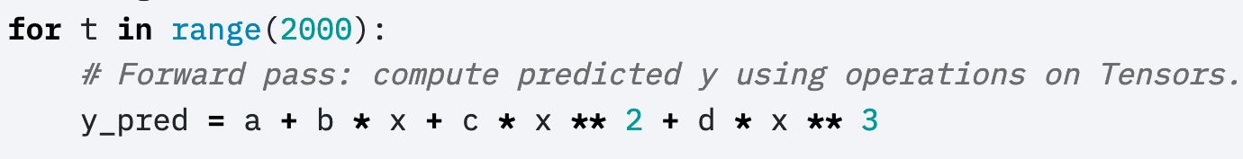
Autograd: Overloaded operators
Here’s how it gets used:
Python overloaded operators: if “b” is an object that has a method named __mul__, then the expression “f=b*x” actually calls “f=b.__mul__(x)”.

Slide 21
Autograd: Overloaded operators
The operator overload code looks something like this:
class Tensor(torch.autograd.Function):
def __init__(self, weight):
self.weight = weight
self.saved_tensors = ()
def __mul__(self, other):
self.saved_tensors = (self.saved_tensors[:], other)
returnvalue = self.weight * other
return Tensor(returnvalue)
Cache x in self.saved_tensors, so we can use it later…
Then calculate the output of the multiply operation,
… and cast the return value as a Tensor.

Slide 22
Autograd: Overloaded operators
Here’s how it gets used:
Stores x in b.saved_tensors
Stores x**2 in c.saved_tensors
Python overloaded operators: the expression “b*x” actually calls b.__mul__(x).

Slide 23
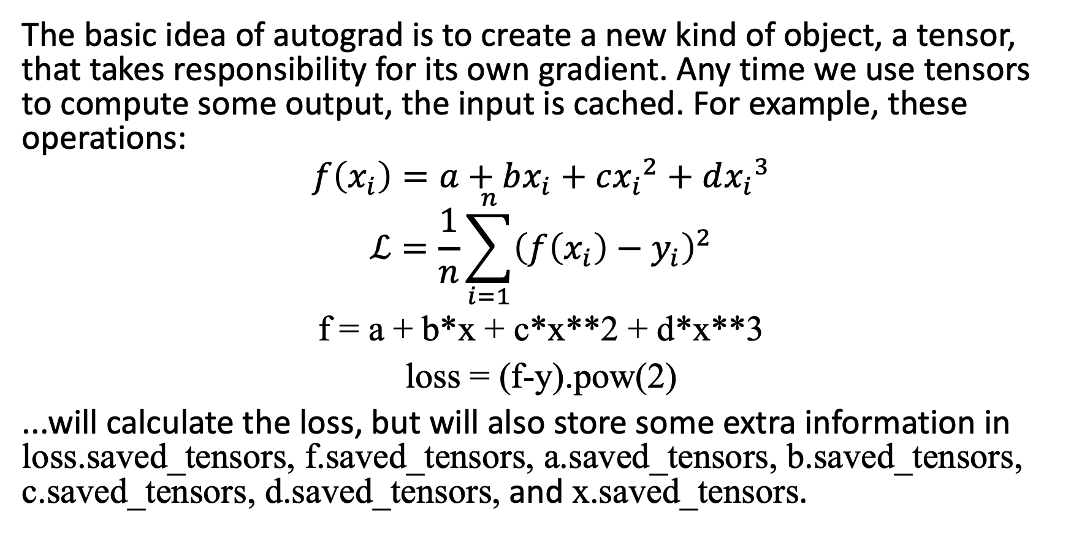
Autograd: the Loss tensor
The basic idea of autograd is to create a new kind of object, a tensor, that takes responsibility for its own gradient. Any time we use tensors to compute some output, the input is cached. For example, these operations:
$$f\left(x_{i}\right)=a+bx_{i}+c{x_{i}}^{2}+d{x_{i}}^{3}$$
$$ℒ=\frac{1}{n}\sum_{i=1}^{n}{{\left(f\left(x_{i}\right)−y_{i}\right)}^{2}}$$
f = a + b*x + c*x**2 + d*x**3
loss = (f-y).pow(2)
...will calculate the loss, but will also store some extra information in loss.saved_tensors, f.saved_tensors, a.saved_tensors, b.saved_tensors, c.saved_tensors, d.saved_tensors, and x.saved_tensors.

Slide 24
Autograd: the Loss tensor
loss
Notice the flow diagram that was implied by those lines of code.
Each tensor’s overloaded __mul__ operator keeps track of the variables used to compute it:
loss.saved_tensors has pointers to f and y
f.saved_tensors has pointers to x, a, b, c, and d
f
y
x
a
b
c
d

Slide 25
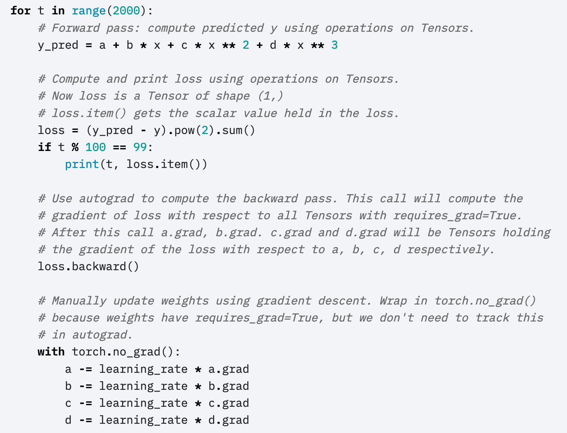
Autograd
loss depends on y_pred, which depends on a, b, c, d.

Slide 26
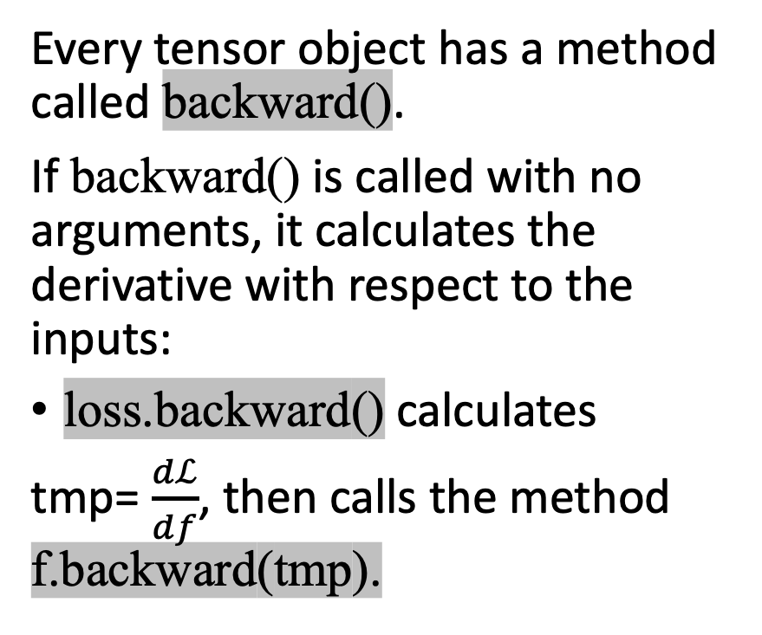
Autograd: the backward function
loss
Every tensor object has a method called backward().
If backward() is called with no arguments, it calculates the derivative with respect to the inputs:
loss.backward() calculates
tmp= $\frac{dℒ}{df}$, then calls the method f.backward(tmp).
f
y
x
a
b
c
d

Slide 27
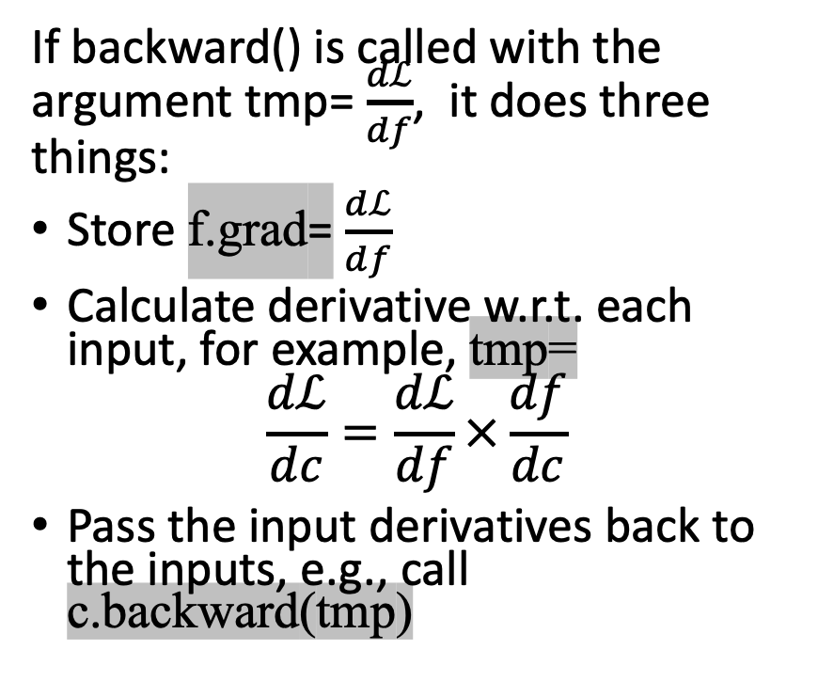
Autograd: the backward function
loss
If backward() is called with the argument tmp= $\frac{dℒ}{df}$, it does three things:
Store f.grad= $\frac{dℒ}{df}$
Calculate derivative w.r.t. each input, for example, tmp=
$$\frac{dℒ}{dc}=\frac{dℒ}{df}×\frac{df}{dc}$$
Pass the input derivatives back to the inputs, e.g., call c.backward(tmp)
f
y
x
a
b
c
d

Slide 28
Autograd
loss depends on y_pred, which depends on a, b, c, d.
Calculates the derivative of the loss w.r.t. each of its input tensors.
Uses the resulting derivatives to update the weights.

Slide 29
Details: How to turn off autograd
As you know, every time you add, subtract, multiply or divide a tensor by anything, the tensor stores data in self.saved_tensors, so it can use that information later to compute the gradient
How do you turn this behavior off?

Slide 30
Dynamically turning off Autograd
These weight updates are not part of the neural network forward pass.

Slide 31
How to zero out the gradients
When you call backward() over a tensor, it doesn’t zero out any previous gradients
Instead, it adds the current gradient to the previous gradients
A very very very common mistake: running 2000 iterations, with the gradient accumulating from each iteration to the next, instead of zeroing it out in between iterations

Slide 32
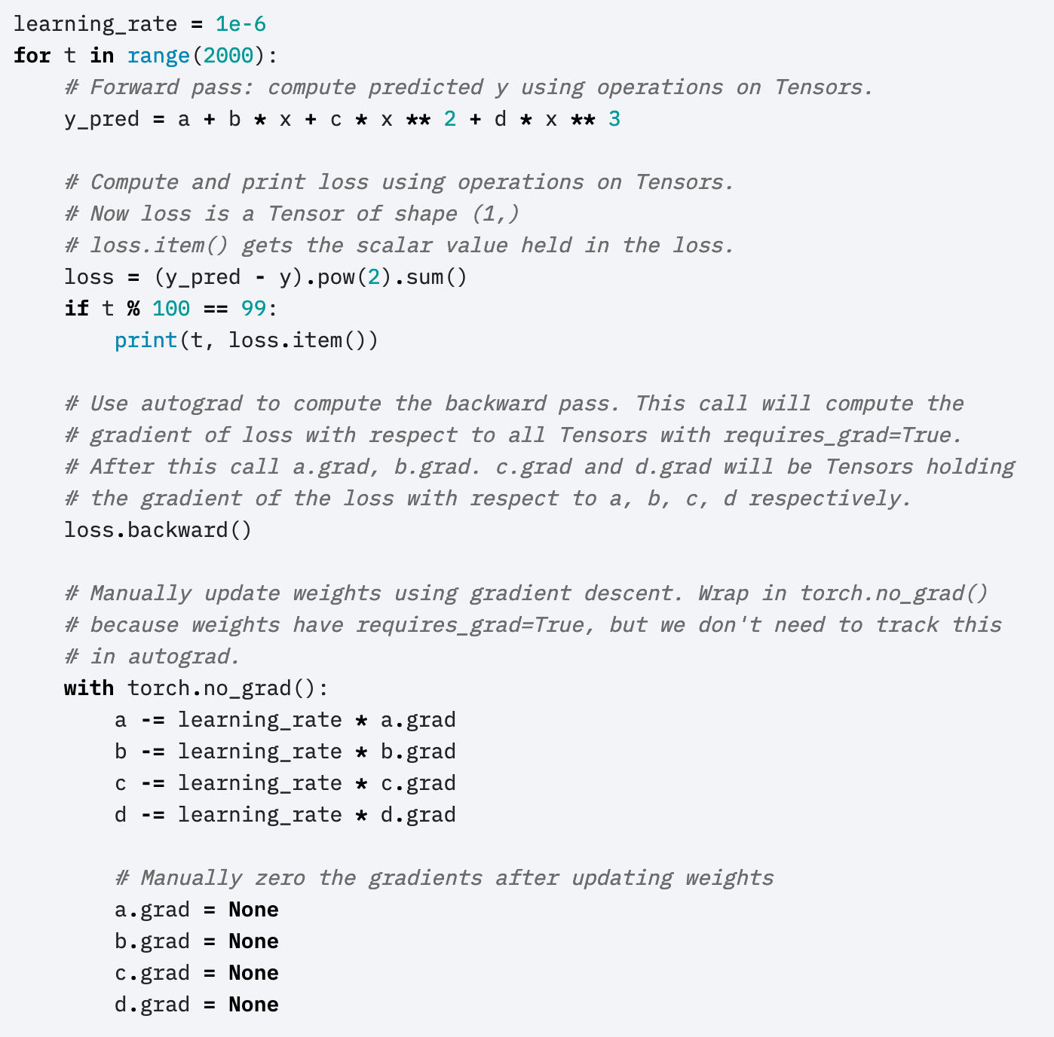
Manually zeroing out the gradients
Here’s the part I didn’t show you before.

Slide 33
Outline
Review: linear regression
Training a linear regression model using numpy
The same example with pytorch
torch.nn module: using predefined neural net components

Slide 34
Pytorch nn module
The autograd feature of pytorch allows you to define only the forward propagation of your neural net. As long as all of the component operations are in pytorch’s library, the back-propagation will be computed for you.
Tensors just do multiplication and addition. What about other types of operations?
General operations are contained in the nn module, using the formalism of a “layer.”

Slide 35
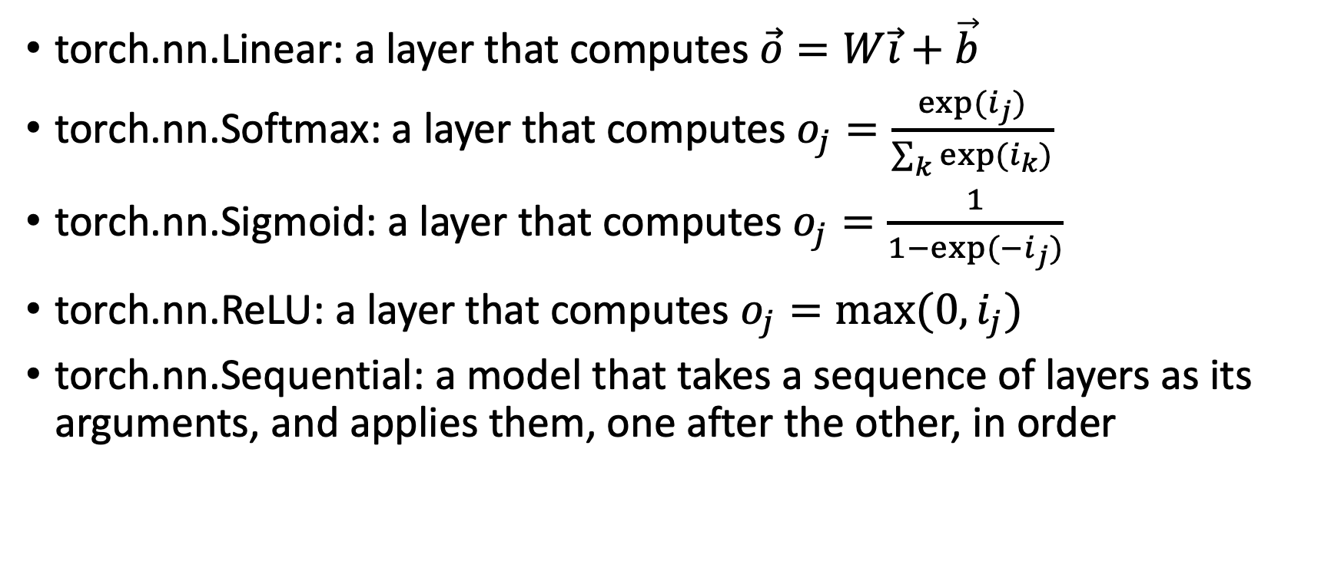
Some types of layers
torch.nn.Linear: a layer that computes $\vec{o}=W\vec{i}+\vec{b}$
torch.nn.Softmax: a layer that computes $o_{j}=\frac{exp⁡(i_{j})}{\sum_{k}{exp⁡(i_{k})}}$
torch.nn.Sigmoid: a layer that computes $o_{j}=\frac{1}{1−exp⁡(−i_{j})}$
torch.nn.ReLU: a layer that computes $o_{j}=max⁡(0,i_{j})$
torch.nn.Sequential: a model that takes a sequence of layers as its arguments, and applies them, one after the other, in order

Slide 36
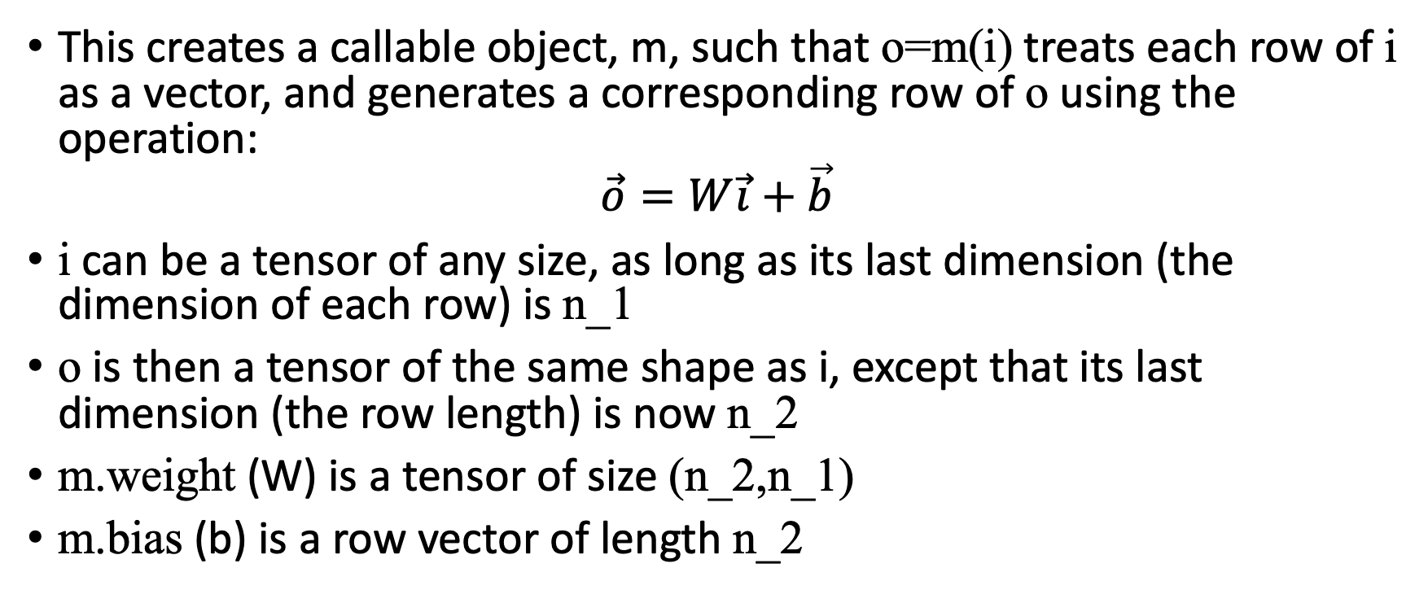
m=torch.nn.Linear(n_1,n_2)
This creates a callable object, m, such that o=m(i) treats each row of i as a vector, and generates a corresponding row of o using the operation:
$$\vec{o}=W\vec{i}+\vec{b}$$
i can be a tensor of any size, as long as its last dimension (the dimension of each row) is n_1
o is then a tensor of the same shape as i, except that its last dimension (the row length) is now n_2
m.weight (W) is a tensor of size (n_2,n_1)
m.bias (b) is a row vector of length n_2

Slide 37
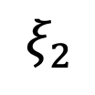
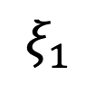
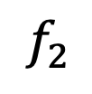


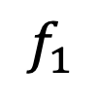


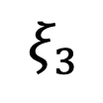

Example: Linear, Sigmoid, Softmax
Here’s an example flowgraph. We could create the layers as:
linear1 = torch.nn.Linear(2,3)
sigmoid1 = torch.nn.Sigmoid()
linear2 = torch.nn.Linear(3,2)
loss_function = torch.nn.MSEloss()
Having created them, we could then run forward pass as:
xi = linear1(x)
h = sigmoid1(xi)
f = linear2(h)
loss = loss_function(f,y)
Then we could calculate all of the gradients by running
loss.backward()
$$f_{1}$$
$$f_{2}$$
$$h_{1}$$
$$h_{2}$$
$$h_{3}$$
$$ξ_{1}$$
$$ξ_{2}$$
$$ξ_{3}$$
$$x_{1}$$
$$x_{2}$$

Slide 38
torch.nn.Sequential
torch.nn.Sequential is a special module that creates a sequence of layers, where each layer’s output is the next layer’s input. For example:
model = torch.nn.Sequential(
torch.nn.Linear(2,3),
torch.nn.Sigmoid(),
torch.nn.Linear(3,2))
loss_function = torch.nn.MSEloss()
Then you can run forward pass by just typing:
f = model(x)
loss = loss_function(f,y)
You can still calculate all of the gradients by running
loss.backward()
$$f_{1}$$
$$f_{2}$$
$$h_{1}$$
$$h_{2}$$
$$h_{3}$$
$$ξ_{1}$$
$$ξ_{2}$$
$$ξ_{3}$$
$$x_{1}$$
$$x_{2}$$

Slide 39
torch.nn.Sequential: where are the parameters?
The layers each have their own parameters, for example, a model created using the commands on the previous slide would have
model[0].weight
model[0].bias
model[2].weight
model[2].bias
Accessing them that way requires you to know which layers have weights and biases, and which don’t. An easier way is to use the function model.parameters(), which iterates through all trainable parameters, regardless of where they are actually stored:
for param in model.parameters():
param -= learning_rate * param.grad

Slide 40
Outline
Review: linear regression
Training a linear regression model using numpy
https://pytorch.org/tutorials/beginner/pytorch_with_examples.html#warm-up-numpy
The same example with pytorch
https://pytorch.org/tutorials/beginner/pytorch_with_examples.html#pytorch-tensors
torch.nn module: using predefined neural net components
https://pytorch.org/tutorials/beginner/pytorch_with_examples.html#nn-module

