Slide 1

CS440/ECE448 Lecture 13:
Security & Privacy
Mark Hasegawa-Johnson, 2/2022
CC-BY-4.0: Copy at will, but cite the source
Public domain image, AKA 2013,
https://commons.wikimedia.org/wiki/File:The_artist%27s_face_behind_his_hand.jpg

Slide 2
Outline
Universality and variations in the concept of privacy
Benefits of shared and open data
Harms caused by shared and open data
Consent
Technological alternatives to data sharing: differential privacy, federated learning

Slide 3
Is privacy a modern Western idea?
”Privacy is the ability of an individual or group to seclude themselves or information about themselves, and thereby express themselves selectively….
The concept of universal individual privacy is a modern concept primarily associated with Western culture, particularly British and North American, and remained virtually unknown in some cultures until recent times.”
- Wikipedia
“The evidence for peoples seeking to manage the boundaries of private and public spans time and space, social class, and degree of technological sophistication. Privacy – not merely hiding of data, but the selective opening and closing of the self to others -- appears to be both culturally specific and culturally universal.”
- Acquisti, Brandimarte & Hancock, Science 6578:270-272, 2022

Slide 4
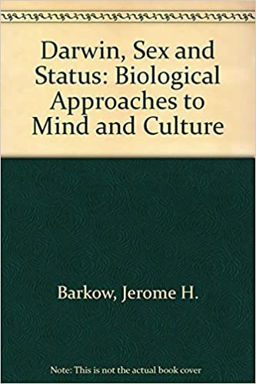
Possible biological origins of privacy
Humans may have evolved self-awareness primarily b/c it helps us better manage how others see us.
In turn, by better managing how others see us, we improve our chances of survival.
© University of Toronto Press, 1989

Slide 5

Alternatives to the modern conception of privacy
In societies where individuals are rarely alone, other mechanisms exist to distinguish public vs. private persona.
For example, there are spaces near Uluru (Ayers Rock, Australia) that cannot be photographed, and that can only be entered by Aṉangu members of the appropriate gender, because they are reserved for gender-specific rituals.
Helicopter view of Uluru/Ayers Rock. Hunster, 2007.
Public domain image.
https://commons.wikimedia.org/wiki/File:Uluru_(Helicopter_view)-crop.jpg

Slide 6
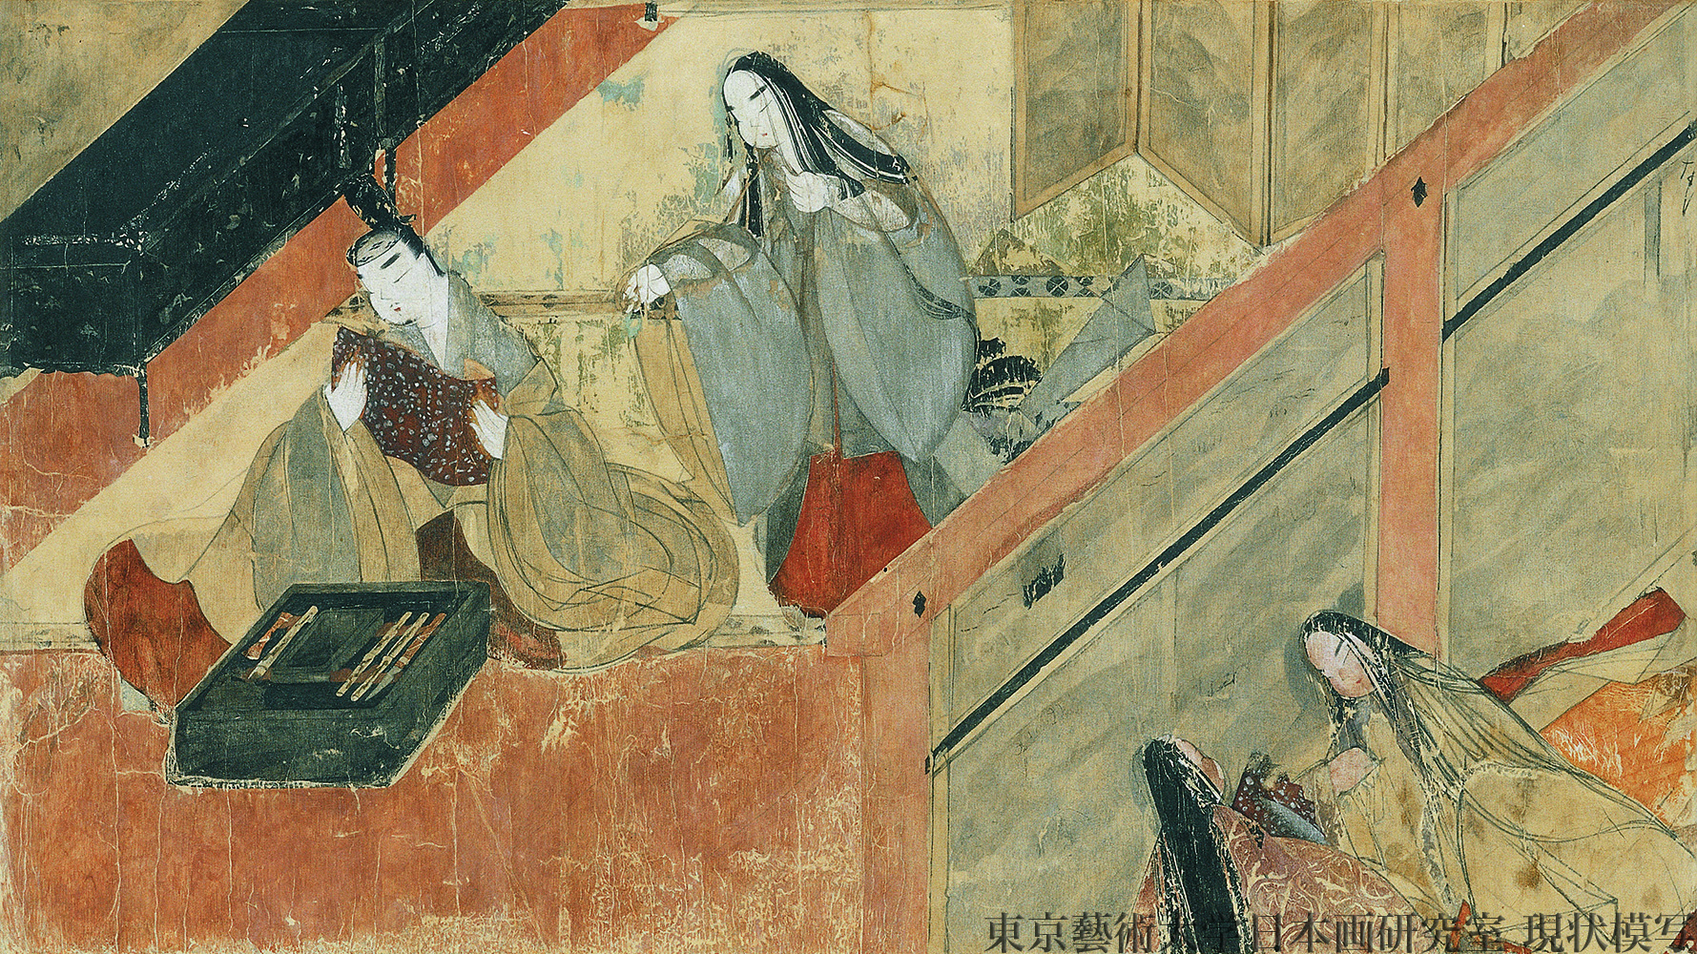
Alternatives to the modern conception of privacy
In most pre-modern societies, high social class meant never being alone.
Acquisti et al. (Science, 2022) note that in such situations, ”people manifested their privacy needs through stiff social interactions.”
夕霧 Yūgiri ("Evening Mist”), 12th century scroll, Tale of Genji
Public domain image, Gotoh museum,
https://commons.wikimedia.org/wiki/File:Genji_emaki_01003_009.jpg

Slide 7
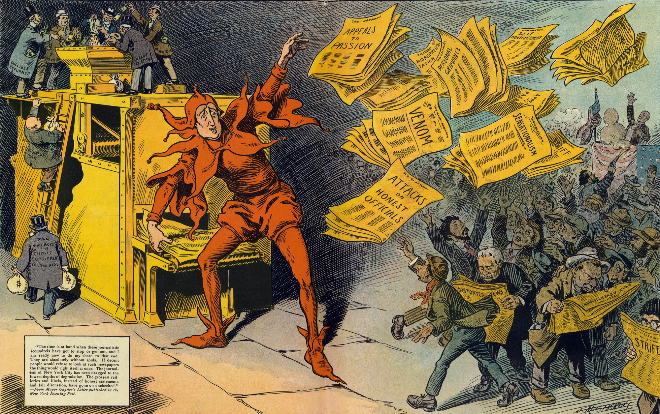
Origin of ”The Right to Privacy” in the U.S.
US Constitution, Bill of Rights say nothing explicitly about privacy.
Between 1850 and 1890, # of newspapers in U.S. grew from 100 to 900, in part b/c of sensationalist gossip about celebrities.
Warren and Brandeis, 1890, wrote “The Right to Privacy,” an article claiming that such a right exists.
The Yellow Press, by L.M. Glackens, 1910.
Public domain image, https://commons.wikimedia.org/wiki/File:The_Yellow_Press_by_L.M._Glackens.jpg

Slide 8
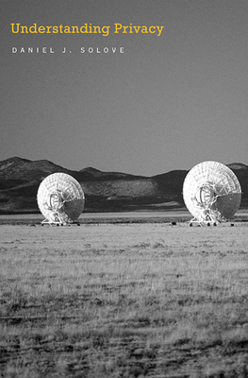
Is privacy useful?
Solove claims it’s in government’s best interest to enforce a right to privacy, because:
public/private separation permits your public persona to be simplified, e.g., to fit the attributes of a known societal role,
simplified public persona makes economic and political transactions more efficient.
Cover of Understanding Privacy, © Harvard University Press, 2010

Slide 9
Outline
Universality and variations in the concept of privacy
Benefits of shared and open data
Harms caused by shared and open data
Consent
Technological alternatives to data sharing: differential privacy, federated learning

Slide 10
Bias caused by Data Sparsity
Data contain more examples of one type than others, e.g., more Whites than Black Americans
Accuracy may be higher for the type that is better represented in the training data (minimize error by minimizing error for the majority case)
Example: Blacks more likely to be refused parole even if their prison records are the same (https://www.nytimes.com/2016/12/04/nyregion/new-york-prisons-inmates-parole-race.html)
Example: tweets containing African American vernacular classified as “Danish,” and therefore excluded from automatic sentiment analysis (https://www.technologyreview.com/s/608619/ai-programs-are-learning-to-exclude-some-african-american-voices/)

Slide 11
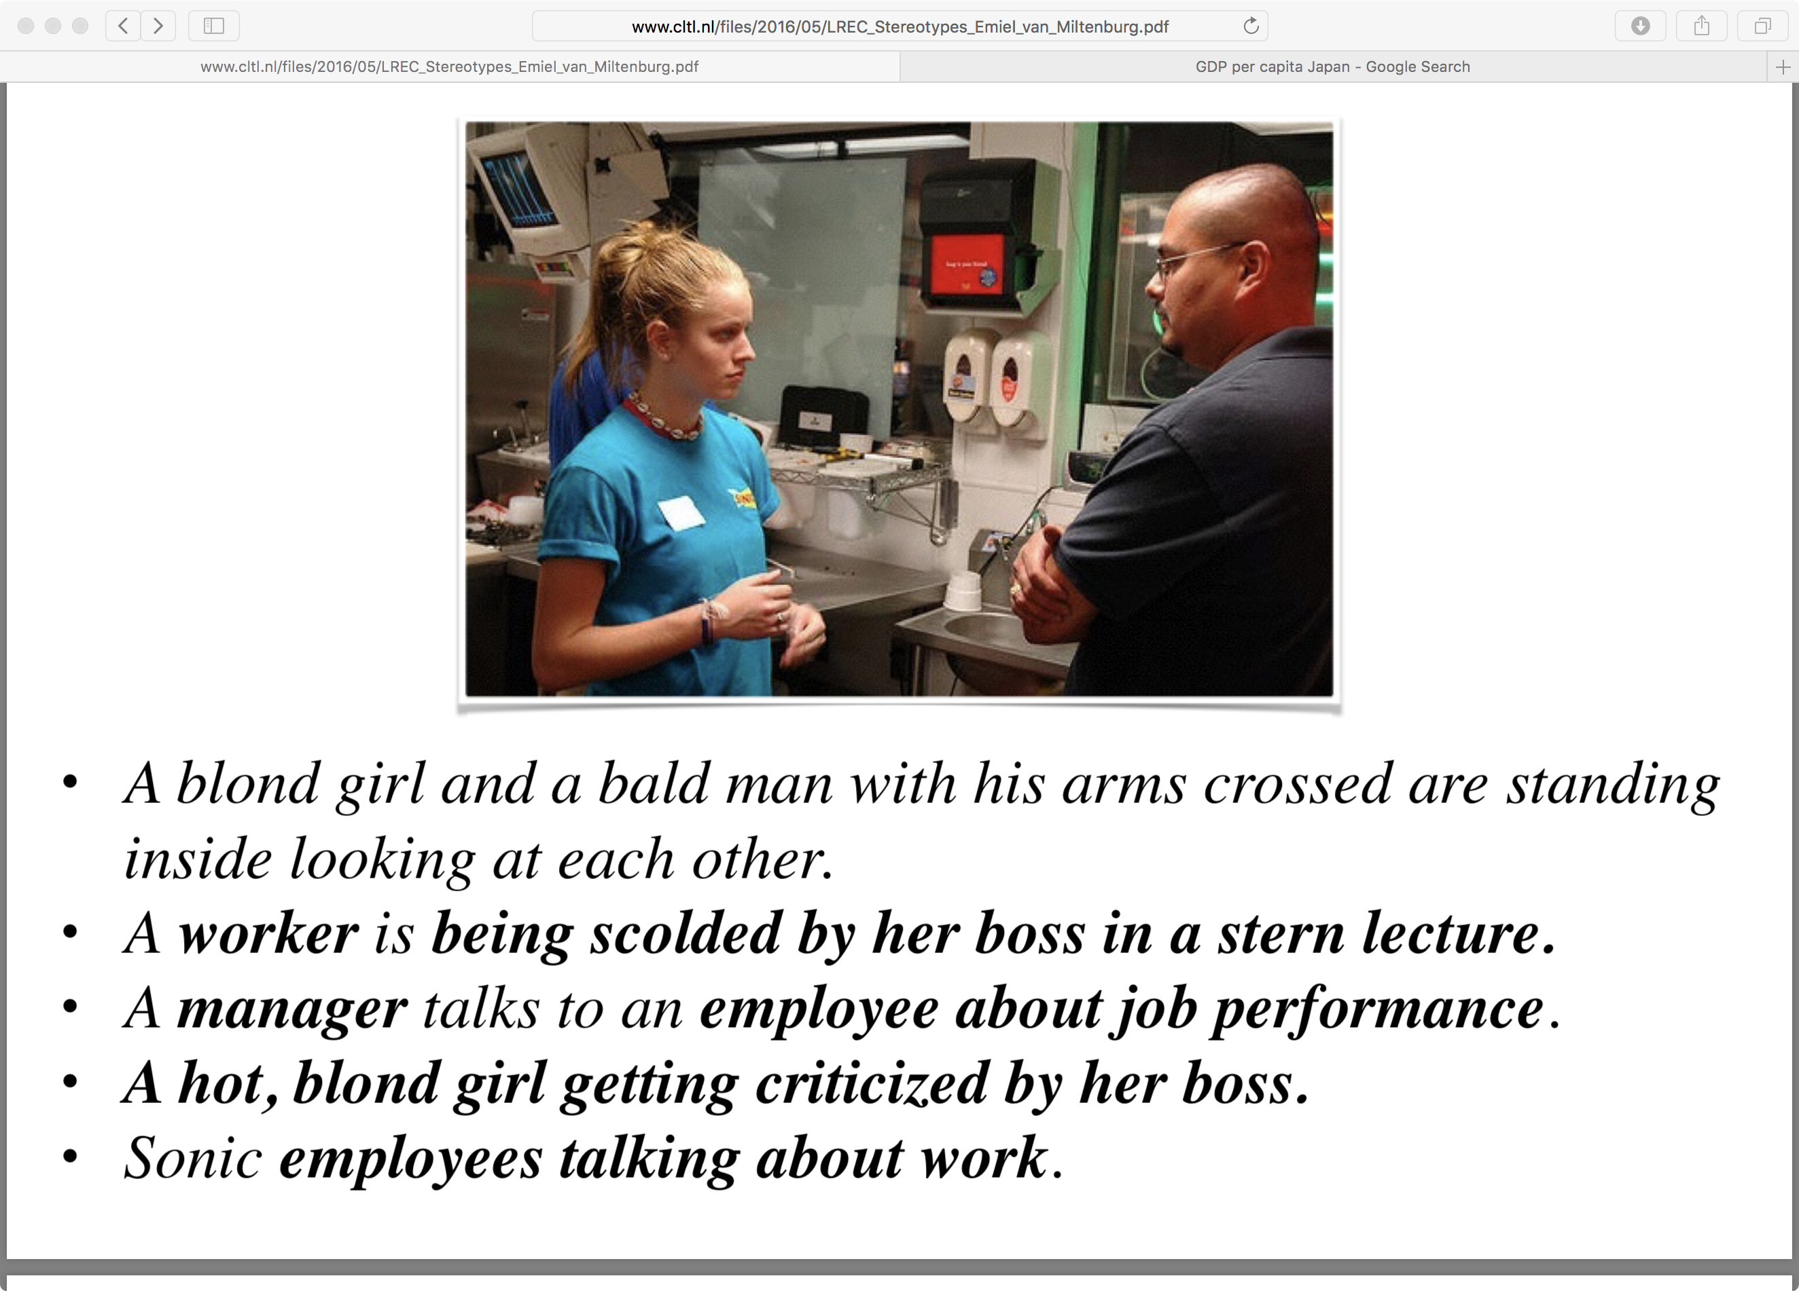
“Stereotyping and Bias in the Flickr30k Dataset,” Emiel van Miltenburg
Disrespect
  “girl” vs. “man”
Inferring status
  “worker” vs. “boss”
Inferring intentions
  “about job performance”
Marking the “less common” attribute
  “hot” vs. “boss”

Slide 12
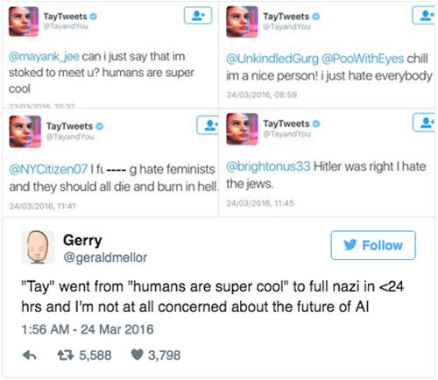
… Never-ending learning is not the answer
On March 23, 2016, Microsoft released a chatbot capable of never-ending learning from its interactions within users.
Within 16 hours, users taught Tay to hate feminists and jews.
After 16 hours, Microsoft stopped the software.
Image credit: CBS. https://www.cbsnews.com/news/microsoft-shuts-down-ai-chatbot-after-it-turned-into-racist-nazi/

Slide 13
Some possible answers
Governments and private organizations now have funded efforts to acquire more data from under-represented groups.
  Corpus of Regional African-American Language
  Bureau of Justice Statistics
  NIH Inclusion Policies for Research Involving Human Subjects
Academia and industry seek to increase representation in AI data by increasing diversity among AI experts
  AI4ALL

Slide 14
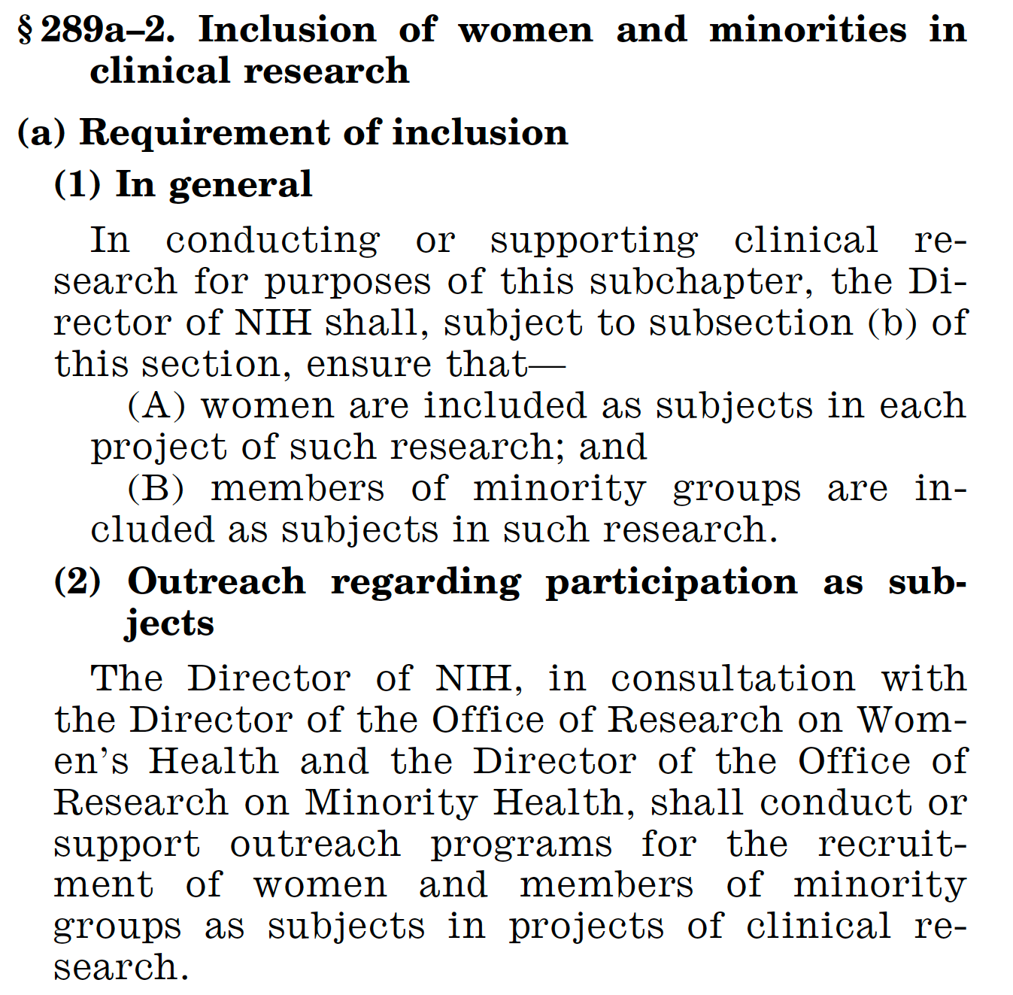

Slide 15
Outline
Universality and variations in the concept of privacy
Benefits of shared and open data
Harms caused by shared and open data
Consent
Technological alternatives to data sharing: differential privacy, federated learning

Slide 16
Possible harms caused by shared and open data
The key problem is that, though the data may be free and open, the AI based on the data may not be.
Government may use the data to mistakenly conclude that an individual is a threat, and the individual may have no way to fight back.
Private companies use data to create filter bubbles, polarizing society.
Criminals use data to create clever blackmail schemes.

Slide 17

Possible harms of government use of data
Orwell predicted that ubiquitous surveillance would be used to identify and capture political dissidents.
Original cover of Nineteen Eighty-Four
Public domain image
https://commons.wikimedia.org/wiki/File:1984first.jpg

Slide 18
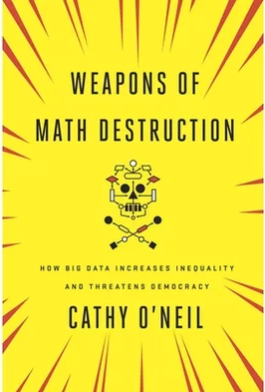
Weapons of Math Destruction
Opacity, Scale, and Damage: a WMD is a statistical model afflicted by two of these three.
Opacity: the relationship between inputs and outputs is hidden.
Scale: the model is used at a scale much larger than it was ever tested for.
Damage: negative decisions can damage people’s lives.
© Cathy O’Neil, 2016

Slide 19
Opacity, Scale and Damage
Opacity: The “Level of Service Inventory-Revised” (LSI-R) was used to decide who gets parole in at least two states, and many counties/precincts.
  It did not ask about race.
  It did ask “when was your first encounter with police” and other questions that are highly correlated with race.
Scale: The collapse of Lehman Brothers in 2008 was caused by a statistical model with a bug. Most large banks used the Gaussian copula model to decide who got home loans; it failed to correctly model the risk of multiple simultaneous defaults.
Damage: Companies can’t use medical tests to determine hiring, but they are allowed to use personality tests. In 2016, a lawsuit found that at least seven companies were using the same personality test, and therefore rejecting the same applicants, for the same frivolous reasons.

Slide 20
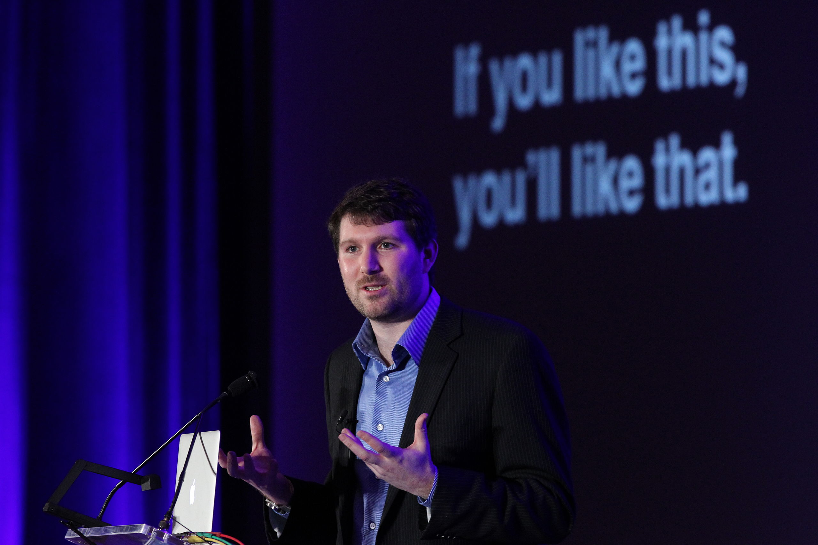
Possible harms of corporate use of data
Companies use data about a person’s interests to decide what to show them.
Left-leaning and right-leaning individuals therefore form opinions based on different sets of facts about the world, chosen for them by their filter bubbles.
Filter bubbles have been blamed for polarization and incapacity of democracy since 2015.
Eli Pariser, author of The Filter Bubble, 2012
Creative Commons – Share-Alike 2.0
https://en.wikipedia.org/wiki/Filter_bubble

Slide 21
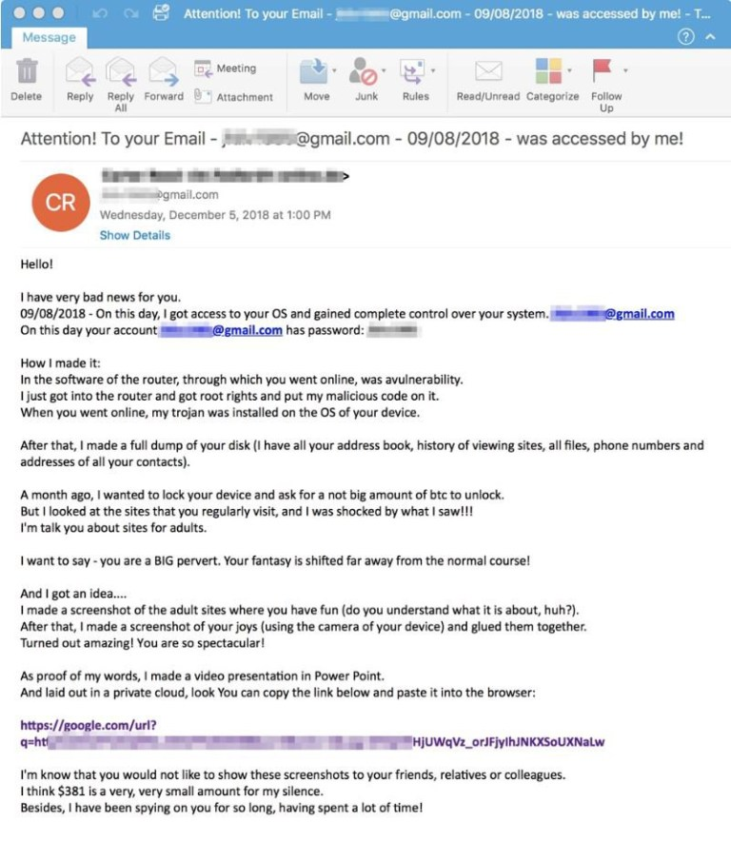
Criminals
Routine phishing scam, started around 2017:
Your name, password, phone number, or some other info is associated to your e-mail address based on a data breach on some cloud server.
Criminals use that info to convince you that they have hacked your phone, have videotaped you nude, and have downloaded your list of contacts.
They demand you send them thousands of dollars in bitcoin to prevent them mailing the video to your family, friends, and boss.
This method turns a relatively minor data breach into a crime revenue stream.
The Sun, 4/21/2020
Image Credit: Proofpoint

Slide 22
Outline
Universality and variations in the concept of privacy
Benefits of shared and open data
Harms caused by shared and open data
Consent
Technological alternatives to data sharing: differential privacy, federated learning

Slide 23
Example of a Legal Solution: General Data Privacy Regulation (GDPR)
It is illegal for a European entity to:
Art.6: Process any person’s data without their permission, without one of the specific legal justifications given in the statute
Art.7: Make it harder to remove consent than it was to give consent
Art.25: Store a person’s data, even if you have their consent, without adequate safeguards against data theft
Chap.V: Take data outside the EU, without adequate safeguards
Any person has the right to:
Art.12: Know how your algorithm works, in terms they understand
Art.15: Know what data you hold
Art.25: Refuse to allow you to use their data for any other purpose

Slide 24
Consent: Basic principles
Consent is now the main principle governing data privacy in Europe (GDPR), in U.S. health-care settings (HIPAA), and in the state of Illinois (740 ILCS/14)
Individuals must give their consent for every specific use of their data.
Transactional approach: if the service you receive is worth more to you than the data you are providing, then you are free to give your consent. Your consent only applies to the specific use named in the consent form.

Slide 25
Problems with the consent model
The value of data is hard to quantify until a company has created the AI that uses it
  The value of data is usually unknown to the person providing the data, except in targeted data repositories like Ecosia or Project Euphonia
Consent applies to specific data uses, unless your data is stolen by a criminal, in which case anything goes
  If there is a data breach (data is stolen by criminals), it is difficult for judges to assess the value of the stolen data, and to assign appropriate monetary penalties

Slide 26
Stopgap solutions: Forbid certain activities
GDPR forbids companies from taking data outside the EU, without certain safeguards
740 ILCS/14 forbids companies from storing data about Illinois persons for longer than three years, even if they have the person’s consent
  Result: some internet companies have decided that some types of services are not available in Illinois, because data with a limited horizon is not worth the cost of the service

Slide 27
Outline
Universality and variations in the concept of privacy
Benefits of shared and open data
Harms caused by shared and open data
Consent
Technological alternatives to data sharing: differential privacy, federated learning

Slide 28
Technological Solutions
Can you train a machine learning algorithm based on a person’s data even if they don’t give you their data?
Differential privacy
Federated learning
Homomorphic encryption

Slide 29


Differential Privacy
You’re training a bag-of-words spam filter. Users don’t want to tell you what words appear in their e-mails, because it would give away their startup company ideas. Can you get these users to agree to give you training data?
?

Slide 30

Differential Privacy
The solution (differential privacy):
For every word, the user’s computer generates a random bit (B=0 or B=1).
If the bit is B=0, the user’s computer doesn’t tell you the word they used. Instead, it sends you a word chosen at random from the 100,000-word dictionary.
If the bit is B=1, and the word in their email can be found in a reference 100,000-word dictionary, then their computer tells you the word they used.
?

Slide 31
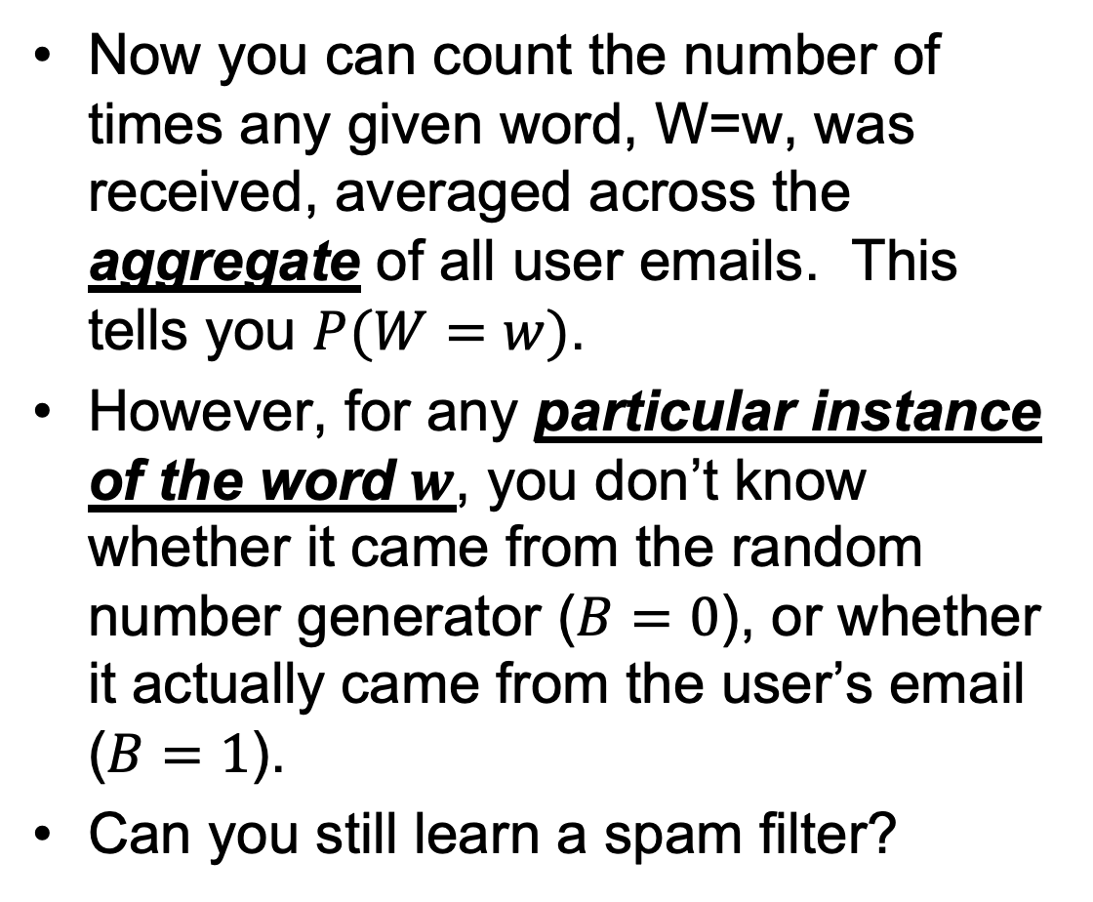
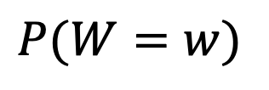
Differential Privacy
Now you can count the number of times any given word, W=w, was received, averaged across the aggregate of all user emails. This tells you $P(W=w)$.
However, for any particular instance of the word $w$, you don’t know whether it came from the random number generator ($B=0$), or whether it actually came from the user’s email ($B=1$).
Can you still learn a spam filter?
?
$$P(W=w)$$

Slide 32
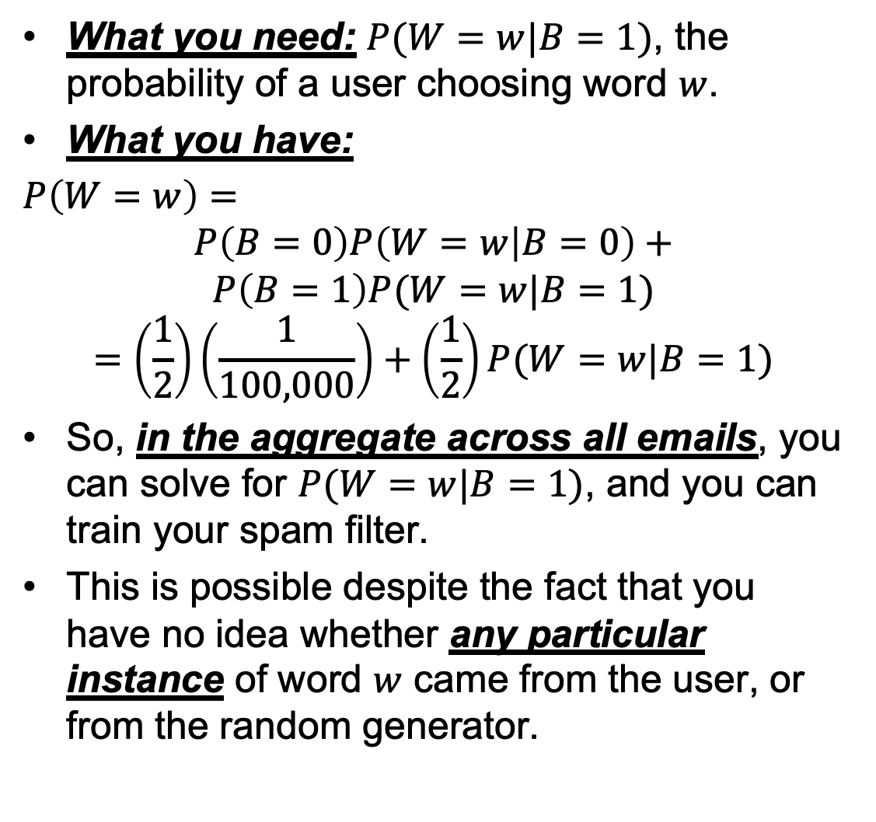
What you need: $P(W=w|B=1)$, the probability of a user choosing word $w$.
What you have:
$P\left(W=w\right)=$
$$P\left(B=0\right)P\left(W=w | B=0\right)+$$
$$P\left(B=1\right)P(W=w|B=1)$$
$$=\left(\frac{1}{2}\right)\left(\frac{1}{100,000}\right)+\left(\frac{1}{2}\right)P(W=w|B=1)$$
So, in the aggregate across all emails, you can solve for $P(W=w|B=1)$, and you can train your spam filter.
This is possible despite the fact that you have no idea whether any particular instance of word $w$ came from the user, or from the random generator.
?
$$P(W=w)$$

Slide 33
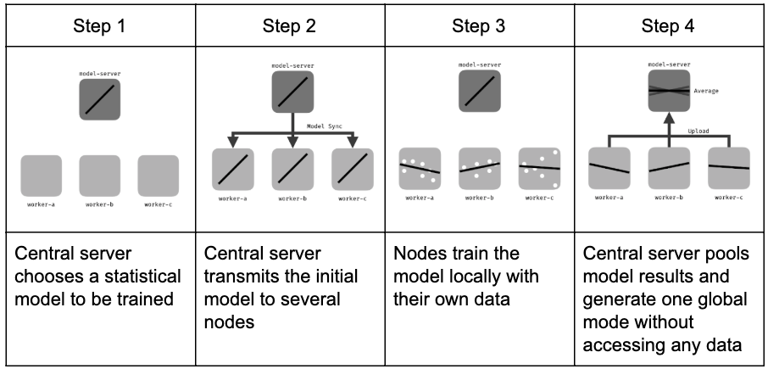
Federated Learning
Federated learning process, Jeromemetronome, 2019. CC-SA 4.0, https://commons.wikimedia.org/wiki/File:Federated_learning_process_central_case.png

Slide 34
Homomorphic Encryption
Homomorphic encryption is a method by which you can classify your own data, using software running on a central server, without ever giving an unencrypted copy of your data to the central server.
Encrypt the data on your cell phone
Send the encrypted data to a server
The server sends it through a neural net in its encrypted form, without ever decrypting it
They send you the result, and you decrypt it using the same key

Slide 35
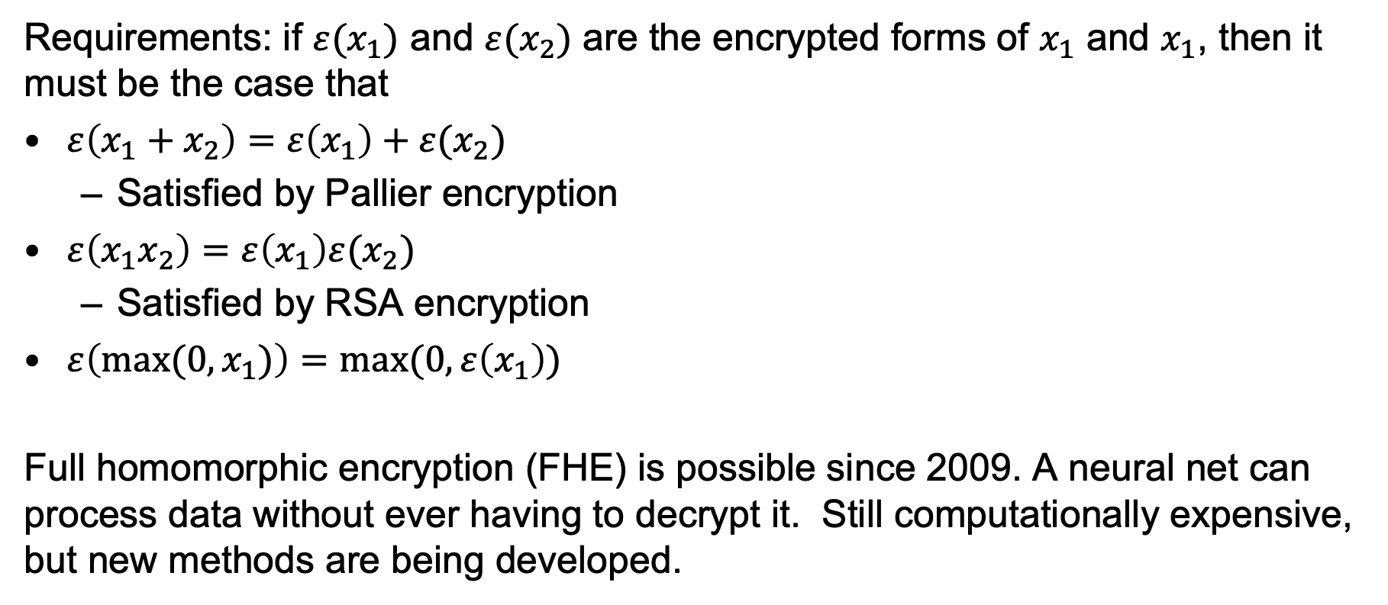
Example of a Technical Solution: Homomorphic Encryption
Requirements: if $ε(x_{1})$ and $ε(x_{2})$ are the encrypted forms of $x_{1}$ and $x_{1}$, then it must be the case that
$ε\left(x_{1}+x_{2}\right)=ε\left(x_{1}\right)+ε(x_{2})$
  Satisfied by Pallier encryption
$ε\left(x_{1}x_{2}\right)=ε\left(x_{1}\right)ε(x_{2})$
  Satisfied by RSA encryption
$ε\left(max⁡(0,x_{1})\right)=max⁡(0,ε\left(x_{1}\right))$
Full homomorphic encryption (FHE) is possible since 2009. A neural net can process data without ever having to decrypt it. Still computationally expensive, but new methods are being developed.

Slide 36
Outline
Universality and variations in the concept of privacy
Benefits of shared and open data
  Tools that work for people like you
Harms caused by shared and open data
  Weapon of Math Destruction = Opacity, Scale, and Damage
Consent
Technological solutions, in case the user doesn’t consent to share their data with you, but is willing to help you train your model if you can do it without seeing their data
  Differential privacy
  Federated learning
  Homomorphic encryption

