Slide 1
CS440/ECE448 Lecture 14:
Exam 1 Review
Mark Hasegawa-Johnson, 2/2022
Slides may be redistributed under CC-BY 4.0.

Slide 2
Exam 1 Review
Mechanics: How to take the exam
Review topics
Sample review problem

Slide 3
Mechanics: How to take the exam
No calculators, computers, or textbooks
You may bring one 8.5x11 page of notes, handwritten, front & back
If you’re taking the exam in person:
Show up to class on Monday, ready to take an exam.

Slide 4
Mechanics: How to take the exam
If you are taking it online:
You will receive a zoom URL by e-mail by Sunday night. If you do not receive it by Sunday night, please let us know.
Log on to that zoom URL before 1:00pm on Monday.
Turn on your webcam. Your webcam needs to show your hands, face, and workspace.
At 1:00pm, if everybody has their webcam on, the TA will post the exam PDF in the zoom chat window.
You can write your answers electronically or on paper.
At exactly 1:50pm, the TA will tell you to stop working, and to start photographing your answers, and uploading them to Gradescope.

Slide 5
How to study: Recommended approach
Review the quiz problems and MPs: for each quiz, there is now a 0-point “practice quiz” that you can re-take as often as you like.
Review the lecture slides – try to extract a few key bullet points or equations from each lecture.
Do the sample exam problems. Do them yourself, then compare your answer with your friend’s answer, then check the solutions.
Write your cheat sheet (8.5x11, both sides if you wish).

Slide 6
Exam 1 Review
Mechanics: How to take the exam
Review topics
Sample review problem

Slide 7
Topics on the exam
Broadly, there are just two topics:
Probability
Machine learning

Slide 8
Topics on the exam
Narrowing down a little bit:
Probability (lecture 2: definition)
  Lecture 2: conditional probability, axioms of probability, independence
  Lecture 3: Bayesian classifier, naïve Bayes
  Lecture 4: recall & precision, train, dev, & test corpora, Laplace smoothing
Machine learning (lecture 5: definition)
  Lecture 6: perceptron
  Lecture 7: linear regression
  Lecture 8: logistic regression
  Lectures 9-11: multilayer networks, back-propagation
  Lecture 12: computer vision (pinhole camera equations, convolution)

Slide 9
The axioms of probability
Axiom 1: every event has a non-negative probability.
$$P\left(A=T\right)≥0$$
Axiom 2: If an event always occurs, we say it has probability 1.
$$Ω=\left\{\begin{matrix}T & always \\ F & never\end{matrix}\right.$$
$P(Ω=T)=1$
Axiom 3: probability measures behave like set measures.
$$P\left(A⋁B=T\right)=P\left(A=T\right)+P\left(B=T\right)−P(A⋀B=T)$$

Slide 10
Joint and Conditional distributions of random variables
$P\left(X,Y\right)$ is the joint probability distribution over all possible outcomes $P\left(X=x,Y=y\right)$.
$P(X|Y)$ is the conditional probability distribution of outcomes $P(X=x|Y=y)$.
$$P\left(X=x | Y=y\right)=\frac{P\left(X=x,Y=y\right)}{P\left(Y=y\right)}$$

Slide 11
MPE = MAP using Bayes’ rule
Suppose your goal is to minimize the probability of error:
$$f(x)=\operatorname{argmin}{P(Error|X=x)}$$
…but the only things you know are the prior $P(Y=y)$, and the likelihood $P\left(X=x | Y=y\right)$. Well, presto! Using Bayes’ rule, we can prove that the MPE decision rule is:
$$f(x)=\underset{y}{argmax}{P(Y=y)P\left(X=x | Y=y\right)}$$
Notes:
A: some unobservable aspect of the world that we are trying to predict (query variable)
B: observable evidence

Slide 12
MPE = MAP using naïve Bayes
Using naïve Bayes, the MPE decision rule is:
$$f(x)=\underset{y}{argmax}{P(Y=y)\prod_{i=1}^{n}{P(W=w_{i}|Y=y)}}$$
Notes:
A: some unobservable aspect of the world that we are trying to predict (query variable)
B: observable evidence

Slide 13
Laplace Smoothing for Naïve Bayes
The basic idea: add $k$ “unobserved observations” to the count of every unigram
  If a word occurs 2000 times in the training data, Count = 2000+k
  If a word occur once in training data, Count = 1+k
  If a word never occurs in the training data, then it gets a pseudo-Count of k
Estimated probability of a word that occurred Count(w) times in the training data: =
$$P\left(w\right)=\frac{Count(w)+k}{\sum_{w}{Count(w)}+k(1+\sum_{w}{1})}$$
Estimated probability of a word that never occurred in the training data (an “out of vocabulary” or OOV word):
$$P\left(OOV\right)=\frac{0+k}{\sum_{w}{Count(w)}+k(1+\sum_{w}{1})}$$
Notice that
$$P\left(OOV\right)+\sum_{w}{P(w)}=1$$

Slide 14
Bayes Error Rate
The “Bayes Error Rate” is the smallest possible error rate of any classifier with labels $y$ and features $x$:
$$Error Rate=\sum_{x}{P\left(X=x\right)\min_{y}{P(Y≠y|X=x)}}$$
It’s called the “Bayes error rate” because it’s the error rate of the Bayesian classifier.

Slide 15
How IR and AI summarize confusions
Precision:
$$P=P(Y=1|f\left(X\right)=1)=\frac{TP}{TP+FP}$$
Recall = Sensitivity = TPR:
$$R=P(f\left(X\right)=1|Y=1)=\frac{TP}{TP+FN}$$
Classified As:
 | 0 | 1
0 | TN | FP
1 | FN | TP
Correct Label:

Slide 16
Training vs. development test vs. evaluation test corpora
Training Corpus = a set of data that you use in order to optimize the parameters of your classifier (for example, optimize which features you measure, what are the weights of those features, what are the thresholds, and so on).
Development Test (DevTest or Validation) Corpus = a dataset, separate from the training dataset, on which you test 200 different fully-trained classifiers (trained, e.g., using different training algorithms, or different features) to find the best.
Evaluation Test Corpus = a dataset that is used only to test the ONE classifier that does best on DevTest. From this corpus, you learn how well your classifier will perform in the real world.

Slide 17
A mathematical definition of learning
Environment: there are two random variables, $x\sim X$ and $y\sim Y$, that are jointly distributed according to
$$P(X=x,Y=y)$$
Data: $P(X,Y)$ is unknown, but we have a sample of training data
$$𝒟=\{(x_{1},y_{1}),…,(x_{n},y_{n})\}$$
Objective: We would like a function $f$ such that $f(x)≈y$
Definition of learning: Learning is the task of estimating the function $f$, given knowledge of nothing other than $𝒟$.

Slide 18
Training a Multi-Class Perceptron
First, classify a training token, $f(\vec{x})={argmax}_{c=1}^{V}\left({\vec{w}}_{c}^{T}\vec{x}\right)$. Then:
  If $f\left(\vec{x}\right)=y$ then do nothing
  If $f\left(\vec{x}\right)≠y$ then
    Add x to the vector that should have been the winner:
    $${\vec{w}}_{y}={\vec{w}}_{y}+η\vec{x}$$
    Subtract x from the vector that shouldn’t have won, but did:
    $${\vec{w}}_{f(x)}={\vec{w}}_{f(x)}−η\vec{x}$$
    Don’t change any of the other classes

Slide 19
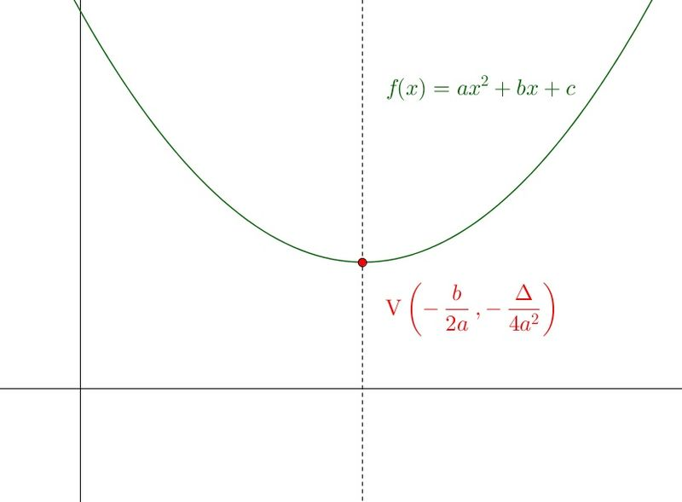
Linear Regression
$${ε_{i}^{2}=\left({\vec{x}}_{i}^{T}\vec{w}−y_{i}\right)}^{2}$$
If we differentiate that, we discover that:
$$∇_{\vec{w}}ε_{i}^{2}=2ε_{i}{\vec{x}}_{i}$$
So the stochastic gradient descent algorithm is:
$$\vec{w}←\vec{w}−ηε_{i}{\vec{x}}_{i}$$
$$ε_{i}^{2}=aw^{2}+bw+c$$
$$w$$

Slide 20
Perceptron versus logistic regression
Remember that for the perceptron, we have
$$f\left({\vec{x}}_{i}\right)=\left[\begin{matrix}f_{1}\left({\vec{x}}_{i}\right) \\ ⋮ \\ f_{V}\left({\vec{x}}_{i}\right)\end{matrix}\right], f_{c}\left({\vec{x}}_{i}\right)=\left\{\begin{matrix}1 & c=\operatorname{argmax}{{\vec{w}}_{c}^{T}\vec{x}} \\ 0 & otherwise\end{matrix}\right.$$
For logistic regression, we have
$$f\left({\vec{x}}_{i}\right)=\left[\begin{matrix}f_{1}\left({\vec{x}}_{i}\right) \\ ⋮ \\ f_{V}\left({\vec{x}}_{i}\right)\end{matrix}\right], f_{c}\left({\vec{x}}_{i}\right)=\frac{e^{{\vec{w}}_{c}^{T}\vec{x}}}{\sum_{k=1}^{V}{e^{{\vec{w}}_{k}^{T}\vec{x}}}}$$

Slide 21
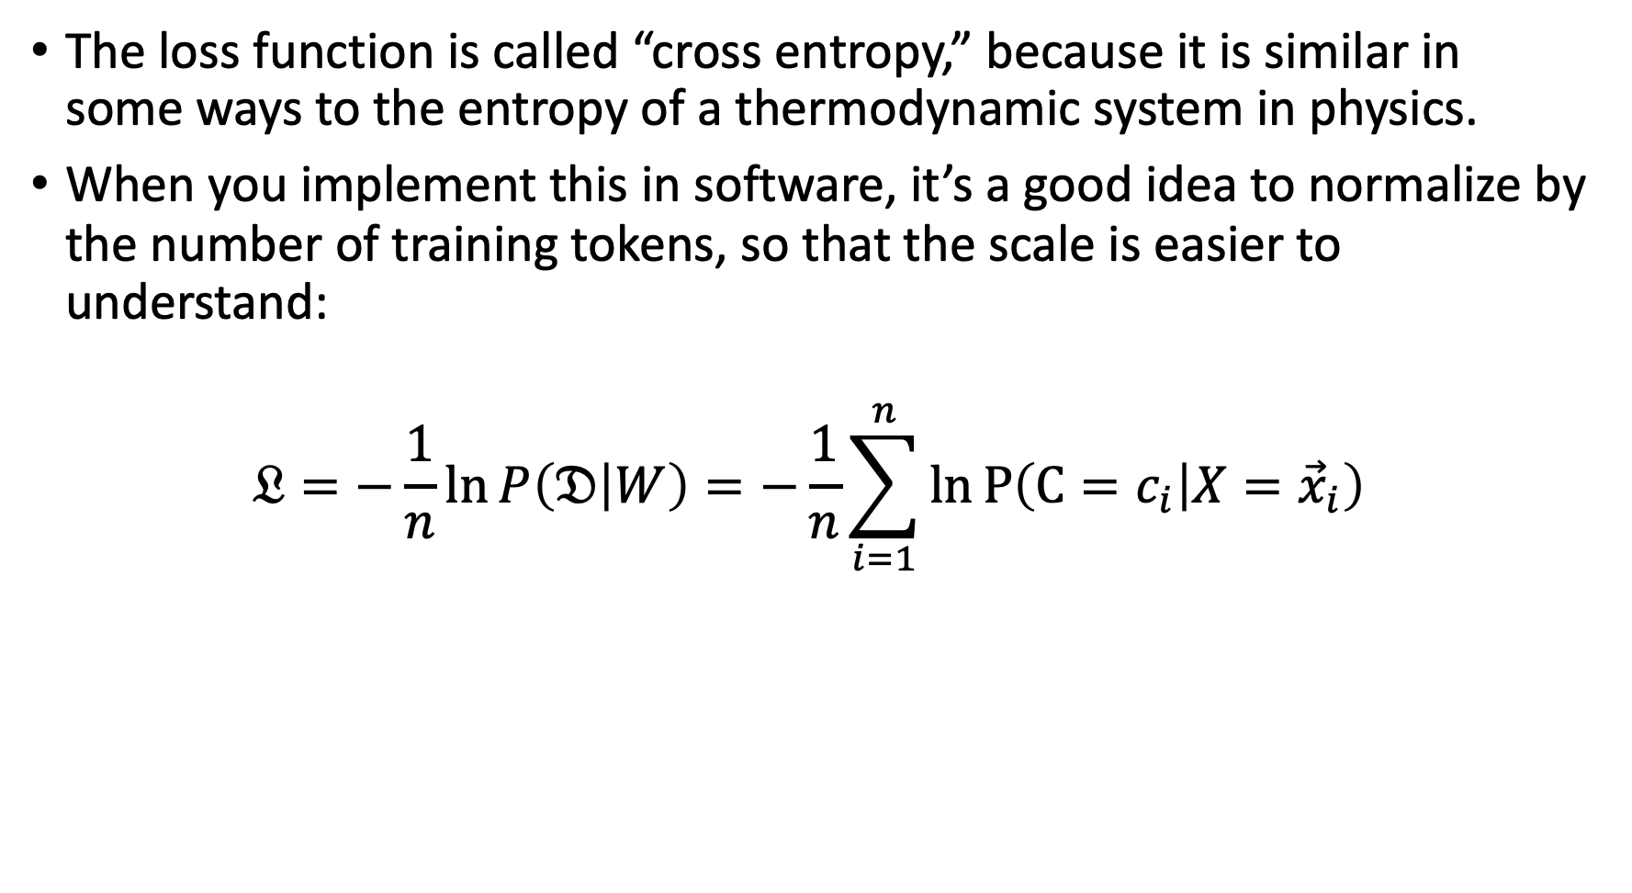
Some details: Cross entropy
The loss function is called “cross entropy,” because it is similar in some ways to the entropy of a thermodynamic system in physics.
When you implement this in software, it’s a good idea to normalize by the number of training tokens, so that the scale is easier to understand:
$$𝔏=−\frac{1}{n}\ln{P\left(𝔇 | W\right)}=−\frac{1}{n}\sum_{i=1}^{n}{\ln{P\left(C=c_{i} | X={\vec{x}}_{i}\right)}}$$

Slide 22
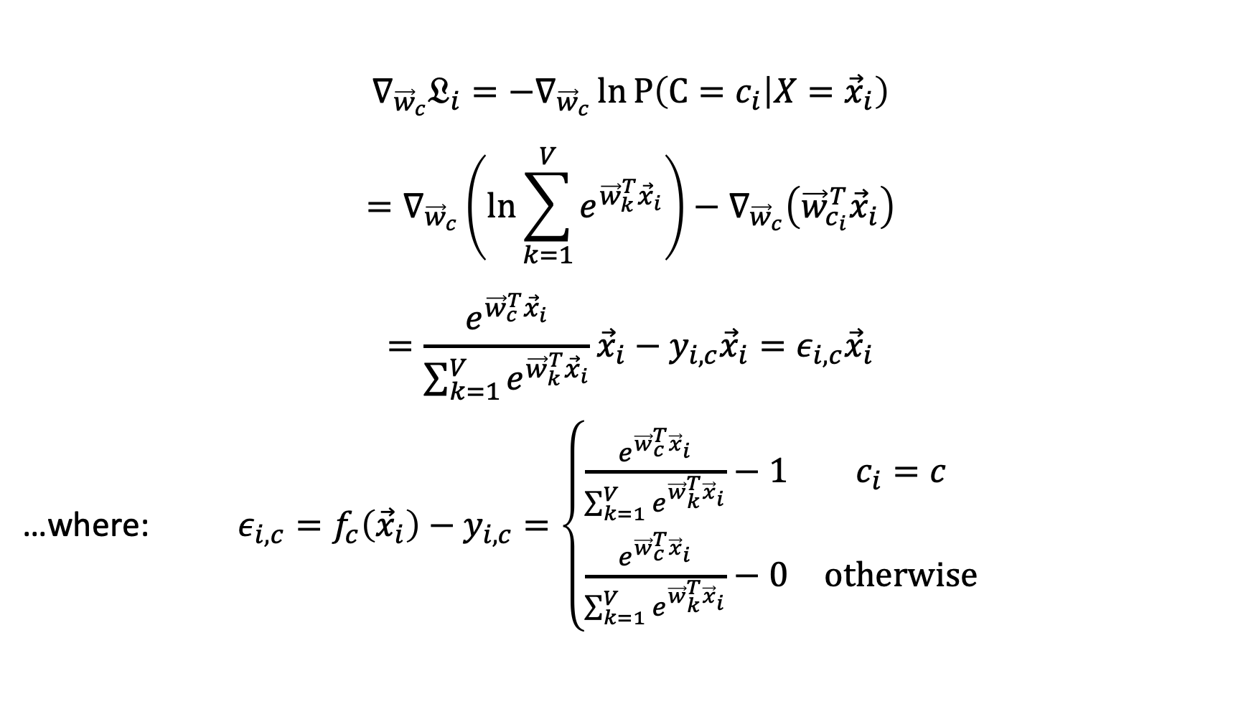
The gradient of the cross-entropy of a softmax
$$∇_{{\vec{w}}_{c}}𝔏_{i}=−∇_{{\vec{w}}_{c}}\ln{P\left(C=c_{i} | X={\vec{x}}_{i}\right)}$$
$$=∇_{{\vec{w}}_{c}}\left(\ln{\sum_{k=1}^{V}{e^{{\vec{w}}_{k}^{T}{\vec{x}}_{i}}}}\right)−∇_{{\vec{w}}_{c}}\left({\vec{w}}_{c_{i}}^{T}{\vec{x}}_{i}\right)$$
$$=\frac{e^{{\vec{w}}_{c}^{T}{\vec{x}}_{i}}}{\sum_{k=1}^{V}{e^{{\vec{w}}_{k}^{T}{\vec{x}}_{i}}}}{\vec{x}}_{i}−y_{i,c}{\vec{x}}_{i}=ε_{i,c}{\vec{x}}_{i}$$
…where: $ε_{i,c}=f_{c}\left({\vec{x}}_{i}\right)−y_{i,c}=\left\{\begin{matrix}\frac{e^{{\vec{w}}_{c}^{T}{\vec{x}}_{i}}}{\sum_{k=1}^{V}{e^{{\vec{w}}_{k}^{T}{\vec{x}}_{i}}}}−1 & c_{i}=c \\ \frac{e^{{\vec{w}}_{c}^{T}{\vec{x}}_{i}}}{\sum_{k=1}^{V}{e^{{\vec{w}}_{k}^{T}{\vec{x}}_{i}}}}−0 & otherwise\end{matrix}\right.$

Slide 23
Back-propagation
$$f$$
The key idea of back-propagation is to calculate $\frac{∂ℒ\left(\vec{w}\right)}{∂w_{j,k}^{(l)} }$, for every layer l, for every pair of nodes j and k, as follows:
Start at the output node.
Apply the chain rule of calculus backward, layer-by-layer, from the output node backward toward the input.
$$h_{1}^{(2)}$$
$$h_{2}^{(2)}$$
$$h_{1}^{(1)}$$
$$h_{2}^{(1)}$$
$$w_{1,2}^{(1)}$$
$$x_{1}$$
$$x_{2}$$

Slide 24
Back-propagation: splitting it up into excitation and activation
Activation to excitation: here, the derivative is pre-computed. For example, if g=ReLU, then g’=unit step:
$$h_{j}^{(l)}=ReLU\left(ξ_{j}^{(l)}\right)⟹\frac{∂h_{j}^{\left(l\right)}}{∂ξ_{j}^{\left(l\right)}}=u\left(ξ_{j}^{(l)}\right)$$
Excitation to activation: here, the derivative is just the network weight!
$$ξ_{j}^{(l)}=b_{j}^{(l)}+\sum_{k}{w_{j,k}^{(l)}h_{k}^{(l−1)}}⟹\frac{∂ξ_{j}^{\left(l\right)}}{∂h_{k}^{(l−1)}}=w_{j,k}^{(l)}$$

Slide 25

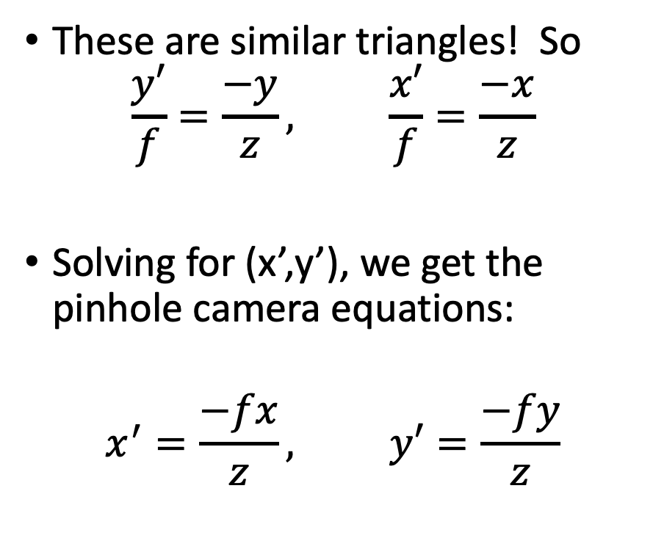
The pinhole camera equations
These are similar triangles! So
$$\frac{y′}{f}=\frac{−y}{z}, \frac{x′}{f}=\frac{−x}{z}$$
Solving for (x’,y’), we get the pinhole camera equations:
$$x^{′}=\frac{−fx}{z}, y′=\frac{−fy}{z}$$
y’
z
Image
plane
Pinhole
y
z
Object
f

Slide 26
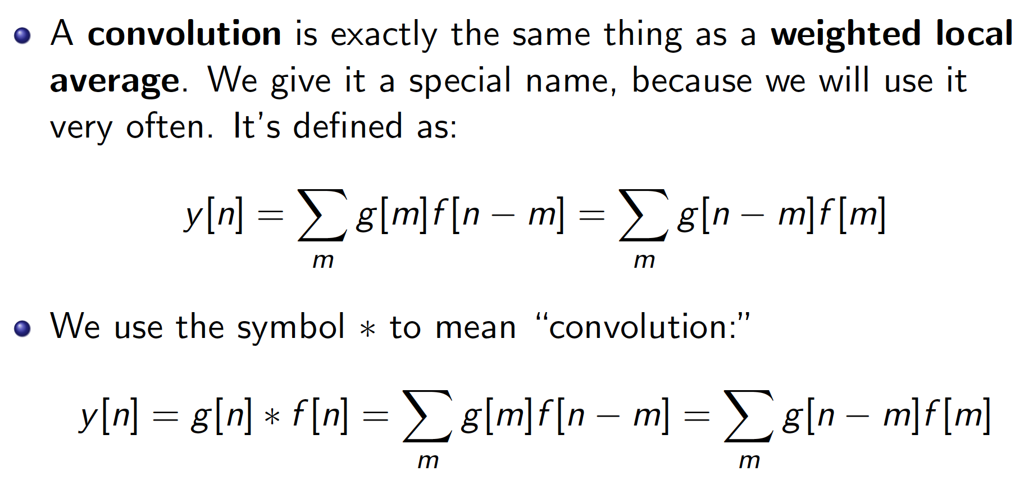

Slide 27
Exam 1 Review
Mechanics: How to take the exam
Review topics
Sample review problem

Slide 28
Sample review problem
Boofs | Tizzles | ?
Yellow pacman
Blue
pentagon
Green
diamond
Red
teardrop
Yellow square
Blue
diamond
Green
heptagon

Slide 29
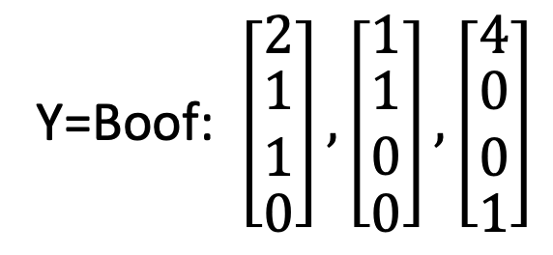
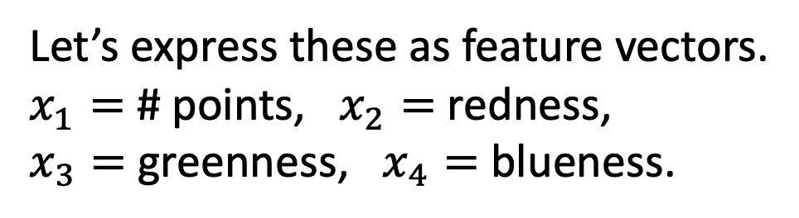
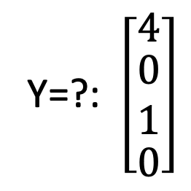
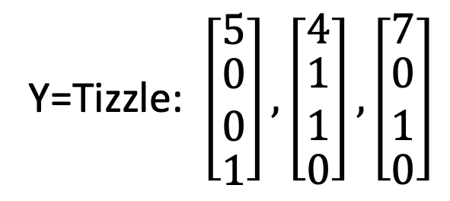
Sample review problem
Boofs | Tizzles | ?
Yellow pacman
Blue
pentagon
Green
diamond
Red
teardrop
Yellow square
Let’s express these as feature vectors.
$x_{1}=$ # points, $x_{2}=$ redness,
$x_{3}=$ greenness, $x_{4}=$ blueness.
Blue
diamond
Green
heptagon
Y=Boof: $\left[\begin{matrix}2 \\ \begin{matrix}1 \\ 1\end{matrix} \\ 0\end{matrix}\right],\left[\begin{matrix}1 \\ \begin{matrix}1 \\ 0\end{matrix} \\ 0\end{matrix}\right],\left[\begin{matrix}4 \\ \begin{matrix}0 \\ 0\end{matrix} \\ 1\end{matrix}\right]$
Y=Tizzle: $\left[\begin{matrix}5 \\ \begin{matrix}0 \\ 0\end{matrix} \\ 1\end{matrix}\right],\left[\begin{matrix}4 \\ \begin{matrix}1 \\ 1\end{matrix} \\ 0\end{matrix}\right],\left[\begin{matrix}7 \\ \begin{matrix}0 \\ 1\end{matrix} \\ 0\end{matrix}\right]$
Y=?: $\left[\begin{matrix}4 \\ \begin{matrix}0 \\ 1\end{matrix} \\ 0\end{matrix}\right]$

Slide 30
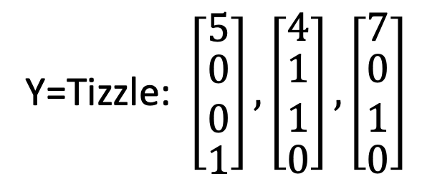
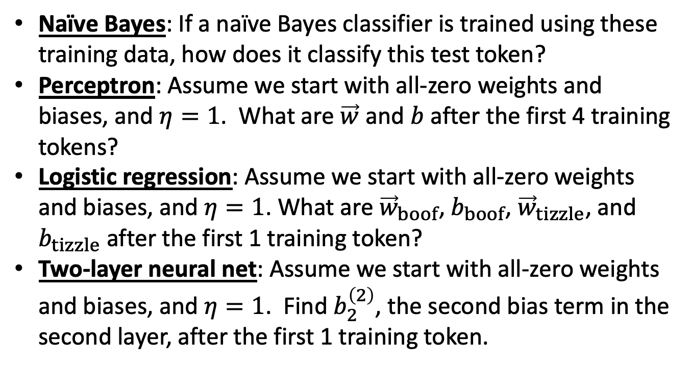
Sample review problem
Boofs | Tizzles | ?
Yellow pacman
Blue
pentagon
Green
diamond
Red
teardrop
Yellow square
Y=Boof: $\left[\begin{matrix}2 \\ \begin{matrix}1 \\ 1\end{matrix} \\ 0\end{matrix}\right],\left[\begin{matrix}1 \\ \begin{matrix}1 \\ 0\end{matrix} \\ 0\end{matrix}\right],\left[\begin{matrix}4 \\ \begin{matrix}0 \\ 0\end{matrix} \\ 1\end{matrix}\right]$
Blue
diamond
Green
heptagon
Naïve Bayes: If a naïve Bayes classifier is trained using these training data, how does it classify this test token?
Perceptron: Assume we start with all-zero weights and biases, and $η=1$. What are $\vec{w}$ and $b$ after the first 4 training tokens?
Logistic regression: Assume we start with all-zero weights and biases, and $η=1$. What are ${\vec{w}}_{boof}$, $b_{boof}$, ${\vec{w}}_{tizzle}$, and $b_{tizzle}$ after the first 1 training token?
Two-layer neural net: Assume we start with all-zero weights and biases, and $η=1$. Find $b_{2}^{\left(2\right)}$, the second bias term in the second layer, after the first 1 training token.
Y=Tizzle: $\left[\begin{matrix}5 \\ \begin{matrix}0 \\ 0\end{matrix} \\ 1\end{matrix}\right],\left[\begin{matrix}4 \\ \begin{matrix}1 \\ 1\end{matrix} \\ 0\end{matrix}\right],\left[\begin{matrix}7 \\ \begin{matrix}0 \\ 1\end{matrix} \\ 0\end{matrix}\right]$
Y=?: $\left[\begin{matrix}4 \\ \begin{matrix}0 \\ 1\end{matrix} \\ 0\end{matrix}\right]$

Slide 31
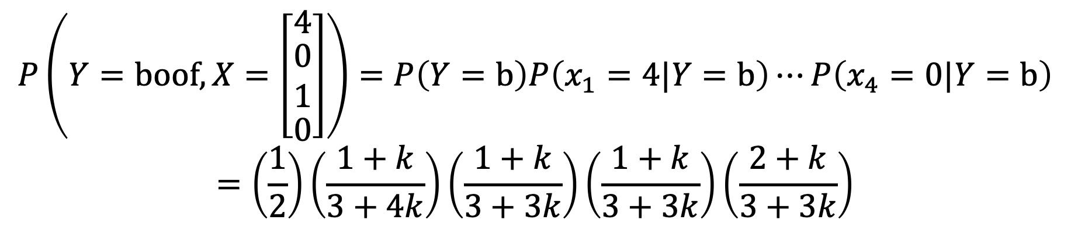
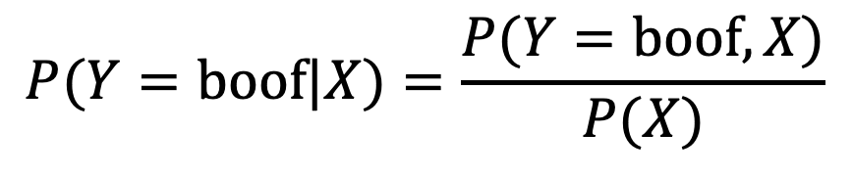
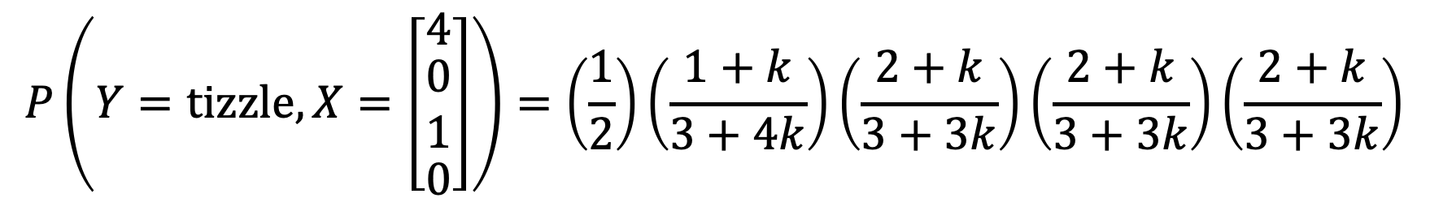
Naïve Bayes
Boofs | Tizzles | ?
Yellow pacman
Blue
pentagon
Green
diamond
Red
teardrop
Yellow square
$$P(Y=boof|X)=\frac{P(Y=boof,X)}{P(X)}$$
Blue
diamond
Green
heptagon
$$P\left(Y=boof,X=\left[\begin{matrix}4 \\ \begin{matrix}0 \\ 1\end{matrix} \\ 0\end{matrix}\right]\right)=P\left(Y=b\right)P\left(x_{1}=4|Y=b\right)⋯P\left(x_{4}=0|Y=b\right)$$
$$=\left(\frac{1}{2}\right)\left(\frac{1+k}{3+4k}\right)\left(\frac{1+k}{3+3k}\right)\left(\frac{1+k}{3+3k}\right)\left(\frac{2+k}{3+3k}\right)$$
$$P\left(Y=tizzle,X=\left[\begin{matrix}4 \\ \begin{matrix}0 \\ 1\end{matrix} \\ 0\end{matrix}\right]\right)=\left(\frac{1}{2}\right)\left(\frac{1+k}{3+4k}\right)\left(\frac{2+k}{3+3k}\right)\left(\frac{2+k}{3+3k}\right)\left(\frac{2+k}{3+3k}\right)$$

Slide 32
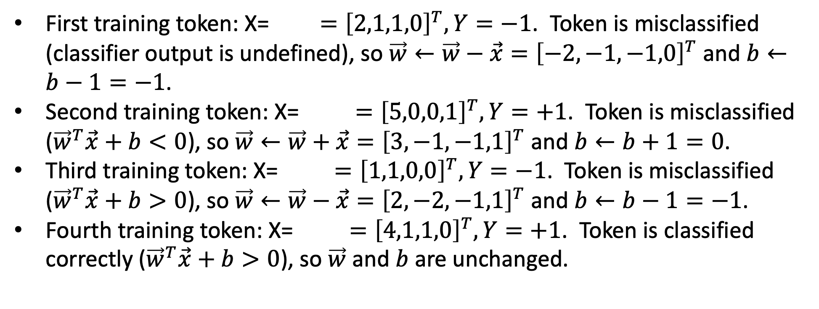
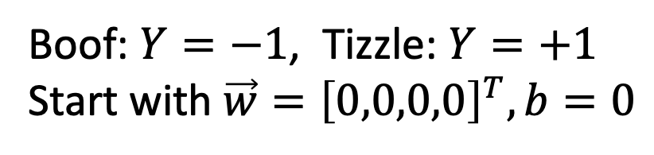
Perceptron
Boofs | Tizzles | ?
Yellow pacman
Blue
pentagon
Green
diamond
Boof: $Y=−1$, Tizzle: $Y=+1$
Start with $\vec{w}={\left[0,0,0,0\right]}^{T},b=0$
Red
teardrop
Yellow square
Blue
diamond
Green
heptagon
First training token: X= $={\left[2,1,1,0\right]}^{T}, Y=−1$. Token is misclassified (classifier output is undefined), so $\vec{w}←\vec{w}−\vec{x}={\left[−2,−1,−1,0\right]}^{T}$ and $b←b−1=−1$.
Second training token: X= $={\left[5,0,0,1\right]}^{T}, Y=+1$. Token is misclassified (${\vec{w}}^{T}\vec{x}+b<0$), so $\vec{w}←\vec{w}+\vec{x}={\left[3,−1,−1,1\right]}^{T}$ and $b←b+1=0$.
Third training token: X= $={\left[1,1,0,0\right]}^{T}, Y=−1$. Token is misclassified (${\vec{w}}^{T}\vec{x}+b>0$), so $\vec{w}←\vec{w}−\vec{x}={\left[2,−2,−1,1\right]}^{T}$ and $b←b−1=−1$.
Fourth training token: X= $={\left[4,1,1,0\right]}^{T}, Y=+1$. Token is classified correctly (${\vec{w}}^{T}\vec{x}+b>0$), so $\vec{w}$ and $b$ are unchanged.

Slide 33
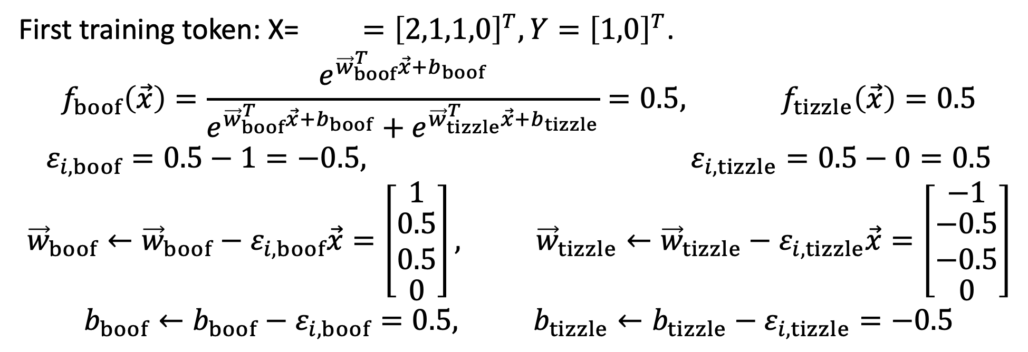
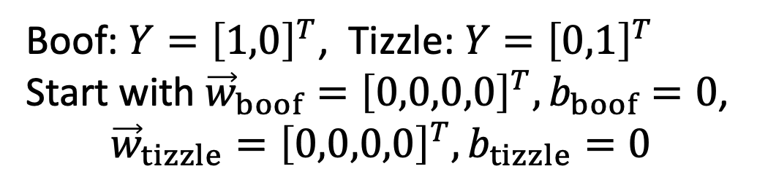
Logistic Regression
Boofs | Tizzles | ?
Yellow pacman
Blue
pentagon
Green
diamond
Boof: $Y={\left[1,0\right]}^{T}$, Tizzle: $Y={\left[0,1\right]}^{T}$
Start with ${\vec{w}}_{boof}={\left[0,0,0,0\right]}^{T},b_{boof}=0$,
$${\vec{w}}_{tizzle}={\left[0,0,0,0\right]}^{T},b_{tizzle}=0$$
Red
teardrop
Yellow square
Blue
diamond
Green
heptagon
First training token: X= $={\left[2,1,1,0\right]}^{T}, Y={\left[1,0\right]}^{T}$.
$$f_{boof}\left(\vec{x}\right)=\frac{e^{{\vec{w}}_{boof}^{T}\vec{x}+b_{boof}}}{e^{{\vec{w}}_{boof}^{T}\vec{x}+b_{boof}}+e^{{\vec{w}}_{tizzle}^{T}\vec{x}+b_{tizzle}}}=0.5, f_{tizzle}\left(\vec{x}\right)=0.5$$
$$ε_{i,boof}=0.5−1=−0.5, ε_{i,tizzle}=0.5−0=0.5$$
$${\vec{w}}_{boof}←{\vec{w}}_{boof}−ε_{i,boof}\vec{x}=\left[\begin{matrix}1 \\ \begin{matrix}0.5 \\ 0.5\end{matrix} \\ 0\end{matrix}\right], {\vec{w}}_{tizzle}←{\vec{w}}_{tizzle}−ε_{i,tizzle}\vec{x}=\left[\begin{matrix}−1 \\ \begin{matrix}−0.5 \\ −0.5\end{matrix} \\ 0\end{matrix}\right]$$
$$b_{boof}←b_{boof}−ε_{i,boof}=0.5, b_{tizzle}←b_{tizzle}−ε_{i,tizzle}=−0.5$$

Slide 34
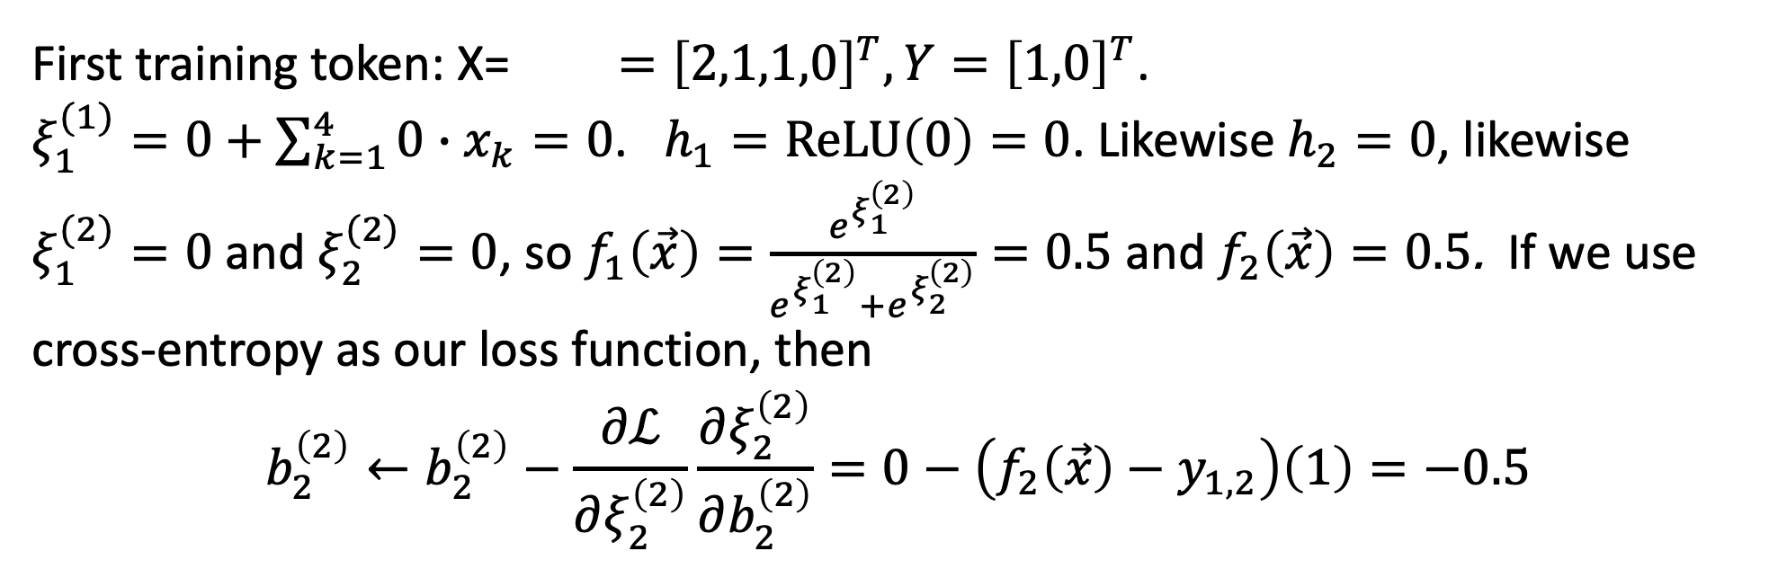
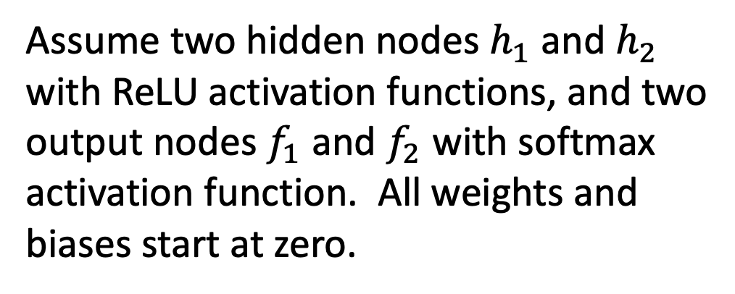
Two-Layer Network
Boofs | Tizzles | ?
Assume two hidden nodes $h_{1}$ and $h_{2}$
with ReLU activation functions, and two
output nodes $f_{1}$ and $f_{2}$ with softmax
activation function. All weights and biases start at zero.
Yellow pacman
Blue
pentagon
Green
diamond
Red
teardrop
Yellow square
Blue
diamond
Green
heptagon
First training token: X= $={\left[2,1,1,0\right]}^{T}, Y={\left[1,0\right]}^{T}$.
$ξ_{1}^{(1)}=0+\sum_{k=1}^{4}{0∙x_{k}=0}$. $h_{1}=ReLU\left(0\right)=0$. Likewise $h_{2}=0$, likewise $ξ_{1}^{(2)}=0$ and $ξ_{2}^{(2)}=0$, so $f_{1}\left(\vec{x}\right)=\frac{e^{ξ_{1}^{\left(2\right)}}}{e^{ξ_{1}^{\left(2\right)}}+e^{ξ_{2}^{\left(2\right)}}}=0.5$ and $f_{2}\left(\vec{x}\right)=0.5$. If we use cross-entropy as our loss function, then
$$b_{2}^{\left(2\right)}←b_{2}^{\left(2\right)}−\frac{∂ℒ}{∂ξ_{2}^{\left(2\right)}}\frac{∂ξ_{2}^{\left(2\right)}}{∂b_{2}^{\left(2\right)}}=0−\left(f_{2}\left(\vec{x}\right)−y_{1,2}\right)\left(1\right)=−0.5$$

Slide 35
Exam 1 Review
Mechanics: How to take the exam
Review topics
  Probability and Machine Learning
Sample review problem
  Any of these four classifiers can solve this problem!
  The equations are a bit more complex for the two-layer network…

