Slide 1

Lecture 16: Uniform Cost Search and A*
Mark Hasegawa-Johnson, February 2022
With some slides by Svetlana Lazebnik, 9/2016
Distributed under CC-BY 3.0
Title image: By Harrison Weir - From reuseableart.com, Public Domain, https://commons.wikimedia.org/w/index.php?curid=47879234

Slide 2
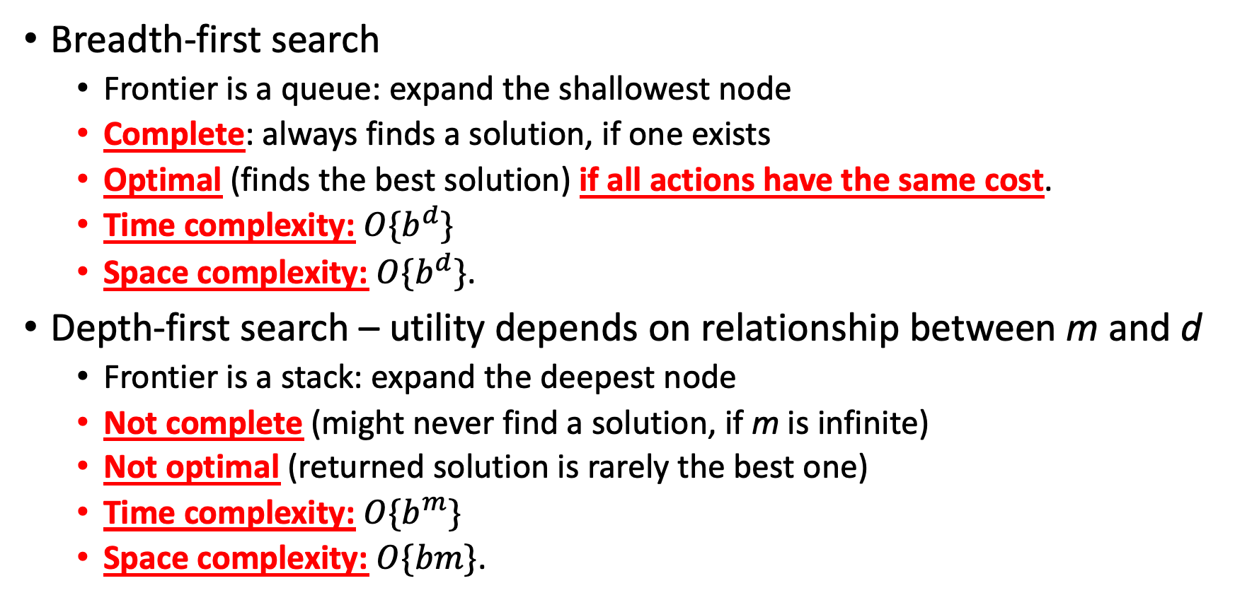
Review: DFS and BFS
Breadth-first search
  Frontier is a queue: expand the shallowest node
  Complete: always finds a solution, if one exists
  Optimal (finds the best solution) if all actions have the same cost.
  Time complexity: $O\{b^{d}\}$
  Space complexity: $O\{b^{d}\}$.
Depth-first search – utility depends on relationship between m and d
  Frontier is a stack: expand the deepest node
  Not complete (might never find a solution, if m is infinite)
  Not optimal (returned solution is rarely the best one)
  Time complexity: $O\{b^{m}\}$
  Space complexity: $O\{bm\}$.

Slide 3
Outline of today’s lecture
Uniform Cost Search (UCS): like BFS, but for actions that have different costs
  Complete: always finds a solution, if one exists
  Optimal: finds the best solution
  Time complexity = # nodes that have cost < goal
  Space complexity = # nodes that have cost < goal
Heuristics, e.g., Manhattan distance
Greedy Best-first search
A*: Like UCS but adds an estimate of the remaining path length
  Complete: always finds a solution, if one exists
  Optimal: finds the best solution
  Time complexity = # nodes that have cost+heuristic < goal
  Space complexity = # nodes that have cost+heuristic < goal

Slide 4
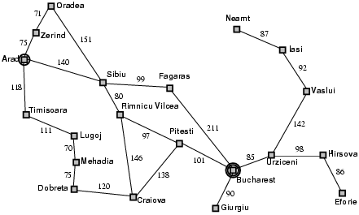
An example for which BFS is not optimal: Romania
Arad
Timisoara
Sibiu
Zerind
Lugoj
RV
Fagaras
Oradea
Mehadia
C
P
Bucharest
BFS returns this path, because it requires only 3 actions.
Cost = 450 km

Slide 5
An example for which BFS is not optimal: Romania
Arad
Timisoara
Sibiu
Zerind
Lugoj
RV
Fagaras
Oradea
Mehadia
C
P
Bucharest
Bucharest
It would have been better to find this path!
Cost = 418 km

Slide 6
The solution: Uniform Cost Search
Breadth-first search (BFS): Next node expanded is the one with the fewest required actions
  Frontier is a queue
  First node into the queue is the first one expanded (FIFO)
Uniform cost search (UCS): Next node expanded is the one with the lowest accumulated path cost
  Frontier is a priority queue
  Lowest-cost node is the first one expanded

Slide 7
Example of UCS: Romania
Arad
Arad:0

Slide 8
Example of UCS: Romania
Arad
Timisoara
Sibiu
Zerind
Zerind:75, Timisoara:118, Sibiu:140

Slide 9
Example of UCS: Romania
Arad
Timisoara
Sibiu
Zerind
Oradea
Timisoara:118, Sibiu:140, Oradea:146

Slide 10
Example of UCS: Romania
Arad
Timisoara
Sibiu
Zerind
Lugoj
Oradea
Sibiu:140, Oradea:146, Lugoj:239

Slide 11
Example of UCS: Romania
Arad
Timisoara
Sibiu
Zerind
Lugoj
RV
Fagaras
Oradea
Oradea:146, Ramnicu Valcea:220, Lugoj:239, Fagaras:239

Slide 12
Example of UCS: Romania
Arad
Timisoara
Sibiu
Zerind
Lugoj
RV
Fagaras
Oradea
Ramnicu Valcea:220, Lugoj:239, Fagaras:239

Slide 13
Example of UCS: Romania
Arad
Timisoara
Sibiu
Zerind
Lugoj
RV
Fagaras
Oradea
C
P
Lugoj:239, Fagaras:239, Pitesti:317, Craiova:366

Slide 14
Example of UCS: Romania
Arad
Timisoara
Sibiu
Zerind
Lugoj
RV
Fagaras
Oradea
Mehadia
C
P
Fagaras:239, Mehadia:309, Pitesti:317, Craiova:366

Slide 15
Example of UCS: Romania
Arad
Timisoara
Sibiu
Zerind
Lugoj
RV
Fagaras
Oradea
Mehadia
C
P
Bucharest
Mehadia:309, Pitesti:317, Craiova:366, Bucharest:450

Slide 16
Example of UCS: Romania
Arad
Timisoara
Sibiu
Zerind
Lugoj
RV
Fagaras
Oradea
Mehadia
C
P
Bucharest
Dobreta
Pitesti:317, Craiova:366, Dobreta:384, Bucharest:450

Slide 17
Example of UCS: Romania
Arad
Timisoara
Sibiu
Zerind
Lugoj
RV
Fagaras
Oradea
Mehadia
C
P
Dobreta
Bucharest
Craiova:366, Dobreta:384, Bucharest:418

Slide 18
Example of UCS: Romania
Arad
Timisoara
Sibiu
Zerind
Lugoj
RV
Fagaras
Oradea
Mehadia
C
P
Dobreta
Bucharest
Dobreta:384, Bucharest:418

Slide 19
Example of UCS: Romania
Arad
Timisoara
Sibiu
Zerind
Lugoj
RV
Fagaras
Oradea
Mehadia
C
P
Dobreta
Bucharest
Bucharest:418

Slide 20

GOAL!!!! GOL!!!!!
Image by Rick Dikeman, GFDL 1996, https://commons.wikimedia.org/wiki/File:Football_iu_1996.jpg

Slide 21
Outline of today’s lecture
Uniform Cost Search (UCS): like BFS, but for actions that have different costs
  Complete: always finds a solution, if one exists
  Optimal: finds the best solution
  Time complexity = # nodes that have cost < goal
  Space complexity = # nodes that have cost < goal
Heuristics, e.g., Manhattan distance
Greedy Best-first search
A*: Like UCS but adds an estimate of the remaining path length
  Complete: always finds a solution, if one exists
  Optimal: finds the best solution
  Time complexity = # nodes that have cost+heuristic < goal
  Space complexity = # nodes that have cost+heuristic < goal

Slide 22
Heuristics main idea
Instead of choosing the node with the smallest total cost so far (UCS),
why not choose the node that’s CLOSEST TO GOAL,
and expand that one first?

Slide 23

Why not choose the node CLOSEST TO GOAL?
Answer: because we don’t know which node that is!!
Example: which of these two is closest to goal?
Start state
Goal state

Slide 24
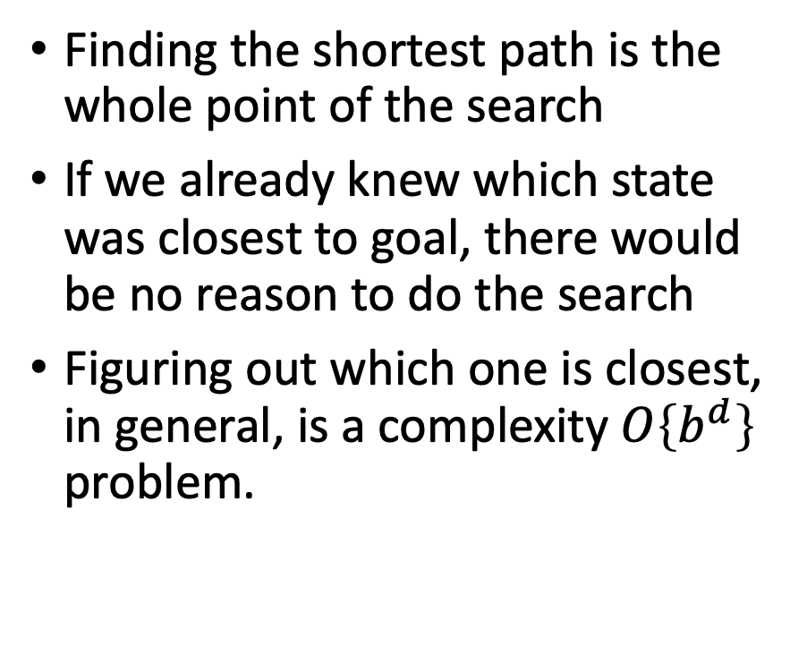
We don’t know which state is closest to goal
Finding the shortest path is the whole point of the search
If we already knew which state was closest to goal, there would be no reason to do the search
Figuring out which one is closest, in general, is a complexity $O\left\{b^{d}\right\}$ problem.
Start state
Goal state

Slide 25
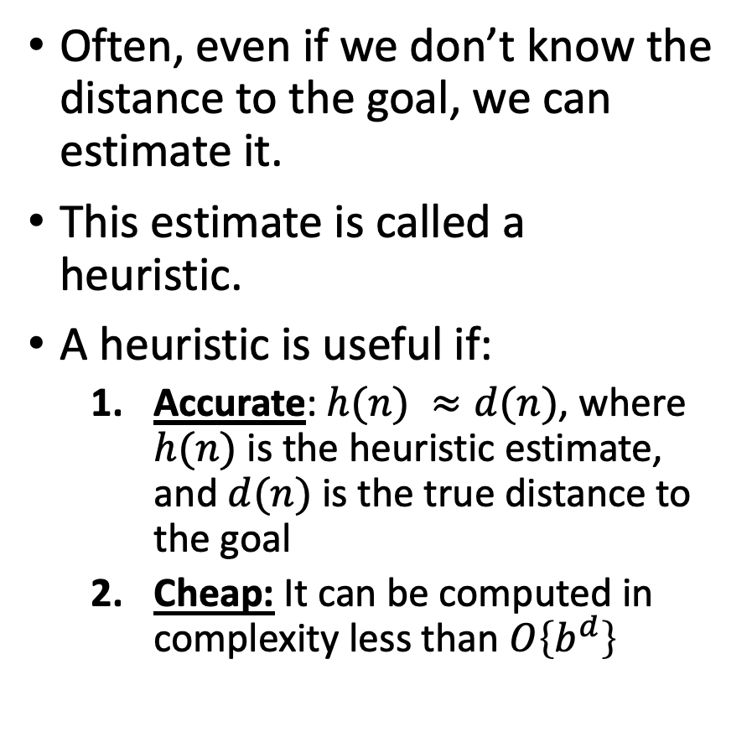
Search heuristics: estimates of distance-to-goal
Often, even if we don’t know the distance to the goal, we can estimate it.
This estimate is called a heuristic.
A heuristic is useful if:
  Accurate: $h(n) ≈d(n)$, where $h(n)$ is the heuristic estimate, and $d(n)$ is the true distance to the goal
  Cheap: It can be computed in complexity less than $O\left\{b^{d}\right\}$
Start state
Goal state

Slide 26


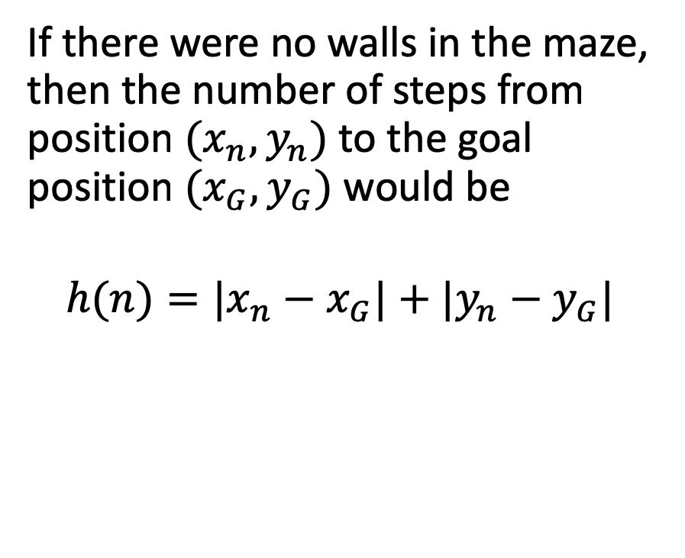



Example heuristic: Manhattan distance
If there were no walls, this would be the path to goal: straight down, then straight right.
If there were no walls in the maze, then the number of steps from position $(x_{n},y_{n})$ to the goal position $(x_{G},y_{G})$ would be
$$h(n)=|x_{n}−x_{G}|+|y_{n}−y_{G}|$$
Start state
$$y_{n}$$
$$y_{G}$$
Goal state
$$x$$
$$x_{n}$$
$$x_{G}$$

Slide 27
Outline of today’s lecture
Uniform Cost Search (UCS): like BFS, but for actions that have different costs
  Complete: always finds a solution, if one exists
  Optimal: finds the best solution
  Time complexity = # nodes that have cost < goal
  Space complexity = # nodes that have cost < goal
Heuristics, e.g., Manhattan distance
Greedy Best-first search
A*: Like UCS but adds an estimate of the remaining path length
  Complete: always finds a solution, if one exists
  Optimal: finds the best solution
  Time complexity = # nodes that have cost+heuristic < goal
  Space complexity = # nodes that have cost+heuristic < goal

Slide 28
Greedy Best-First Search
Instead of choosing the node with the smallest total cost so far (UCS),
why not choose the node whose
HEURISTIC ESTIMATE
indicates that it might be
CLOSEST TO GOAL?

Slide 29
Greedy Search Example
According to the Manhattan distance heuristic, these two nodes are equally far from the goal, so we have to choose one at random.
Start state
Goal state

Slide 30
Greedy Search Example
If our random choice goes badly, we might end up very far from the goal.
= states in the explored set
= states on the frontier
Start state
Goal state

Slide 31
The problem with Greedy Search
Having gone down a bad path, it’s very hard to recover, because now, the frontier node closest to goal (according to the Manhattan distance heuristic) is this one:
Start state
Goal state

Slide 32
The problem with Greedy Search
That’s not a useful path…
Start state
Goal state

Slide 33
The problem with Greedy Search
Neither is that one…
Start state
Goal state

Slide 34
What went wrong?

Slide 35
Outline of today’s lecture
Uniform Cost Search (UCS): like BFS, but for actions that have different costs
  Complete: always finds a solution, if one exists
  Optimal: finds the best solution
  Time complexity = # nodes that have cost < goal
  Space complexity = # nodes that have cost < goal
Heuristics, e.g., Manhattan distance
Greedy Best-first search
A*: Like UCS but adds an estimate of the remaining path length
  Complete: always finds a solution, if one exists
  Optimal: finds the best solution
  Time complexity = # nodes that have cost+heuristic < goal
  Space complexity = # nodes that have cost+heuristic < goal

Slide 36
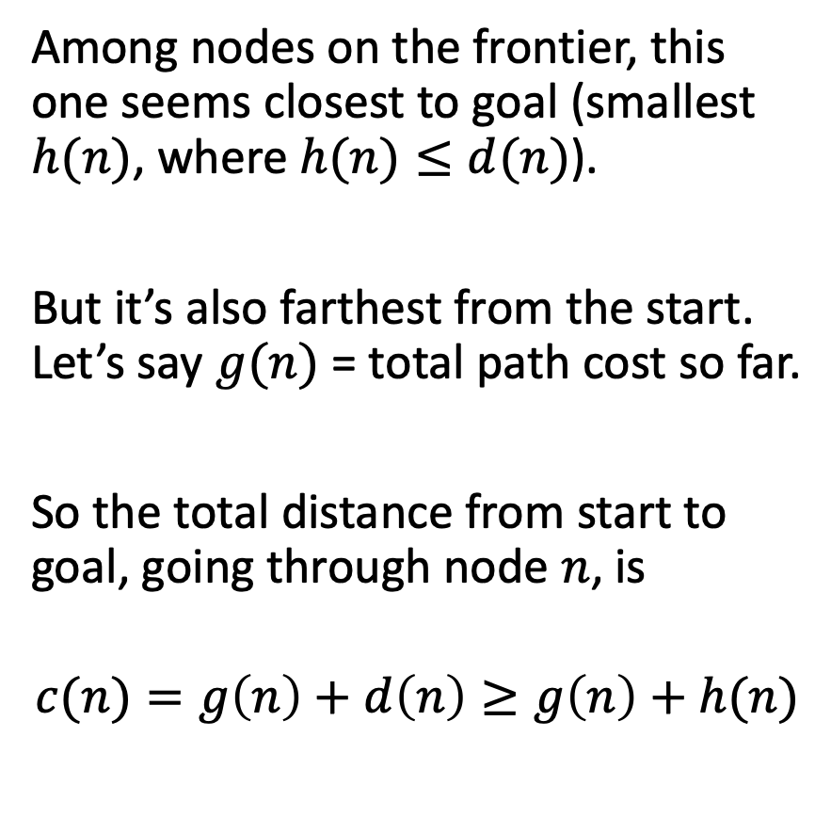
The problem with Greedy Search
Among nodes on the frontier, this one seems closest to goal (smallest $h(n)$, where $h(n)≤d(n)$).
But it’s also farthest from the start. Let’s say $g(n)$ = total path cost so far.
So the total distance from start to goal, going through node $n$, is
$$c(n)=g\left(n\right)+d\left(n\right)≥g\left(n\right)+h(n)$$
Start state
Goal state

Slide 37
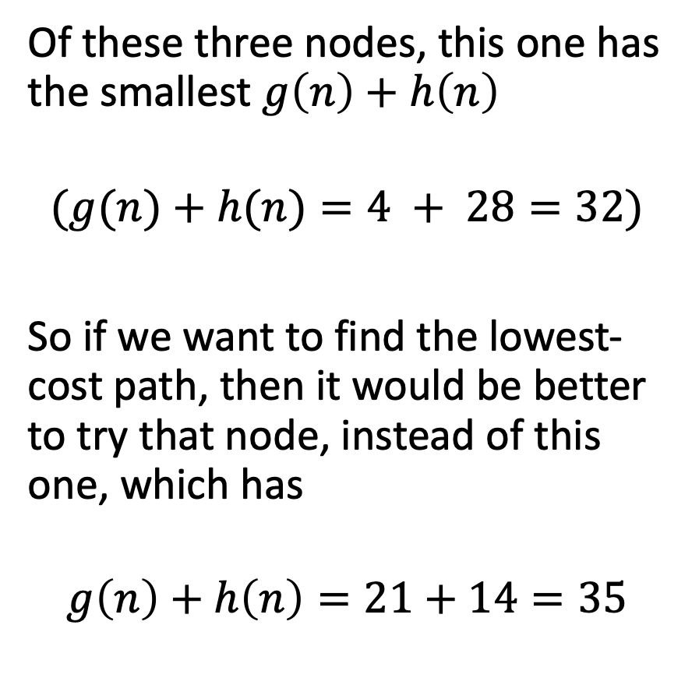
The problem with Greedy Search
Of these three nodes, this one has the smallest $g\left(n\right)+h\left(n\right)$
$$(g(n)+h(n)=4 + 28=32)$$
So if we want to find the lowest-cost path, then it would be better to try that node, instead of this one, which has
$$g\left(n\right)+h\left(n\right)=21+14=35$$
15
13
2
12

Slide 38
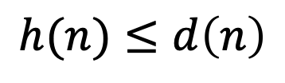
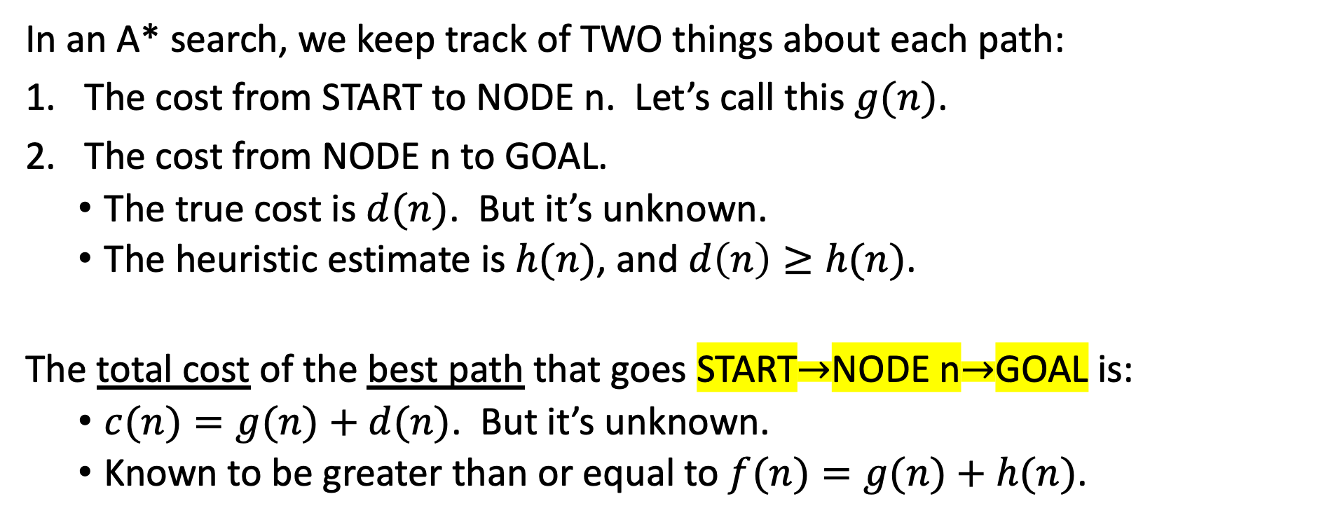

A* search
p
S
G
n
$$g\left(n\right)$$
$$h(n)≤d\left(n\right)$$
In an A* search, we keep track of TWO things about each path:
The cost from START to NODE n. Let’s call this $g(n)$.
The cost from NODE n to GOAL.
  The true cost is $d(n)$. But it’s unknown.
  The heuristic estimate is $h(n)$, and $d\left(n\right)≥h(n)$.
The total cost of the best path that goes START$→$NODE n$→$GOAL is:
  $c(n)=g(n)+d(n)$. But it’s unknown.
  Known to be greater than or equal to $f(n)=g(n)+h(n)$.

Slide 39
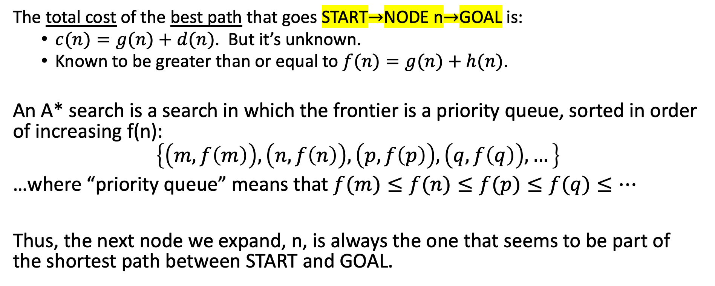
A* search
p
S
G
n
$$g\left(n\right)$$
$$h(n)≤d\left(n\right)$$
The total cost of the best path that goes START$→$NODE n$→$GOAL is:
  $c(n)=g(n)+d(n)$. But it’s unknown.
  Known to be greater than or equal to $f(n)=g(n)+h(n)$.
An A* search is a search in which the frontier is a priority queue, sorted in order of increasing f(n):
$$\left\{\left(m,f\left(m\right)\right), \left(n,f\left(n\right)\right), \left(p,f\left(p\right)\right), \left(q,f\left(q\right)\right),…\right\}$$
…where “priority queue” means that $f(m)≤f(n)≤f(p)≤f(q)≤…$
Thus, the next node we expand, n, is always the one that seems to be part of the shortest path between START and GOAL.

Slide 40

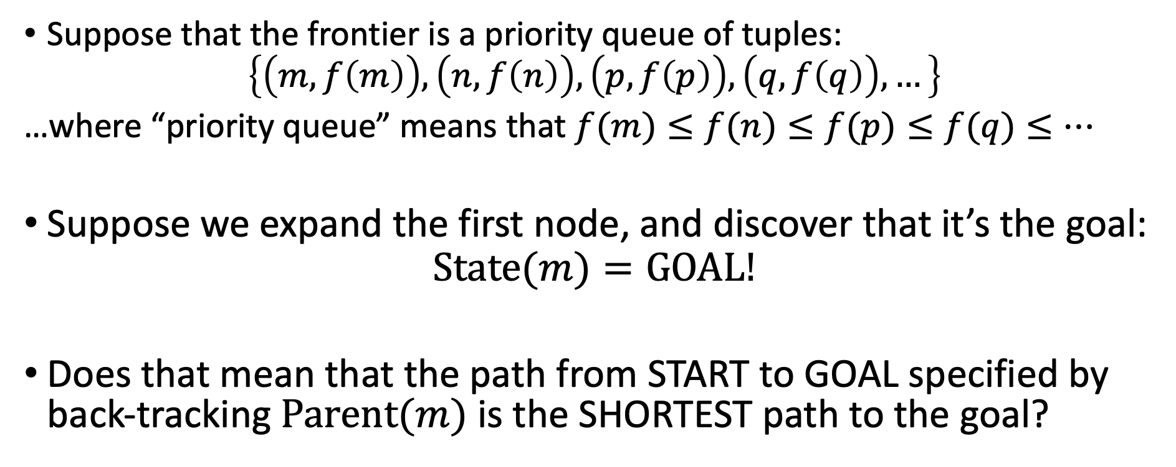
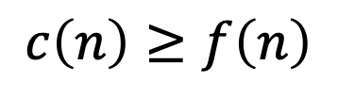
Optimality of A*
$$c\left(m\right)$$
Parent(m)
S
m
n
$$c\left(n\right)≥f\left(n\right)$$
Suppose that the frontier is a priority queue of tuples:
$$\left\{\left(m,f\left(m\right)\right), \left(n,f\left(n\right)\right), \left(p,f\left(p\right)\right), \left(q,f\left(q\right)\right),…\right\}$$
…where “priority queue” means that $f(m)≤f(n)≤f(p)≤f(q)≤…$
Suppose we expand the first node, and discover that it’s the goal:
$$State(m)=GOAL!$$
Does that mean that the path from START to GOAL specified by back-tracking $Parent(m)$ is the SHORTEST path to the goal?

Slide 41
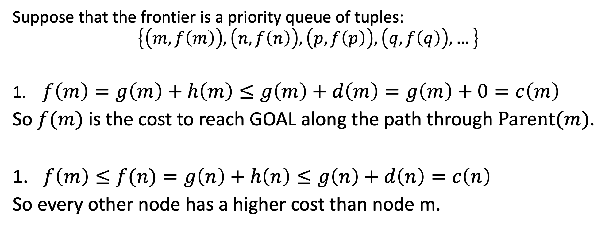
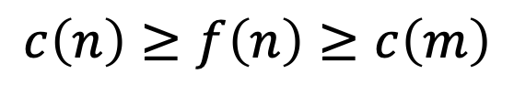
Optimality of A*
$$c\left(m\right)$$
Parent(m)
S
m
n
$$c\left(n\right)≥f\left(n\right)≥c\left(m\right)$$
Suppose that the frontier is a priority queue of tuples:
$$\left\{\left(m,f\left(m\right)\right), \left(n,f\left(n\right)\right), \left(p,f\left(p\right)\right), \left(q,f\left(q\right)\right),…\right\}$$
$f\left(m\right)=g\left(m\right)+h\left(m\right)≤g\left(m\right)+d\left(m\right)=g\left(m\right)+0=c\left(m\right)$
So $f(m)$ is the cost to reach GOAL along the path through $Parent(m)$.
$f\left(m\right)≤f(n)=g\left(n\right)+h\left(n\right)≤g\left(n\right)+d\left(n\right)=c\left(n\right)$
So every other node has a higher cost than node m.

Slide 42
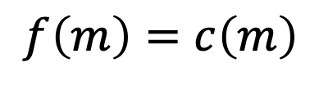
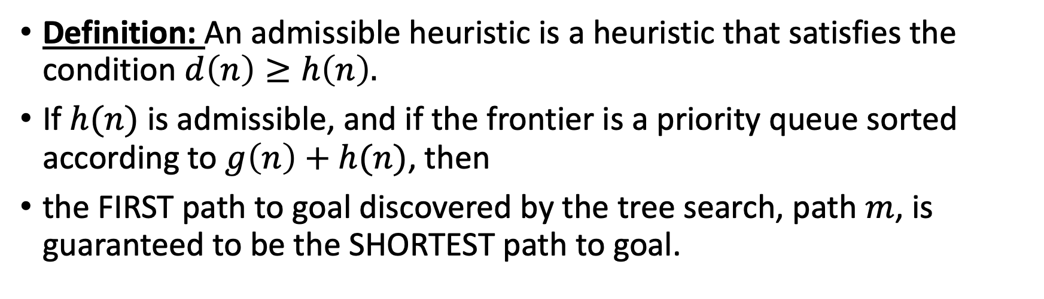

Optimality of A* Search
$$f\left(m\right)=c\left(m\right)$$
Parent(m)
S
m
n
$$g\left(n\right)$$
$$h(n)≤d\left(n\right)$$
$$c\left(n\right)=g\left(n\right)+d\left(n\right)≥g\left(n\right)+h\left(n\right)=f\left(n\right)≥f\left(m\right)$$
Definition: An admissible heuristic is a heuristic that satisfies the condition $d\left(n\right)≥h\left(n\right).$
If $h(n)$ is admissible, and if the frontier is a priority queue sorted according to $g\left(n\right)+h(n)$, then
the FIRST path to goal discovered by the tree search, path $m$, is guaranteed to be the SHORTEST path to goal.

Slide 43

Example of A*: Romania
Suppose we don’t know the distance from Sibiu to Bucharest on highways, but we DO know the distance “as the crow flies.”
$h(n) =$ Euclidean distance (as the crow flies)
Sibiu: h(n) = 260km
Timisoara: h(n) = 410km
Zerind: h(n) = 422km

Slide 44
Romania using UCS
Arad
Timisoara
Sibiu
Zerind
Pick this one first?
Zerind:75, Timisoara:118, Sibiu:140

Slide 45
Romania using A*
Arad
Timisoara
Sibiu
Zerind
No, pick this one first!!!
Sibiu:140+260=400, Zerind:75+422=495, Timisoara:118+410=528

Slide 46
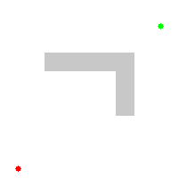
BFS vs. A* Search Example
The heuristic h(n)=Euclidean distance favors nodes on the main diagonal. Those nodes all have the same g(n)+h(n), so A* evaluates them first.
CC-BY 3.0 by Subh83, 2011, https://en.wikipedia.org/wiki/File:Astar_progress_animation.gif

Slide 47
Outline of today’s lecture
Uniform Cost Search (UCS): like BFS, but for actions that have different costs
  Complete: always finds a solution, if one exists
  Optimal: finds the best solution
  Time complexity = # nodes that have cost < goal
  Space complexity = # nodes that have cost < goal
Heuristics, e.g., Manhattan distance
Greedy Best-first search
A*: Like UCS but adds a lower bound of the remaining path length
  Complete: always finds a solution, if one exists
  Optimal: finds the best solution
  Time complexity = # nodes that have cost+heuristic < goal
  Space complexity = # nodes that have cost+heuristic < goal

