Slide 1

Lecture 17: The “animal kingdom” of heuristics: Admissible, Consistent, Zero, Relaxed, Dominant
Mark Hasegawa-Johnson, February 2022
Distributed under CC-BY 4.0
Title image: Peaceable Kingdom by Edward Hicks, National Gallery of Art, Washington, DC

Slide 2
Outline of lecture
Admissible heuristics
Consistent heuristics
The zero heuristic: Uniform Cost Search
Relaxed heuristics
Dominant heuristics

Slide 3

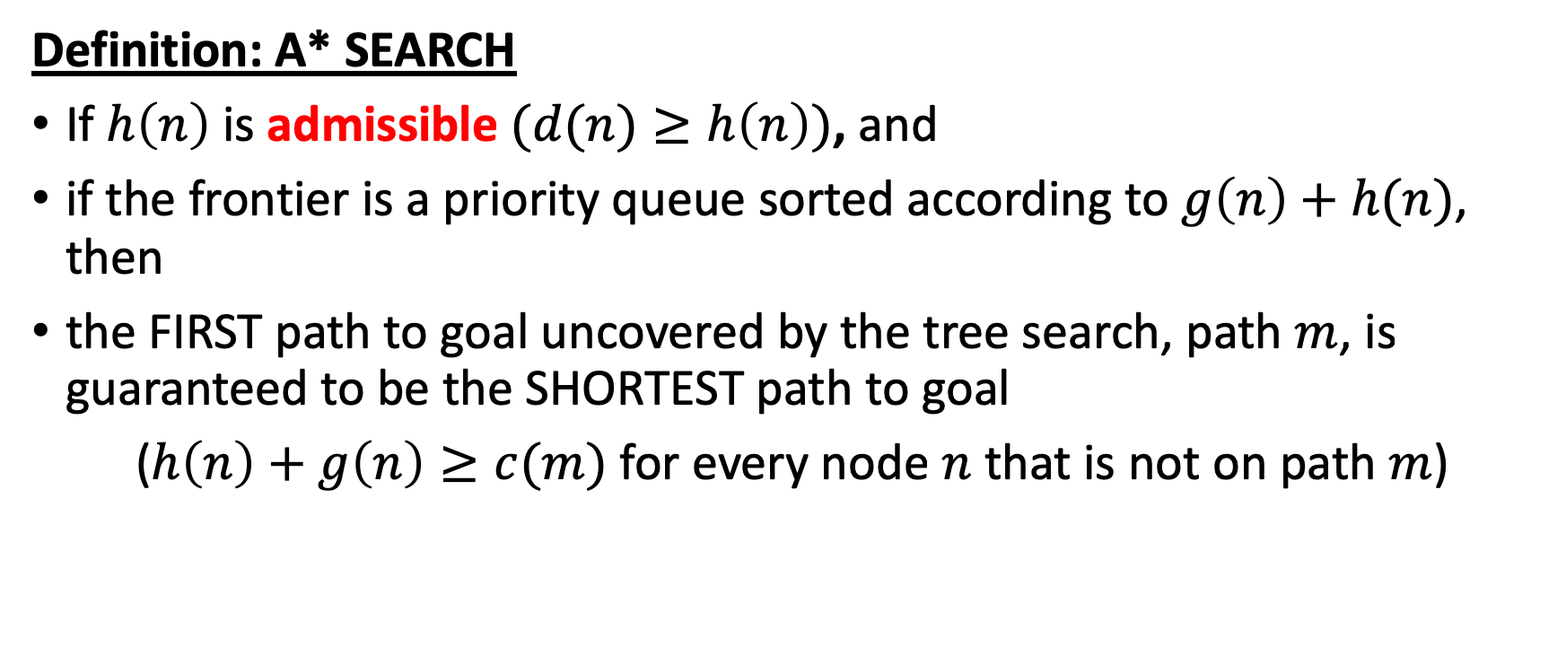


A* Search
$$c\left(m\right)$$
m
S
G
n
$$g\left(n\right)$$
$$≥h\left(n\right)$$
Definition: A* SEARCH
If $h\left(n\right)$ is admissible $(d(n)≥h\left(n\right))$, and
if the frontier is a priority queue sorted according to $g\left(n\right)+h(n)$, then
the FIRST path to goal uncovered by the tree search, path $m$, is guaranteed to be the SHORTEST path to goal
($h\left(n\right)+g\left(n\right)≥c(m)$ for every node $n$ that is not on path $m$)

Slide 4
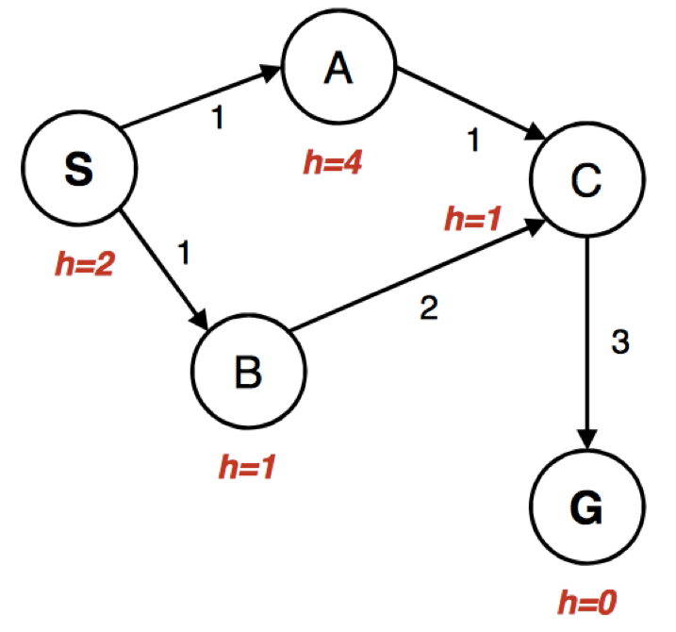
Bad interaction between A* and the explored set
Explored Set:
empty
Frontier
S: g(S)+h(S)=2, g(S)=0, parent=none
Expand: S, put its children A and B on the frontier.

Slide 5
Bad interaction between A* and the explored set
Explored Set:
S
Frontier
A: g(A)+h(A)=5, g(A)=1, parent=S
B: g(B)+h(B)=2, g(B)=1, parent=S
Expand: B, put its child C on the frontier.

Slide 6
Bad interaction between A* and the explored set
Explored Set:
S, B
Frontier
A: g(A)+h(A)=5, g(A)=1, parent=S
C: g(C)+h(C)=4, g(C)=3, parent=B
Expand: C, put its child G on the frontier.

Slide 7
Bad interaction between A* and the explored set
Explored Set:
S, B, C
Frontier
A: g(A)+h(A)=5, g(A)=1, parent=S
G: g(G)+h(G)=6, g(G)=6, parent=C
Expand: A. But we can’t put its child, C, on the frontier, because C is already in the explored set!

Slide 8
Bad interaction between A* and the explored set
Explored Set:
S, B, C
Frontier
G: g(G)+h(G)=6, g(G)=6, parent=C
Expand: G. Return the path SBCG, with cost 6. OOPS!

Slide 9
Why did this happen?
Well, because we used an explored set instead of an explored dict.
explored dict lists the h(n)+g(n) for each explored state
If the same state shows up later, with lower h(n)+g(n), then put it back on the frontier.
An explored set undermines A*, but an explored dict works just fine.
But actually, why did the higher-cost path SBC get explored before the lower-cost path SAC?
That never happens for goal. An admissible heuristic guarantees that the first time you pop Goal from the frontier, it will have its lowest cost.
Can we make the same idea true for every state, not just the goal state?

Slide 10
Outline of lecture
Admissible heuristics
Consistent heuristics
The zero heuristic: Uniform Cost Search
Relaxed heuristics
Dominant heuristics

Slide 11
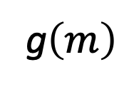
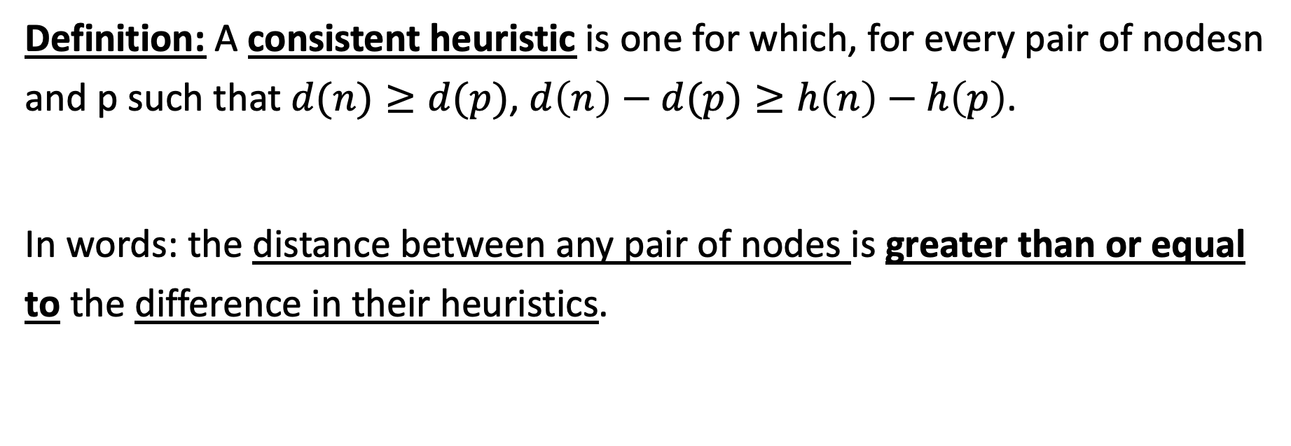
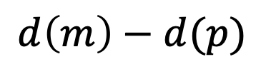

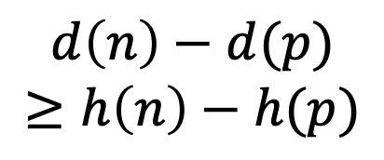
Consistent (monotonic) heuristic
g$\left(m\right)$
$$d\left(m\right)−d(p)$$
m
S
p
n
$$g\left(n\right)$$
$$d\left(n\right)−d(p)$$
$$≥h\left(n\right)−h(p)$$
Definition: A consistent heuristic is one for which, for every pair of nodesn and p such that $d(n)≥d(p)$, $d\left(n\right)−d(p)≥h\left(n\right)−h\left(p\right)$.
In words: the distance between any pair of nodes is greater than or equal to the difference in their heuristics.

Slide 12
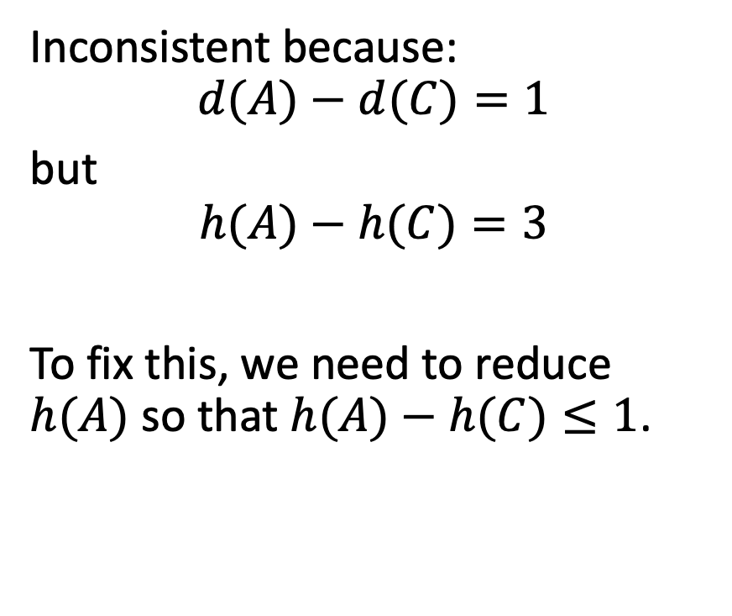
A* with an inconsistent heuristic
Inconsistent because:
$$d(A)−d(C)=1$$
but
$$h(A)−h(C)=3$$
To fix this, we need to reduce $h(A)$ so that $h(A)−h(C)≤1$.

Slide 13
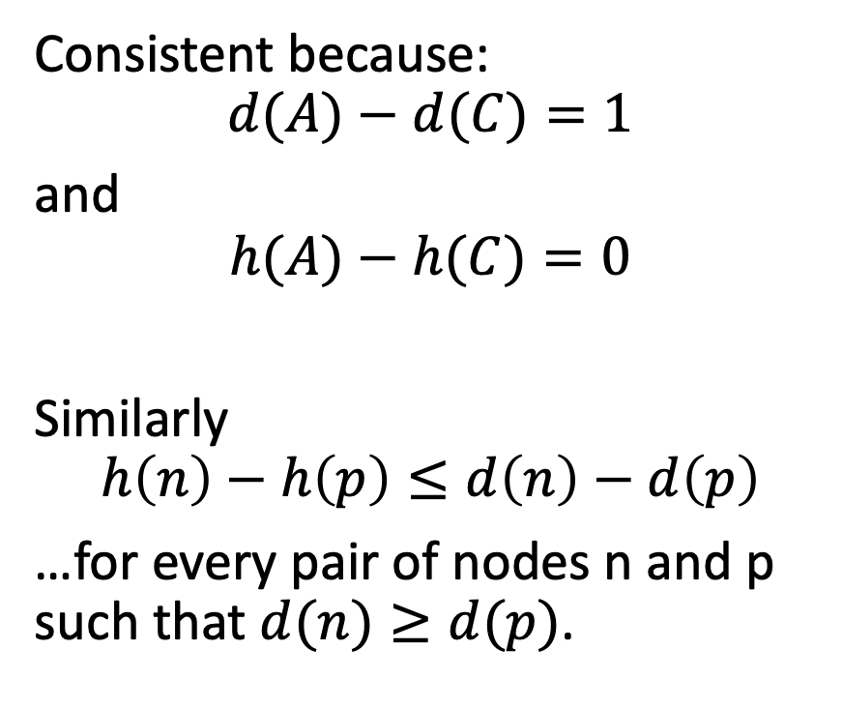
A* with a consistent heuristic
Consistent because:
$$d(A)−d(C)=1$$
and
$$h(A)−h(C)=0$$
Similarly
$$h\left(n\right)−h\left(p\right)≤d\left(n\right)−d\left(p\right)$$
…for every pair of nodes n and p such that $d(n)≥d(p)$.
h=1

Slide 14
A* with an inconsistent heuristic
Explored Set
S, B
Frontier
A: g(A)+h(A)=5, g(A)=1, parent=S
C: g(C)+h(C)=4, g(C)=3, parent=B
Expand: C

Slide 15
A* with a consistent heuristic
Explored Set
S, B
Frontier
A: g(A)+h(A)=2, g(A)=1, parent=S
C: g(C)+h(C)=4, g(C)=3, parent=B
Expand: A
h=1

Slide 16
A* with a consistent heuristic
Explored Set
S, B, A
Frontier
C: g(C)+h(C)=4, g(C)=3, parent=B
C: g(C)+h(C)=3, g(C)=2, parent=A
Expand: the copy of C that has A as its parent.
h=1

Slide 17
A* with a consistent heuristic
Explored Set
S, B, A, C
Frontier
C: g(C)+h(C)=4, g(C)=3, parent=B
G: g(G)+h(G)=5, parent=C
Expand: The copy of C that has B as its parent. But C is already in the explored set, and since our heuristic is consistent, we know that the new path (with B as parent) has a higher cost than the old path (with A as parent), so we can safely ignore the new path.
h=1
?

Slide 18
A* with a consistent heuristic
Explored Set
S, B, A, C
Frontier
G: g(G)+h(G)=5, parent=C
Expand: G
h=1

Slide 19
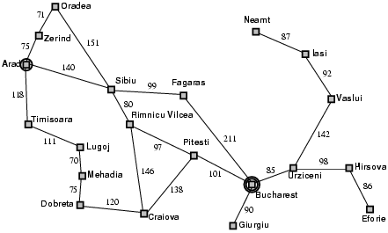

Admissible heuristic example: Romania
Admissible:
$$h(n)≤d(n)$$
Example:
$$d(Sibiu) = 278$$
$$h(Sibiu) ≤ 278$$

Slide 20

Consistent heuristic example: Romania
Consistent:
$$h\left(n\right)−h\left(p\right)≤d\left(n\right)−d(p)$$
Example:
$$d\left(Arad\right)−d(Sibiu) =140$$
$$h\left(Arad\right)−h(Sibiu) ≤140$$
The heuristic difference is always less than or equal to the cost of the action.

Slide 21
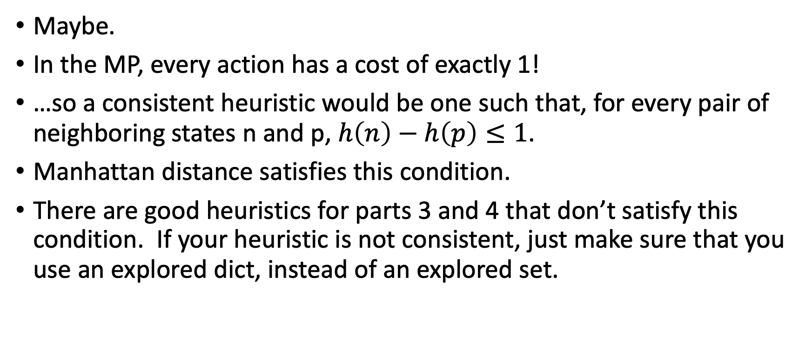
Can you use this in the MP?
Maybe.
In the MP, every action has a cost of exactly 1!
…so a consistent heuristic would be one such that, for every pair of neighboring states n and p, $h\left(n\right)−h\left(p\right)≤1$.
Manhattan distance satisfies this condition.
There are good heuristics for parts 3 and 4 that don’t satisfy this condition. If your heuristic is not consistent, just make sure that you use an explored dict, instead of an explored set.

Slide 22
Outline of lecture
Admissible heuristics
Consistent heuristics
The zero heuristic: Uniform Cost Search
Relaxed heuristics
Dominant heuristics

Slide 23
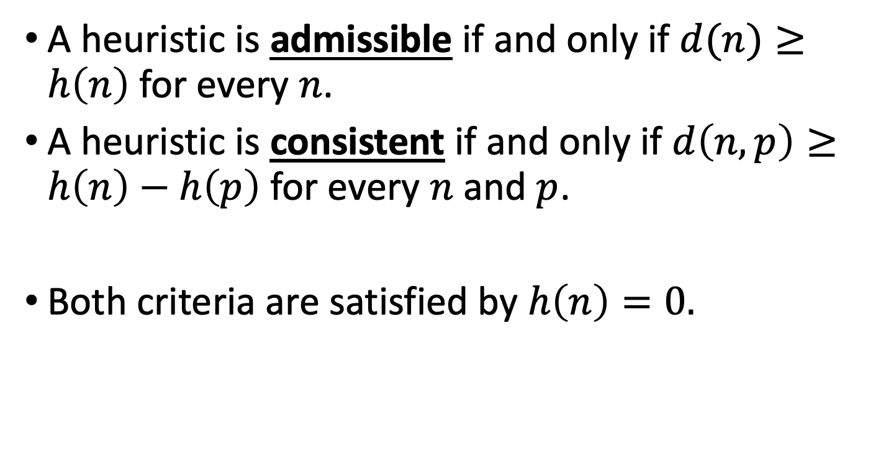
The trivial case: h(n)=0
A heuristic is admissible if and only if $d(n)≥h\left(n\right)$ for every $n$.
A heuristic is consistent if and only if $d\left(n,p\right)≥h\left(n\right)−h\left(p\right)$ for every $n$ and $p$.
Both criteria are satisfied by $h\left(n\right)=0.$

Slide 24
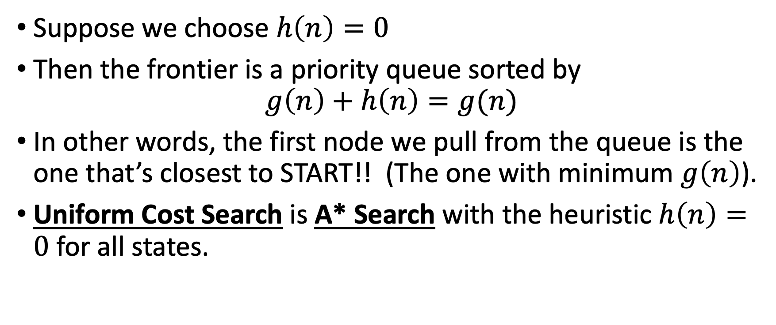
UCS = A* with h(n)=0
Suppose we choose $h\left(n\right)=0$
Then the frontier is a priority queue sorted by
$$g\left(n\right)+h\left(n\right)=g(n)$$
In other words, the first node we pull from the queue is the one that’s closest to START!! (The one with minimum $g\left(n\right)$).
Uniform Cost Search is A* Search with the heuristic $h\left(n\right)=0$ for all states.

Slide 25
Outline of lecture
Admissible heuristics
Consistent heuristics
The zero heuristic: Uniform Cost Search
Relaxed heuristics
Dominant heuristics

Slide 26
Heuristics from relaxed problems
A problem with fewer restrictions on the actions is called a relaxed problem
In most problems, having fewer restrictions on your action means that you can reach the goal faster.
So designing a heuristic is usually the same as finding a relaxed problem that makes it easy to calculate the distance to goal.

Slide 27



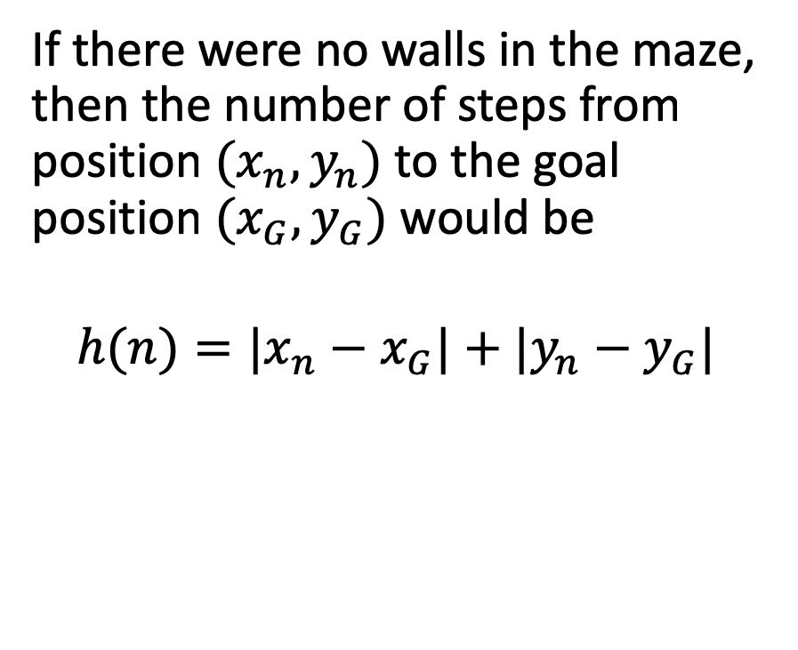



Relaxed heuristic example: Manhattan distance
If there were no walls, this would be the path to goal: straight down, then straight right.
If there were no walls in the maze, then the number of steps from position $(x_{n},y_{n})$ to the goal position $(x_{G},y_{G})$ would be
$$h(n)=|x_{n}−x_{G}|+|y_{n}−y_{G}|$$
Start state
$$y_{n}$$
$$y_{G}$$
Goal state
$$x$$
$$x_{n}$$
$$x_{G}$$

Slide 28


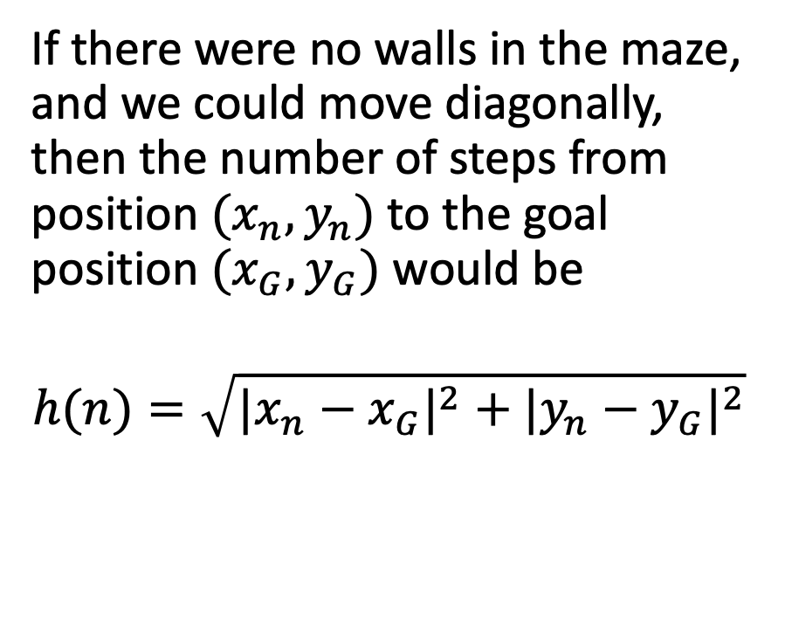



Relaxed heuristic example: Euclidean distance
If there were no walls and we could move diagonally
If there were no walls in the maze, and we could move diagonally, then the number of steps from position $(x_{n},y_{n})$ to the goal position $(x_{G},y_{G})$ would be
$$h(n)=\sqrt{{|x_{n}−x_{G}|}^{2}+{|y_{n}−y_{G}|}^{2}}$$
Start state
$$y_{n}$$
$$y_{G}$$
Goal state
$$x$$
$$x_{n}$$
$$x_{G}$$

Slide 29
Relaxed heuristic example: Corner dots
Suppose that, instead of touching ALL of the waypoints, you only had to touch the most extreme waypoints?

Slide 30
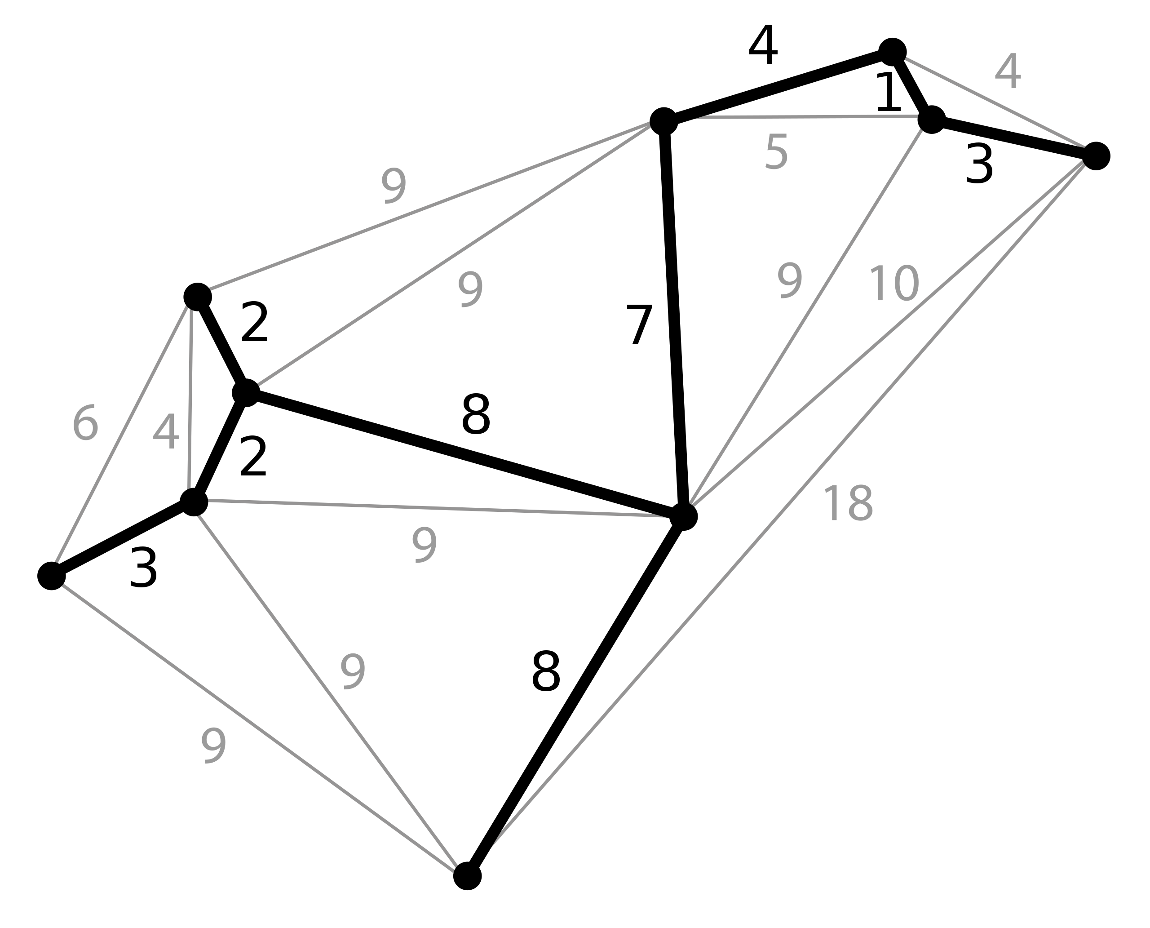
Relaxed heuristic example: Many dots
Suppose that, after you reached a waypoint, you could magically fly back to the nearest branch in the minimum spanning tree?
In other words, you only have to go one-way from where you are to the waypoint – you don’t have to come back again.

Slide 31
Outline of lecture
Admissible heuristics
Consistent heuristics
The zero heuristic: Uniform Cost Search
Relaxed heuristics
Dominant heuristics

Slide 32
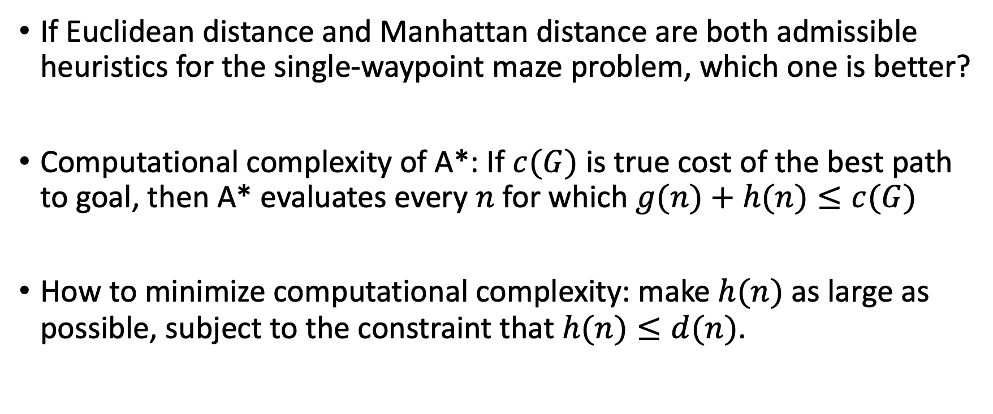
Which heuristic is better
If Euclidean distance and Manhattan distance are both admissible heuristics for the single-waypoint maze problem, which one is better?
Computational complexity of A*: If $c(G)$ is true cost of the best path to goal, then A* evaluates every $n$ for which $g(n)+h(n)≤c(G)$
How to minimize computational complexity: make $h(n)$ as large as possible, subject to the constraint that $h(n)≤d(n)$.

Slide 33

Euclidean distance
$$h_{2}(n)=\sqrt{{|x_{n}−x_{G}|}^{2}+{|y_{n}−y_{G}|}^{2}}$$
Start state
$$y_{n}$$
$$y_{G}$$
Goal state
$$x$$
$$x_{n}$$
$$x_{G}$$

Slide 34
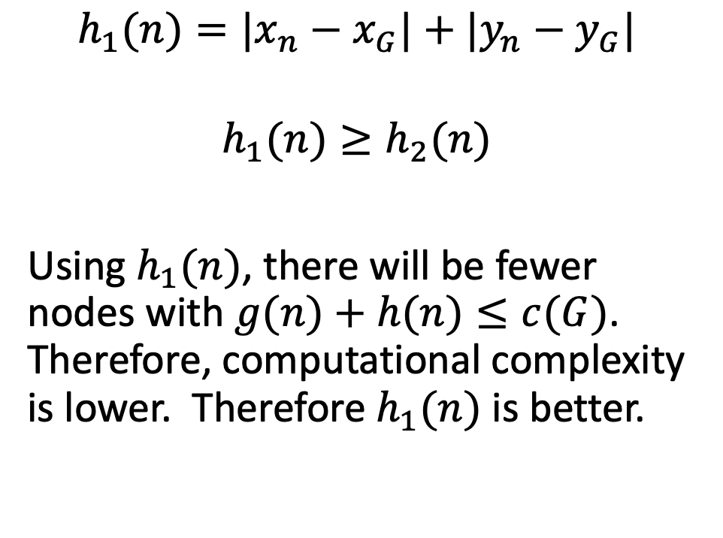
Manhattan distance
$$h_{1}(n)=|x_{n}−x_{G}|+|y_{n}−y_{G}|$$
$$h_{1}(n)≥h_{2}(n)$$
Using $h_{1}(n)$, there will be fewer nodes with $g(n)+h(n)≤c(G)$. Therefore, computational complexity is lower. Therefore $h_{1}(n)$ is better.
Start state
$$y_{n}$$
$$y_{G}$$
Goal state
$$x$$
$$x_{n}$$
$$x_{G}$$

Slide 35
Dominance
If h₂(n) ≥ h₁(n) for all n, (both admissible) then h₂ dominates h₁
As long as they’re both admissible, they will both find the optimum path.
But h₂(n) will require less computation to find it.

Slide 36
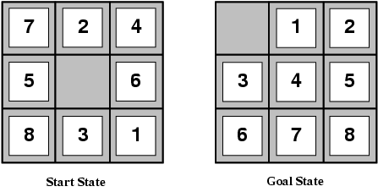
Example: the 8-puzzle
Problem statement: given a shuffled set of numbers (left), re-arrange them in order (right).
State: ordering of the numbers and of the space.
Possible actions: swap the space with any of its neighbors.
Like traveling salesman, this is an NP-complete problem.

Slide 37


8-puzzle: Heuristic $h_{1}(n)$
Suppose that, on each step, we could move any tile, anywhere on the board, regardless of where other tiles were.
Then $h_{1}(n) =$ # tiles that need to be moved.
Example below: $h_{1}\left(n\right)=8$

Slide 38

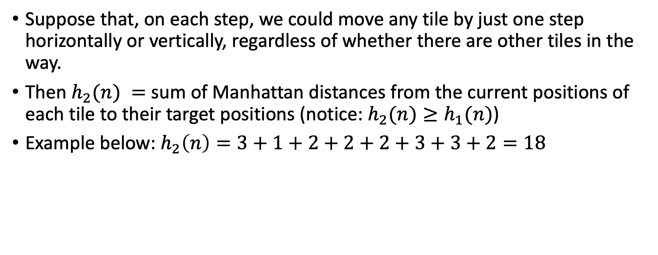
8-puzzle: Heuristic $h_{2}(n)$
Suppose that, on each step, we could move any tile by just one step horizontally or vertically, regardless of whether there are other tiles in the way.
Then $h_{2}(n) =$ sum of Manhattan distances from the current positions of each tile to their target positions (notice: $h_{2}(n)≥h_{1}(n)$)
Example below: $h_{2}\left(n\right)=3+1+2+2+2+3+3+2=18$

Slide 39
Dominance Experiment results reported by Svetlana Lazebnik
Typical search costs for the 8-puzzle (average number of nodes expanded for different solution depths):
d=12 BFS expands 3,644,035 nodes A*(h₁) expands 227 nodes A*(h₂) expands 73 nodes
d=24 BFS expands 54,000,000,000 nodes A*(h₁) expands 39,135 nodes A*(h₂) expands 1,641 nodes

Slide 40
Combining heuristics
Suppose we have a collection of admissible heuristics h₁(n), h₂(n), …, h_{m}(n), but none of them dominates the others
How can we combine them?
h(n) = max{h₁(n), h₂(n), …, h_{m}(n)}

Slide 41
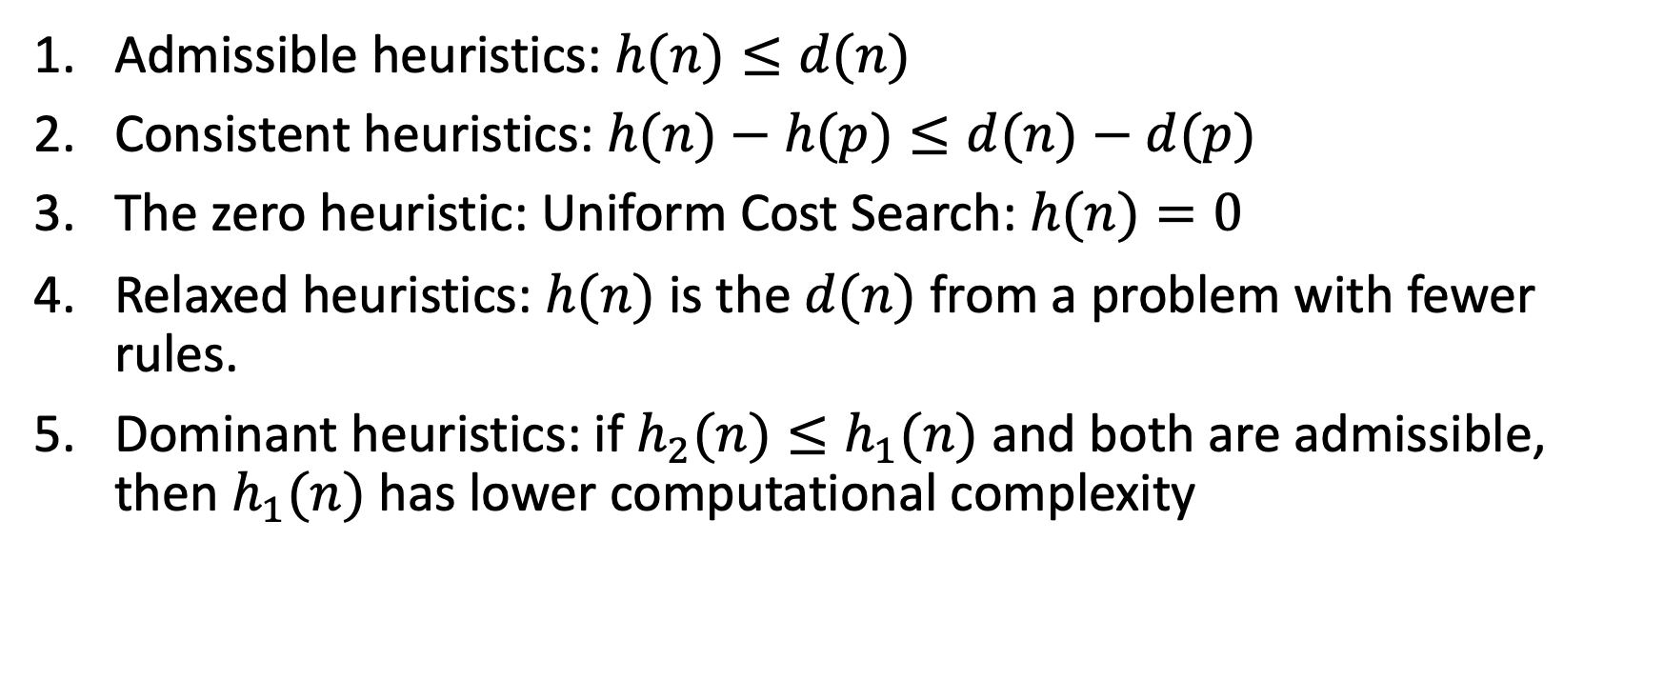
Outline of lecture
Admissible heuristics: $h(n)≤d(n)$
Consistent heuristics: $h(n)−h(p)≤d(n)−d(p)$
The zero heuristic: Uniform Cost Search: $h(n)=0$
Relaxed heuristics: $h(n)$ is the $d(n)$ from a problem with fewer rules.
Dominant heuristics: if $h_{2}(n)≤h_{1}(n)$ and both are admissible, then $h_{1}(n)$ has lower computational complexity

Slide 42
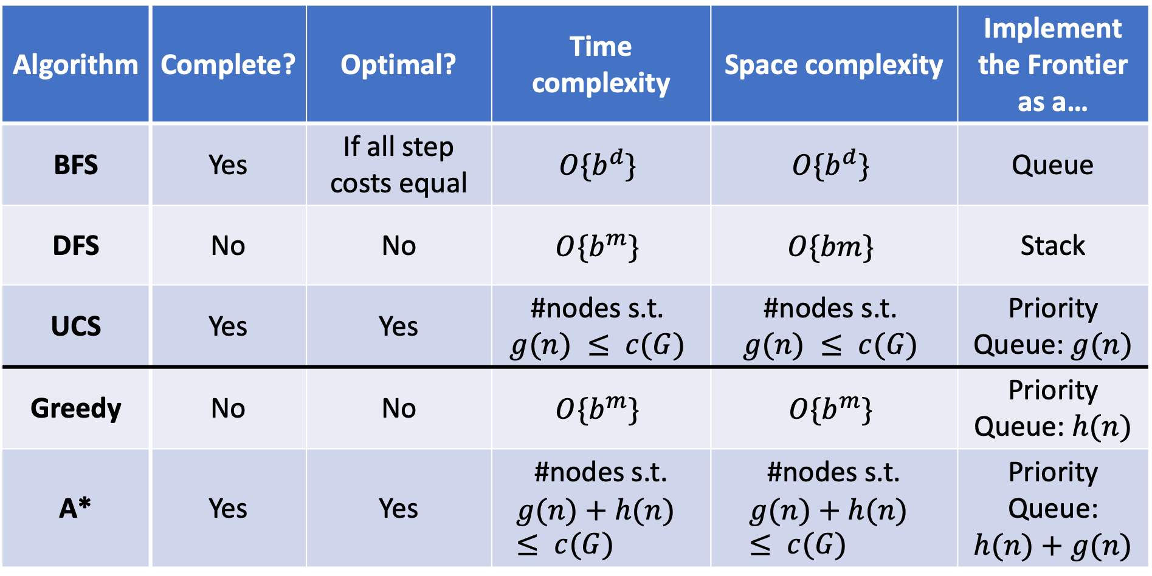
Five search strategies
Algorithm | Complete? | Optimal? | Time complexity | Space complexity | Implement the Frontier as a…
BFS | Yes | If all step costs equal | $$O\{b^{d}\}$$ | $$O\{b^{d}\}$$ | Queue
DFS | No | No | $$O\{b^{m}\}$$ | $$O\{bm\}$$ | Stack
UCS | Yes | Yes | #nodes s.t. $$g(n) ≤ c(G)$$ | #nodes s.t. $$g(n) ≤ c(G)$$ | Priority Queue: $g(n)$
Greedy | No | No | $$O\{b^{m}\}$$ | $$O\{b^{m}\}$$ | Priority Queue: $h(n)$
A* | Yes | Yes | #nodes s.t. $$g(n)+h(n) ≤ c(G)$$ | #nodes s.t. $$g(n)+h(n) ≤ c(G)$$ | Priority Queue: $h(n)+g(n)$

