Slide 1
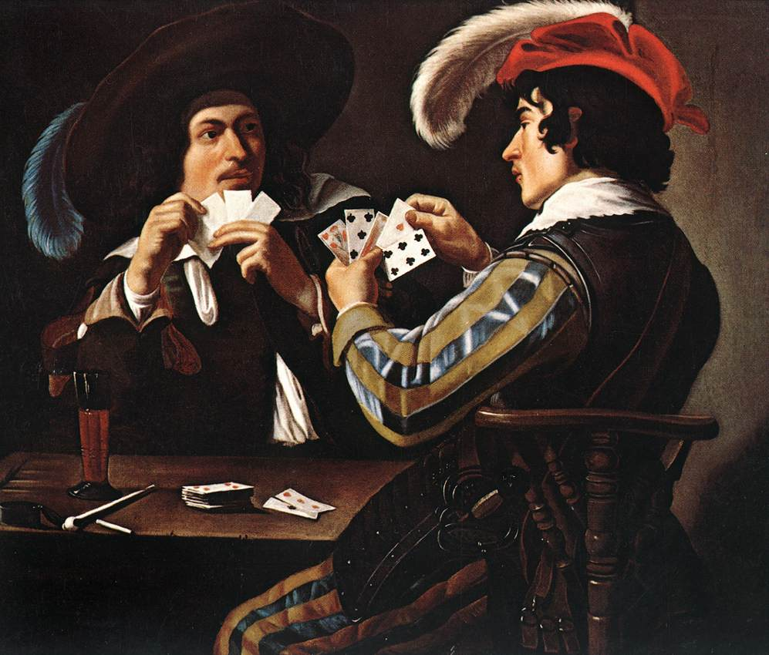
CS440/ECE 448, Lecture 19: Search in Partially Observable Environments
Slides by Mark Hasegawa-Johnson, 2/2022
CC-BY 4.0: You are free to: copy and redistribute the material in any medium or format, remix, transform, and build upon the material for any purpose, even commercially, if you give appropriate credit.
Theodore Rombouts, The Card Players.
Public domain image, Residenzgalerie Salzburg,
https://commons.wikimedia.org/wiki/File:Theodoor_Rombouts_-_Joueurs_de_cartes.jpg

Slide 2
Content
Unobservable environments: belief states
Partially observable environments: predict and update
Stochastic partially observable environments

Slide 3

Unobservable environments
Consider an environment that’s relatively simple:
Deterministic
Discrete
Known
Single-agent
Static
Sequential
As we’ve learned, it should be possible to solve this problem using A* search, right?

Slide 4

Unobservable environments
But suppose this environment is unobservable.
We know the layout of the map (it’s a known environment), but we don’t know which square we’re starting from. Once we move, we can’t tell whether we moved successfully, or ran into a wall.
Isn’t that a hopeless problem?
??

Slide 5
Unobservable environments
Let’s use pink to color in all the squares where we might be.
At the beginning of the search, we might be in any square, so all squares are pink.
??

Slide 6
Unobservable environments
Now take 1 step to the right.
If the environment is deterministic, then we can now guarantee that we are in one of the pink squares shown here. We know we’re not in any of the white squares.
??

Slide 7
Unobservable environments
Take 4 steps right, then 4 steps down, then 4 steps right, then 4 steps down, then 2 steps right.
Now we know that we are in one of these five squares.
??

Slide 8
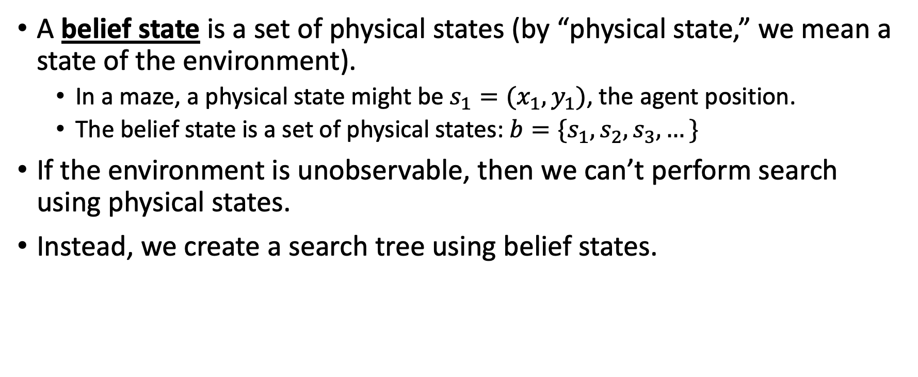
Belief state
A belief state is a set of physical states (by “physical state,” we mean a state of the environment).
In a maze, a physical state might be $s_{1}=(x_{1},y_{1})$, the agent position.
The belief state is a set of physical states: $b=\{s_{1},s_{2},s_{3},…\}$
If the environment is unobservable, then we can’t perform search using physical states.
Instead, we create a search tree using belief states.

Slide 9
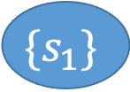
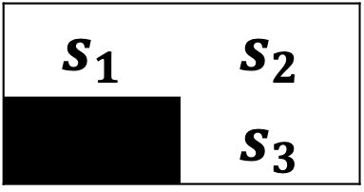

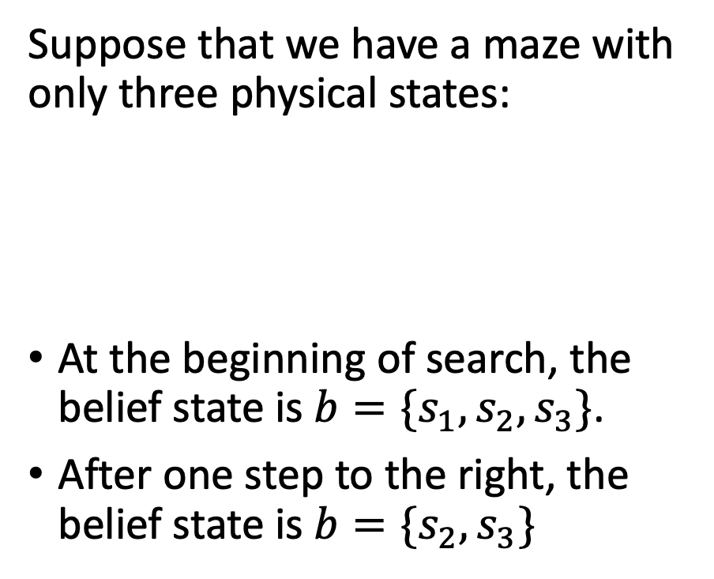

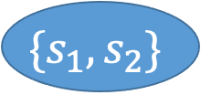

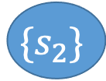

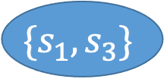
Belief states
$$\{s_{1},s_{2},s_{3}\}$$
U
R
D,L
$$\{s_{1},s_{2}\}$$
$$\{s_{1},s_{3}\}$$
$$\{s_{2},s_{3}\}$$
Suppose that we have a maze with only three physical states:
At the beginning of search, the belief state is $b=\{s_{1},s_{2},s_{3}\}$.
After one step to the right, the belief state is $b=\{s_{2},s_{3}\}$
R
L
U
D
$$s_{1}$$ | $$s_{2}$$
 | $$s_{3}$$
$$\{s_{1}\}$$
$$\{s_{1},s_{3}\}$$
$$\{s_{2}\}$$
$$\{s_{1},s_{2}\}$$

Slide 10
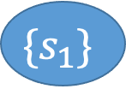
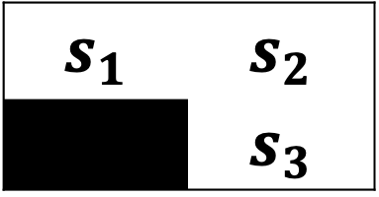
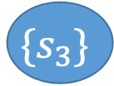
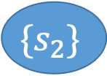
Belief states
$$\{s_{1},s_{2},s_{3}\}$$
U
R
D,L
$$s_{1}$$ | $$s_{2}$$
 | $$s_{3}$$
$$\{s_{1},s_{2}\}$$
$$\{s_{1},s_{3}\}$$
$$\{s_{2},s_{3}\}$$
R
L
U
D
A full breadth-first search on this maze can reach any desired physical state in just 2 steps, even if we have no idea where we started from.
(Shown here: the tree without any repeated states).
$$\{s_{1}\}$$
$$\{s_{2}\}$$
$$\{s_{2}\}$$
$$\{s_{3}\}$$

Slide 11
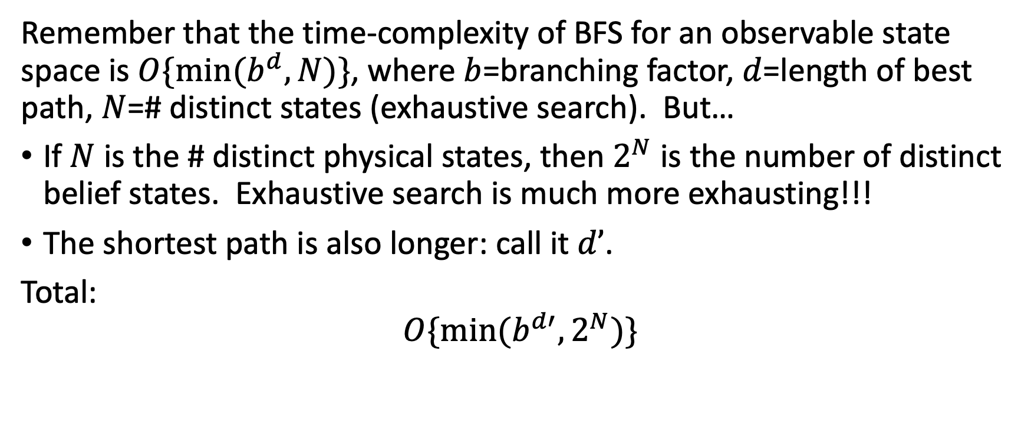
Computational Complexity
Remember that the time-complexity of BFS for an observable state space is $O\{min⁡(b^{d},N)\}$, where $b$=branching factor, $d$=length of best path, $N$=# distinct states (exhaustive search). But…
If $N$ is the # distinct physical states, then $2^{N}$ is the number of distinct belief states. Exhaustive search is much more exhausting!!!
The shortest path is also longer: call it $d’$.
Total:
$$O\{min⁡(b^{d′},2^{N})\}$$

Slide 12
Content
Unobservable environments: belief states
Partially observable environments: predict and update
Stochastic partially observable environments

Slide 13
Partially observable environments
Observable environment: the agent knows its state.
Unobservable environment: the agent doesn’t know its state.
Partially observable environment: the agent can observe something, but not everything.

Slide 14
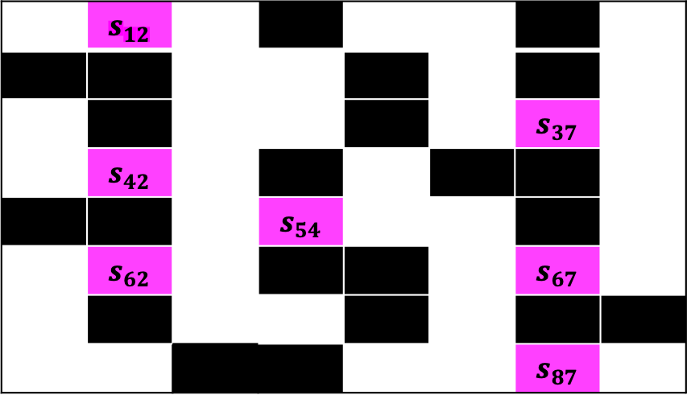
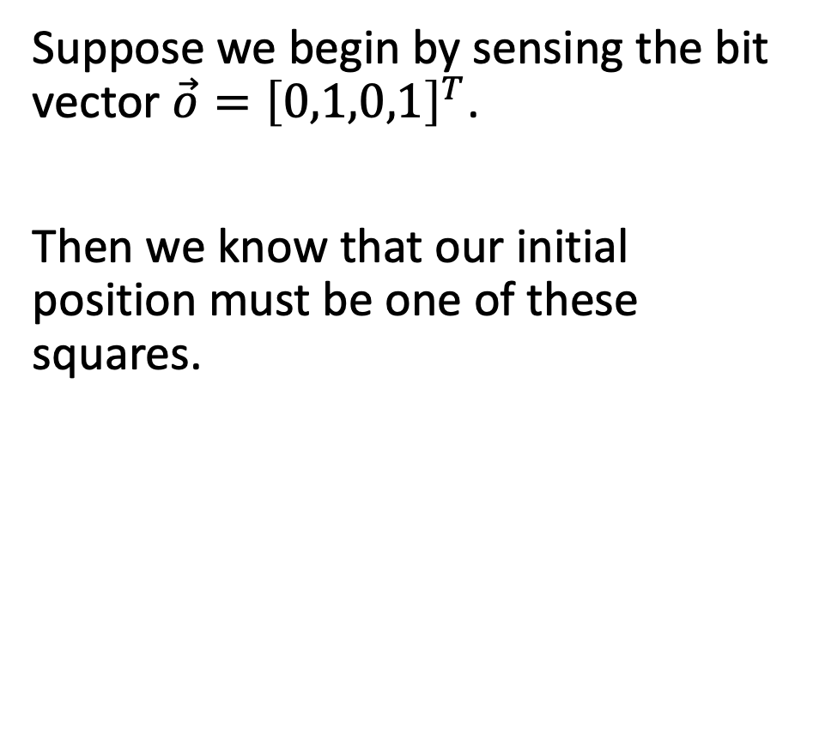
Partially observable environment
Suppose we begin by sensing the bit vector $\vec{o}={\left[0,1,0,1\right]}^{T}$.
Then we know that our initial position must be one of these squares.
 | $$s_{12}$$
 |  |  |  |  |  | $$s_{37}$$
 | $$s_{42}$$
 |  |  | $$s_{54}$$
 | $$s_{62}$$ |  |  |  |  | $$s_{67}$$
 |  |  |  |  |  | $$s_{87}$$
??

Slide 15
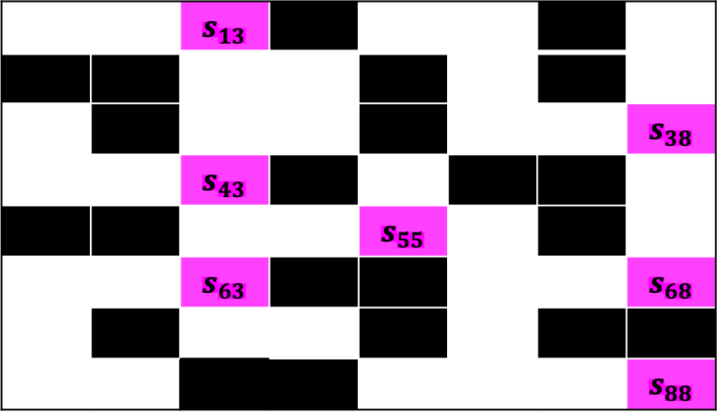
Partially observable environment
Move one step to the right.
Now we know that our position must be one of these squares.
 |  | $$s_{13}$$
 |  |  |  |  |  |  | $$s_{38}$$
 |  | $$s_{43}$$
 |  |  |  | $$s_{55}$$
 |  | $$s_{63}$$ |  |  |  |  | $$s_{68}$$
 |  |  |  |  |  |  | $$s_{88}$$
??

Slide 16
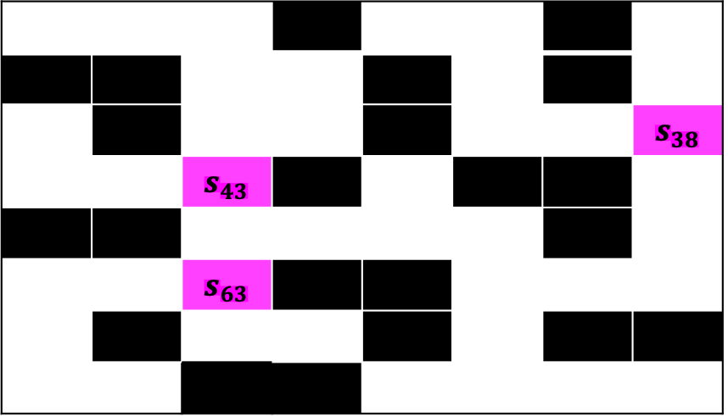
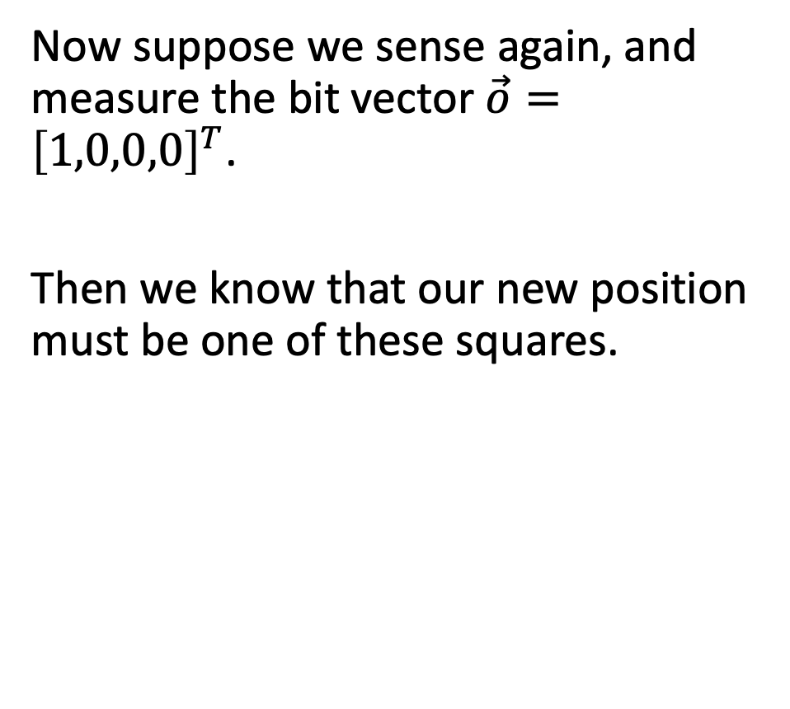
Partially observable environment
Now suppose we sense again, and measure the bit vector $\vec{o}={\left[1,0,0,0\right]}^{T}$.
Then we know that our new position must be one of these squares.
 |  |  |  |  |  |  | $$s_{38}$$
 |  | $$s_{43}$$
 |  | $$s_{63}$$
??

Slide 17
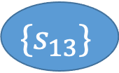














The predict-update cycle
$$\{s_{12},s_{37},s_{42},s_{54},s_{62},s_{67},s_{87}\}$$
ACT
R
D
Notice that our algorithm is now the repetition of two steps:
Take an action
Take a new measurement of the environment
L
U
$$\{s_{13},s_{38},s_{43},s_{55},s_{63},s_{68},s_{88}\}$$
$$\{…$$
$$\{…$$
$$\{…$$
MEASURE
$$\left[\begin{matrix}1 \\ 0 \\ \begin{matrix}0 \\ 0\end{matrix}\end{matrix}\right]$$
$$\left[\begin{matrix}1 \\ 0 \\ \begin{matrix}0 \\ 1\end{matrix}\end{matrix}\right]$$
$$\left[\begin{matrix}0 \\ 1 \\ \begin{matrix}0 \\ 0\end{matrix}\end{matrix}\right]$$
$$\left[\begin{matrix}1 \\ 1 \\ \begin{matrix}0 \\ 0\end{matrix}\end{matrix}\right]$$
$$\left[\begin{matrix}1 \\ 1 \\ \begin{matrix}0 \\ 1\end{matrix}\end{matrix}\right]$$
$$\{s_{38},s_{43},s_{63}\}$$
$$\{s_{13}\}$$
$$\{s_{55}\}$$
$$\{s_{68}\}$$
$$\{s_{88}\}$$
…
ACT
R
L
U
D

Slide 18
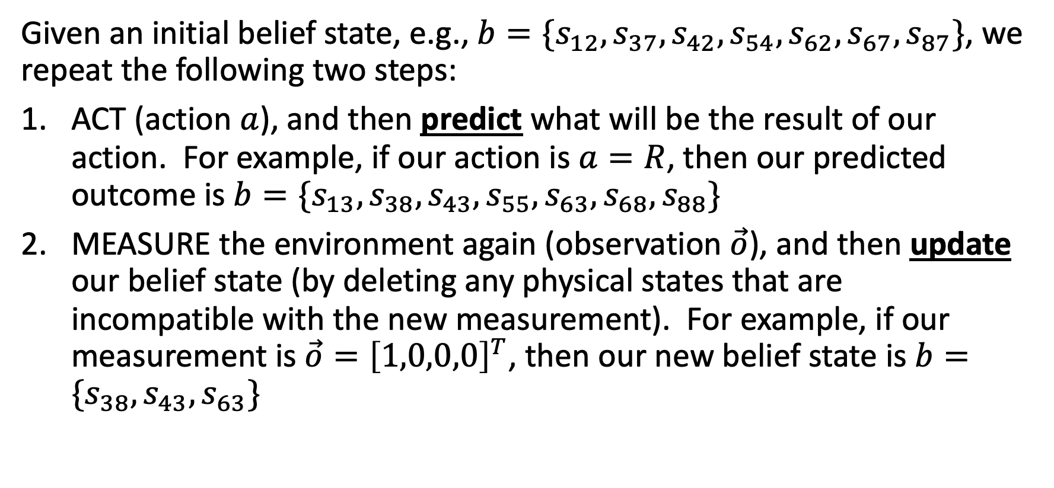
The predict-update cycle
Given an initial belief state, e.g., $b=\{s_{12},s_{37},s_{42},s_{54},s_{62},s_{67},s_{87}\}$, we repeat the following two steps:
ACT (action $a$), and then predict what will be the result of our action. For example, if our action is $a=R$, then our predicted outcome is $b=\{s_{13},s_{38},s_{43},s_{55},s_{63},s_{68},s_{88}\}$
MEASURE the environment again (observation $\vec{o}$), and then update our belief state (by deleting any physical states that are incompatible with the new measurement). For example, if our measurement is $\vec{o}={\left[1,0,0,0\right]}^{T}$, then our new belief state is $b=\{s_{38},s_{43}, s_{63}\}$

Slide 19
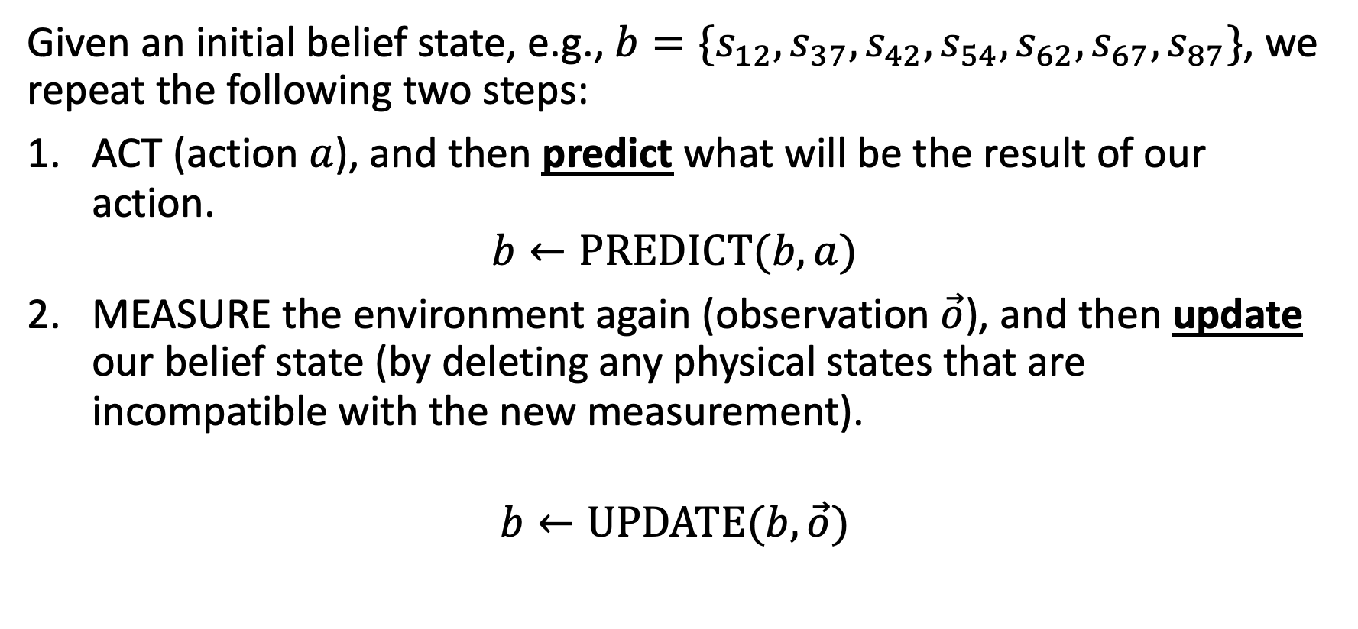
The predict-update cycle
Given an initial belief state, e.g., $b=\{s_{12},s_{37},s_{42},s_{54},s_{62},s_{67},s_{87}\}$, we repeat the following two steps:
ACT (action $a$), and then predict what will be the result of our action.
$$b←PREDICT(b,a)$$
MEASURE the environment again (observation $\vec{o}$), and then update our belief state (by deleting any physical states that are incompatible with the new measurement).
$$b←UPDATE(b,\vec{o})$$

Slide 20
Controllability of the outcome
$$\{s_{12},s_{37},s_{42},s_{54},s_{62},s_{67},s_{87}\}$$
ACT
Notice something:
How we ACT is under the agent’s control
What we MEASURE is not under the agent’s control!
D
R
L
U
$$\{s_{13},s_{38},s_{43},s_{55},s_{63},s_{68},s_{88}\}$$
$$\{…$$
$$\{…$$
$$\{…$$
MEASURE
$$\left[\begin{matrix}1 \\ 0 \\ \begin{matrix}0 \\ 0\end{matrix}\end{matrix}\right]$$
$$\left[\begin{matrix}1 \\ 0 \\ \begin{matrix}0 \\ 1\end{matrix}\end{matrix}\right]$$
$$\left[\begin{matrix}0 \\ 1 \\ \begin{matrix}0 \\ 0\end{matrix}\end{matrix}\right]$$
$$\left[\begin{matrix}1 \\ 1 \\ \begin{matrix}0 \\ 0\end{matrix}\end{matrix}\right]$$
$$\left[\begin{matrix}1 \\ 1 \\ \begin{matrix}0 \\ 1\end{matrix}\end{matrix}\right]$$
$$\{s_{38},s_{43},s_{63}\}$$
$$\{s_{13}\}$$
$$\{s_{55}\}$$
$$\{s_{68}\}$$
$$\{s_{88}\}$$
…
ACT
R
L
U
D

Slide 21
Controllability of the outcome
$$\{s_{12},s_{37},s_{42},s_{54},s_{62},s_{67},s_{87}\}$$
ACT
For BFS:
We can only finish the search if we find a node whose state is GOAL regardless of the measurement.
D
R
L
U
$$\{s_{13},s_{38},s_{43},s_{55},s_{63},s_{68},s_{88}\}$$
$$\{…$$
$$\{…$$
$$\{…$$
MEASURE
$$\left[\begin{matrix}1 \\ 0 \\ \begin{matrix}0 \\ 0\end{matrix}\end{matrix}\right]$$
$$\left[\begin{matrix}1 \\ 0 \\ \begin{matrix}0 \\ 1\end{matrix}\end{matrix}\right]$$
$$\left[\begin{matrix}0 \\ 1 \\ \begin{matrix}0 \\ 0\end{matrix}\end{matrix}\right]$$
$$\left[\begin{matrix}1 \\ 1 \\ \begin{matrix}0 \\ 0\end{matrix}\end{matrix}\right]$$
$$\left[\begin{matrix}1 \\ 1 \\ \begin{matrix}0 \\ 1\end{matrix}\end{matrix}\right]$$
$$\{s_{38},s_{43},s_{63}\}$$
$$\{s_{13}\}$$
$$\{s_{55}\}$$
$$\{s_{68}\}$$
$$\{s_{88}\}$$
…
ACT
R
L
U
D

Slide 22
Controllability
$$\{s_{12},s_{37},s_{42},s_{54},s_{62},s_{67},s_{87}\}$$
For DFS, A*, and most other algorithms:
In order to expand the action a=R, you need to expand all of the resulting measurement states.
This may affect how you calculate the heuristic for A*.
ACT
R
D
L
U
$$\{s_{13},s_{38},s_{43},s_{55},s_{63},s_{68},s_{88}\}$$
$$\{…$$
$$\{…$$
$$\{…$$
MEASURE
$$\left[\begin{matrix}1 \\ 0 \\ \begin{matrix}0 \\ 0\end{matrix}\end{matrix}\right]$$
$$\left[\begin{matrix}1 \\ 0 \\ \begin{matrix}0 \\ 1\end{matrix}\end{matrix}\right]$$
$$\left[\begin{matrix}0 \\ 1 \\ \begin{matrix}0 \\ 0\end{matrix}\end{matrix}\right]$$
$$\left[\begin{matrix}1 \\ 1 \\ \begin{matrix}0 \\ 0\end{matrix}\end{matrix}\right]$$
$$\left[\begin{matrix}1 \\ 1 \\ \begin{matrix}0 \\ 1\end{matrix}\end{matrix}\right]$$
$$\{s_{38},s_{43},s_{63}\}$$
$$\{s_{13}\}$$
$$\{s_{55}\}$$
$$\{s_{68}\}$$
$$\{s_{88}\}$$
…
ACT
R
L
U
D

Slide 23
Content
Unobservable environments: belief states
Partially observable environments: predict and update
Stochastic partially observable environments

Slide 24
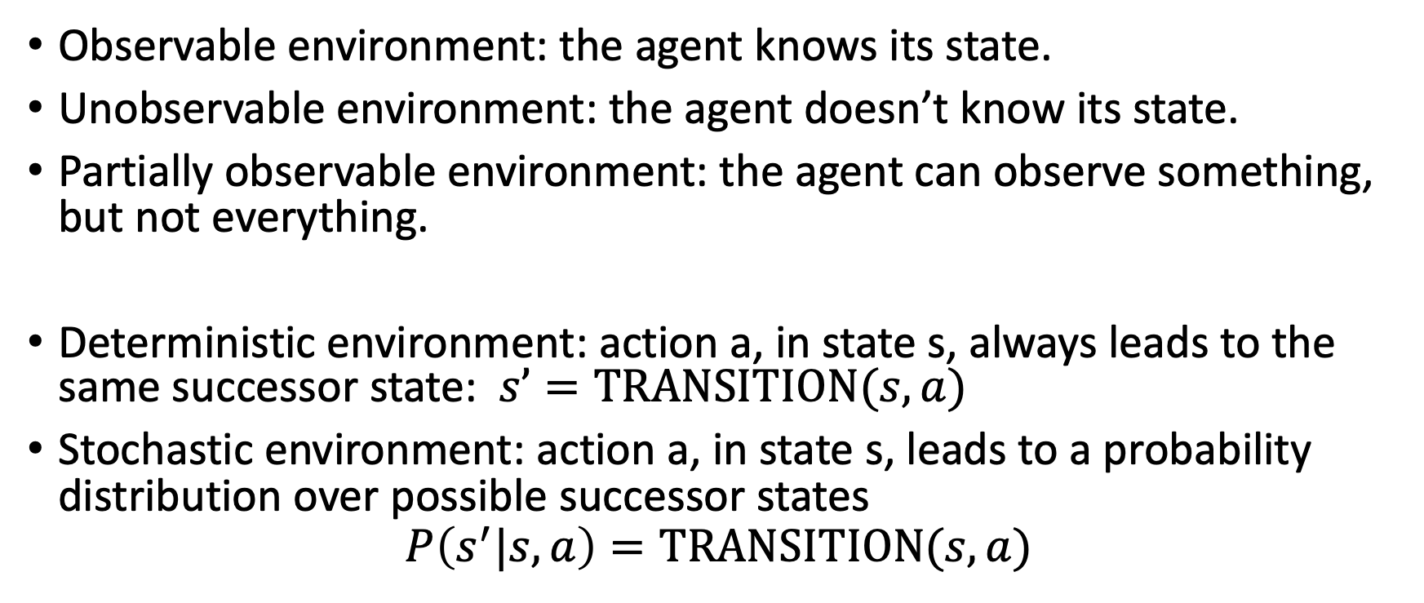
Stochastic partially observable environments
Observable environment: the agent knows its state.
Unobservable environment: the agent doesn’t know its state.
Partially observable environment: the agent can observe something, but not everything.
Deterministic environment: action a, in state s, always leads to the same successor state: $s’=TRANSITION(s,a)$
Stochastic environment: action a, in state s, leads to a probability distribution over possible successor states
$$P\left(s^{′}|s,a\right)=TRANSITION(s,a)$$

Slide 25
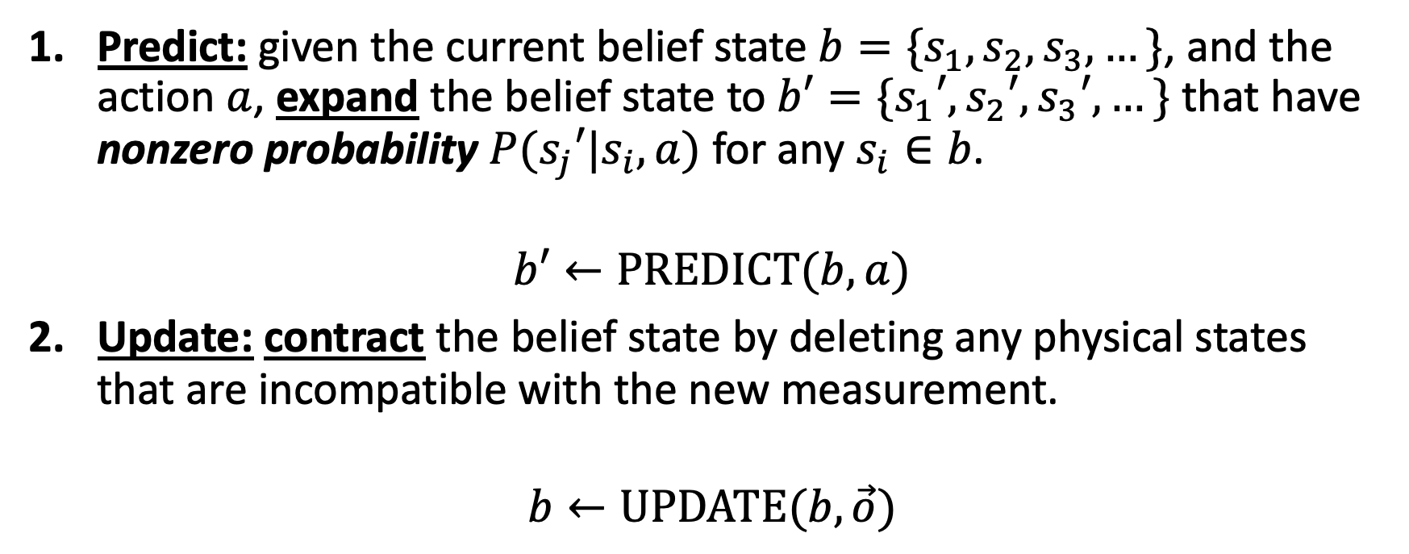
Stochastic partially observable environments
Predict: given the current belief state $b=\{s_{1},s_{2},s_{3},…\}$, and the action $a$, expand the belief state to $b′=\{s_{1}′,s_{2}′,s_{3}′,…\}$ that have nonzero probability $P(s_{j}′|s_{i},a)$ for any $s_{i}∈b$.
$$b′←PREDICT(b,a)$$
Update: contract the belief state by deleting any physical states that are incompatible with the new measurement.
$$b←UPDATE(b,\vec{o})$$
The randomness is dealt with here.

Slide 26
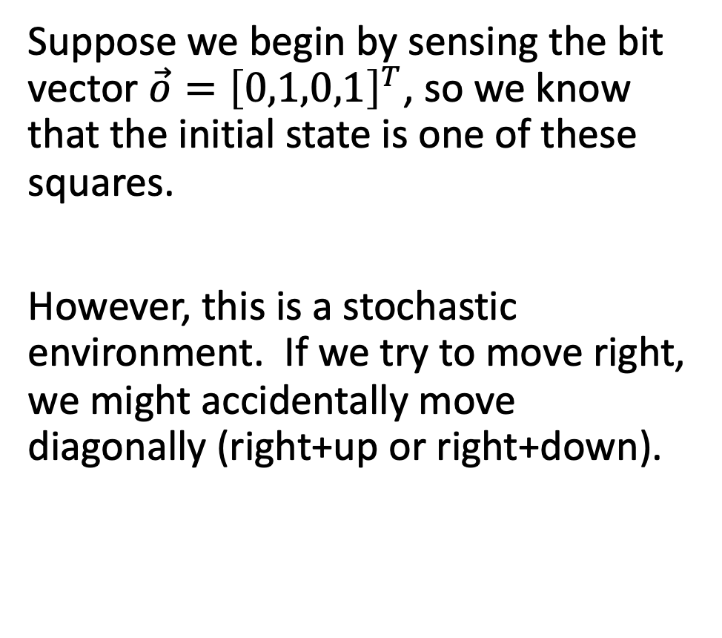
Stochastic partially observable environment
Suppose we begin by sensing the bit vector $\vec{o}={\left[0,1,0,1\right]}^{T}$, so we know that the initial state is one of these squares.
However, this is a stochastic environment. If we try to move right, we might accidentally move diagonally (right+up or right+down).
 | $$s_{12}$$
 |  |  |  |  |  | $$s_{37}$$
 | $$s_{42}$$
 |  |  | $$s_{54}$$
 | $$s_{62}$$ |  |  |  |  | $$s_{67}$$
 |  |  |  |  |  | $$s_{87}$$
??

Slide 27
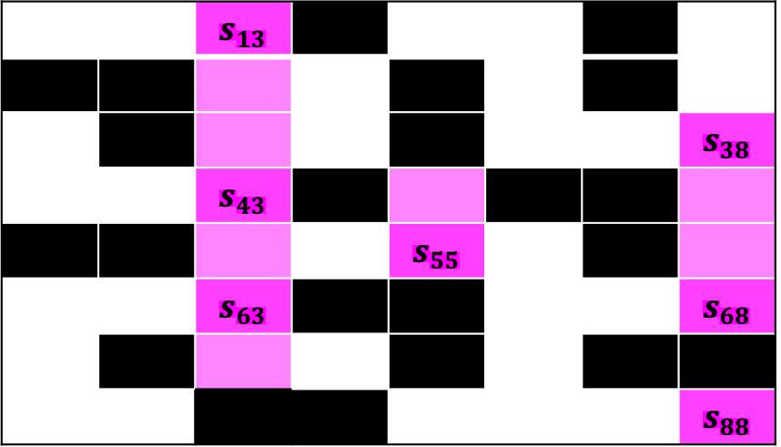
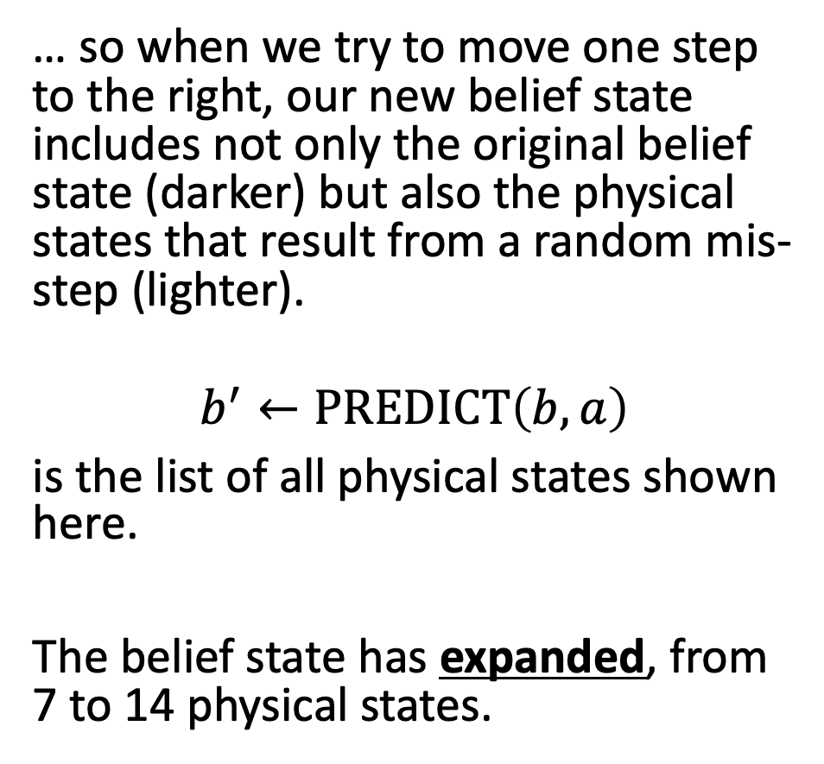
Stochastic partially observable environment
… so when we try to move one step to the right, our new belief state includes not only the original belief state (darker) but also the physical states that result from a random mis-step (lighter).
$$b^{′}←PREDICT\left(b,a\right)$$
is the list of all physical states shown here.
The belief state has expanded, from 7 to 14 physical states.
 |  | $$s_{13}$$
 |  |  |  |  |  |  | $$s_{38}$$
 |  | $$s_{43}$$
 |  |  |  | $$s_{55}$$
 |  | $$s_{63}$$ |  |  |  |  | $$s_{68}$$
 |  |  |  |  |  |  | $$s_{88}$$
??

Slide 28
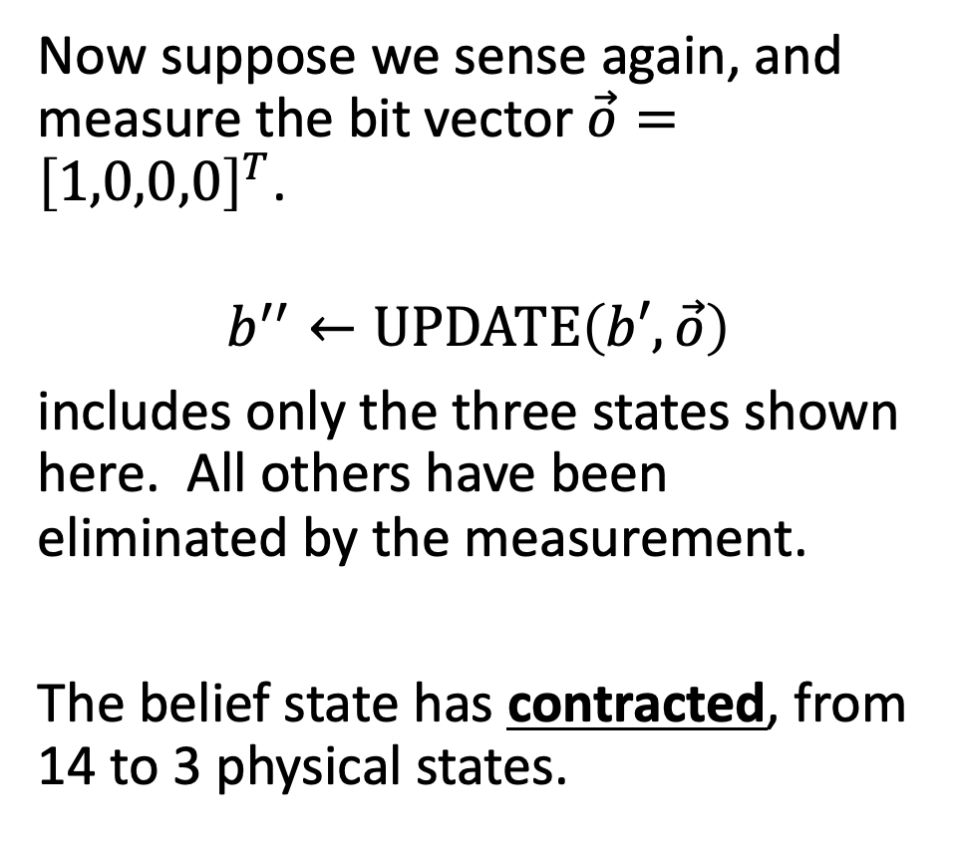
Stochastic partially observable environment
Now suppose we sense again, and measure the bit vector $\vec{o}={\left[1,0,0,0\right]}^{T}$.
$$b^{′′}←UPDATE\left(b′,\vec{o}\right)$$
includes only the three states shown here. All others have been eliminated by the measurement.
The belief state has contracted, from 14 to 3 physical states.
 |  |  |  |  |  |  | $$s_{38}$$
 |  | $$s_{43}$$
 |  | $$s_{63}$$
??

Slide 29
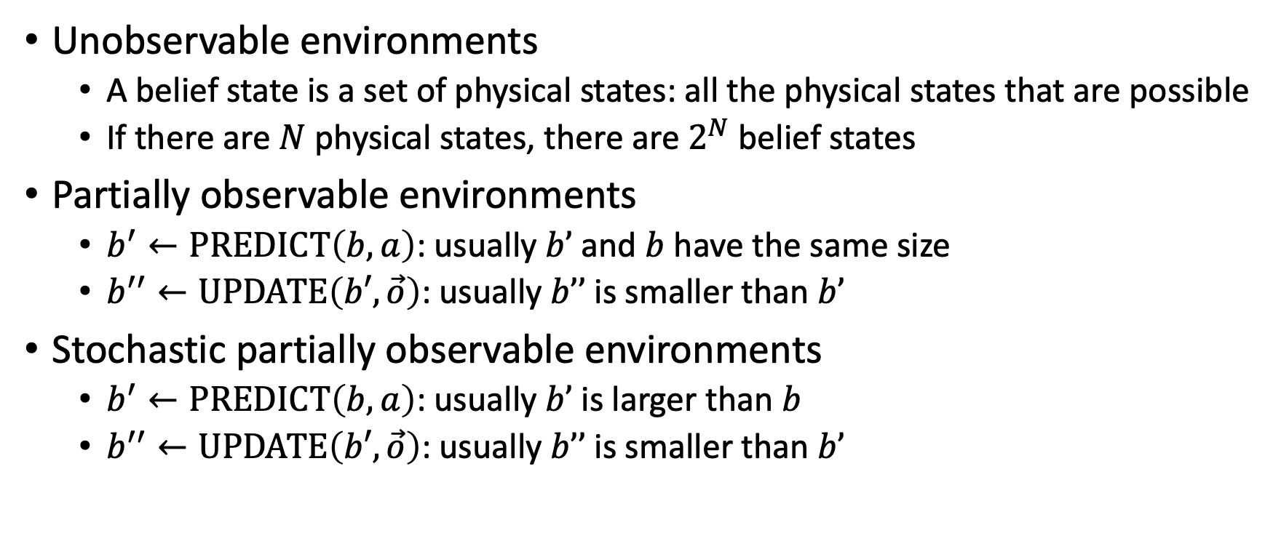
Content
Unobservable environments
A belief state is a set of physical states: all the physical states that are possible
If there are $N$ physical states, there are $2^{N}$ belief states
Partially observable environments
$b^{′}←PREDICT\left(b,a\right)$: usually $b’$ and $b$ have the same size
$b^{′′}←UPDATE\left(b′,\vec{o}\right)$: usually $b’’$ is smaller than $b’$
Stochastic partially observable environments
$b^{′}←PREDICT\left(b,a\right)$: usually $b’$ is larger than $b$
$b^{′′}←UPDATE\left(b′,\vec{o}\right)$: usually $b’’$ is smaller than $b’$

