Slide 1
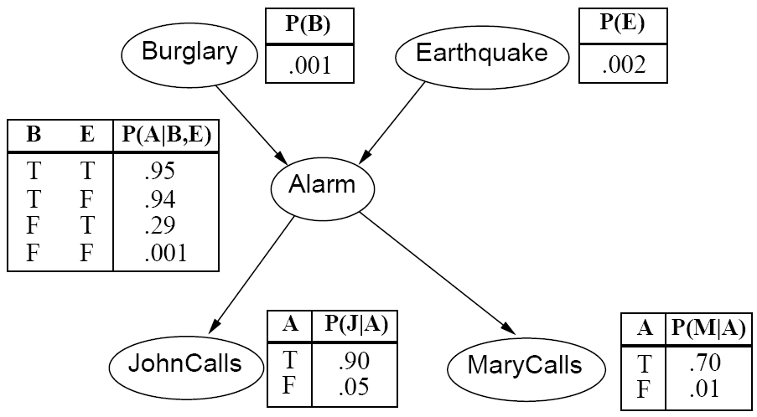
CS440/ECE448 Lecture 20: Bayesian Networks
Mark Hasegawa-Johnson, 3/2022
License: CC-BY 4.0: You may redistribute or remix if you cite the source.

Slide 2
Outline
Why Bayes nets? The complexity of a true Bayes classifier
Space complexity
Time complexity
Independence and Conditional independence

Slide 3
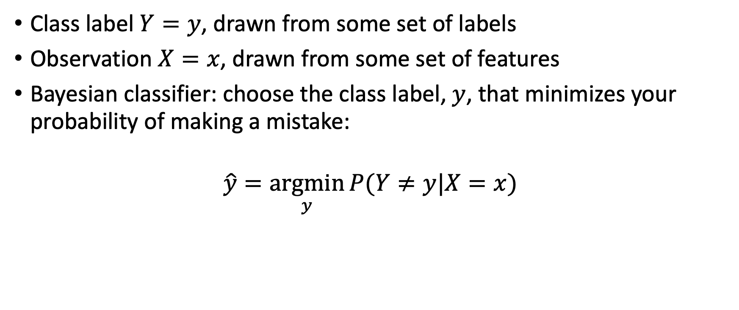
Review: Bayesian Classifier
Class label $Y=y$, drawn from some set of labels
Observation $X=x$, drawn from some set of features
Bayesian classifier: choose the class label, $y$, that minimizes your probability of making a mistake:
$$\hat{y}=\underset{y}{argmin}{P(Y≠y|X=x) }$$

Slide 4
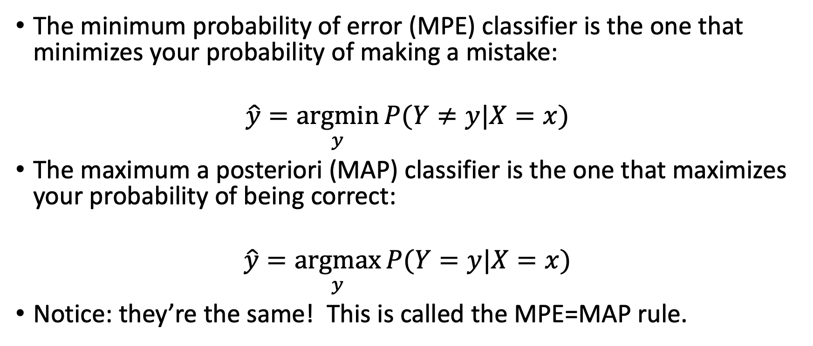
Minimum Probability of Error = Maximum A Posteriori
The minimum probability of error (MPE) classifier is the one that minimizes your probability of making a mistake:
$$\hat{y}=\underset{y}{argmin}{P(Y≠y|X=x) }$$
The maximum a posteriori (MAP) classifier is the one that maximizes your probability of being correct:
$$\hat{y}=\underset{y}{argmax}{P(Y=y|X=x) }$$
Notice: they’re the same! This is called the MPE=MAP rule.

Slide 5
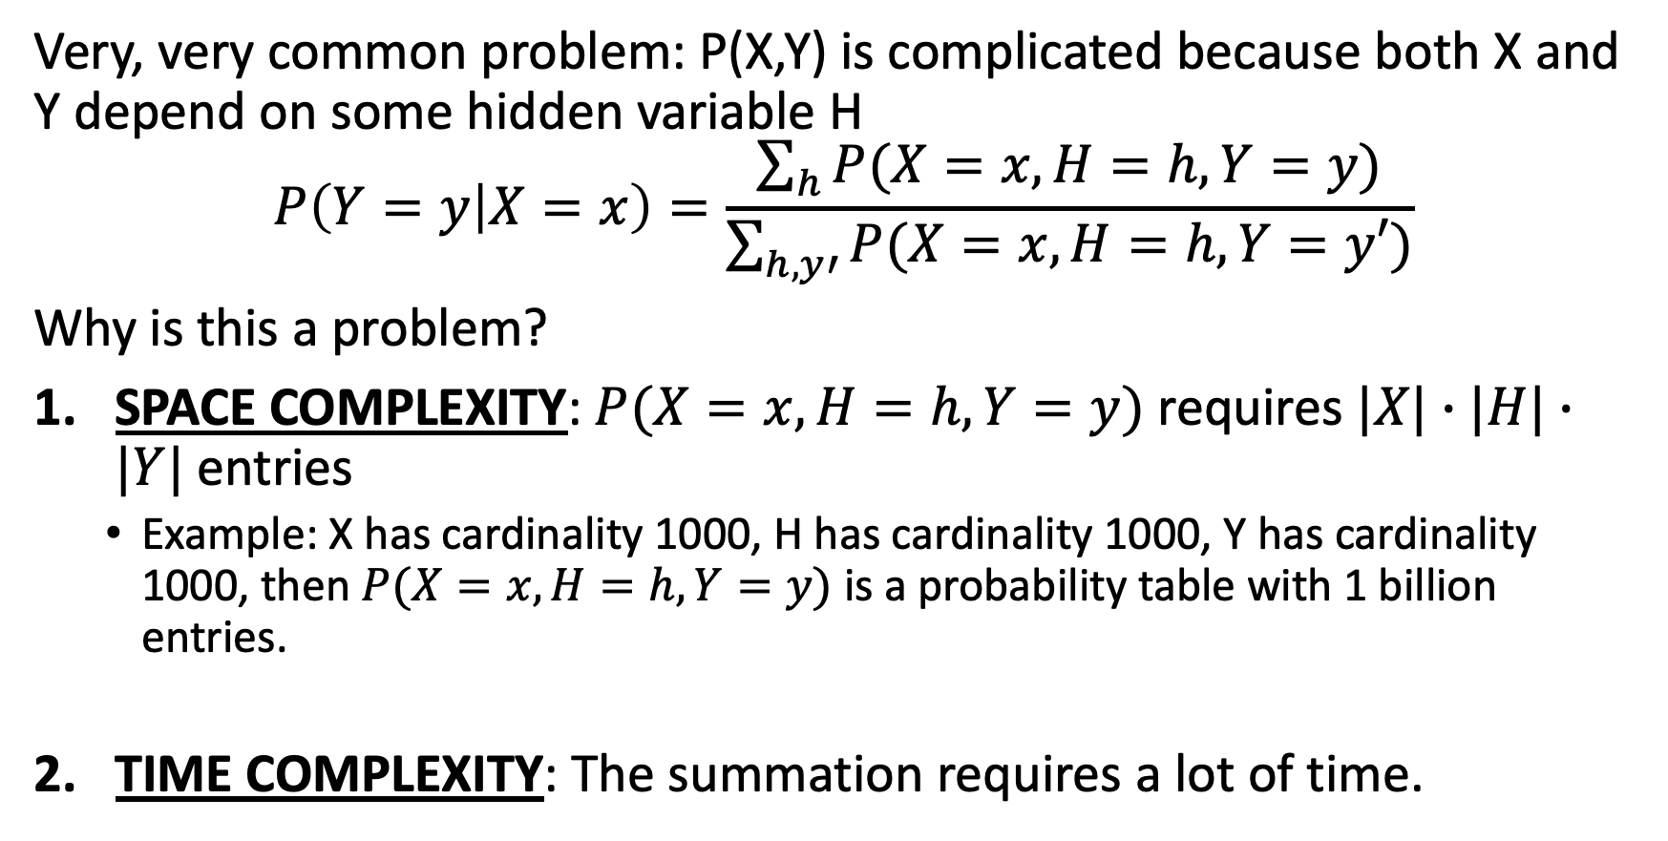
Today: What if P(X,Y) is complicated?
Very, very common problem: P(X,Y) is complicated because both X and Y depend on some hidden variable H
$$P\left(Y=y | X=x\right)=\frac{\sum_{h}{P(X=x,H=h,Y=y)}}{\sum_{h,y′}{P(X=x,H=h,Y=y′)}}$$
Why is this a problem?
SPACE COMPLEXITY: $P(X=x,H=h,Y=y)$ requires $|X|∙|H|∙|Y|$entries
Example: X has cardinality 1000, H has cardinality 1000, Y has cardinality 1000, then $P(X=x,H=h,Y=y)$ is a probability table with 1 billion entries.
TIME COMPLEXITY: The summation requires a lot of time.

Slide 6
Outline
Why Bayes nets? The complexity of a true Bayes classifier
Space complexity
Time complexity
Independence and Conditional independence

Slide 7
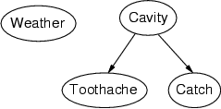
Bayesian networks: Structure
Nodes: random variables
Arcs: interactions
An arrow from one variable to another indicates direct causal influence of variable #1 on variable #2
Must form a directed, acyclic graph

Slide 8
Conditional independence and the joint distribution
Key property: each node is conditionally independent of its non-descendants given its parents
Suppose the nodes X₁, …, X_{n} are sorted in topological order
To get the joint distribution P(X₁, …, X_{n}), use chain rule:

Slide 9

Example: Los Angeles Burglar Alarm
I have a burglar alarm that is sometimes set off by minor earthquakes. My two neighbors, John and Mary, promised to call me at work if they hear the alarm
Example inference task: suppose Mary calls and John doesn’t call. What is the probability of a burglary?
What are the random variables?
Burglary, Earthquake, Alarm, John, Mary
What are the direct influence relationships?
A burglar can set the alarm off
An earthquake can set the alarm off
The alarm can cause Mary to call
The alarm can cause John to call

Slide 10
Example: Burglar Alarm

Slide 11
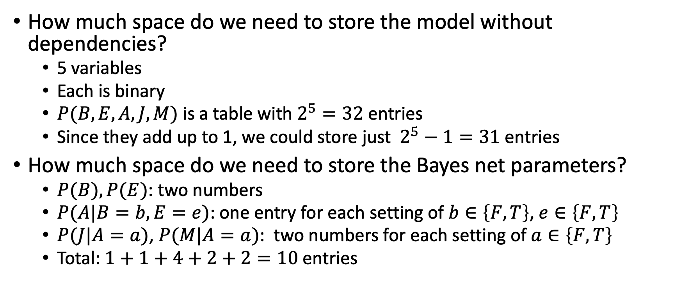
Space complexity: LA Burglar Alarm
How much space do we need to store the model without dependencies?
5 variables
Each is binary
$P(B,E,A,J,M)$ is a table with $2^{5}=32$ entries
Since they add up to 1, we could store just $2^{5}−1=31$ entries
How much space do we need to store the Bayes net parameters?
$P(B), P(E)$: two numbers
$P(A|B=b,E=e)$: one entry for each setting of $b∈\left\{F,T\right\}$, $e∈\left\{F,T\right\}$
$P(J|A=a)$, $P(M|A=a)$: two numbers for each setting of $a∈\left\{F,T\right\}$
Total: $1+1+4+2+2=10$ entries

Slide 12
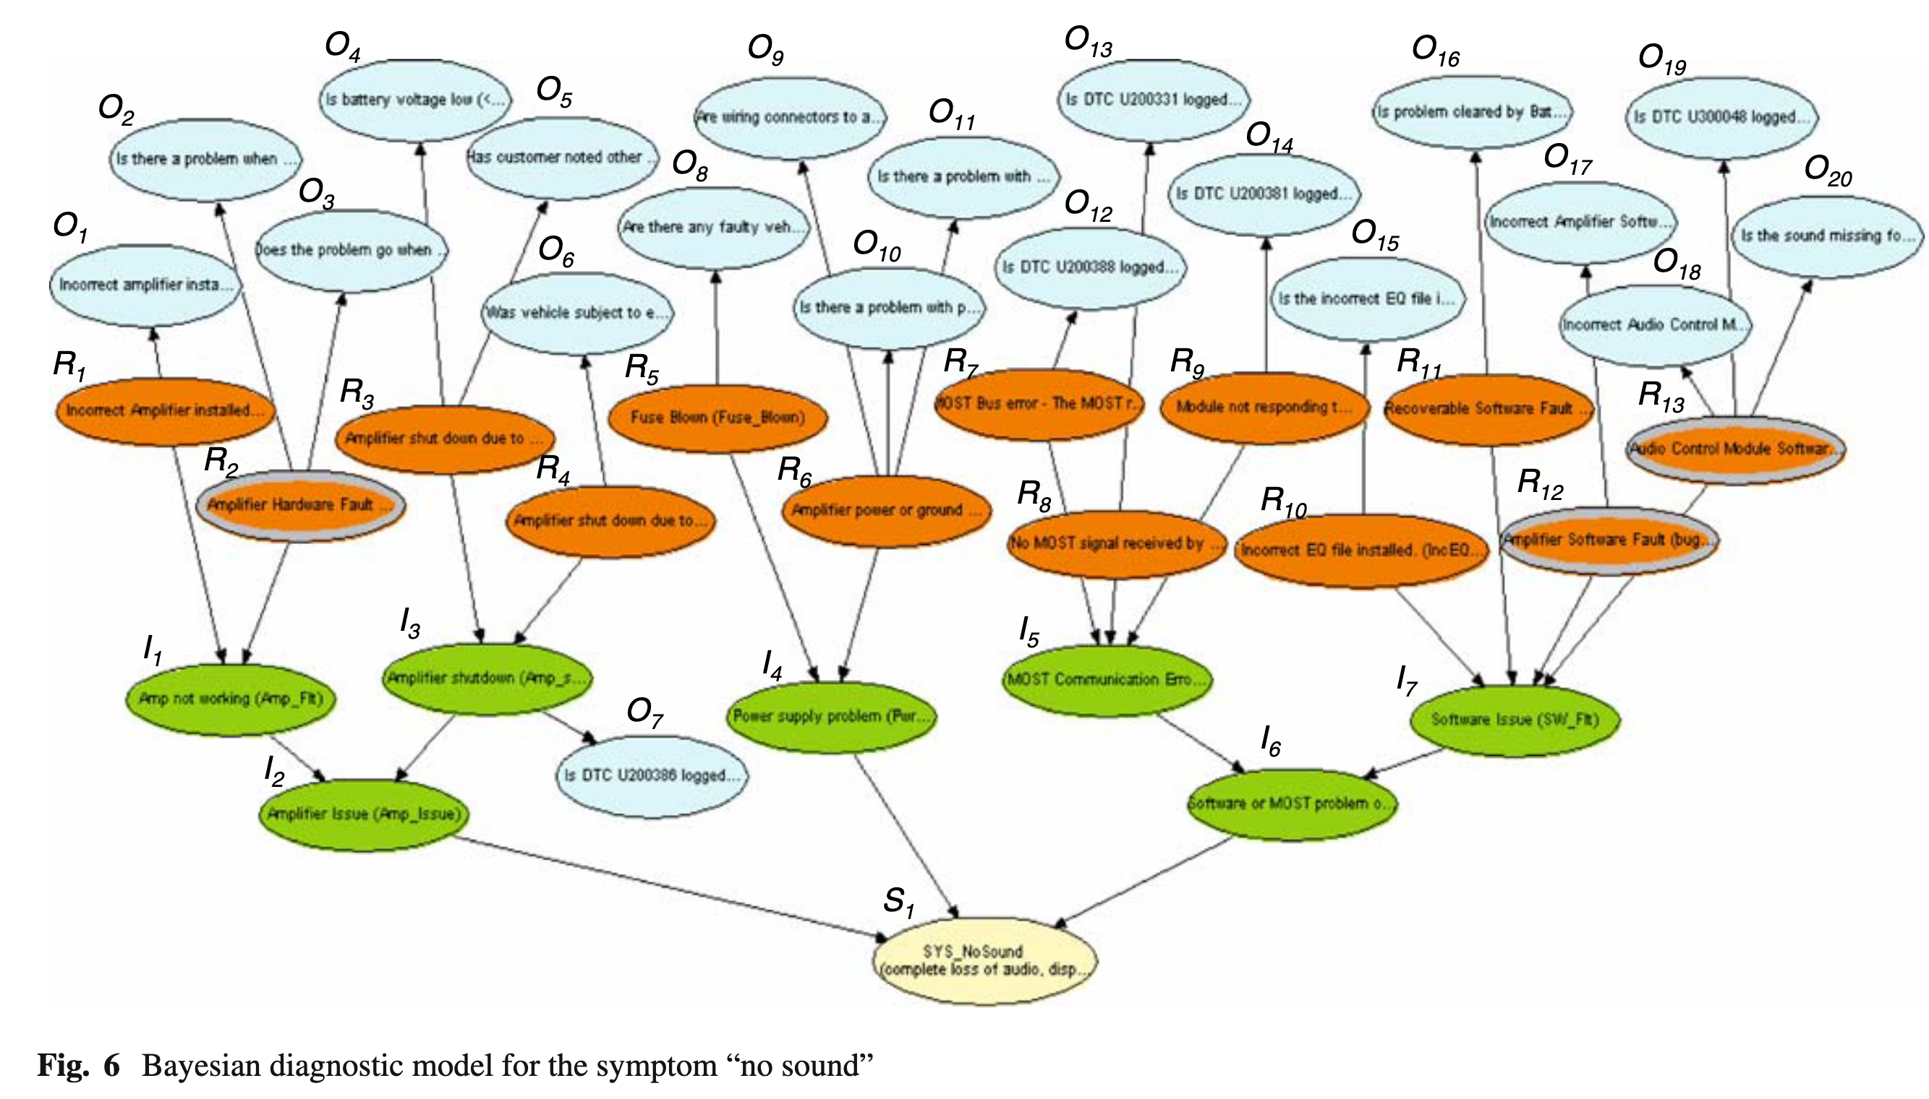
Huang, McMurran, Dhadyalla & Jones, ”Probability-based vehicle fault diagnosis: Bayesian network method,” 2008

Slide 13
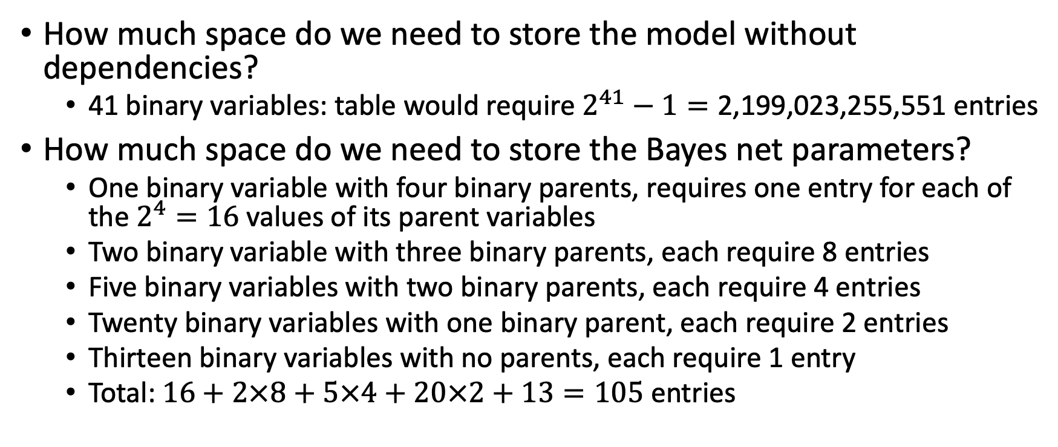
Space complexity, Huang et al. “no sound” diagnosis model
How much space do we need to store the model without dependencies?
41 binary variables: table would require $2^{41}−1=\text{2}\text{,}\text{199}\text{,}\text{023}\text{,}\text{255}\text{,}\text{55}\text{1}$ entries
How much space do we need to store the Bayes net parameters?
One binary variable with four binary parents, requires one entry for each of the $2^{4}=16$ values of its parent variables
Two binary variable with three binary parents, each require 8 entries
Five binary variables with two binary parents, each require 4 entries
Twenty binary variables with one binary parent, each require 2 entries
Thirteen binary variables with no parents, each require 1 entry
Total: $16+2×8+5×4+20×2+13=105$ entries

Slide 14





Example: Burglar Alarm
$$P(B)$$
$$P(E)$$
A “model” is a complete specification of the dependencies.
The conditional probability tables are the model parameters.
$$P(A|B,E)$$
$$P(J|A)$$
$$P(M|A)$$

Slide 15
Outline
Why Bayes nets? The complexity of a true Bayes classifier
Space complexity
Time complexity
Independence and Conditional independence

Slide 16
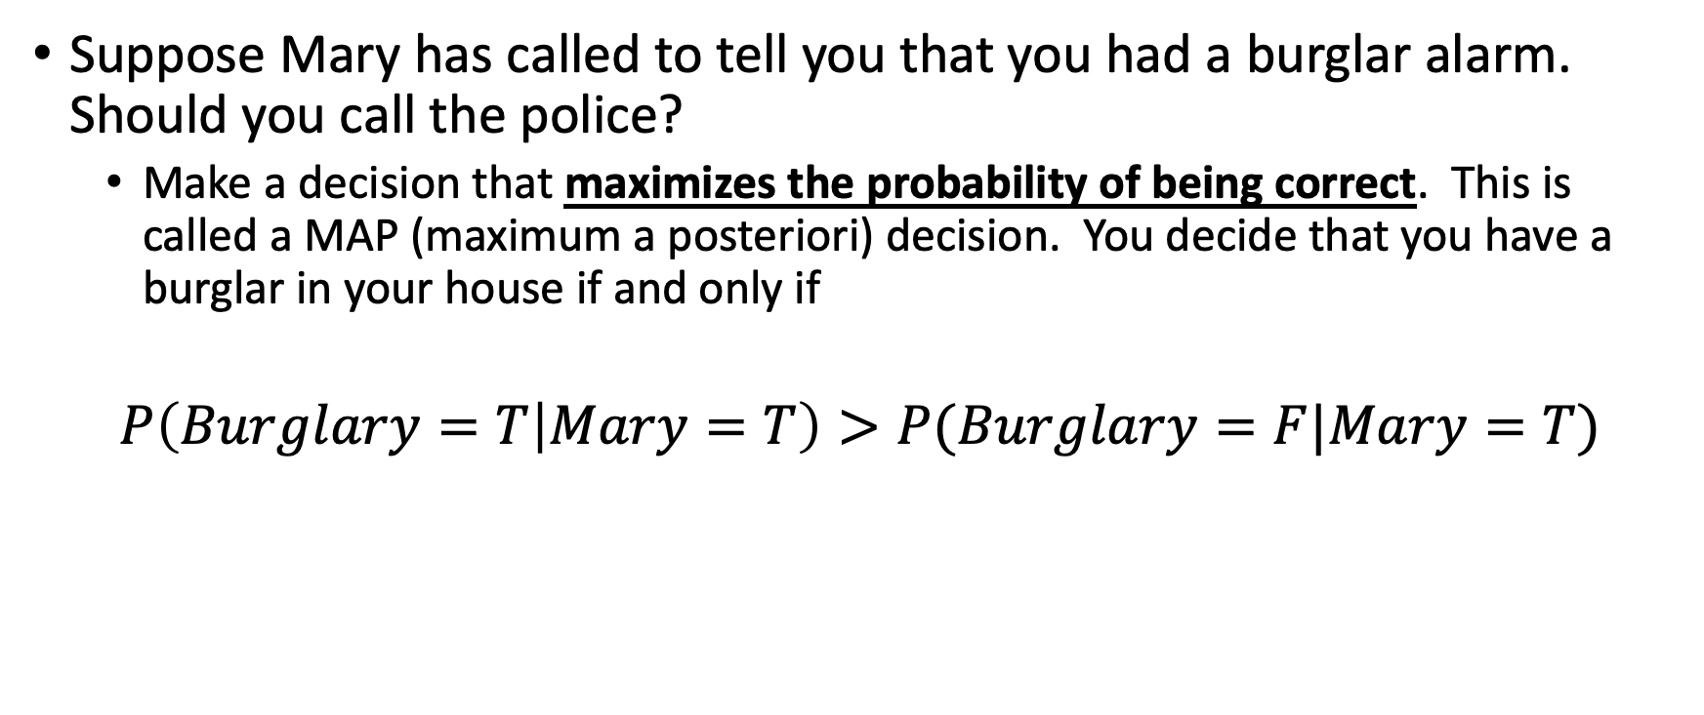
Classification using probabilities
Suppose Mary has called to tell you that you had a burglar alarm. Should you call the police?
Make a decision that maximizes the probability of being correct. This is called a MAP (maximum a posteriori) decision. You decide that you have a burglar in your house if and only if
$$P\left(Burglary=T | Mary=T\right)>P(Burglary=F|Mary=T)$$

Slide 17
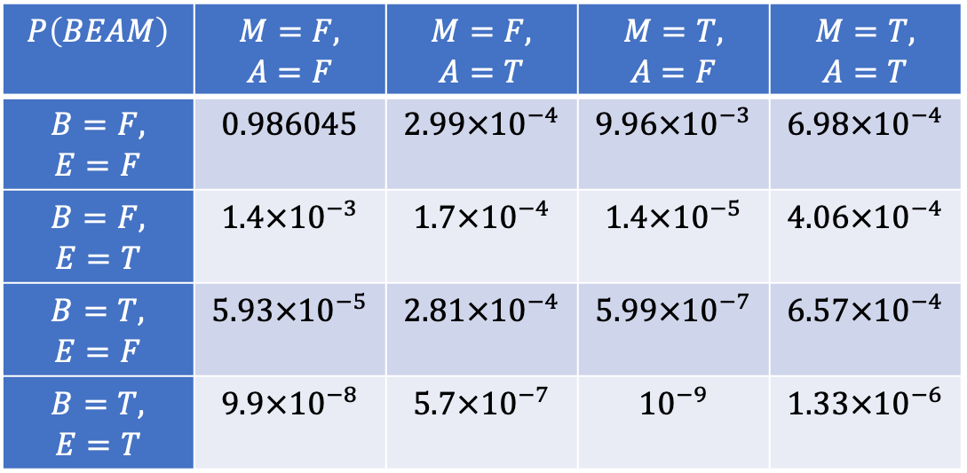
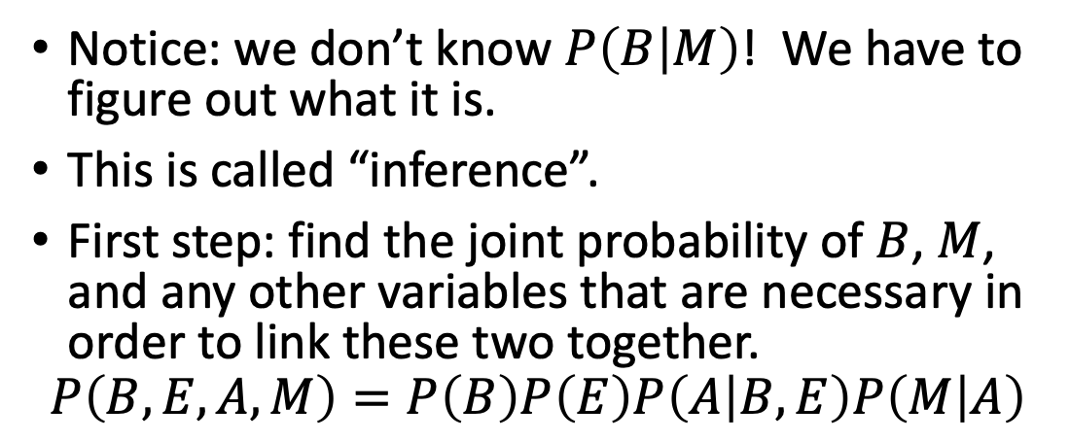
Using a Bayes network to estimate a posteriori probabilities
Notice: we don’t know $P\left(B | M\right)$! We have to figure out what it is.
This is called “inference”.
First step: find the joint probability of $B$, $M$, and any other variables that are necessary in order to link these two together.
$$P\left(B,E,A,M\right)=P\left(B\right)P\left(E\right)P\left(A | B,E\right)P\left(M | A\right)$$
$$P\left(BEAM\right)$$ | $$M=F,$$ $$A=F$$ | $$M=F,$$ $$A=T$$ | $$M=T,$$ $$A=F$$ | $$M=T,$$ $$A=T$$
$$B=F,$$ $$E=F$$ | $$0.986045$$ | $$2.99×{10}^{−4}$$ | $$9.96×{10}^{−3}$$ | $$6.98×{10}^{−4}$$
$$B=F,$$ $$E=T$$ | $$1.4×{10}^{−3}$$ | $$1.7×{10}^{−4}$$ | $$1.4×{10}^{−5}$$ | $$4.06×{10}^{−4}$$
$$B=T,$$ $$E=F$$ | $$5.93×{10}^{−5}$$ | $$2.81×{10}^{−4}$$ | $$5.99×{10}^{−7}$$ | $$6.57×{10}^{−4}$$
$$B=T,$$ $$E=T$$ | $$9.9×{10}^{−8}$$ | $$5.7×{10}^{−7}$$ | $${10}^{−9}$$ | $$1.33×{10}^{−6}$$

Slide 18
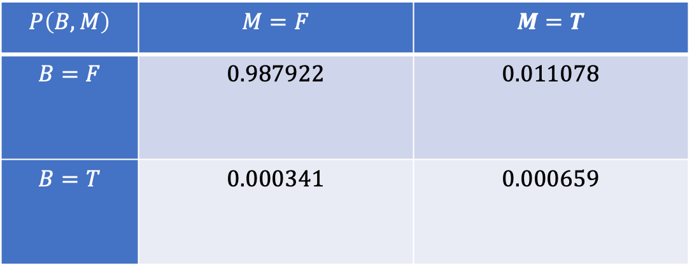
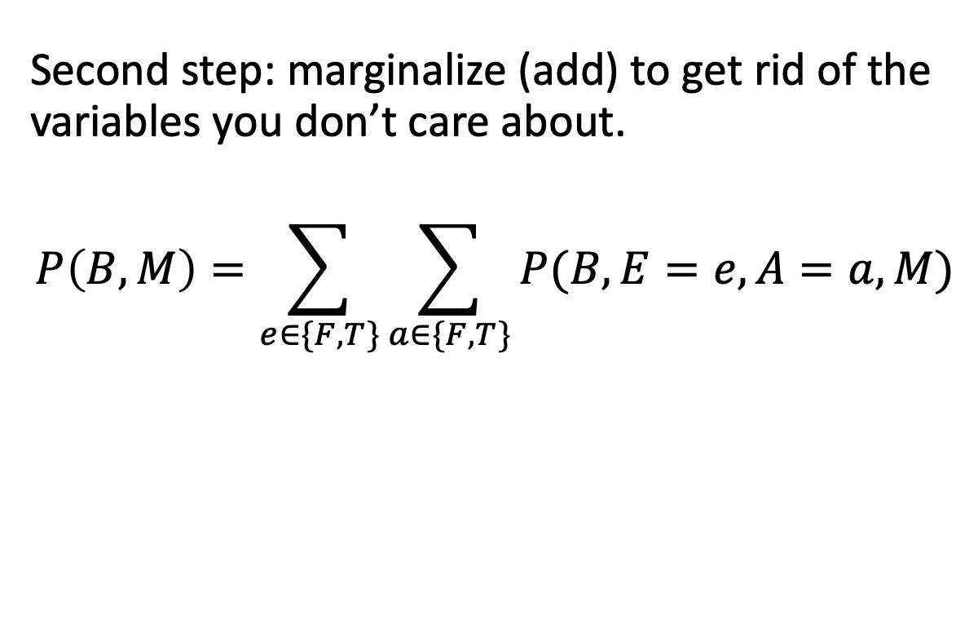
Using a Bayes network to estimate a posteriori probabilities
Second step: marginalize (add) to get rid of the variables you don’t care about.
$$P\left(B, M\right)=\sum_{e∈\{F,T\}}{\sum_{a∈\{F,T\}}{P(B,E=e,A=a,M)}}$$
$$P\left(B,M\right)$$ | $$M=F$$ | $$M=T$$
$$B=F$$ | $$0.987922$$ | $$0.011078$$
$$B=T$$ | $$0.000341$$ | $$0.000659$$

Slide 19
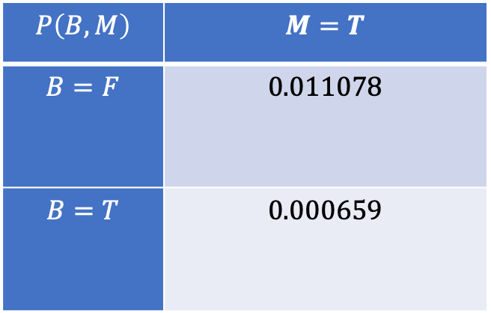
Using a Bayes network to estimate a posteriori probabilities
Third step: ignore (delete) the column that didn’t happen.
$$P\left(B,M\right)$$ | $$M=T$$
$$B=F$$ | $$0.011078$$
$$B=T$$ | $$0.000659$$

Slide 20
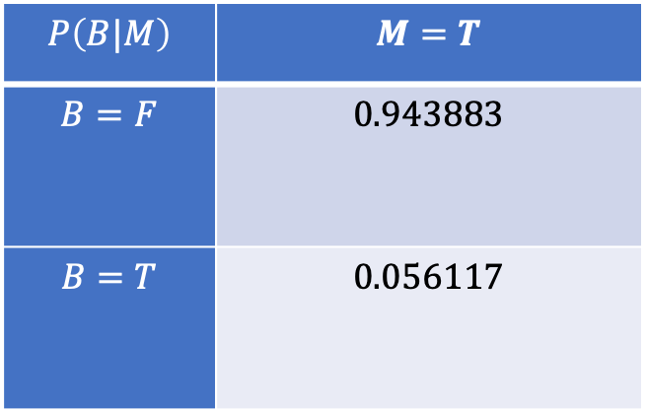
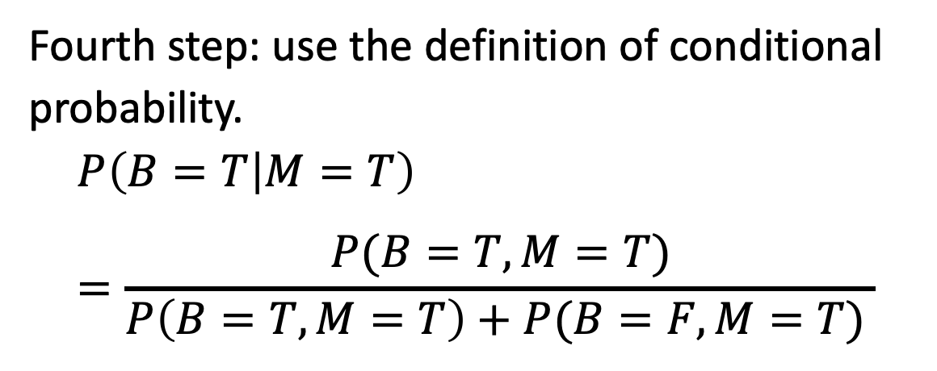
Using a Bayes network to estimate a posteriori probabilities
Fourth step: use the definition of conditional probability.
$$P\left(B=T | M=T\right)=\frac{P(B=T,M=T)}{P\left(B=T,M=T\right)+P(B=F, M=T) }$$
$$P\left(B|M\right)$$ | $$M=T$$
$$B=F$$ | $$0.943883$$
$$B=T$$ | $$0.056117$$

Slide 21
Some unexpected conclusions
Burglary is so unlikely that, if only Mary calls or only John calls, the probability of a burglary is still only about 5%.
If both Mary and John call, the probability is ~50%.

Slide 22


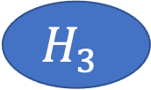
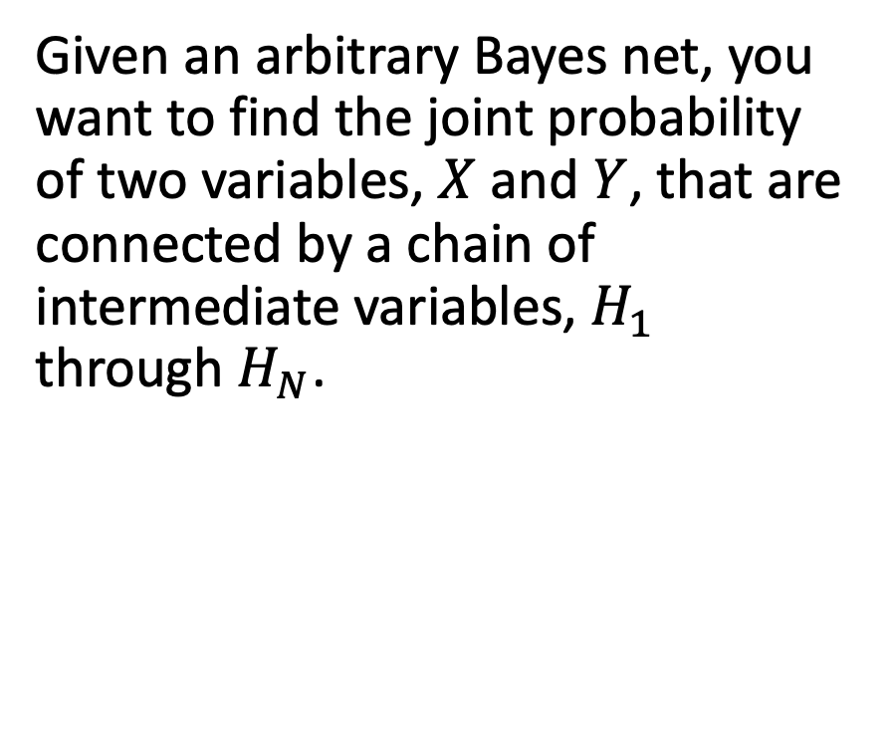
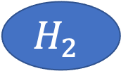



Belief propagation: The general algorithm
$$X$$
Given an arbitrary Bayes net, you want to find the joint probability of two variables, $X$ and $Y$, that are connected by a chain of intermediate variables, $H_{1}$ through $H_{N}$.
$$H_{1}$$
$$H_{2}$$
$$H_{3}$$
$$H_{4}$$
$$H_{5}$$
$$Y$$

Slide 23
Belief propagation: The general algorithm
$$X$$
Initialize:
Start with P(X)
Iterate:
PRODUCT: Multiply in the next variable
SUM: Marginalize out any variables you no longer need
Terminate:
When you have P(X,Y)
$$H_{1}$$
$$H_{2}$$
$$H_{3}$$
$$H_{4}$$
$$H_{5}$$
$$Y$$

Slide 24
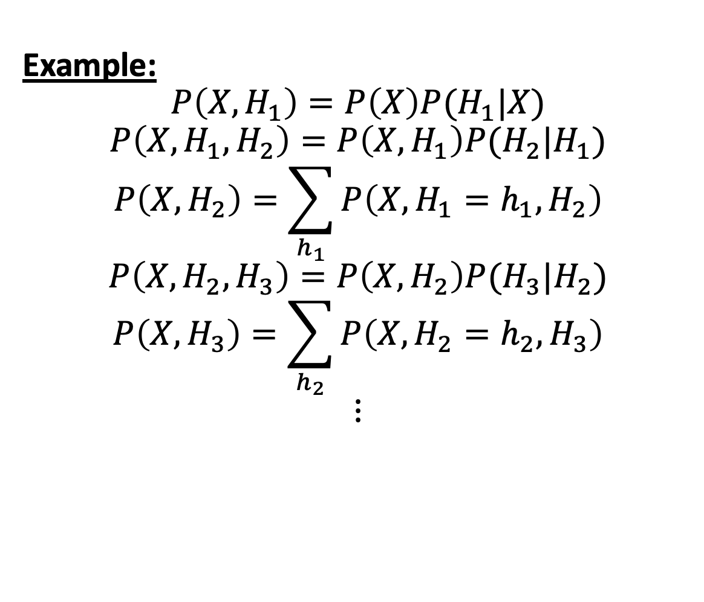
Belief propagation: The general algorithm
$$X$$
Example:
$$P\left(X,H_{1}\right)=P\left(X\right)P(H_{1}|X)$$
$$P\left(X,H_{1},H_{2}\right)=P\left(X,H_{1}\right)P(H_{2}|H_{1})$$
$$P\left(X,H_{2}\right)=\sum_{h_{1}}{P\left(X,H_{1}=h_{1},H_{2}\right)}$$
$$P\left(X,H_{2},H_{3}\right)=P\left(X,H_{2}\right)P(H_{3}|H_{2})$$
$$P\left(X,H_{3}\right)=\sum_{h_{2}}{P\left(X,H_{2}=h_{2},H_{3}\right)}$$
$$⋮$$
$$H_{1}$$
$$H_{2}$$
$$H_{3}$$
$$H_{4}$$
$$H_{5}$$
$$Y$$

Slide 25
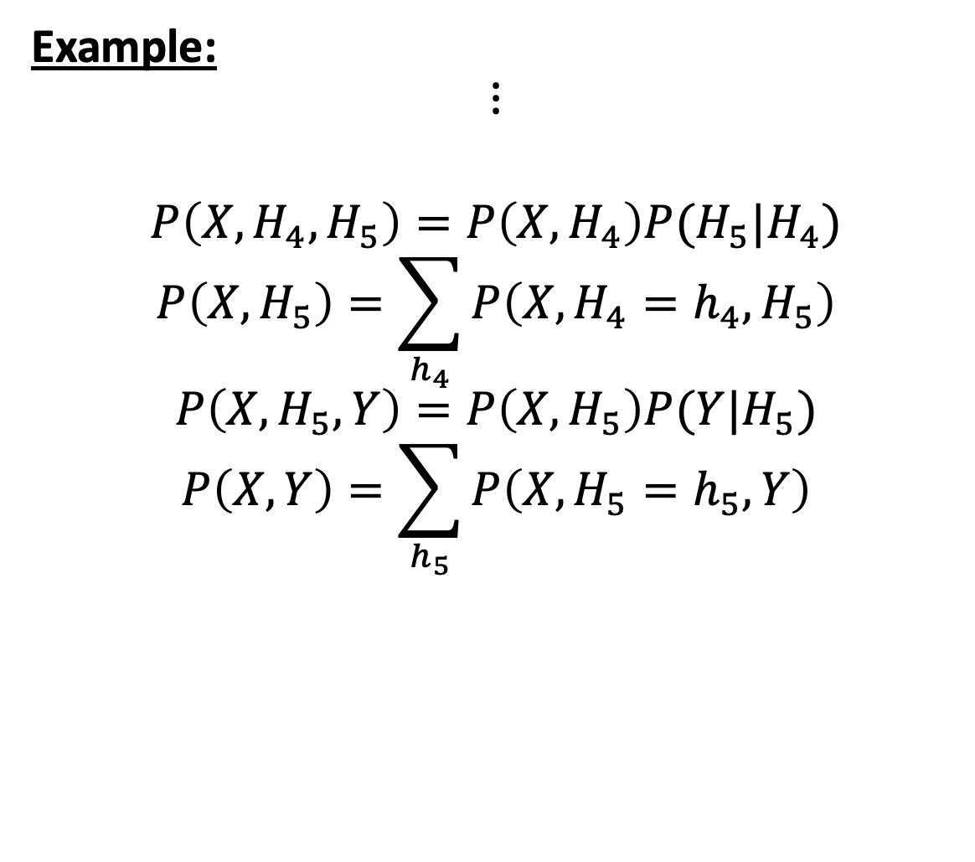
Belief propagation: The general algorithm
$$X$$
Example:
$$⋮$$
$$P\left(X,H_{4},H_{5}\right)=P\left(X,H_{4}\right)P(H_{5}|H_{4})$$
$$P\left(X,H_{5}\right)=\sum_{h_{4}}{P\left(X,H_{4}=h_{4},H_{5}\right)}$$
$$P\left(X,H_{5},Y\right)=P\left(X,H_{5}\right)P(Y|H_{5})$$
$$P\left(X,Y\right)=\sum_{h_{5}}{P\left(X,H_{5}=h_{5},Y\right)}$$
$$H_{1}$$
$$H_{2}$$
$$H_{3}$$
$$H_{4}$$
$$H_{5}$$
$$Y$$

Slide 26
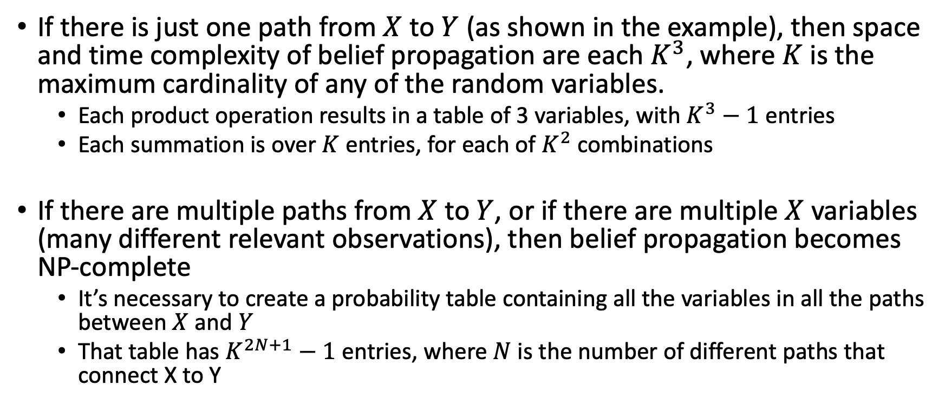
Belief propagation: Space and time complexity
If there is just one path from $X$ to $Y$ (as shown in the example), then space and time complexity of belief propagation are each $K^{3}$, where $K$ is the maximum cardinality of any of the random variables.
Each product operation results in a table of 3 variables, with $K^{3}−1$ entries
Each summation is over $K$ entries, for each of $K^{2}$ combinations
If there are multiple paths from $X$ to $Y$, or if there are multiple $X$ variables (many different relevant observations), then belief propagation becomes NP-complete
It’s necessary to create a probability table containing all the variables in all the paths between $X$ and $Y$
That table has $K^{2N+1}−1$ entries, where $N$ is the number of different paths that connect X to Y

Slide 27
Outline
Why Bayes nets? The complexity of a true Bayes classifier
Space complexity
Time complexity
Independence and Conditional independence

Slide 28
Using a Bayes network to estimate a posteriori probabilities
Fourth step: use the definition of conditional probability.
$$P\left(B=T | M=T\right)=\frac{P(B=T,M=T)}{P\left(B=T,M=T\right)+P(B=F, M=T) }$$
$$P\left(B|M\right)$$ | $$M=T$$
$$B=F$$ | $$0.943883$$
$$B=T$$ | $$0.056117$$

Slide 29
Some unexpected conclusions
If only Mary calls or only John calls, the probability of a burglary is about 5% or 6%.
unless …
If you know that there was an earthquake, then it’s very likely that the alarm was caused by the earthquake. In that case, the probability you had a burglary is vanishingly small, even if twenty of your neighbors call you.
This is called the “explaining away” effect. The earthquake “explains away” the burglar alarm.

Slide 30
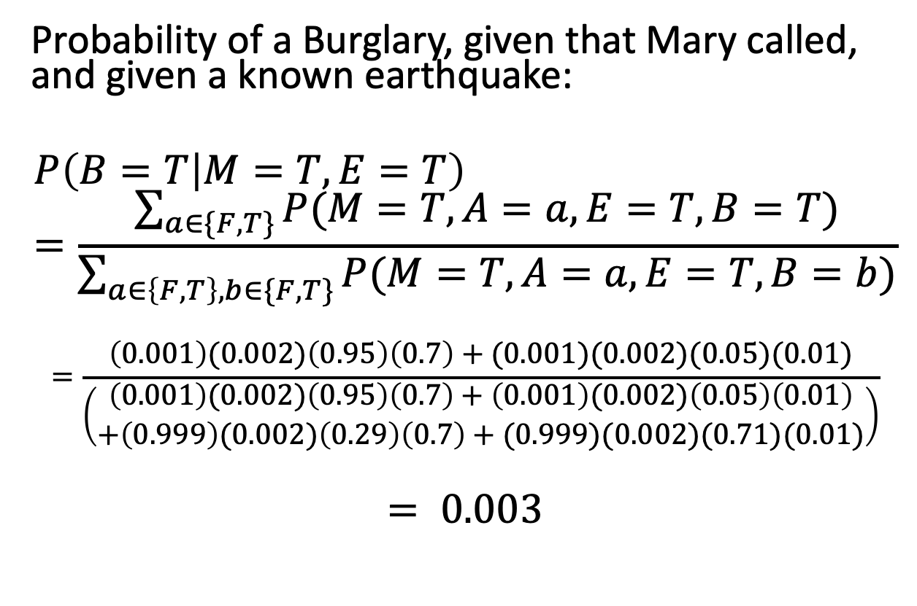
The “Explaining Away” Effect
Probability of a Burglary, given that Mary called, and given a known earthquake:
$$P\left(B=T | M=T,E=T\right)=\frac{\sum_{a∈\{F,T\}}{P(M=T,A=a,E=T,B=T)}}{\sum_{a∈\left\{F,T\right\},b∈\{F,T\}}{P(M=T,A=a,E=T,B=b)}}$$
$$=\frac{\left(0.001\right)(0.002)\left(0.95\right)\left(0.7\right)+(0.001)(0.002)(0.05)(0.01)}{\left(\begin{aligned}\left(0.001\right)(0.002)\left(0.95\right)\left(0.7\right)+\left(0.001\right)(0.002)\left(0.05\right)\left(0.01\right) \\ +\left(0.999\right)(0.002)\left(0.29\right)\left(0.7\right)+(0.999)(0.002)(0.71)(0.01)\end{aligned}\right)}$$
$$= 0.003$$

Slide 31
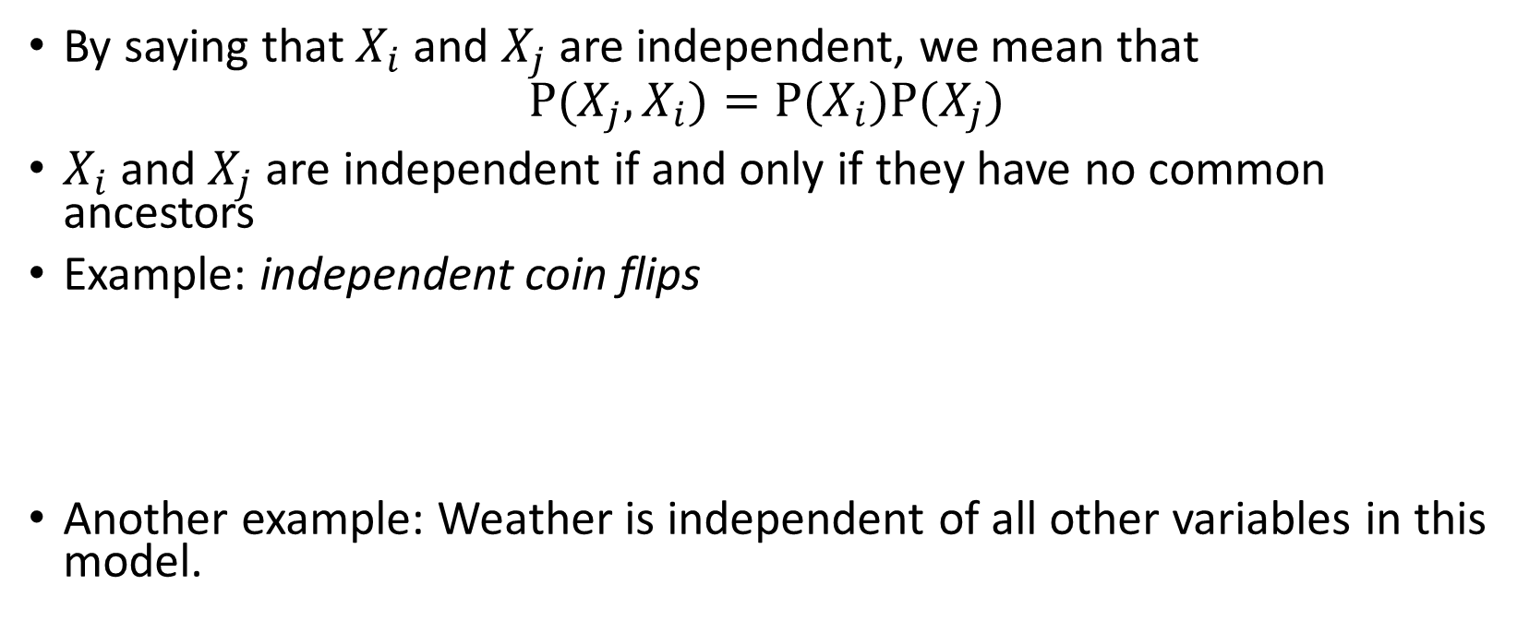
Independence
By saying that $X_{i}$and $X_{j}$are independent, we mean that
$$P(X_{j},X_{i})=P(X_{i})P(X_{j})$$
$X_{i}$and $X_{j}$ are independent if and only if they have no common ancestors
Example: independent coin flips
Another example: Weather is independent of all other variables in this model.
…
X₁
X₂
X_{n}

Slide 32
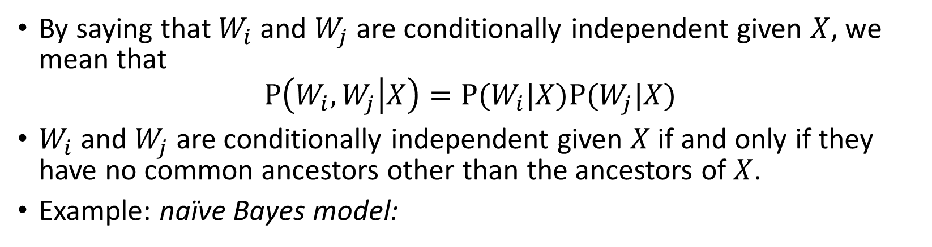
Conditional independence
By saying that $W_{i}$and $W_{j}$are conditionally independent given $X$, we mean that
$$P\left(W_{i},W_{j} | X\right)=P(W_{i}|X)P(W_{j}|X)$$
$W_{i}$and $W_{j}$are conditionally independent given $X$ if and only if they have no common ancestors other than the ancestors of $X$.
Example: naïve Bayes model:
X
…
W₁
W₂
W_{n}

Slide 33
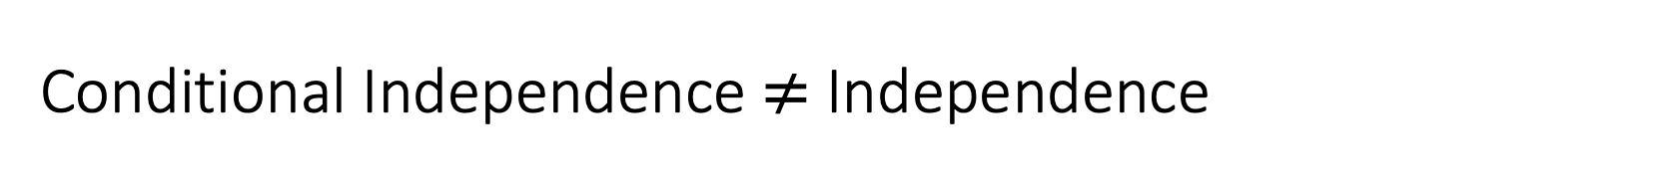
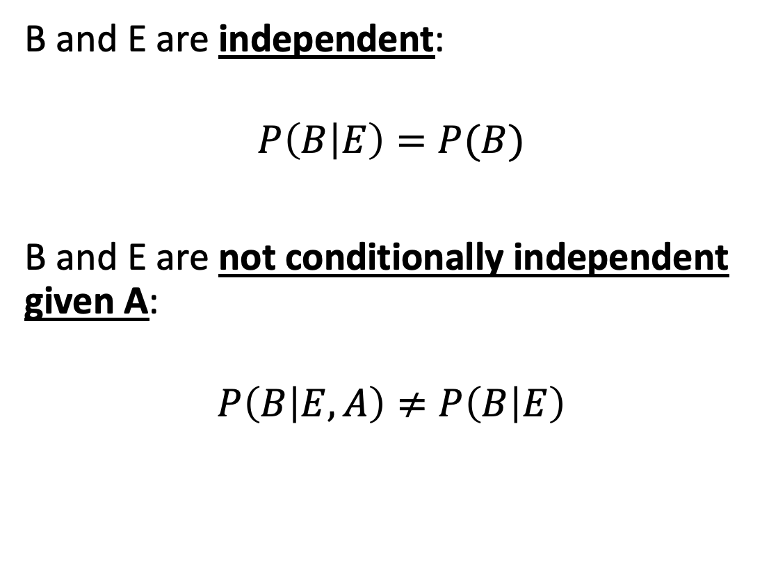
Conditional Independence $≠$ Independence
B and E are independent:
$$P\left(B | E\right)=P(B)$$
B and E are not conditionally independent given A:
$$P\left(B | E,A\right)≠P\left(B | E\right)$$

Slide 34
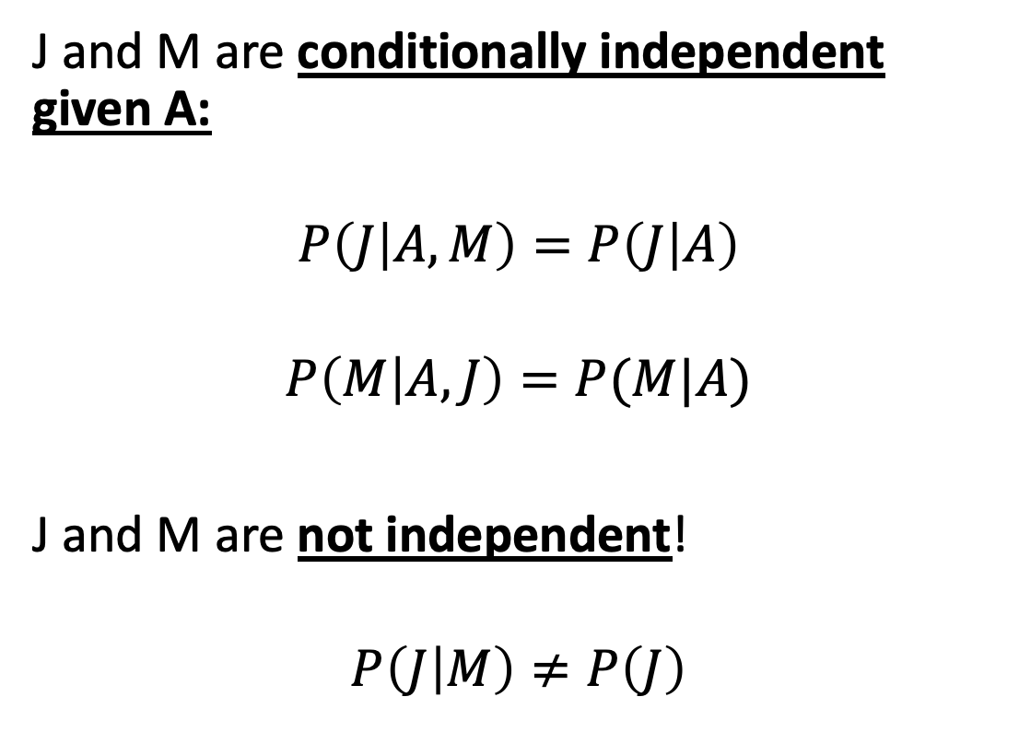
Conditional Independence $≠$ Independence
J and M are conditionally independent given A:
$$P\left(J | A,M\right)=P\left(J | A\right)$$
$$P\left(M | A,J\right)=P(M|A)$$
J and M are not independent!
$$P\left(J | M\right)≠P\left(J\right)$$

Slide 35
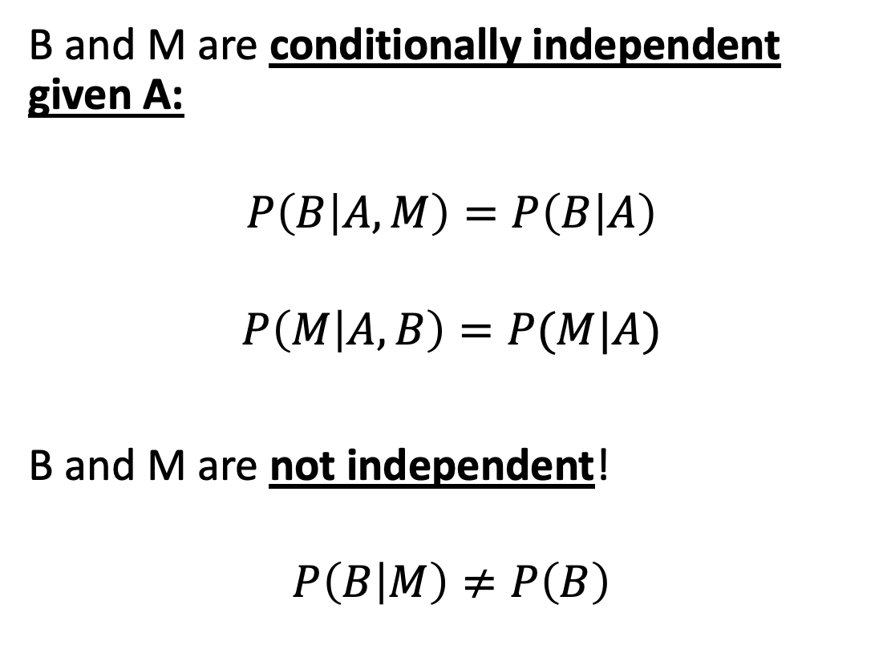
Conditional Independence $≠$ Independence
B and M are conditionally independent given A:
$$P\left(B | A,M\right)=P\left(B | A\right)$$
$$P\left(M | A,B\right)=P(M|A)$$
B and M are not independent!
$$P\left(B | M\right)≠P\left(B\right)$$

Slide 36
Conditional Independence $≠$ Independence
B and E (no common ancestor, common descendant A):
Independent
Not conditionally independent given A
J and M (common ancestor A, no common descendant):
Not independent
Conditionally independent given A
B and M (B is the ancestor of M):
Not independent
Conditionally independent given A

Slide 37

Conditional Independence $≠$ Independence
Variables in a Bayes net are independent if they have no common ancestors
If they have a common ancestor (e.g., J and M), they are not independent
If one is the ancestor of the other (e.g., B and M), they are not independent
Variables in a Bayes net are conditionally independent given knowledge of:
Their common ancestors, and
A variable that is a descendant of one, and an ancestor of the other

Slide 38
Outline
Understand Bayesian Networks
Why Bayes nets? The complexity of a true Bayes classifier
Space complexity
Time complexity
Independence and Conditional independence
Easily implement minimum-error classifiers with low space complexity
Succeed in life

