Slide 1


CS440/ECE448 Lecture 21:
Parameter Learning for Bayesian Networks
By Mark Hasegawa-Johnson, 3/2022
License: CC-BY 4.0
You may redistribute or remix if you cite the source.

Slide 2
Parameter Learning for Bayesian Networks
From observed data: Maximum likelihood
From observed data: Laplace smoothing
From partially observed data: Expectation maximization

Slide 3
Flying cows
The scenario:
Central Illinois has recently had a problem with flying cows.
Farmers have called the university to complain that their cows flew away.

Slide 4
Flying cows
The university dispatched a team of expert vaccavolatologists. They determined that almost all flying cows were explained by one or both of the following causes:
Smart cows. The cows learned how to fly, on their own, without help.
Alien intervention. UFOs taught the cows how to fly.

Slide 5
Flying cows
The vaccavolatologists created a Bayes net, to help them predict any future instances of cow flying:
P(A) = Probability that aliens teach the cow.
P(S) = Probability that a cow is smart enough to figure out how to fly on its own.
P(F|S,A) = Probability that a cow learns to fly.
A
S
F

Slide 6
Flying cows
A
S
F
Day | A | S | F
1
2 |  | T | T
3
4 | T | T | T
5 | T
6
7 | T |  | T
8
9 |  |  | T
10
They went out to watch a nearby pasture for ten days.
They reported the number of days on which A, S, and/or F occurred.
Their results are shown in the table at left (True is marked as “T”; False is shown with a blank).

Slide 7
Flying cows
A
S
F
Day | A | S | F
1
2 |  | T | T
3
4 | T | T | T
5 | T
6
7 | T |  | T
8
9 |  |  | T
10
The vaccavolatologists now wish to estimate the parameters of their Bayes net
P(A)
P(S)
P(F|S,A)
…so that they will be better able to testify before Congress about the relative dangers of aliens versus smart cows.

Slide 8
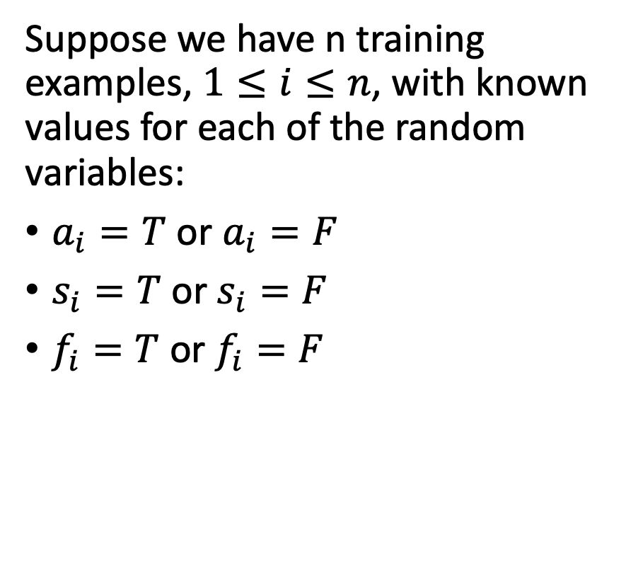
Maximum Likelihood Estimation
A
S
F
Day | A | S | F
1
2 |  | T | T
3
4 | T | T | T
5 | T
6
7 | T |  | T
8
9 |  |  | T
10
Suppose we have n training examples, $1≤i≤n$, with known values for each of the random variables:
$a_{i}=T$ or $a_{i}=F$
$s_{i}=T$ or $s_{i}=F$
$f_{i}=T$ or $f_{i}=F$

Slide 9
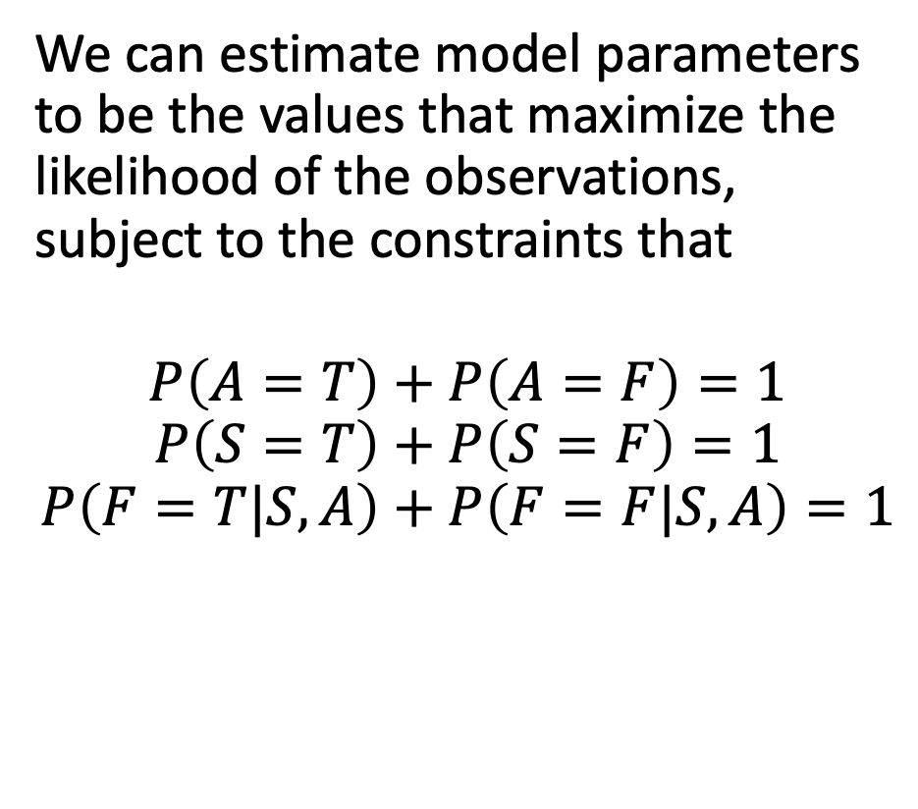
Maximum Likelihood Estimation
A
S
F
Day | A | S | F
1
2 |  | T | T
3
4 | T | T | T
5 | T
6
7 | T |  | T
8
9 |  |  | T
10
We can estimate model parameters to be the values that maximize the likelihood of the observations, subject to the constraints that
$$P\left(A=T\right)+P\left(A=F\right)=1$$
$$P\left(S=T\right)+P\left(S=F\right)=1$$
$$P\left(F=T|S,A\right)+P\left(F=F|S,A\right)=1$$

Slide 10
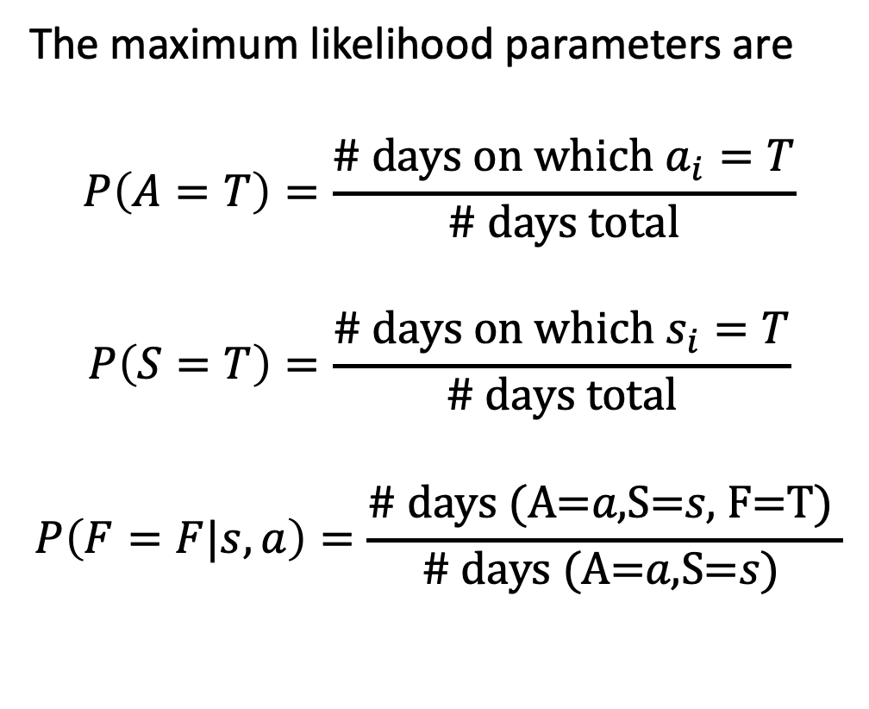
Maximum Likelihood Estimation
A
S
F
Day | A | S | F
1
2 |  | T | T
3
4 | T | T | T
5 | T
6
7 | T |  | T
8
9 |  |  | T
10
The maximum likelihood parameters are
$$P\left(A=T\right)=\frac{\# \text{days} \text{on} \text{which} a_{i}=T}{\# \text{days} \text{total}}$$
$$P\left(S=T\right)=\frac{\# \text{days} \text{on} \text{which} s_{i}=T}{\# \text{days} \text{total}}$$
$$P\left(F=F|s,a\right)=\frac{\text{\# }\text{days} \text{(}\text{A}\text{=}a\text{,}\text{S}\text{=}s\text{, }\text{F}\text{=}\text{T}\text{) }}{\text{\# }\text{days} \text{(}\text{A}\text{=}a\text{,}\text{S}\text{=}s\text{)} }$$

Slide 11
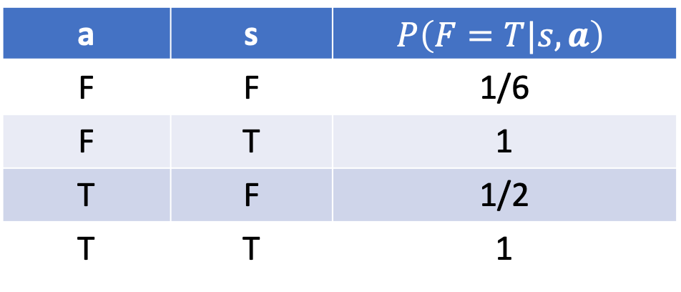
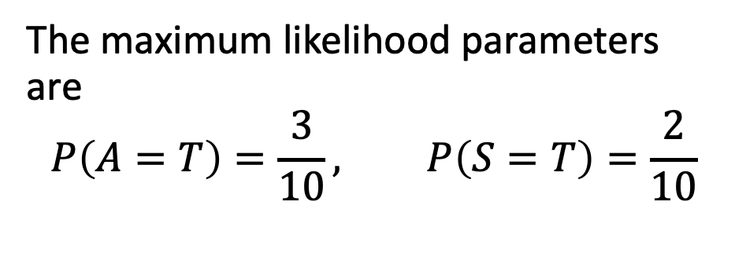
Maximum Likelihood Estimation
A
S
F
Day | A | S | F
1
2 |  | T | T
3
4 | T | T | T
5 | T
6
7 | T |  | T
8
9 |  |  | T
10
The maximum likelihood parameters are
$$P\left(A=T\right)=\frac{3}{10}, P\left(S=T\right)=\frac{2}{10}$$
a | s | $$P\left(F=T|s,a\right)$$
F | F | 1/6
F | T | 1
T | F | 1/2
T | T | 1

Slide 12
Conclusions: maximum likelihood estimation
Smart cows are far more dangerous than aliens.
Maximum likelihood estimation is very easy to use, IF you have training data in which the values of ALL variables are observed.

Slide 13
Parameter Learning for Bayesian Networks
From observed data: Maximum likelihood
From observed data: Laplace smoothing
From partially observed data: Expectation maximization

Slide 14
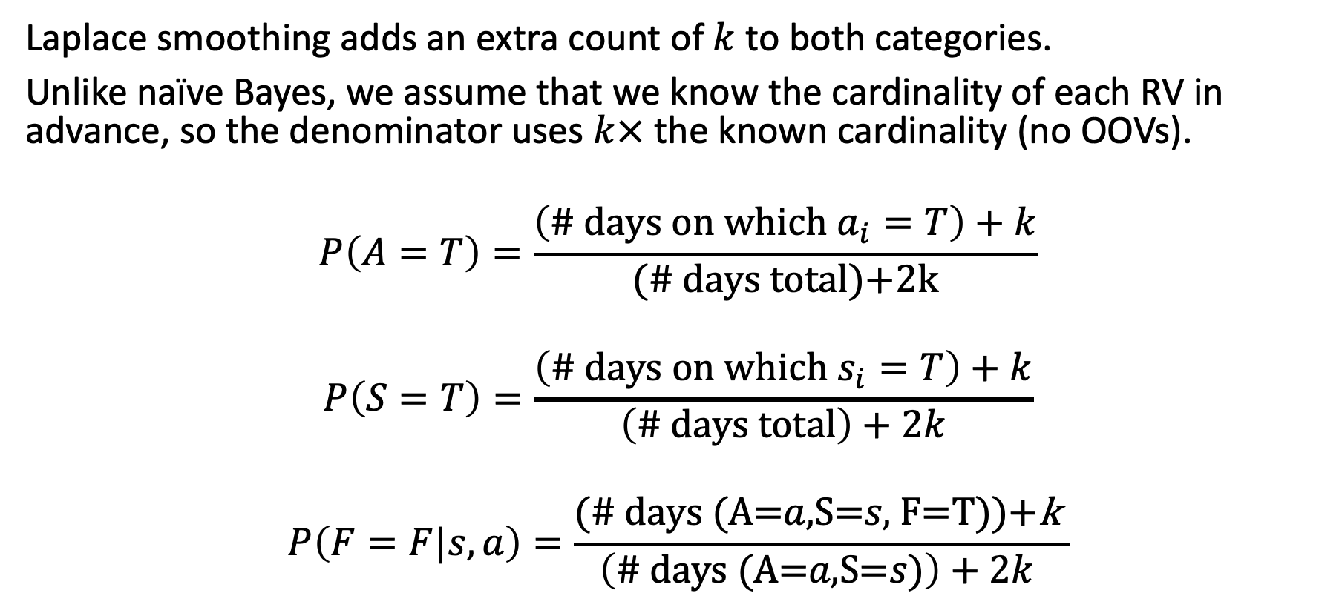
Laplace smoothing
A
S
F
Laplace smoothing adds an extra count of $k$ to both categories.
Unlike naïve Bayes, we assume that we know the cardinality of each RV in advance, so the denominator uses $k×$ the known cardinality (no OOVs).
$$P\left(A=T\right)=\frac{\left(\# \text{days} \text{on} \text{which} a_{i}=T\right)+k}{(\# \text{days} \text{total}\text{)+2}\text{k}}$$
$$P\left(S=T\right)=\frac{\left(\# \text{days} \text{on} \text{which} s_{i}=T\right)+k}{\left(\# \text{days} \text{total}\right)+2k}$$
$$P\left(F=F|s,a\right)=\frac{\text{(\# }\text{days} \text{(}\text{A}\text{=}a\text{,}\text{S}\text{=}s\text{, }\text{F}\text{=}\text{T}\text{))+}\text{k} }{\left(\text{\# }\text{days} \text{(}\text{A}\text{=}a\text{,}\text{S}\text{=}s\text{)}\right)+2k }$$

Slide 15
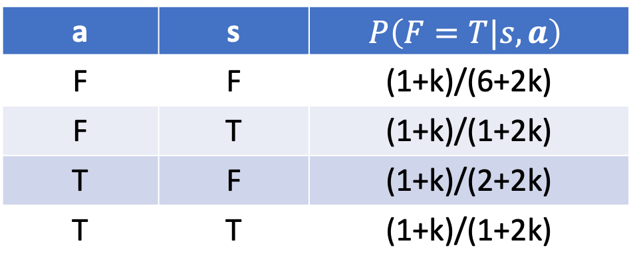
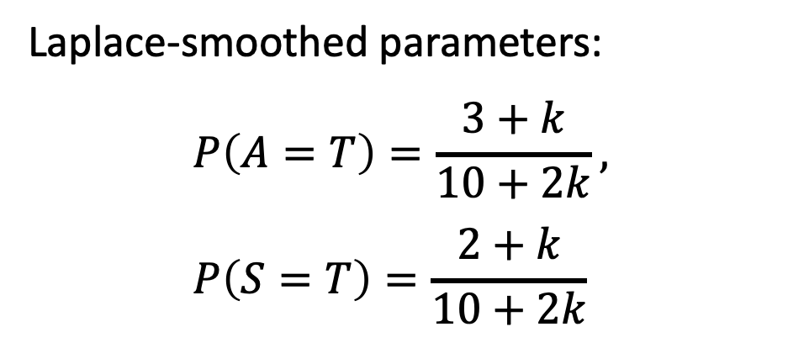
Laplace smoothing
A
S
F
Day | A | S | F
1
2 |  | T | T
3
4 | T | T | T
5 | T
6
7 | T |  | T
8
9 |  |  | T
10
Laplace-smoothed parameters:
$$P\left(A=T\right)=\frac{3+k}{10+2k}, P\left(S=T\right)=\frac{2+k}{10+2k}$$
a | s | $$P\left(F=T|s,a\right)$$
F | F | (1+k)/(6+2k)
F | T | (1+k)/(1+2k)
T | F | (1+k)/(2+2k)
T | T | (1+k)/(1+2k)

Slide 16
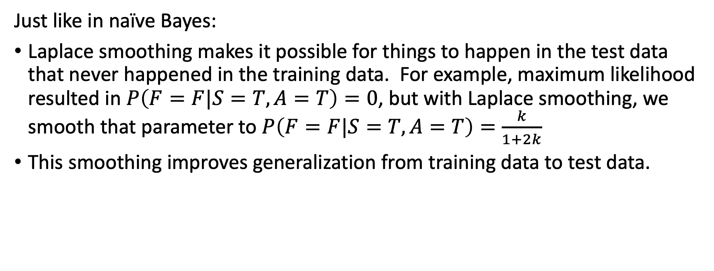
Conclusions: Laplace smoothing
Just like in naïve Bayes:
Laplace smoothing makes it possible for things to happen in the test data that never happened in the training data. For example, maximum likelihood resulted in $P\left(F=F|S=T,A=T\right)=0$, but with Laplace smoothing, we smooth that parameter to $P\left(F=F|S=T,A=T\right)=\frac{k}{1+2k}$
This smoothing improves generalization from training data to test data.

Slide 17
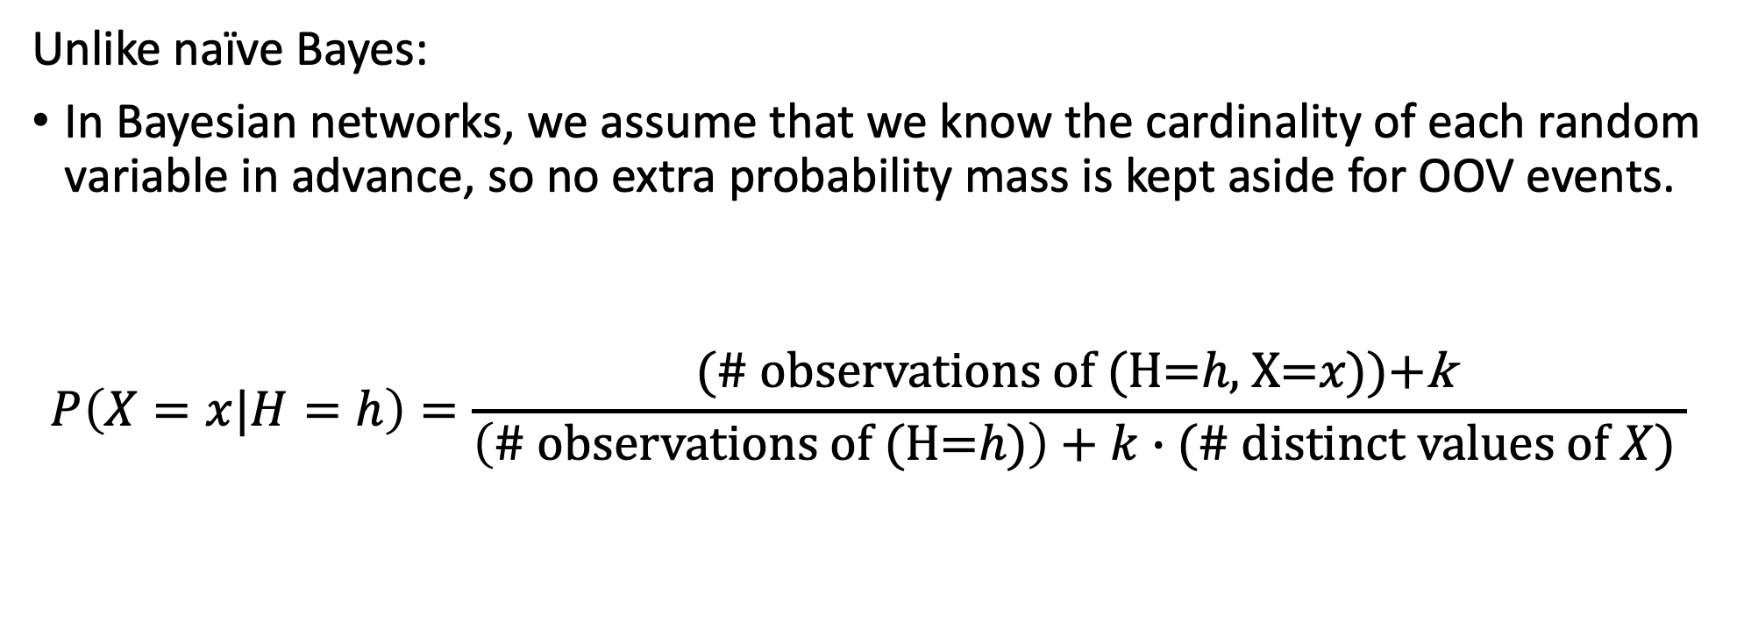
Conclusions: Laplace smoothing
Unlike naïve Bayes:
In Bayesian networks, we assume that we know the cardinality of each random variable in advance, so no extra probability mass is kept aside for OOV events.
$$P\left(X=x|H=h\right)=\frac{\text{(\# }\text{observations} \text{of} \text{(}\text{H}\text{=}h\text{,} \text{X}\text{=}x\text{))+}\text{k} }{\left(\text{\# }\text{observations} \text{of} \text{(}\text{H}\text{=}h\text{)}\right)+k∙(\# distinct values of X) }$$

Slide 18
Parameter Learning for Bayesian Networks
From observed data: Maximum likelihood
From observed data: Laplace smoothing
From partially observed data: Expectation maximization

Slide 19
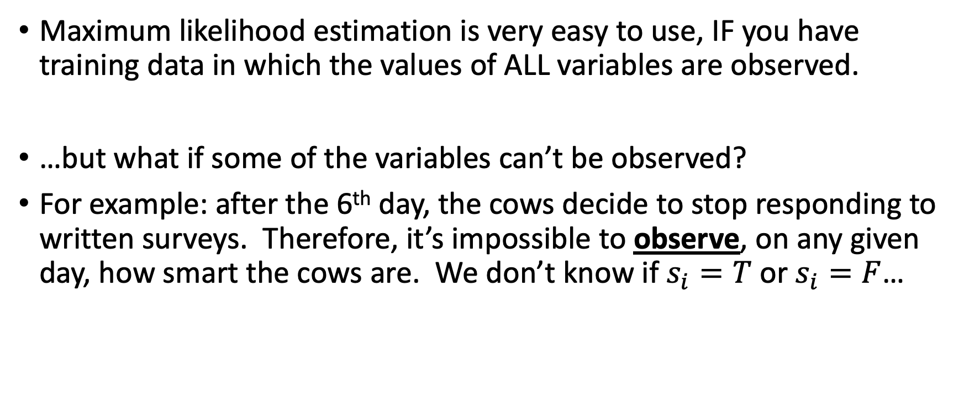
Partially observed data
Maximum likelihood estimation is very easy to use, IF you have training data in which the values of ALL variables are observed.
…but what if some of the variables can’t be observed?
For example: after the 6th day, the cows decide to stop responding to written surveys. Therefore, it’s impossible to observe, on any given day, how smart the cows are. We don’t know if $s_{i}=T$ or $s_{i}=F$…

Slide 20
Partially observed data
A
S
F
Day | A | S | F
1
2 |  | T | T
3
4 | T | T | T
5 | T
6
7 | T | ? | T
8 |  | ?
9 |  | ? | T
10 |  | ?
Suppose that we have the following observations:
We know whether A=True or False.
We know whether F=True or False.
After the 6th day, we don’t know whether S is True or False (shown as ”?”).

Slide 21
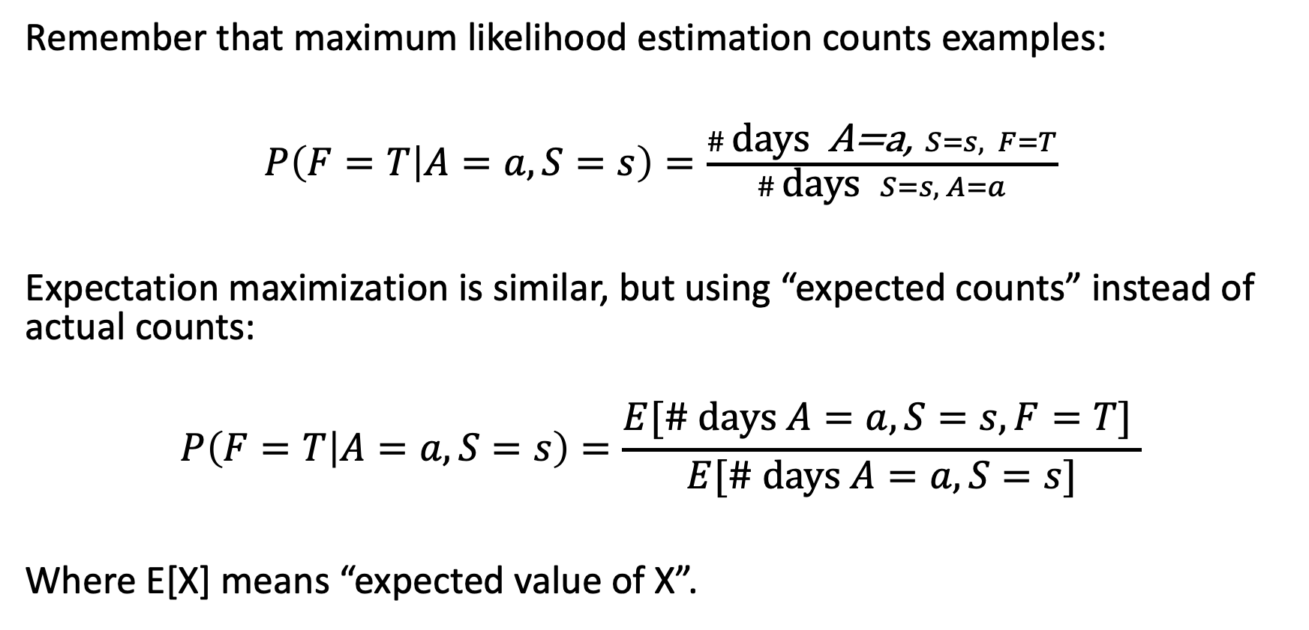
Expectation Maximization (EM): Main idea
Remember that maximum likelihood estimation counts examples:
$P\left(F=T | A=a,S=s\right)=\frac{\# \text{days} \text{A}\text{=}\text{a}\text{,} S=s, F=T}{\# \text{days} S=s, A=a}$
Expectation maximization is similar, but using “expected counts” instead of actual counts:
$$P\left(F=T | A=a,S=s\right)=\frac{E[\# \text{days} A=a, S=s, F=T] }{E[\# \text{days} A=a, S=s]}$$
Where E[X] means “expected value of X”.

Slide 22
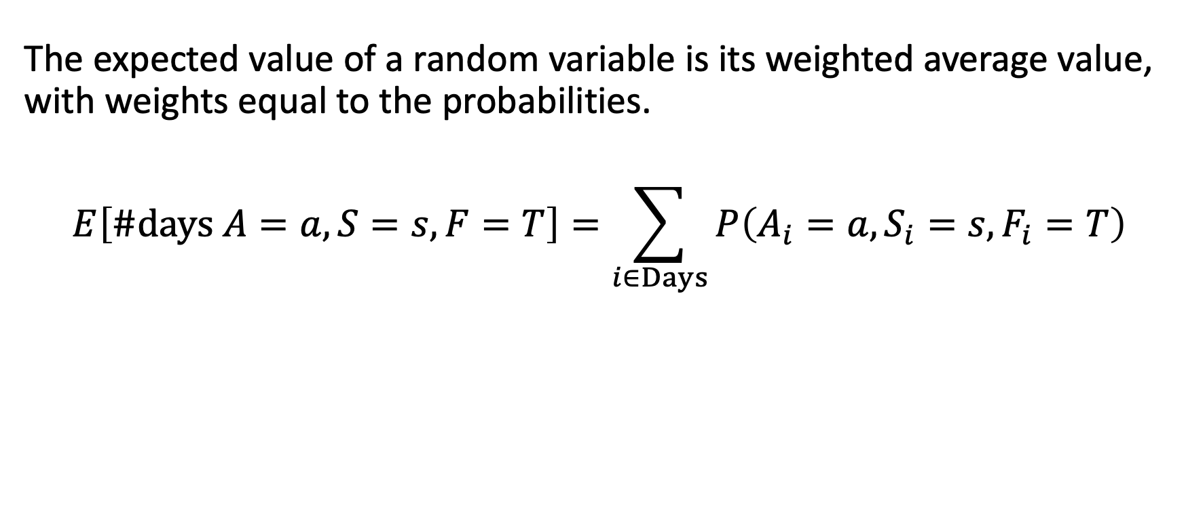
Definition of Expectation
The expected value of a random variable is its weighted average value, with weights equal to the probabilities.
$$E\left[\#\text{days} A=a,S=s, F=T\right]=\sum_{i∈Days}{P\left(A_{i}=a,S_{i}=s,F_{i}=T\right)}$$

Slide 23

Expectation
A
S
F
Day | A | S | F
1
2 |  | T | T
3
4 | T | T | T
5 | T
6
7 | T | ? | T
8 |  | ?
9 |  | ? | T
10 |  | ?
$$E\left[\#\text{days} A=F,S=T, F=T\right]$$
$$=\sum_{i=1}^{10}{P\left(A_{i}=F,S_{i}=T,F_{i}=T\right)}$$

Slide 24
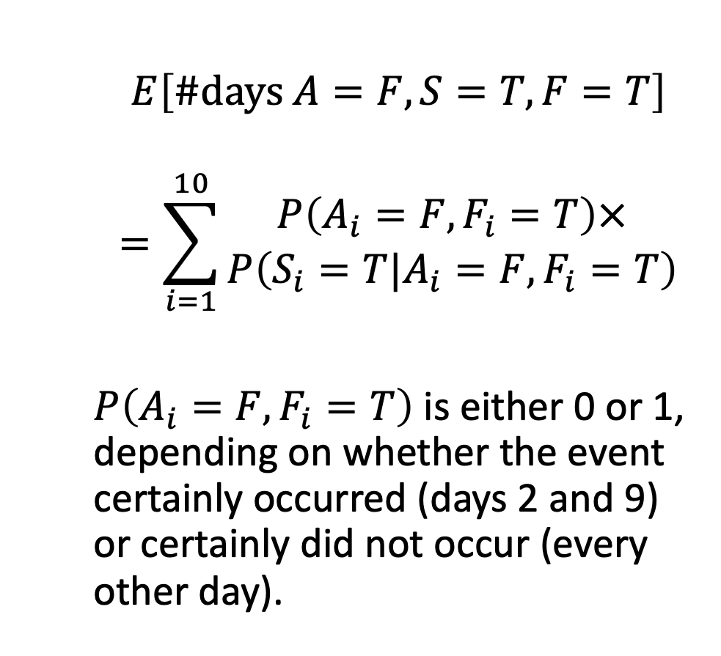
Expectation
A
S
F
Day | A | S | F
1
2 |  | T | T
3
4 | T | T | T
5 | T
6
7 | T | ? | T
8 |  | ?
9 |  | ? | T
10 |  | ?
$$E\left[\#\text{days} A=F,S=T, F=T\right]$$
$$=\sum_{i=1}^{10}{\begin{aligned}P\left(A_{i}=F,F_{i}=T\right)× \\ P\left(S_{i}=T|A_{i}=F, F_{i}=T\right)\end{aligned}}$$
$P\left(A_{i}=F,F_{i}=T\right)$ is either 0 or 1, depending on whether the event certainly occurred (days 2 and 9) or certainly did not occur (every other day).

Slide 25
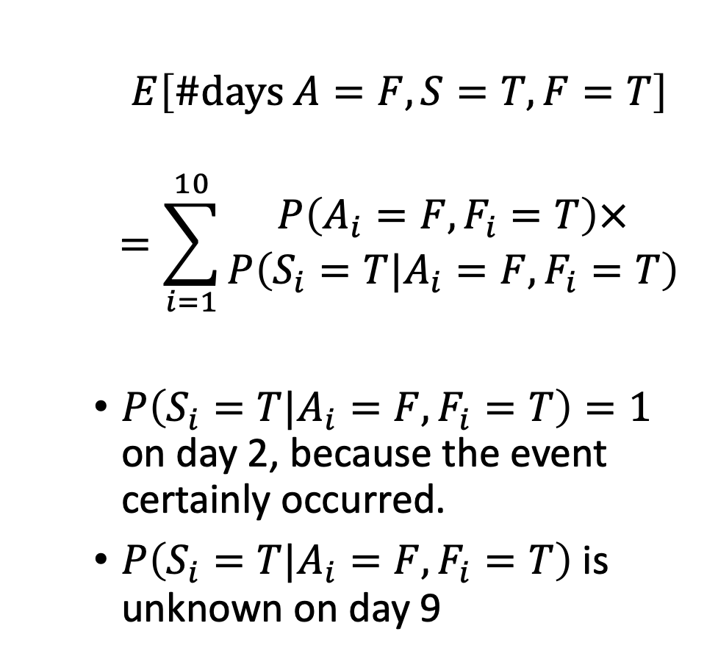
Expectation
A
S
F
Day | A | S | F
1
2 |  | T | T
3
4 | T | T | T
5 | T
6
7 | T | ? | T
8 |  | ?
9 |  | ? | T
10 |  | ?
$$E\left[\#\text{days} A=F,S=T, F=T\right]$$
$$=\sum_{i=1}^{10}{\begin{aligned}P\left(A_{i}=F,F_{i}=T\right)× \\ P\left(S_{i}=T|A_{i}=F, F_{i}=T\right)\end{aligned}}$$
$P\left(S_{i}=T|A_{i}=F, F_{i}=T\right)=1$ on day 2, because the event certainly occurred.
$P\left(S_{i}=T|A_{i}=F, F_{i}=T\right)$ is unknown on day 9

Slide 26
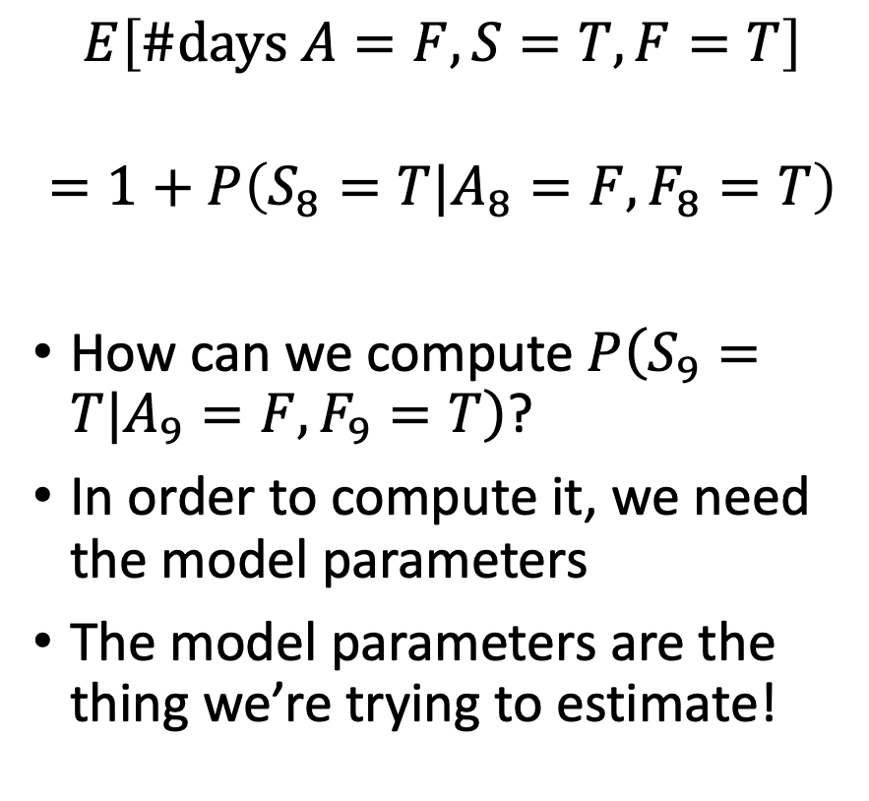
Expectation
A
S
F
Day | A | S | F
1
2 |  | T | T
3
4 | T | T | T
5 | T
6
7 | T | ? | T
8 |  | ?
9 |  | ? | T
10 |  | ?
$$E\left[\#\text{days} A=F,S=T, F=T\right]$$
$$=1+P\left(S_{8}=T|A_{8}=F, F_{8}=T\right)$$
How can we compute $P\left(S_{9}=T|A_{9}=F, F_{9}=T\right)$?
In order to compute it, we need the model parameters
The model parameters are the thing we’re trying to estimate!

Slide 27
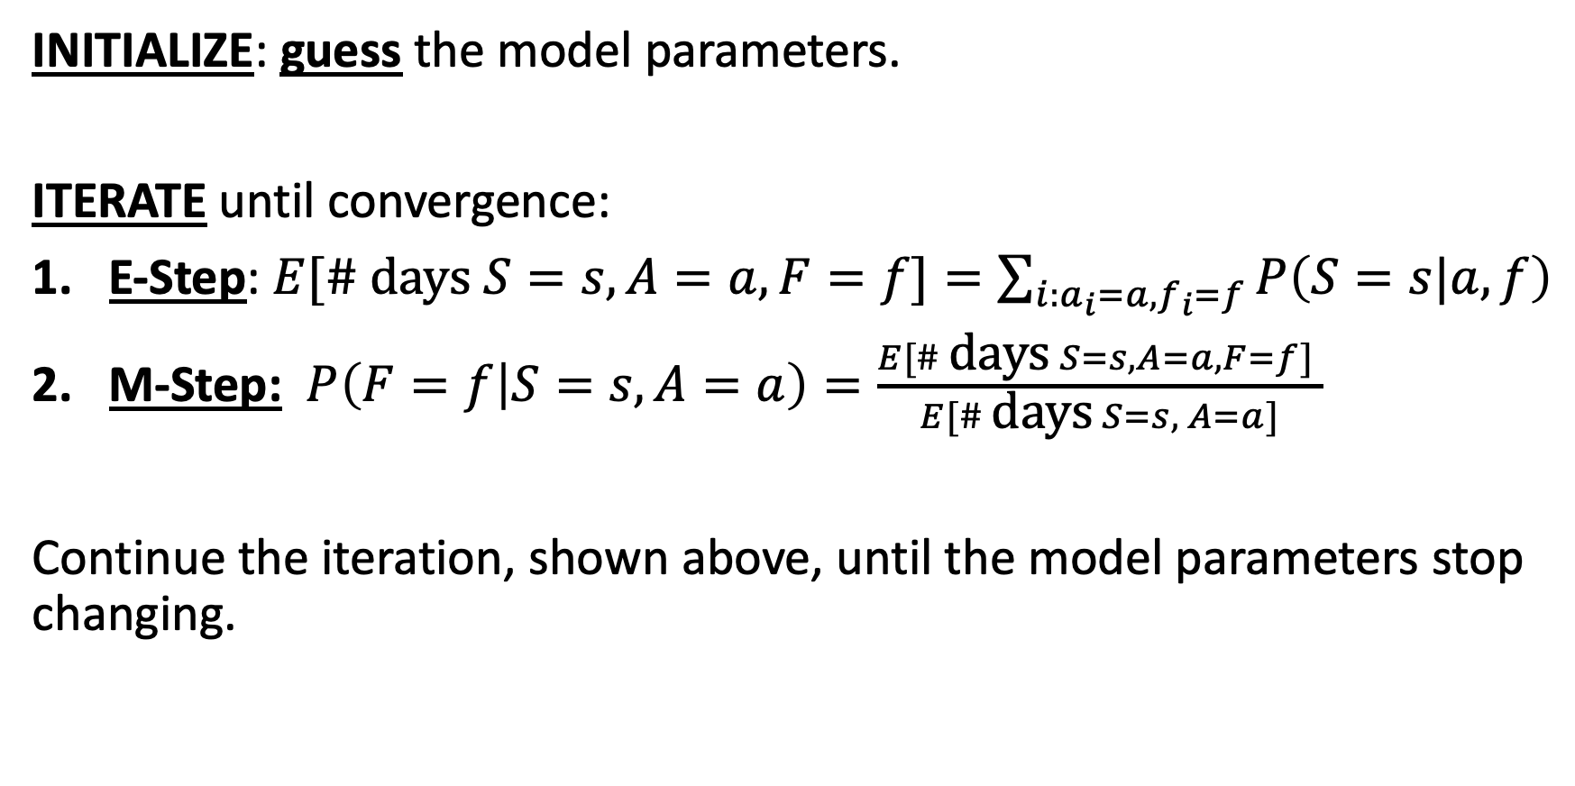
Expectation Maximization (EM) is iterative
INITIALIZE: guess the model parameters.
ITERATE until convergence:
E-Step: $E[\# \text{days} S=s,A=a, F=f]=\sum_{i:a_{i}=a,f_{i}=f}{P\left(S=s|a,f\right)}$
M-Step: $P\left(F=f | S=s,A=a\right)=\frac{E[\# \text{days} S=s,A=a, F=f] }{E[\# \text{days} S=s, A=a]}$
Continue the iteration, shown above, until the model parameters stop changing.

Slide 28
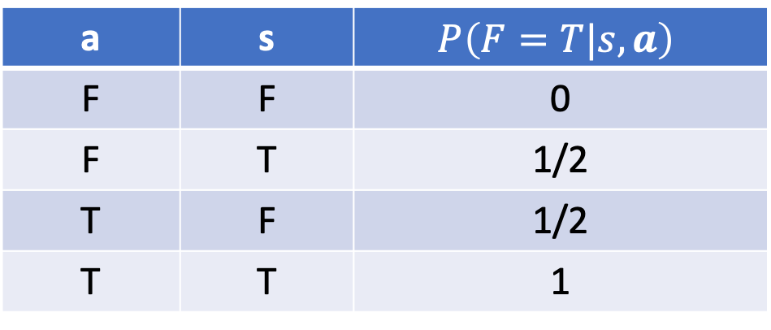

Example: Initialize
A
S
F
Marilyn Modigliani is a professional vaccavolatologist. She gives us these initial guesses about the possible model parameters (her guesses are probably not quite right, but they are as good a guess as anybody else’s):
$$P\left(A=T\right)=\frac{1}{4}, P\left(S=T\right)=\frac{1}{4}$$
a | s | $$P\left(F=T|s,a\right)$$
F | F | 0
F | T | 1/2
T | F | 1/2
T | T | 1

Slide 29

E-Step
A
S
F
Day | A | S | F
1
2 |  | T | T
3
4 | T | T | T
5 | T
6
7 | T | 2/5 | T
8 |  | 1/7
9 |  | 1 | T
10 |  | 1/7
Based on Marilyn’s model, we calculate $P\left(S=T|a_{i},f_{i}\right)$ for each of the missing days, as shown in the table at right.

Slide 30
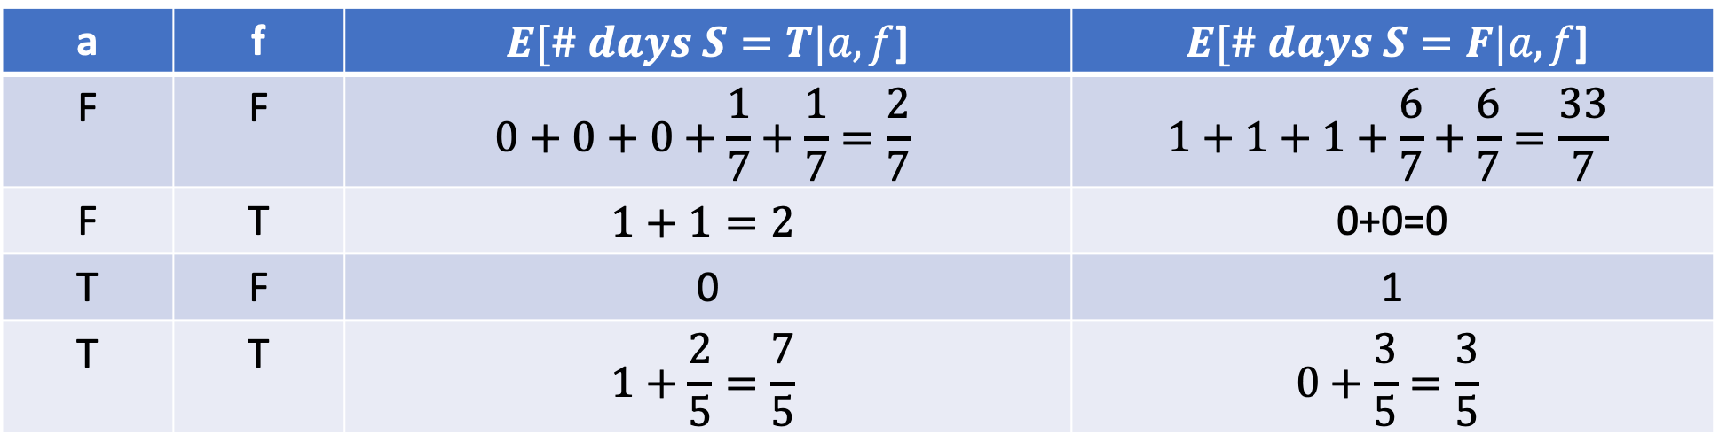
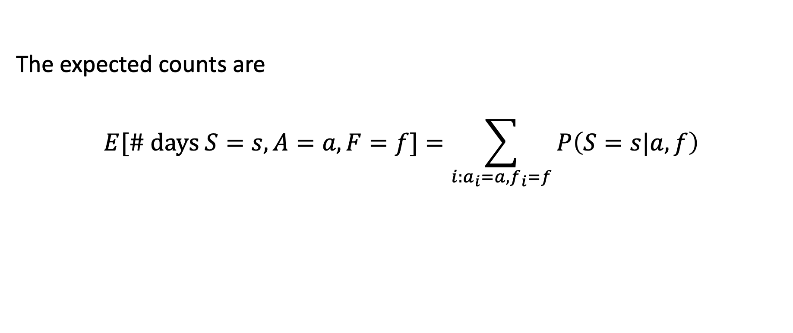
E-Step
A
S
F
The expected counts are
$$E[\# \text{days} S=s,A=a, F=f]=\sum_{i:a_{i}=a,f_{i}=f}{P\left(S=s|a,f\right)}$$
a | f | $E[\# days S=T|a,f$] | $$E[\# days S=F|a,f\text{]}$$
F | F | $$0+0+0+\frac{1}{7}+\frac{1}{7}=\frac{2}{7}$$ | $$1+1+1+\frac{6}{7}+\frac{6}{7}=\frac{33}{7}$$
F | T | $$1+1=2$$ | 0+0=0
T | F | 0 | 1
T | T | $$1+\frac{2}{5}=\frac{7}{5}$$ | $$0+\frac{3}{5}=\frac{3}{5}$$

Slide 31
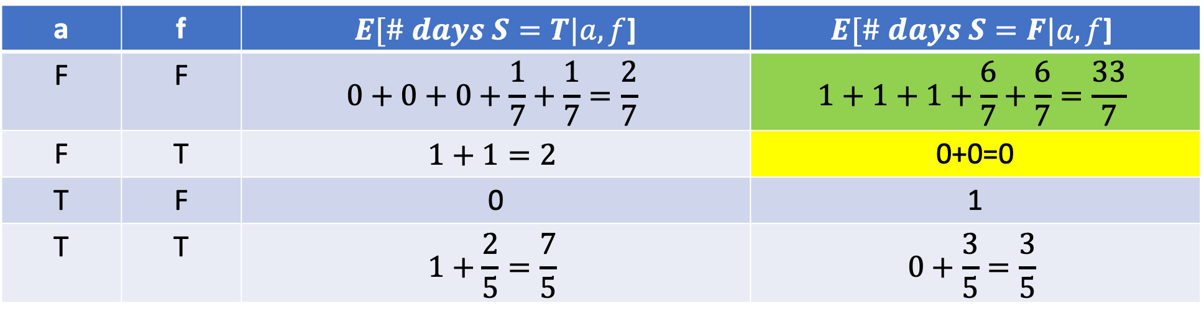
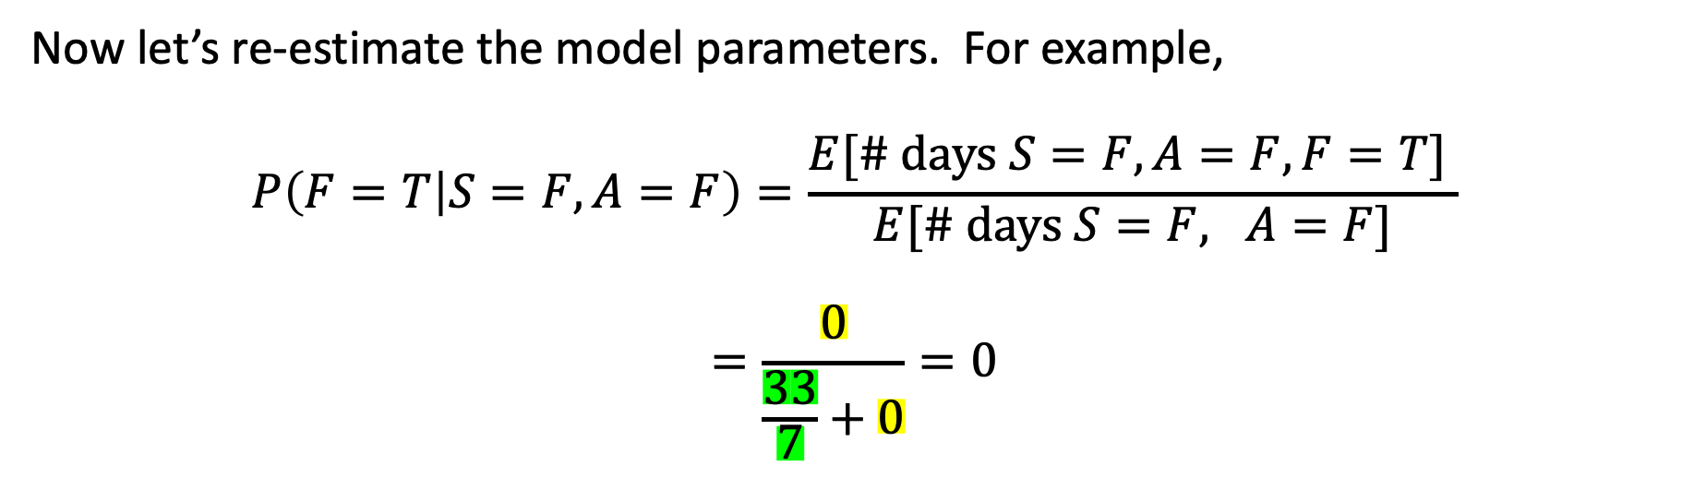
M-Step
a | f | $E[\# days S=T|a,f$] | $$E[\# days S=F|a,f\text{]}$$
F | F | $$0+0+0+\frac{1}{7}+\frac{1}{7}=\frac{2}{7}$$ | $$1+1+1+\frac{6}{7}+\frac{6}{7}=\frac{33}{7}$$
F | T | $$1+1=2$$ | 0+0=0
T | F | 0 | 1
T | T | $$1+\frac{2}{5}=\frac{7}{5}$$ | $$0+\frac{3}{5}=\frac{3}{5}$$
Now let’s re-estimate the model parameters. For example,
$$P\left(F=T | S=F,A=F\right)=\frac{E[\# \text{days} S=F,A=F, F=T] }{E[\# \text{days} S=F, A=F]}$$
$$=\frac{0}{\frac{33}{7}+0}=0$$

Slide 32
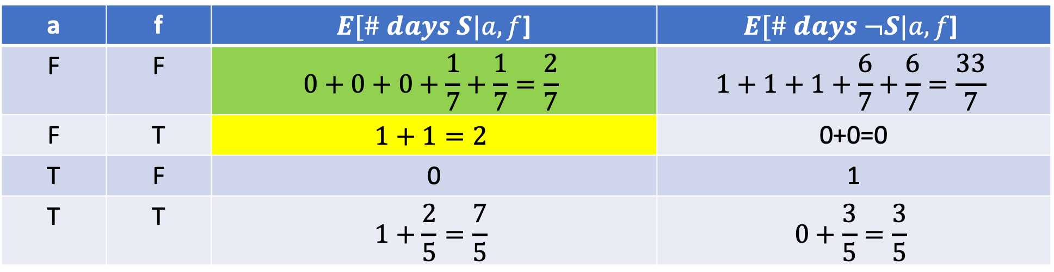
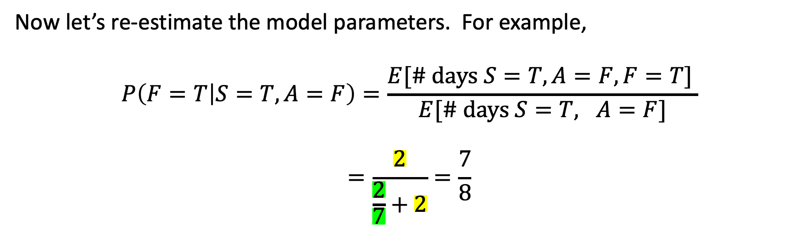
M-Step
a | f | $E[\# days S|a,f$] | $$E[\# days ¬S|a,f\text{]}$$
F | F | $$0+0+0+\frac{1}{7}+\frac{1}{7}=\frac{2}{7}$$ | $$1+1+1+\frac{6}{7}+\frac{6}{7}=\frac{33}{7}$$
F | T | $$1+1=2$$ | 0+0=0
T | F | 0 | 1
T | T | $$1+\frac{2}{5}=\frac{7}{5}$$ | $$0+\frac{3}{5}=\frac{3}{5}$$
Now let’s re-estimate the model parameters. For example,
$$P\left(F=T | S=T,A=F\right)=\frac{E[\# \text{days} S=T,A=F, F=T] }{E[\# \text{days} S=T, A=F]}$$
$$=\frac{2}{\frac{2}{7}+2}=\frac{7}{8}$$

Slide 33
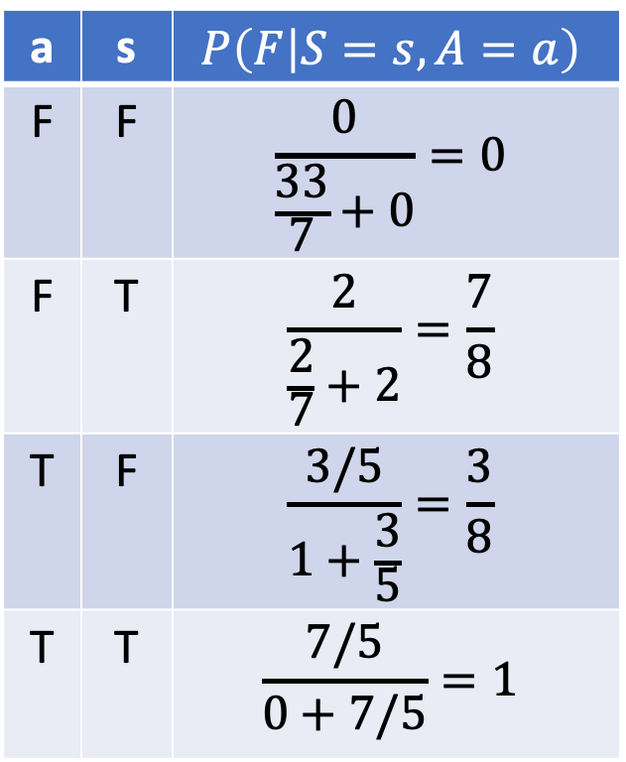
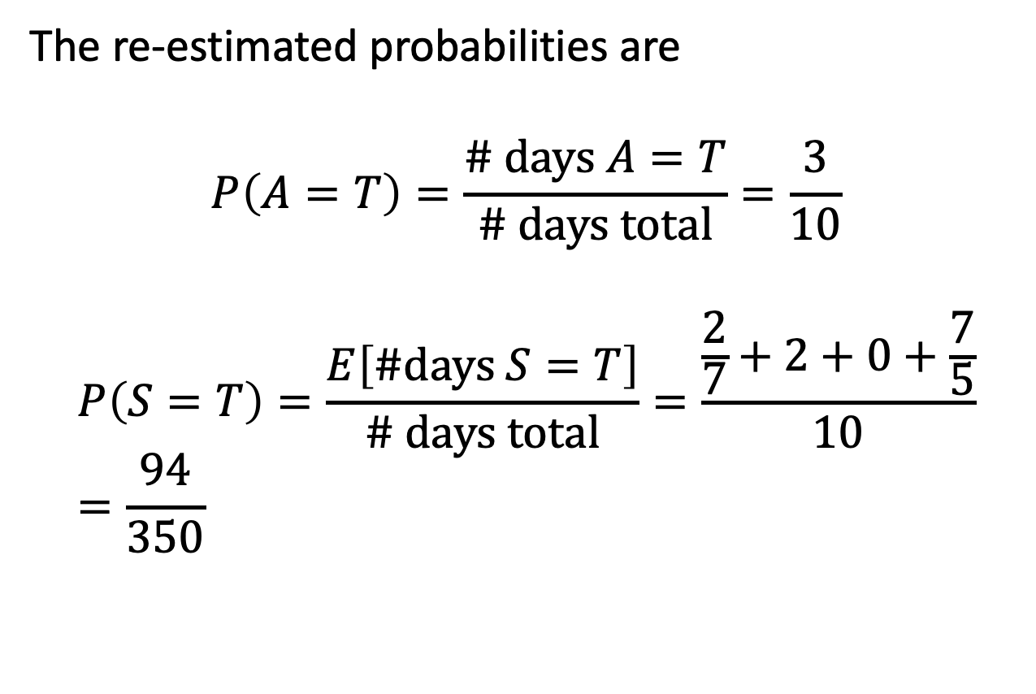
M-Step
A
S
F
The re-estimated probabilities are
$$P\left(A=T\right)=\frac{\# \text{days} A=T}{\# \text{days} \text{total}}=\frac{3}{10}$$
$$P\left(S=T\right)=\frac{E\left[\#\text{days} S=T\right]}{\# \text{days} \text{total}}=\frac{\frac{2}{7}+2+0+\frac{7}{5}}{10}=\frac{94}{350}$$
a | s | $$P\left(F | S=s,A=a\right)$$
F | F | $$\frac{0}{\frac{33}{7}+0}=0$$
F | T | $$\frac{2}{\frac{2}{7}+2}=\frac{7}{8}$$
T | F | $$\frac{3/5}{1+\frac{3}{5}}=\frac{3}{8}$$
T | T | $$\frac{7/5}{0+7/5}=1$$

Slide 34
Expectation Maximization (EM): review
INITIALIZE: guess the model parameters.
ITERATE until convergence:
E-Step: $E[\# \text{days} S=s,A=a, F=f]=\sum_{i:a_{i}=a,f_{i}=f}{P\left(S=s|a,f\right)}$
M-Step: $P\left(F=f | S=s,A=a\right)=\frac{E[\# \text{days} S=s,A=a, F=f] }{E[\# \text{days} S=s, A=a]}$
Continue the iteration, shown above, until the model parameters stop changing.

Slide 35
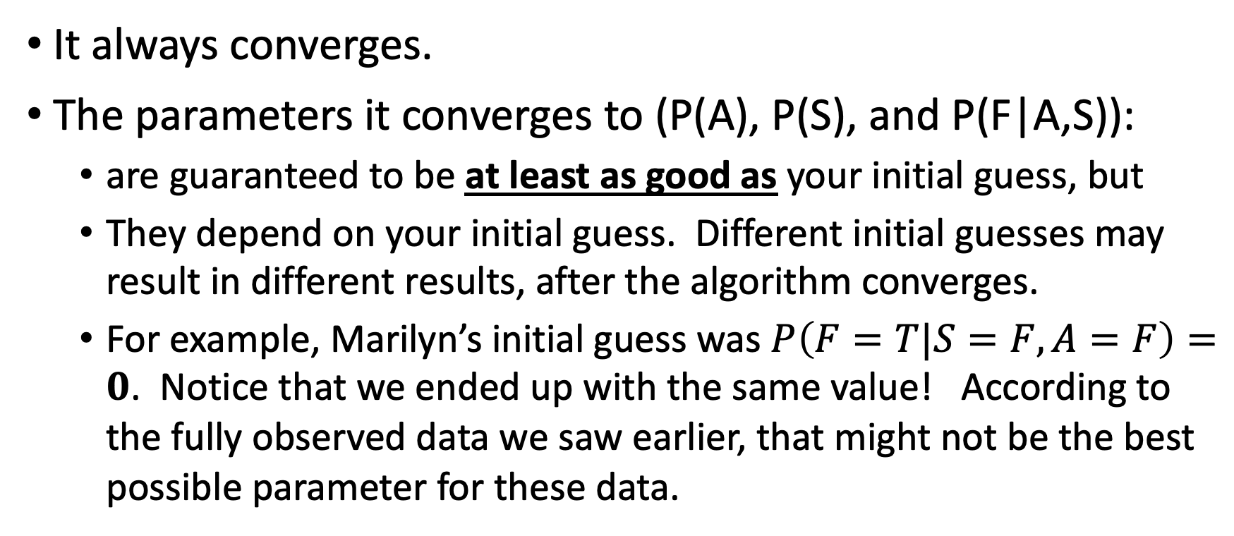
Properties of the EM algorithm
It always converges.
The parameters it converges to (P(A), P(S), and P(F|A,S)):
  are guaranteed to be at least as good as your initial guess, but
  They depend on your initial guess. Different initial guesses may result in different results, after the algorithm converges.
  For example, Marilyn’s initial guess was $P\left(F=T|S=F, A=F\right)=0$. Notice that we ended up with the same value! According to the fully observed data we saw earlier, that might not be the best possible parameter for these data.

Slide 36
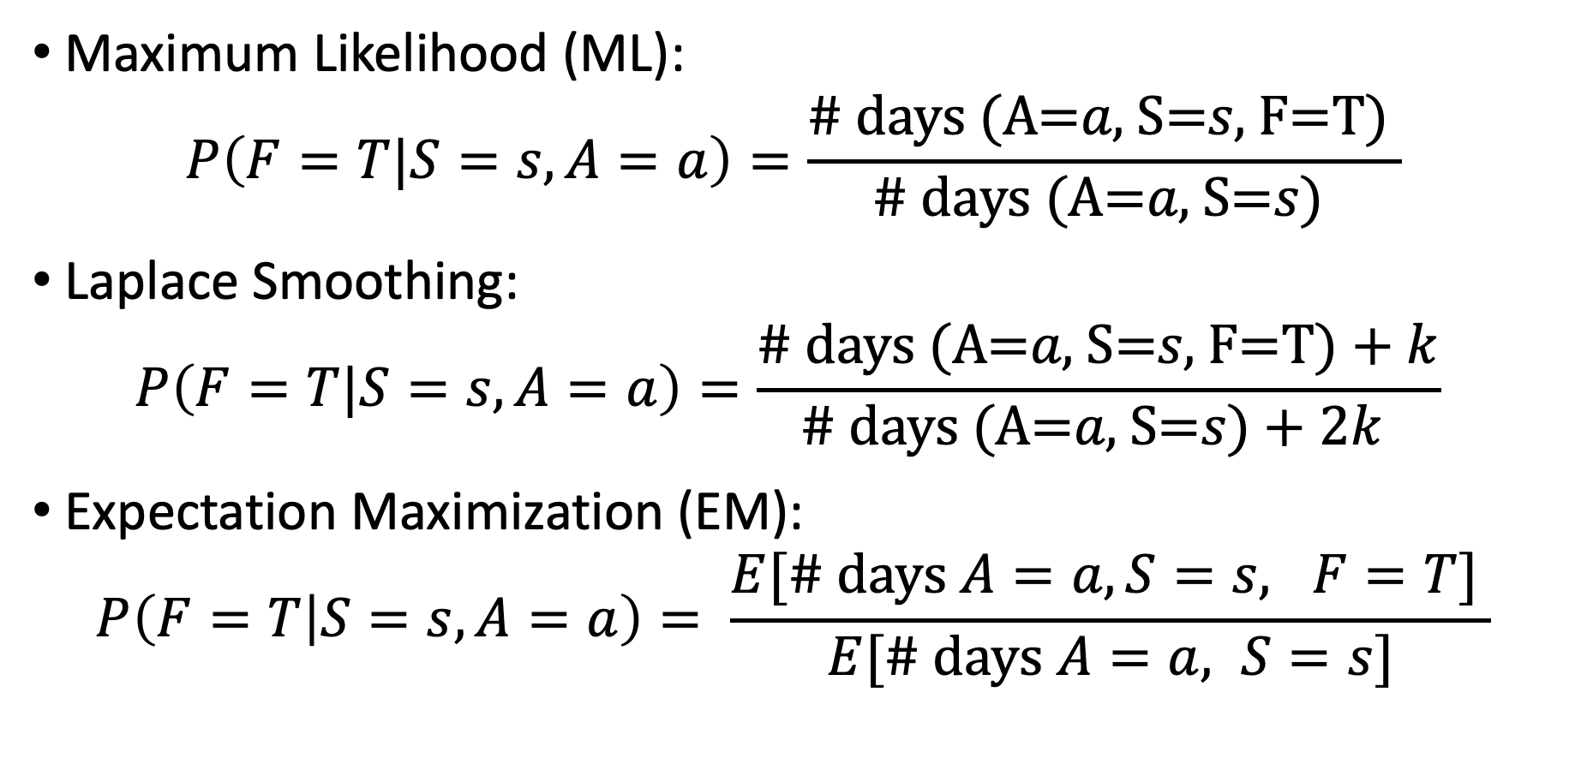
Parameter Learning for Bayesian Networks
Maximum Likelihood (ML):
$$P\left(F=T|S=s,A=a\right)=\frac{\text{\# }\text{days} \text{(}\text{A}\text{=}a\text{,} \text{S}\text{=}s\text{,} \text{F}\text{=}\text{T}\text{) }}{\text{\# }\text{days} \text{(}\text{A}\text{=}a\text{,} \text{S}\text{=}s\text{)} }$$
Laplace Smoothing:
$$P\left(F=T|S=s,A=a\right)=\frac{\text{\# }\text{days} \text{(}\text{A}\text{=}a\text{, }\text{S}\text{=}s\text{, }\text{F}\text{=}\text{T}\text{)}+k}{\text{\# }\text{days} \text{(}\text{A}\text{=}a\text{, }\text{S}\text{=}s\text{)}+2k }$$
Expectation Maximization (EM):
$$P\left(F=T | S=s,A=a\right)= \frac{E[\# \text{days} A=a, S=s, F=T] }{E[\# \text{days} A=a, S=s]}$$

