Slide 1
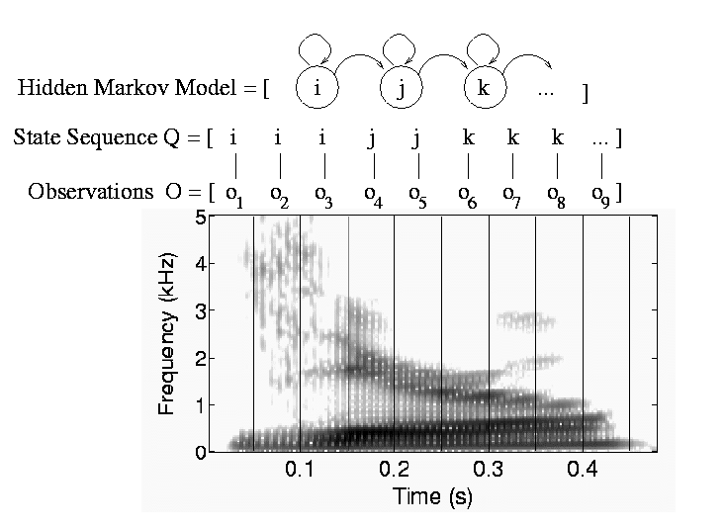
CS440/ECE448 Lecture 22:
Hidden Markov Models
Mark Hasegawa-Johnson, 3/2022
CC-BY 4.0
You may remix or redistribute if you cite the source.

Slide 2
Outline
HMM: Probabilistic reasoning over time
Two views of an HMM: as a Bayes Net, as an FSM
Inference: Belief propagation in an HMM
Parameter learning: Maximum likelihood
Parameter learning: EM

Slide 3
Probabilistic reasoning over time
So far, we’ve mostly dealt with episodic environments
  Exceptions: games with multiple moves, planning
In particular, the Bayesian networks we’ve seen so far describe static situations
  Each random variable gets a single fixed value in a single problem instance
Now we consider the problem of describing probabilistic environments that evolve over time
  Examples: robot localization, human activity detection, tracking, speech recognition, machine translation,

Slide 4
Probabilistic reasoning over time
At each time slice t, the state of the world is described by an unobservable state variable Y_{t} and an observable observation variable X_{t}
State Transitions: in general, the value of Y_{t} depends on the whole past history:
P(Y_{t} | Y₀, …, Y_{t-1}) = P(Y_{t} | Y_{0:t-1})
Observation model: in general, the value of X_{t} depends on all current and past states and observations:
P(X_{t} | Y₀, …, Y_{t}, X₁, …, X_{t-1}) = P(X_{t} | Y_{0:t}, X_{1:t-1})

Slide 5
Hidden Markov Model
A hidden Markov model assumes that both the state and the observation are Markov.
State Transitions: the Markov assumption means that each state variable depends only on the preceding time step:
P(Y_{t} | Y₀, …, Y_{t-1}) = P(Y_{t} | Y_{t-1})
Observation model: the Markov assumption means that each state variable depends only on the current state:
P(X_{t} | Y₀, …, Y_{t}, X₁, …, X_{t-1}) = P(X_{t} | Y_{t})
…
Y₀
Y₁
Y₂
Y_{t-1}
Y_{t}
X₁
X₂
X_{t-1}
X_{t}

Slide 6
Example Scenario: UmbrellaWorld
Characters from the novel Hammered by Elizabeth Bear,
Scenario from chapter 15 of Russell & Norvig
Elspeth Dunsany is an AI researcher at the Canadian company Unitek.
Richard Feynman is an AI, named after the famous physicist, whose personality he resembles.
To keep him from escaping, Richard’s workstation is not connected to the internet. He knows about rain but has never seen it.
He has noticed, however, that Elspeth sometimes brings an umbrella to work. He correctly infers that she is more likely to carry an umbrella on days when it rains.

Slide 7
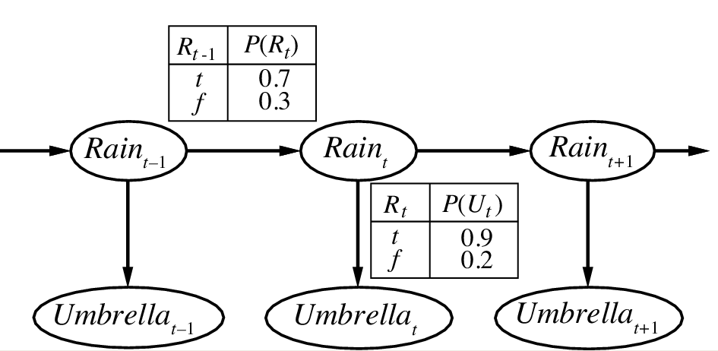
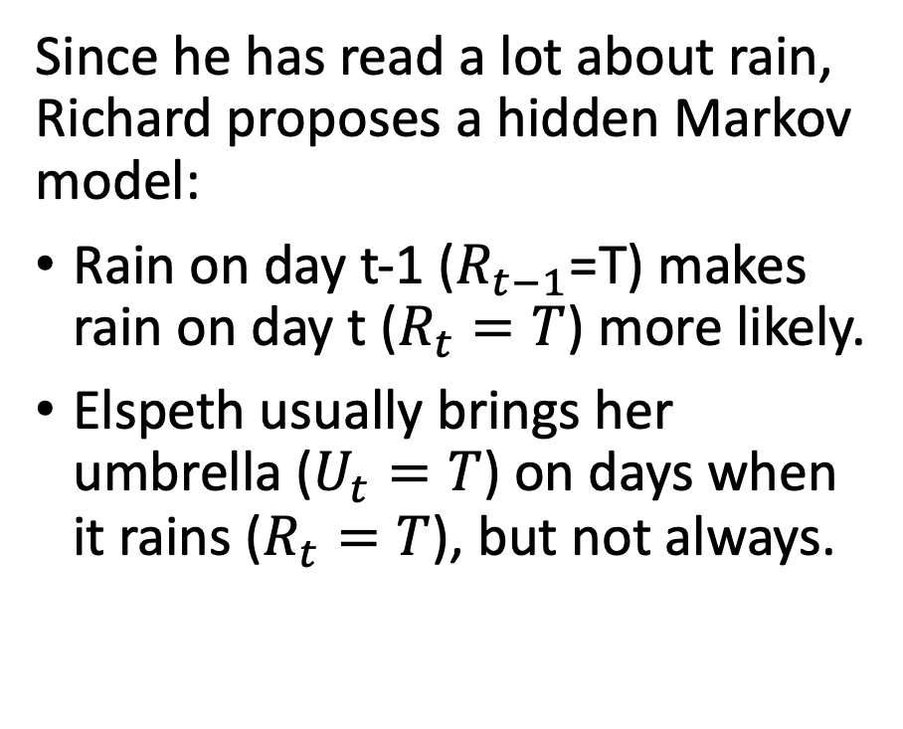
Example Scenario: UmbrellaWorld
Characters from the novel Hammered by Elizabeth Bear,
Scenario from chapter 15 of Russell & Norvig
Since he has read a lot about rain, Richard proposes a hidden Markov model:
Rain on day t-1 ($R_{t−1}$=T) makes rain on day t ($R_{t}=T$) more likely.
Elspeth usually brings her umbrella ($U_{t}=T$) on days when it rains ($R_{t}=T$), but not always.
state
observation
Notes:
The example is described in Section 15.1.1

Slide 8
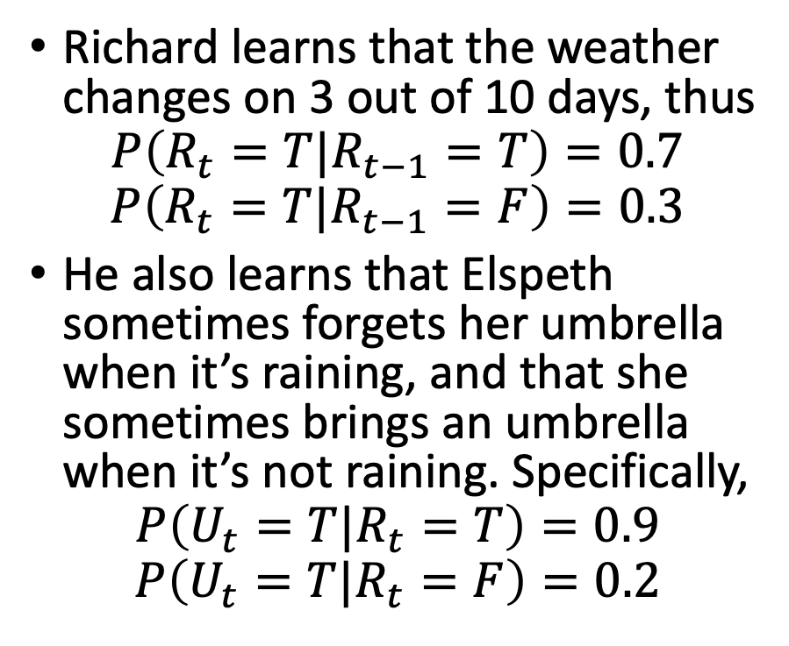
Example Scenario: UmbrellaWorld
Characters from the novel Hammered by Elizabeth Bear,
Scenario from chapter 15 of Russell & Norvig
Richard learns that the weather changes on 3 out of 10 days, thus
$$P\left(R_{t}=T|R_{t−1}=T\right)=0.7$$
$$P\left(R_{t}=T|R_{t−1}=F\right)=0.3$$
He also learns that Elspeth sometimes forgets her umbrella when it’s raining, and that she sometimes brings an umbrella when it’s not raining. Specifically,
$$P\left(U_{t}=T|R_{t}=T\right)=0.9$$
$$P\left(U_{t}=T|R_{t}=F\right)=0.2$$
Transition model
state
observation
Observation model
Notes:
The example is described in Section 15.1.1

Slide 9


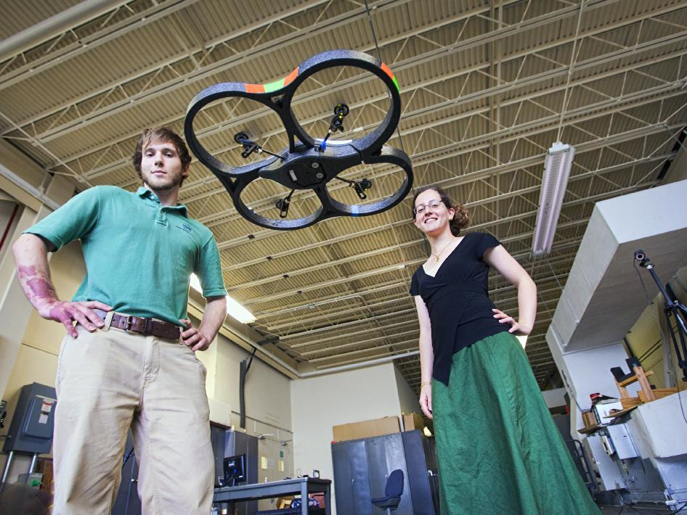
Applications of HMMs
Speech recognition HMMs:
  Observations are acoustic signals (continuous valued)
  States are specific positions in specific words (so, tens of thousands)
Machine translation HMMs:
  Observations are words (tens of thousands)
  States are cross-lingual alignments
Robot tracking:
  Observations are range readings (continuous)
  States are positions on a map
Source: Tamara Berg
Notes:
HMMs are used all over the place. They’re used for speech recognition in HMMs. Here observations are acoustic signals, states are phonemes in words. HMMs are used for machine translation where observations are words and states are translation options (ie what word in german should we translate this word in english to?) in robot tracking hmm’s are used to localize where the robot is located in space. Here observations are range readings and states are positions on a map. We’ll see some of these examples in a little more depth later.

Slide 10
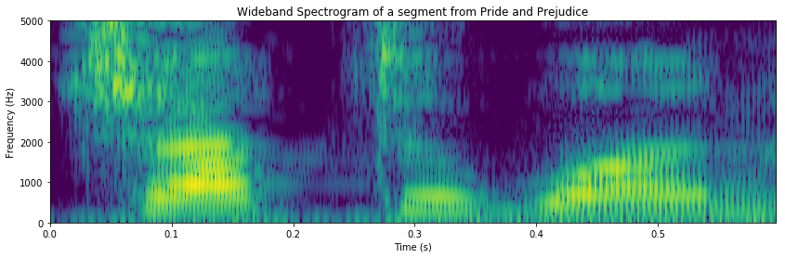
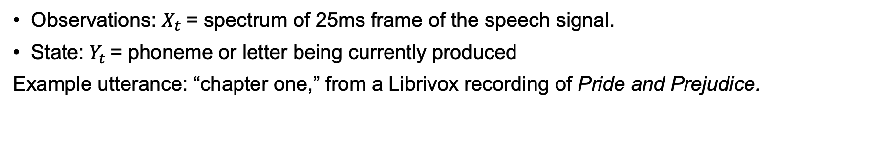
Example: Speech Recognition
Observations: $X_{t}$= spectrum of 25ms frame of the speech signal.
State: $Y_{t}$= phoneme or letter being currently produced
Example utterance: “chapter one,” from a Librivox recording of Pride and Prejudice.
_
_
c
c
c
h
h
a
a
a

Slide 11
Outline
HMM: Probabilistic reasoning over time
Two views of an HMM: as a Bayes Net, as an FSM
Inference: Belief propagation in an HMM
Parameter learning: Maximum likelihood
Parameter learning: EM and Hard EM

Slide 12
HMM as a Bayes Net
This slide shows an HMM as a Bayes Net. You should remember the graph semantics of a Bayes net:
Nodes are random variables.
Edges denote stochastic dependence.
Transition model
state
observation
Observation model
Notes:
The example is described in Section 15.1.1

Slide 13
HMM as a Finite State Machine
U=T: 0.9
U=F: 0.1
This slide shows exactly the same HMM, viewed in a totally different way. Here, we show it as a finite state machine:
Nodes denote states.
Edges denote possible transitions between the states.
Observation probabilities must be written using little table thingies, hanging from each state.
0.3
0.7
R=T
R=F
0.7
0.3
U=T: 0.2
U=F: 0.8
Transition probabilities
Observation probabilities
 | R_{t} = T | R_{t} = F
R_{t-1} = T | 0.7 | 0.3
R_{t-1} = F | 0.3 | 0.7
 | U_{t} = T | U_{t} = F
R_{t} = T | 0.9 | 0.1
R_{t} = F | 0.2 | 0.8
Notes:
The example is described in Section 15.1.1

Slide 14
Bayes Net vs. Finite State Machine
Finite State Machine:
Lists the different possible states that the world can be in, at one particular time.
Evolution over time is not shown.
Bayes Net:
Lists the different time slices.
The various possible settings of the state variable are not shown.
0.3
0.7
R=T
R=F
0.7
0.3

Slide 15










Speech Recognition as a Bayes Net
Observations: $X_{t}$= spectrum of 25ms frame of the speech signal.
State: $Y_{t}$= phoneme or letter being currently produced
Example utterance: “chapter one,” from a Librivox recording of Pride and Prejudice.
$$Y_{1}$$
$$Y_{2}$$
$$Y_{3}$$
$$Y_{4}$$
$$Y_{5}$$
$$Y_{6}$$
$$Y_{7}$$
$$Y_{8}$$
$$Y_{9}$$
$$Y_{10}$$

Slide 16

Speech Recognition as a Finite State Machine
Observations: $X_{t}$= spectrum of 10ms “frame” of the speech signal.
States: $Y_{t}$= letter or phoneme.
Finite State Machine model of the first part of the word “chapter”
0.05
0.5
0.1
0.2
_
c
h
a
p
0.95
0.5
0.9
0.8
1.0

Slide 17
Outline
HMM: Probabilistic reasoning over time
Two views of an HMM: as a Bayes Net, as an FSM
Inference: Belief propagation in an HMM
Parameter learning: Maximum likelihood
Parameter learning: EM and Hard EM

Slide 18
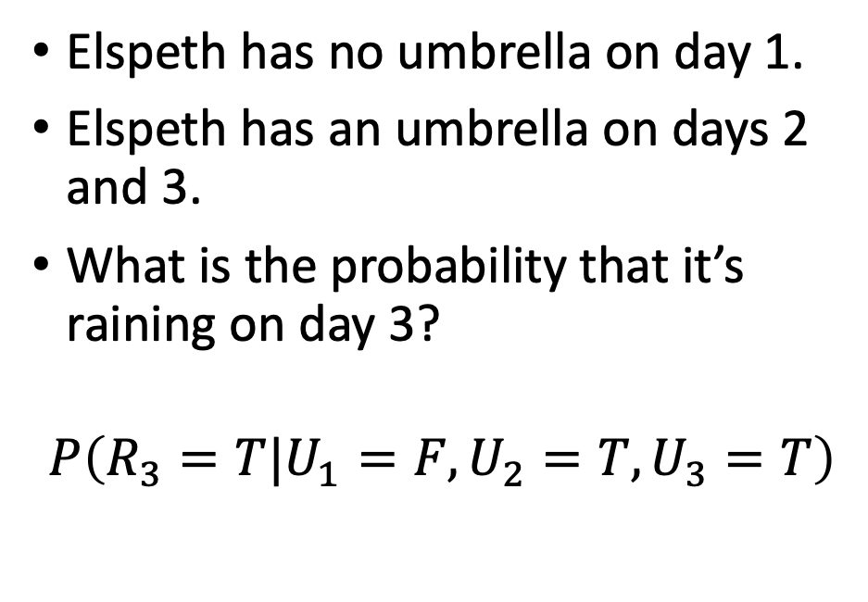

Belief propagation in an HMM: Example
Initial
state
model
Transition
model
Elspeth has no umbrella on day 1.
Elspeth has an umbrella on days 2 and 3.
What is the probability that it’s raining on day 3?
$$P\left(R_{3}=T|U_{1}=F,U_{2}=T,U_{3}=T\right)$$
$$P\left(R_{1}\right)$$
$$0.5$$
state
observation
Observation model

Slide 19
Belief propagation, step by step
Identify a path through the Bayesian network that includes all variables, including the query variable and all observed variables, starting at their common ancestor
Calculate the joint probability of the query variable and all observed variables, iteratively marginalizing out all intermediate variables step-by-step along the path.
Apply Bayes’ rule to get the desired conditional probability

Slide 20
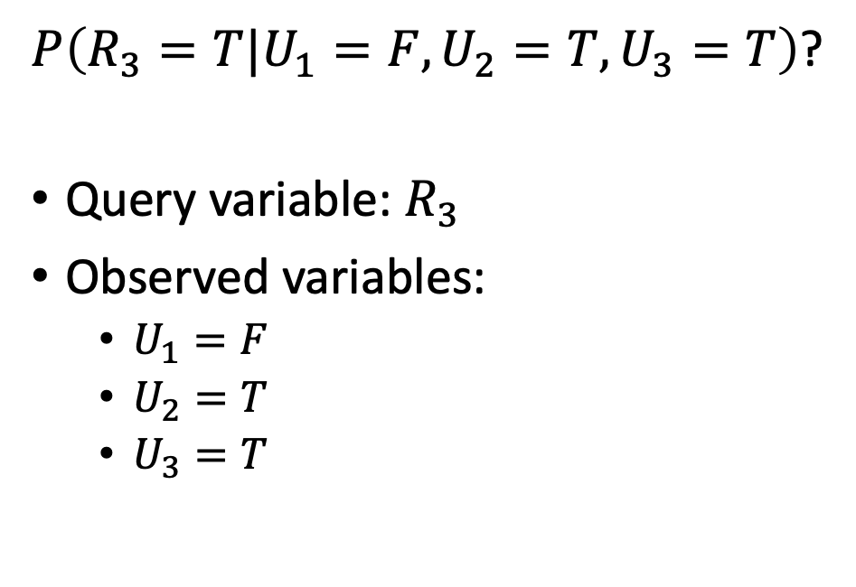
Step 1: Identify a path starting at their common ancestor
$P\left(R_{3}=T|U_{1}=F,U_{2}=T,U_{3}=T\right)$?
Query variable: $R_{3}$
Observed variables:
  $U_{1}=F$
  $U_{2}=T$
  $U_{3}=T$
Initial
state
model
Transition
model
$$P\left(R_{1}\right)$$
$$0.5$$
state
observation
Observation model

Slide 21

Step 2: Calculate the joint probability, step-by-step…
$P\left(R_{1}=T\right)=0.5$
$P\left(R_{1}=F\right)=0.5$
Initial
state
model
Transition
model
$$P\left(R_{1}\right)$$
$$0.5$$
state
observation
Observation model

Slide 22

Step 2: Calculate the joint probability, step-by-step…
$P\left(R_{1}=T,U_{1}=F\right)=(0.5)(0.1)$
$P\left(R_{1}=F,U_{1}=F\right)=(0.5)(0.8)$
Initial
state
model
Transition
model
$$P\left(R_{1}\right)$$
$$0.5$$
state
observation
Observation model

Slide 23
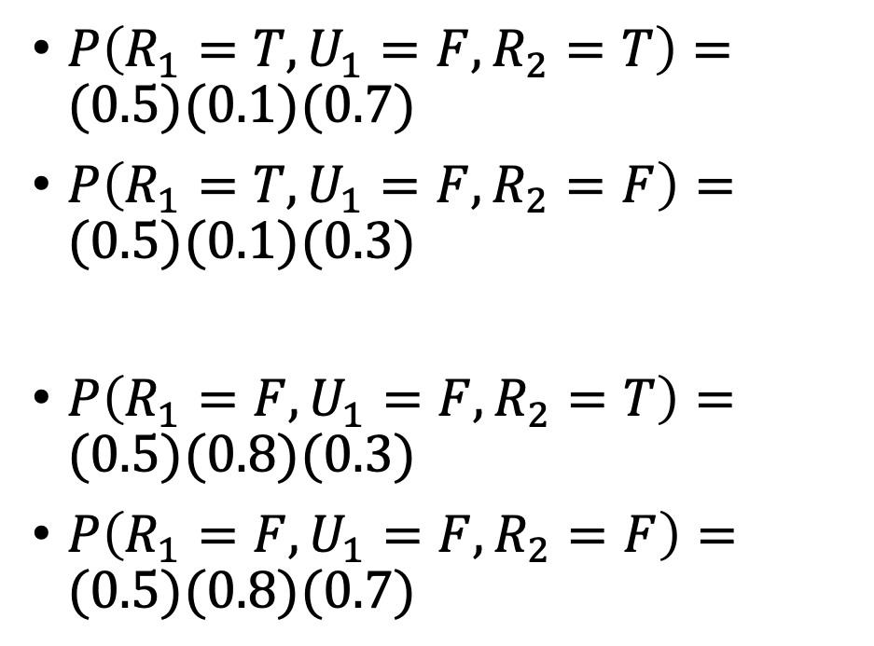
Step 2: Calculate the joint probability, step-by-step…
$P\left(R_{1}=T,U_{1}=F,R_{2}=T\right)=(0.5)(0.1)(0.7)$
$P\left(R_{1}=T,U_{1}=F,R_{2}=F\right)=(0.5)(0.1)(0.3)$
$P\left(R_{1}=F,U_{1}=F,R_{2}=T\right)=(0.5)(0.8)(0.3)$
$P\left(R_{1}=F,U_{1}=F,R_{2}=F\right)=(0.5)(0.8)(0.7)$
Initial
state
model
Transition
model
$$P\left(R_{1}\right)$$
$$0.5$$
state
observation
Observation model

Slide 24
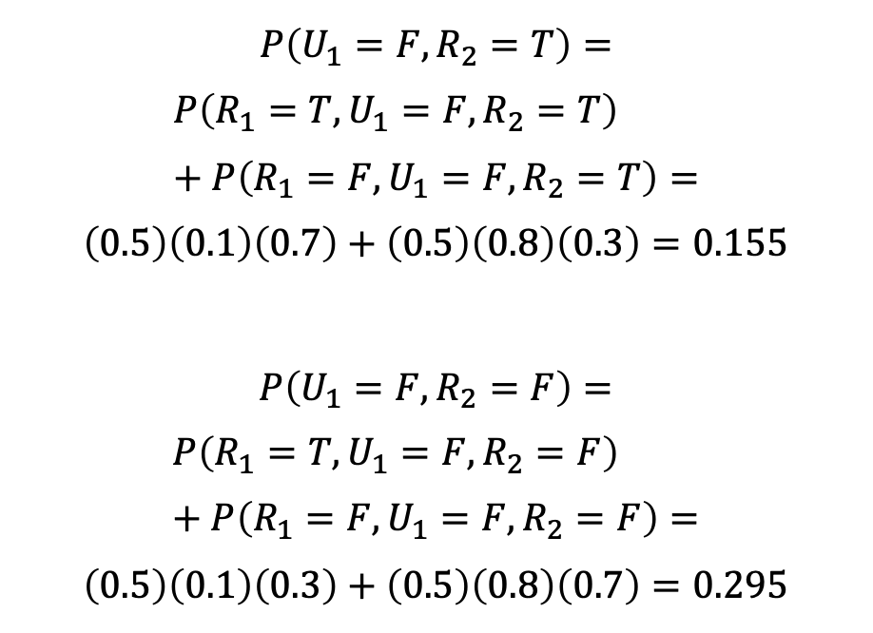
…iteratively marginalizing out intermediate variables as you go…
$$P\left(U_{1}=F,R_{2}=T\right)=$$
$$P\left(R_{1}=T,U_{1}=F,R_{2}=T\right)+P\left(R_{1}=F,U_{1}=F,R_{2}=T\right)=$$
$$\left(0.5\right)\left(0.1\right)\left(0.7\right)+\left(0.5\right)\left(0.8\right)\left(0.3\right)=0.155$$
$$P\left(U_{1}=F,R_{2}=F\right)=$$
$$P\left(R_{1}=T,U_{1}=F,R_{2}=F\right)+P\left(R_{1}=F,U_{1}=F,R_{2}=F\right)=$$
$$\left(0.5\right)\left(0.1\right)\left(0.3\right)+\left(0.5\right)\left(0.8\right)\left(0.7\right)=0.295$$
Initial
state
model
Transition
model
$$P\left(R_{1}\right)$$
$$0.5$$
state
observation
Observation model

Slide 25
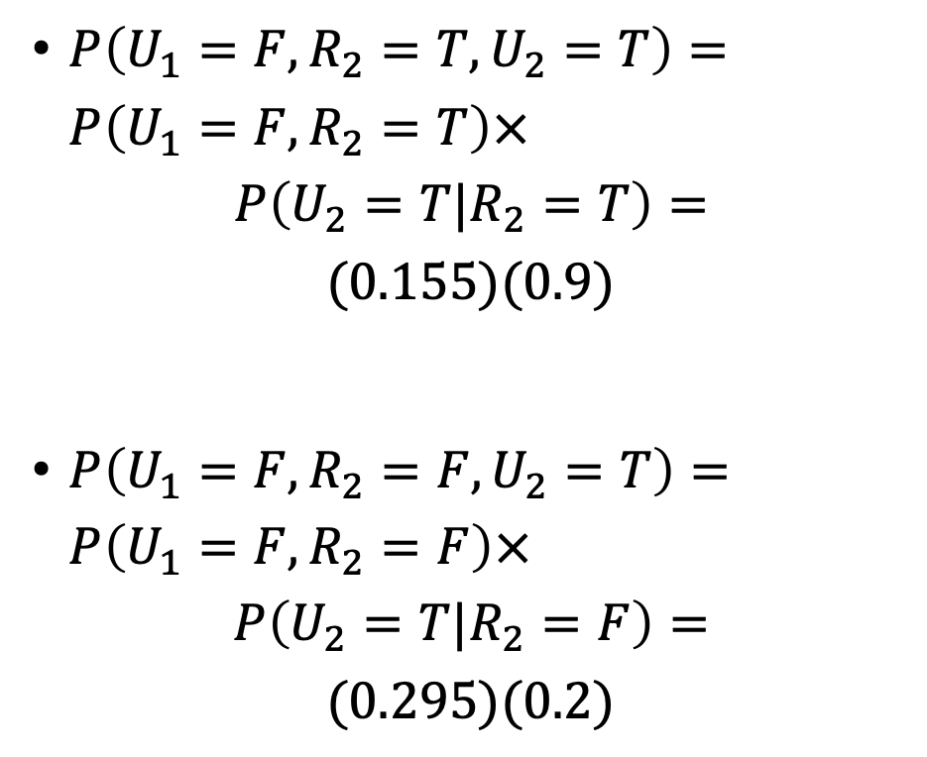
Step 2: Calculate the joint probability, step-by-step…
$P\left(U_{1}=F,R_{2}=T,U_{2}=T\right)=P\left(U_{1}=F,R_{2}=T\right)×$
$$P\left(U_{2}=T|R_{2}=T\right)=$$
$$(0.155)(0.9)$$
$P\left(U_{1}=F,R_{2}=F,U_{2}=T\right)=P\left(U_{1}=F,R_{2}=F\right)×$
$$P\left(U_{2}=T|R_{2}=F\right)=$$
$$(0.295)(0.2)$$
Initial
state
model
Transition
model
$$P\left(R_{1}\right)$$
$$0.5$$
state
observation
Observation model

Slide 26
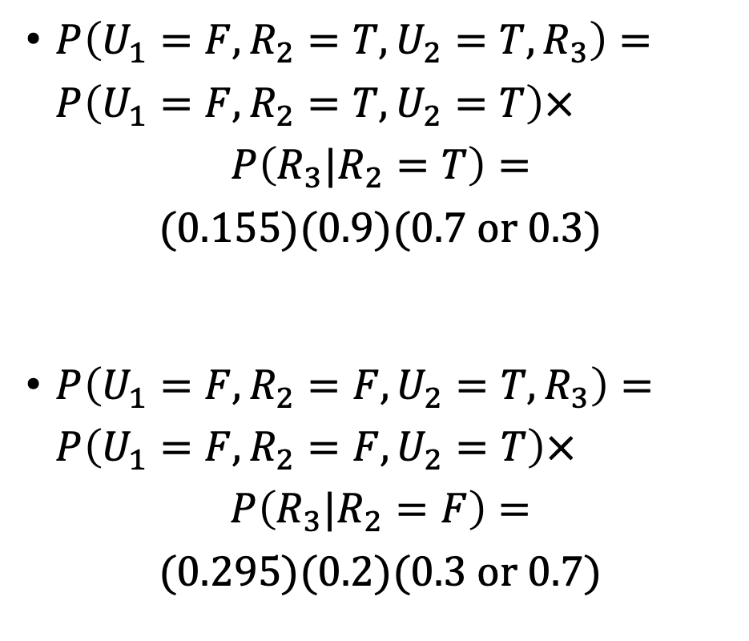
Step 2: Calculate the joint probability, step-by-step…
$P\left(U_{1}=F,R_{2}=T,U_{2}=T,R_{3}\right)=P\left(U_{1}=F,R_{2}=T,U_{2}=T\right)×$
$$P\left(R_{3}|R_{2}=T\right)=$$
$$(0.155)(0.9)(0.7 or 0.3)$$
$P\left(U_{1}=F,R_{2}=F,U_{2}=T,R_{3}\right)=P\left(U_{1}=F,R_{2}=F,U_{2}=T\right)×$
$$P\left(R_{3}|R_{2}=F\right)=$$
$$(0.295)(0.2)(0.3 or 0.7)$$
Initial
state
model
Transition
model
$$P\left(R_{1}\right)$$
$$0.5$$
state
observation
Observation model

Slide 27
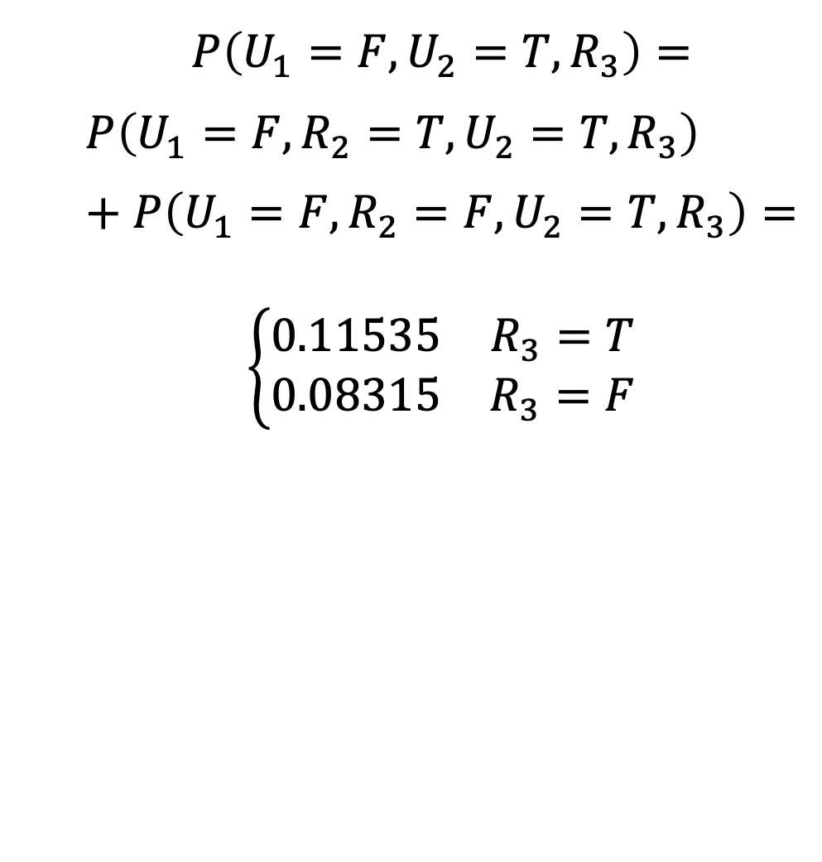
…iteratively marginalizing out intermediate variables as you go…
$$P\left(U_{1}=F,U_{2}=T,R_{3}\right)=$$
$$P\left(U_{1}=F,R_{2}=T,U_{2}=T,R_{3}\right)+P\left(U_{1}=F,R_{2}=F,U_{2}=T,R_{3}\right)=$$
$$\left\{\begin{matrix}0.11535 & R_{3}=T \\ 0.08315 & R_{3}=F\end{matrix}\right.$$
Initial
state
model
Transition
model
$$P\left(R_{1}\right)$$
$$0.5$$
state
observation
Observation model

Slide 28
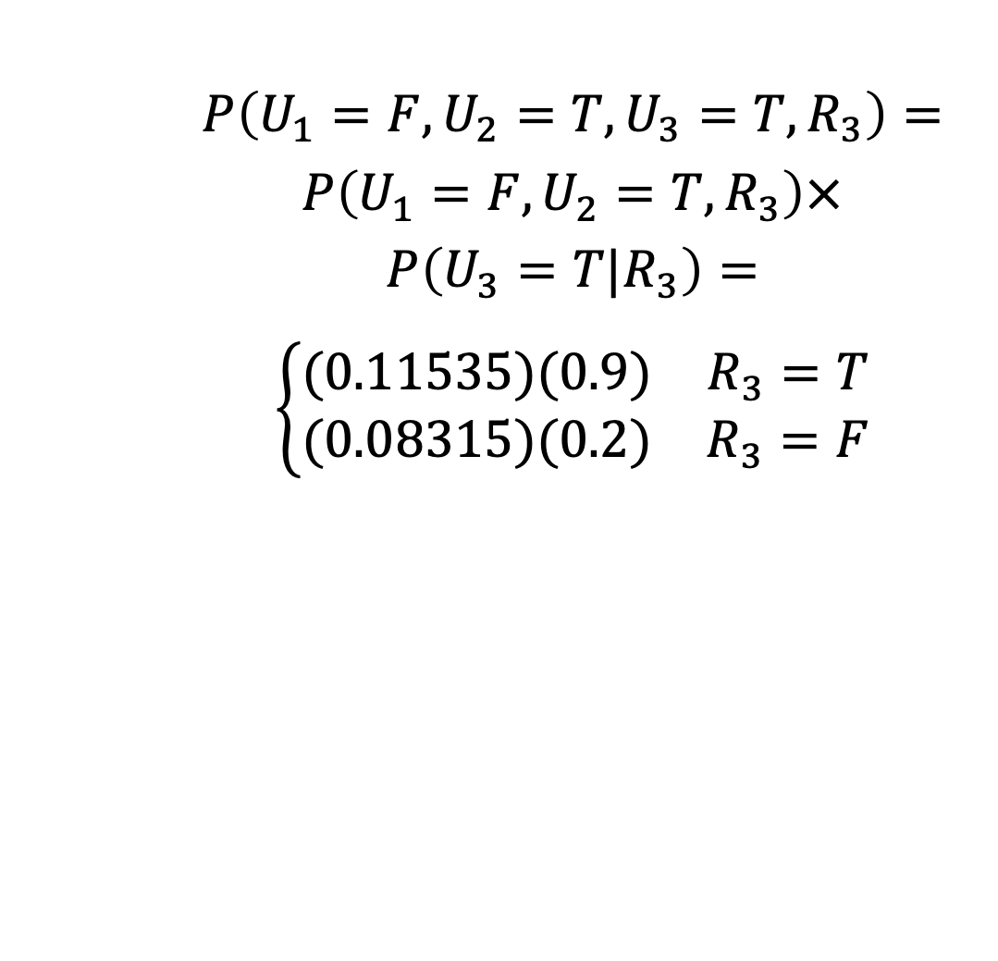
Step 2: Calculate the joint probability, step-by-step…
$$P\left(U_{1}=F,U_{2}=T,U_{3}=T,R_{3}\right)=$$
$$P\left(U_{1}=F,U_{2}=T,R_{3}\right)×$$
$$P\left(U_{3}=T|R_{3}\right)=$$
$$\left\{\begin{matrix}(0.11535)(0.9) & R_{3}=T \\ (0.08315)(0.2) & R_{3}=F\end{matrix}\right.$$
Initial
state
model
Transition
model
$$P\left(R_{1}\right)$$
$$0.5$$
state
observation
Observation model

Slide 29
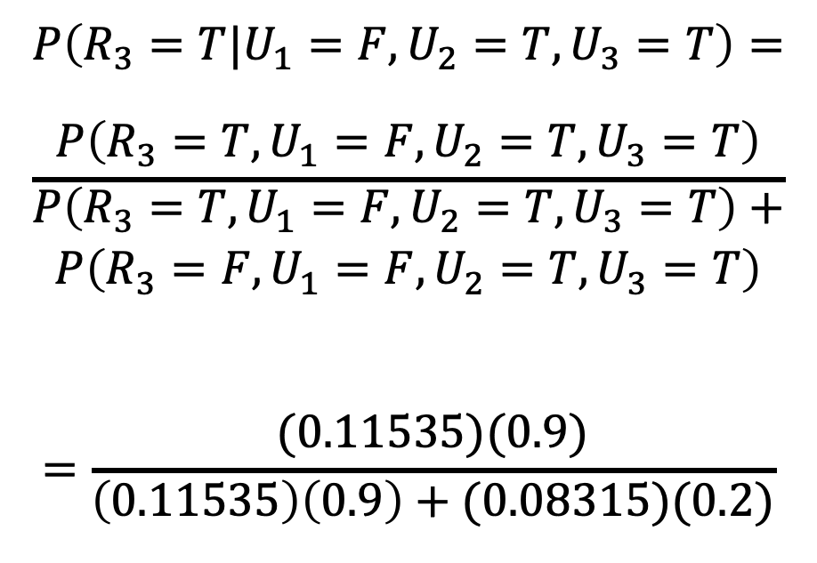
Step 3: Apply Bayes’ rule to get conditional probability
$$P\left(R_{3}=T|U_{1}=F,U_{2}=T,U_{3}=T\right)=$$
$$\frac{P\left(R_{3}=T,U_{1}=F,U_{2}=T,U_{3}=T\right)}{\begin{aligned}P\left(R_{3}=T,U_{1}=F,U_{2}=T,U_{3}=T\right)+ \\ P\left(R_{3}=F,U_{1}=F,U_{2}=T,U_{3}=T\right)\end{aligned}}$$
$$=\frac{(0.11535)(0.9)}{\left(0.11535\right)\left(0.9\right)+(0.08315)(0.2)}$$
Initial
state
model
Transition
model
$$P\left(R_{1}\right)$$
$$0.5$$
state
observation
Observation model

Slide 30
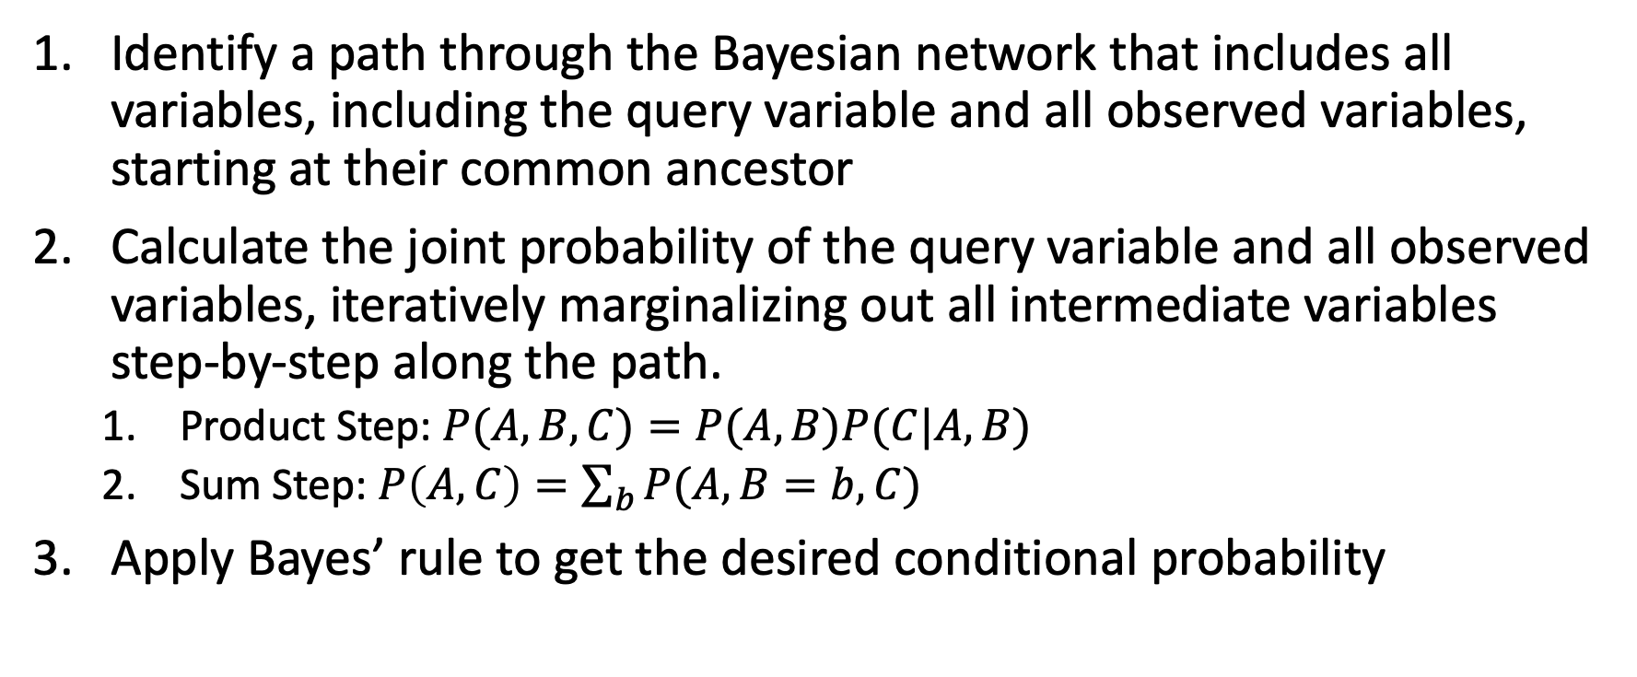
Belief propagation, step by step
Identify a path through the Bayesian network that includes all variables, including the query variable and all observed variables, starting at their common ancestor
Calculate the joint probability of the query variable and all observed variables, iteratively marginalizing out all intermediate variables step-by-step along the path.
  Product Step: $P(A,B,C)=P(A,B)P(C|A,B)$
  Sum Step: $P\left(A,C\right)=\sum_{b}{P(A,B=b,C)}$
Apply Bayes’ rule to get the desired conditional probability

Slide 31
Outline
HMM: Probabilistic reasoning over time
Two views of an HMM: as a Bayes Net, as an FSM
Inference: Belief propagation in an HMM
Parameter learning: Maximum likelihood
Parameter learning: EM and Hard EM

Slide 32
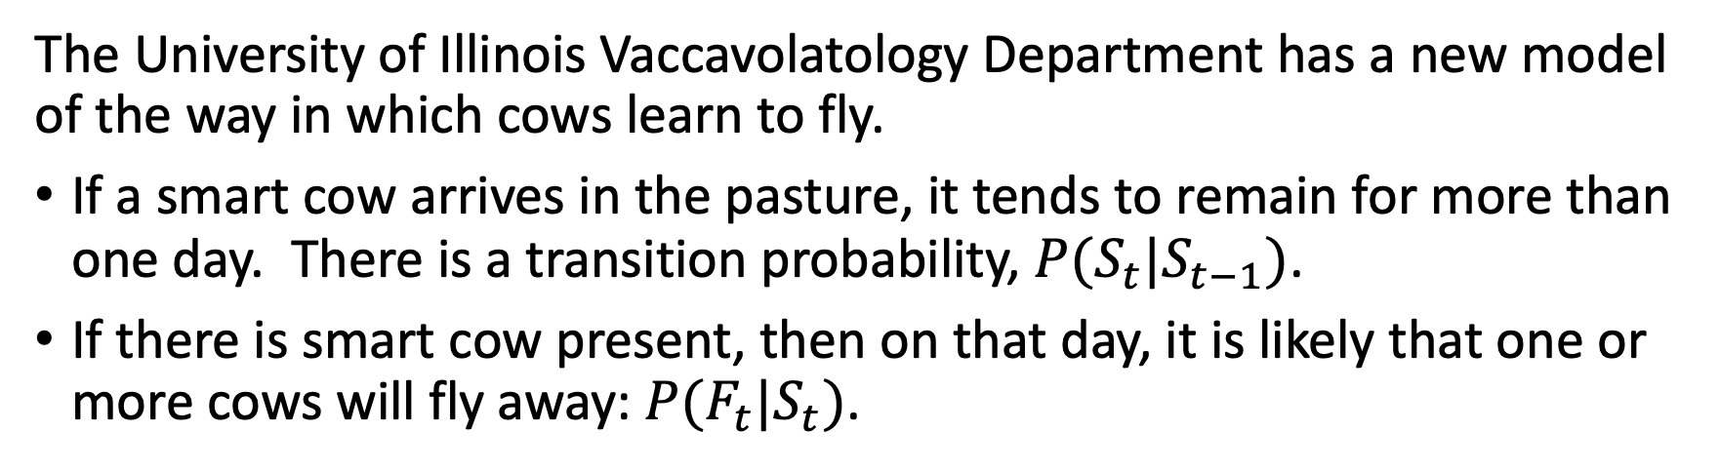
Flying Cows
The University of Illinois Vaccavolatology Department has a new model of the way in which cows learn to fly.
If a smart cow arrives in the pasture, it tends to remain for more than one day. There is a transition probability, $P(S_{t}|S_{t−1})$.
If there is smart cow present, then on that day, it is likely that one or more cows will fly away: $P(F_{t}|S_{t})$.
…
S₁
S₂
S_{T-1}
S_{T}
F₁
F₂
F_{T-1}
F_{T}

Slide 33


Flying cows
…
S₁
S₂
F₁
F₂
Day | S | F
1
2
3 | T
4 | T | T
5 | T
6 | T | T
7 | T | T
8
9 |  | T
10
The Vaccavolatologists went out to watch a nearby pasture for ten days.
Their results are shown in the table at left (True is marked as “T”; False is shown with a blank).

Slide 34
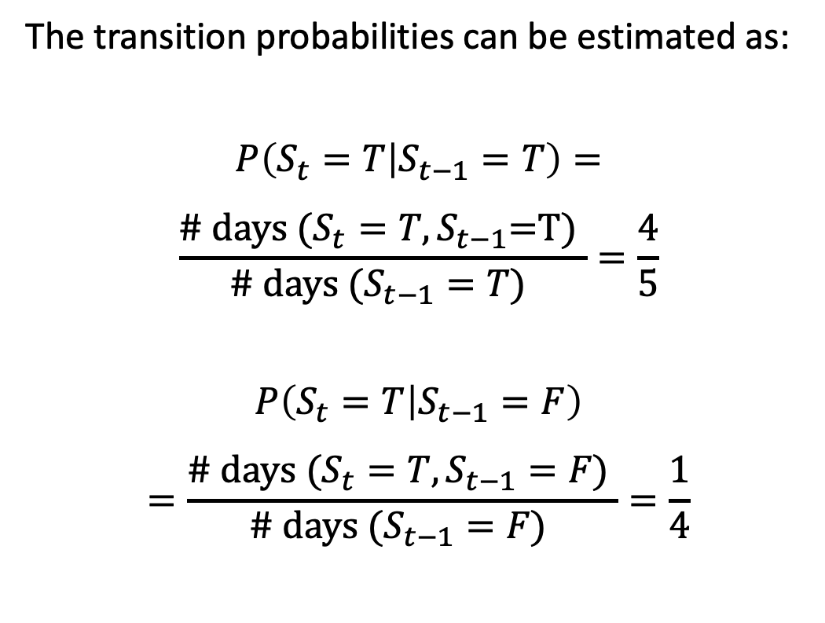
Maximum
Likelihood
…
S₁
S₂
F₁
F₂
Day | S | F
1
2
3 | T
4 | T | T
5 | T
6 | T | T
7 | T | T
8
9 |  | T
10
The transition probabilities can be estimated as:
$$P\left(S_{t}=T | S_{t−1}=T\right)=$$
$$\frac{\text{\# }\text{days} \text{(}S_{t}=T,S_{t−1}\text{=}\text{T}\text{) }}{\text{\# }\text{days} \text{(}S_{t−1}=T\text{)} }=\frac{4}{5}$$
$$P\left(S_{t}=T | S_{t−1}=F\right)$$
$$=\frac{\text{\# }\text{days} \text{(}S_{t}=T,S_{t−1}=F\text{) }}{\text{\# }\text{days} \text{(}S_{t−1}=F\text{)} }=\frac{1}{4}$$

Slide 35
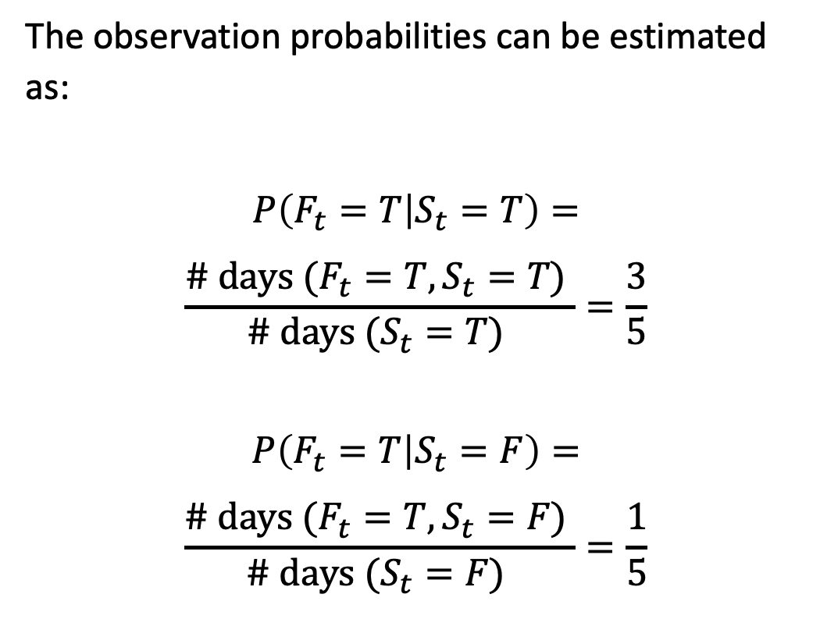
Maximum
Likelihood
…
S₁
S₂
F₁
F₂
Day | S | F
1
2
3 | T
4 | T | T
5 | T
6 | T | T
7 | T | T
8
9 |  | T
10
The observation probabilities can be estimated as:
$$P\left(F_{t}=T | S_{t}=T\right)=$$
$$\frac{\text{\# }\text{days} \text{(}F_{t}=T,S_{t}=T\text{) }}{\text{\# }\text{days} \text{(}S_{t}=T\text{)} }=\frac{3}{5}$$
$$P\left(F_{t}=T | S_{t}=F\right)=$$
$$\frac{\text{\# }\text{days} \text{(}F_{t}=T,S_{t}=F\text{) }}{\text{\# }\text{days} \text{(}S_{t}=F\text{)} }=\frac{1}{5}$$

Slide 36
Outline
HMM: Probabilistic reasoning over time
Two views of an HMM: as a Bayes Net, as an FSM
Inference: Belief propagation in an HMM
Parameter learning: Maximum likelihood
Parameter learning: EM

Slide 37
Missing data
…
S₁
S₂
F₁
F₂
Day | S | F
1
2
3 | T
4 | T | T
5 | T
6 | T | T
7 | ? | T
8 | ?
9 | ? | T
10 | ?
What can we do if some of the observations are missing?

Slide 38
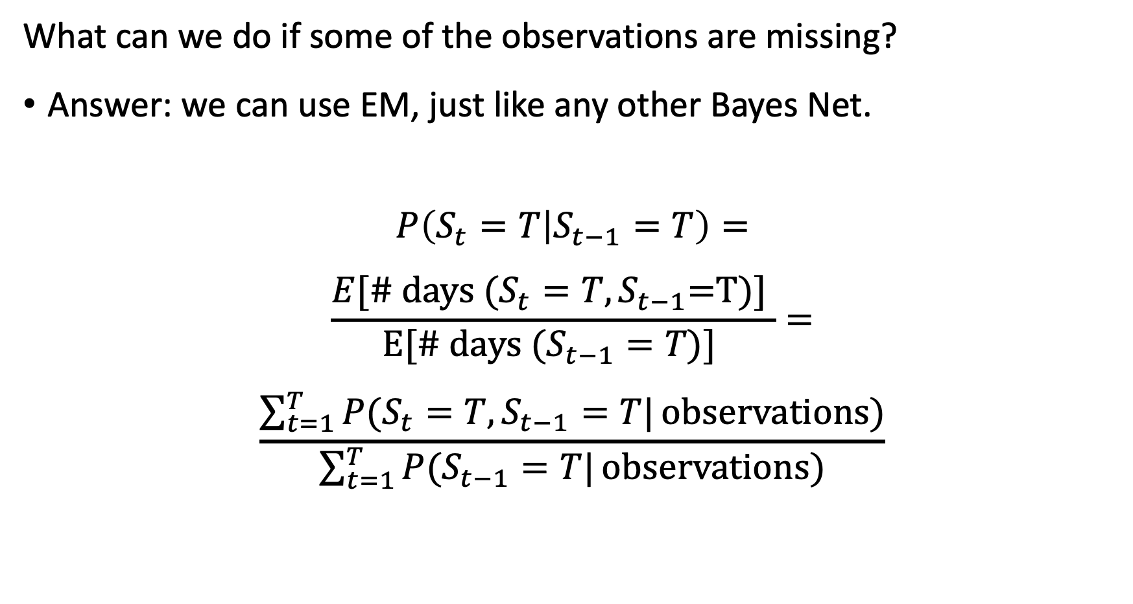
Missing data
What can we do if some of the observations are missing?
Answer: we can use EM, just like any other Bayes Net.
$$P\left(S_{t}=T | S_{t−1}=T\right)=$$
$$\frac{E[\text{\# }\text{days} \text{(}S_{t}=T,S_{t−1}\text{=}\text{T}\text{)}\text{]} }{\text{E}\text{[\# }\text{days} \text{(}S_{t−1}=T\text{)}\text{]} }=$$
$$\frac{\sum_{t=1}^{T}{P(S_{t}=T,S_{t−1}=T|}observations)}{\sum_{t=1}^{T}{P(S_{t−1}=T|}observations)}$$

Slide 39
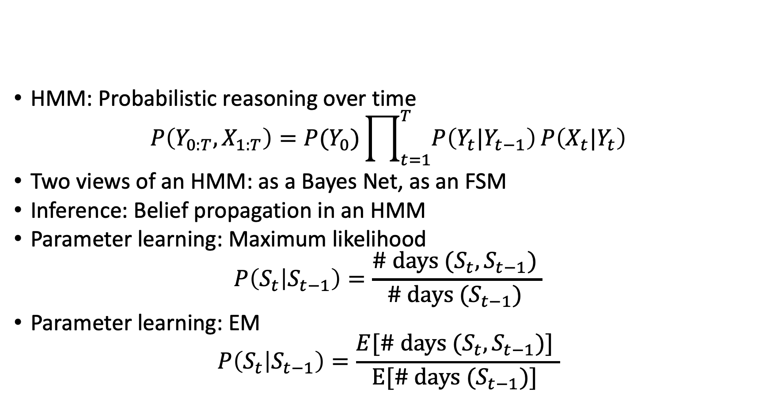
Outline
HMM: Probabilistic reasoning over time
$$P\left(Y_{0:T},X_{1:T}\right)=P(Y_{0})\prod_{t=1}^{T}{P\left(Y_{t}|Y_{t−1}\right)}P\left(X_{t}|Y_{t}\right)$$
Two views of an HMM: as a Bayes Net, as an FSM
Inference: Belief propagation in an HMM
Parameter learning: Maximum likelihood
$$P\left(S_{t} | S_{t−1}\right)=\frac{\text{\# }\text{days} \text{(}S_{t},S_{t−1}\text{) }}{\text{\# }\text{days} \text{(}S_{t−1}\text{)} }$$
Parameter learning: EM
$$P\left(S_{t} | S_{t−1}\right)=\frac{E[\text{\# }\text{days} \text{(}S_{t},S_{t−1}\text{)] }}{\text{E}\text{[\# }\text{days} \text{(}S_{t−1}\text{)]} }$$

