Slide 1
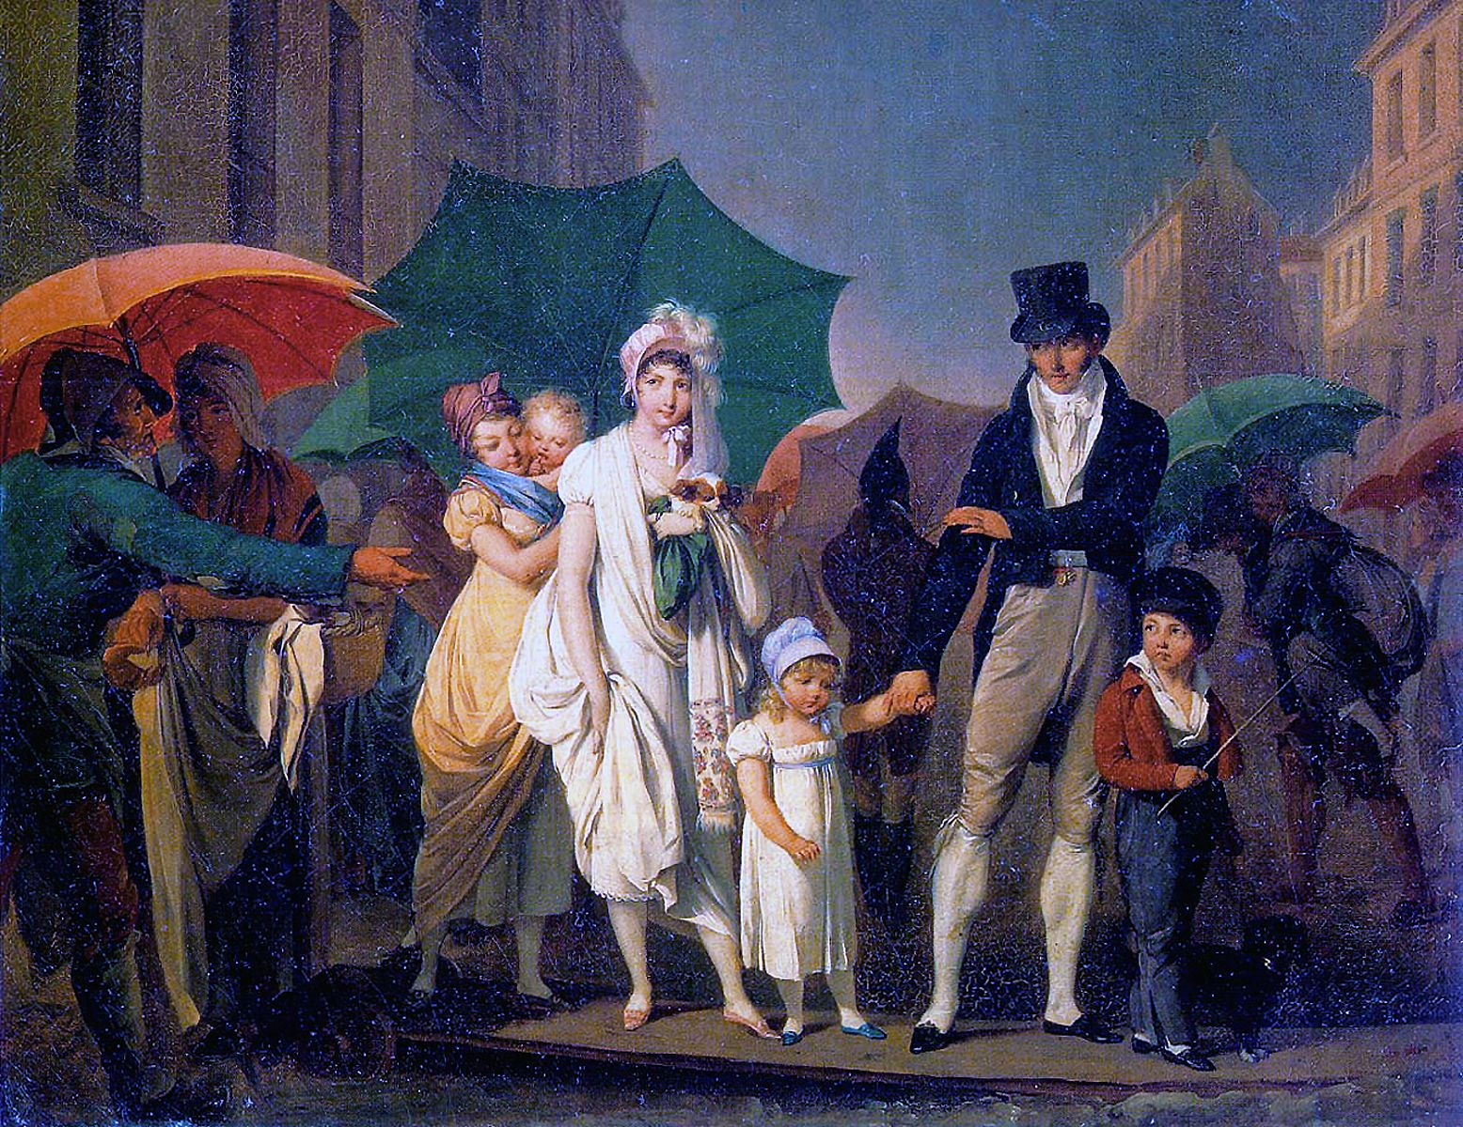
CS440/ECE448 Lecture 23: HMM Inference and the Viterbi Algorithm
Mark Hasegawa-Johnson, 3/2022
CC-BY 4.0: You may remix or redistribute if you cite the source.
Louis-Leopold Boilly, Passer Payez, 1803. Public domain work of art, https://en.wikipedia.org/wiki/Umbrella

Slide 2

Outline
Belief propagation
What is $P(Y_{t}|X_{1}=x_{1},…,X_{T}=x_{T})$?
Viterbi Algorithm
What is the most probable sequence $\{Y_{1},…,Y_{T}\}$ given observations $\{X_{1}=x_{1},…,X_{T}=x_{T}\}$?

Slide 3
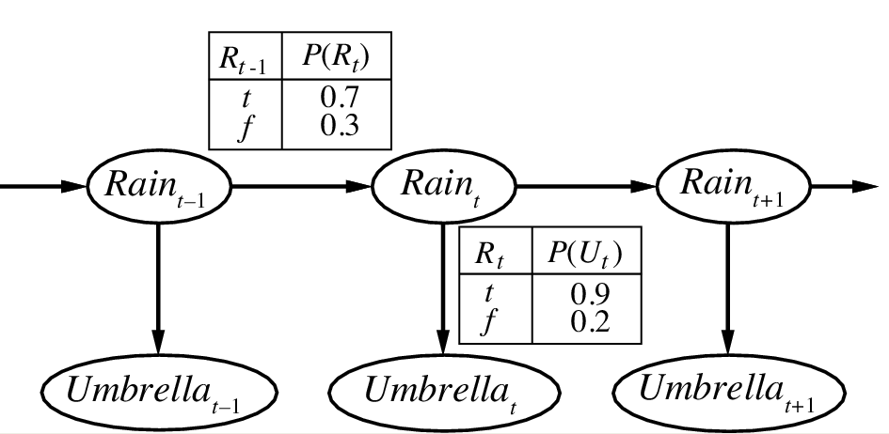
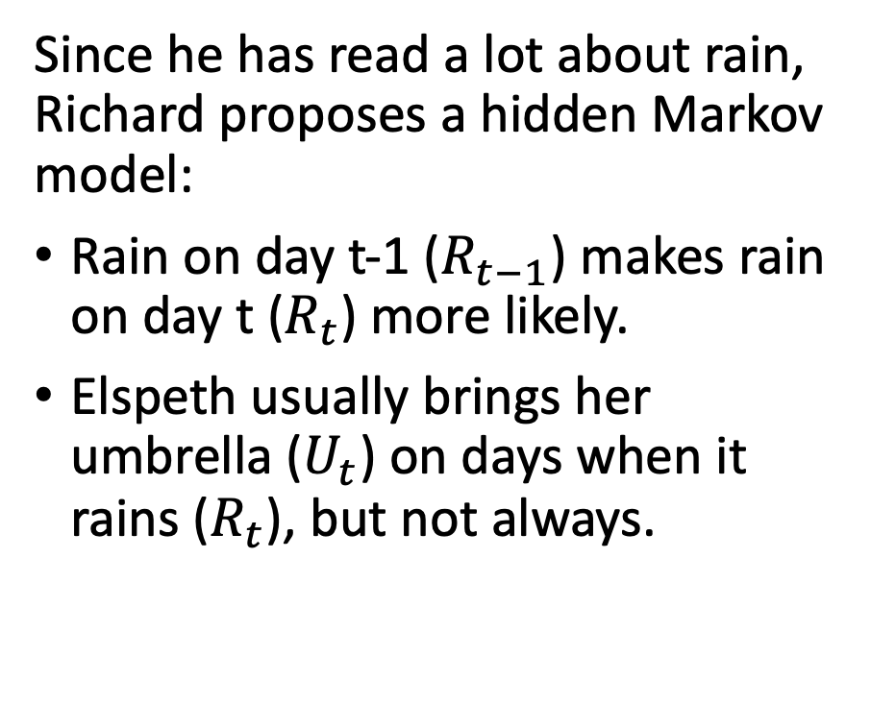
Example Scenario: UmbrellaWorld Characters from the novel Hammered by Elizabeth Bear, Scenario from chapter 15 of Russell & Norvig
Since he has read a lot about rain, Richard proposes a hidden Markov model:
Rain on day t-1 ($R_{t−1}$) makes rain on day t ($R_{t}$) more likely.
Elspeth usually brings her umbrella ($U_{t}$) on days when it rains ($R_{t}$), but not always.
state
observation
Notes:
The example is described in Section 15.1.1

Slide 4

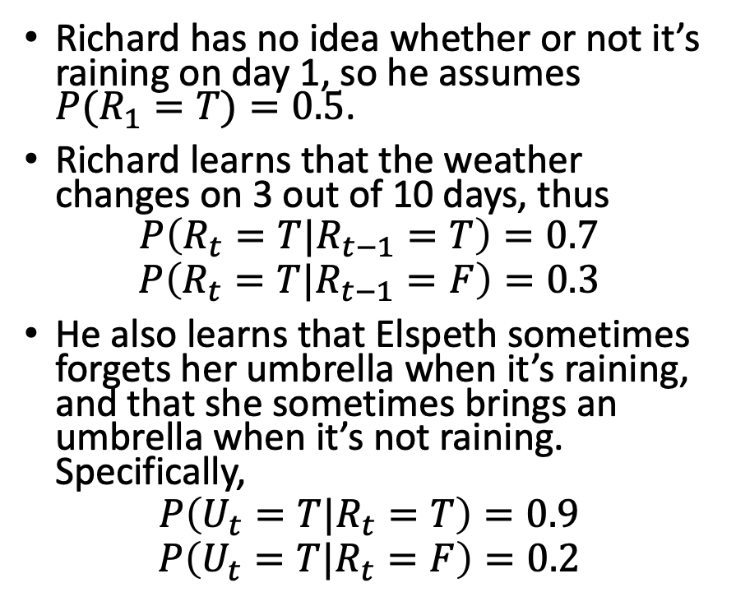
Example Scenario: UmbrellaWorld Characters from the novel Hammered by Elizabeth Bear, Scenario from chapter 15 of Russell & Norvig
Initial
state
model
Richard has no idea whether or not it’s raining on day 1, so he assumes $P(R_{1}=T)=0.5$.
Richard learns that the weather changes on 3 out of 10 days, thus
$$P\left(R_{t}=T|R_{t−1}=T\right)=0.7$$
$$P\left(R_{t}=T|R_{t−1}=F\right)=0.3$$
He also learns that Elspeth sometimes forgets her umbrella when it’s raining, and that she sometimes brings an umbrella when it’s not raining. Specifically,
$$P\left(U_{t}=T|R_{t}=T\right)=0.9$$
$$P\left(U_{t}=T|R_{t}=F\right)=0.2$$
Transition model
$$P\left(R_{1}\right)$$
$$0.5$$
state
observation
Observation model
Notes:
The example is described in Section 15.1.1

Slide 5
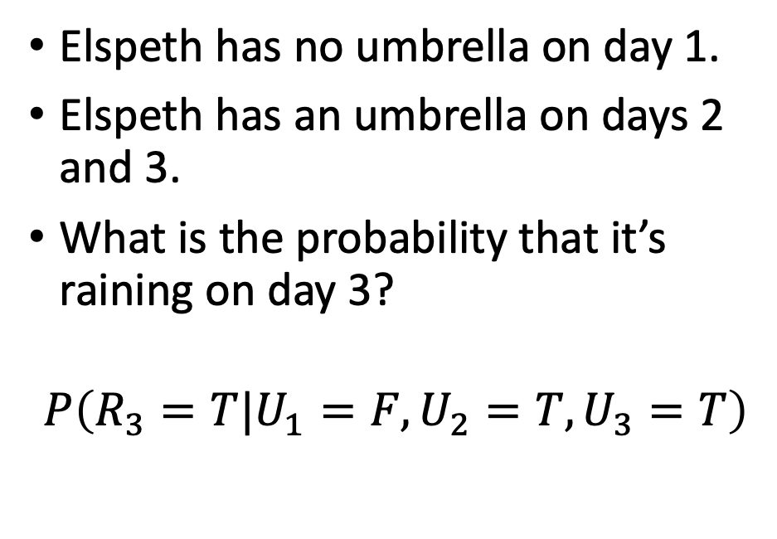

Belief propagation in an HMM: Example
Initial
state
model
Transition
model
Elspeth has no umbrella on day 1.
Elspeth has an umbrella on days 2 and 3.
What is the probability that it’s raining on day 3?
$$P\left(R_{3}=T|U_{1}=F,U_{2}=T,U_{3}=T\right)$$
$$P\left(R_{1}\right)$$
$$0.5$$
state
observation
Observation model

Slide 6
Belief propagation, step by step
Identify a path through the Bayesian network that includes all variables, including the query variable and all observed variables, starting at their common ancestor
Calculate the joint probability of the query variable and all observed variables, iteratively marginalizing out all intermediate variables step-by-step along the path.
Apply Bayes’ rule to get the desired conditional probability

Slide 7
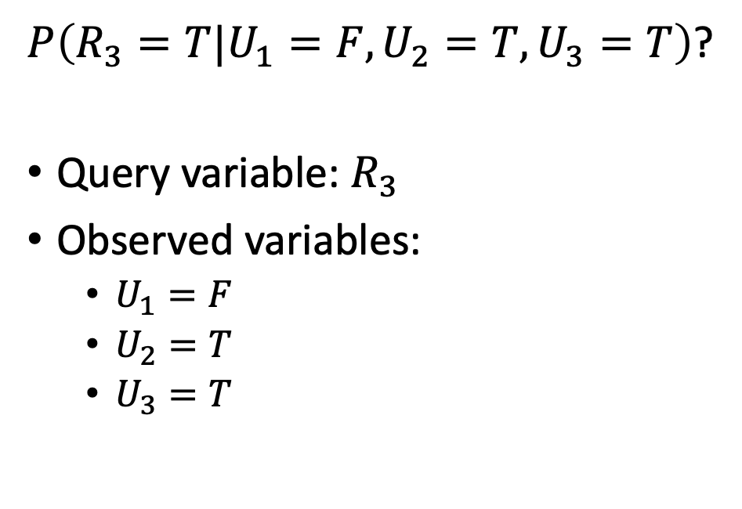
Step 1: Identify a path starting at their common ancestor
$P\left(R_{3}=T|U_{1}=F,U_{2}=T,U_{3}=T\right)$?
Query variable: $R_{3}$
Observed variables:
$U_{1}=F$
$U_{2}=T$
$U_{3}=T$
Initial
state
model
Transition
model
$$P\left(R_{1}\right)$$
$$0.5$$
state
observation
Observation model

Slide 8
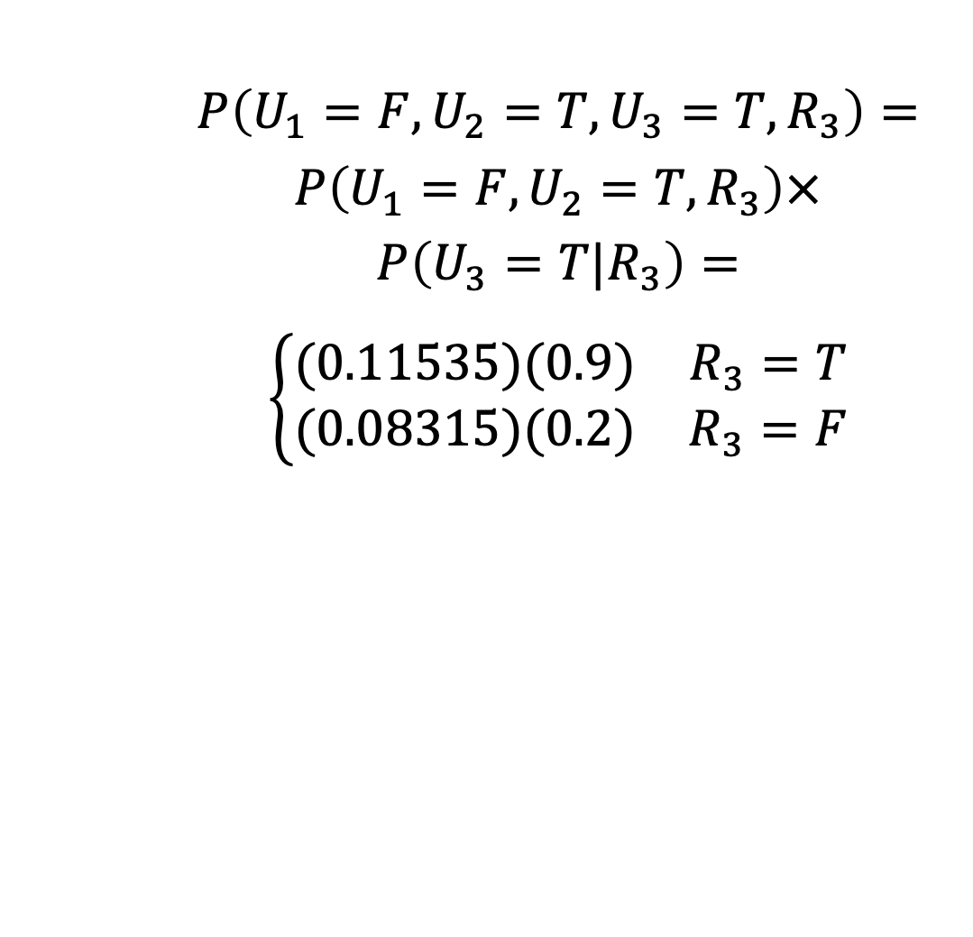
Step 2: Calculate the joint probability, step-by-step…
$$P\left(U_{1}=F,U_{2}=T,U_{3}=T,R_{3}\right)=$$
$$P\left(U_{1}=F,U_{2}=T,R_{3}\right)×$$
$$P\left(U_{3}=T|R_{3}\right)=$$
$$\left\{\begin{matrix}(0.11535)(0.9) & R_{3}=T \\ (0.08315)(0.2) & R_{3}=F\end{matrix}\right.$$
Initial
state
model
Transition
model
$$P\left(R_{1}\right)$$
$$0.5$$
state
observation
Observation model

Slide 9
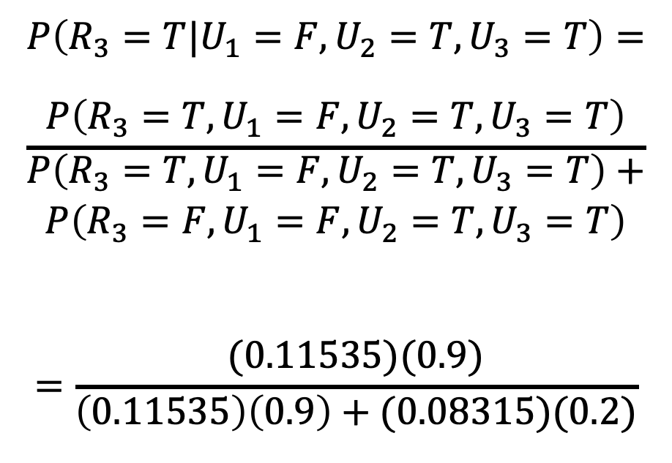
Step 3: Apply Bayes’ rule to get conditional probability
$$P\left(R_{3}=T|U_{1}=F,U_{2}=T,U_{3}=T\right)=$$
$$\frac{P\left(R_{3}=T,U_{1}=F,U_{2}=T,U_{3}=T\right)}{\begin{aligned}P\left(R_{3}=T,U_{1}=F,U_{2}=T,U_{3}=T\right)+ \\ P\left(R_{3}=F,U_{1}=F,U_{2}=T,U_{3}=T\right)\end{aligned}}$$
$$=\frac{(0.11535)(0.9)}{\left(0.11535\right)\left(0.9\right)+(0.08315)(0.2)}$$
Initial
state
model
Transition
model
$$P\left(R_{1}\right)$$
$$0.5$$
state
observation
Observation model

Slide 10
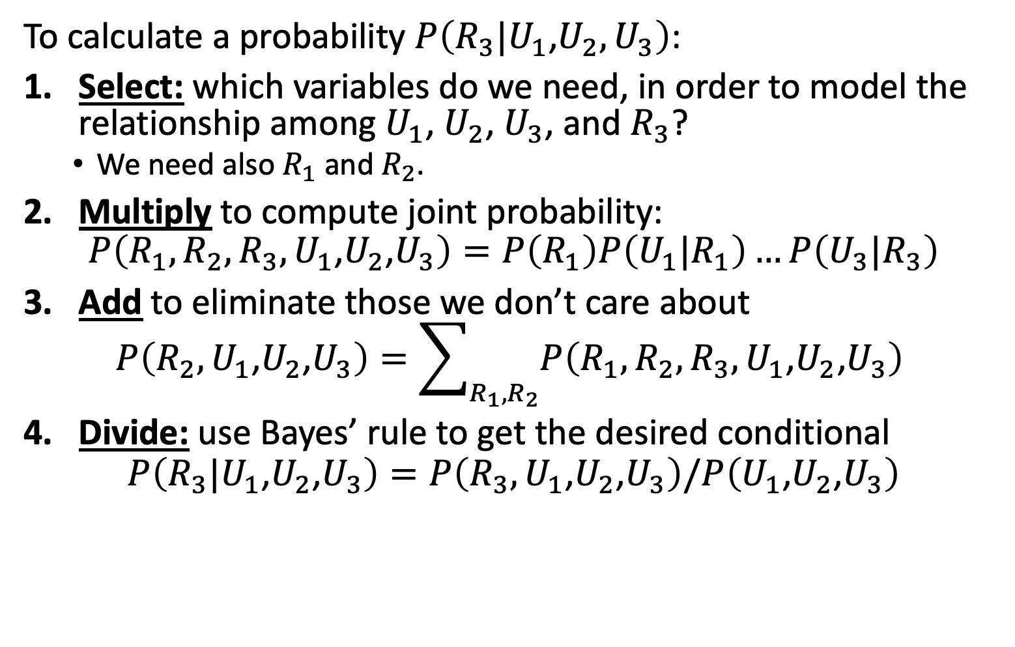
Inference by Enumeration
To calculate a probability $P\left(R_{3}|U_{1}\text{,}U_{2},U_{3}\right)$:
Select: which variables do we need, in order to model the relationship among $U_{1}$, $U_{2}$, $U_{3}$, and $R_{3}$?
We need also $R_{1}$ and $R_{2}$.
Multiply to compute joint probability:
$$P\left(R_{1},R_{2},R_{3},U_{1}\text{,}U_{2}\text{,}U_{3}\right)=P\left(R_{1}\right)P\left(U_{1}|R_{1}\right)…P\left(U_{3}|R_{3}\right)$$
Add to eliminate those we don’t care about
$$P\left(R_{2},U_{1}\text{,}U_{2}\text{,}U_{3}\right)=\sum_{R_{1},R_{2}}{P\left(R_{1},R_{2},R_{3},U_{1}\text{,}U_{2}\text{,}U_{3}\right)}$$
Divide: use Bayes’ rule to get the desired conditional
$$P\left(R_{3}|U_{1}\text{,}U_{2}\text{,}U_{3}\right)=P\left(R_{3},U_{1}\text{,}U_{2}\text{,}U_{3}\right)/P\left(U_{1}\text{,}U_{2}\text{,}U_{3}\right)$$
…
R₁
R₂
R_{T-1}
R_{T}
U₁
U₂
U_{T-1}
U_{T}

Slide 11
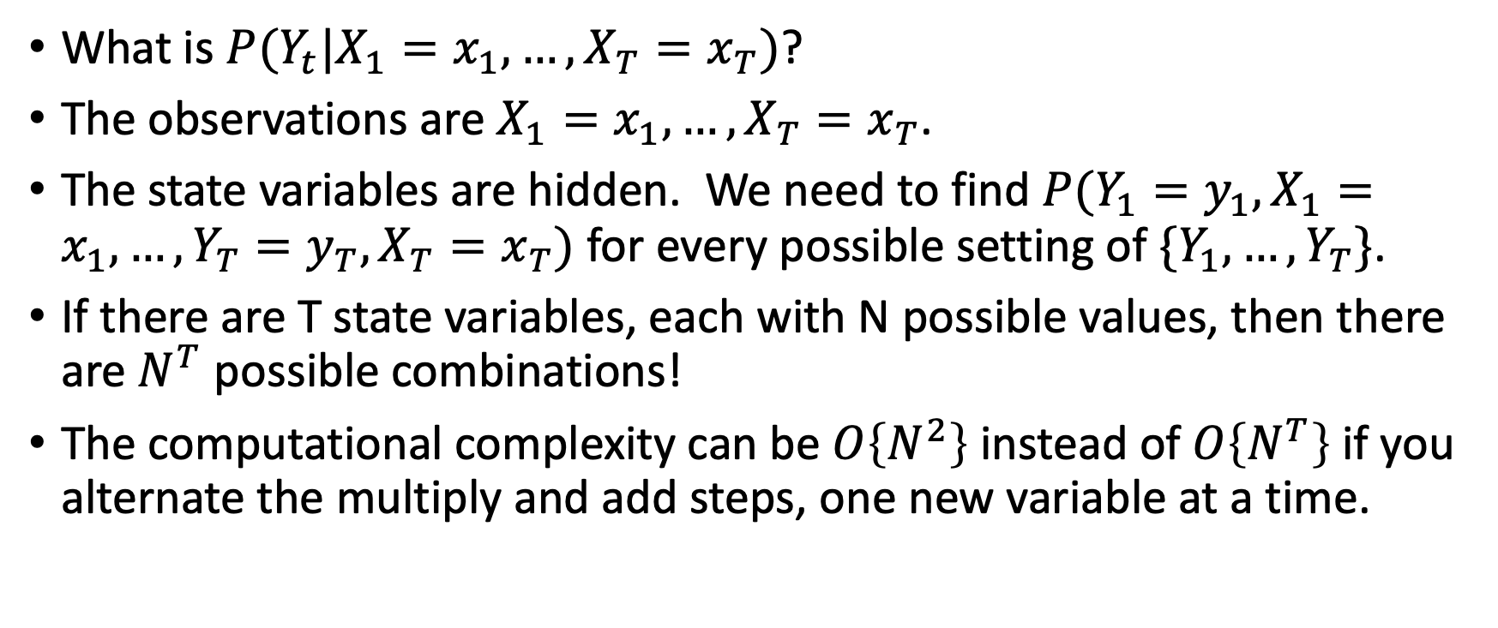
Belief Propagation
What is $P(Y_{t}|X_{1}=x_{1},…,X_{T}=x_{T})$?
The observations are $X_{1}=x_{1},…,X_{T}=x_{T}$.
The state variables are hidden. We need to find $P(Y_{1}=y_{1},X_{1}=x_{1}, …,{Y_{T}=y_{T},X}_{T}=x_{T})$ for every possible setting of $\{Y_{1},…,Y_{T}\}$.
If there are T state variables, each with N possible values, then there are $N^{T}$ possible combinations!
The computational complexity can be $O\left\{N^{2}\right\}$ instead of $O\left\{N^{T}\right\}$ if you alternate the multiply and add steps, one new variable at a time.

Slide 12

Outline
Belief propagation
What is $P(Y_{t}|X_{1}=x_{1},…,X_{T}=x_{T})$?
Viterbi Algorithm
What is the most probable sequence $\{Y_{1},…,Y_{T}\}$ given observations $\{X_{1}=x_{1},…,X_{T}=x_{T}\}$?

Slide 13
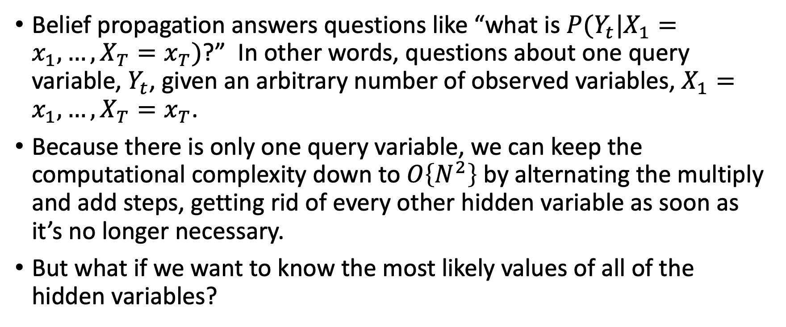
Viterbi algorithm: inferring the entire sequence
Belief propagation answers questions like “what is $P(Y_{t}|X_{1}=x_{1},…,X_{T}=x_{T})$?” In other words, questions about one query variable, $Y_{t}$, given an arbitrary number of observed variables, $X_{1}=x_{1},…,X_{T}=x_{T}$.
Because there is only one query variable, we can keep the computational complexity down to $O\left\{N^{2}\right\}$ by alternating the multiply and add steps, getting rid of every other hidden variable as soon as it’s no longer necessary.
But what if we want to know the most likely values of all of the hidden variables?

Slide 14
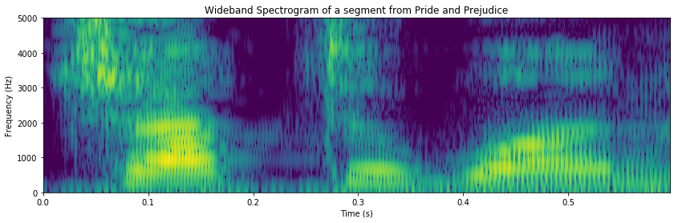
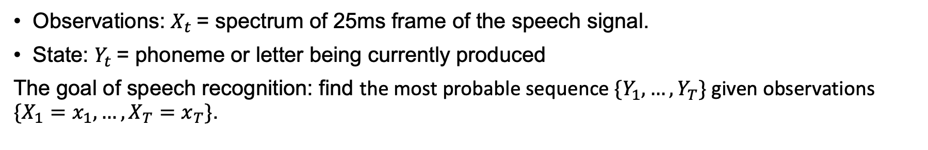
Example: Speech Recognition
Observations: $X_{t}$= spectrum of 25ms frame of the speech signal.
State: $Y_{t}$= phoneme or letter being currently produced
The goal of speech recognition: find the most probable sequence $\{Y_{1},…,Y_{T}\}$ given observations $\{X_{1}=x_{1},…,X_{T}=x_{T}\}$.
_
_
c
c
c
h
h
a
a
a

Slide 15
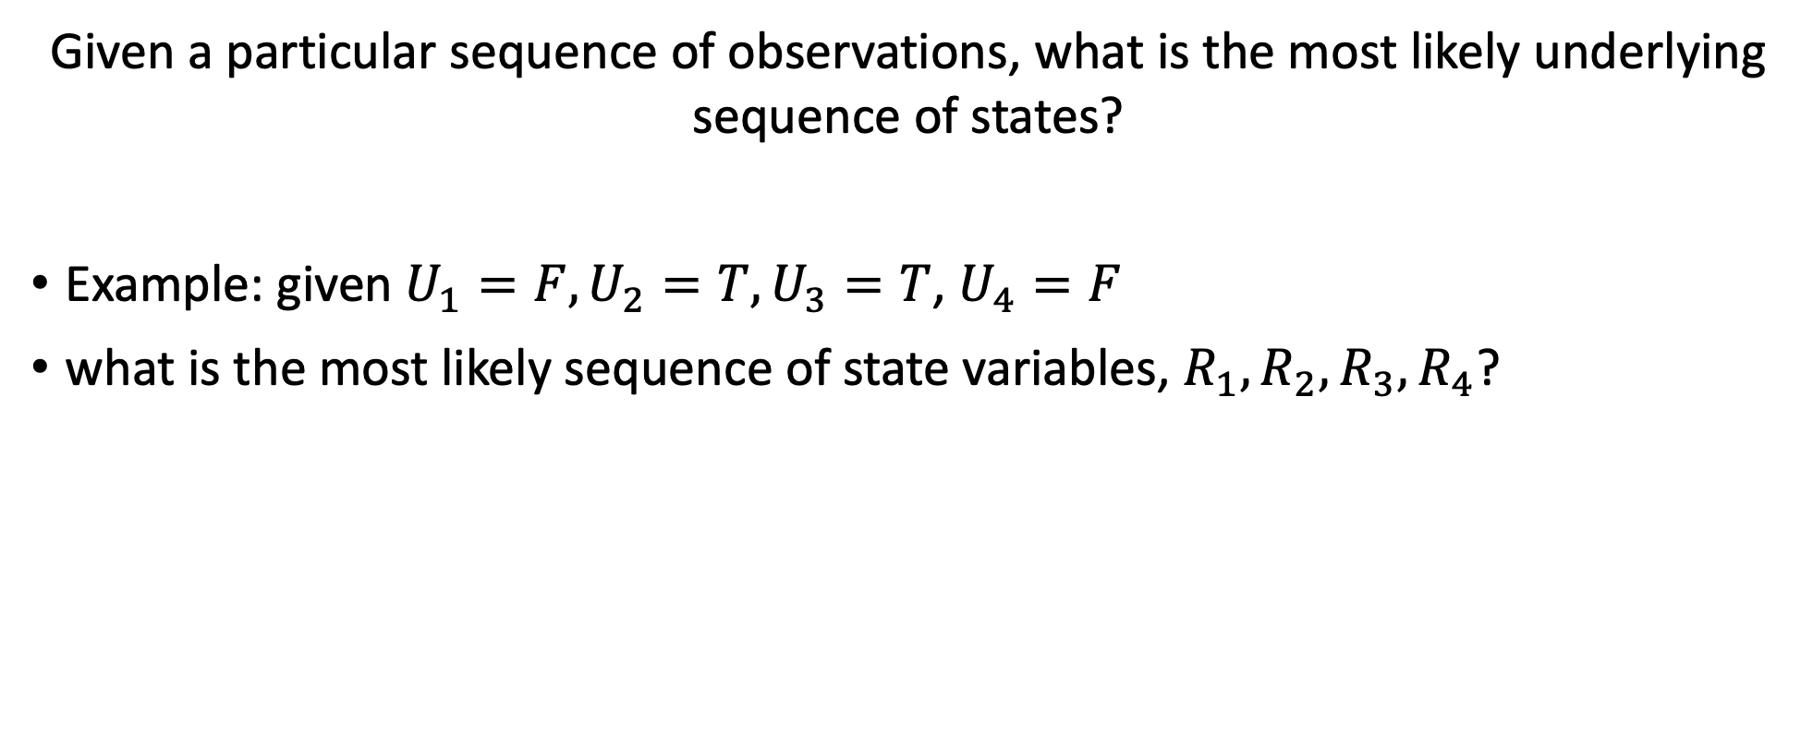
Viterbi Algorithm Example
Given a particular sequence of observations, what is the most likely underlying sequence of states?
Example: given $U_{1}=F,U_{2}=T,U_{3}=T$, $U_{4}=F$
what is the most likely sequence of state variables, $R_{1},R_{2},R_{3},R_{4}$?

Slide 16

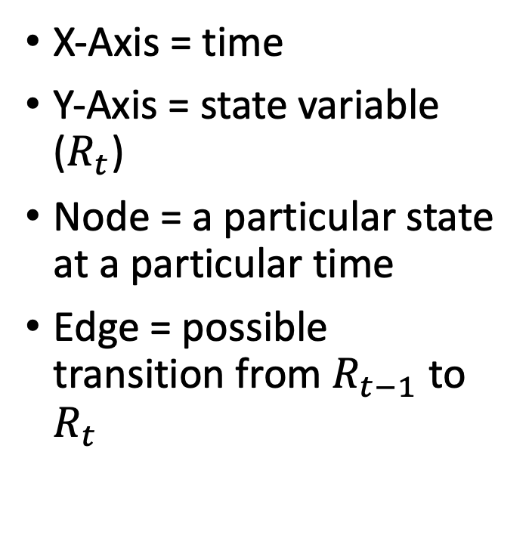
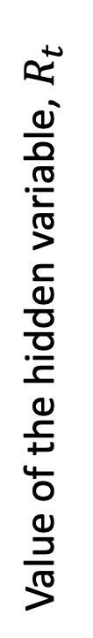



The Trellis
T
X-Axis = time
Y-Axis = state variable ($R_{t}$)
Node = a particular state at a particular time
Edge = possible transition from $R_{t−1}$ to $R_{t}$
…
Value of the hidden variable, $R_{t}$
F
Time
$$U_{1}=F$$
$$U_{2}=T$$
$$U_{3}=T$$
$$U_{4}=F$$

Slide 17
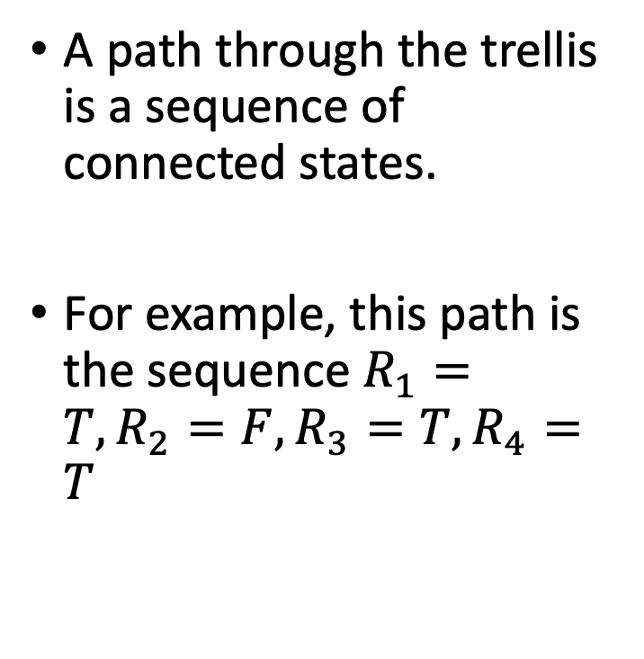
A Path Through the Trellis
T
A path through the trellis is a sequence of connected states.
For example, this path is the sequence $R_{1}=T,R_{2}=F,R_{3}=T,R_{4}=T$
…
Value of the hidden variable, $R_{t}$
F
Time
$$U_{1}=F$$
$$U_{2}=T$$
$$U_{3}=T$$
$$U_{4}=F$$

Slide 18
Viterbi Algorithm Key Concept
Given a particular sequence of observations, what is the most likely underlying sequence of states?
In other words, given a particular sequence of observations, what is the most probable path through the trellis?

Slide 19
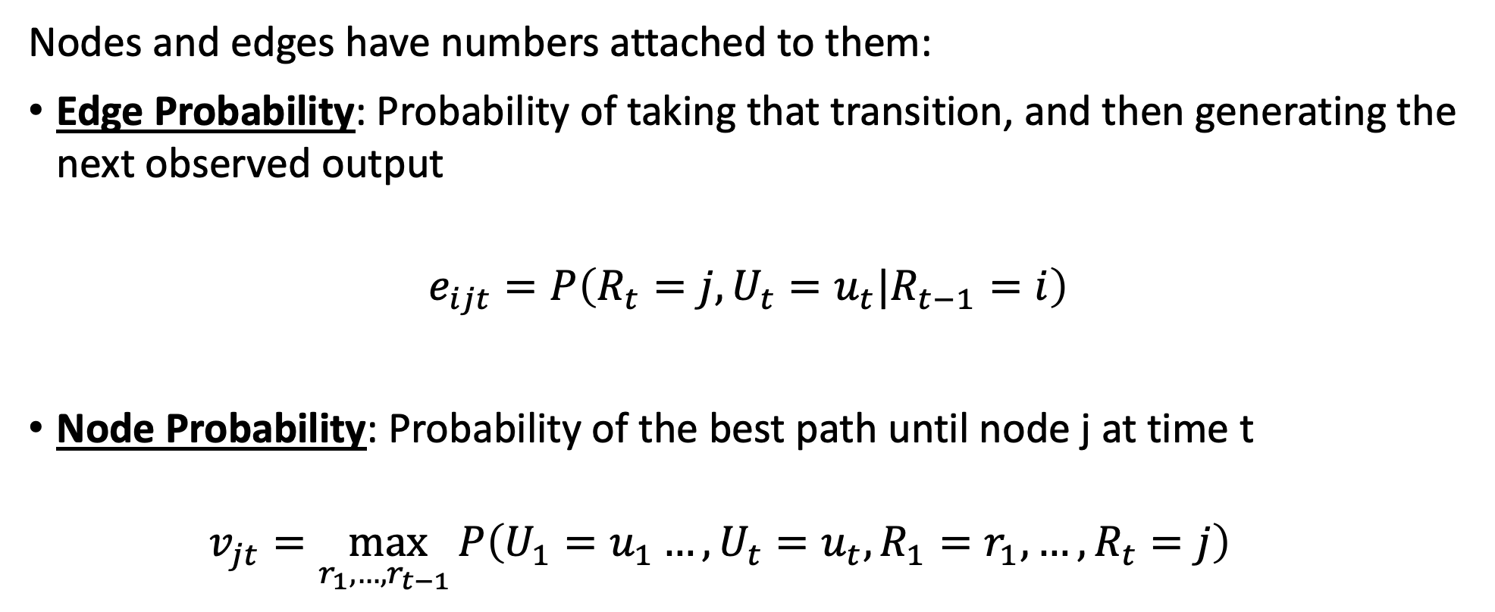
Viterbi Algorithm: Key concepts
Nodes and edges have numbers attached to them:
Edge Probability: Probability of taking that transition, and then generating the next observed output
$$e_{ijt}=P\left(R_{t}=j,U_{t}=u_{t}|R_{t−1}=i\right)$$
Node Probability: Probability of the best path until node j at time t
$$v_{jt}=\max_{r_{1},…,r_{t−1} }P\left(U_{1}=u_{1}…, U_{t}=u_{t},R_{1}=r_{1},…, R_{t}=j\right)$$

Slide 20
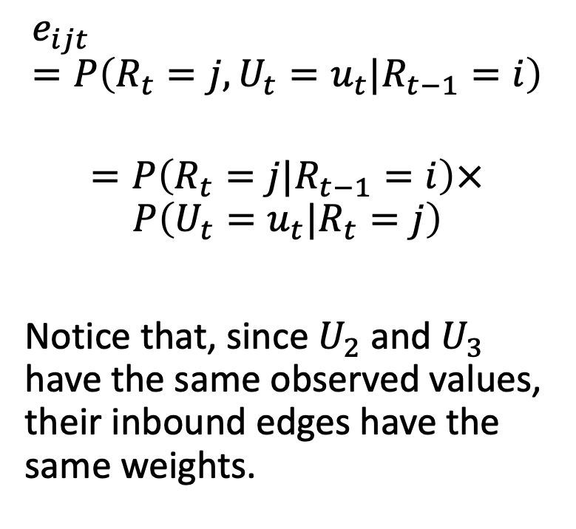
Edge Probabilities
T
$$e_{ijt}=P\left(R_{t}=j,U_{t}=u_{t}|R_{t−1}=i\right)$$
$$=P\left(R_{t}=j|R_{t−1}=i\right)×$$
$$P\left(U_{t}=u_{t}|R_{t}=j\right)$$
Notice that, since $U_{2}$ and $U_{3}$ have the same observed values, their inbound edges have the same weights.
0.63
0.63
0.07
0.06
0.06
0.24
…
Value of the hidden variable, $R_{t}$
0.27
0.27
0.03
0.14
0.14
0.56
F
Time
$$U_{1}=F$$
$$U_{2}=T$$
$$U_{3}=T$$
$$U_{4}=F$$

Slide 21
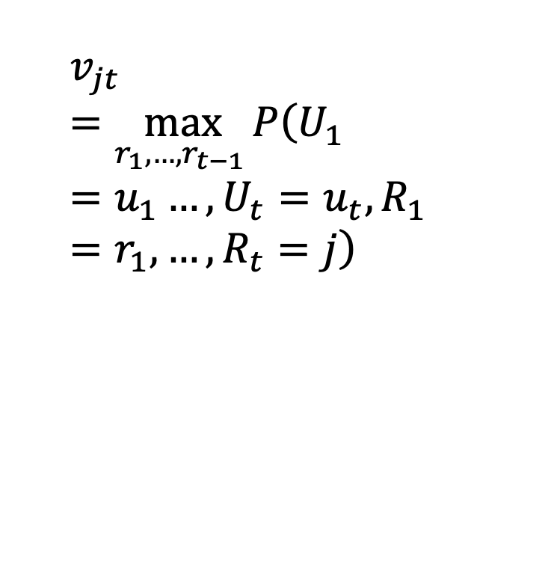
Node Probabilities
T
$$v_{jt}=\max_{r_{1},…,r_{t−1} }P\left(U_{1}=u_{1}…, U_{t}=u_{t},R_{1}=r_{1},…, R_{t}=j\right)$$
0.63
0.63
0.07
?
?
?
?
0.06
0.06
0.24
…
Value of the hidden variable, $R_{t}$
0.27
0.27
0.03
?
?
?
?
0.14
0.14
0.56
F
Time
$$U_{1}=F$$
$$U_{2}=T$$
$$U_{3}=T$$
$$U_{4}=F$$

Slide 22
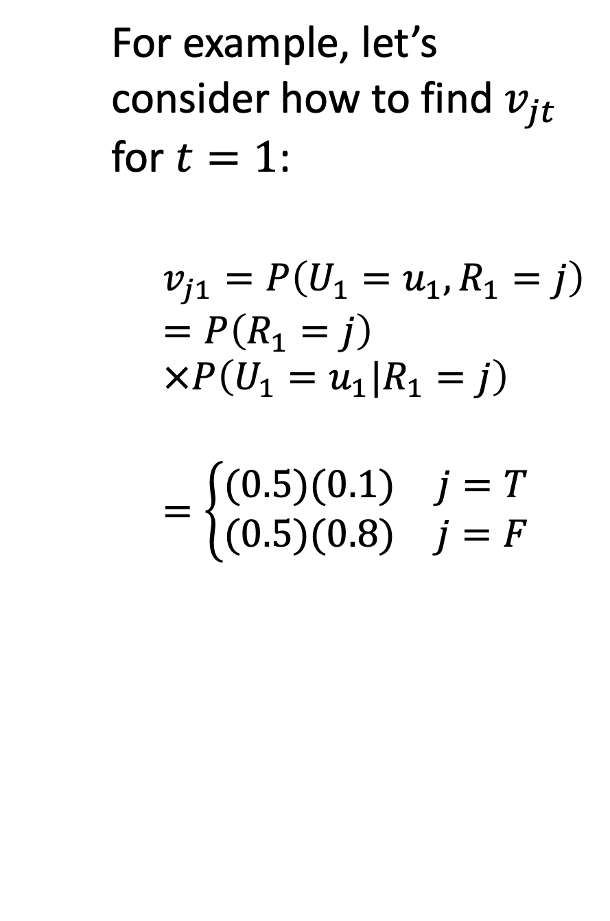
Node Probabilities: Initialization
For example, let’s consider how to find $v_{jt}$ for $t=1$:
$$v_{j1}=P\left(U_{1}=u_{1},R_{1}=j\right)$$
$$=P\left(R_{1}=j\right)×P\left(U_{1}=u_{1}|R_{1}=j\right)$$
$$=\left\{\begin{matrix}(0.5)(0.1) & j=T \\ (0.5)(0.8) & j=F\end{matrix}\right.$$
T
0.63
0.63
0.07
0.05
?
?
?
0.06
0.06
0.24
…
Value of the hidden variable, $R_{t}$
0.27
0.27
0.03
0.40
?
?
?
0.14
0.14
0.56
F
Time
$$U_{1}=F$$
$$U_{2}=T$$
$$U_{3}=T$$
$$U_{4}=F$$

Slide 23
… and what about time t=2?
Notice that, at time t=2, there are two ways to get to any particular state:
The previous state might have been F
The previous state might have been T
T
0.63
0.63
0.07
0.05
?
?
?
0.06
0.06
0.24
…
Value of the hidden variable, $R_{t}$
0.27
0.27
0.03
0.40
?
?
?
0.14
0.14
0.56
F
Time
$$U_{1}=F$$
$$U_{2}=T$$
$$U_{3}=T$$
$$U_{4}=F$$

Slide 24
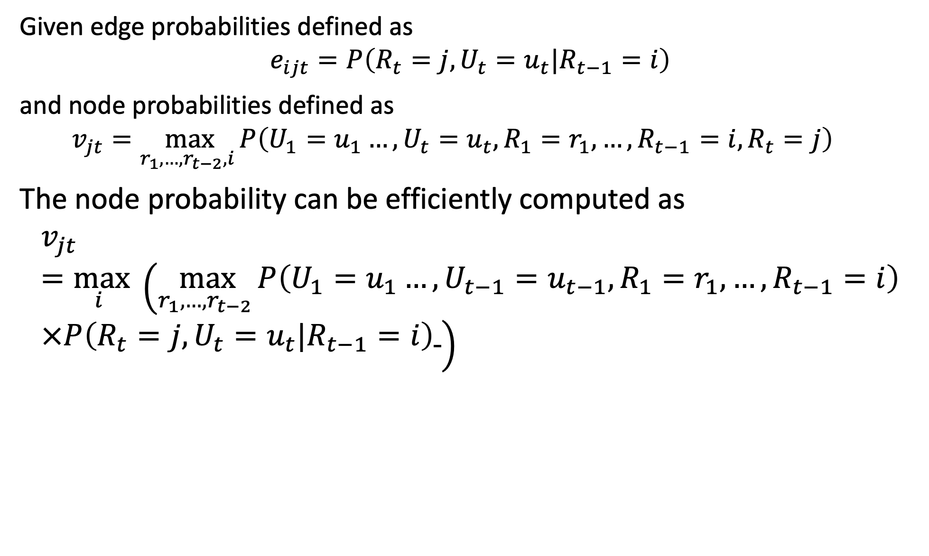
Viterbi Algorithm: the iteration step
Given edge probabilities defined as
$$e_{ijt}=P\left(R_{t}=j,U_{t}=u_{t}|R_{t−1}=i\right)$$
and node probabilities defined as
$$v_{jt}=\max_{r_{1},…,r_{t−2},i }P\left(U_{1}=u_{1}…, U_{t}=u_{t},R_{1}=r_{1},…,R_{t−1}=i,R_{t}=j\right)$$
The node probability can be efficiently computed as
$$v_{jt}=\max_{i } \left(\max_{r_{1},…,r_{t−2} }P\left(U_{1}=u_{1}…, U_{t−1}=u_{t−1},R_{1}=r_{1},…,R_{t−1}=i\right)×P\left(R_{t}=j,U_{t}=u_{t}|R_{t−1}=i\right) \right)$$

Slide 25
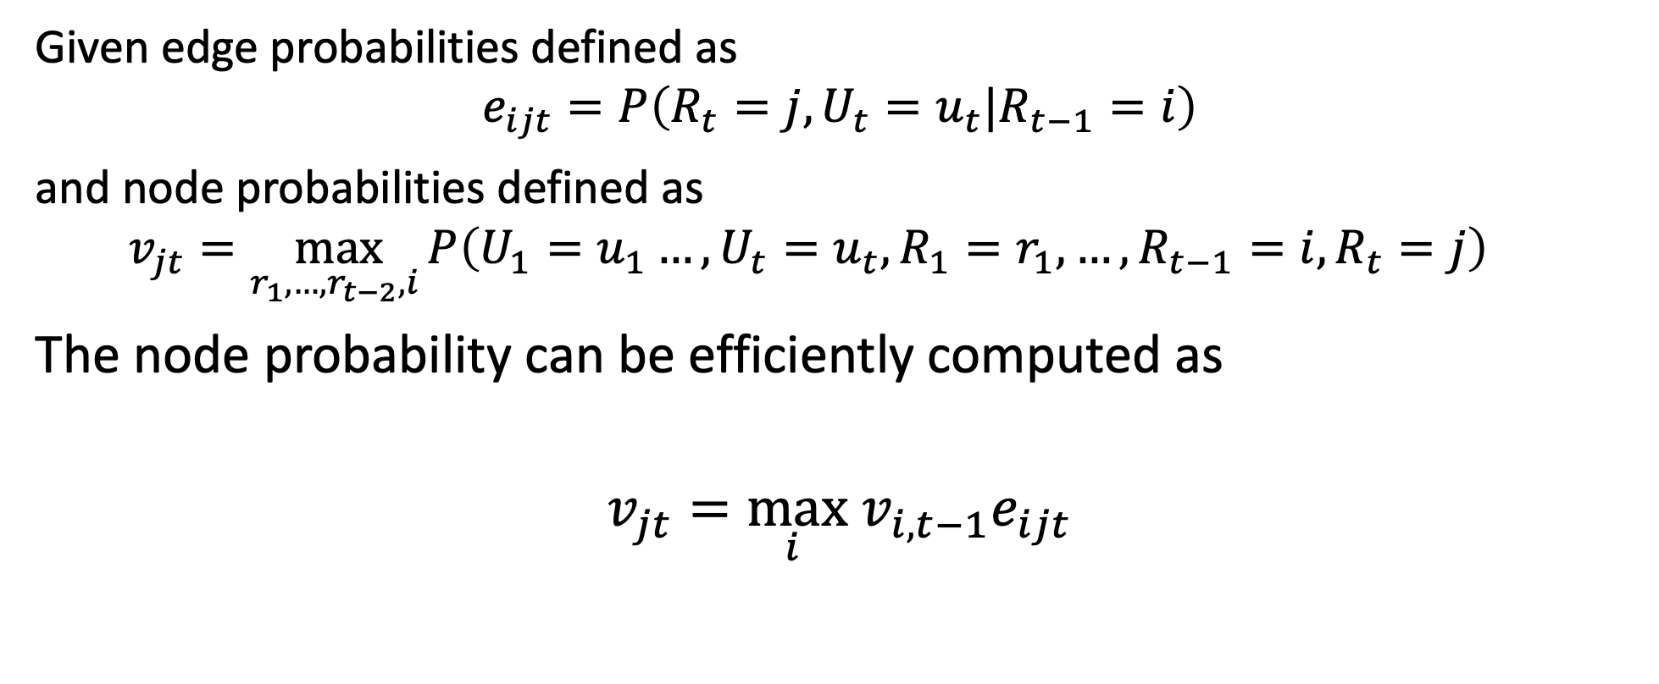
Viterbi Algorithm: the iteration step
Given edge probabilities defined as
$$e_{ijt}=P\left(R_{t}=j,U_{t}=u_{t}|R_{t−1}=i\right)$$
and node probabilities defined as
$$v_{jt}=\max_{r_{1},…,r_{t−2},i }P\left(U_{1}=u_{1}…, U_{t}=u_{t},R_{1}=r_{1},…,R_{t−1}=i,R_{t}=j\right)$$
The node probability can be efficiently computed as
$$v_{jt}=\max_{i } v_{i,t−1}e_{ijt}$$

Slide 26

… and what about time t=2?
$$v_{T,2}=\max_{i } v_{i1}e_{i,T,2}$$
$$=\max\left(\left(0.05\right)\left(0.63\right),(0.4)(0.27)\right)$$
$$= 0.108$$
T
0.63
0.63
0.07
0.05
.108
?
?
0.06
0.06
0.24
…
Value of the hidden variable, $R_{t}$
0.27
0.27
0.03
0.40
?
?
?
0.14
0.14
0.56
F
Time
$$U_{1}=F$$
$$U_{2}=T$$
$$U_{3}=T$$
$$U_{4}=F$$

Slide 27
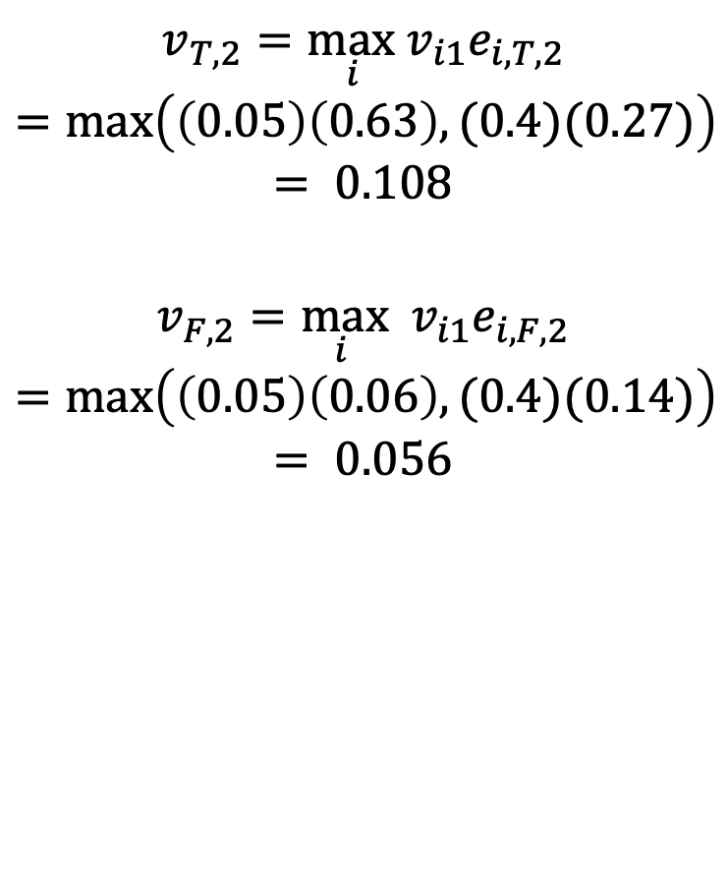
… and what about time t=2?
$$v_{T,2}=\max_{i }v_{i1}e_{i,T,2}$$
$$=\max\left(\left(0.05\right)\left(0.63\right),(0.4)(0.27)\right)$$
$$= 0.108$$
$$v_{F,2}=\max_{i } v_{i1}e_{i,F,2}$$
$$=\max\left(\left(0.05\right)\left(0.06\right),(0.4)(0.14)\right)$$
$$= 0.056$$
T
0.63
0.63
0.07
0.05
.108
?
?
0.06
0.06
0.24
…
Value of the hidden variable, $R_{t}$
0.27
0.27
0.03
0.40
.056
?
?
0.14
0.14
0.56
F
Time
$$U_{1}=F$$
$$U_{2}=T$$
$$U_{3}=T$$
$$U_{4}=F$$

Slide 28
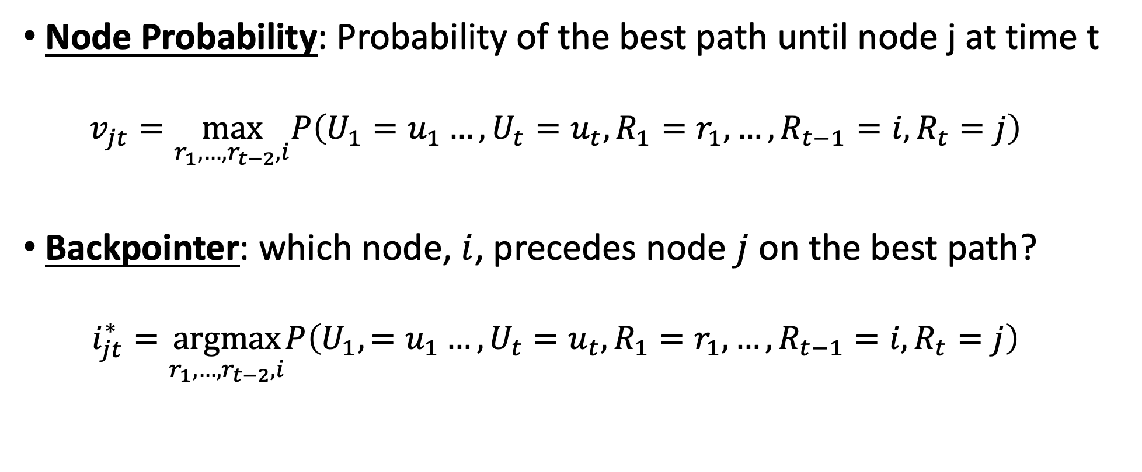
Node probabilities and backpointers
Node Probability: Probability of the best path until node j at time t
$$v_{jt}=\max_{r_{1},…,r_{t−2},i}P\left(U_{1}=u_{1}…, U_{t}=u_{t},R_{1}=r_{1},…,R_{t−1}=i,R_{t}=j\right)$$
Backpointer: which node, $i$, precedes node $j$ on the best path?
$$i_{jt}^{∗}=\underset{r_{1},…,r_{t−2},i}{argmax}P\left(U_{1},=u_{1}…, U_{t}=u_{t},R_{1}=r_{1},…,R_{t−1}=i,R_{t}=j\right)$$

Slide 29
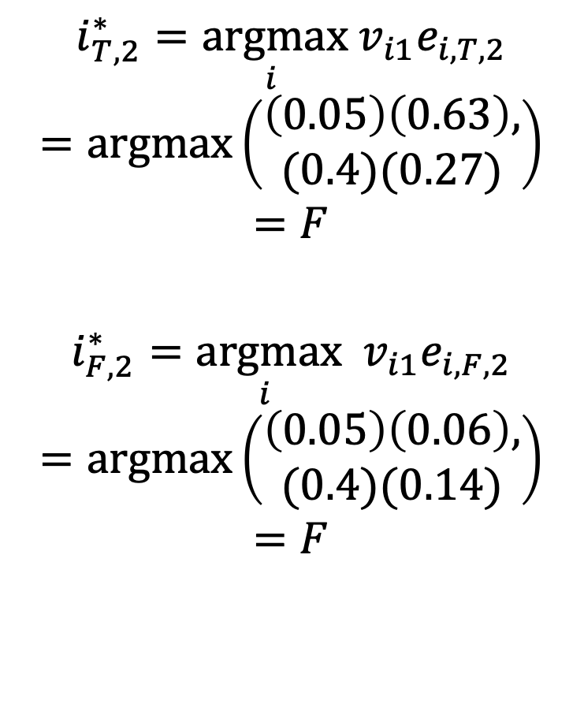
Backpointers at t=2
$$i_{T,2}^{∗}=\underset{i }{argmax}{ v}_{i1}e_{i,T,2}$$
$$=\operatorname{argmax}\left(\begin{aligned}\left(0.05\right)\left(0.63\right), \\ (0.4)(0.27)\end{aligned}\right)$$
$$=F$$
$$i_{F,2}^{∗}=\underset{i }{argmax}{ v}_{i1}e_{i,F,2}$$
$$=\operatorname{argmax}\left(\begin{aligned}\left(0.05\right)\left(0.06\right), \\ (0.4)(0.14)\end{aligned}\right)$$
$$=F$$
T
0.63
0.63
0.07
0.05
.108
?
?
0.06
0.06
0.24
…
Value of the hidden variable, $R_{t}$
0.27
0.27
0.03
0.40
.056
?
?
0.14
0.14
0.56
F
Time
$$U_{1}=F$$
$$U_{2}=T$$
$$U_{3}=T$$
$$U_{4}=F$$

Slide 30
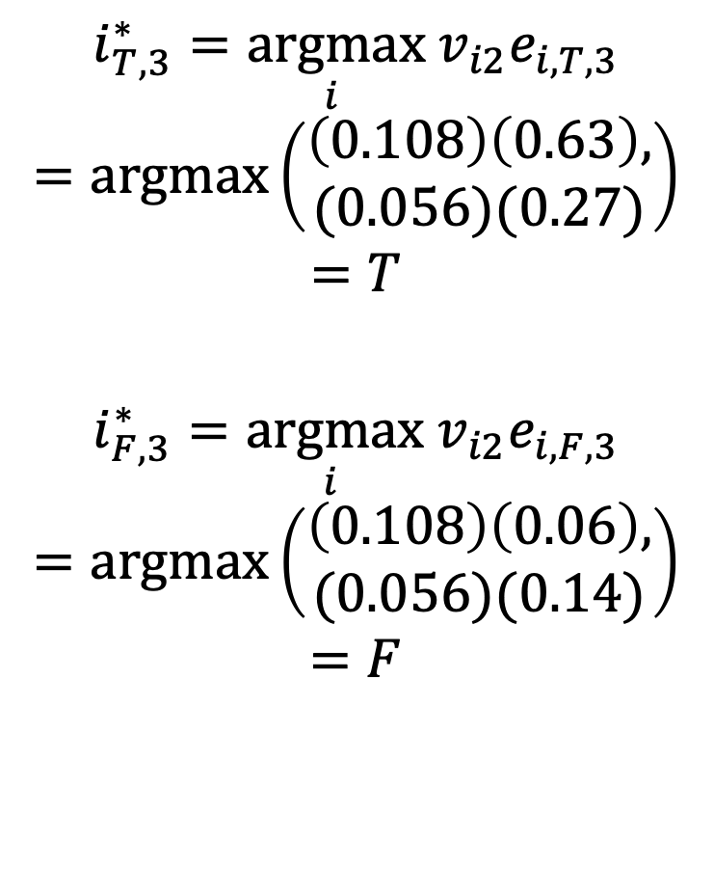
Backpointers at t=3
$$i_{T,3}^{∗}=\underset{i }{argmax}{ v}_{i2}e_{i,T,3}$$
$$=\operatorname{argmax}\left(\begin{aligned}\left(0.108\right)\left(0.63\right), \\ (0.056)(0.27)\end{aligned}\right)$$
$$=T$$
$$i_{F,3}^{∗}=\underset{i }{argmax}{ v}_{i2}e_{i,F,3}$$
$$=\operatorname{argmax}\left(\begin{aligned}\left(0.108\right)\left(0.06\right), \\ (0.056)(0.14)\end{aligned}\right)$$
$$=F$$
T
0.63
0.63
0.07
0.05
.108
.068
?
0.06
0.06
0.24
…
Value of the hidden variable, $R_{t}$
0.27
0.27
0.03
0.40
.056
.008
?
0.14
0.14
0.56
F
Time
$$U_{1}=F$$
$$U_{2}=T$$
$$U_{3}=T$$
$$U_{4}=F$$

Slide 31
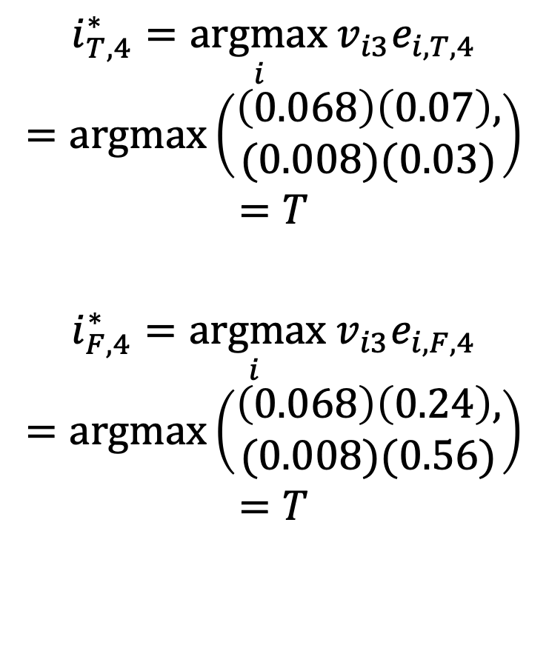
Backpointers at t=4
$$i_{T,4}^{∗}=\underset{i }{argmax}v_{i3}e_{i,T,4}$$
$$=\operatorname{argmax}\left(\begin{aligned}\left(0.068\right)\left(0.07\right), \\ (0.008)(0.03)\end{aligned}\right)$$
$$=T$$
$$i_{F,4}^{∗}=\underset{i }{argmax}{ v}_{i3}e_{i,F,4}$$
$$=\operatorname{argmax}\left(\begin{aligned}\left(0.068\right)\left(0.24\right), \\ (0.008)(0.56)\end{aligned}\right)$$
$$=T$$
T
0.63
0.63
0.07
0.05
.108
.068
.005
0.06
0.06
0.24
…
Value of the hidden variable, $R_{t}$
0.27
0.27
0.03
0.40
.056
.008
.016
0.14
0.14
0.56
F
Time
$$U_{1}=F$$
$$U_{2}=T$$
$$U_{3}=T$$
$$U_{4}=F$$

Slide 32
So which is the best path?
Answer: whichever one is most probable.

Slide 33
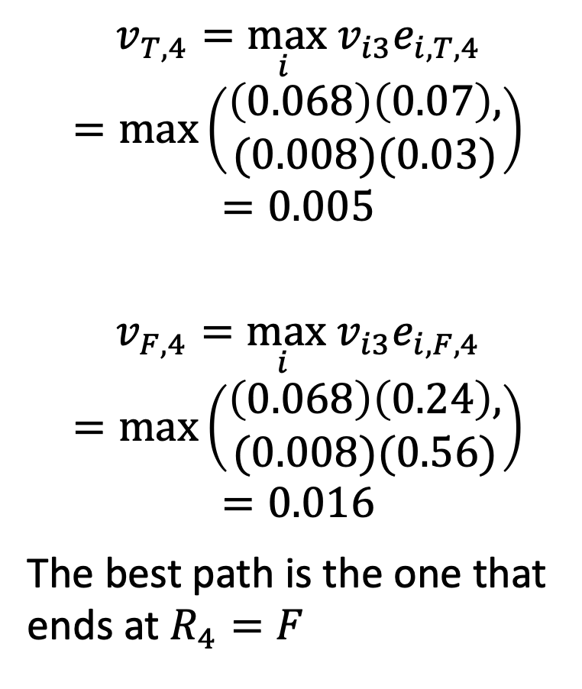
Node probabilities at t=4
$$v_{T,4}=\max_{i } v_{i3}e_{i,T,4}$$
$$=\max\left(\begin{aligned}\left(0.068\right)\left(0.07\right), \\ (0.008)(0.03)\end{aligned}\right)$$
$$=0.005$$
$$v_{F,4}=\max_{i } v_{i3}e_{i,F,4}$$
$$=\max\left(\begin{aligned}\left(0.068\right)\left(0.24\right), \\ (0.008)(0.56)\end{aligned}\right)$$
$$=0.016$$
The best path is the one that ends at $R_{4}=F$
T
0.63
0.63
0.07
0.05
.108
.068
.005
0.06
0.06
0.24
…
Value of the hidden variable, $R_{t}$
0.27
0.27
0.03
0.40
.056
.008
.016
0.14
0.14
0.56
F
Time
$$U_{1}=F$$
$$U_{2}=T$$
$$U_{3}=T$$
$$U_{4}=F$$

Slide 34
Termination: which is the best path?
Best final state is whichever final state has the highest node probability.
The best path leading to that state is the most probable one
… but we’ve already found the most probable path…
…we just need to follow the backpointers!

Slide 35
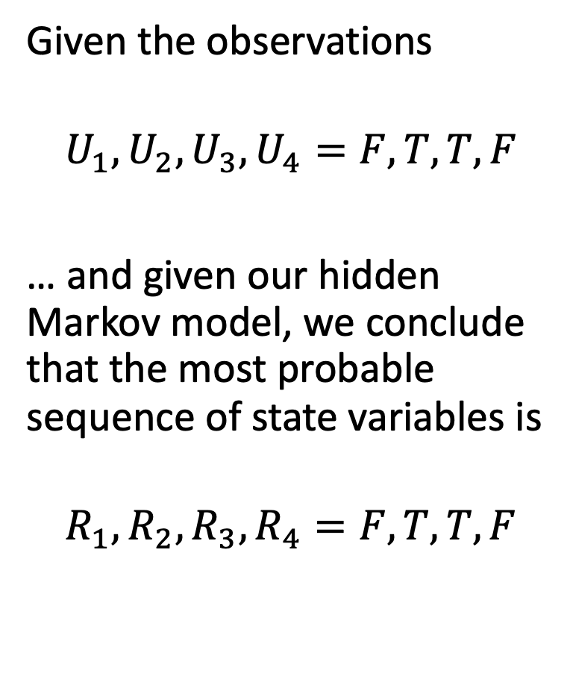
Follow the backpointers!
Given the observations
$$U_{1},U_{2},U_{3},U_{4}=F,T,T,F$$
… and given our hidden Markov model, we conclude that the most probable sequence of state variables is
$$R_{1},R_{2},R_{3},R_{4}=F,T,T,F$$
T
0.63
0.63
0.07
0.05
.108
.068
.005
0.06
0.06
0.24
…
Value of the hidden variable, $R_{t}$
0.27
0.27
0.03
0.40
.056
.008
.016
0.14
0.14
0.56
F
Time
$$U_{1}=F$$
$$U_{2}=T$$
$$U_{3}=T$$
$$U_{4}=F$$

Slide 36
Some conclusions
We have discovered that, if Elspeth brings her umbrella only on days 2 and 3, then the best inference is that it’s raining on only those days.

Slide 37
Some conclusions
Other types of HMMs might be less obvious. For example, consider the following assertion:
A fly flies well. A well does not fly.
In order to decide if these sentences are true or false, you first need to know which words are nouns, which verbs, and which adverbs.
In MP4, you will solve this problem using an HMM.
State variable = part of speech
Observation = word
Transition model: verbs tend to come after nouns.

Slide 38
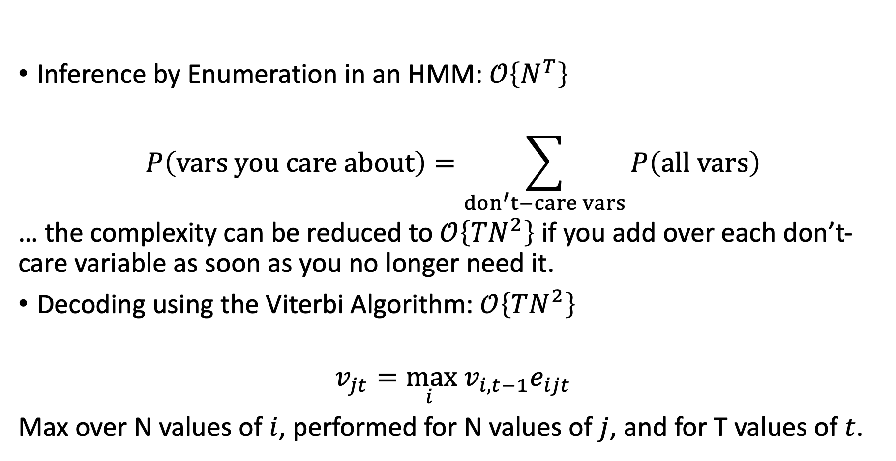
Final Word: Computational Complexity
Inference by Enumeration in an HMM: $𝒪\left\{N^{T}\right\}$
$$P\left(vars you care about\right)=\sum_{don^{′}t−care vars}{P\left(all vars\right)}$$
… the complexity can be reduced to $𝒪\left\{{TN}^{2}\right\}$ if you add over each don’t-care variable as soon as you no longer need it.
Decoding using the Viterbi Algorithm: $𝒪\left\{TN^{2}\right\}$
$$v_{jt}=\max_{i } v_{i,t−1}e_{ijt}$$
Max over N values of $i$, performed for N values of $j$, and for T values of $t$.

