Slide 1
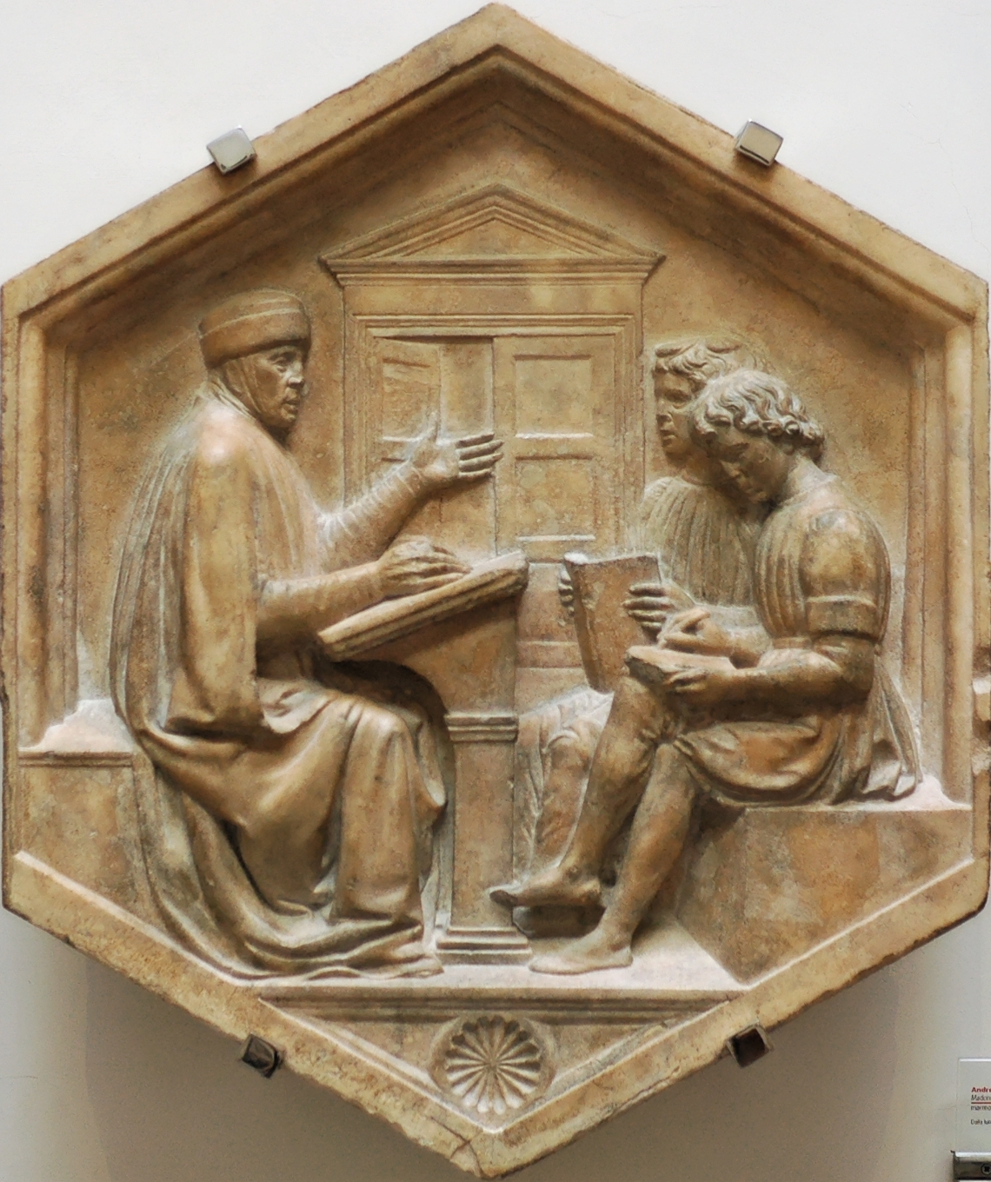
Lecture 24: Part of Speech Tagging
CC-BY 4.0: copy at will, but cite the source
Mark Hasegawa-Johnson
3/2022
Luca della Robbia, Priscian, or the Grammarian (1437-1439). Marble panel from the North side, lower basement of the bell tower of Florence, Italy. Museo dell'Opera del Duomo. Public domain photo by Jastrow, 2006

Slide 2
Outline
Syntax and semantics
Part of speech tagging
An HMM for POS tagging
The Viterbi algorithm

Slide 3
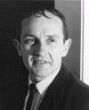
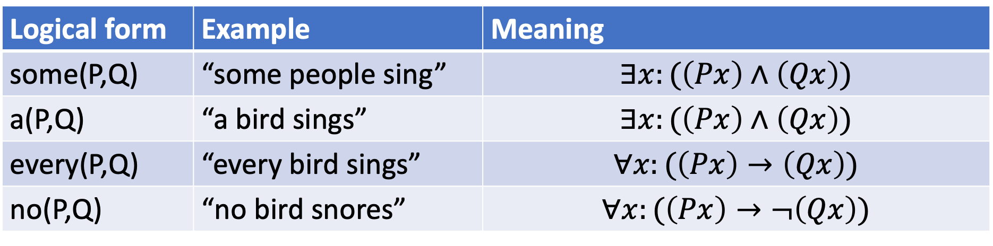
Semantics: Montague grammar
Richard Montague defined formal semantics as follows:
”Understanding a sentence” means that you can specify the conditions under which the sentence would be true
The meaning of a sentence is composed of the meanings of its words. For example:
Richard Montague, 1930-1971
photograph © Richard Thomason
Logical form | Example | Meaning
some(P,Q) | “some people sing” | $$∃x:(\left(Px\right)∧\left(Qx\right))$$
a(P,Q) | “a bird sings” | $$∃x:(\left(Px\right)∧\left(Qx\right))$$
every(P,Q) | “every bird sings” | $$∀x:(\left(Px\right)→\left(Qx\right))$$
no(P,Q) | “no bird snores” | $$∀x:(\left(Px\right)→¬\left(Qx\right))$$

Slide 4
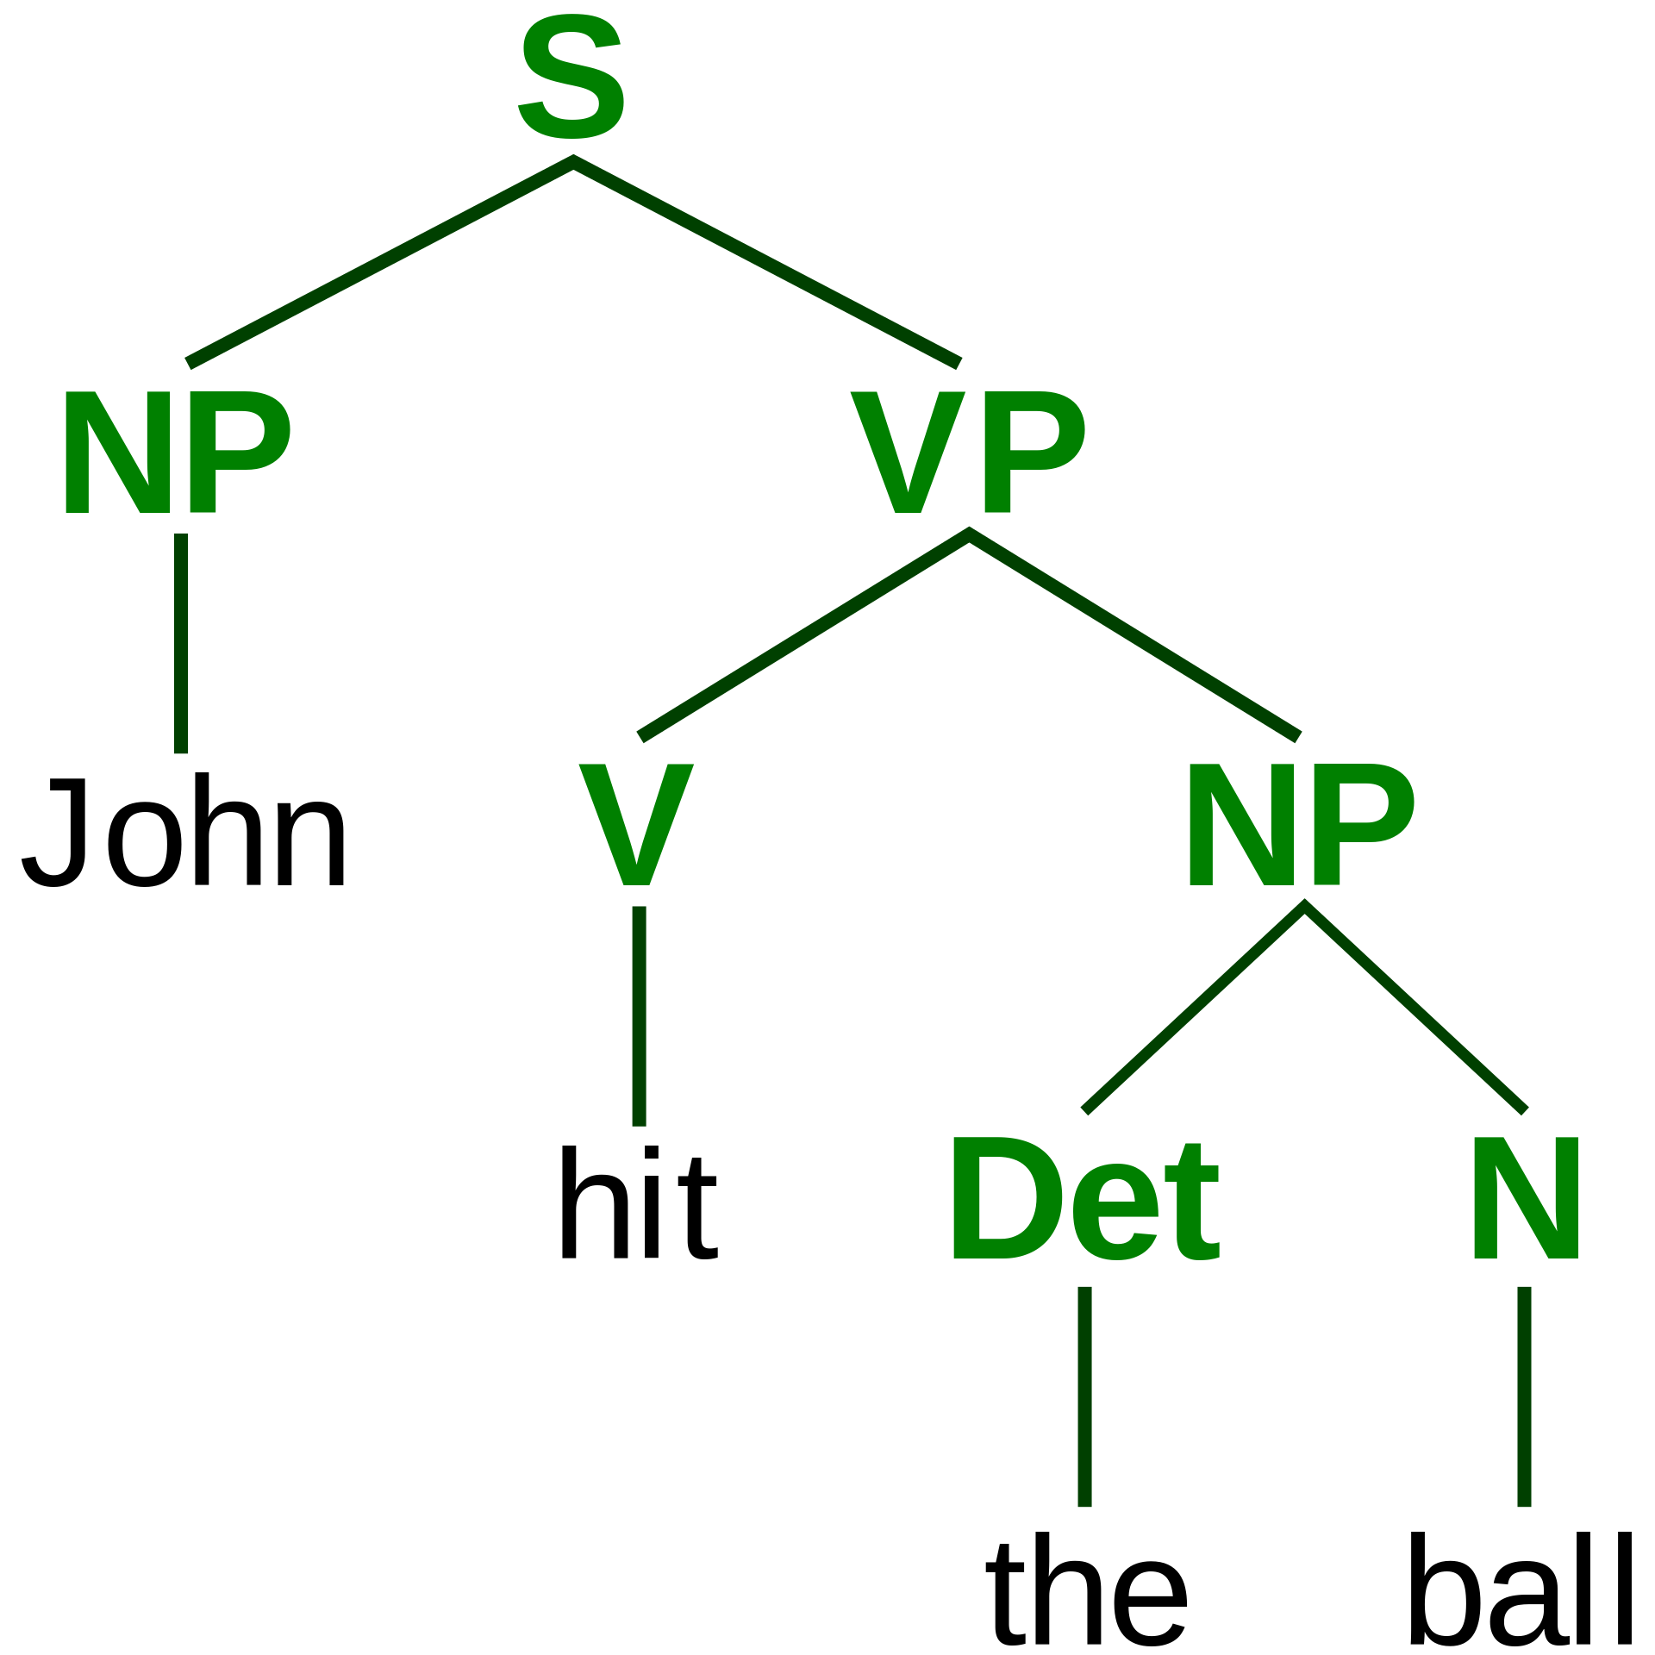
Syntax
Syntax is the study of how words combine.
Syntax is a descriptive science: it simply describes how words combine when people are using them naturally.
Compositional semantics studies the meanings of those combinations.
ParseTree.svg. Public domain image, Stannered, 2007

Slide 5
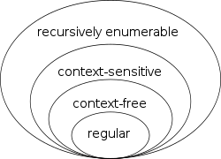
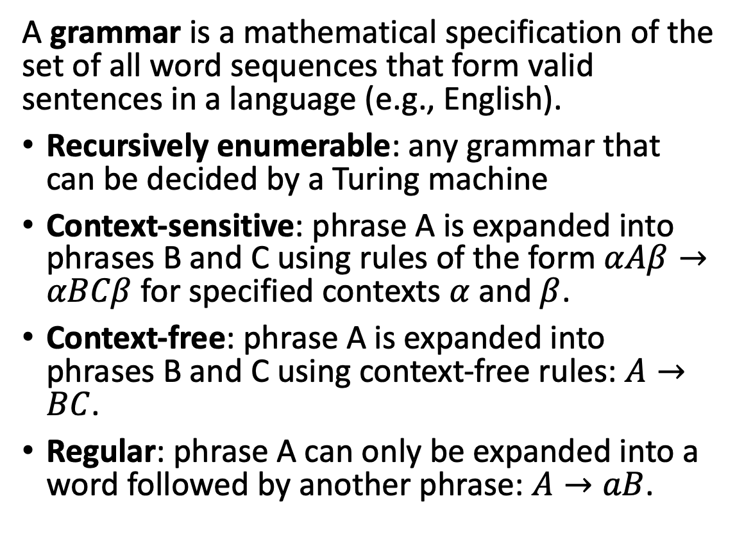
Grammar
A grammar is a mathematical specification of the set of all word sequences that form valid sentences in a language (e.g., English).
Recursively enumerable: any grammar that can be decided by a Turing machine
Context-sensitive: phrase A is expanded into phrases B and C using rules of the form $αAβ→αBCβ$ for specified contexts $α$ and $β$.
Context-free: phrase A is expanded into phrases B and C using context-free rules: $A→BC$.
Regular: phrase A can only be expanded into a word followed by another phrase: $A→aB$.
Chomsky-hierarchy.svg. CC-SA 3.0, J. Finkelstein, 2010

Slide 6
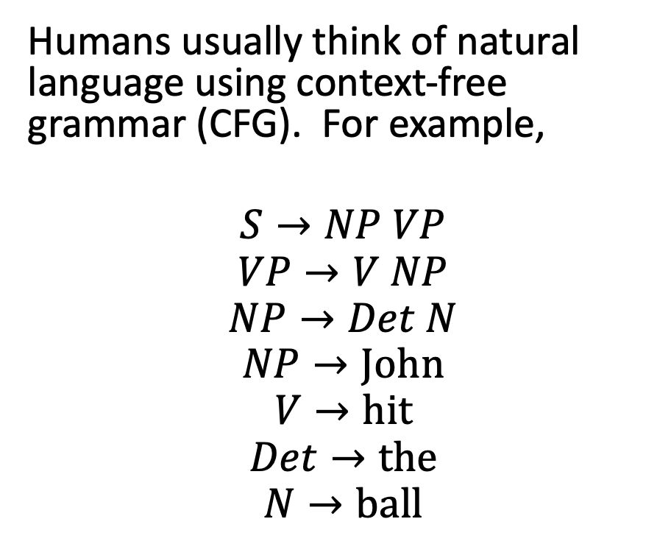
Grammar
Humans usually think of natural language using context-free grammar (CFG). For example,
$$S→NP VP$$
$$VP→V NP$$
$$NP→Det N$$
$$NP→John$$
$$V→hit$$
$$Det→the$$
$$N→ball$$
ParseTree.svg. Public domain image, Stannered, 2007

Slide 7
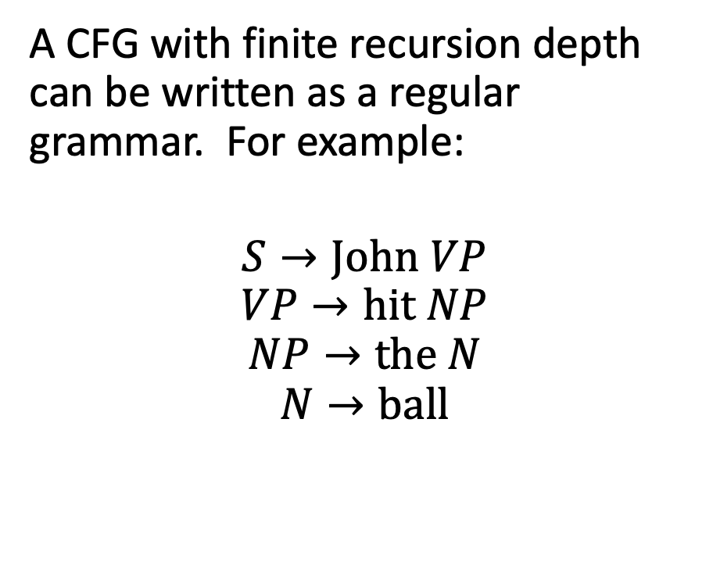
Grammar
A CFG with finite recursion depth can be written as a regular grammar. For example:
$$S→John VP$$
$$VP→hit NP$$
$$NP→the N$$
$$N→ball$$
ParseTree.svg. Public domain image, Stannered, 2007

Slide 8
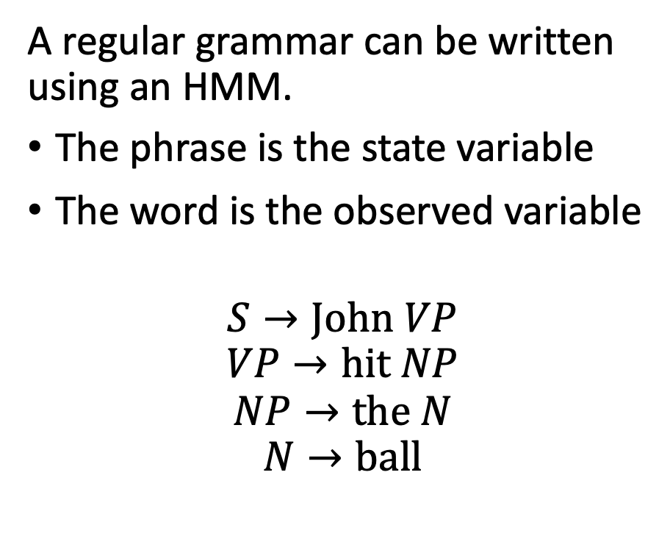
Grammar
A regular grammar can be written using an HMM.
The phrase is the state variable
The word is the observed variable
$$S→John VP$$
$$VP→hit NP$$
$$NP→the N$$
$$N→ball$$
S
VP
NP
N
John
hit
the
ball

Slide 9
Key concepts: syntax and semantics
Compositional semantics studies how sentence meaning is computed from word meanings.
Syntax studies the ways in which words combine.
A grammar is a mathematical specification of the sequences of words that form valid sentences in a language.
A context-free grammar with finite recursion depth can be written as a regular grammar.
A regular grammar can be written as an HMM.

Slide 10
Outline
Syntax and semantics
Part of speech tagging
An HMM for POS tagging
The Viterbi algorithm

Slide 11
Parts of speech
Many grammars are written in terms of parts of speech, to make them a bit more general. For example, this one…
…could be generalized like this…
S
VP
NP
NP
N
V
Det
N
ParseTree.svg. Public domain image, Stannered, 2007

Slide 12
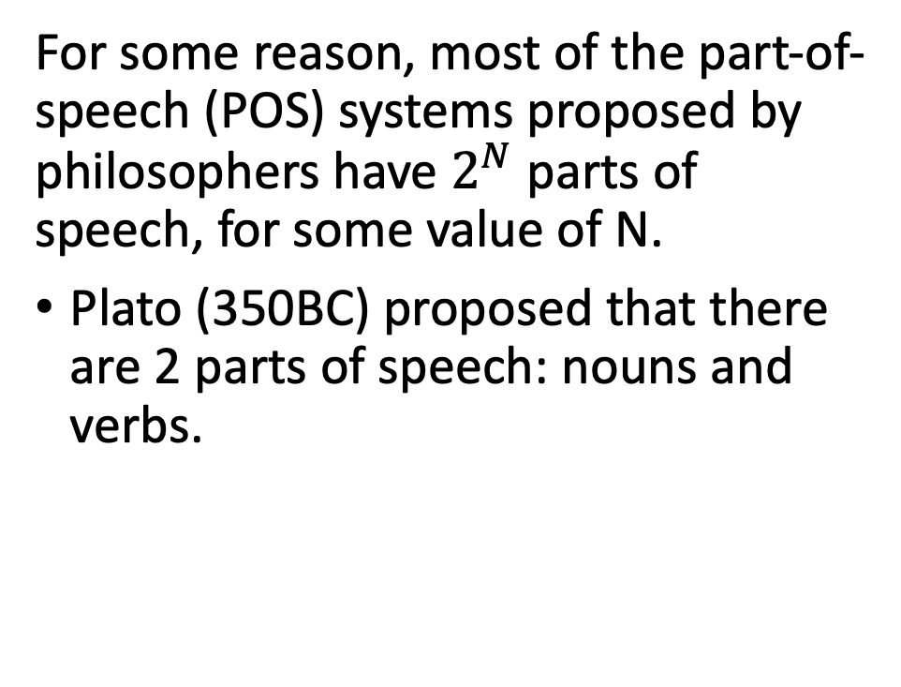
Parts of speech
POS
For some reason, most of the part-of-speech (POS) systems proposed by philosophers have $2^{N}$ parts of speech, for some value of N.
Plato (350BC) proposed that there are 2 parts of speech: nouns and verbs.
Nouns
Verbs

Slide 13
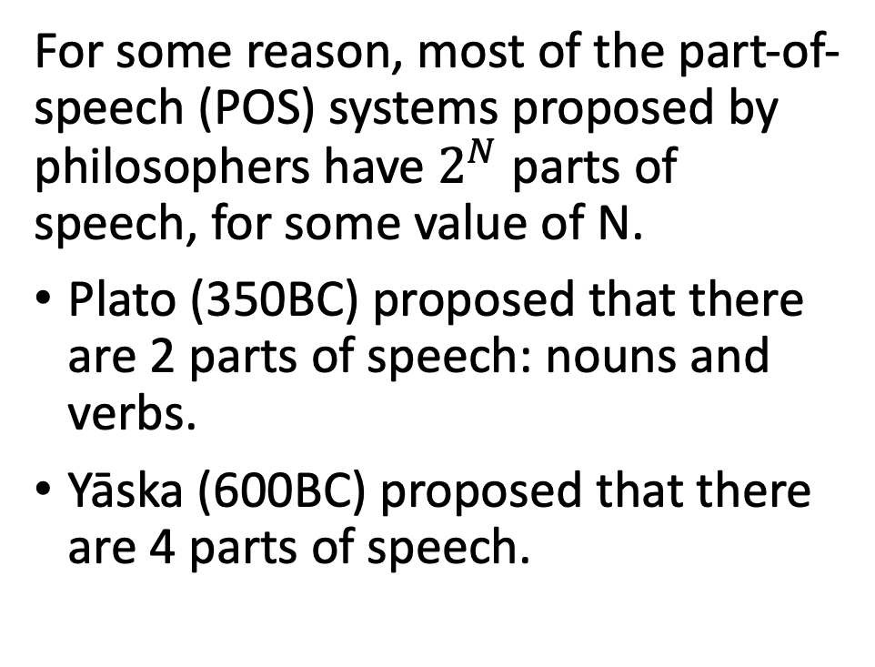
Parts of speech
POS
For some reason, most of the part-of-speech (POS) systems proposed by philosophers have $2^{N}$ parts of speech, for some value of N.
Plato (350BC) proposed that there are 2 parts of speech: nouns and verbs.
Yāska (600BC) proposed that there are 4 parts of speech.
Inflectable
Uninflectable
Nouns
Verbs
Pre-verbs
Particles

Slide 14
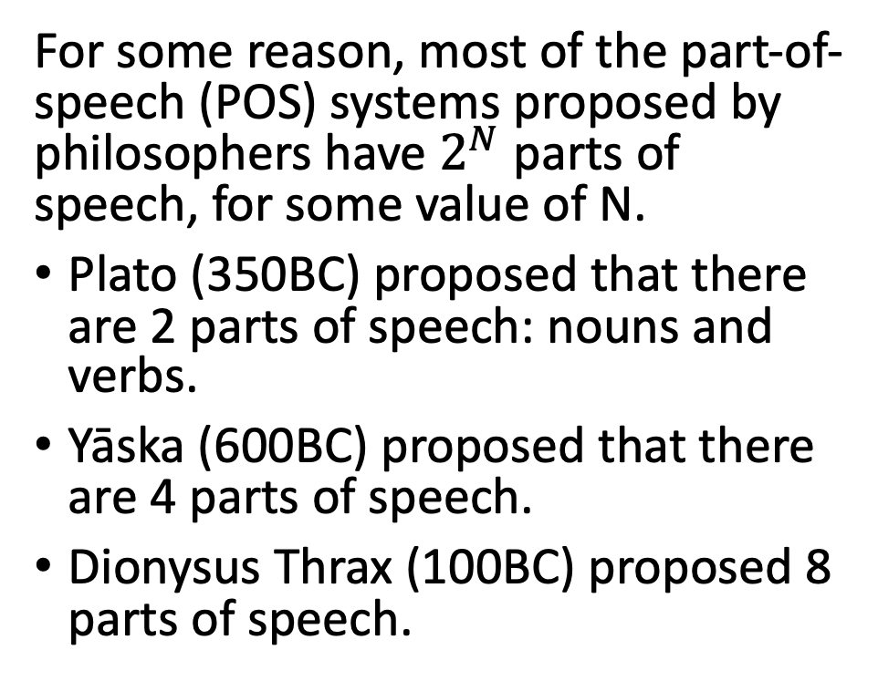
Parts of speech
POS
For some reason, most of the part-of-speech (POS) systems proposed by philosophers have $2^{N}$ parts of speech, for some value of N.
Plato (350BC) proposed that there are 2 parts of speech: nouns and verbs.
Yāska (600BC) proposed that there are 4 parts of speech.
Dionysus Thrax (100BC) proposed 8 parts of speech.
Inflectable
Uninflectable
Nouns
Verbs
Participles
Articles
Pronouns
Prepositions
Adverbs
Conjunctions

Slide 15
Parts of speech
Most modern English dictionaries use these POS tags.
Open-class words (anybody can make up a new word, in any of these classes, at any time): nouns, verbs, adjectives, adverbs, interjections
Closed-class words (it’s hard to make up a new word in these classes): pronouns, prepositions, conjunctions, determiners
Most published, tagged data use POS tags that are finer-grained than the nine tags listed above. For example, the next few slides describe the Penn Treebank POS tag set.

Slide 16
Nouns
The Penn Treebank noun categories are:
NN (singular or mass common noun): llama, thought, communism
NNS (plural common noun): llamas, thoughts
NNP (singular proper noun): Jane, IBM, Mexico
NNPS (plural proper noun): Osbournes, Carolinas
VBG (gerund): eating

Slide 17
Verbs
The Penn Treebank verb categories are:
VB (verb base form): eat
VBD (verb past tense): ate
VBP (verb non-3sg present): eat
VBZ (verb 3sg present): eats
MD (modal): can as in “can lift”, should as in “should go”
RP (particle): up as in “get up,” off as in “take off”

Slide 18
Adjectives
The Penn Treebank has several categories that might be considered types of adjectives:
CD (cardinal number --- use this tag regardless of whether the number is being used as a noun or adjective): one, two, twenty
JJ (adjective): yellow, exceptional, tall
JJR (comparative adjective): yellower, taller
JJS (superlative adjective): yellowest, tallest
PRP$ (possessive pronoun): your, one’s
VBN (verb past participle): eaten, compiled
WP$ (wh-possessive): whose

Slide 19
Determiners, Prepositions and Conjunctions
The Penn Treebank has a lot of things that look like determiners, prepositions, or conjunctions:
CC (coordinating conjunction): and, but, or
DT (determiner): a, the
IN (preposition or subordinating conjunction): of, in, by
PDT (predeterminer): all, both
POS (possessive ending): ‘s, as in “Bob’s dog”
TO (any use of the word “to”): to
WDT (wh-determiner): which, that

Slide 20
Why do POS tagging?
Because it’s highly accurate, typically 97%. That means you can run a POS tagger as a pre-processing step, before doing harder natural language understanding tasks.
Because it’s necessary, if you want to know what the words in the sentence mean.
Will Will ? Will will . Will will will Will ’s will to Will .
MD NNP SYM NNP MD SYM NNP MD VB NNP POS NN TO NNP SYM

Slide 21
Outline
Syntax and semantics
Part of speech tagging
An HMM for POS tagging
The Viterbi algorithm

Slide 22
An HMM for POS tagging
The basic idea of an HMM POS tagger is:
Treat the part of speech as the hidden state variable
Treat the word as observed
N
V
DT
N
John
hit
the
ball
ParseTree.svg. Public domain image, Stannered, 2007

Slide 23
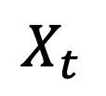
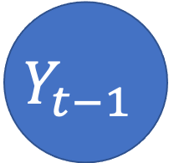
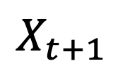
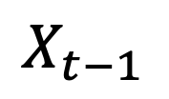
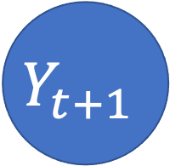
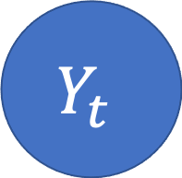
HMM as a Bayes Net
This slide shows an HMM as a Bayes Net. You should remember the graph semantics of a Bayes net:
Nodes are random variables.
Edges denote stochastic dependence.
$$Y_{t−1}$$
$$Y_{t}$$
$$Y_{t+1}$$
…
…
$$X_{t−1}$$
$$X_{t}$$
$$X_{t+1}$$
Notes:
The example is described in Section 15.1.1

Slide 24






HMM as a Finite State Machine
This slide shows exactly the same HMM, viewed in a totally different way. Here, we show it as a finite state machine:
Nodes denote states.
Edges denote possible transitions between the states.
$$P(Y_{t}=V|Y_{t−1}=N)$$
$$P(Y_{t}=V|Y_{t−1}=V)$$
N
V
$$P(Y_{t}=N|Y_{t−1}=N)$$
$$P(Y_{t}=N|Y_{t−1}=N)$$
$$P(Y_{t}=D|Y_{t−1}=V)$$
D
$$P(Y_{t}=D|Y_{t−1}=D)$$
Notes:
The example is described in Section 15.1.1

Slide 25



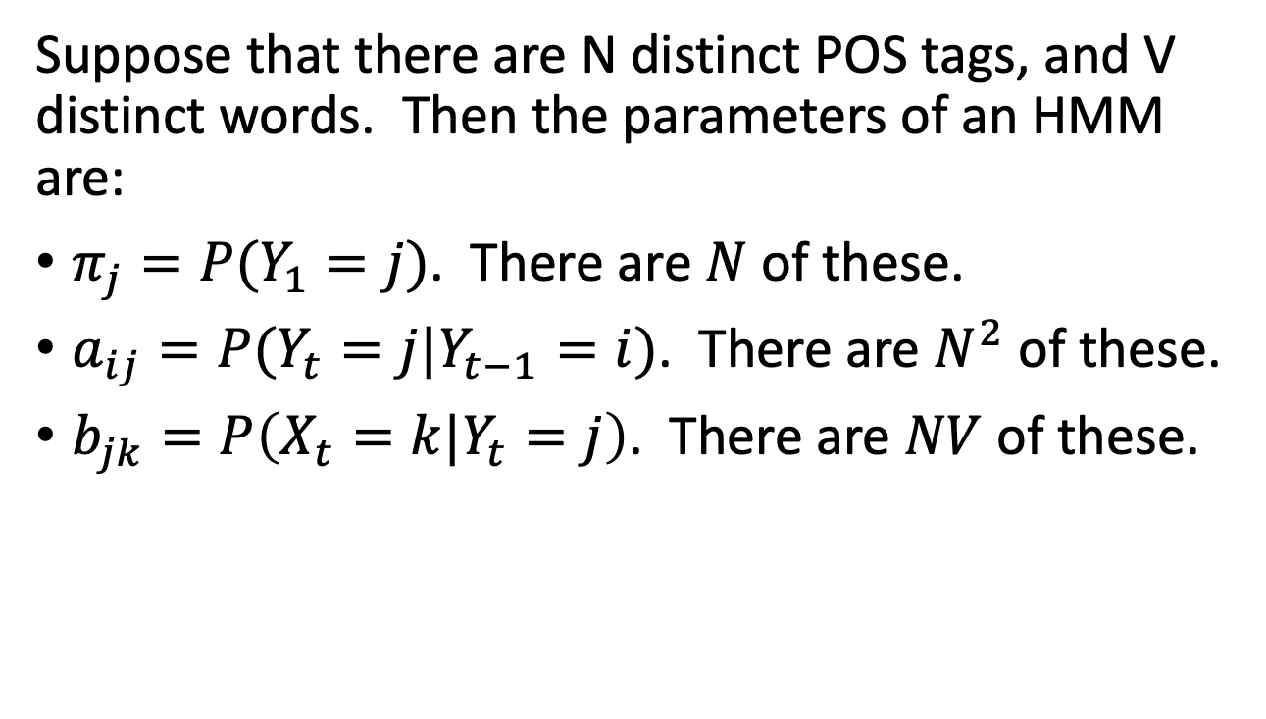



Parameters of an HMM
Suppose that there are N distinct POS tags, and V distinct words. Then the parameters of an HMM are:
$π_{j}=P(Y_{1}=j)$. There are $N$ of these.
$a_{ij}=P(Y_{t}=j|Y_{t−1}=i)$. There are $N^{2}$ of these.
$b_{jk}=P\left(X_{t}=k|Y_{t}=j\right)$. There are $NV$ of these.
$$a_{NV}$$
$$a_{VV}$$
N
V
$$a_{NN}$$
$$a_{DN}$$
$$a_{VD}$$
D
$$a_{DD}$$

Slide 26
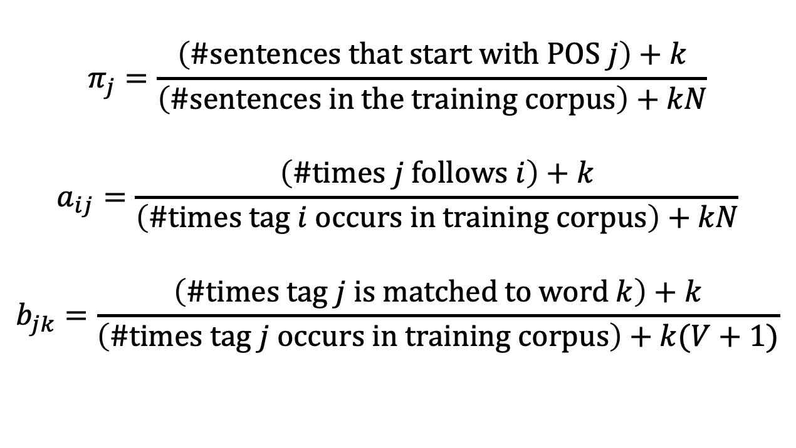
Estimating the Parameters of an HMM
$$π_{j}=\frac{\left(\#sentences that start with POS j\right)+k}{\left(\#sentences in the training corpus\right)+kN}$$
$$a_{ij}=\frac{\left(\#times j follows i\right)+k}{\left(\#times tag i occurs in training corpus\right)+kN}$$
$$b_{jk}=\frac{\left(\#times tag j is matched to word k\right)+k}{\left(\#times tag j occurs in training corpus\right)+k(V+1)}$$
$$a_{NV}$$
$$a_{VV}$$
N
V
$$a_{NN}$$
$$a_{DN}$$
$$a_{VD}$$
D
$$a_{DD}$$

Slide 27
Outline
Syntax and semantics
Part of speech tagging
An HMM for POS tagging
The Viterbi algorithm

Slide 28
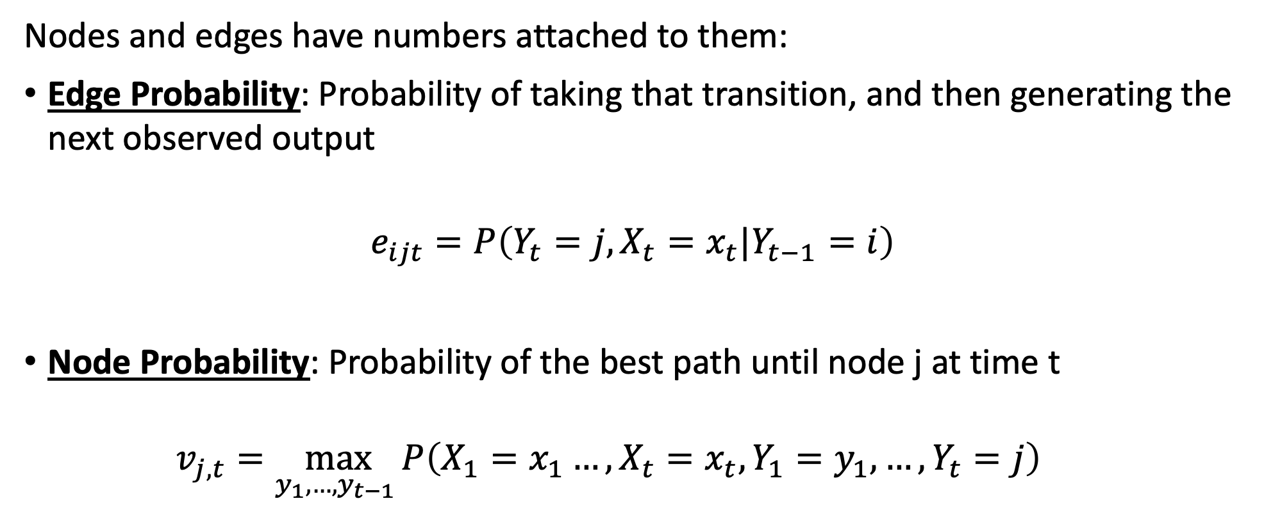
Viterbi Algorithm: Key concepts
Nodes and edges have numbers attached to them:
Edge Probability: Probability of taking that transition, and then generating the next observed output
$$e_{ijt}=P\left(Y_{t}=j,X_{t}=x_{t}|Y_{t−1}=i\right)$$
Node Probability: Probability of the best path until node j at time t
$$v_{j,t}=\max_{y_{1},…,y_{t−1} }P\left(X_{1}=x_{1}…, X_{t}=x_{t},Y_{1}=y_{1},…, Y_{t}=j\right)$$

Slide 29
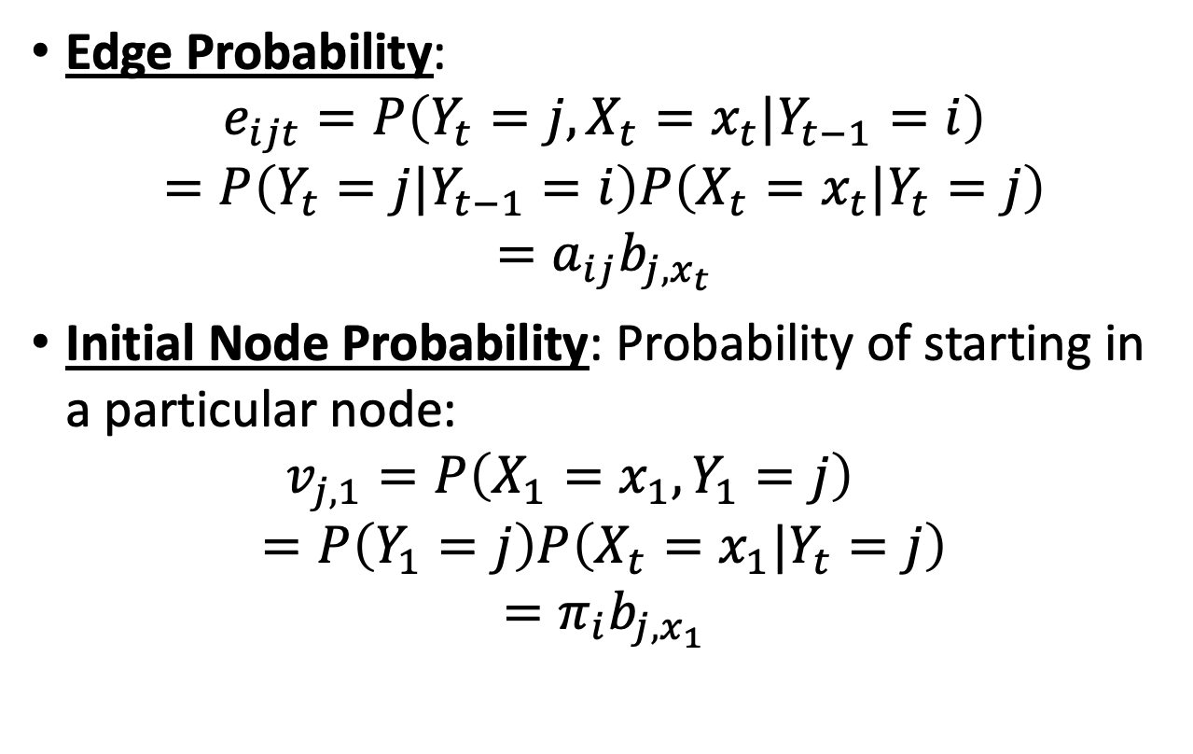
Viterbi Algorithm for POS tagging
Edge Probability:
$$e_{ijt}=P\left(Y_{t}=j,X_{t}=x_{t}|Y_{t−1}=i\right)$$
$$=P\left(Y_{t}=j|Y_{t−1}=i\right)P\left(X_{t}=x_{t}|Y_{t}=j\right)$$
$$=a_{ij}b_{j,x_{t}}$$
Initial Node Probability: Probability of starting in a particular node:
$$v_{j,1}=P\left(X_{1}=x_{1}, Y_{1}=j\right)$$
$$=P\left(Y_{1}=j\right)P\left(X_{t}=x_{1}|Y_{t}=j\right)$$
$$=π_{i}b_{j,x_{1}}$$
$$a_{NV}$$
$$a_{VV}$$
N
V
$$a_{NN}$$
$$a_{DN}$$
$$a_{VD}$$
D
$$a_{DD}$$

Slide 30


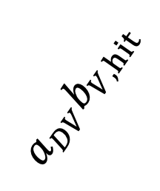
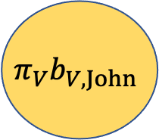



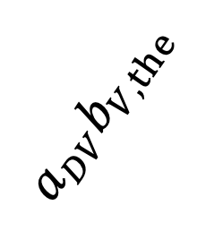
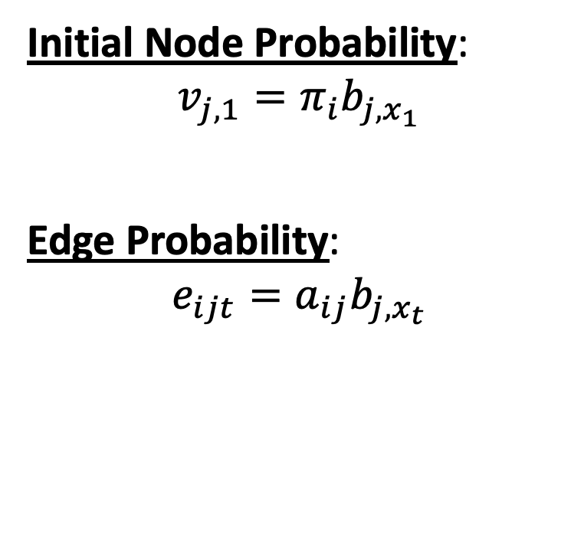
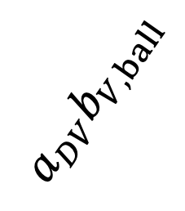





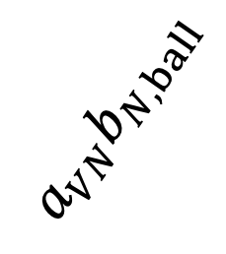

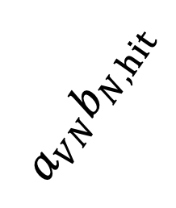

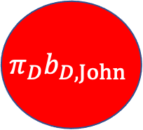
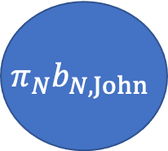
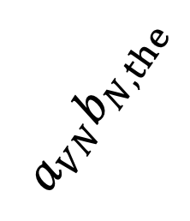

Trellis
$$a_{NN}b_{N,hit}$$
$$a_{NN}b_{N,the}$$
$$a_{NN}b_{N,ball}$$
$$π_{N}b_{N,John}$$
$$Y_{t}=N$$
Initial Node Probability:
$$v_{j,1}=π_{i}b_{j,x_{1}}$$
Edge Probability:
$$e_{ijt}=a_{ij}b_{j,x_{t}}$$
$$a_{VN}b_{N,hit}$$
$$a_{VN}b_{N,the}$$
$$a_{VN}b_{N,ball}$$
$$π_{V}b_{V,John}$$
$$Y_{t}=V$$
$$a_{DV}b_{V,hit}$$
$$a_{DV}b_{V,the}$$
$$a_{DV}b_{V,ball}$$
$$π_{D}b_{D,John}$$
$$Y_{t}=D$$
$$a_{DD}b_{D,hit}$$
$$a_{DD}b_{D,the}$$
$$a_{DD}b_{D,ball}$$
$$X_{1}=John$$
$$X_{2}=hit$$
$$X_{3}=the$$
$$X_{4}=ball$$

Slide 31
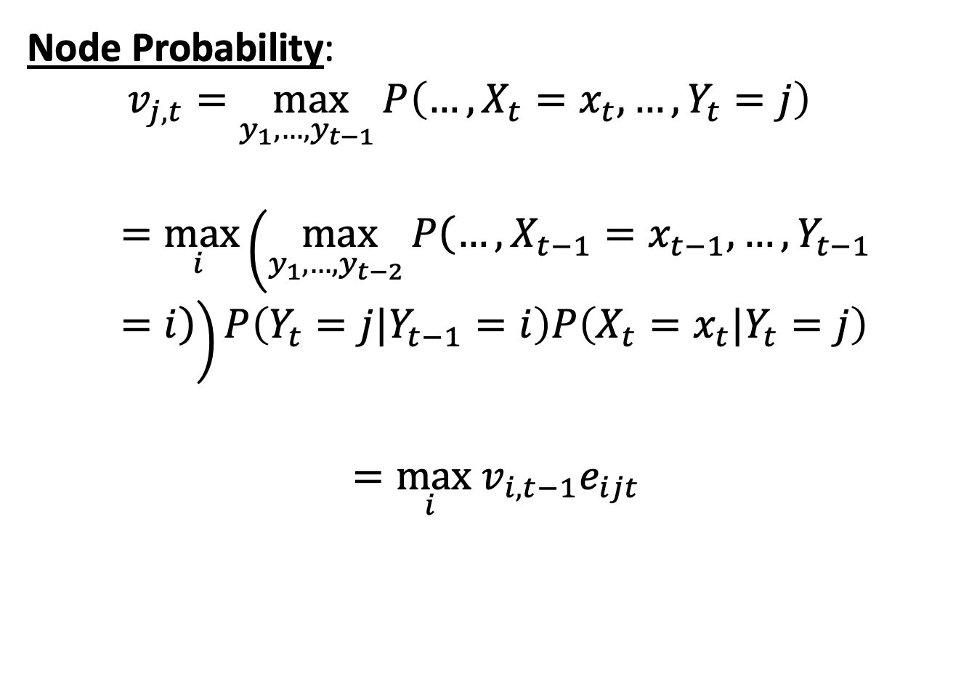
Viterbi Algorithm for POS tagging
Node Probability:
$$v_{j,t}=\max_{y_{1},…,y_{t−1} }P\left(…, X_{t}=x_{t}, …, Y_{t}=j\right)$$
$$=\max_{i }\left(\max_{y_{1},…,y_{t−2} }P\left(…, X_{t−1}=x_{t−1}, …, Y_{t−1}=i\right)\right)P\left(Y_{t}=j|Y_{t−1}=i\right)P\left(X_{t}=x_{t}|Y_{t}=j\right)$$
$$=\max_{i } v_{i,t−1}e_{ijt}$$
$$a_{NV}$$
$$a_{VV}$$
N
V
$$a_{NN}$$
$$a_{DN}$$
$$a_{VD}$$
D
$$a_{DD}$$

Slide 32
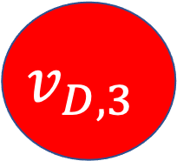
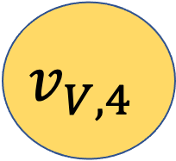
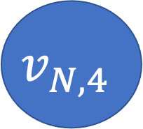
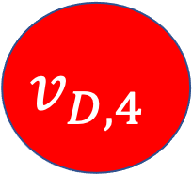
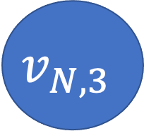
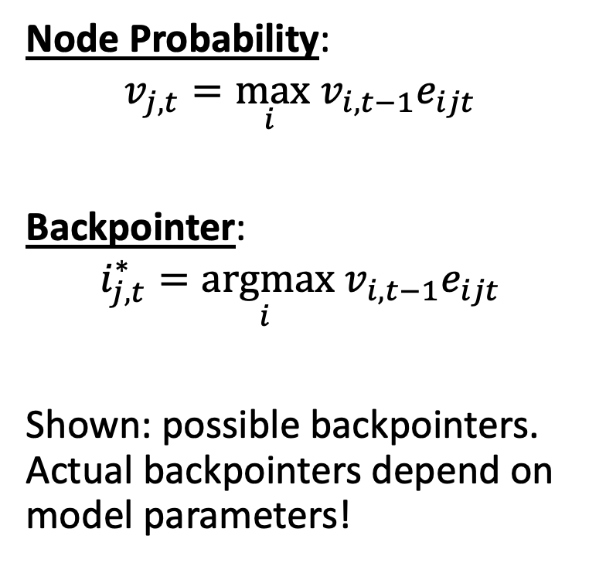
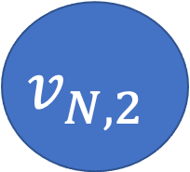
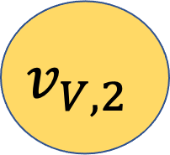
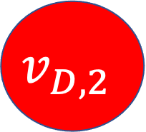
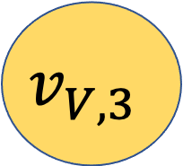
Trellis
$$π_{N}b_{N,John}$$
$$v_{N,2}$$
$$v_{N,3}$$
$$v_{N,4}$$
$$Y_{t}=N$$
Node Probability:
$$v_{j,t}=\max_{i } v_{i,t−1}e_{ijt}$$
Backpointer:
$$i_{j,t}^{∗}=\underset{i }{argmax} v_{i,t−1}e_{ijt}$$
Shown: possible backpointers. Actual backpointers depend on model parameters!
$$π_{V}b_{V,John}$$
$$v_{V,2}$$
$$v_{V,3}$$
$$v_{V,4}$$
$$Y_{t}=V$$
$$π_{D}b_{D,John}$$
$$v_{D,2}$$
$$v_{D,3}$$
$$v_{D,4}$$
$$Y_{t}=D$$
$$a_{DD}b_{D,hit}$$
$$a_{DD}b_{D,the}$$
$$a_{DD}b_{D,ball}$$
$$X_{1}=John$$
$$X_{2}=hit$$
$$X_{3}=the$$
$$X_{4}=ball$$

Slide 33
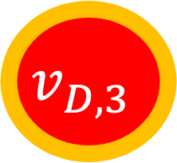
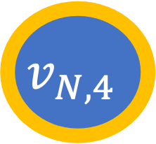
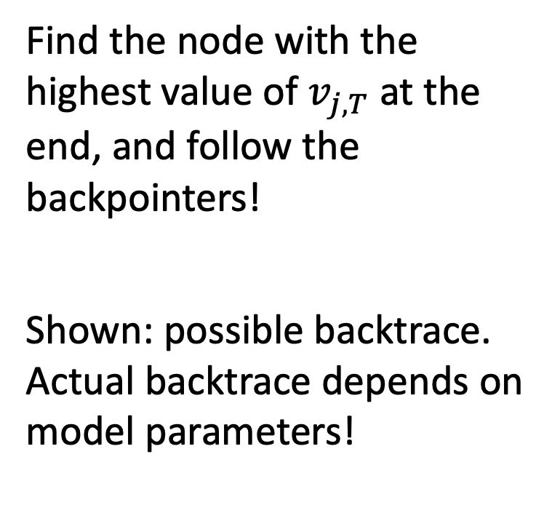
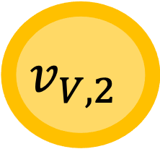
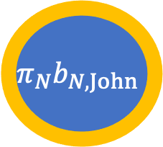
Backtrace
$$π_{N}b_{N,John}$$
$$v_{N,2}$$
$$v_{N,3}$$
$$v_{N,4}$$
$$Y_{t}=N$$
Find the node with the highest value of $v_{j,T}$ at the end, and follow the backpointers!
Shown: possible backtrace. Actual backtrace depends on model parameters!
$$π_{V}b_{V,John}$$
$$v_{V,2}$$
$$v_{V,3}$$
$$v_{V,4}$$
$$Y_{t}=V$$
$$π_{D}b_{D,John}$$
$$v_{D,2}$$
$$v_{D,3}$$
$$v_{D,4}$$
$$Y_{t}=D$$
$$a_{DD}b_{D,hit}$$
$$a_{DD}b_{D,the}$$
$$a_{DD}b_{D,ball}$$
$$X_{1}=John$$
$$X_{2}=hit$$
$$X_{3}=the$$
$$X_{4}=ball$$

Slide 34
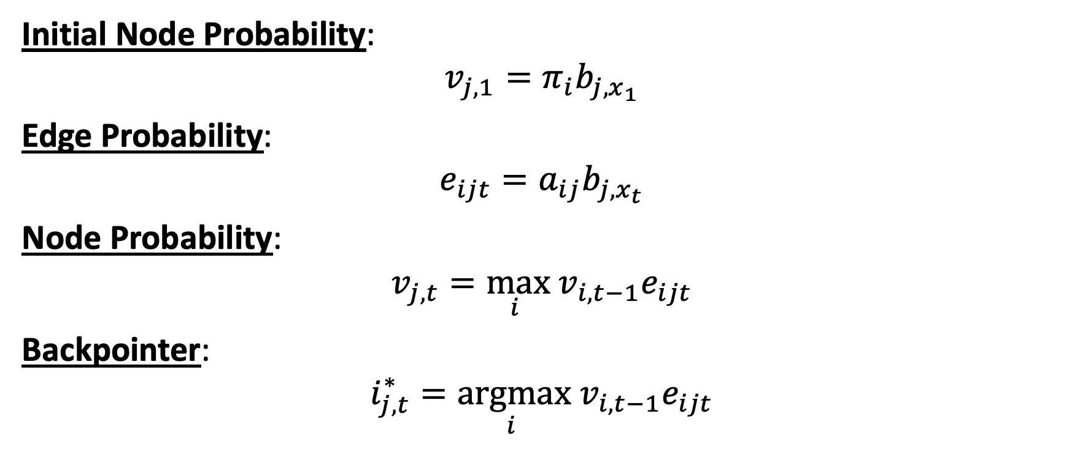
Viterbi algorithm key formulas
Initial Node Probability:
$$v_{j,1}=π_{i}b_{j,x_{1}}$$
Edge Probability:
$$e_{ijt}=a_{ij}b_{j,x_{t}}$$
Node Probability:
$$v_{j,t}=\max_{i } v_{i,t−1}e_{ijt}$$
Backpointer:
$$i_{j,t}^{∗}=\underset{i }{argmax} v_{i,t−1}e_{ijt}$$

Slide 35
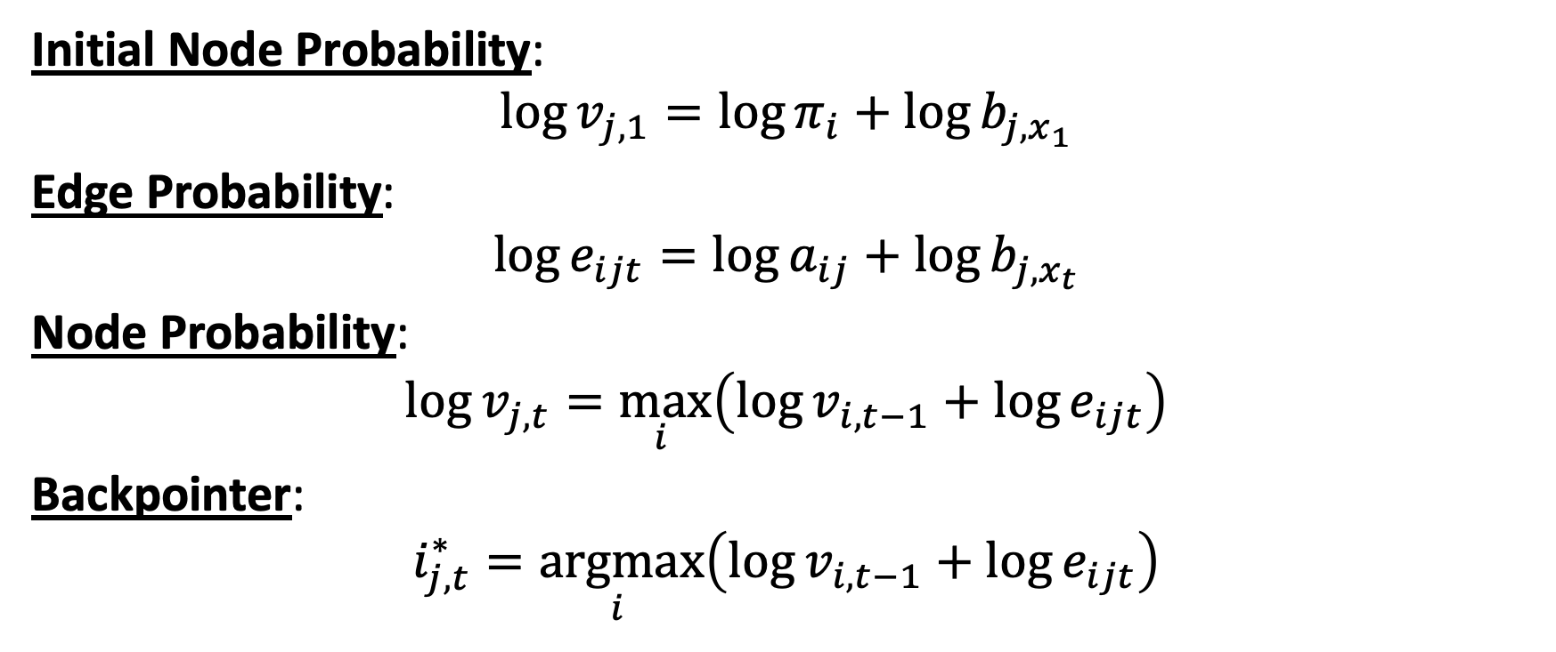
Viterbi algorithm key formulas
Initial Node Probability:
$$\log{v_{j,1}}=\log{π_{i}}+\log{b_{j,x_{1}}}$$
Edge Probability:
$$\log{e_{ijt}}=\log{a_{ij}}+\log{b_{j,x_{t}}}$$
Node Probability:
$$\log{v_{j,t}}=\max_{i }\left(\log{v_{i,t−1}}+\log{e_{ijt}}\right)$$
Backpointer:
$$i_{j,t}^{∗}=\underset{i }{argmax}\left(\log{v_{i,t−1}}+\log{e_{ijt}}\right)$$

Slide 36

Example from Jurafsky & Martin
© Daniel Jurafsky & James H. Martin, 2021

Slide 37

Outline
Syntax and semantics
A grammar specifies which word sequences are valid sentences
Finite-depth CFG = Regular grammar = HMM
Part of speech tagging
Open-class words: nouns, verbs, adverbs, adjectives, interjections
Closed-class words: prepositions, pronouns, conjunctions, determiners
An HMM for POS tagging
State variable is the part of speech
Observation is the word
The Viterbi algorithm
$\log{v_{j,t}}=\max_{i }\left(\log{v_{i,t−1}}+\log{e_{ijt}}\right)$

