Slide 1
Lecture 25: Recurrent Neural Networks
CC-BY 4.0: copy at will, but cite the source
Mark Hasegawa-Johnson
3/2022

Slide 2
Content
Belief propagation
Recurrent neural networks
Training a recurrent neural network
Long short-term memory (LSTM)

Slide 3
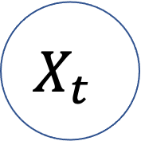
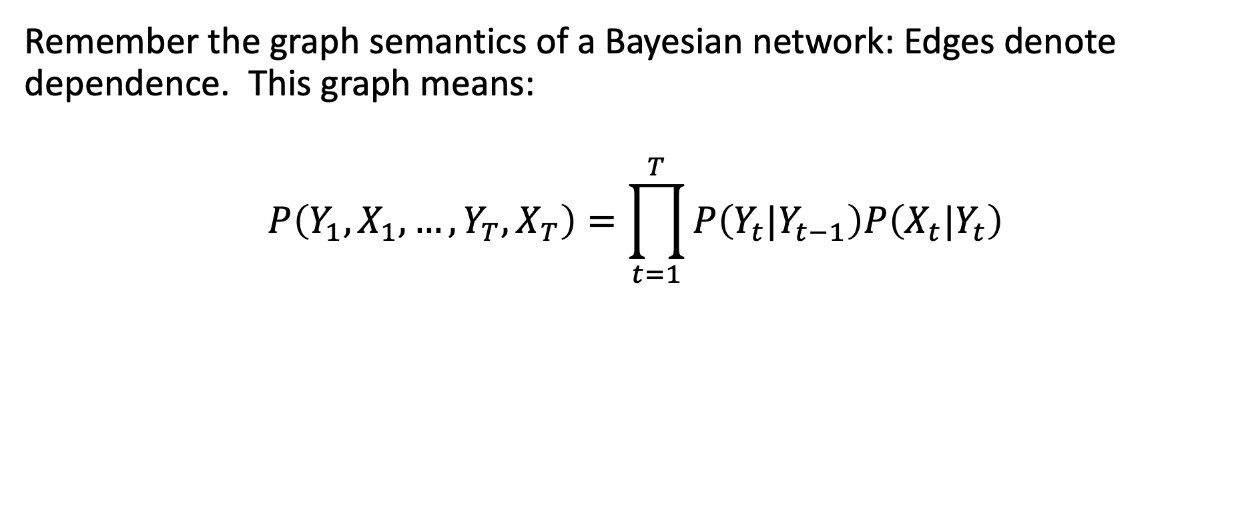
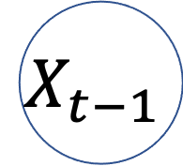



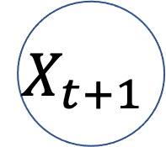
Semantics of Bayesian Networks
…
$$Y_{t−1}$$
$$Y_{t}$$
$$Y_{t+1}$$
…
$$X_{t−1}$$
$$X_{t}$$
$$X_{t+1}$$
Remember the graph semantics of a Bayesian network: Edges denote dependence. This graph means:
$$P\left(Y_{1},X_{1},…,Y_{T},X_{T}\right)=\prod_{t=1}^{T}{P\left(Y_{t}|Y_{t−1}\right)P\left(X_{t}|Y_{t}\right)}$$
Notes:
The example is described in Section 15.1.1

Slide 4
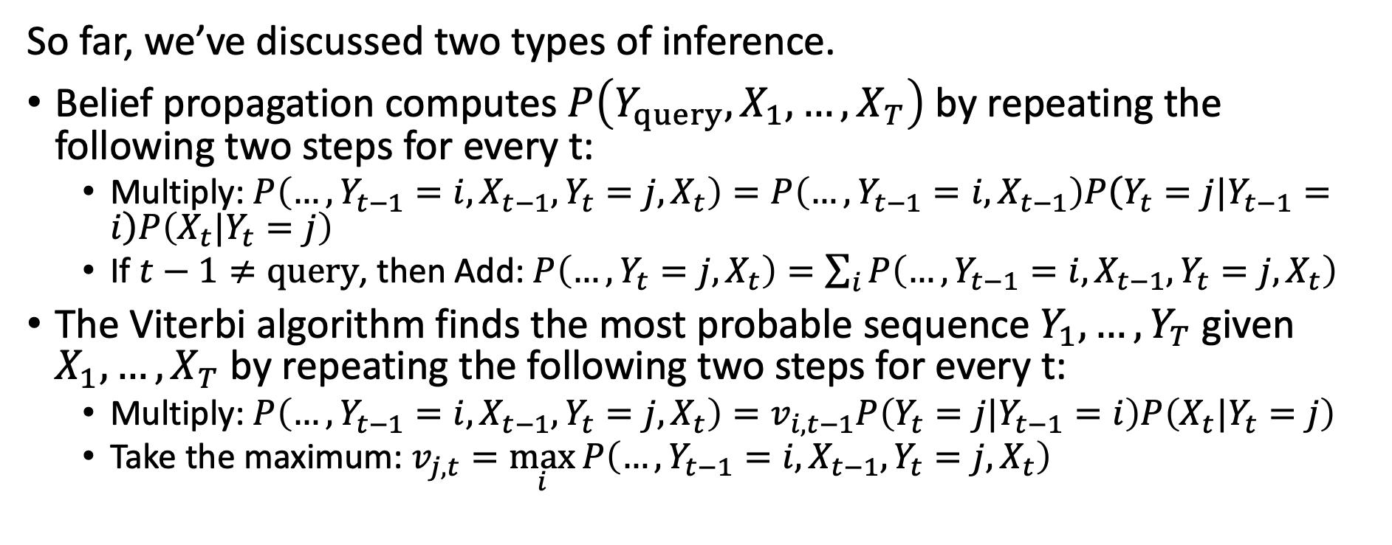
Belief Propagation and Viterbi Algorithm
…
$$Y_{t−1}$$
$$Y_{t}$$
$$Y_{t+1}$$
…
$$X_{t−1}$$
$$X_{t}$$
$$X_{t+1}$$
So far, we’ve discussed two types of inference.
Belief propagation computes $P\left(Y_{query},X_{1},…,X_{T}\right)$ by repeating the following two steps for every t:
  Multiply: $P\left(…,Y_{t−1}=i,X_{t−1},Y_{t}=j,X_{t}\right)=P\left(…,Y_{t−1}=i,X_{t−1}\right)P\left(Y_{t}=j|Y_{t−1}=i\right)P\left(X_{t}|Y_{t}=j\right)$
  If $t−1≠query$, then Add: $P\left(…,Y_{t}=j,X_{t}\right)=\sum_{i}{P\left(…,Y_{t−1}=i,X_{t−1},Y_{t}=j,X_{t}\right)}$
The Viterbi algorithm finds the most probable sequence $Y_{1},…,Y_{T}$ given $X_{1},…,X_{T}$ by repeating the following two steps for every t:
  Multiply: $P\left(…,Y_{t−1}=i,X_{t−1},Y_{t}=j,X_{t}\right)=v_{i,t−1}P\left(Y_{t}=j|Y_{t−1}=i\right)P\left(X_{t}|Y_{t}=j\right)$
  Take the maximum: $v_{j,t}=\max_{i}{P\left(…,Y_{t−1}=i,X_{t−1},Y_{t}=j,X_{t}\right)}$
Notes:
The example is described in Section 15.1.1

Slide 5
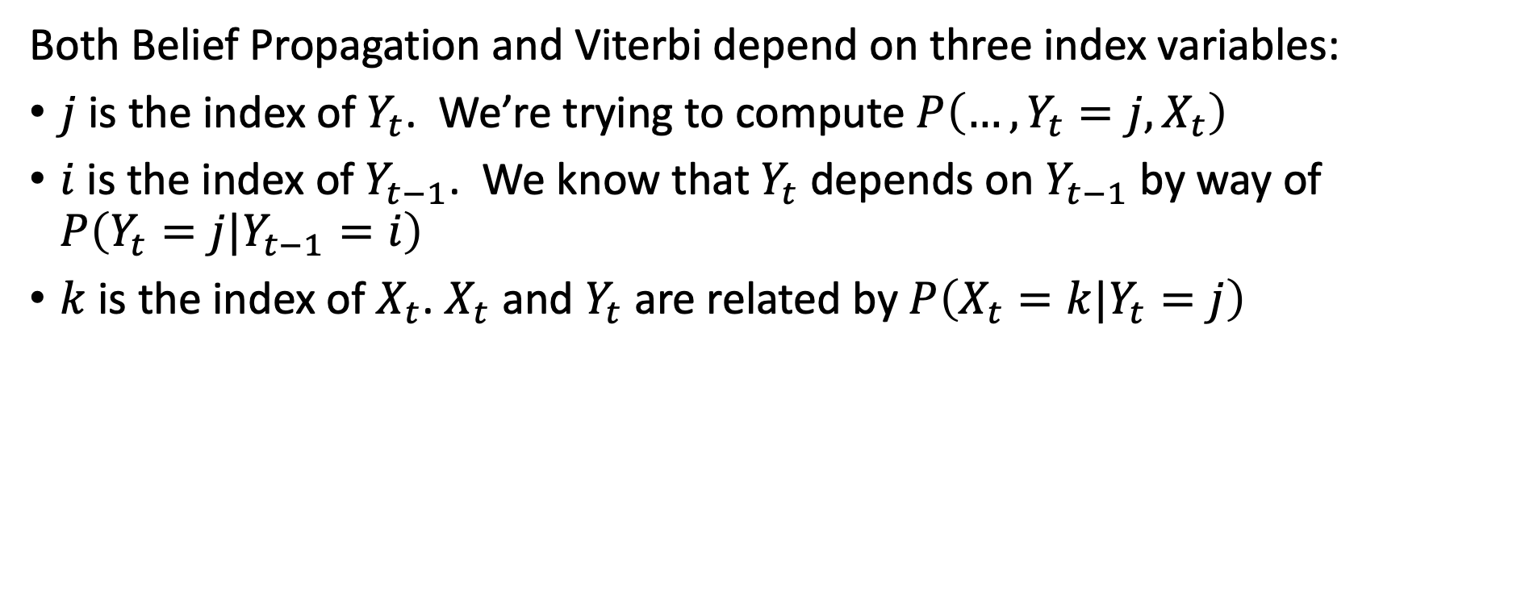
The 3 types of parameters
…
$$Y_{t−1}$$
$$Y_{t}$$
$$Y_{t+1}$$
…
$$X_{t−1}$$
$$X_{t}$$
$$X_{t+1}$$
Both Belief Propagation and Viterbi depend on three index variables:
$j$ is the index of $Y_{t}$. We’re trying to compute $P\left(…,Y_{t}=j,X_{t}\right)$
$i$ is the index of $Y_{t−1}$. We know that $Y_{t}$ depends on $Y_{t−1}$ by way of $P\left(Y_{t}=j|Y_{t−1}=i\right)$
$k$ is the index of $X_{t}$. $X_{t}$ and $Y_{t}$ are related by $P\left(X_{t}=k|Y_{t}=j\right)$
Notes:
The example is described in Section 15.1.1

Slide 6
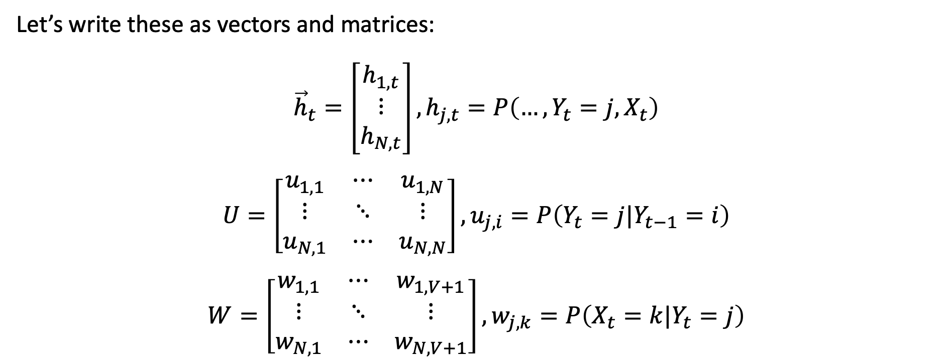
Writing them as vectors and matrices
…
$$Y_{t−1}$$
$$Y_{t}$$
$$Y_{t+1}$$
…
$$X_{t−1}$$
$$X_{t}$$
$$X_{t+1}$$
Let’s write these as vectors and matrices:
$${\vec{h}}_{t}=\left[\begin{matrix}h_{1,t} \\ ⋮ \\ h_{N,t}\end{matrix}\right],h_{j,t}=P\left(…,Y_{t}=j,X_{t}\right)$$
$$U=\left[\begin{matrix}u_{1,1} & ⋯ & u_{1,N} \\ ⋮ & ⋱ & ⋮ \\ u_{N,1} & ⋯ & u_{N,N}\end{matrix}\right],u_{j,i}=P\left(Y_{t}=j|Y_{t−1}=i\right)$$
$$W=\left[\begin{matrix}w_{1,1} & ⋯ & w_{1,V+1} \\ ⋮ & ⋱ & ⋮ \\ w_{N,1} & ⋯ & w_{N,V+1}\end{matrix}\right],w_{j,k}=P\left(X_{t}=k|Y_{t}=j\right)$$
Notes:
The example is described in Section 15.1.1

Slide 7
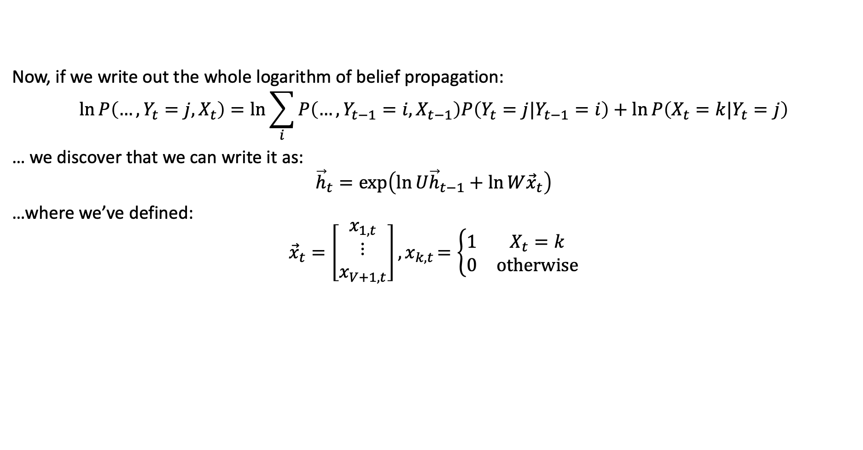
Log Belief Propagation
…
$$Y_{t−1}$$
$$Y_{t}$$
$$Y_{t+1}$$
…
$$X_{t−1}$$
$$X_{t}$$
$$X_{t+1}$$
Now, if we write out the whole logarithm of belief propagation:
$$\ln{P\left(…,Y_{t}=j,X_{t}\right)}=\ln{\sum_{i}{P\left(…,Y_{t−1}=i,X_{t−1}\right)P\left(Y_{t}=j|Y_{t−1}=i\right)}}+\ln{P\left(X_{t}=k|Y_{t}=j\right)}$$
… we discover that we can write it as:
$${\vec{h}}_{t}=\exp\left(\ln{U{\vec{h}}_{t−1}}+\ln{W{\vec{x}}_{t}}\right)$$
…where we’ve defined:
$${\vec{x}}_{t}=\left[\begin{matrix}x_{1,t} \\ ⋮ \\ x_{V+1,t}\end{matrix}\right]{, x}_{k,t}=\left\{\begin{matrix}1 & X_{t}=k \\ 0 & otherwise\end{matrix}\right.$$
Notes:
The example is described in Section 15.1.1

Slide 8
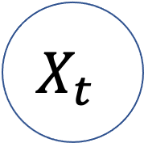
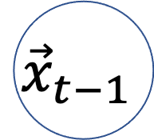
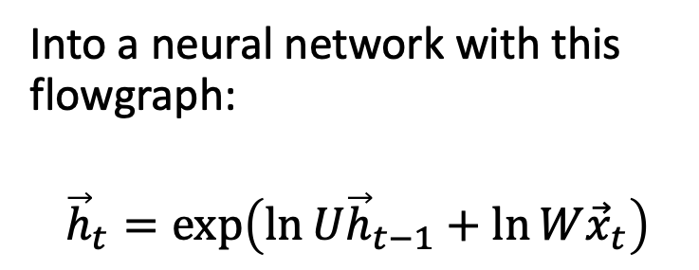
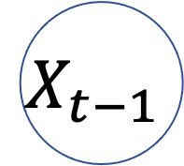

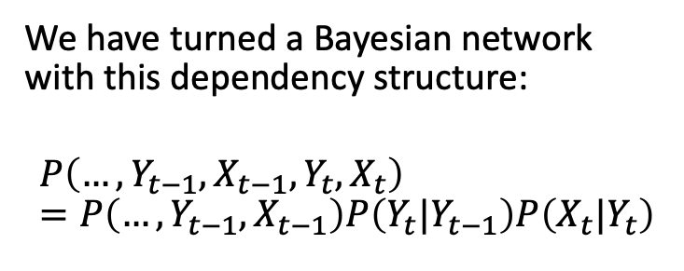



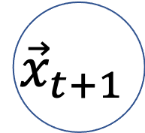
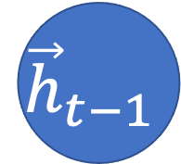

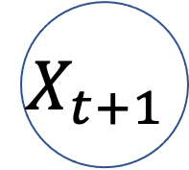
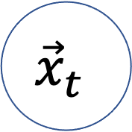
Recurrent neural network
…
$$Y_{t−1}$$
$$Y_{t}$$
$$Y_{t+1}$$
…
We have turned a Bayesian network with this dependency structure:
$$P\left(…,Y_{t−1},X_{t−1},Y_{t},X_{t}\right)=P\left(…,Y_{t−1},X_{t−1}\right)P\left(Y_{t}|Y_{t−1}\right)P\left(X_{t}|Y_{t}\right)$$
$$X_{t−1}$$
$$X_{t}$$
$$X_{t+1}$$
Into a neural network with this flowgraph:
$${\vec{h}}_{t}=\exp\left(\ln{U{\vec{h}}_{t−1}}+\ln{W{\vec{x}}_{t}}\right)$$
…
$${\vec{h}}_{t−1}$$
$${\vec{h}}_{t}$$
$${\vec{h}}_{t+1}$$
…
$${\vec{x}}_{t−1}$$
$${\vec{x}}_{t}$$
$${\vec{x}}_{t+1}$$
Notes:
The example is described in Section 15.1.1

Slide 9
Content
Belief propagation
Recurrent neural networks
Training a recurrent neural network
Long short-term memory (LSTM)

Slide 10
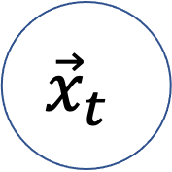
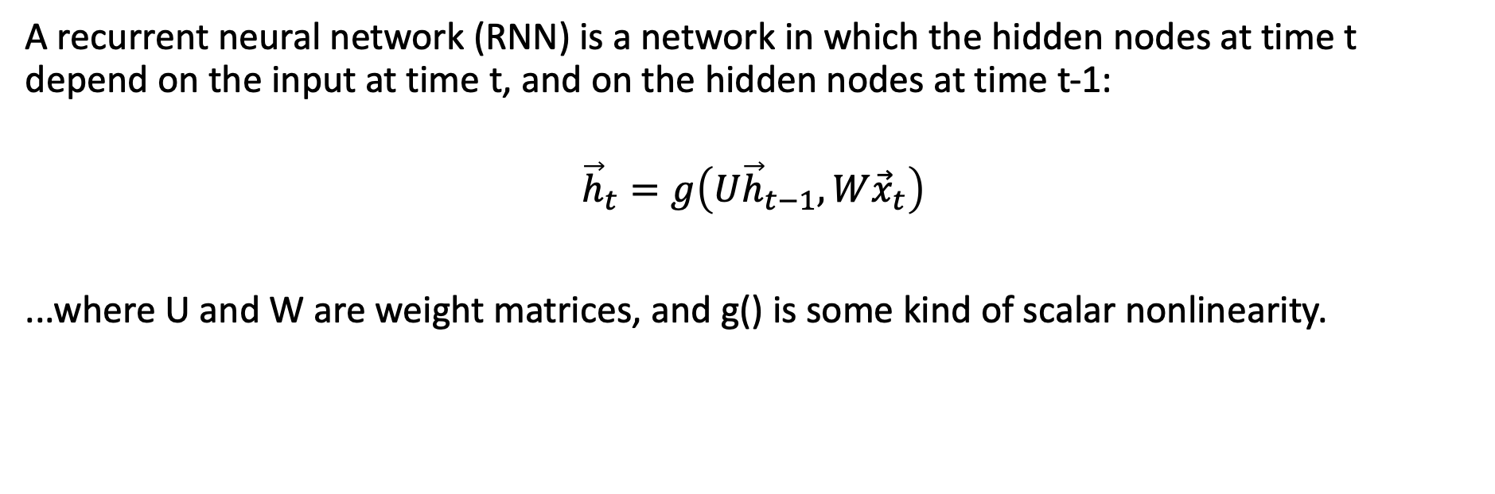
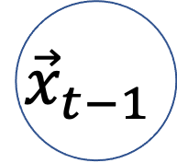


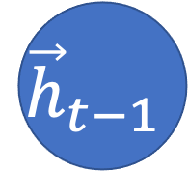
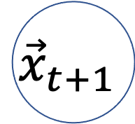
Recurrent neural network (RNN)
$${\vec{h}}_{t−1}$$
$${\vec{h}}_{t}$$
$${\vec{h}}_{t+1}$$
…
…
$${\vec{x}}_{t−1}$$
$${\vec{x}}_{t}$$
$${\vec{x}}_{t+1}$$
A recurrent neural network (RNN) is a network in which the hidden nodes at time t depend on the input at time t, and on the hidden nodes at time t-1:
$${\vec{h}}_{t}=g\left(U{\vec{h}}_{t−1},W{\vec{x}}_{t}\right)$$
...where U and W are weight matrices, and g() is some kind of scalar nonlinearity.
Notes:
The example is described in Section 15.1.1

Slide 11
Recurrent neural network (RNN)
$${\vec{h}}_{t−1}$$
$${\vec{h}}_{t}$$
$${\vec{h}}_{t+1}$$
…
…
$${\vec{x}}_{t−1}$$
$${\vec{x}}_{t}$$
$${\vec{x}}_{t+1}$$
For example, suppose that we have the sentence
“John hit the ball”
... and we want to find each word’s part of speech.
Notes:
The example is described in Section 15.1.1

Slide 12
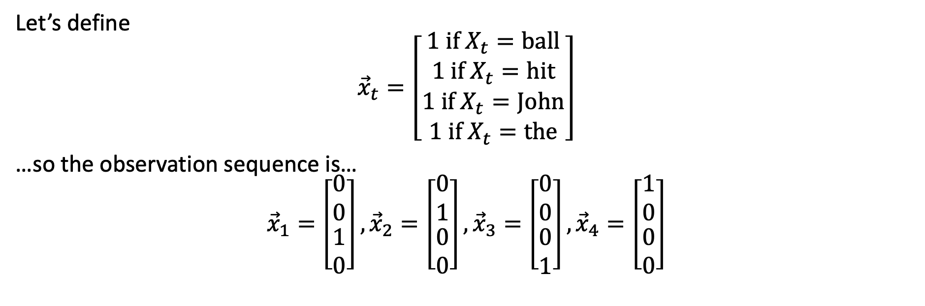
Recurrent neural network (RNN)
$${\vec{h}}_{t−1}$$
$${\vec{h}}_{t}$$
$${\vec{h}}_{t+1}$$
…
…
$${\vec{x}}_{t−1}$$
$${\vec{x}}_{t}$$
$${\vec{x}}_{t+1}$$
Let’s define
$${\vec{x}}_{t}=\left[\begin{matrix}\begin{matrix}1 if X_{t}=ball \\ 1 if X_{t}=hit\end{matrix} \\ \begin{matrix}1 if X_{t}=John \\ 1 if X_{t}=the\end{matrix}\end{matrix}\right]$$
…so the observation sequence is…
$${\vec{x}}_{1}=\left[\begin{matrix}\begin{matrix}0 \\ 0\end{matrix} \\ \begin{matrix}1 \\ 0\end{matrix}\end{matrix}\right],{\vec{x}}_{2}=\left[\begin{matrix}\begin{matrix}0 \\ 1\end{matrix} \\ \begin{matrix}0 \\ 0\end{matrix}\end{matrix}\right],{\vec{x}}_{3}=\left[\begin{matrix}\begin{matrix}0 \\ 0\end{matrix} \\ \begin{matrix}0 \\ 1\end{matrix}\end{matrix}\right],{\vec{x}}_{4}=\left[\begin{matrix}\begin{matrix}1 \\ 0\end{matrix} \\ \begin{matrix}0 \\ 0\end{matrix}\end{matrix}\right]$$
Notes:
The example is described in Section 15.1.1

Slide 13
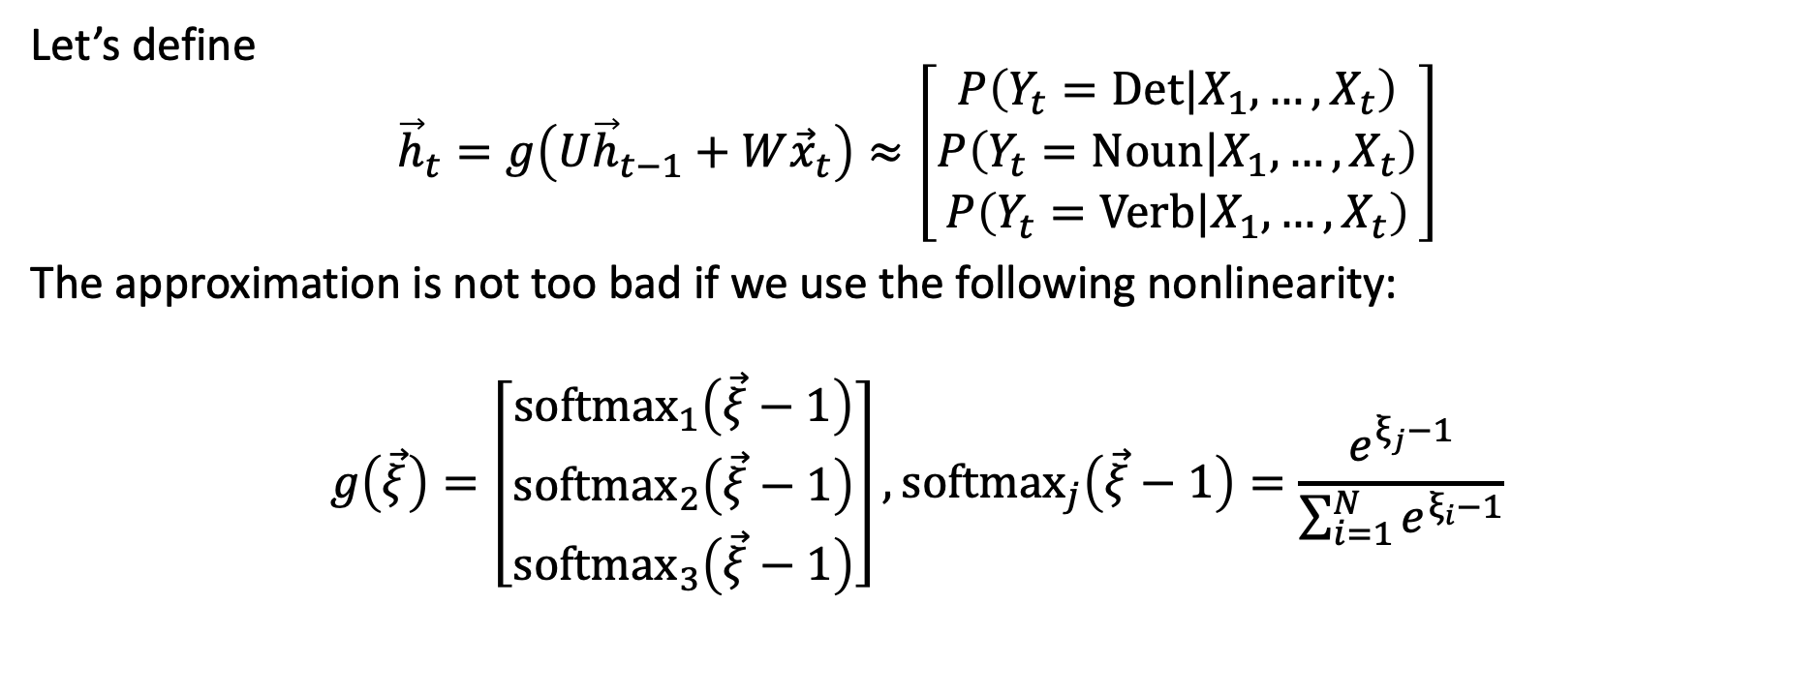
Recurrent neural network (RNN)
$${\vec{h}}_{t−1}$$
$${\vec{h}}_{t}$$
$${\vec{h}}_{t+1}$$
…
…
$${\vec{x}}_{t−1}$$
$${\vec{x}}_{t}$$
$${\vec{x}}_{t+1}$$
Let’s define
$${\vec{h}}_{t}=g\left(U{\vec{h}}_{t−1}+W{\vec{x}}_{t}\right)≈\left[\begin{matrix}\begin{matrix}P\left(Y_{t}=Det|X_{1},…,X_{t}\right) \\ P\left(Y_{t}=Noun|X_{1},…,X_{t}\right)\end{matrix} \\ P\left(Y_{t}=Verb|X_{1},…,X_{t}\right)\end{matrix}\right]$$
The approximation is not too bad if we use the following nonlinearity:
$$g\left(\vec{ξ}\right)=\left[\begin{matrix}\begin{matrix}{softmax}_{1}\left(\vec{ξ}−1\right) \\ {softmax}_{2}\left(\vec{ξ}−1\right)\end{matrix} \\ {softmax}_{3}\left(\vec{ξ}−1\right)\end{matrix}\right],{softmax}_{j}\left(\vec{ξ}−1\right)=\frac{e^{ξ_{j}−1}}{\sum_{i=1}^{N}{e^{ξ_{i}−1}}}$$
Notes:
The example is described in Section 15.1.1

Slide 14
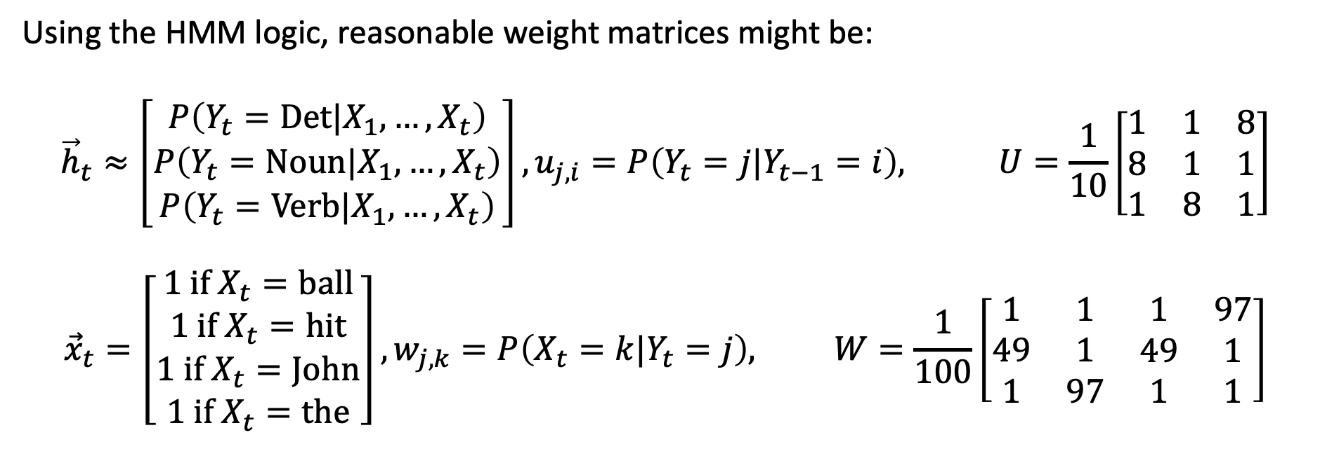
Recurrent neural network (RNN)
$${\vec{h}}_{t−1}$$
$${\vec{h}}_{t}$$
$${\vec{h}}_{t+1}$$
…
…
$${\vec{x}}_{t−1}$$
$${\vec{x}}_{t}$$
$${\vec{x}}_{t+1}$$
Using the HMM logic, reasonable weight matrices might be:
$${\vec{h}}_{t}≈\left[\begin{matrix}\begin{matrix}P\left(Y_{t}=Det|X_{1},…,X_{t}\right) \\ P\left(Y_{t}=Noun|X_{1},…,X_{t}\right)\end{matrix} \\ P\left(Y_{t}=Verb|X_{1},…,X_{t}\right)\end{matrix}\right], u_{j,i}=P\left(Y_{t}=j|Y_{t−1}=i\right), U=\frac{1}{10}\left[\begin{matrix}1 & 1 & 8 \\ 8 & 1 & 1 \\ 1 & 8 & 1\end{matrix}\right]$$
$${\vec{x}}_{t}=\left[\begin{matrix}\begin{matrix}1 if X_{t}=ball \\ 1 if X_{t}=hit\end{matrix} \\ \begin{matrix}1 if X_{t}=John \\ 1 if X_{t}=the\end{matrix}\end{matrix}\right], w_{j,k}=P\left(X_{t}=k|Y_{t}=j\right), W=\frac{1}{100}\left[\begin{matrix}\begin{matrix}1 & 1 \\ 49 & 1 \\ 1 & 97\end{matrix} & \begin{matrix}1 & 97 \\ 49 & 1 \\ 1 & 1\end{matrix}\end{matrix}\right]$$
Notes:
The example is described in Section 15.1.1

Slide 15
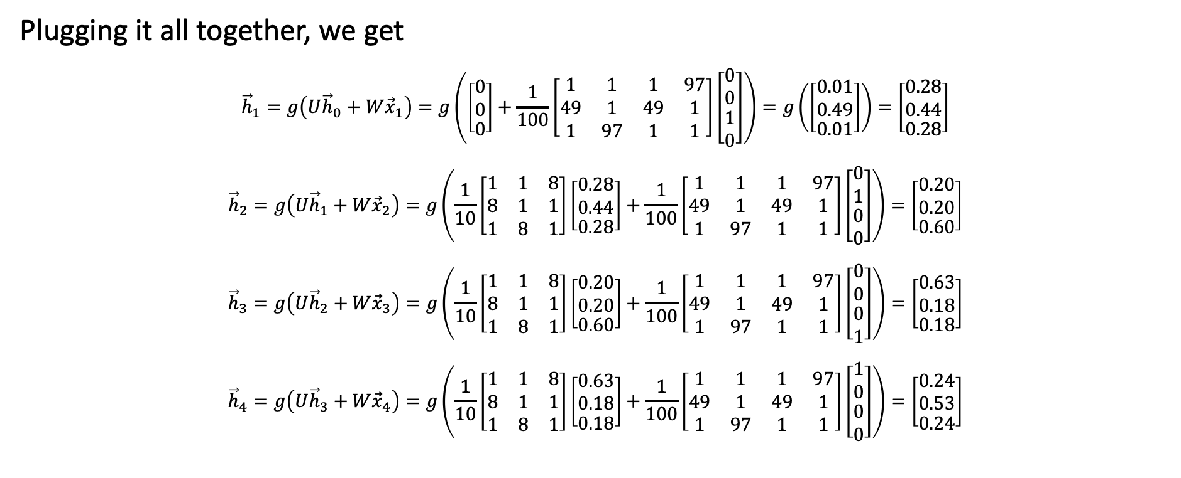
Recurrent neural network (RNN)
$${\vec{h}}_{t−1}$$
$${\vec{h}}_{t}$$
$${\vec{h}}_{t+1}$$
…
…
$${\vec{x}}_{t−1}$$
$${\vec{x}}_{t}$$
$${\vec{x}}_{t+1}$$
Plugging it all together, we get
$${\vec{h}}_{1}=g\left(U{\vec{h}}_{0}+W{\vec{x}}_{1}\right)=g\left(\left[\begin{matrix}\begin{matrix}0 \\ 0\end{matrix} \\ 0\end{matrix}\right]+\frac{1}{100}\left[\begin{matrix}\begin{matrix}1 & 1 \\ 49 & 1 \\ 1 & 97\end{matrix} & \begin{matrix}1 & 97 \\ 49 & 1 \\ 1 & 1\end{matrix}\end{matrix}\right]\left[\begin{matrix}\begin{matrix}0 \\ 0\end{matrix} \\ \begin{matrix}1 \\ 0\end{matrix}\end{matrix}\right]\right)=g\left(\left[\begin{matrix}\begin{matrix}0.01 \\ 0.49\end{matrix} \\ 0.01\end{matrix}\right]\right)=\left[\begin{matrix}\begin{matrix}0.28 \\ 0.44\end{matrix} \\ 0.28\end{matrix}\right]$$
$${\vec{h}}_{2}=g\left(U{\vec{h}}_{1}+W{\vec{x}}_{2}\right)=g\left(\frac{1}{10}\left[\begin{matrix}1 & 1 & 8 \\ 8 & 1 & 1 \\ 1 & 8 & 1\end{matrix}\right]\left[\begin{matrix}\begin{matrix}0.28 \\ 0.44\end{matrix} \\ 0.28\end{matrix}\right]+\frac{1}{100}\left[\begin{matrix}\begin{matrix}1 & 1 \\ 49 & 1 \\ 1 & 97\end{matrix} & \begin{matrix}1 & 97 \\ 49 & 1 \\ 1 & 1\end{matrix}\end{matrix}\right]\left[\begin{matrix}\begin{matrix}0 \\ 1\end{matrix} \\ \begin{matrix}0 \\ 0\end{matrix}\end{matrix}\right]\right)=\left[\begin{matrix}\begin{matrix}0.20 \\ 0.20\end{matrix} \\ 0.60\end{matrix}\right]$$
$${\vec{h}}_{3}=g\left(U{\vec{h}}_{2}+W{\vec{x}}_{3}\right)=g\left(\frac{1}{10}\left[\begin{matrix}1 & 1 & 8 \\ 8 & 1 & 1 \\ 1 & 8 & 1\end{matrix}\right]\left[\begin{matrix}\begin{matrix}0.20 \\ 0.20\end{matrix} \\ 0.60\end{matrix}\right]+\frac{1}{100}\left[\begin{matrix}\begin{matrix}1 & 1 \\ 49 & 1 \\ 1 & 97\end{matrix} & \begin{matrix}1 & 97 \\ 49 & 1 \\ 1 & 1\end{matrix}\end{matrix}\right]\left[\begin{matrix}\begin{matrix}0 \\ 0\end{matrix} \\ \begin{matrix}0 \\ 1\end{matrix}\end{matrix}\right]\right)=\left[\begin{matrix}\begin{matrix}0.63 \\ 0.18\end{matrix} \\ 0.18\end{matrix}\right]$$
$${\vec{h}}_{4}=g\left(U{\vec{h}}_{3}+W{\vec{x}}_{4}\right)=g\left(\frac{1}{10}\left[\begin{matrix}1 & 1 & 8 \\ 8 & 1 & 1 \\ 1 & 8 & 1\end{matrix}\right]\left[\begin{matrix}\begin{matrix}0.63 \\ 0.18\end{matrix} \\ 0.18\end{matrix}\right]+\frac{1}{100}\left[\begin{matrix}\begin{matrix}1 & 1 \\ 49 & 1 \\ 1 & 97\end{matrix} & \begin{matrix}1 & 97 \\ 49 & 1 \\ 1 & 1\end{matrix}\end{matrix}\right]\left[\begin{matrix}\begin{matrix}1 \\ 0\end{matrix} \\ \begin{matrix}0 \\ 0\end{matrix}\end{matrix}\right]\right)=\left[\begin{matrix}\begin{matrix}0.24 \\ 0.53\end{matrix} \\ 0.24\end{matrix}\right]$$
Notes:
The example is described in Section 15.1.1

Slide 16
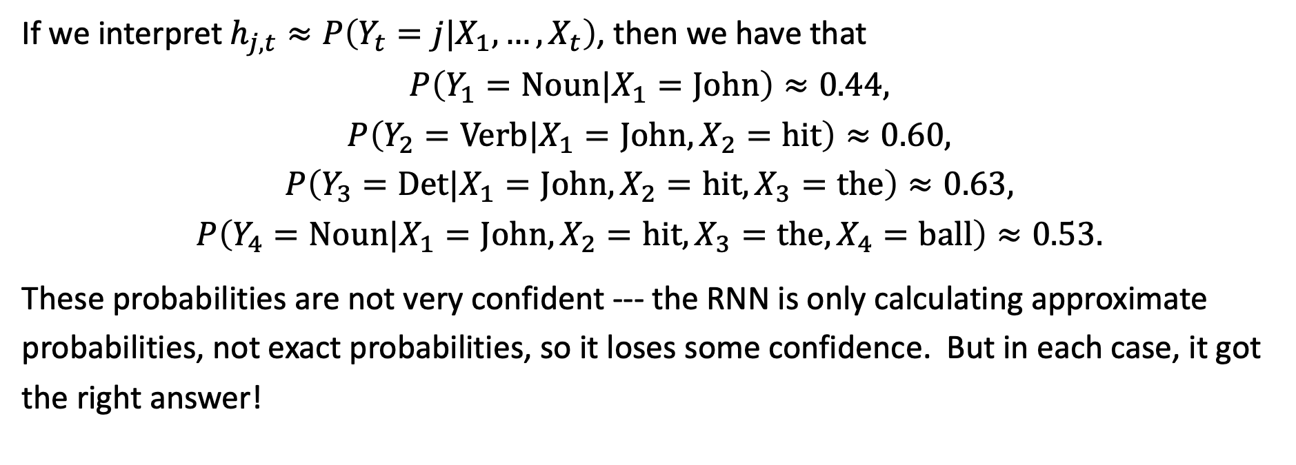
Recurrent neural network (RNN)
$${\vec{h}}_{t−1}$$
$${\vec{h}}_{t}$$
$${\vec{h}}_{t+1}$$
…
…
$${\vec{x}}_{t−1}$$
$${\vec{x}}_{t}$$
$${\vec{x}}_{t+1}$$
If we interpret $h_{j,t}≈P\left(Y_{t}=j|X_{1},…,X_{t}\right)$, then we have that
$$P\left(Y_{1}=Noun|X_{1}=John\right)≈0.44,$$
$$P\left(Y_{2}=Verb|X_{1}=John,X_{2}=hit\right)≈0.60,$$
$$P\left(Y_{3}=Det|X_{1}=John,X_{2}=hit,X_{3}=the\right)≈0.63,$$
$$P\left(Y_{4}=Noun|X_{1}=John,X_{2}=hit,X_{3}=the,X_{4}=ball\right)≈0.53.$$
These probabilities are not very confident --- the RNN is only calculating approximate probabilities, not exact probabilities, so it loses some confidence. But in each case, it got the right answer!
Notes:
The example is described in Section 15.1.1

Slide 17
Content
Belief propagation
Recurrent neural networks
Training a recurrent neural network
Long short-term memory (LSTM)

Slide 18
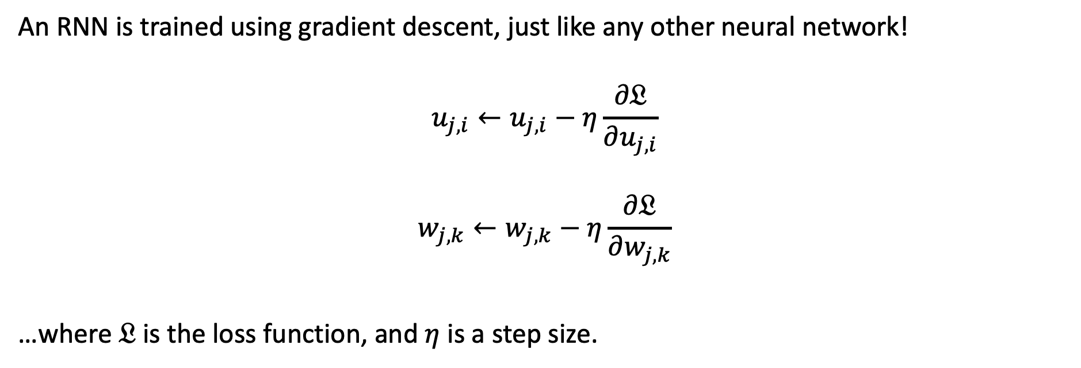
Training an RNN
$${\vec{h}}_{t−1}$$
$${\vec{h}}_{t}$$
$${\vec{h}}_{t+1}$$
…
…
$${\vec{x}}_{t−1}$$
$${\vec{x}}_{t}$$
$${\vec{x}}_{t+1}$$
An RNN is trained using gradient descent, just like any other neural network!
$$u_{j,i}←u_{j,i}−η\frac{∂𝔏}{∂u_{j,i}}$$
$$w_{j,k}←w_{j,k}−η\frac{∂𝔏}{∂w_{j,k}}$$
…where $𝔏$ is the loss function, and $η$ is a step size.
Notes:
The example is described in Section 15.1.1

Slide 19
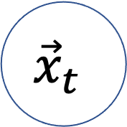
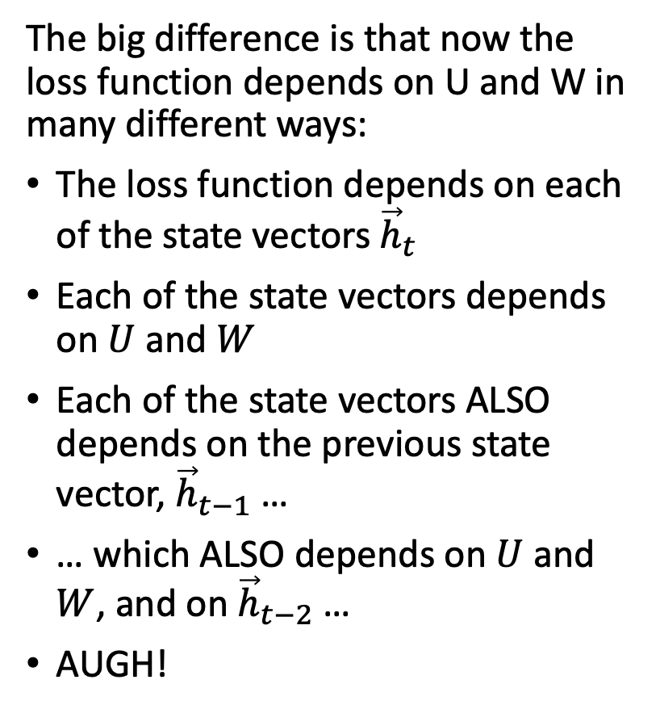
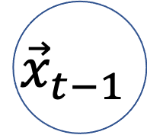



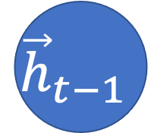
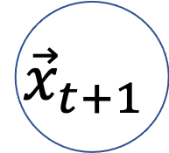
Training an RNN: How can we solve this?
$$𝔏$$
The big difference is that now the loss function depends on U and W in many different ways:
The loss function depends on each of the state vectors ${\vec{h}}_{t}$
Each of the state vectors depends on $U$ and $W$
Each of the state vectors ALSO depends on the previous state vector, ${\vec{h}}_{t−1}$ …
… which ALSO depends on $U$ and $W$, and on ${\vec{h}}_{t−2}$ …
AUGH!
…
$${\vec{h}}_{t−1}$$
$${\vec{h}}_{t}$$
$${\vec{h}}_{t+1}$$
…
$${\vec{x}}_{t−1}$$
$${\vec{x}}_{t}$$
$${\vec{x}}_{t+1}$$
Notes:
The example is described in Section 15.1.1

Slide 20
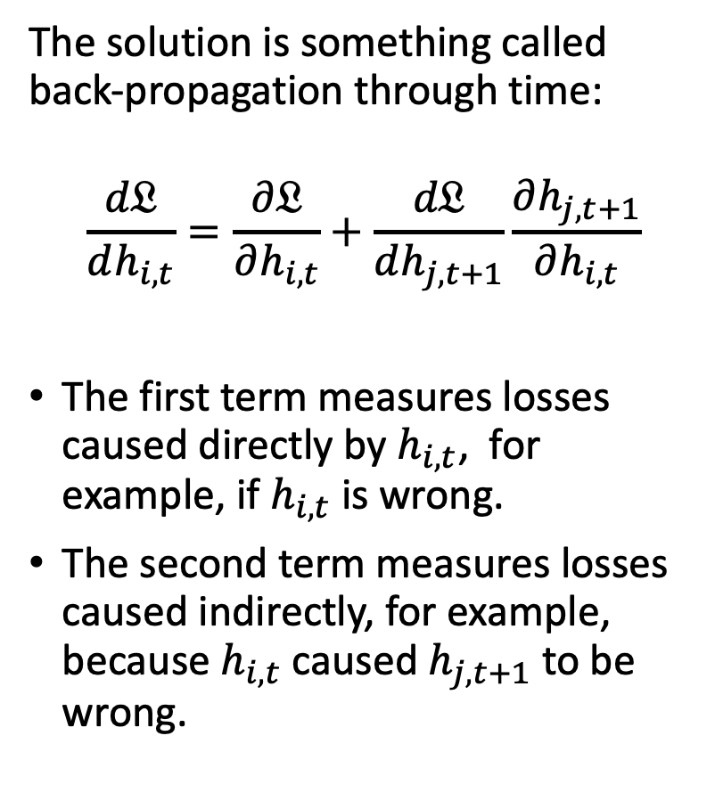
Back-propagation through time
$$𝔏$$
The solution is something called back-propagation through time:
$$\frac{d𝔏}{dh_{i,t}}=\frac{∂𝔏}{∂h_{i,t}}+\frac{d𝔏}{dh_{j,t+1}}\frac{∂h_{j,t+1}}{∂h_{i,t}}$$
The first term measures losses caused directly by $h_{i,t}$, for example, if $h_{i,t}$ is wrong.
The second term measures losses caused indirectly, for example, because $h_{i,t}$ caused $h_{j,t+1}$ to be wrong.
…
$${\vec{h}}_{t−1}$$
$${\vec{h}}_{t}$$
$${\vec{h}}_{t+1}$$
…
$${\vec{x}}_{t−1}$$
$${\vec{x}}_{t}$$
$${\vec{x}}_{t+1}$$
Notes:
The example is described in Section 15.1.1

Slide 21
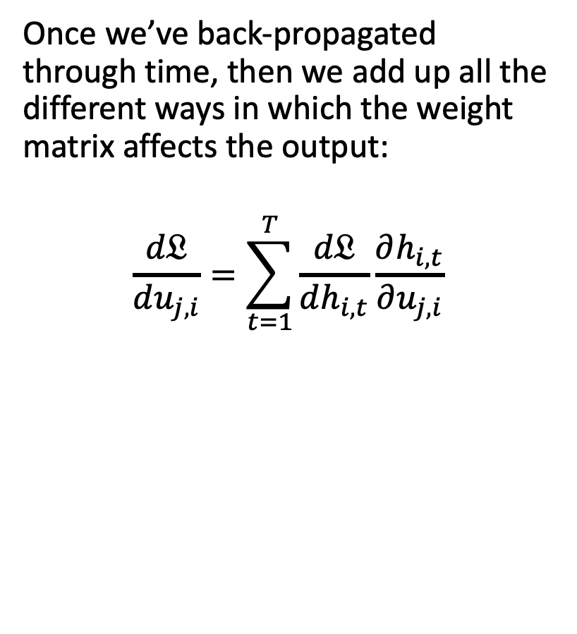
Back-propagation through time
$$𝔏$$
Once we’ve back-propagated through time, then we add up all the different ways in which the weight matrix affects the output:
$$\frac{d𝔏}{du_{j,i}}=\sum_{t=1}^{T}{\frac{d𝔏}{dh_{i,t}}}\frac{∂h_{i,t}}{∂u_{j,i}}$$
…
$${\vec{h}}_{t−1}$$
$${\vec{h}}_{t}$$
$${\vec{h}}_{t+1}$$
…
$${\vec{x}}_{t−1}$$
$${\vec{x}}_{t}$$
$${\vec{x}}_{t+1}$$
Notes:
The example is described in Section 15.1.1

Slide 22
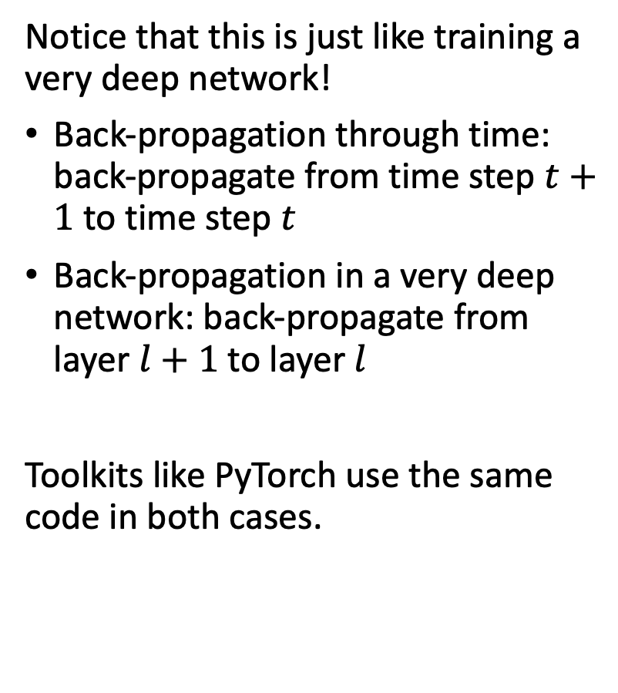
Back-propagation through time
$$𝔏$$
Notice that this is just like training a very deep network!
Back-propagation through time: back-propagate from time step $t+1$ to time step $t$
Back-propagation in a very deep network: back-propagate from layer $l+1$ to layer $l$
Toolkits like PyTorch use the same code in both cases.
…
$${\vec{h}}_{t−1}$$
$${\vec{h}}_{t}$$
$${\vec{h}}_{t+1}$$
…
$${\vec{x}}_{t−1}$$
$${\vec{x}}_{t}$$
$${\vec{x}}_{t+1}$$
Notes:
The example is described in Section 15.1.1

Slide 23
Content
Log belief propagation
Recurrent neural networks
Training a recurrent neural network
Long short-term memory (LSTM)

Slide 24
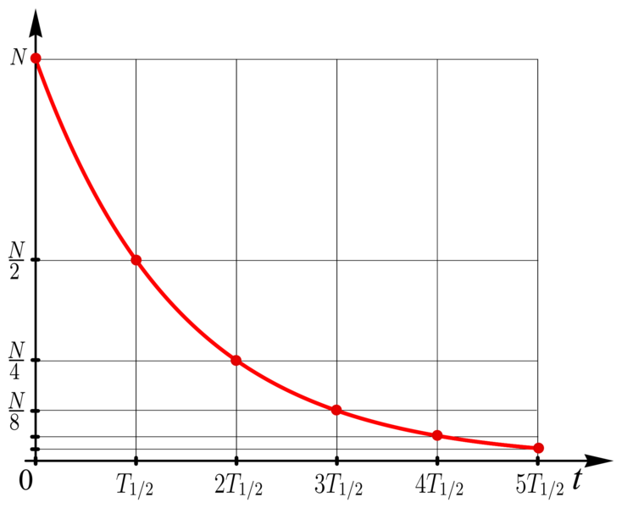
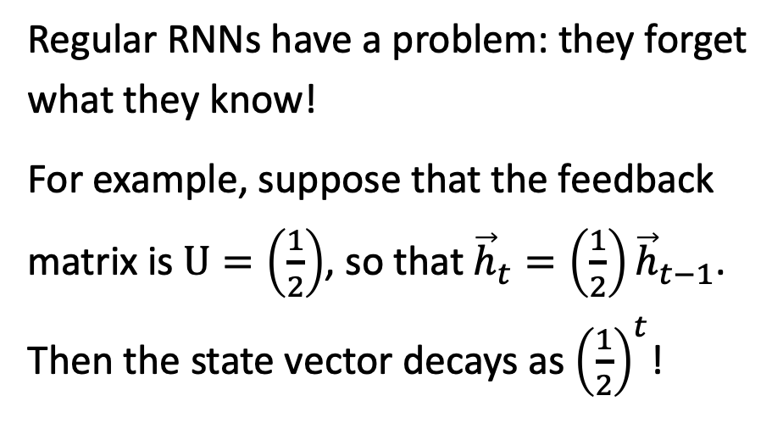
Exponential forgetting
$${\vec{h}}_{t−1}$$
$${\vec{h}}_{t}$$
$${\vec{h}}_{t+1}$$
…
…
$${\vec{x}}_{t−1}$$
$${\vec{x}}_{t}$$
$${\vec{x}}_{t+1}$$
Regular RNNs have a problem: they forget what they know!
For example, suppose that the feedback matrix is $U=\left(\frac{1}{2}\right)$, so that ${\vec{h}}_{t}=\left(\frac{1}{2}\right){\vec{h}}_{t−1}$. Then the state vector decays as ${\left(\frac{1}{2}\right)}^{t}$!
Exponential-decay.png. CC-SA-4.0, Svjo, 2017
Notes:
The example is described in Section 15.1.1

Slide 25
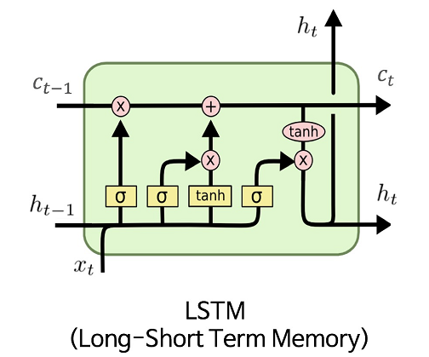
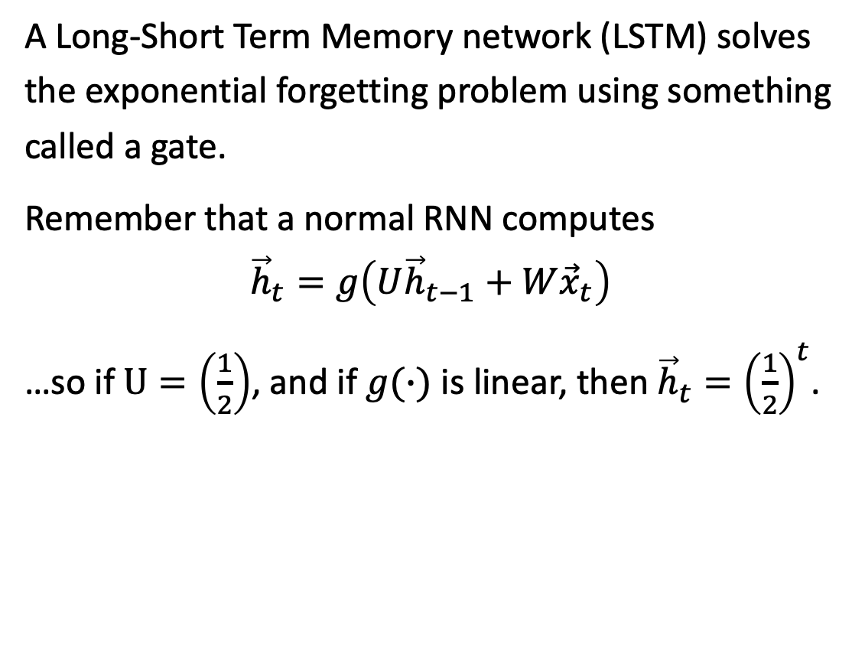
Long-Short Term Memory (LSTM)
A Long-Short Term Memory network (LSTM) solves the exponential forgetting problem using something called a gate.
Remember that a normal RNN computes
$${\vec{h}}_{t}=g\left(U{\vec{h}}_{t−1}+W{\vec{x}}_{t}\right)$$
…so if $U=\left(\frac{1}{2}\right)$, and if $g(∙)$ is linear, then ${{\vec{h}}_{t}=\left(\frac{1}{2}\right)}^{t}$.
CC-SA-4.0, MingxianLin, 2018
Notes:
The example is described in Section 15.1.1

Slide 26
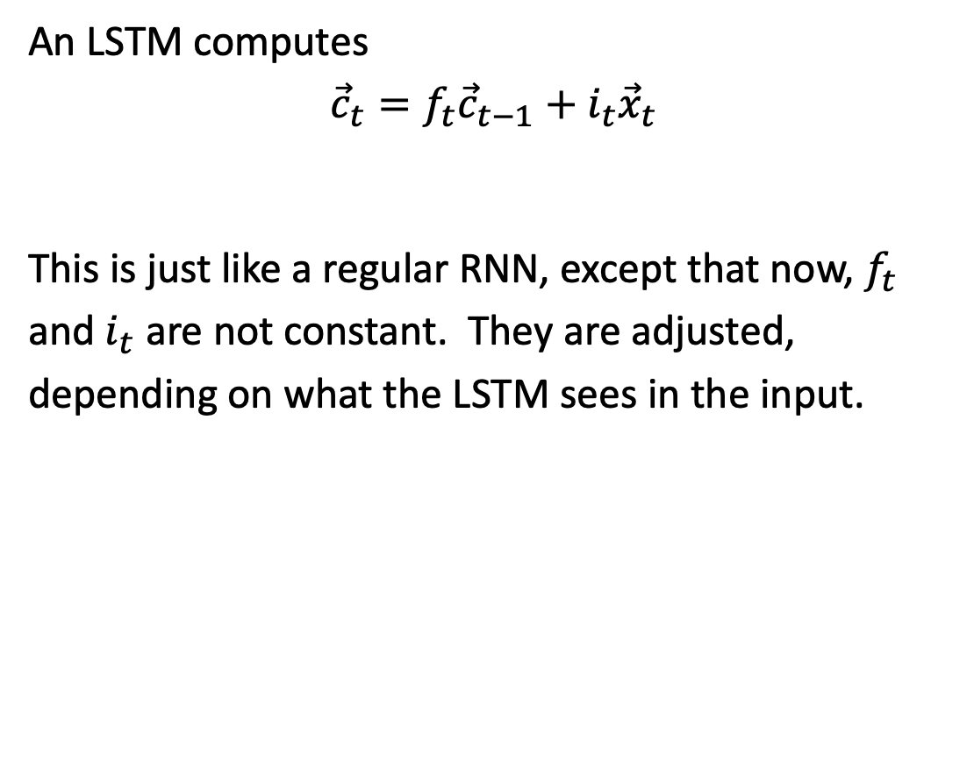
Long-Short Term Memory (LSTM)
An LSTM computes
$${\vec{c}}_{t}=f_{t}{\vec{c}}_{t−1}+i_{t}{\vec{x}}_{t}$$
This is just like a regular RNN, except that now, $f_{t}$ and $i_{t}$ are not constant. They are adjusted, depending on what the LSTM sees in the input.
CC-SA-4.0, MingxianLin, 2018
Notes:
The example is described in Section 15.1.1

Slide 27
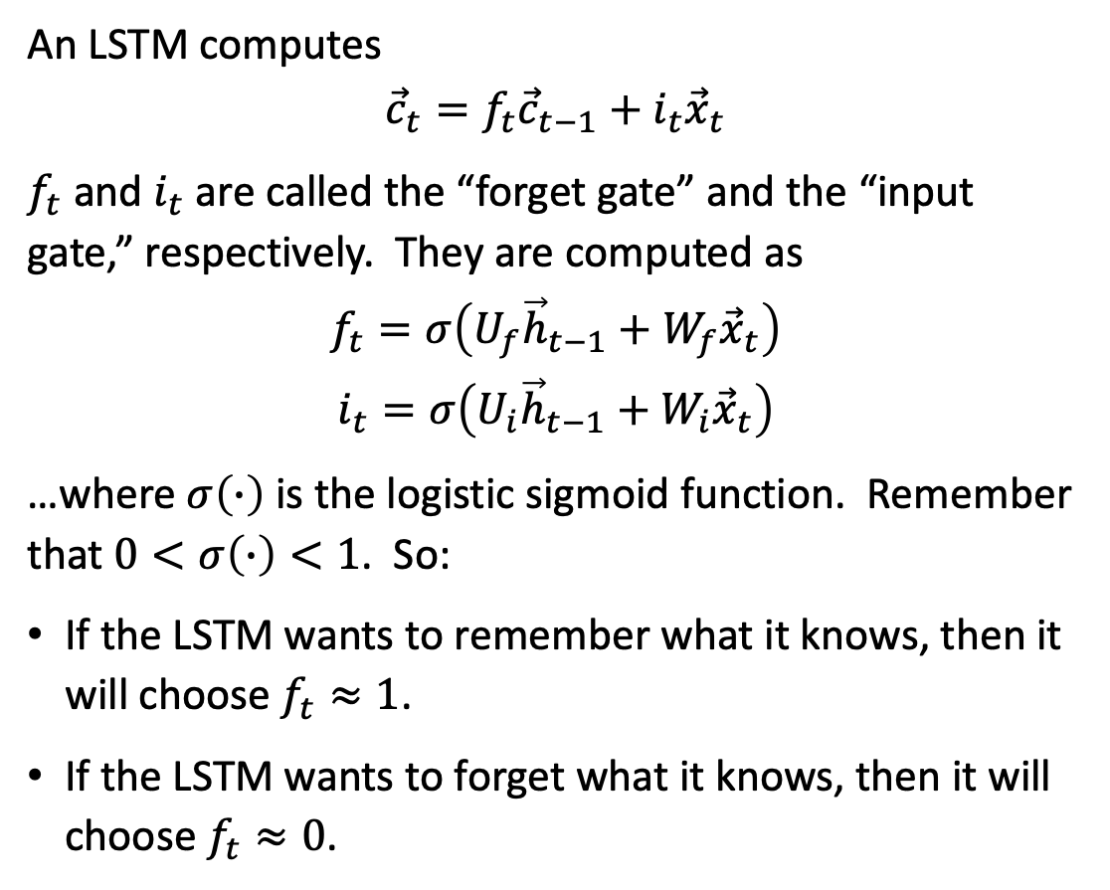
Long-Short Term Memory (LSTM)
An LSTM computes
$${\vec{c}}_{t}=f_{t}{\vec{c}}_{t−1}+i_{t}{\vec{x}}_{t}$$
$f_{t}$ and $i_{t}$ are called the “forget gate” and the “input gate,” respectively. They are computed as
$$f_{t}=σ\left(U_{f}{\vec{h}}_{t−1}+W_{f}{\vec{x}}_{t}\right)$$
$$i_{t}=σ\left(U_{i}{\vec{h}}_{t−1}+W_{i}{\vec{x}}_{t}\right)$$
…where $σ\left(∙\right)$ is the logistic sigmoid function. Remember that $0<σ\left(∙\right)<1$. So:
If the LSTM wants to remember what it knows, then it will choose $f_{t}≈1$.
If the LSTM wants to forget what it knows, then it will choose $f_{t}≈0$.
CC-SA-4.0, MingxianLin, 2018
Notes:
The example is described in Section 15.1.1

Slide 28
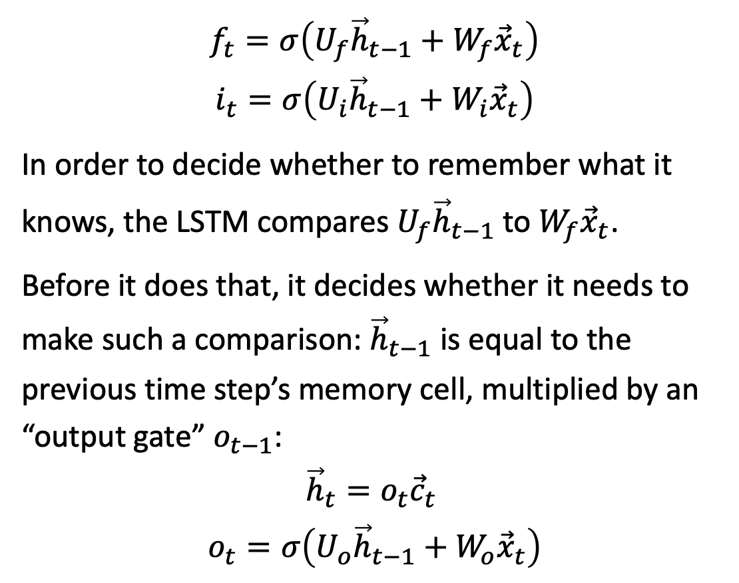
Long-Short Term Memory (LSTM)
$$f_{t}=σ\left(U_{f}{\vec{h}}_{t−1}+W_{f}{\vec{x}}_{t}\right)$$
$$i_{t}=σ\left(U_{i}{\vec{h}}_{t−1}+W_{i}{\vec{x}}_{t}\right)$$
In order to decide whether to remember what it knows, the LSTM compares $U_{f}{\vec{h}}_{t−1}$ to $W_{f}{\vec{x}}_{t}$.
Before it does that, it decides whether it needs to make such a comparison: ${\vec{h}}_{t−1}$ is equal to the previous time step’s memory cell, multiplied by an “output gate” $o_{t−1}$:
$${\vec{h}}_{t}=o_{t}{\vec{c}}_{t}$$
$$o_{t}=σ\left(U_{o}{\vec{h}}_{t−1}+W_{o}{\vec{x}}_{t}\right)$$
CC-SA-4.0, MingxianLin, 2018
Notes:
The example is described in Section 15.1.1

Slide 29
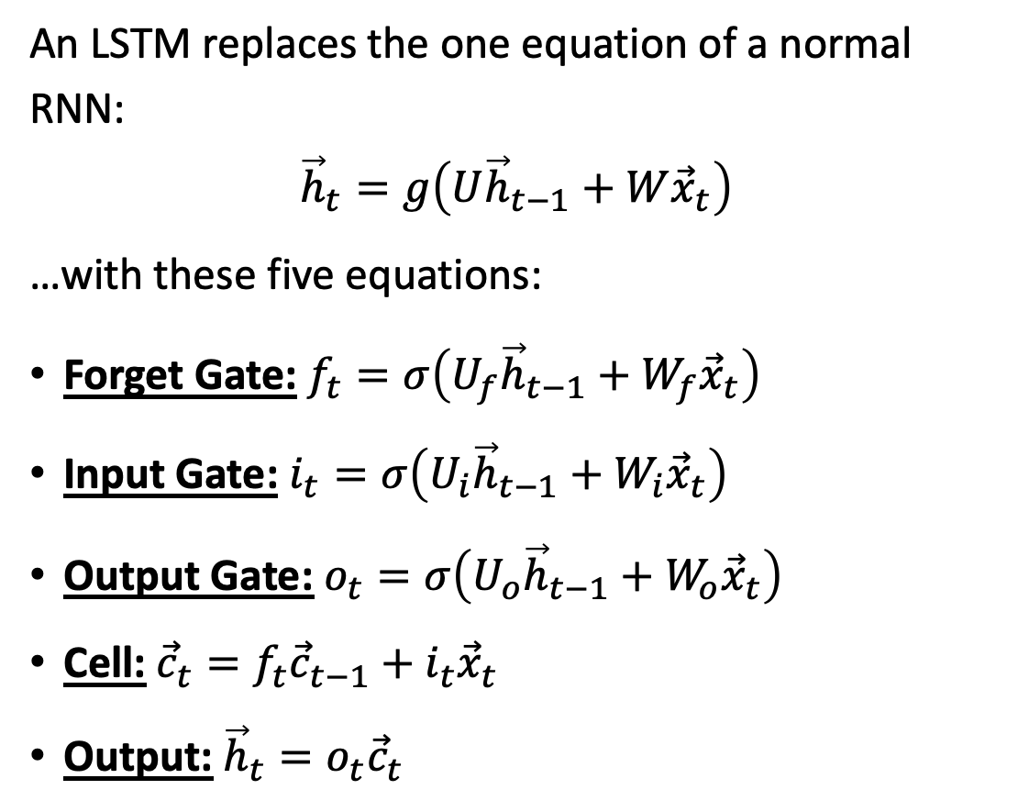
Long-Short Term Memory (LSTM)
An LSTM replaces the one equation of a normal RNN:
$${\vec{h}}_{t}=g\left(U{\vec{h}}_{t−1}+W{\vec{x}}_{t}\right)$$
…with these five equations:
Forget Gate: $f_{t}=σ\left(U_{f}{\vec{h}}_{t−1}+W_{f}{\vec{x}}_{t}\right)$
Input Gate: $i_{t}=σ\left(U_{i}{\vec{h}}_{t−1}+W_{i}{\vec{x}}_{t}\right)$
Output Gate: $o_{t}=σ\left(U_{o}{\vec{h}}_{t−1}+W_{o}{\vec{x}}_{t}\right)$
Cell: ${\vec{c}}_{t}=f_{t}{\vec{c}}_{t−1}+i_{t}{\vec{x}}_{t}$
Output: ${\vec{h}}_{t}=o_{t}{\vec{c}}_{t}$
CC-SA-4.0, MingxianLin, 2018
Notes:
The example is described in Section 15.1.1

Slide 30





LSTM: Remember when you want to remember, forget when you want to forget
$${\vec{h}}_{t}$$
Remember that an RNN tends to forget exponentially, like this:
Exponential-decay.png. CC-SA-4.0, Svjo, 2017
$${\vec{c}}_{t}$$
An LSTM forgets more like this:
$$t$$
$f_{t}≈1$ during these time steps
$f_{t}≈0$ during these time steps

Slide 31
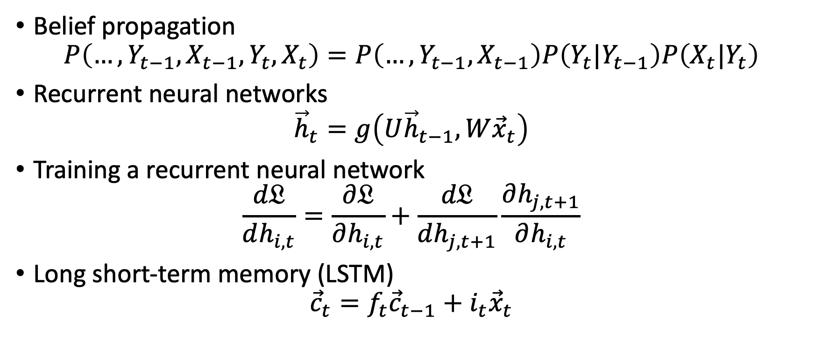
Content
Belief propagation
$$P\left(…,Y_{t−1},X_{t−1},Y_{t},X_{t}\right)=P\left(…,Y_{t−1},X_{t−1}\right)P\left(Y_{t}|Y_{t−1}\right)P\left(X_{t}|Y_{t}\right)$$
Recurrent neural networks
$${\vec{h}}_{t}=g\left(U{\vec{h}}_{t−1},W{\vec{x}}_{t}\right)$$
Training a recurrent neural network
$$\frac{d𝔏}{dh_{i,t}}=\frac{∂𝔏}{∂h_{i,t}}+\frac{d𝔏}{dh_{j,t+1}}\frac{∂h_{j,t+1}}{∂h_{i,t}}$$
Long short-term memory (LSTM)
$${\vec{c}}_{t}=f_{t}{\vec{c}}_{t−1}+i_{t}{\vec{x}}_{t}$$

