Slide 1
CS440/ECE448 Lecture 26:
Causal Networks
CC-BY 4.0: copy at will, but cite the source
Mark Hasegawa-Johnson
3/2022

Slide 2
Outline
Review: Inference in Bayesian networks
The do-calculus
Some applications

Slide 3
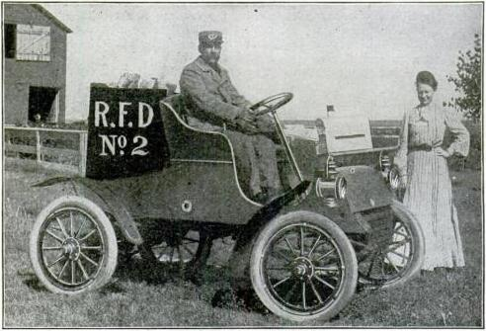
Mail delivery in Whoville
P
S
C
M
Rural_Free_Delivery_early_vehicle.JPG
The village of Whoville sometimes pays its employees, and sometimes doesn’t
When the employees are paid, they are more likely to go out and shovel snow from the sidewalks
When the employees are paid, they are more likely to charge the village’s delivery vehicles
When the delivery vehicle is charged, and the sidewalks are shoveled, the mailman is more likely to deliver mail

Slide 4
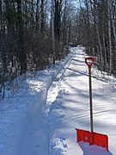
Mail delivery in Whoville
P
S
C
M
Rural_Free_Delivery_early_vehicle.JPG
Mary Lou Who loves to get mail, but she hates to go out to her mailbox and find it empty. Here are some questions she might ask:
If the sidewalk has been shoveled, what’s the probability that she has mail?
If she goes out and shovels her sidewalk by herself, does that increase her chance of getting mail? By how much?
Snow shovelling.jpg

Slide 5
Review: Inference in Bayesian Networks
Find a path that includes all the variables of interest
Multiply conditional probabilities together to get the joint distribution of all variables on the path
Add the probabilities that correspond to different values of any variable you don’t care about
Divide in order to get the conditional probability of the query given the observations

Slide 6
1. Find a path
P
S
C
M
Rural_Free_Delivery_early_vehicle.JPG
M is the query variable, S=T is the observation
Their parents are P and C
…in this case, the path we need to model is the whole graph, (P,S,C,M).

Slide 7
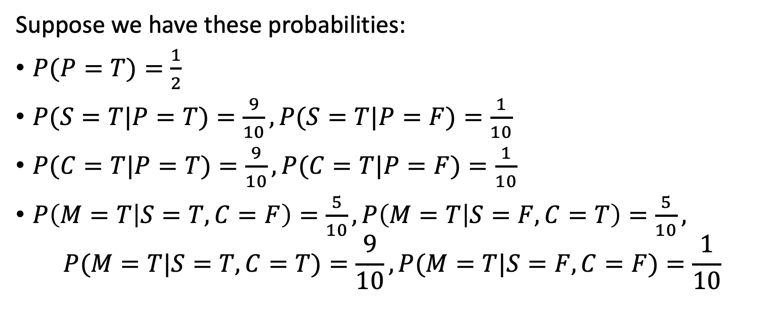
2. Multiply
P
S
C
M
Rural_Free_Delivery_early_vehicle.JPG
Suppose we have these probabilities:
$P(P=T)=\frac{1}{2}$
$P(S=T|P=T)=\frac{9}{10}, P(S=T|P=F)=\frac{1}{10}$
$P(C=T|P=T)=\frac{9}{10}, P(C=T|P=F)=\frac{1}{10}$
$P\left(M=T | S=T,C=F\right)=\frac{5}{10}, P\left(M=T | S=F,C=T\right)=\frac{5}{10},$
$$P(M=T|S=T,C=T)=\frac{9}{10}, P(M=T|S=F,C=F)=\frac{1}{10}$$

Slide 8
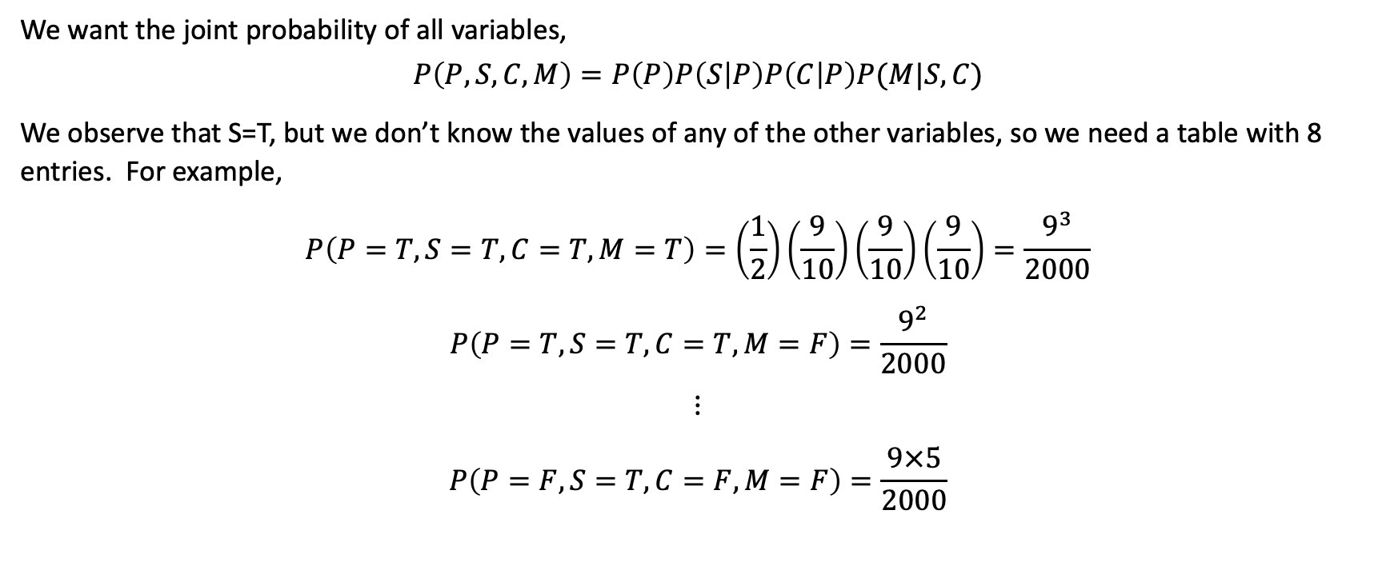
2. Multiply
P
S
C
M
Rural_Free_Delivery_early_vehicle.JPG
We want the joint probability of all variables,
$$P\left(P,S,C,M\right)=P\left(P\right)P\left(S | P\right)P\left(C | P\right)P(M|S,C)$$
We observe that S=T, but we don’t know the values of any of the other variables, so we need a table with 8 entries. For example,
$$P\left(P=T,S=T,C=T,M=T\right)=\left(\frac{1}{2}\right)\left(\frac{9}{10}\right)\left(\frac{9}{10}\right)\left(\frac{9}{10}\right)=\frac{9^{3}}{2000}$$
$$P\left(P=T,S=T,C=T,M=F\right)=\frac{9^{2}}{2000}$$
$$⋮$$
$$P\left(P=F,S=T,C=F,M=F\right)=\frac{9×5}{2000}$$

Slide 9
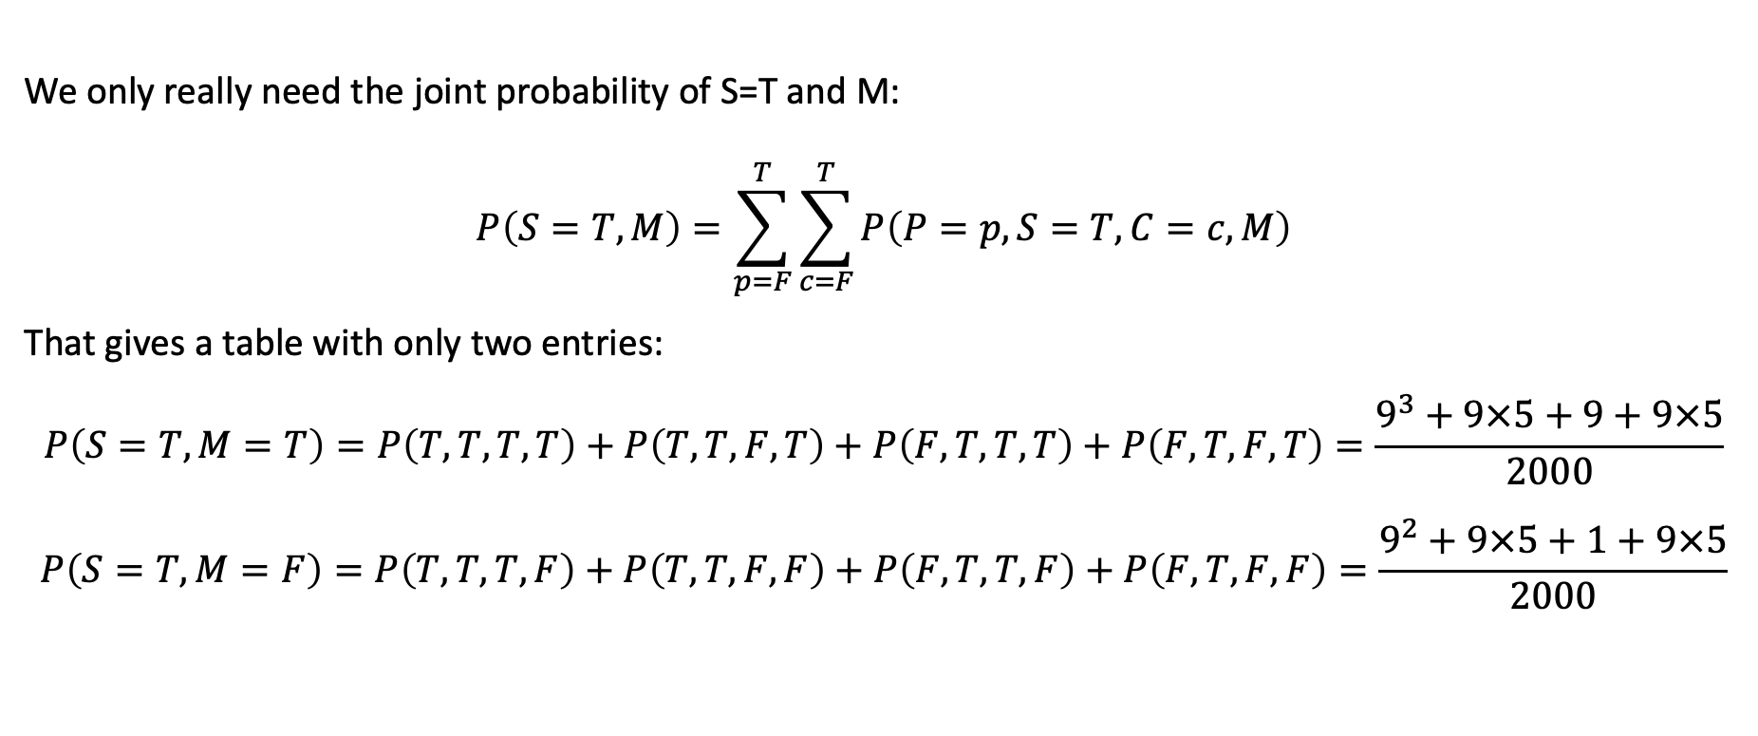
3. Add
P
S
C
M
Rural_Free_Delivery_early_vehicle.JPG
We only really need the joint probability of S=T and M:
$$P\left(S=T, M\right)=\sum_{p=F}^{T}{\sum_{c=F}^{T}{P\left(P=p,S=T,C=c,M\right)}}$$
That gives a table with only two entries:
$$P\left(S=T,M=T\right)=P\left(T,T,T,T\right)+P\left(T,T,F,T\right)+P\left(F,T,T,T\right)+P\left(F,T,F,T\right)=\frac{9^{3}+9×5+9+9×5}{2000}$$
$$P\left(S=T,M=F\right)=P\left(T,T,T,F\right)+P\left(T,T,F,F\right)+P\left(F,T,T,F\right)+P\left(F,T,F,F\right)=\frac{9^{2}+9×5+1+9×5}{2000}$$

Slide 10
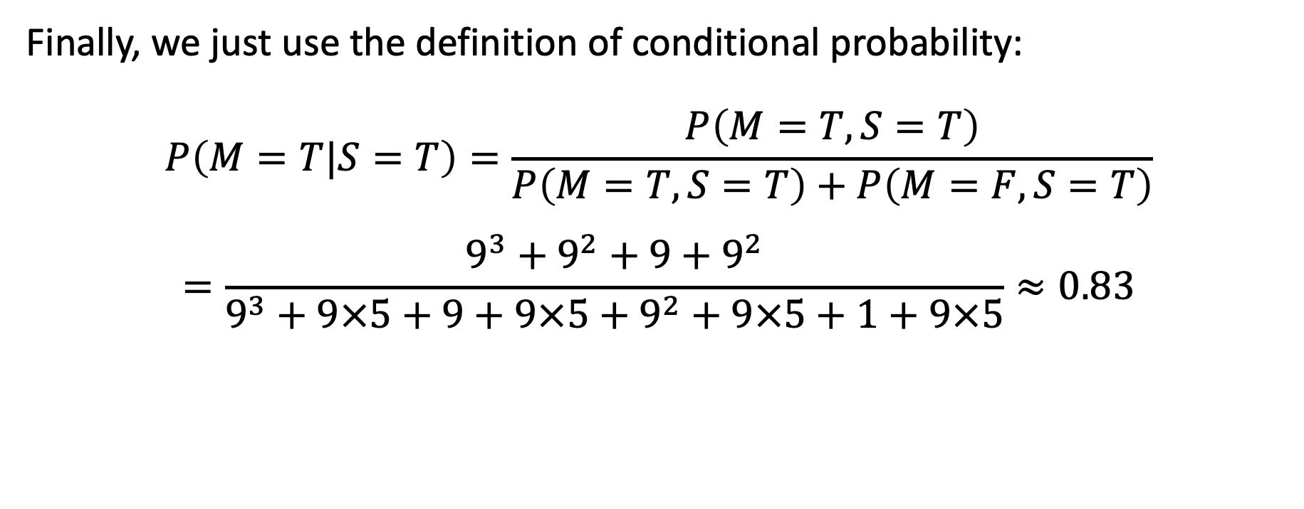
4. Divide
P
S
C
M
Rural_Free_Delivery_early_vehicle.JPG
Finally, we just use the definition of conditional probability:
$$P\left(M=T|S=T\right)=\frac{P\left(M=T,S=T\right)}{P\left(M=T,S=T\right)+P\left(M=F,S=T\right)}$$
$$=\frac{9^{3}+9^{2}+9+9^{2}}{9^{3}+9×5+9+9×5+9^{2}+9×5+1+9×5}≈0.83$$

Slide 11
Mail delivery in Whoville
P
S
C
M
Rural_Free_Delivery_early_vehicle.JPG
Mary Lou Who loves to get mail, but she hates to go out to her mailbox and find it empty. Here are some questions she might ask:
If the sidewalk has been shoveled, what’s the probability that she has mail? ANSWER: 0.83
If she goes out and shovels her sidewalk by herself, does that increase her chance of getting mail? By how much?
How can we answer the second question?
Snow shovelling.jpg

Slide 12
Outline
Review: Inference in Bayesian networks
The do-calculus
Some applications

Slide 13
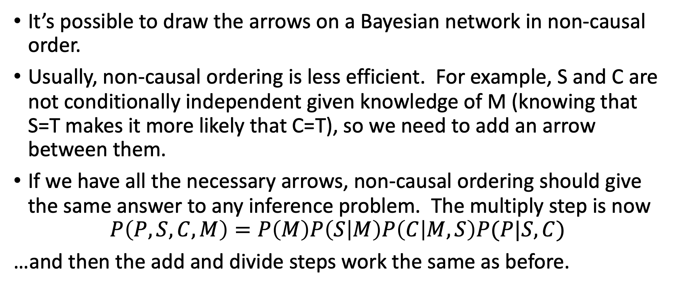
Non-Causal Bayesian Networks
P
S
C
M
It’s possible to draw the arrows on a Bayesian network in non-causal order.
Usually, non-causal ordering is less efficient. For example, S and C are not conditionally independent given knowledge of M (knowing that S=T makes it more likely that C=T), so we need to add an arrow between them.
If we have all the necessary arrows, non-causal ordering should give the same answer to any inference problem. The multiply step is now
$$P\left(P,S,C,M\right)=P\left(M\right)P\left(S | M\right)P\left(C | M,S\right)P(P|S,C)$$
…and then the add and divide steps work the same as before.

Slide 14
Non-Causal Bayesian Networks
P
S
C
M
Using a non-causal network, however, we can’t answer questions like:
“If I act on the system by changing the value of one variable, what will happen to the other variables?”
We lose the ability to represent causal changes. For example, if Mary Lou puts a letter in her own mailbox, that sets M=T, but it does not cause her sidewalk to get shoveled.

Slide 15
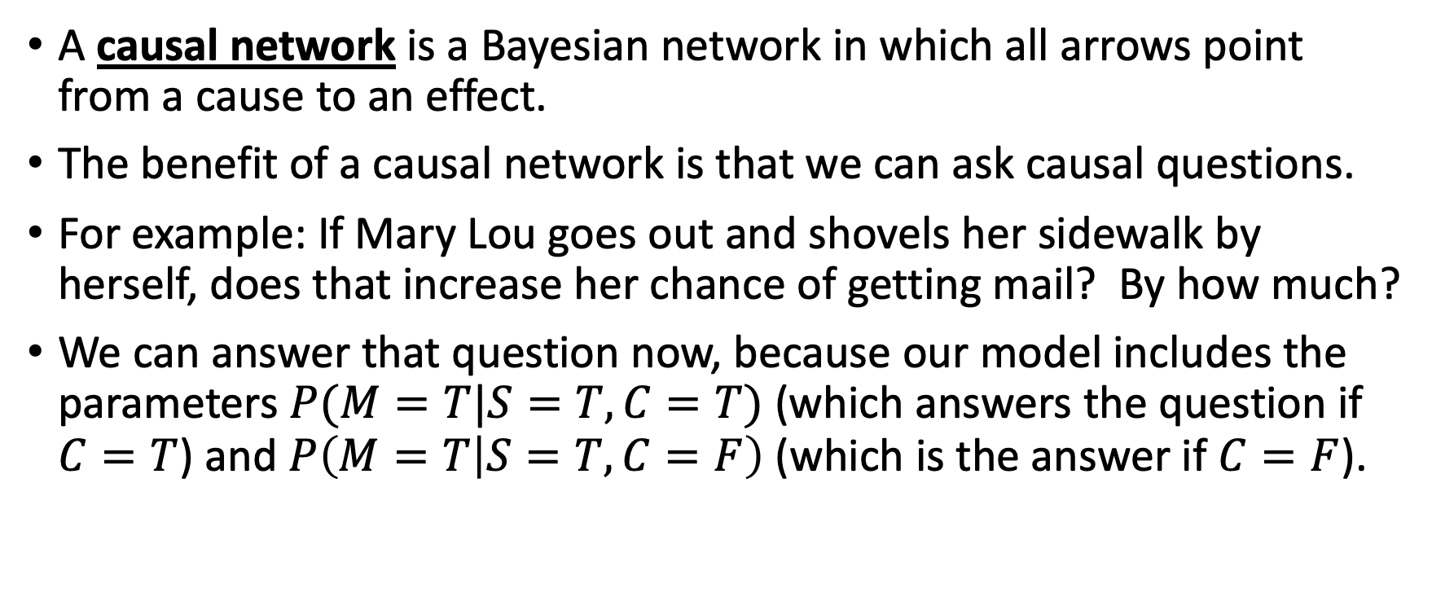
Causal Networks
P
S
C
M
A causal network is a Bayesian network in which all arrows point from a cause to an effect.
The benefit of a causal network is that we can ask causal questions.
For example: If Mary Lou goes out and shovels her sidewalk by herself, does that increase her chance of getting mail? By how much?
We can answer that question now, because our model includes the parameters $P(M=T|S=T,C=T)$ (which answers the question if $C=T$) and $P\left(M=T | S=T,C=F\right)$ (which is the answer if $C=F$).

Slide 16
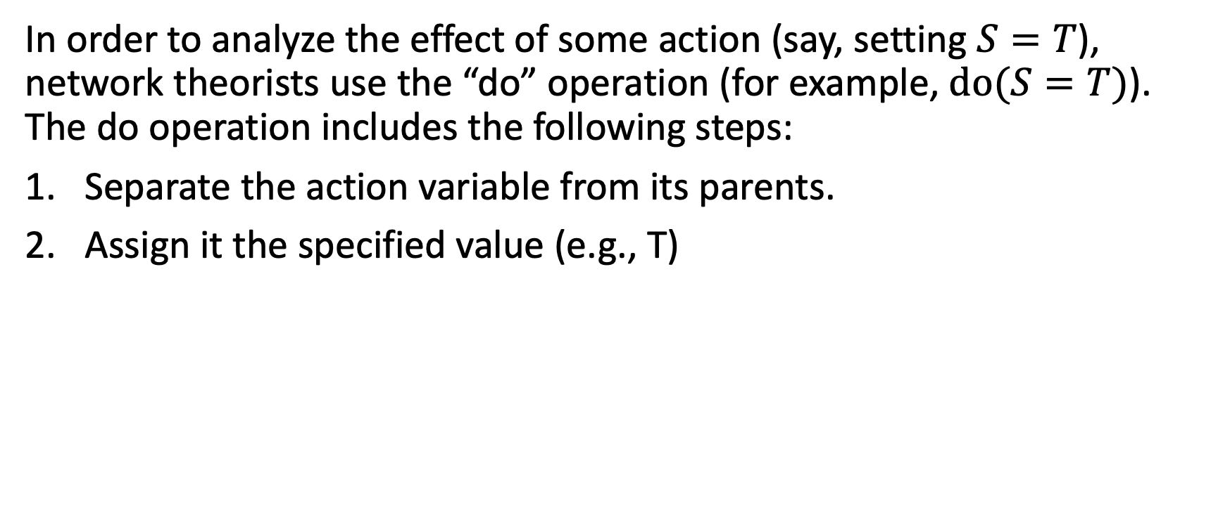
Do-calculus
P
S=T
C
M
In order to analyze the effect of some action (say, setting $S=T$), network theorists use the “do” operation (for example, $do(S=T)$). The do operation includes the following steps:
Separate the action variable from its parents.
Assign it the specified value (e.g., T)

Slide 17
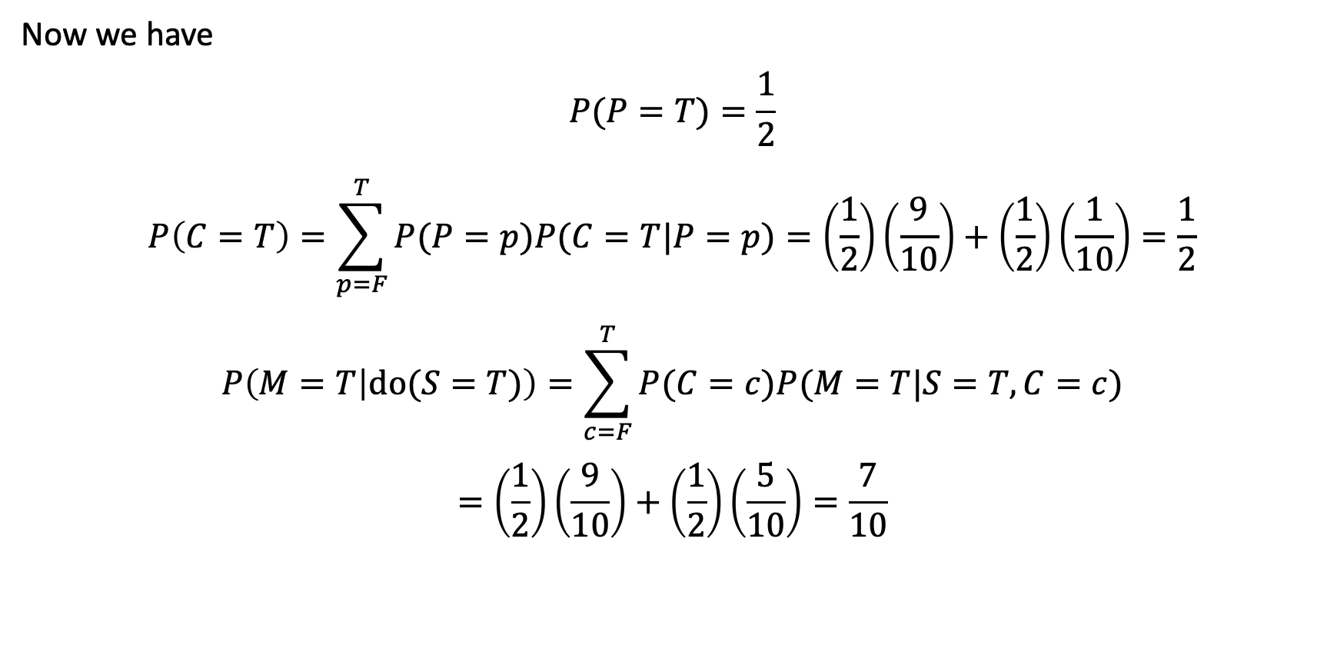
Do-calculus
P
S=T
C
M
Now we have
$$P(P=T)=\frac{1}{2}$$
$$P\left(C=T\right)=\sum_{p=F}^{T}{P(P=p)P(C=T|P=p)}=\left(\frac{1}{2}\right)\left(\frac{9}{10}\right)+\left(\frac{1}{2}\right)\left(\frac{1}{10}\right)=\frac{1}{2}$$
$$P\left(M=T | do(S=T)\right)=\sum_{c=F}^{T}{P(C=c)P(M=T|S=T,C=c)}$$
$$=\left(\frac{1}{2}\right)\left(\frac{9}{10}\right)+\left(\frac{1}{2}\right)\left(\frac{5}{10}\right)=\frac{7}{10}$$

Slide 18
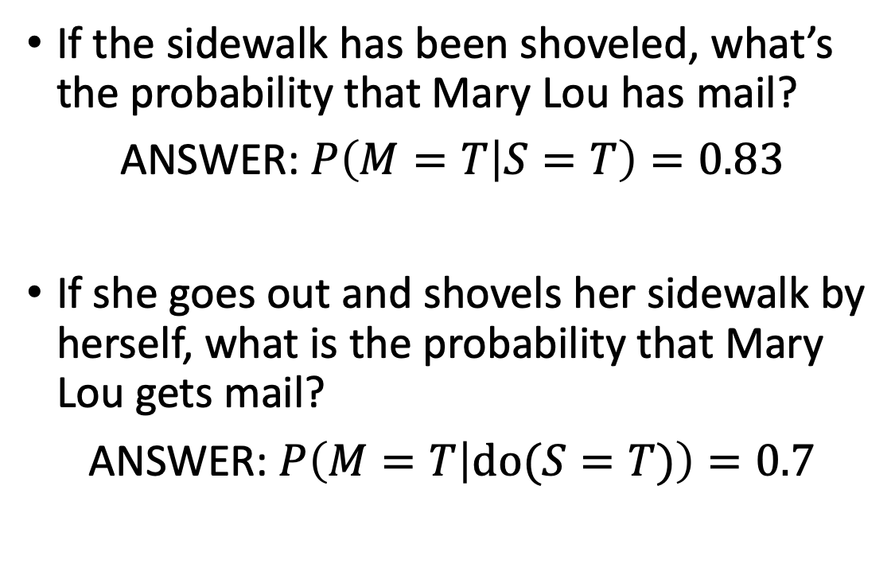
Mail delivery in Whoville
If the sidewalk has been shoveled, what’s the probability that Mary Lou has mail?
ANSWER: $P\left(M=T | S=T\right)=0.83$
If she goes out and shovels her sidewalk by herself, what is the probability that Mary Lou gets mail?
ANSWER: $P\left(M=T | do(S=T)\right)=0.7$
P
S
C
M
Rural_Free_Delivery_early_vehicle.JPG
P
S=T
C
M
Snow shovelling.jpg

Slide 19
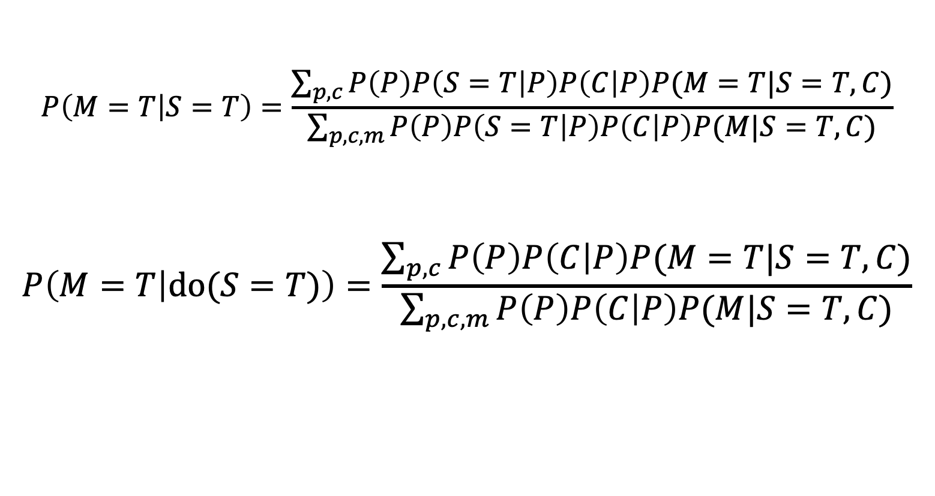
Why are they different?
$$P\left(M=T | S=T\right)=\frac{\sum_{p,c}{P\left(P\right)P\left(S=T | P\right)P\left(C | P\right)P(M=T|S=T,C)}}{\sum_{p,c,m}{P\left(P\right)P\left(S=T | P\right)P\left(C | P\right)P(M|S=T,C)}}$$
$$P\left(M=T | do(S=T)\right)=\frac{\sum_{p,c}{P\left(P\right)P\left(C | P\right)P(M=T|S=T,C)}}{\sum_{p,c,m}{P\left(P\right)P\left(C | P\right)P(M|S=T,C)}}$$
P
S
C
M
P
S=T
C
M

Slide 20
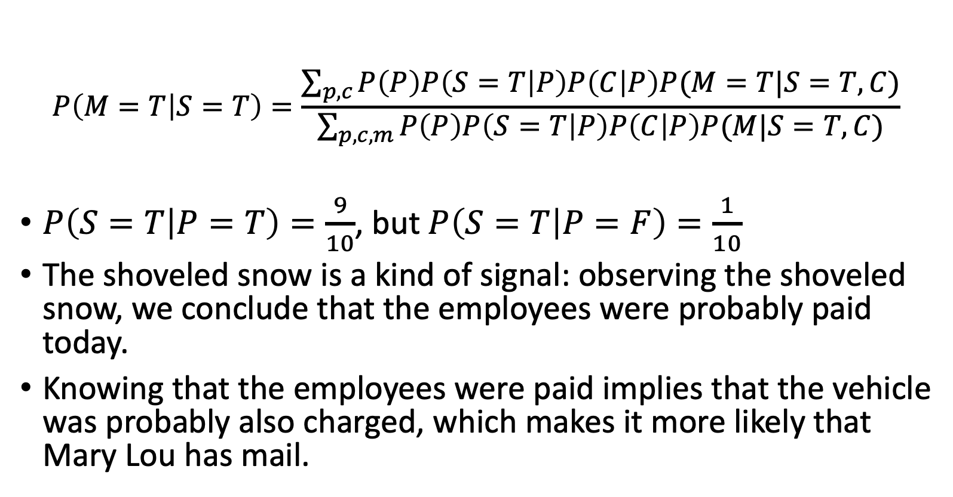
Why are they different?
$$P\left(M=T | S=T\right)=\frac{\sum_{p,c}{P\left(P\right)P\left(S=T | P\right)P\left(C | P\right)P(M=T|S=T,C)}}{\sum_{p,c,m}{P\left(P\right)P\left(S=T | P\right)P\left(C | P\right)P(M|S=T,C)}}$$
$P\left(S=T | P=T\right)=\frac{9}{10}$, but $P\left(S=T | P=F\right)=\frac{1}{10}$
The shoveled snow is a kind of signal: observing the shoveled snow, we conclude that the employees were probably paid today.
Knowing that the employees were paid implies that the vehicle was probably also charged, which makes it more likely that Mary Lou has mail.
P
S
C
M
P
S=T
C
M

Slide 21
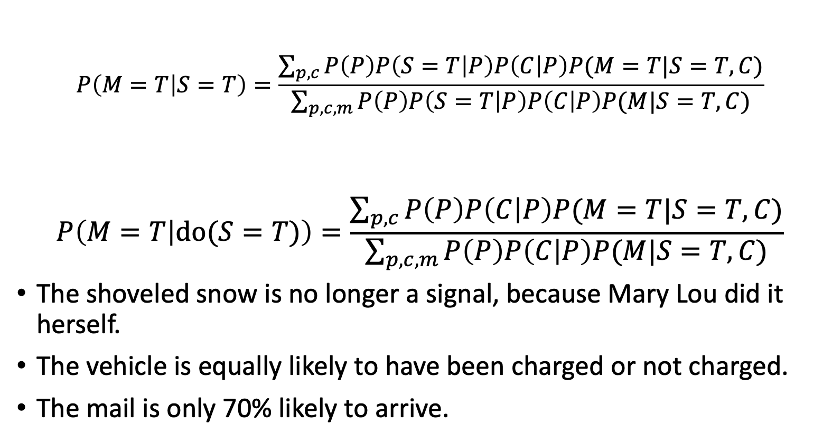
Why are they different?
$$P\left(M=T | S=T\right)=\frac{\sum_{p,c}{P\left(P\right)P\left(S=T | P\right)P\left(C | P\right)P(M=T|S=T,C)}}{\sum_{p,c,m}{P\left(P\right)P\left(S=T | P\right)P\left(C | P\right)P(M|S=T,C)}}$$
$$P\left(M=T | do(S=T)\right)=\frac{\sum_{p,c}{P\left(P\right)P\left(C | P\right)P(M=T|S=T,C)}}{\sum_{p,c,m}{P\left(P\right)P\left(C | P\right)P(M|S=T,C)}}$$
The shoveled snow is no longer a signal, because Mary Lou did it herself.
The vehicle is equally likely to have been charged or not charged.
The mail is only 70% likely to arrive.
P
S
C
M
P
S=T
C
M

Slide 22
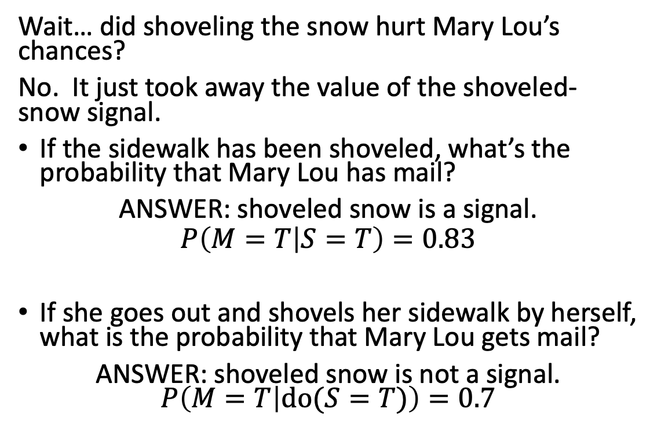
Mail delivery in Whoville
Wait… did shoveling the snow hurt Mary Lou’s chances?
No. It just took away the value of the shoveled-snow signal.
If the sidewalk has been shoveled, what’s the probability that Mary Lou has mail?
ANSWER: shoveled snow is a signal.
$$P\left(M=T | S=T\right)=0.83$$
If she goes out and shovels her sidewalk by herself, what is the probability that Mary Lou gets mail?
ANSWER: shoveled snow is not a signal. $P\left(M=T | do(S=T)\right)=0.7$
P
S
C
M
Rural_Free_Delivery_early_vehicle.JPG
P
S=T
C
M
Snow shovelling.jpg

Slide 23
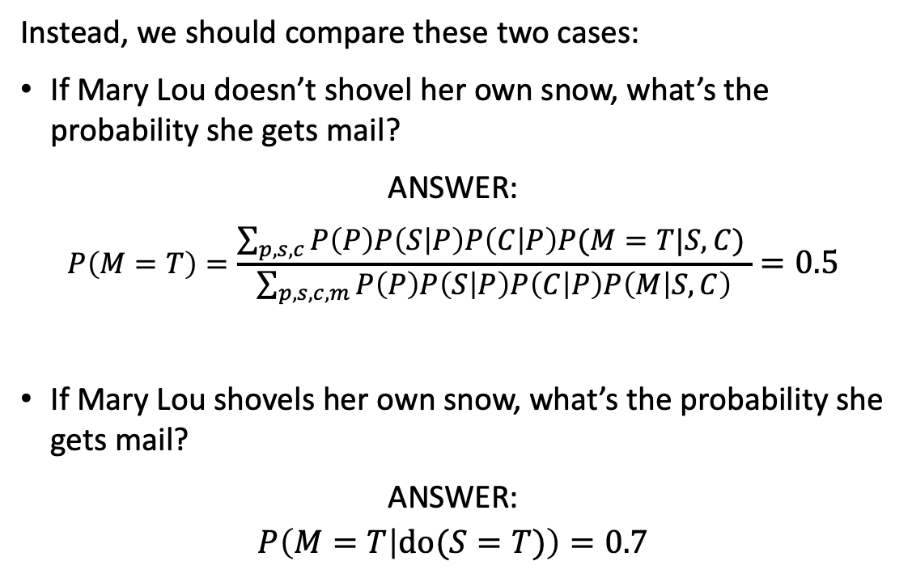
Mail delivery in Whoville
Instead, we should compare these two cases:
If Mary Lou doesn’t shovel her own snow, what’s the probability she gets mail?
ANSWER:
$$P\left(M=T\right)=\frac{\sum_{p,s,c}{P\left(P\right)P\left(S | P\right)P\left(C | P\right)P(M=T|S,C) }}{\sum_{p,s,c,m}{P\left(P\right)P\left(S | P\right)P\left(C | P\right)P\left(M | S,C\right)}}=0.5$$
If Mary Lou shovels her own snow, what’s the probability she gets mail?
ANSWER:
$$P\left(M=T | do(S=T)\right)=0.7$$
P
S
C
M
Rural_Free_Delivery_early_vehicle.JPG
P
S=T
C
M
Snow shovelling.jpg

Slide 24
Outline
Review: Inference in Bayesian networks
The do-calculus
Some applications

Slide 25
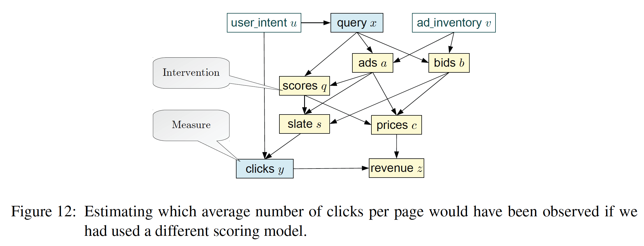
Choosing which ads to show to a user
(©Bottou et al., Counterfactual Reasoning and Learning Systems, ICML 2013)

Slide 26
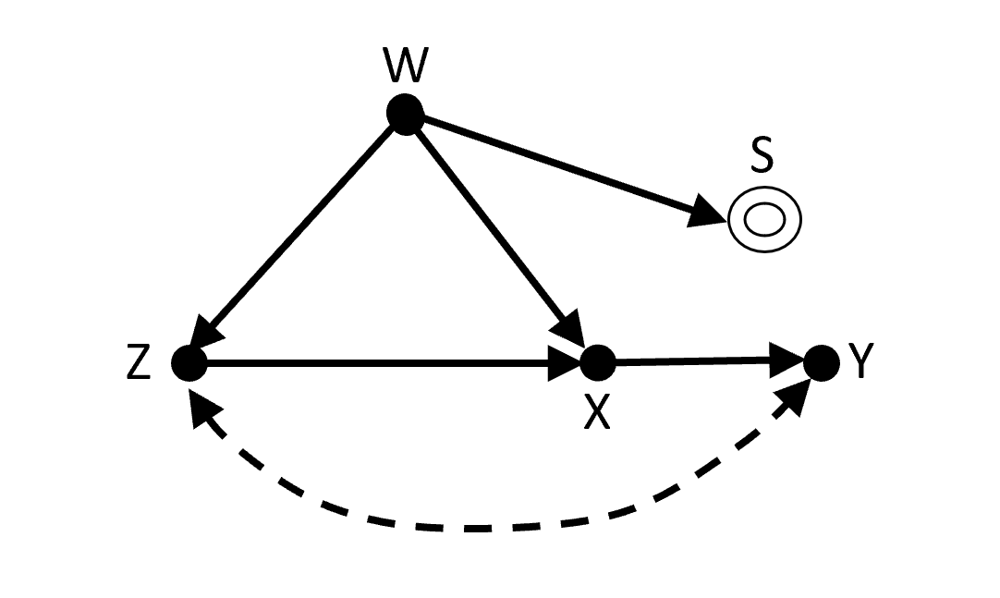
Figuring out whether students would score well if they all studied equally hard
(© Ben Ogorek, https://towardsdatascience.com/do-calculus-and-continuous-distributions-866fb6a963bc)
S = is student enrolled in the course?
W = # hours a student has available until the test
Z = how much student enjoys the material
X = # hours student spends studying for the test
Y = grade received

Slide 27
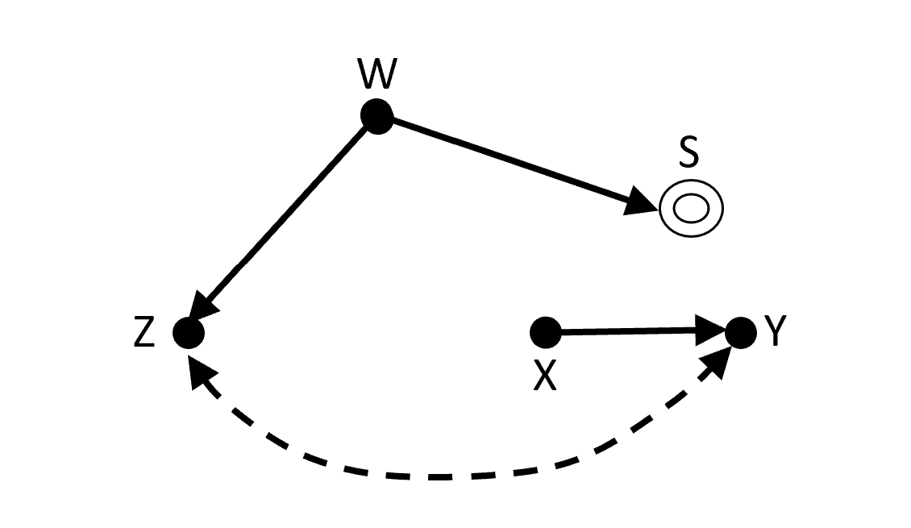
Figuring out whether students would score well if they all studied equally hard
(© Ben Ogorek, https://towardsdatascience.com/do-calculus-and-continuous-distributions-866fb6a963bc)
Factual graph: students who enjoy the class more tend to spend more time studying, hence get better grades.
Counterfactual graph: what if all students spent the same amount of time studying?

Slide 28
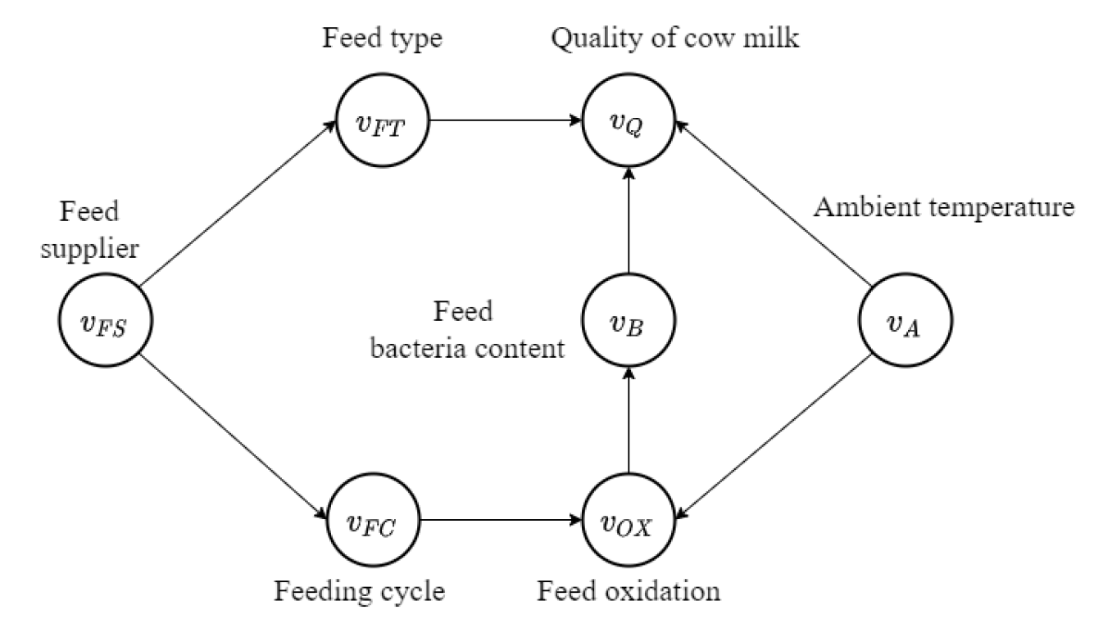
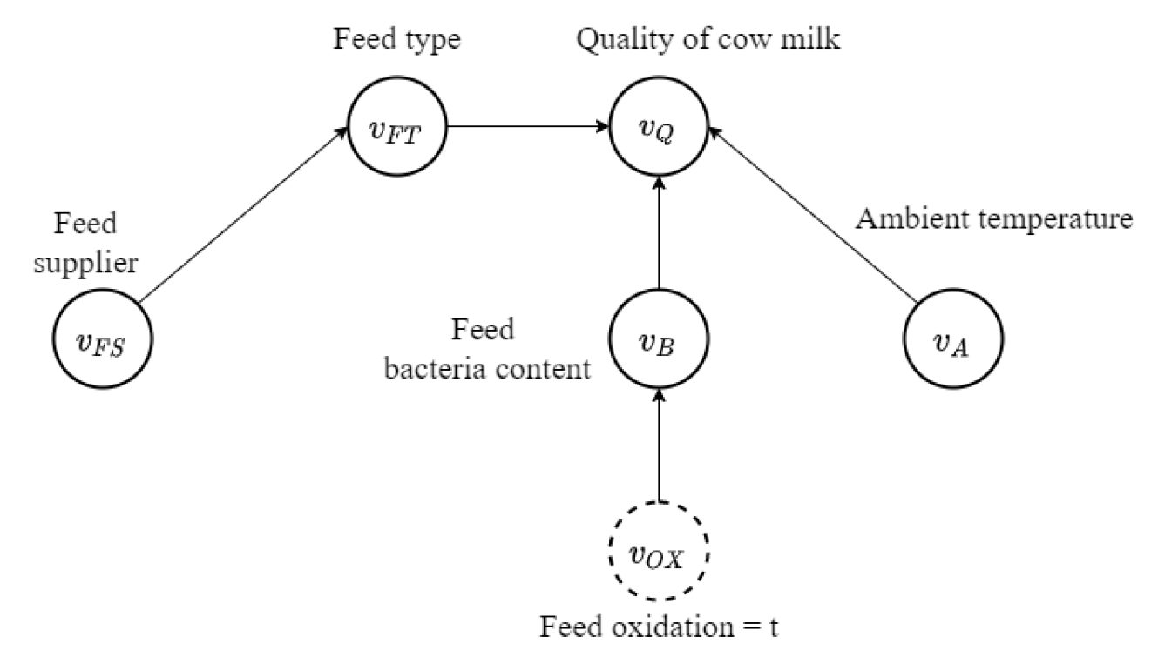
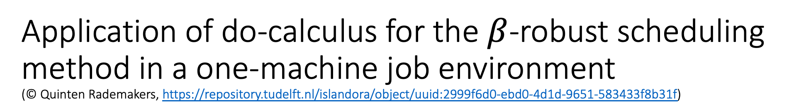
Application of do-calculus for the $β$-robust scheduling method in a one-machine job environment
(© Quinten Rademakers, https://repository.tudelft.nl/islandora/object/uuid:2999f6d0-ebd0-4d1d-9651-583433f8b31f)
Model of a dairy farm
What would happen if we left the air seal on the feed container open all the time?

Slide 29
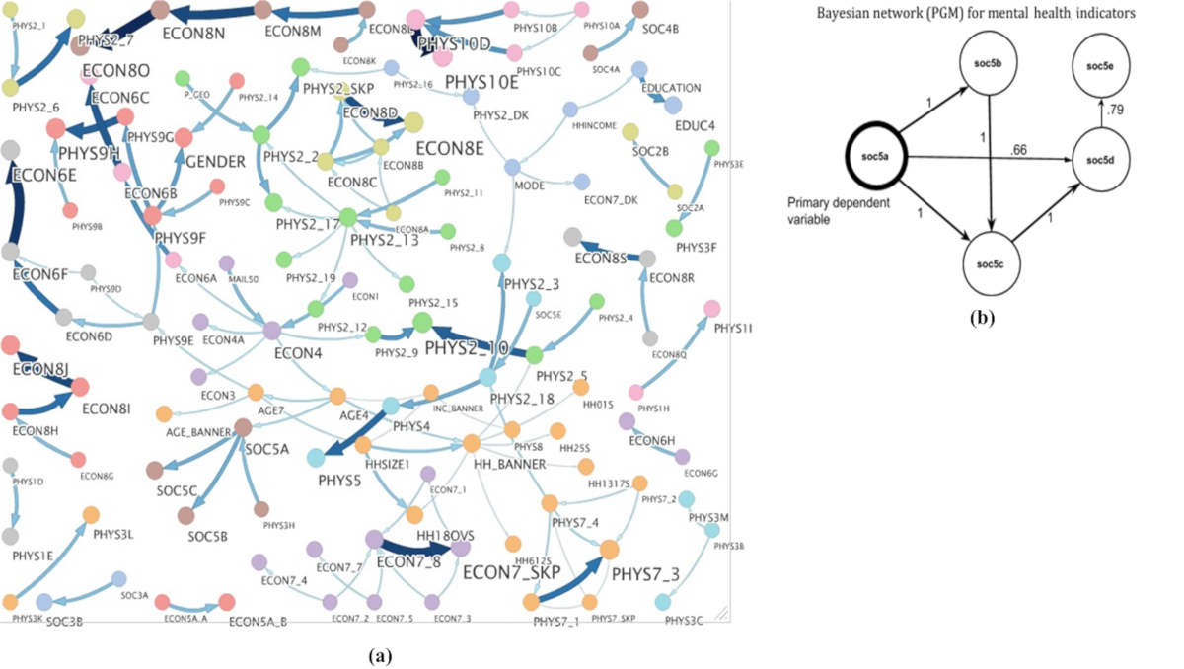
Learning the Mental Health Impact of COVID-19 in the United States With Explainable Artificial Intelligence: Observational Study
© JMIR, https://mental.jmir.org/2021/4/e25097
“The mental health consequences of the COVID-19 pandemic have been substantial… This study addresses this gap through the use of Bayesian networks (BNs), an explainable artificial intelligence approach that captures the joint multivariate distribution underlying large survey data”

Slide 30
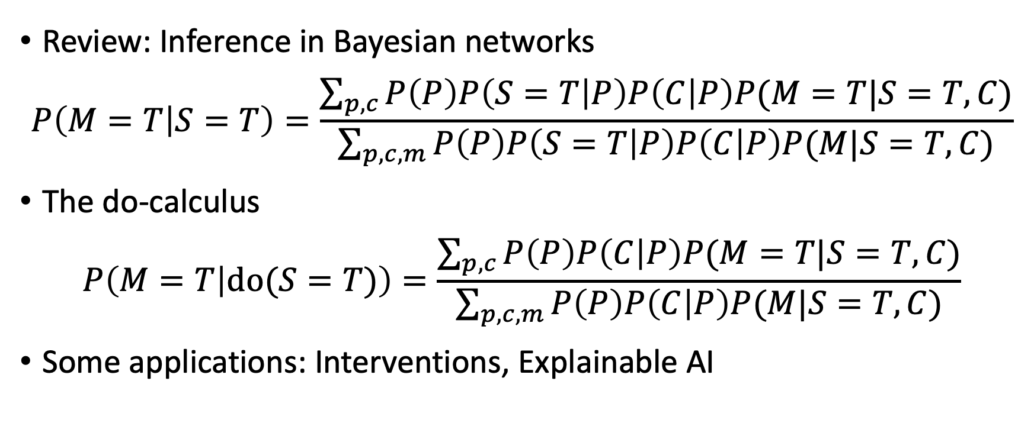
Outline
Review: Inference in Bayesian networks
$$P\left(M=T | S=T\right)=\frac{\sum_{p,c}{P\left(P\right)P\left(S=T | P\right)P\left(C | P\right)P(M=T|S=T,C)}}{\sum_{p,c,m}{P\left(P\right)P\left(S=T | P\right)P\left(C | P\right)P(M|S=T,C)}}$$
The do-calculus
$$P\left(M=T | do(S=T)\right)=\frac{\sum_{p,c}{P\left(P\right)P\left(C | P\right)P(M=T|S=T,C)}}{\sum_{p,c,m}{P\left(P\right)P\left(C | P\right)P(M|S=T,C)}}$$
Some applications: Interventions, Explainable AI

