Slide 1
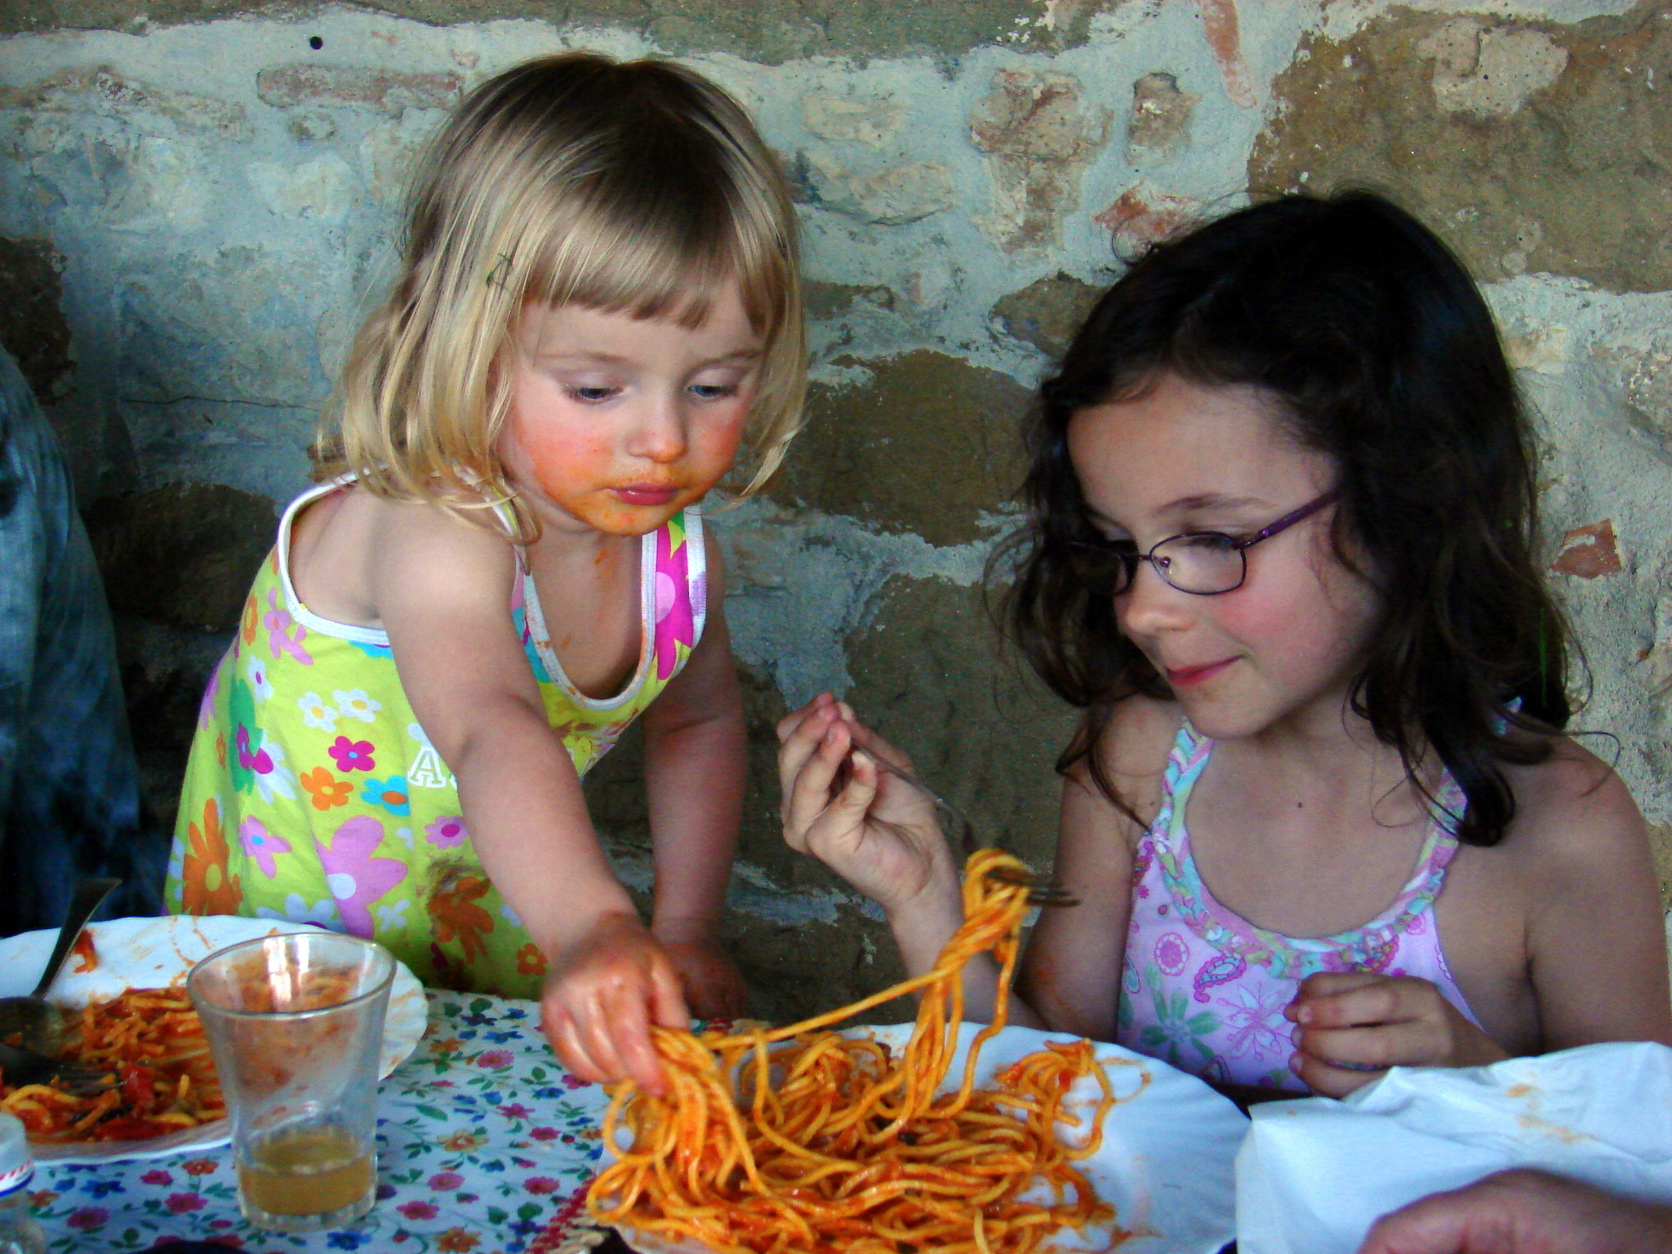
CS440/ECE448 Lecture 27: Fairness, Bias & Trust
Mark Hasegawa-Johnson, 2/2022
CC-BY-4.0: Copy at will, but cite the source
CC-SA 2.0, Kathy Simon, 2008
https://commons.wikimedia.org/wiki/File:Viola_and_Mina_share_food.jpg

Slide 2
Outline
What’s the problem?
Fairness
Representation
Proportion, Precision, Recall: Demographic Parity, Predictive Parity, Equalized Odds
Counterfactual Fairness
Trust
Physical safety
Data safety
Explainable AI

Slide 3
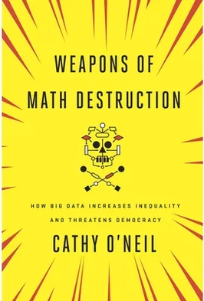

Slide 4
Examples of the problem
Opacity: The “Level of Service Inventory-Revised” (LSI-R) was used to decide who gets parole in at least two states, and many counties/precincts.
It did not ask about race.
It did ask “when was your first encounter with police” and other questions that are highly correlated with race.
Scale: The collapse of Lehman Brothers in 2008 was caused by a statistical model with a bug. Most large banks used the Gaussian copula model to decide who got home loans; it failed to correctly model the risk of multiple simultaneous defaults.
Damage: Companies can’t use medical tests to determine hiring, but they are allowed to use personality tests. In 2016, a lawsuit found that at least seven companies were using the same personality test, and therefore rejecting the same applicants, for the same frivolous reasons.

Slide 5
Weapons of Math Destruction
Opacity, Scale, and Damage: a WMD is a statistical model afflicted by two of these three.
Opacity: the relationship between inputs and outputs is hidden.
Scale: the model is used at a scale much larger than it was ever tested for.
Damage: negative decisions can damage people’s lives.

Slide 6
Developments since 2016: Scale
UCLA had 139,500 applicants in 2021 (CBS).
In one 24-hour period (September 16, 2020), 384,000 people applied for jobs at Amazon (Forbes).
NeurIPS had 9454 submitted papers in 2020. They don’t use AI to review the papers (yet?), but they use an automated paper-reviewer assignment system. The same system (Toronto Paper Matching System) is used by ICML, CVPR, ICCV, and ECCV.

Slide 7




Example: Automatic Speech Recognition
I need some information
I need some information
Let me help you.
Let me help you.
ASR is a useful productivity tool
If ASR works for you, it gives you a socioeconomic advantage, compared to somebody for whom ASR fails
The people for whom ASR fails are often those who are already socioeconomically disadvantaged
Success
Success
I don’t know what you are saying.
I need some information
Smaller Success

Slide 8
Why does ASR fail?
I need some information
I need some information
Let me help you.
Let me help you.
Reasons it may fail for a group:
Under-representation: The training corpus doesn’t have enough examples
Inter-group variance: The group speaks differently from other groups
Intra-group variance: Members of the group all speak differently from one another
Intra-individual variance: Members of the group speak less precisely
Success
Success
I don’t know what you are saying.
I need some information
Smaller Success

Slide 9
Automatic Speech Recognition Word Error Rates (WER)
Gender:
Women > Men (51% > 38%: Tatman, 2017, YouTube captioning)
Women > Men (61% > 47%: Garnerin et al., 2019, European broadcast news)
Black Men > Black Women (41% > 30%: Koenecke et al., 2020)
Dialect:
Scottish > American (53% > 42%: Tatman, 2017)
American Deep South > General American (Picone 1991)
Race:
Black > White (35% > 19%: Koenecke: avg of Amazon, Apple, Google, IBM, Microsoft)
Disability:
People w/Cerebral Palsy > People w/o (41% > 33%: Issa et al., in review)
Age:
Teenage (<20)) > Old (>70) > Young adult (20-30) > Old adult (50-70) (Feng & Scharenborg, 2020, Sarı et al., 2021)

Slide 10
Outline
What’s the problem?
Fairness
Representation
Proportion, Precision, Recall: Demographic Parity, Predictive Parity, Equalized Odds
Counterfactual Fairness
Trust
Physical safety
Data safety
Explainable AI

Slide 11
Bias caused by Data Sparsity
Data contain more examples of one type than others, e.g., more Caucasians than African Americans
Accuracy may be higher for the type that is better represented in the training data (minimize error by minimizing error for the majority case)
Example: blacks more likely to be refused parole even if their prison records are the same (https://www.nytimes.com/2016/12/04/nyregion/new-york-prisons-inmates-parole-race.html)
Example: tweets containing African American vernacular classified as “Danish,” and therefore excluded from automatic sentiment analysis (https://www.technologyreview.com/s/608619/ai-programs-are-learning-to-exclude-some-african-american-voices/)

Slide 12
Some possible answers
Governments and private organizations now have funded efforts to acquire more data from under-represented groups.
Corpus of Regional African-American Language
Bureau of Justice Statistics
NIH Inclusion Policies for Research Involving Human Subjects
Academia and industry seek to increase representation in AI data by increasing diversity among AI experts
AI4ALL

Slide 13
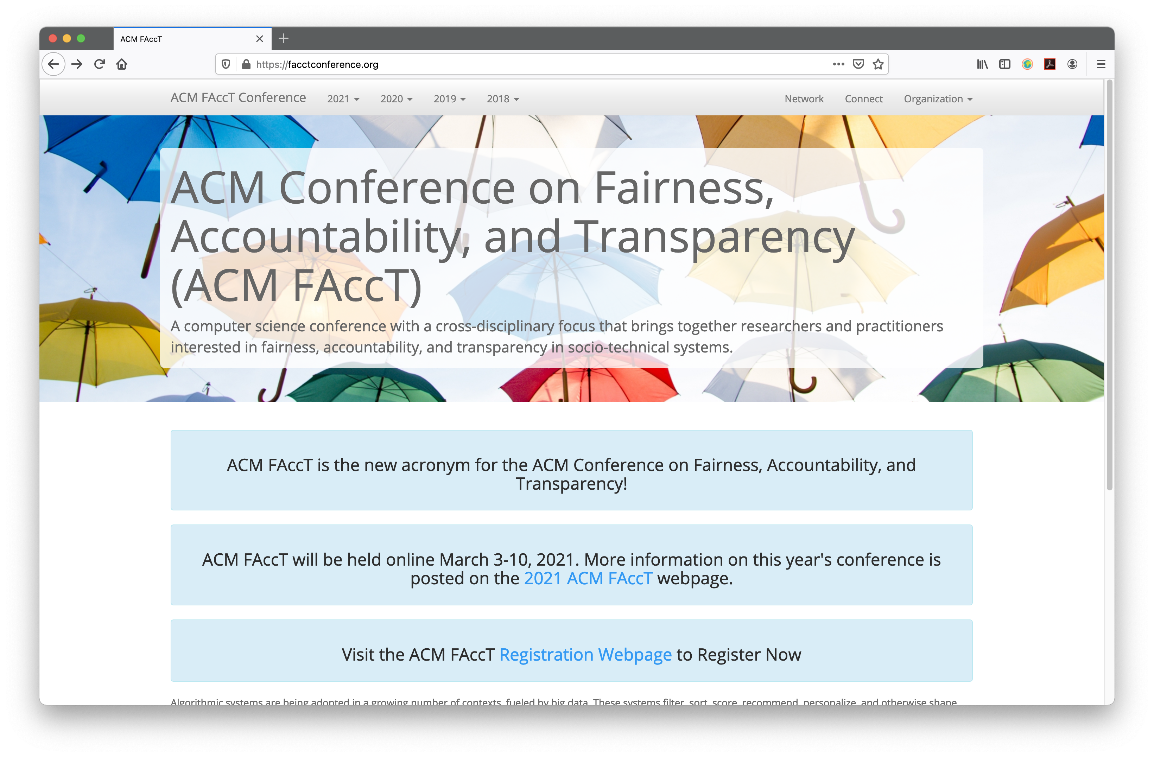

Slide 14
Automatic Speech Recognition: Database Collection Efforts
Targeted to particular user groups:
UASpeech: dysarthria as a symptom of Cerebral Palsy
3.2 hours
CORAAL (Corpus of Regional African American Languages)
200 hours
Recent efforts with lots of speech from lots of people; we currently have no idea what is the distribution across race, ethnicity, gender, orientation, native language, etc., but we’re working on it:
100,000 Podcasts Corpus
40,000 hours
The People’s Speech (recordings of town hall meetings, etc)
30,000 hours

Slide 15
Outline
What’s the problem?
Fairness
Representation
Proportion, Precision, Recall: Demographic Parity, Predictive Parity, Equalized Odds
Counterfactual Fairness
Trust
Physical safety
Data safety
Explainable AI

Slide 16
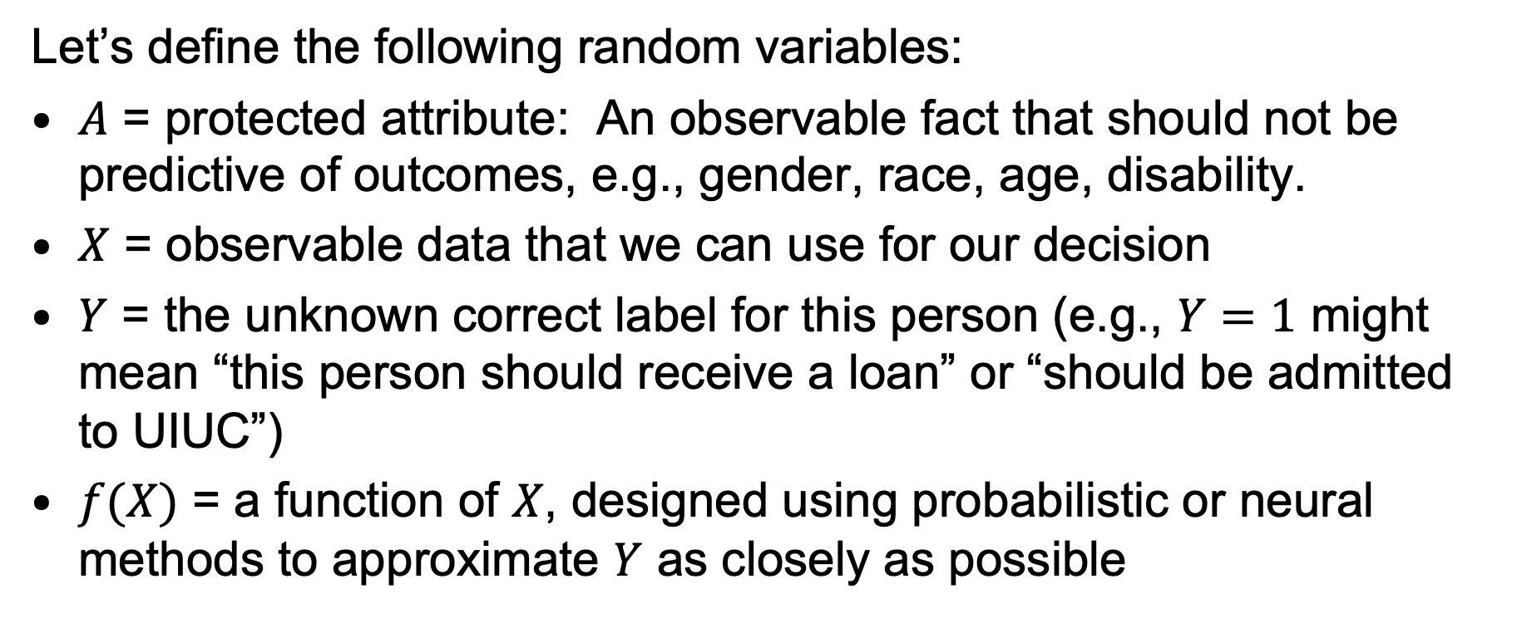
Standard Definitions of Fairness in AI
Let’s define the following random variables:
$A$ = protected attribute: An observable fact that should not be predictive of outcomes, e.g., gender, race, age, disability.
$X$ = observable data that we can use for our decision
$Y$ = the unknown correct label for this person (e.g., $Y=1$ might mean “this person should receive a loan” or “should be admitted to UIUC”)
$f(X)$ = a function of $X$, designed using probabilistic or neural methods to approximate $Y$ as closely as possible

Slide 17
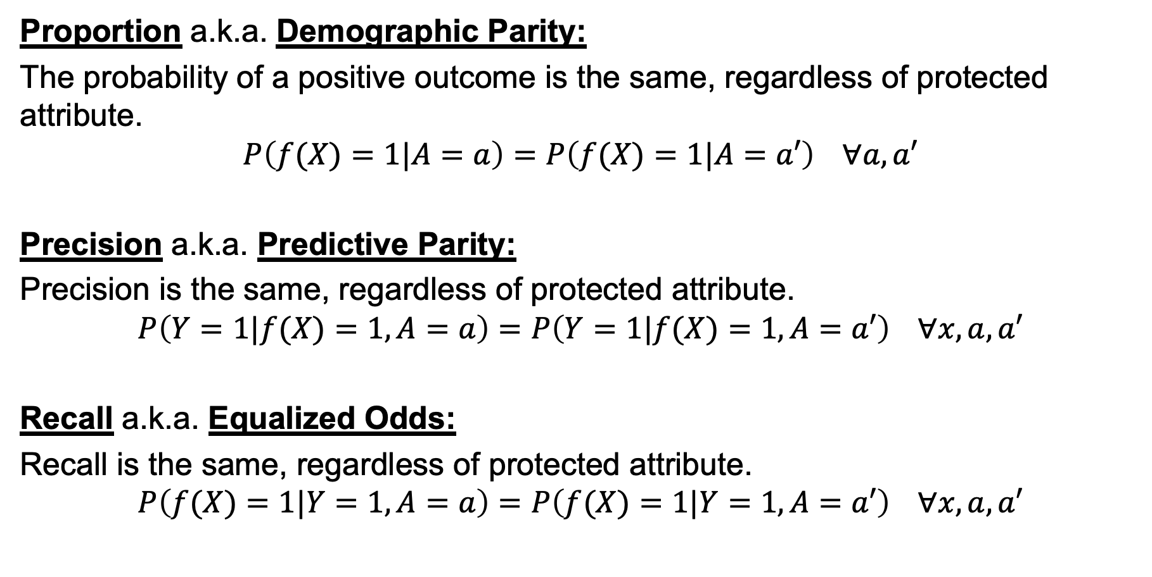
Standard Definitions of Fairness in AI
Proportion a.k.a. Demographic Parity:
The probability of a positive outcome is the same, regardless of protected attribute.
$$P\left(f(X)=1|A=a\right)=P\left(f(X)=1|A=a′\right) ∀a,a′$$
Precision a.k.a. Predictive Parity:
Precision is the same, regardless of protected attribute.
$$P\left(Y=1|f(X)=1,A=a\right)=P\left(Y=1|f(X)=1,A=a′\right) ∀x,a,a′$$
Recall a.k.a. Equalized Odds:
Recall is the same, regardless of protected attribute.
$$P\left(f(X)=1|Y=1,A=a\right)=P\left(f(X)=1|Y=1,A=a′\right) ∀x,a,a′$$

Slide 18
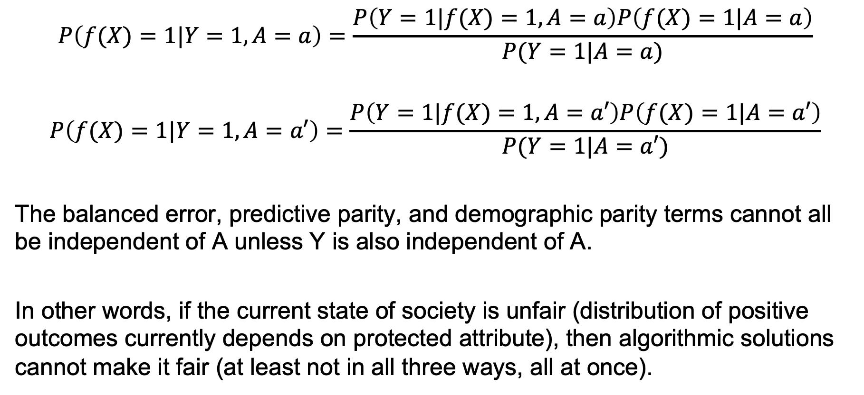
You can’t have all three
$$P\left(f(X)=1|Y=1,A=a\right)=\frac{P\left(Y=1|f(X)=1,A=a\right)P\left(f(X)=1|A=a\right)}{P(Y=1|A=a)}$$
$$P\left(f(X)=1|Y=1,A=a′\right)=\frac{P\left(Y=1|f(X)=1,A=a′\right)P\left(f(X)=1|A=a′\right)}{P(Y=1|A=a′)}$$
The balanced error, predictive parity, and demographic parity terms cannot all be independent of A unless Y is also independent of A.
In other words, if the current state of society is unfair (distribution of positive outcomes currently depends on protected attribute), then algorithmic solutions cannot make it fair (at least not in all three ways, all at once).

Slide 19
Other problems with algorithmic solutions
Dwork (2012) points out that demographic parity can lead to socially undesirable outcomes, e.g., people gaming the system.
… but …
Srivastava, Heidari and Krause (2019) found that users of an AI judge its fairness based on demographic parity. They ignore predictive parity and balanced error, even when these concepts are explained to them.

Slide 20
Other Useful Definitions of Fairness in AI
Individual Fairness:
The dissimilarity between two outcomes should be less than the dissimilarity between the people.
Counterfactual Fairness:
If a person’s protected attribute were changed (and all their other attributes were possibly changed, according to their dependence on the protected attribute), then the outcome should not change.

Slide 21
Outline
What’s the problem?
Fairness
Representation
Proportion, Precision, Recall: Demographic Parity, Predictive Parity, Equalized Odds
Counterfactual Fairness
Trust
Physical safety
Data safety
Explainable AI

Slide 22
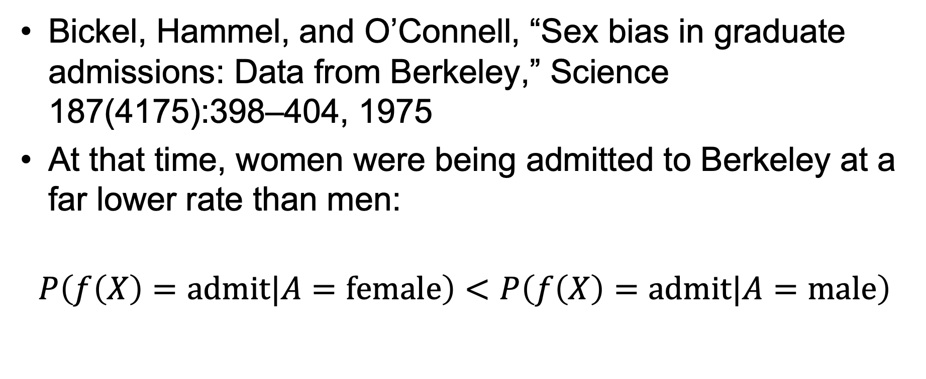
Are College Admissions Fair?
Bickel, Hammel, and O’Connell, “Sex bias in graduate admissions: Data from Berkeley,” Science 187(4175):398–404, 1975
At that time, women were being admitted to Berkeley at a far lower rate than men:
$$P\left(f\left(X\right)=admit|A=female\right)<P\left(f\left(X\right)=admit|A=male\right)$$

Slide 23
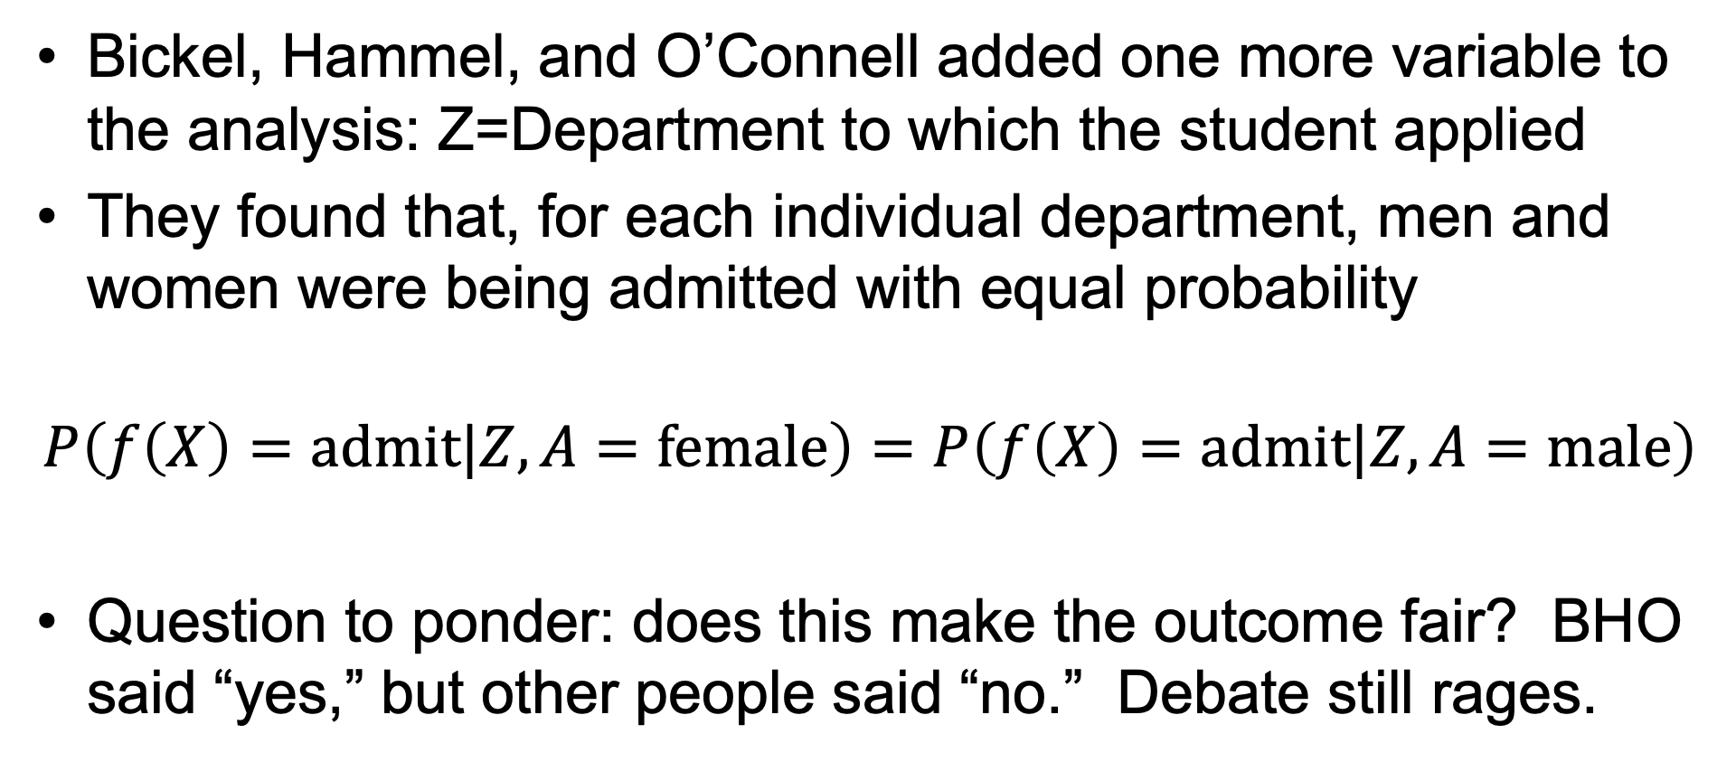
Are College Admissions Fair?
Bickel, Hammel, and O’Connell added one more variable to the analysis: Z=Department to which the student applied
They found that, for each individual department, men and women were being admitted with equal probability
$$P\left(f\left(X\right)=admit|Z,A=female\right)=P\left(f\left(X\right)=admit|Z,A=male\right)$$
Question to ponder: does this make the outcome fair? BHO said “yes,” but other people said “no.” Debate still rages.

Slide 24
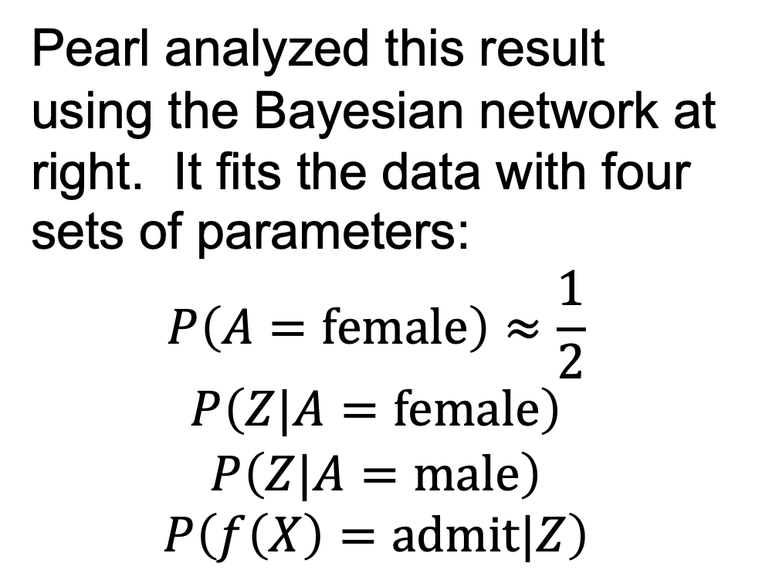
Analyzing Fairness Using Bayesian Networks
Pearl analyzed this result using the Bayesian network at right. It fits the data with four sets of parameters:
$$P\left(A=female\right)≈\frac{1}{2}$$
$$P\left(Z|A=female\right)$$
$$P\left(Z|A=male\right)$$
$$P\left(f\left(X\right)=admit|Z\right)$$
A
Z
f

Slide 25



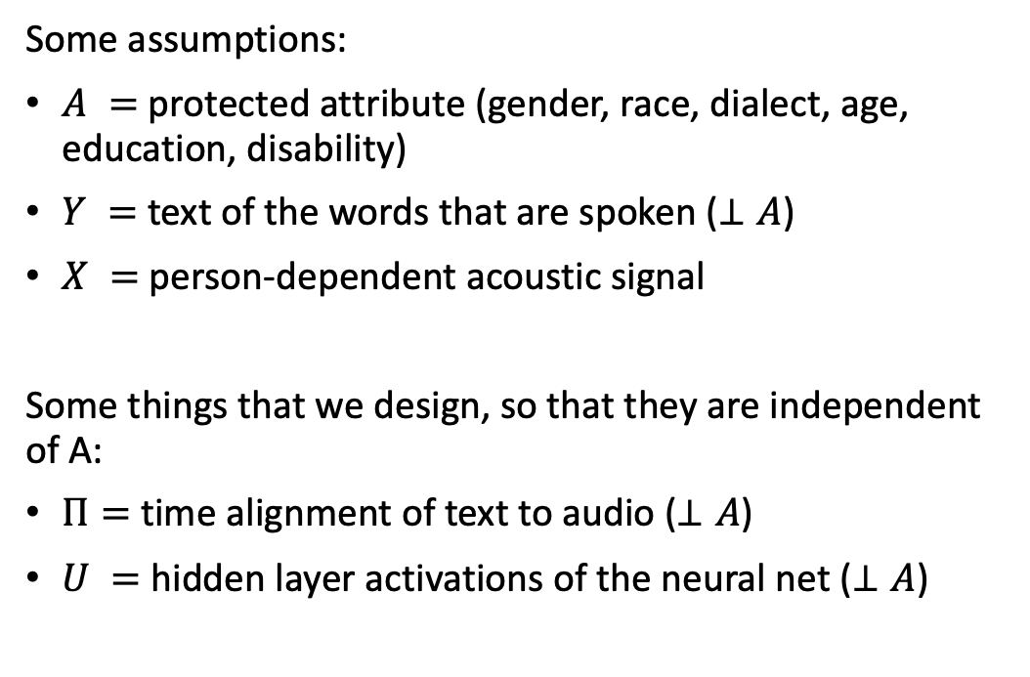


Counterfactually Fair Automatic Speech Recognition Sarı, Hasegawa-Johnson & Yoo, 2021
Some assumptions:
$A =$ protected attribute (gender, race, dialect, age, education, disability)
$Y =$ text of the words that are spoken ($⊥A$)
$X =$ person-dependent acoustic signal
Some things that we design, so that they are independent of A:
$Π=$ time alignment of text to audio ($⊥A$)
$U =$ hidden layer activations of the neural net ($⊥A$)
$$A$$
$$X$$
$$Y$$
$$Π$$
$$U$$
Open circles denote unobserved variables
Filled circles denote variables that are observed during training

Slide 26


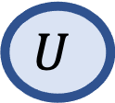
Counterfactually Fair Automatic Speech Recognition Sarı, Hasegawa-Johnson & Yoo, in review
Abduction:
Infer $U$and $Π$ from $X$, $Y$ and $A$
$$A$$
$$X$$
$$Y$$
$$Π$$
$$U$$
Lightly-shaded circles denote variables whose values are inferred based on models of joint probability distribution

Slide 27



Counterfactually Fair Automatic Speech Recognition Sarı, Hasegawa-Johnson & Yoo, in review
Action:
Change $A$ (e.g., male$→$female, old $→$young, etc.).
Change $X$, using the new value of $A$, and the previously inferred value of $U$.
$$A$$
$$X$$
$$Y$$
$$Π$$
$$U$$
Change in color denotes counterfactual action upon a variable

Slide 28



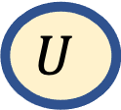
Counterfactually Fair Automatic Speech Recognition Sarı, Hasegawa-Johnson & Yoo, in review
Prediction:
Re-compute the values of $U, Π$, and $Y$ from the modified versions of $X$ and $A$
$$A$$
$$X$$
$$Y$$
$$Π$$
$$U$$

Slide 29




Counterfactually Fair Automatic Speech Recognition Sarı, Hasegawa-Johnson & Yoo, in review
Regularization:
Train the neural net so that, no matter what the value of A is, $U,Π$ are unchanged
$$A$$
$$X$$
$$Y$$
$$Π$$
$$U$$

Slide 30
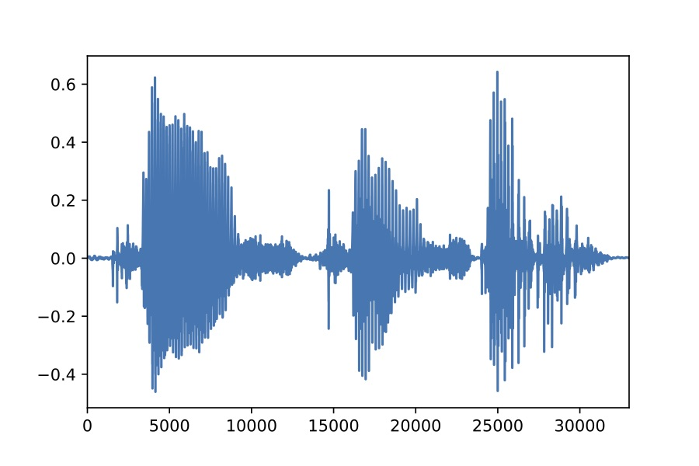
















Action: change male->female, old-> young … How? By using a voice conversion neural net.
AutoVC: Zero-shot voice style transfer with only autoencoder loss (Qian et al., 2019)
Spectrogram Inverter
Content Encoder
Decoder
$$X_{1}$$
(a)
512 32$×$2 320 512 1024 80 512 80
$${\hat{X}}_{1→2}$$
(d)
Down1
$$C_{1→}$$
Up1
BLSTM $×2$
WaveNet
5$×$1 ConvNorm $×3$
1$×$1 Conv
Deconv $×4$
5$×$1 ConvNorm $×4$
LSTM $×3$
5$×$1 ConvNorm
5$×$1 ConvNorm $×3$
+
$$E_{s}\left(⋅\right)$$
Down2
$$C_{1←}$$
Up2
$$X_{2}$$
Concatenate
LSTM $×$2
Full Connect
Copy
Down1
Up1
Down2
Up2
Last Output
$$S_{2}$$
(b)
(c)
(e)
(f)
768 256 80
Speaker Encoder

Slide 31

AutoVC: Zero-shot voice style transfer with only autoencoder loss Qian, Zhang, Chang, Yang, and Hasegawa-Johnson, 2019
To hear is to believe
Here are the reference speakers, in their own voices:
Adversarial game: Utterance will be “Please call Stella.” All three (T1, T2, and T3) are resynthesized from the content code of one (T1, T2, or T3). Which one?
Who is Sa? T1, T2 or T3?
Who is Sb? T1, T2 or T3?
 | T1 | T2 | T3
Sa
Sb

Slide 32
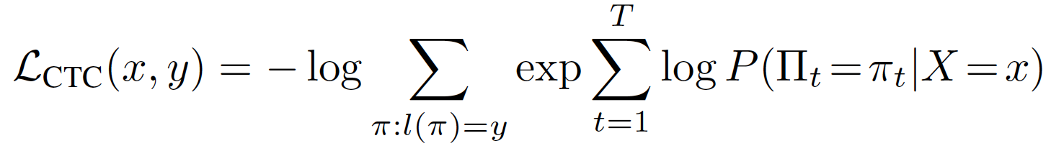

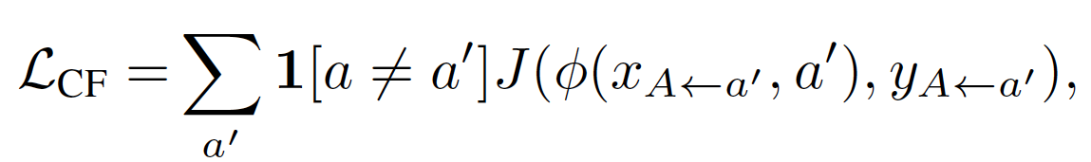
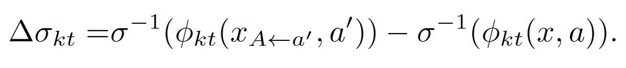
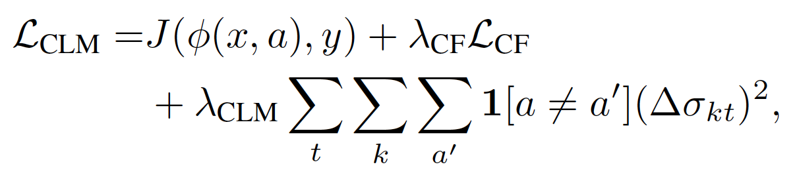

Counterfactually Fair Automatic Speech Recognition
Counterfactual Speech Recognizer Training: Train the neural net so that the values of $U, Π$, and $Y$ do not change when you change the values of $X$ and $A$.
CTC loss estimates character error rate on real speech:
CF loss estimates error rate on counterfactual speech:
Counterfactual logit matching: how different are the system’s responses to factual vs. counterfactual speech?
$$A$$
$$X$$
$$Y$$
$$Π$$
$$U$$

Slide 33
Average error rate, averaged across all speakers, as a function of regularization weight
Train the neural net using regularized training so that…
CTC = P(sentence|audio)…
Post = P(character|spectrum) …
LogProb = log P(character|spectrum)…
... is independent of factual vs. counterfactual group identity
CER (character error rate) = a measure of average performance across all groups

Slide 34
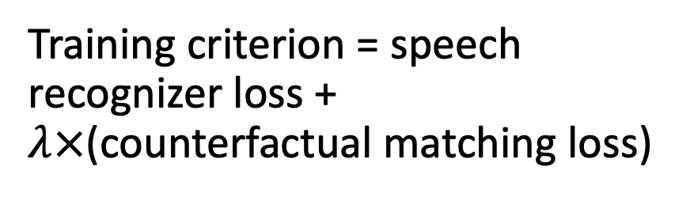
Standard deviation of error rate across speakers, as a function of regularization weight
Training criterion = speech recognizer loss + $λ×$(counterfactual matching loss)
Stdev (of error rate, across speakers) = a measure of unfairness of the ASR

Slide 35
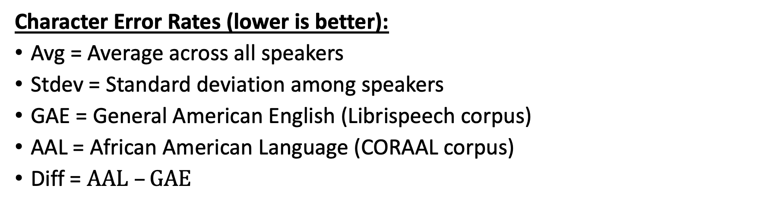
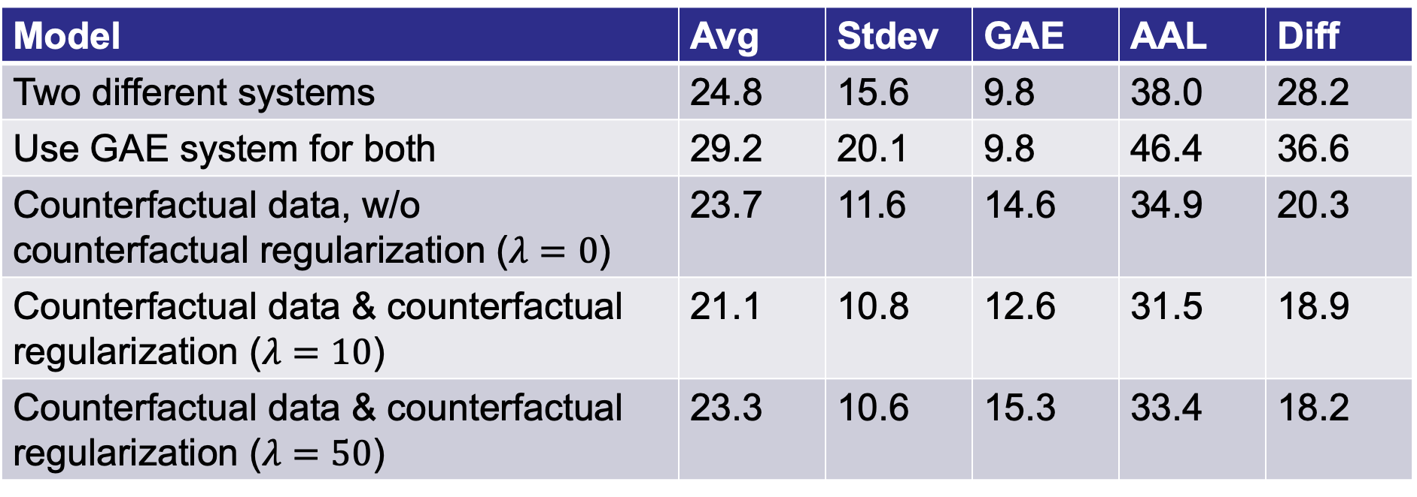
Model | Avg | Stdev | GAE | AAL | Diff
Two different systems | 24.8 | 15.6 | 9.8 | 38.0 | 28.2
Use GAE system for both | 29.2 | 20.1 | 9.8 | 46.4 | 36.6
Counterfactual data, w/o counterfactual regularization ($λ=0$) | 23.7 | 11.6 | 14.6 | 34.9 | 20.3
Counterfactual data & counterfactual regularization ($λ=10$) | 21.1 | 10.8 | 12.6 | 31.5 | 18.9
Counterfactual data & counterfactual regularization ($λ=50$) | 23.3 | 10.6 | 15.3 | 33.4 | 18.2
Character Error Rates (lower is better):
Avg = Average across all speakers
Stdev = Standard deviation among speakers
GAE = General American English (Librispeech corpus)
AAL = African American Language (CORAAL corpus)
Diff = $AAL –GAE$

Slide 36
Model | Avg | Stdev | GAE | AAL | Diff
Two different systems | 24.8 | 15.6 | 9.8 | 38.0 | 28.2
Use GAE system for both | 29.2 | 20.1 | 9.8 | 46.4 | 36.6
Counterfactual data, w/o counterfactual regularization ($λ=0$) | 23.7 | 11.6 | 14.6 | 34.9 | 20.3
Counterfactual data & counterfactual regularization ($λ=10$) | 21.1 | 10.8 | 12.6 | 31.5 | 18.9
Counterfactual data & counterfactual regularization ($λ=50$) | 23.3 | 10.6 | 15.3 | 33.4 | 18.2
Observations:
You can’t just use the GAE system to transcribe AAL (46.4% error)

Slide 37
Model | Avg | Stdev | GAE | AAL | Diff
Two different systems | 24.8 | 15.6 | 9.8 | 38.0 | 28.2
Use GAE system for both | 29.2 | 20.1 | 9.8 | 46.4 | 36.6
Counterfactual data, w/o counterfactual regularization ($λ=0$) | 23.7 | 11.6 | 14.6 | 34.9 | 20.3
Counterfactual data & counterfactual regularization ($λ=10$) | 21.1 | 10.8 | 12.6 | 31.5 | 18.9
Counterfactual data & counterfactual regularization ($λ=50$) | 23.3 | 10.6 | 15.3 | 33.4 | 18.2
Observations:
You can’t just use the GAE system to transcribe AAL (46.4% error)
Generating synthetic training data helps AAL, but harms GAE

Slide 38
Model | Avg | Stdev | GAE | AAL | Diff
Two different systems | 24.8 | 15.6 | 9.8 | 38.0 | 28.2
Use GAE system for both | 29.2 | 20.1 | 9.8 | 46.4 | 36.6
Counterfactual data, w/o counterfactual regularization ($λ=0$) | 23.7 | 11.6 | 14.6 | 34.9 | 20.3
Counterfactual data & counterfactual regularization ($λ=10$) | 21.1 | 10.8 | 12.6 | 31.5 | 18.9
Counterfactual data & counterfactual regularization ($λ=50$) | 23.3 | 10.6 | 15.3 | 33.4 | 18.2
Observations:
You can’t just use the GAE system to transcribe AAL (46.4% error)
Generating synthetic training data helps AAL, but harms GAE
Counterfactual regularization helps (less harm to GAE, more benefit to AAL).

Slide 39
Notes
What we have done:
Used GAE data to lower AAL error rates
… at the expense of higher GAE error rates.
Is that desirable? It depends on your customers:
Minimin use case: Minimize error for the low-error users. Sell your product to only the people for whom it works.
Minimax use case: Minimize error for the high-error users. Sell your product to everybody.

Slide 40
Outline
What’s the problem?
Fairness
Representation
Proportion, Precision, Recall: Demographic Parity, Predictive Parity, Equalized Odds
Counterfactual Fairness
Trust
Physical safety
Data safety
Explainable AI

Slide 41
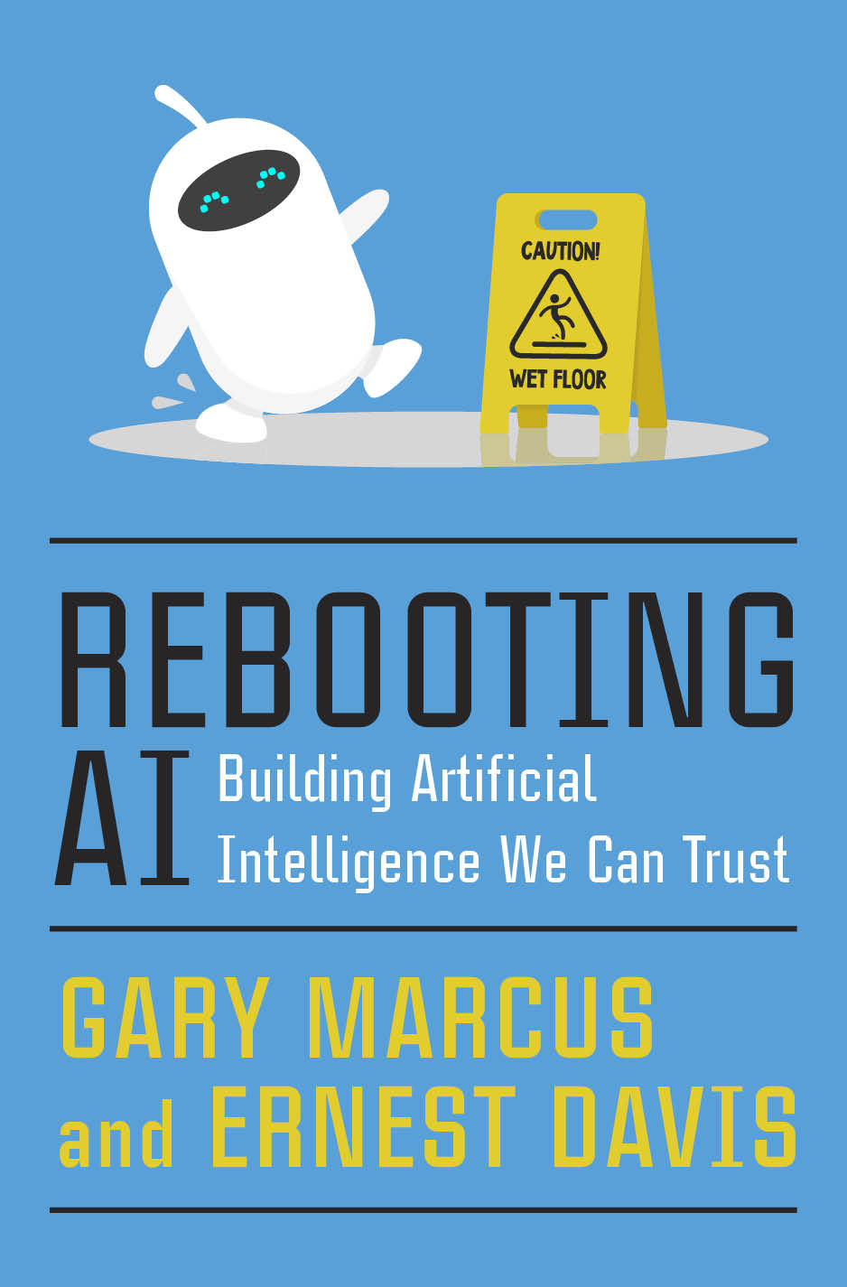

Slide 42
Trust Issues
Physical Safety
April 18, 2021: 2 Killed in Driverless Tesla Car Crash
Data Safety
March 2020: CAM4 data breach exposed 10 billion records

Slide 43
Physical Safety
Robustness to changes in data distribution
Avoiding catastrophic “edge cases”
Robustness to adversarial examples or attacks
Avoiding negative side effects in reward function
Avoiding “reward hacking”
Reading: Concrete AI safety problems

Slide 44
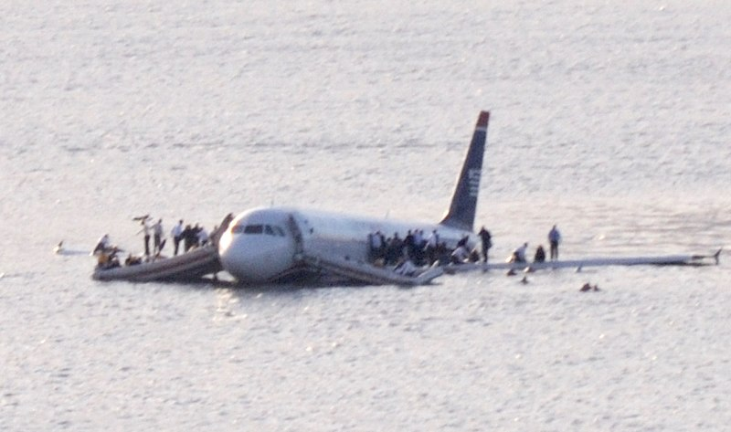
The Virtual Sully Research Project
At 3:27 on 1/15/2009, US Airways 1549 lost power in both engines.
Capt. “Sully” Sullenberger tried to turn back to LaGuardia, then tried to turn toward Teterboro, then realized there was no time.
At 3:31 he landed the plane in the Hudson river.
All passengers were saved.
Creative commons 2.0, multichill, 2009

Slide 45
The Virtual Sully Research Project
Virtual Sully research project seeks to give AI
the ability to plan a course of action with backup plans available in case of unexpected disaster,
the ability to quickly discard low-priority goals in favor of threatened high-priority goals in case of the unexpected inability to achieve both.
Creative commons 2.0, multichill, 2009

Slide 46
Outline
What’s the problem?
Fairness
Representation
Proportion, Precision, Recall: Demographic Parity, Predictive Parity, Equalized Odds
Counterfactual Fairness
Trust
Physical safety
Data safety
Explainable AI

Slide 47
Data Safety
“Passports, however, use a different technology known as RFID (or Radio Frequency Identification), the same type used to tag clothing, pets, even artificial replacements for hips and knees. When embedded in a U.S. passport, the chip can be scanned only by someone at close range with an RFID reader, usually within a couple feet…
“Yes, someone nearby could read what’s in your wallet. That’s why I keep my passport in an RFID-shielded wallet,” said G. Mark Hardy, president of National Security Corp., based in Rosedale, Md., which provides cybersecurity expertise to government and corporate clients.
But, he said, “it’s less likely to happen, at this point in time, because it’s so much easier to do fraud some other way.””
Read more here: http://www.sacbee.com/news/business/personal-finance/claudia-buck/article2599038.html#storylink=cpy

Slide 48
Example of a Technical Solution: Homomorphic Encryption
Encrypt the data on your cell phone
Send the encrypted data to a server
The server sends it through a neural net in its encrypted form, without ever decrypting it
They send you the result, and you decrypt it using the same key

Slide 49
Outline
What’s the problem?
Fairness
Representation
Proportion, Precision, Recall: Demographic Parity, Predictive Parity, Equalized Odds
Counterfactual Fairness
Trust
Physical safety
Data safety
Explainable AI

Slide 50
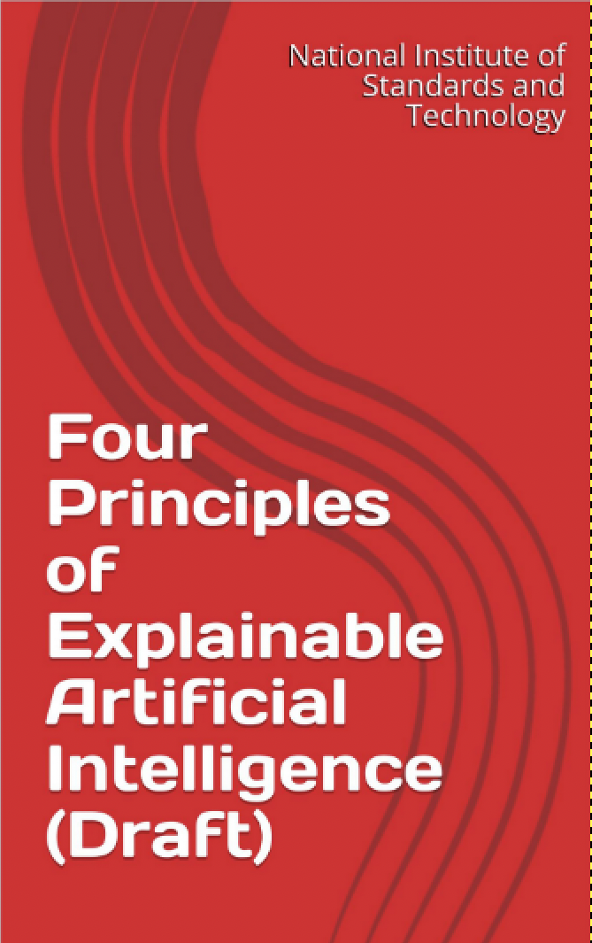

Slide 51
Four Principles of Explainable AI
Explanation: The system can explain its reasons for any decision
Meaningful: The explanation can be understood by the user
Explanation Accuracy: The explanation correctly describes how the system made its decision
Knowledge Limits: The system is only used under circumstances for which it was designed.

Slide 52
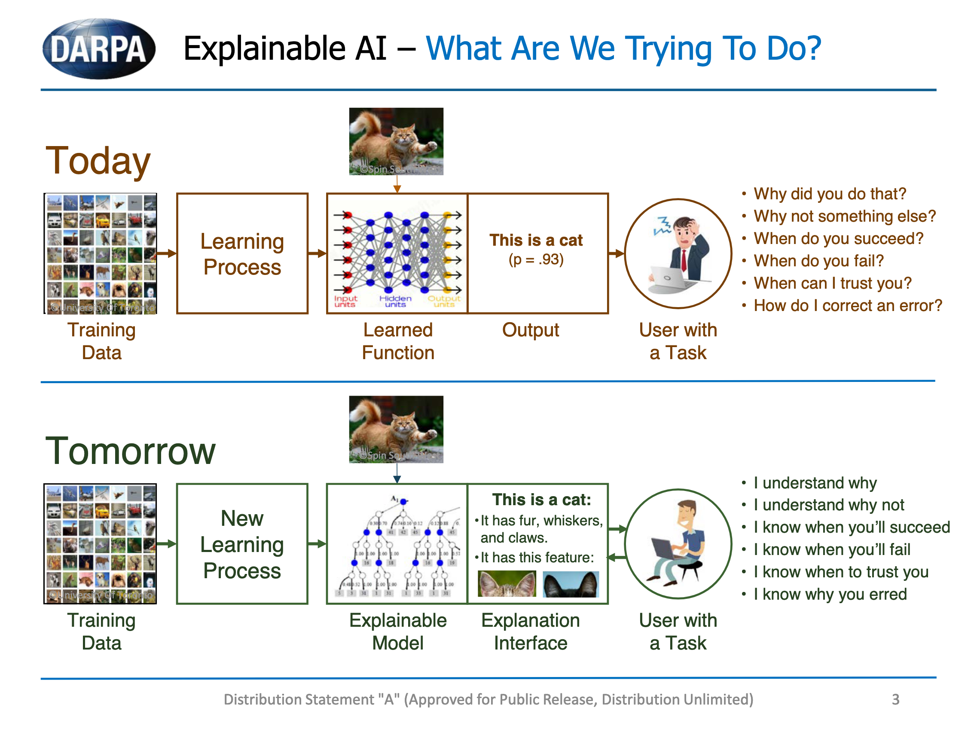
David Gunning, “Explainable Artifcial Intelliigence (XAI),” 2017

Slide 53
Methods
Visualization
Pro: provides intuitively useful descriptions of typical behavior
Con: post-hoc explanation of the typical behavior; may not tell you much about worst-case behavior
Causal Graphs/Bayesian Networks
Pro: describes reasoning process of the AI exactly
Con: constraining AI reasoning process to obey an explainable causal graph sometimes harms accuracy

Slide 54
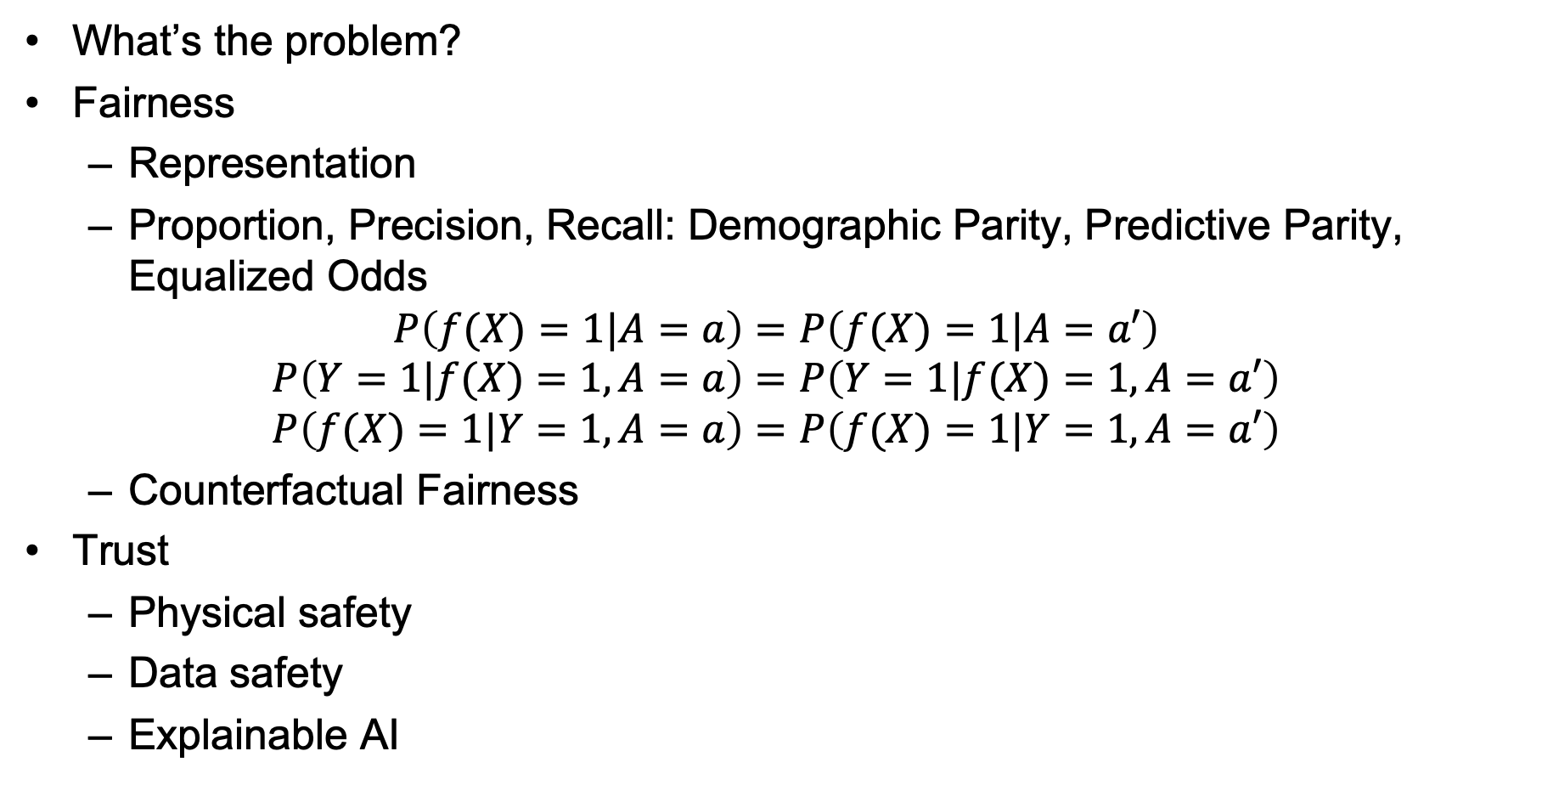
Outline
What’s the problem?
Fairness
Representation
Proportion, Precision, Recall: Demographic Parity, Predictive Parity, Equalized Odds
$$P\left(f(X)=1|A=a\right)=P\left(f(X)=1|A=a′\right)$$
$$P\left(Y=1|f(X)=1,A=a\right)=P\left(Y=1|f(X)=1,A=a′\right)$$
$$P\left(f(X)=1|Y=1,A=a\right)=P\left(f(X)=1|Y=1,A=a′\right)$$
Counterfactual Fairness
Trust
Physical safety
Data safety
Explainable AI

