Slide 1
Lecture 28: Exam 2 Review
CC-BY 4.0: share at will, but cite the source
Mark Hasegawa-Johnson, 4/2022

Slide 2
Exam 2 Mechanics
If you’re in the online section, or have signed up to take the exam online, you should get an email sometime during the day Friday (4/1) giving you a zoom URL
If you’ve signed up for a conflict exam, you should get email sometime during the day Friday (4/1) to schedule it
Otherwise, please show up here (1002 ECEB) on Monday 4/4 at 1:00pm.

Slide 3
Exam 2 Mechanics
Permitted: one page of handwritten notes, front & back
Not permitted: calculators, computers, textbook

Slide 4
Exam 2 Content
Lectures 15-18: Search
  Search: BFS, DFS, Explored set, Explored dict
  UCS, Greedy, A* Search
  Heuristics: admissible, consistent, dominant
  Constraint satisfaction problems
Lectures 20-24: Bayesian networks
  Bayesian networks; inference by enumeration
  Learning: Laplace smoothing, Expectation maximization
  Hidden Markov models
  Viterbi algorithm
  Part of speech tagging

Slide 5
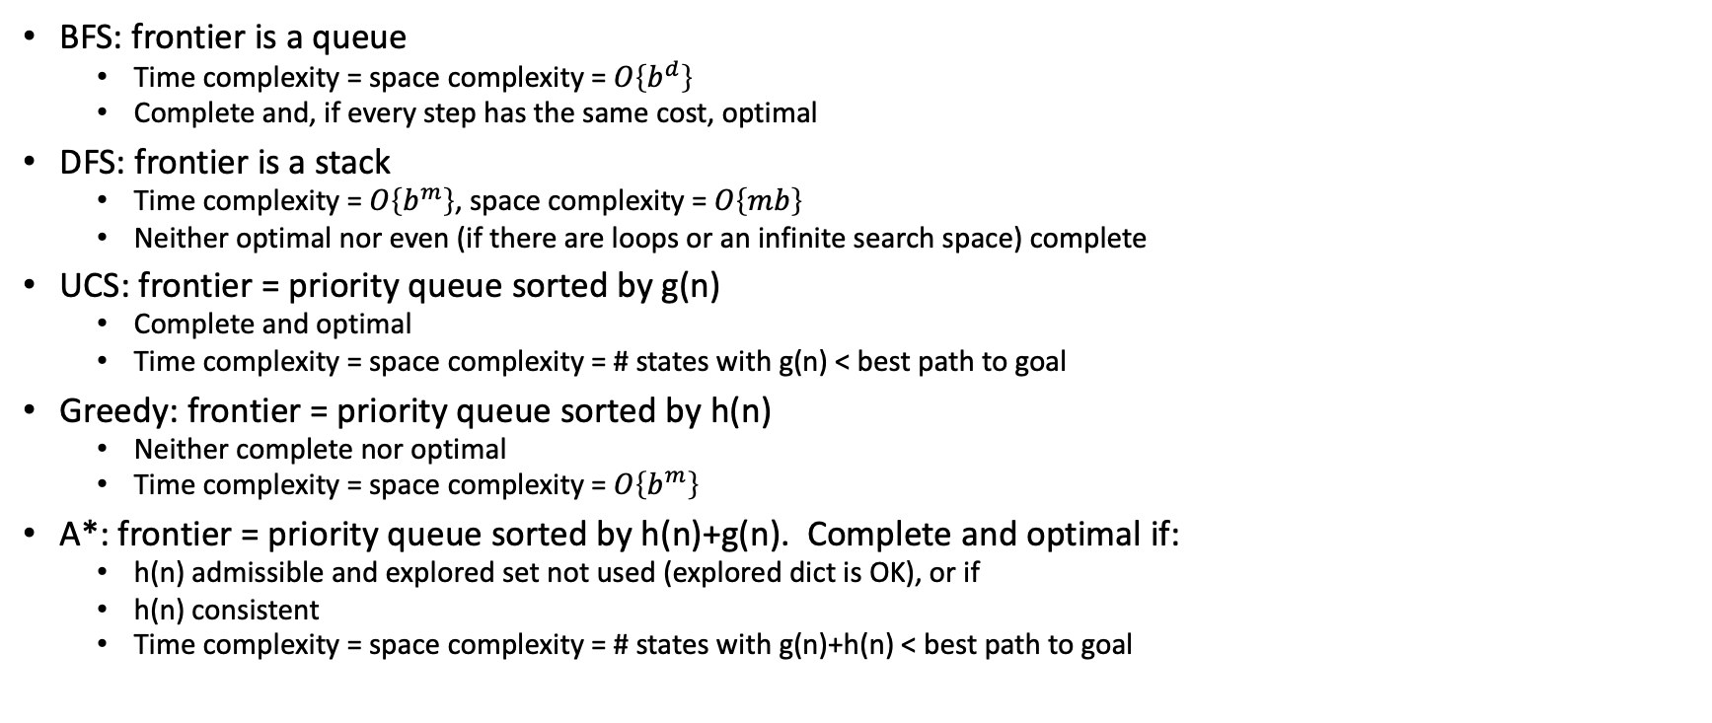
Search
BFS: frontier is a queue
  Time complexity = space complexity = $O\left\{b^{d}\right\}$
  Complete and, if every step has the same cost, optimal
DFS: frontier is a stack
  Time complexity = $O\left\{b^{m}\right\}$, space complexity = $O\left\{mb\right\}$
  Neither optimal nor even (if there are loops or an infinite search space) complete
UCS: frontier = priority queue sorted by g(n)
  Complete and optimal
  Time complexity = space complexity = # states with g(n) < best path to goal
Greedy: frontier = priority queue sorted by h(n)
  Neither complete nor optimal
  Time complexity = space complexity = $O\left\{b^{m}\right\}$
A*: frontier = priority queue sorted by h(n)+g(n). Complete and optimal if:
  h(n) admissible and explored set not used (explored dict is OK), or if
  h(n) consistent
  Time complexity = space complexity = # states with g(n)+h(n) < best path to goal

Slide 6
Explored set vs. Explored dict
Explored set
  Advantage: complexity is never worse than exhaustive search
  Disadvantage: suboptimal if there is any reason to think the first path to a state might ever not be the best path to that state
Explored dict
  Advantage: guaranteed to be optimal
  Disadvantage: not guaranteed to limit complexity below that of an exhaustive search, if there is any reason to think the first path to a state might ever not be the best path to that state

Slide 7
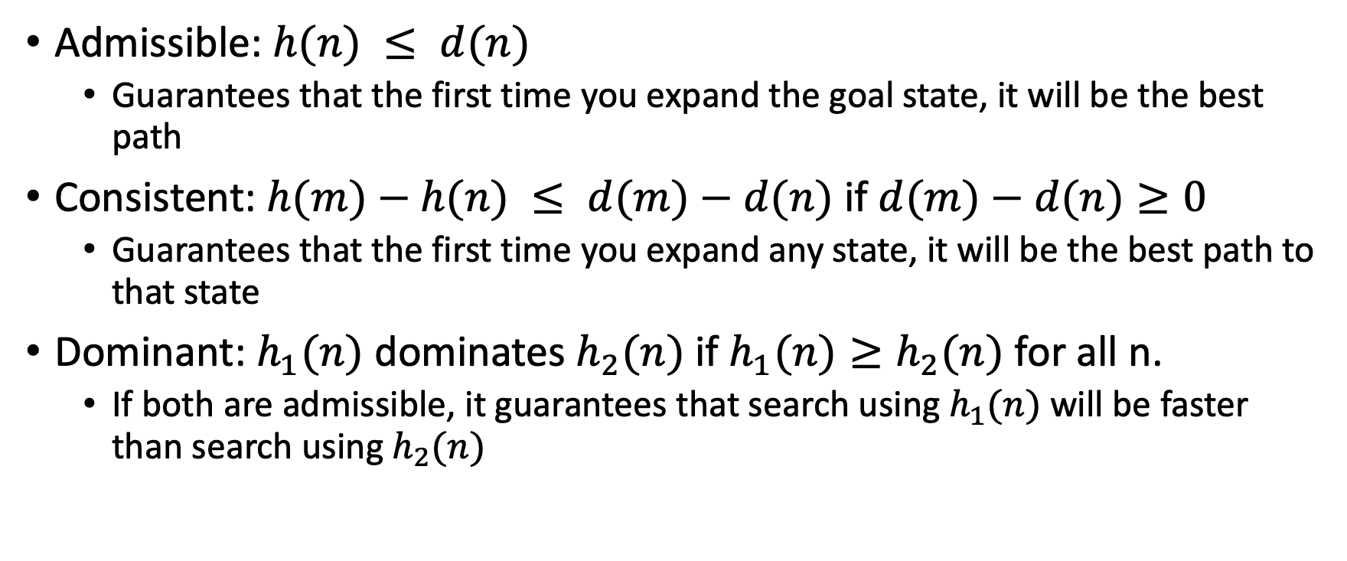
Heuristics
Admissible: $h(n) ≤ d(n)$
  Guarantees that the first time you expand the goal state, it will be the best path
Consistent: $h(m)−h(n) ≤ d(m)−d(n)$ if $d(m)−d(n)≥0$
  Guarantees that the first time you expand any state, it will be the best path to that state
Dominant: $h_{1}(n)$ dominates $h_{2}(n)$ if $h_{1}(n)≥h_{2}(n)$ for all n.
  If both are admissible, it guarantees that search using $h_{1}(n)$ will be faster than search using $h_{2}(n)$

Slide 8
Constraint satisfaction problem
Every path to goal has the same depth, so DFS is as good as BFS
Every successful path has the same cost, so the A* complexity guarantee (# states with g(n)+h(n)<best cost) is trivial and useless
Instead, we use heuristics that rank-order search candidates based on rough estimates of probability of success
LRV: choose the variable with the fewest remaining values
  Minimize the current branching factor
MCV: choose the variable that causes the most constraints
  Because you’ll have to solve that variable eventually
LCV: choose the value that causes the fewest constraints
  Because it’s most likely to be the correct answer

Slide 9
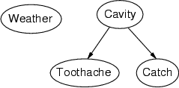
Bayesian networks: Structure
Nodes: random variables
Arcs: interactions
  An arrow from one variable to another indicates
  direct causal influence of variable #1 on variable #2
  Must form a directed, acyclic graph

Slide 10
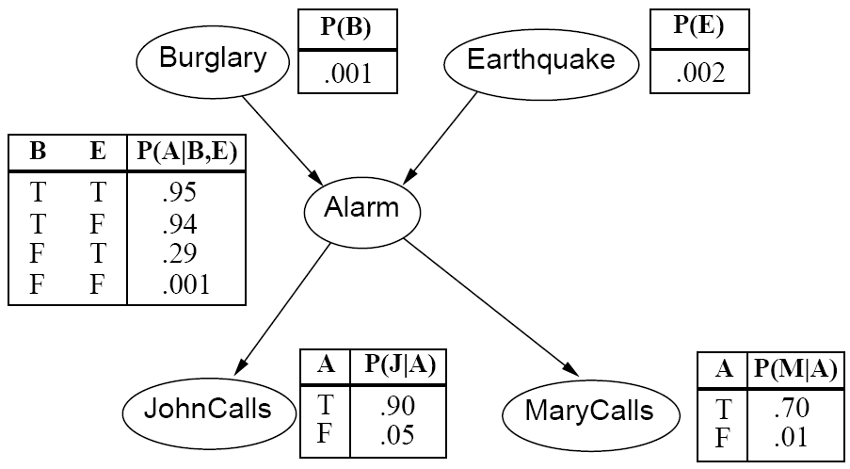
Conditional Independence $≠$ Independence
B and E (no common ancestor, common descendant A):
  Independent
  Not conditionally independent given A
J and M (common ancestor A, no common descendant):
  Not independent
  Conditionally independent given A
B and M (B is the ancestor of M):
  Not independent
  Conditionally independent given A

Slide 11
Belief propagation, step by step
Identify a path through the Bayesian network that includes all variables, including the query variable and all observed variables, starting at their common ancestor
Calculate the joint probability of the query variable and all observed variables, iteratively marginalizing out all intermediate variables step-by-step along the path.
  Product Step: $P(A,B,C)=P(A,B)P(C|A,B)$
  Sum Step: $P\left(A,C\right)=\sum_{b}{P(A,B=b,C)}$
Apply Bayes’ rule to get the desired conditional probability

Slide 12
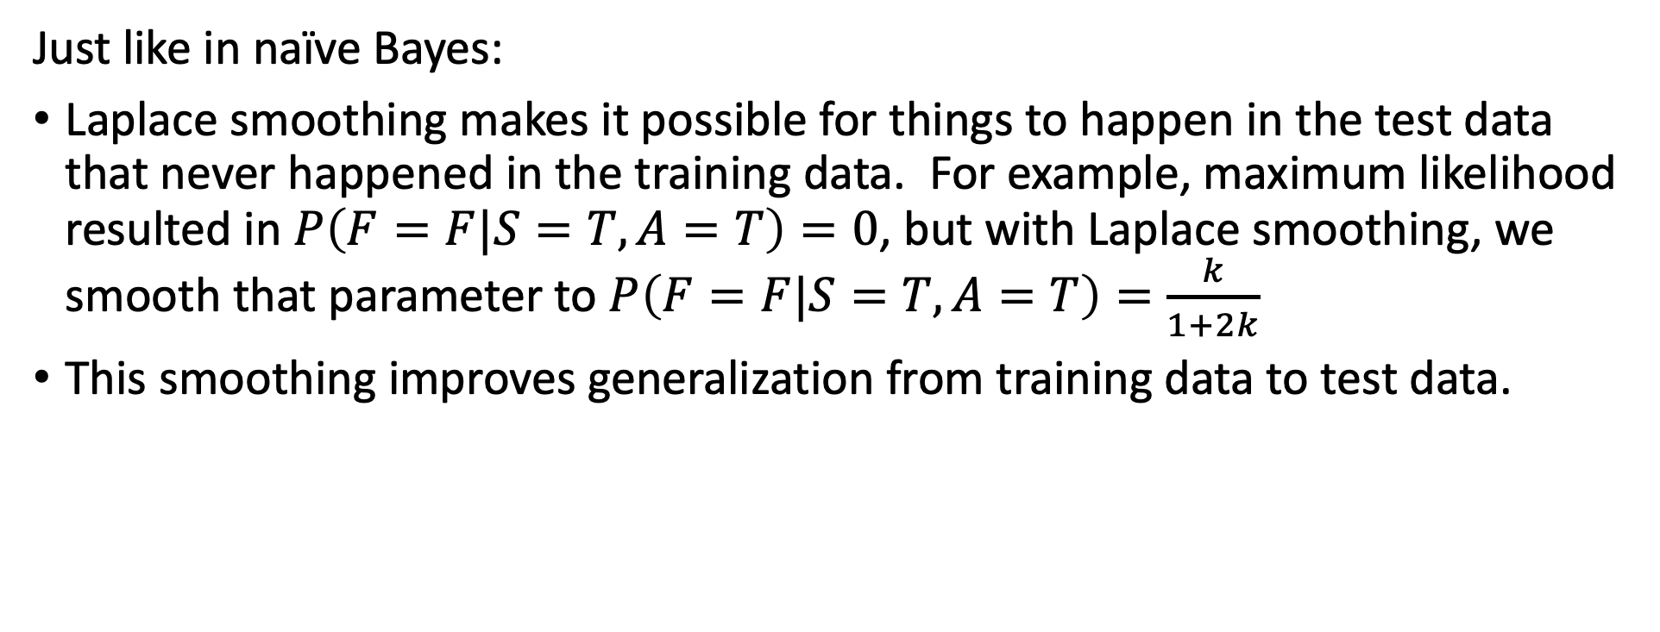
Laplace smoothing
Just like in naïve Bayes:
Laplace smoothing makes it possible for things to happen in the test data that never happened in the training data. For example, maximum likelihood resulted in $P\left(F=F|S=T,A=T\right)=0$, but with Laplace smoothing, we smooth that parameter to $P\left(F=F|S=T,A=T\right)=\frac{k}{1+2k}$
This smoothing improves generalization from training data to test data.

Slide 13
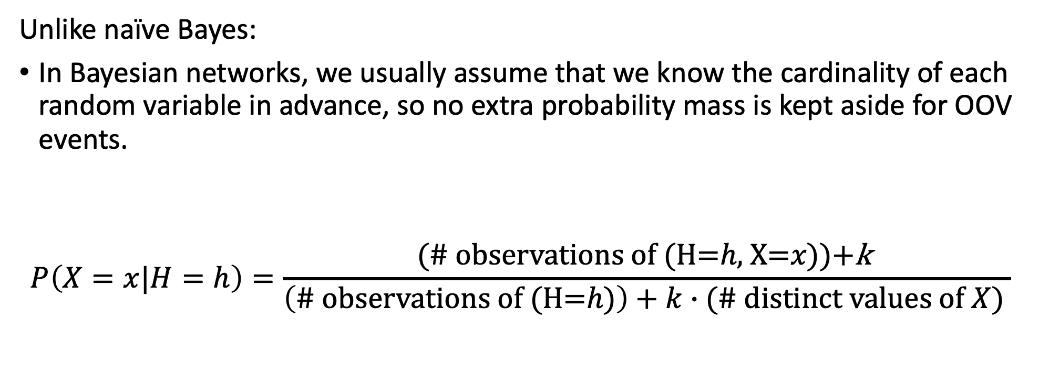
Laplace smoothing
Unlike naïve Bayes:
In Bayesian networks, we usually assume that we know the cardinality of each random variable in advance, so no extra probability mass is kept aside for OOV events.
$$P\left(X=x|H=h\right)=\frac{\text{(\# }\text{observations} \text{of} \text{(}\text{H}\text{=}h\text{,} \text{X}\text{=}x\text{))+}\text{k} }{\left(\text{\# }\text{observations} \text{of} \text{(}\text{H}\text{=}h\text{)}\right)+k∙(\# distinct values of X) }$$

Slide 14
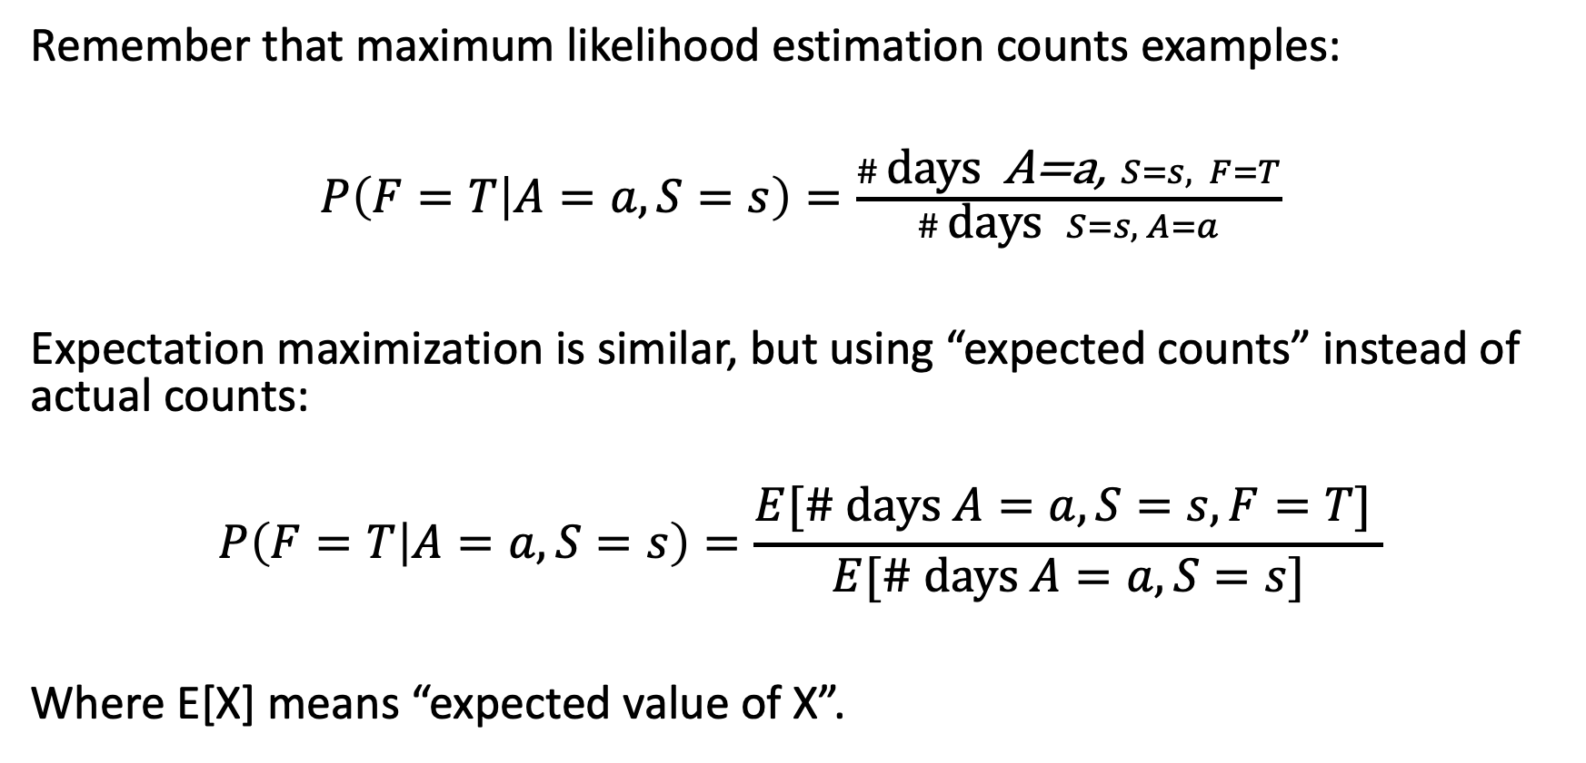
Expectation Maximization (EM): Main idea
Remember that maximum likelihood estimation counts examples:
$P\left(F=T | A=a,S=s\right)=\frac{\# \text{days} \text{A}\text{=}\text{a}\text{,} S=s, F=T}{\# \text{days} S=s, A=a}$
Expectation maximization is similar, but using “expected counts” instead of actual counts:
$$P\left(F=T | A=a,S=s\right)=\frac{E[\# \text{days} A=a, S=s, F=T] }{E[\# \text{days} A=a, S=s]}$$
Where E[X] means “expected value of X”.

Slide 15
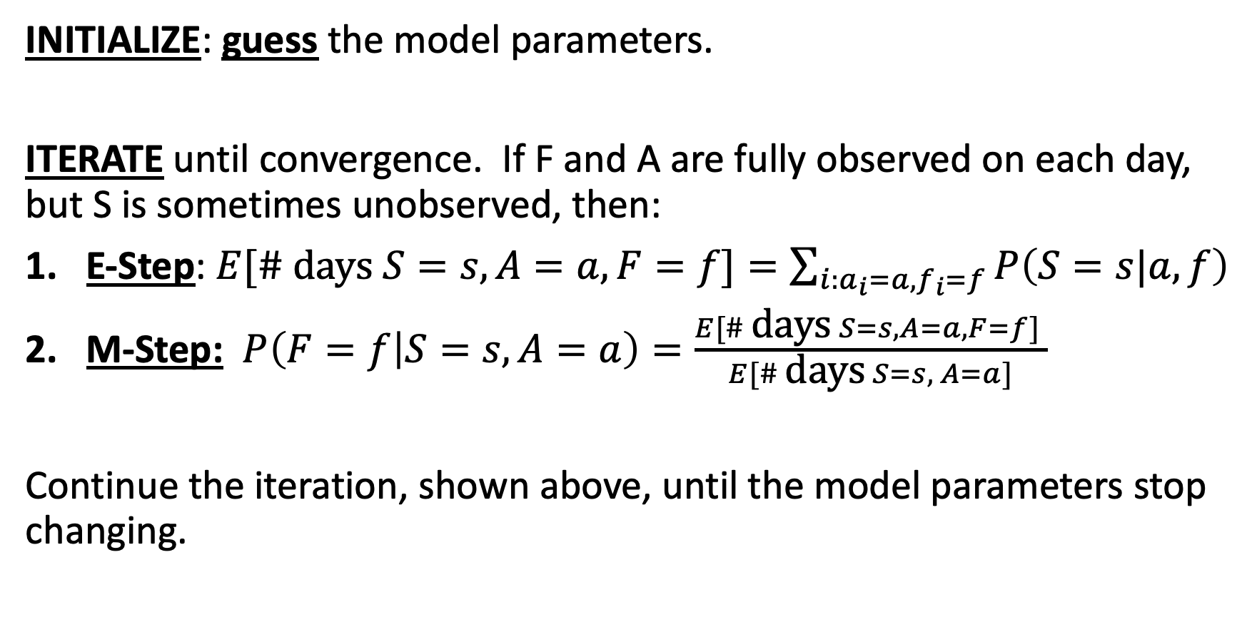
Expectation Maximization (EM) is iterative
INITIALIZE: guess the model parameters.
ITERATE until convergence. If F and A are fully observed on each day, but S is sometimes unobserved, then:
E-Step: $E[\# \text{days} S=s,A=a, F=f]=\sum_{i:a_{i}=a,f_{i}=f}{P\left(S=s|a,f\right)}$
M-Step: $P\left(F=f | S=s,A=a\right)=\frac{E[\# \text{days} S=s,A=a, F=f] }{E[\# \text{days} S=s, A=a]}$
Continue the iteration, shown above, until the model parameters stop changing.

Slide 16
Hidden Markov Model
A hidden Markov model assumes that both the state and the observation are Markov.
State Transitions: the Markov assumption means that each state variable depends only on the preceding time step:
P(Y_{t} | Y₀, …, Y_{t-1}) = P(Y_{t} | Y_{t-1})
Observation model: the Markov assumption means that each state variable depends only on the current state:
P(X_{t} | Y₀, …, Y_{t}, X₁, …, X_{t-1}) = P(X_{t} | Y_{t})
…
Y₀
Y₁
Y₂
Y_{t-1}
Y_{t}
X₁
X₂
X_{t-1}
X_{t}

Slide 17

Outline
Belief propagation
  What is $P(Y_{t}|X_{1}=x_{1},…,X_{T}=x_{T})$?
Viterbi Algorithm
  What is the most probable sequence $\{Y_{1},…,Y_{T}\}$ given observations $\{X_{1}=x_{1},…,X_{T}=x_{T}\}$?

Slide 18

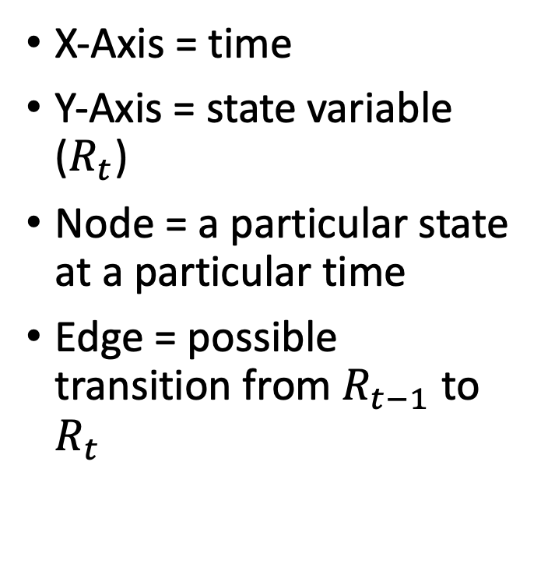
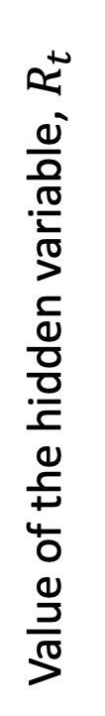



The Trellis
T
X-Axis = time
Y-Axis = state variable ($R_{t}$)
Node = a particular state at a particular time
Edge = possible transition from $R_{t−1}$ to $R_{t}$
…
Value of the hidden variable, $R_{t}$
F
Time
$$U_{1}=F$$
$$U_{2}=T$$
$$U_{3}=T$$
$$U_{4}=F$$

Slide 19
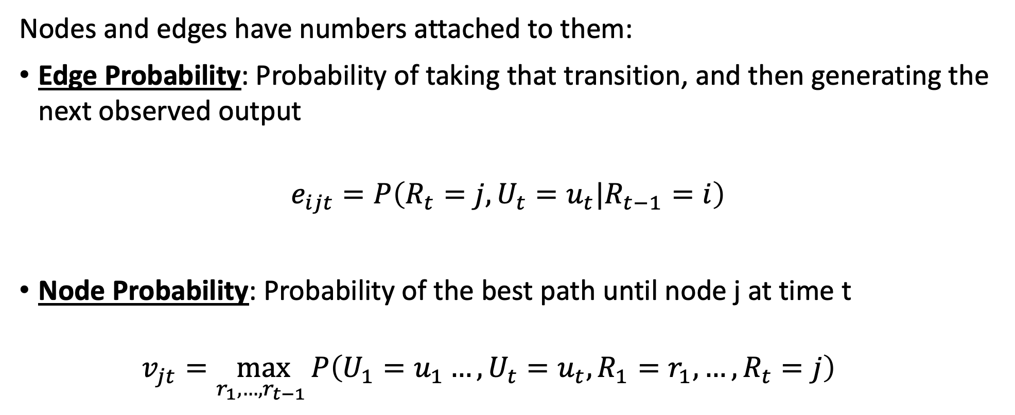
Viterbi Algorithm: Key concepts
Nodes and edges have numbers attached to them:
Edge Probability: Probability of taking that transition, and then generating the next observed output
$$e_{ijt}=P\left(R_{t}=j,U_{t}=u_{t}|R_{t−1}=i\right)$$
Node Probability: Probability of the best path until node j at time t
  $$v_{jt}=\max_{r_{1},…,r_{t−1} }P\left(U_{1}=u_{1}…, U_{t}=u_{t},R_{1}=r_{1},…, R_{t}=j\right)$$

Slide 20
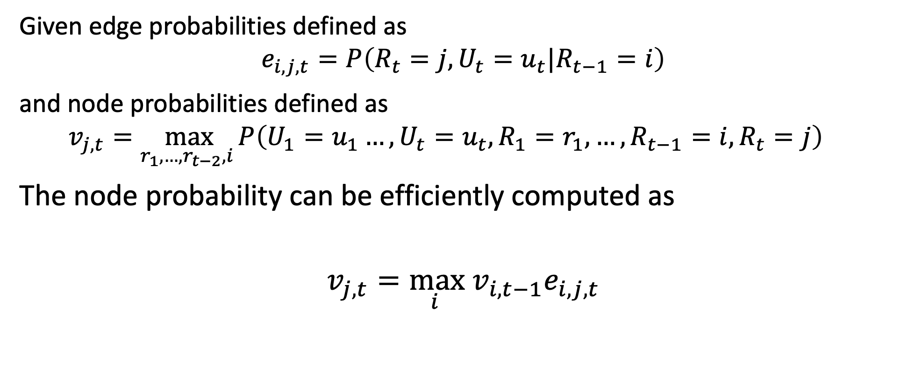
Viterbi Algorithm: the iteration step
Given edge probabilities defined as
$$e_{i,j,t}=P\left(R_{t}=j,U_{t}=u_{t}|R_{t−1}=i\right)$$
and node probabilities defined as
  $$v_{j,t}=\max_{r_{1},…,r_{t−2},i }P\left(U_{1}=u_{1}…, U_{t}=u_{t},R_{1}=r_{1},…,R_{t−1}=i,R_{t}=j\right)$$
The node probability can be efficiently computed as
$$v_{j,t}=\max_{i } v_{i,t−1}e_{i,j,t}$$

Slide 21
Parts of speech
Most modern English dictionaries use these POS tags.
Open-class words (anybody can make up a new word, in any of these classes, at any time): nouns, verbs, adjectives, adverbs, interjections
Closed-class words (it’s hard to make up a new word in these classes): pronouns, prepositions, conjunctions, determiners
Most published, tagged data use POS tags that are finer-grained than the nine tags listed above. For example, the next few slides describe the Penn Treebank POS tag set.

Slide 22
Why do POS tagging?
Because it’s highly accurate, typically 97%. That means you can run a POS tagger as a pre-processing step, before doing harder natural language understanding tasks.
Because it’s necessary, if you want to know what the words in the sentence mean.
Will Will ? Will will . Will will will Will ’s will to Will .
MD NNP SYM NNP MD SYM NNP MD VB NNP POS NN TO NNP SYM

Slide 23
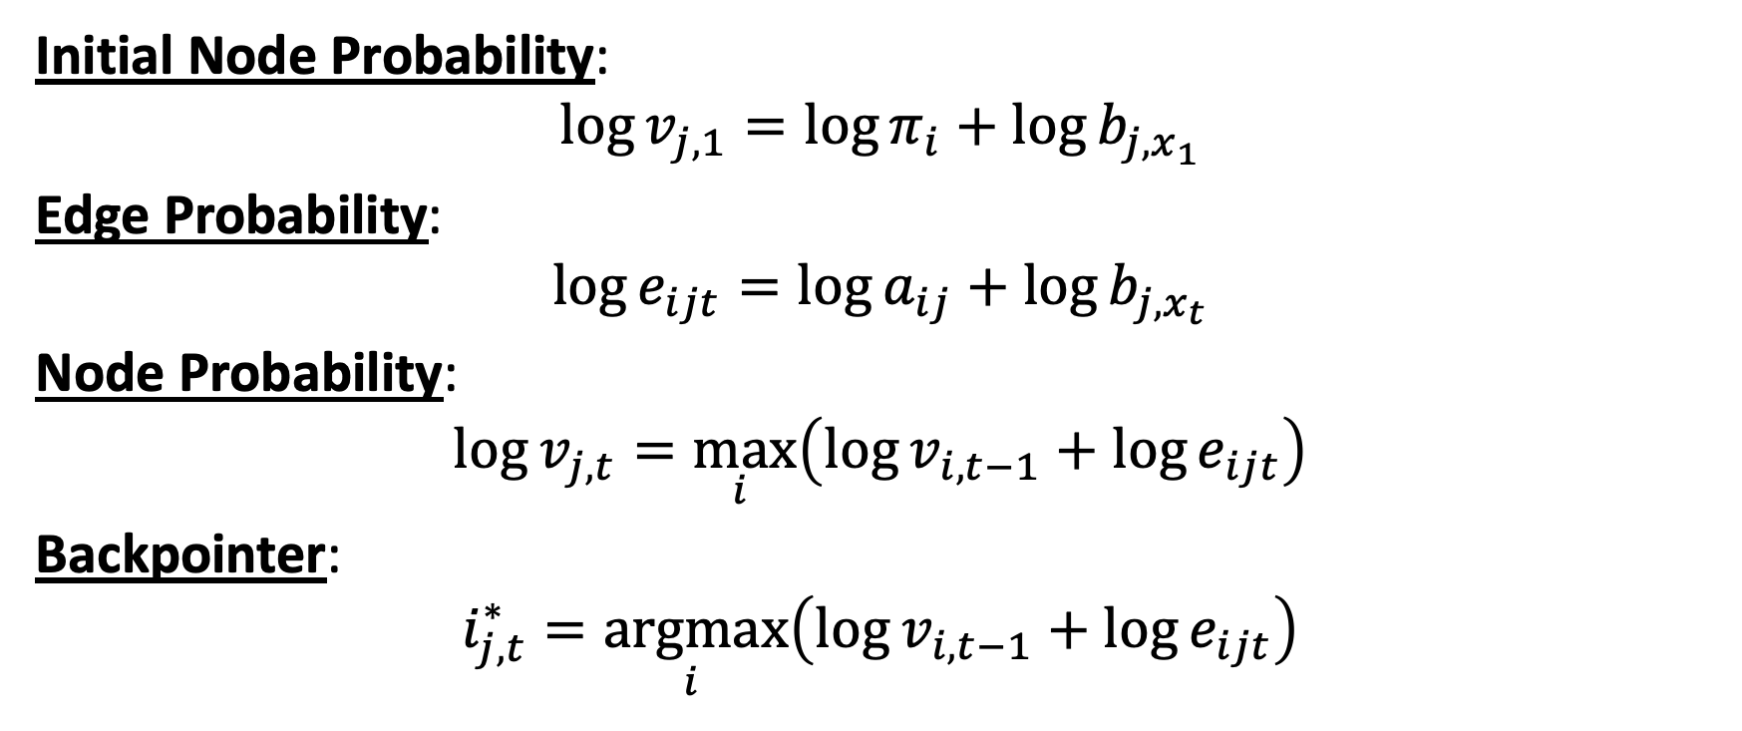
Viterbi algorithm key formulas
Initial Node Probability:
$$\log{v_{j,1}}=\log{π_{i}}+\log{b_{j,x_{1}}}$$
Edge Probability:
$$\log{e_{ijt}}=\log{a_{ij}}+\log{b_{j,x_{t}}}$$
Node Probability:
$$\log{v_{j,t}}=\max_{i }\left(\log{v_{i,t−1}}+\log{e_{ijt}}\right)$$
Backpointer:
$$i_{j,t}^{∗}=\underset{i }{argmax}\left(\log{v_{i,t−1}}+\log{e_{ijt}}\right)$$

Slide 24
Some sample problems
Search
BN
HMM

Slide 25
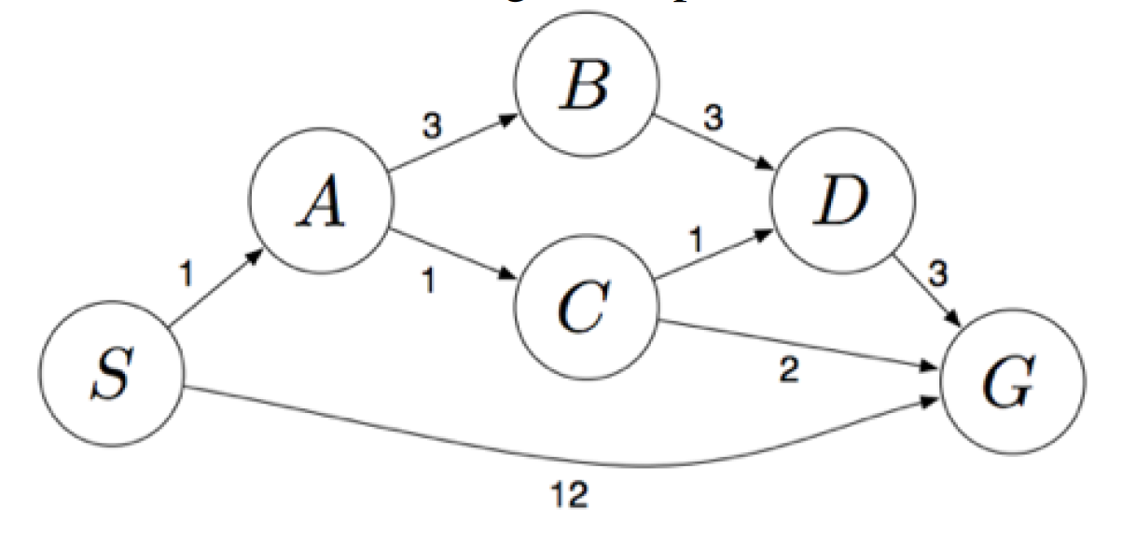
Sample problem:
Search
(Assume ties are resolved in alphabetical order)
What path would BFS return? Answer: SG
  What states would be expanded? Answer: S, A, and G
What path would DFS return? Answer: SABDG
  What states would be expanded? Answer: S, A, B, D, and G
What path would UCS return? Answer: SACG
  What states would be expanded? Answer: S, A, C, D, B, and G

Slide 26
Sample problem:
Search
(Assume ties are resolved in alphabetical order)
State | H1 | H2
S | 5 | 4
A | 3 | 2
B | 6 | 6
C | 2 | 1
D | 3 | 3
G | 0 | 0
Find the smallest possible modification that makes h1 admissible
  Answer: h1(S)=4
After your modification, which of these two heuristics will result in the fastest run-time for A* search?
  Answer: h1, because it still dominates h2
Find the smallest possible modification that makes h2 both admissible and consistent
  Answer: h2(S)=3

Slide 27
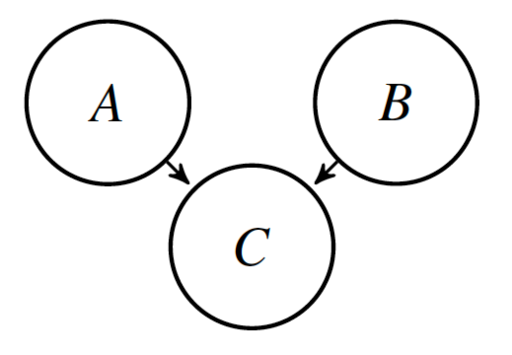
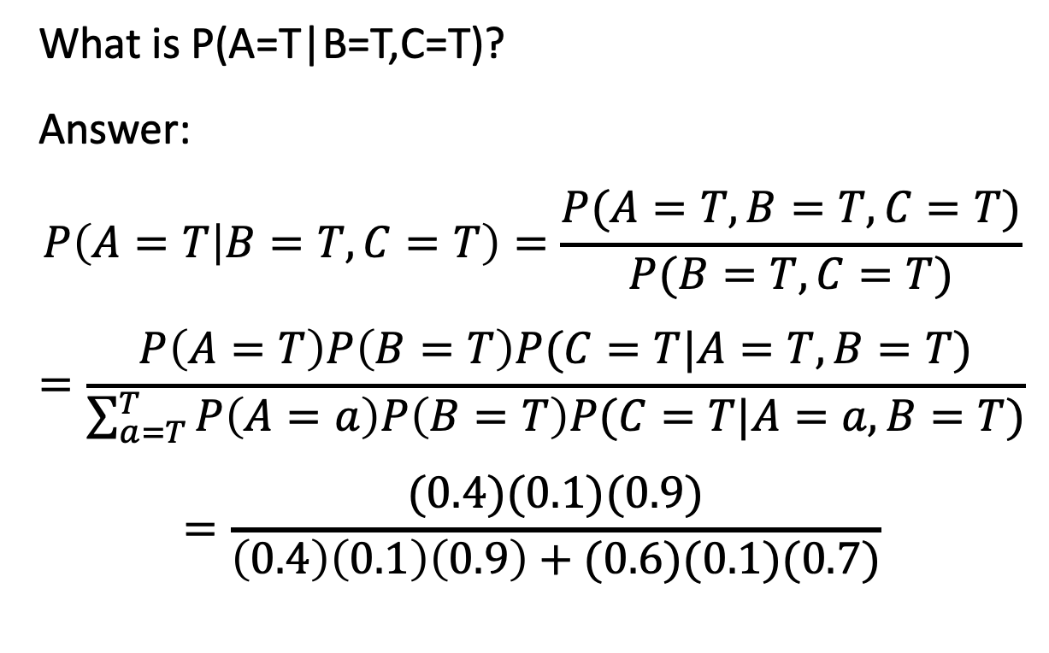
Sample problem: Bayesian network
What is P(A=T|B=T,C=T)?
Answer:
$$P\left(A=T | B=T,C=T\right)=\frac{P(A=T,B=T,C=T)}{P(B=T,C=T)}$$
$$=\frac{P\left(A=T\right)P\left(B=T\right)P(C=T|A=T,B=T)}{\sum_{a=T}^{T}{P\left(A=a\right)P\left(B=T\right)P(C=T|A=a,B=T)}}$$
$$=\frac{(0.4)(0.1)(0.9)}{\left(0.4\right)\left(0.1\right)\left(0.9\right)+(0.6)(0.1)(0.7)}$$
P(A=T)=0.4, P(B=T)=0.1, and
A, B | P(C=T|A,B)
F,F | 0.7
F,T | 0.7
T,F | 0.1
T,T | 0.9

Slide 28
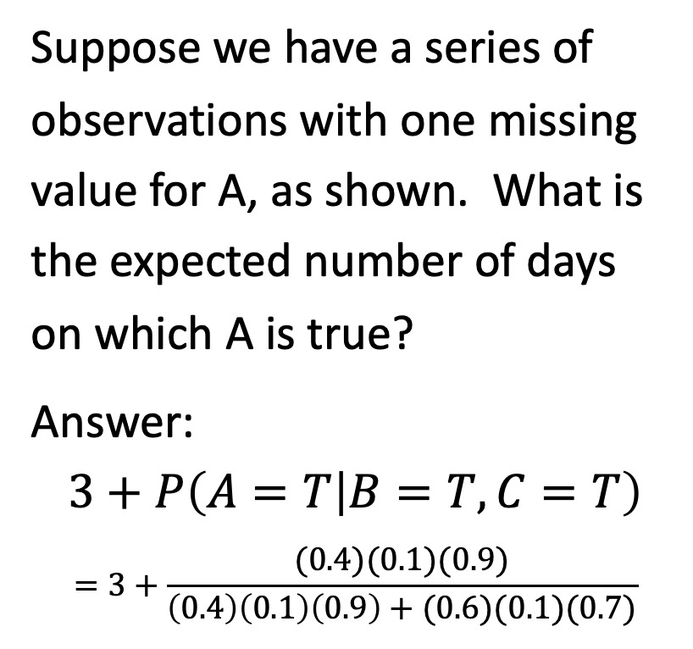
Sample problem: Bayesian network
Suppose we have a series of observations with one missing value for A, as shown. What is the expected number of days on which A is true?
Answer:
$$3+P\left(A=T | B=T,C=T\right)$$
$$=3+\frac{(0.4)(0.1)(0.9)}{\left(0.4\right)\left(0.1\right)\left(0.9\right)+(0.6)(0.1)(0.7)}$$
P(A=T)=0.4, P(B=T)=0.1, and
Day | A | B | C
1 | T | T | F
2 | T | F | T
3 | F | T | T
4 | T | T | T
5 | ? | T | T
A, B | P(C=T|A,B)
F,F | 0.7
F,T | 0.7
T,F | 0.1
T,T | 0.9

Slide 29
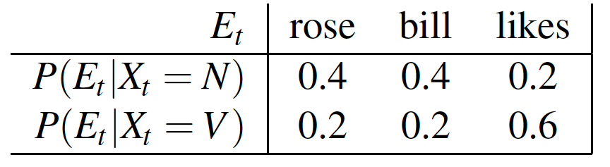
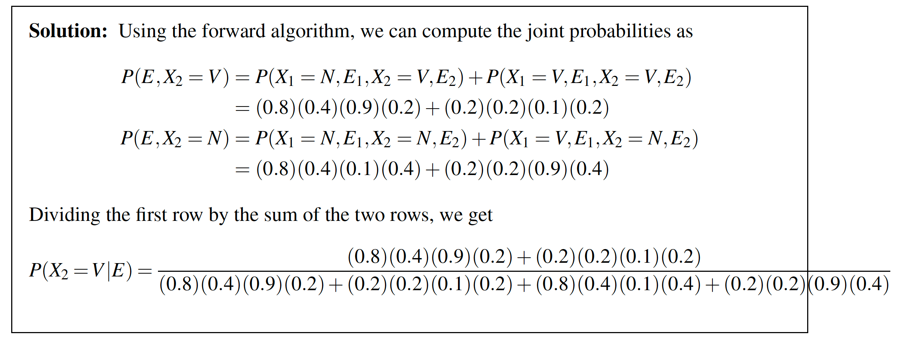




Sample problem: HMM
$$0.8$$
$$0.2$$
N
V
$$0.2$$
$$0.8$$
Find P(X2=V|E1=bill, E2=rose)

Slide 30


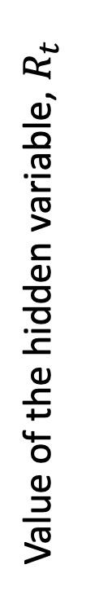


Sample problem: HMM
$$0.8$$
$$0.1$$
N
V
$$0.8$$
$$0.8$$
Find the most likely state sequence
N
Value of the hidden variable, $R_{t}$
V
$$E_{1}=bill$$
$$E_{2}=rose$$

