Slide 1
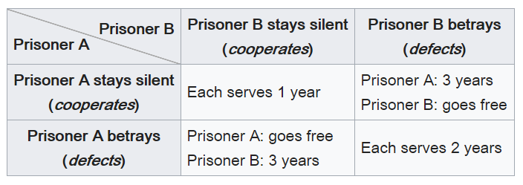
CS 440/ECE448 Lecture 29:
Game Theory
Mark Hasegawa-Johnson, 4/2022
CC-BY 4.0: you may remix or redistribute if you cite the source.
https://en.wikipedia.org/wiki/Prisoner’s_dilemma

Slide 2
Game theory
Game theory deals with systems of interacting agents where the outcome for an agent depends on the actions of all the other agents
  Applied in sociology, politics, economics, biology, and, of course, AI
Agent design: determining the best strategy for a rational agent in a given game
Mechanism design: how to set the rules of the game to ensure a desirable outcome

Slide 3

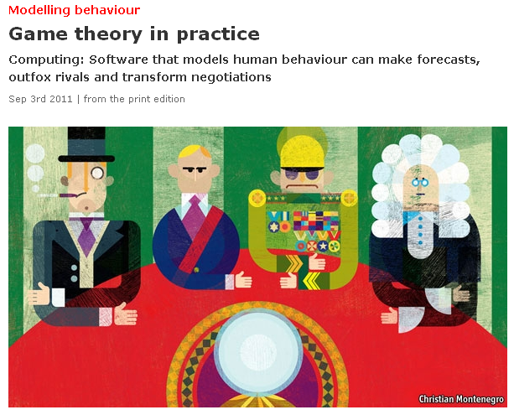
http://www.economist.com/node/21527025
Notes:
Applications: modeling auctions, negotiations, effect of regulatory schemes, military moves

Slide 4
Different Types of Games
Simultaneous vs. Sequential:
  Do the different agents all act at the same time, or do they take turns?
Two-Player vs. Multi-Player:
  How many agents are interacting?
Rational vs. Random Agents:
  Are the other players behaving randomly, or are the other players behaving rationally (i.e., each one plans their actions in order to maximize their own rewards)?
Zero-sum vs. Non-Zero-Sum:
  Zero-sum means that whatever one player wins, the other one loses
  Non-zero-sum means that some outcomes might allow all agents to win, while other outcomes might cause all agents to lose

Slide 5
Today: Games with Simultaneous Moves
Assume: two-player game, rational players, deterministic environment, but NOT necessarily zero-sum.
  These assumptions are not necessary, but they simplify the problem.
Both players play at the same time.
What is the rational thing to do:
  If you know in advance what the other player will do?
  If you can negotiate your move with the other player?
  If you DON’T know in advance what the other player will do?
  If it is rational to behave randomly?

Slide 6
Outline of today’s lecture
Games with simultaneous moves: Notation
Example: Stag Hunt (Coordination Games)
  Nash Equilibrium: Each player knows what the other will do, and responds rationally
Example: Asymmetric Coordination Games
  Pareto Optimal outcome: No player can win more w/o some other player winning less
Example: Prisoners’ Dilemma (Betrayal Games)
  Dominant Strategy: an action that is rational regardless of what the other player does
Example: Chicken (Anti-Coordination Games)
  Factors external to the game: How well can you bluff?
  Rational action within the game: Mixed Nash Equilibrium
Example: Generative Adversarial Networks (GAN)

Slide 7
Notation: sequential games (next week’s subject)
🐶
L
R
🐱
🐱
Players take turns acting (e.g., dog moves first, then cat)
Each node represents the action of one player (e.g., each animal can go either L or R)
Terminal node is marked with the value for each player
L
R
L
R
🐶1 🐱2
🐶7 🐱4
🐶5 🐱1
🐶5 🐱4

Slide 8
Notation: simultaneous games
(today’s subject)
🐶
L
R
🐱
🐱
L
R
L
R
The payoff matrix shows:
Each column is a different move for player 1.
Each row is a different move for player 2.
Each square is labeled with the rewards earned by each player in that square.
🐶1 🐱2
🐶7 🐱4
🐶5 🐱1
🐶5 🐱4
🐱
L
R
2
4
L
1
7
🐶
1
4
R
5
5
Payoff matrix

Slide 9
Outline of today’s lecture
Games with simultaneous moves: Notation
Example: Stag Hunt (Coordination Games)
  Nash Equilibrium: Each player knows what the other will do, and responds rationally
Example: Asymmetric Coordination Games
  Pareto Optimal outcome: No player can win more w/o some other player winning less
Example: Prisoners’ Dilemma (Betrayal Games)
  Dominant Strategy: an action that is rational regardless of what the other player does
Example: Chicken (Anti-Coordination Games)
  Factors external to the game: How well can you bluff?
  Rational action within the game: Mixed Nash Equilibrium
Example: Generative Adversarial Network (GAN)

Slide 10
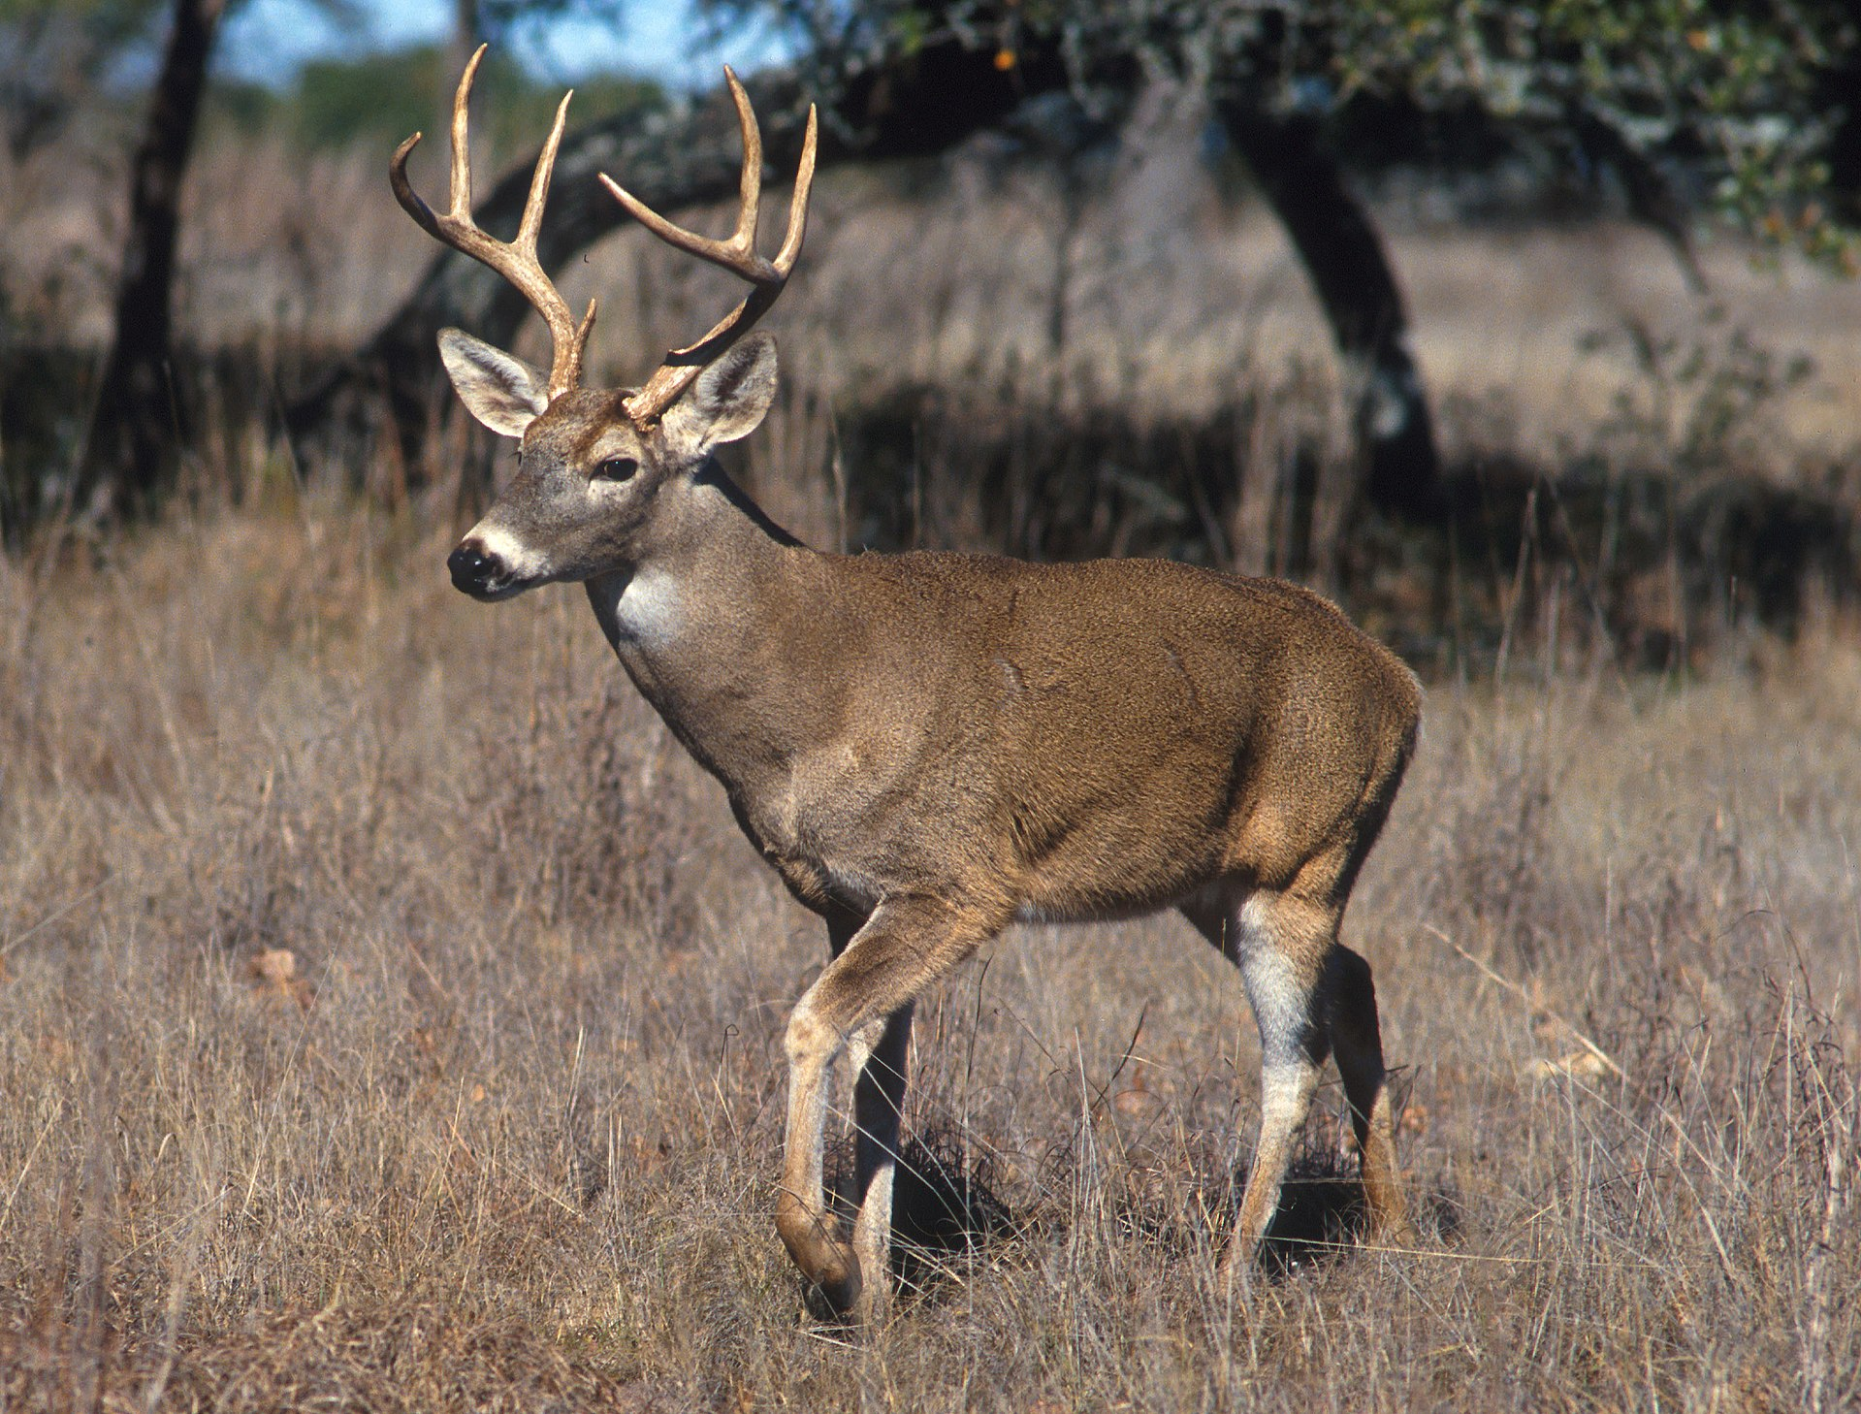
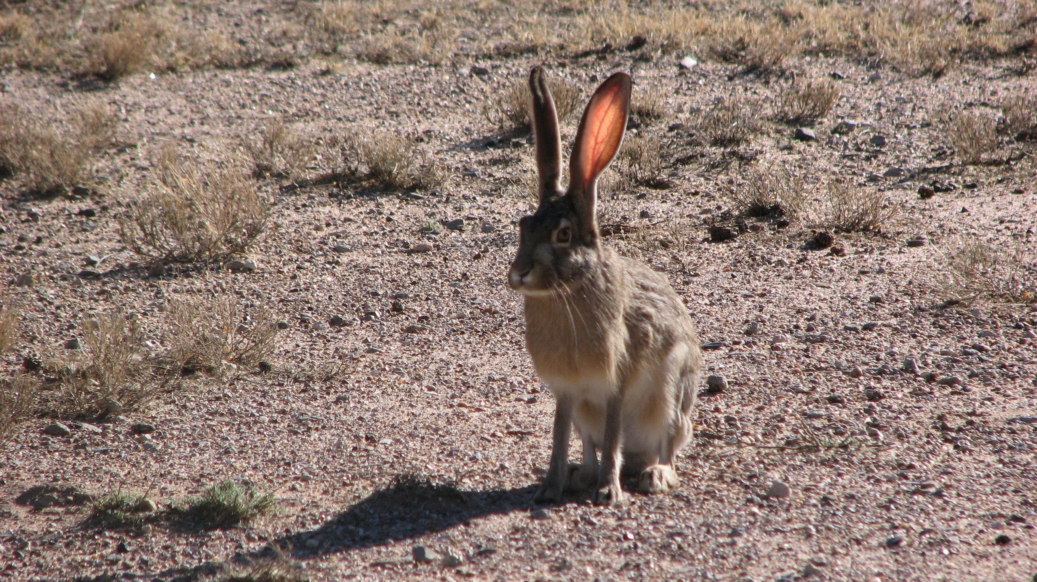
Stag hunt
Alice
 | Defect | Cooperate
Defect
Cooperate
10
0
10
10
Bob
10
100
0
100
Photo by Scott Bauer, Public Domain, https://commons.wikimedia.org/w/index.php?curid=245466
By Ancheta Wis, CC BY-SA 3.0, https://commons.wikimedia.org/w/index.php?curid=68432449
Apparently first described by Jean-Jacques Rousseau:
If both hunters (Bob and Alice) cooperate in hunting for the stag → each gets to take home half a stag (100lbs)
If one hunts for the stag, while the other wanders off and bags a hare → the defector gets a hare (10lbs), the cooperator gets nothing.
If both hunters defect → each gets to take home a hare.

Slide 11
Nash Equilibrium
Alice
 | Defect | Cooperate
Defect
Cooperate
10
0
10
10
Bob
10
100
0
100
Photo by Scott Bauer, Public Domain, https://commons.wikimedia.org/w/index.php?curid=245466
By Ancheta Wis, CC BY-SA 3.0, https://commons.wikimedia.org/w/index.php?curid=68432449
A Nash Equilibrium is a game outcome such that each player, knowing the other player’s move in advance, responds rationally.

Slide 12
Nash Equilibrium
Alice
 | Defect | Cooperate
Defect
Cooperate
10
0
10
10
Bob
10
100
0
100
Photo by Scott Bauer, Public Domain, https://commons.wikimedia.org/w/index.php?curid=245466
By Ancheta Wis, CC BY-SA 3.0, https://commons.wikimedia.org/w/index.php?curid=68432449
Example: (Defect,Defect) is a Nash equilibrium.
Alice knows that Bob will defect, so she defects.
Bob knows that Alice will defect, so he defects.
Neither player can rationally change his or her move, unless the other player also changes.

Slide 13
Nash Equilibrium
Alice
 | Defect | Cooperate
Defect
Cooperate
10
0
10
10
Bob
10
100
0
100
Photo by Scott Bauer, Public Domain, https://commons.wikimedia.org/w/index.php?curid=245466
By Ancheta Wis, CC BY-SA 3.0, https://commons.wikimedia.org/w/index.php?curid=68432449
(Cooperate,Cooperate) is also a Nash equilibrium!
Alice knows that Bob will cooperate, so she cooperates!
Bob knows that Alice will cooperate, so she cooperates!
Neither player can rationally change his or her move, unless the other player also changes.

Slide 14
Pareto-optimal outcome
Alice
 | Defect | Cooperate
Defect
Cooperate
10
0
10
10
Bob
10
100
Photo by Scott Bauer, Public Domain, https://commons.wikimedia.org/w/index.php?curid=245466
0
100
By Ancheta Wis, CC BY-SA 3.0, https://commons.wikimedia.org/w/index.php?curid=68432449
What if the players talk to each other in advance, and make promises, and trust one another’s promises?
Then they will both choose to cooperate.

Slide 15
Outline of today’s lecture
Games with simultaneous moves: Notation
Example: Stag Hunt (Coordination Games)
  Nash Equilibrium: Each player knows what the other will do, and responds rationally
Example: Asymmetric Coordination Games
  Pareto Optimal outcome: No player can win more w/o some other player winning less
Example: Prisoners’ Dilemma (Betrayal Games)
  Dominant Strategy: an action that is rational regardless of what the other player does
Example: Chicken (Anti-Coordination Games)
  Factors external to the game: How well can you bluff?
  Rational action within the game: Mixed Nash Equilibrium
Example: Generative Adversarial Network (GAN)

Slide 16
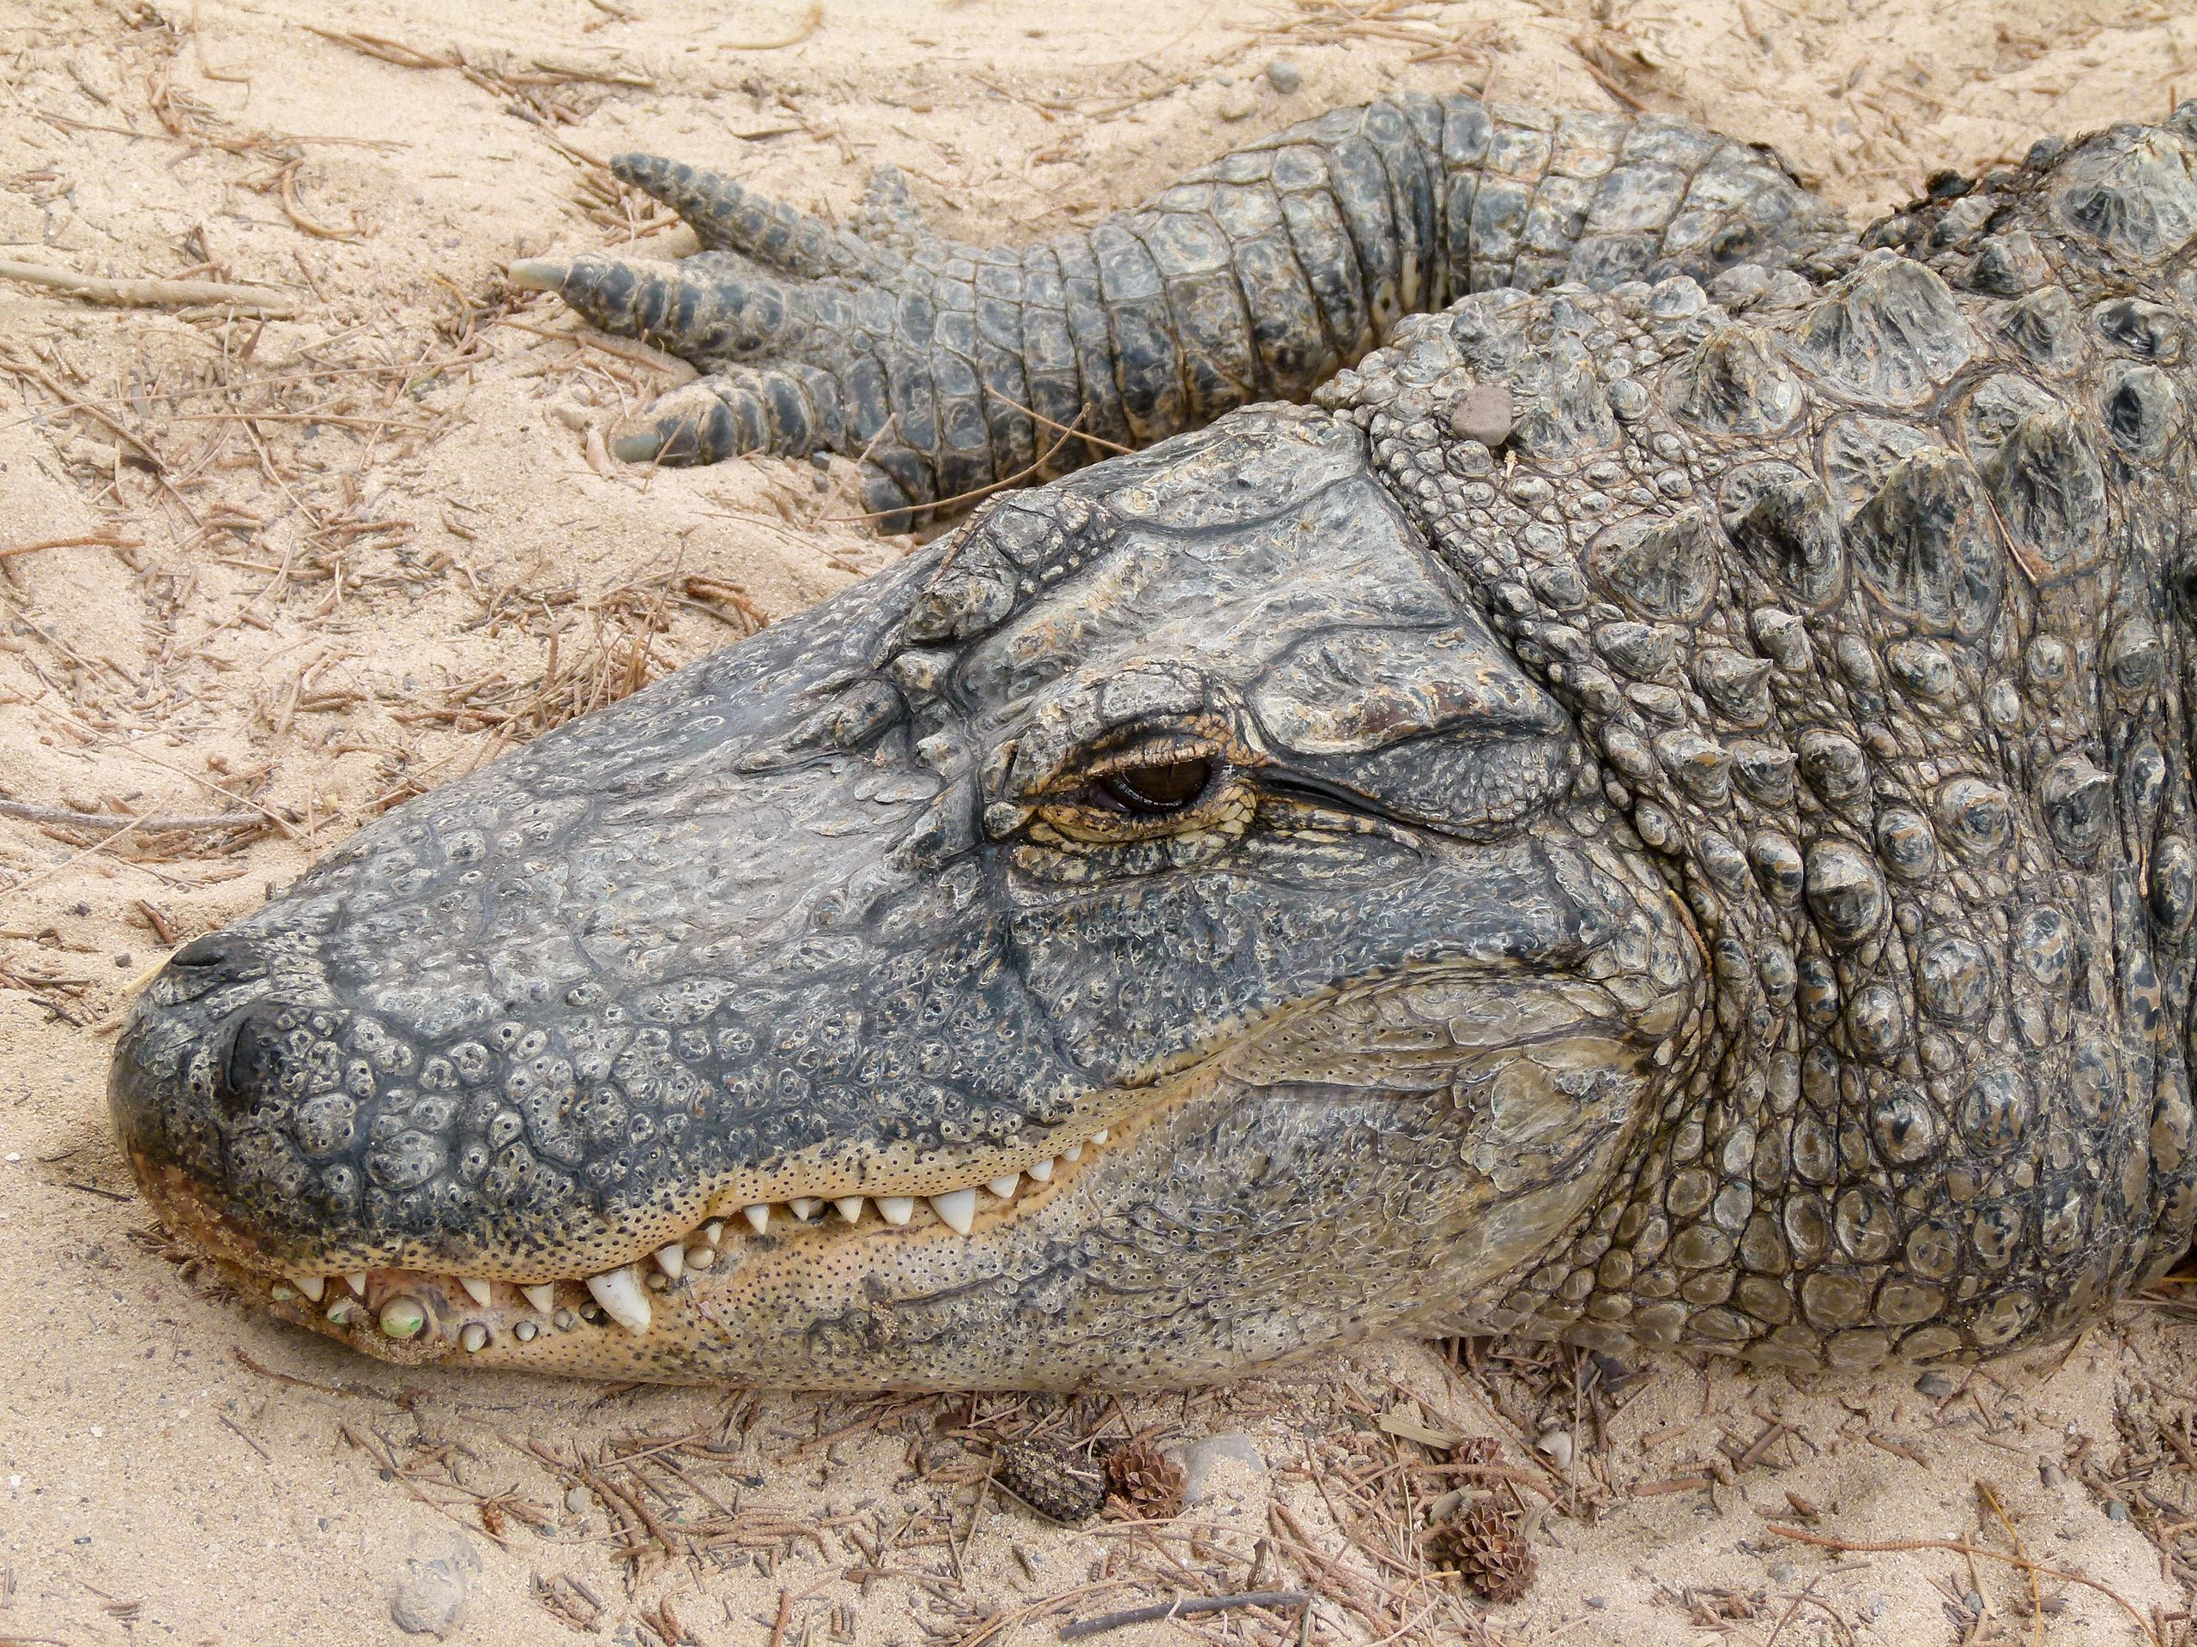
Asymmetric Coordination Games
 | Stag | Alligator
Stag
Alligator
Alice
10
0
20
0
Bob
0
20
Photo by Scott Bauer, Public Domain, https://commons.wikimedia.org/w/index.php?curid=245466
0
10
By Ancheta Wis, CC BY-SA 3.0, https://commons.wikimedia.org/w/index.php?curid=68432449
Alice prefers alligator. Bob prefers stag.
If they don’t cooperate, they each get nothing.

Slide 17
Asymmetric Coordination Games
 | Stag | Alligator
Stag
Alligator
Alice
10
0
20
0
Bob
0
20
Photo by Scott Bauer, Public Domain, https://commons.wikimedia.org/w/index.php?curid=245466
0
10
By Ancheta Wis, CC BY-SA 3.0, https://commons.wikimedia.org/w/index.php?curid=68432449
The Nash equilibria are (Stag,Stag) and (Gator,Gator).
If Bob knows that Alice will hunt gator, then it’s rational for him to do the same.
If Alice knows that Bob will hunt stag, then it’s rational for her to do the same.

Slide 18
What happens if they trust one another?
 | Stag | Alligator
Stag
Alligator
Alice
10
0
20
0
Bob
0
20
Photo by Scott Bauer, Public Domain, https://commons.wikimedia.org/w/index.php?curid=245466
0
10
By Ancheta Wis, CC BY-SA 3.0, https://commons.wikimedia.org/w/index.php?curid=68432449
What happens if they discuss their actions, and make promises, and trust one another?
It depends: whose needs are considered more important?
If Bob’s needs are more important, then they will hunt stag.
If Alice’s needs are more important, then they will hunt alligator.

Slide 19
Pareto optimal outcome
 | Stag | Alligator
Stag
Alligator
Alice
10
0
20
0
Bob
0
20
Photo by Scott Bauer, Public Domain, https://commons.wikimedia.org/w/index.php?curid=245466
0
10
By Ancheta Wis, CC BY-SA 3.0, https://commons.wikimedia.org/w/index.php?curid=68432449
An outcome is Pareto-optimal if the only way to increase value for one player is by decreasing value for the other.
(Stag,Stag) is Pareto-optimal: one could increase Alice’s value, but only by decreasing Bob’s value.
(Alligator,Alligator) is Pareto-optimal: one could increase Bob’s value, but only by decreasing Alice’s value.

Slide 20
Outline of today’s lecture
Games with simultaneous moves: Notation
Example: Stag Hunt (Coordination Games)
  Nash Equilibrium: Each player knows what the other will do, and responds rationally
Example: Asymmetric Coordination Games
  Pareto Optimal outcome: No player can win more w/o some other player winning less
Example: Prisoners’ Dilemma (Betrayal Games)
  Dominant Strategy: an action that is rational regardless of what the other player does
Example: Chicken (Anti-Coordination Games)
  Factors external to the game: How well can you bluff?
  Rational action within the game: Mixed Nash Equilibrium
Example: Generative Adversarial Network (GAN)

Slide 21
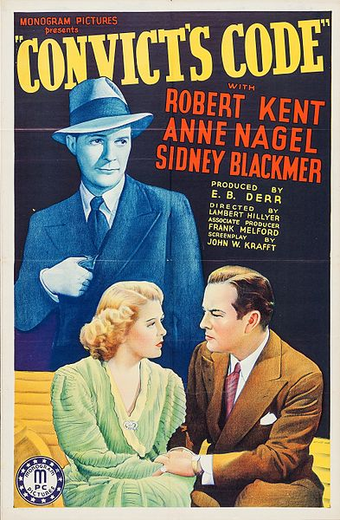
Prisoner’s dilemma
 | Alice: Testify | Alice: Refuse
Bob: Testify
Bob: Refuse
Two criminals have been arrested and the police visit them separately
If one player testifies against the other and the other refuses, the one who testified goes free and the one who refused gets a 10-year sentence
If both players testify against each other, they each get a 5-year sentence
If both refuse to testify, they each get a 1-year sentence
By Monogram Pictures, Public Domain, https://commons.wikimedia.org/w/index.php?curid=50338507

Slide 22
Prisoner’s dilemma
 | Alice: Testify | Alice: Refuse
Bob: Testify
Bob: Refuse
Two criminals have been arrested and the police visit them separately
If one player testifies against the other and the other refuses, the one who testified goes free and the one who refused gets a 10-year sentence
If both players testify against each other, they each get a 5-year sentence
If both refuse to testify, they each get a 1-year sentence
-5
-10
-5
0
0
-1
-10
-1
By Monogram Pictures, Public Domain, https://commons.wikimedia.org/w/index.php?curid=50338507

Slide 23
Questions that can be asked
If you were permitted to discuss options with the other player, but if one of you is more persuasive than the other, what are the different possible outcomes that might result from that discussion?
If you knew in advance what your opponent was going to do, what would you do?
If you didn’t know in advance what your opponent was going to do, what would you do?

Slide 24
Pareto optimality
 | Alice: Testify | Alice: Refuse
Bob: Testify
Bob: Refuse
If you were permitted to discuss options with the other player, what are the different possible outcomes that might result from that discussion?
If Bob’s needs are considered most important, the (-10,0) outcome might result.
If Alice’s needs are considered more important, the (0,-10) outcome might result.
If their needs are equally important, the (-1,-1) outcome might result.
A Pareto optimal outcome is an outcome whose cost to player A can only be reduced by increasing the cost to player B.
-5
-10
-5
0
0
-1
-10
-1
By Monogram Pictures, Public Domain, https://commons.wikimedia.org/w/index.php?curid=50338507

Slide 25
Nash equilibrium
 | Alice: Testify | Alice: Refuse
Bob: Testify
Bob: Refuse
If you knew in advance what your opponent was going to do, what would you do?
If Bob knew that Alice was going to refuse, then it be rational for Bob to testify (he’d get 0 years, instead of 1).
If Alice knew that Bob was going to testify, then it would be rational for her to testify (she’d get 5 years, instead of 10).
If Bob knew that Alice was going to testify, then it would be rational for him to testify (he’d get 5 years, instead of 10).
A Nash equilibrium is an outcome such that foreknowledge of the other player’s action does not cause either player to change their action.
-5
-10
-5
0
0
-1
-10
-1
By Monogram Pictures, Public Domain, https://commons.wikimedia.org/w/index.php?curid=50338507

Slide 26
Dominant strategy
 | Alice: Testify | Alice: Refuse
Bob: Testify
Bob: Refuse
If you didn’t know in advance what your opponent was going to do, what would you do?
If Bob knew that Alice was going to refuse, then it be rational for Bob to testify (he’d get 0 years, instead of 1).
If Bob knew that Alice was going to testify, then it would still be rational for him to testify (he’d get 5 years, instead of 10).
A dominant strategy is an action that minimizes cost, for one player, regardless of what the other player does.
-5
-10
-5
0
0
-1
-10
-1
By Monogram Pictures, Public Domain, https://commons.wikimedia.org/w/index.php?curid=50338507

Slide 27
What makes it a Prisoner’s Dilemma?
We use that term to mean a game in which
Defecting is the dominant strategy for each player, therefore
(Defect,Defect) is the only Nash equilibrium, even though
(Defect,Defect) is not a Pareto-optimal solution.
 | Defect | Cooperate
Defect
Cooperate
Lose
Lose Big
Lose
Win Big
Win Big
Win
Lose Big
Win
http://en.wikipedia.org/wiki/Prisoner’s_dilemma
Notes:
Diner’s dilemma [Wikipedia]: several individuals go out to eat, and prior to ordering they agree to split the check equally between all of them. Each individual must now choose whether to order the expensive or inexpensive dish. It is presupposed that the expensive dish is better than the cheaper, but not by enough to warrant paying the difference compared to eating alone. Each individual reasons that the expense they add to their bill by ordering the more expensive item is very small, and thus the improved dining experience is worth the money. However, every individual reasons this way and they all end up paying for the cost of the more expensive meal, which, by assumption, is worse for everyone than ordering and paying for the cheaper meal.

Slide 28
Prisoner’s Dilemma vs. Stag Hunt
Prisoner’s Dilemma
Stag Hunt
 | Defect | Cooperate
Defect
Cooperate
 | Defect | Cooperate
Defect
Cooperate
Lose
Lose Big
Win
Lose
Lose
Win Big
Win
Win
Win Big
Win
Win
Win Big
Lose Big
Win
Lose
Win Big
Players improve their winnings by defecting unilaterally
Players reduce their winnings by defecting unilaterally

Slide 29
Prisoner’s dilemma in real life
 | Defect | Cooperate
Defect
Cooperate
Price war
Arms race
Steroid use
Diner’s dilemma
Lose
Lose Big
Lose
Win
Win
Draw
Lose Big
Draw
http://en.wikipedia.org/wiki/Prisoner’s_dilemma
Notes:
Diner’s dilemma [Wikipedia]: several individuals go out to eat, and prior to ordering they agree to split the check equally between all of them. Each individual must now choose whether to order the expensive or inexpensive dish. It is presupposed that the expensive dish is better than the cheaper, but not by enough to warrant paying the difference compared to eating alone. Each individual reasons that the expense they add to their bill by ordering the more expensive item is very small, and thus the improved dining experience is worth the money. However, every individual reasons this way and they all end up paying for the cost of the more expensive meal, which, by assumption, is worse for everyone than ordering and paying for the cheaper meal.

Slide 30
Outline of today’s lecture
Games with simultaneous moves: Notation
Example: Stag Hunt (Coordination Games)
  Nash Equilibrium: Each player knows what the other will do, and responds rationally
Example: Asymmetric Coordination Games
  Pareto Optimal outcome: No player can win more w/o some other player winning less
Example: Prisoners’ Dilemma (Betrayal Games)
  Dominant Strategy: an action that is rational regardless of what the other player does
Example: Chicken (Anti-Coordination Games)
  Factors external to the game: How well can you bluff?
  Rational action within the game: Mixed Nash Equilibrium
Example: Generative Adversarial Network (GAN)

Slide 31
Payoff matrices
Working for RAND (a defense contractor) in 1950, Flood and Dresher formalized the “Prisoner’s Dilemma” (PD): a class of payoff matrices that encourages betrayal. Was used as a worst-case scenario for the cold war; policies were designed to avoid it.
Jean-Jacques Rosseau (Swiss philosopher, 1700s) invented the “Stag Hunt” (SH): a class of payoff matrices that reward cooperation, but don’t force it. Has been used as a model of climate-change treaties.
Both PD and SH have stable Nash equilibria. The “Game of Chicken” is a popular subject in movies (Rebel Without a Cause, Footloose, Crazy Rich Asians) because of its inherent instability: the only way to win is by convincing your opponent to lose.

Slide 32


Game of Chicken
Alice
 | Straight | Chicken
Straight
Chicken
Player 1
Player 2
Straight
Chicken
-10
-1
Straight
-10
1
Chicken
Bob
Two players each bet $1000 that the other player will chicken out
Outcomes:
  If one player chickens out, the other wins $1000
  If both players chicken out, neither wins anything
  If neither player chickens out, they both lose $10,000 (the cost of the car)
1
0
-1
0
http://en.wikipedia.org/wiki/Game_of_chicken

Slide 33
Prisoner’s Dilemma vs. Game of Chicken
Prisoner’s Dilemma
Game of Chicken
 | Defect | Cooperate
Defect
Cooperate
 | Straight | Chicken
Straight
Chicken
Lose
Lose Big
Lose Big
Lose
Lose
Win Big
Lose Big
Win Big
Win Big
Win
Win Big
Win
Lose Big
Win
Lose
Win
Players cut their losses by defecting if the other player defects
Defecting, if the other player defects, is the worst thing you can do

Slide 34
Game of Chicken
Alice
 | Straight | Chicken
Straight
Chicken
Player 1
Player 2
Straight
Chicken
-10
-1
Straight
-10
1
Chicken
Bob
Is there a dominant strategy for either player?
Is there a Nash equilibrium?
  (straight, chicken) or (chicken, straight)
Anti-coordination game: it is mutually beneficial for the two players to choose different strategies
  Model of escalated conflict in humans and animals
  (hawk-dove game)
How are the players to decide what to do?
  Bluff! You have to somehow convince your opponent that you will drive straight, no matter what happens, even if it’s irrational for you to do so.
  In that case, the rational thing for your opponent to do is to chicken out.
1
0
-1
0
http://en.wikipedia.org/wiki/Game_of_chicken

Slide 35
Game of Chicken
Alice
 | Straight | Chicken
Straight
Chicken
Player 1
Player 2
Straight
Chicken
-10
-1
Straight
-10
1
Chicken
Bob
Is there a dominant strategy for either player?
Is there a Nash equilibrium?
  (straight, chicken) or (chicken, straight)
Anti-coordination game: it is mutually beneficial for the two players to choose different strategies
  Model of escalated conflict in humans and animals
  (hawk-dove game)
How are the players to decide what to do?
  Bluff! You have to somehow convince your opponent that you will drive straight, no matter what happens, even if it’s irrational for you to do so.
  In that case, the rational thing for your opponent to do is to chicken out.
1
0
-1
0
Seriously??!!
Is there no way to win this game without convincing the other player that you are irrational??!!
http://en.wikipedia.org/wiki/Game_of_chicken

Slide 36
Irrational versus Random
The game of chicken has two different types of Nash equilibria:
Bluff. One player convinces the other that he will behave irrationally. The other player concedes the game. Result: (straight,chicken) or (chicken,straight).
Mixed Nash Equilibrium.
  Alice chooses a move at random, according to some probability distribution. She tells Bob, in advance, what probability distribution she will use.
  Bob responds rationally.
  One of Bob’s rational options is to choose his move, also, at random.

Slide 37
Game of Chicken
Alice
 | Straight | Chicken
Straight
Chicken
Player 1
Player 2
Straight
Chicken
-10
-1
Straight
-10
1
Chicken
Bob
1
0
-1
0
Mixed strategy: a player chooses between the different possible actions according to a probability distribution.
For example, suppose that each player chooses to go straight (S) with probability 1/10.
Is that a Nash equilibrium?

Slide 38
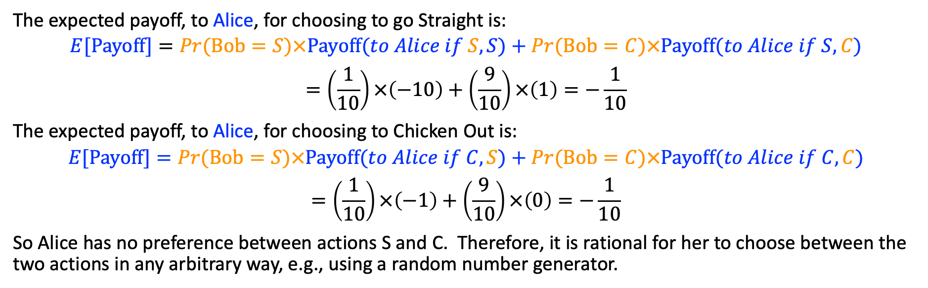
Game of Chicken
Alice
 | Straight | Chicken
Straight
Chicken
Player 1
Player 2
Straight
Chicken
-10
-1
Straight
-10
1
Chicken
Bob
1
0
-1
0
The expected payoff, to Alice, for choosing to go Straight is:
$$E[Payoff]=Pr(Bob=S)×Payoff(to Alice if S,S)+Pr(Bob=C)×Payoff(to Alice if S,C)$$
$$=\left(\frac{1}{10}\right)×\left(−10\right)+\left(\frac{9}{10}\right)×\left(1\right)=−\frac{1}{10}$$
The expected payoff, to Alice, for choosing to Chicken Out is:
$$E[Payoff]=Pr(Bob=S)×Payoff(to Alice if C,S)+Pr(Bob=C)×Payoff(to Alice if C,C)$$
$$=\left(\frac{1}{10}\right)×\left(−1\right)+\left(\frac{9}{10}\right)×\left(0\right)=−\frac{1}{10}$$
So Alice has no preference between actions S and C. Therefore, it is rational for her to choose between the two actions in any arbitrary way, e.g., using a random number generator.

Slide 39

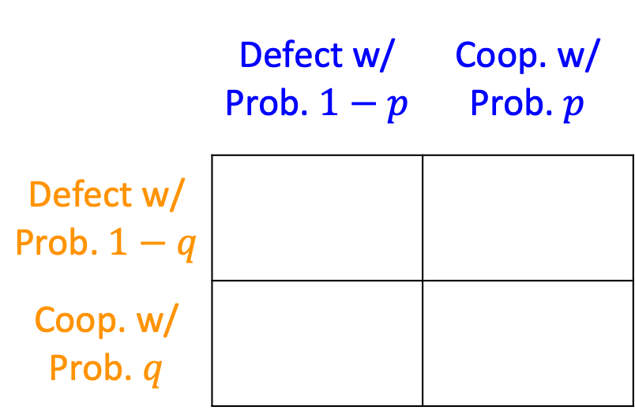







Finding mixed strategy equilibria
 | Defect w/ Prob. $1−p$ | Coop. w/ Prob. $p$
Defect w/ Prob. $1−q$
Coop. w/ Prob. $q$
Alice
$$a$$
$$b$$
$$w$$
$$x$$
Bob
$$c$$
$$d$$
$$y$$
$$z$$
Here’s the trick: for Bob, random selection is rational only if he can’t improve his winnings by definitively choosing one action or the other. So, for Bob to decide whether a mixed strategy is rational, he needs to know:
His own reward for each possible outcome (w, x, y, and z), and …
the probability (p) of Alice cooperating.

Slide 40
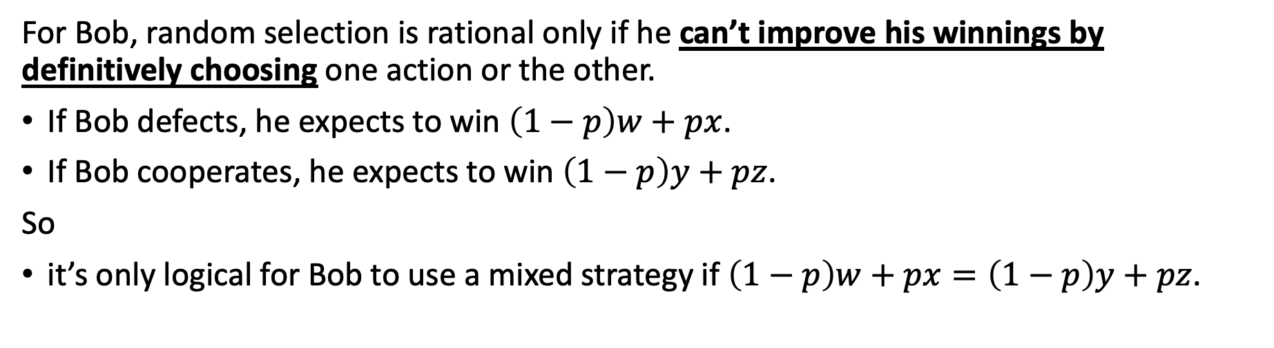
Finding mixed strategy equilibria
 | Defect w/ Prob. $1−p$ | Coop. w/ Prob. $p$
Defect w/ Prob. $1−q$
Coop. w/ Prob. $q$
Alice
$$a$$
$$b$$
$$w$$
$$x$$
Bob
$$c$$
$$d$$
$$y$$
$$z$$
For Bob, random selection is rational only if he can’t improve his winnings by definitively choosing one action or the other.
If Bob defects, he expects to win $\left(1−p\right)w+px$.
If Bob cooperates, he expects to win $\left(1−p\right)y+pz$.
So
it’s only logical for Bob to use a mixed strategy if $\left(1−p\right)w+px=\left(1−p\right)y+pz$.

Slide 41
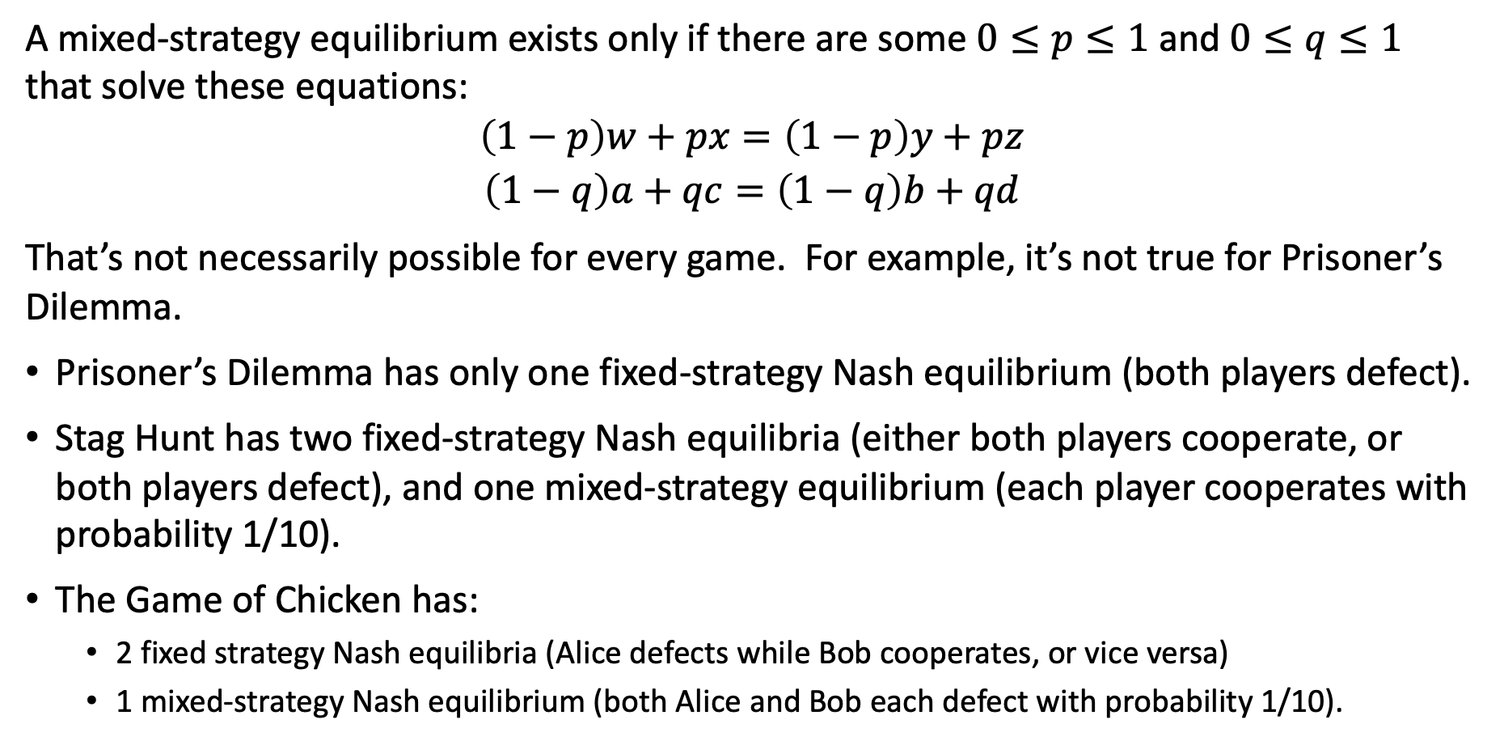
Does every game have a mixed-strategy equilibrium?
A mixed-strategy equilibrium exists only if there are some $0≤p≤1$ and $0≤q≤1$ that solve these equations:
$$\left(1−p\right)w+px=\left(1−p\right)y+pz$$
$$\left(1−q\right)a+qc=\left(1−q\right)b+qd$$
That’s not necessarily possible for every game. For example, it’s not true for Prisoner’s Dilemma.
Prisoner’s Dilemma has only one fixed-strategy Nash equilibrium (both players defect).
Stag Hunt has two fixed-strategy Nash equilibria (either both players cooperate, or both players defect), and one mixed-strategy equilibrium (each player cooperates with probability 1/10).
The Game of Chicken has:
  2 fixed strategy Nash equilibria (Alice defects while Bob cooperates, or vice versa)
  1 mixed-strategy Nash equilibrium (both Alice and Bob each defect with probability 1/10).

Slide 42
Existence of Nash equilibria
Any game with a finite set of actions has at least one Nash equilibrium (which may be a mixed-strategy equilibrium).
If a player has a dominant strategy, there exists a Nash equilibrium in which the player plays that strategy and the other player plays the best response to that strategy.
If both players have dominant strategies, there exists a Nash equilibrium in which they play those strategies.

Slide 43
Outline of today’s lecture
Games with simultaneous moves: Notation
Example: Stag Hunt (Coordination Games)
  Nash Equilibrium: Each player knows what the other will do, and responds rationally
Example: Asymmetric Coordination Games
  Pareto Optimal outcome: No player can win more w/o some other player winning less
Example: Prisoners’ Dilemma (Betrayal Games)
  Dominant Strategy: an action that is rational regardless of what the other player does
Example: Chicken (Anti-Coordination Games)
  Factors external to the game: How well can you bluff?
  Rational action within the game: Mixed Nash Equilibrium
Example: Generative Adversarial Network (GAN)

Slide 44
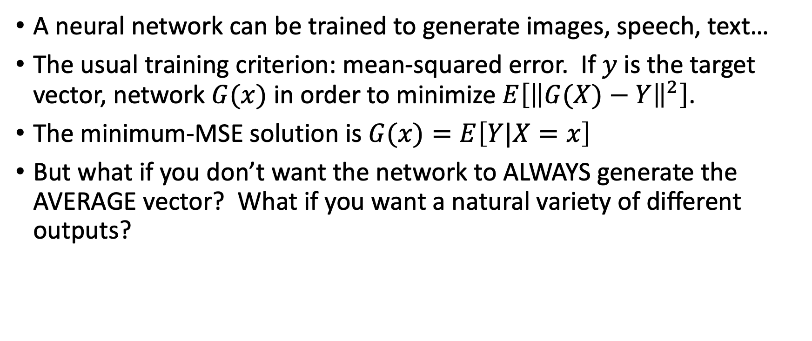
Using a neural net to generate synthetic data
A neural network can be trained to generate images, speech, text…
The usual training criterion: mean-squared error. If $y$ is the target vector, network $G(x)$ in order to minimize $E\left[{\left\|G(X)−Y\right\|}^{2}\right]$.
The minimum-MSE solution is $G(x)=E\left[Y|X=x\right]$
But what if you don’t want the network to ALWAYS generate the AVERAGE vector? What if you want a natural variety of different outputs?

Slide 45
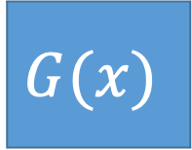
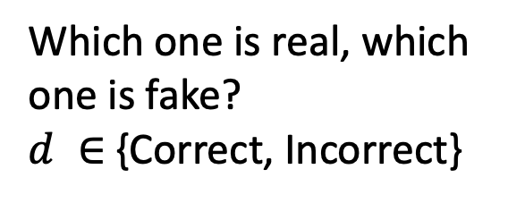
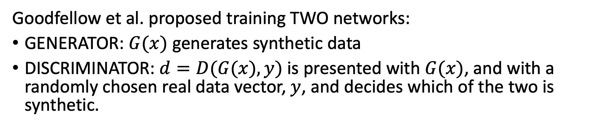
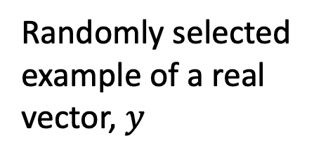
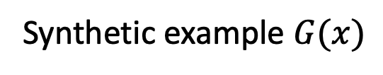
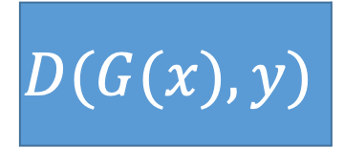
Generative Adversarial Network
$$G(x)$$
Synthetic example $G(x)$
Which one is real, which one is fake?
$d ∈${Correct, Incorrect}
$$D(G(x),y)$$
Database of natural examples of y
Random selection
Randomly selected
example of a real
vector, $y$
Goodfellow et al. proposed training TWO networks:
GENERATOR: $G(x)$ generates synthetic data
DISCRIMINATOR: $d=D(G(x),y)$ is presented with $G(x)$, and with a randomly chosen real data vector, $y$, and decides which of the two is synthetic.

Slide 46
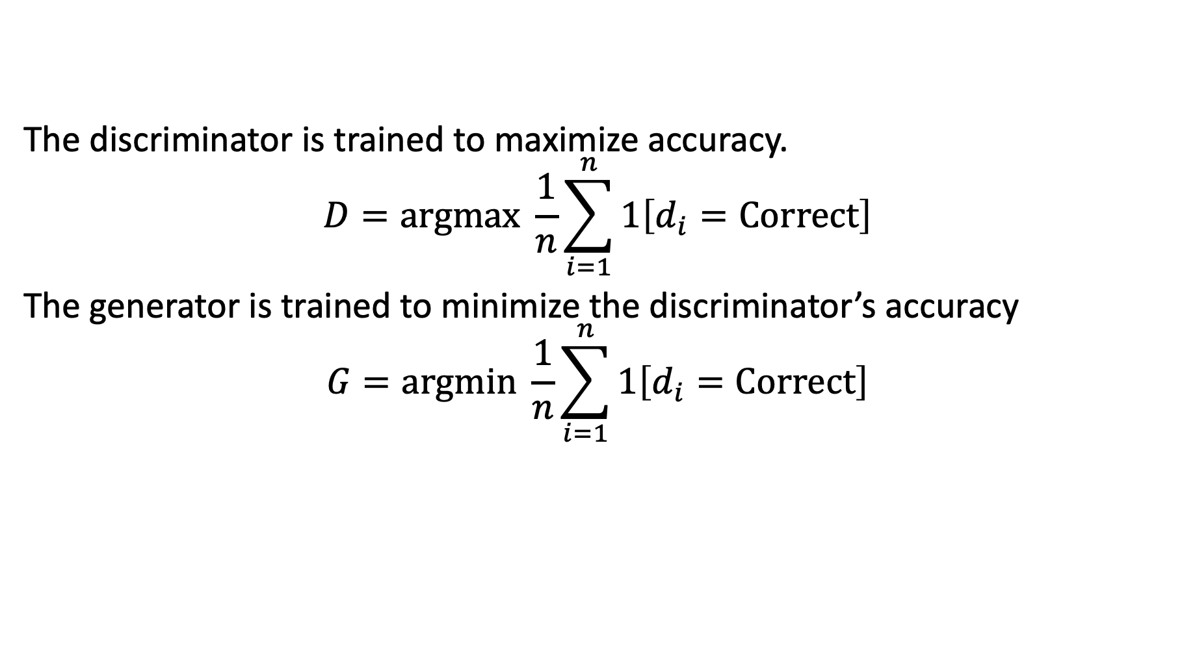
$$G(x)$$
Synthetic example $G(x)$
Which one is real, which one is fake?
$d ∈${Correct, Incorrect}
$$D(G(x),y)$$
Database of natural examples of y
Random selection
Randomly selected
example of a real
vector, $y$
The discriminator is trained to maximize accuracy.
$$D=argmax \frac{1}{n}\sum_{i=1}^{n}{1\left[d_{i}=Correct\right]}$$
The generator is trained to minimize the discriminator’s accuracy
$$G=argmin \frac{1}{n}\sum_{i=1}^{n}{1\left[d_{i}=Correct\right]}$$

Slide 47
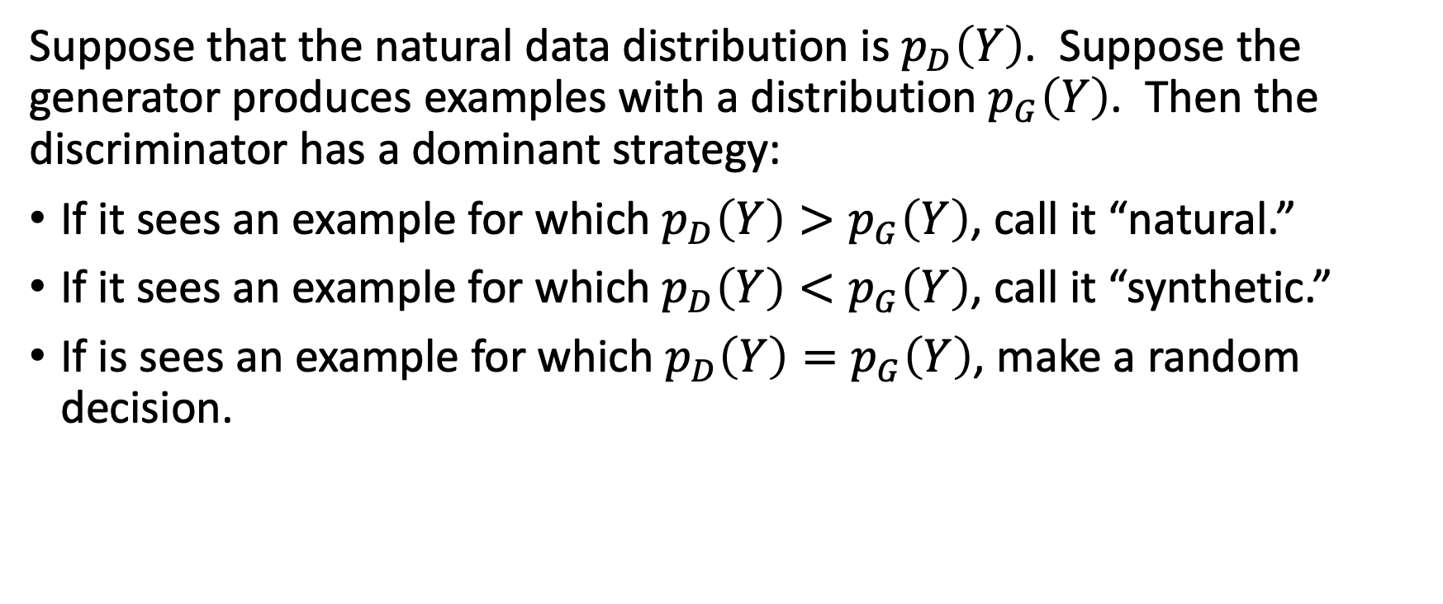
Dominant strategy
Suppose that the natural data distribution is $p_{D}\left(Y\right)$. Suppose the generator produces examples with a distribution $p_{G}\left(Y\right)$. Then the discriminator has a dominant strategy:
If it sees an example for which $p_{D}\left(Y\right)>p_{G}\left(Y\right)$, call it “natural.”
If it sees an example for which $p_{D}\left(Y\right)<p_{G}\left(Y\right)$, call it “synthetic.”
If is sees an example for which $p_{D}\left(Y\right)=p_{G}\left(Y\right)$, make a random decision.

Slide 48
Reminder: Existence of Nash equilibria
Any game with a finite set of actions has at least one Nash equilibrium (which may be a mixed-strategy equilibrium).
If a player has a dominant strategy, there exists a Nash equilibrium in which the player plays that strategy and the other player plays the best response to that strategy.
If both players have dominant strategies, there exists a Nash equilibrium in which they play those strategies.

Slide 49
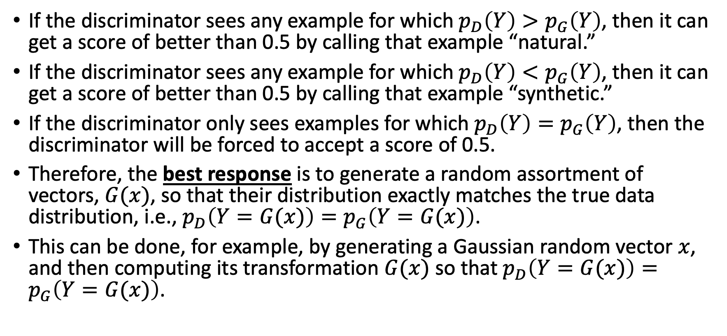
Generator’s best response to the Discriminator’s dominant strategy
If the discriminator sees any example for which $p_{D}\left(Y\right)>p_{G}\left(Y\right)$, then it can get a score of better than 0.5 by calling that example “natural.”
If the discriminator sees any example for which $p_{D}\left(Y\right)<p_{G}\left(Y\right)$, then it can get a score of better than 0.5 by calling that example “synthetic.”
If the discriminator only sees examples for which $p_{D}\left(Y\right)=p_{G}\left(Y\right)$, then the discriminator will be forced to accept a score of 0.5.
Therefore, the best response is to generate a random assortment of vectors, $G(x)$, so that their distribution exactly matches the true data distribution, i.e., $p_{D}\left(Y=G(x)\right)=p_{G}\left(Y=G(x)\right)$.
This can be done, for example, by generating a Gaussian random vector $x$, and then computing its transformation $G(x)$ so that $p_{D}\left(Y=G(x)\right)=p_{G}\left(Y=G(x)\right)$.

Slide 50

Nash equilibrium for the generative adversarial network
Generator produces a random assortment of vectors, $G(x)$, with a distribution that exactly matches the true data distribution, i.e., $p_{D}\left(Y=G(x)\right)=p_{G}\left(Y=G(x)\right)$.
Discriminator has no choice but to accept a correctness score of 50%.

Slide 51
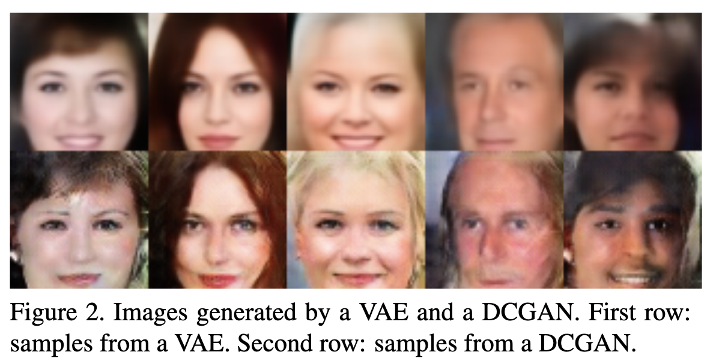
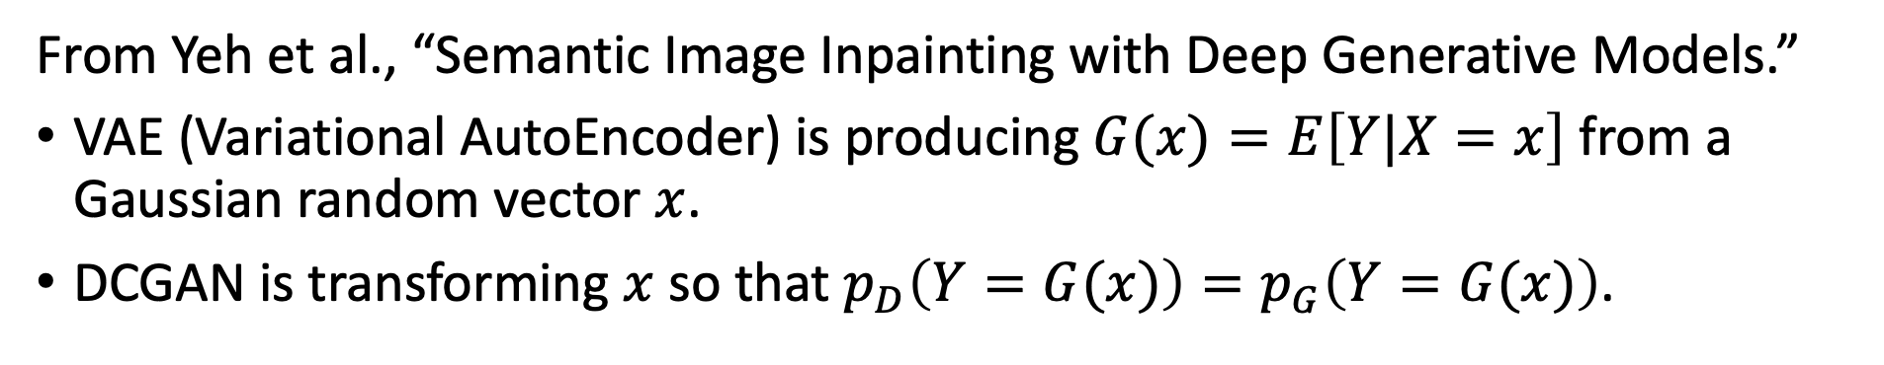
Example
From Yeh et al., “Semantic Image Inpainting with Deep Generative Models.”
VAE (Variational AutoEncoder) is producing $G(x)=E\left[Y|X=x\right]$ from a Gaussian random vector $x$.
DCGAN is transforming $x$ so that $p_{D}\left(Y=G(x)\right)=p_{G}\left(Y=G(x)\right)$.

Slide 52
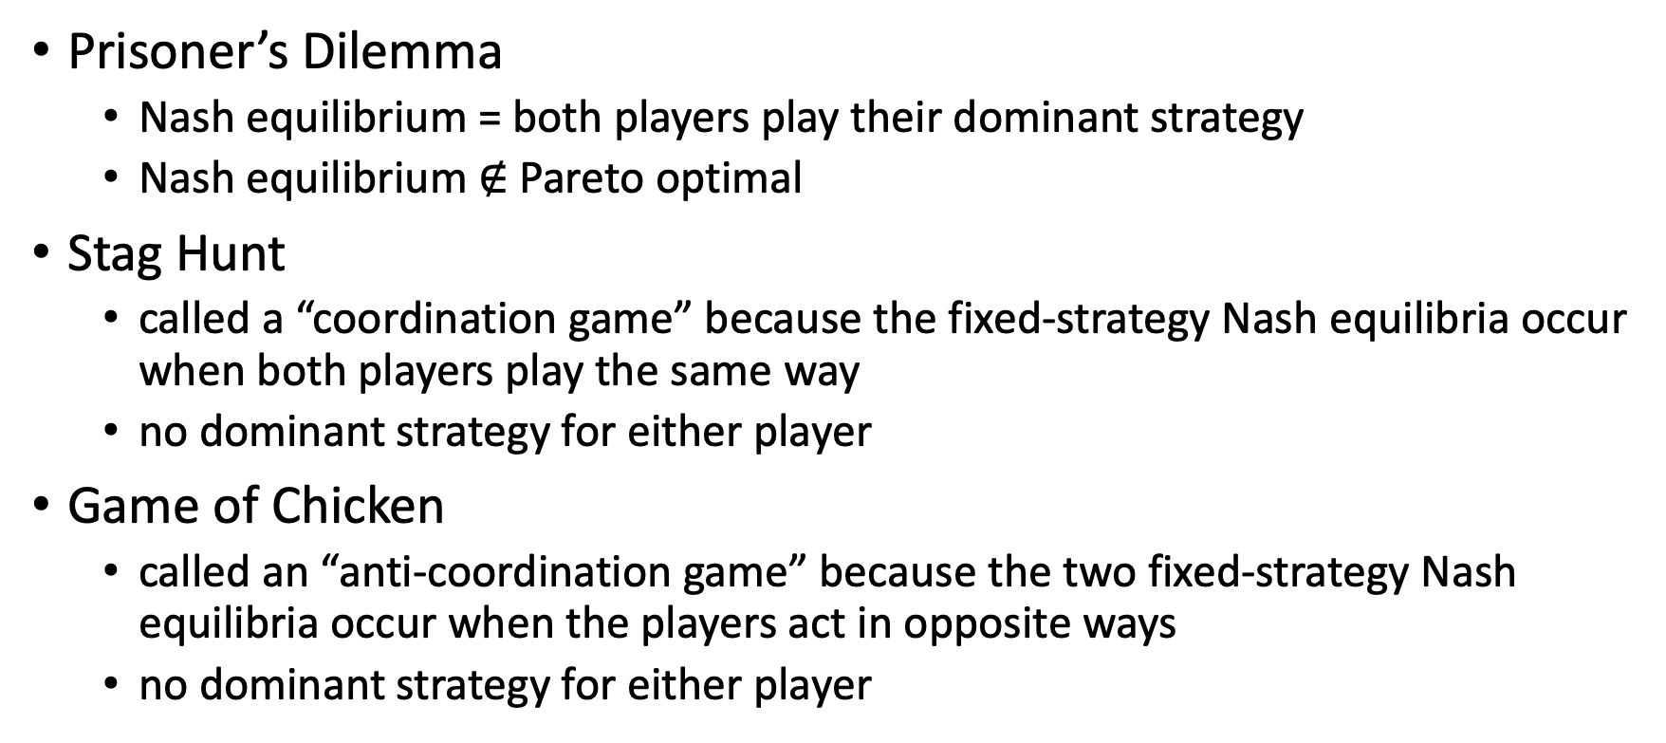
Summary
Prisoner’s Dilemma
  Nash equilibrium = both players play their dominant strategy
  Nash equilibrium $∉$ Pareto optimal
Stag Hunt
  called a “coordination game” because the fixed-strategy Nash equilibria occur when both players play the same way
  no dominant strategy for either player
Game of Chicken
  called an “anti-coordination game” because the two fixed-strategy Nash equilibria occur when the players act in opposite ways
  no dominant strategy for either player

Slide 53
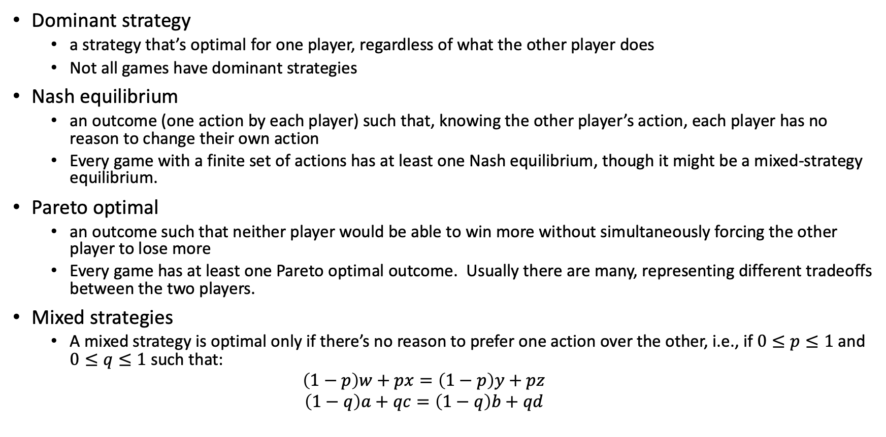
Summary
Dominant strategy
  a strategy that’s optimal for one player, regardless of what the other player does
  Not all games have dominant strategies
Nash equilibrium
  an outcome (one action by each player) such that, knowing the other player’s action, each player has no reason to change their own action
  Every game with a finite set of actions has at least one Nash equilibrium, though it might be a mixed-strategy equilibrium.
Pareto optimal
  an outcome such that neither player would be able to win more without simultaneously forcing the other player to lose more
  Every game has at least one Pareto optimal outcome. Usually there are many, representing different tradeoffs between the two players.
Mixed strategies
  A mixed strategy is optimal only if there’s no reason to prefer one action over the other, i.e., if $0≤p≤1$ and $0≤q≤1$ such that:
  $$\left(1−p\right)w+px=\left(1−p\right)y+pz$$
  $$\left(1−q\right)a+qc=\left(1−q\right)b+qd$$

