Slide 1
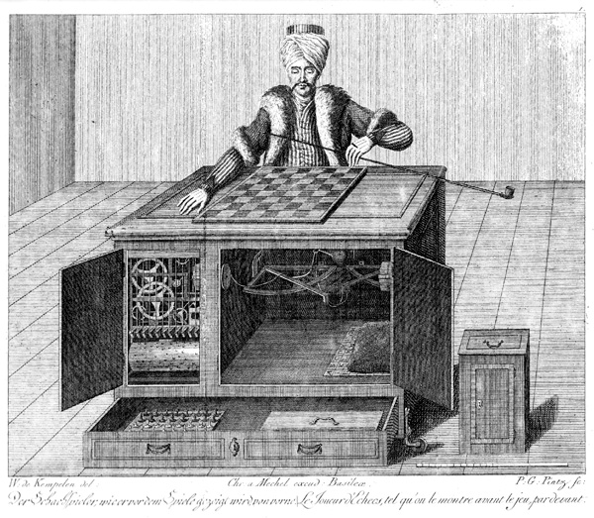
CS440/ECE448 Lecture 30:
Two-Player Games
Mark Hasegawa-Johnson, 4/2022
CC-BY 4.0: copy at will, but cite the source
By Karl Gottlieb von Windisch - Copper engraving from the book: Karl Gottlieb von Windisch, Briefe über den Schachspieler des Hrn. von Kempelen, nebst drei Kupferstichen die diese berühmte Maschine vorstellen. 1783.Original Uploader was Schaelss (talk) at 11:12, 7. Apr 2004., Public Domain, https://commons.wikimedia.org/w/index.php?curid=424092

Slide 2
Why study games?
Games are a traditional hallmark of intelligence
Games are easy to formalize
Games can be a good model of real-world competitive or cooperative activities
  Military confrontations, negotiation, auctions, etc.

Slide 3
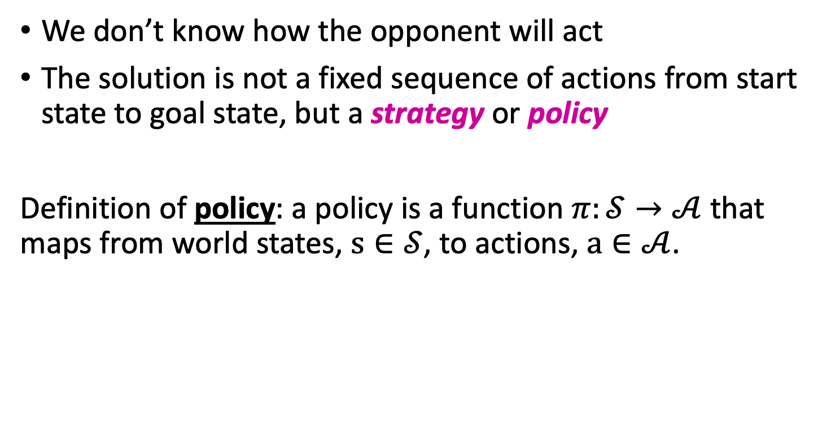
Games vs. single-agent search
We don’t know how the opponent will act
The solution is not a fixed sequence of actions from start state to goal state, but a strategy or policy
Definition of policy: a policy is a function $π:𝒮→𝒜$ that maps from world states, $s∈𝒮$, to actions, $a∈𝒜$.

Slide 4
Outline
Alternating two-player zero-sum games
Minimax search
Limited-horizon computation and heuristic evaluation functions
Alpha-beta search
Computational complexity of minimax and alpha-beta

Slide 5
Alternating two-player zero-sum games
Players take turns
Each game outcome or terminal state has a utility for each player (e.g., 1 for win, 0 for tie, -1 for loss)
The sum of both players’ utilities is a constant, e.g.,
Utility(player 0) + Utility(player 1) = 0
Player 0 tries to maximize Utility(player 0). Let’s call this player “Max”
Player 1 tries to minimize Utility(player 0). Let’s call this player “Min”

Slide 6
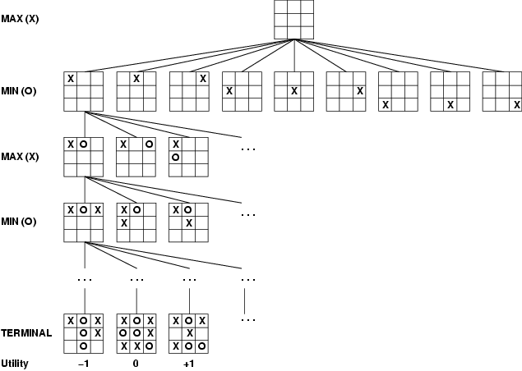
Game tree
A game of tic-tac-toe between two players, “max” and “min”

Slide 7
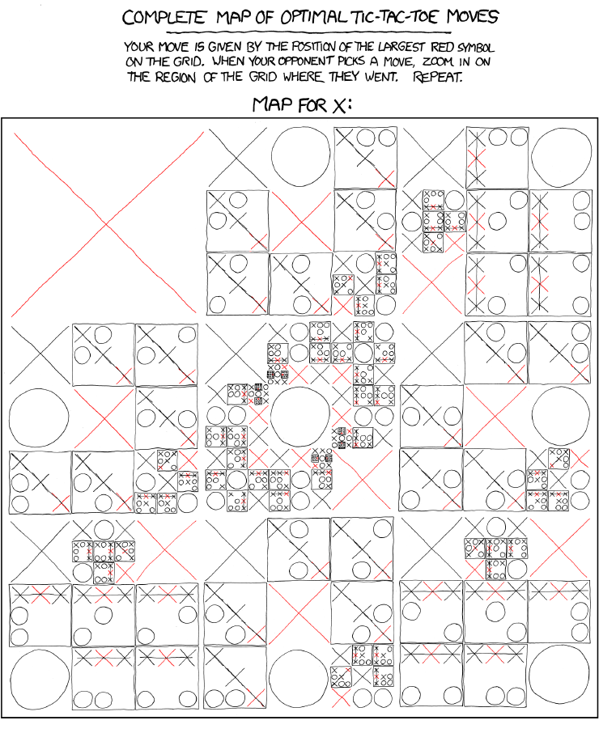
http://xkcd.com/832/

Slide 8
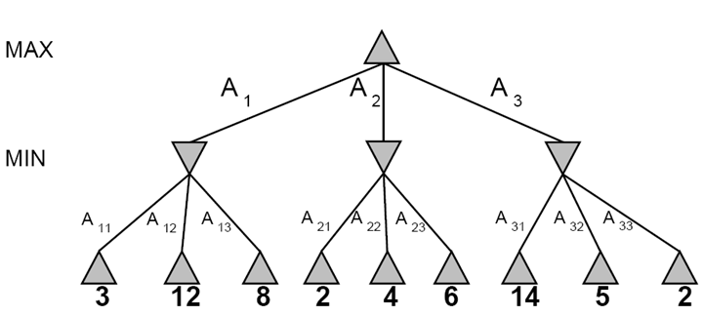
A more abstract game tree
Terminal utilities (for MAX)
A depth-two game

Slide 9
Standard notation for game trees
= game state from which MAX can play
= game state from which MIN can play
number = value of that game state for MAX

Slide 10
Outline
Alternating two-player zero-sum games
Minimax search
Limited-horizon computation and heuristic evaluation functions
Alpha-beta search
Computational complexity of minimax and alpha-beta

Slide 11
The rules of every game
Every possible outcome has a value (or “utility”) for me.
Zero-sum game: if the value to me is +V, then the value to my opponent is –V.
Phrased another way:
  My rational action, on each move, is to choose a move that will maximize the value of the outcome
  My opponent’s rational action is to choose a move that will minimize the value of the outcome
Call me “Max”
Call my opponent “Min”

Slide 12
Game tree search
3
3
2
2
Minimax value of a node: the utility (for MAX) of being in the corresponding state, assuming perfect play on both sides
Minimax strategy: Choose the move that gives the best worst-case payoff

Slide 13
Computing the minimax value of a node
3
3
2
2
Minimax(node) =
  Utility(node) if node is terminal
  max_{action} Minimax(Succ(node, action)) if player = MAX
  min_{action} Minimax(Succ(node, action)) if player = MIN

Slide 14
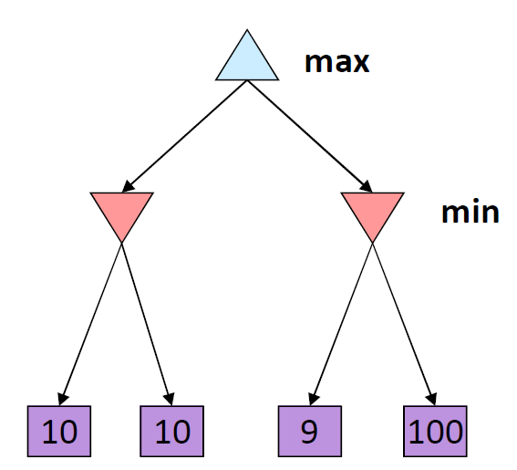
Optimality of minimax
The minimax strategy is optimal against an optimal opponent
What if your opponent is suboptimal?
If you play using the minimax-optimal sequence of moves, then the utility you earn will always be greater than or equal to the amount that you predict.
11
Example from D. Klein and P. Abbeel

Slide 15
Multi-player games; Non-zero-sum games
More than two players. For example:
  Dog (🐶) tries to maximize the number of doggie treats
  Cat (🐱) tries to maximize the number of cat treats
  Mouse (🐭) tries to maximize the number of mouse treats
Non-zero-sum. We can’t just assume that Min’s score is the opposite of Max’s. Instead, utilities are now tuples. For example:
  (🐶5, 🐱8, 🐭2) = 5 doggie treats, 8 kitty treats, 2 mouse treats
Each player maximizes their own utility at their node

Slide 16
Minimax in multi-player & non-zero-sum games
(🐶2, 🐱5, 🐭2)
🐶
(🐶1, 🐱2, 🐭6)
(🐶2, 🐱5, 🐭2)
🐱
🐱
(🐶1, 🐱2, 🐭6)
(🐶6, 🐱1, 🐭2)
(🐶2, 🐱5, 🐭2)
(🐶5, 🐱4, 🐭5)
🐭
🐭
🐭
🐭
(🐶1, 🐱2, 🐭6)
(🐶4, 🐱3, 🐭2)
(🐶6, 🐱1, 🐭2)
(🐶7, 🐱4, 🐭1)
(🐶5, 🐱1, 🐭1)
(🐶2, 🐱5, 🐭2)
(🐶7, 🐱7, 🐭1)
(🐶5, 🐱4, 🐭5)

Slide 17
Outline
Alternating two-player zero-sum games
Minimax search
Limited-horizon computation and heuristic evaluation functions
Alpha-beta search
Computational complexity of minimax and alpha-beta

Slide 18
Games vs. single-agent search
We don’t know how the opponent will act
  The solution is not a fixed sequence of actions from start state to goal state, but a strategy or policy (a mapping from state to best move in that state)

Slide 19
Games vs. single-agent search
We don’t know how the opponent will act
  The solution is not a fixed sequence of actions from start state to goal state, but a strategy or policy (a mapping from state to best move in that state)
Efficiency is critical to playing well
  The time to make a move is limited
  The branching factor, search depth, and number of terminal configurations are huge
    In chess, branching factor ≈ 35 and depth ≈ 100, giving a search tree of 10¹⁵⁴ nodes
      Number of atoms in the observable universe ≈ 10⁸⁰
  This rules out searching all the way to the end of the game

Slide 20
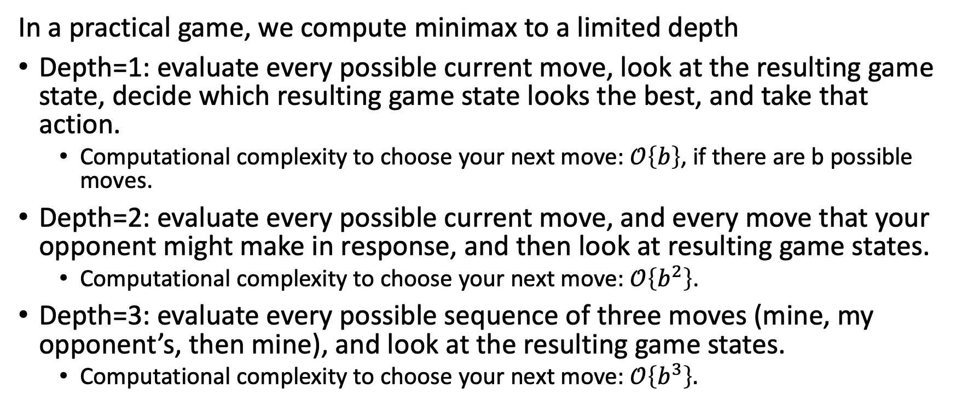
Limited-Horizon Search
In a practical game, we compute minimax to a limited depth
Depth=1: evaluate every possible current move, look at the resulting game state, decide which resulting game state looks the best, and take that action.
  Computational complexity to choose your next move: $𝒪\left\{b\right\}$, if there are b possible moves.
Depth=2: evaluate every possible current move, and every move that your opponent might make in response, and then look at resulting game states.
  Computational complexity to choose your next move: $𝒪\left\{b^{2}\right\}$.
Depth=3: evaluate every possible sequence of three moves (mine, my opponent’s, then mine), and look at the resulting game states.
  Computational complexity to choose your next move: $𝒪\left\{b^{3}\right\}.$

Slide 21
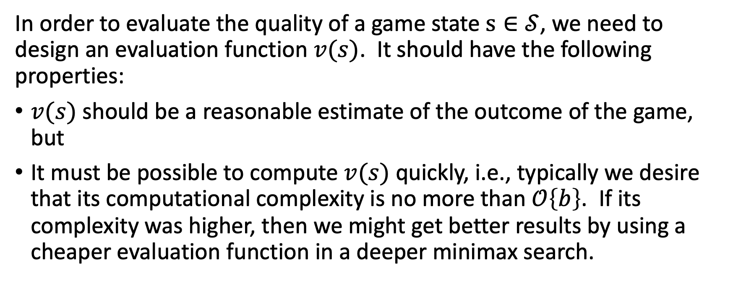
Evaluation functions
In order to evaluate the quality of a game state $s∈𝒮$, we need to design an evaluation function $v(s)$. It should have the following properties:
$v(s)$ should be a reasonable estimate of the outcome of the game, but
It must be possible to compute $v(s)$ quickly, i.e., typically we desire that its computational complexity is no more than $𝒪\left\{b\right\}$. If its complexity was higher, then we might get better results by using a cheaper evaluation function in a deeper minimax search.

Slide 22
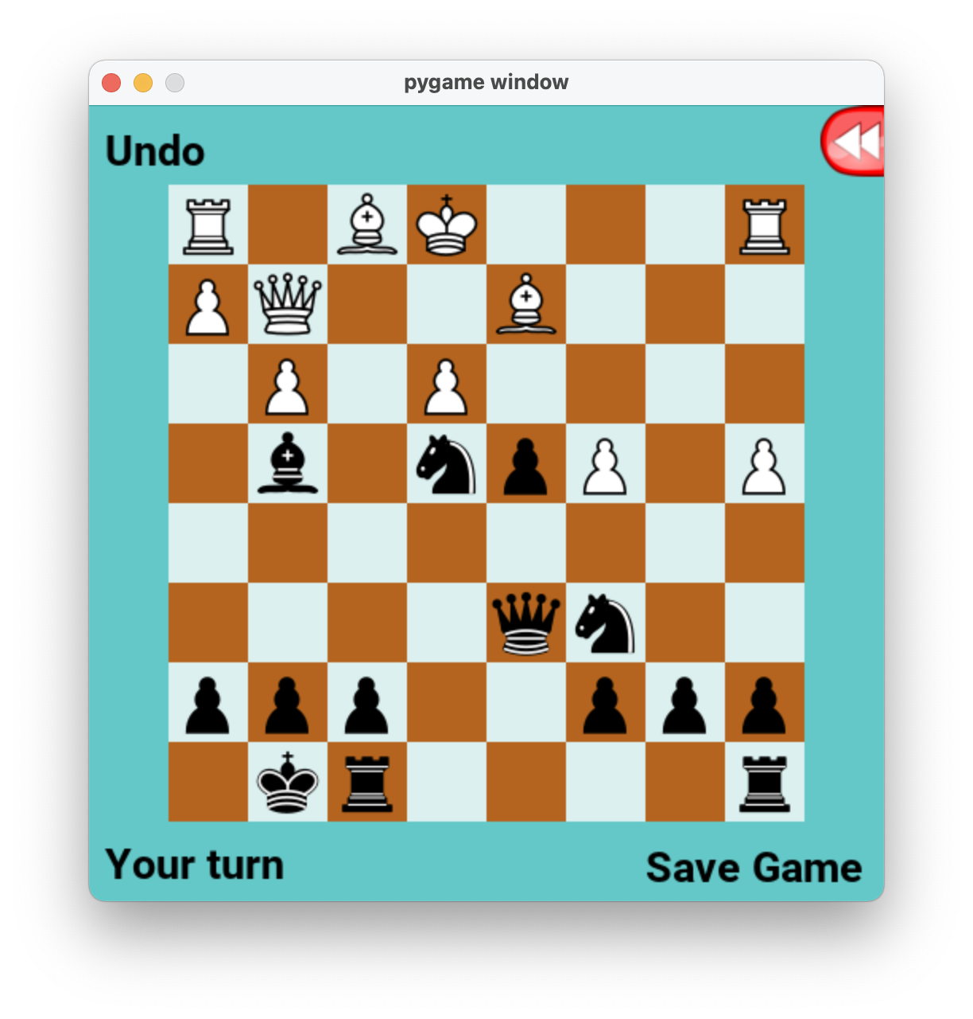
Example: Depth 1 search, Chess
In chess, traditionally, the black player is MIN.
What move should MIN choose, from this board position?
Graphics: created by the PyChess community.
Game board shown: game1.txt from the MP5 distribution.

Slide 23
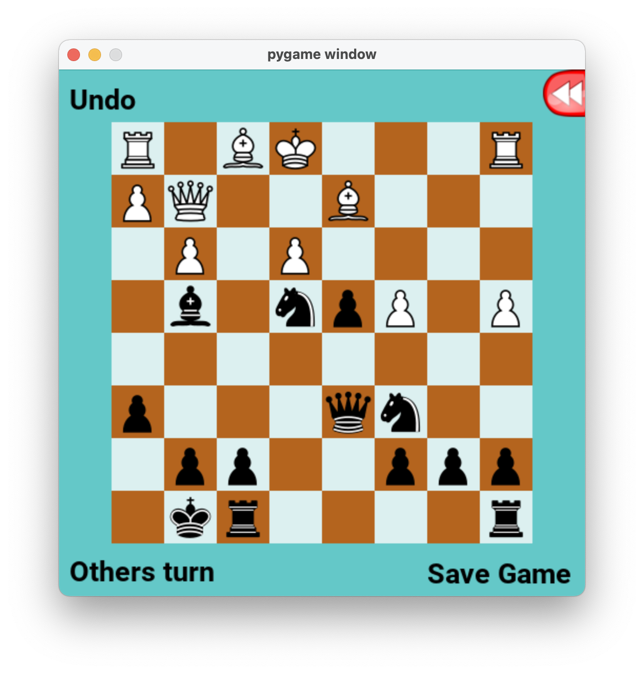
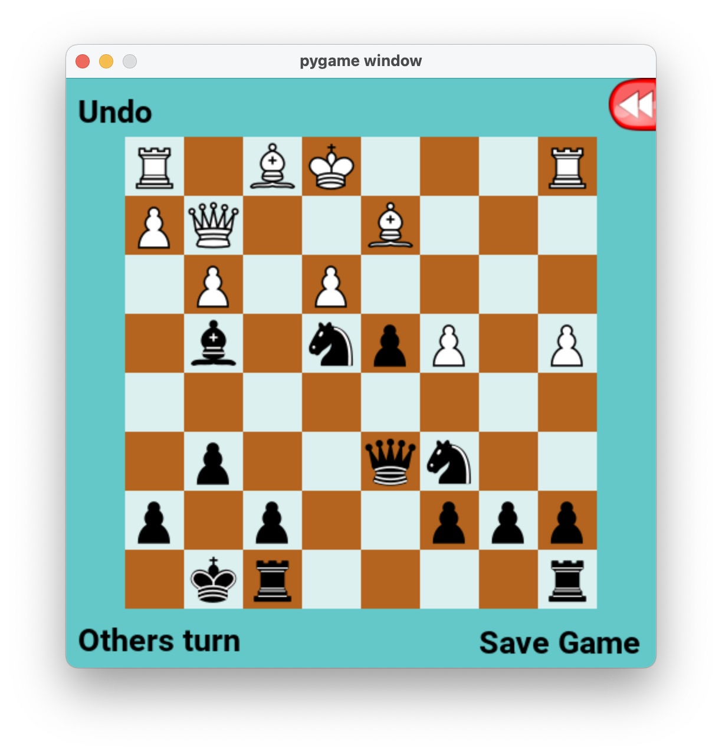
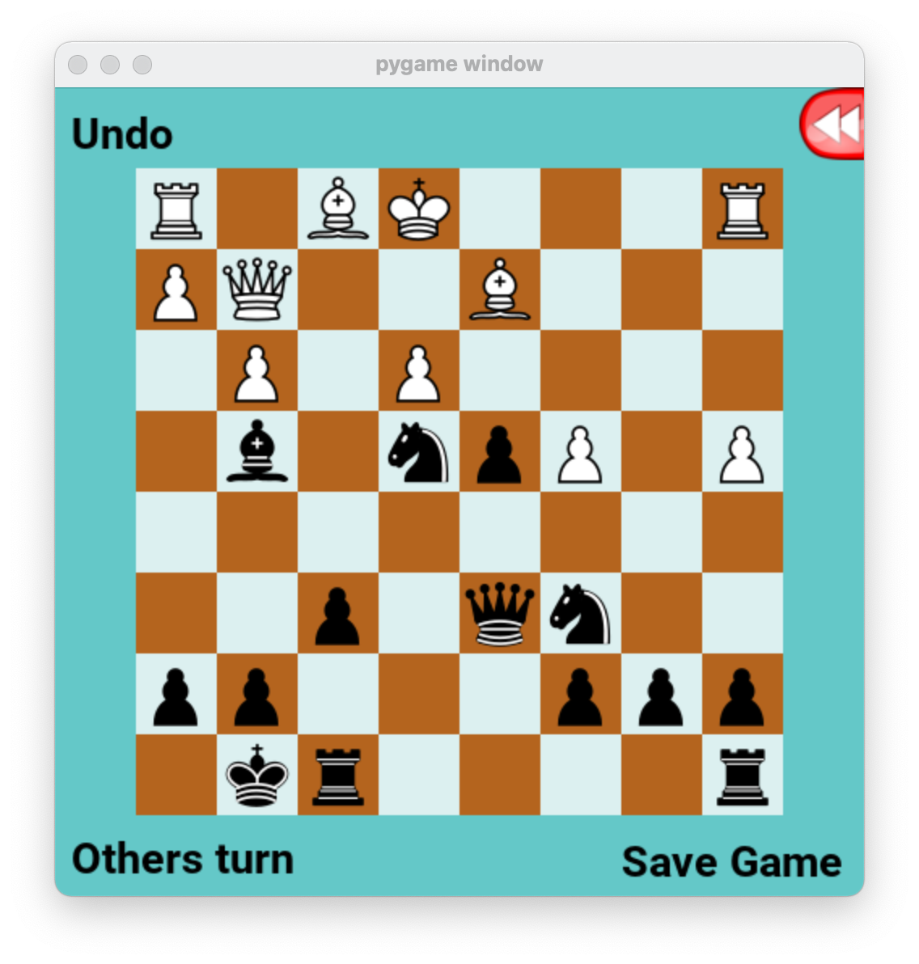
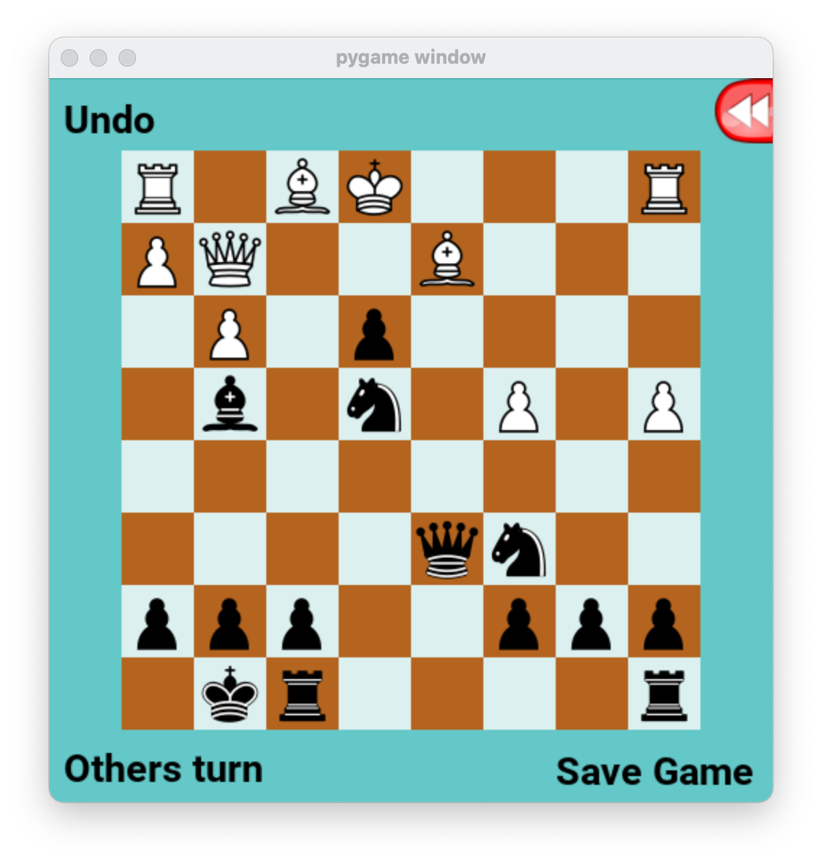
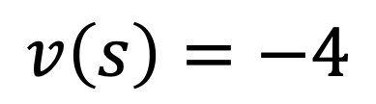
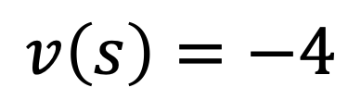
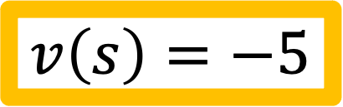
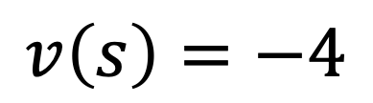
Example: Depth 1 search, Chess
In chess, traditionally, the black player is MIN.
Since one move has a final board value less than the others, MIN will choose that move (in a depth-1 search).
$$v\left(s\right)=−4$$
$$v\left(s\right)=−4$$
$$v\left(s\right)=−4$$
$$v\left(s\right)=−5$$

Slide 24
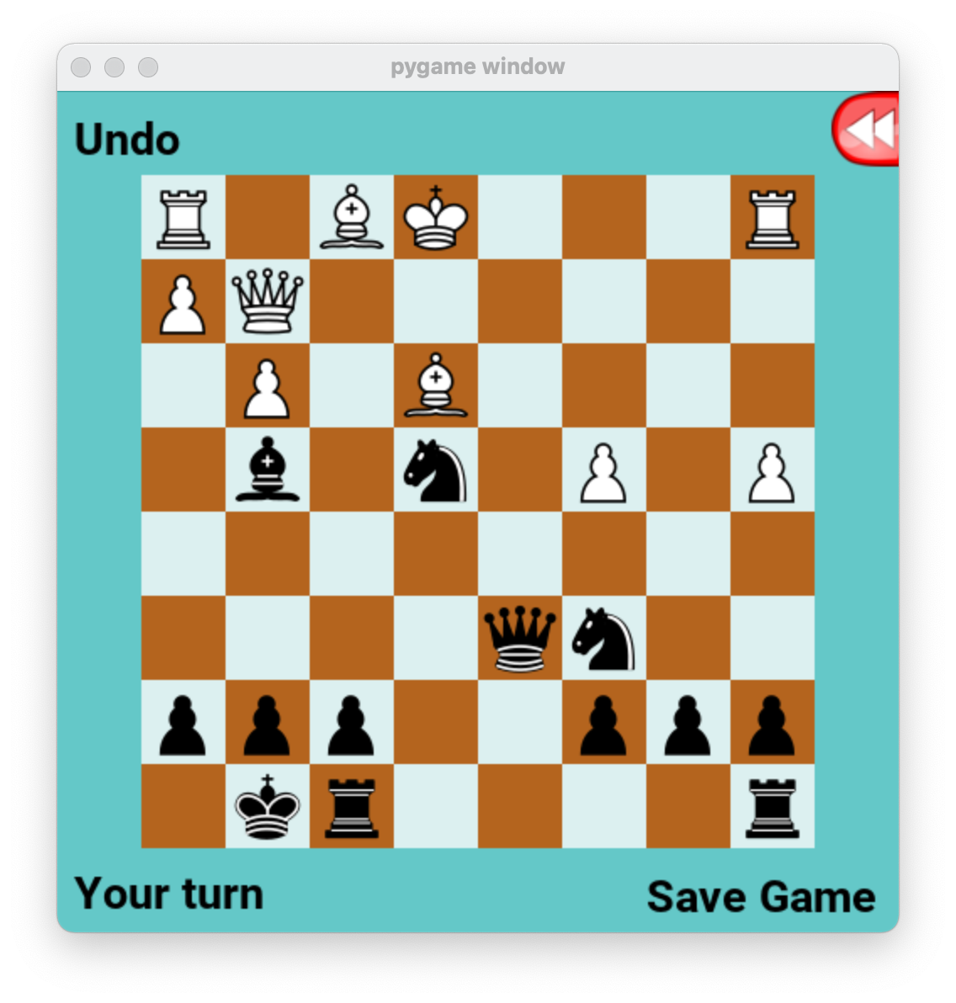
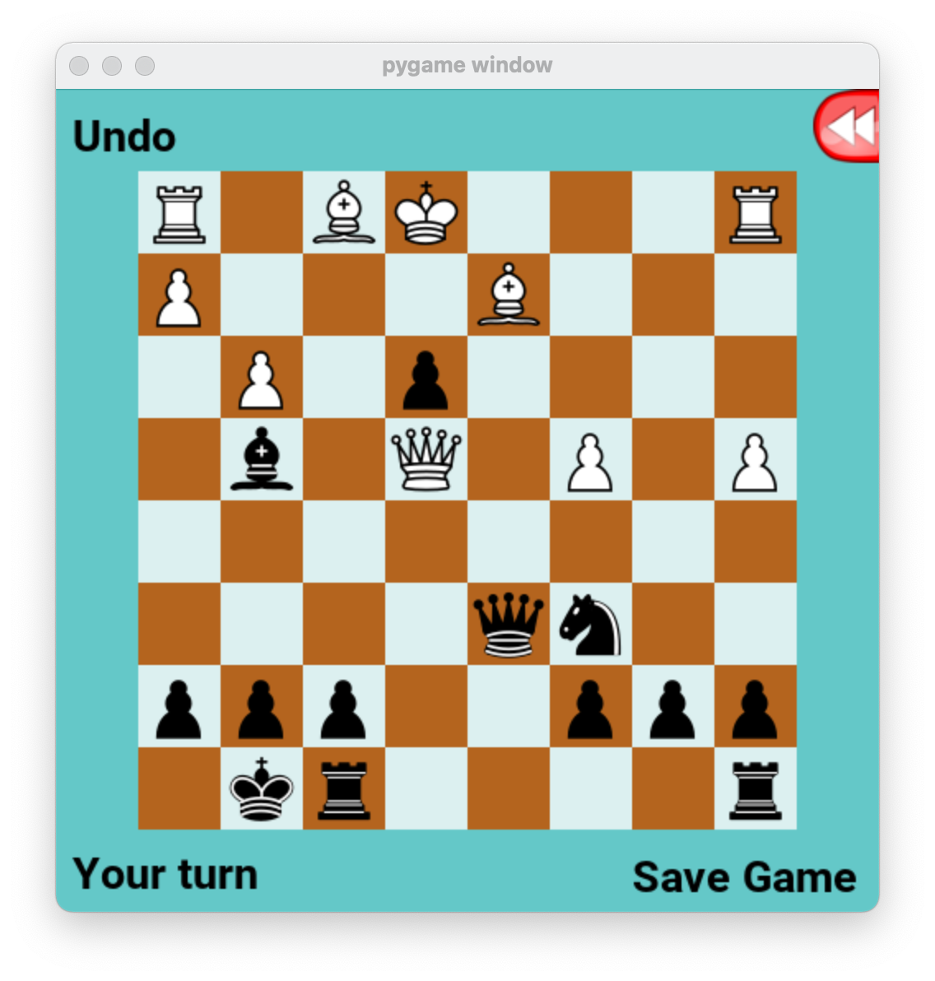


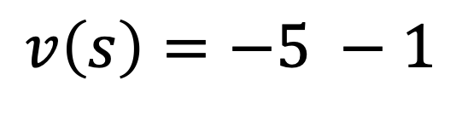



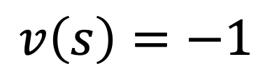
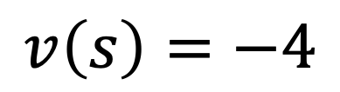

Example: Depth 2 search, Chess
X
$$…$$
$$v\left(s\right)=−5 −1$$
$$…$$
$$…$$
$$…$$
$$…$$
$$…$$
$$v\left(s\right)=−4$$
$$v\left(s\right)=−1$$

Slide 25





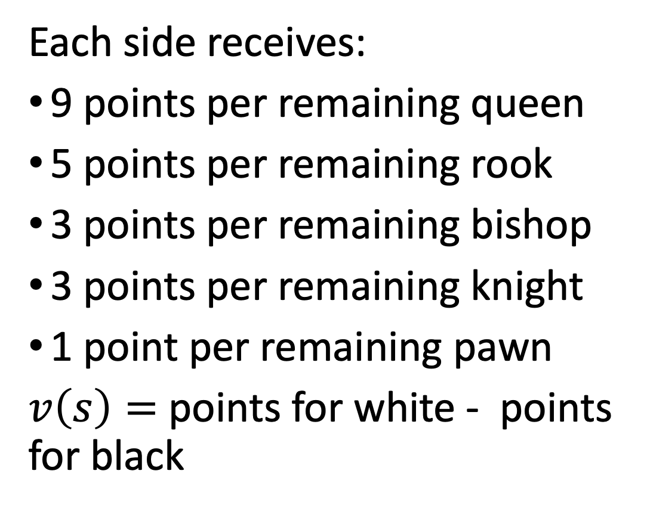
Typical chess evaluation function
Each side receives:
9 points per remaining queen
5 points per remaining rook
3 points per remaining bishop
3 points per remaining knight
1 point per remaining pawn
$v\left(s\right)=$ points for white - points for black
The PyChess evaluation function provides extra point depending on the location of each piece on the board.

Slide 26
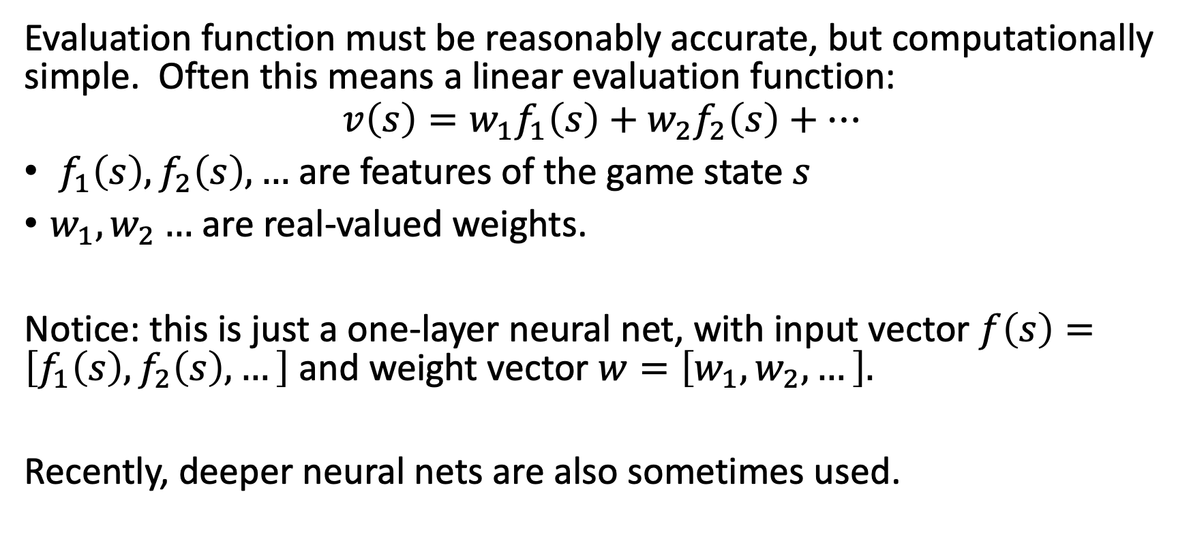
Evaluation functions in general
Evaluation function must be reasonably accurate, but computationally simple. Often this means a linear evaluation function:
$$v\left(s\right)=w_{1}f_{1}\left(s\right)+w_{2}f_{2}\left(s\right)+⋯$$
$f_{1}\left(s\right), f_{2}\left(s\right),…$ are features of the game state $s$
$w_{1},w_{2}…$ are real-valued weights.
Notice: this is just a one-layer neural net, with input vector $f\left(s\right)=\left[f_{1}\left(s\right), f_{2}\left(s\right),…\right]$ and weight vector $w=\left[w_{1}, w_{2},…\right].$
Recently, deeper neural nets are also sometimes used.

Slide 27
Cutting off search
Horizon effect: you may incorrectly estimate the value of a state by overlooking an event that is just beyond the depth limit
  For example, a damaging move by the opponent that can be delayed but not avoided
Remedies: search a small number of possible extensions to depth+1.
  Quiescence search: extend only “unstable” moves, e.g., moves that capture a piece.
  Singular extension: extend only very strong moves.
  Stochastic search: randomly sample a small number of possible future paths.

Slide 28
Outline
Alternating two-player zero-sum games
Minimax search
Limited-horizon computation and heuristic evaluation functions
Alpha-beta search
Computational complexity of minimax and alpha-beta

Slide 29

Computational complexity of minimax
Suppose that, at each game state, there are b possible moves
Suppose we search to a depth of d
Then the computational complexity is $O\{b^{d}\}$!

Slide 30
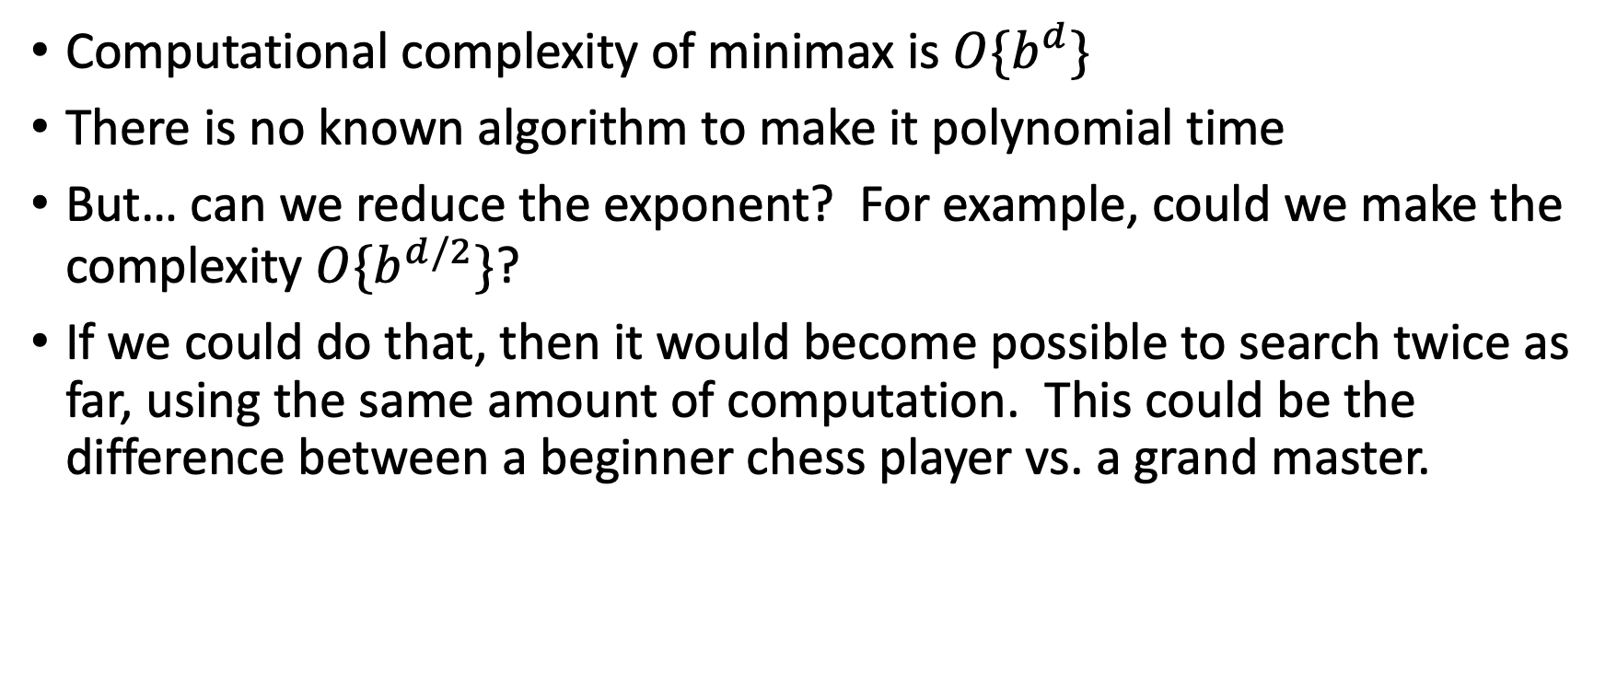
Basic idea of alpha-beta pruning
Computational complexity of minimax is $O\{b^{d}\}$
There is no known algorithm to make it polynomial time
But… can we reduce the exponent? For example, could we make the complexity $O\{b^{d/2}\}$?
If we could do that, then it would become possible to search twice as far, using the same amount of computation. This could be the difference between a beginner chess player vs. a grand master.

Slide 31
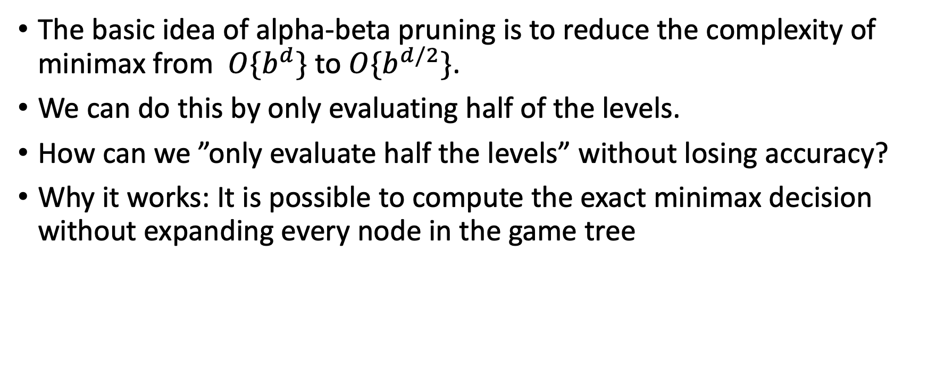
Basic idea of alpha-beta pruning
The basic idea of alpha-beta pruning is to reduce the complexity of minimax from $O\{b^{d}\}$ to $O\{b^{d/2}\}$.
We can do this by only evaluating half of the levels.
How can we ”only evaluate half the levels” without losing accuracy?
Why it works: It is possible to compute the exact minimax decision without expanding every node in the game tree

Slide 32
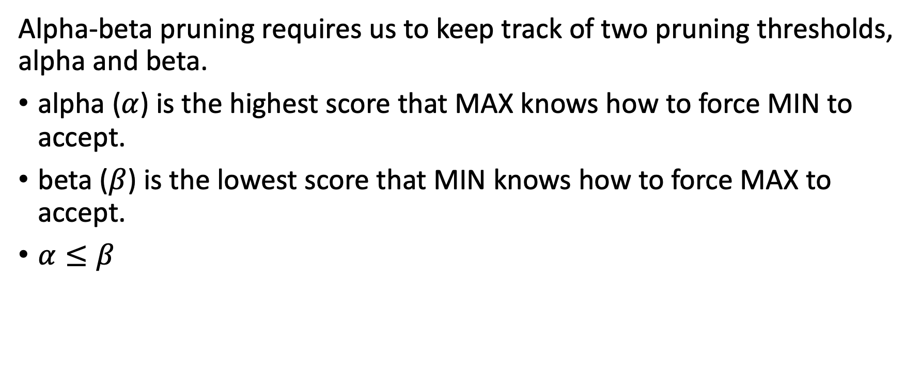
The pruning thresholds, alpha and beta
Alpha-beta pruning requires us to keep track of two pruning thresholds, alpha and beta.
alpha ($α$) is the highest score that MAX knows how to force MIN to accept.
beta ($β$) is the lowest score that MIN knows how to force MAX to accept.
$α≤β$

Slide 33
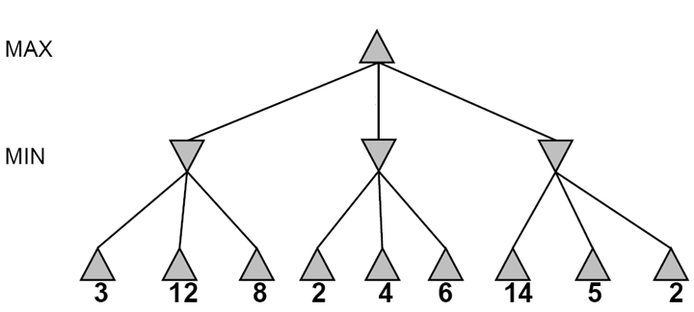
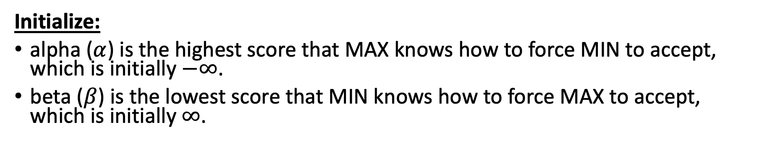
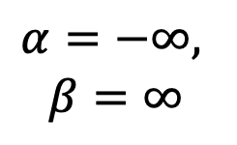
Alpha-beta pruning
Initialize:
alpha ($α$) is the highest score that MAX knows how to force MIN to accept, which is initially $−∞$.
beta ($β$) is the lowest score that MIN knows how to force MAX to accept, which is initially $∞$.
$$α=−∞,$$
$$β=∞$$

Slide 34
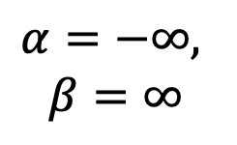
Alpha-beta pruning
Inheritance: Child inherits alpha and beta from its parent
$$α=−∞,$$
$$β=∞$$
$$α=−∞,$$
$$β=∞$$

Slide 35
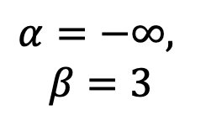
Alpha-beta pruning
Update: a min node can update beta. A max node can update alpha.
$$α=−∞,$$
$$β=∞$$
$$α=−∞,$$
$$β=3$$
3

Slide 36
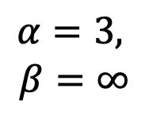
Alpha-beta pruning
Update: a min node can update beta. A max node can update alpha.
$$α=3,$$
$$β=∞$$
≥3
$$α=−∞,$$
$$β=3$$
3

Slide 37
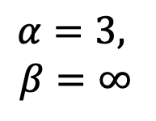
Alpha-beta pruning
Inheritance: Child inherits alpha and beta from its parent
$$α=3,$$
$$β=∞$$
≥3
$$α=3,$$
$$β=∞$$
3

Slide 38
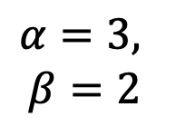
Alpha-beta pruning
Update: a min node can update beta. A max node can update alpha.
$$α=3,$$
$$β=∞$$
≥3
$$α=3,$$
$$β=2$$
3
≤2

Slide 39
Alpha-beta pruning
Pruning: If beta ever falls below alpha, prune any remaining children, and return.
$$α=3,$$
$$β=∞$$
≥3
PRUNE!
If MAX lets us get to this state, then MIN would achieve a final score <=2
Therefore MAX will never let us get to this state!
Therefore there’s no need to score the remaning children of this node.
$$α=3,$$
$$β=2$$
3
≤2
X

Slide 40
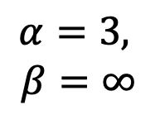
Alpha-beta pruning
Inheritance: Child inherits alpha and beta from its parent
$$α=3,$$
$$β=∞$$
≥3
$$α=3,$$
$$β=∞$$
3
≤2

Slide 41
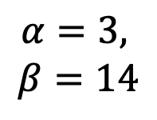
Alpha-beta pruning
Update: a min node can update beta. A max node can update alpha.
$$α=3,$$
$$β=∞$$
≥3
$$α=3,$$
$$β=14$$
3
≤2

Slide 42
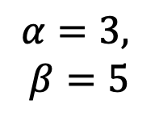
Alpha-beta pruning
Update: a min node can update beta. A max node can update alpha.
$$α=3,$$
$$β=∞$$
≥3
$$α=3,$$
$$β=5$$
3
≤2

Slide 43

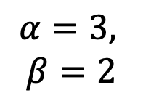
Alpha-beta pruning
Pruning: If beta ever falls below alpha, prune any remaining children, and return.
Violation of $α<β$ means it is now possible to prune any remaining children of this node.
$$α=3,$$
$$β=∞$$
3
$$α=3,$$
$$β=2$$
3
≤2
Notes:
Could we have done better with the right branch?

Slide 44
Outline
Alternating two-player zero-sum games
Minimax search
Limited-horizon computation and heuristic evaluation functions
Alpha-beta search
Computational complexity of minimax and alpha-beta

Slide 45

Computational complexity of alpha-beta pruning
The basic idea of alpha-beta pruning is to reduce the complexity of minimax from $O\{b^{d}\}$ to $O\{b^{d/2}\}$.
That can be done with no loss of accuracy,
… but only if the children of any given node are optimally ordered.

Slide 46
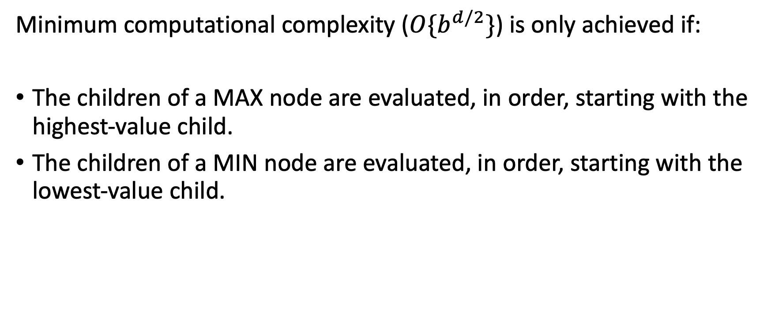
Optimal ordering
Minimum computational complexity ($O\{b^{d/2}\}$) is only achieved if:
The children of a MAX node are evaluated, in order, starting with the highest-value child.
The children of a MIN node are evaluated, in order, starting with the lowest-value child.

Slide 47
Non-optimal ordering
In this tree, the moves are not optimally ordered, so we were only able to prune two nodes.
3
3
≤2
2
X
X

Slide 48
Optimal ordering
In this tree, the moves ARE optimally ordered, so we are able to prune four nodes (out of nine).
3
3
≤2
≤2
X
X
X
X
2
5
14

Slide 49
Optimal ordering
In this tree, the moves ARE optimally ordered, so we are able to prune four nodes (out of nine).
3
3
≤2
≤2
X
X
X
X
2
5
14

Slide 50
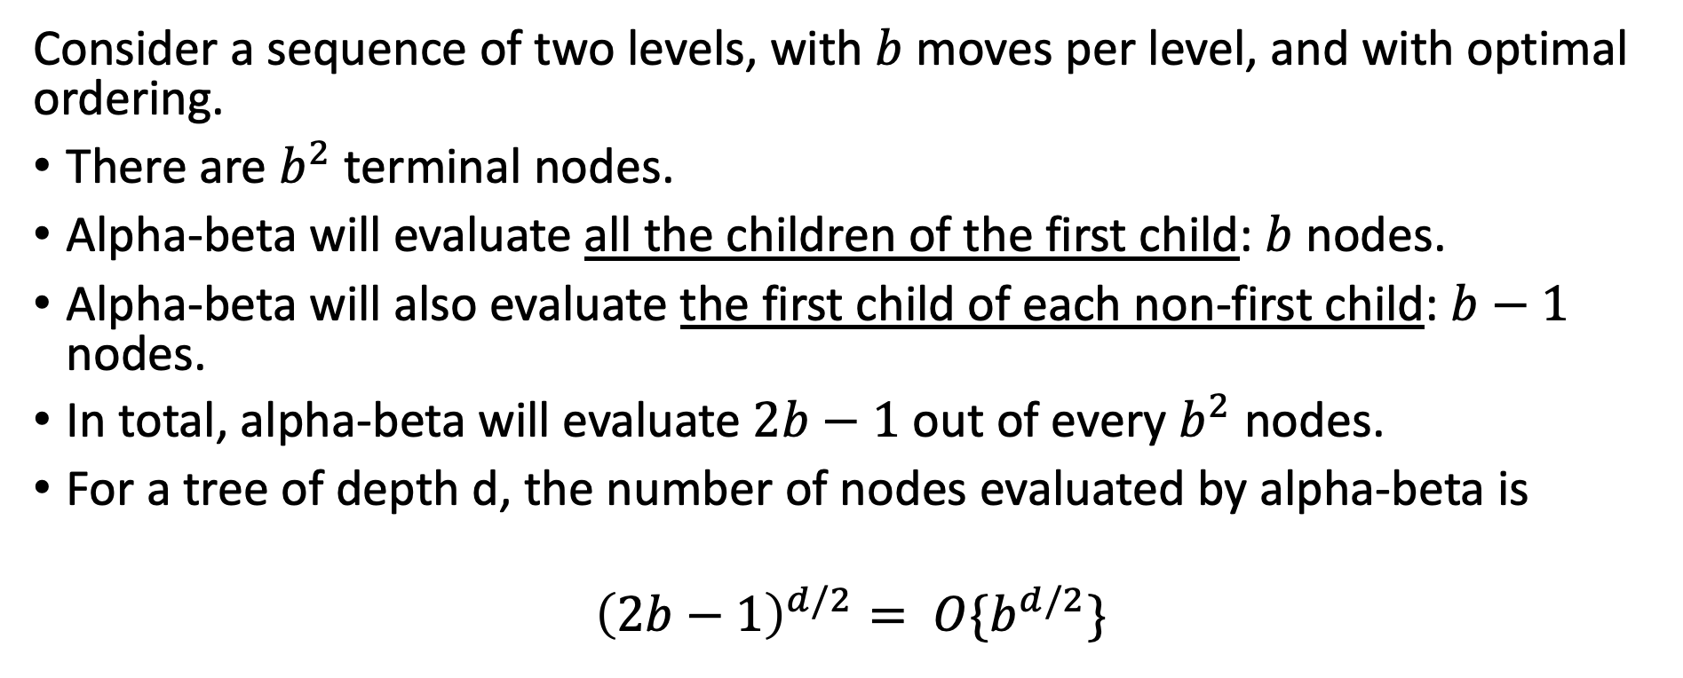
Computational Complexity
X
X
X
X
2
5
14
Consider a sequence of two levels, with $b$ moves per level, and with optimal ordering.
There are $b^{2}$ terminal nodes.
Alpha-beta will evaluate all the children of the first child: $b$ nodes.
Alpha-beta will also evaluate the first child of each non-first child: $b−1$ nodes.
In total, alpha-beta will evaluate $2b−1$ out of every $b^{2}$ nodes.
For a tree of depth d, the number of nodes evaluated by alpha-beta is
$${\left(2b−1\right)}^{d/2}= O\{b^{d/2}\}$$

Slide 51

Computational Complexity
X
X
X
X
2
5
14
…but wait… this means we need to know, IN ADVANCE, which move has the highest value, and which move has the lowest value!!
Obviously, it is not possible to know the true value of a move without evaluating it.
However, heuristics often are pretty good.
We use the heuristic to decide which move to evaluate first.
For games like chess, with good heuristics, complexity of alpha-beta is closer to $O\{b^{d/2}\}$ than to $O\{b^{d}\}$.

Slide 52

Conclusions
Alternating two-player zero-sum games
  $\bigwedge{=}$ a max node, $⋁=$ a min node
Minimax search
  $v\left(s\right)=\max_{a}{v(child(s,a))}$ or $v\left(s\right)=\min_{a}{v(child(s,a))}$
Limited-horizon computation and heuristic evaluation functions
$v\left(s\right)=w_{1}f_{1}\left(s\right)+w_{2}f_{2}\left(s\right)+⋯$
Alpha-beta search
  Min node can update beta, Max node can update alpha
  If beta ever falls below alpha, prune the rest of the children
Computational complexity of minimax and alpha-beta
  Minimax is $O\{b^{d}\}$. With optimal move ordering, alpha-beta is $O\{b^{d/2}\}$.

