Slide 1
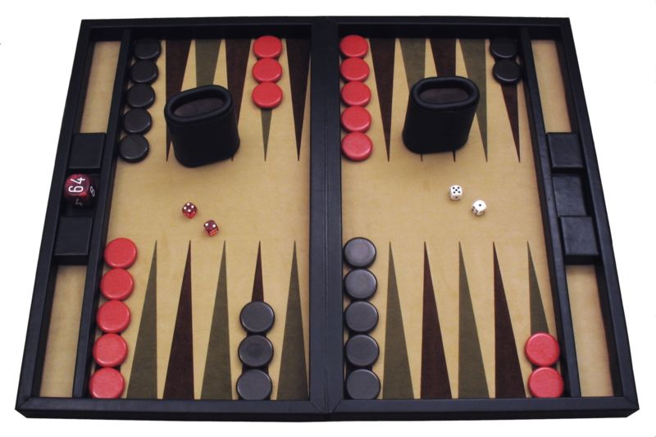
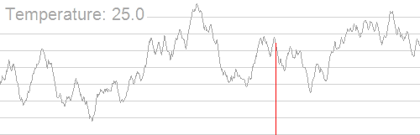
CS440/ECE448 Lecture 31:
Stochastic Search & Stochastic Games
Mark Hasegawa-Johnson, 4/2022
CC-BY-4.0: feel free to copy if you cite the source
Hill_Climbing_with_Simulated_Annealing.gif, Public domain image, Kingpin13, 2013
A contemporary backgammon set. Public domain photo by Manuel Hegner, 2013, https://commons.wikimedia.org/w/index.php?curid=25006945

Slide 2
Outline
Stochastic games: the game itself is random
Stochastic search: the game is deterministic, but we use randomness in the search, to find a fast approximate solution

Slide 3
Stochastic games
How can we incorporate dice throwing into the game tree?

Slide 4
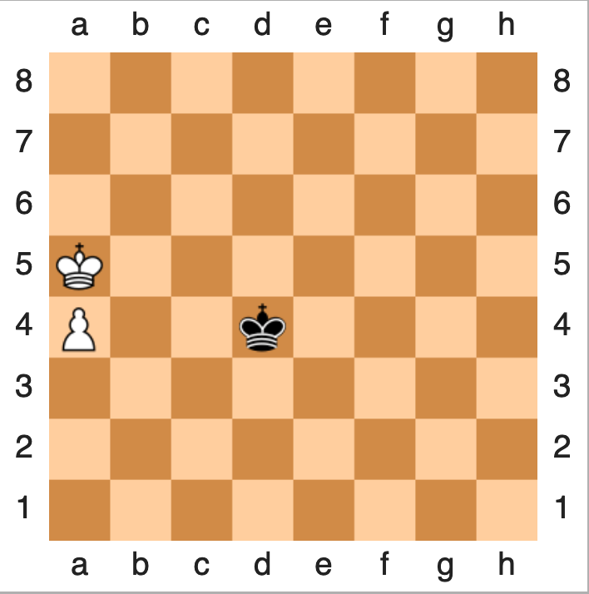
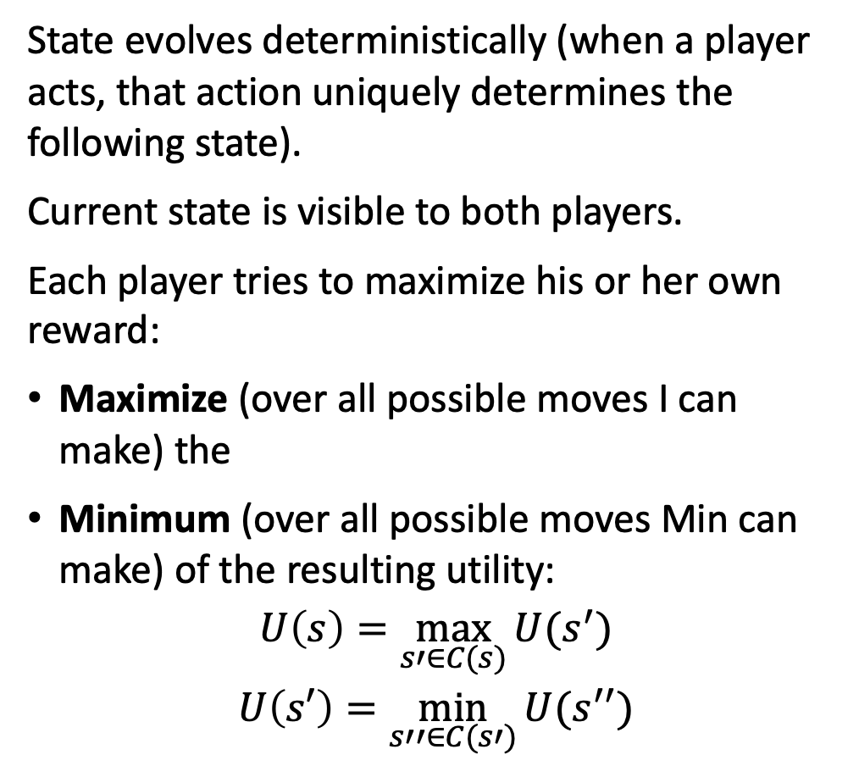
Minimax
State evolves deterministically (when a player acts, that action uniquely determines the following state).
Current state is visible to both players.
Each player tries to maximize his or her own reward:
Maximize (over all possible moves I can make) the
Minimum (over all possible moves Min can make) of the resulting utility:
$$U\left(s\right)=\max_{s′∈C(s)}{U(s^{′})}$$
$$U\left(s′\right)=\min_{s′′∈C(s′)}{U(s^{′′})}$$

Slide 5


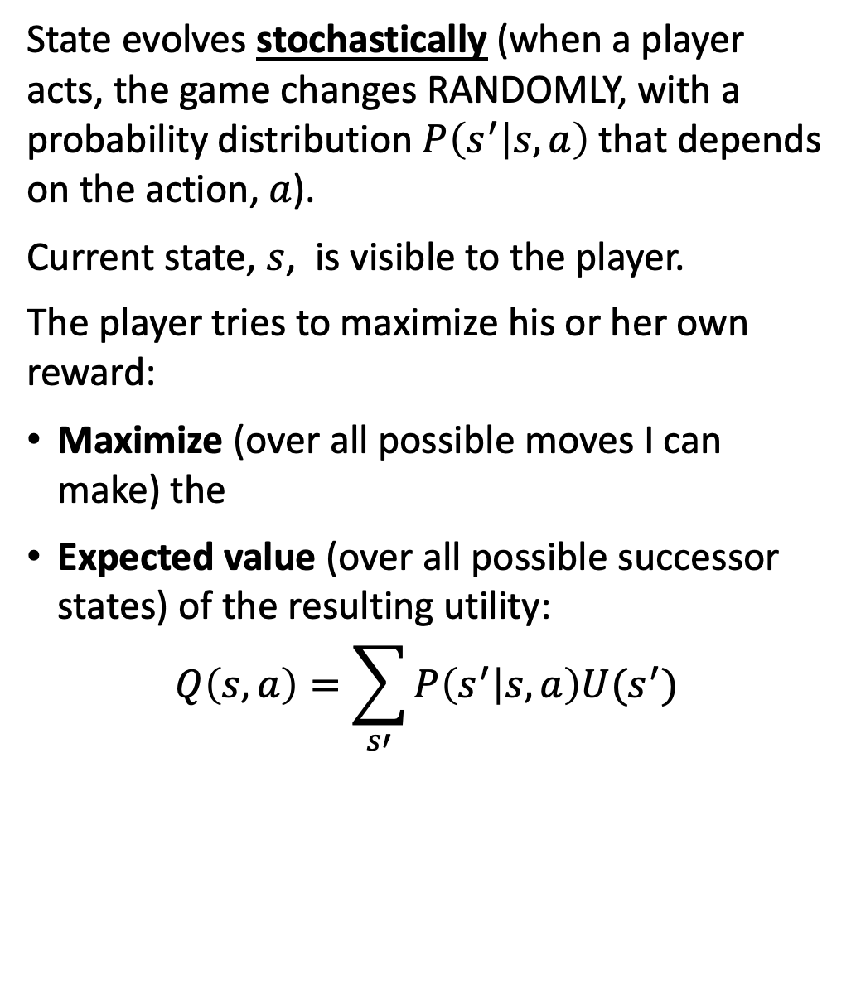
Expectiminimax
State evolves stochastically (when a player acts, the game changes RANDOMLY, with a probability distribution $P\left(s^{′} | s,a\right)$that depends on the action, $a$).
Current state, $s$, is visible to the player.
The player tries to maximize his or her own reward:
Maximize (over all possible moves I can make) the
Expected value (over all possible successor states) of the resulting utility:
$$Q\left(s,a\right)=\sum_{s′}{P\left(s^{′} | s,a\right)U(s^{′})}$$

Slide 6
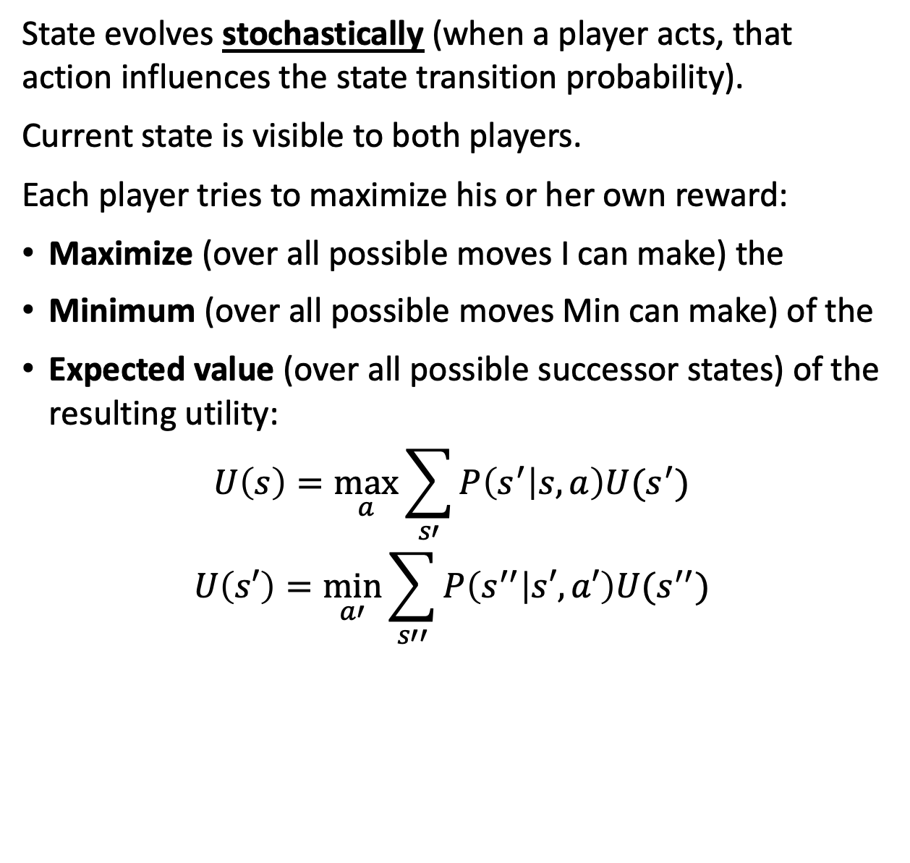
Expectiminimax
State evolves stochastically (when a player acts, that action influences the state transition probability).
Current state is visible to both players.
Each player tries to maximize his or her own reward:
Maximize (over all possible moves I can make) the
Minimum (over all possible moves Min can make) of the
Expected value (over all possible successor states) of the resulting utility:
$$U\left(s\right)=\max_{a}{\sum_{s′}{P\left(s^{′} | s,a\right)U(s^{′})}}$$
$$U\left(s′\right)=\min_{a′}{\sum_{s′′}{P\left(s^{′′} | s′,a′\right)U(s^{′′})}}$$

Slide 7
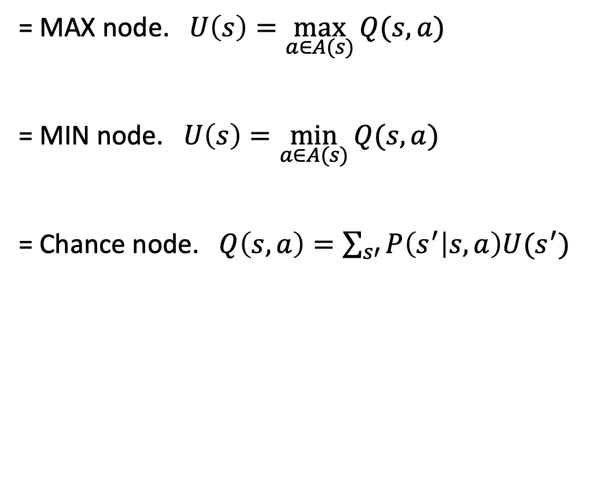
Expectiminimax: notation
= MAX node. $U\left(s\right)=\max_{a∈A(s)}{Q(s,a)}$
= MIN node. $U\left(s\right)=\min_{a∈A(s)}{Q(s,a)}$
= Chance node. $Q\left(s,a\right)=\sum_{s′}{P\left(s^{′} | s,a\right)U(s^{′})}$

Slide 8

Expectiminimax example
MIN: Min decides whether to count heads (action H) or tails (action T) as a forward movement.
H
Emojis by Twitter, CC BY 4.0, https://commons.wikimedia.org/w/index.php?curid=59974366

Slide 9
Expectiminimax example
MIN: Min decides whether to count heads (action H) or tails (action T) as a forward movement.
H
Emojis by Twitter, CC BY 4.0, https://commons.wikimedia.org/w/index.php?curid=59974366

Slide 10

Expectiminimax example
MIN: Min decides whether to count heads (action H) or tails (action T) as a forward movement.
Chance: she flips a coin and moves her game piece in the direction indicated.
By ICMA Photos - Coin Toss, CC BY-SA 2.0, https://commons.wikimedia.org/w/index.php?curid=71147286
Emojis by Twitter, CC BY 4.0, https://commons.wikimedia.org/w/index.php?curid=59974366

Slide 11
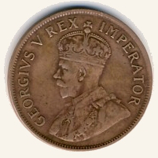
Expectiminimax example
MIN: Min decides whether to count heads (action H) or tails (action T) as a forward movement.
Chance: she flips a coin and moves her game piece in the direction indicated.
By NJR ZA - Own work, CC BY-SA 3.0, https://commons.wikimedia.org/w/index.php?curid=4228918
Emojis by Twitter, CC BY 4.0, https://commons.wikimedia.org/w/index.php?curid=59974366

Slide 12
Expectiminimax example
MIN: Min decides whether to count heads (action H) or tails (action T) as a forward movement.
Chance: she flips a coin and moves her game piece in the direction indicated.
MAX: Max decides whether to count heads (action H) or tails (action T) as a forward movement.
By NJR ZA - Own work, CC BY-SA 3.0, https://commons.wikimedia.org/w/index.php?curid=4228918
H
Emojis by Twitter, CC BY 4.0, https://commons.wikimedia.org/w/index.php?curid=59974366

Slide 13
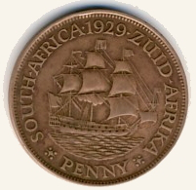
Expectiminimax example
MIN: Min decides whether to count heads (action H) or tails (action T) as a forward movement.
Chance: she flips a coin and moves her game piece in the direction indicated.
MAX: Max decides whether to count heads (action H) or tails (action T) as a forward movement.
Chance: he flips a coin and moves his game piece in the direction indicated.
By NJR ZA - Own work, CC BY-SA 3.0, https://commons.wikimedia.org/w/index.php?curid=4228918
By NJR ZA - Own work, CC BY-SA 3.0, https://commons.wikimedia.org/w/index.php?curid=4228918
Emojis by Twitter, CC BY 4.0, https://commons.wikimedia.org/w/index.php?curid=59974366

Slide 14
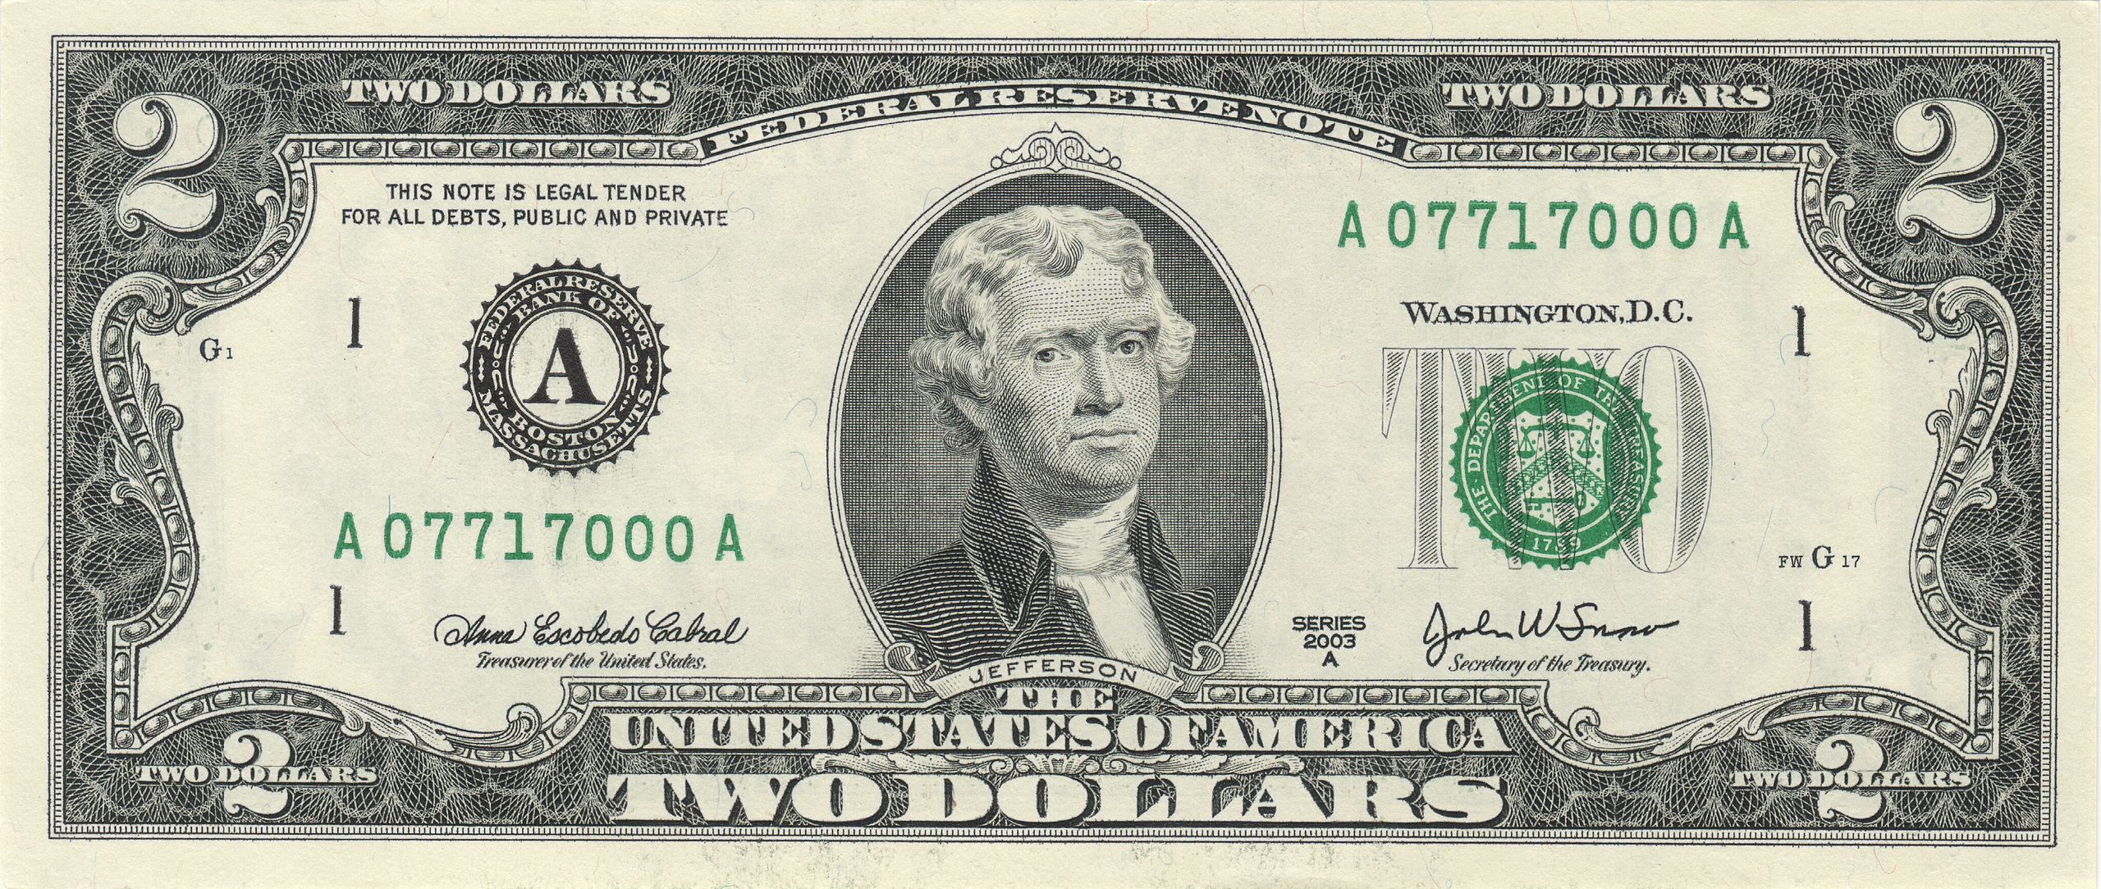
Expectiminimax example
MIN: Min decides whether to count heads (action H) or tails (action T) as a forward movement.
Chance: she flips a coin and moves her game piece in the direction indicated.
MAX: Max decides whether to count heads (action H) or tails (action T) as a forward movement.
Chance: he flips a coin and moves his game piece in the direction indicated.
Reward: $2 to the winner, $0 for a draw.
By NJR ZA - Own work, CC BY-SA 3.0, https://commons.wikimedia.org/w/index.php?curid=4228918
By NJR ZA - Own work, CC BY-SA 3.0, https://commons.wikimedia.org/w/index.php?curid=4228918
Emojis by Twitter, CC BY 4.0, https://commons.wikimedia.org/w/index.php?curid=59974366.
$2 By Bureau of Engraving and Printing: U.S. Department of the Treasury - own scanned, Public Domain, https://commons.wikimedia.org/w/index.php?curid=56299470

Slide 15
Expectiminimax example
MIN: Min decides whether to count heads (action H) or tails (action T) as a forward movement.
Chance: she flips a coin and moves her game piece in the direction indicated.
MAX: Max decides whether to count heads (action H) or tails (action T) as a forward movement.
Chance: he flips a coin and moves his game piece in the direction indicated.
Reward: $2 to the winner, $0 for a draw.
T
H
T
H
T
H
T
H
T
H
T
H
T
H
T
H
H
0
-2
-2
0
2
0
0
2
2
0
0
2
0
-2
-2
0

Slide 16

Expectiminimax example
Chance node:
$Q\left(s,a\right)=\sum_{s′}{P\left(s^{′} | s,a\right)U(s^{′})}$
T
H
T
H
T
H
T
H
T
H
T
H
T
H
-1
-1
1
1
1
1
-1
-1
T
H
H
0
-2
-2
0
2
0
0
2
2
0
0
2
0
-2
-2
0

Slide 17

Expectiminimax example
Max node:
$$U\left(s\right)=\max_{a∈A(s)}{Q(s,a)}$$
T
H
T
H
T
H
-1
1
1
-1
T
H
T
H
T
H
T
H
-1
-1
1
1
1
1
-1
-1
T
H
H
0
-2
-2
0
2
0
0
2
2
0
0
2
0
-2
-2
0

Slide 18
Expectiminimax example
Chance node:
$Q\left(s,a\right)=\sum_{s′}{P\left(s^{′} | s,a\right)U(s^{′})}$
T
H
0
0
T
H
T
H
-1
1
1
-1
T
H
T
H
T
H
T
H
-1
-1
1
1
1
1
-1
-1
T
H
H
0
-2
-2
0
2
0
0
2
2
0
0
2
0
-2
-2
0

Slide 19

Expectiminimax example
0
Min node:
$$U\left(s\right)=\min_{a∈A(s)}{Q(s,a)}$$
T
H
0
0
T
H
T
H
-1
1
-1
1
T
H
T
H
T
H
T
H
-1
-1
1
1
1
1
-1
-1
T
H
H
0
-2
-2
0
2
0
0
2
2
0
0
2
0
-2
-2
0

Slide 20
Outline
Stochastic games: the game itself is random
Stochastic search: the game is deterministic, but we use randomness in the search, to find a fast approximate solution

Slide 21
Stochastic search
Hill_Climbing_with_Simulated_Annealing.gif, Public domain image, Kingpin13, 2013

Slide 22
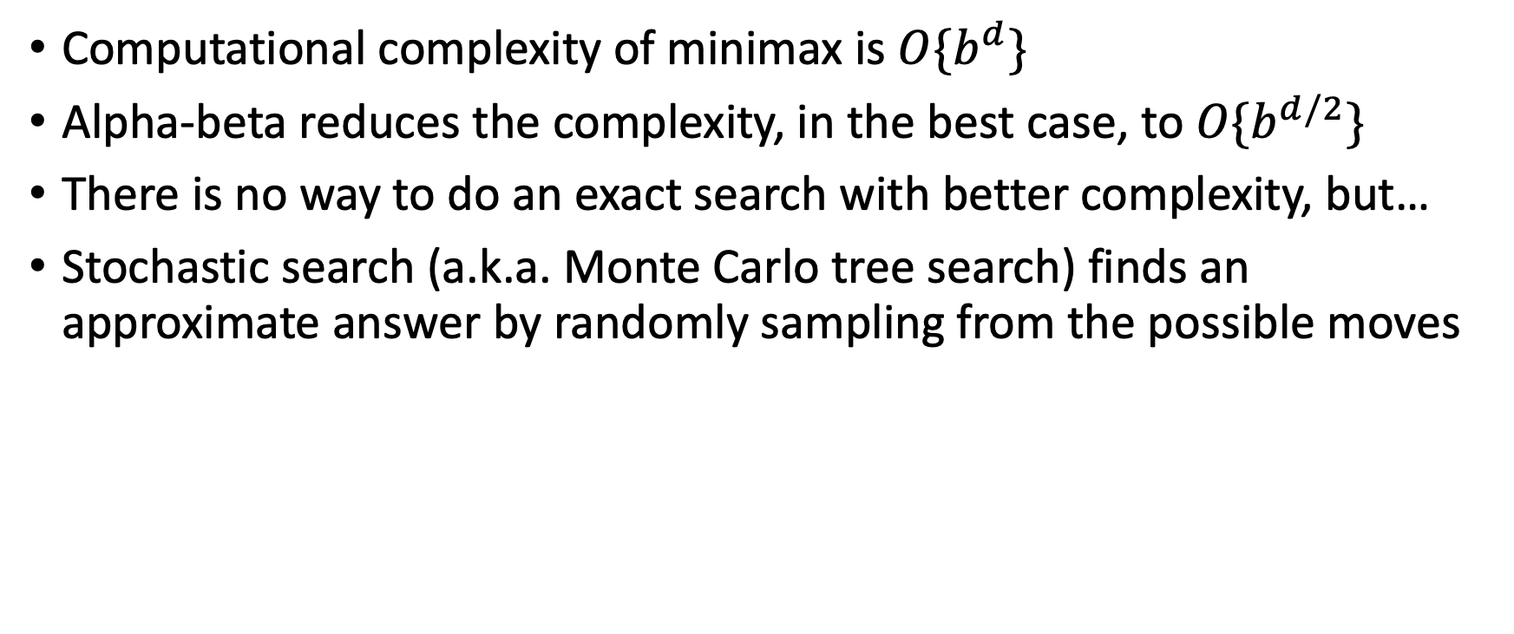
Computational Complexity of Minimax & Alpha-Beta for Deterministic Games
Computational complexity of minimax is $O\{b^{d}\}$
Alpha-beta reduces the complexity, in the best case, to $O\{b^{d/2}\}$
There is no way to do an exact search with better complexity, but…
Stochastic search (a.k.a. Monte Carlo tree search) finds an approximate answer by randomly sampling from the possible moves

Slide 23
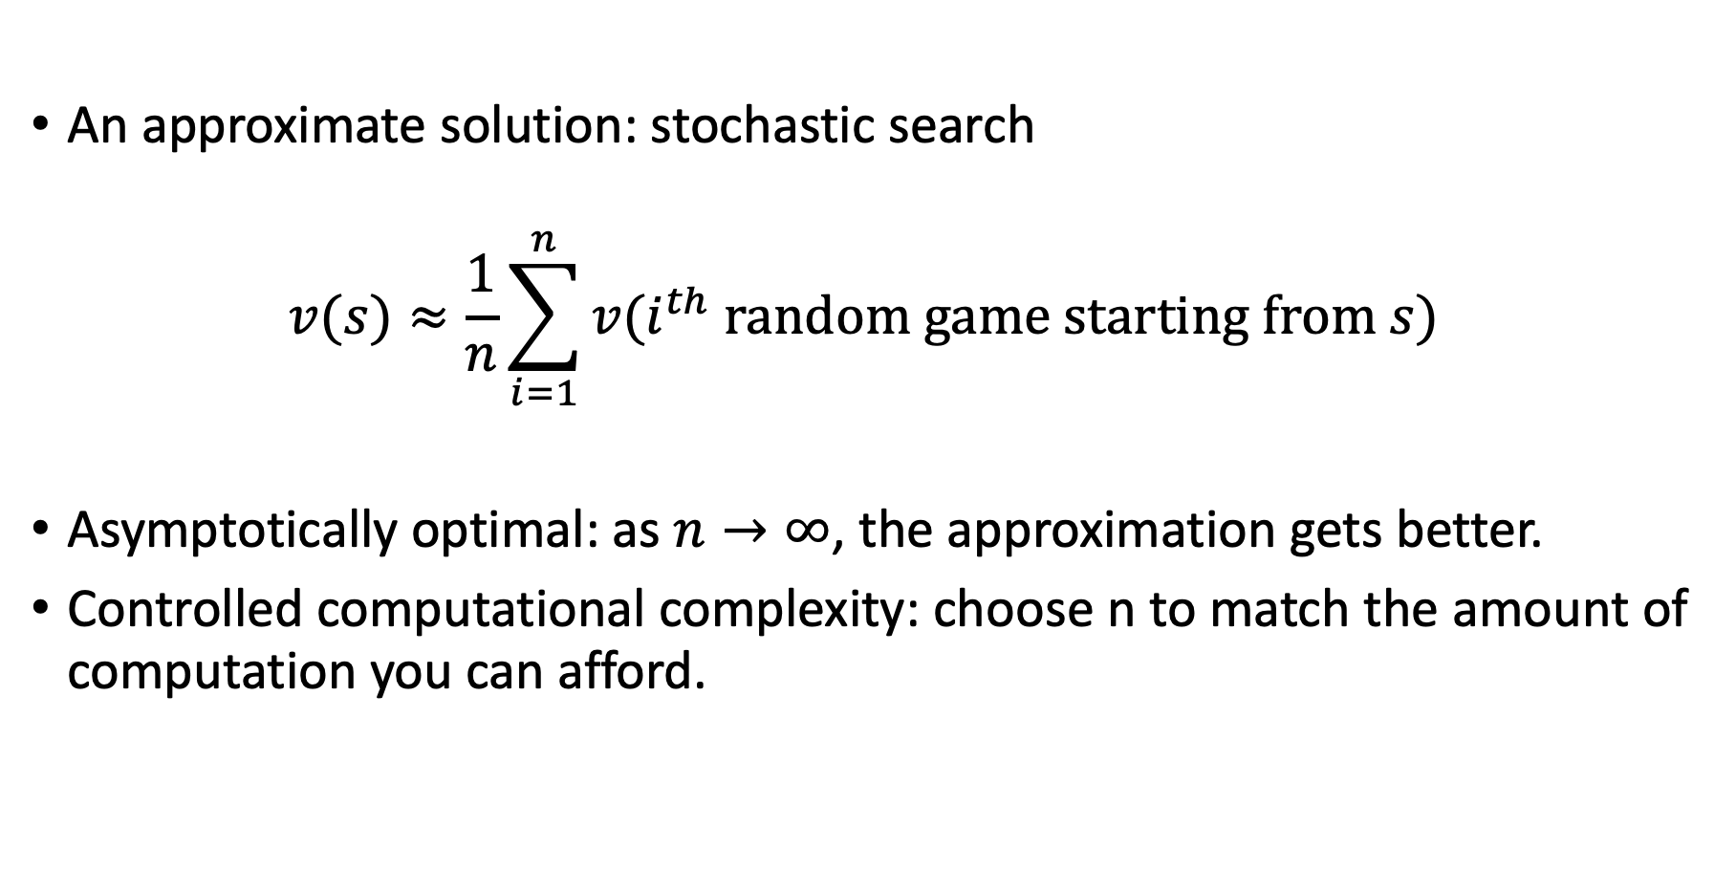
Stochastic search
An approximate solution: stochastic search
$$v(s)≈\frac{1}{n}\sum_{i=1}^{n}{v(i^{th} random game starting from s)}$$
Asymptotically optimal: as $n→∞$, the approximation gets better.
Controlled computational complexity: choose n to match the amount of computation you can afford.

Slide 24
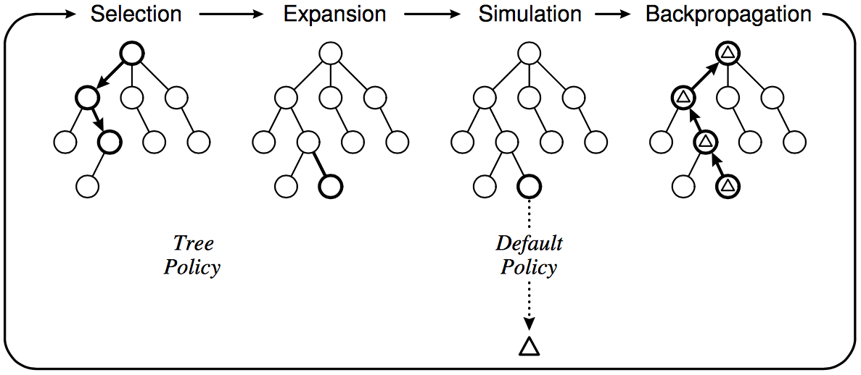
Stochastic search
Depth-limited search out to level d, then random simulation for a few levels after that
Starting at level d:
  Select: choose the next state in the frontier
  Expand: find all of its children
  Simulate: play a random game from that node, to see what value results. Take that value to be the true value of this state
  Backpropagate: use these values in a minimax search, over d levels, to find the best move
C. Browne et al., A survey of Monte Carlo Tree Search Methods, 2012

Slide 25
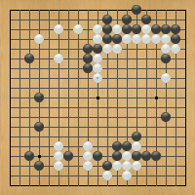
Case study: AlphaGo
“Gentlemen should not waste their time on trivial games -- they should play Go.”
-- Confucius,
The Analects
ca. 500 B. C. E.
Anton Ninno, Roy Laird, Ph.D.
antonninno@yahoo.com roylaird@gmail.com
special thanks to Kiseido Publications

Slide 26
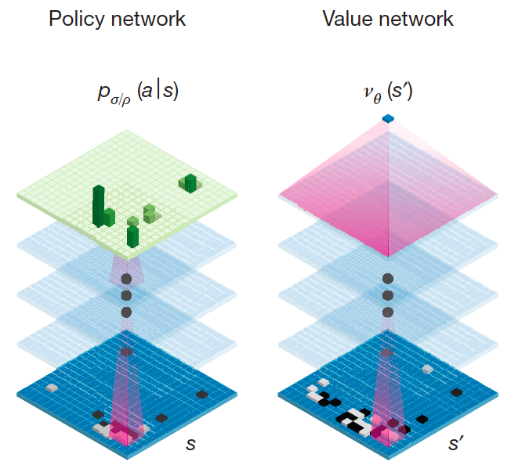
AlphaGo
Deep convolutional neural networks
  Treat the Go board as an image
  Can be trained to predict distribution over possible moves (policy) or expected value of position
D. Silver et al., Mastering the Game of Go with Deep Neural Networks and Tree Search, Nature 529, January 2016

Slide 27
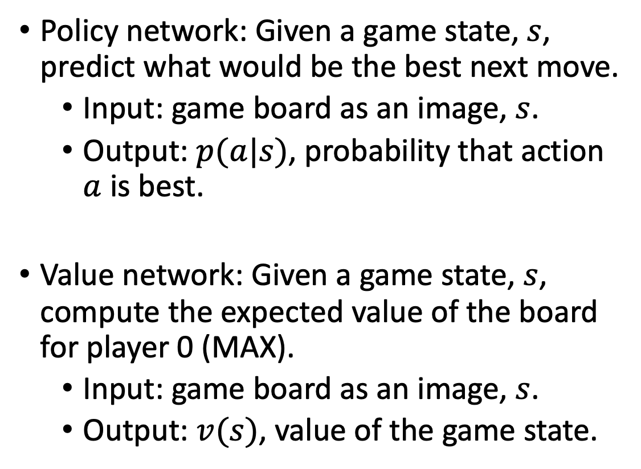
AlphaGo
Policy network: Given a game state, $s$, predict what would be the best next move.
  Input: game board as an image, $s$.
  Output: $p(a|s)$, probability that action $a$ is best.
Value network: Given a game state, $s$, compute the expected value of the board for player 0 (MAX).
  Input: game board as an image, $s$.
  Output: $v(s)$, value of the game state.
D. Silver et al., Mastering the Game of Go with Deep Neural Networks and Tree Search, Nature 529, January 2016

Slide 28
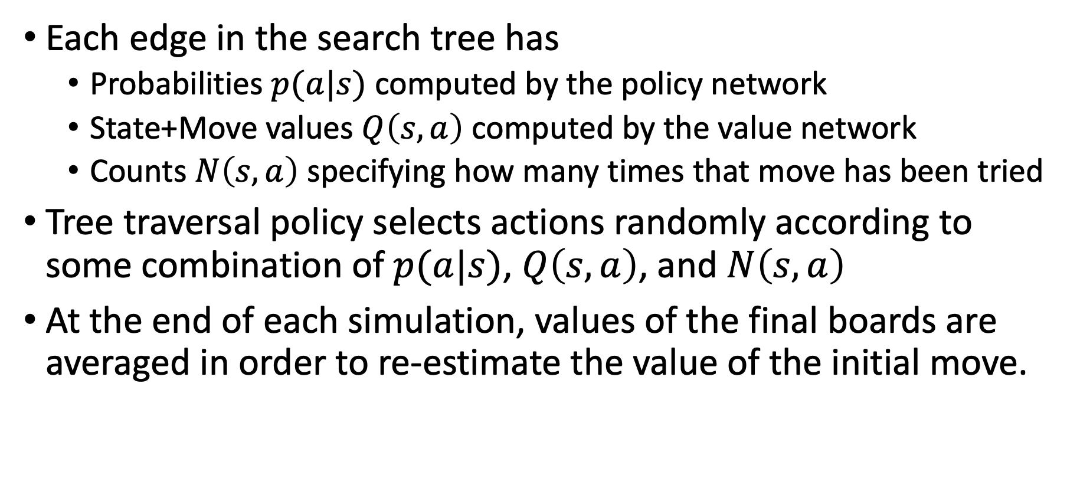
Stochastic Search in AlphaGo
Each edge in the search tree has
  Probabilities $p(a|s)$ computed by the policy network
  State+Move values $Q\left(s,a\right)$ computed by the value network
  Counts $N\left(s,a\right)$ specifying how many times that move has been tried
Tree traversal policy selects actions randomly according to some combination of $p(a|s)$, $Q\left(s,a\right)$, and $N\left(s,a\right)$
At the end of each simulation, values of the final boards are averaged in order to re-estimate the value of the initial move.

Slide 29
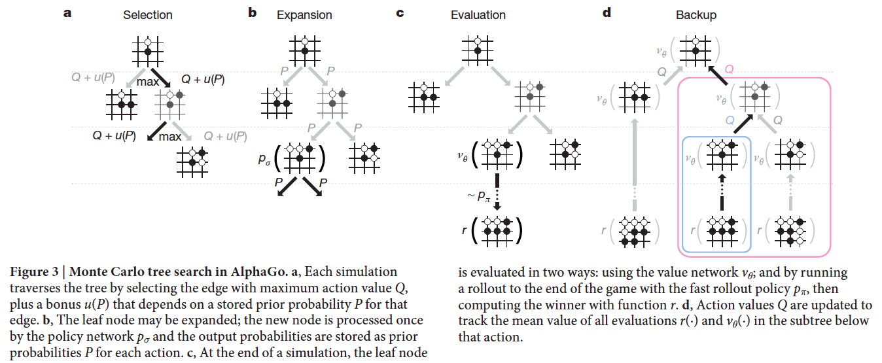
Stochastic Search in AlphaGo
D. Silver et al., Mastering the Game of Go with Deep Neural Networks and Tree Search, Nature 529, January 2016

Slide 30
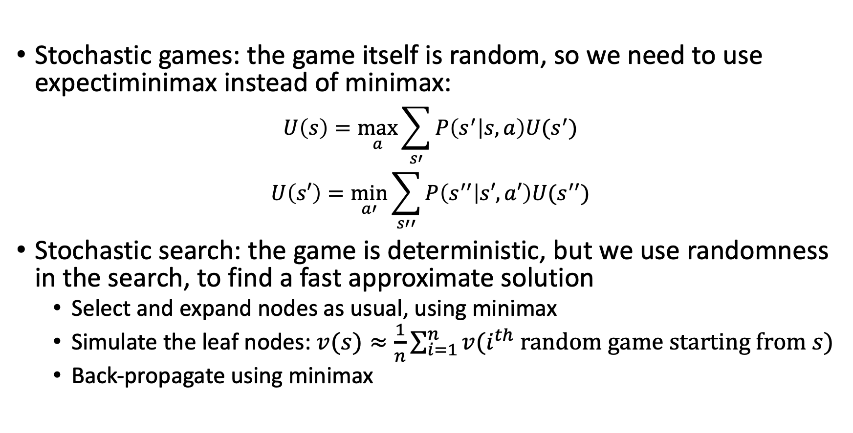
Conclusions
Stochastic games: the game itself is random, so we need to use expectiminimax instead of minimax:
$$U\left(s\right)=\max_{a}{\sum_{s′}{P\left(s^{′} | s,a\right)U(s^{′})}}$$
$$U\left(s′\right)=\min_{a′}{\sum_{s′′}{P\left(s^{′′} | s′,a′\right)U(s^{′′})}}$$
Stochastic search: the game is deterministic, but we use randomness in the search, to find a fast approximate solution
  Select and expand nodes as usual, using minimax
  Simulate the leaf nodes: $v(s)≈\frac{1}{n}\sum_{i=1}^{n}{v(i^{th} random game starting from s)}$
  Back-propagate using minimax

