Slide 1
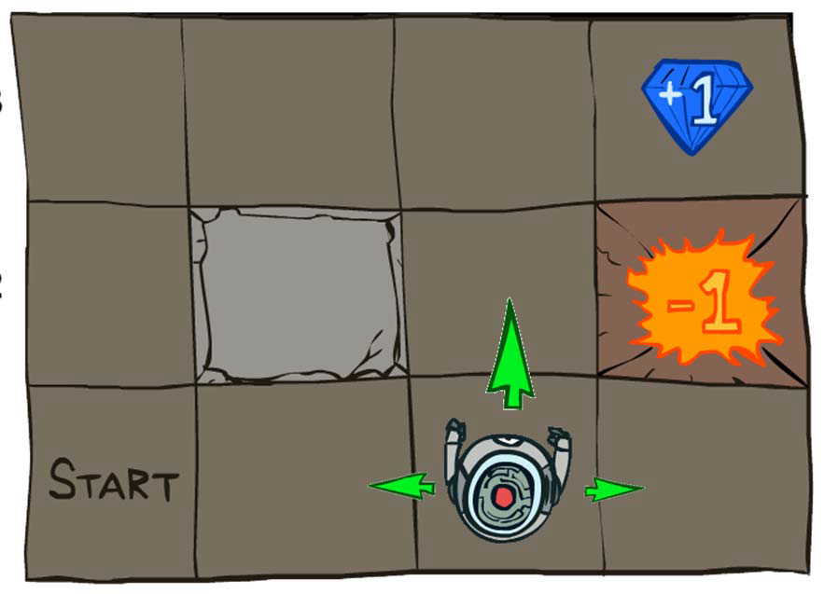
CS440/ECE448 Lecture 32:
Markov Decision Processes
Mark Hasegawa-Johnson, 4/2022
Including slides by Svetlana Lazebnik, 11/2016
Including many figures by Peter Abbeel and Dan Klein, UC Berkeley CS 188
CC-BY-4.0: You may re-use or redistribute if you cite the source.
Grid World
Invented and drawn by Peter Abbeel and Dan Klein, UC Berkeley CS 188

Slide 2
Markov Decision Processes
In HMMs, we see a sequence of observations and try to reason about the underlying state sequence
  There are no actions involved
But what if we have to take an action at each step that, in turn, will affect the state of the world?

Slide 3
Markov Decision Processes
Components that define the MDP. Depending on the problem statement, you either know these, or you learn them from data:
  Like an HMM, we have States s, beginning with initial state s₀
  Unlike an HMM, we also have Actions a
    Each state s has actions A(s) available from it
  Unlike an HMM, the Transition model P(s’ | s, a) depends on both the state you’re in, and the action you perform.
    Markov assumption: the probability of going to s’ from s depends only on s and a and not on any other past actions or states

Slide 4
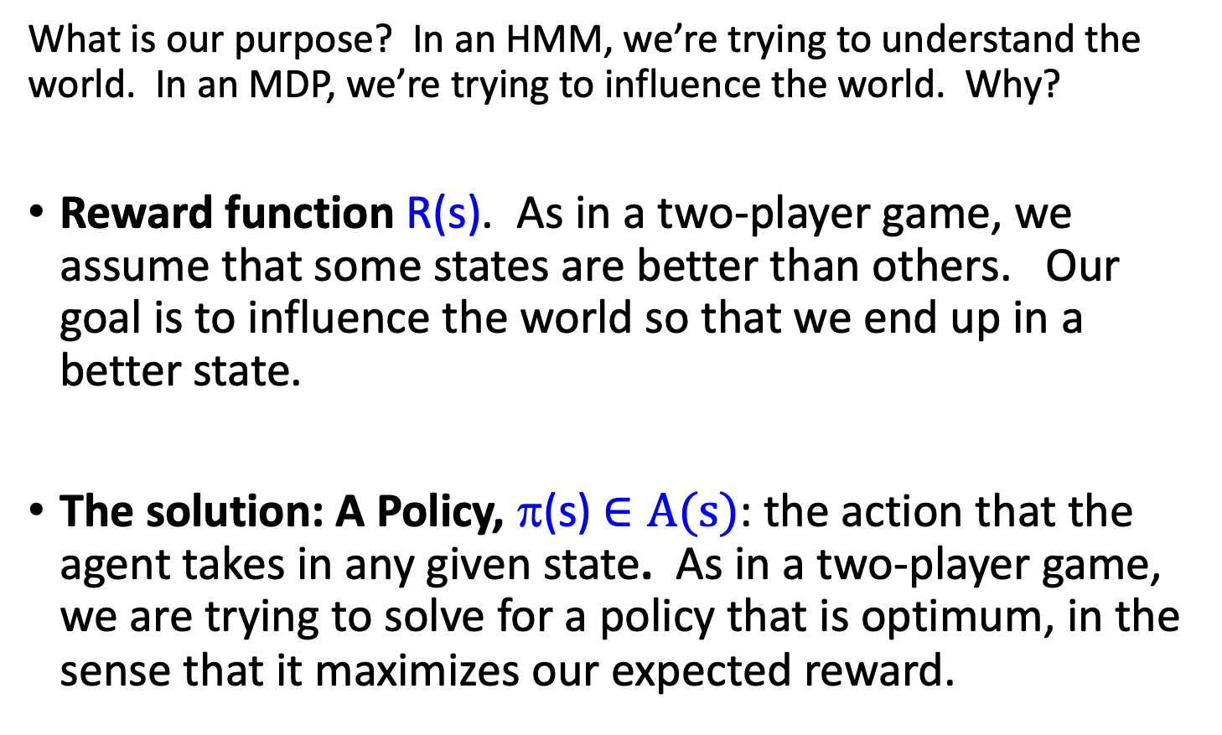
Markov Decision Processes
What is our purpose? In an HMM, we’re trying to understand the world. In an MDP, we’re trying to influence the world. Why?
Reward function R(s). As in a two-player game, we assume that some states are better than others. Our goal is to influence the world so that we end up in a better state.
The solution: A Policy, π(s) $∈A(s)$: the action that the agent takes in any given state. As in a two-player game, we are trying to solve for a policy that is optimum, in the sense that it maximizes our expected reward.

Slide 5
Outline
What we need to know: transition model, reward function.
The closed-form optimum solution: The Bellman equation.
Iterative solutions that approximate the Bellman equation in polynomial time
  Value Iteration
  Policy Iteration

Slide 6
Example: Game show
A series of questions with increasing level of difficulty and increasing payoff
Decision: at each step, take your earnings and quit, or go for the next question
  If you answer wrong, you lose everything
$100 question
$1,000 question
$10,000 question
$50,000 question
Correct:
$61,100
Q1
Correct
Q2
Correct
Q3
Correct
Q4
1/100
3/4
1/2
1/10
99/100
1/4
1/2
9/10
Incorrect:
$0
Incorrect:
$0
Incorrect:
$0
Incorrect:
$0
Quit:
$100
Quit:
$1,100
Quit:
$11,100

Slide 7
Example: Game show
Consider $50,000 question
  Probability of guessing correctly: 1/10
  Quit or go for the question?
What is the expected payoff for continuing?
  0.1 * 61,100 + 0.9 * 0 = 6,110
  What is the optimal decision?
$100 question
$1,000 question
$10,000 question
$50,000 question
Correct:
$61,100
Q1
Correct
Q2
Correct
Q3
Correct
Q4
1/100
3/4
1/2
1/10
99/100
1/4
1/2
9/10
Incorrect:
$0
Incorrect:
$0
Incorrect:
$0
Incorrect:
$0
Quit:
$100
Quit:
$1,100
Quit:
$11,100

Slide 8
Example: Game show
What should we do in Q3?
  Payoff for quitting: $1,100
  Expected payoff (utility) for continuing: 0.5 * $11,100 = $5,550
What about Q2?
  $100 for quitting vs. $4,162 for continuing
What about Q1?
U = $42
U = $4,163
U = $5,550
U = $11,100
$100 question
$1,000 question
$10,000 question
$50,000 question
Correct:
$61,100
Q1
Correct
Q2
Correct
Q3
Correct
Q4
1/100
3/4
1/2
1/10
99/100
1/4
1/2
9/10
Incorrect:
$0
Incorrect:
$0
Incorrect:
$0
Incorrect:
$0
Quit:
$100
Quit:
$1,100
Quit:
$11,100

Slide 9
Example: Game show
Let’s talk about two different ways of calculating our winnings:
R(s) = the reward that we receive for reaching state s
U(s) = the total expected utility or value of state s
U(s) is the expected sum of all current and future rewards, given that we have reached state s, assuming we know the best actions to perform from here on out.
Calculating U(s) is kind of like expectiminimax. But first, let’s look at another example…
U = $42
U = $4,163
U = $5,550
U = $11,100
$100 question
$1,000 question
$10,000 question
$50,000 question
Correct:
$61,100
Q1
Correct
Q2
Correct
Q3
Correct
Q4
1/100
3/4
1/2
1/10
99/100
1/4
1/2
9/10
Incorrect:
$0
Incorrect:
$0
Incorrect:
$0
Incorrect:
$0
Quit:
$100
Quit:
$1,100
Quit:
$11,100

Slide 10
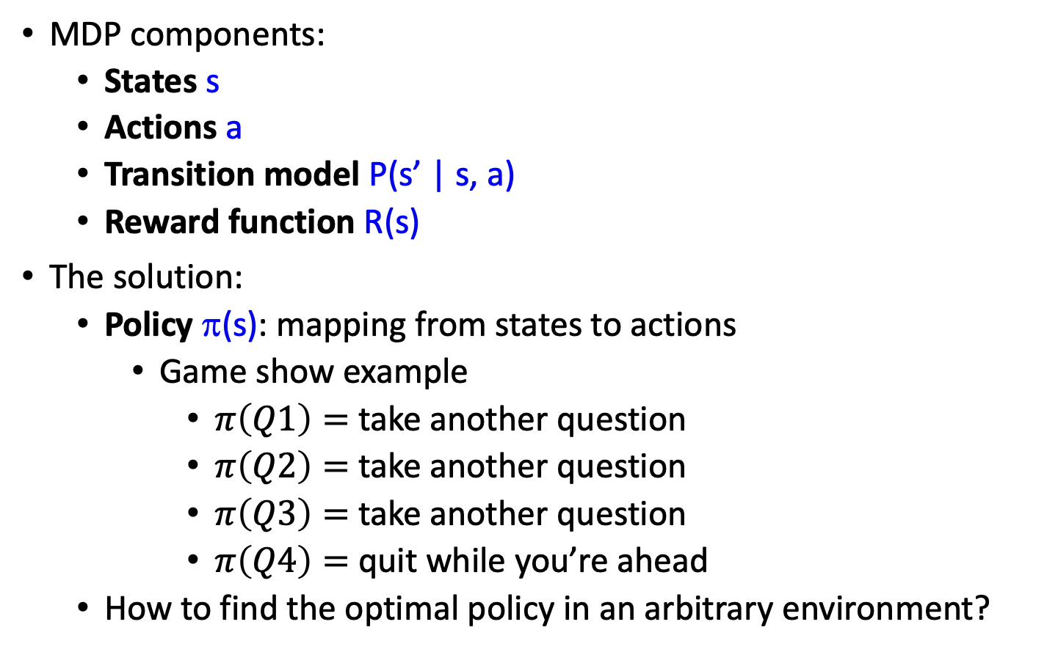
Solving MDPs
MDP components:
  States s
  Actions a
  Transition model P(s’ | s, a)
  Reward function R(s)
The solution:
  Policy π(s): mapping from states to actions
    Game show example
      $π\left(Q1\right)=$ take another question
      $π\left(Q2\right)=$ take another question
      $π\left(Q3\right)=$ take another question
      $π\left(Q4\right)=$ quit while you’re ahead
  How to find the optimal policy in an arbitrary environment?

Slide 11
Outline
What we need to know: transition model, reward function.
The closed-form optimum solution: The Bellman equation.
Iterative solutions that approximate the Bellman equation in polynomial time
  Value Iteration
  Policy Iteration

Slide 12
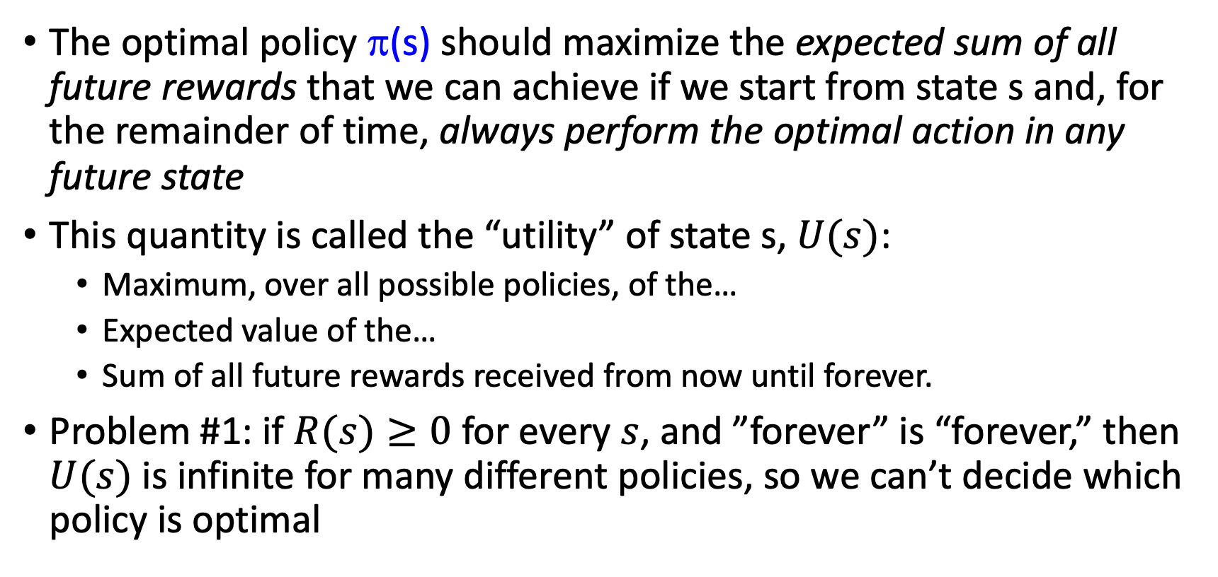
Maximizing expected utility
The optimal policy π(s) should maximize the expected sum of all future rewards that we can achieve if we start from state s and, for the remainder of time, always perform the optimal action in any future state
This quantity is called the “utility” of state s, $U(s)$:
  Maximum, over all possible policies, of the…
  Expected value of the…
  Sum of all future rewards received from now until forever.
Problem #1: if $R(s)≥0$ for every $s$, and ”forever” is “forever,” then $U(s)$ is infinite for many different policies, so we can’t decide which policy is optimal

Slide 13
Utilities of state sequences
Normally, we would define the utility of a state sequence as the sum of the rewards of the individual states
Problem: infinite state sequences
Solution: discount the individual state rewards by a factor γ between 0 and 1:
  Sooner rewards count more than later rewards
  Makes sure the total utility stays bounded
  Helps algorithms converge

Slide 14
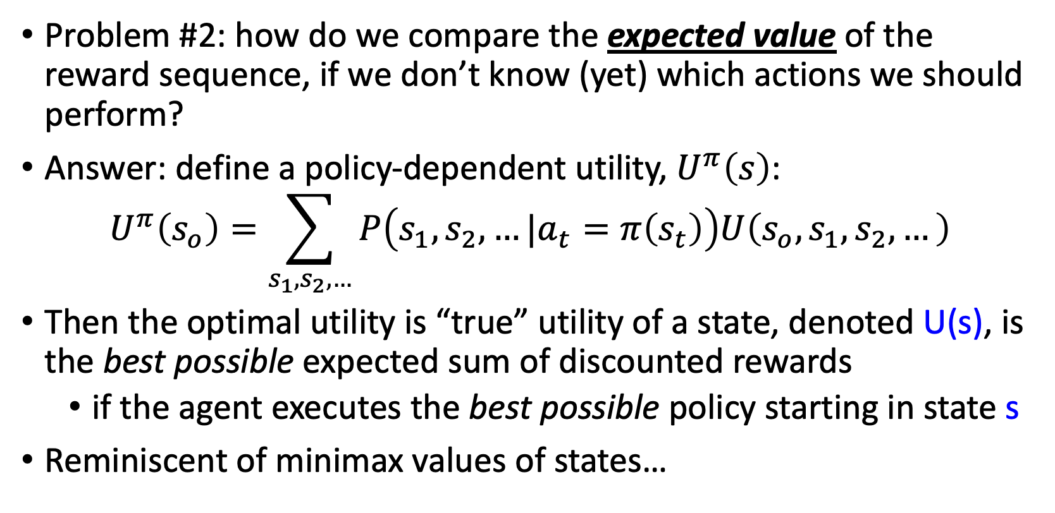
Utilities of states
Problem #2: how do we compare the expected value of the reward sequence, if we don’t know (yet) which actions we should perform?
Answer: define a policy-dependent utility, $U^{π}\left(s\right)$:
$$U^{π}\left(s_{o}\right)=\sum_{s_{1},s_{2},…}{P\left(s_{1},s_{2},…|a_{t}=π\left(s_{t}\right)\right)U\left(s_{o},s_{1},s_{2},…\right)}$$
Then the optimal utility is “true” utility of a state, denoted U(s), is the best possible expected sum of discounted rewards
  if the agent executes the best possible policy starting in state s
Reminiscent of minimax values of states…

Slide 15
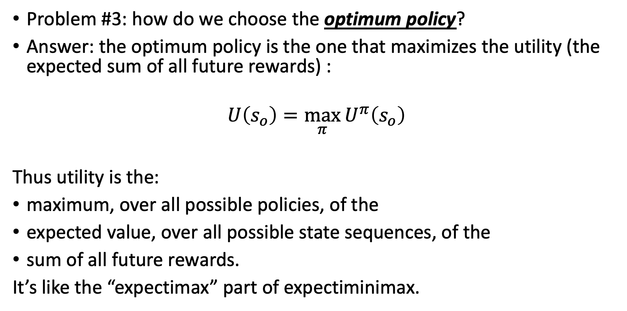
Optimal utility
Problem #3: how do we choose the optimum policy?
Answer: the optimum policy is the one that maximizes the utility (the expected sum of all future rewards) :
$$U\left(s_{o}\right)=\max_{π}{U^{π}\left(s_{o}\right)}$$
Thus utility is the:
maximum, over all possible policies, of the
expected value, over all possible state sequences, of the
sum of all future rewards.
It’s like the “expectimax” part of expectiminimax.

Slide 16
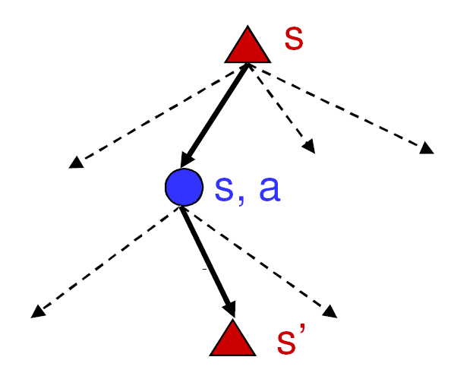
Finding the utilities of states
Max node
If state s’ has utility U(s’), then what is the expected utility of taking action a in state s?
How do we choose the optimal action?
Chance node
P(s’ | s, a)
U(s’)
What is the recursive expression for U(s) in terms of the utilities of its successor states?

Slide 17
The Bellman equation
Recursive relationship between the utilities of successive states:
Receive reward R(s)
Choose optimal action a
End up here with P(s’ | s, a)
Get utility U(s’)
(discounted by γ)

Slide 18
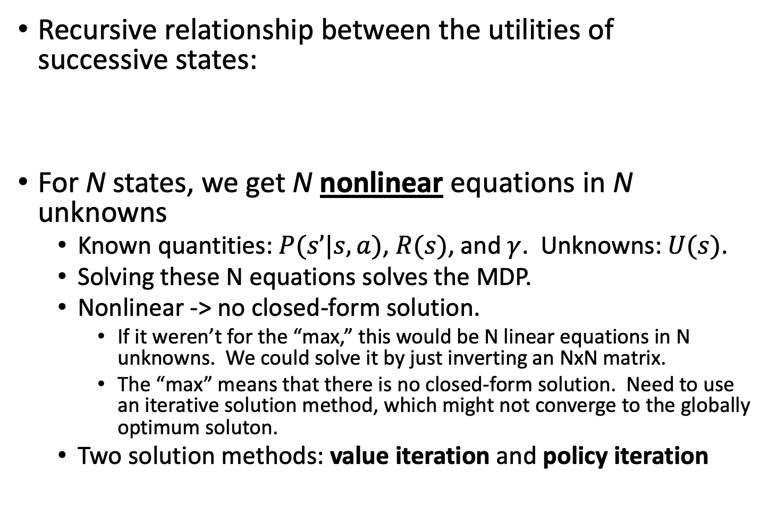
The Bellman equation
Recursive relationship between the utilities of successive states:
For N states, we get N nonlinear equations in N unknowns
  Known quantities: $P(s’|s,a)$, $R(s)$, and $γ$. Unknowns: $U(s)$.
  Solving these N equations solves the MDP.
  Nonlinear -> no closed-form solution.
    If it weren’t for the “max,” this would be N linear equations in N unknowns. We could solve it by just inverting an NxN matrix.
    The “max” means that there is no closed-form solution. Need to use an iterative solution method, which might not converge to the globally optimum soluton.
  Two solution methods: value iteration and policy iteration

Slide 19
Outline
What we need to know: transition model, reward function.
The closed-form optimum solution: The Bellman equation.
Iterative solutions that approximate the Bellman equation in polynomial time
  Value Iteration
  Policy Iteration

Slide 20
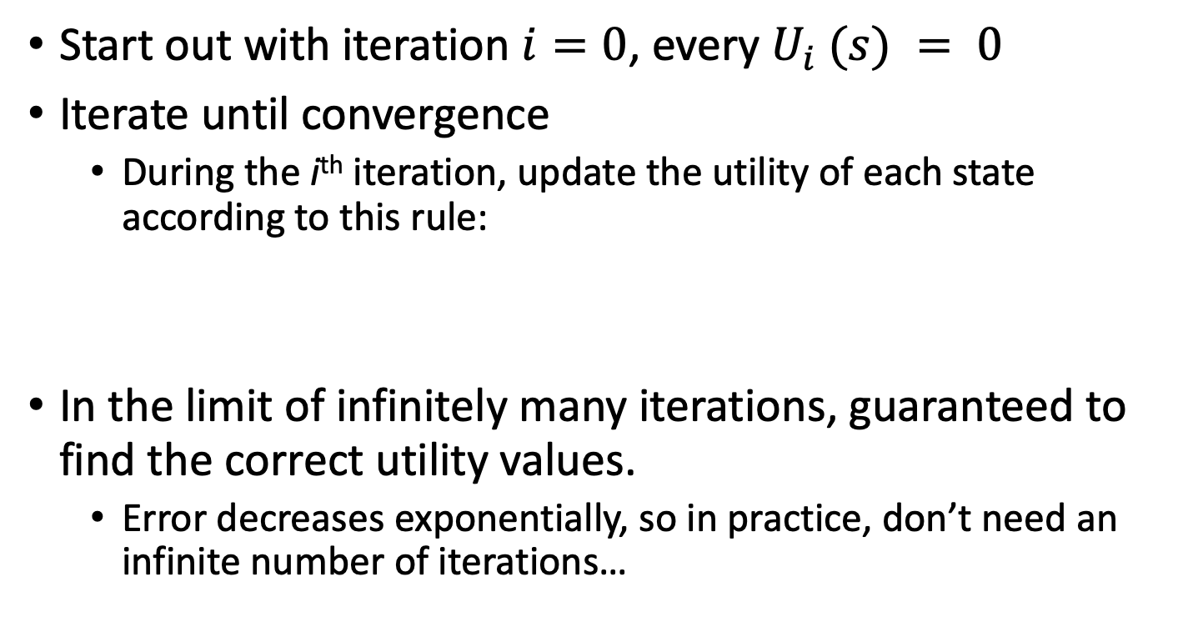
Method 1: Value iteration
Start out with iteration $i=0$, every $U_{i} (s) = 0$
Iterate until convergence
  During the i^{th} iteration, update the utility of each state according to this rule:
In the limit of infinitely many iterations, guaranteed to find the correct utility values.
  Error decreases exponentially, so in practice, don’t need an infinite number of iterations…

Slide 21
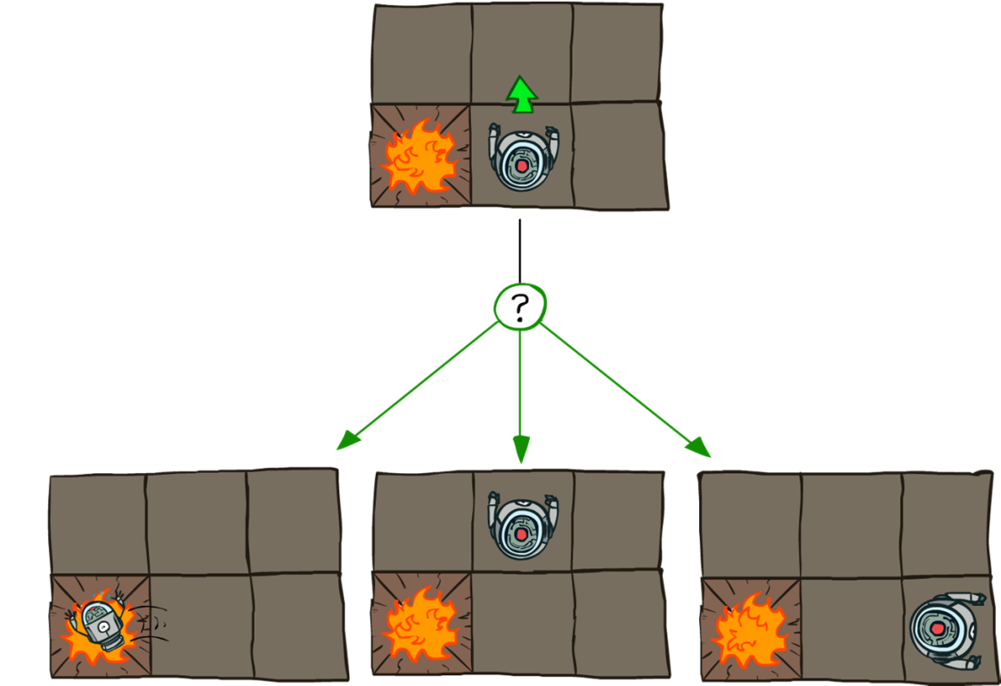
Example: Grid world
Transition model:
0.1
0.8
0.1
R(s) = -0.04 for every non-terminal state
Source: P. Abbeel and D. Klein

Slide 22

Goal: Policy
Source: P. Abbeel and D. Klein

Slide 23
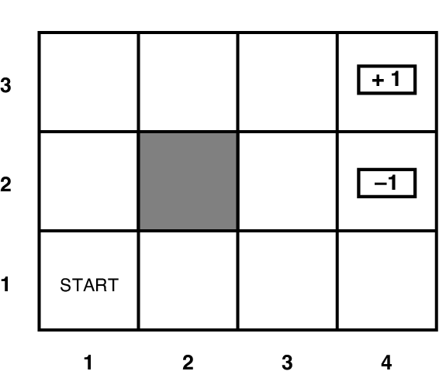
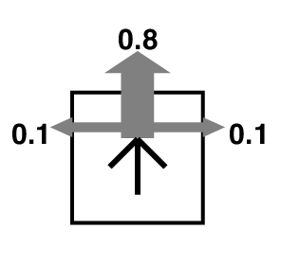
Grid world
Transition model:
R(s) = -0.04 for every non-terminal state

Slide 24
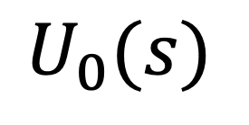


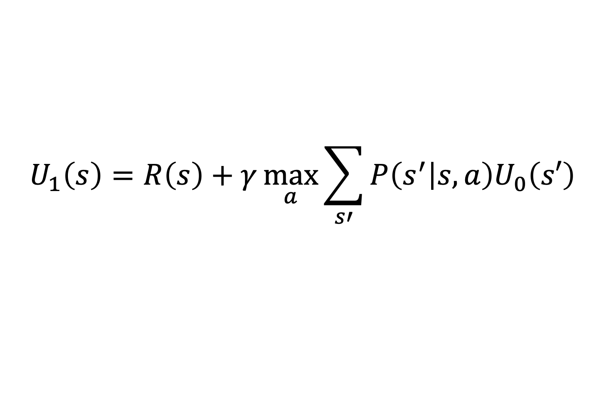
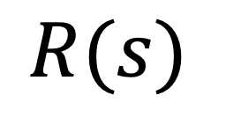
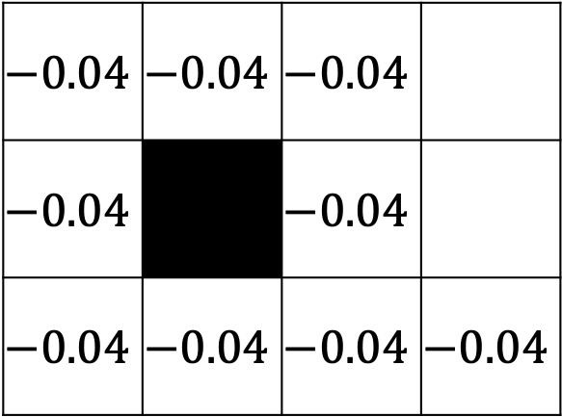
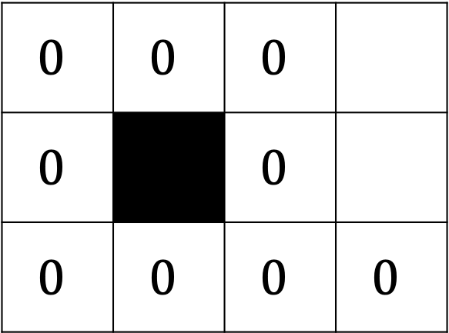
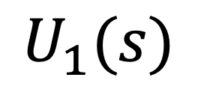
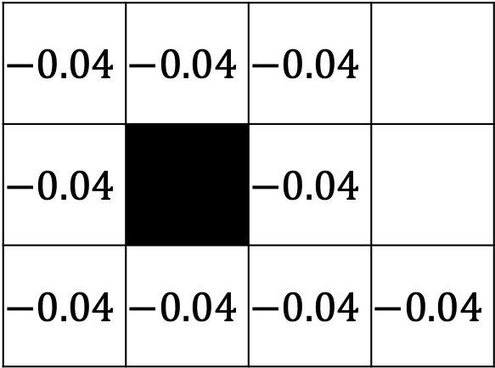
Value Iteration: Iteration 1
$$U_{1}\left(s\right)=R\left(s\right)+γ\max_{a}{\sum_{s′}{P\left(s^{′} | s,a\right)U_{0}\left(s′\right)}}$$
$$U_{1}(s)$$
$$R(s)$$
$$U_{0}(s)$$
$$−0.04$$ | $$−0.04$$ | $$−0.04$$
$$−0.04$$ |  | $$−0.04$$
$$−0.04$$ | $$−0.04$$ | $$−0.04$$ | $$−0.04$$
$$−0.04$$ | $$−0.04$$ | $$−0.04$$
$$−0.04$$ |  | $$−0.04$$
$$−0.04$$ | $$−0.04$$ | $$−0.04$$ | $$−0.04$$
$$0$$ | $$0$$ | $$0$$
$$0$$ |  | $$0$$
$$0$$ | $$0$$ | $$0$$ | $$0$$

Slide 25
Value Iteration: Iteration 2
$$U_{1}(s)$$
$$−0.04$$ | $$−0.04$$ | $$−0.04$$
$$−0.04$$ |  | $$−0.04$$
$$−0.04$$ | $$−0.04$$ | $$−0.04$$ | $$−0.04$$

Slide 26
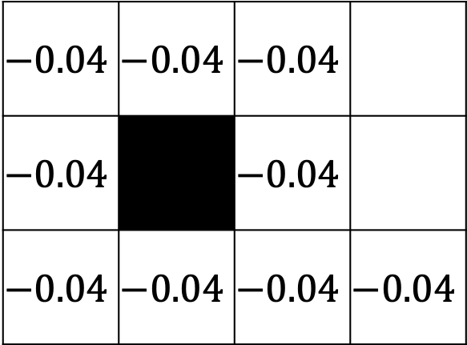
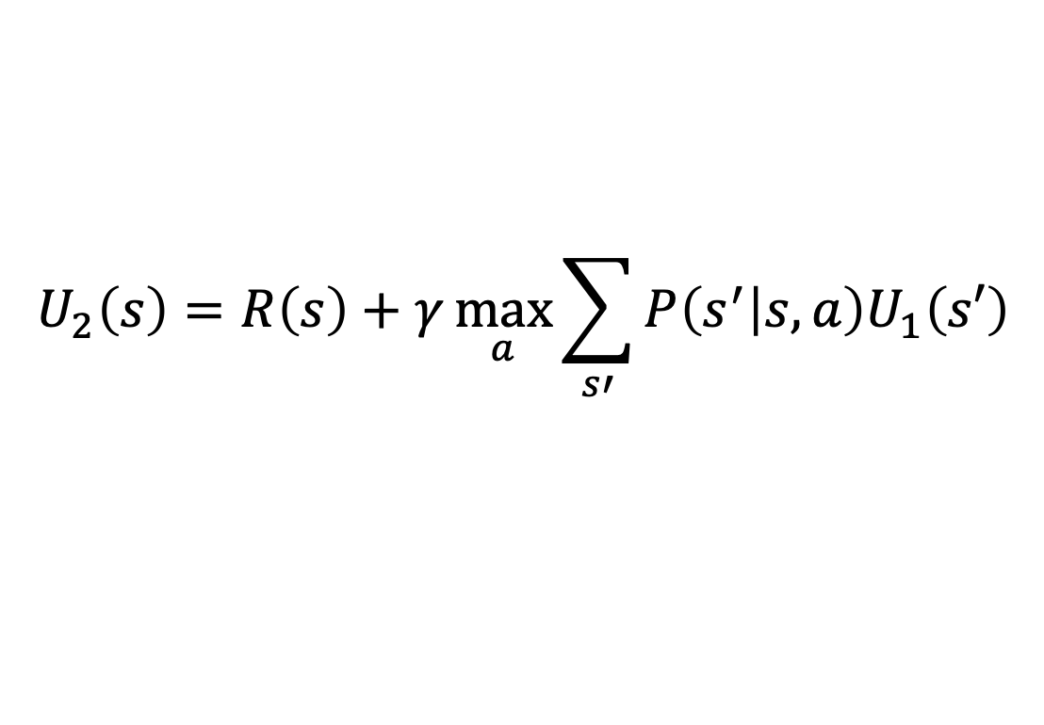
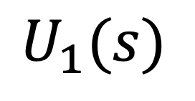
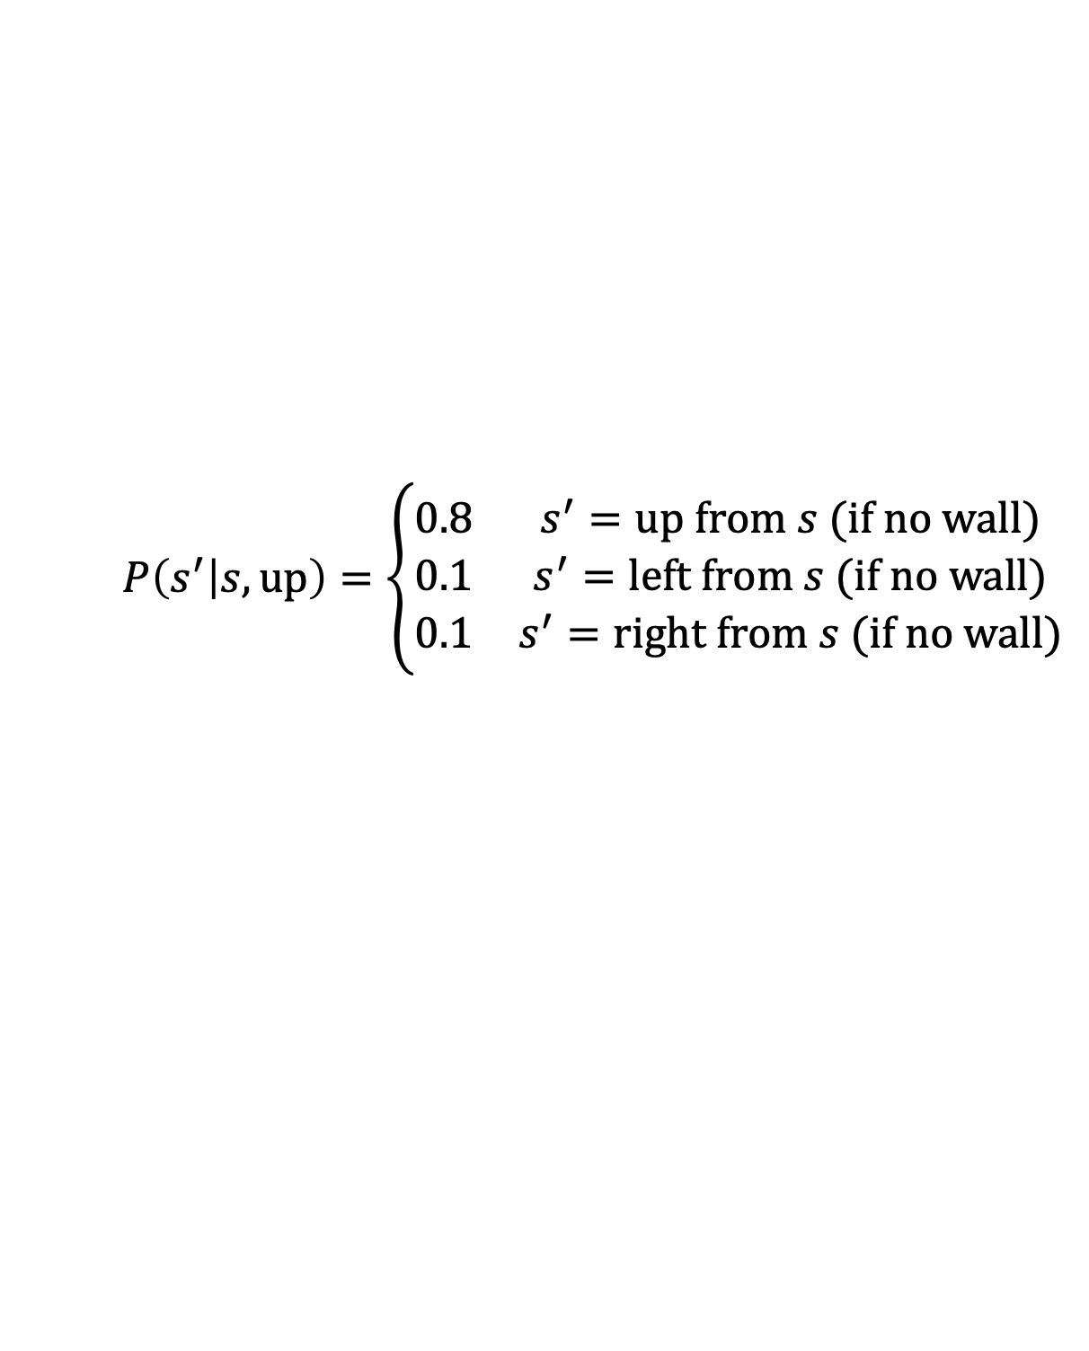
Value Iteration: Iteration 2
$$U_{2}\left(s\right)=R\left(s\right)+γ\max_{a}{\sum_{s′}{P\left(s^{′} | s,a\right)U_{1}\left(s′\right)}}$$
$$U_{1}(s)$$
Transition model:
$$−0.04$$ | $$−0.04$$ | $$−0.04$$
$$−0.04$$ |  | $$−0.04$$
$$−0.04$$ | $$−0.04$$ | $$−0.04$$ | $$−0.04$$
$$P\left(s^{′} | s,up\right)=\left\{\begin{matrix}0.8 & s^{′}=up from s (if no wall) \\ 0.1 & s^{′}=left from s (if no wall) \\ 0.1 & s^{′}=right from s (if no wall)\end{matrix}\right.$$

Slide 27
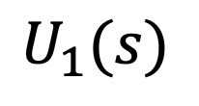
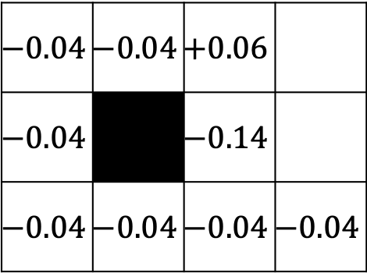
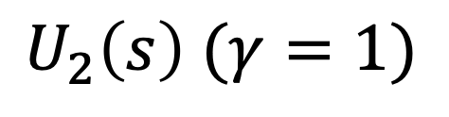
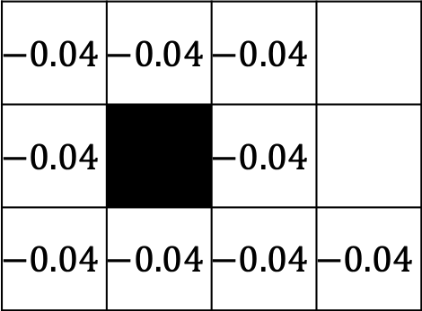
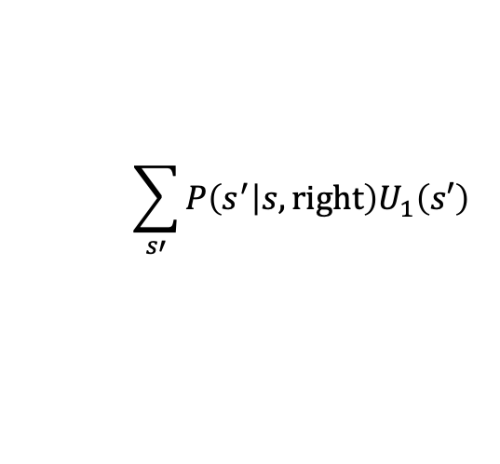
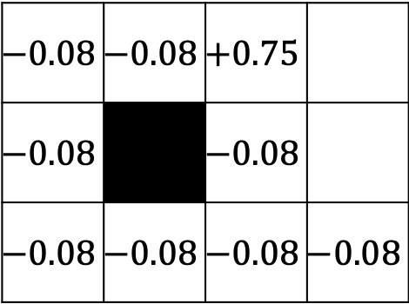
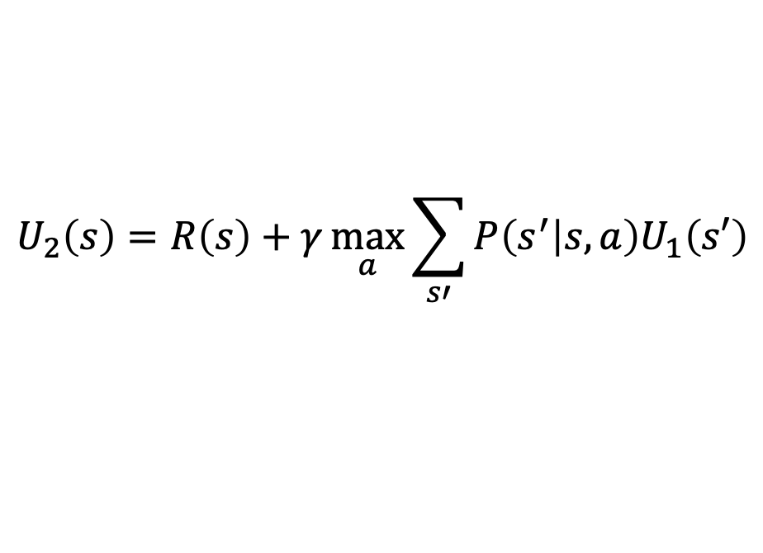
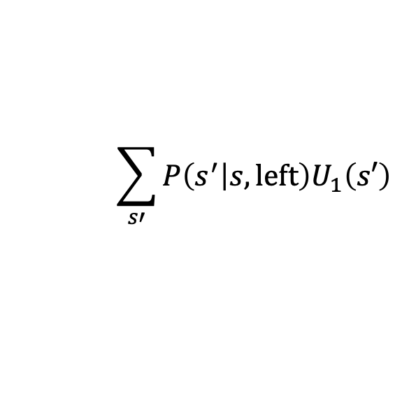
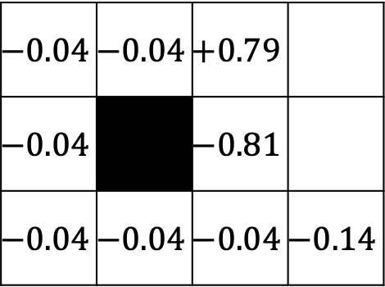
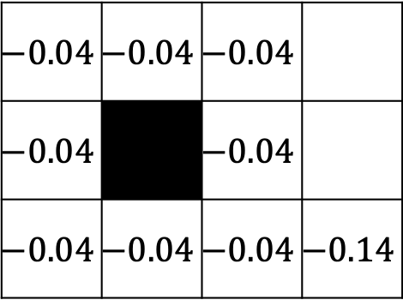
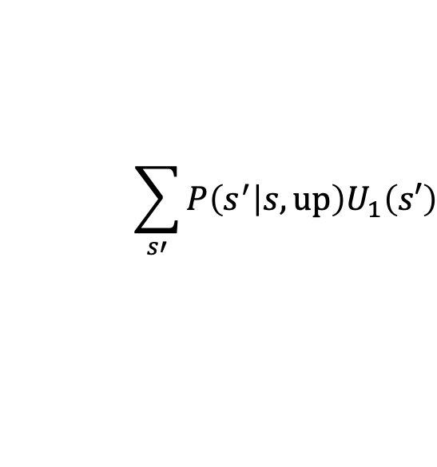
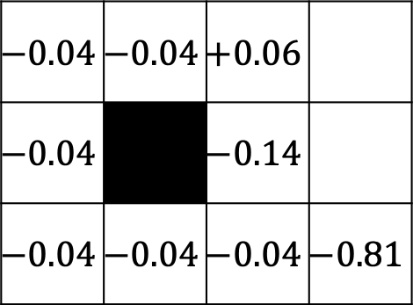
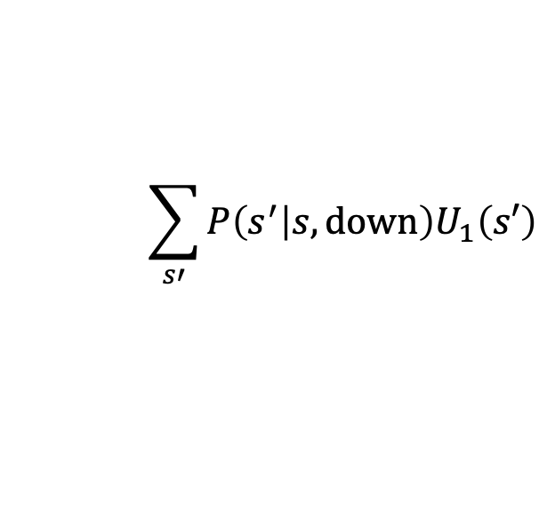
Value Iteration: Iteration 2
$$U_{2}\left(s\right)=R\left(s\right)+γ\max_{a}{\sum_{s′}{P\left(s^{′} | s,a\right)U_{1}\left(s′\right)}}$$
$$\sum_{s′}{P\left(s^{′} | s,down\right)U_{1}\left(s′\right)}$$
$$\sum_{s′}{P\left(s^{′} | s,up\right)U_{1}\left(s′\right)}$$
$$−0.04$$ | $$−0.04$$ | $$+0.06$$
$$−0.04$$ |  | $$−0.14$$
$$−0.04$$ | $$−0.04$$ | $$−0.04$$ | $$−0.04$$
$$−0.04$$ | $$−0.04$$ | $$+0.06$$
$$−0.04$$ |  | $$−0.14$$
$$−0.04$$ | $$−0.04$$ | $$−0.04$$ | $$−0.81$$
$$U_{2}\left(s\right) (γ=1)$$
$$U_{1}(s)$$
$$−0.08$$ | $$−0.08$$ | $$+0.75$$
$$−0.08$$ |  | $$−0.08$$
$$−0.08$$ | $$−0.08$$ | $$−0.08$$ | $$−0.08$$
$$−0.04$$ | $$−0.04$$ | $$−0.04$$
$$−0.04$$ |  | $$−0.04$$
$$−0.04$$ | $$−0.04$$ | $$−0.04$$ | $$−0.04$$
$$\sum_{s′}{P\left(s^{′} | s,left\right)U_{1}\left(s′\right)}$$
$$\sum_{s′}{P\left(s^{′} | s,right\right)U_{1}\left(s′\right)}$$
$$−0.04$$ | $$−0.04$$ | $$−0.04$$
$$−0.04$$ |  | $$−0.04$$
$$−0.04$$ | $$−0.04$$ | $$−0.04$$ | $$−0.14$$
$$−0.04$$ | $$−0.04$$ | $$+0.79$$
$$−0.04$$ |  | $$−0.81$$
$$−0.04$$ | $$−0.04$$ | $$−0.04$$ | $$−0.14$$

Slide 28
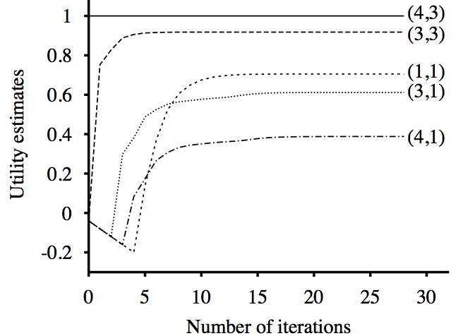
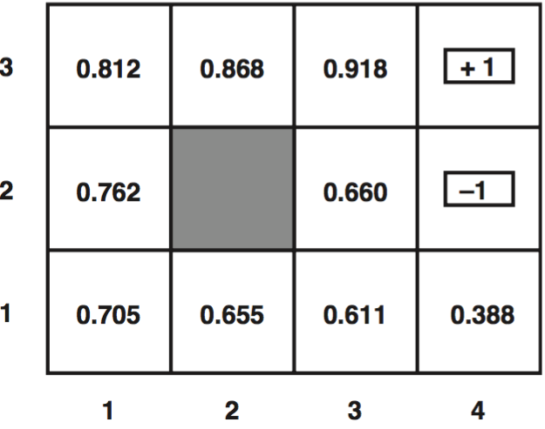
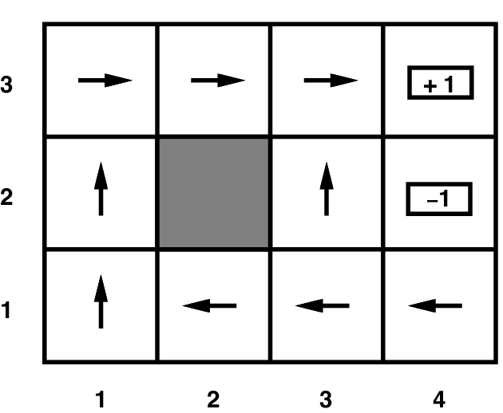
Value iteration
Optimal utilities with discount factor 1
(Result of value iteration)
Final policy

Slide 29
Grid world
Optimal policy when R(s) = -0.04 for every non-terminal state

Slide 30
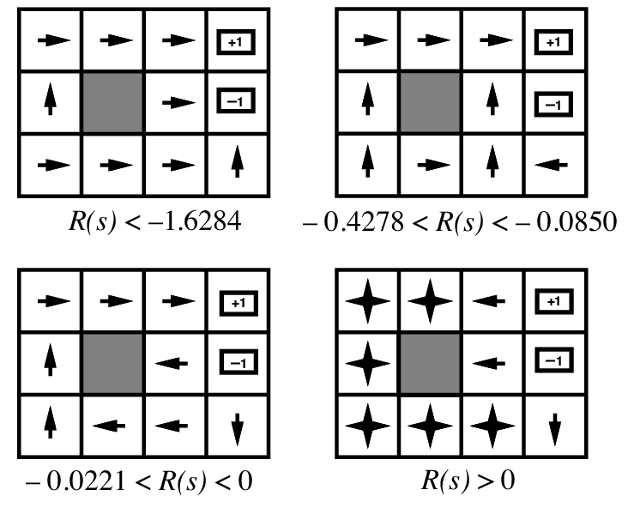
Grid world
Optimal policies for other values of R(s):

Slide 31
Outline
What we need to know: transition model, reward function.
The closed-form optimum solution: The Bellman equation.
Iterative solutions that approximate the Bellman equation in polynomial time
  Value Iteration
  Policy Iteration

Slide 32
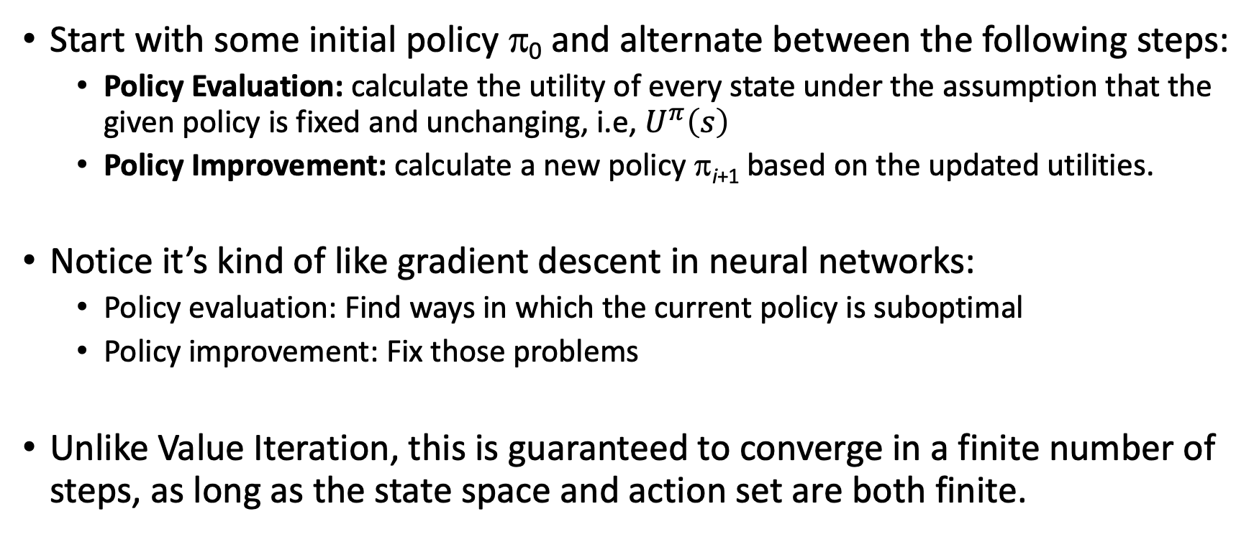
Method 2: Policy Iteration
Start with some initial policy π₀ and alternate between the following steps:
  Policy Evaluation: calculate the utility of every state under the assumption that the given policy is fixed and unchanging, i.e, $U^{π}\left(s\right)$
  Policy Improvement: calculate a new policy π_{i+1} based on the updated utilities.
Notice it’s kind of like gradient descent in neural networks:
  Policy evaluation: Find ways in which the current policy is suboptimal
  Policy improvement: Fix those problems
Unlike Value Iteration, this is guaranteed to converge in a finite number of steps, as long as the state space and action set are both finite.

Slide 33
Step 1: Policy Evaluation
Policy Evaluation: Given a fixed policy π, calculate the policy-dependent utility, U^{π}(s), for every state s
Notice how this differs from the Bellman equation:
The difference is that policy evaluation is N _linear_ equations in N unknowns, whereas the Bellman equation is N _nonlinear_ equations in N unknowns (N=# states).

Slide 34

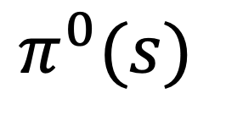
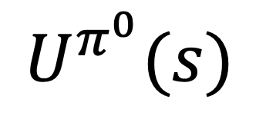
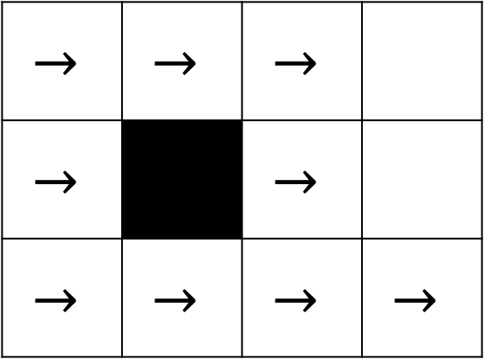
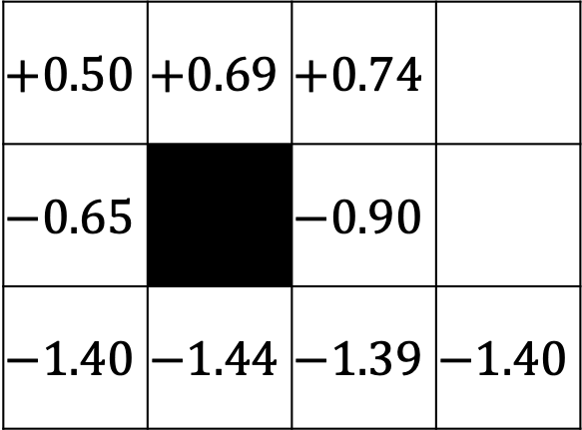
Policy Evaluation: Iteration 1
$$U^{π^{0}}(s)=R\left(s\right)+γ\sum_{s′}{P\left(s^{′} | s,a\right)U^{π^{0}}\left(s′\right)}$$
Policy Evaluation:
$$U^{π^{0}}(s)$$
$$π^{0}(s)$$
$$+0.50$$ | $$+0.69$$ | $$+0.74$$
$$−0.65$$ |  | $$−0.90$$
$$−1.40$$ | $$−1.44$$ | $$−1.39$$ | $$−1.40$$
$$→$$ | $$→$$ | $$→$$
$$→$$ |  | $$→$$
$$→$$ | $$→$$ | $$→$$ | $$→$$

Slide 35
Step 2: Policy Improvement
Policy Evaluation: Given a fixed policy π, calculate the policy-dependent utility, U^{π}(s), for every state s
Policy Improvement: Given U^{π}(s) for every state s, find an improved π(s)

Slide 36


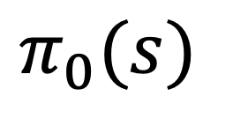
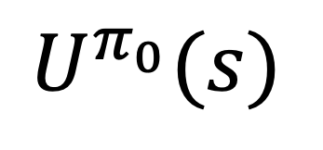


Policy Improvement: Iteration 1
$$U^{π_{0}}(s)=R\left(s\right)+γ\sum_{s′}{P\left(s^{′} | s,π_{0}(s)\right)U^{π_{0}}\left(s′\right)}$$
Policy Evaluation:
$$π_{1}(s)=\underset{a}{argmax}{\sum_{s′}{P\left(s^{′} | s,a\right)U^{π_{0}}\left(s′\right)}}$$
Policy Improvement:
$$U^{π_{0}}(s)$$
$$π_{1}(s)$$
$$π_{0}(s)$$
$$→$$ | $$→$$ | $$→$$
$$↑$$ |  | $$↑$$
$$↑$$ | $$→$$ | $$↑$$ | $$↑$$
$$+0.50$$ | $$+0.69$$ | $$+0.74$$
$$−0.65$$ |  | $$−0.90$$
$$−1.40$$ | $$−1.44$$ | $$−1.39$$ | $$−1.40$$
$$→$$ | $$→$$ | $$→$$
$$→$$ |  | $$→$$
$$→$$ | $$→$$ | $$→$$ | $$→$$

Slide 37
Summary
MDP defined by states, actions, transition model, reward function
The “solution” to an MDP is the policy: what do you do when you’re in any given state
The Bellman equation tells the utility of any given state, and incidentally, also tells you the optimum policy. The Bellman equation is N nonlinear equations in N unknowns (the policy), therefore it can’t be solved in closed form.
Value iteration:
  At the beginning of the (i+1)’st iteration, each state’s value is based on looking ahead i steps in time
  … so finding the best action = optimize based on (i+1)-step lookahead
Policy iteration:
  Find the utilities that result from the current policy,
  Improve the current policy

