Slide 1

CS 440/ECE448 Lecture 33: Model-Based Reinforcement Learning
Mark Hasegawa-Johnson, 4/2022
Including slides by Svetlana Lazebnik, 11/2016
CC-BY 4.0: Re-use at will, but please cite the source.
By Nicolas P. Rougier - Own work, CC BY-SA 3.0, https://commons.wikimedia.org/w/index.php?curid=29327040

Slide 2
Review: Markov Decision Process
MDP defined by states, actions, transition model, reward function
The “solution” to an MDP is the policy: what do you do when you’re in any given state
The Bellman equation tells the utility of any given state, and incidentally, also tells you the optimum policy. The Bellman equation is N nonlinear equations in N unknowns (the policy), therefore it can’t be solved in closed form.
Value iteration:
  At the beginning of the (i+1)’st iteration, each state’s value is based on looking ahead i steps in time
  … so finding the best action = optimize based on (i+1)-step lookahead
Policy iteration:
  Find the utilities that result from the current policy,
  Improve the current policy

Slide 3
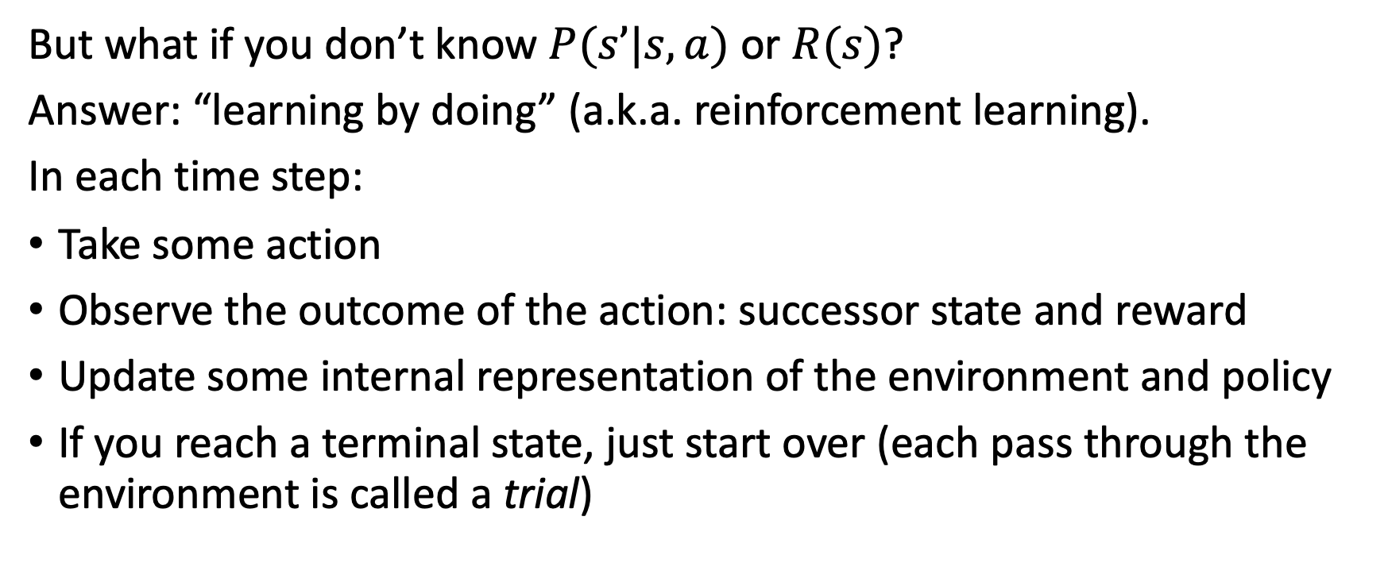
Reinforcement learning:
Basic scheme
But what if you don’t know $P(s’|s,a)$ or $R(s)$?
Answer: “learning by doing” (a.k.a. reinforcement learning).
In each time step:
Take some action
Observe the outcome of the action: successor state and reward
Update some internal representation of the environment and policy
If you reach a terminal state, just start over (each pass through the environment is called a trial)
Notes:
See http://en.wikipedia.org/wiki/Reinforcement for discussion of reinforcement learning in psychology

Slide 4
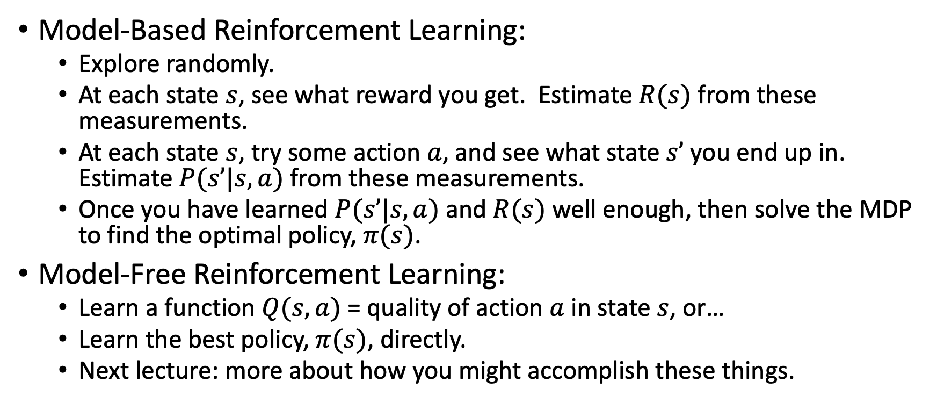
Model-Based and Model-Free RL
Model-Based Reinforcement Learning:
  Explore randomly.
  At each state $s$, see what reward you get. Estimate $R(s)$ from these measurements.
  At each state $s$, try some action $a$, and see what state $s’$ you end up in. Estimate $P(s’|s,a)$ from these measurements.
  Once you have learned $P(s’|s,a)$ and $R(s)$ well enough, then solve the MDP to find the optimal policy, $π(s)$.
Model-Free Reinforcement Learning:
  Learn a function $Q(s,a)$ = quality of action $a$ in state $s$, or…
  Learn the best policy, $π(s)$, directly.
  Next lecture: more about how you might accomplish these things.

Slide 5
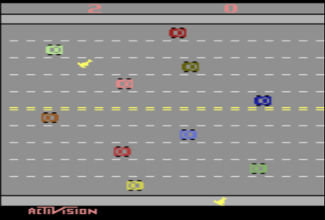
Example of model-based reinforcement learning: Playing classic Atari video games
Model-Based Reinforcement Learning for Atari (Kaiser, Babaeizadeh, Milos, Osinski, Campbell, Czechowski, Erhan, Finn, Kozakowski, Levine, Mohiuddin, Sepassi, Tucker, and Michalewski)
Blog and videos: https://sites.google.com/view/modelbasedrlatari/home
Article: https://arxiv.org/abs/1903.00374
Screenshot of the video game “Freeway,” copyright Activision. Reproduced here under the terms of fair use enumerated at https://en.wikipedia.org/w/index.php?curid=56419703

Slide 6
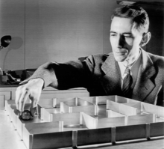
Example of model-based reinforcement learning: Theseus the Mouse
Claude Shannon and Theseus the Mouse. Public domain image, Bell Labs.

Slide 7
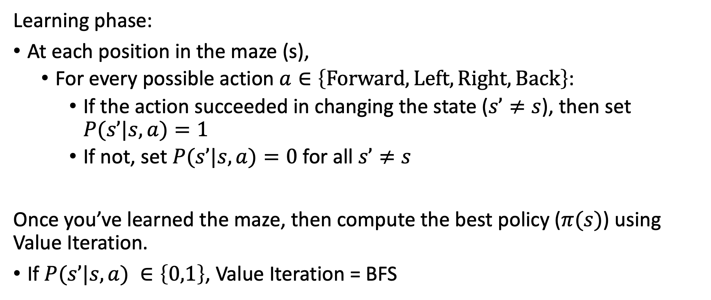
Model-based reinforcement learning:
Theseus’ strategy
Learning phase:
At each position in the maze (s),
  For every possible action $a∈\left\{Forward, Left, Right, Back\right\}$:
    If the action succeeded in changing the state ($s’≠s$), then set $P(s’|s,a)=1$
    If not, set $P(s’|s,a)=0$ for all $s’≠s$
Once you’ve learned the maze, then compute the best policy ($π(s)$) using Value Iteration.
If $P(s’|s,a) ∈\left\{0,1\right\}$, Value Iteration = BFS

Slide 8
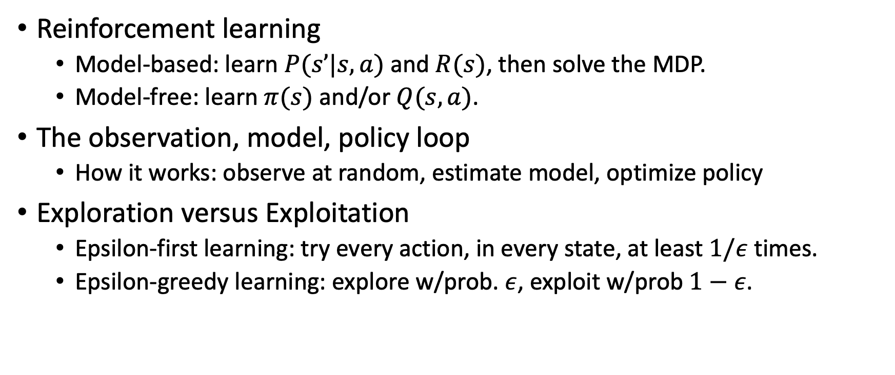
Outline of Today’s Lecture
Reinforcement learning
  Model-based: learn $P(s’|s,a)$ and $R(s)$, then solve the MDP.
  Model-free: learn $π(s)$ and/or $Q(s,a)$.
The observation, model, policy loop
  How it works: observe at random, estimate model, optimize policy
Exploration versus Exploitation
  Epsilon-first learning: try every action, in every state, at least $1/ε$ times.
  Epsilon-greedy learning: explore w/prob. $ε$, exploit w/prob $1−ε$.

Slide 9
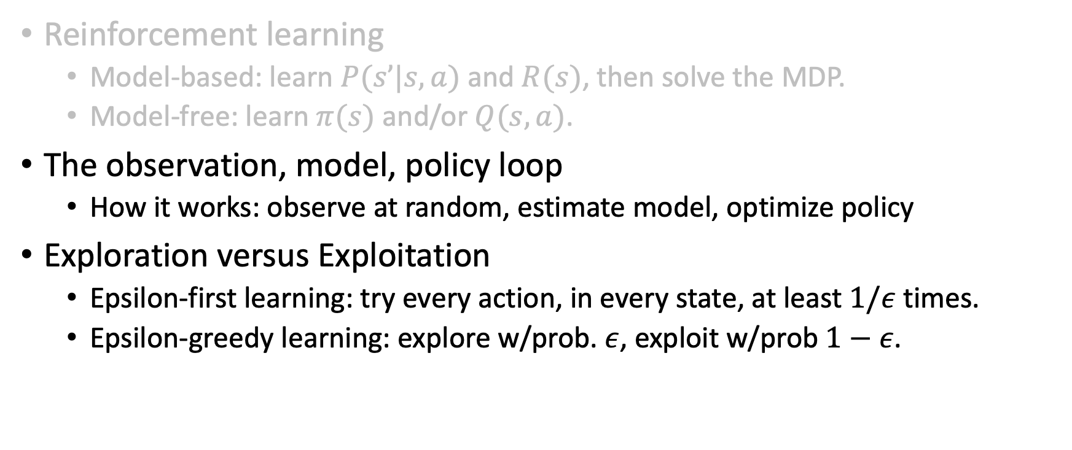
Outline
Reinforcement learning
  Model-based: learn $P(s’|s,a)$ and $R(s)$, then solve the MDP.
  Model-free: learn $π(s)$ and/or $Q(s,a)$.
The observation, model, policy loop
  How it works: observe at random, estimate model, optimize policy
Exploration versus Exploitation
  Epsilon-first learning: try every action, in every state, at least $1/ε$ times.
  Epsilon-greedy learning: explore w/prob. $ε$, exploit w/prob $1−ε$.

Slide 10
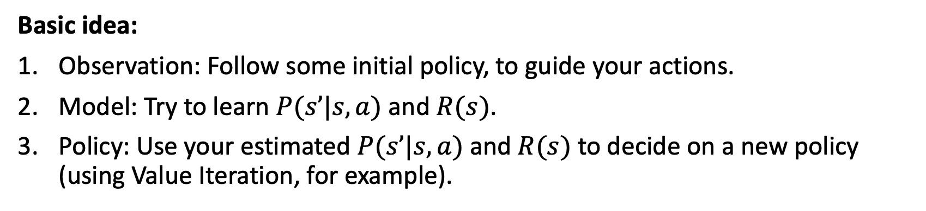
The observation-model-policy loop
Basic idea:
Observation: Follow some initial policy, to guide your actions.
Model: Try to learn $P(s’|s,a)$ and $R(s)$.
Policy: Use your estimated $P(s’|s,a)$ and $R(s)$ to decide on a new policy (using Value Iteration, for example).

Slide 11
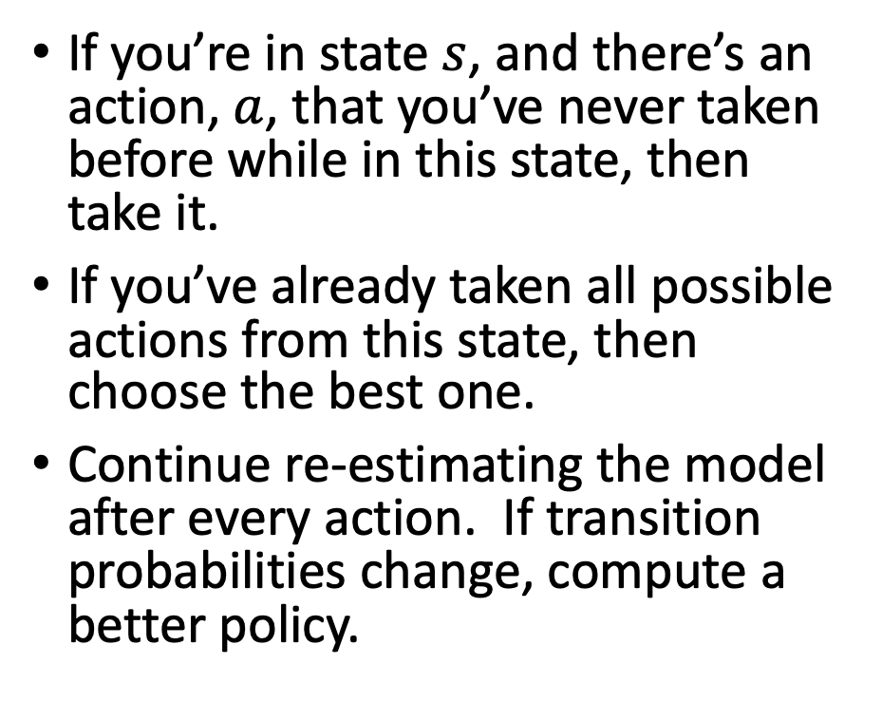
Observation-Model-Policy Loop: Theseus
If you’re in state $s$, and there’s an action, $a$, that you’ve never taken before while in this state, then take it.
If you’ve already taken all possible actions from this state, then choose the best one.
Continue re-estimating the model after every action. If transition probabilities change, compute a better policy.
Claude Shannon and Theseus the Mouse. Public domain image, Bell Labs.

Slide 12
What Theseus never had to deal with: Probabilities
What happens if P(s’|s,a) is not 0 or 1, but something in between?
Trying it just once is not enough
Claude Shannon and Theseus the Mouse. Public domain image, Bell Labs.

Slide 13
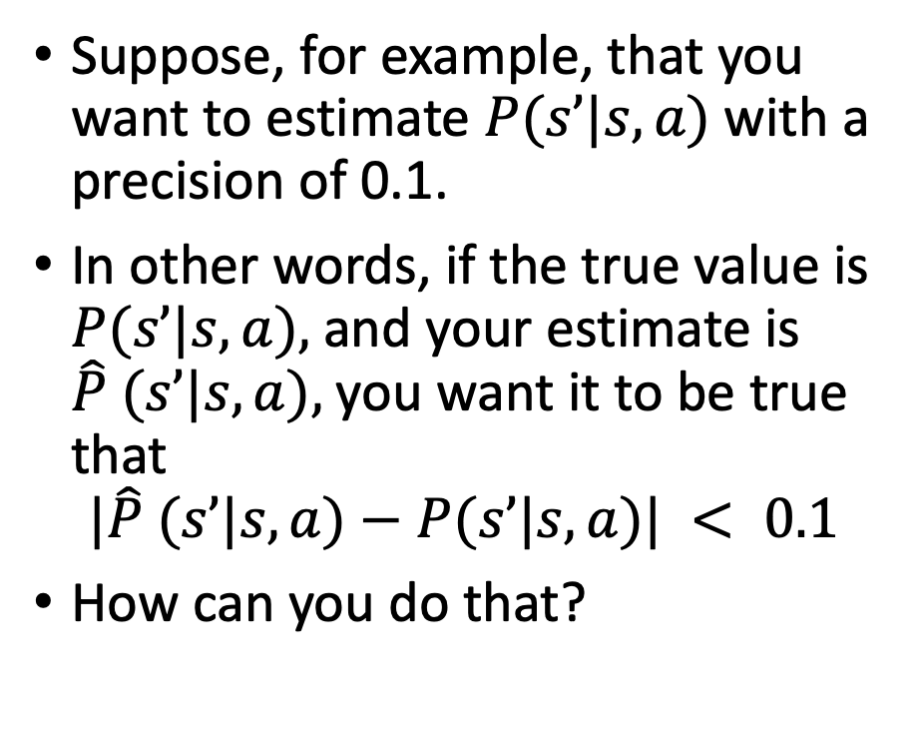
How to deal with probabilities
Suppose, for example, that you want to estimate $P(s’|s,a)$with a precision of 0.1.
In other words, if the true value is $P(s’|s,a),$and your estimate is $\hat{P} (s’|s,a),$you want it to be true that
$$|\hat{P} (s’|s,a)−P(s’|s,a)| < 0.1$$
How can you do that?
Claude Shannon and Theseus the Mouse. Public domain image, Bell Labs.

Slide 14
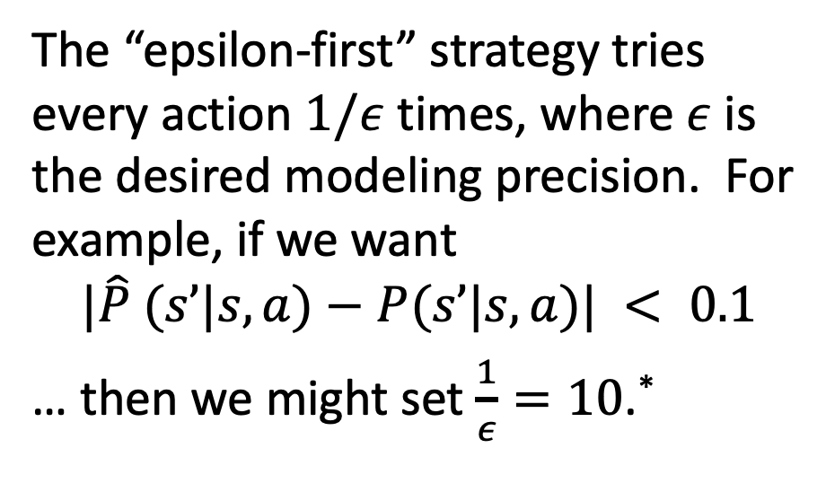
The epsilon-first strategy
The “epsilon-first” strategy tries every action $1/ε$ times, where $ε$ is the desired modeling precision. For example, if we want
$$|\hat{P} (s’|s,a)−P(s’|s,a)| < 0.1$$
… then we might set $\frac{1}{ε}=10$.*
Claude Shannon and Theseus the Mouse. Public domain image, Bell Labs.
* We can never guarantee that $|\hat{P} (s’|s,a)−P(s’|s,a)|<ε$ with 100% confidence, but using $1/ε$ trials is enough to be pretty confident. If you’ve taken ECE 313 or CS 361, you should be able to work out the relationship more precisely.

Slide 15
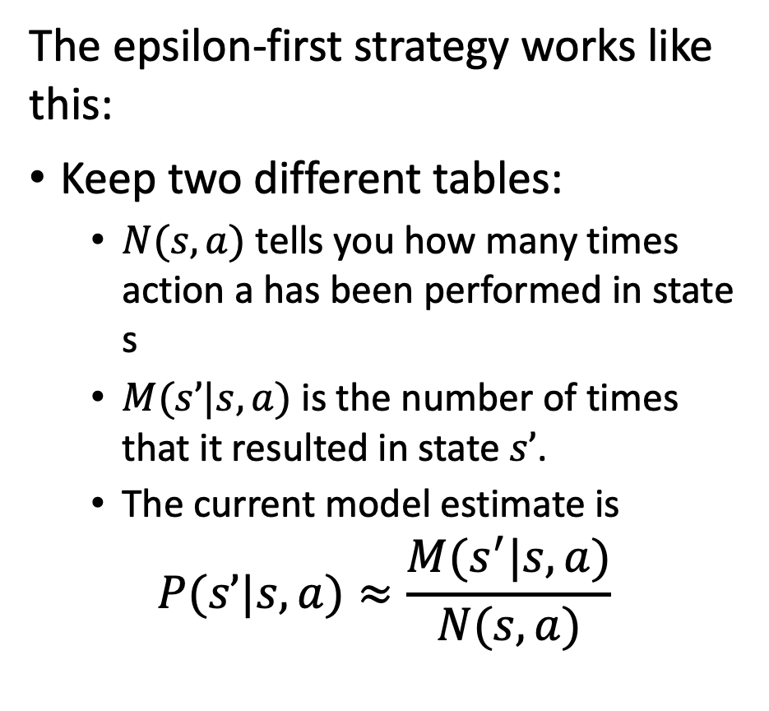
The epsilon-first strategy
The epsilon-first strategy works like this:
Keep two different tables:
  $N(s,a)$ tells you how many times action a has been performed in state s
  $M(s’|s,a)$ is the number of times that it resulted in state $s’$.
  The current model estimate is
$$P(s’|s,a)≈\frac{M(s^{′}|s,a)}{N(s,a)}$$
Claude Shannon and Theseus the Mouse. Public domain image, Bell Labs.

Slide 16
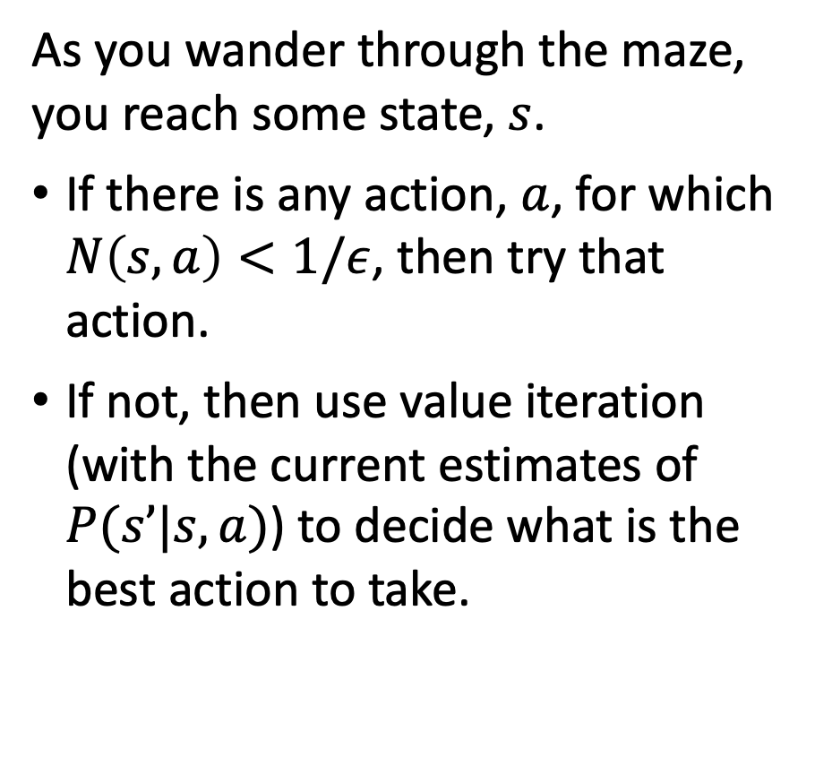
The epsilon-first strategy
As you wander through the maze, you reach some state, $s$.
If there is any action, $a$, for which $N\left(s,a\right)<1/ε$, then try that action.
If not, then use value iteration (with the current estimates of $P(s’|s,a)$) to decide what is the best action to take.
Claude Shannon and Theseus the Mouse. Public domain image, Bell Labs.

Slide 17
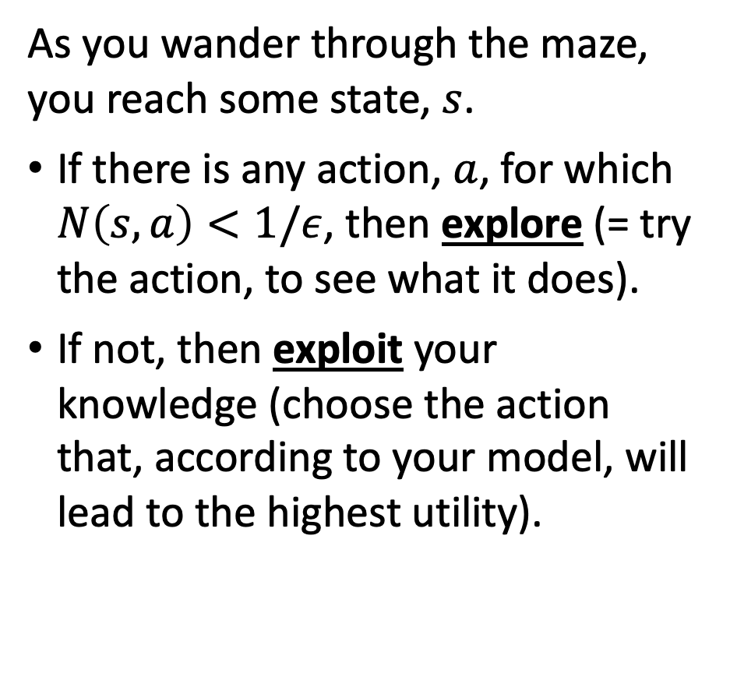
The epsilon-first strategy
As you wander through the maze, you reach some state, $s$.
If there is any action, $a$, for which $N\left(s,a\right)<1/ε$, then explore (= try the action, to see what it does).
If not, then exploit your knowledge (choose the action that, according to your model, will lead to the highest utility).
Claude Shannon and Theseus the Mouse. Public domain image, Bell Labs.

Slide 18
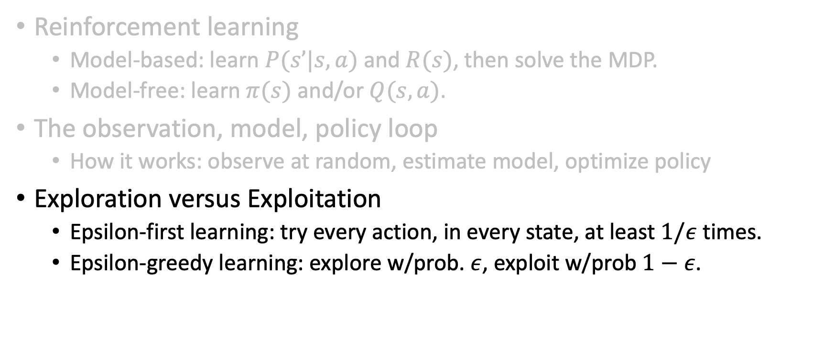
Outline
Reinforcement learning
  Model-based: learn $P(s’|s,a)$ and $R(s)$, then solve the MDP.
  Model-free: learn $π(s)$ and/or $Q(s,a)$.
The observation, model, policy loop
  How it works: observe at random, estimate model, optimize policy
Exploration versus Exploitation
  Epsilon-first learning: try every action, in every state, at least $1/ε$ times.
  Epsilon-greedy learning: explore w/prob. $ε$, exploit w/prob $1−ε$.

Slide 19
Exploration vs. Exploitation
Exploration: take a new action with unknown consequences
  Pros:
    Get a more accurate model of the environment
    Discover higher-reward states than the ones found so far
  Cons:
    When you’re exploring, you’re not maximizing your utility
    Something bad might happen
Exploitation: go with the best strategy found so far
  Pros:
    Maximize reward as reflected in the current utility estimates
    Avoid bad stuff
  Cons:
    Might also prevent you from discovering the true optimal strategy
“Search represents a core feature of cognition:” Exploration versus exploitation in space, mind, and society.

Slide 20
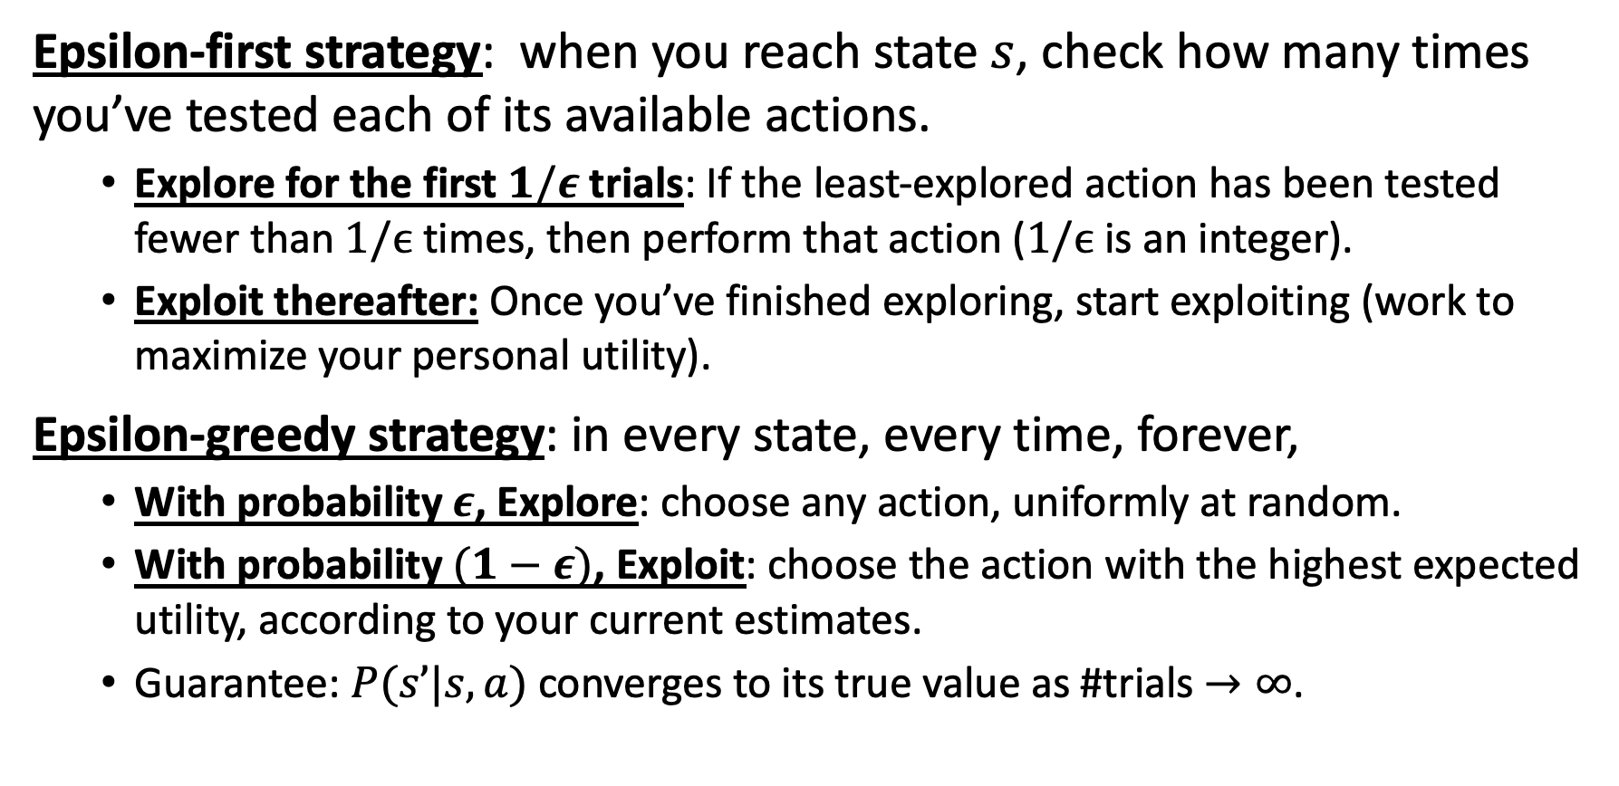
How to trade off exploration vs. exploitation
Epsilon-first strategy: when you reach state $s$, check how many times you’ve tested each of its available actions.
  Explore for the first $1/ε$ trials: If the least-explored action has been tested fewer than $1/ϵ$ times, then perform that action ($1/ϵ$ is an integer).
  Exploit thereafter: Once you’ve finished exploring, start exploiting (work to maximize your personal utility).
Epsilon-greedy strategy: in every state, every time, forever,
  With probability $ε$, Explore: choose any action, uniformly at random.
  With probability $(1−ε)$, Exploit: choose the action with the highest expected utility, according to your current estimates.
  Guarantee: $P(s’|s,a)$ converges to its true value as #trials $→∞$.

Slide 21
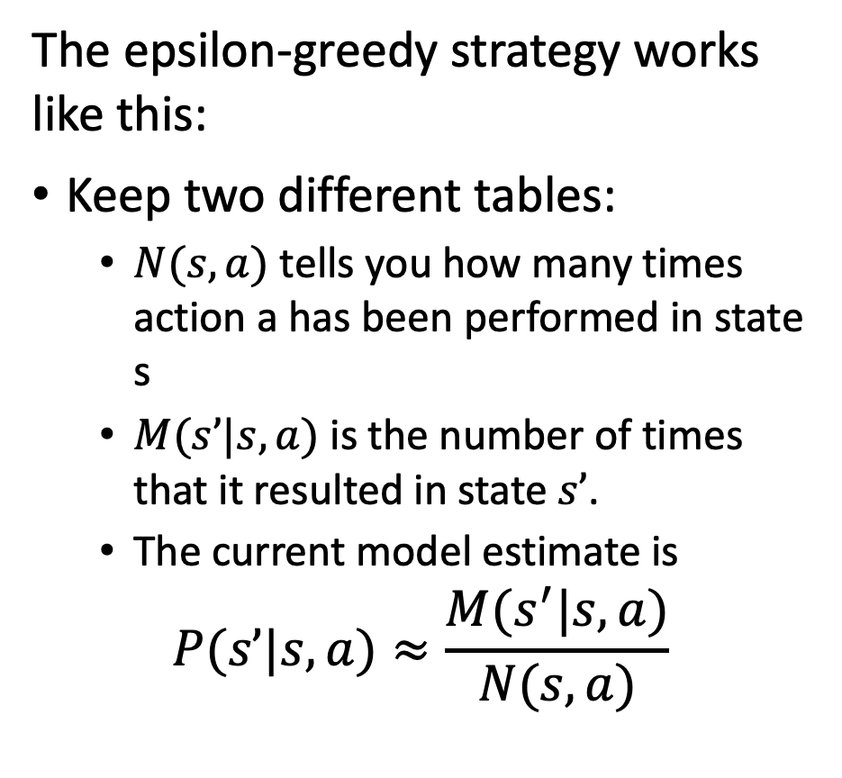
The epsilon-greedy strategy
The epsilon-greedy strategy works like this:
Keep two different tables:
  $N(s,a)$ tells you how many times action a has been performed in state s
  $M(s’|s,a)$ is the number of times that it resulted in state $s’$.
  The current model estimate is
$$P(s’|s,a)≈\frac{M(s^{′}|s,a)}{N(s,a)}$$
Claude Shannon and Theseus the Mouse. Public domain image, Bell Labs.

Slide 22
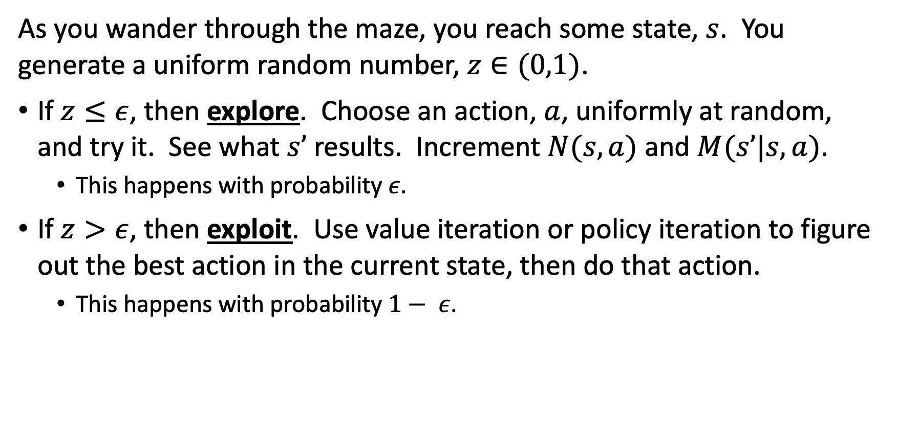
The epsilon-greedy strategy
As you wander through the maze, you reach some state, $s$. You generate a uniform random number, $z∈(0,1)$.
If $z≤ε$, then explore. Choose an action, $a$, uniformly at random, and try it. See what $s’$ results. Increment $N(s,a)$ and $M(s’|s,a)$.
  This happens with probability $ε$.
If $z>ε$, then exploit. Use value iteration or policy iteration to figure out the best action in the current state, then do that action.
  This happens with probability $1− ε$.

Slide 23
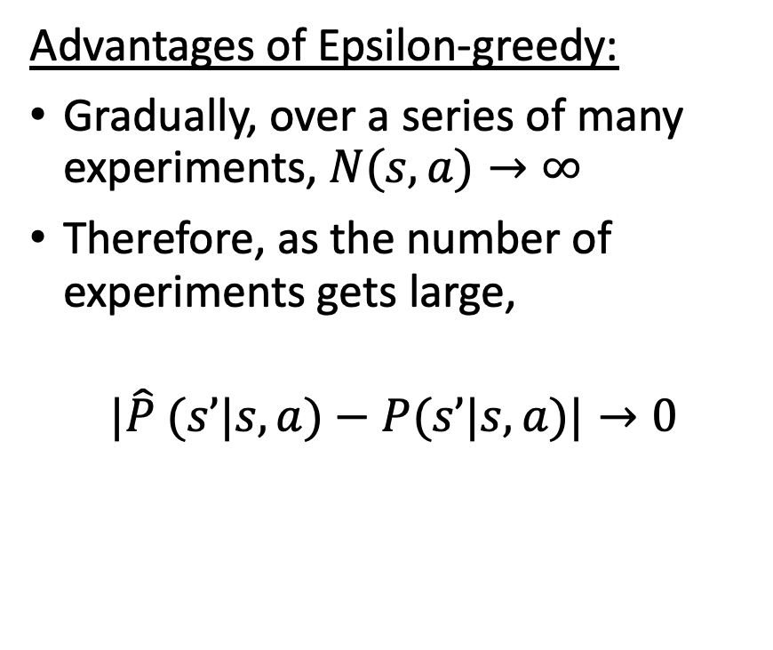
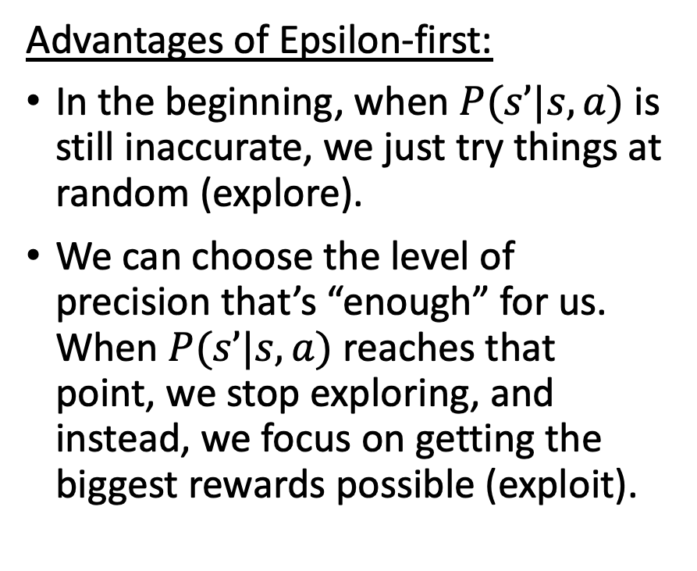

Compare: Epsilon-first and Epsilon-greedy
  For both: $P(s’|s,a)≈\frac{M(s^{′}|s,a)}{N(s,a)}$
Advantages of Epsilon-first:
In the beginning, when $P(s’|s,a)$ is still inaccurate, we just try things at random (explore).
We can choose the level of precision that’s “enough” for us. When $P(s’|s,a)$ reaches that point, we stop exploring, and instead, we focus on getting the biggest rewards possible (exploit).
Advantages of Epsilon-greedy:
Gradually, over a series of many experiments, $N(s,a)→∞⁡$
Therefore, as the number of experiments gets large,
$$|\hat{P} (s’|s,a)−P(s’|s,a)|→0$$

Slide 24
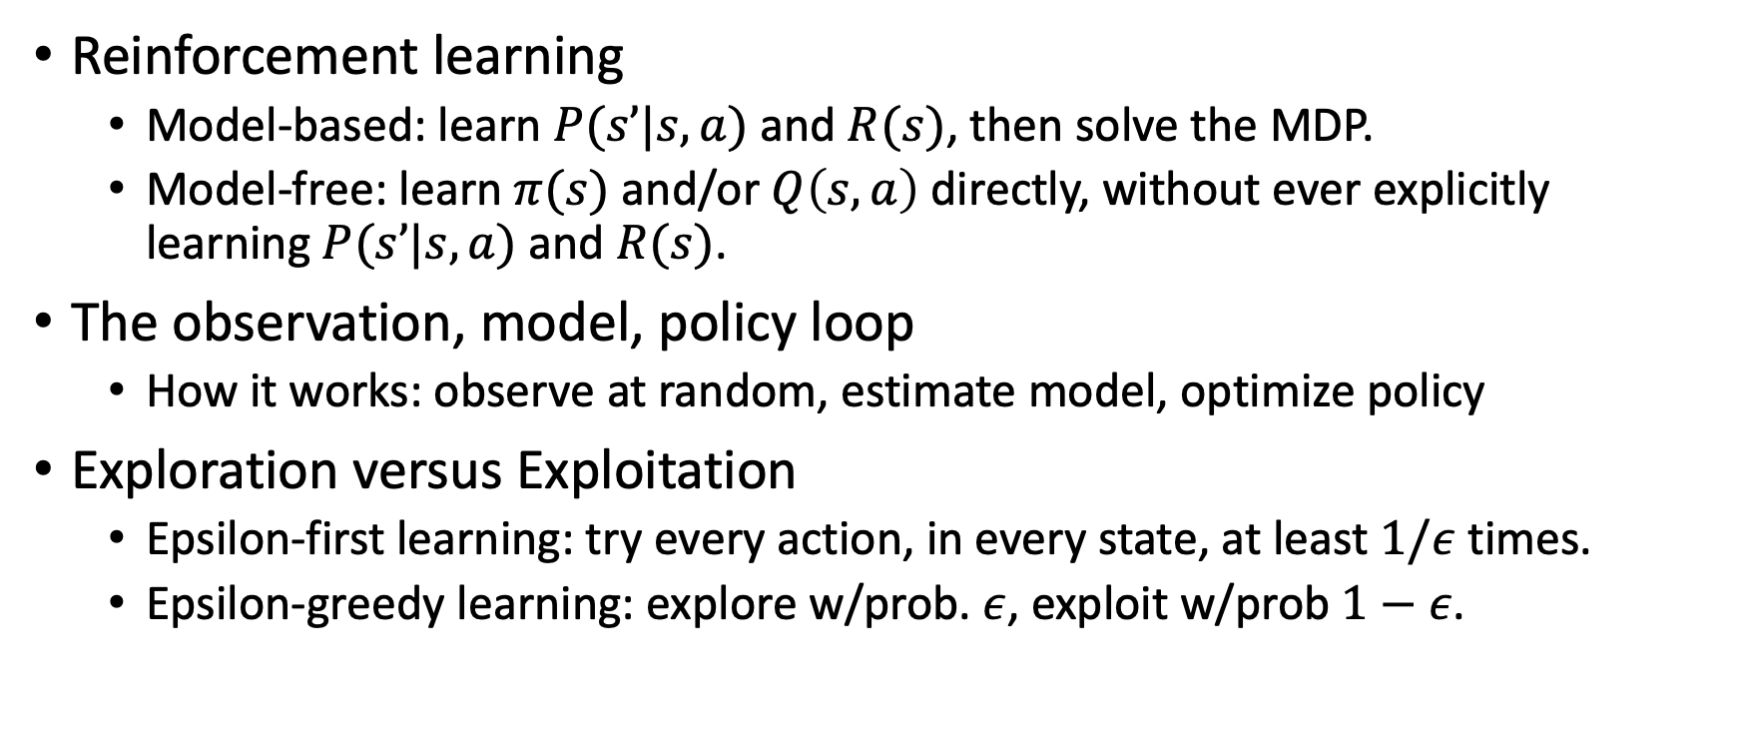
Outline
Reinforcement learning
  Model-based: learn $P(s’|s,a)$ and $R(s)$, then solve the MDP.
  Model-free: learn $π(s)$ and/or $Q\left(s,a\right)$ directly, without ever explicitly learning $P(s’|s,a)$ and $R(s)$.
The observation, model, policy loop
  How it works: observe at random, estimate model, optimize policy
Exploration versus Exploitation
  Epsilon-first learning: try every action, in every state, at least $1/ε$ times.
  Epsilon-greedy learning: explore w/prob. $ε$, exploit w/prob $1−ε$.

