Slide 1
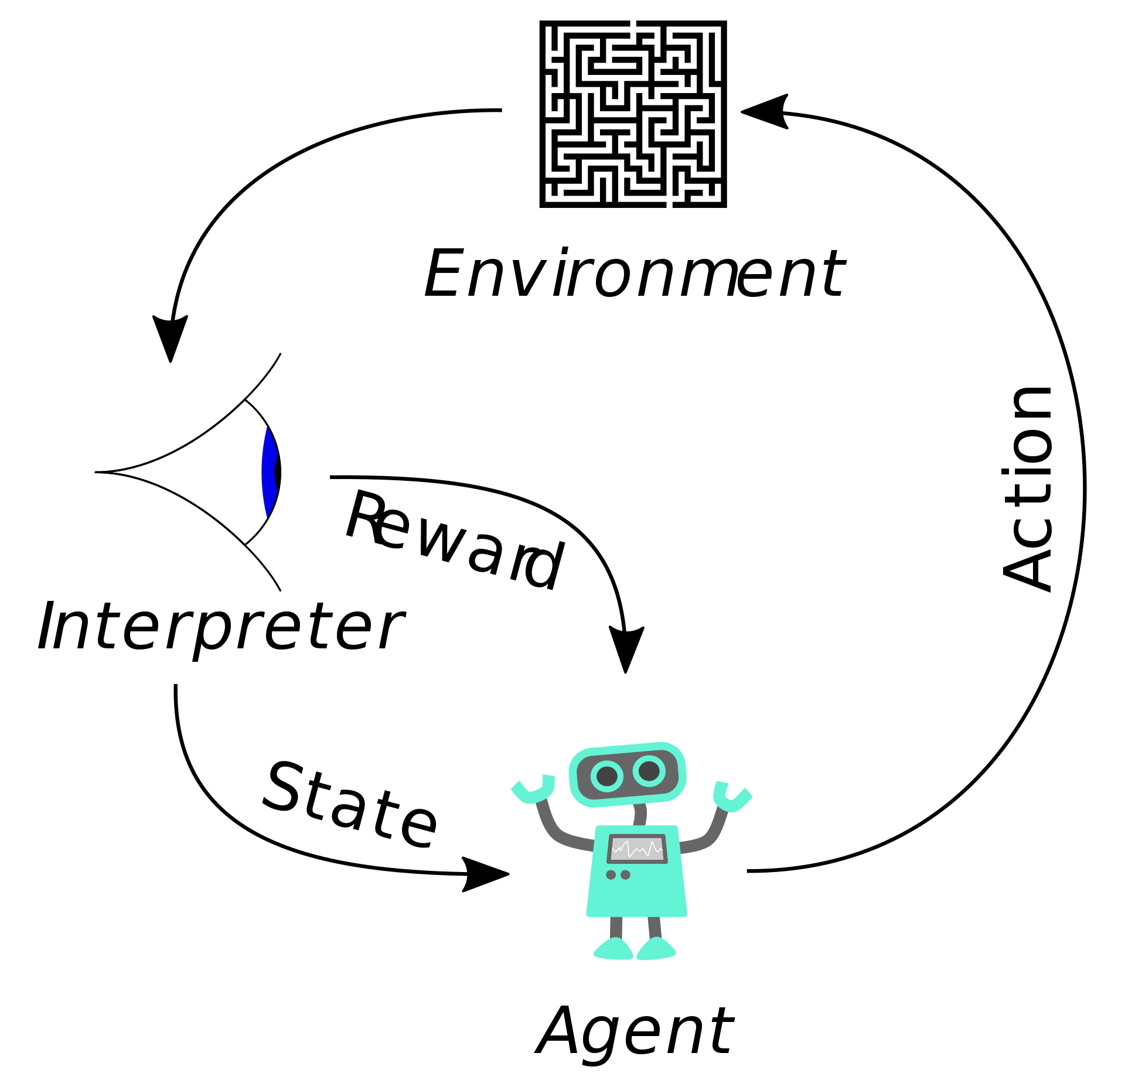
Deep Reinforcement Learning CS440/ECE448 Lecture 35
Mark Hasegawa-Johnson, 4/2022
CC-BY 4.0: you may remix or redistribute if you cite the source
Image: Megajuice, CC0, https://commons.wikimedia.org/
w/index.php?curid=57895741

Slide 2
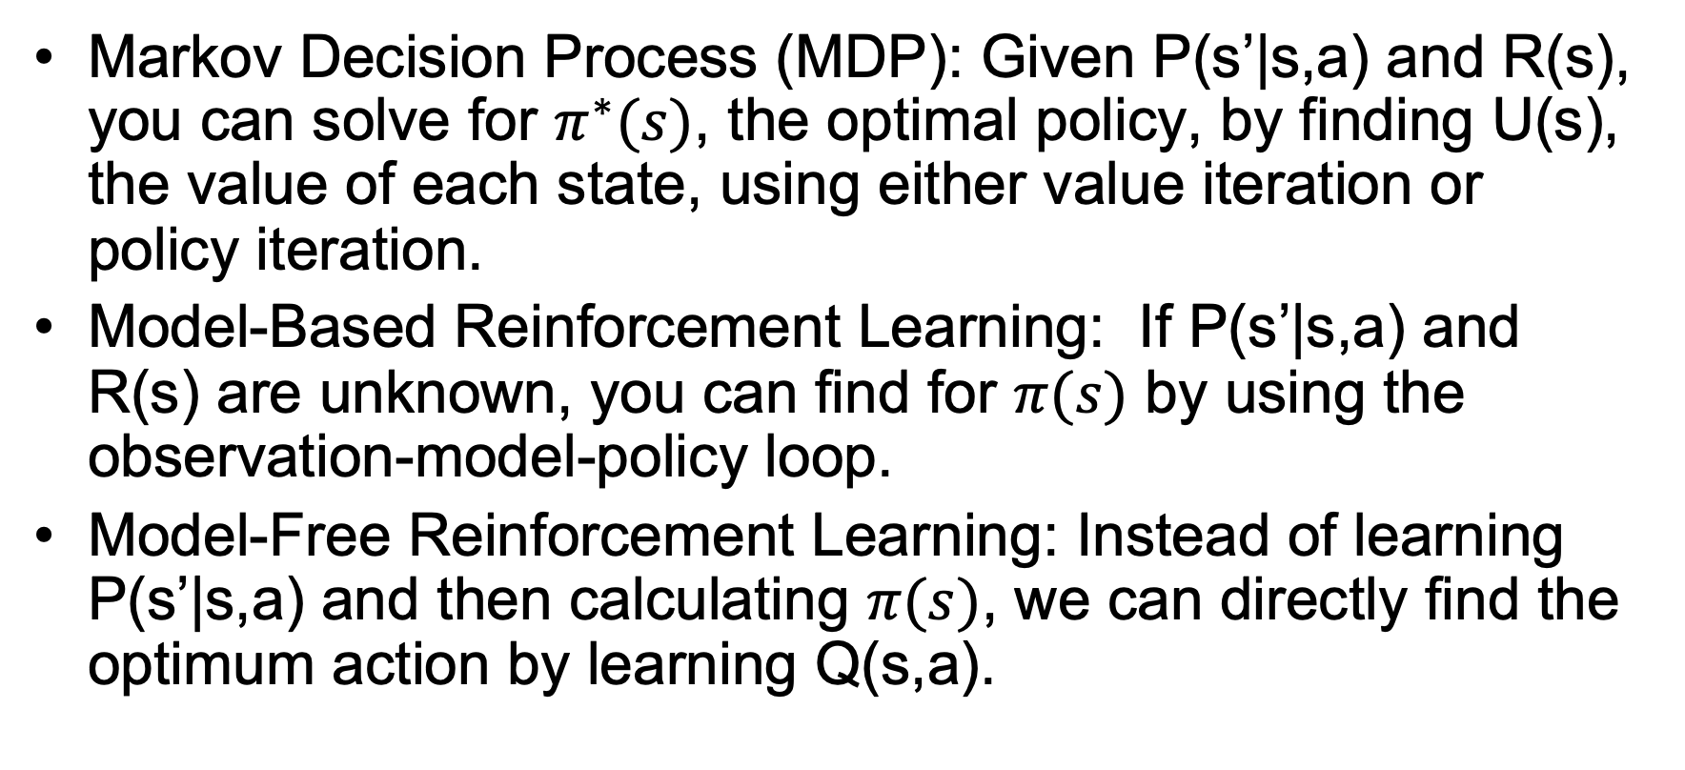
Review: Reinforcement Learning
Markov Decision Process (MDP): Given P(s’|s,a) and R(s), you can solve for $π^{∗}(s)$, the optimal policy, by finding U(s), the value of each state, using either value iteration or policy iteration.
Model-Based Reinforcement Learning: If P(s’|s,a) and R(s) are unknown, you can find for $π(s)$ by using the observation-model-policy loop.
Model-Free Reinforcement Learning: Instead of learning P(s’|s,a) and then calculating $π(s)$, we can directly find the optimum action by learning Q(s,a).

Slide 3
Outline
Imitation learning: learn the optimal policy by imitating a human
Deep Q learning: compute Q(s,a) using a neural network

Slide 4
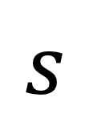
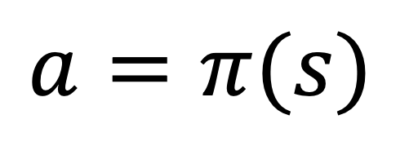
Policy Learning
Why can’t we just learn a model (neural net, or even a table lookup) that does this:
Model
$$s$$
$$a=π(s)$$

Slide 5
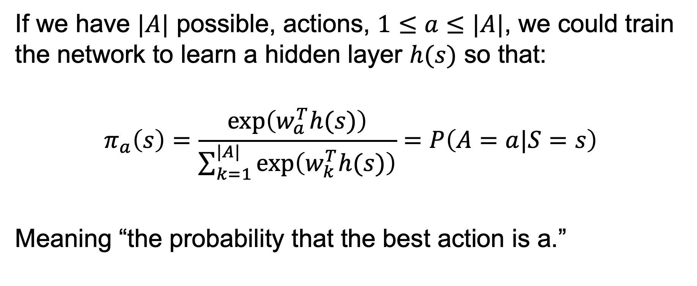
Probabilistic Policy
If we have $|A|$ possible, actions, $1≤a≤|A|$, we could train the network to learn a hidden layer $h(s)$ so that:
$$π_{a}\left(s\right)=\frac{exp⁡\left(w_{a}^{T}h(s)\right)}{\sum_{k=1}^{|A|}{exp⁡\left(w_{k}^{T}h(s)\right)}}=P\left(A=a|S=s\right)$$
Meaning “the probability that the best action is a.”

Slide 6
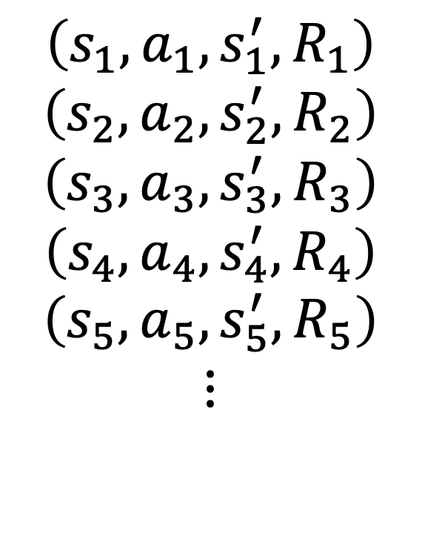
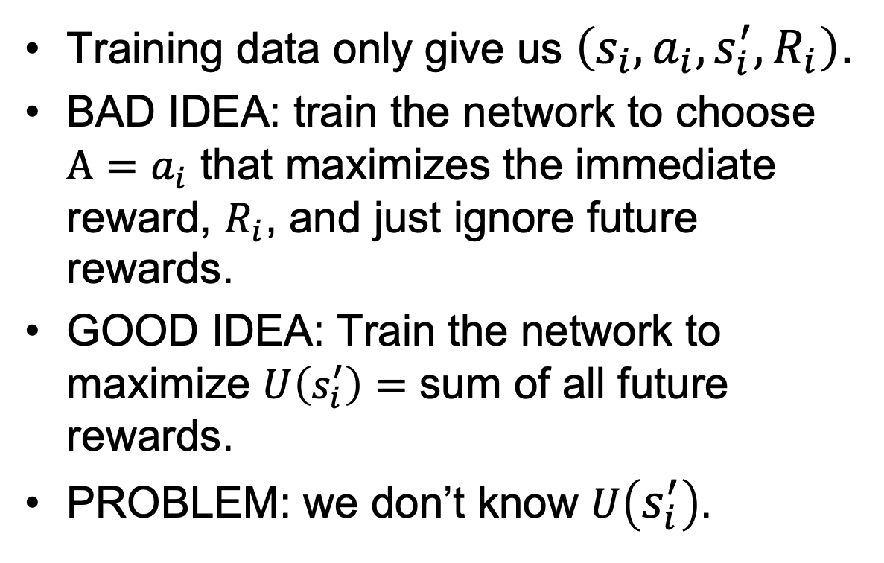
How do we train it?
Training data only give us $\left(s_{i},a_{i},s_{i}^{′},R_{i}\right)$.
BAD IDEA: train the network to choose $A=a_{i}$ that maximizes the immediate reward, $R_{i}$, and just ignore future rewards.
GOOD IDEA: Train the network to maximize $U\left(s_{i}^{′}\right)=$ sum of all future rewards.
PROBLEM: we don’t know $U\left(s_{i}^{′}\right)$.
$$\left(s_{1},a_{1},s_{1}^{′},R_{1}\right)$$
$$\left(s_{2},a_{2},s_{2}^{′},R_{2}\right)$$
$$\left(s_{3},a_{3},s_{3}^{′},R_{3}\right)$$
$$\left(s_{4},a_{4},s_{4}^{′},R_{4}\right)$$
$$\left(s_{5},a_{5},s_{5}^{′},R_{5}\right)$$
$$⋮$$

Slide 7
How to make Policy Learning trainable
Actor-Critic RL. We’ll come back to this next time.
Imitation learning.

Slide 8


Imitation learning
In some applications, you cannot bootstrap yourself from random policies
High-dimensional state and action spaces where most random trajectories fail miserably
Expensive to evaluate policies in the physical world, especially in cases of failure
Solution: learn to imitate sample trajectories or demonstrations
This is also helpful when there is no natural reward formulation

Slide 9
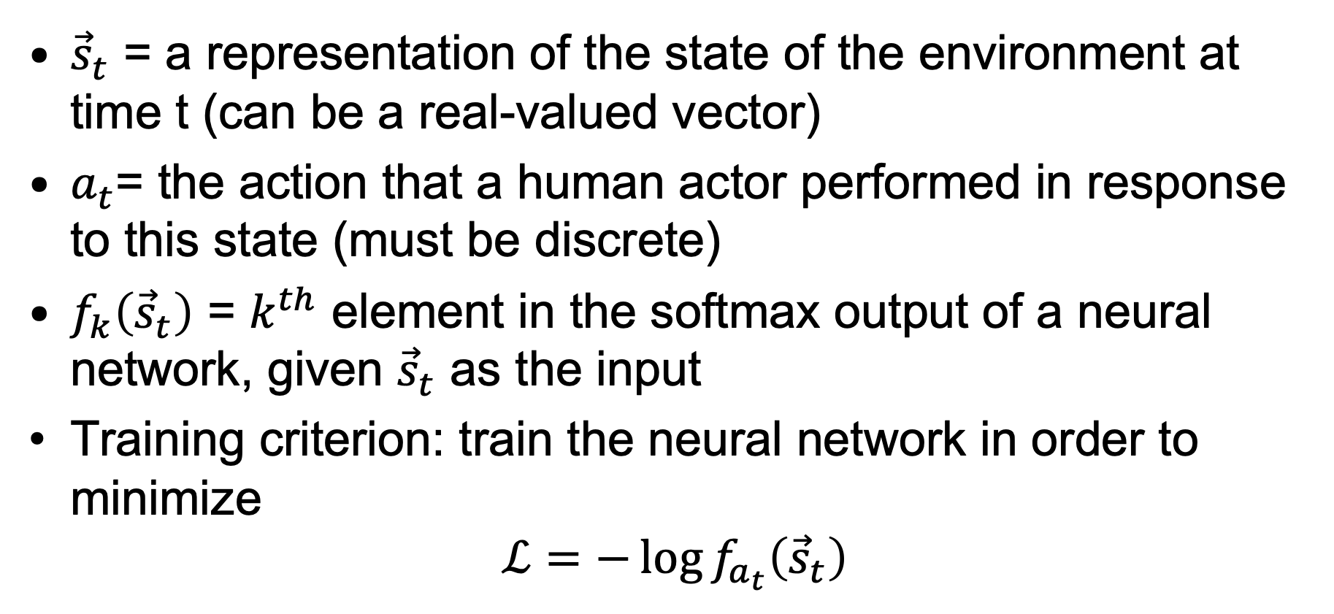
Imitation learning
${\vec{s}}_{t}$ = a representation of the state of the environment at time t (can be a real-valued vector)
$a_{t}$= the action that a human actor performed in response to this state (must be discrete)
$f_{k}\left({\vec{s}}_{t}\right)$ = $k^{th}$ element in the softmax output of a neural network, given ${\vec{s}}_{t}$ as the input
Training criterion: train the neural network in order to minimize
$$ℒ=−\log{f_{a_{t}}\left({\vec{s}}_{t}\right)}$$

Slide 10
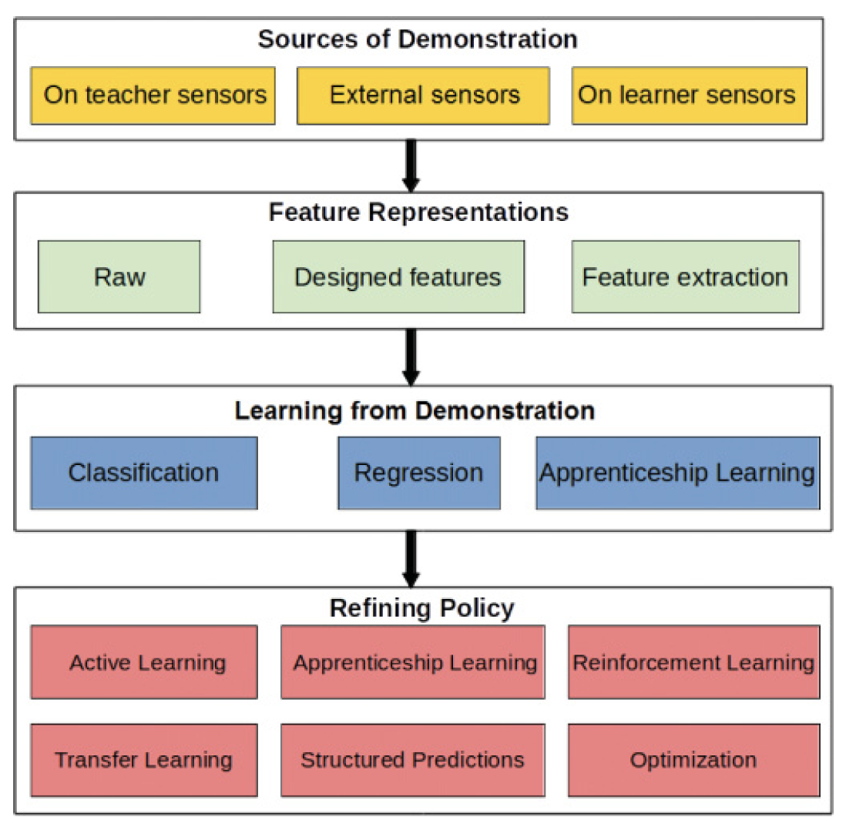
Overview of imitation learning methods
Methods differ in:
Feature representation: raw pixels/joint angles, or have you already used some other method to learn a deep feature representation?
Training criterion: classification (discrete actions), or regression (continuous actions)?
Hussein et al. Imitation Learning: A Survey of Learning Methods, 2018.

Slide 11
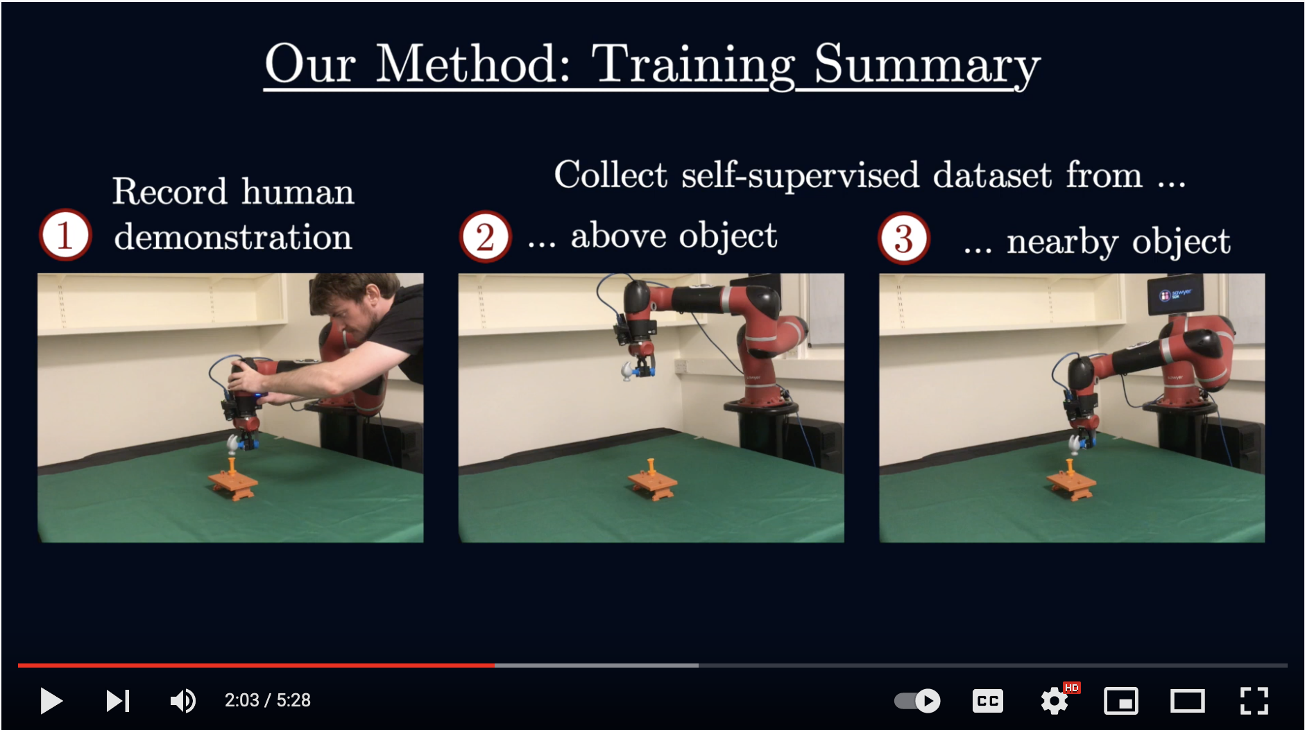
Example: Coarse-to-Fine Imitation Learning
Edward Johns, Coarse-to-Fine Imitation Learning: Robot Manipulation from a Single Demonstration, 2021.

Slide 12
Outline
Imitation learning: learn the optimal policy by imitating a human
Deep Q learning: compute Q(s,a) using a neural network

Slide 13
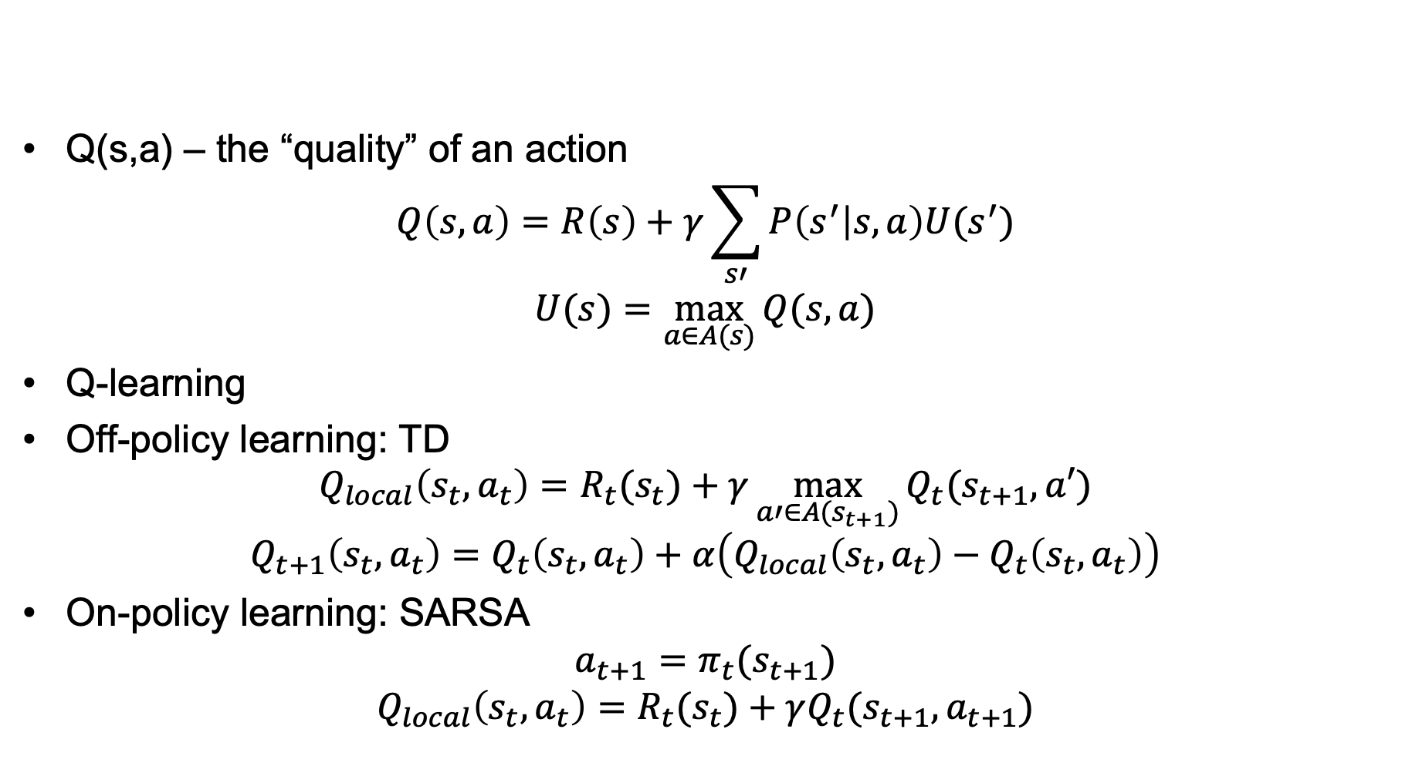
Review: Q-Learning
Q(s,a) – the “quality” of an action
$$Q\left(s,a\right)=R\left(s\right)+γ\sum_{s′}{P\left(s^{′} | s,a\right)U(s^{′})}$$
$$U(s)=\max_{a∈A(s)}{Q(s,a)}$$
Q-learning
Off-policy learning: TD
$$Q_{local}\left(s_{t},a_{t}\right)=R_{t}(s_{t})+γ\max_{a′∈A(s_{t+1})}{Q_{t}(s_{t+1},a′)}$$
$$Q_{t+1}\left(s_{t},a_{t}\right)=Q_{t}\left(s_{t},a_{t}\right)+α\left(Q_{local}\left(s_{t},a_{t}\right)−Q_{t}\left(s_{t},a_{t}\right)\right)$$
On-policy learning: SARSA
$${a_{t+1}=π}_{t}(s_{t+1})$$
$$Q_{local}\left(s_{t},a_{t}\right)=R_{t}(s_{t})+γQ_{t}(s_{t+1},a_{t+1})$$

Slide 14
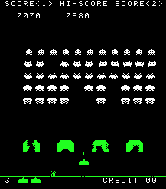
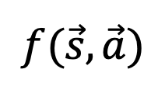




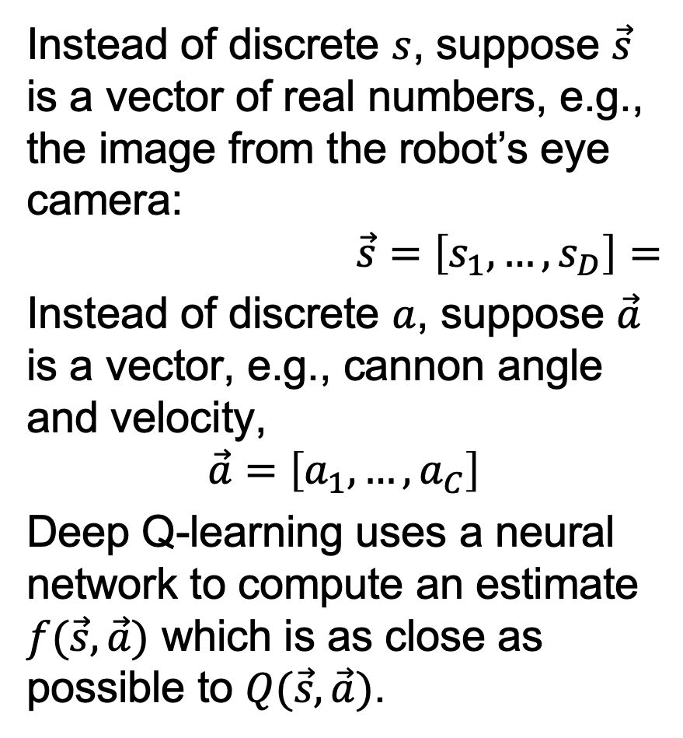







Deep Q learning
Instead of discrete $s$, suppose $\vec{s}$ is a vector of real numbers, e.g., the image from the robot’s eye camera:
$$\vec{s}=\left[s_{1},…,s_{D}\right]=$$
Instead of discrete $a$, suppose $\vec{a}$ is a vector, e.g., cannon angle and velocity,
$$\vec{a}=\left[a_{1},…,a_{C}\right]$$
Deep Q-learning uses a neural network to compute an estimate $f(\vec{s},\vec{a})$ which is as close as possible to $Q(\vec{s},\vec{a})$.
$$f(\vec{s},\vec{a})$$
$$1$$
$$1$$
Copyright Taito.
$$1$$
$$1$$
$$s_{1}$$
$$…$$
$$s_{D}$$
$$a_{1}$$
$$…$$
$$a_{C}$$
$$1$$
$$…$$

Slide 15
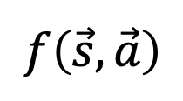
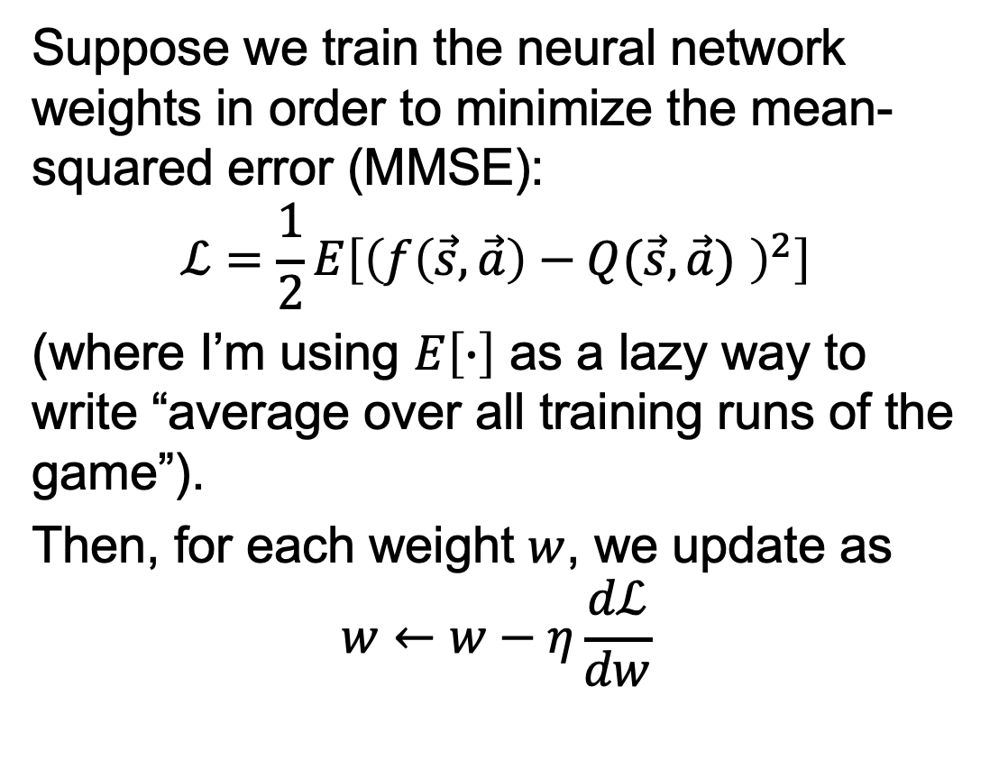
MMSE Deep Q learning
Suppose we train the neural network weights in order to minimize the mean-squared error (MMSE):
$$ℒ=\frac{1}{2}E\left[{\left(f\left(\vec{s},\vec{a}\right)−Q(\vec{s},\vec{a}) \right)}^{2}\right]$$
(where I’m using $E\left[∙\right]$ as a lazy way to write “average over all training runs of the game”).
Then, for each weight $w$, we update as
$$w←w−η\frac{dℒ}{dw}$$
$$f\left(\vec{s},\vec{a}\right)$$
$$1$$
$$1$$
$$1$$
$$1$$
$$s_{1}$$
$$…$$
$$s_{D}$$
$$a_{1}$$
$$…$$
$$a_{C}$$
$$1$$
$$…$$

Slide 16
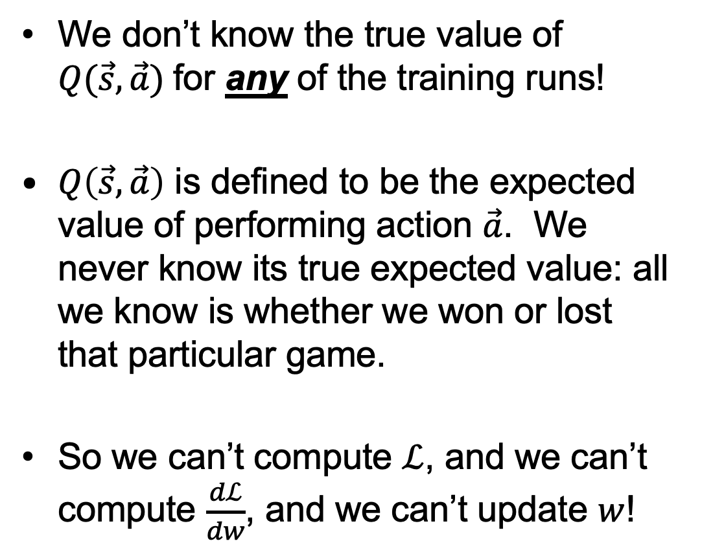
What makes deep Q learning harder than normal neural network training
We don’t know the true value of $Q(\vec{s},\vec{a})$for any of the training runs!
$Q\left(\vec{s},\vec{a}\right)$ is defined to be the expected value of performing action $\vec{a}$. We never know its true expected value: all we know is whether we won or lost that particular game.
So we can’t compute $ℒ$, and we can’t compute $\frac{dℒ}{dw}$, and we can’t update $w$!
$$f\left(\vec{s},\vec{a}\right)$$
$$1$$
$$1$$
$$1$$
$$1$$
$$s_{1}$$
$$…$$
$$s_{D}$$
$$a_{1}$$
$$…$$
$$a_{C}$$
$$1$$
$$…$$

Slide 17



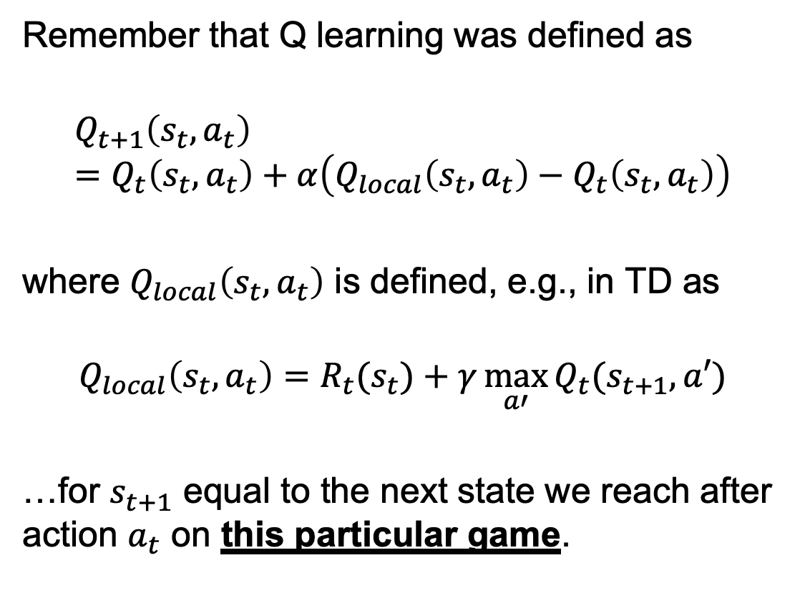
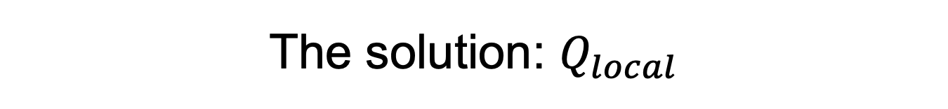
The solution: $Q_{local}$
Remember that Q learning was defined as
$$Q_{t+1}\left(s_{t},a_{t}\right)=Q_{t}\left(s_{t},a_{t}\right)+α\left(Q_{local}\left(s_{t},a_{t}\right)−Q_{t}\left(s_{t},a_{t}\right)\right)$$
where $Q_{local}\left(s_{t},a_{t}\right)$ is defined, e.g., in TD as
$$Q_{local}\left(s_{t},a_{t}\right)=R_{t}(s_{t})+γ\max_{a′}{Q_{t}(s_{t+1},a′)}$$
…for $s_{t+1}$ equal to the next state we reach after action $a_{t}$ on this particular game.
$$…$$

Slide 18
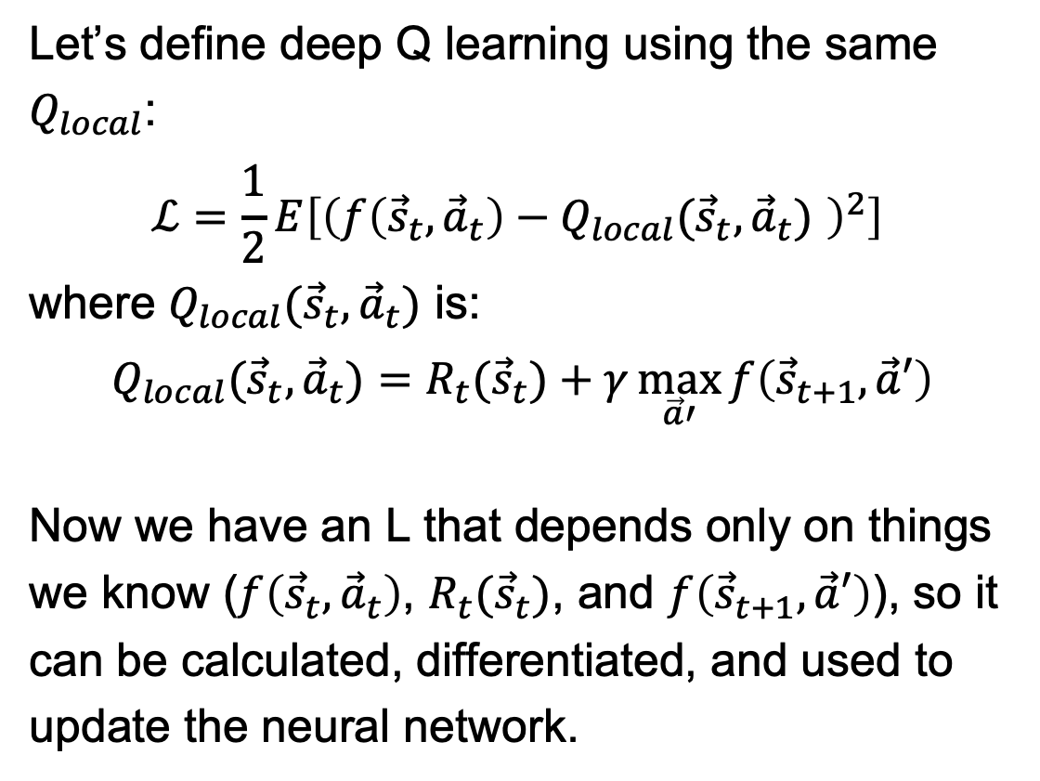
The solution: $Q_{local}$
Let’s define deep Q learning using the same $Q_{local}$:
$$ℒ=\frac{1}{2}E\left[{\left(f\left({\vec{s}}_{t},{\vec{a}}_{t}\right)−Q_{local}({\vec{s}}_{t},{\vec{a}}_{t}) \right)}^{2}\right]$$
where $Q_{local}({\vec{s}}_{t},{\vec{a}}_{t})$ is:
$$Q_{local}({\vec{s}}_{t},{\vec{a}}_{t})=R_{t}({\vec{s}}_{t})+γ\max_{\vec{a}′}{f\left({\vec{s}}_{t+1},\vec{a}′\right)}$$
Now we have an L that depends only on things we know ($f\left({\vec{s}}_{t},{\vec{a}}_{t}\right)$, $R_{t}({\vec{s}}_{t})$, and $f\left({\vec{s}}_{t+1},\vec{a}′\right)$), so it can be calculated, differentiated, and used to update the neural network.
$$…$$

Slide 19
Dealing with training instability
Challenges
Target values are not fixed
Successive experiences are correlated and dependent on the policy
Policy may change rapidly with slight changes to parameters, leading to drastic change in data distribution
Solutions
Freeze target Q network
Use experience replay

Slide 20
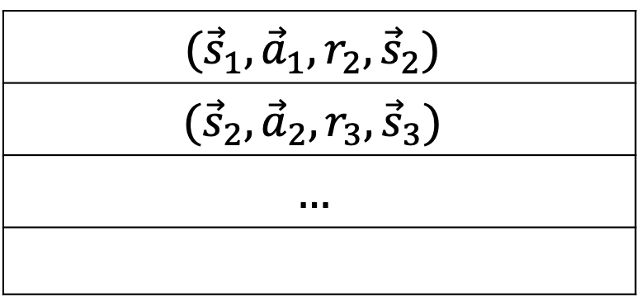
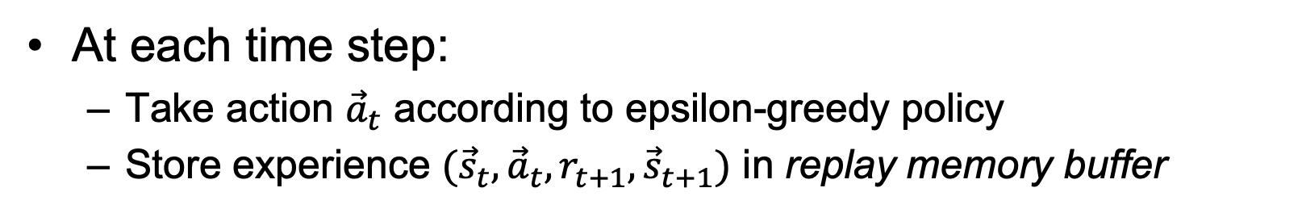
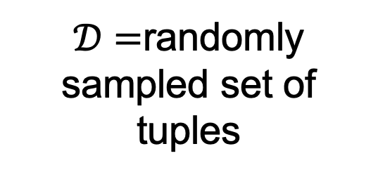
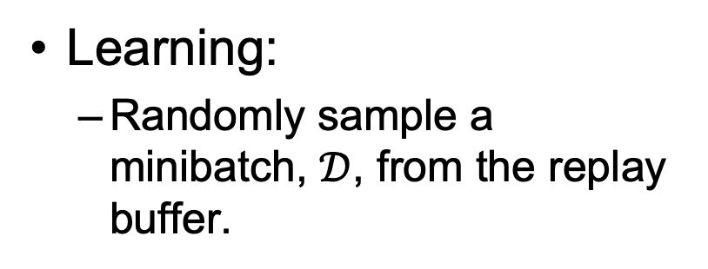
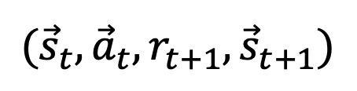
Experience replay
At each time step:
Take action ${\vec{a}}_{t}$ according to epsilon-greedy policy
Store experience $({\vec{s}}_{t},{\vec{a}}_{t},r_{t+1},{\vec{s}}_{t+1})$ in replay memory buffer
$$({\vec{s}}_{1},{\vec{a}}_{1},r_{2},{\vec{s}}_{2})$$
$$({\vec{s}}_{2},{\vec{a}}_{2},r_{3},{\vec{s}}_{3})$$
$$…$$
$$({\vec{s}}_{t},{\vec{a}}_{t},r_{t+1},{\vec{s}}_{t+1})$$
Learning:
Randomly sample a minibatch, $𝒟$, from the replay buffer.
$𝒟=$randomly sampled set of tuples

Slide 21
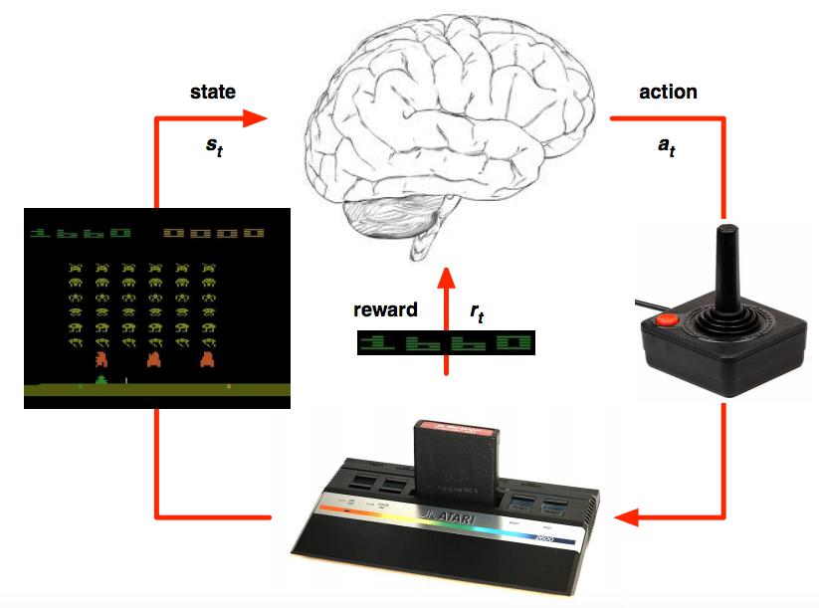
Deep Q learning in Atari
Mnih et al. Human-level control through deep reinforcement learning, Nature 2015

Slide 22
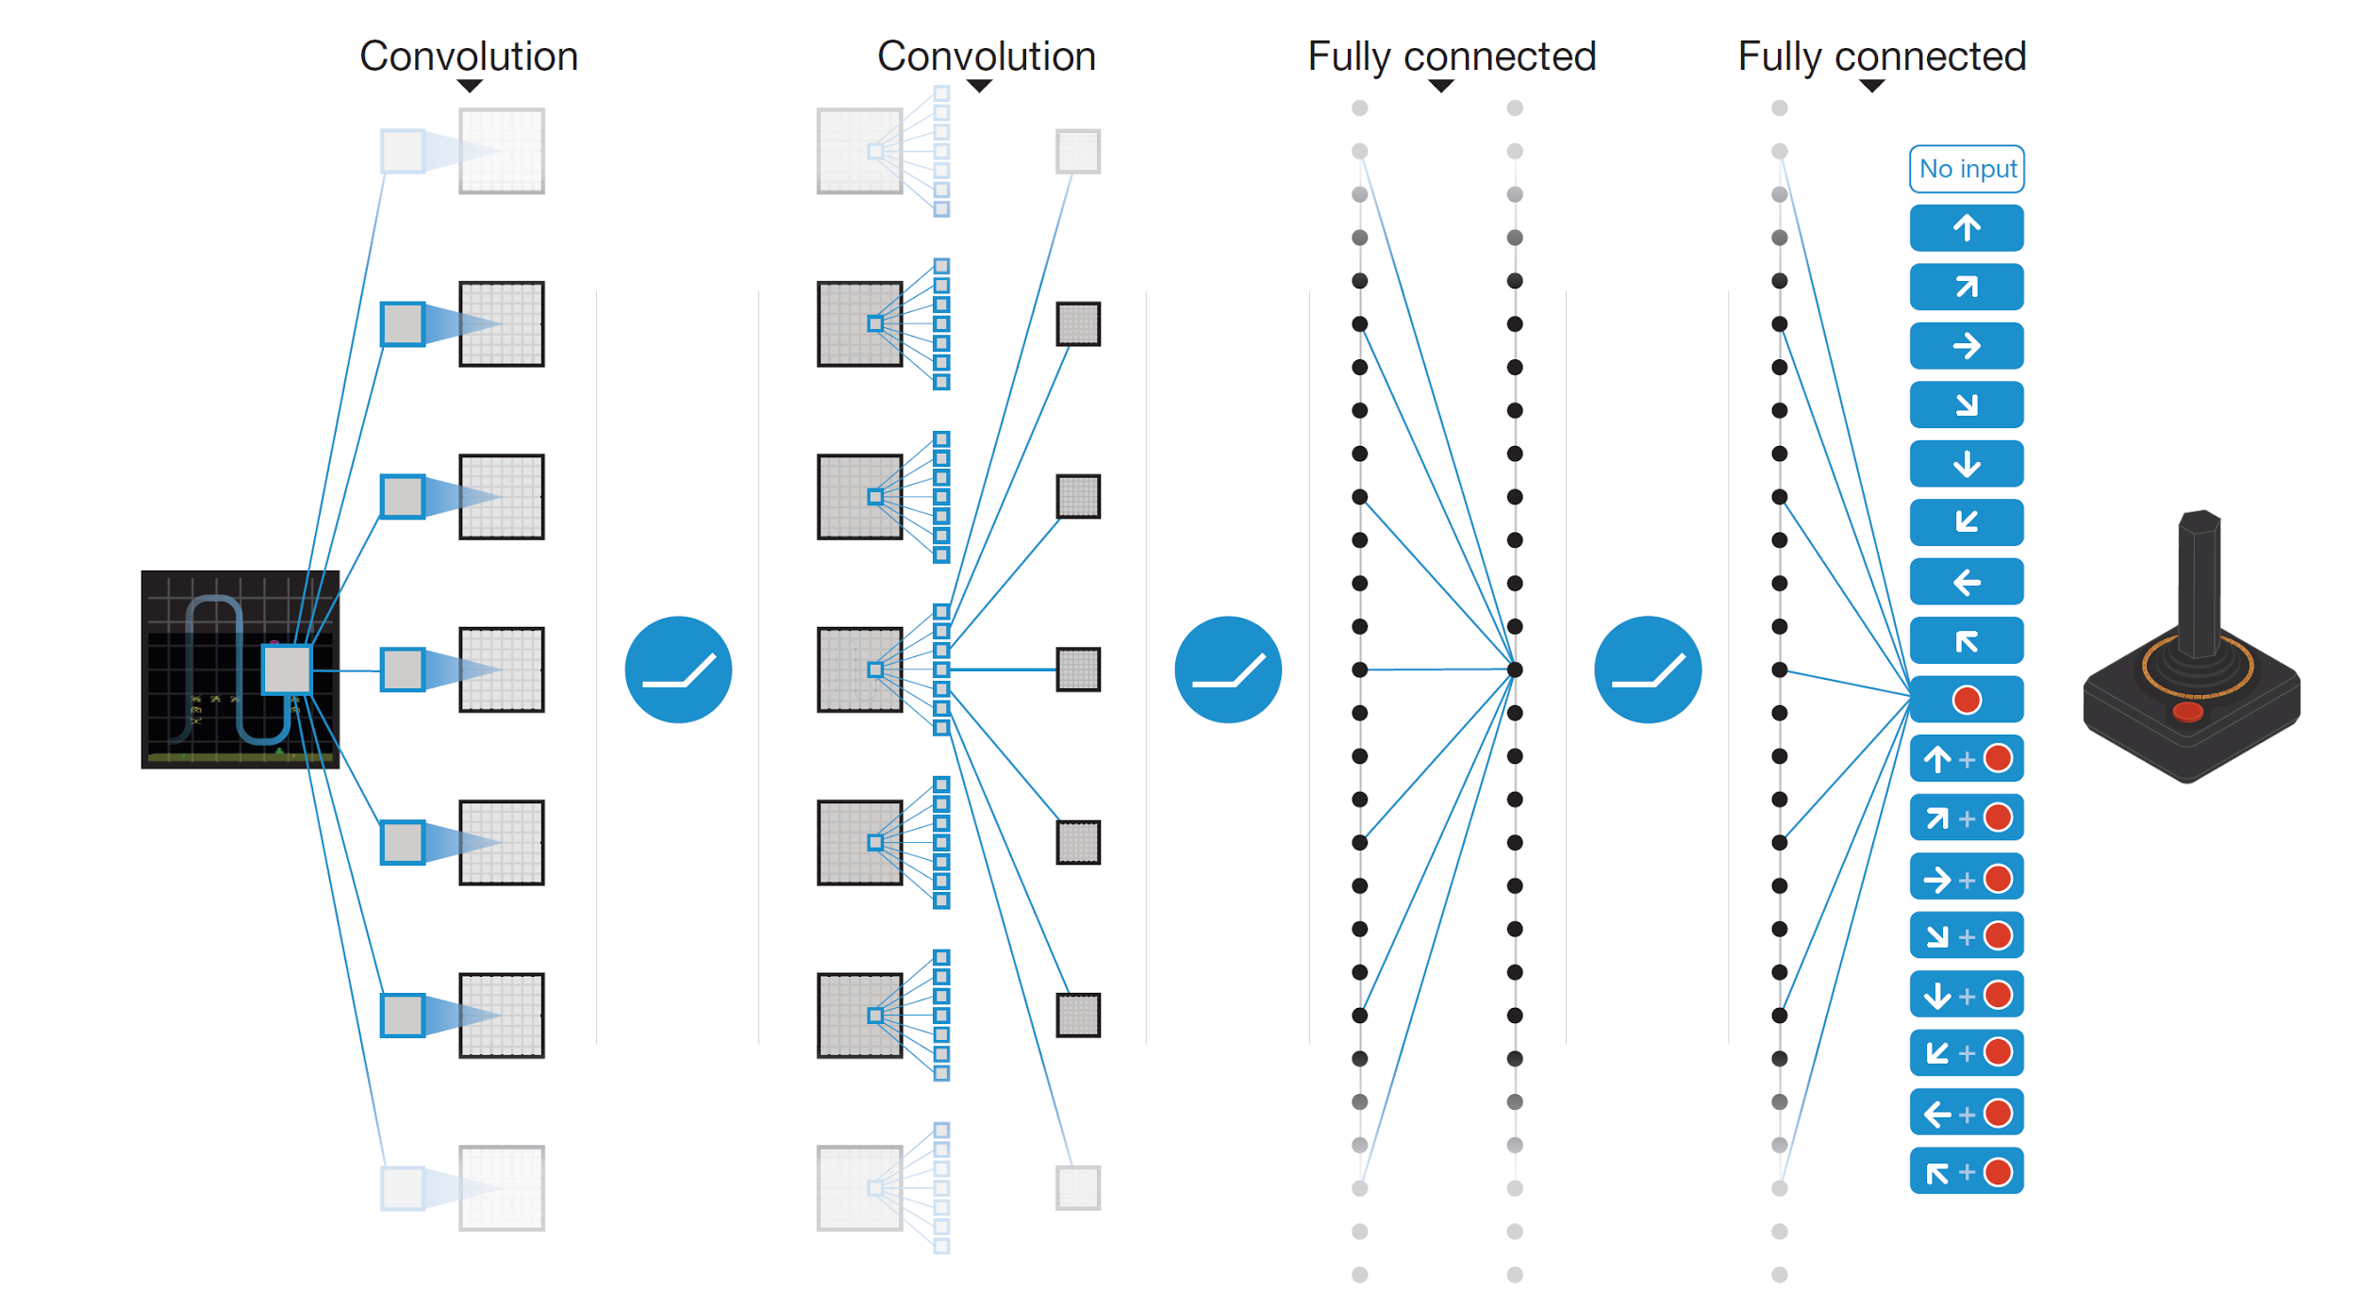
Deep Q learning in Atari
End-to-end learning of Q(s,a) from pixels s
Output is Q(s,a) for 18 joystick/button configurations
Reward is change in score for that step
Q(s,a₁)
Q(s,a₂)
Q(s,a₃)
.
.
.
.
.
.
.
.
.
.
.
Q(s,a₁₈)
Mnih et al. Human-level control through deep reinforcement learning, Nature 2015

Slide 23
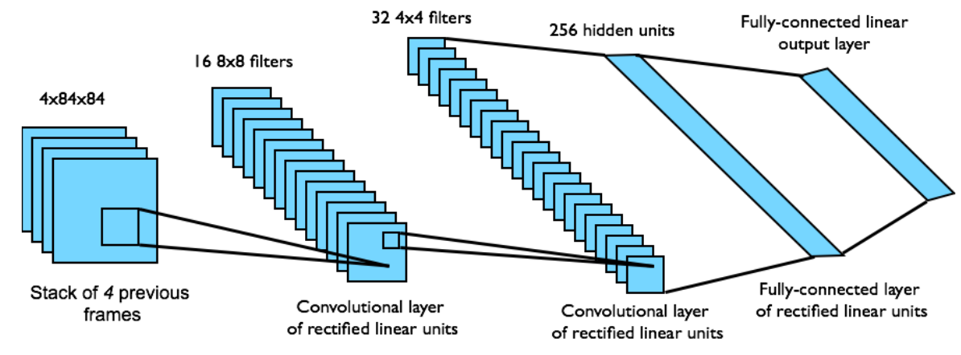
Deep Q learning in Atari
Input state s is stack of raw pixels from last 4 frames
Network architecture and hyperparameters fixed for all games
Mnih et al. Human-level control through deep reinforcement learning, Nature 2015

Slide 24
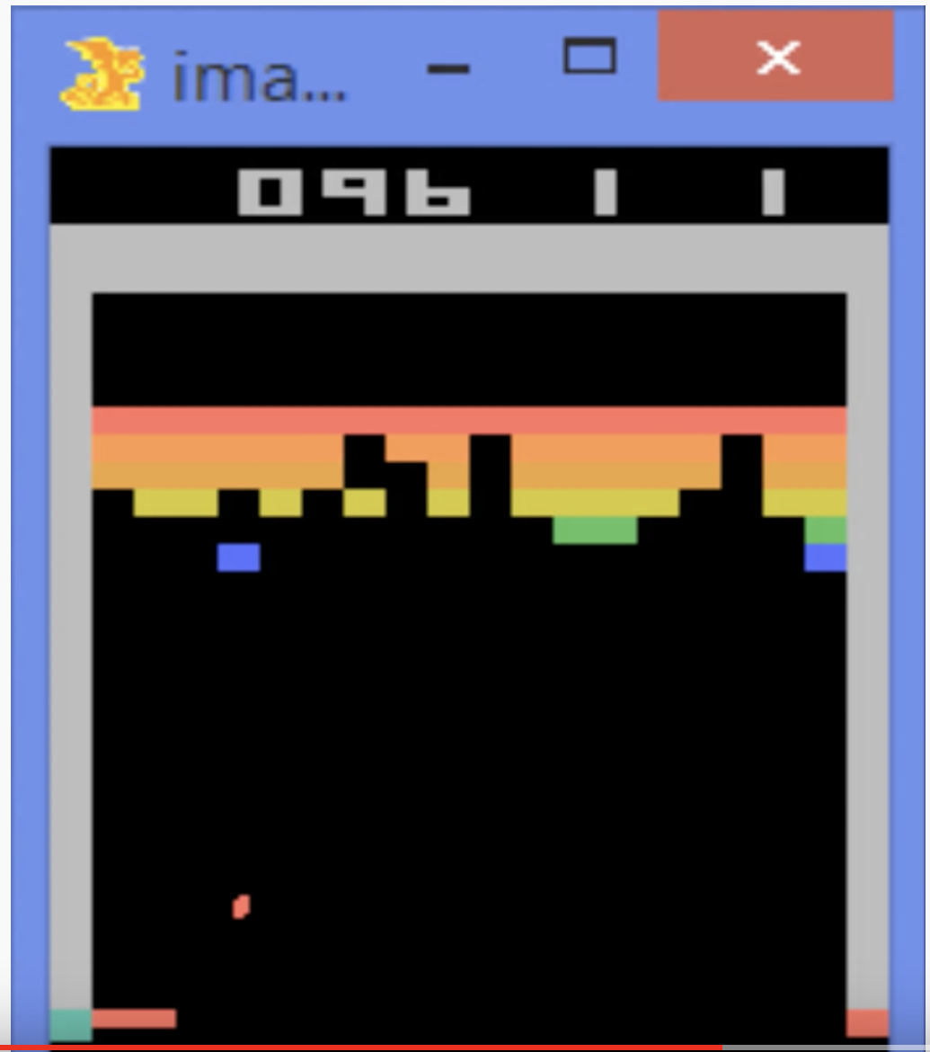
Deep Q learning in Atari
Deep Q-Learning Playing Atari Breakout

Slide 25
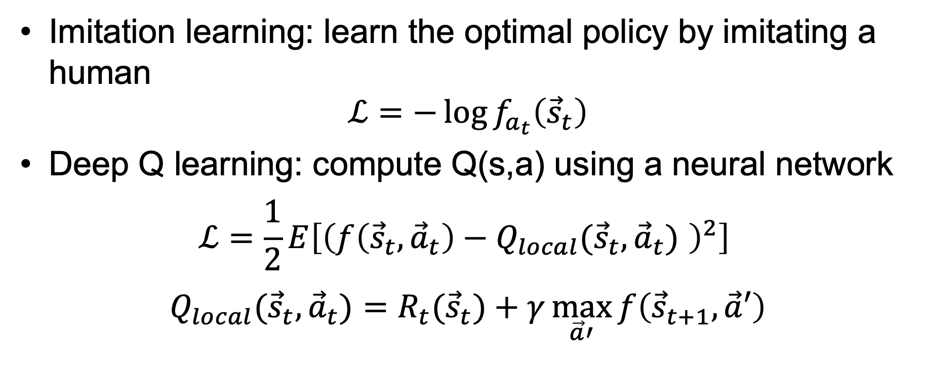
Summary: Deep RL, Part 1
Imitation learning: learn the optimal policy by imitating a human
$$ℒ=−\log{f_{a_{t}}\left({\vec{s}}_{t}\right)}$$
Deep Q learning: compute Q(s,a) using a neural network
$$ℒ=\frac{1}{2}E\left[{\left(f\left({\vec{s}}_{t},{\vec{a}}_{t}\right)−Q_{local}({\vec{s}}_{t},{\vec{a}}_{t}) \right)}^{2}\right]$$
$$Q_{local}({\vec{s}}_{t},{\vec{a}}_{t})=R_{t}({\vec{s}}_{t})+γ\max_{\vec{a}′}{f\left({\vec{s}}_{t+1},\vec{a}′\right)}$$

