Slide 1
CS440/ECE448 Lecture 38: Configuration Space
Mark Hasegawa-Johnson, 4/2022
CC-BY 4.0: You are free to: copy and redistribute the material in any medium or format, remix, transform, and build upon the material for any purpose, even commercially, if you give appropriate credit.

Slide 2
Outline
Planning = Search
Poor Robot!
Configuration Space
The Robot Arm Problem
Geometry of the Robot Arm Problem
Searching for a Solution in Configuration Space

Slide 3
Planning = search
Restaurant
The problem: robot needs to get to the stockroom
Counter
Kitchen
Stockroom
Food Prep
Pantry
Freezer

Slide 4
Planning = search
Restaurant
Step #1: Robot consults his internal map and uses BFS or A* to find the best path.
Counter
Kitchen
Stockroom
Food Prep
Pantry
Freezer

Slide 5
Planning = search
Restaurant
Step #1: Robot consults his internal map and uses BFS or A* to find the best path.
Counter
Kitchen
Stockroom
Food Prep
Pantry
Freezer

Slide 6
Planning = search
Restaurant
Step #1: Robot consults his internal map and uses BFS or A* to find the best path.
Counter
Kitchen
Stockroom
Food Prep
Pantry
Freezer

Slide 7
Planning = search
Restaurant
Step #1: Robot consults his internal map and uses BFS or A* to find the best path.
Counter
Kitchen
Stockroom
Food Prep
Pantry
Freezer

Slide 8
Planning = search
Restaurant
Step #1: Robot consults his internal map and uses BFS or A* to find the best path.
Counter
Kitchen
Stockroom
Food Prep
Pantry
Freezer

Slide 9
Planning = search
Restaurant
Step #1: Robot consults his internal map and uses BFS or A* to find the best path.
Counter
Kitchen
Stockroom
Food Prep
Pantry
Freezer

Slide 10
Planning = search
Restaurant
Step #1: Robot consults his internal map and uses BFS or A* to find the best path.
Counter
Kitchen
Stockroom
Food Prep
Pantry
Freezer

Slide 11
Planning = search
Restaurant
Step #1: Robot consults his internal map and uses BFS or A* to find the best path.
Counter
Kitchen
Stockroom
Food Prep
Pantry
Freezer

Slide 12
Planning = search
Restaurant
Step #1: Robot consults his internal map and uses BFS or A* to find the best path.
Counter
Kitchen
Stockroom
Food Prep
Pantry
Freezer

Slide 13
Planning = search
Restaurant
Step #1: Robot consults his internal map and uses BFS or A* to find the best path.
Counter
Kitchen
Stockroom
Food Prep
Pantry
Freezer

Slide 14
Planning = search
Restaurant
Step #2: Robot attempts to follow that path.
Counter
Kitchen
Stockroom
Food Prep
Pantry
Freezer

Slide 15
Planning = search
Restaurant
Step #2: Robot attempts to follow that path.
Counter
Kitchen
Stockroom
Food Prep
Pantry
Freezer

Slide 16
Planning = search
Restaurant
Step #2: Robot attempts to follow that path.
Counter
Kitchen
Stockroom
Food Prep
Pantry
Freezer

Slide 17
Planning = search
Restaurant
Step #2: Robot attempts to follow that path.
Counter
Kitchen
Stockroom
Food Prep
Pantry
Freezer

Slide 18
Planning = search
Restaurant
Step #3: Robot bumps into the doorframe.
Poor robot.
Counter
Kitchen
Stockroom
Food Prep
Pantry
Freezer

Slide 19
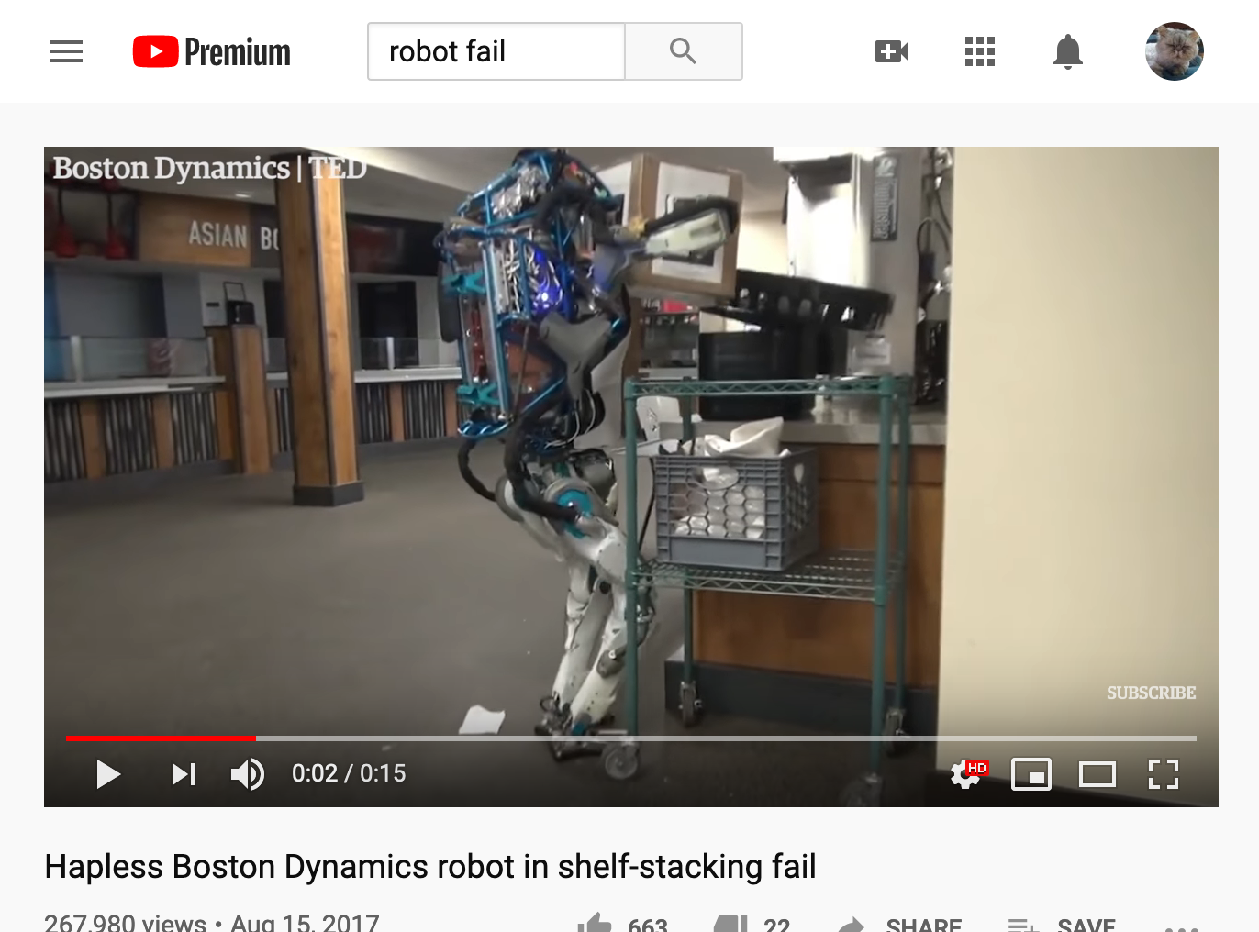
Poor robot https://www.youtube.com/watch?v=JzlsvFN_5HI

Slide 20
How can we help the robot?
Restaurant
Let’s give it more information.
Let’s tell it how wide it is.
Counter
Kitchen
Stockroom
Food Prep
Pantry
Freezer

Slide 21
How can we help the robot?
Restaurant
Option #1: every node in the search tree carries information about the size of the robot.
Counter
Kitchen
Stockroom
Food Prep
Pantry
Freezer

Slide 22
How can we help the robot?
Restaurant
Option #1: every node in the search tree carries information about the size of the robot.
Counter
Kitchen
Stockroom
Food Prep
Pantry
Freezer

Slide 23
How can we help the robot?
Restaurant
Option #1: every node in the search tree carries information about the size of the robot.
Counter
Kitchen
Stockroom
Food Prep
Pantry
Freezer

Slide 24
OK, that’s a little unwieldy…

Slide 25
How can we help the robot?
Restaurant
Option #2: the map tells the robot how wide it is.
Kitchen
Stockroom
Food Prep
Pantry
Freezer

Slide 26
How can we help the robot?
Restaurant
Option #2: the map tells the robot how wide it is.
Now, any optimal path that the robot finds is a path that it can actually use.
Kitchen
Stockroom
Food Prep
Pantry
Freezer

Slide 27
Configuration Space
Restaurant
This new search space is called a configuration space.
It specifies which configurations are possible.
Kitchen
Stockroom
Food Prep
Pantry
Freezer

Slide 28
Configuration Space
In classical mechanics,
the parameters that define the configuration of a system are called generalized coordinates, and
the vector space defined by these coordinates is called the configuration space.
https://en.wikipedia.org/wiki/Configuration_space_(physics)

Slide 29
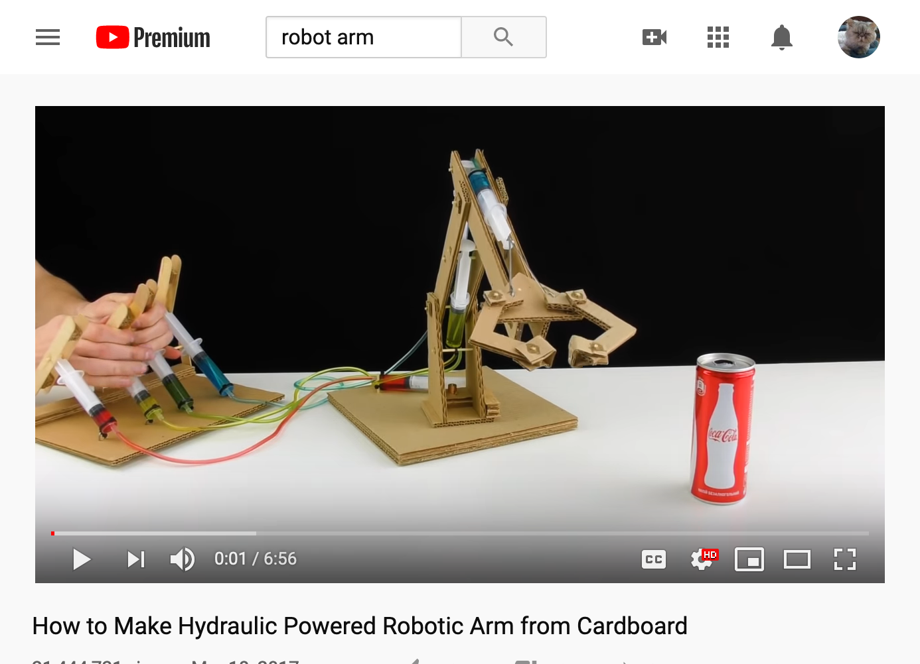
Configuration Space Example: Robot Arm https://www.youtube.com/watch?v=P2r9U4wkjcc

Slide 30
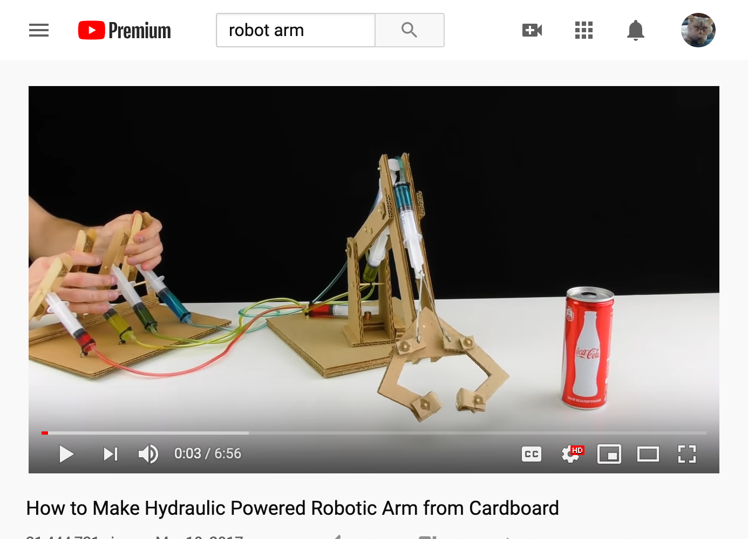
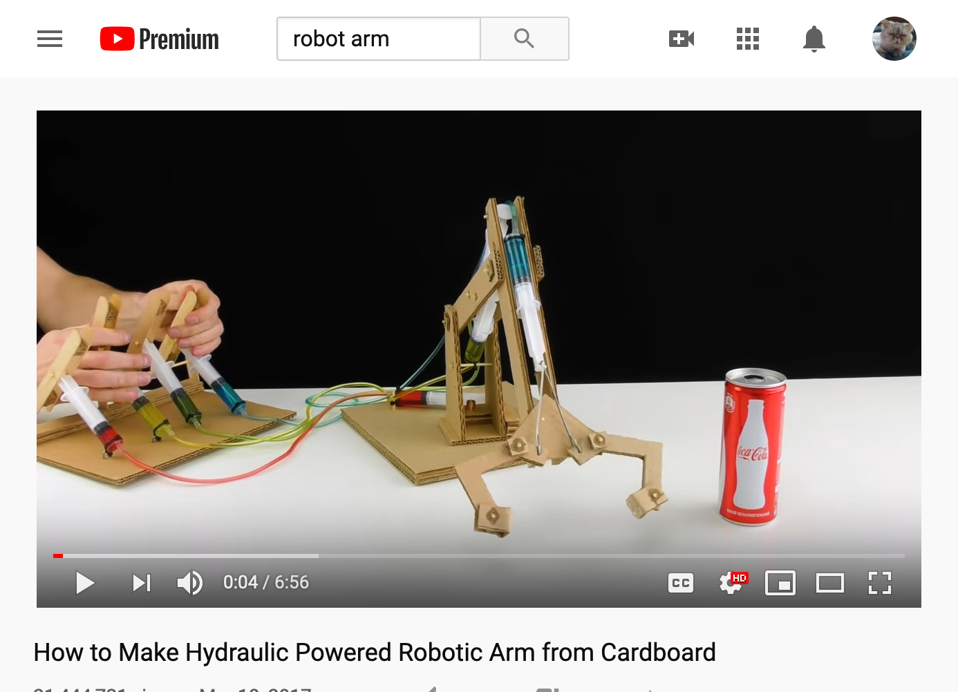
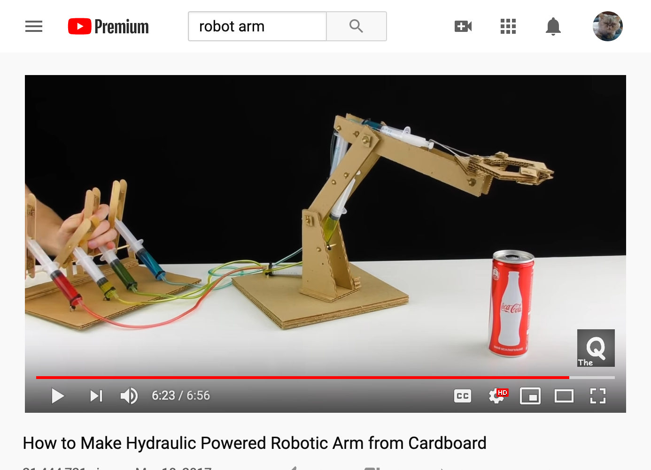
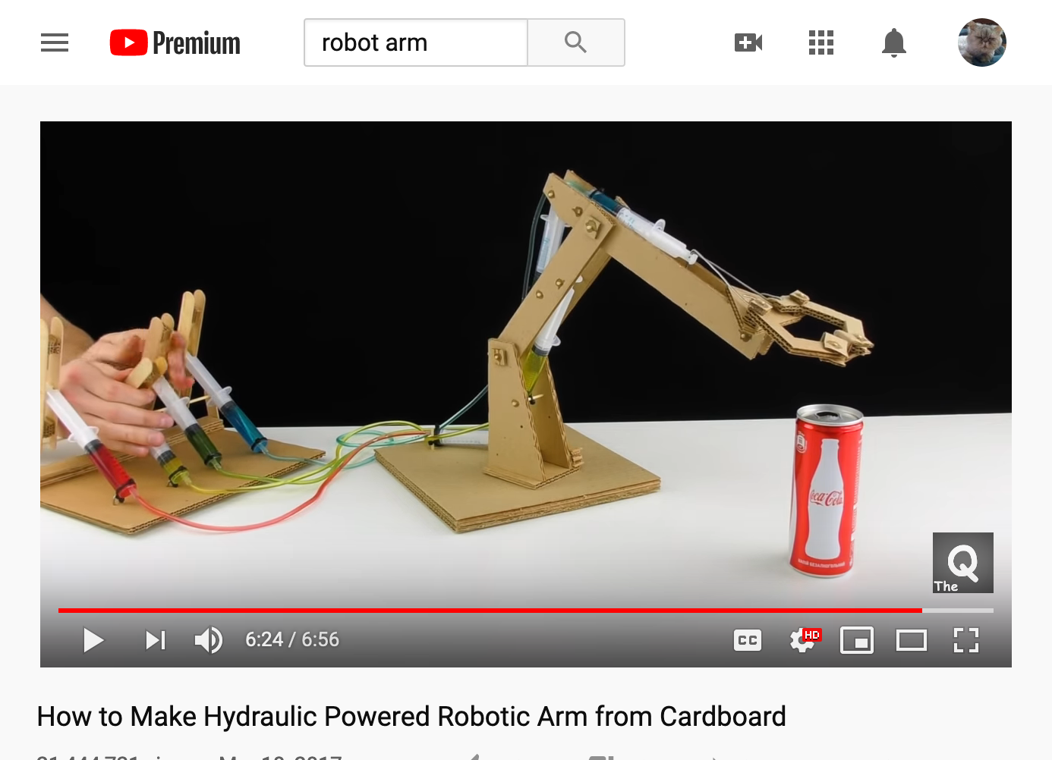
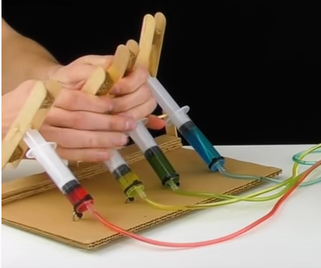
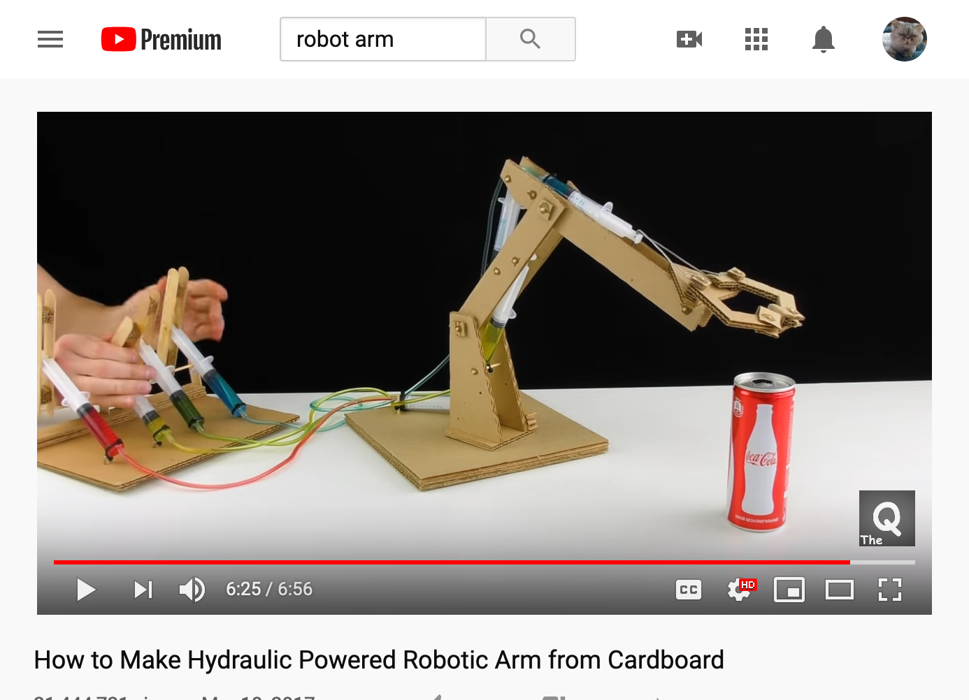
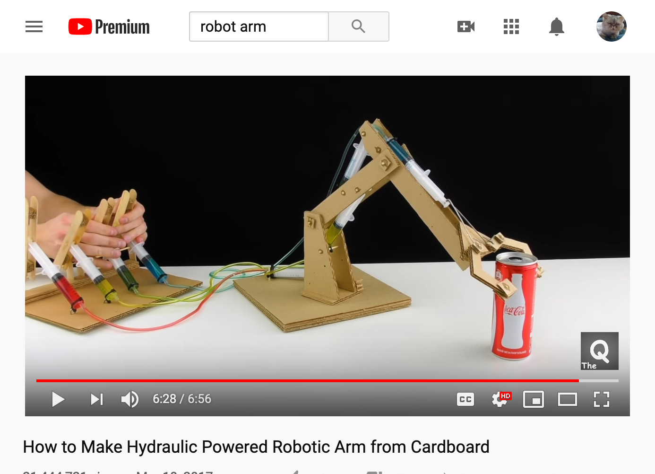
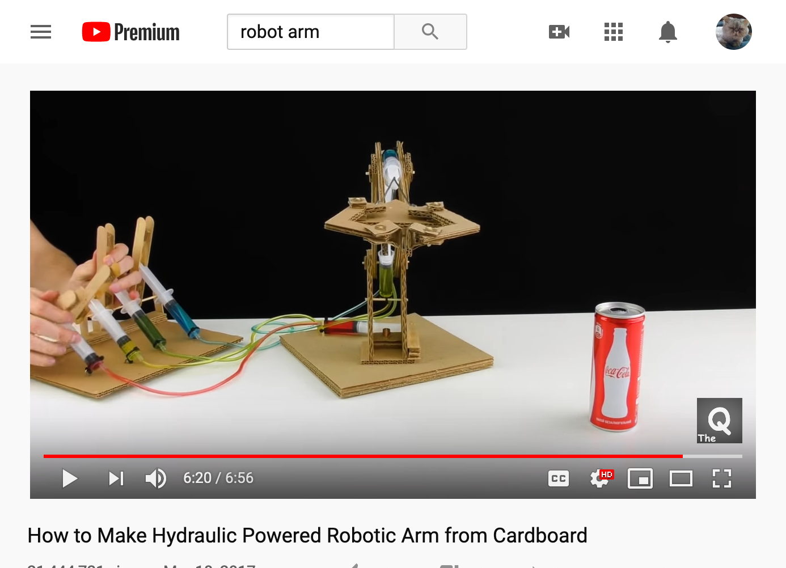
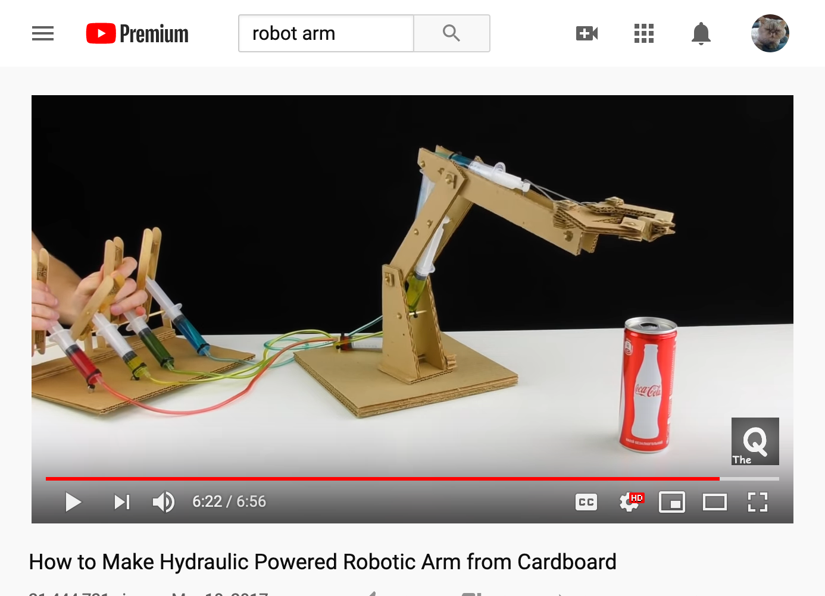
Configuration Space Example
Configuration space:
4 coordinates
Grip
Elbow
Shoulder
Rotation

Slide 31




The MP2 Configuration Space:
Just 2 coordinates
Elbow $≈{120}^{∘}$
Elbow $≈{90}^{∘}$
Shoulder $≈{60}^{∘}$
Shoulder $≈{45}^{∘}$

Slide 32
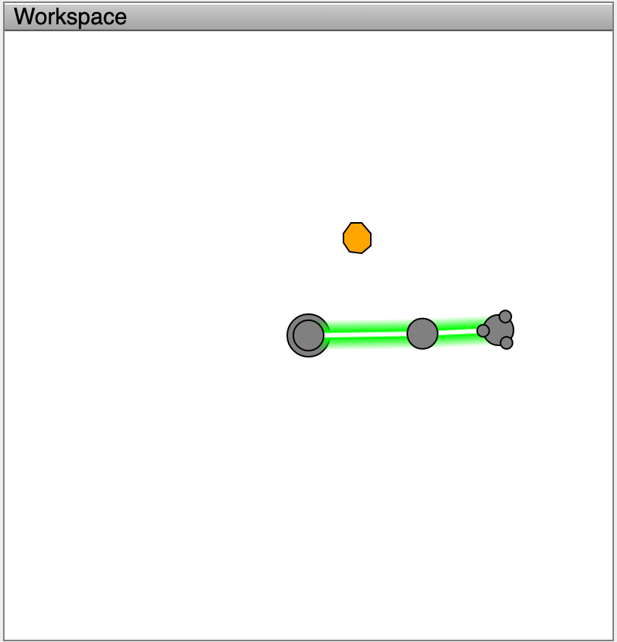
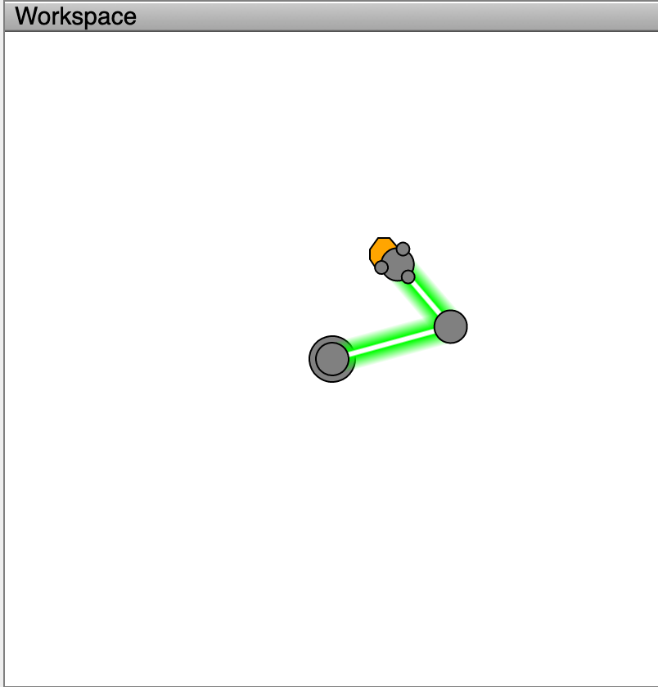
The Robot Arm Reaching Problem
Jeff Ichnowski, University of North Carolina, https://www.cs.unc.edu/~jeffi/c-space/robot.xhtml
Given a robot arm in START,
how should I adjust ELBOW and SHOULDER to most quickly reach GOAL?
START
GOAL

Slide 33

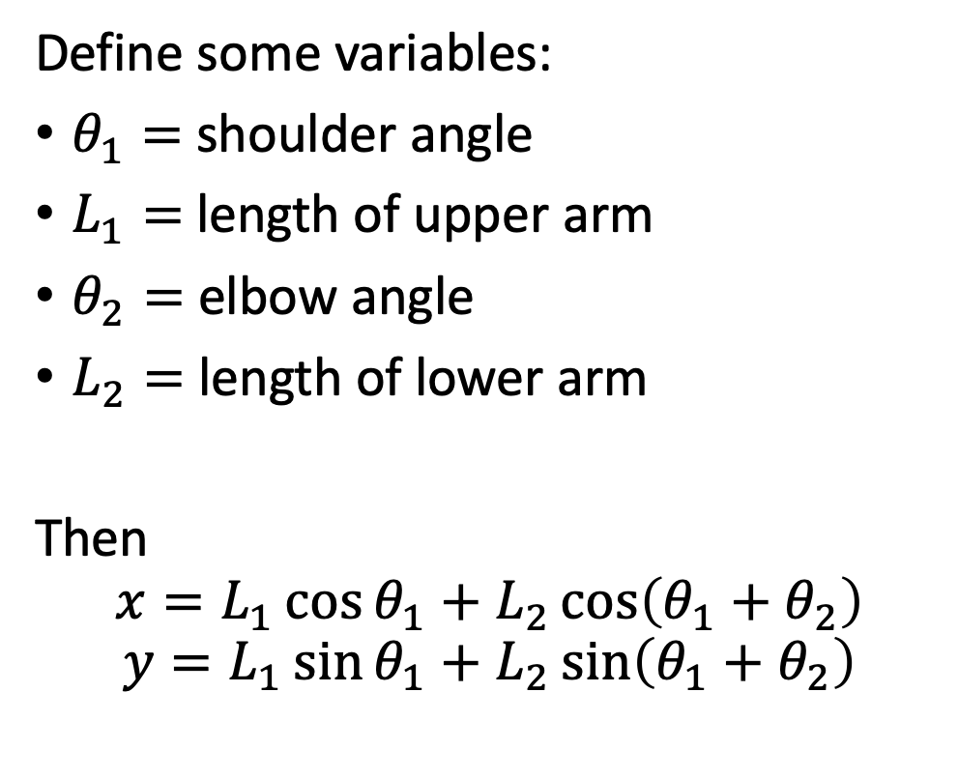



The Robot Arm Reaching Problem
Jeff Ichnowski, University of North Carolina, https://www.cs.unc.edu/~jeffi/c-space/robot.xhtml
Define some variables:
$θ_{1}=$ shoulder angle
$L_{1}=$ length of upper arm
$θ_{2}=$ elbow angle
$L_{2}=$ length of lower arm
Then
$$x=L_{1}\cos{θ_{1}}+L_{2}\cos\left(θ_{1}+θ_{2}\right)$$
$$y=L_{1}\sin{θ_{1}}+L_{2}\sin\left(θ_{1}+θ_{2}\right)$$
$$y$$
$$θ_{2}$$
$$θ_{1}$$
$$x$$

Slide 34
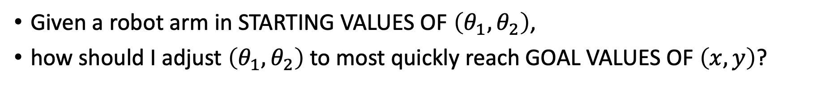
The Robot Arm Reaching Problem
Jeff Ichnowski, University of North Carolina, https://www.cs.unc.edu/~jeffi/c-space/robot.xhtml
Given a robot arm in STARTING VALUES OF $\left(θ_{1},θ_{2}\right)$,
how should I adjust $\left(θ_{1},θ_{2}\right)$ to most quickly reach GOAL VALUES OF $\left(x,y\right)$?
START
GOAL

Slide 35
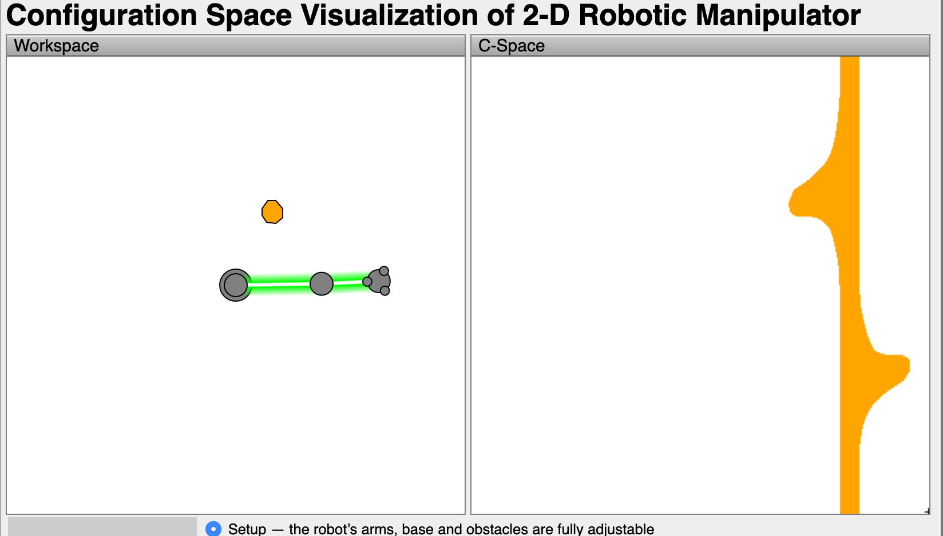
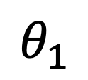
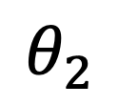
$$θ_{2}$$
$$θ_{1}$$

Slide 36
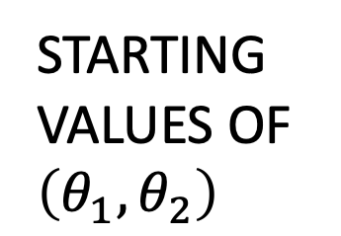
$$θ_{2}$$
$$θ_{1}$$
STARTING VALUES OF $\left(θ_{1},θ_{2}\right)$

Slide 37
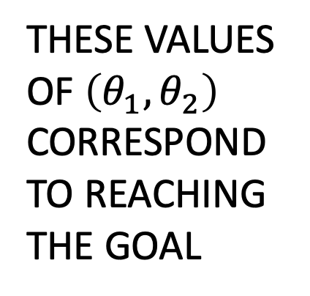
$$θ_{2}$$
THESE VALUES OF $\left(θ_{1},θ_{2}\right)$
CORRESPOND TO REACHING THE GOAL
$$θ_{1}$$
STARTING VALUES OF $\left(θ_{1},θ_{2}\right)$

Slide 38
$$θ_{2}$$
Bumping anywhere else on the orange bar means that the upper or lower arm collides, not the hand. Call these regions OBSTACLES.
STARTING VALUES OF $\left(θ_{1},θ_{2}\right)$

Slide 39
$$θ_{2}$$
This is the shortest path from START to GOAL avoiding all OBSTACLES
STARTING VALUES OF $\left(θ_{1},θ_{2}\right)$

Slide 40
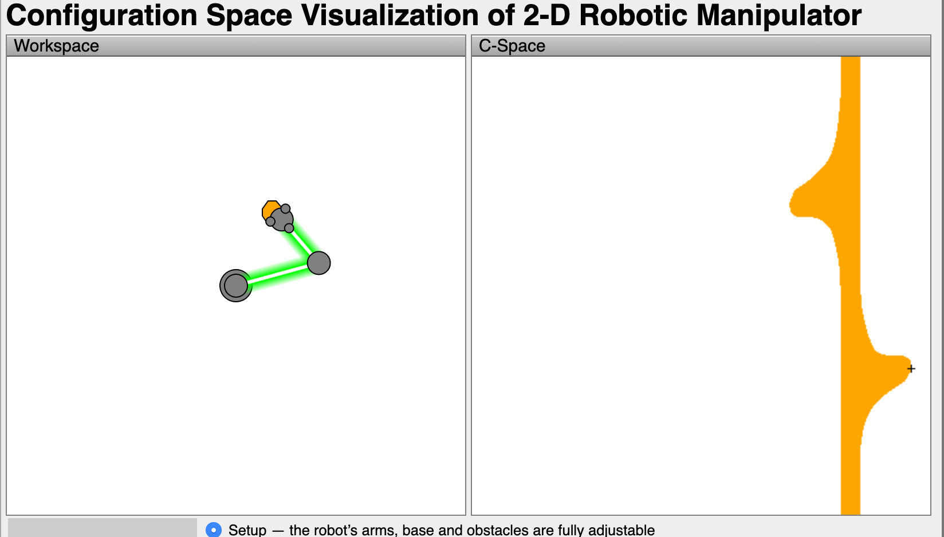
$$θ_{2}$$
DONE!
$$θ_{1}$$

Slide 41
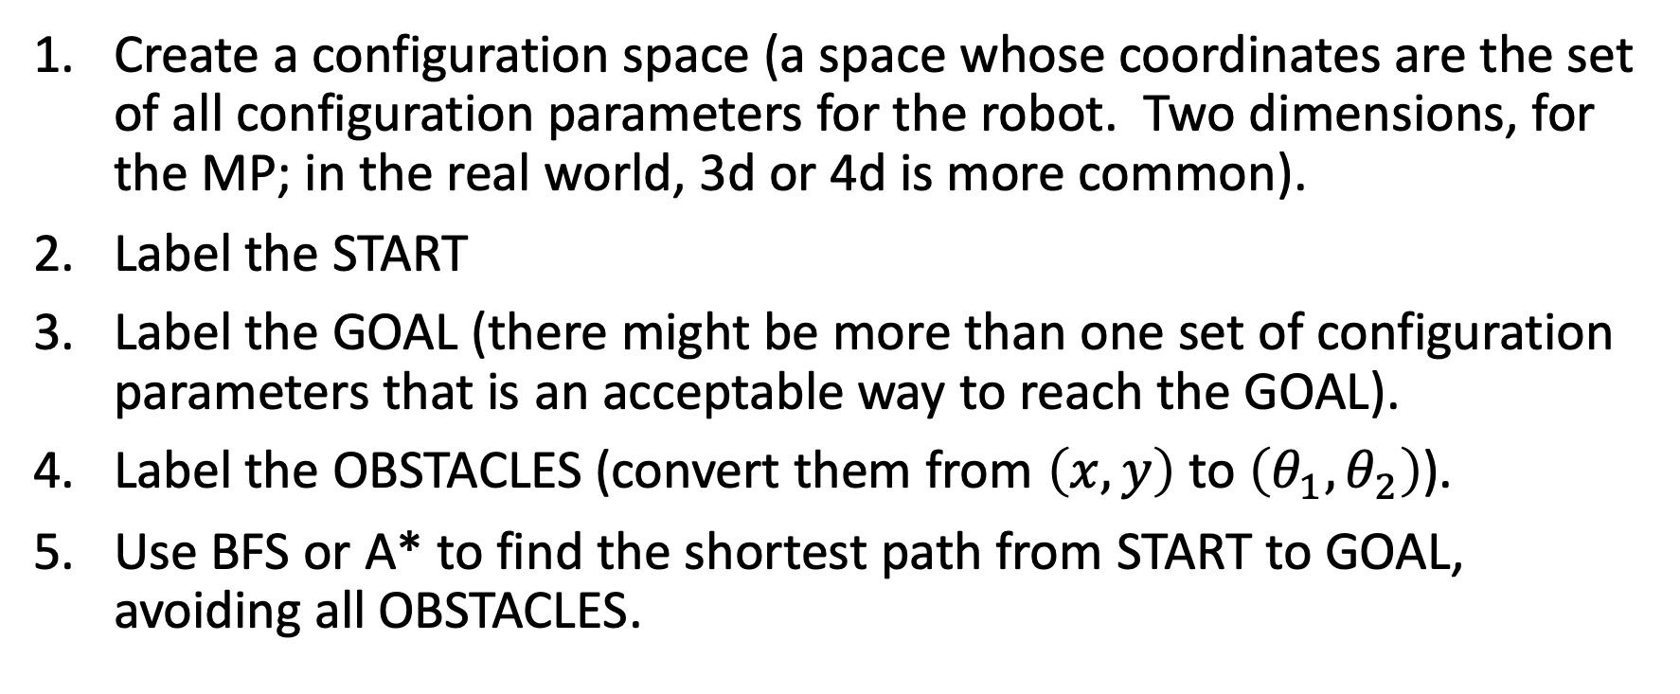
How to solve the Robot Arm problem
Create a configuration space (a space whose coordinates are the set of all configuration parameters for the robot. Two dimensions, for the MP; in the real world, 3d or 4d is more common).
Label the START
Label the GOAL (there might be more than one set of configuration parameters that is an acceptable way to reach the GOAL).
Label the OBSTACLES (convert them from $\left(x,y\right)$ to $\left(θ_{1},θ_{2}\right)$).
Use BFS or A* to find the shortest path from START to GOAL, avoiding all OBSTACLES.

Slide 42
BTW, this person is really a maestro.
Watch it again, if you want to. https://www.youtube.com/watch?v=P2r9U4wkjcc

