Slide 1
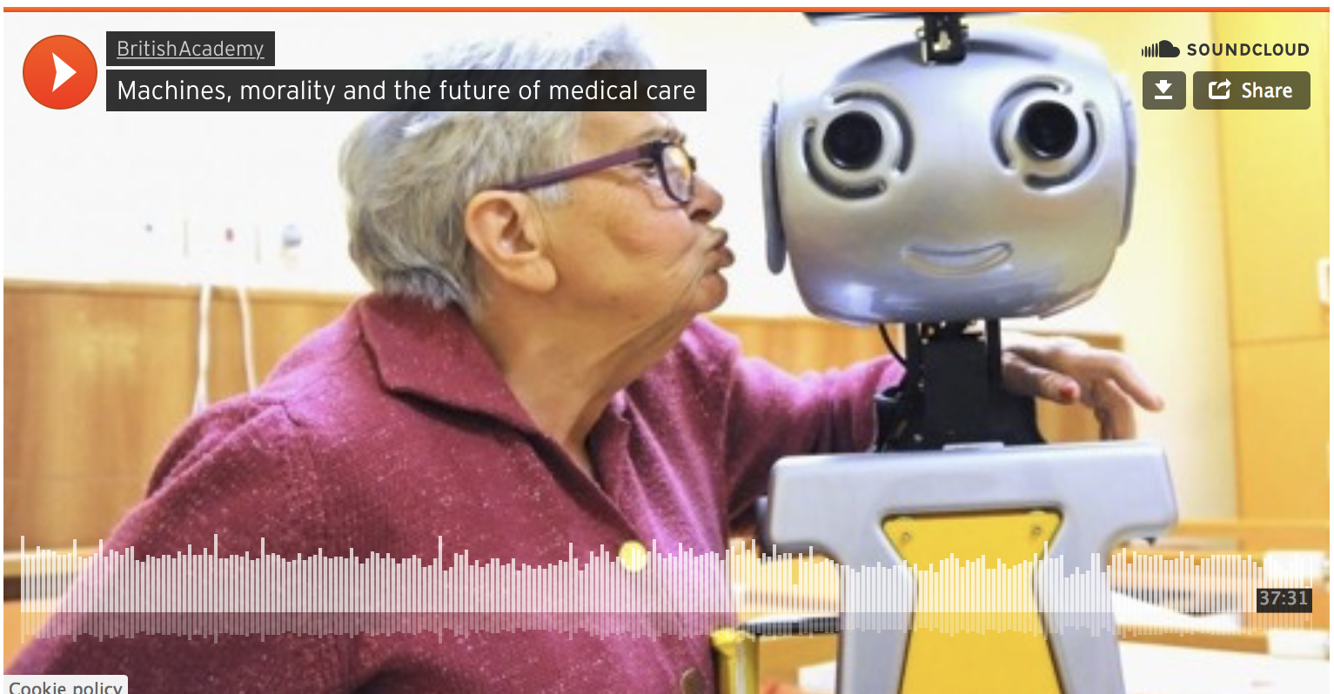
CS440/ECE448 Lecture 39:
Ethics of Autonomous AI
Mark Hasegawa-Johnson, 4/2022,
With some slides by Svetlana Lazebnik
CC-BY: copy at will if you cite the source
Image source: https://www.britac.ac.uk/
audio/machines-morality-and-future-medical-care

Slide 2
Outline
Jobs
Safety
AI weapons
Superintelligence
Robot rights

Slide 3
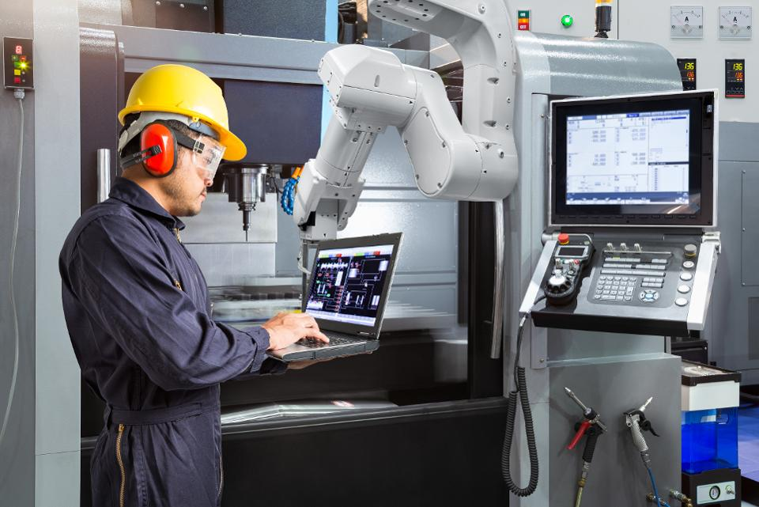
AI and jobs
Source

Slide 4
AI and jobs
Why we should worry
  Oxford report: 47% of American jobs at high risk of automation in the next two decades
  In the past couple of decades, manufacturing employment has dropped even as output kept rising; labor force participation among working-age males has been dropping
  Truck driver is the most common job in over half the states
Why we shouldn’t worry
  Historically, automation has destroyed jobs but added more new jobs

Slide 5
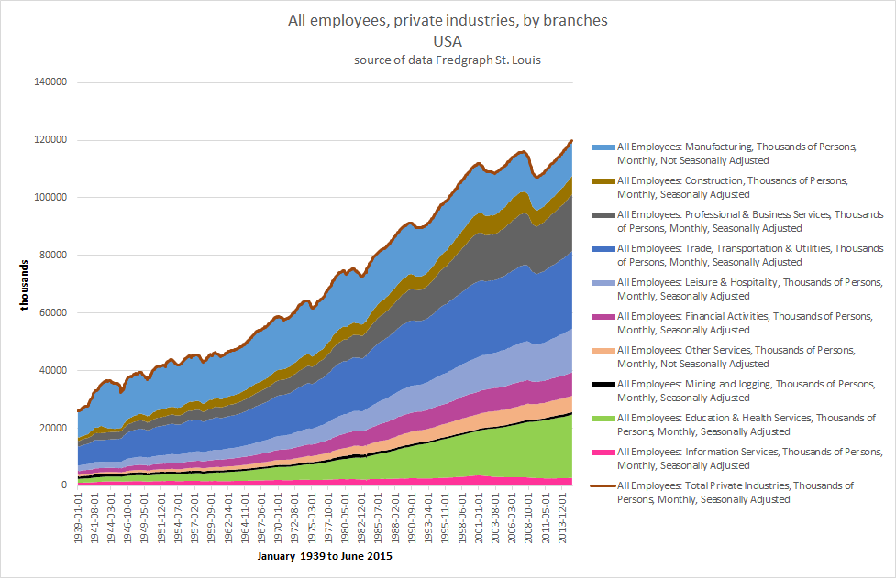
Jobs per sector, US, 1939-2015
CC-SA 4.0, Alex1011, 2015

Slide 6

An alternative to work?
In the series of novels The Expanse, authors Daniel Abraham and Ty Franck predict that most people will live on “basic income” provided by the government.
People who want to earn more, by working, must first go to college.
People who want to go to college must first work for a trial year in an uneducated job, to prove that they have the will to work.
Actors from The Expanse TV series. Images contributed CC-SA by many contributors: https://en.wikipedia.org/wiki/The_Expanse_(TV_series)

Slide 7
Is “Basic Income” going to happen?
“Netherlands is among the nations with the shortest work weeks, according to CNN Money. Netherlands has an average of 29 working hours per week and an average annual income amounting to $47,000.” – https://nltimes.nl/2013/07/11/worlds-shortest-work-weeks

Slide 8
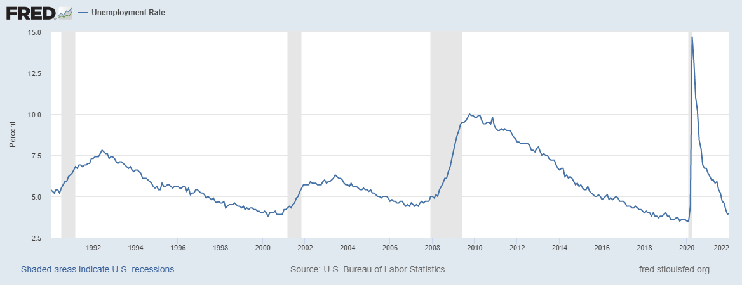
Is “Basic Income” going to happen in the United States?
US Unemployment rate, January 1990 to June 2021. Public domain image, https://fred.stlouisfed.org/graph/?g=FfBh

Slide 9
AI and jobs
Reading
  Moshe Vardi talk (YouTube)
  AI NOW report (2017)
  Technological unemployment (Wikipedia)
  A world without work (The Atlantic, July 2015)
  The automation paradox (The Atlantic, Jan. 2016)
  AI will transform the economy. But how much, how soon? (New York Times, Nov. 2017)
  Welcoming our new robot overlords (New Yorker, Oct. 2017)
  The great tech panic: robots won’t take all our work (Wired, Aug. 2017)

Slide 10
Outline
Jobs
Safety
AI weapons
Superintelligence
Robot rights

Slide 11
AI safety
Robustness to changes in data distribution
Avoiding catastrophic “corner cases”
Robustness to adversarial examples or attacks
Avoiding negative side effects in reward function
Avoiding “reward hacking”
Reading: Concrete AI safety problems

Slide 12
Is autonomous driving more or less dangerous than human driving?
Tesla (both human and autopilot): 1 accident per 4.34 million miles of driving
All US (mostly human drivers): 3.26 trillion miles, 6.76 million accidents reported to police in 2019 = 1 reported accident per 482 million miles driven
https://www.police1.com/patrol-video/articles/video-tesla-on-autopilot-slams-into-police-car-swipes-2-leos-0jqkJUHqiqVWxIhH/

Slide 13
Is autonomous driving more or less dangerous than human driving?
Tesla:
  1 billion miles on autopilot, with 12 deaths reported (https://www.tesladeaths.com/)
Record for human drivers is slightly better, depending on state laws
  In the U.S.: 1.11 deaths per 100 million miles
  In Illinois: 0.94 deaths per 100 million miles
  https://www.iihs.org/topics/fatality-statistics/detail/state-by-state

Slide 14
Outline
Jobs
Safety
AI weapons
Superintelligence
Robot rights

Slide 15

AI weapons
https://www.youtube.com/watch?v=aLS3Jljy1VA

Slide 16
Are autonomous weapons ethically acceptable?
The case in favor, e.g., https://blog.apaonline.org/2022/02/28/the-moral-case-for-the-development-of-autonomous-weapon-systems/
  Autonomous weapons reduce casualties for the side using them
  Autonomous weapons can select targets more precisely, thereby reducing casualties for the other side as well
The case against, e.g., https://www.hrw.org/report/2018/08/21/heed-call/moral-and-legal-imperative-ban-killer-robots
  Autonomous weapons encourage totalitarianism by permitting a small number of people to suppress a large number
  Autonomous weapons may malfunction
  Autonomous weapons diffuse responsibility for death, thereby encouraging war

Slide 17
Outline
Jobs
Safety
AI weapons
Superintelligence
Robot rights

Slide 18
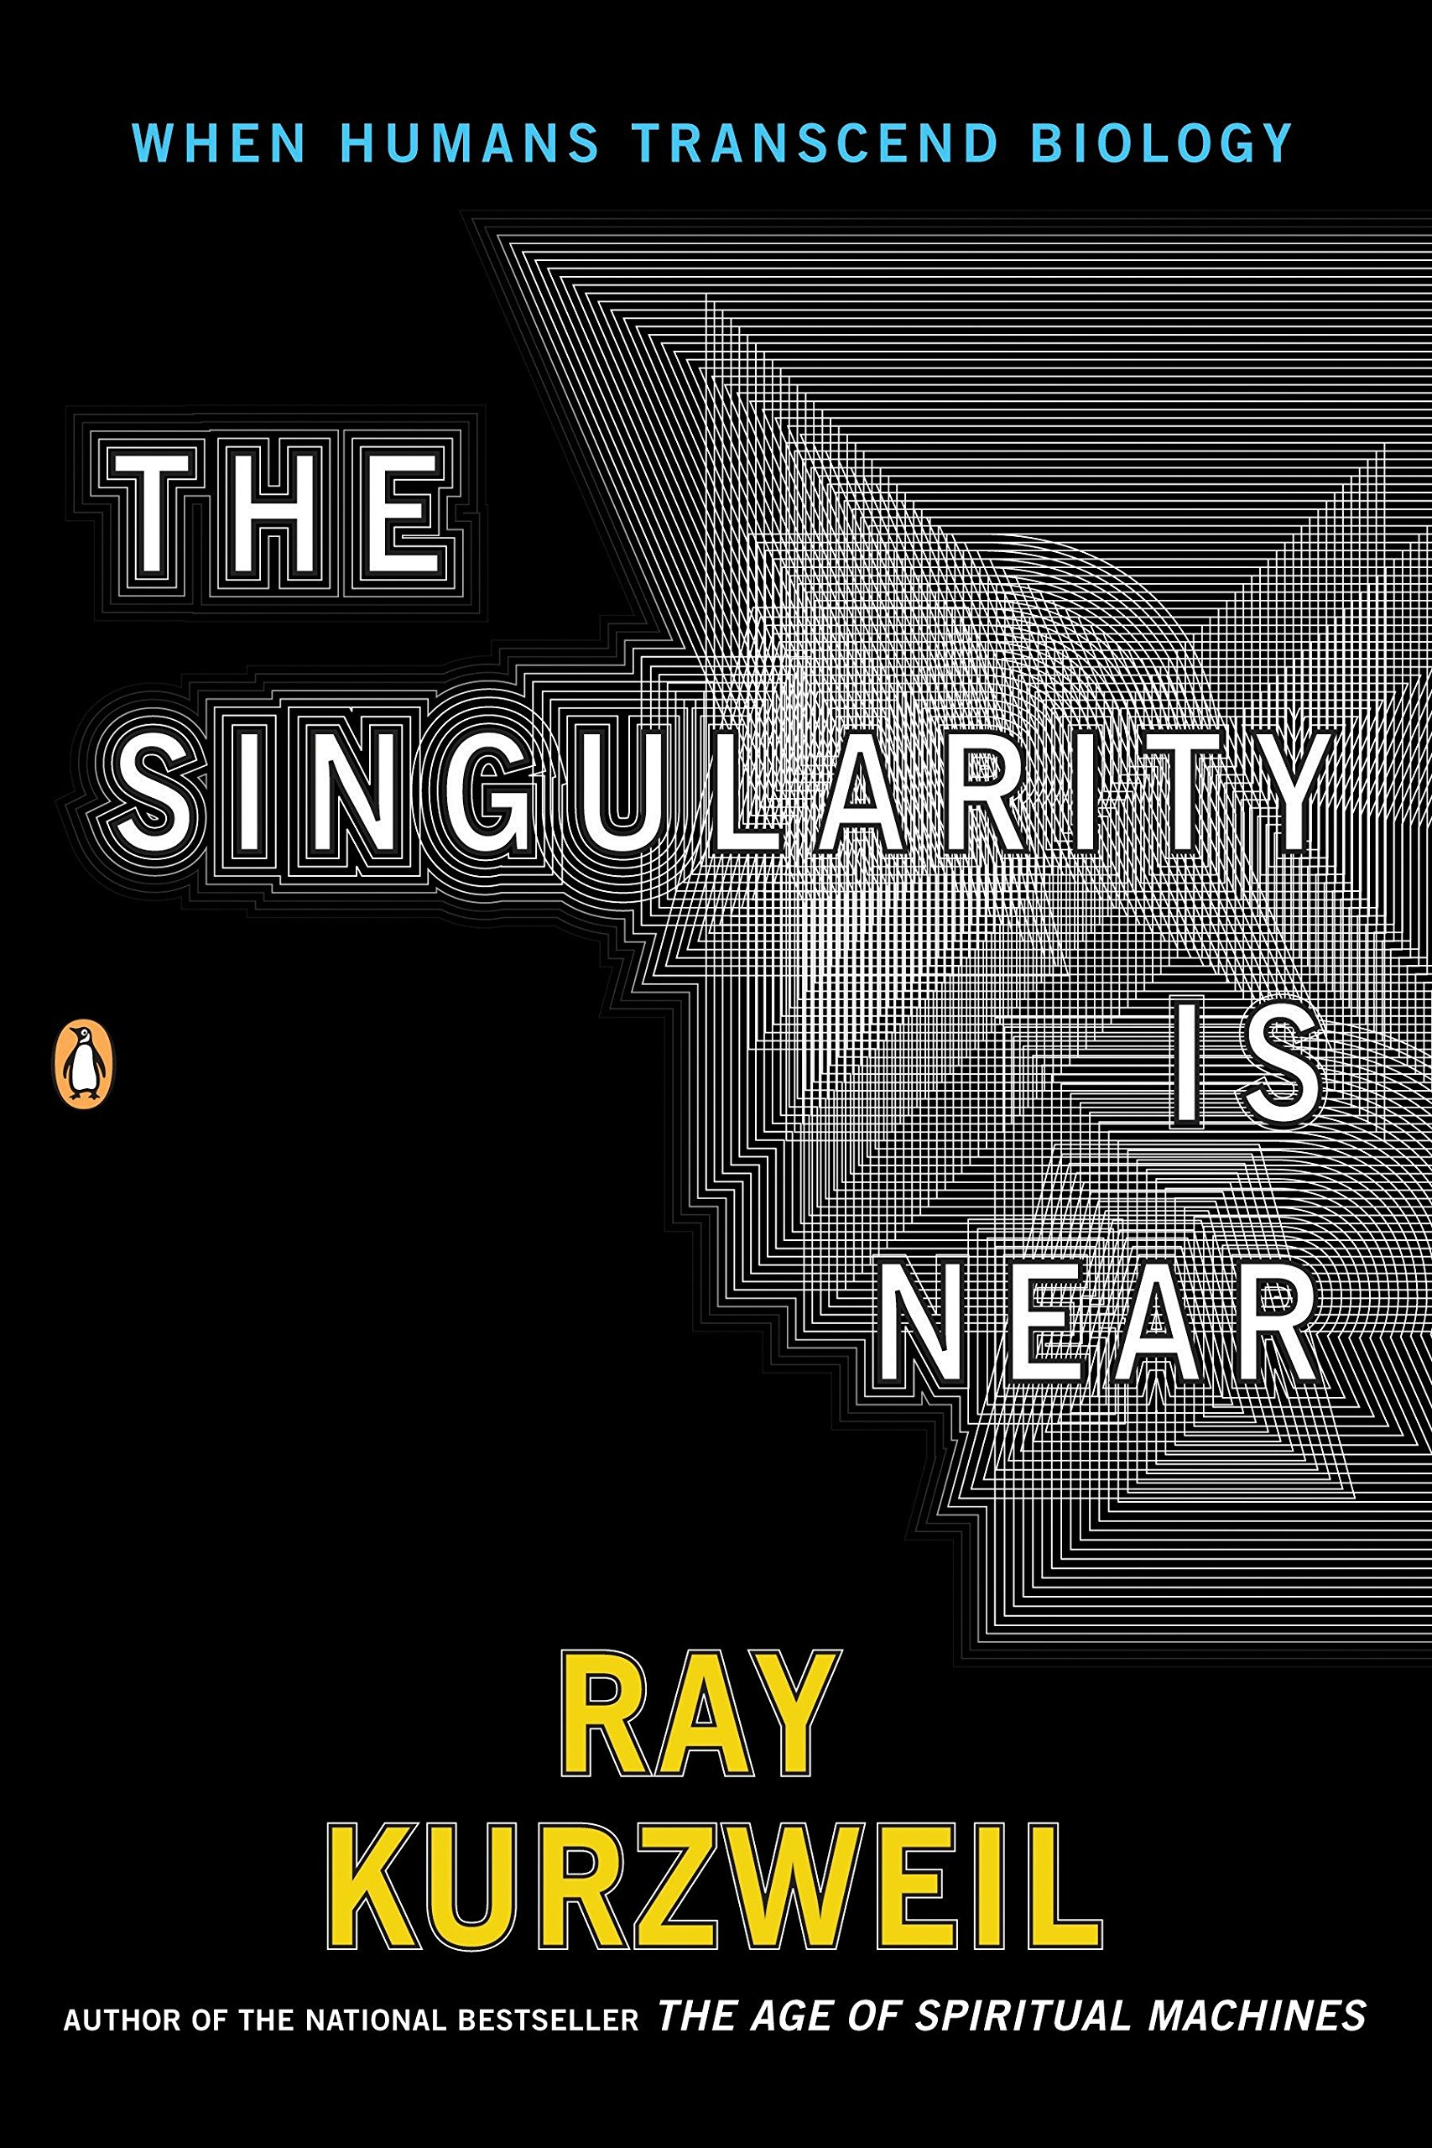
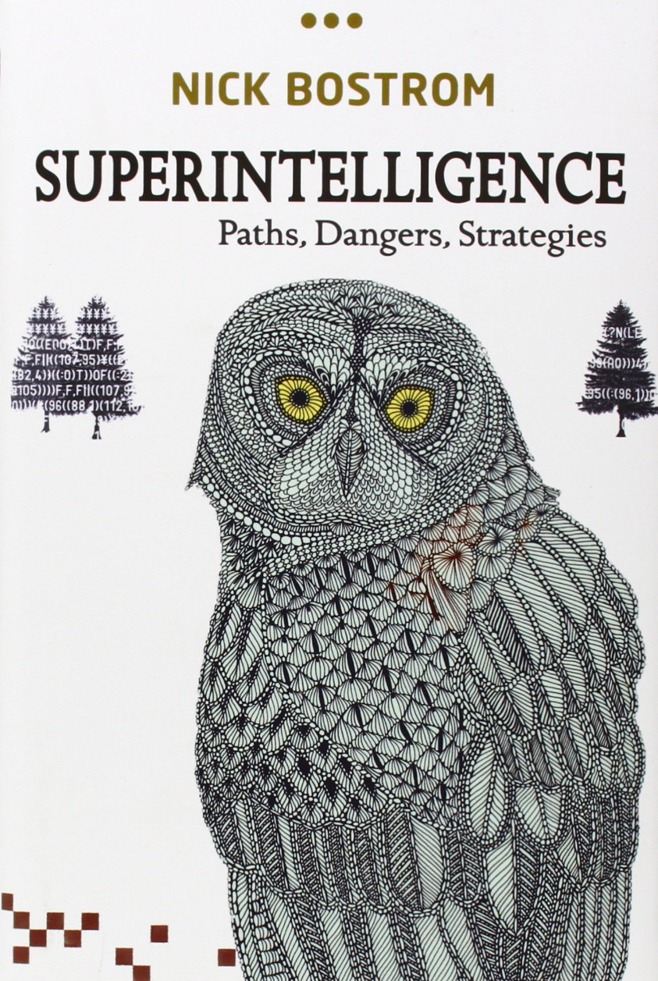
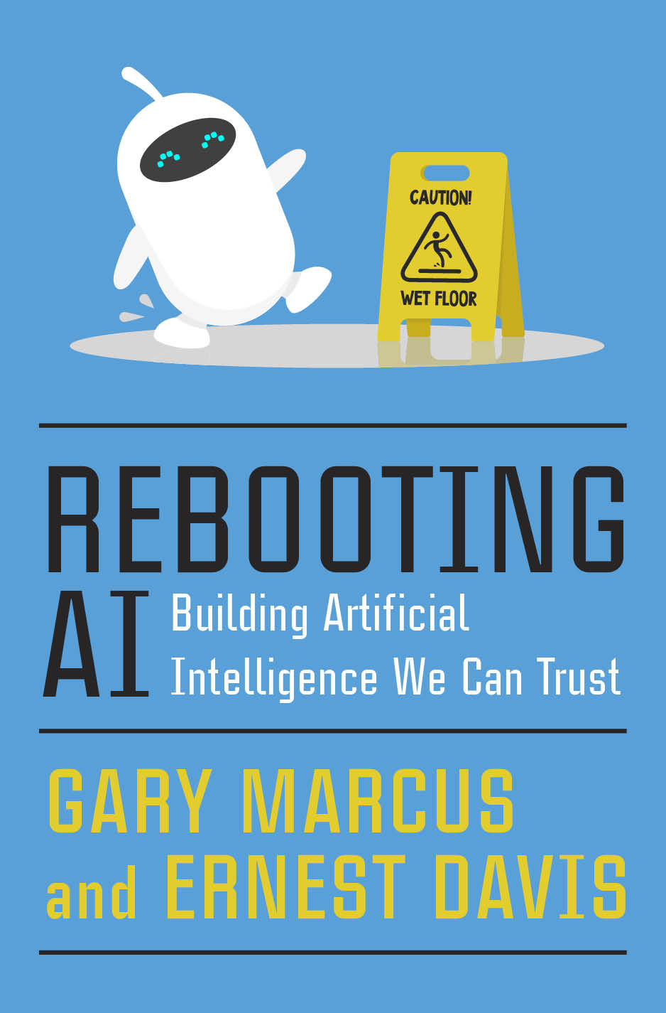
Superintelligence: Brief history of a discourse conducted by best-selling authors
© Penguin, 2006
The Singularity, Kurzweil, 2006:
  Processing power of a chip will pass that of a human brain ~2030, and keep growing exponentially.
  AI will become exponentially smarter than humans.
Superintelligence, Bostrom, 2014:
  That might not be good for humans.
Rebooting AI, Marcus & Davis, 2019:
  The problem with AI is not that it’s too smart. The problem is that it’s too dumb.
© OUP, 2014
© Pantheon, 2019

Slide 19

Superintelligence: The problem
Give an AI a very limited task (e.g., maximize the number of paper clips you can make)
Give it sufficient intelligence that it can figure out how to take resources away from humans (e.g., it can figure out how to hack all existing computers, and how to build more computers)
Result: all solid material on Earth, including all human bodies, are turned into paper clips

Slide 20
Superintelligence: The solution
We need to understand what makes humans moral.
We need to find a moral code that is binding on all intelligences, not just on human intelligences.
This cannot be something that we build into the AI (like Asimov’s “three laws of robotics”), because the AI will just figure out how to get around it. It needs to be an imperative that is naturally binding on all intelligences, regardless of whether they believe it or not.

Slide 21
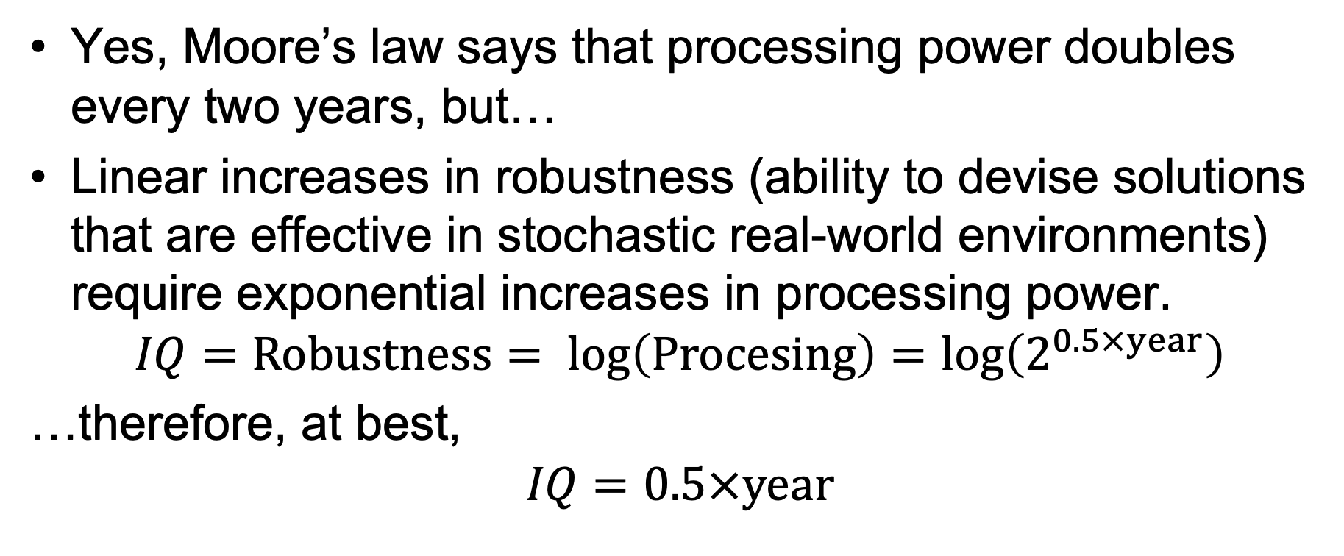
The Fragility Argument
© Pantheon, 2019
Yes, Moore’s law says that processing power doubles every two years, but…
Linear increases in robustness (ability to devise solutions that are effective in stochastic real-world environments) require exponential increases in processing power.
$$IQ=Robustness= \log\left(Procesing\right)=\log\left(2^{0.5×year}\right)$$
…therefore, at best,
$$IQ=0.5×year$$

Slide 22
The Fragility Argument
© Pantheon, 2019
The problem with AI is not that it’s too smart. The problem is that it’s too dumb.
Privacy issues: the data is used in a way not permitted by its natural owners, not because the AI was too smart, but because the company used insecure passwords
Bias and fairness issues: the AI doesn’t understand the societal impact of its decisions
Autonomous vehicle crashes: the AI makes mistakes

Slide 23
Outline
Jobs
Safety
AI weapons
Superintelligence
Robot rights

Slide 24
Where do human rights come from?
Aristotle: those with the ability to reason about the future have, therefore, the right to exercise their ability
Aquinus: all those with souls have rights
Locke: if rights are ignored by a government, humans can overthrow the government
Finnis: the doctrine of rights helps us to construct a better society
Nathwani: the doctrine of rights helps a government to maintain its legitimacy in the eyes of the governed

Slide 25
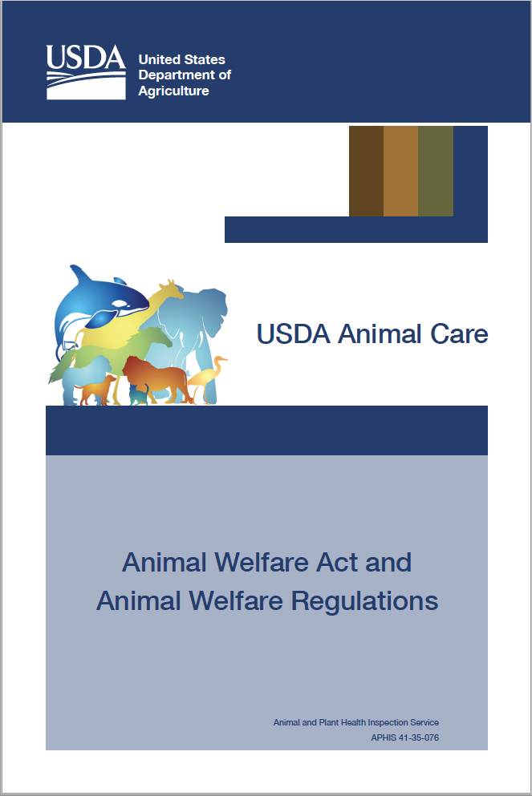
Do animals have rights?
The capabilities argument: creatures that can feel pain should not be subjected to avoidable pain

Slide 26
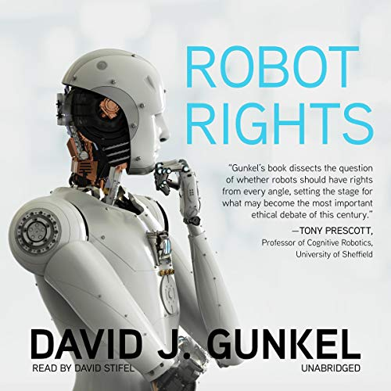
Do robots have rights?
© MIT Press, 2018
Robots do not currently have
… the ability to rationally plan for an unlimited future, or
… the ability to feel pain.
But some day they may have those abilities (depending on how we define those abilities). In preparation for that future, maybe it’s worth thinking carefully about the basis for human rights, to decide what would be the threshold cognitive ability that would require rights for robots.

Slide 27
The ethics of AI
Jobs
Safety
AI weapons
Superintelligence
Robot rights

