Slide 1
Lecture 40: Exam 3 Review
CC-BY 4.0: share at will, but cite the source
Mark Hasegawa-Johnson, 5/2022

Slide 2
Exam 3 Mechanics
If you want to take the exam online, fill out the “Exam 3 Online” poll by May 6
  https://www.gradescope.com/courses/348086/assignments/2021464
  Do this regardless of whether you’re in the online or in-person section
  If you don’t sign up for an online exam, take the exam in person
If you need a conflict exam, tell us why, and your schedule, by May 6
  https://www.gradescope.com/courses/348086/assignments/2021473
  The date and time of the conflict exam will be chosen May 7, based on the schedules submitted by people who sign up for it, and we will communicate about it by e-mail
  The exam will happen during the week of May 8 – May 12

Slide 3
Exam 3 Mechanics
Permitted: two pages of handwritten notes, front & back
Not permitted: calculators, computers, textbook

Slide 4
Exam 3 Content
One or two questions based on Exam 1 material
One or two questions based on Exam 2 material
Ten to twelve questions based on the last third of the course:
  Lecture 29: Game theory
  Lectures 30-31: Two-player games
  Lecture 32: Markov Decision Process
  Lectures 33-36: Reinforcement Learning
  Lectures 37-38: Robots

Slide 5
Game Theory
Dominant strategy
  a strategy that’s optimal for one player, regardless of what the other player does
  Not all games have dominant strategies
Nash equilibrium
  an outcome (one action by each player) such that, knowing the other player’s action, each player has no reason to change their own action
  Every game with a finite set of actions has at least one Nash equilibrium, though it might be a mixed-strategy equilibrium.
Pareto optimal
  an outcome such that neither player would be able to win more without simultaneously forcing the other player to lose more
  Every game has at least one Pareto optimal outcome. Usually there are many, representing different tradeoffs between the two players.
Mixed strategies
  A mixed strategy is optimal only if there’s no reason to prefer one action over the other, i.e., if $0≤p≤1$ and $0≤q≤1$ such that:
  $$\left(1−p\right)w+px=\left(1−p\right)y+pz$$
  $$\left(1−q\right)a+qc=\left(1−q\right)b+qd$$

Slide 6
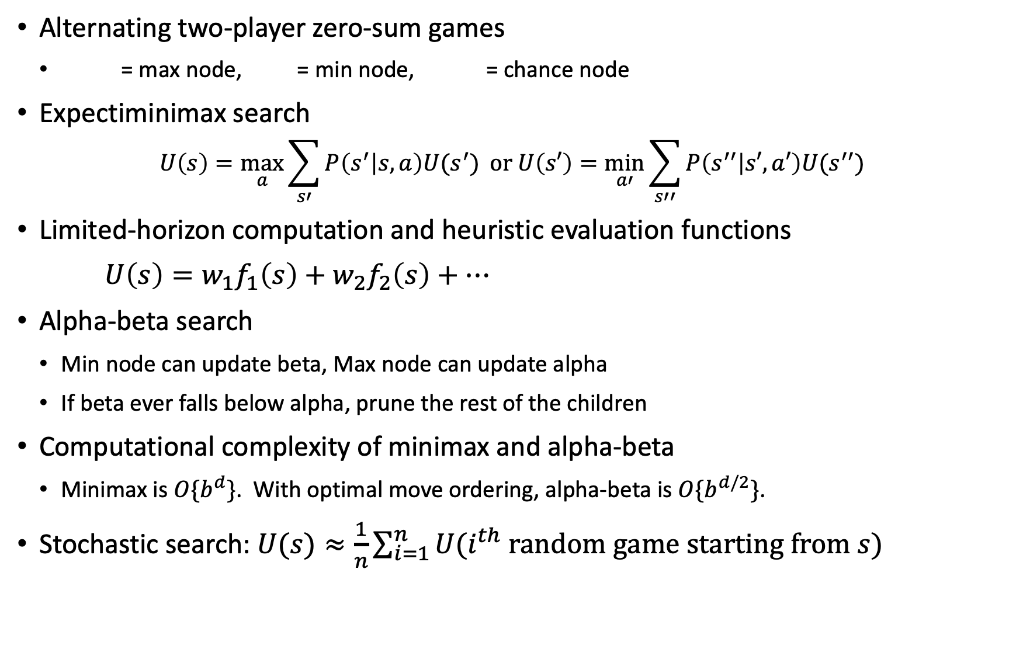
Two-Player Games
Alternating two-player zero-sum games
    = max node, = min node, = chance node
Expectiminimax search
$$U\left(s\right)=\max_{a}{\sum_{s′}{P\left(s^{′} | s,a\right)U(s^{′})}} or U\left(s′\right)=\min_{a′}{\sum_{s′′}{P\left(s^{′′} | s′,a′\right)U(s^{′′})}}$$
Limited-horizon computation and heuristic evaluation functions
$U\left(s\right)=w_{1}f_{1}\left(s\right)+w_{2}f_{2}\left(s\right)+⋯$
Alpha-beta search
    Min node can update beta, Max node can update alpha
    If beta ever falls below alpha, prune the rest of the children
Computational complexity of minimax and alpha-beta
    Minimax is $O\{b^{d}\}$. With optimal move ordering, alpha-beta is $O\{b^{d/2}\}$.
Stochastic search: $U(s)≈\frac{1}{n}\sum_{i=1}^{n}{U(i^{th} random game starting from s)}$

Slide 7
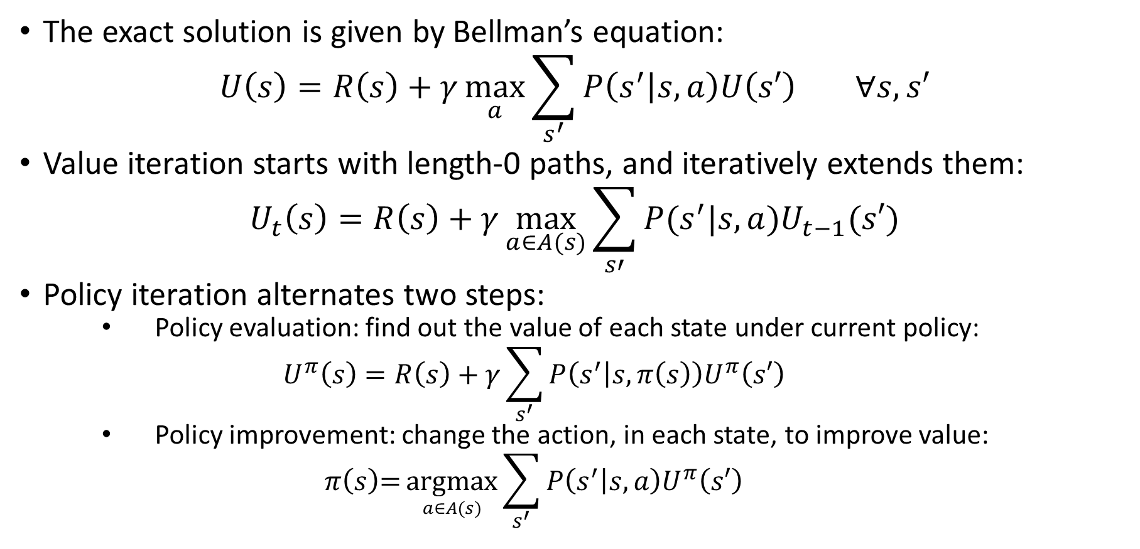
Markov Decision Process
The exact solution is given by Bellman’s equation:
$$U\left(s\right)=R\left(s\right)+γ\max_{a}{\sum_{s^{′}}{P\left(s^{′} | s,a\right)U\left(s′\right)}} ∀s,s′$$
Value iteration starts with length-0 paths, and iteratively extends them:
$$U_{t}\left(s\right)=R\left(s\right)+γ\max_{a∈A(s)}{\sum_{s′}{P(s^{′}|s,a)U_{t−1}(s′)}}$$
Policy iteration alternates two steps:
    Policy evaluation: find out the value of each state under current policy:
    $$U^{π}\left(s\right)=R\left(s\right)+γ\sum_{s^{′}}{P\left(s^{′} | s,π\left(s\right)\right)U^{π}\left(s′\right)}$$
    Policy improvement: change the action, in each state, to improve value:
    $$π\left(s\right)\text{=}\underset{a∈A(s)}{argmax}{\sum_{s^{′}}{P\left(s^{′} | s,a\right)U^{π}\left(s′\right)}}$$

Slide 8
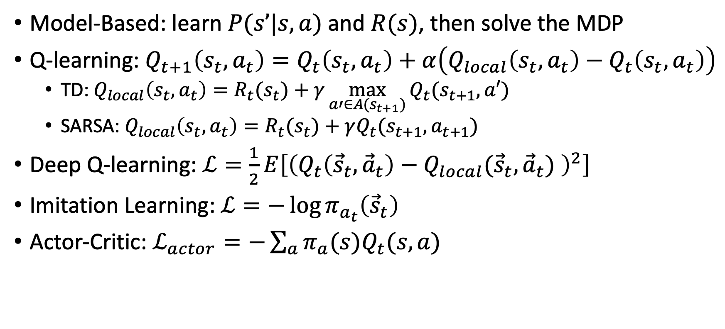
Reinforcement Learning
Model-Based: learn $P(s’|s,a)$ and $R(s)$, then solve the MDP
Q-learning: $Q_{t+1}\left(s_{t},a_{t}\right)=Q_{t}\left(s_{t},a_{t}\right)+α\left(Q_{local}\left(s_{t},a_{t}\right)−Q_{t}\left(s_{t},a_{t}\right)\right)$
  TD: $Q_{local}\left(s_{t},a_{t}\right)=R_{t}(s_{t})+γ\max_{a′∈A(s_{t+1})}{Q_{t}(s_{t+1},a′)}$
  SARSA: $Q_{local}\left(s_{t},a_{t}\right)=R_{t}(s_{t})+γQ_{t}(s_{t+1},a_{t+1})$
Deep Q-learning: $ℒ=\frac{1}{2}E\left[{\left(Q_{t}\left({\vec{s}}_{t},{\vec{a}}_{t}\right)−Q_{local}({\vec{s}}_{t},{\vec{a}}_{t}) \right)}^{2}\right]$
Imitation Learning: $ℒ=−\log{π_{a_{t}}\left({\vec{s}}_{t}\right)}$
Actor-Critic: $ℒ_{actor}=−\sum_{a}{π_{a}(s)Q_{t}(s,a)}$

Slide 9
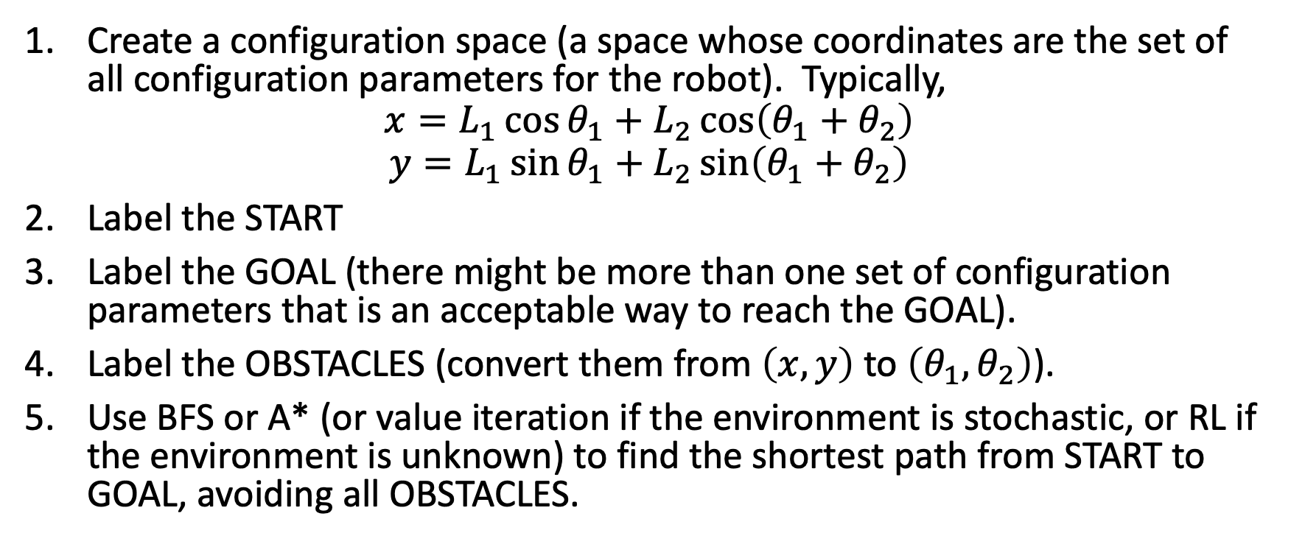
How to solve the Robot Arm problem
Create a configuration space (a space whose coordinates are the set of all configuration parameters for the robot). Typically,
$$x=L_{1}\cos{θ_{1}}+L_{2}\cos\left(θ_{1}+θ_{2}\right)$$
$$y=L_{1}\sin{θ_{1}}+L_{2}\sin\left(θ_{1}+θ_{2}\right)$$
Label the START
Label the GOAL (there might be more than one set of configuration parameters that is an acceptable way to reach the GOAL).
Label the OBSTACLES (convert them from $\left(x,y\right)$ to $\left(θ_{1},θ_{2}\right)$).
Use BFS or A* (or value iteration if the environment is stochastic, or RL if the environment is unknown) to find the shortest path from START to GOAL, avoiding all OBSTACLES.

Slide 10
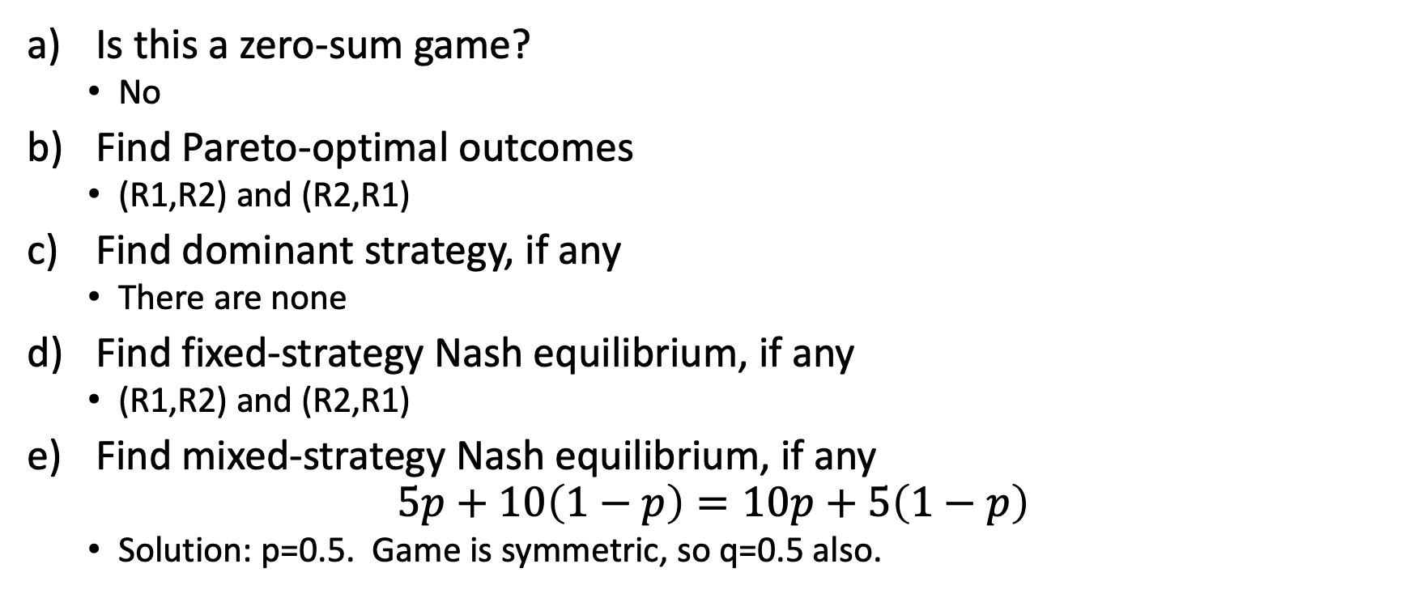
Sample problem: Game theory
 | Alice R1 | Alice R2
Bob R1 | A:5,B:5 | A:10,B:10
Bob R2 | A:10,B:10 | A:5,B:5
Is this a zero-sum game?
  No
Find Pareto-optimal outcomes
  (R1,R2) and (R2,R1)
Find dominant strategy, if any
  There are none
Find fixed-strategy Nash equilibrium, if any
  (R1,R2) and (R2,R1)
Find mixed-strategy Nash equilibrium, if any
$$5p+10\left(1−p\right)=10p+5\left(1−p\right)$$
  Solution: p=0.5. Game is symmetric, so q=0.5 also.

Slide 11
Sample problem:
Minimax and Alpha-beta
B
R
What is the value of each node?
Re-arrange the tree so that, if moves are evaluated in order from right to left, alpha-beta will only evaluate 5 of the 8 terminal nodes
After your re-arrangement, which edges are pruned
B
R
B
R
B
R
B
R
B
R
B
R
-4
-3
-1
-2
3
4
2
1

Slide 12
Sample problem:
Minimax and Alpha-beta
2
B
R
-3
2
What is the value of each node?
Re-arrange the tree so that, if moves are evaluated in order from right to left, alpha-beta will only evaluate 5 of the 8 terminal nodes
After your re-arrangement, which edges are pruned
B
R
B
R
-3
-1
4
2
B
R
B
R
B
R
B
R
-4
-3
-1
-2
3
4
2
1

Slide 13
Sample problem:
Minimax and Alpha-beta
R
B
What is the value of each node?
Re-arrange the tree so that, if moves are evaluated in order from right to left, alpha-beta will only evaluate 5 of the 8 terminal nodes
After your re-arrangement, which edges are pruned
R
B
B
R
B
R
R
B
R
B
B
R
2
1
4
3
-3
-4
-1
-2

Slide 14
Sample problem:
Minimax and Alpha-beta
R
B
What is the value of each node?
Re-arrange the tree so that, if moves are evaluated in order from right to left, alpha-beta will only evaluate 5 of the 8 terminal nodes
After your re-arrangement, which edges are pruned
R
B
B
X
R
B
R
R
X
B
R
B
B
R
2
1
4
3
-3
-4
-1
-2

Slide 15
Expectiminimax
T
H
Find values of all nodes
T
H
T
H
T
H
T
H
T
H
T
H
T
H
H
5
3
8
2
2
6
9
1
1
7
3
5
8
2
2
6

Slide 16
Expectiminimax
5
T
H
Find values of all nodes
5
5
T
H
T
H
5
5
4
6
T
H
T
H
T
H
T
H
4
5
4
5
4
4
6
4
T
H
H
5
3
8
2
2
6
9
1
1
7
3
5
8
4
2
6

Slide 17
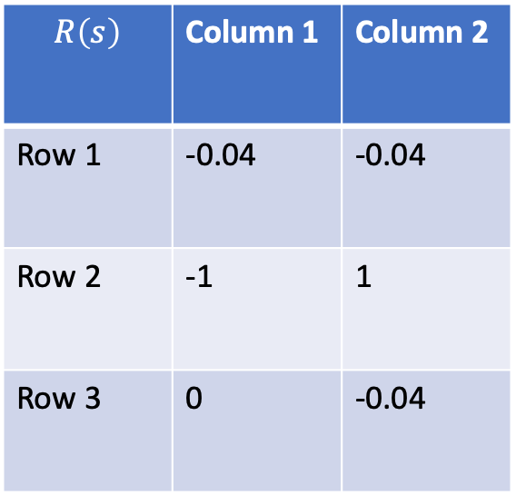
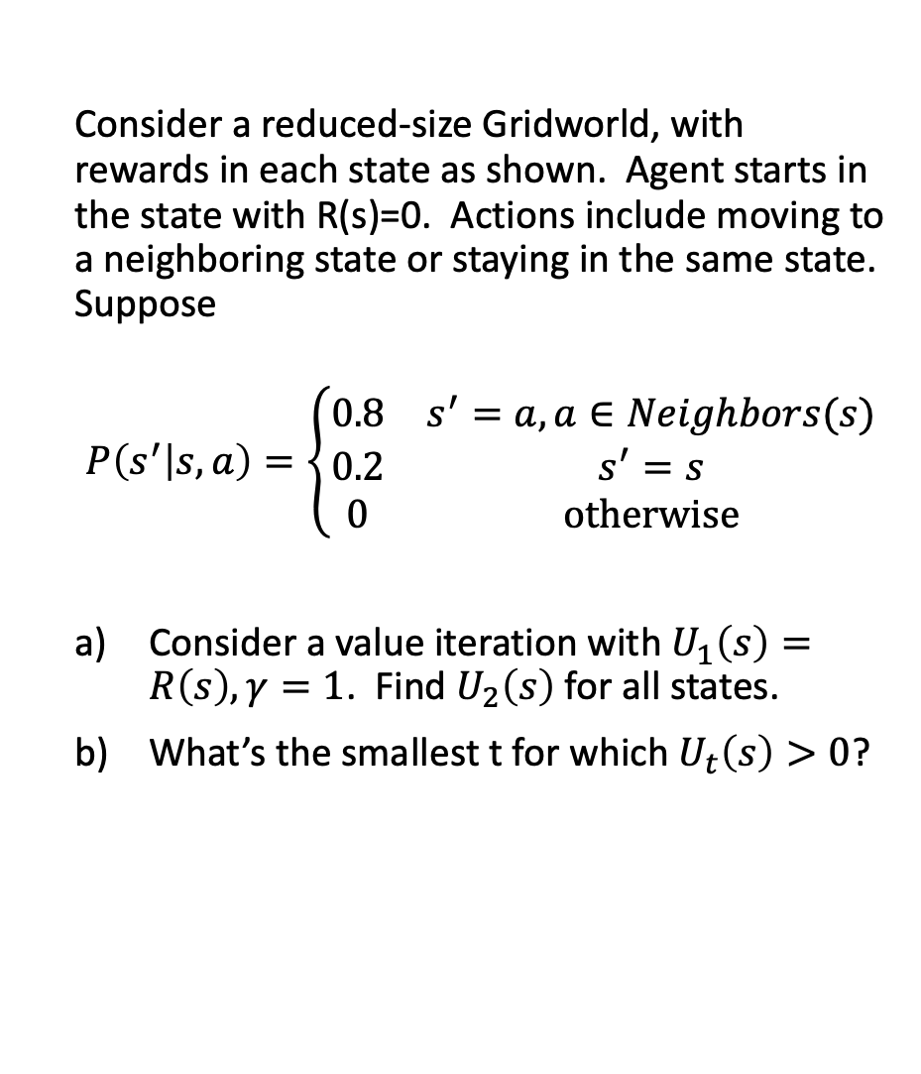
Markov Decision Process
$$R\left(s\right)$$ | Column 1 | Column 2
Row 1 | -0.04 | -0.04
Row 2 | -1 | 1
Row 3 | 0 | -0.04
Consider a reduced-size Gridworld, with rewards in each state as shown. Agent starts in the state with R(s)=0. Actions include moving to a neighboring state or staying in the same state. Suppose
$$P\left(s^{′} | s,a\right)=\left\{\begin{matrix}0.8 & s^{′}=a,a∈Neighbors(s) \\ 0.2 & s^{′}=s \\ 0 & otherwise\end{matrix}\right.$$
Consider a value iteration with $U_{1}\left(s\right)=R\left(s\right), γ=1$. Find $U_{2}\left(s\right)$ for all states.
What’s the smallest t for which $U_{t}\left(s\right)>0$?

Slide 18
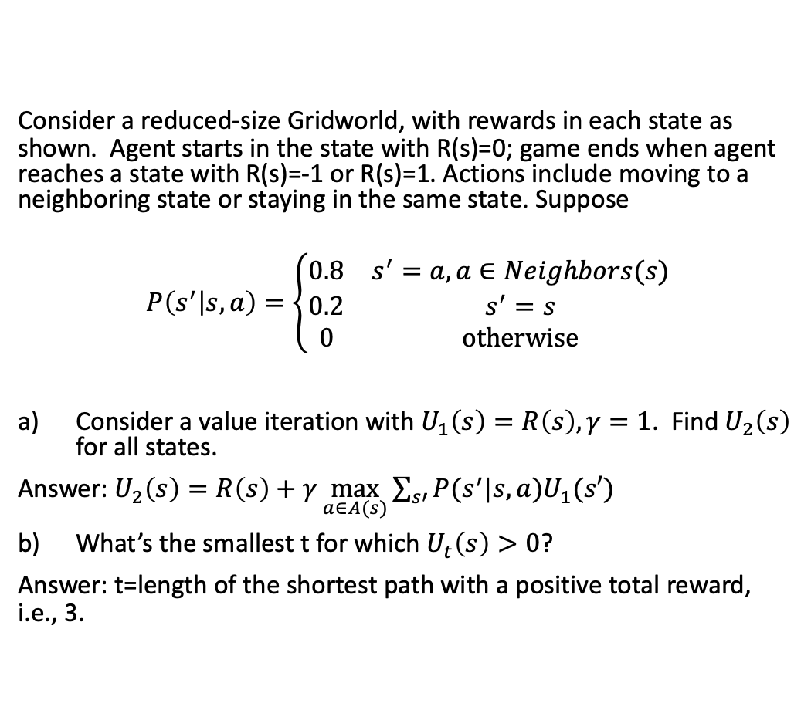
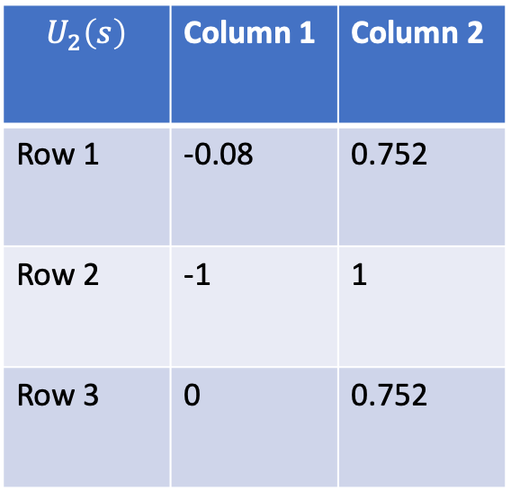
Markov Decision Process
$$R\left(s\right)$$ | Column 1 | Column 2
Row 1 | -0.04 | -0.04
Row 2 | -1 | 1
Row 3 | 0 | -0.04
Consider a reduced-size Gridworld, with rewards in each state as shown. Agent starts in the state with R(s)=0; game ends when agent reaches a state with R(s)=-1 or R(s)=1. Actions include moving to a neighboring state or staying in the same state. Suppose
$$P\left(s^{′} | s,a\right)=\left\{\begin{matrix}0.8 & s^{′}=a,a∈Neighbors(s) \\ 0.2 & s^{′}=s \\ 0 & otherwise\end{matrix}\right.$$
Consider a value iteration with $U_{1}\left(s\right)=R\left(s\right), γ=1$. Find $U_{2}\left(s\right)$ for all states.
Answer: $U_{2}\left(s\right)=R\left(s\right)+γ\max_{a∈A(s)}{\sum_{s′}{P(s^{′}|s,a)U_{1}(s′)}}$
What’s the smallest t for which $U_{t}\left(s\right)>0$?
Answer: t=length of the shortest path with a positive total reward, i.e., 3.
$$U_{2}\left(s\right)$$ | Column 1 | Column 2
Row 1 | -0.08 | 0.752
Row 2 | -1 | 1
Row 3 | 0 | 0.752

Slide 19
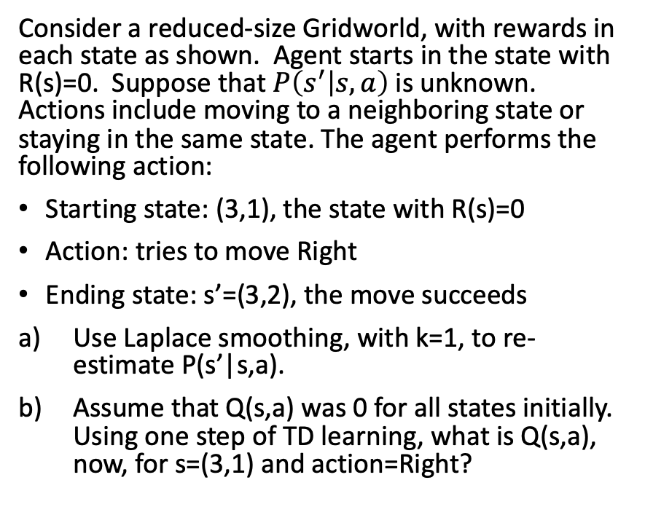
Reinforcement Learning
$$R\left(s\right)$$ | Column 1 | Column 2
Row 1 | -0.04 | -0.04
Row 2 | -1 | 1
Row 3 | 0 | -0.04
Consider a reduced-size Gridworld, with rewards in each state as shown. Agent starts in the state with R(s)=0. Suppose that $P\left(s^{′} | s,a\right)$ is unknown. Actions include moving to a neighboring state or staying in the same state. The agent performs the following action:
Starting state: (3,1), the state with R(s)=0
Action: tries to move Right
Ending state: s’=(3,2), the move succeeds
Use Laplace smoothing, with k=1, to re-estimate P(s’|s,a).
Assume that Q(s,a) was 0 for all states initially. Using one step of TD learning, what is Q(s,a), now, for s=(3,1) and action=Right?

Slide 20
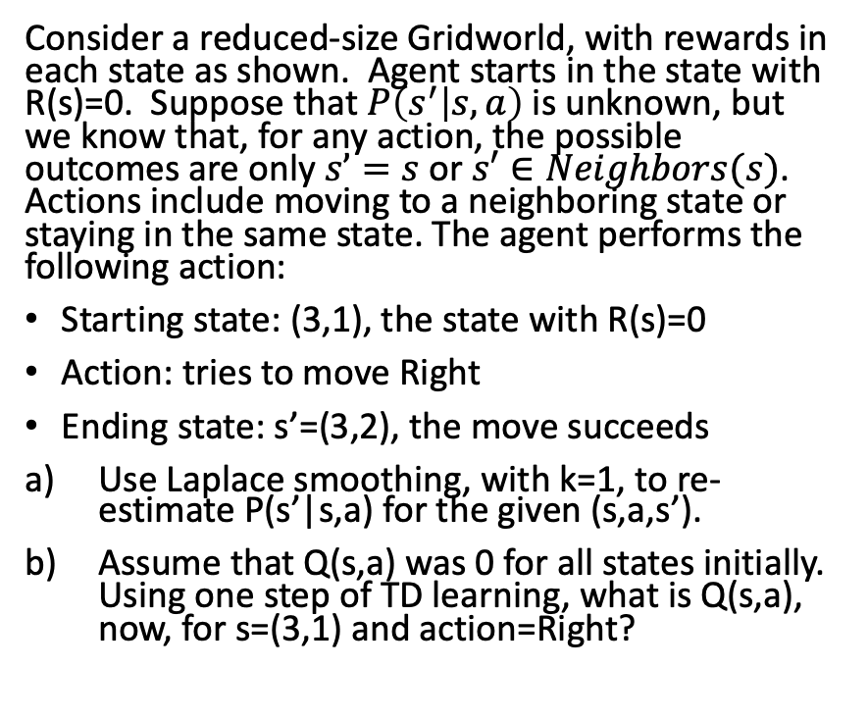
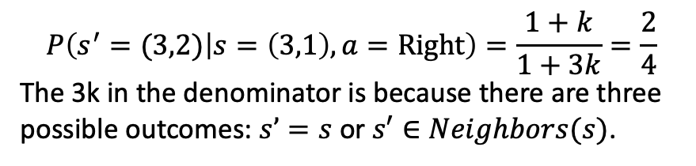
Reinforcement Learning
$$R\left(s\right)$$ | Column 1 | Column 2
Row 1 | -0.04 | -0.04
Row 2 | -1 | 1
Row 3 | 0 | -0.04
Consider a reduced-size Gridworld, with rewards in each state as shown. Agent starts in the state with R(s)=0. Suppose that $P\left(s^{′} | s,a\right)$ is unknown, but we know that, for any action, the possible outcomes are only $s’=s$ or $s′∈Neighbors(s)$. Actions include moving to a neighboring state or staying in the same state. The agent performs the following action:
Starting state: (3,1), the state with R(s)=0
Action: tries to move Right
Ending state: s’=(3,2), the move succeeds
Use Laplace smoothing, with k=1, to re-estimate P(s’|s,a) for the given (s,a,s’).
Assume that Q(s,a) was 0 for all states initially. Using one step of TD learning, what is Q(s,a), now, for s=(3,1) and action=Right?
$$P\left(s^{′}=(3,2) | s=\left(3,1\right),a=Right\right)=\frac{1+k}{1+3k}=\frac{2}{4}$$
The 3k in the denominator is because there are three possible outcomes: $s’=s$ or $s′∈Neighbors(s)$.

Slide 21
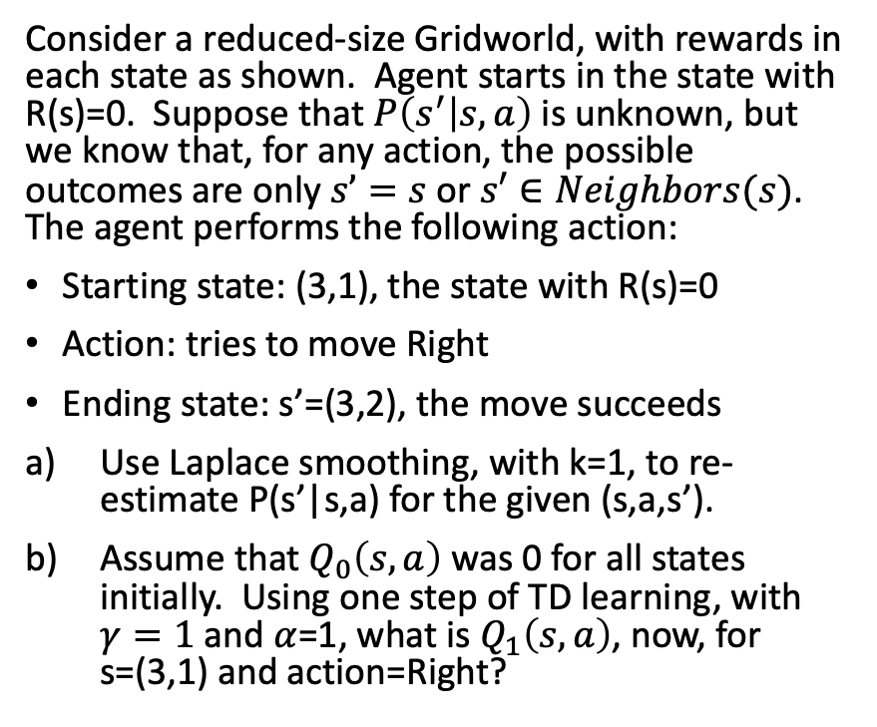
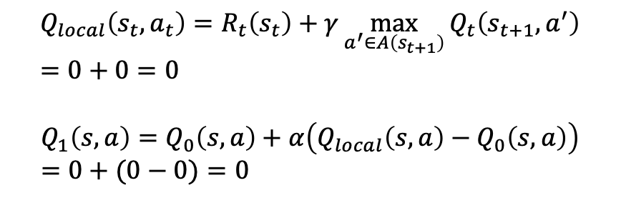
Reinforcement Learning
$$R\left(s\right)$$ | Column 1 | Column 2
Row 1 | -0.04 | -0.04
Row 2 | -1 | 1
Row 3 | 0 | -0.04
Consider a reduced-size Gridworld, with rewards in each state as shown. Agent starts in the state with R(s)=0. Suppose that $P\left(s^{′} | s,a\right)$ is unknown, but we know that, for any action, the possible outcomes are only $s’=s$ or $s′∈Neighbors(s)$. The agent performs the following action:
Starting state: (3,1), the state with R(s)=0
Action: tries to move Right
Ending state: s’=(3,2), the move succeeds
Use Laplace smoothing, with k=1, to re-estimate P(s’|s,a) for the given (s,a,s’).
Assume that $Q_{0}\left(s,a\right)$ was 0 for all states initially. Using one step of TD learning, with $γ=1$ and $α$=1, what is $Q_{1}\left(s,a\right)$, now, for s=(3,1) and action=Right?
$$Q_{local}\left(s_{t},a_{t}\right)=R_{t}\left(s_{t}\right)+γ\max_{a^{′}∈A\left(s_{t+1}\right)}{Q_{t}\left(s_{t+1},a^{′}\right)}=0+0=0$$
$$Q_{1}\left(s,a\right)=Q_{0}\left(s,a\right)+α\left(Q_{local}\left(s,a\right)−Q_{0}\left(s,a\right)\right)=0+(0−0)=0$$

Slide 22




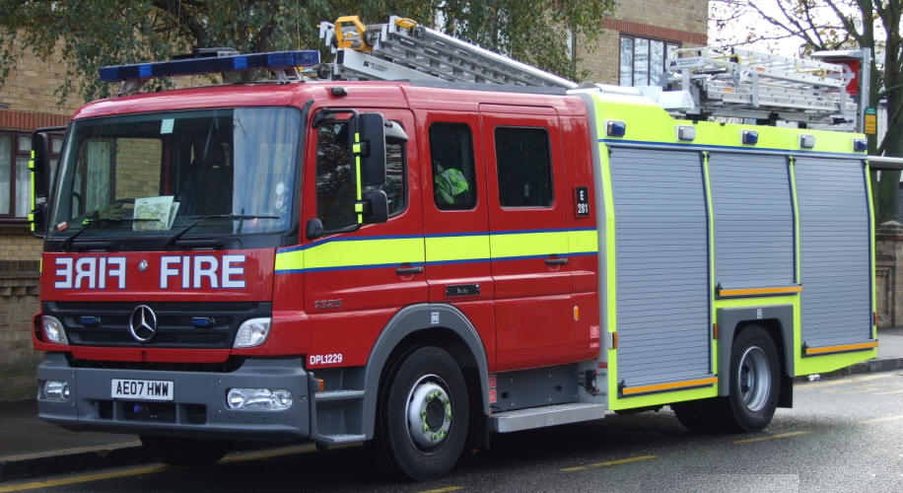
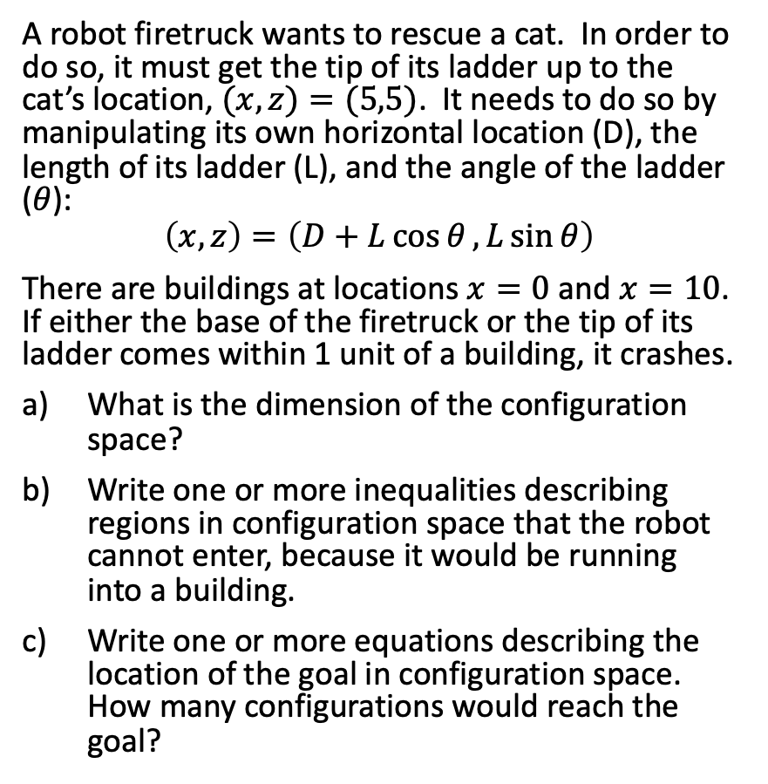
Robotics
A robot firetruck wants to rescue a cat. In order to do so, it must get the tip of its ladder up to the cat’s location, $(x,z)=(5,5)$. It needs to do so by manipulating its own horizontal location (D), the length of its ladder (L), and the angle of the ladder ($θ$):
$$\left(x,z\right)=\left(D+L\cos{θ},L\sin{θ}\right)$$
There are buildings at locations $x=0$ and $x=10$. If either the base of the firetruck or the tip of its ladder comes within 1 unit of a building, it crashes.
What is the dimension of the configuration space?
Write one or more inequalities describing regions in configuration space that the robot cannot enter, because it would be running into a building.
Write one or more equations describing the location of the goal in configuration space. How many configurations would reach the goal?
(5,5)
0
D
5
10

Slide 23
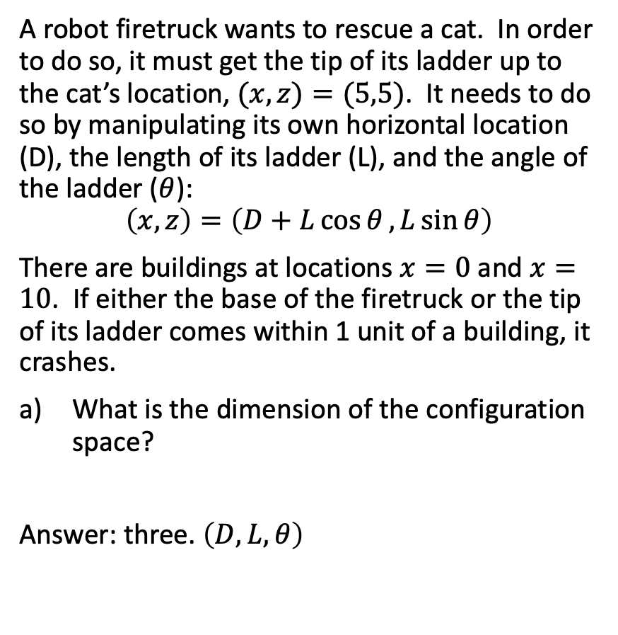
Robotics
A robot firetruck wants to rescue a cat. In order to do so, it must get the tip of its ladder up to the cat’s location, $(x,z)=(5,5)$. It needs to do so by manipulating its own horizontal location (D), the length of its ladder (L), and the angle of the ladder ($θ$):
$$\left(x,z\right)=\left(D+L\cos{θ},L\sin{θ}\right)$$
There are buildings at locations $x=0$ and $x=10$. If either the base of the firetruck or the tip of its ladder comes within 1 unit of a building, it crashes.
What is the dimension of the configuration space?
Answer: three. $\left(D,L,θ\right)$
(5,5)
0
D
5
10

Slide 24
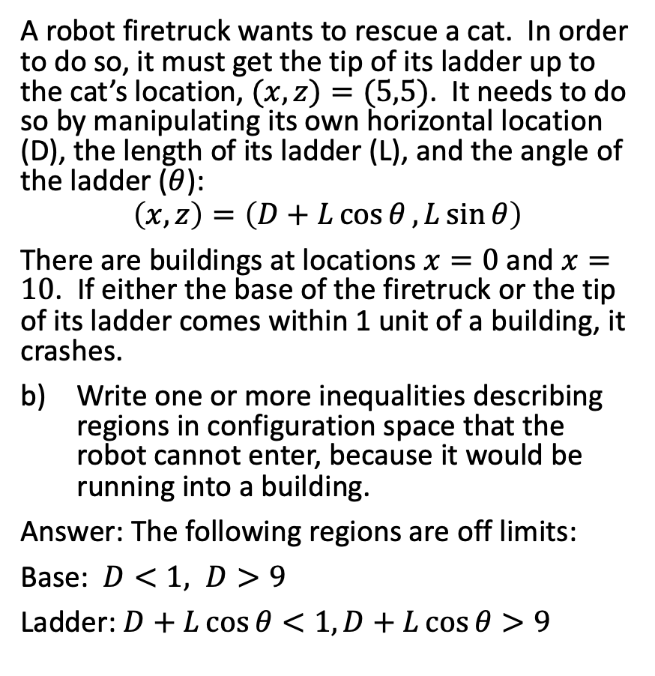
Robotics
A robot firetruck wants to rescue a cat. In order to do so, it must get the tip of its ladder up to the cat’s location, $(x,z)=(5,5)$. It needs to do so by manipulating its own horizontal location (D), the length of its ladder (L), and the angle of the ladder ($θ$):
$$\left(x,z\right)=\left(D+L\cos{θ},L\sin{θ}\right)$$
There are buildings at locations $x=0$ and $x=10$. If either the base of the firetruck or the tip of its ladder comes within 1 unit of a building, it crashes.
Write one or more inequalities describing regions in configuration space that the robot cannot enter, because it would be running into a building.
Answer: The following regions are off limits:
Base: $D<1, D>9$
Ladder: $D+L\cos{θ}<1,D+L\cos{θ}>9$
(5,5)
0
D
5
10

Slide 25
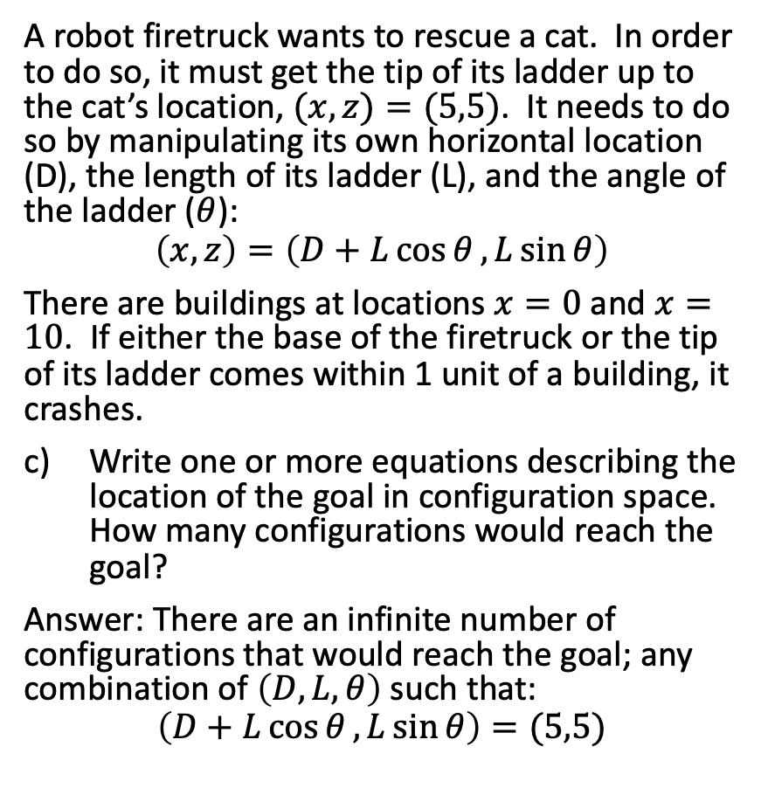
Robotics
A robot firetruck wants to rescue a cat. In order to do so, it must get the tip of its ladder up to the cat’s location, $(x,z)=(5,5)$. It needs to do so by manipulating its own horizontal location (D), the length of its ladder (L), and the angle of the ladder ($θ$):
$$\left(x,z\right)=\left(D+L\cos{θ},L\sin{θ}\right)$$
There are buildings at locations $x=0$ and $x=10$. If either the base of the firetruck or the tip of its ladder comes within 1 unit of a building, it crashes.
Write one or more equations describing the location of the goal in configuration space. How many configurations would reach the goal?
Answer: There are an infinite number of configurations that would reach the goal; any combination of $\left(D,L,θ\right)$ such that:
$$\left(D+L\cos{θ},L\sin{θ}\right)=(5,5)$$
(5,5)
0
D
5
10

