Slide 1
Natural Language Processing with Neural Nets
CC-BY 4.0: copy at will, but cite the source
Mark Hasegawa-Johnson
5/2022

Slide 2
Outline
Syntax and semantics
Part of speech tagging
An HMM for POS tagging
The Viterbi algorithm for POS tagging
From HMM to Neural Net
Recurrent neural networks
Training a recurrent neural network
Long short-term memory (LSTM)

Slide 3
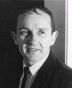
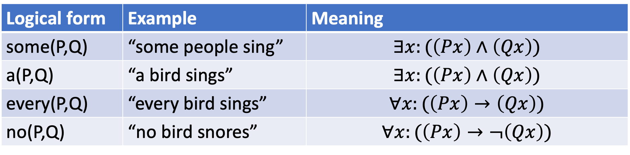
Semantics: Montague grammar
Richard Montague defined formal semantics as follows:
”Understanding a sentence” means that you can specify the conditions under which the sentence would be true
The meaning of a sentence is composed of the meanings of its words. For example:
Richard Montague, 1930-1971
photograph © Richard Thomason
Logical form | Example | Meaning
some(P,Q) | “some people sing” | $$∃x:(\left(Px\right)∧\left(Qx\right))$$
a(P,Q) | “a bird sings” | $$∃x:(\left(Px\right)∧\left(Qx\right))$$
every(P,Q) | “every bird sings” | $$∀x:(\left(Px\right)→\left(Qx\right))$$
no(P,Q) | “no bird snores” | $$∀x:(\left(Px\right)→¬\left(Qx\right))$$

Slide 4
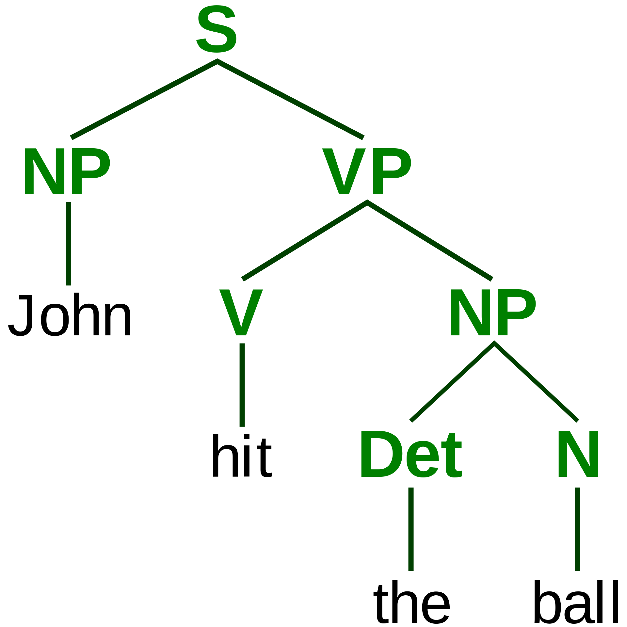
Syntax
Syntax is the study of how words combine.
Syntax is a descriptive science: it simply describes how words combine when people are using them naturally.
Compositional semantics studies the meanings of those combinations.
ParseTree.svg. Public domain image, Stannered, 2007

Slide 5
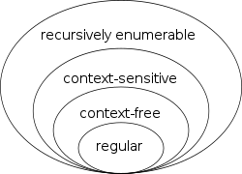
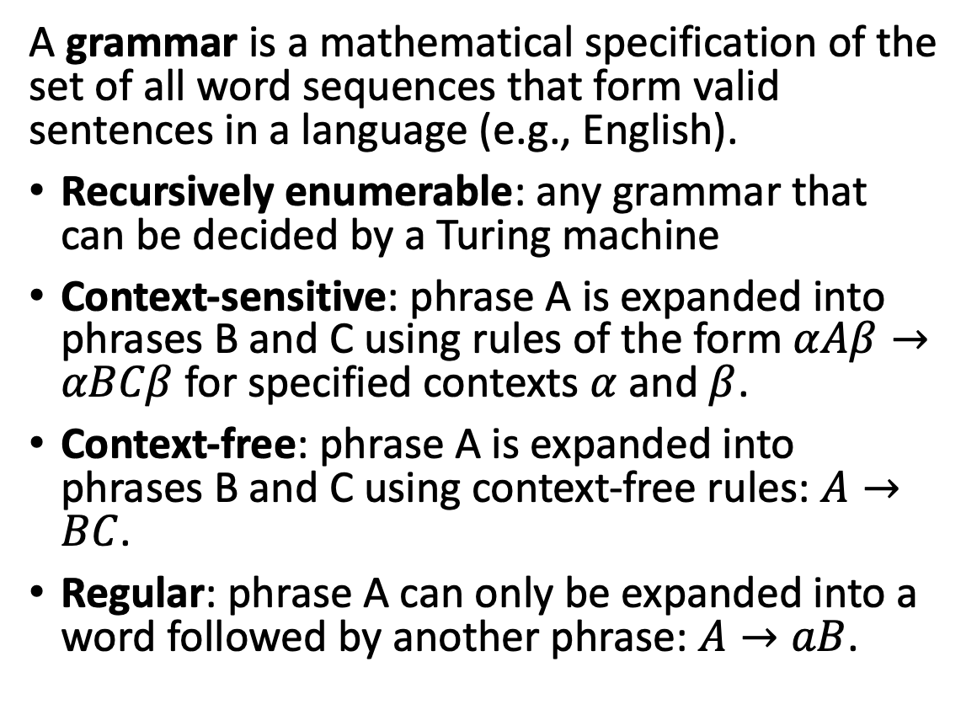
Grammar
A grammar is a mathematical specification of the set of all word sequences that form valid sentences in a language (e.g., English).
Recursively enumerable: any grammar that can be decided by a Turing machine
Context-sensitive: phrase A is expanded into phrases B and C using rules of the form $αAβ→αBCβ$ for specified contexts $α$ and $β$.
Context-free: phrase A is expanded into phrases B and C using context-free rules: $A→BC$.
Regular: phrase A can only be expanded into a word followed by another phrase: $A→aB$.
Chomsky-hierarchy.svg. CC-SA 3.0, J. Finkelstein, 2010

Slide 6
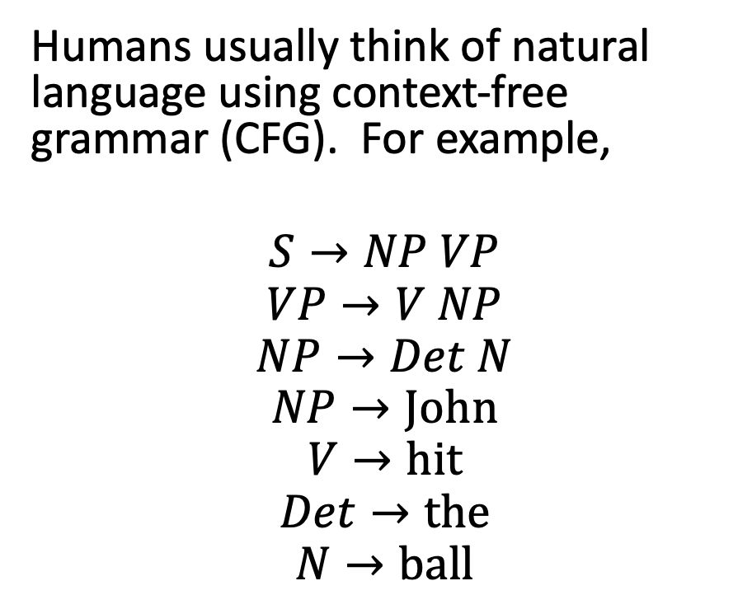
Grammar
Humans usually think of natural language using context-free grammar (CFG). For example,
$$S→NP VP$$
$$VP→V NP$$
$$NP→Det N$$
$$NP→John$$
$$V→hit$$
$$Det→the$$
$$N→ball$$
ParseTree.svg. Public domain image, Stannered, 2007

Slide 7
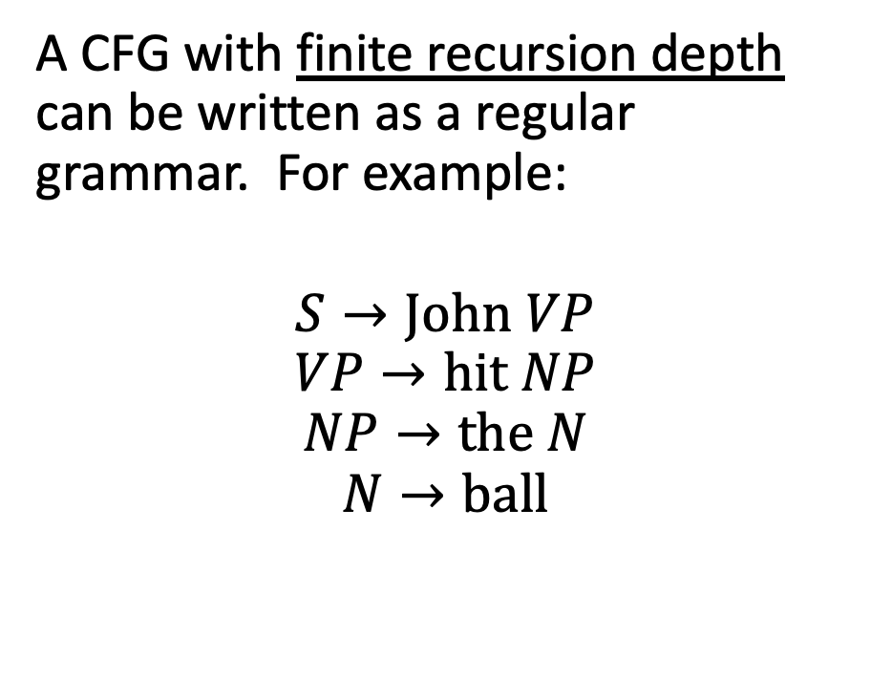
Grammar
A CFG with finite recursion depth can be written as a regular grammar. For example:
$$S→John VP$$
$$VP→hit NP$$
$$NP→the N$$
$$N→ball$$
ParseTree.svg. Public domain image, Stannered, 2007

Slide 8
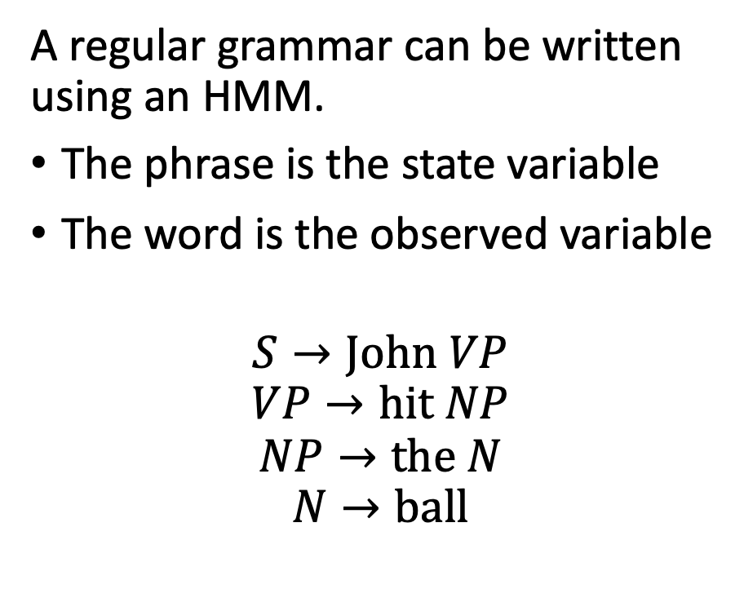
Grammar
A regular grammar can be written using an HMM.
The phrase is the state variable
The word is the observed variable
$$S→John VP$$
$$VP→hit NP$$
$$NP→the N$$
$$N→ball$$
S
VP
NP
N
John
hit
the
ball

Slide 9
Key concepts: syntax and semantics
Compositional semantics studies how sentence meaning is computed from word meanings.
Syntax studies the ways in which words combine.
A grammar is a mathematical specification of the sequences of words that form valid sentences in a language.
A context-free grammar with finite recursion depth can be written as a regular grammar.
A regular grammar can be written as an HMM.

Slide 10
Outline
Syntax and semantics
Part of speech tagging
An HMM for POS tagging
The Viterbi algorithm for POS tagging
From HMM to Neural Net
Recurrent neural networks
Training a recurrent neural network
Long short-term memory (LSTM)

Slide 11
Parts of speech
Many grammars are written in terms of parts of speech, to make them a bit more general. For example, this one…
…could be generalized like this…
S
VP
NP
NP
N
V
Det
N
ParseTree.svg. Public domain image, Stannered, 2007

Slide 12
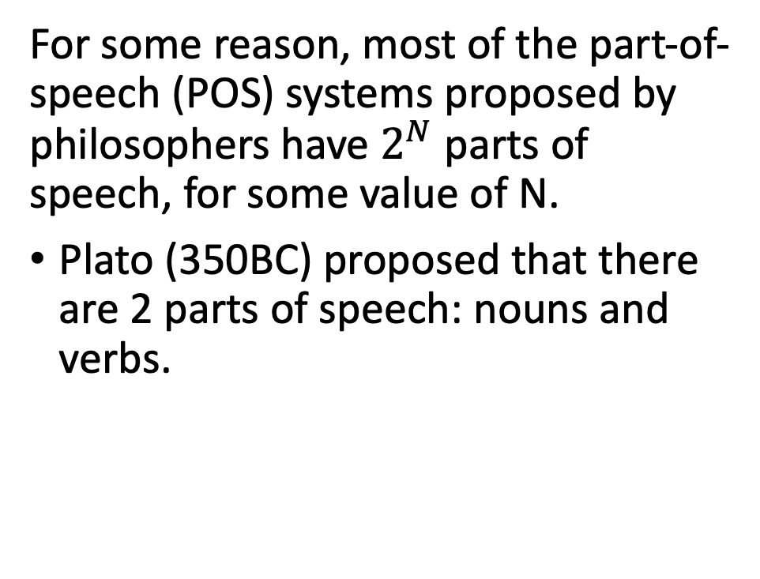
Parts of speech
POS
For some reason, most of the part-of-speech (POS) systems proposed by philosophers have $2^{N}$ parts of speech, for some value of N.
Plato (350BC) proposed that there are 2 parts of speech: nouns and verbs.
Nouns
Verbs

Slide 13
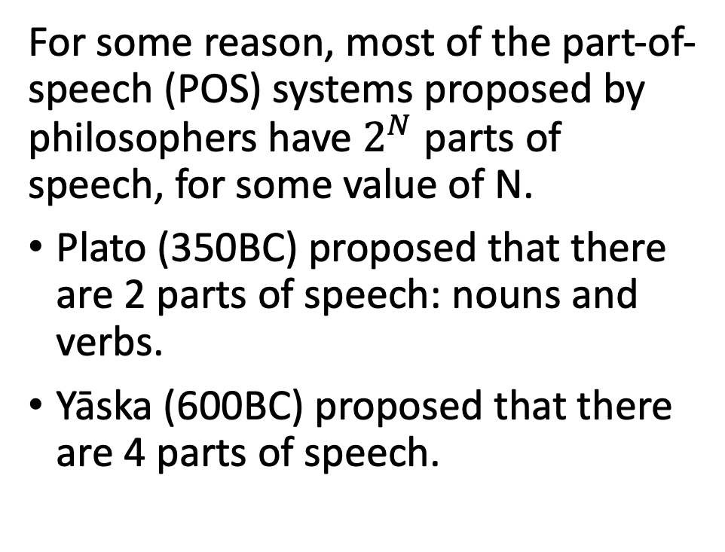
Parts of speech
POS
For some reason, most of the part-of-speech (POS) systems proposed by philosophers have $2^{N}$ parts of speech, for some value of N.
Plato (350BC) proposed that there are 2 parts of speech: nouns and verbs.
Yāska (600BC) proposed that there are 4 parts of speech.
Inflectable
Uninflectable
Nouns
Verbs
Pre-verbs
Particles

Slide 14
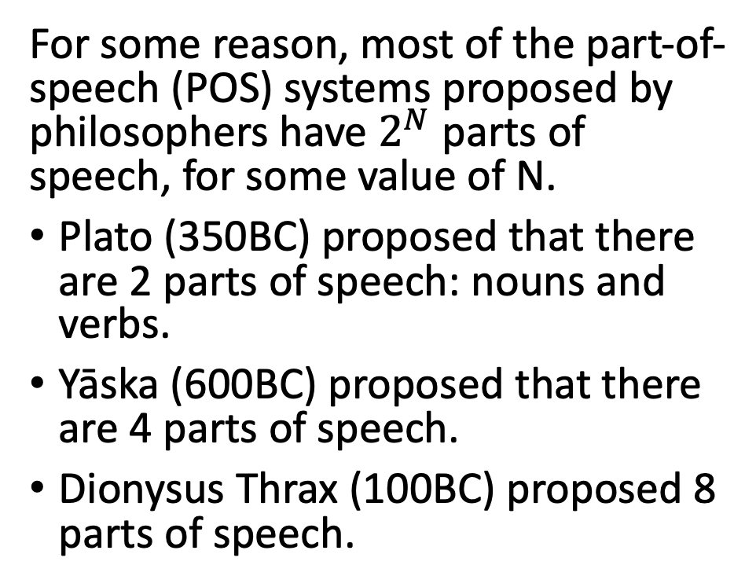
Parts of speech
POS
For some reason, most of the part-of-speech (POS) systems proposed by philosophers have $2^{N}$ parts of speech, for some value of N.
Plato (350BC) proposed that there are 2 parts of speech: nouns and verbs.
Yāska (600BC) proposed that there are 4 parts of speech.
Dionysus Thrax (100BC) proposed 8 parts of speech.
Inflectable
Uninflectable
Nouns
Verbs
Participles
Articles
Pronouns
Prepositions
Adverbs
Conjunctions

Slide 15
Parts of speech
Most modern English dictionaries use these POS tags.
Open-class words (anybody can make up a new word, in any of these classes, at any time): nouns, verbs, adjectives, adverbs, interjections
Closed-class words (it’s hard to make up a new word in these classes): pronouns, prepositions, conjunctions, determiners
Most published, tagged data use POS tags that are finer-grained than the nine tags listed above. For example, the next few slides describe the Penn Treebank POS tag set.

Slide 16
Nouns
The Penn Treebank noun categories are:
NN (singular or mass common noun): llama, thought, communism
NNS (plural common noun): llamas, thoughts
NNP (singular proper noun): Jane, IBM, Mexico
NNPS (plural proper noun): Osbournes, Carolinas
VBG (gerund): eating

Slide 17
Verbs
The Penn Treebank verb categories are:
VB (verb base form): eat
VBD (verb past tense): ate
VBP (verb non-3sg present): eat
VBZ (verb 3sg present): eats
MD (modal): can as in “can lift”, should as in “should go”
RP (particle): up as in “get up,” off as in “take off”

Slide 18
Adjectives
The Penn Treebank has several categories that might be considered types of adjectives:
CD (cardinal number --- use this tag regardless of whether the number is being used as a noun or adjective): one, two, twenty
JJ (adjective): yellow, exceptional, tall
JJR (comparative adjective): yellower, taller
JJS (superlative adjective): yellowest, tallest
PRP$ (possessive pronoun): your, one’s
VBN (verb past participle): eaten, compiled
WP$ (wh-possessive): whose

Slide 19
Determiners, Prepositions and Conjunctions
The Penn Treebank has a lot of things that look like determiners, prepositions, or conjunctions:
CC (coordinating conjunction): and, but, or
DT (determiner): a, the
IN (preposition or subordinating conjunction): of, in, by
PDT (predeterminer): all, both
POS (possessive ending): ‘s, as in “Bob’s dog”
TO (any use of the word “to”): to
WDT (wh-determiner): which, that

Slide 20
Why do POS tagging?
Because it’s highly accurate, typically 97%. That means you can run a POS tagger as a pre-processing step, before doing harder natural language understanding tasks.
Because it’s necessary, if you want to know what the words in the sentence mean.
Will Will ? Will will . Will will will Will ’s will to Will .
MD NNP SYM NNP MD SYM NNP MD VB NNP POS NN TO NNP SYM

Slide 21
Outline
Syntax and semantics
Part of speech tagging
An HMM for POS tagging
The Viterbi algorithm for POS tagging
From HMM to Neural Net
Recurrent neural networks
Training a recurrent neural network
Long short-term memory (LSTM)

Slide 22
An HMM for POS tagging
The basic idea of an HMM POS tagger is:
Treat the part of speech as the hidden state variable
Treat the word as observed
N
V
DT
N
John
hit
the
ball
ParseTree.svg. Public domain image, Stannered, 2007

Slide 23
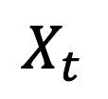
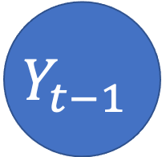
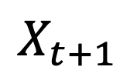
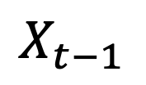
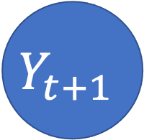
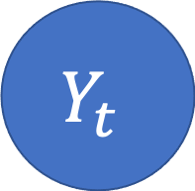
HMM as a Bayes Net
This slide shows an HMM as a Bayes Net. You should remember the graph semantics of a Bayes net:
Nodes are random variables.
Edges denote stochastic dependence.
$$Y_{t−1}$$
$$Y_{t}$$
$$Y_{t+1}$$
…
…
$$X_{t−1}$$
$$X_{t}$$
$$X_{t+1}$$
Notes:
The example is described in Section 15.1.1

Slide 24






HMM as a Finite State Machine
This slide shows exactly the same HMM, viewed in a totally different way. Here, we show it as a finite state machine:
Nodes denote states.
Edges denote possible transitions between the states.
$$P(Y_{t}=V|Y_{t−1}=N)$$
$$P(Y_{t}=V|Y_{t−1}=V)$$
N
V
$$P(Y_{t}=N|Y_{t−1}=N)$$
$$P(Y_{t}=N|Y_{t−1}=N)$$
$$P(Y_{t}=D|Y_{t−1}=V)$$
D
$$P(Y_{t}=D|Y_{t−1}=D)$$
Notes:
The example is described in Section 15.1.1

Slide 25



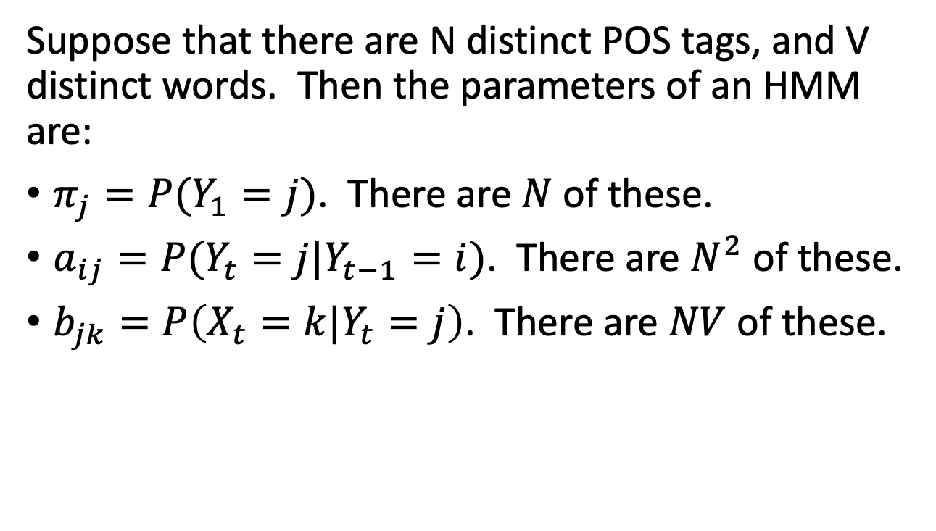



Parameters of an HMM
Suppose that there are N distinct POS tags, and V distinct words. Then the parameters of an HMM are:
$π_{j}=P(Y_{1}=j)$. There are $N$ of these.
$a_{ij}=P(Y_{t}=j|Y_{t−1}=i)$. There are $N^{2}$ of these.
$b_{jk}=P\left(X_{t}=k|Y_{t}=j\right)$. There are $NV$ of these.
$$a_{NV}$$
$$a_{VV}$$
N
V
$$a_{NN}$$
$$a_{DN}$$
$$a_{VD}$$
D
$$a_{DD}$$

Slide 26
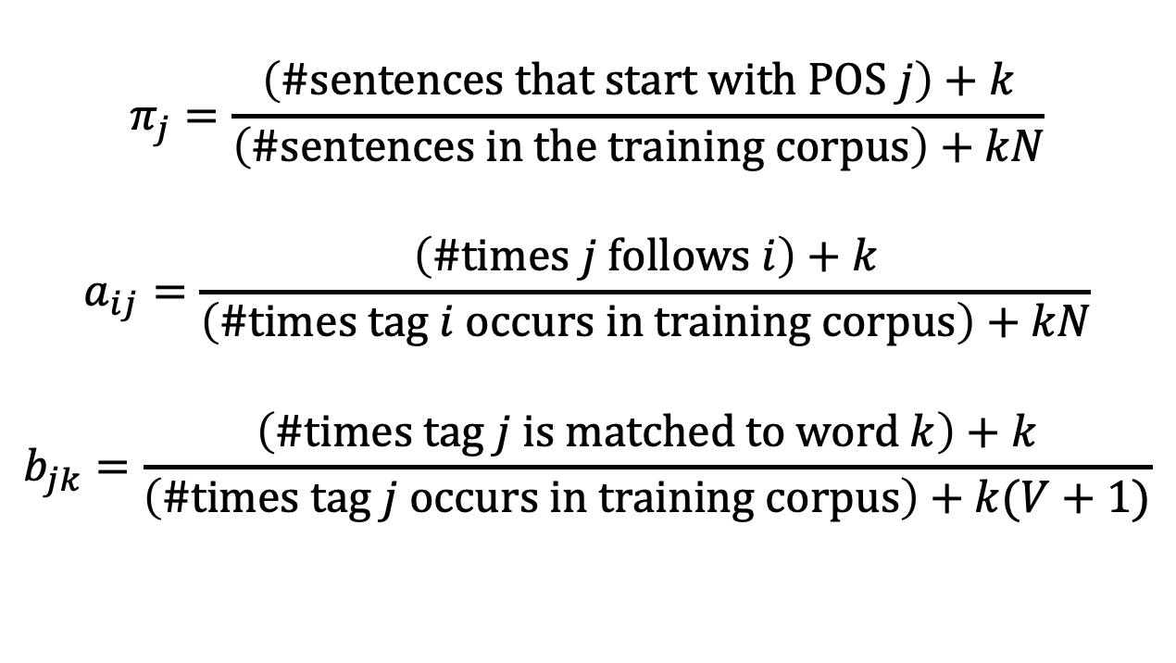
Estimating the Parameters of an HMM
$$π_{j}=\frac{\left(\#sentences that start with POS j\right)+k}{\left(\#sentences in the training corpus\right)+kN}$$
$$a_{ij}=\frac{\left(\#times j follows i\right)+k}{\left(\#times tag i occurs in training corpus\right)+kN}$$
$$b_{jk}=\frac{\left(\#times tag j is matched to word k\right)+k}{\left(\#times tag j occurs in training corpus\right)+k(V+1)}$$
$$a_{NV}$$
$$a_{VV}$$
N
V
$$a_{NN}$$
$$a_{DN}$$
$$a_{VD}$$
D
$$a_{DD}$$

Slide 27
Outline
Syntax and semantics
Part of speech tagging
An HMM for POS tagging
The Viterbi algorithm for POS tagging
From HMM to Neural Net
Recurrent neural networks
Training a recurrent neural network
Long short-term memory (LSTM)

Slide 28
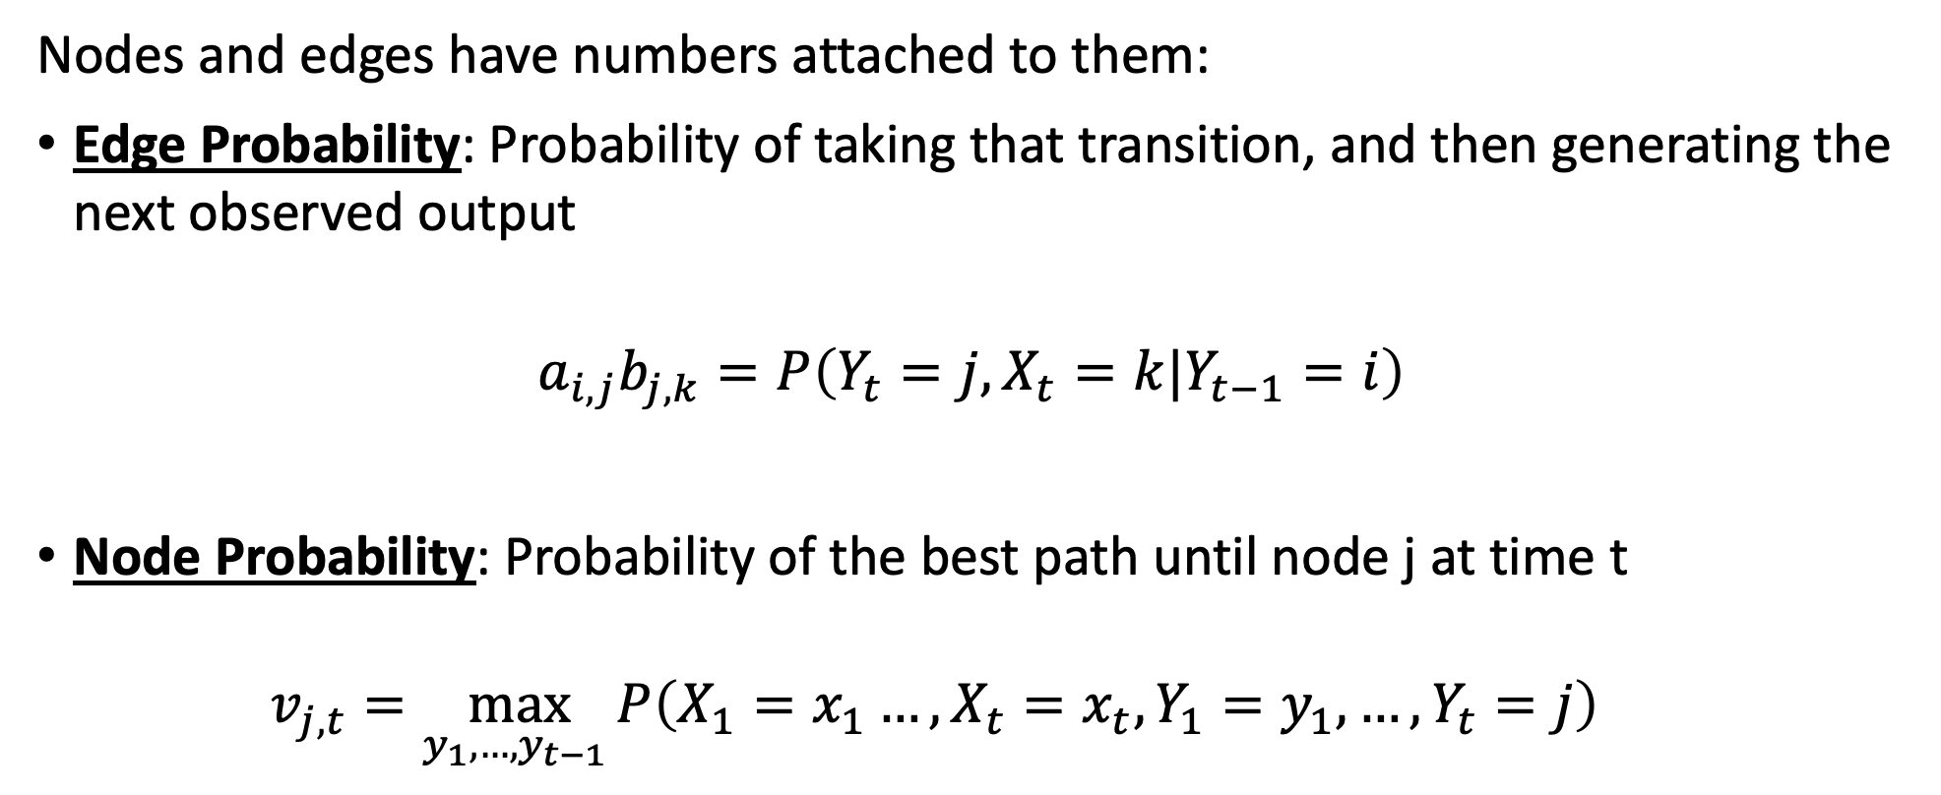
Viterbi Algorithm: Key concepts
Nodes and edges have numbers attached to them:
Edge Probability: Probability of taking that transition, and then generating the next observed output
$$a_{i,j}b_{j,k}=P\left(Y_{t}=j,X_{t}=k|Y_{t−1}=i\right)$$
Node Probability: Probability of the best path until node j at time t
  $$v_{j,t}=\max_{y_{1},…,y_{t−1} }P\left(X_{1}=x_{1}…, X_{t}=x_{t},Y_{1}=y_{1},…, Y_{t}=j\right)$$

Slide 29

Viterbi Algorithm for POS tagging
Initial Node Probability: Probability of starting in a particular node:
  $$v_{j,1}=P\left(X_{1}=x_{1}, Y_{1}=j\right)$$
$$=P\left(Y_{1}=j\right)P\left(X_{t}=x_{1}|Y_{t}=j\right)$$
$$=π_{j}b_{j,x_{1}}$$
$$a_{NV}$$
$$a_{VV}$$
N
V
$$a_{NN}$$
$$a_{DN}$$
$$a_{VD}$$
D
$$a_{DD}$$

Slide 30


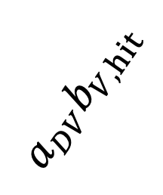
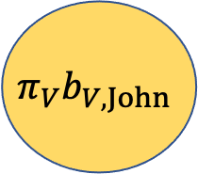




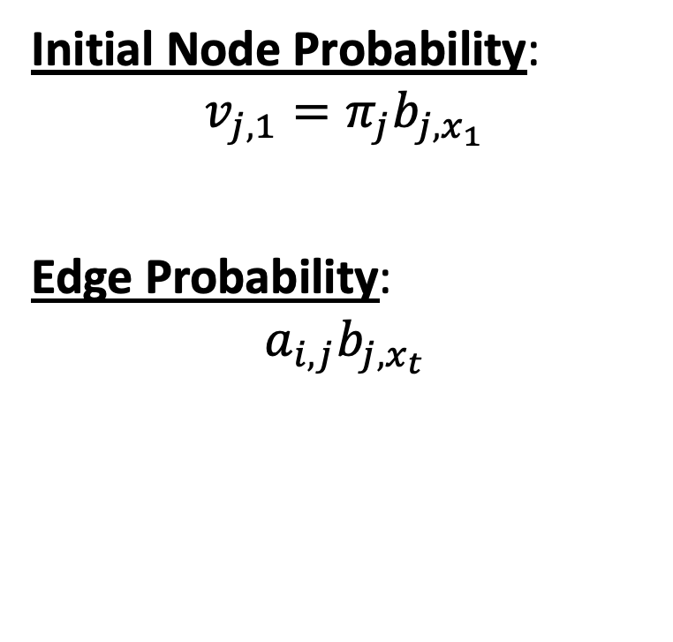
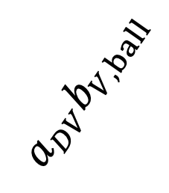





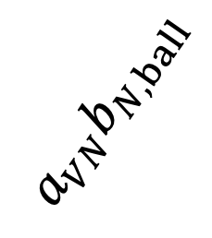

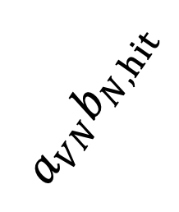

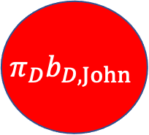
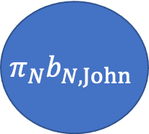


Trellis
$$a_{NN}b_{N,hit}$$
$$a_{NN}b_{N,the}$$
$$a_{NN}b_{N,ball}$$
$$π_{N}b_{N,John}$$
$$Y_{t}=N$$
Initial Node Probability:
$$v_{j,1}=π_{j}b_{j,x_{1}}$$
Edge Probability:
$$a_{i,j}b_{j,x_{t}}$$
$$a_{VN}b_{N,hit}$$
$$a_{VN}b_{N,the}$$
$$a_{VN}b_{N,ball}$$
$$π_{V}b_{V,John}$$
$$Y_{t}=V$$
$$a_{DV}b_{V,hit}$$
$$a_{DV}b_{V,the}$$
$$a_{DV}b_{V,ball}$$
$$π_{D}b_{D,John}$$
$$Y_{t}=D$$
$$a_{DD}b_{D,hit}$$
$$a_{DD}b_{D,the}$$
$$a_{DD}b_{D,ball}$$
$$X_{1}=John$$
$$X_{2}=hit$$
$$X_{3}=the$$
$$X_{4}=ball$$

Slide 31
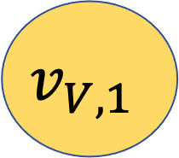
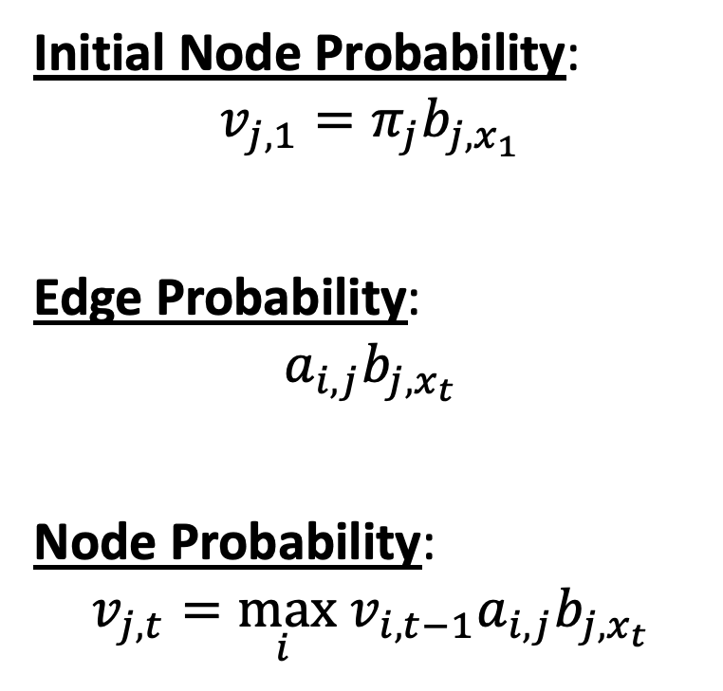
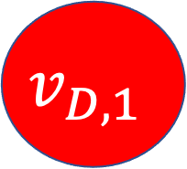
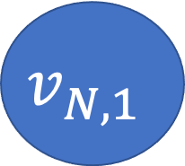
Trellis
$$a_{NN}b_{N,hit}$$
$$a_{NN}b_{N,the}$$
$$a_{NN}b_{N,ball}$$
$$v_{N,1}$$
$$Y_{t}=N$$
Initial Node Probability:
$$v_{j,1}=π_{j}b_{j,x_{1}}$$
Edge Probability:
$$a_{i,j}b_{j,x_{t}}$$
Node Probability:
$$v_{j,t}=\max_{i } v_{i,t−1}a_{i,j}b_{j,x_{t}}$$
$$a_{VN}b_{N,hit}$$
$$a_{VN}b_{N,the}$$
$$a_{VN}b_{N,ball}$$
$$v_{V,1}$$
$$Y_{t}=V$$
$$a_{DV}b_{V,hit}$$
$$a_{DV}b_{V,the}$$
$$a_{DV}b_{V,ball}$$
$$v_{D,1}$$
$$Y_{t}=D$$
$$a_{DD}b_{D,hit}$$
$$a_{DD}b_{D,the}$$
$$a_{DD}b_{D,ball}$$
$$X_{1}=John$$
$$X_{2}=hit$$
$$X_{3}=the$$
$$X_{4}=ball$$

Slide 32
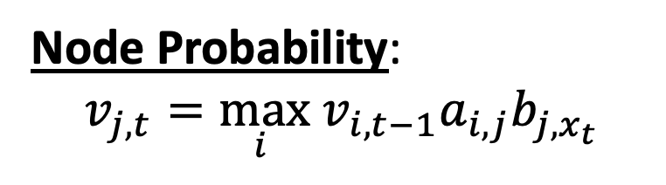
Trellis
$$a_{NN}b_{N,hit}$$
$$a_{NN}b_{N,the}$$
$$a_{NN}b_{N,ball}$$
$$v_{N,1}$$
$$Y_{t}=N$$
$$a_{VN}b_{N,hit}$$
$$a_{VN}b_{N,the}$$
$$a_{VN}b_{N,ball}$$
$$v_{V,1}$$
$$Y_{t}=V$$
$$a_{DV}b_{V,hit}$$
$$a_{DV}b_{V,the}$$
$$a_{DV}b_{V,ball}$$
Node Probability:
$$v_{j,t}=\max_{i } v_{i,t−1}a_{i,j}b_{j,x_{t}}$$
$$v_{D,1}$$
$$Y_{t}=D$$
$$a_{DD}b_{D,hit}$$
$$a_{DD}b_{D,the}$$
$$a_{DD}b_{D,ball}$$
$$X_{1}=John$$
$$X_{2}=hit$$
$$X_{3}=the$$
$$X_{4}=ball$$

Slide 33
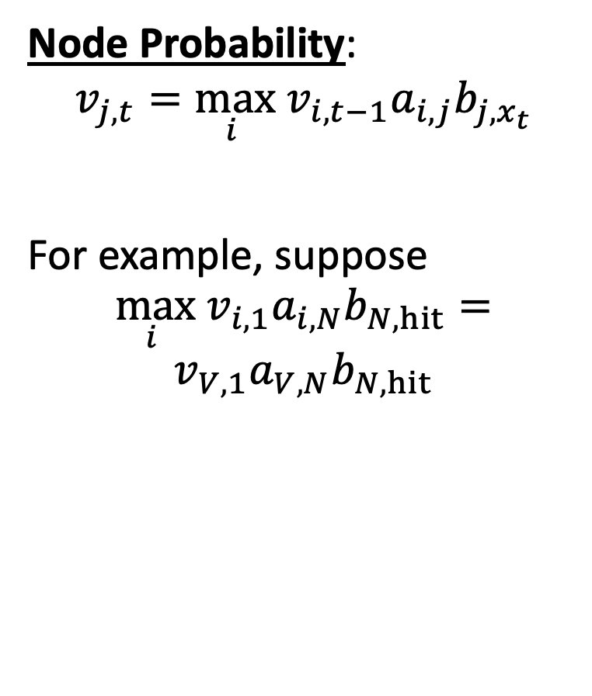
Trellis
$$a_{NN}b_{N,hit}$$
$$a_{NN}b_{N,the}$$
$$a_{NN}b_{N,ball}$$
$$v_{N,1}$$
Node Probability:
$$v_{j,t}=\max_{i } v_{i,t−1}a_{i,j}b_{j,x_{t}}$$
For example, suppose
$$\max_{i } v_{i,1}a_{i,N}b_{N,hit}=$$
$$v_{V,1}a_{V,N}b_{N,hit}$$
$$Y_{t}=N$$
$$a_{VN}b_{N,hit}$$
$$a_{VN}b_{N,the}$$
$$a_{VN}b_{N,ball}$$
$$v_{V,1}$$
$$Y_{t}=V$$
$$a_{DV}b_{V,hit}$$
$$a_{DV}b_{V,the}$$
$$a_{DV}b_{V,ball}$$
$$v_{D,1}$$
$$Y_{t}=D$$
$$a_{DD}b_{D,hit}$$
$$a_{DD}b_{D,the}$$
$$a_{DD}b_{D,ball}$$
$$X_{1}=John$$
$$X_{2}=hit$$
$$X_{3}=the$$
$$X_{4}=ball$$

Slide 34
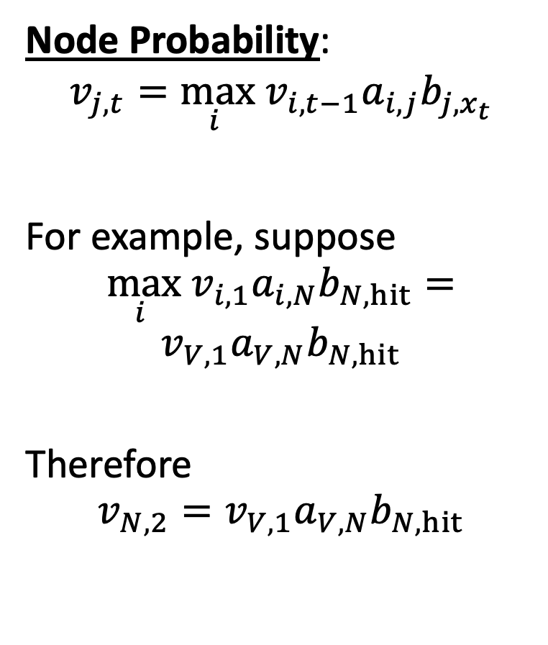
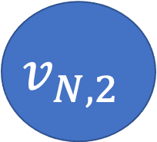
Trellis
$$a_{NN}b_{N,hit}$$
$$a_{NN}b_{N,the}$$
$$a_{NN}b_{N,ball}$$
$$v_{N,1}$$
$$v_{N,2}$$
Node Probability:
$$v_{j,t}=\max_{i } v_{i,t−1}a_{i,j}b_{j,x_{t}}$$
For example, suppose
$$\max_{i } v_{i,1}a_{i,N}b_{N,hit}=$$
$$v_{V,1}a_{V,N}b_{N,hit}$$
Therefore
$$v_{N,2}=v_{V,1}a_{V,N}b_{N,hit}$$
$$Y_{t}=N$$
$$a_{VN}b_{N,hit}$$
$$a_{VN}b_{N,the}$$
$$a_{VN}b_{N,ball}$$
$$v_{V,1}$$
$$Y_{t}=V$$
$$a_{DV}b_{V,hit}$$
$$a_{DV}b_{V,the}$$
$$a_{DV}b_{V,ball}$$
$$v_{D,1}$$
$$Y_{t}=D$$
$$a_{DD}b_{D,hit}$$
$$a_{DD}b_{D,the}$$
$$a_{DD}b_{D,ball}$$
$$X_{1}=John$$
$$X_{2}=hit$$
$$X_{3}=the$$
$$X_{4}=ball$$

Slide 35
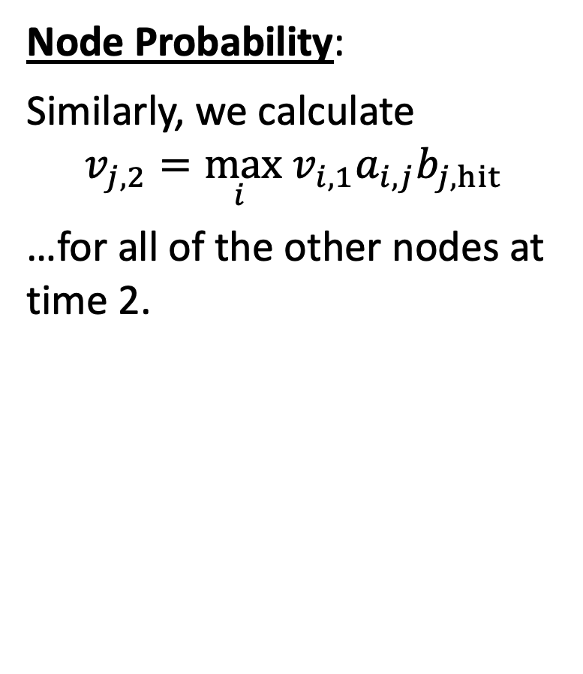
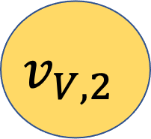
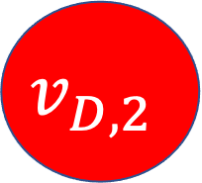
Trellis
$$a_{NN}b_{N,hit}$$
$$a_{NN}b_{N,the}$$
$$a_{NN}b_{N,ball}$$
$$v_{N,1}$$
$$v_{N,2}$$
Node Probability:
Similarly, we calculate
$$v_{j,2}=\max_{i } v_{i, 1}a_{i,j}b_{j,hit}$$
…for all of the other nodes at time 2.
$$Y_{t}=N$$
$$a_{VN}b_{N,hit}$$
$$a_{VN}b_{N,the}$$
$$a_{VN}b_{N,ball}$$
$$v_{V,1}$$
$$v_{V,2}$$
$$Y_{t}=V$$
$$a_{DV}b_{V,hit}$$
$$a_{DV}b_{V,the}$$
$$a_{DV}b_{V,ball}$$
$$v_{D,1}$$
$$v_{D,2}$$
$$Y_{t}=D$$
$$a_{DD}b_{D,hit}$$
$$a_{DD}b_{D,the}$$
$$a_{DD}b_{D,ball}$$
$$X_{1}=John$$
$$X_{2}=hit$$
$$X_{3}=the$$
$$X_{4}=ball$$

Slide 36
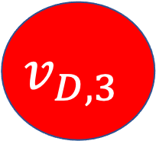
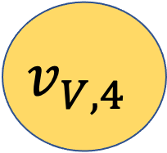
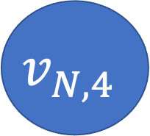
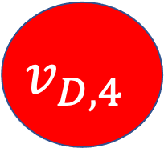
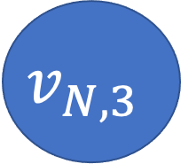
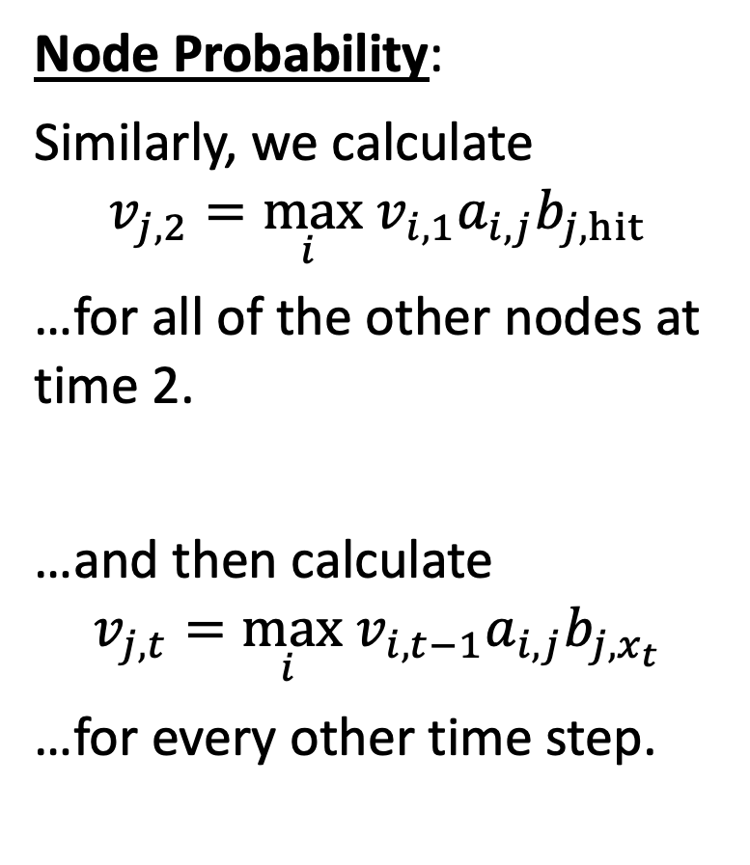
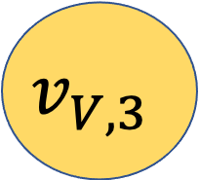
Trellis
$$v_{N,1}$$
$$v_{N,2}$$
$$v_{N,3}$$
$$v_{N,4}$$
Node Probability:
Similarly, we calculate
$$v_{j,2}=\max_{i } v_{i, 1}a_{i,j}b_{j,hit}$$
…for all of the other nodes at time 2.
…and then calculate
$$v_{j,t}=\max_{i } v_{i,t−1}a_{i,j}b_{j,x_{t}}$$
…for every other time step.
$$Y_{t}=N$$
$$v_{V,1}$$
$$v_{V,2}$$
$$v_{V,3}$$
$$v_{V,4}$$
$$Y_{t}=V$$
$$v_{D,1}$$
$$v_{D,2}$$
$$v_{D,3}$$
$$v_{D,4}$$
$$Y_{t}=D$$
$$a_{DD}b_{D,hit}$$
$$a_{DD}b_{D,the}$$
$$a_{DD}b_{D,ball}$$
$$X_{1}=John$$
$$X_{2}=hit$$
$$X_{3}=the$$
$$X_{4}=ball$$

Slide 37
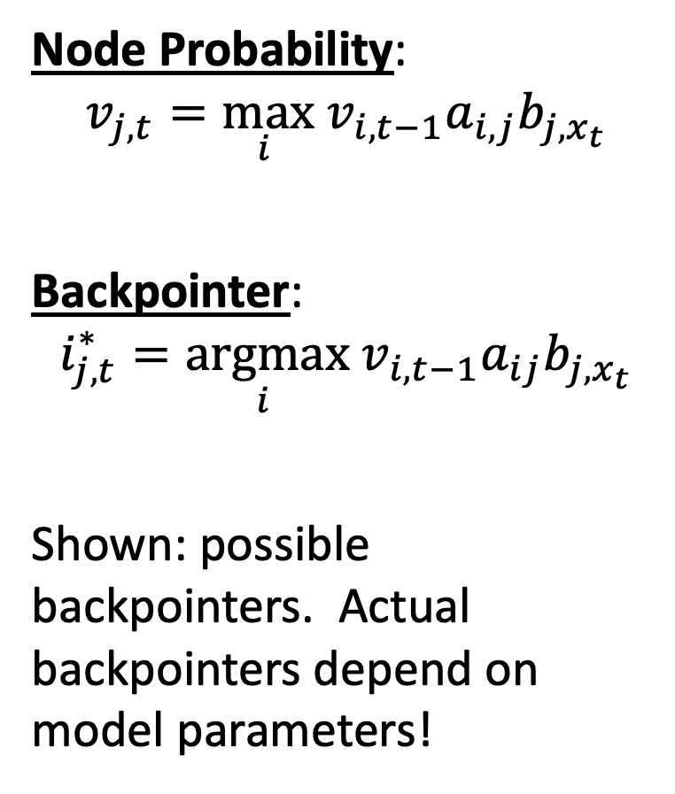
Trellis
$$v_{N,1}$$
$$v_{N,2}$$
$$v_{N,3}$$
$$v_{N,4}$$
Node Probability:
$$v_{j,t}=\max_{i } v_{i,t−1}a_{i,j}b_{j,x_{t}}$$
Backpointer:
$$i_{j,t}^{∗}=\underset{i }{argmax} v_{i,t−1}a_{ij}b_{j,x_{t}}$$
Shown: possible backpointers. Actual backpointers depend on model parameters!
$$Y_{t}=N$$
$$v_{V,1}$$
$$v_{V,2}$$
$$v_{V,3}$$
$$v_{V,4}$$
$$Y_{t}=V$$
$$v_{D,1}$$
$$v_{D,2}$$
$$v_{D,3}$$
$$v_{D,4}$$
$$Y_{t}=D$$
$$a_{DD}b_{D,hit}$$
$$a_{DD}b_{D,the}$$
$$a_{DD}b_{D,ball}$$
$$X_{1}=John$$
$$X_{2}=hit$$
$$X_{3}=the$$
$$X_{4}=ball$$

Slide 38
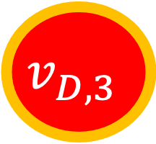

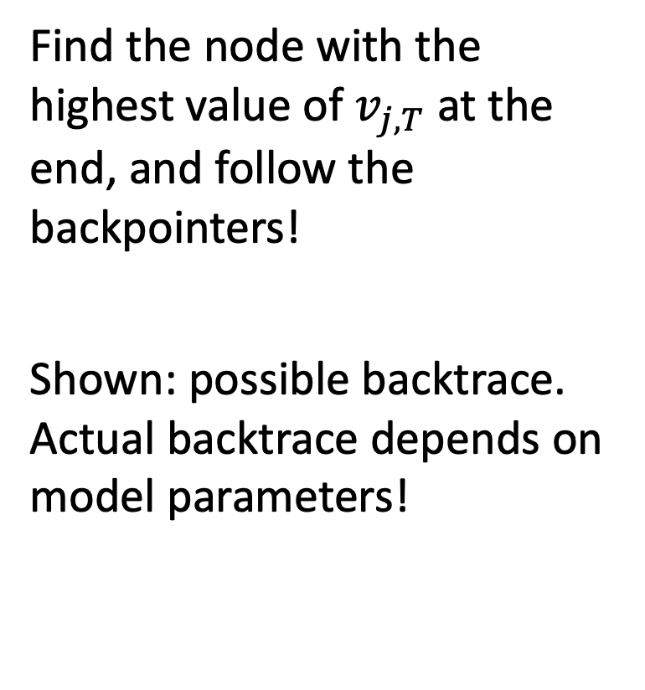


Backtrace
$$v_{N,1}$$
$$v_{N,2}$$
$$v_{N,3}$$
$$v_{N,4}$$
$$Y_{t}=N$$
Find the node with the highest value of $v_{j,T}$ at the end, and follow the backpointers!
Shown: possible backtrace. Actual backtrace depends on model parameters!
$$v_{V,1}$$
$$v_{V,2}$$
$$v_{V,3}$$
$$v_{V,4}$$
$$Y_{t}=V$$
$$v_{D,1}$$
$$v_{D,2}$$
$$v_{D,3}$$
$$v_{D,4}$$
$$Y_{t}=D$$
$$a_{DD}b_{D,hit}$$
$$a_{DD}b_{D,the}$$
$$a_{DD}b_{D,ball}$$
$$X_{1}=John$$
$$X_{2}=hit$$
$$X_{3}=the$$
$$X_{4}=ball$$

Slide 39

Viterbi algorithm key formulas
Initial Node Probability:
$$v_{j,1}=π_{j}b_{j,x_{1}}$$
Edge Probability:
$$a_{ij}b_{j,x_{t}}$$
Node Probability:
$$v_{j,t}=\max_{i } v_{i,t−1}a_{ij}b_{j,x_{t}}$$
Backpointer:
$$i_{j,t}^{∗}=\underset{i }{argmax} v_{i,t−1}a_{ij}b_{j,x_{t}}$$

Slide 40

Viterbi algorithm key formulas
Initial Node Probability:
$$\log{v_{j,1}}=\log{π_{j}}+\log{b_{j,x_{1}}}$$
Edge Probability:
$$\log{a_{ij}}+\log{b_{j,x_{t}}}$$
Node Probability:
$$\ln{v_{j,t}}=\max_{i }\left(\ln{v_{i,t−1}}+\ln{a_{ij}}+\ln{b_{j,x_{t}}}\right)$$
Backpointer:
$$i_{j,t}^{∗}=\underset{i }{argmax}\left(\ln{v_{i,t−1}}+\ln{a_{ij}}+\ln{b_{j,x_{t}}}\right)$$

Slide 41

Example from Jurafsky & Martin
© Daniel Jurafsky & James H. Martin, 2021

Slide 42
Outline
Syntax and semantics
Part of speech tagging
An HMM for POS tagging
The Viterbi algorithm for POS tagging
From HMM to Neural Net
Recurrent neural networks
Training a recurrent neural network
Long short-term memory (LSTM)

Slide 43

From HMM to Neural Net
$$v_{N,1}$$
$$v_{N,2}$$
$$v_{N,3}$$
$$v_{N,4}$$
Viterbi algorithm:
$$v_{j,t}=\max_{i } v_{i,t−1}a_{i,j}b_{j,x_{t}}$$
$$Y_{t}=N$$
$$v_{V,1}$$
$$v_{V,2}$$
$$v_{V,3}$$
$$v_{V,4}$$
$$Y_{t}=V$$
$$v_{D,1}$$
$$v_{D,2}$$
$$v_{D,3}$$
$$v_{D,4}$$
$$Y_{t}=D$$
$$a_{DD}b_{D,hit}$$
$$a_{DD}b_{D,the}$$
$$a_{DD}b_{D,ball}$$
$$X_{1}=John$$
$$X_{2}=hit$$
$$X_{3}=the$$
$$X_{4}=ball$$

Slide 44

From HMM to Neural Net
$$v_{N,1}$$
$$v_{N,2}$$
$$v_{N,3}$$
$$v_{N,4}$$
Viterbi algorithm:
$$v_{j,t}=\max_{i } v_{i,t−1}a_{i,j}b_{j,x_{t}}$$
Suppose we want $v_{j,t}$to add over all previous paths, instead of being the maximum. We get this using the belief propagation equation:
$$v_{j,t}=\sum_{i}{v_{i,t−1}a_{i,j}b_{j,x_{t}}}$$
$$Y_{t}=N$$
$$v_{V,1}$$
$$v_{V,2}$$
$$v_{V,3}$$
$$v_{V,4}$$
$$Y_{t}=V$$
$$v_{D,1}$$
$$v_{D,2}$$
$$v_{D,3}$$
$$v_{D,4}$$
$$Y_{t}=D$$
$$a_{DD}b_{D,hit}$$
$$a_{DD}b_{D,the}$$
$$a_{DD}b_{D,ball}$$
$$X_{1}=John$$
$$X_{2}=hit$$
$$X_{3}=the$$
$$X_{4}=ball$$

Slide 45

From HMM to Neural Net
Here’s a weird way to write the belief propagation equation ($v_{j,t}=\sum_{i}{v_{i,t−1}a_{i,j}b_{j,x_{t}}}$):
$$v_{j,t}=e^{\ln{b_{j,x_{t}}}+\ln{\sum_{i}{v_{i,t−1}a_{i,j}}}}$$
Suppose that we define an input one-hot vector, ${\vec{z}}_{t}$, such that
$$z_{k,t}=\left\{\begin{matrix}1 & k=x_{t} \\ 0 & otherwise\end{matrix}\right.$$
…and suppose we define a matrix B as:
$$B=\left[\begin{matrix}b_{1,1} & ⋯ & b_{1,|V|} \\ ⋮ & ⋱ & ⋮ \\ b_{N,1} & ⋯ & b_{N,|V|}\end{matrix}\right]$$
…then $b_{j,x_{t}}$ is the $j^{th}$ element of the vector $B{\vec{z}}_{t}$.

Slide 46

From HMM to Neural Net
$$v_{j,t}=e^{\ln{b_{j,x_{t}}}+\ln{\sum_{i}{v_{i,t−1}a_{i,j}}}}$$
Similarly, define the vector ${\vec{v}}_{t}$ and the matrix A to be:
$${\vec{v}}_{t}=\left[\begin{matrix}v_{1,t} \\ ⋮ \\ v_{N,t}\end{matrix}\right], A=\left[\begin{matrix}a_{1,1} & ⋯ & a_{1,N} \\ ⋮ & ⋱ & ⋮ \\ a_{N,1} & ⋯ & a_{N,N}\end{matrix}\right]$$
…then $\sum_{i}{v_{i,t−1}a_{i,j}}$ is the $j^{th}$ element of the vector $A^{T}{\vec{v}}_{t−1}$.

Slide 47




















From HMM to Neural Net
With those definitions, the belief propagation equation can be implemented using the following neural network:
$$v_{j,t}=e^{\ln{b_{j,x_{t}}}+\ln{\sum_{i}{v_{i,t−1}a_{i,j}}}}$$
$$v_{1,t−1}$$
$$a_{1,1}$$
ln
exp
$$v_{1,t}$$
$$a_{1,N}$$
$$⋮$$
$$⋮$$
$$⋮$$
$$a_{N,1}$$
$$v_{N,t−1}$$
ln
exp
$$a_{N,N}$$
$$v_{N,t}$$
$$z_{1,t}$$
$$b_{1,1}$$
ln
$$b_{N,1}$$
$$⋮$$
$$⋮$$
$$b_{1,|V|}$$
$$z_{|V|,t}$$
ln
$$b_{N,|V|}$$

Slide 48






From HMM to Neural Net
Using scalar nonlinearities applied after matrix transforms, we can write it as:
$${\vec{v}}_{t}=e^{\ln{B{\vec{z}}_{t}}+\ln{A^{T}{\vec{v}}_{t−1}}}$$
$${\vec{v}}_{t−1}$$
$$A^{T}$$
ln
$${\vec{v}}_{t−1}$$
The “exp” is implied here.
$${\vec{z}}_{t}$$
$$B$$
ln

Slide 49

From HMM to Neural Net: Implementation Hack
If we want to implement belief propagation exactly, then we need to use these nonlinearities:
$${\vec{v}}_{t}=e^{\ln{B{\vec{z}}_{t}}+\ln{A^{T}{\vec{v}}_{t−1}}}$$
In a neural network, though, the parameters will be learned from data, in order to minimize some loss function. The exact form of the nonlinearity is therefore not too important, so we usually choose some nonlinearity that’s easily available in pytorch. For example, a common one in recurrent neural networks is:
$${\vec{v}}_{t}=\tanh\left(B{\vec{z}}_{t}+A^{T}{\vec{v}}_{t−1}\right)=\frac{1−e^{−2\left(B{\vec{z}}_{t}+A^{T}{\vec{v}}_{t−1}\right)}}{1+e^{−2\left(B{\vec{z}}_{t}+A^{T}{\vec{v}}_{t−1}\right)}}$$

Slide 50







From HMM to Neural Net: Implementation Hack
Using the implementation hack, the network simplifies to:
$${\vec{v}}_{t}=\tanh\left(B{\vec{z}}_{t}+A^{T}{\vec{v}}_{t−1}\right)$$
…
$${\vec{v}}_{t−1}$$
$${\vec{v}}_{t}$$
$${\vec{v}}_{t+1}$$
…
$${\vec{z}}_{t−1}$$
$${\vec{z}}_{t}$$
$${\vec{z}}_{t+1}$$
The “tanh” is implied here.

Slide 51
Outline
Syntax and semantics
Part of speech tagging
An HMM for POS tagging
The Viterbi algorithm for POS tagging
From HMM to Neural Net
Recurrent neural networks
Training a recurrent neural network
Long short-term memory (LSTM)

Slide 52







Recurrent neural network (RNN)
$${\vec{h}}_{t−1}$$
$${\vec{h}}_{t}$$
$${\vec{h}}_{t+1}$$
…
…
$${\vec{x}}_{t−1}$$
$${\vec{x}}_{t}$$
$${\vec{x}}_{t+1}$$
A recurrent neural network (RNN) is a network in which the hidden nodes at time t depend on the input at time t, and on the hidden nodes at time t-1:
$${\vec{h}}_{t}=g\left(A^{T}{\vec{h}}_{t−1}+B{\vec{x}}_{t}\right)$$
...where A and B are weight matrices, and g() is some kind of scalar nonlinearity.
Notes:
The example is described in Section 15.1.1

Slide 53
Recurrent neural network (RNN)
$${\vec{h}}_{t−1}$$
$${\vec{h}}_{t}$$
$${\vec{h}}_{t+1}$$
…
…
$${\vec{x}}_{t−1}$$
$${\vec{x}}_{t}$$
$${\vec{x}}_{t+1}$$
For example, suppose that we have the sentence
“John hit the ball”
... and we want to find each word’s part of speech.
Notes:
The example is described in Section 15.1.1

Slide 54

Recurrent neural network (RNN)
$${\vec{h}}_{t−1}$$
$${\vec{h}}_{t}$$
$${\vec{h}}_{t+1}$$
…
…
$${\vec{x}}_{t−1}$$
$${\vec{x}}_{t}$$
$${\vec{x}}_{t+1}$$
Let’s define
$${\vec{x}}_{t}=\left[\begin{matrix}\begin{matrix}1 if X_{t}=ball \\ 1 if X_{t}=hit\end{matrix} \\ \begin{matrix}1 if X_{t}=John \\ 1 if X_{t}=the\end{matrix}\end{matrix}\right]$$
…so the observation sequence is…
$${\vec{x}}_{1}=\left[\begin{matrix}\begin{matrix}0 \\ 0\end{matrix} \\ \begin{matrix}1 \\ 0\end{matrix}\end{matrix}\right],{\vec{x}}_{2}=\left[\begin{matrix}\begin{matrix}0 \\ 1\end{matrix} \\ \begin{matrix}0 \\ 0\end{matrix}\end{matrix}\right],{\vec{x}}_{3}=\left[\begin{matrix}\begin{matrix}0 \\ 0\end{matrix} \\ \begin{matrix}0 \\ 1\end{matrix}\end{matrix}\right],{\vec{x}}_{4}=\left[\begin{matrix}\begin{matrix}1 \\ 0\end{matrix} \\ \begin{matrix}0 \\ 0\end{matrix}\end{matrix}\right]$$
Notes:
The example is described in Section 15.1.1

Slide 55

Recurrent neural network (RNN)
$${\vec{h}}_{t−1}$$
$${\vec{h}}_{t}$$
$${\vec{h}}_{t+1}$$
…
…
$${\vec{x}}_{t−1}$$
$${\vec{x}}_{t}$$
$${\vec{x}}_{t+1}$$
Let’s define
$${\vec{h}}_{t}=g\left(A^{T}{\vec{h}}_{t−1}+B{\vec{x}}_{t}\right)≈\left[\begin{matrix}\begin{matrix}P\left(Y_{t}=Det|X_{1},…,X_{t}\right) \\ P\left(Y_{t}=Noun|X_{1},…,X_{t}\right)\end{matrix} \\ P\left(Y_{t}=Verb|X_{1},…,X_{t}\right)\end{matrix}\right]$$
If we define ${\vec{h}}_{0}={\left[0,0,0\right]}^{T}$, and with a reasonable set of weight matrices and a softmax nonlinearity (instead of tanh), one simulation result gave this result:
$${\vec{h}}_{1}=\left[\begin{matrix}\begin{matrix}0.28 \\ 0.44\end{matrix} \\ 0.28\end{matrix}\right],{\vec{h}}_{2}=\left[\begin{matrix}\begin{matrix}0.20 \\ 0.20\end{matrix} \\ 0.60\end{matrix}\right],{\vec{h}}_{3}=\left[\begin{matrix}\begin{matrix}0.63 \\ 0.18\end{matrix} \\ 0.18\end{matrix}\right],{\vec{h}}_{4}=\left[\begin{matrix}\begin{matrix}0.24 \\ 0.53\end{matrix} \\ 0.24\end{matrix}\right]$$
Thus “John hit the ball” has the following most-likely POS: “Noun Verb Det Noun.”
Notes:
The example is described in Section 15.1.1

Slide 56
Outline
Syntax and semantics
Part of speech tagging
An HMM for POS tagging
The Viterbi algorithm for POS tagging
From HMM to Neural Net
Recurrent neural networks
Training a recurrent neural network
Long short-term memory (LSTM)

Slide 57

Training an RNN
$${\vec{h}}_{t−1}$$
$${\vec{h}}_{t}$$
$${\vec{h}}_{t+1}$$
…
…
$${\vec{x}}_{t−1}$$
$${\vec{x}}_{t}$$
$${\vec{x}}_{t+1}$$
In order to match the convention used in Wikipedia, let’s rename the weight matrices as
$${\vec{h}}_{t}=g\left(U{\vec{h}}_{t−1}+W{\vec{x}}_{t}\right)$$
An RNN is trained using gradient descent, just like any other neural network!
$$u_{j,i}←u_{j,i}−η\frac{∂𝔏}{∂u_{j,i}}$$
$$w_{j,k}←w_{j,k}−η\frac{∂𝔏}{∂w_{j,k}}$$
…where $𝔏$ is the loss function, and $η$ is a step size.
Notes:
The example is described in Section 15.1.1

Slide 58








Training an RNN: How can we solve this?
$$𝔏$$
The big difference is that now the loss function depends on U and W in many different ways:
The loss function depends on each of the state vectors ${\vec{h}}_{t}$
Each of the state vectors depends on $U$ and $W$
Each of the state vectors ALSO depends on the previous state vector, ${\vec{h}}_{t−1}$ …
… which ALSO depends on $U$ and $W$, and on ${\vec{h}}_{t−2}$ …
AUGH!
…
$${\vec{h}}_{t−1}$$
$${\vec{h}}_{t}$$
$${\vec{h}}_{t+1}$$
…
$${\vec{x}}_{t−1}$$
$${\vec{x}}_{t}$$
$${\vec{x}}_{t+1}$$
Notes:
The example is described in Section 15.1.1

Slide 59

Back-propagation through time
$$𝔏$$
The solution is something called back-propagation through time:
$$\frac{d𝔏}{dh_{i,t}}=\frac{∂𝔏}{∂h_{i,t}}+\frac{d𝔏}{dh_{j,t+1}}\frac{∂h_{j,t+1}}{∂h_{i,t}}$$
The first term measures losses caused directly by $h_{i,t}$, for example, if $h_{i,t}$ is wrong.
The second term measures losses caused indirectly, for example, because $h_{i,t}$ caused $h_{j,t+1}$ to be wrong.
…
$${\vec{h}}_{t−1}$$
$${\vec{h}}_{t}$$
$${\vec{h}}_{t+1}$$
…
$${\vec{x}}_{t−1}$$
$${\vec{x}}_{t}$$
$${\vec{x}}_{t+1}$$
Notes:
The example is described in Section 15.1.1

Slide 60

Back-propagation through time
$$𝔏$$
Once we’ve back-propagated through time, then we add up all the different ways in which the weight matrix affects the output:
$$\frac{d𝔏}{du_{j,i}}=\sum_{t=1}^{T}{\frac{d𝔏}{dh_{i,t}}}\frac{∂h_{i,t}}{∂u_{j,i}}$$
…
$${\vec{h}}_{t−1}$$
$${\vec{h}}_{t}$$
$${\vec{h}}_{t+1}$$
…
$${\vec{x}}_{t−1}$$
$${\vec{x}}_{t}$$
$${\vec{x}}_{t+1}$$
Notes:
The example is described in Section 15.1.1

Slide 61

Back-propagation through time
$$𝔏$$
Notice that this is just like training a very deep network!
Back-propagation through time: back-propagate from time step $t+1$ to time step $t$
Back-propagation in a very deep network: back-propagate from layer $l+1$ to layer $l$
Toolkits like PyTorch use the same code in both cases.
…
$${\vec{h}}_{t−1}$$
$${\vec{h}}_{t}$$
$${\vec{h}}_{t+1}$$
…
$${\vec{x}}_{t−1}$$
$${\vec{x}}_{t}$$
$${\vec{x}}_{t+1}$$
Notes:
The example is described in Section 15.1.1

Slide 62
Outline
Syntax and semantics
Part of speech tagging
An HMM for POS tagging
The Viterbi algorithm for POS tagging
From HMM to Neural Net
Recurrent neural networks
Training a recurrent neural network
Long short-term memory (LSTM)

Slide 63


Exponential forgetting
$${\vec{h}}_{t−1}$$
$${\vec{h}}_{t}$$
$${\vec{h}}_{t+1}$$
…
…
$${\vec{x}}_{t−1}$$
$${\vec{x}}_{t}$$
$${\vec{x}}_{t+1}$$
Regular RNNs have a problem: they forget what they know!
For example, suppose that the feedback matrix is $U=\left(\frac{1}{2}\right)$, so that ${\vec{h}}_{t}=\left(\frac{1}{2}\right){\vec{h}}_{t−1}$. Then the state vector decays as ${\left(\frac{1}{2}\right)}^{t}$!
Exponential-decay.png. CC-SA-4.0, Svjo, 2017
Notes:
The example is described in Section 15.1.1

Slide 64


Long-Short Term Memory (LSTM)
A Long-Short Term Memory network (LSTM) solves the exponential forgetting problem using something called a gate.
Remember that a normal RNN computes
$${\vec{h}}_{t}=g\left(U{\vec{h}}_{t−1}+W{\vec{x}}_{t}\right)$$
…so if $U=\left(\frac{1}{2}\right)$, and if $g(∙)$ is linear, then ${{\vec{h}}_{t}=\left(\frac{1}{2}\right)}^{t}$.
CC-SA-4.0, MingxianLin, 2018
Notes:
The example is described in Section 15.1.1

Slide 65

Long-Short Term Memory (LSTM)
An LSTM computes
$${\vec{c}}_{t}=f_{t}{\vec{c}}_{t−1}+i_{t}{\vec{x}}_{t}$$
This is just like a regular RNN, except that now, $f_{t}$ and $i_{t}$ are not constant. They are adjusted, depending on what the LSTM sees in the input.
CC-SA-4.0, MingxianLin, 2018
Notes:
The example is described in Section 15.1.1

Slide 66

Long-Short Term Memory (LSTM)
An LSTM computes
$${\vec{c}}_{t}=f_{t}{\vec{c}}_{t−1}+i_{t}{\vec{x}}_{t}$$
$f_{t}$ and $i_{t}$ are called the “forget gate” and the “input gate,” respectively. They are computed as
$$f_{t}=σ\left(U_{f}{\vec{h}}_{t−1}+W_{f}{\vec{x}}_{t}\right)$$
$$i_{t}=σ\left(U_{i}{\vec{h}}_{t−1}+W_{i}{\vec{x}}_{t}\right)$$
…where $σ\left(∙\right)$ is the logistic sigmoid function. Remember that $0<σ\left(∙\right)<1$. So:
If the LSTM wants to remember what it knows, then it will choose $f_{t}≈1$.
If the LSTM wants to forget what it knows, then it will choose $f_{t}≈0$.
CC-SA-4.0, MingxianLin, 2018
Notes:
The example is described in Section 15.1.1

Slide 67

Long-Short Term Memory (LSTM)
$$f_{t}=σ\left(U_{f}{\vec{h}}_{t−1}+W_{f}{\vec{x}}_{t}\right)$$
$$i_{t}=σ\left(U_{i}{\vec{h}}_{t−1}+W_{i}{\vec{x}}_{t}\right)$$
In order to decide whether to remember what it knows, the LSTM compares $U_{f}{\vec{h}}_{t−1}$ to $W_{f}{\vec{x}}_{t}$.
Before it does that, it decides whether it needs to make such a comparison: ${\vec{h}}_{t−1}$ is equal to the previous time step’s memory cell, multiplied by an “output gate” $o_{t−1}$:
$${\vec{h}}_{t}=o_{t}{\vec{c}}_{t}$$
$$o_{t}=σ\left(U_{o}{\vec{h}}_{t−1}+W_{o}{\vec{x}}_{t}\right)$$
CC-SA-4.0, MingxianLin, 2018
Notes:
The example is described in Section 15.1.1

Slide 68

Long-Short Term Memory (LSTM)
An LSTM replaces the one equation of a normal RNN:
$${\vec{h}}_{t}=g\left(U{\vec{h}}_{t−1}+W{\vec{x}}_{t}\right)$$
…with these five equations:
Forget Gate: $f_{t}=σ\left(U_{f}{\vec{h}}_{t−1}+W_{f}{\vec{x}}_{t}\right)$
Input Gate: $i_{t}=σ\left(U_{i}{\vec{h}}_{t−1}+W_{i}{\vec{x}}_{t}\right)$
Output Gate: $o_{t}=σ\left(U_{o}{\vec{h}}_{t−1}+W_{o}{\vec{x}}_{t}\right)$
Cell: ${\vec{c}}_{t}=f_{t}{\vec{c}}_{t−1}+i_{t}{\vec{x}}_{t}$
Output: ${\vec{h}}_{t}=o_{t}{\vec{c}}_{t}$
CC-SA-4.0, MingxianLin, 2018
Notes:
The example is described in Section 15.1.1

Slide 69





LSTM: Remember when you want to remember, forget when you want to forget
$${\vec{h}}_{t}$$
Remember that an RNN tends to forget exponentially, like this:
Exponential-decay.png. CC-SA-4.0, Svjo, 2017
$${\vec{c}}_{t}$$
An LSTM forgets more like this:
$$t$$
$f_{t}≈1$ during these time steps
$f_{t}≈0$ during these time steps

Slide 70

Outline
Syntax and semantics
  A grammar specifies which word sequences are valid sentences
  Finite-depth CFG = Regular grammar = HMM
Part of speech tagging
  Open-class words: nouns, verbs, adverbs, adjectives, interjections
  Closed-class words: prepositions, pronouns, conjunctions, determiners
An HMM for POS tagging
  State variable is the part of speech
  Observation is the word
The Viterbi algorithm
  $\ln{v_{j,t}}=\max_{i }\left(\ln{v_{i,t−1}}+\ln{a_{ij}}+\ln{b_{j,x_{t}}}\right)$

Slide 71

Content
Recurrent neural networks
$${\vec{h}}_{t}=g\left(U{\vec{h}}_{t−1},W{\vec{x}}_{t}\right)$$
Training a recurrent neural network: Back-propagation through time (BPTT)
$$\frac{d𝔏}{dh_{i,t}}=\frac{∂𝔏}{∂h_{i,t}}+\frac{d𝔏}{dh_{j,t+1}}\frac{∂h_{j,t+1}}{∂h_{i,t}}$$
Avoid catastrophic forgetting: use Long short-term memory (LSTM)
$${\vec{c}}_{t}=f_{t}{\vec{c}}_{t−1}+i_{t}{\vec{x}}_{t}$$

