Slide 1
ECE 448
Speech
Mark Hasegawa-Johnson, 5/2022

Slide 2
Outline
Speech Production: Source-Filter Model
Speech Perception: Spectrogram and Filterbank Coefficients
Phonemes: Vowels and Consonants
Automatic Speech Recognition
Text-to-Speech Synthesis

Slide 3
Speech
(Slide: Scharenborg, 2017)
Specific to humans
Allows us to convey information very fast
Central role in many other language-related processes
One of the most complex skills humans perform:
  https://www.youtube.com/watch?v=DcNMCB-Gsn8

Slide 4
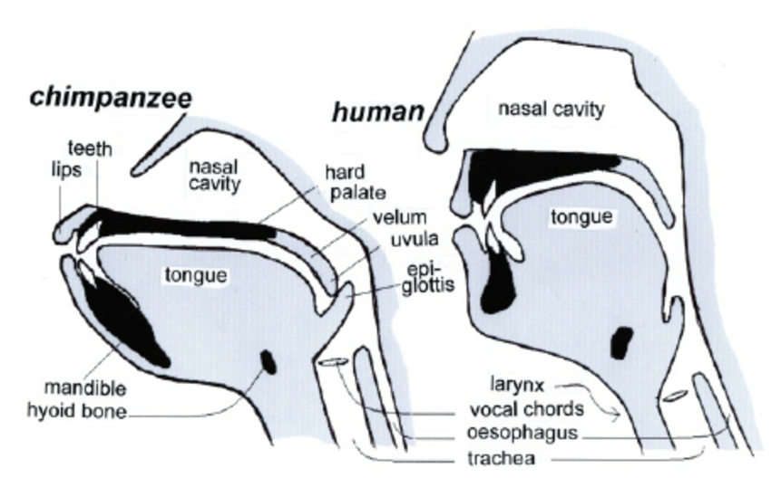
Evolution of the vocal tract
(Slide: Scharenborg, 2017)
Lowering of the tongue into the pharynx → lowering of the larynx
Lengthening of the neck
At the cost of an increase in the risk of choking on food
Neanderthals were not capable of human speech
Modern human vocal tract: since 50,000 years
Notes:
How did humans learn to produce sounds?

Slide 5
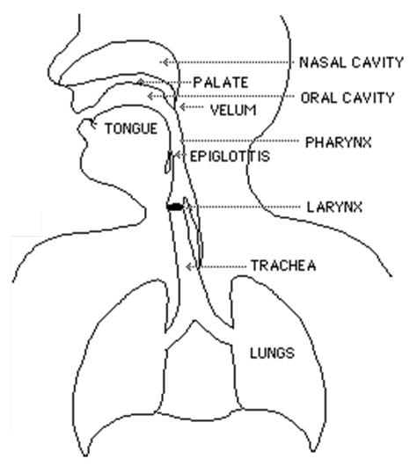
The anatomy and physiology of speech
(Slide: Scharenborg, 2017)
Vocal tract
Area between vocal cords and lips
Pharynx + nasal cavity
+ oral cavity
and lungs

Slide 6
3 steps to produce sounds
(Slide: Scharenborg, 2017)
step 3: articulation =
distortion of air
time-varying formant-frequency
pattern
= speech
step 2: phonation
step 1: initiation
Filter
Source
Notes:
Step 1: air from the lungs is pushed past the vocal cords
If they start to vibrate it is called phonation
Step 3: the air, whether vibrating or not, travels through the oral and nasal cavity. Here the air is distorted/changed depending on the shape of the lips, teeth, tongue.

Slide 7
The Source-Filter Model of Speech Production
(Chiba & Kajiyama, 1940)
Sources: there are only three, all of them have wideband spectrum
  Voicing: vibration of the vocal folds, same type of aerodynamic mechanism as a flag flapping in the wind.
  Frication or Aspiration: turbulence created when air passes through a narrow aperture
  Burst: the “pop” that occurs when high air pressure is suddenly released
Filter:
  Vocal tract = the air cavity between glottis and lips
  Just like a flute or a shower stall, it has resonances
  The excitation has energy at all frequencies; excitation at the resonant frequencies is enhanced

Slide 8
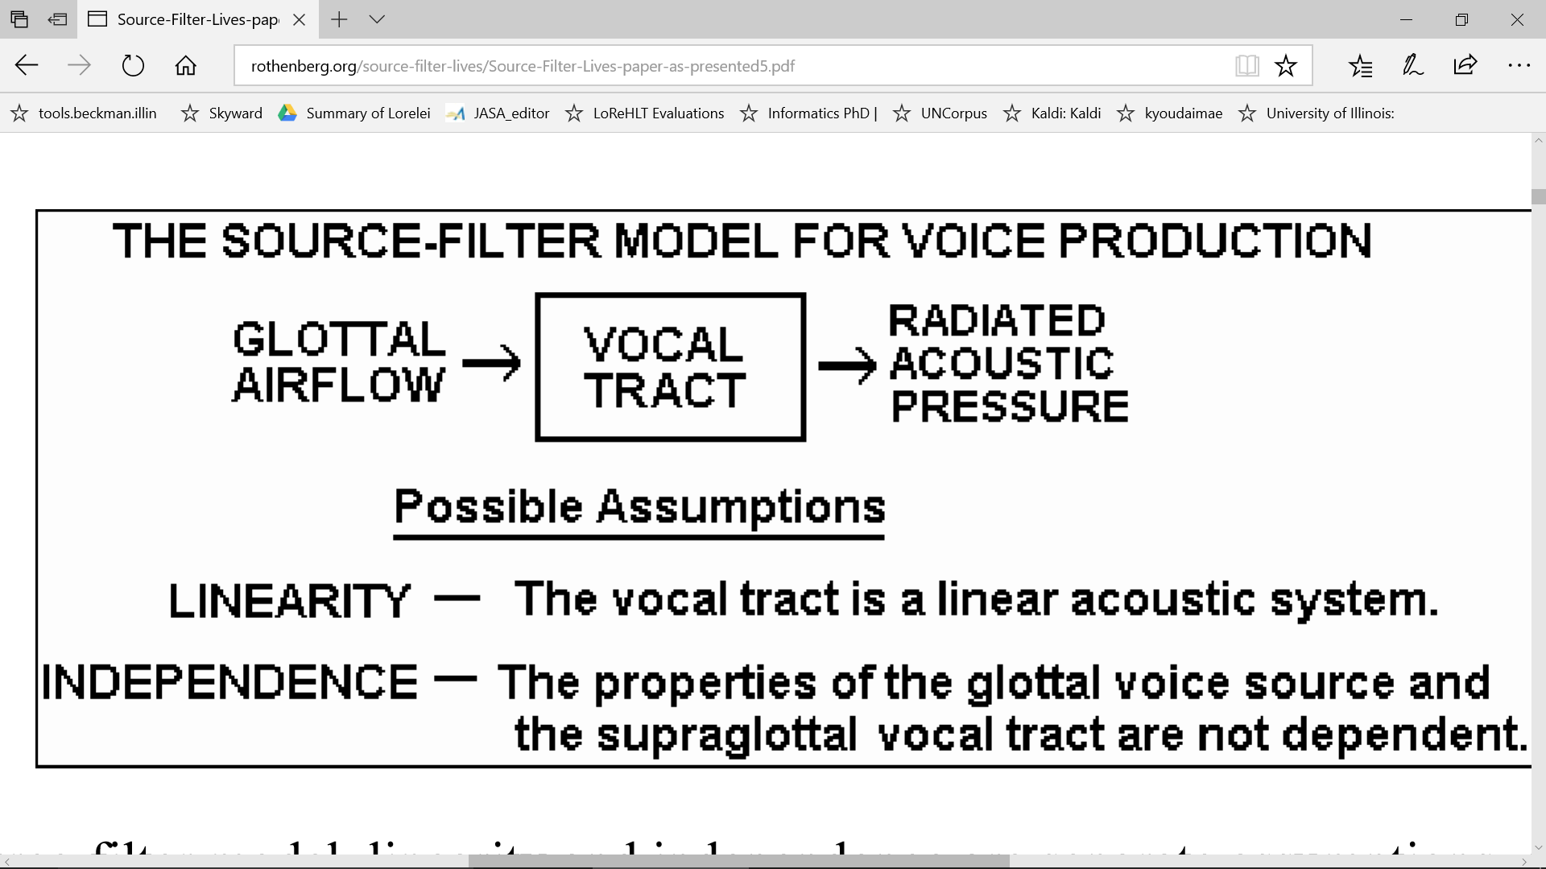
The Source-Filter Model of Speech Production
A picture from Martin Rothenberg’s website
Notes:
Step 1: air from the lungs is pushed past the vocal cords
If they start to vibrate it is called phonation
Step 3: the air, whether vibrating or not, travels through the oral and nasal cavity. Here the air is distorted/changed depending on the shape of the lips, teeth, tongue.

Slide 9
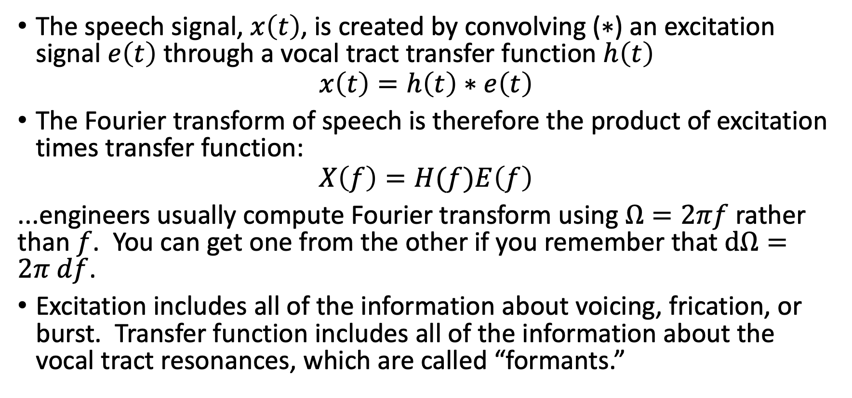
The Source-Filter Model
The speech signal, $x\left(t\right)$, is created by convolving ($∗$) an excitation signal $e\left(t\right)$ through a vocal tract transfer function $h\left(t\right)$
$$x\left(t\right)=h\left(t\right)∗e\left(t\right)$$
The Fourier transform of speech is therefore the product of excitation times transfer function:
$$X\left(f\right)=H(f)E\left(f\right)$$
...engineers usually compute Fourier transform using $Ω=2πf$ rather than $f$. You can get one from the other if you remember that $dΩ=2π df$.
Excitation includes all of the information about voicing, frication, or burst. Transfer function includes all of the information about the vocal tract resonances, which are called “formants.”

Slide 10
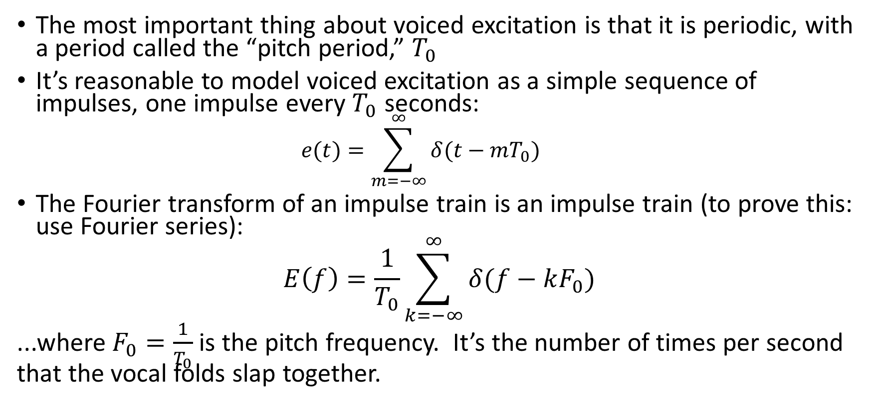
Source-Filter Model: Voice Source
The most important thing about voiced excitation is that it is periodic, with a period called the “pitch period,” $T_{0}$
It’s reasonable to model voiced excitation as a simple sequence of impulses, one impulse every $T_{0}$ seconds:
  $$e(t)=\sum_{m=−∞}^{∞}{δ(t−mT_{0})}$$
The Fourier transform of an impulse train is an impulse train (to prove this: use Fourier series):
$$E\left(f\right)=\frac{1}{T_{0}}\sum_{k=−∞}^{∞}{δ(f−kF_{0})}$$
...where $F_{0}=\frac{1}{T_{0}}$ is the pitch frequency. It’s the number of times per second that the vocal folds slap together.

Slide 11
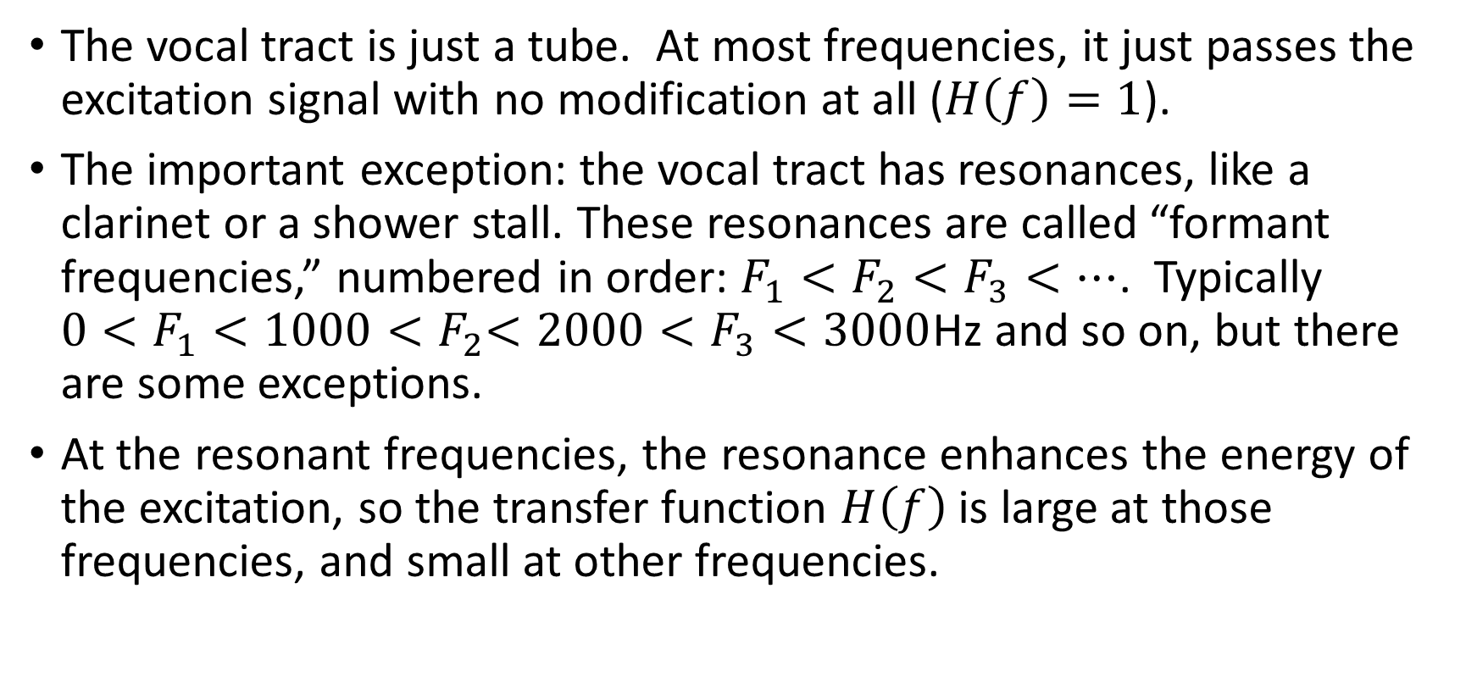
Source-Filter Model: Filter
The vocal tract is just a tube. At most frequencies, it just passes the excitation signal with no modification at all ($H\left(f\right)=1$).
The important exception: the vocal tract has resonances, like a clarinet or a shower stall. These resonances are called “formant frequencies,” numbered in order: $F_{1}<F_{2}<F_{3}<…$. Typically ${0<F}_{1}<1000{<F}_{2}<2000<F_{3}<3000$Hz and so on, but there are some exceptions.
At the resonant frequencies, the resonance enhances the energy of the excitation, so the transfer function $H\left(f\right)$ is large at those frequencies, and small at other frequencies.

Slide 12
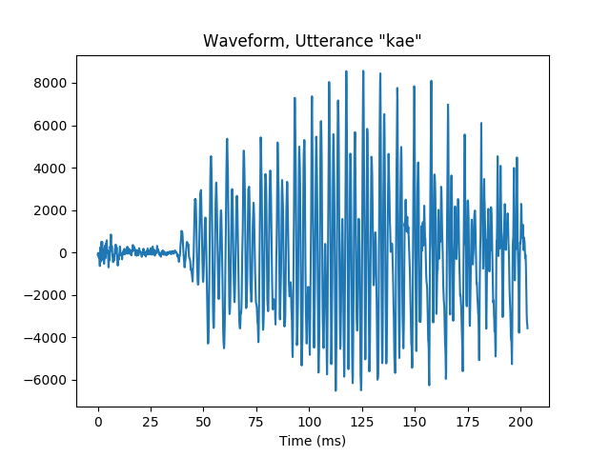


Speech signal: Time domain
$T_{0}=\frac{1}{F_{0}}$=8ms
$T_{1}=\frac{1}{F_{1}}$=2ms
/k/ burst
/k/ aspiration
voicing

Slide 13
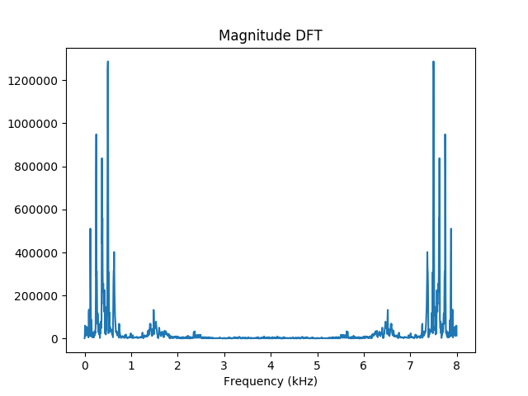
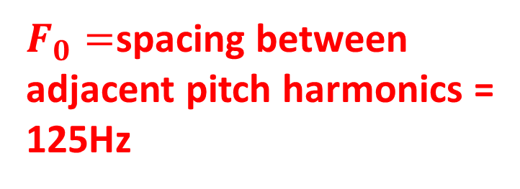

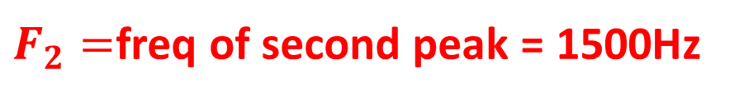
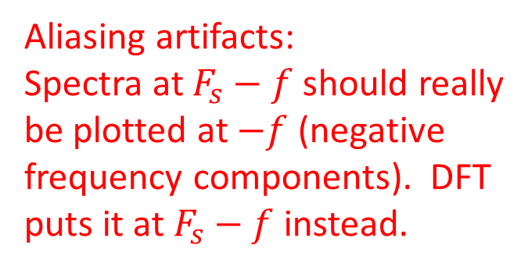
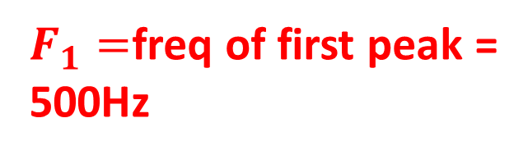
Speech signal: Magnitude Fourier Transform
$F_{1}=$freq of first peak =
500Hz
Aliasing artifacts:
Spectra at $F_{s}−f$ should really
be plotted at $−f$ (negative
frequency components). DFT
puts it at $F_{s}−f$ instead.
$F_{0}=$spacing between
adjacent pitch harmonics =
125Hz
$F_{2}=$freq of second peak = 1500Hz
$$F_{3}$$

Slide 14
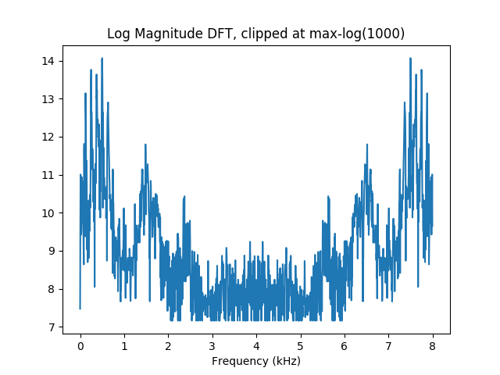
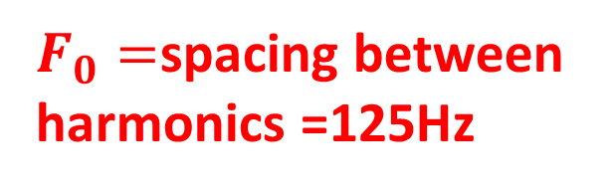
Speech signal: Log Magnitude Transform
$F_{1}=$freq of first peak =
500Hz
Aliasing artifacts:
Spectra at $F_{s}−f$ should really
be plotted at $−f$ (negative
frequency components). DFT
puts it at $F_{s}−f$ instead.
$F_{0}=$spacing between
harmonics =125Hz
$F_{2}=$freq of second peak = 1500Hz
$$F_{3}$$

Slide 15
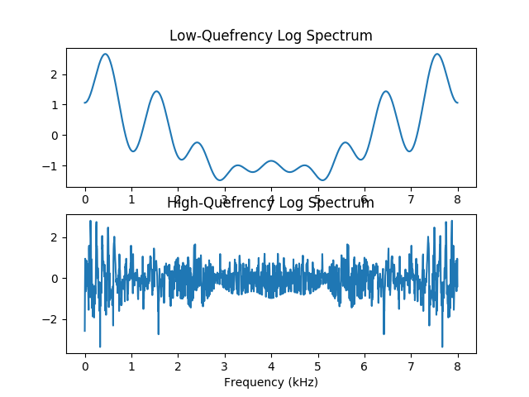
The Source-Filter Model
Transfer Function log|H(f)|
Speech Spectrum log|S(f)|=log|H(f)|+log|E(f)|
Voice Source Spectrum log|E(f)|

Slide 16
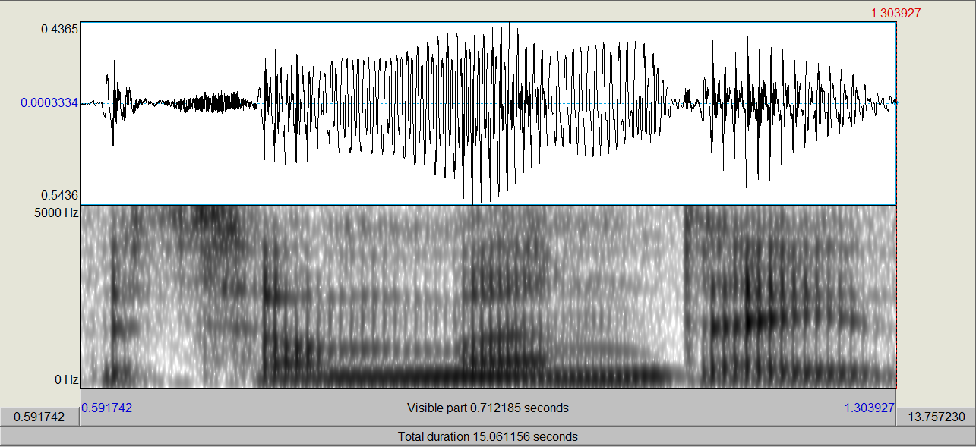

Spectrogram: ln(energy(frequency,time))
Scharenborg, 2017
bu t o nM o n d a y
Spectrum lets you measure formants, so it gives some information about vowels.
Timing is important to know about consonants.
Spectrogram = time on the horizontal axis, frequency on vertical axis.
Notes:
Explain about amplitude (energy) and frequency ranges, voiced sounds, formants and formant transitions, differences in spectral shape
Each sound has its own spectral pattern depending on the shape of the vocal tract
Differences in formant transitions between the o after t and the o after M
Plosion of the d
Difference in formant tracks between o and a
Diphtong ay

Slide 17
Outline
Speech Production: Source-Filter Model
Speech Perception: Spectrogram and Filterbank Coefficients
Phonemes: Vowels and Consonants
Automatic Speech Recognition
Text-to-Speech Synthesis

Slide 18
What spectrum do people hear? Basilar membrane

Slide 19
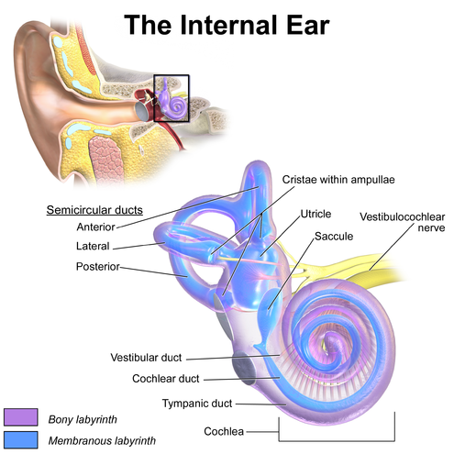
Inner ear

Slide 20
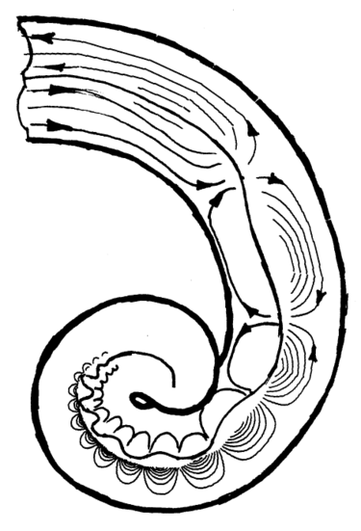
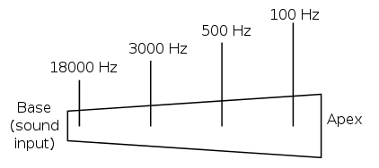
Basilar membrane of the cochlea = a bank of mechanical bandpass filters

Slide 21
Frequency scales for hearing: mel scale, ERB scale

Slide 22
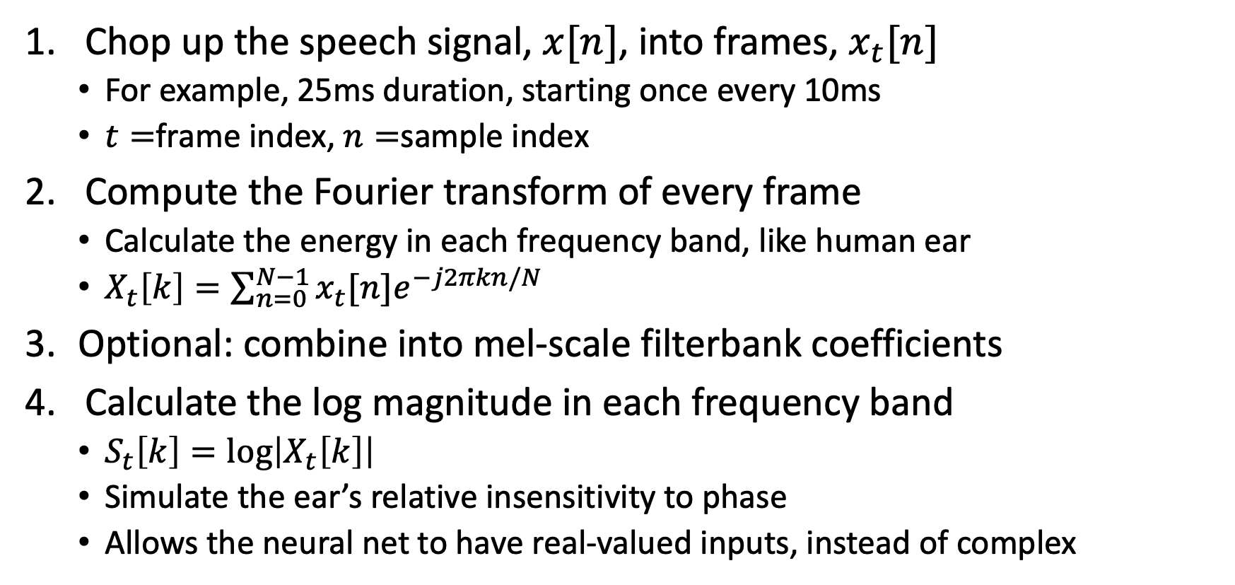
How is a spectrogram created?
Short-Time Fourier Transform (STFT)
Chop up the speech signal, $x[n]$, into frames, $x_{t}[n]$
  For example, 25ms duration, starting once every 10ms
  $t=$frame index, $n=$sample index
Compute the Fourier transform of every frame
  Calculate the energy in each frequency band, like human ear
  $X_{t}\left[k\right]=\sum_{n=0}^{N−1}{x_{t}[n]e^{−j2πkn/N}}$
Optional: combine into mel-scale filterbank coefficients
Calculate the log magnitude in each frequency band
  $S_{t}\left[k\right]=\log\left|X_{t}\left[k\right]\right|$
  Simulate the ear’s relative insensitivity to phase
  Allows the neural net to have real-valued inputs, instead of complex

Slide 23
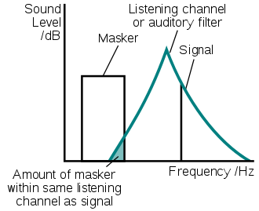
Critical bands
When two tones play at exactly the same frequency, users can’t tell the difference between x(t) versus x(t)+y(t) if y(t) is about 14dB below x(t) (in other words, the summed power is 1.03 times the power of x(t) alone)
When x(t) and y(t) are at different frequencies, the masking power of x(t) is reduced
Model: assume that the reduced masking power of x(t) is caused because x(t) is coming in through the tails of the bandpass filter centered at y(t).

Slide 24
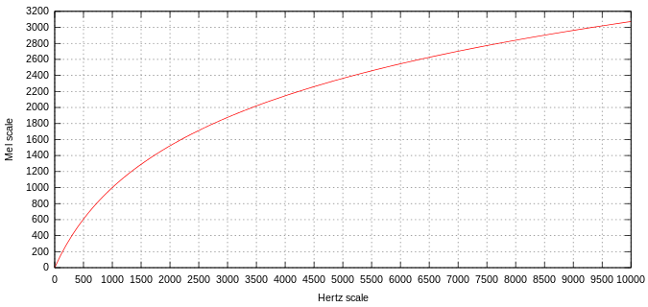
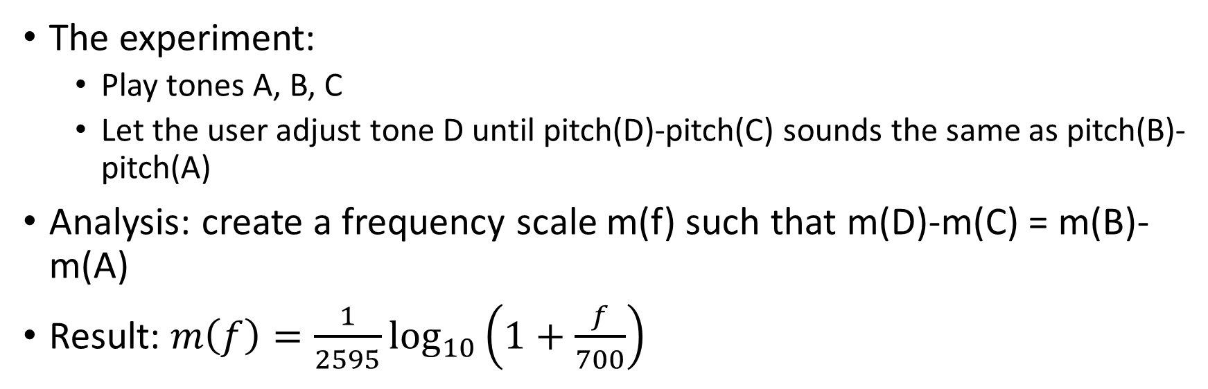
Mel-scale
The experiment:
  Play tones A, B, C
  Let the user adjust tone D until pitch(D)-pitch(C) sounds the same as pitch(B)-pitch(A)
Analysis: create a frequency scale m(f) such that m(D)-m(C) = m(B)-m(A)
Result: $m\left(f\right)=\frac{1}{2595}\log_{10}\left(1+\frac{f}{700}\right)$

Slide 25
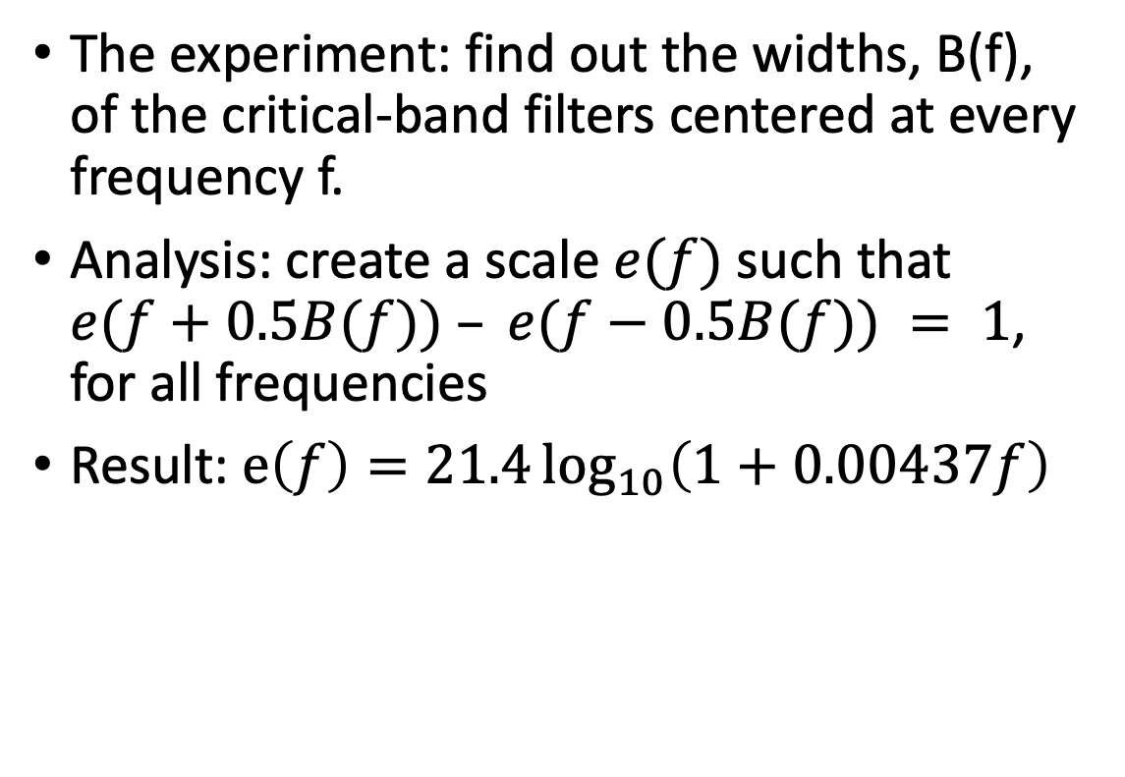
ERB scale
The experiment: find out the widths, B(f), of the critical-band filters centered at every frequency f.
Analysis: create a scale $e(f)$ such that $e(f+0.5B(f)) – e(f−0.5B(f)) = 1$, for all frequencies
Result: $e\left(f\right)=21.4\log_{10}\left(1+0.00437f\right)$

Slide 26
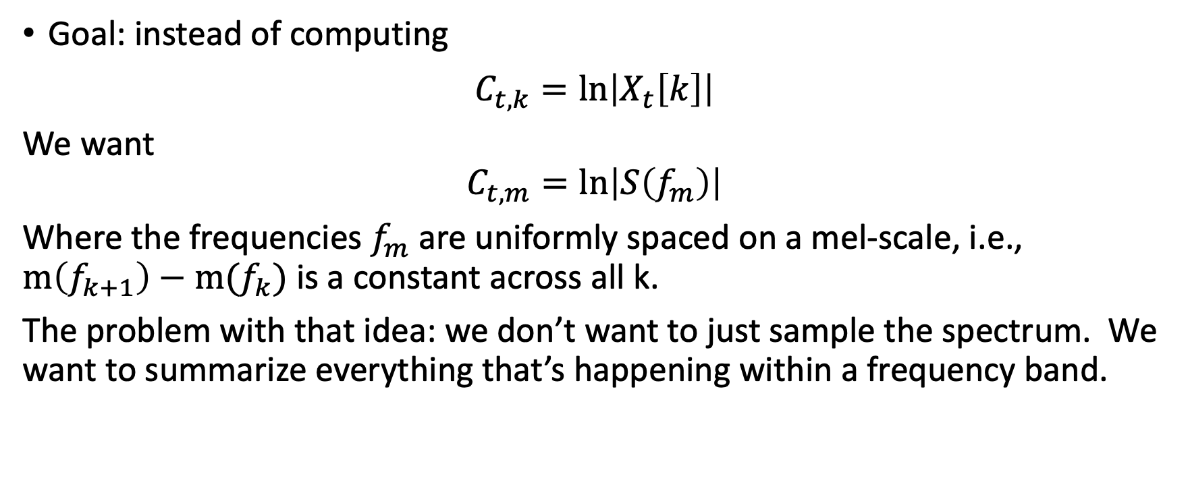
Mel filterbank coefficients: convert the spectrum from Hertz-frequency to mel-frequency
Goal: instead of computing
$C_{t,k}=ln\left|X_{t}\left[k\right]\right|$
We want
$$C_{t,m}=ln\left|S\left(f_{m}\right)\right|$$
Where the frequencies $f_{m}$ are uniformly spaced on a mel-scale, i.e., $m\left(f_{k+1}\right)−m(f_{k})$ is a constant across all k.
The problem with that idea: we don’t want to just sample the spectrum. We want to summarize everything that’s happening within a frequency band.

Slide 27
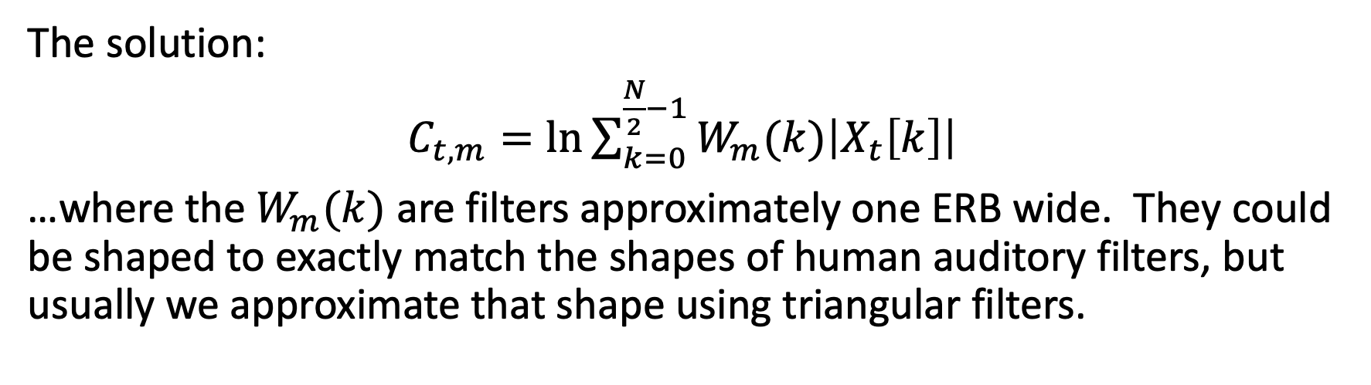
Mel filterbank coefficients: convert the spectrum from Hertz-frequency to mel-frequency
The solution:
$C_{t,m}=ln{\sum_{k=0}^{\frac{N}{2}−1}{W_{m}(k)\left|X_{t}\left[k\right]\right|}}$
…where the $W_{m}(k)$ are filters approximately one ERB wide. They could be shaped to exactly match the shapes of human auditory filters, but usually we approximate that shape using triangular filters.

Slide 28
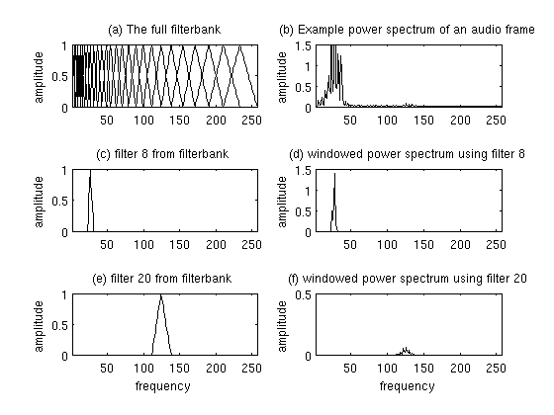
Mel filterbank coefficients: convert the spectrum from Hertz-frequency to mel-frequency

Slide 29
Outline
Speech Production: Source-Filter Model
Speech Perception: Filterbank Coefficients
Phonemes: Vowels and Consonants
Automatic Speech Recognition
Text-to-Speech Synthesis

Slide 30
Linguistic units
Scharenborg, 2017
Speech signal
Linguistic units are:
Phone(me)s
Words
Notes:
In the context of this project:
Linguistics units are sounds, sound sequences, partial words, words, multi-word sequences

Slide 31
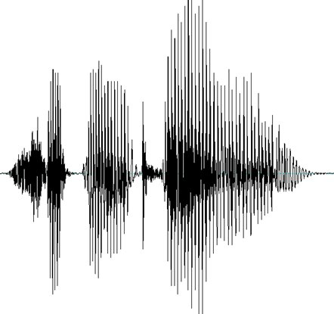
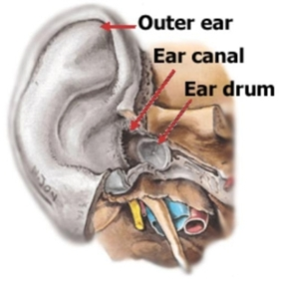
Linguistic units
Scharenborg, 2017
Speech = sound
Sound = differences in air pressure
Air pressure waves perceived as different phone(me)s, phone(me) sequences, and (partial or multi) words
Via eardrum, cochlea, and auditory nerve to brain
speech signal
Notes:
In the context of this project:
Linguistics units are sounds, sound sequences, partial words, words, multi-word sequences

Slide 32
Some terminology
Scharenborg, 2017
Phoneme: the smallest contrastive linguistic unit that distinguishes meaning, e.g., tip vs. dip
Allophone: a variation of a phoneme, eg., p^{h}ot vs. spot
Phone: a distinct speech sound
Word: the smallest distinct unit that can be uttered in isolation which has meaning

Slide 33
Speech sounds
Scharenborg, 2017
Vowels: unblocked air stream
Consonants: constricted or blocked air stream
Notes:
Speech sounds can be divided into two types

Slide 34
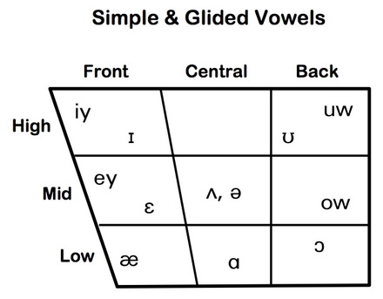
Different sounds: Vowels
Scharenborg, 2017
Tongue height:
  Low: e.g., /a/
  Mid: e.g., /e/
  High: e.g., /i/
Tongue advancement:
  Front : e.g., /i/
  Central : e.g., /ə/
  Back : e.g., /u/
Lip rounding:
  Unrounded: e.g., /ɪ, ɛ, e, ǝ/
  Rounded: e.g., /u, o, ɔ/
Tense/lax:
  Tense: e.g., /i, e, u, o, ɔ, ɑ/
  Lax: e.g., /ɪ, ɛ, æ, ə/
heed
who’d
hid
hood
hayed
head
hoed
had
hawed
hod
Notes:
In producing vowels the tongue and lips are important for shaping the vocal tract
Tense vowels are typically produced with a narrower mouth than lax vowels, less centralization, and longer duration

Slide 35
Different sounds: Vowels
Scharenborg, 2017
Tongue height:
  Low: e.g., /a/
  Mid: e.g., /e/
  High: e.g., /i/
Tongue advancement:
  Front : e.g., /i/
  Central : e.g., /ə/
  Back : e.g., /u/
Lip rounding:
  Unrounded: e.g., /ɪ, ɛ, e, ǝ/
  Rounded: e.g., /u, o, ɔ/
Tense/lax:
  Tense: e.g., /i, e, u, o, ɔ, ɑ/
  Lax: e.g., /ɪ, ɛ, æ, ə/
300
heed
who’d
hid
hood
hayed
F1
head
hoed
had
hawed
900
hod
2000
F2
800
Notes:
In producing vowels the tongue and lips are important for shaping the vocal tract
Tense vowels are typically produced with a narrower mouth than lax vowels, less centralization, and longer duration

Slide 36
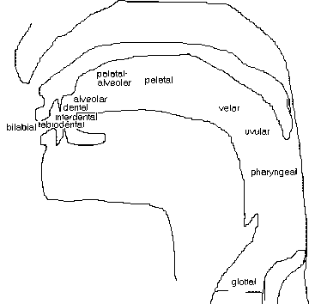
Different sounds: Consonants
Scharenborg, 2017
Place of articulation
  Where is the constriction/blocking of the air stream?
Manner of articulation
  Stops: /p, t, k, b, d, g/
  Fricatives: /f, s, S, v, z, Z/
  Affricates: /tS, dZ/
  Approximants/Liquids: /l, r, w, j/
  Nasals: /m, n, ng/
Voicing
Notes:
The type of consonant or sound that is produced depends on three factors: the place of articulation, the manner of articulation and whether the vocal cords vibrate
Manner of articulation: is it a full blockage or a constriction and how much of a constriction is there?
Plosion
Bit of noise
Combination
Air through the nasal cavity
Fairly open

Slide 37

Speech sound production
Scharenborg, 2017
https://www.youtube.com/watch?v=DcNMCB-Gsn8
Recorded in 1962, Ken Stevens
Source: YouTube
Notes:
We all know what speech sounds like, and now we know how they are produced, but what does it look like when we produce speech?

Slide 38
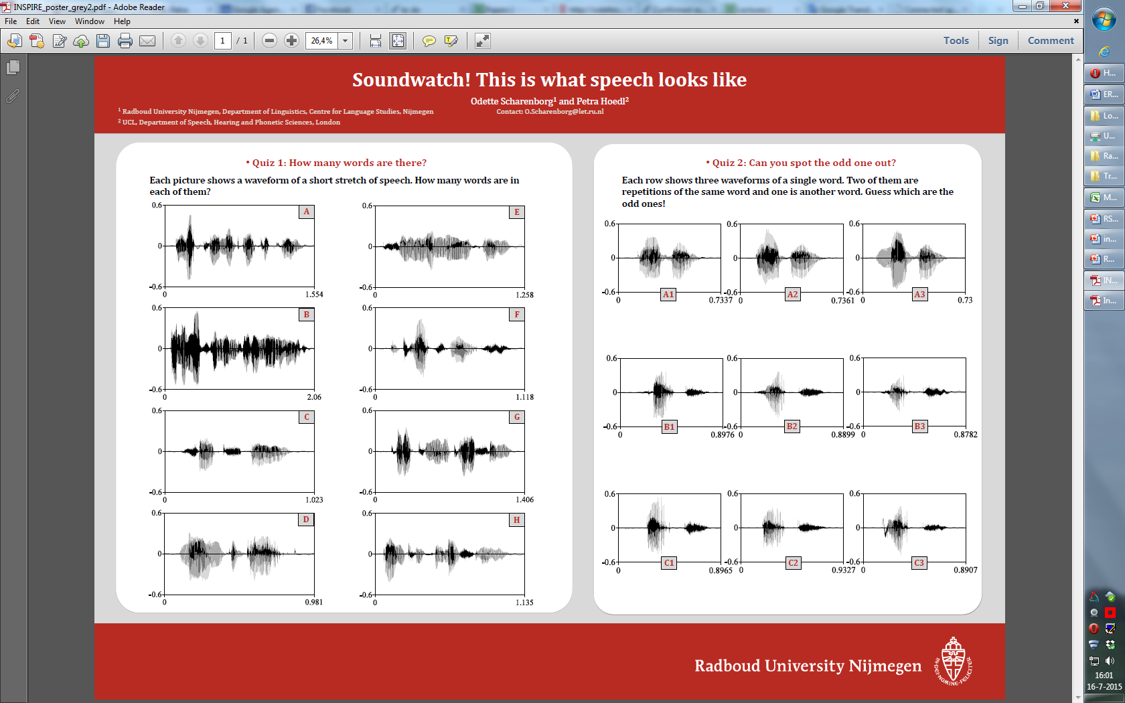
Quiz 1: How many words are there?
Scharenborg, 2017
Each picture shows a waveform of a short stretch of speech:
C
D
A: Electromagnetically (1)
B: Emma loves her mum’s yellow marmelade (6)
C: See you in the evening (5)
D: Attachment (1)
Notes:
Finding the ‘linguistic units’ in speech

Slide 39
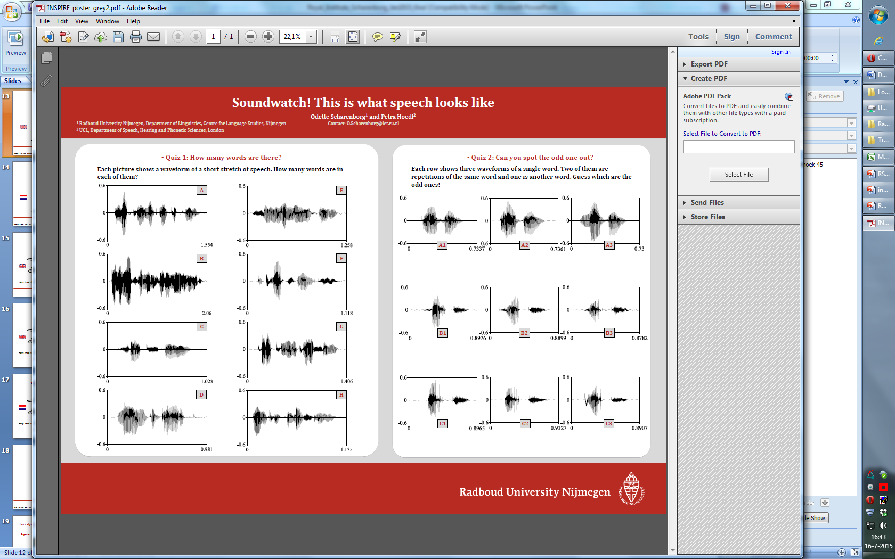
Electromagnetically
Scharenborg, 2017
Why is it so hard to determine the number of words?
/i l ɛ kt romæ g nɛ t ɪ k ǝ l i/
silence ≠ word boundary

Slide 40
Quiz 2: Can you spot the odd one out?
Scharenborg, 2017
Below are three waveforms each containing a single word:
Every time you produce a word it sounds differently
A3 (brother, brother, mother)
Notes:
Every

Slide 41
Enormous variability
Scharenborg, 2017
Speaker differences, e.g., gender, vocal tract length, age
Speaker idiosyncracies , e.g., lisp, creaky voice
Accent: dialects, non-nativeness
Coarticulation: production of a speech sound becomes more like that of a preceding/following speech sound
Speaking style → reductions

Slide 42
Outline
Speech Production: Source-Filter Model
Speech Perception: Filterbank Coefficients
Phonemes: Vowels and Consonants
Automatic Speech Recognition
Text-to-Speech Synthesis

Slide 43
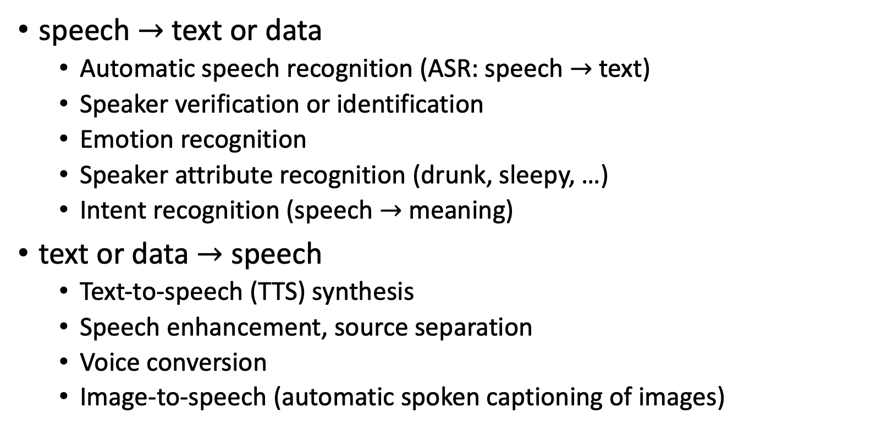
Speech Technologies
speech $→$ text or data
  Automatic speech recognition (ASR: speech $→$ text)
  Speaker verification or identification
  Emotion recognition
  Speaker attribute recognition (drunk, sleepy, …)
  Intent recognition (speech $→$ meaning)
text or data $→$ speech
  Text-to-speech (TTS) synthesis
  Speech enhancement, source separation
  Voice conversion
  Image-to-speech (automatic spoken captioning of images)

Slide 44
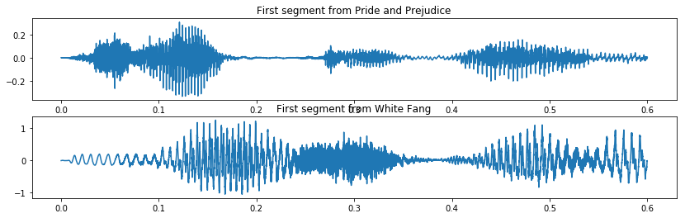
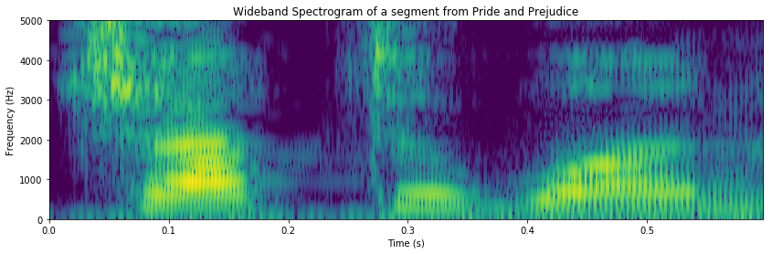
ASR using spectrograms
STFT
LSTM, Transformer, or Conformer Neural Net
During training: NN loss calculated using an HMM (connectionist temporal classification)
---cc--aaa-----t---

Slide 45
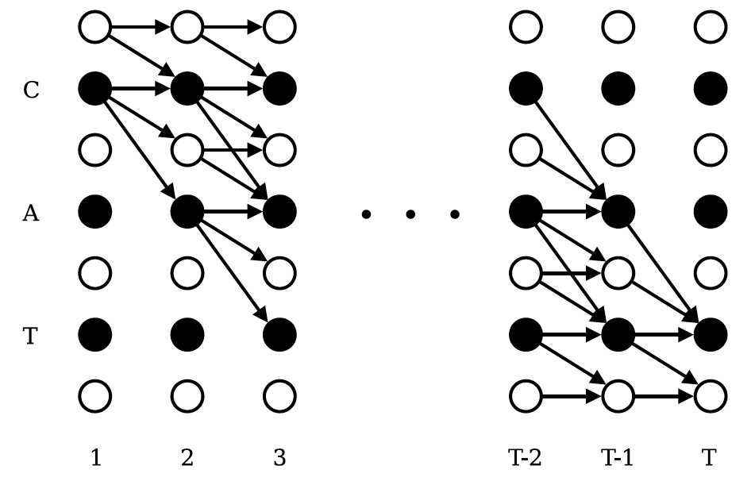
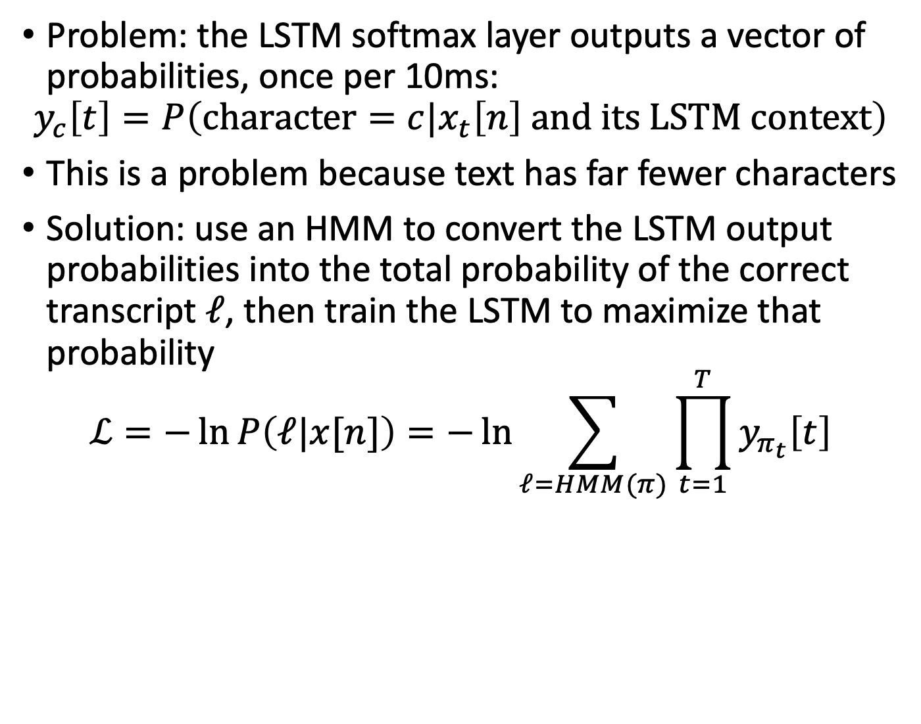
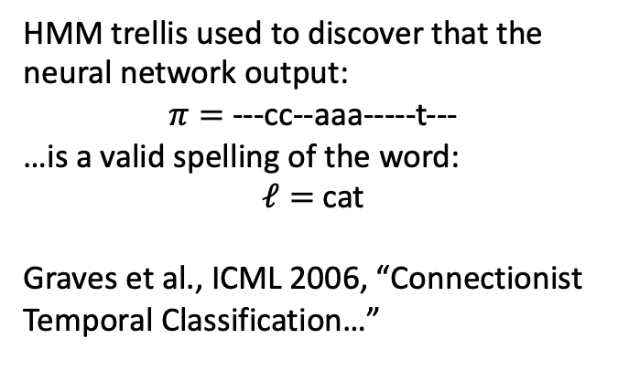
How is the neural net trained?
Connectionist Temporal Classification (CTC)
Problem: the LSTM softmax layer outputs a vector of probabilities, once per 10ms:
$$y_{c}\left[t\right]=P\left(character=c|x_{t}\left[n\right] and its LSTM context\right)$$
This is a problem because text has far fewer characters
Solution: use an HMM to convert the LSTM output probabilities into the total probability of the correct transcript $ℓ$, then train the LSTM to maximize that probability
$$ℒ=−\ln{P\left(ℓ|x[n]\right)=−\ln{\sum_{ℓ=HMM(π)}{\prod_{t=1}^{T}{y_{π_{t}}\left[t\right]}}}}$$
HMM trellis used to discover that the neural network output:
$π=$ ---cc--aaa-----t---
…is a valid spelling of the word:
$ℓ=$cat
Graves et al., ICML 2006, “Connectionist Temporal Classification…”

Slide 46
ASR using 1-D Convolutional Neural Net
1D CNN with trainable filters instead of the STFT
LSTM, Transformer, or Conformer Neural Net
During training: NN loss calculated using an HMM (connectionist temporal classification)
---cc--aaa-----t---

Slide 47
Outline
Speech Production: Source-Filter Model
Speech Perception: Filterbank Coefficients
Phonemes: Vowels and Consonants
Automatic Speech Recognition
Text-to-Speech Synthesis

Slide 48
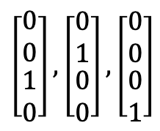
TTS using spectrograms
LSTM or Transformer Neural Net
1-hot embeddings
$$\left[\begin{matrix}\begin{matrix}0 \\ 0\end{matrix} \\ \begin{matrix}1 \\ 0\end{matrix}\end{matrix}\right], \left[\begin{matrix}\begin{matrix}0 \\ 1\end{matrix} \\ \begin{matrix}0 \\ 0\end{matrix}\end{matrix}\right], \left[\begin{matrix}\begin{matrix}0 \\ 0\end{matrix} \\ \begin{matrix}0 \\ 1\end{matrix}\end{matrix}\right]$$
Griffin-Lim Algorithm
cat
Training:
MSE loss
Training data: correct spectrogram for this word

Slide 49
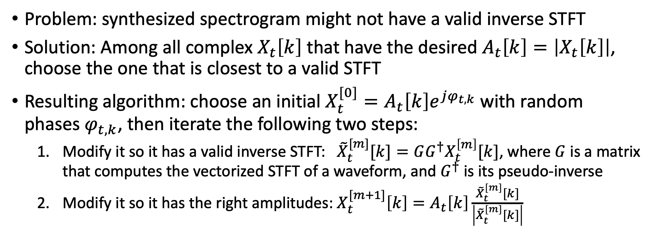
Griffin-Lim Algorithm
Problem: synthesized spectrogram might not have a valid inverse STFT
Solution: Among all complex $X_{t}\left[k\right]$ that have the desired $A_{t}\left[k\right]=\left|X_{t}\left[k\right]\right|$, choose the one that is closest to a valid STFT
Resulting algorithm: choose an initial $X_{t}^{[0]}=A_{t}\left[k\right]e^{jφ_{t,k}}$ with random phases $φ_{t,k}$, then iterate the following two steps:
  Modify it so it has a valid inverse STFT: ${\tilde{X}}_{t}^{[m]}[k]=GG^{†}X_{t}^{\left[m\right]}[k]$, where $G$ is a matrix that computes the vectorized STFT of a waveform, and $G^{†}$ is its pseudo-inverse
  Modify it so it has the right amplitudes: $X_{t}^{[m+1]}\left[k\right]=A_{t}\left[k\right]\frac{{\tilde{X}}_{t}^{[m]}[k]}{\left|{\tilde{X}}_{t}^{[m]}[k]\right|}$

Slide 50
TTS using 1-D Convolutions
1D CNN filterbank representation
LSTM or Transformer Neural Net
1-hot embeddings
$$\left[\begin{matrix}\begin{matrix}0 \\ 0\end{matrix} \\ \begin{matrix}1 \\ 0\end{matrix}\end{matrix}\right], \left[\begin{matrix}\begin{matrix}0 \\ 1\end{matrix} \\ \begin{matrix}0 \\ 0\end{matrix}\end{matrix}\right], \left[\begin{matrix}\begin{matrix}0 \\ 0\end{matrix} \\ \begin{matrix}0 \\ 1\end{matrix}\end{matrix}\right]$$
Inverse 1D CNN with trainable weights
cat
Training:
Measure difference in some way (usually uses STFT + other things)
Training data: correct waveform for this word

Slide 51
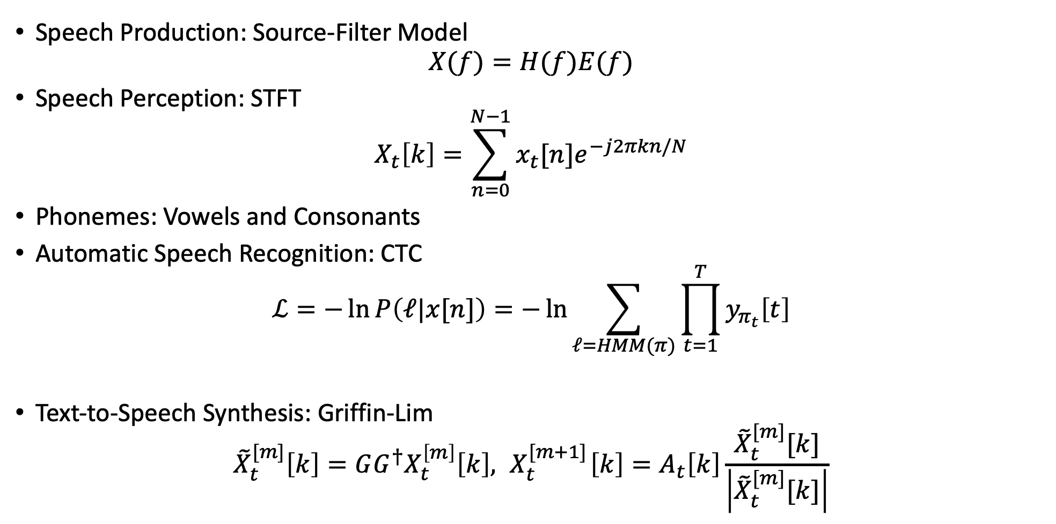
Outline
Speech Production: Source-Filter Model
$$X(f)=H(f)E(f)$$
Speech Perception: STFT
$$X_{t}\left[k\right]=\sum_{n=0}^{N−1}{x_{t}[n]e^{−j2πkn/N}}$$
Phonemes: Vowels and Consonants
Automatic Speech Recognition: CTC
$$ℒ=−\ln{P\left(ℓ|x[n]\right)=−\ln{\sum_{ℓ=HMM(π)}{\prod_{t=1}^{T}{y_{π_{t}}\left[t\right]}}}}$$
Text-to-Speech Synthesis: Griffin-Lim
$${\tilde{X}}_{t}^{[m]}\left[k\right]=GG^{†}X_{t}^{\left[m\right]}\left[k\right],{ X}_{t}^{[m+1]}\left[k\right]=A_{t}\left[k\right]\frac{{\tilde{X}}_{t}^{[m]}[k]}{\left|{\tilde{X}}_{t}^{[m]}[k]\right|}$$

