Slide 1
ECE 576 – Power System Dynamics and Stability
Lecture 10: Synchronous Machines Models
Prof. Tom Overbye
Dept. of Electrical and Computer Engineering
University of Illinois at Urbana-Champaign
overbye@illinois.edu

Slide 2
Announcements
Homework 2 is due now
Homework 3 is on the website and is due on Feb 27
Read Chapters 6 and then 4

Slide 3
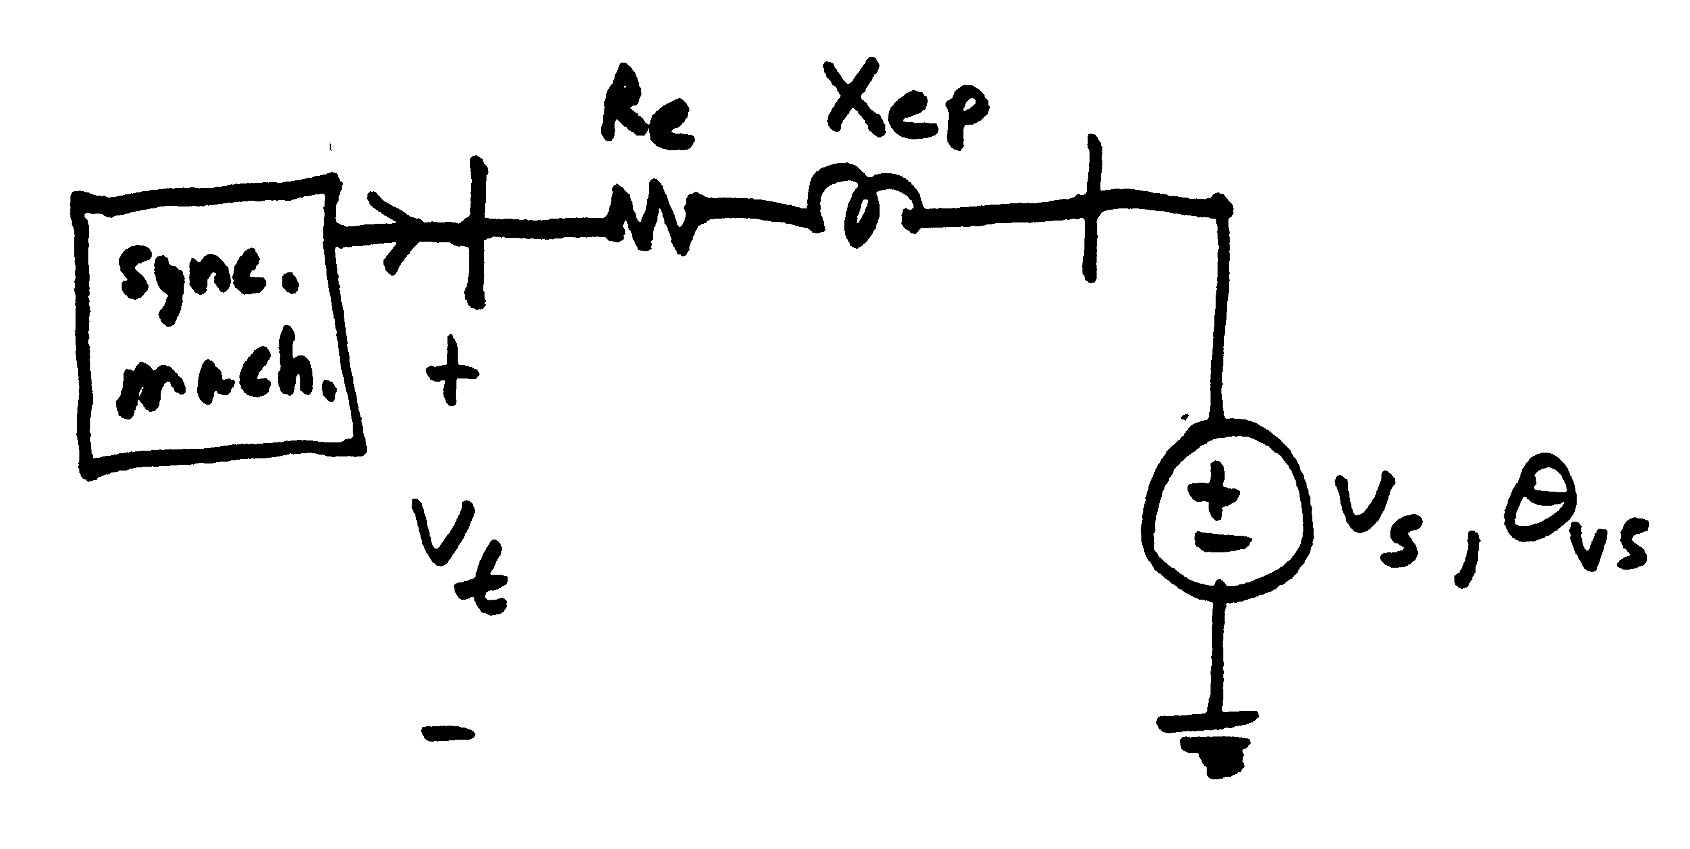
Single Machine, Infinite Bus System (SMIB)
Usually infinite bus
angle, θ_{vs}, is zero
Book introduces new variables by combining machine
values with line values

Slide 4
Introduce New Constants
“Transient Speed”
Mechanical time constant
A small parameter
We are ignoring the exciter and governor for now; they will be covered in much more detail later

Slide 5
Stator Flux Differential Equations

Slide 6
Special Case of Zero Resistance
Without resistance
this is just an
oscillator
An exact integral manifold (for any sized ε):

Slide 7
Direct Axis Equations

Slide 8
Quadrature Axis Equations

Slide 9
Swing Equations
These are equivalent to the more traditional swing expressions

Slide 10
Stator Flux Expressions

Slide 11
Network Expressions

Slide 12
Machine Variable Summary
3 fast dynamic states
We'll get
to the
exciter
and
governor
shortly;
for now
Efd is
fixed
6 not so fast dynamic states
8 algebraic states

Slide 13
Elimination of Stator Transients
If we assume the stator flux equations are much faster than the remaining equations, then letting ε go to zero creates an integral manifold with

Slide 14
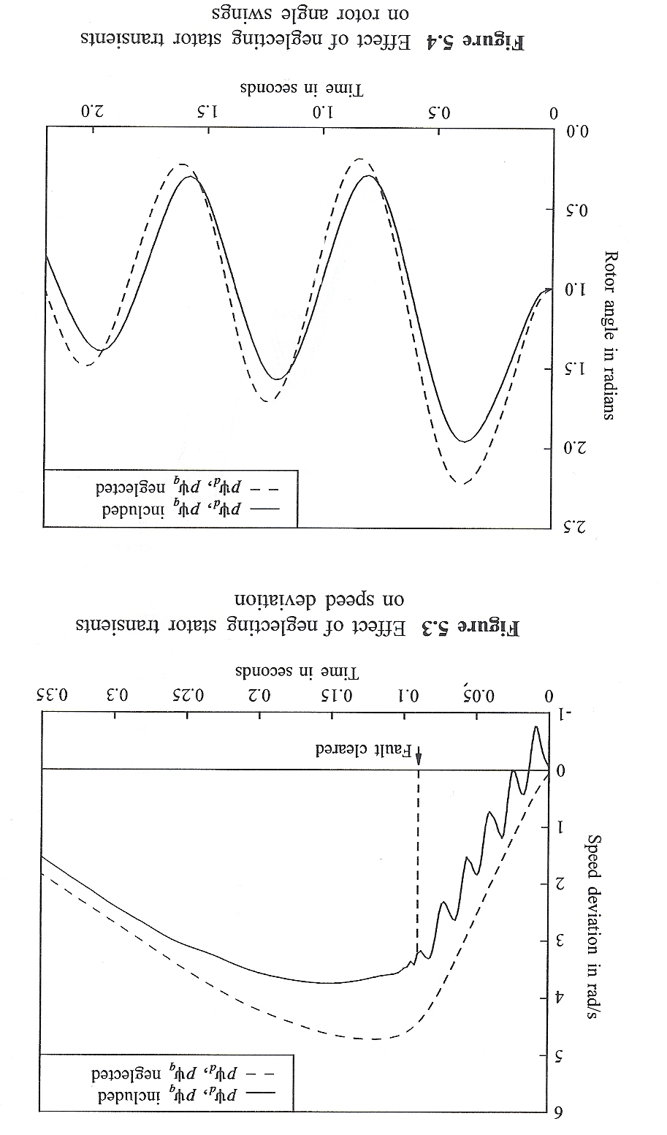
Impact on Studies
Image Source: P. Kundur, Power System Stability and Control, EPRI, McGraw-Hill, 1994

Slide 15
Stator Flux Expressions

Slide 16
Network Constraints

Slide 17
"Interesting" Dynamic Circuit

Slide 18
"Interesting" Dynamic Circuit
These last two equations can be written as one complex equation.

Slide 19
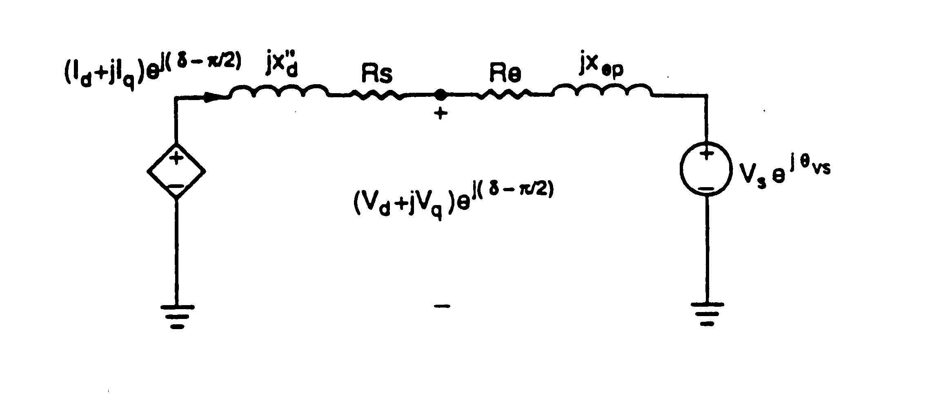
Subtransient Algebraic Circuit

Slide 20
Subtransient Algebraic Circuit
Subtransient
saliency use
to be ignored
(i.e., assuming
X"_{q}=X"_{d}).
However that
is increasingly
no longer
the case

Slide 21
Simplified Machine Models
Often more simplified models were used to represent synchronous machines
These simplifications are becoming much less common
Next several slides go through how these models can be simplified, then we'll cover the standard industrial models

Slide 22
Two-Axis Model
If we assume the damper winding dynamics are sufficiently fast, then T"_{do} and T"_{qo} go to zero, so there is an integral manifold for their dynamic states

Slide 23
Two-Axis Model
Then

Slide 24
Two-Axis Model
And

Slide 25
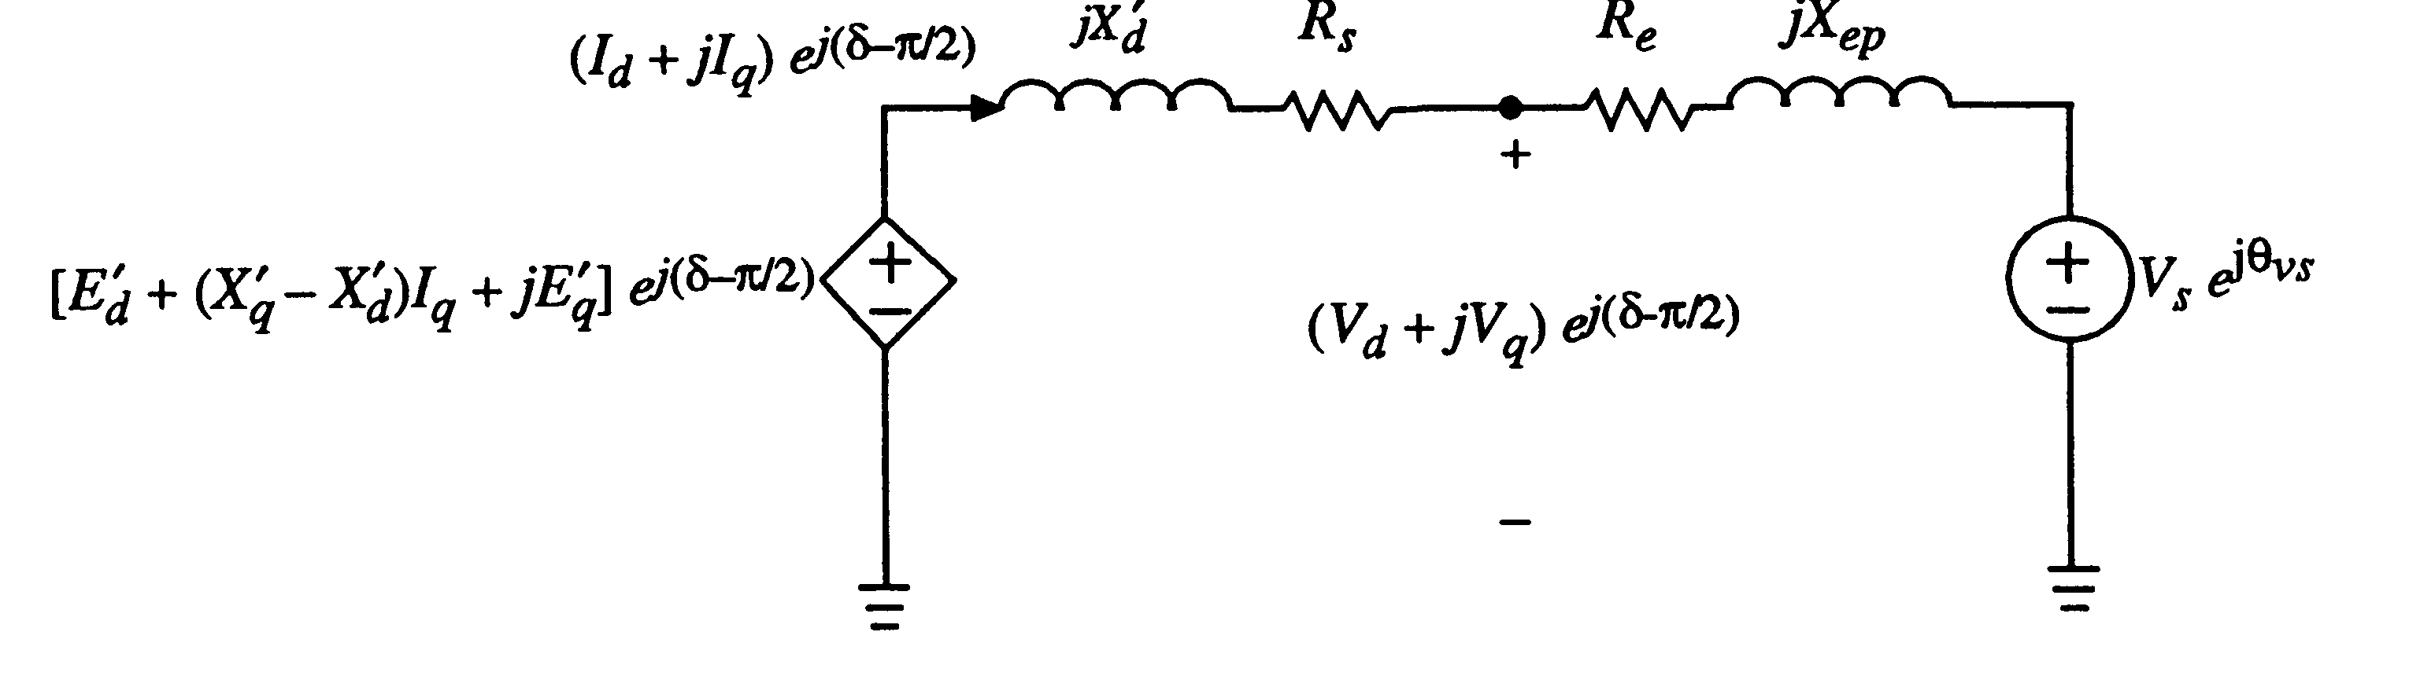
Two-Axis Model

Slide 26
Two-Axis Model
No saturation
effects are
included
with this
model

Slide 27
Two-Axis Model

Slide 28
Flux Decay Model
If we assume T'qo is sufficiently fast then

Slide 29
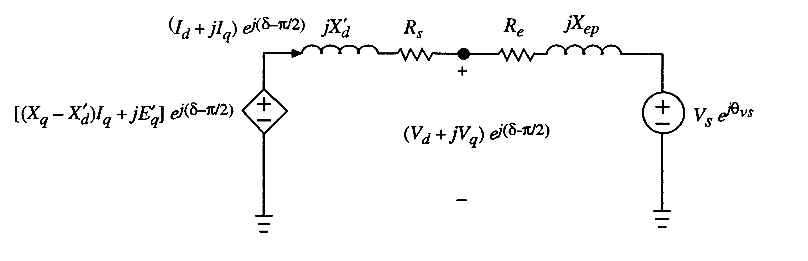
Flux Decay Model
This model is no longer common

Slide 30
Classical Model
Has been widely used, but most difficult to justify
From flux decay model
Or go back to the two-axis model and assume

Slide 31
Classical Model
Or, argue that an integral manifold exists for
such that

Slide 32
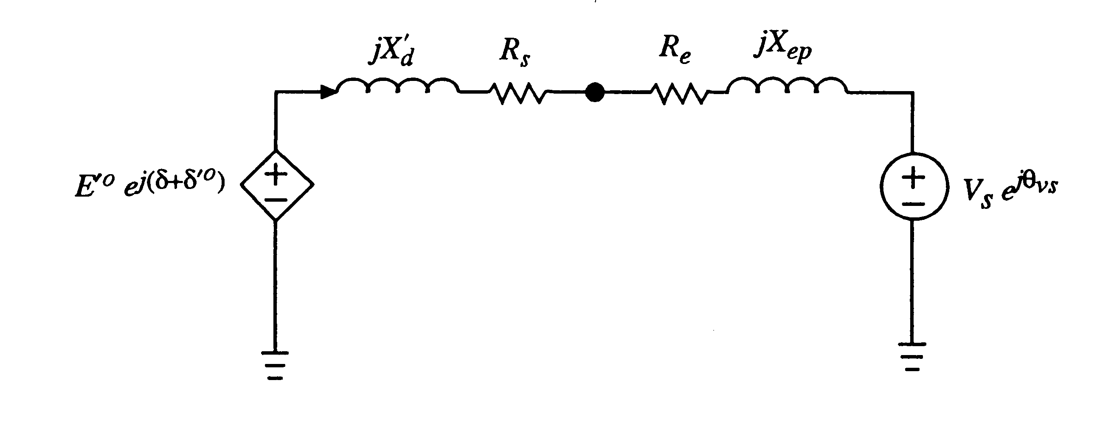
Classical Model
This is a pendulum model

Slide 33
Summary of Five Book Models
Full model with stator transients
Sub-transient model
Two-axis model
One-axis model
Classical model (const. E behind
)

Slide 34
Damping Torques
Friction and windage
  Usually small
Stator currents (load)
  Usually represented in the load models
Damper windings
  Directly included in the detailed machine models
  Can be added to classical model as D(ω-ω_{s})

Slide 35
Industrial Models
There are just a handful of synchronous machine models used in North America
  GENSAL
    Salient pole model
  GENROU
    Round rotor model that has X"_{d} = X"_{q}
  GENTPF
    Round or salient pole model that allows X"_{d} <> X"_{q}
  GENTPJ
    Just a slight variation on GENTPF
We'll briefly cover each one

Slide 36
Network Reference Frame
In transient stability the initial generator values are set from a power flow solution, which has the terminal voltage and power injection
  Current injection is just conjugate of Power/Voltage
These values are on the network reference frame, with the angle given by the slack bus angle
Voltages at bus j converted to d-q reference by
Similar for current; see book 7.24, 7.25

Slide 37
Network Reference Frame
Issue of calculating δ, which is key, will be considered for each model
Starting point is the per unit stator voltages (3.215 and 3.216 from the book)
Sometimes the scaling of the flux by the speed is neglected, but this can have a major impact on the solution

Slide 38
Two-Axis Model
We'll start with the PowerWorld two-axis model (two-axis models are not common commercially, but they match the book on 6.110 to 6.113
Represented by two algebraic equations and four differential equations
The bus number subscript
is omitted since it is not used
in commercial block diagrams

Slide 39
Two-Axis Model
Value of δ is determined from (3.229 from book)
Once δ is determined then we can directly solve for E'_{q} and E'_{d}
Sign convention on
current is out of the
generator is positive

Slide 40
Example (Used for All Models)
Below example will be used with all models. Assume a 100 MVA base, with gen supplying 1.0+j0.3286 power into infinite bus with unity voltage through network impedance of j0.22
  Gives current of 1.0-j0.3286 and generator terminal voltage of 1.072+j0.22 = 1.0946 ∠11.59 °

Slide 41
Two-Axis Example
For the two-axis model assume H = 3.0 per unit-seconds, R_{s}=0, X_{d} = 2.1, X_{q} = 2.0, X'_{d}= 0.3, X'_{q} = 0.5, T'_{do} = 7.0, T'_{qo} = 0.75 per unit using the 100 MVA base.
Solving we get

Slide 42
Two-Axis Example
And
Saved as case B4_TwoAxis

Slide 43
Subtransient Models
The two-axis model is a transient model
Essentially all commercial studies now use subtransient models
First models considered are GENSAL and GENROU, which require X"_{d}=X"_{q}
This allows the internal, subtransient voltage to be represented as

Slide 44
Subtransient Models
Usually represented by a Norton Injection with
May also be shown as
In steady-state ω = 1.0

Slide 45
GENSAL
  The GENSAL model has been widely used to model salient pole synchronous generators
  In the 2010 WECC cases about 1/3 of machine models were GENSAL; in 2013 essentially none are, being replaced by GENTPF or GENTPJ
In salient pole models saturation is only assumed to affect the d-axis

Slide 46
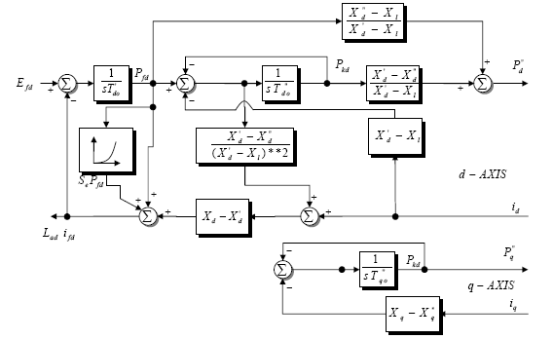
GENSAL Block Diagram (PSLF)
A quadratic saturation function is used. For
initialization it only impacts the Efd value

Slide 47
GENSAL Initialization
To initialize this model
  Use S(1.0) and S(1.2) to solve for the saturation coefficients
  Determine the initial value of δ with
  Transform current into dq reference frame, giving i_{d} and i_{q}
  Calculate the internal subtransient voltage as
  Convert to dq reference, giving P"_{d}+jP"_{q}=Ψ"_{d}+ Ψ "_{q}
  Determine remaining elements from block diagram by recognizing in steady-state input to integrators must be zero

Slide 48
GENSAL Example
Assume same system as before, but with the generator parameters as H=3.0, D=0, R_{a} = 0.01, X_{d} = 1.1, X_{q} = 0.82, X'_{d} = 0.5, X"_{d}=X"_{q}=0.28, X_{l} = 0.13, T'_{do} = 8.2, T"_{do} = 0.073, T"_{qo} =0.07, S(1.0) = 0.05, and S(1.2) = 0.2.
Same terminal conditions as before
    Current of 1.0-j0.3286 and generator terminal voltage of 1.072+j0.22 = 1.0946 ∠11.59 °
Use same equation to get initial δ

Slide 49
GENSAL Example
Then
And

Slide 50
GENSAL Example
Giving the initial fluxes (with ω = 1.0)
To get the remaining variables set the differential equations equal to zero, e.g.,
Solving the d-axis requires solving two linear
equations for two unknowns

Slide 51
GENSAL Example
Once E'_{q} has been determined, the initial field current (and hence field voltage) are easily determined by recognizing in steady-state the E'_{q} is zero
Saturation
coefficients
were determined
from the two
initial values
Saved as case B4_GENSAL

