Slide 1
ECE 576 – Power System Dynamics and Stability
Lecture 16: Governors, Multimachine Simulations
Prof. Tom Overbye
Dept. of Electrical and Computer Engineering
University of Illinois at Urbana-Champaign
overbye@illinois.edu

Slide 2
Announcements
Exam average was 85
Homework 5 is assigned today; due on April 3
Read Chapter 7
A useful reference is B. Stott, "Power System Dynamic Response Calculations," Proc. IEEE, vol. 67, pp. 219-241

Slide 3
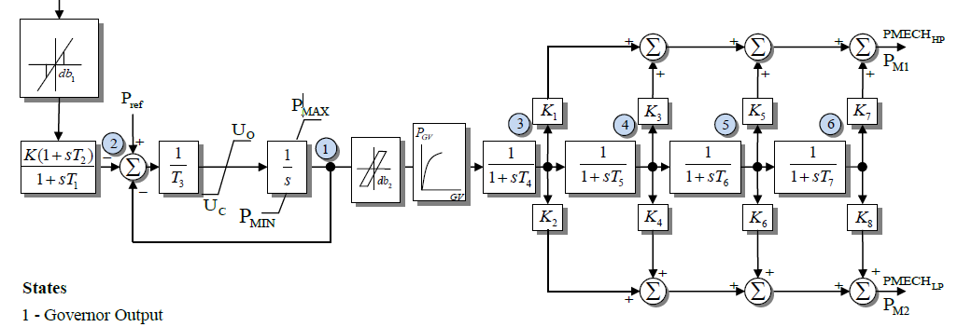
IEEEG1
A common stream turbine model, is the IEEEG1, originally introduced in the below 1973 paper
In this model K=1/R
It can be used to represent
cross-compound units, with
high and low pressure steam
U_{o} and U_{c} are rate limits
IEEE Committee Report, “Dynamic Models for Steam and Hydro Turbines in Power System Studies,” Transactions in Power Apparatus & Systems, volume 92, No. 6, Nov./Dec. 1973, pp 1904-15

Slide 4
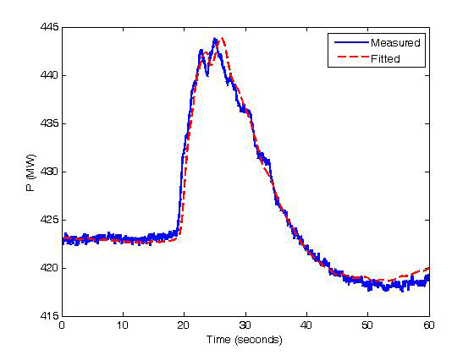
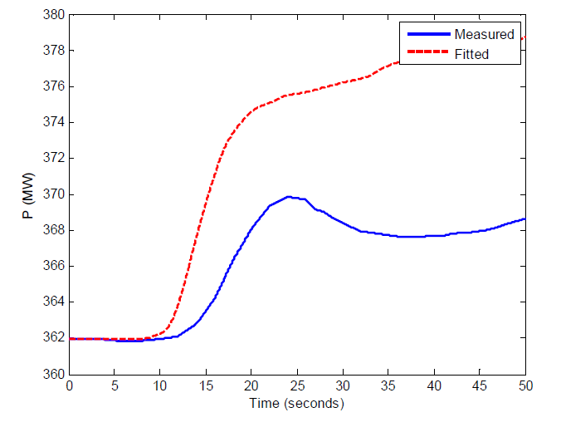
IEEEG1
Blocks on the right model the various steam stages
About 12% of WECC governors are currently IEEEG1s
Below figures show two test comparison with this model with one matching well and one not
Image Source: Figs 2-4, 2-6 of IEEE PES, "Dynamic Models for Turbine-Governors in Power System Studies," Jan 2013

Slide 5
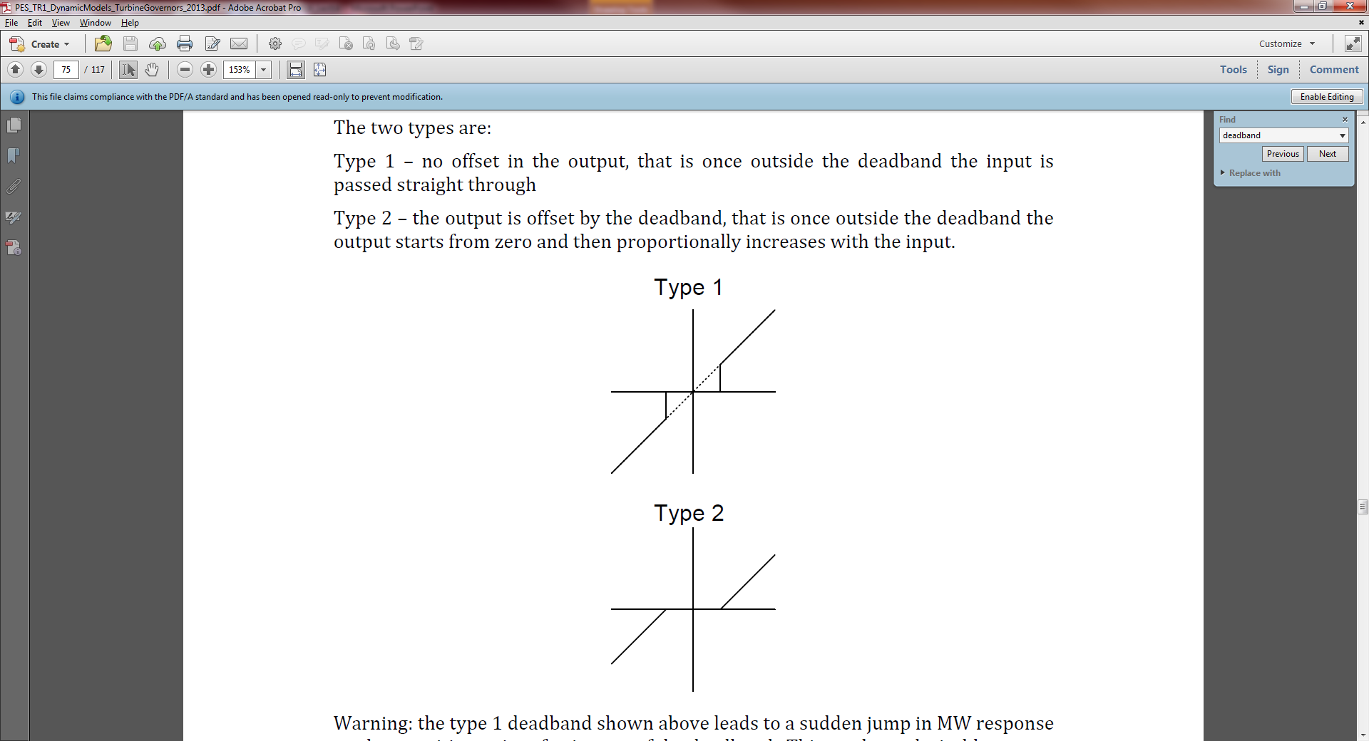
Deadbands
Before going further, it is useful to briefly consider deadbands, with two types shown with IEEEG1 and described in the 2013 IEEE PES Governor Report
The type 1 is an intentional deadband, implemented to prevent excessive response
  Until the deadband activates there is no response, then normal response after that; this can cause a potentially
  large jump in the response
  Also, once activated there is normal
  response coming back into range
  Used on input to IEEEG1

Slide 6
Deadbands
The type 2 is also an intentional deadband, implemented to prevent excessive response
  Difference is response does not jump, but rather only starts once outside of the range
Another type of deadband is the
unintentional, such as will occur
with loose gears
  Until deadband "engages"
  there is no response
  Once engaged there is
  a hysteresis in the
  response

Slide 7
Deadband Example: ERCOT
Prior to November 2008, ERCOT required that the governor deadbands be no greater than +/- 0.036 Hz
After 11/3/08 deadbands were changed to +/- 0.0166 Hz
2008 did
have
two
months
with the
lower
values
Image Source: Sydney Niemeyer, NRG, 2/9/10 presentation to Texas Regional Entity (part of ERCOT)

Slide 8
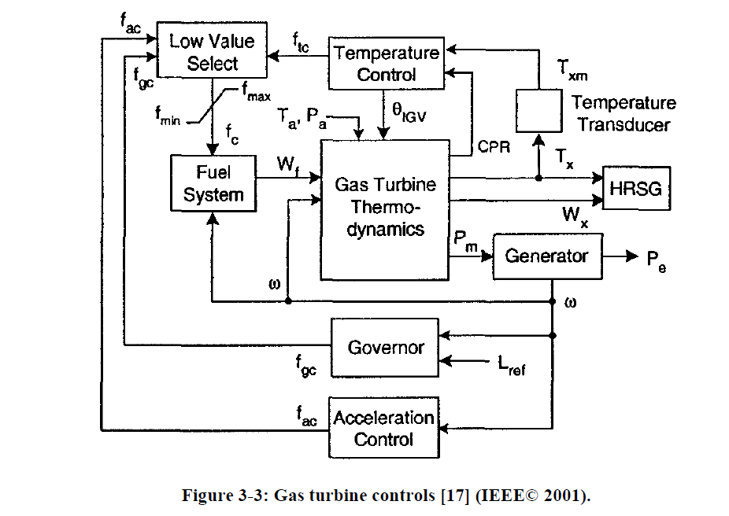
Gas Turbines
A gas turbine (usually using natural gas) has a compressor, a combustion chamber and then a turbine
The below figure gives an overview of the modeling
HRSG is
the heat
recovery
steam
generator
(if it is a
combined
cycle unit)
Image from IEEE PES, "Dynamic Models for Turbine-Governors in Power System Studies," Jan 2013

Slide 9
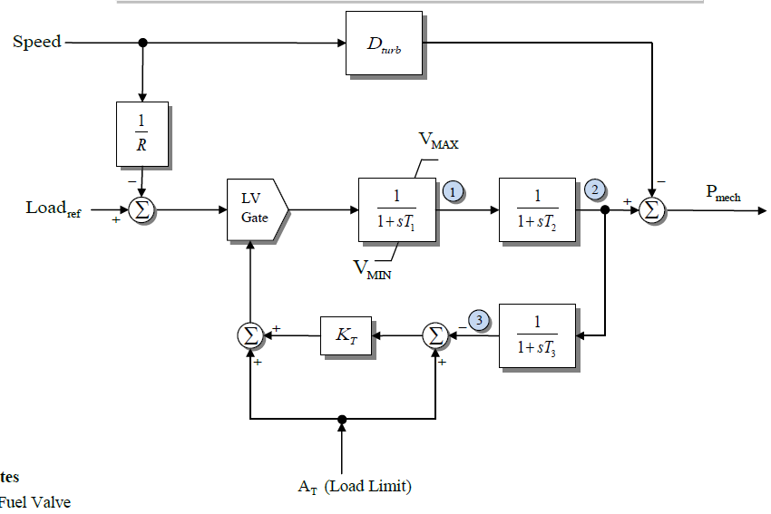
GAST Model
Quite detailed gas turbine models exist; we'll just consider the simplest, which is still used some
It is somewhat similar
to the TGOV1. T₁ is for
the fuel valve, T₂
is for the turbine, and
T₃ is for the load
limit response based
on the ambient
temperature (At);
T₃ is the delay in
measuring the exhaust
temperature

Slide 10
Play-in (Playback) Models
Often time in system simulations there is a desire to test the response of units (or larger parts of the simulation) to particular changes in voltage or frequency
  These values may come from an actual system event
"Play-in" or playback models can be used to vary an infinite bus voltage magnitude and frequency, with data specified in a file
PowerWorld allows both the use of files (for say recorded data) or auto-generated data
  Machine type GENCLS_PLAYBACK can play back a file
  Machine type InfiniteBusSignalGen can auto-generate a signal

Slide 11
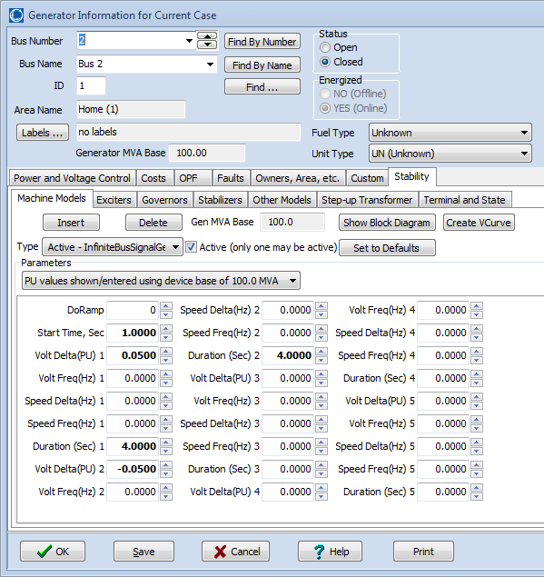
PowerWorld Infinite Bus
Signal Generation
Below dialog shows some options for auto-generation of voltage magnitude and frequency variations
Start Time tells when to start; values are then defined for up to five separate time periods
Volt Delta is the magnitude of the pu voltage deviation; Volt Freq is the frequency of the voltage deviation in Hz (zero for dc)
Speed Delta is the magnitude of the frequency deviation in Hz; Speed Freq is the frequency of the frequency deviation
Duration is the time in seconds for the time period

Slide 12
Example: Step Change Voltage Response
Below graph shows the voltage response for the four bus system for a change in the infinite bus voltage
Case name: B4_SignalGen_IEEEG2

Slide 13
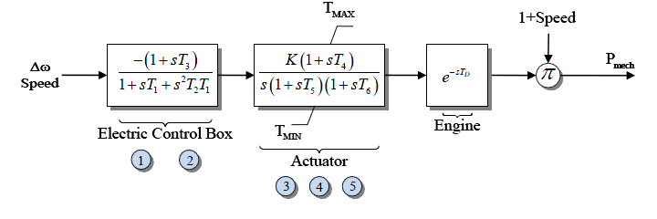
Simple Diesel Model: DEGOV
Sometimes models implement time delays (DEGOV)
  Often delay values are set to zero
Delays can be implemented either by saving the input value or by using a Pade approximation, with a 2nd order given below; a 4th is common

Slide 14
DEGOV Delay Approximation
With T_{D} set to 0.5 seconds (which is longer than normal in order to illustrate the delay)

Slide 15
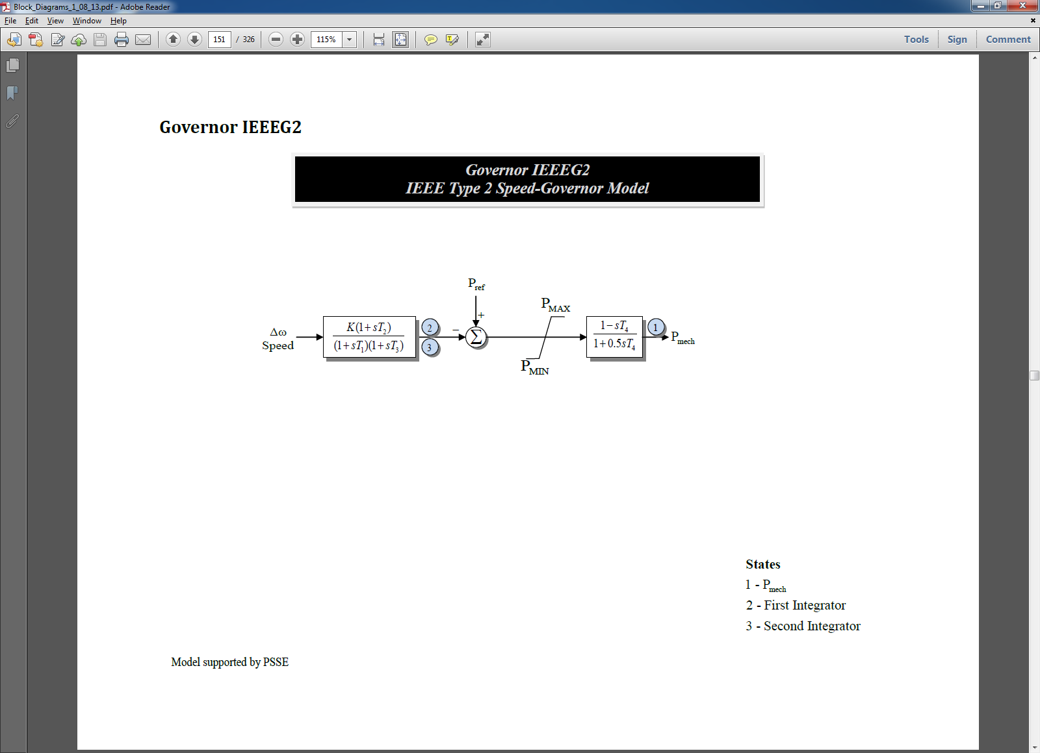
Hydro Units
Hydro units tend to respond slower than steam and gas units; since early transient stability studies focused on just a few seconds (first or second swing instability), detailed hydro units were not used
  The original IEEEG2 and IEEEG3 models just gave the linear response; now considered obsolete
Below is the IEEEG2; left side is the governor, right side is the turbine and water column
For sudden changes
there is actually an
inverse change in
the output power

Slide 16
Four Bus with an IEEEG2
Graph below shows the mechanical power output of gen 2 for a unit step decrease in the infinite bus frequency; note the power initially goes down!
Physically this is
caused by a transient
decrease in the water
pressure when the
valve is opened to
increase the water
flow
Case name: B4_SignalGen_IEEEG2

Slide 17
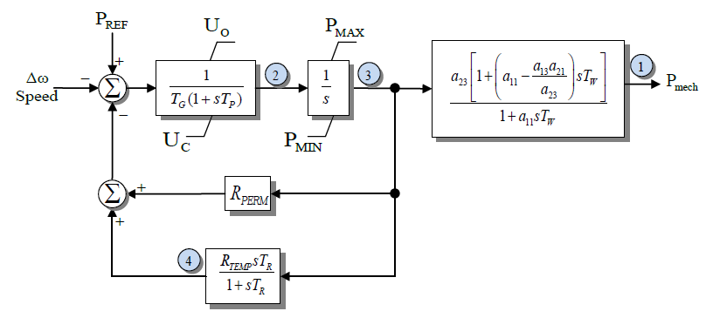
IEEEG3
This model has a more detailed governor model, but the same linearized turbine/water column model
Because of the initial inverse power change, for fast deviations the droop value is transiently set to a larger value (resulting in less of a power change)
WECC has
about 10% of
their governors
modeled with
IEEEG3s

Slide 18
Washout Filters
A washout filter is a high pass filter that removes the steady-state response (i.e., it "washes it out") while passing the high frequency response
They are commonly used with hydro governors and (as we shall see) with power system stabilizers
With hydro turbines ballpark values for Tw are around one or two seconds

Slide 19
IEEEG3 Four Bus Frequency Change
The two graphs compare the case response for the frequency change with different R_{temp} values
Rtemp = 0.5, Rperm = 0.05
Rtemp = 0.05, Rperm = 0.05
Case name: B4_SignalGen_IEEEG2

Slide 20
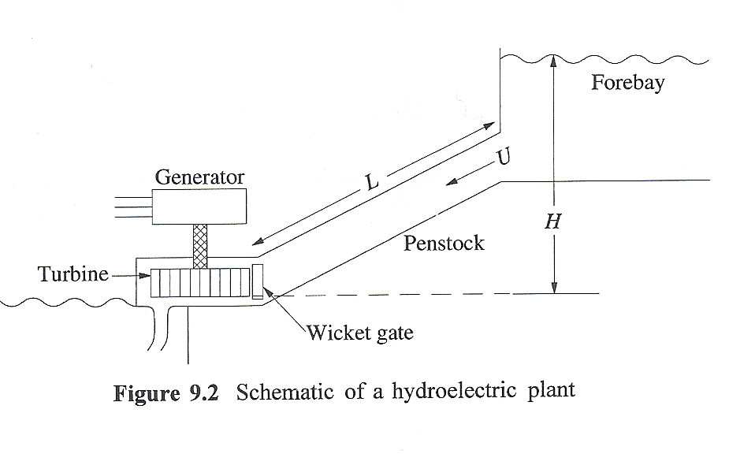
Basic Nonlinear Hydro Turbine Model
Basic hydro system is shown below
  Hydro turbines work be converting the kinetic energy in the water into mechanical energy
  assume the water is incompressible
At the gate assume a velocity of U, a cross-sectional penstock area of A; then the
volume flow is A*U=Q;
Source: 9.2, Kundur, Power System Stability and Control, 1994

Slide 21
Basic Nonlinear Hydro Turbine Model
From Newton's law
As per [a] paper, this equation is normalized to
T is called the water time
constant, or water
starting time
[a] "Hydraulic Turbine and Turbine Control Models for System Dynamic Studies," IEEE Trans. Power Syst., Feb, 92

Slide 22
Basic Nonlinear Hydro Turbine Model
With h_{base} the static head, q_{base} the flow when the gate is fully open, an interpretation of T_{w} is the time (in seconds) taken for the flow to go from stand-still to full flow if the total head is h_{base}
If included the head losses, h_{loss}, vary with the square of the flow
The flow is assumed to vary as linearly with the gate position (denoted by c)

Slide 23
Basic Nonlinear Hydro Turbine Model
Power developed is proportional to flow rate and head, with a term q_{nl} added to model the fixed turbine (no load) losses
  The term At is used to change the per unit scaling to that of the electric generator

Slide 24
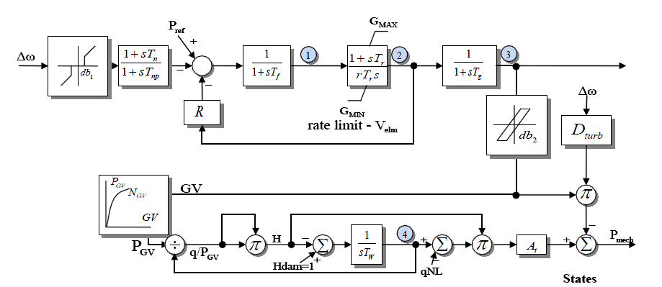
Model HYGOV
This simple model, combined with a governor, is implemented in HYGOV
About
10% of
WECC
governors
use this
model
H_{loss} is assumed small and not included
The gate position (gv) to gate power (pgv)
is sometimes represented with a nonlinear curve

Slide 25
Linearized Model Derivation
The previously
mentioned
linearized model
can now be
derived as

Slide 26
Four Bus Case with HYGOV
The below graph plots the gate position and the power output for the bus 2 signal generator decreasing the speed then increasing it
Note that just
like in the
linearized
model, opening
the gate
initially
decreases the
power output

Slide 27
PID Controllers
Governors and exciters often use proportional-integral-derivative (PID) controllers
PIDs combine
  Proportional gain, which produces an output value that is proportional to the current error
  Integral gain, which produces an output value that varies with the integral of the error; this will eventually drive the error to zero
  Derivative gain, which acts to predict the system behavior. This can enhance system stability, but it can be quite susceptible to noise

Slide 28
PID Example: Position Control
Say we wish to get an object to a position in 1-dimensional space by controlling its acceleration (force)
  Error is distance from desired position
  Control is speed
With just proportional control, acceleration will be decreasing, but we'd reach maximum speed at the desired point, overshooting
With derivative control, we'll be slowing down, avoiding the overshoot
The integral term will make sure we stay at the desired point

Slide 29
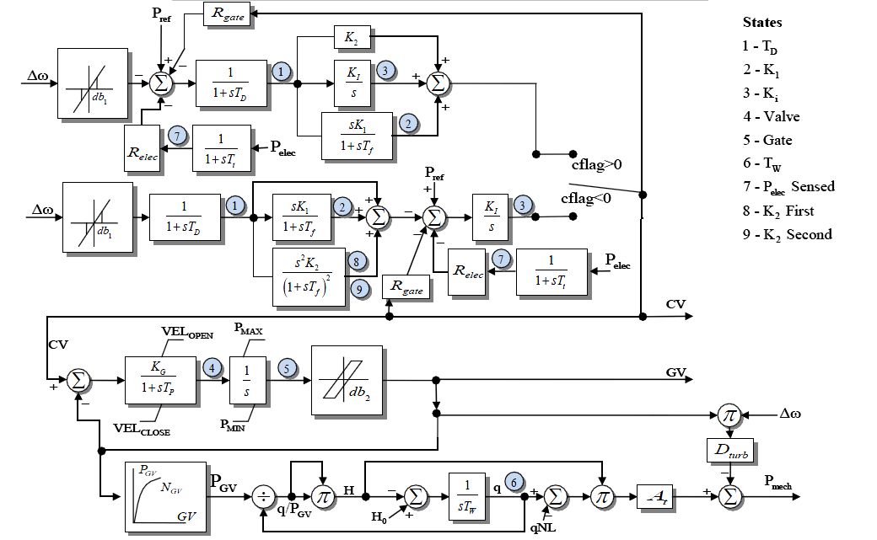
HYG3
The HYG3 models either a PID or a double derivative
Looks more
complicated
than it is
since
depending
on cflag
only one of
the upper
paths is
used

