Slide 1
ECE 576 – Power System Dynamics and Stability
Lecture 23: Renewable Energy Systems
Prof. Tom Overbye
University of Illinois at Urbana-Champaign
overbye@illinois.edu

Slide 2
Announcements
Read Chapter 8
Homework 7 is due on Thursday April 24

Slide 3
Renewable Resource Modeling
With the advent of more renewable generation in power systems worldwide it is important to have correct models
Hydro systems have already been covered
Solar thermal and geothermal are modeled similar to existing stream generation, so they are not covered here
Coverage will focus on transient stability level models for wind and solar PV for integrated system studies
More detailed EMTP-level models may be needed for individual plant issues, like subsynchronous resonance
Models are evolving, with a desire by many to have as generic as possible models

Slide 4
Growth in Wind Worldwide
Source: Global Wind 2013 Report, Global Wind Energy Council

Slide 5
Growth in Wind Worldwide
Source: Global Wind 2013 Report, Global Wind Energy Council

Slide 6
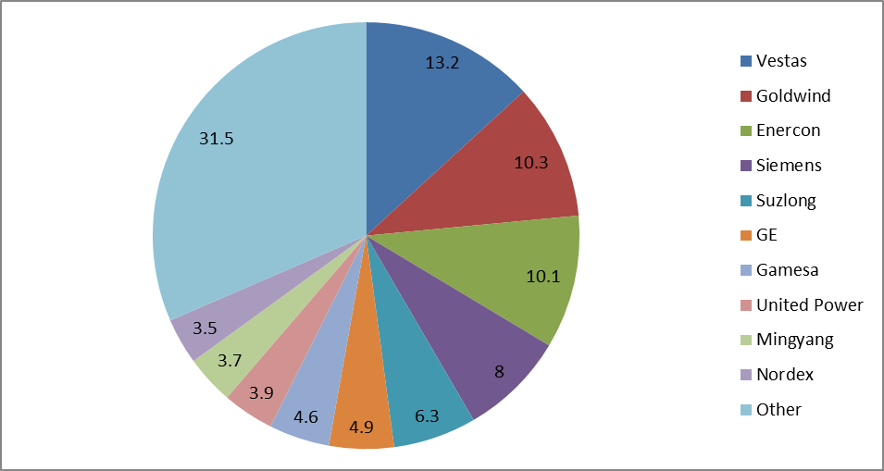
2013 Worldwide Wind Turbine Market Share
Vestas regains first, GE fell from first in 2012 to 6th; with "other" at 31.5% there are lots of manufacturers!
Data source: http://www.nawindpower.com/e107_plugins/content/content.php?content.12710

Slide 7
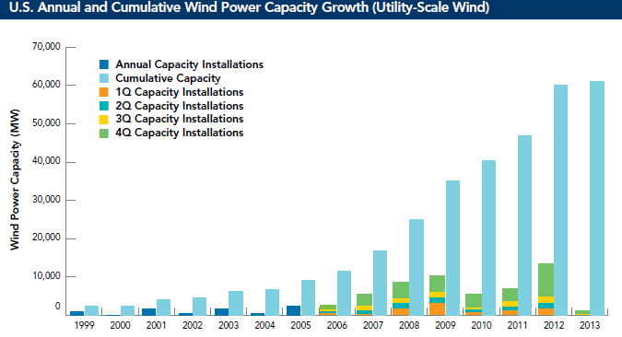
Growth in US Wind
Currently about 61 GW; production tax credit expired at the end of 2013 but the 12 GW of projects under construction at end of 2013 will qualify
Source: American Wind Energy Association

Slide 8
State Renewable Portfolio Standards
Image source: dsireusa.org

Slide 9
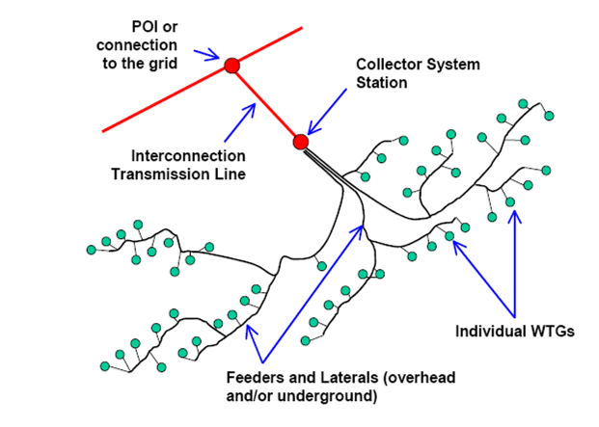
Wind Models
A good reference guide is the WECC Wind Power Plant Dynamic Modeling Guide
Posted one is from Nov 2010; there is a draft April 2014 version that is not yet publically released; Nov 2010 provides good background
Usually wind farm is modeled in aggregate for grid studies; wind farm can consist of many small (1 to 3 MW) wind turbine-generators (WTGs) operating at low voltage (e.g. 0.6kV) stepped up to distribution level (e.g., 34.5 kV)

Slide 10
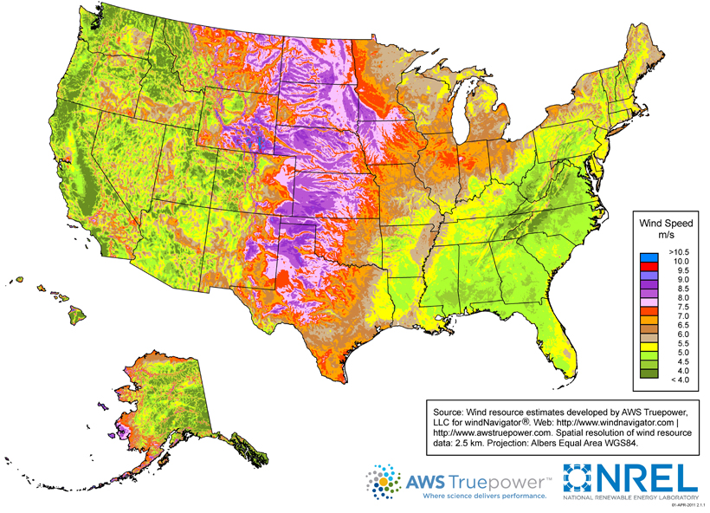
US Wind Resources
Source: http://www.windpoweringamerica.gov/wind_maps.asp

Slide 11
Global Wind Speed 50m Map
http://www.climate-charts.com/World-Climate-Maps.html#wind-speed

Slide 12
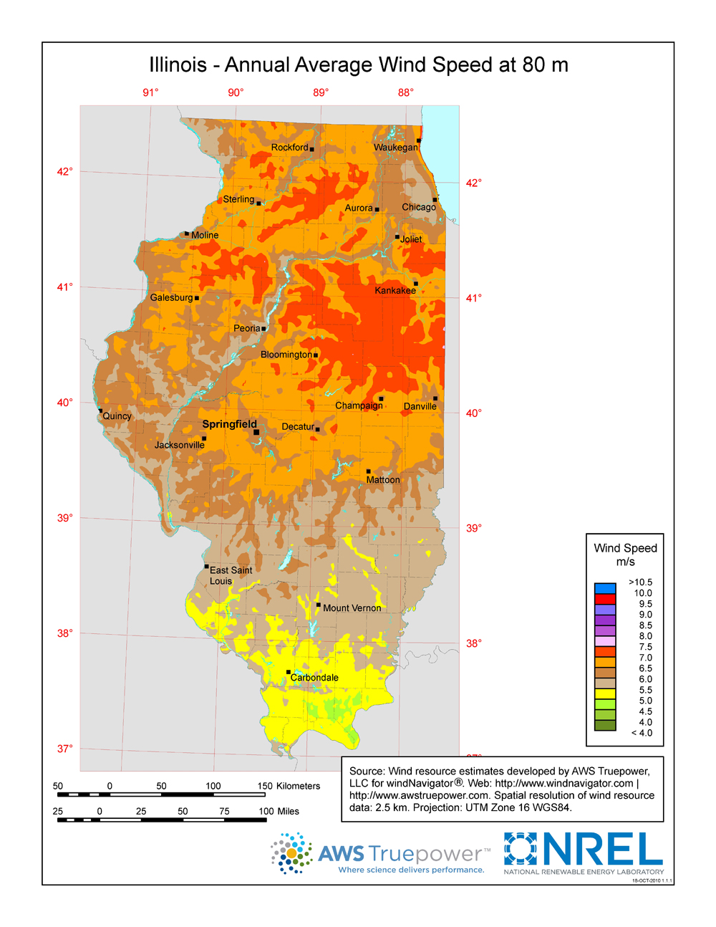
Wind Map Illinois – 80m Height
http://www.windpoweringamerica.gov/wind_resource_maps.asp?stateab=il

Slide 13
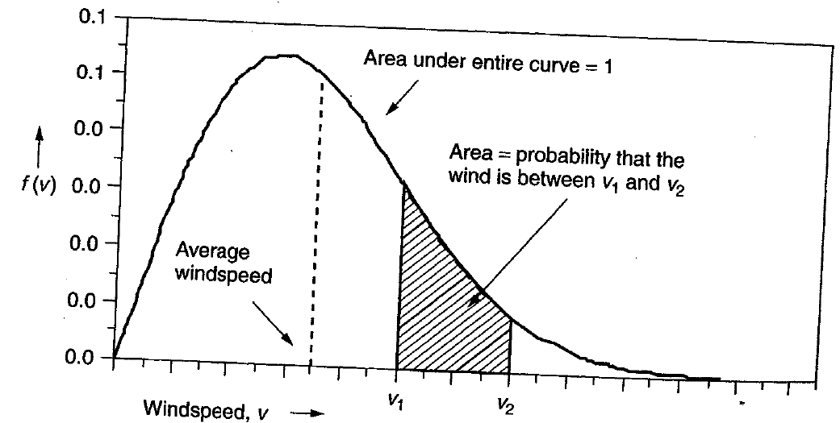
Power in the Wind
The power in the wind is proportional to the cube of the wind speed
Velocity increases with height, with more increase over rougher terrain (doubling at 100m compared to 10m for a small town, but only increasing by 60% over crops or 30% over calm water)
Maximum rotor efficiency is 59.3%, from Betz' law
Expected available energy depends on the wind speed probability density function (pdf)

Slide 14
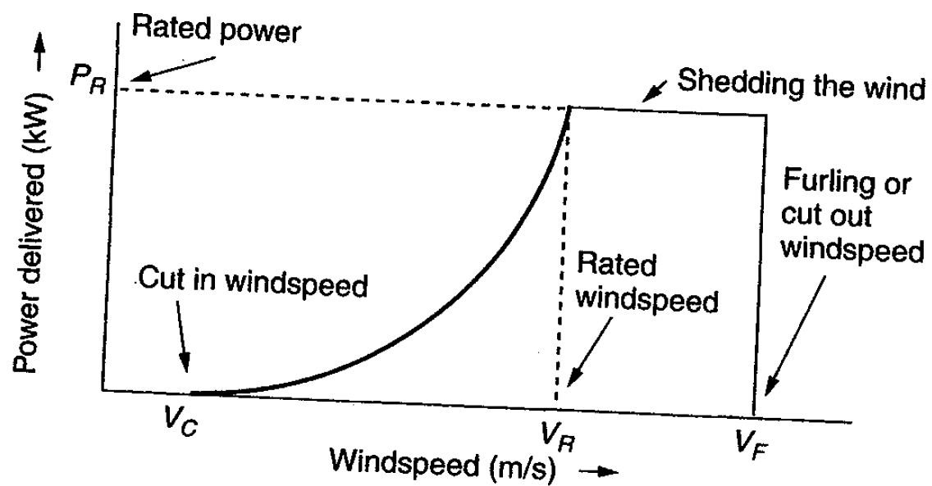
Extracted Power
WTGs are designed for rated power and windspeed
For speeds above this blades are pitched to operate at rated power; at furling speed the WTG is cut out

Slide 15
Example: GE 1.5 and 1.6 MW Turbines
Power speed curves for the GE 1.5 and 1.6 MW WTGs
Hub height is 80/100 m; cut-out at 25 m/s wind
Average 80m wind in Champaign
County is 6.5 to 7.0 m/sec (about 15 mph)
Source: http://site.ge-energy.com/prod_serv/products/wind_turbines/en/15mw/index.htm

Slide 16
Types of Wind Turbines for Power Flow and Transient Stability
Several different approaches to aggregate modeling of wind farms in power flow and transient stability
Wind turbine manufacturers provide detailed, public models of their WTGs; these models are incorporated into software packages; example is GE 1.5, 1.6 and 3.6 MW WTGs (see Modeling of GE Wind Turbine-Generators for Grid Studies, version 4.6, March 2013, GE Energy)
Proprietary models are included as user defined models; covered under NDAs to maintain confidentiality
Generic models are developed to cover the range of WTGs, with parameters set based on the individual turbine types
Concern by some manufacturers that the generic models to not capture their WTGs' behavior, such as during low voltage ride through (LVRT)

Slide 17
Types of Wind Turbines for Power Flow and Transient Stability
Electrically there are four main generic types of wind turbines
Type 1: Induction machine; treated as PQ bus with negative P load; dynamically modeled as an induction motor
Type 2: Induction machine with varying rotor resistance; treated as PQ bus in power flow; induction motor model with dynamic slip adjustment
Type 3: Doubly Fed Asynchronous Generator (DFAG) (or DFIG); treated as PV bus in power flow
Type 4: Full Asynchronous Generator; treated as PV bus in power flow
New wind farms (or parks) are primarily of Type 3 or 4

Slide 18
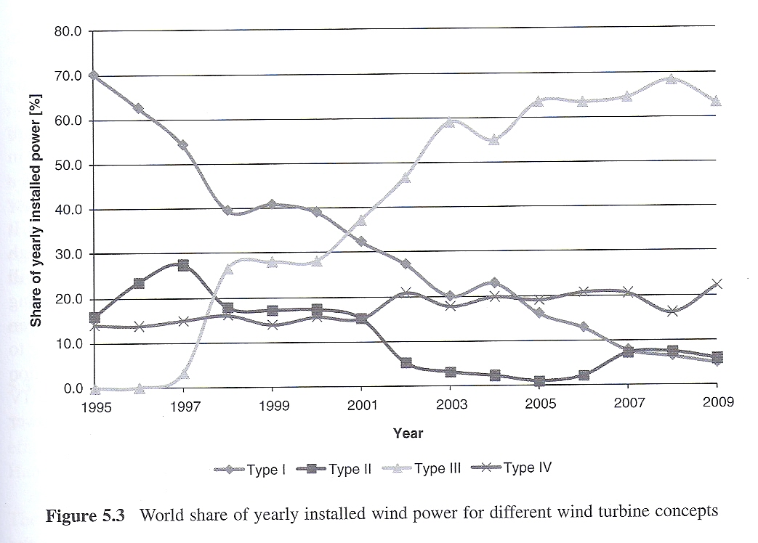
Wind Turbine Installations by Type
Image source: T. Ackermann, Wind Power in Power Systems, 2nd Edition, Wiley, 2012

Slide 19
Generic Modeling Approach
The generic modeling approach is to divide the wind farm models by functionality
Generator model: either an induction machine for Type 1 and 2's or a voltage source converter for Type 3 and 4
Reactive power control (exciter): none for Type 1, rotor resistance control for Type 2, commanded reactive current for Type 3 and 4
Drive train models: Type 1 and 2 in which the inertia appears in the transient stability
Aerodynamics and Pitch Models: Model impact of changing blade angles (pitch) on power output

Slide 20
Wind Turbine Issues
Models are designed to represent the system level impacts of the aggregate wind turbines during disturbances such as low voltages (nearby faults) and frequency deviations
Low voltage ride through (LVRT) is a key issue, in which the wind turbines need to stay connected to the grid during nearby faults
Active and reactive power control is also an issue

Slide 21
Low Voltage Ride Through (LVRT)
The concern is if during low voltages, such as during faults, the WTGs trip, it could quickly setup a cascading situation particularly in areas with lots of Type 3 WTGs
Tripping had been a strategy to protect the DFAG from high rotor currents and over voltages in the dc capacitor.
When there were just a few WTGs, tripping was acceptable
Standards now require specific low voltage performance
Image from California ISO presentation

Slide 22
Type 1 Models
Type 1 models are just represented by an induction machine, with possible pitch control
Usually represent older wind turbines
No voltage control – just an induction generator
Below is a one mass turbine model
Quite similar to a synchro- nous generator swing equation

